Slide 1
TEMPO Aerosol Algorithm and Products Update
Shobha Kondragunta¹, Hai Zhang², Pubu Ciren²
¹NOAA | ²MSG at NOAA
Disclaimer: The scientific results and conclusions, as well as any views or opinions expressed
herein, are those of the author(s) and do not necessarily reflect those of NOAA or
the Department of Commerce.
Disclaimer：TEMPO L1B data courtesy of NASA and all results are preliminary.

Slide 2
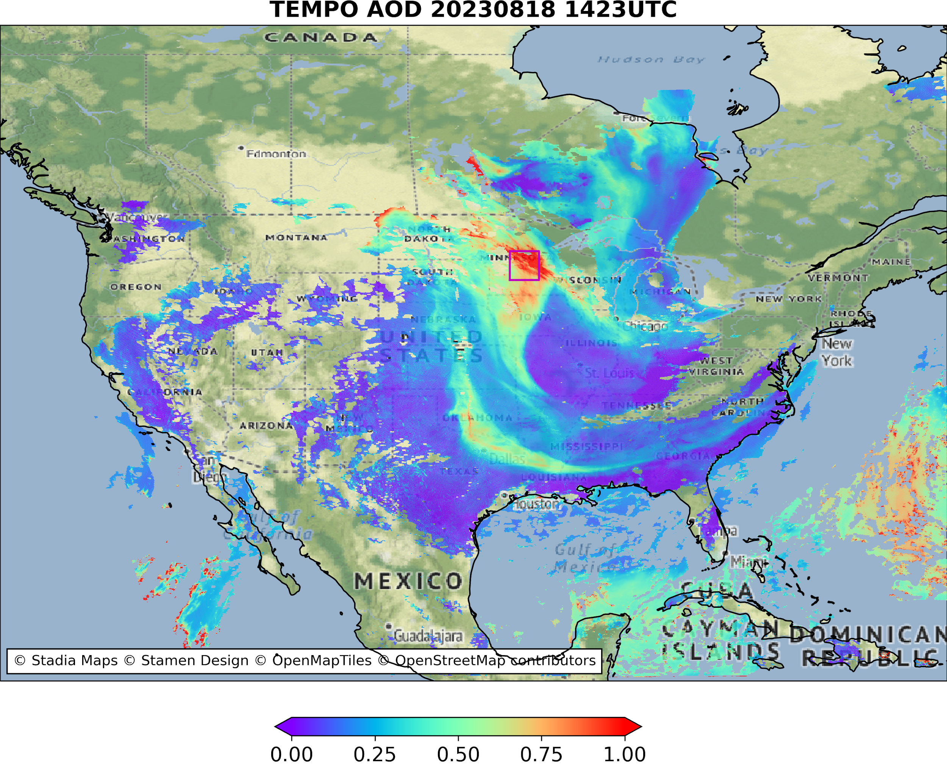
Aerosol Retrieval Algorithm Development
Aerosol Optical Depth
Aerosol Layer Height
Aerosol Detection (smoke and dust)
Surface PM2,5
UV Aerosol Index
True color RGB

Slide 3
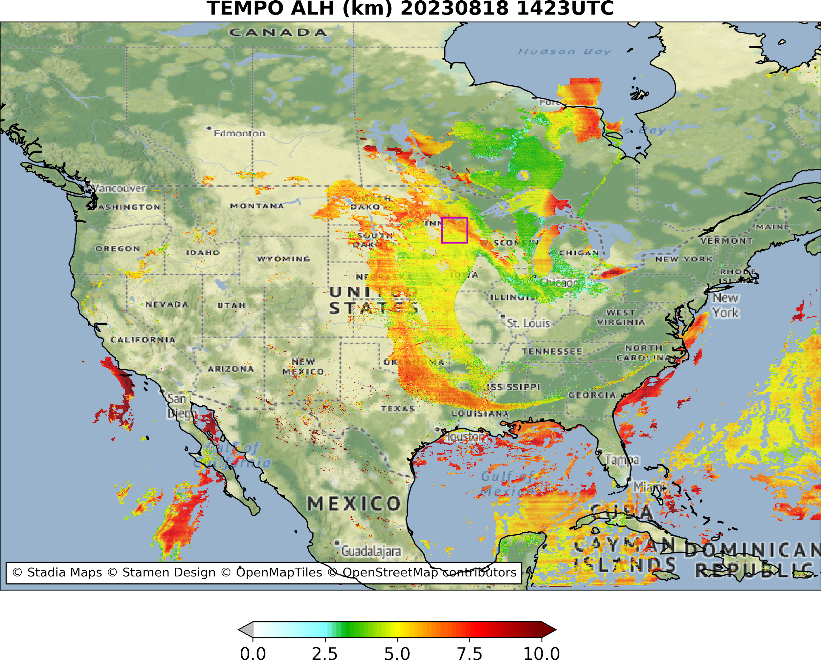
Aerosol Retrieval Algorithm Development
Aerosol Optical Depth
Aerosol Layer Height
Aerosol Detection (smoke and dust)
Surface PM2,5
UV Aerosol Index
True color RGB

Slide 4
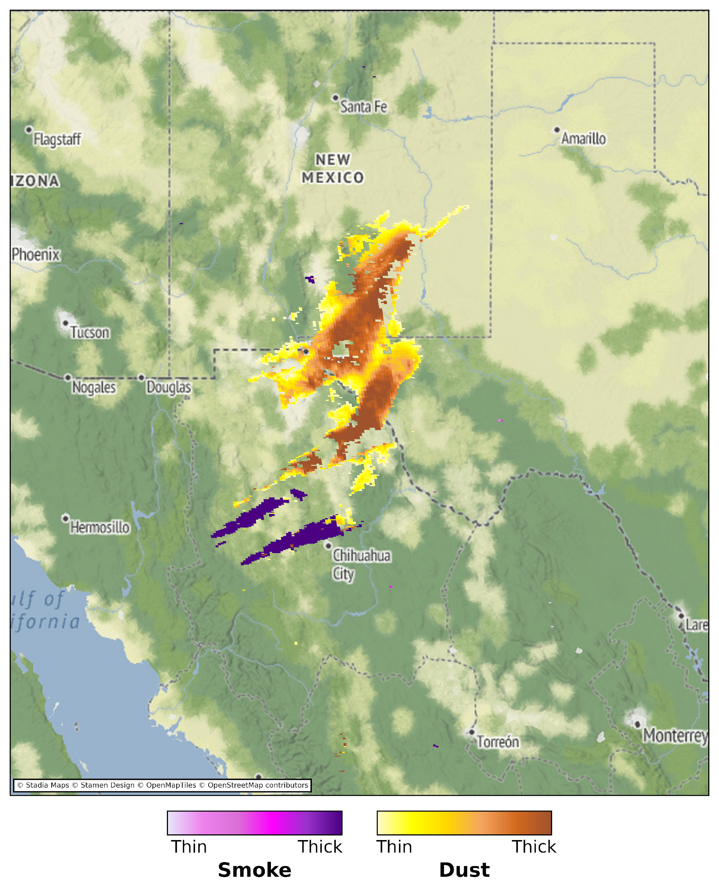
Aerosol Retrieval Algorithm Development
GOES-16 ABI + TEMPO
Aerosol Optical Depth
Aerosol Layer Height
Aerosol Detection (smoke and dust)
Surface PM2.5
UV Aerosol Index
True color RGB

Slide 5
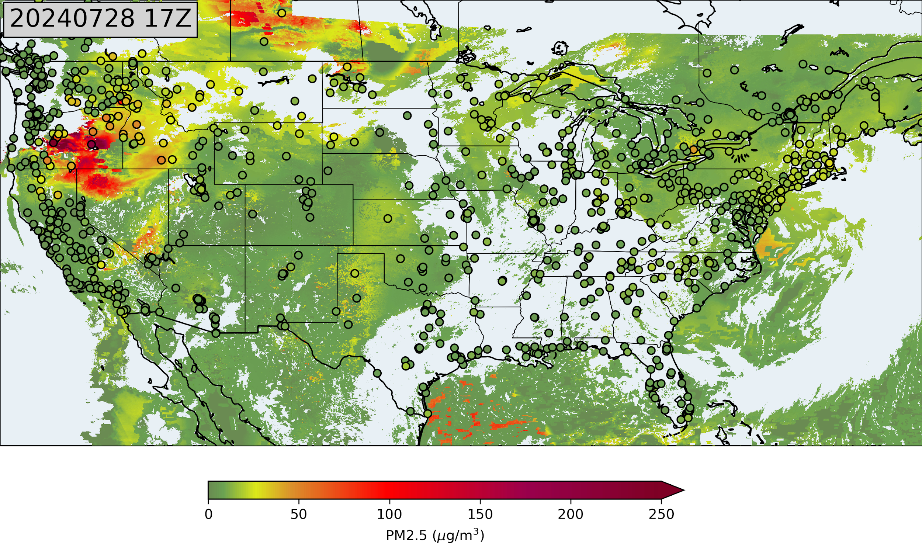
Aerosol Retrieval Algorithm Development
Aerosol Optical Depth
Aerosol Layer Height
Aerosol Detection (smoke and dust)
Surface PM2.5
UV Aerosol Index
True color RGB
ABI + TEMPO

Slide 6
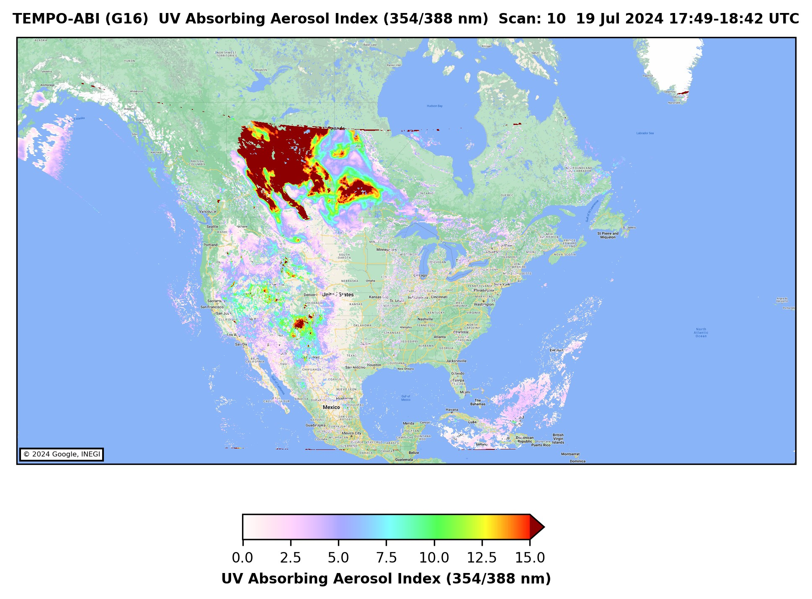
Aerosol Retrieval Algorithm Development
Aerosol Optical Depth
Aerosol Layer Height
Aerosol Detection (smoke and dust)
Surface PM2.5
UV Aerosol Index
True color RGB

Slide 7
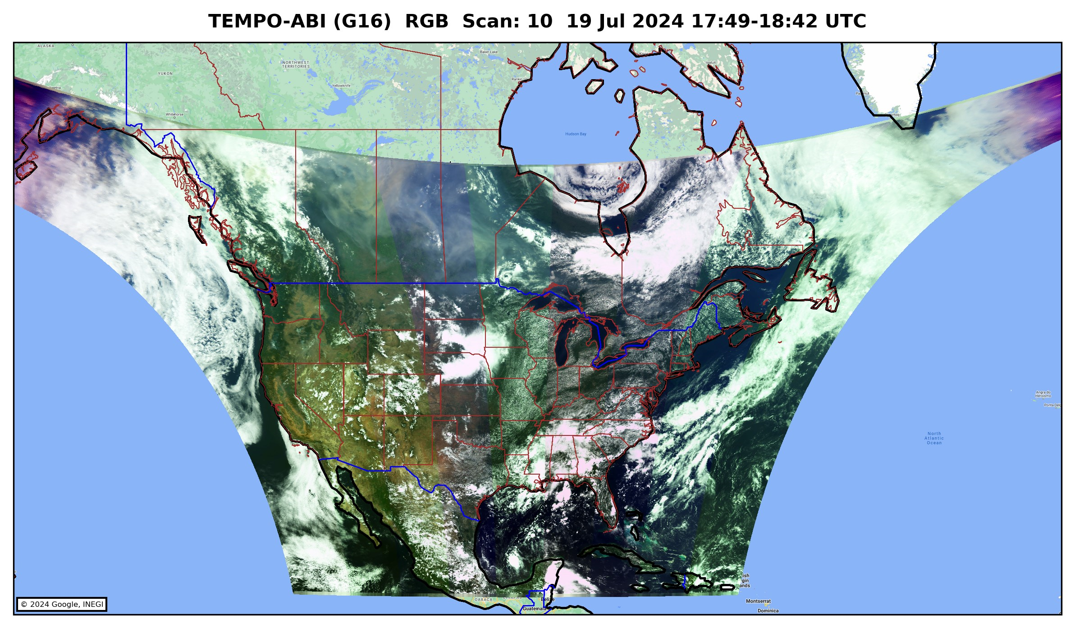
Aerosol Retrieval Algorithm Development
Aerosol Optical Depth
Aerosol Layer Height
Aerosol Detection (smoke and dust)
Surface PM2.5
UV Aerosol Index
True color RGB

Slide 8
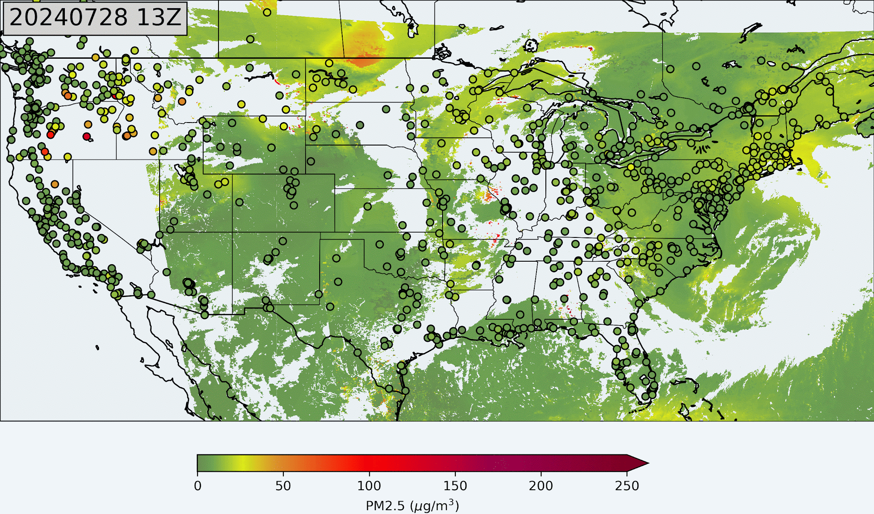
Hourly Variation of Surface PM2.5

Slide 9
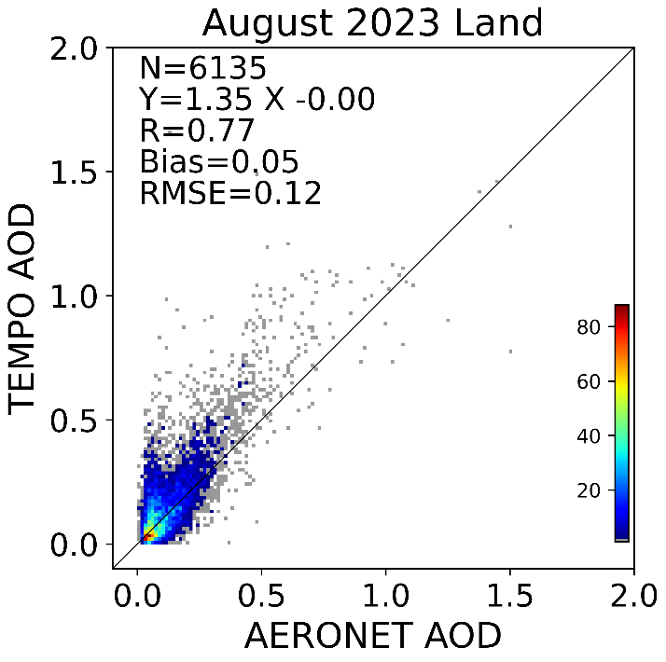
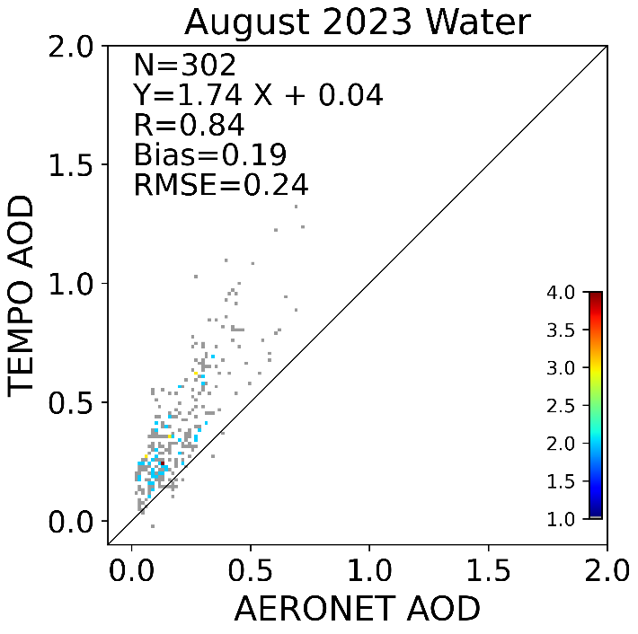
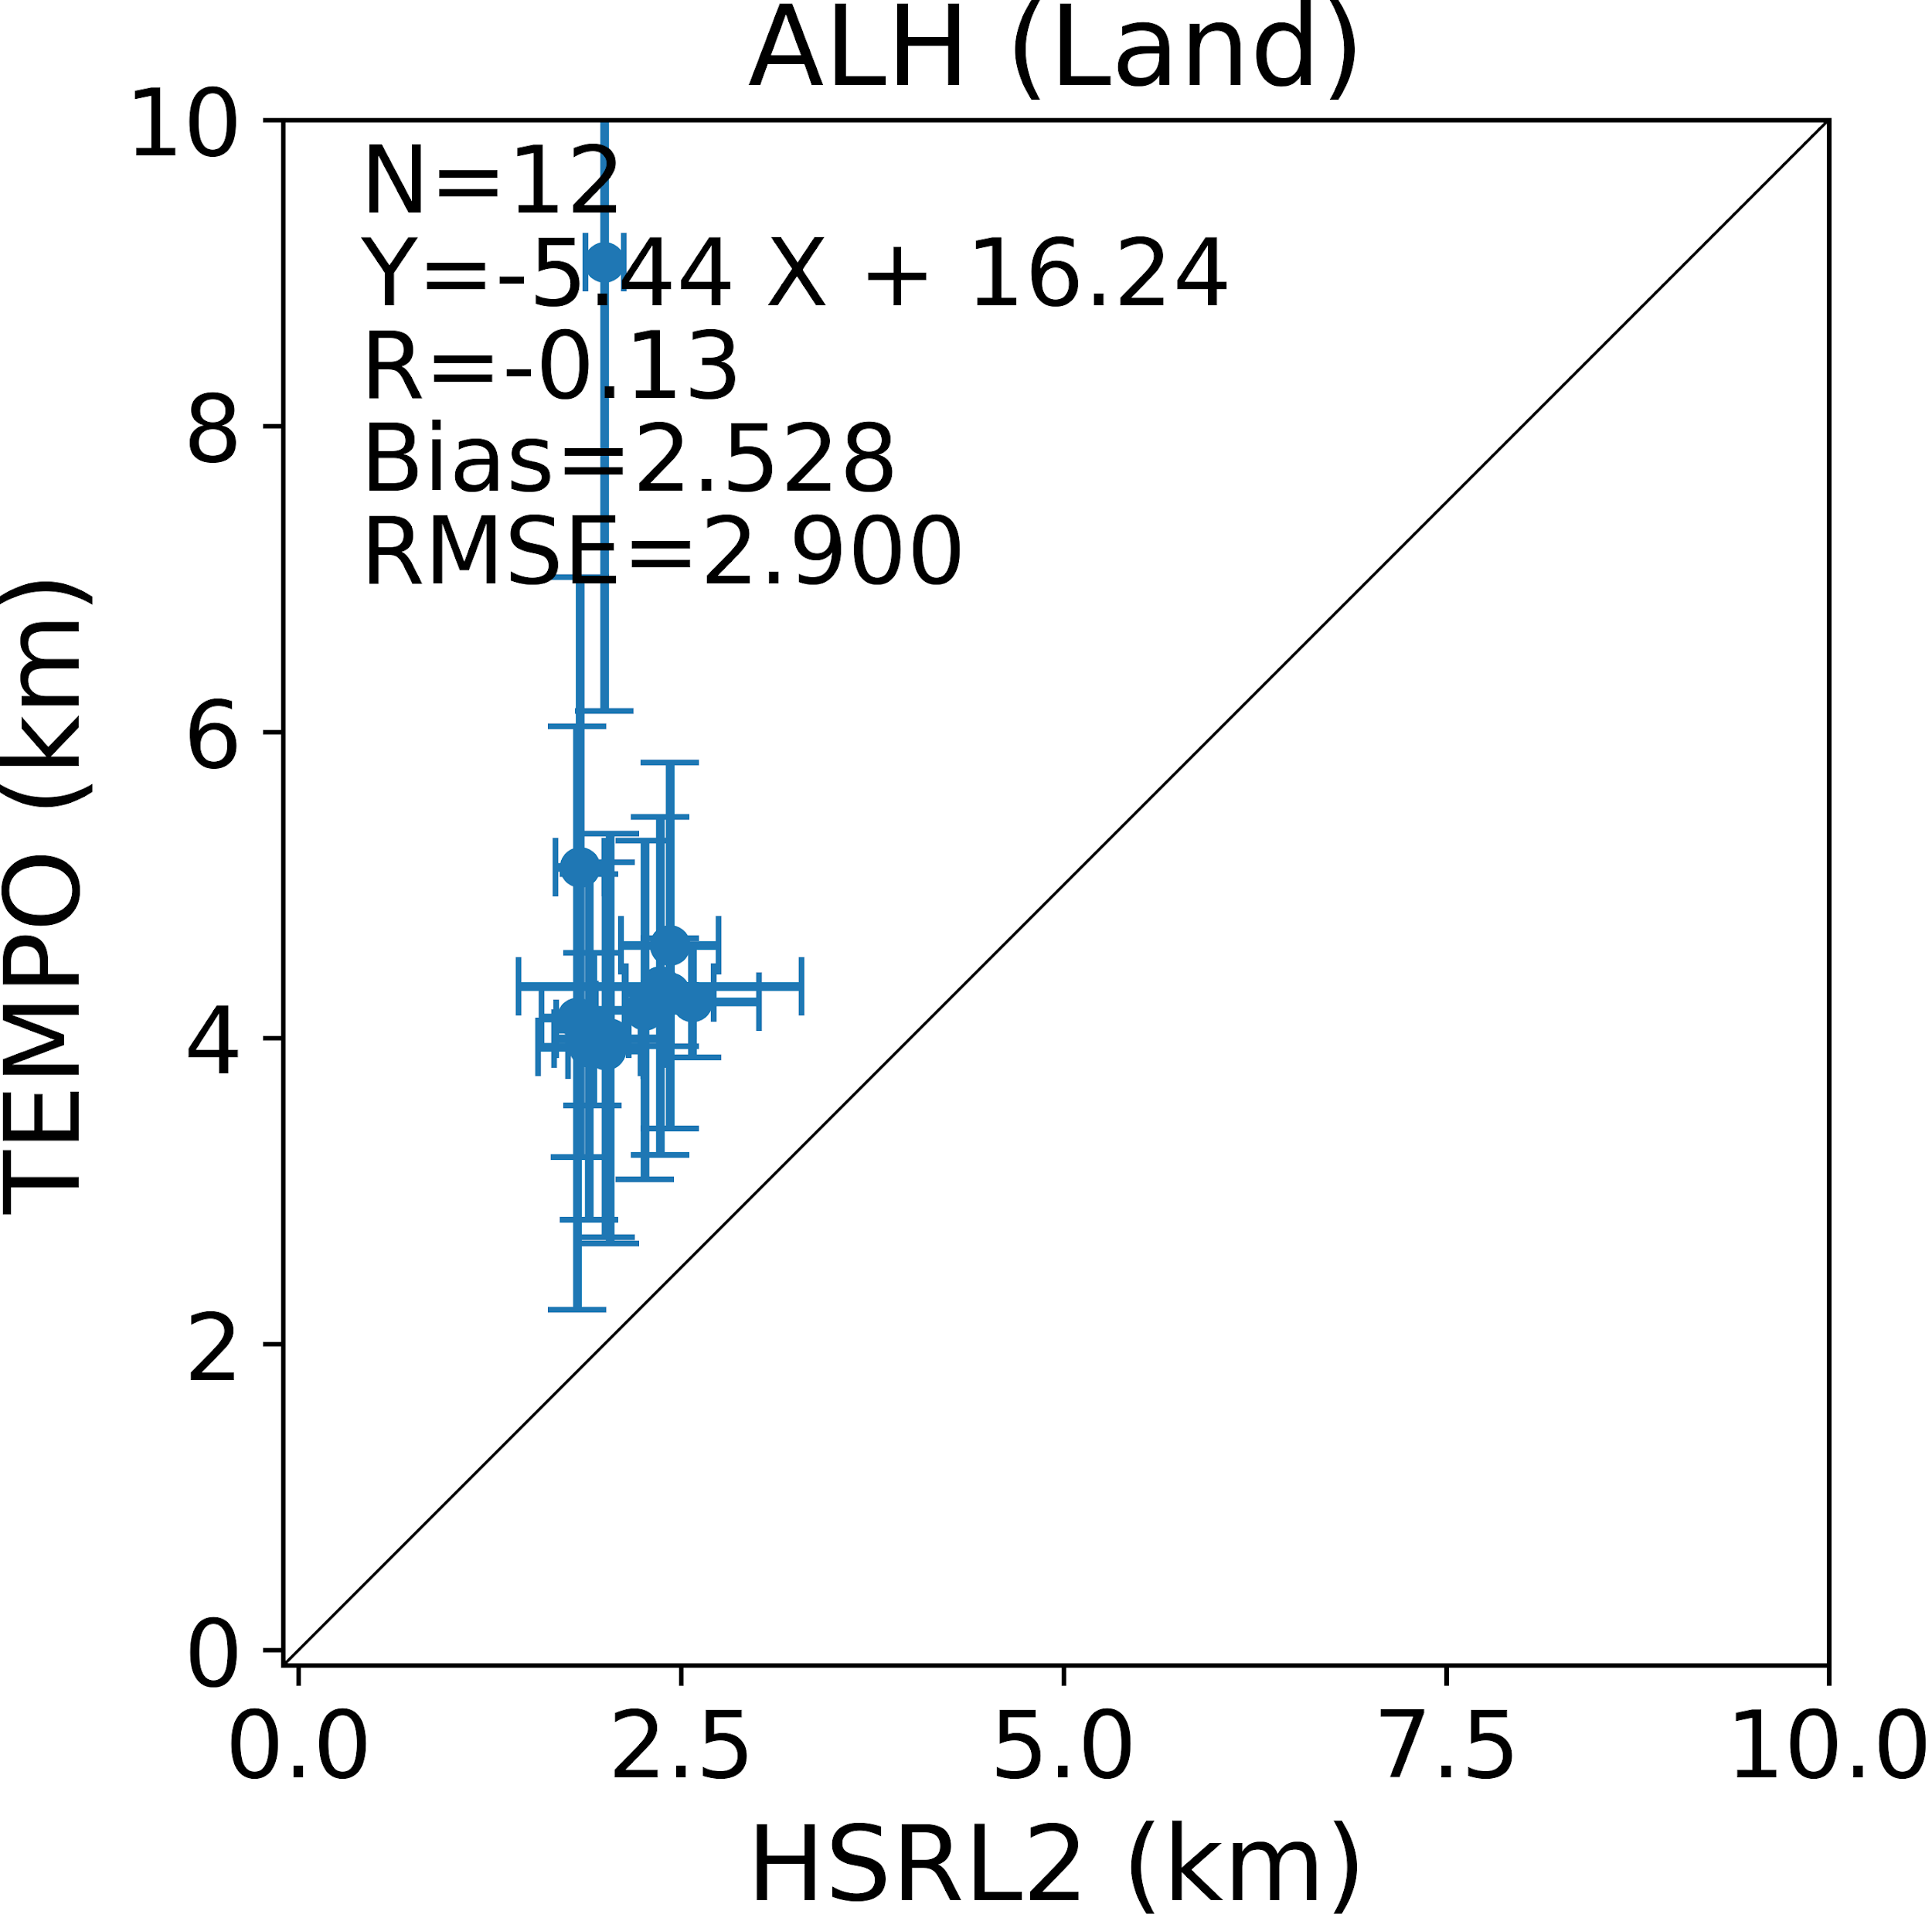
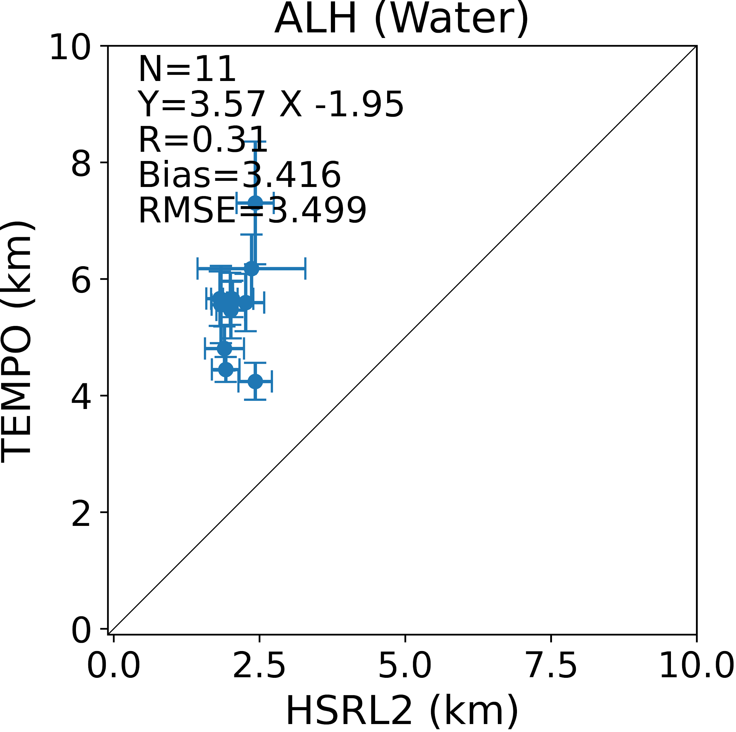
Validation of aerosol products
Large AOD and ALH bias over water points towards calibration errors rather than algorithm errors

Slide 10
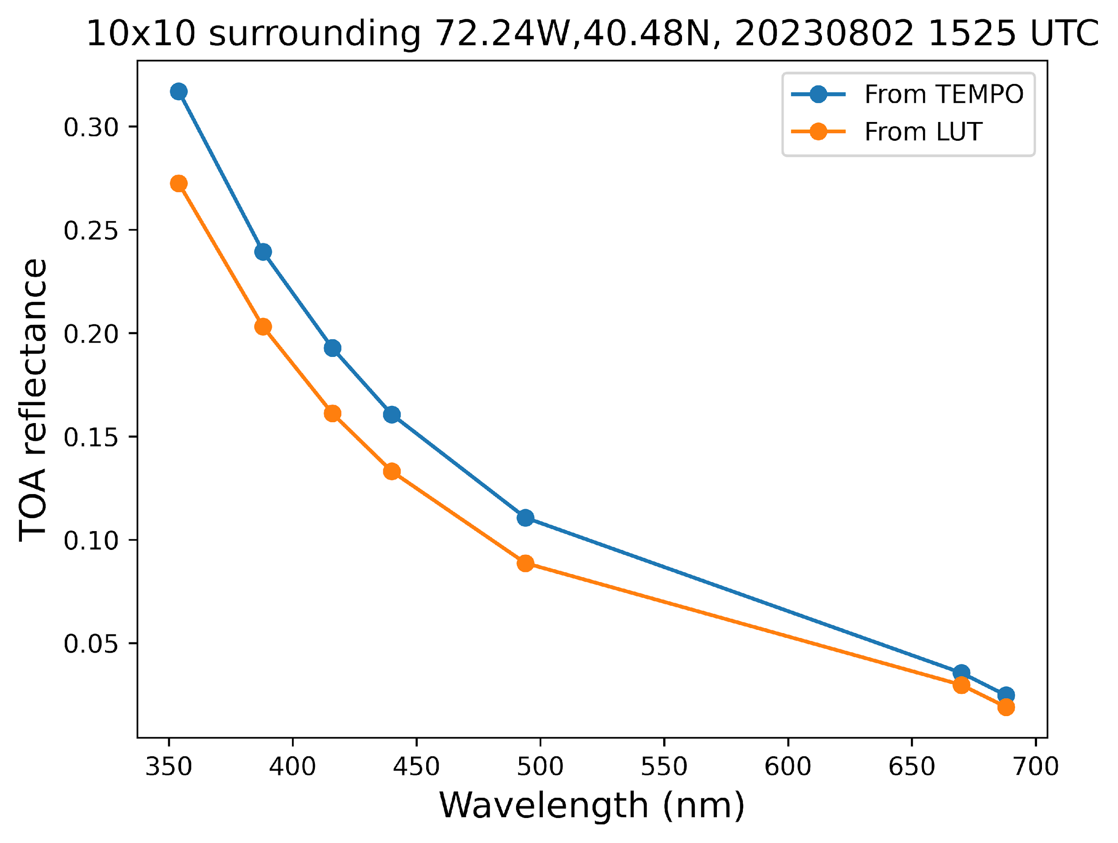
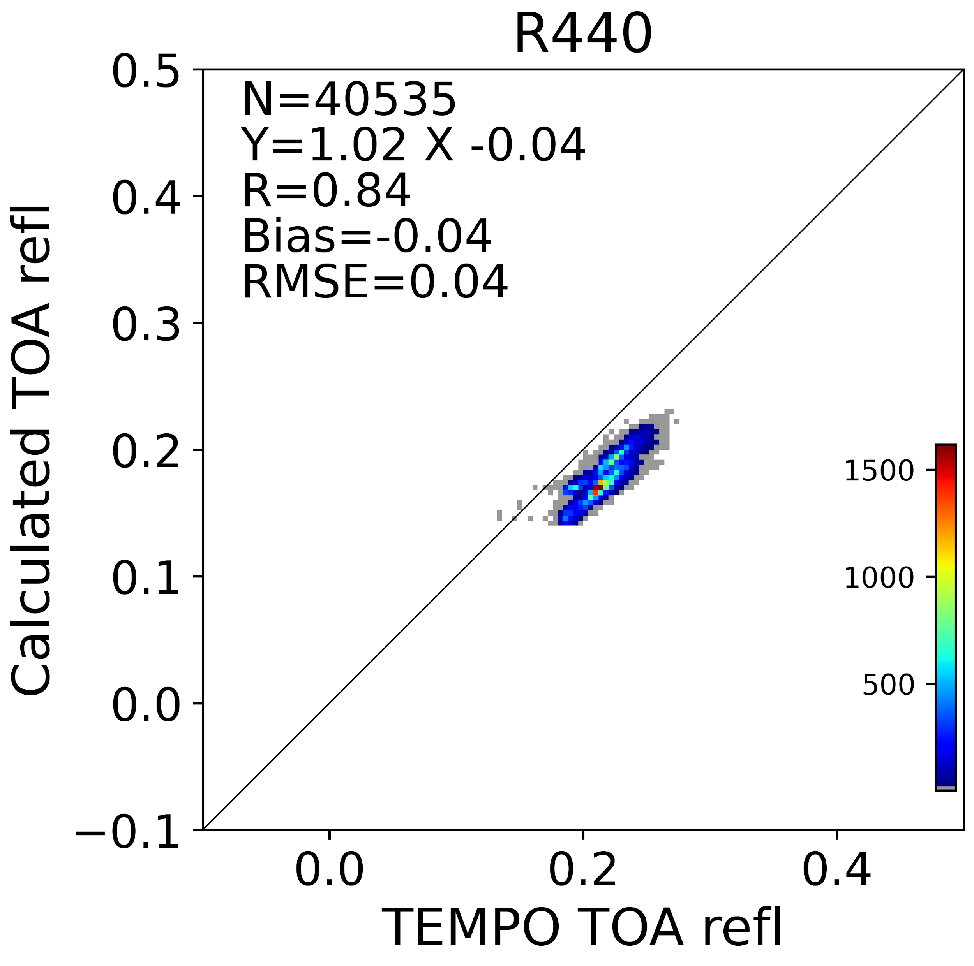
Calibration Assessment
Used a remote location over ocean to calculate surface reflectance, and nearby AERONET station AOD to compute TOA.

Slide 11
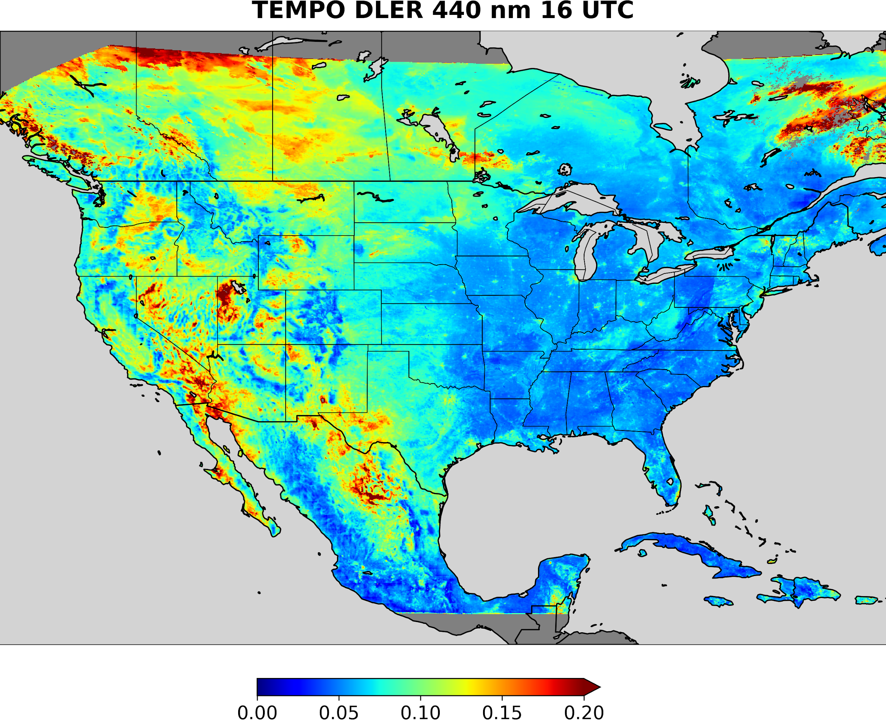
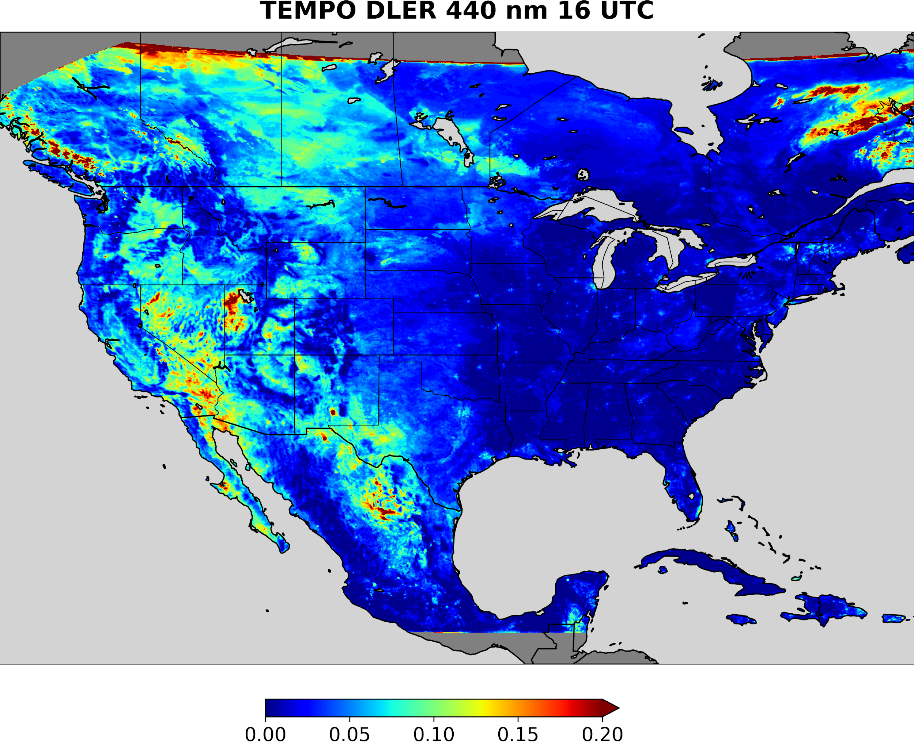
Directional Lambertian Equivalent Reflectivity
Original
After soft calibration

Slide 12
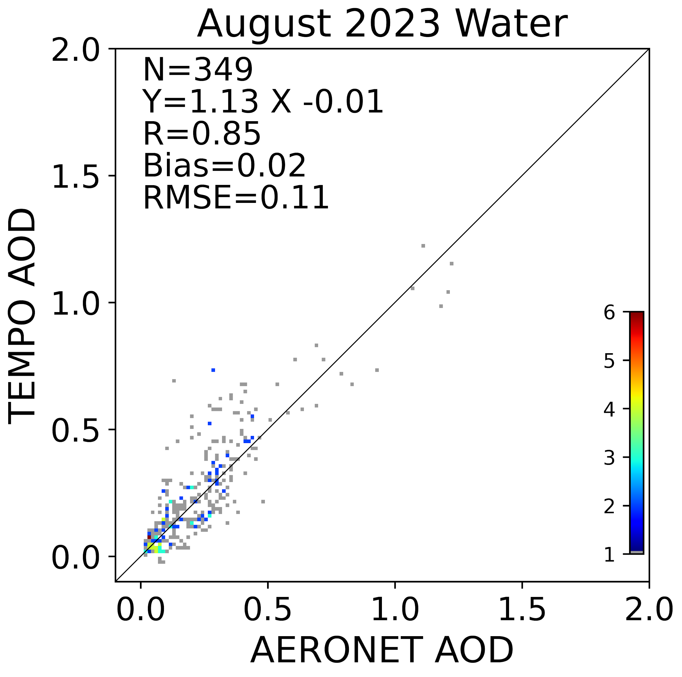
The Effect of Soft Calibration on AOD Retrieval
Original
After soft calibration
Original

Slide 13
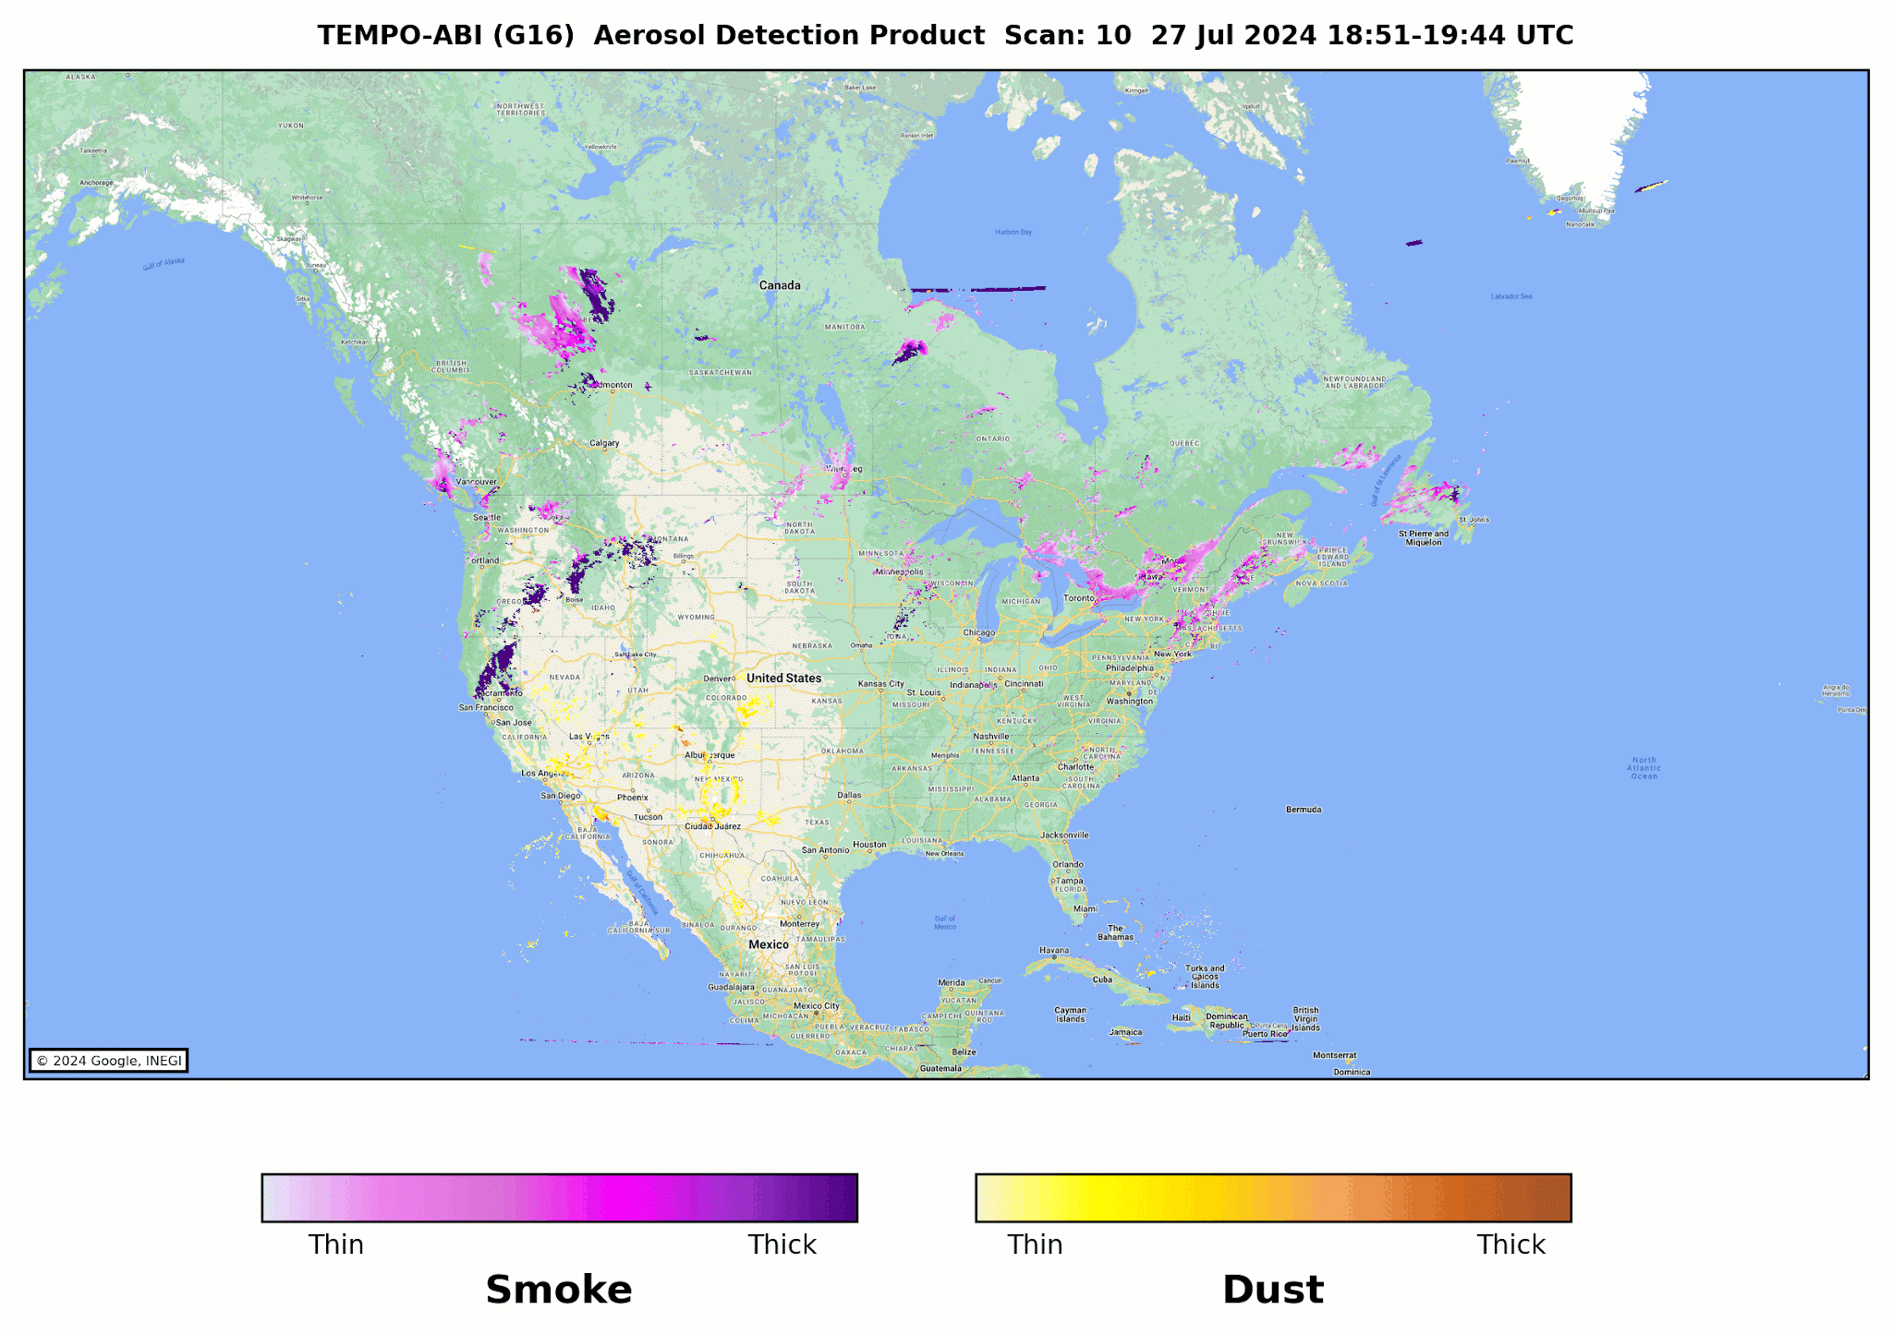
Validation of Smoke and Dust Detection
Smoke
AERONET |  | POCD | POFD | Accuracy
08/2023-09/2024 | G16 | 85.1 | 26.6 | 83.1
08/2023-09/2024 | G18 | 85.1 | 26.6 | 83.1
Dust
AERONET |  | POCD | POFD | Accuracy
08/2023-09/2024 | G16 | 74.5 | 8.3 | 71.7
08/2023-09/2024 | G18 | 74.8 | 2.7 | 76.3
Original
After soft calibration
Original

Slide 14
Summary
Aerosol algorithm work is ongoing. Product evaluation revealed calibration errors that need to be understood. Only one month of data processing with soft calibration is completed.
One year of AOD and ADP retrievals with original calibration completed. To reprocess full one year requires calibration upgrade as function of time. We need to work with SAO.
Algorithm documents are being written
August 2023 products available to the scientific community for testing and evaluation
Products will be distributed through NASA ASDC November 2024 (after the ROSES call closes)
Further improvements include cloud mask updates
We suspect positive bias in AOD is due to residual cloud contamination. Developing a few internal tests to minimize cloud contamination.

