Slide 1
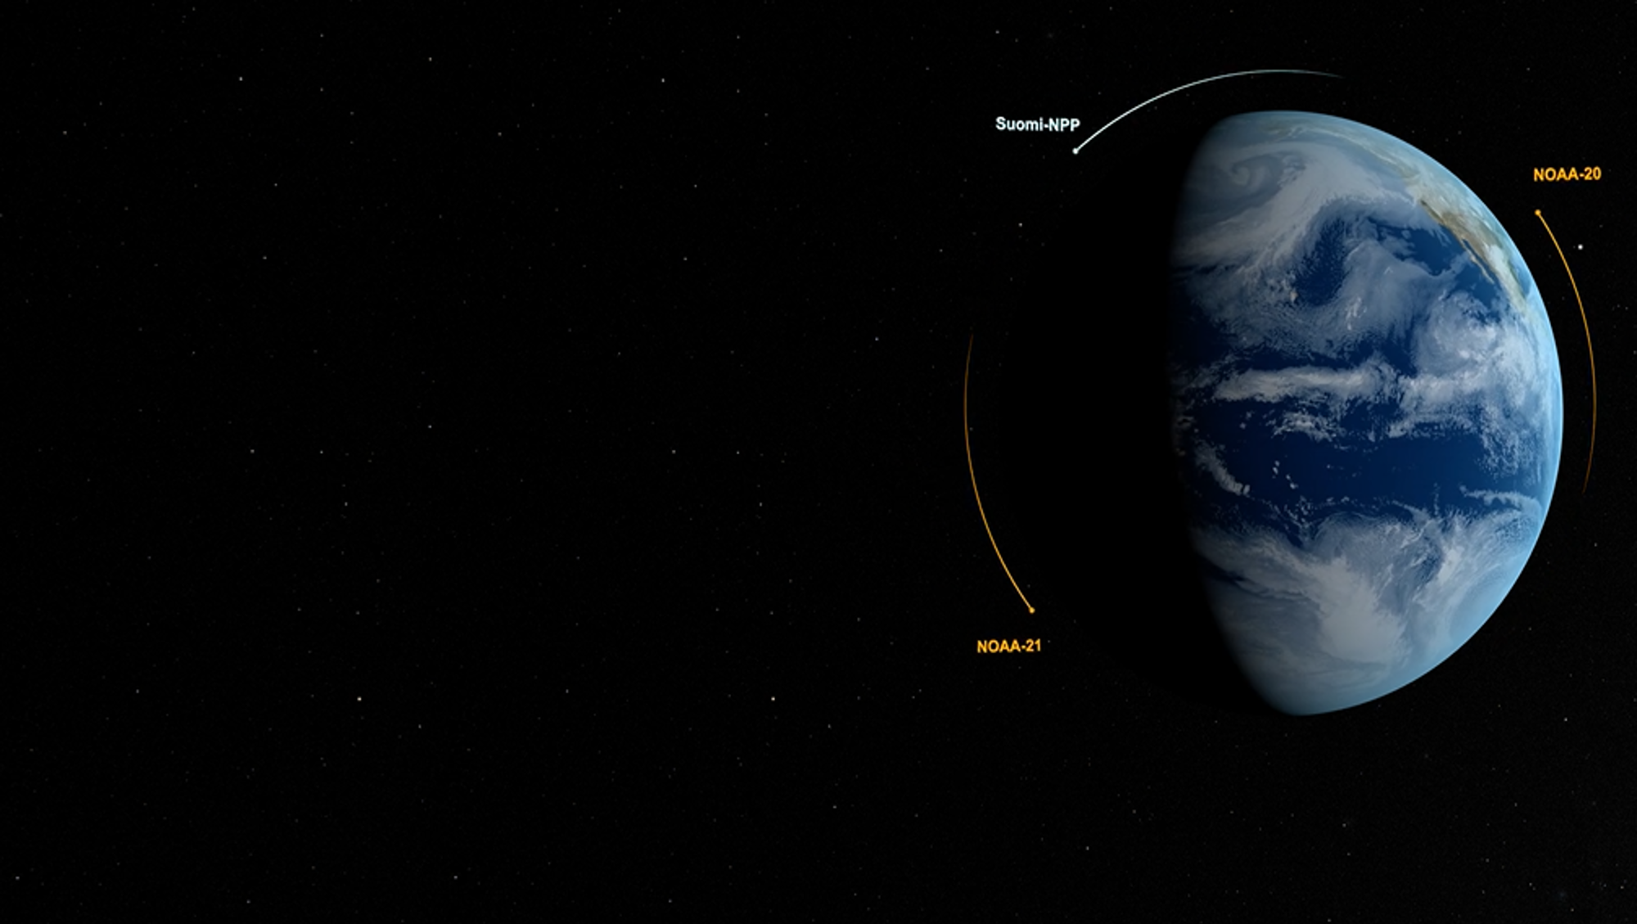
JPSS Aerosol Update
Hongqing Liu, Istvan Laszlo, Shobha Kondragunta,
and NOAA/NESDIS/STAR Aerosol Team
CEOS AC-VC-20 Meeting
October 15th - 18th, 2024
NOAA Center for Weather and Climate Prediction in College Park, MD, USA

Slide 2
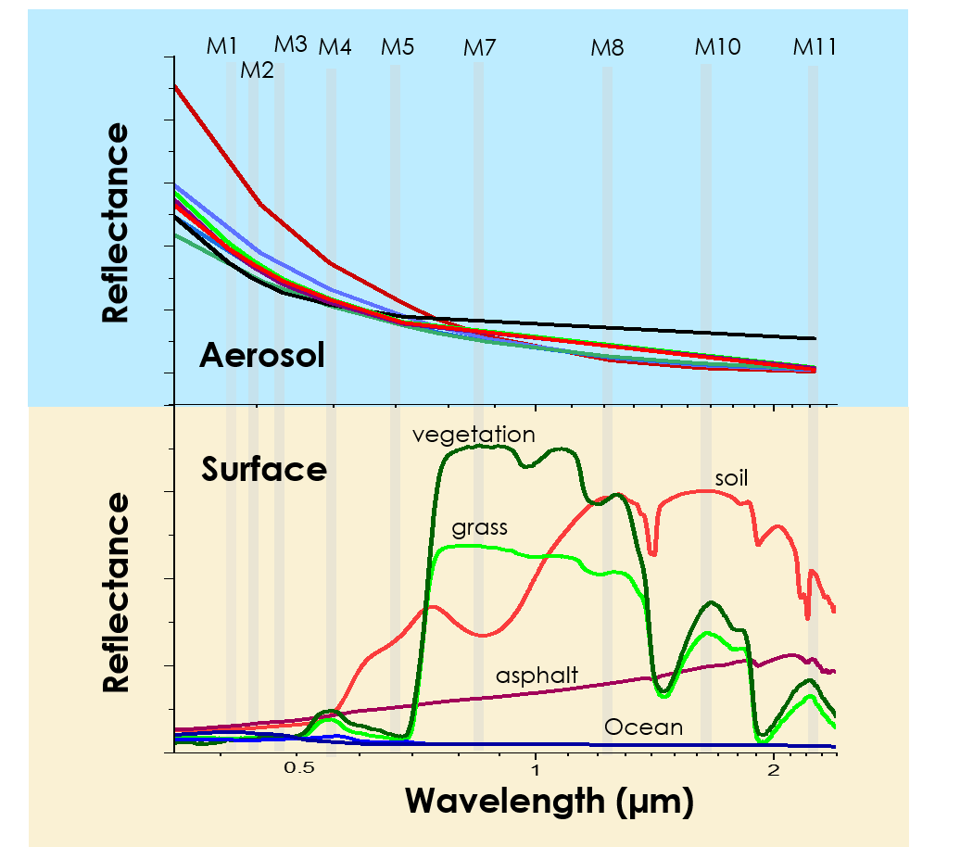
JPSS AOD Algorithm
Retrieves AOD from multispectral, single-look, unpolarized reflectance at pixel level (750m)
Separate retrievals over land and water
Surface reflectance
Calculated over water
Spectral relationship prescribed over land
Aerosol Optical Depth
Match the TOA reflectance at the primary channel (M3 over land, M7 over water)
Aerosol model
Selected based on the minimum residual

Slide 3
Availability of JPSS AOD Product
Operational JPSS VIIRS AOD are available from NOAA Comprehensive Large Array-data Stewardship System (CLASS) (https://www.aev.class.noaa.gov/)
S-NPP AOD available from July 06, 2017;
NOAA-20 AOD available from March 07, 2019
NOAA-21 AOD available from July 24, 2023
Past two years data also available at NOAA Open Data Dissemination (NODD)
https://noaa-nesdis-snpp-pds.s3.amazonaws.com/index.html#VIIRS-JRR-AOD/
https://noaa-nesdis-n20-pds.s3.amazonaws.com/index.html#VIIRS-JRR-AOD/
https://noaa-nesdis-n21-pds.s3.amazonaws.com/index.html#VIIRS-JRR-AOD/

Slide 4
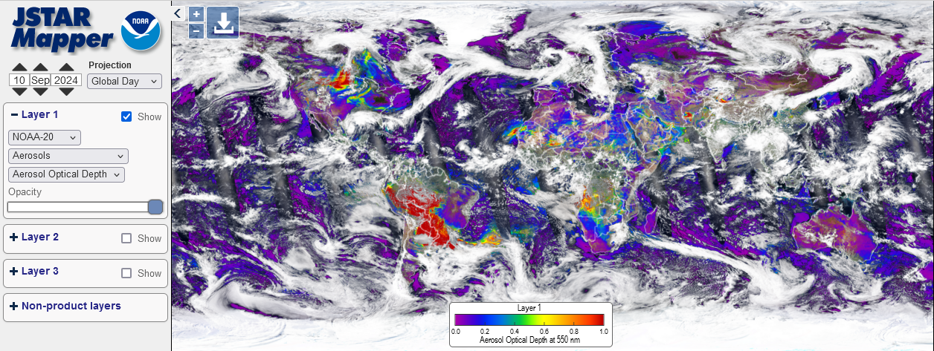
Global Images
NRT images available at the JSTAR Mapper https://www.star.nesdis.noaa.gov/mapper

Slide 5
Validation over Land
Performances of the three VIIRS retrievals are similar: small negative bias of -0.01 to -0.02; RMSE is about 0.1
Larger uncertainty and underestimation at high AODs.

Slide 6
Validation over Water
More accurate than retrievals over land
Performances of the three VIIRS retrievals are similar: small bias around 0.01; RMSE is about 0.06

Slide 7
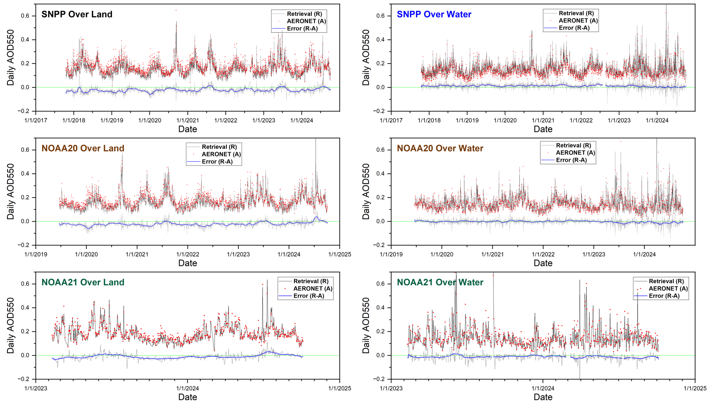
Time Series

Slide 8
Reprocessed AOD Products
Reprocessed the historical VIIRS AOD on
SNPP: 2012-2022; NOAA20:2018-2022
Used reprocessed VIIRS SDR
Data are available at Amazon Simple Storage Service (S3 buckets)
Level-2 AOD data
https://noaa-jpss.s3.amazonaws.com/index.html#SNPP/VIIRS/SNPP_VIIRS_Aerosol_Optical_Depth_EDR_Reprocessed/
https://noaa-nesdis-n20-pds.s3.amazonaws.com/index.html#reprocessed/VIIRS-JRR-AOD_R/
Gridded AOD data
https://noaa-jpss.s3.amazonaws.com/index.html#SNPP/VIIRS/SNPP_VIIRS_Aerosol_Optical_Depth_Gridded_Reprocessed/
https://noaa-jpss.s3.amazonaws.com/index.html#NOAA20/VIIRS/NOAA20_VIIRS_Aerosol_Optical_Depth_Gridded_Reprocessed/
More information from the START Atmospheric Composition Product Training website: https://www.star.nesdis.noaa.gov/atmospheric-composition-training/satellite_data.php#satellite_data_archives

Slide 9
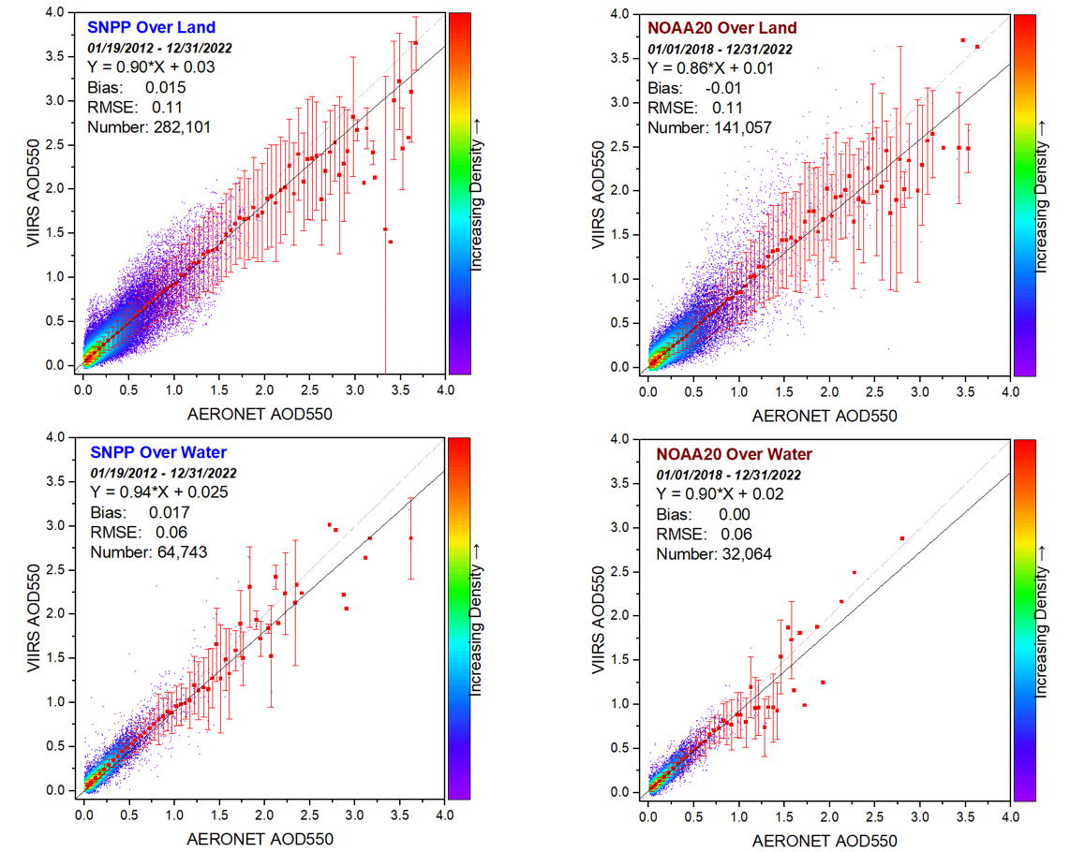
Validation of the Reprocessed AOD
Performances are similar to the operational VIIRS AOD

Slide 10
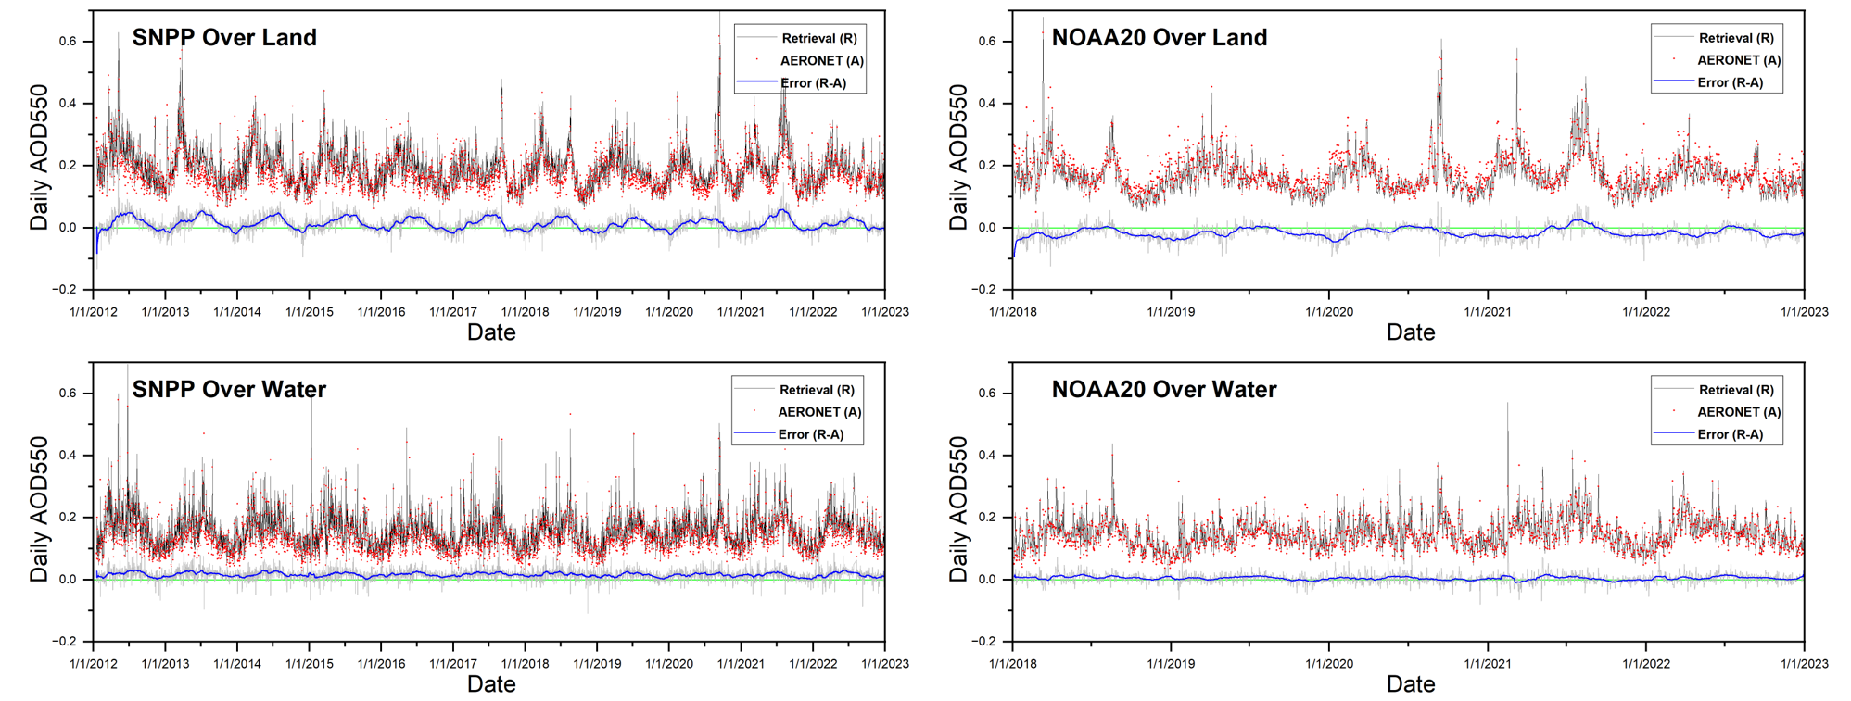
Time Series of the Reprocessed AOD

Slide 11
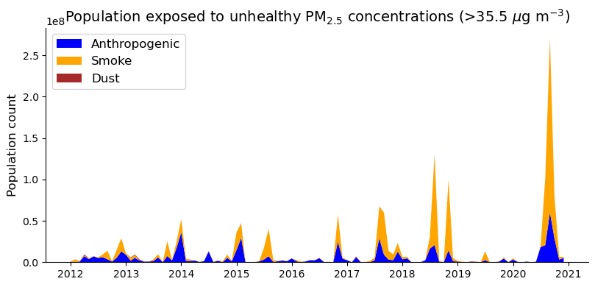
Application (PM2.5)
More details in Michael’s presentation “Satellite perspectives to changing federal standards for PM2.5” (15:30 - 15:45 today)

Slide 12
Future Plans
Current issues
Candidate aerosol models are not globally representative
Dynamic model selection favors dust and smoke
Underestimation over Africa and India
Future updates – implement operationally
Expanded candidate aerosol models derived from AERONET
Updated spectral surface reflectance relationships
Adjust the model selection scheme

Slide 13
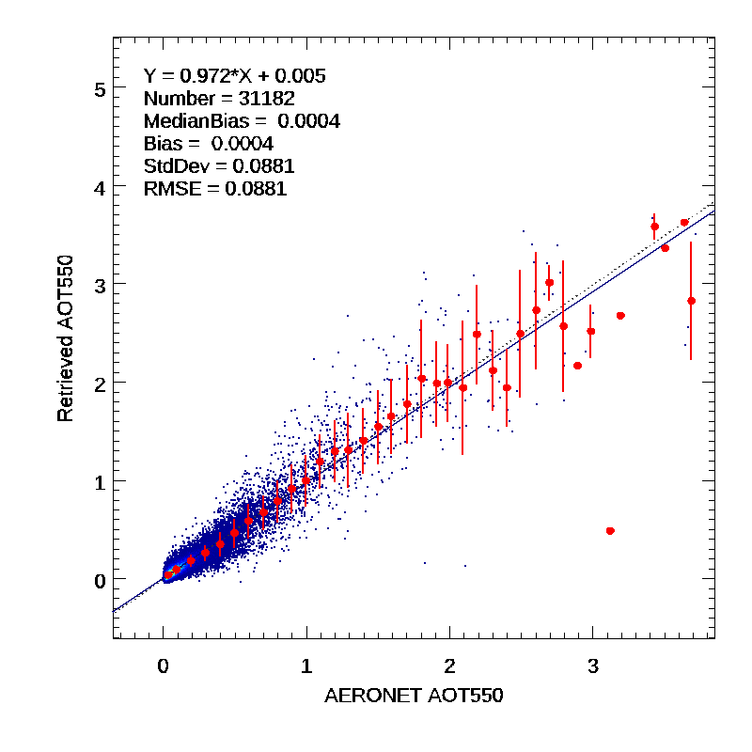
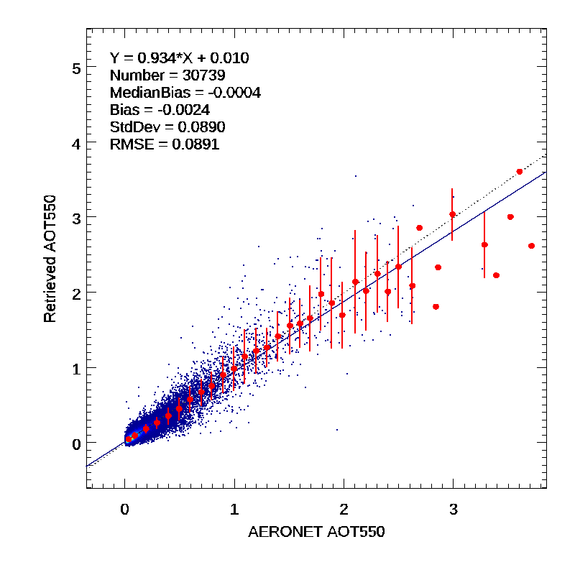
Preliminary Results
One-year (2023) test with SNPP/NOAA20/NOAA21 AOD retrievals over dark land
SNPP
NOAA20
NOAA21
SNPP
NOAA20
NOAA21
Over Land
Over Land
Over Land

