Slide 1
Multi-model multi-constituent chemical (MOMO-Chem) data assimilation
for city-to-global scale atmospheric composition and emission analysis
Kazuyuki Miyazaki
NASA Jet Propulsion Laboratory, California Institute of Technology , USA
Kevin Bowman (JPL), Longtao Wu (JPL), Takashi Sekiya (JAMSTEC), Dylan Jones (Univ. Toronto), Helen Worden (NCAR), Henk Eskes (KNMI), Pieter Rijsdijk (KNMI), Mukesh Rai (JPL), Vivienne Payne (JPL), Nathaniel Livesey (JPL), Emanuele Emili (BSC), Antje Inness (ECMWF), Zhen Qu (NCSU), Brad Pierce (Univ. of Wisconsin-Madison), William Chen (NCAR), Vincent Huijnen (KNMI), Gerbrand Koren (Utrecht Univ.), Rajesh Kumar (NCAR), Pablo Saide (UCLA)
Copyright 2024, California Institute of Technology. Government sponsorship acknowledged.

Slide 2
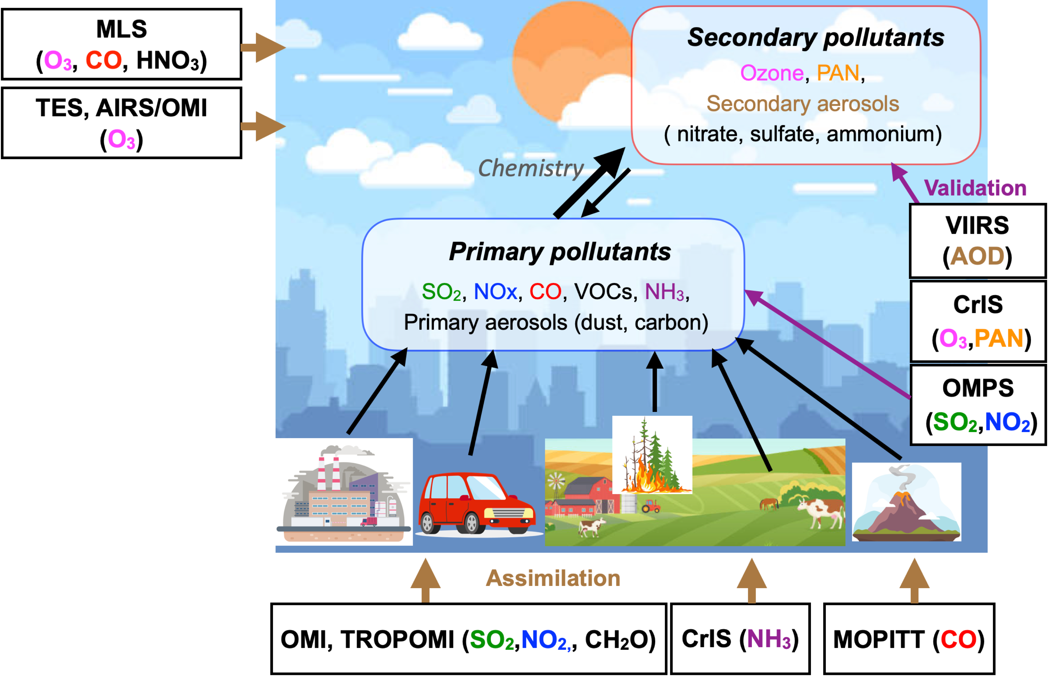
Miyazaki et al.,
In prep.
(updated from Miyazaki et al., 2020)
Long-lived GHGs
Oxidation capacity (OH)
↓
CH4
AQ-GHG co-emissions
↓
CO2
MOMO-Chem Tropospheric Chemistry Reanalysis (TCR-3)

Slide 3
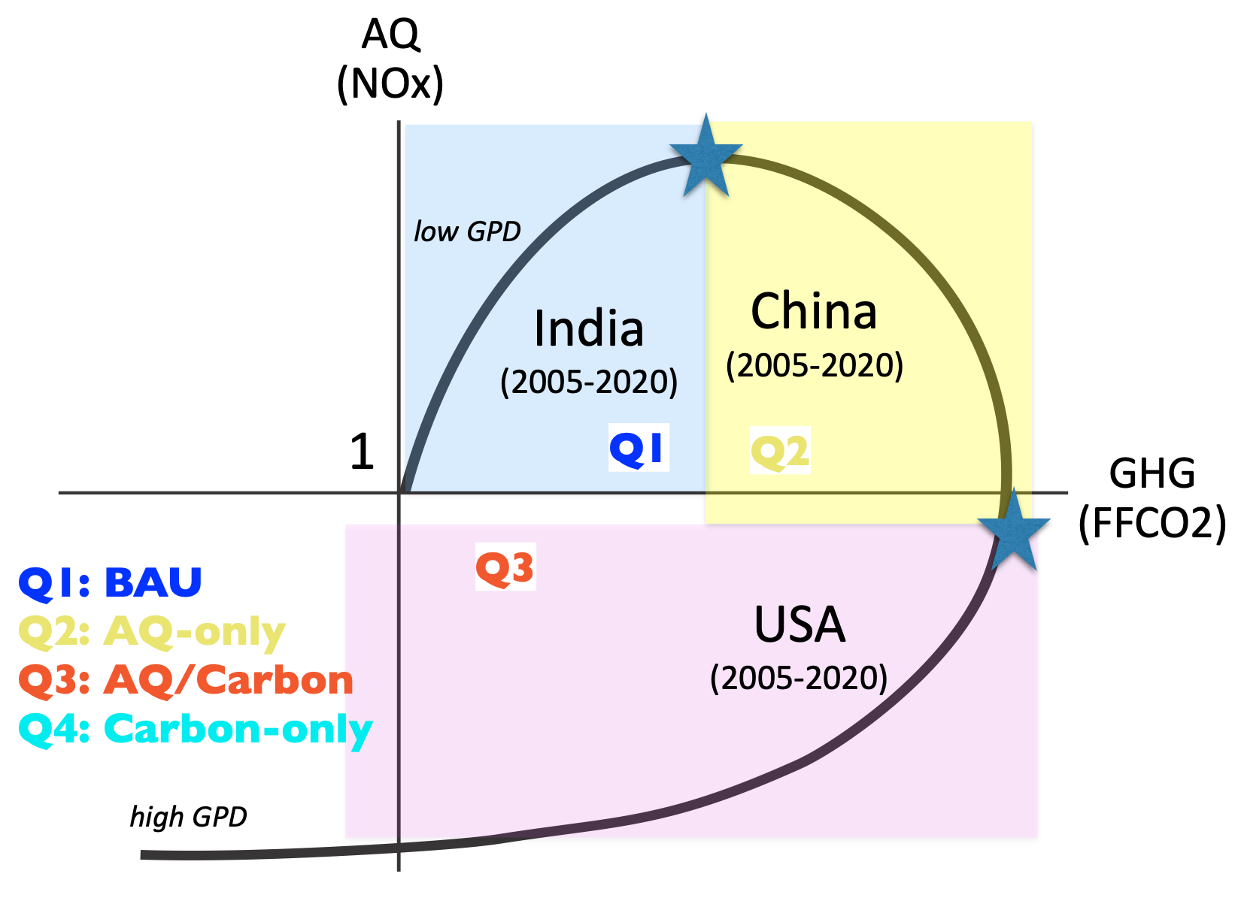
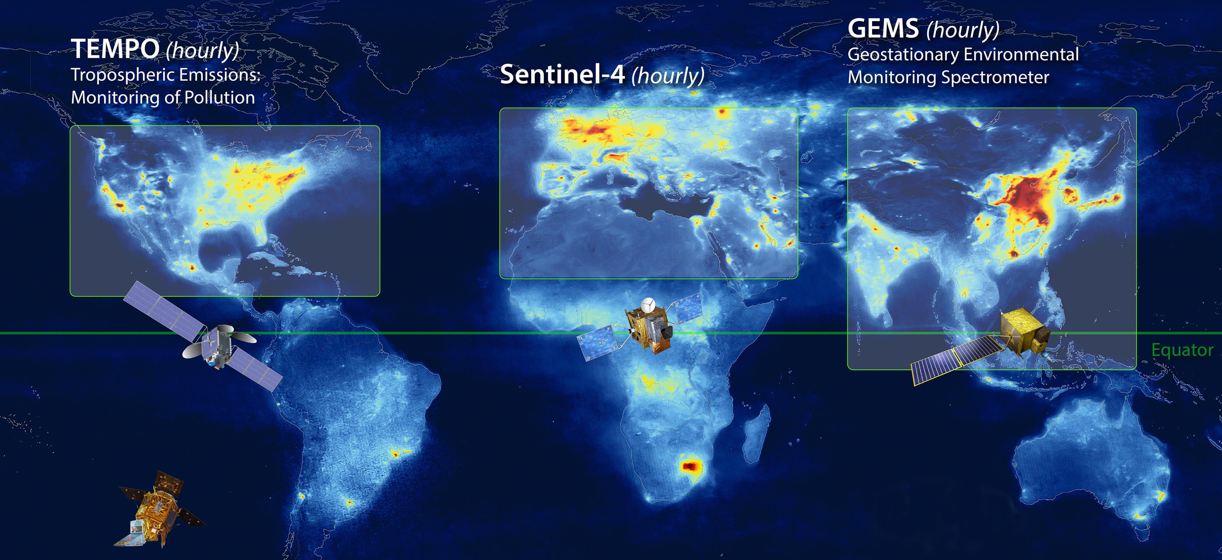
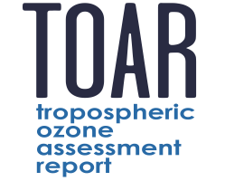
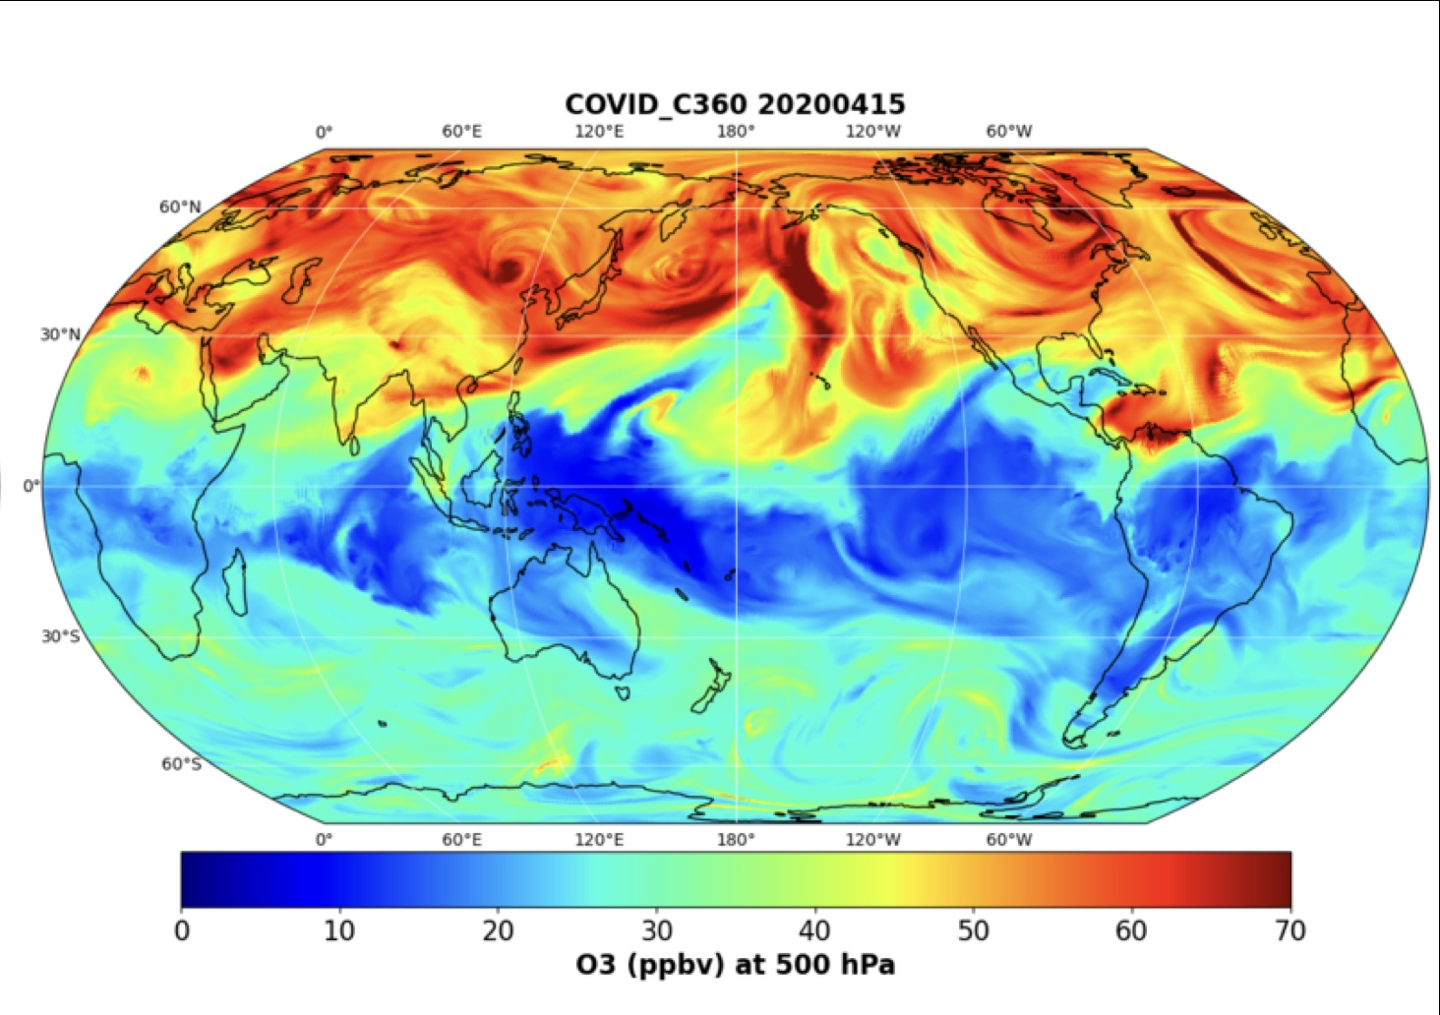
MOMO-Chem contribute to NASA’s current and future missions
Top-down emissions (NOx,CO,SO2,Isopren)
Attribution
GEO+LEO AQ integration
AQ-GHG synergy
OSSEs mission formation
GEMS, TEMPO
Explore class missions
CMS-flux, GOSAT-GW,
OCO-2/3, CO2M
New generation
chemical reanalysis
Aircraft campaigns (ASIA-AQ)
Support policy decisions
We do science!
(not operational or engineering)
Broad communities
TROPESS new
satellite products
9 papers using MOMO-Chem and TROPESS data in TOAR-2
Satellite assessment paper lead
Health & Climate impacts
High-resolution DA
- IGAC GEIA, AMIGO, TOAR-2
- ISSI GEO AQ
NASA chemDA
CEOS-AC-VC
WMO observing system impact
Earth Science to Action

Slide 4
Chemical reanalysis Focus Working Group
Co-leads: Kazuyuki Miyazaki, Dylan Jones, Helen Worden
Evaluate current chemical reanalysis products to assess their potential (Jones et al.).
Assesses the relative importance of individual observations (e.g., ozone vs precursor) to improve ozone analyses and help to design observing systems (Sekiya et al.)
Evaluate representativeness of FT ground-based ozone measurements (Miyazaki et al.).
Human health impact assessment (Wang et al)
ML downscaling and bias correction (Miyazaki et al)
Satellite ozone assessment paper
Co-leads: Daan Hubert, Kazuyuki Miyazaki
Provide present day maps, long-term changes, and attributions of tropospheric ozone
Evaluate agreements between satellite records and harmonized data products.
APARC Reanalysis Intercomparison (A-RIP)

Slide 5
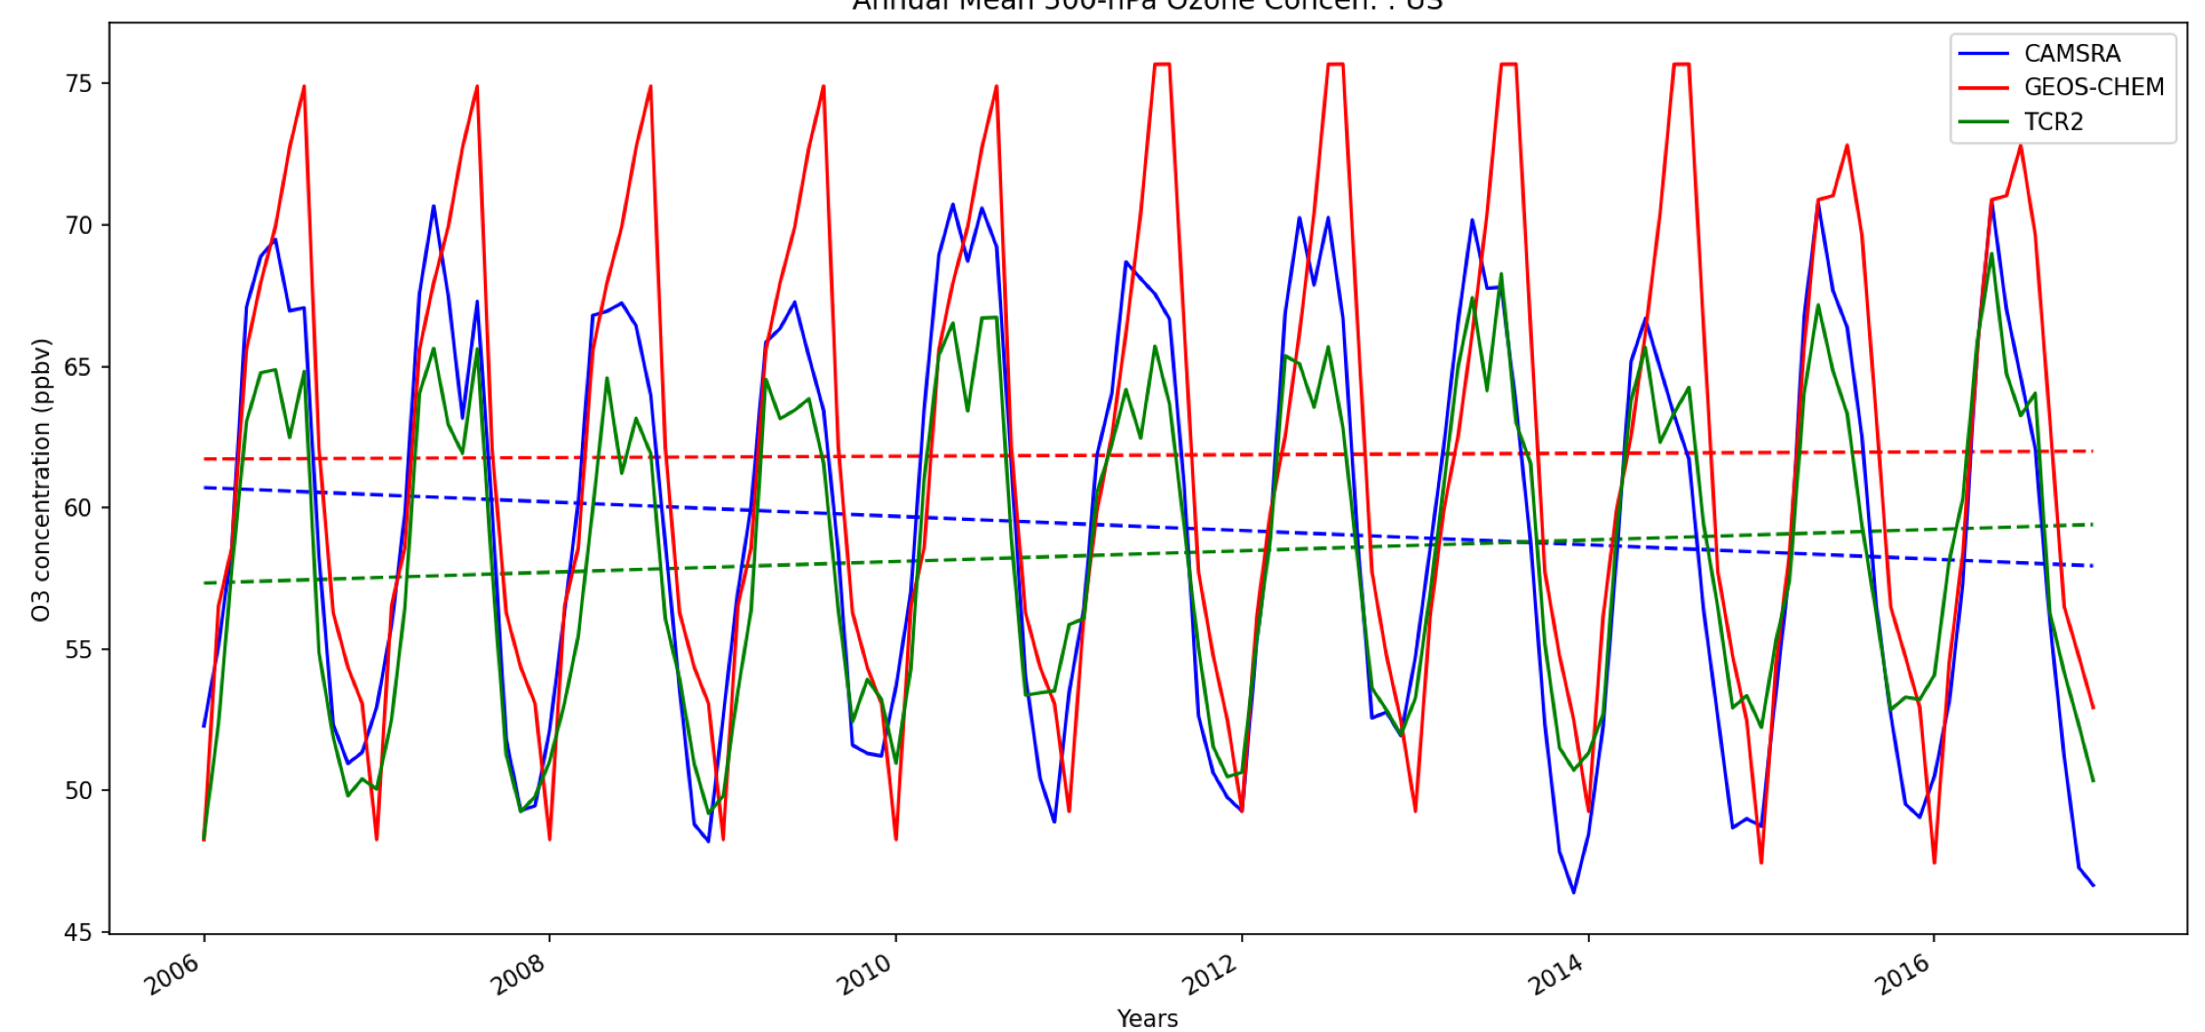
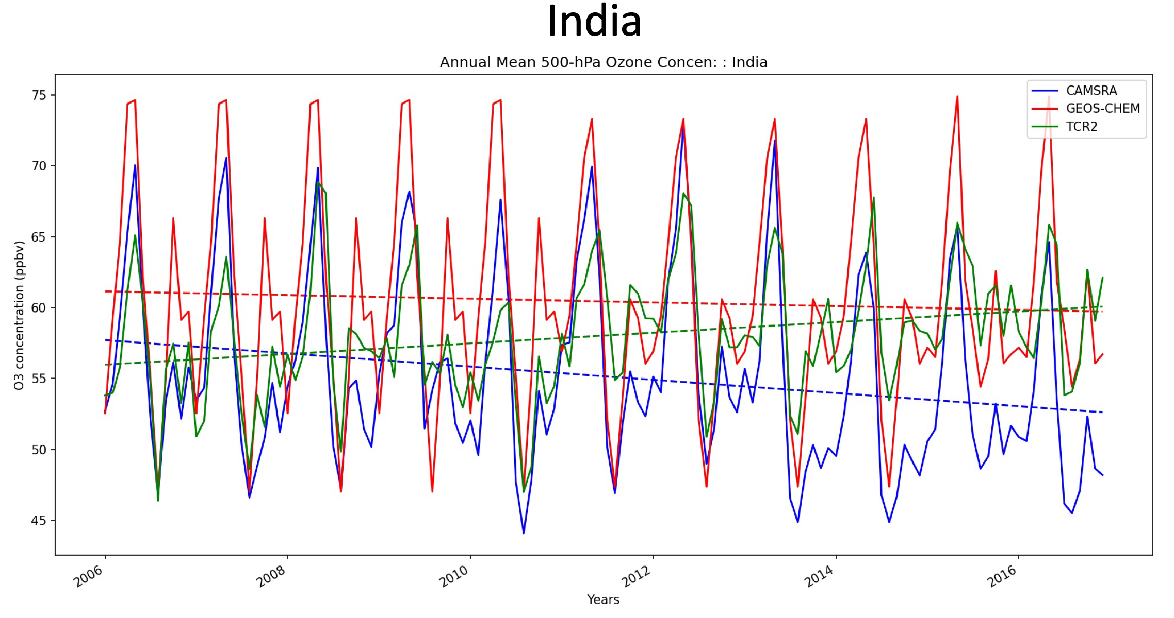
500 hPa ozone
Chemical reanalysis intercomparisons
U.S.
Reanalysis | Area | Resolution | Scheme
CAMS (A. Inness) | GLOBAL | T255 | 4D-Var
GEOS-CHEM (Z. Qu) | GLOBAL | 2°x2.5° | 4D-Var
TCR2 (K. Miyazaki) | GLOBAL | 1.125°x1.125° | EnKF
CAQRA (X. Tang) | CHINA | 15 km x 15 km | EnKF
CMAQ-GSI (R.Kumar) | US, Asia | 12 km x 12 km | 3D-Var
TCR-2
CAMS
GEOS-Chem
India
Jones et al. (in prep)
Toward further development of chemical reanalysis and observing systems

Slide 6
2005-2018 surface ozone linear trends
Jones et al. (in prep)
Further improvements in DA settings, temporal consistency, enhanced constrains on surface pollutants

Slide 7
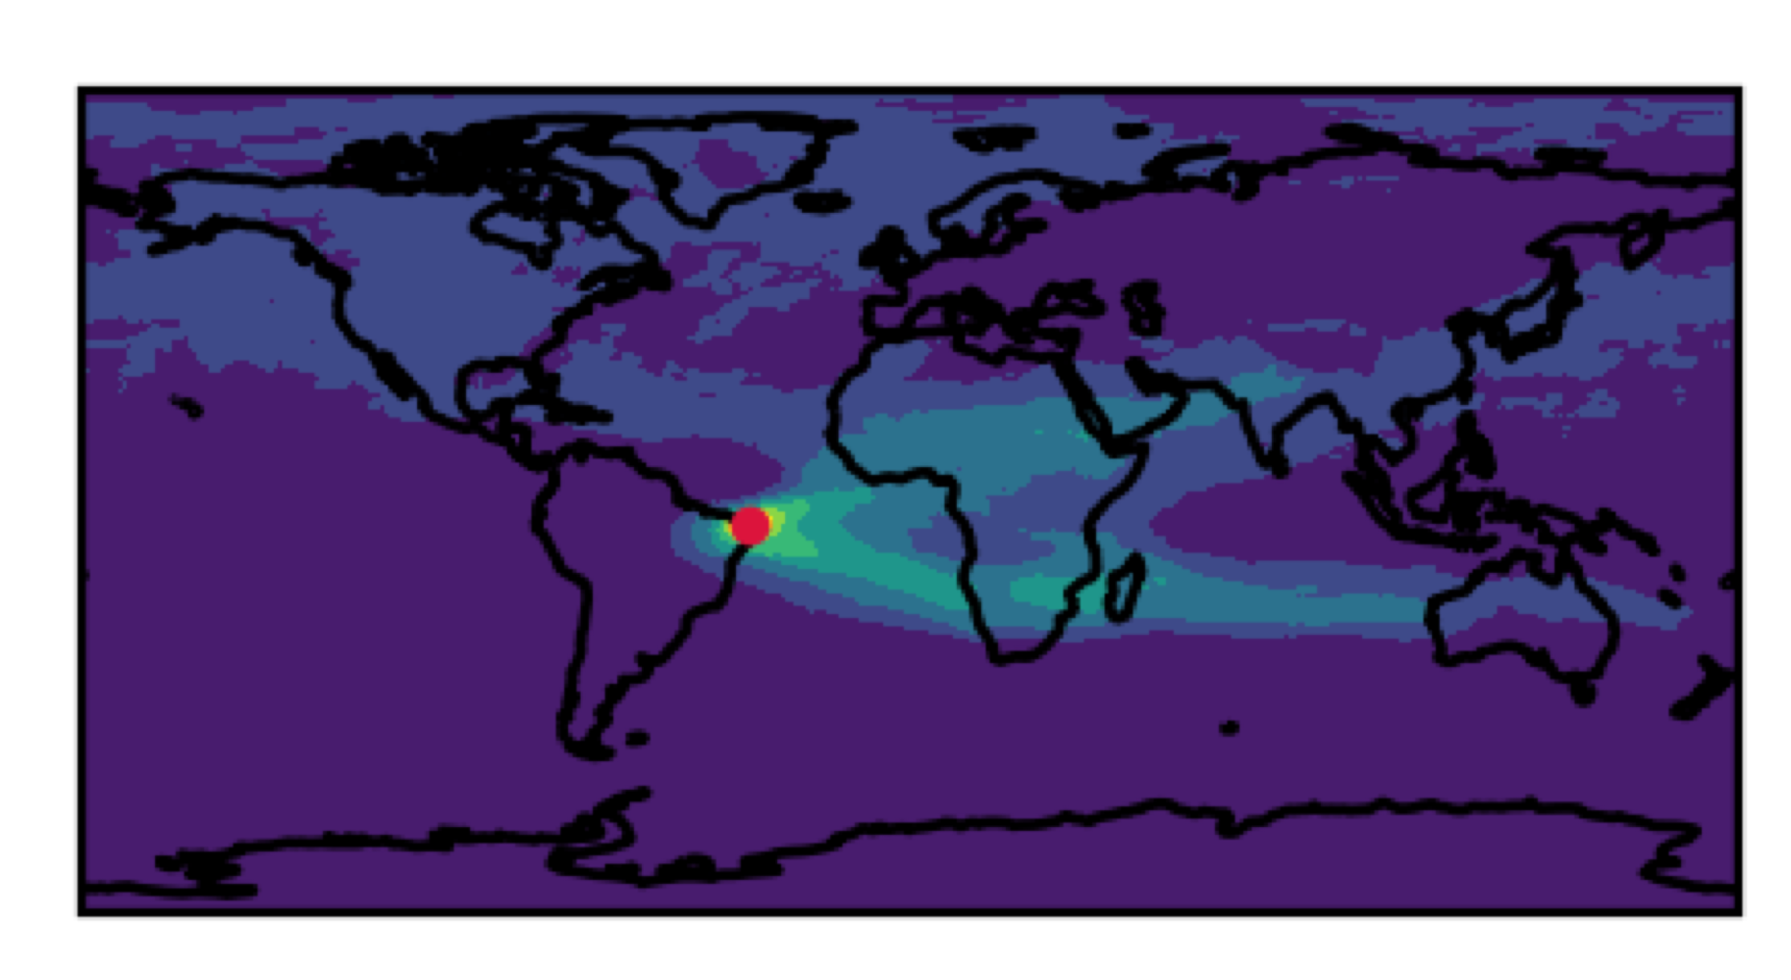
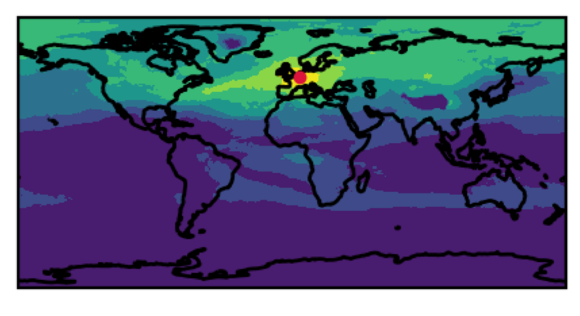
Representative errors of ground-based observations
Occur when the atmospheric state is not uniformly and frequently sampled and lead to spurious signals in trend analysis. In regions where variability is dominated by short-term and/or small-scale variations, limited sampling may lead to a large random sampling error.
TOC temporal correlations between individual stations and remote locations using chemical reanalysis
What are the spatial & temporal representative scales of
individual ground-based stations and networks?
Miyazaki et al. (in prep)

Slide 8
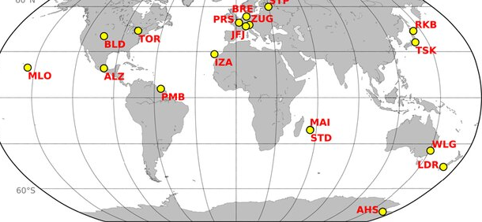
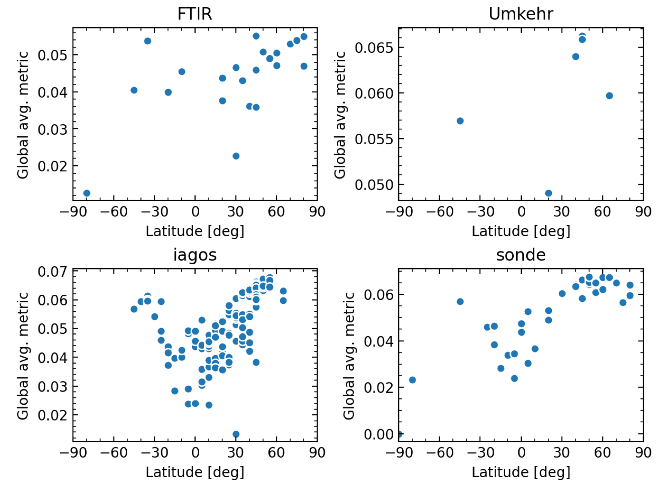
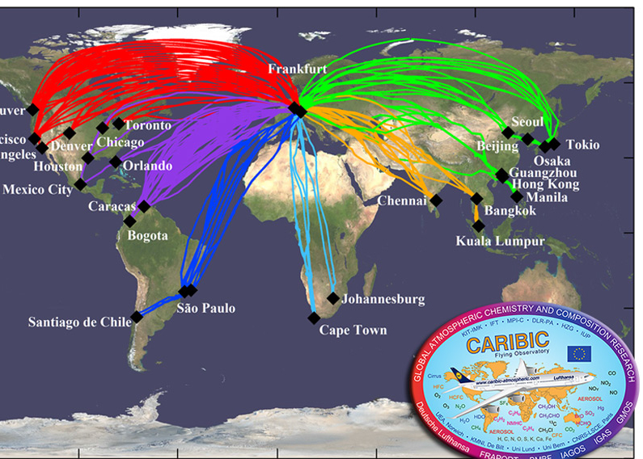
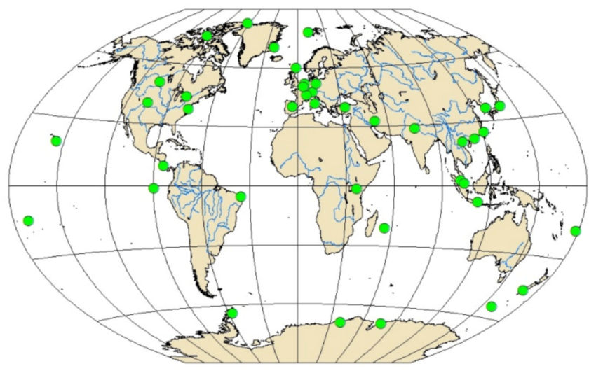
Miyazaki et al. (in prep)
Toward effective observing system design to better capture regional-global scale ozone variations

Slide 9
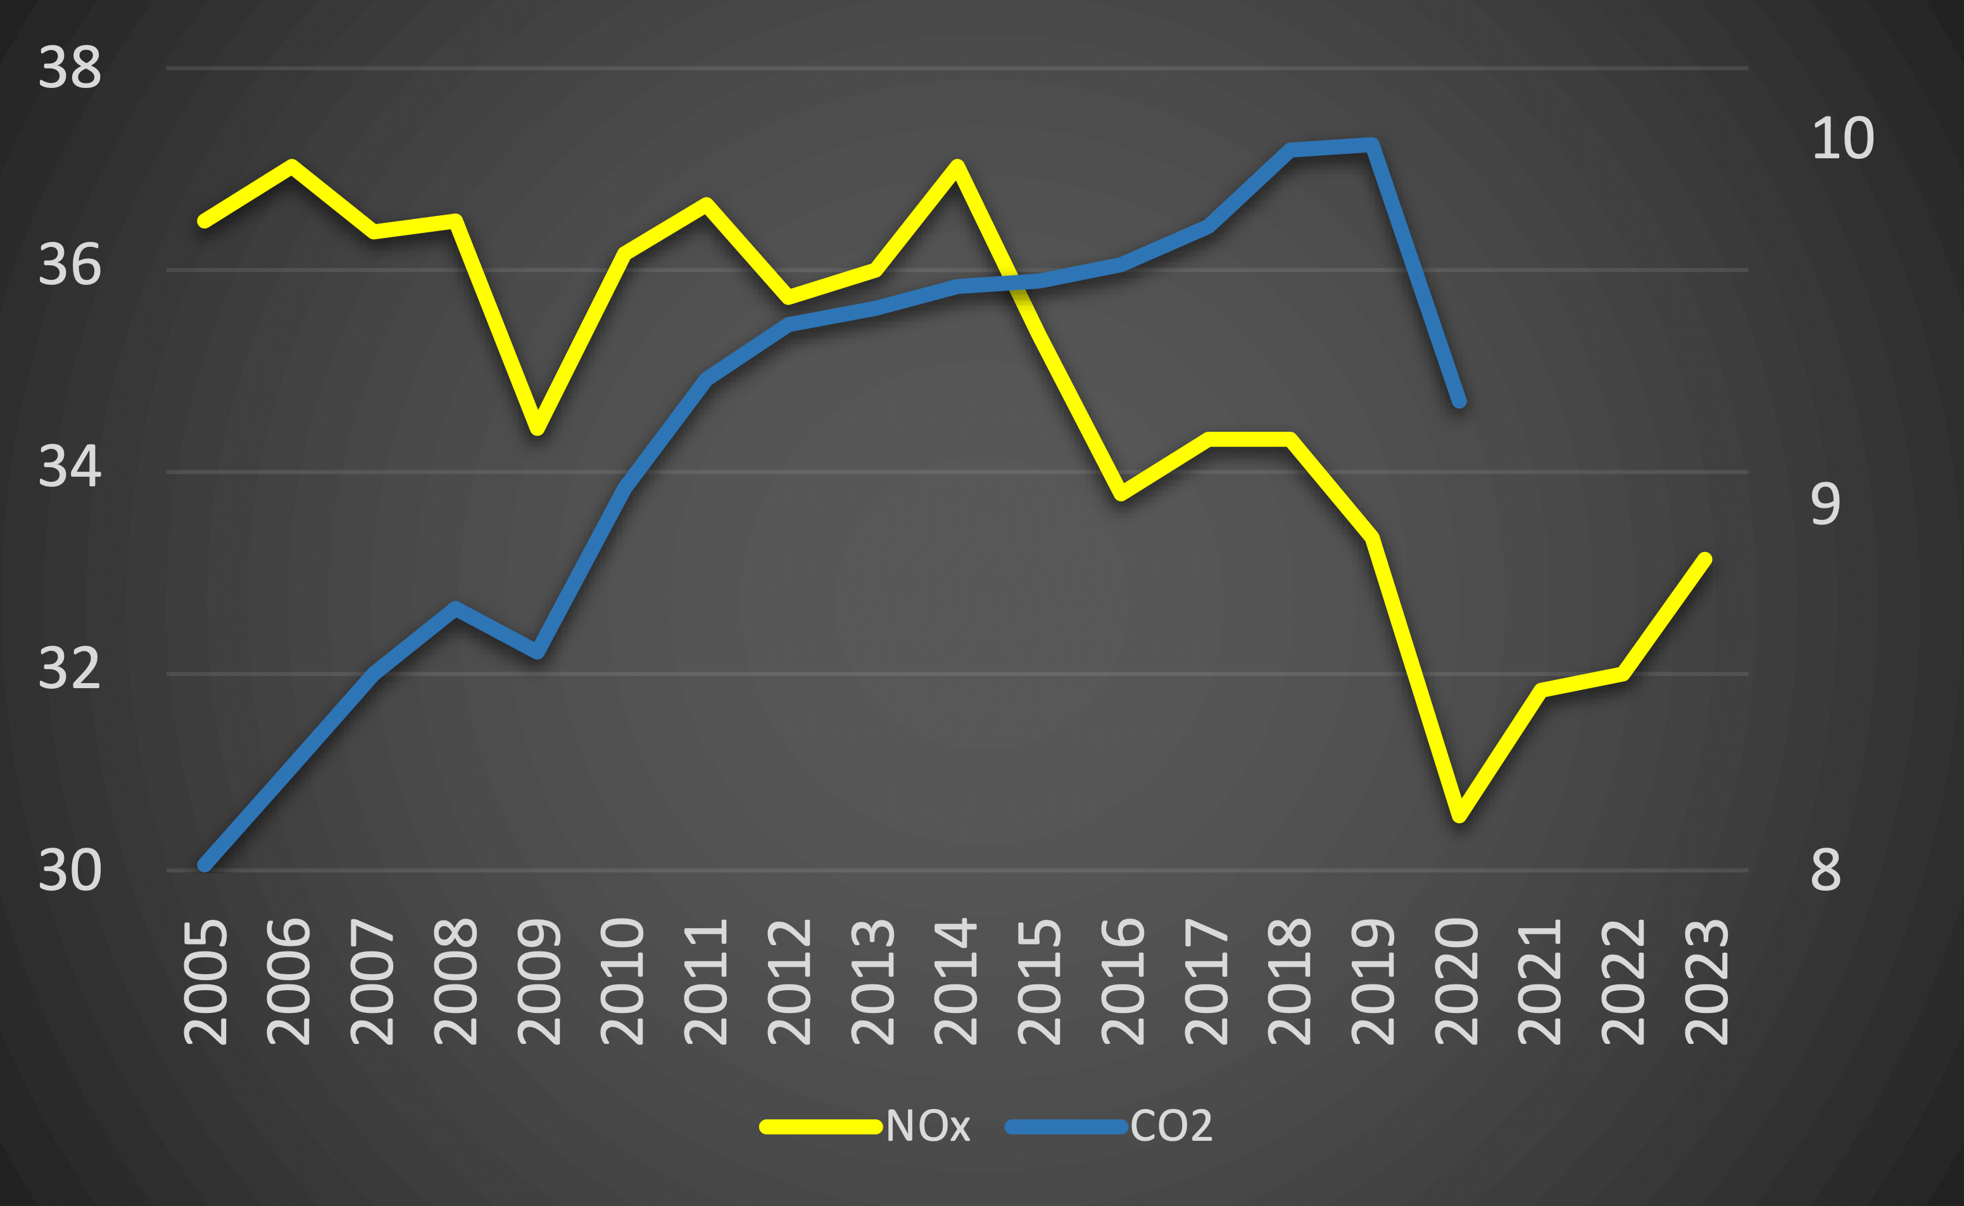
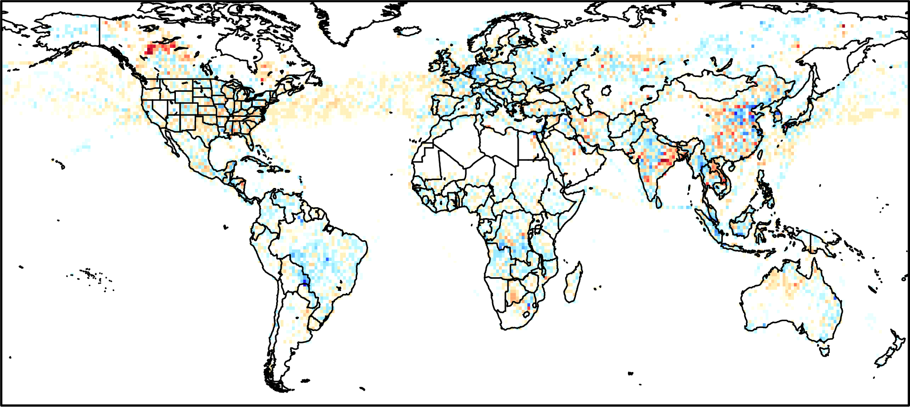
Global anthropogenic emissions over 19 years
Europe & USA ↓
China ↑
China ↓
India ↑
Top-down NOx (TgN/yr)
MOMO-Chem
Bottom-up CO2 (GtC/yr)
Le Quéré (2020)
Recovery & India ↑
COVID
NOx emissions
2023 - 2019
Higher, India, W China, SE USA
Lower: Europe, NE China
Updated from Laughner et al 2021 (PNAS)
and Miyazaki et al. 2021 (Sci Adv)

Slide 10
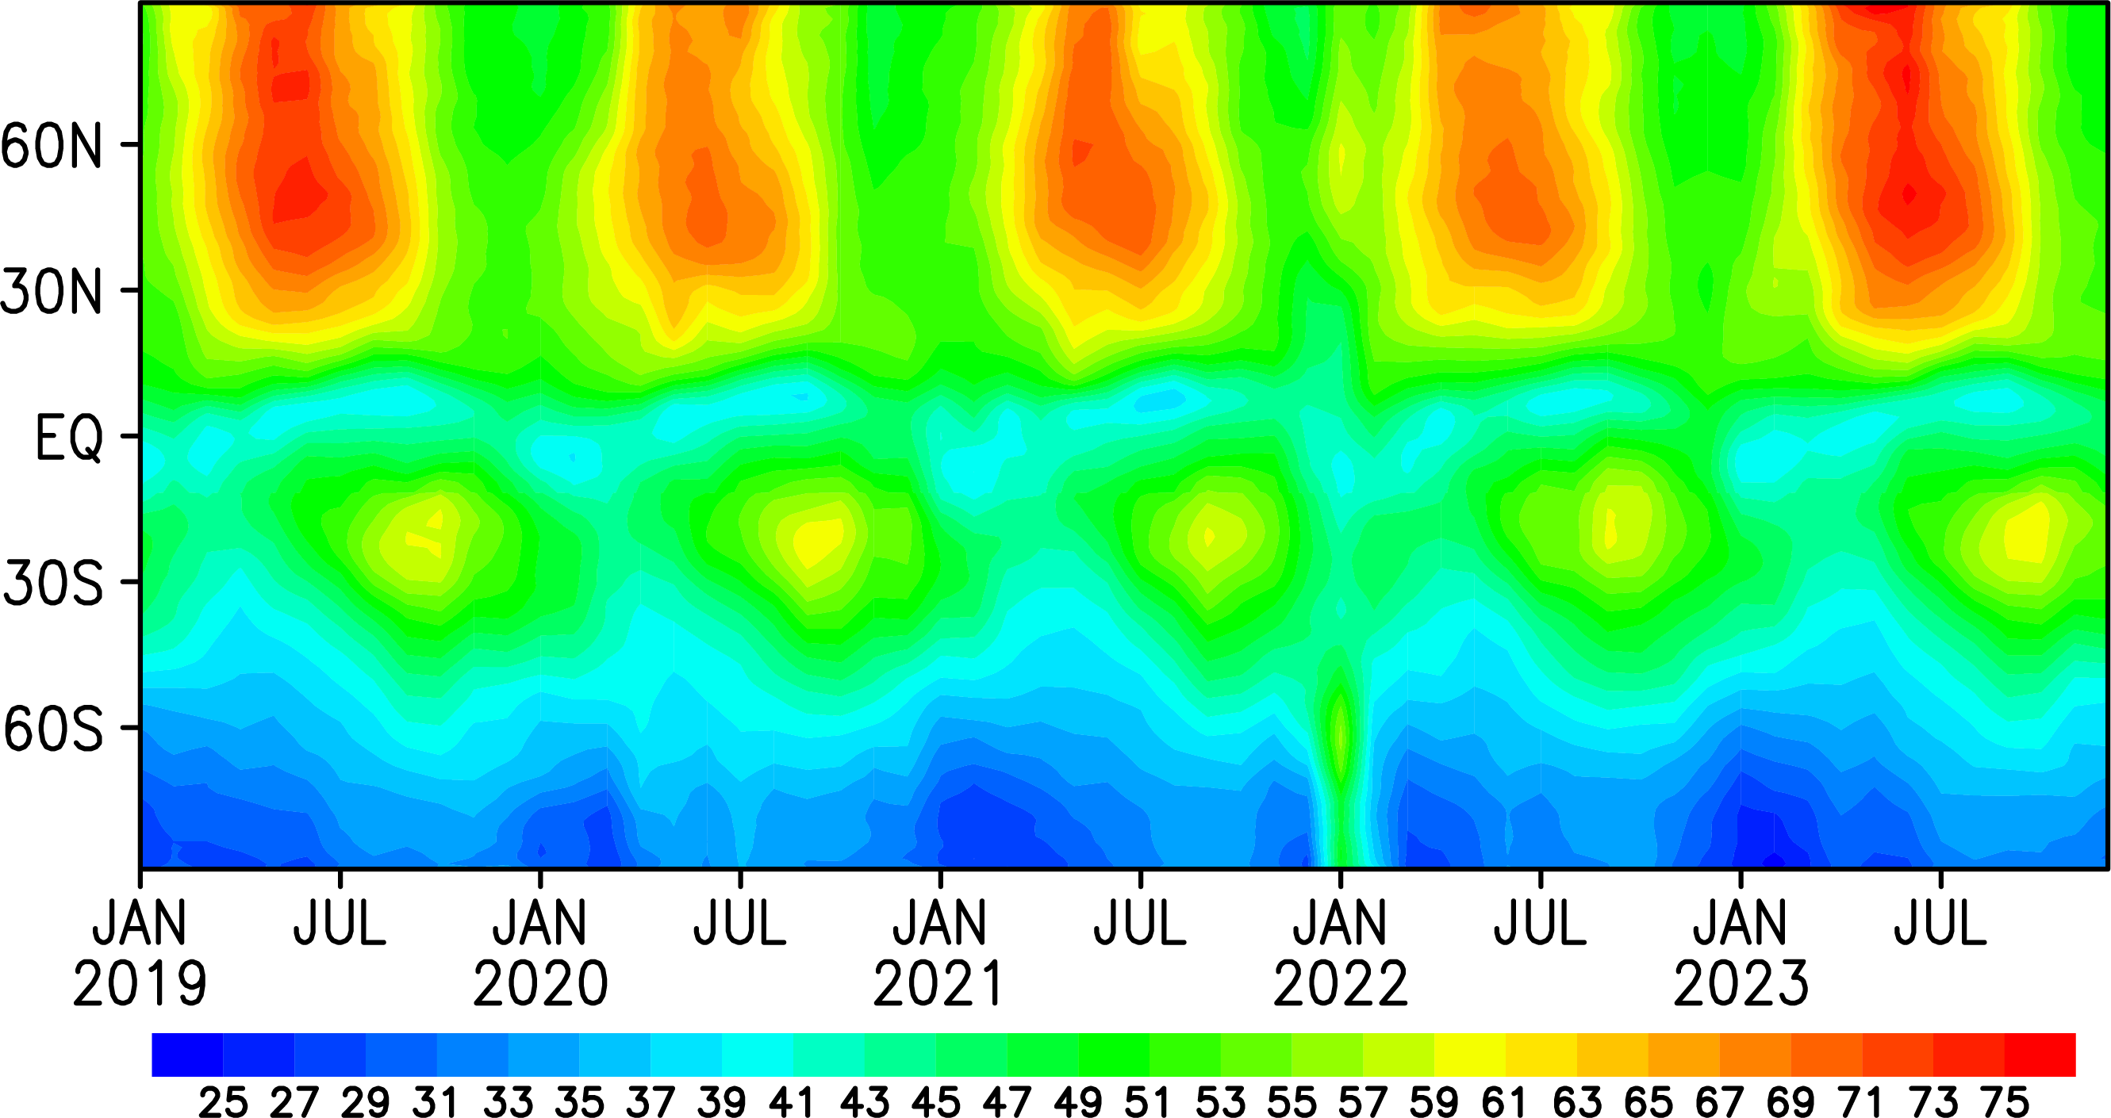
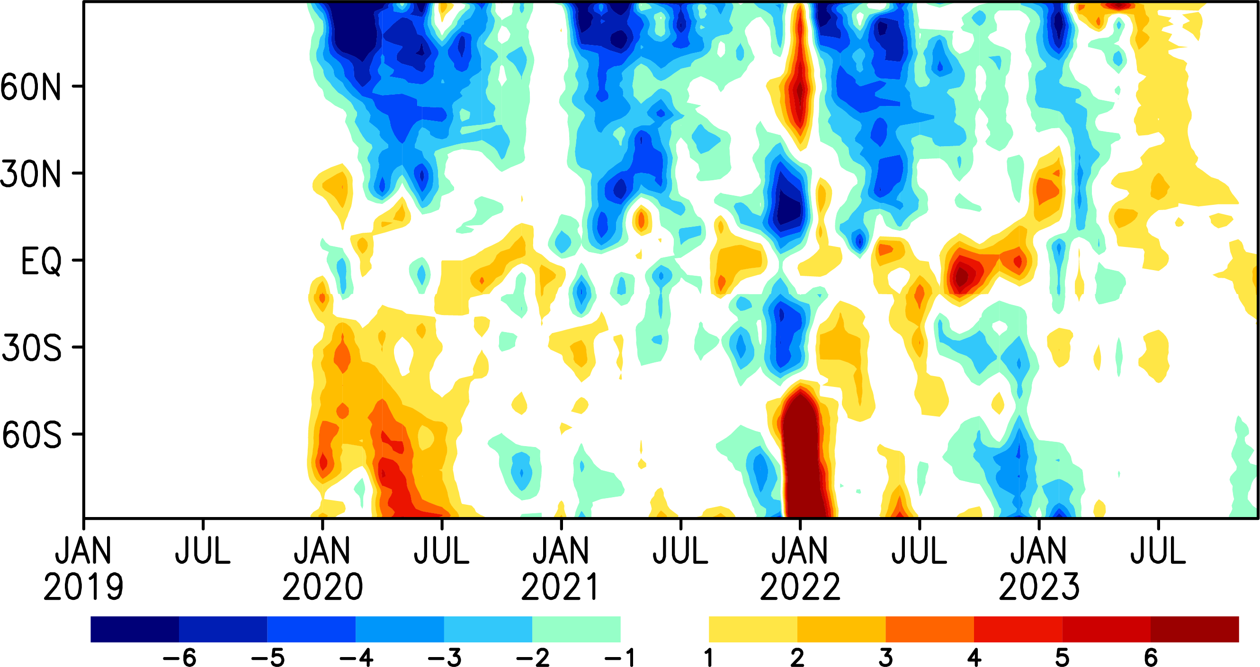
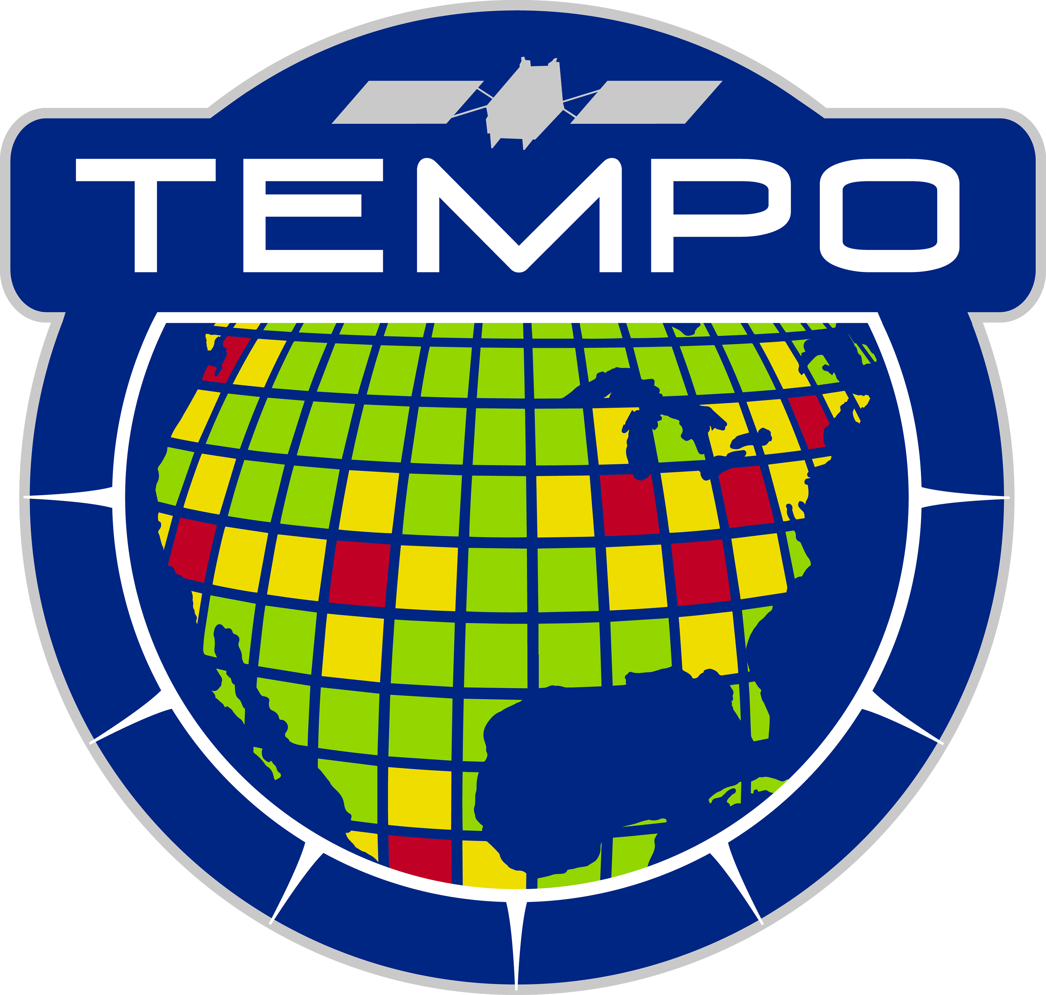
Updated from Miyazaki et al. 2021 (Sci Adv)
Zonal mean O3
at 500 hPa
from MOMO-Chem
?
Anomaly from 2019
?
2020: The tropospheric ozone burden declined by 6TgO3 (∼2%)
2021-early2023: Continued low ozone in NH?
COVID
Hunga Tonga–Hunga
Australian fires
Canadian fires

Slide 11
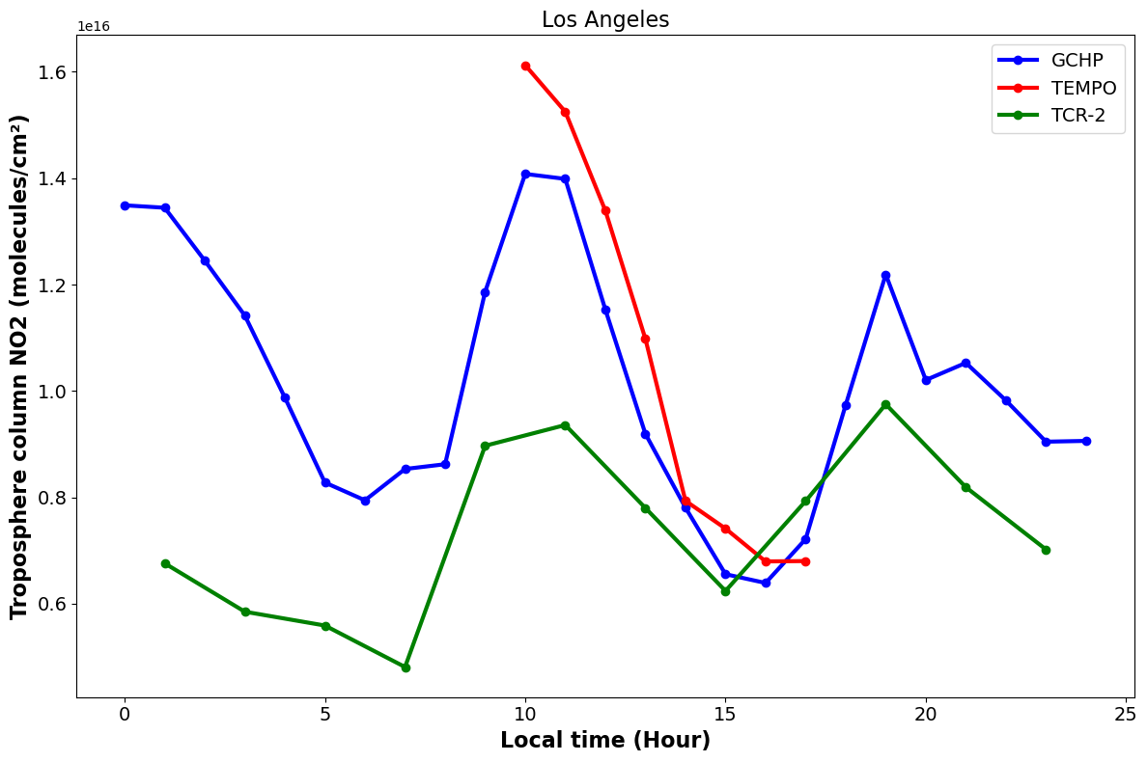
Global high-resolution DA in MOMO-Chem
Surface ozone
TEMPO
GCHP (0.25°)
TCR-2 (1.1°)
GCHP (0.25°)
TCR-2 (1.1°)
Tropospheric NO2 column over LA
Effective DA of high-resolution obs (GEO, in situ + LEO)
Evaluation of DA uncertainty due to model errors
City-to-global scale seamless analysis
GCHP
TEMPO
GEO+LEO will enable seamless local to global scale analysis and improve diurnal emissions while improving background chemical conditions and long-range transport
TCR-2
Local time (Hour)
0
5
10
15
20

Slide 12
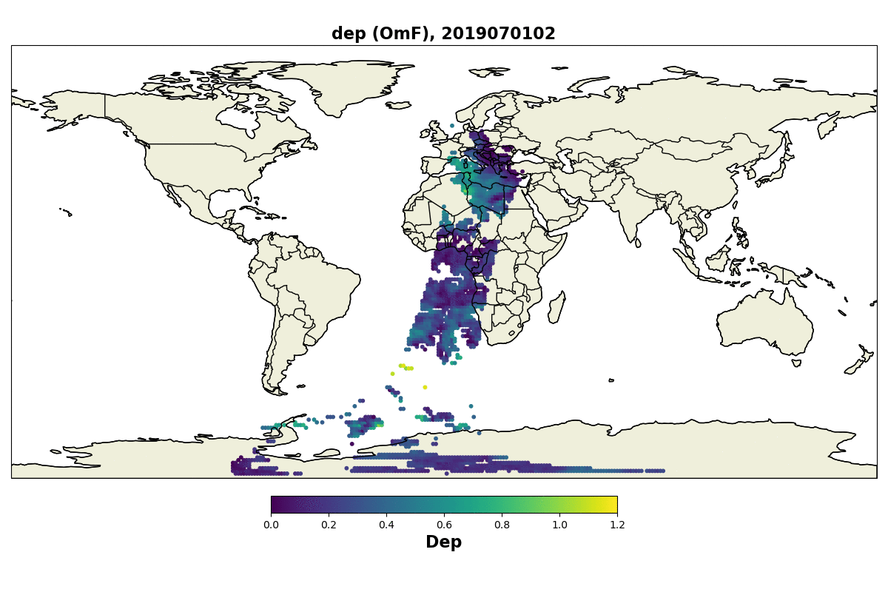
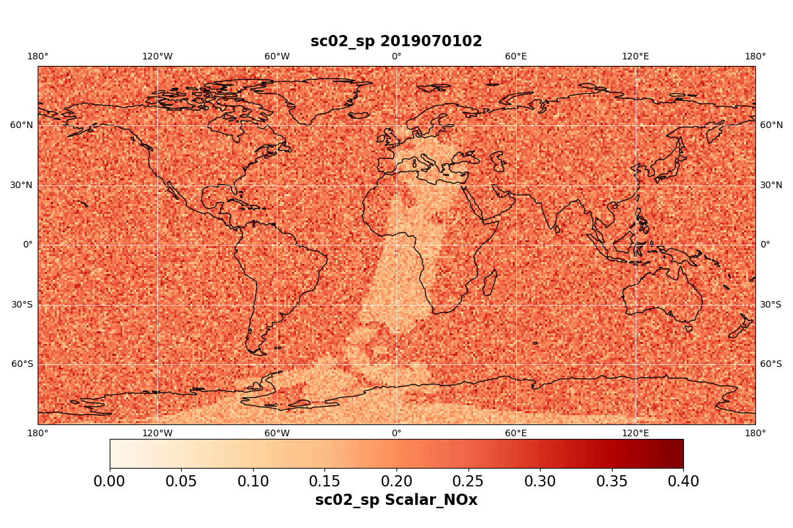
GCHP-EnKF TROPOMI data assimilation
OmF
Spread of NOx scale factor

Slide 13
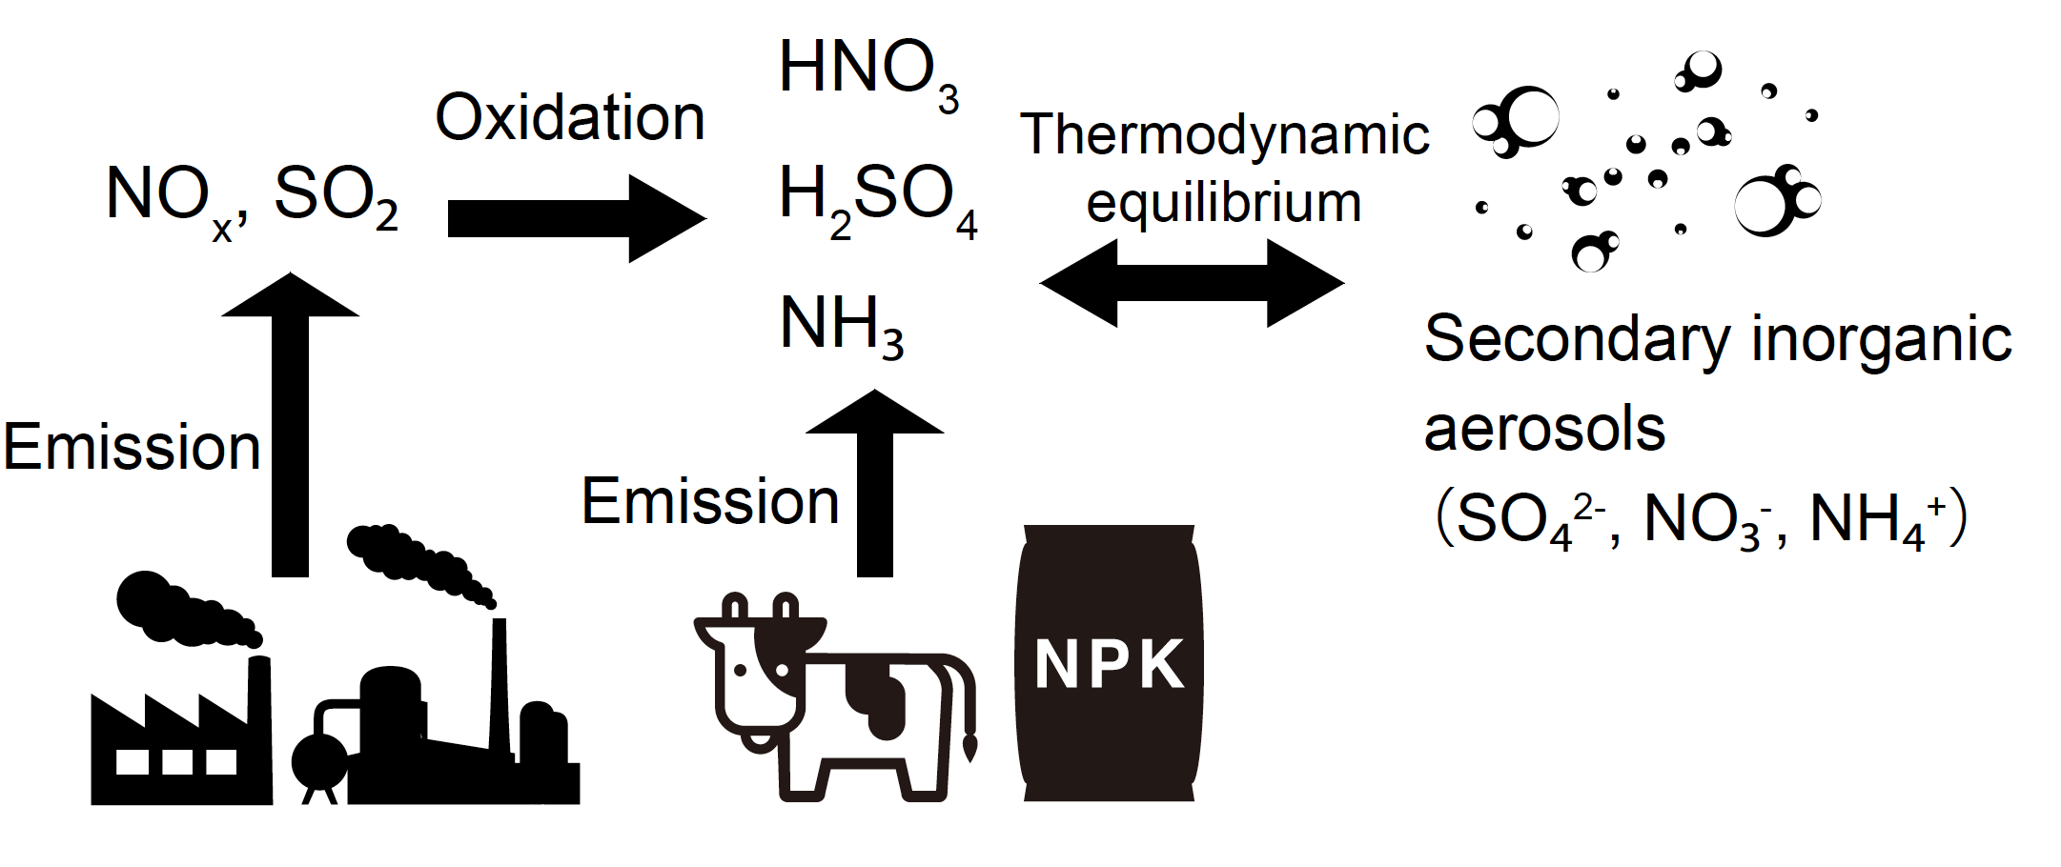
Trace gas and AOD simultaneous DA
Primary aerosols
AOD
Precursor emissions
Sekiya et al. (2023 & in prep)
SO2,NO2,(NH3)
Trace gases and AOD observations provide independent information on the relative changes in directly primary aerosols and secondary inorganic aerosols

Slide 14
Trace gas + AOD DA
Trace gas DA
AOD DA
Δ Sulfate
Δ PM2.5
Sekiya et al. (in prep)
Combined DA provide better agreements with independent aerosol species and PM2.5 observations
Optimized speciation aerosol emission information support more detailed policy decision
Enhanced constrained by the modern satellites (TROPOMI+VIIRS) than the previous gen (OMI+MODIS)

Slide 15
Summary
Combined use of multi-scale multi-component DA in MOMO-Chem advance AQ and climate sciences and contribute to NASA’s missions.
Current & future applications: Satellites (GOSAT-GW, CO2M, GEMS, TEMPO, GEO-XO, Sentinel-4), aircraft missions (ASIA-AQ), scientific focuses (AQ+GHG, trace gas + aerosol interactions, OH, wildfires, VOCs), techniques (DA+ML).
Contributions/collaborations: Explore class missions, Schmidt Futures FETCH4 (Co-I), IGAC AMIGO (SC), IGAC TOAR-2 (Lead: Chemical reanalysis WG & satellite assessment report), ISSI (GEO AQ summary paper), JEDI, WMO observing system impacts, CEOS-AC-VC, TRACER-1 (NASA Ames regional reanalysis), JPL TROPESS (new satellite products)
NASA funded projects: AST (PI, Decadal reanalysis), ACMAP (PI, MOMO-Chem), ESUSPI (PI, GOSAT-GW), Earth to Action for Air Quality (PI), JPL ML-AQ (PI), HAQAST (LBC), CMS-Flux (CO2-CO-NOx), NPP (VOCs), ACMAP (trace gas atmospheric river)

