Slide 1
Uptake of satellite data in the CAMS system
AC-VC#20 meeting, Maryland, USA (15 Oct 2024)
Antje Inness (ECMWF)

Slide 2
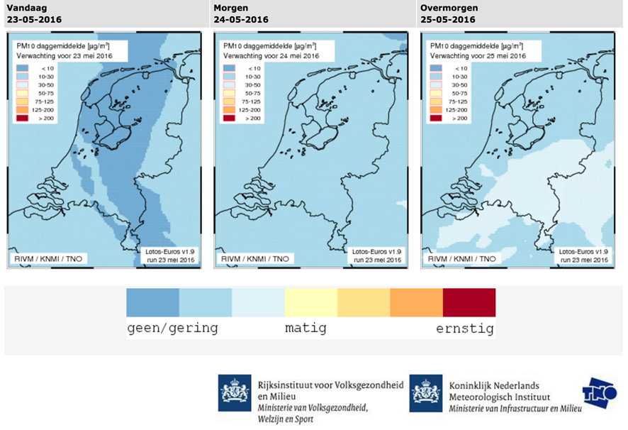
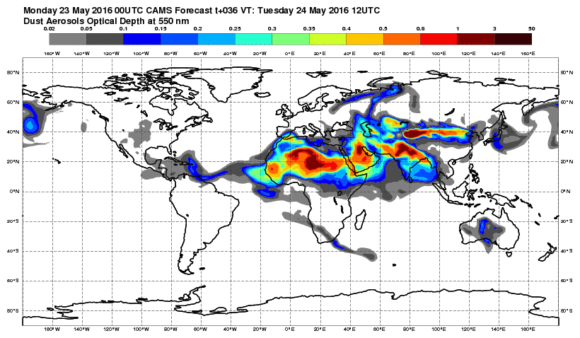
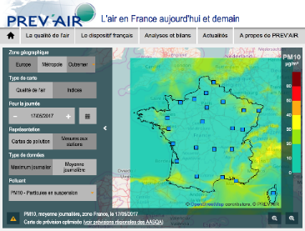
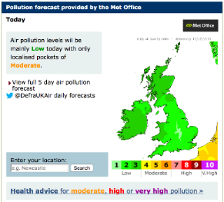
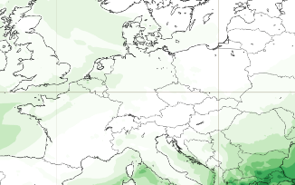
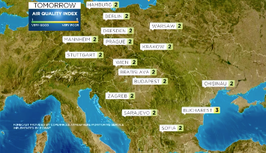
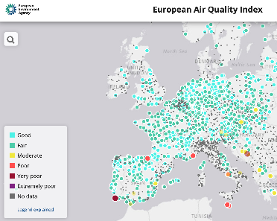
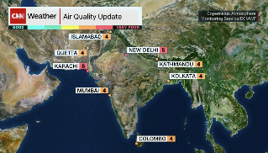
CAMS Information Flow
CAMS users
Applications
Policy products
Two global 5-day forecasts daily
IFS 40km (oper) / 80km (rean) Globe
CAMS main operational data assimilation and modelling systems
Earth Observation from satellite (>75 instruments) and in-situ (regulatory and research)
11-member ensemble
10km Europe
atmosphere.copernicus.eu

Slide 3
Satellite data and types used in NRT by CAMS
 | O₃ |  |  |  |  | CO |  |  | NO₂ |  | SO₂ |  | AOD |  |  |  | CH₄ |  |  | CO₂
Satellite | AURA |  | Metop BC | S-NPP & NOAA 20 | Sentinel 5p | Metop BC | TERRA | Sentinel 5p | Metop BC | Sentinel 5p | Metop BC | Sentinel 5p | AQUA & TERRA | Metop BC | S-NPP & NOAA-20 | Sentinel-3 | GOSAT | Metop BC | Sentinel 5p | GOSAT | Metop BC | OCO-2
Instrument | MLS | OMI | GOME-2 | OMPS | TropOMI | IASI | MOPITT | TropOMI | GOME-2 | TropOMI | GOME-2 | TropOMI | MODIS | PMAP | VIIRS | SLSTR | TANSO | IASI | TropOMI | TANSO | IASI | OCO-2
Type | Strat Profiles | Total Columns | Total Columns | Layers | Total Columns | Total Columns | Total Columns | Total Columns | Tropospheric Columns | Tropospheric Columns | Total Columns | Ttotal Columns | AOD | AOD | AOD | AOD | Total Columns | Total Columns | Total Columns | Total Columns | Total Columns | Total columns

Slide 4
Observation data flow at ECMWF
EUMETCast
Ingestion & processing
(SAPP)
Analysis & forecast
(Atos supercomputer)
internet
Acquisition (ECPDS)
Data storage (DHS)
GTS
Notes:
SAPP: scalable acquisition and pre-processing system

Slide 5
Observation data flow
For this to be implemented we need
useful test data
ATBD/ User Guide etc
EUMETCast
Ingestion & processing
(SAPP)
Analysis & forecast
(CCA/CCB)
internet
Converter: Read S4 data and convert into BUFR
Include the S4 BUFR data into CAMS model
S4 monitoring statistics and feedback to retrieval teams
Acquisition (ECPDS)
Data storage (DHS)
GTS

Slide 6
CAMS analysis window and cut-off times
Timely data provision important for NRT use
00Z analysis window
1st minimisation
2nd minimisation
Time
(UTC hours)
15
00
03
07
Observation cut-off
12Z analysis window
1st minimisation
2nd minimisation
Time
(UTC hours)
03
12
15
19
Observation cut-off
CAMS runs two 12-hour assimilation windows, with observation cut-off times at 07 UTC and 19 UTC (4 hours)

Slide 7
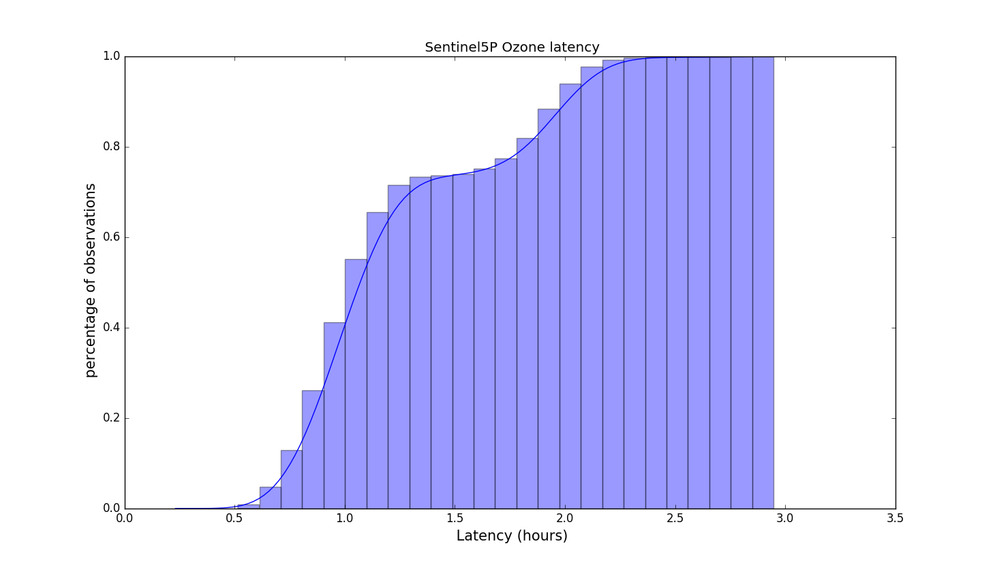
Timeliness of data (Example Tropomi O3)
00Z analysis window
Time
(UTC hours)
15
00
03
07
Observation cut-off
12Z analysis window
Time
(UTC hours)
03
12
15
19
2.5 hours
Observation cut-off
Timeliness of observations is important
Observations received within 4 hours of sensing time are guaranteed to be included in the 12-hour analysis window
Arrival time – sensing time

Slide 8
Monitoring of data wiht the CAMS DA system
CAMS DA system is a powerful tool to monitor the quality of data
Looking at departures (e.g. obs – model) can highlight problems
Global statistics are built up quickly
CAMS system as reference frame to compare data from different instruments
New data are monitored passively first
Departures are calculated but data do not influence analysis
=> information about quality of data and potential issues before using the data
=> feedback to producers (e.g. ESA, Eumetsat,…) on the data quality
Assimilation tests follow if the data are of good quality
Can help Cal/Val activities of future missions (e.g. Sentinel-4, Sentinel-5, Altius,…)
$$Departures= y_{i}−H_{i}\left[{Mi(x}_{0})\right]$$
Model equivalent of observation (observation operator applied to model data)
observation

Slide 9
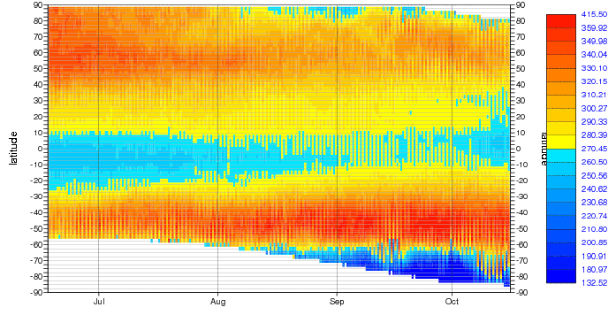
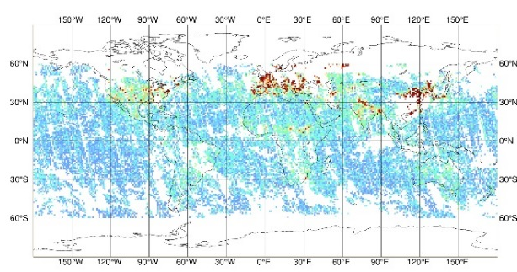
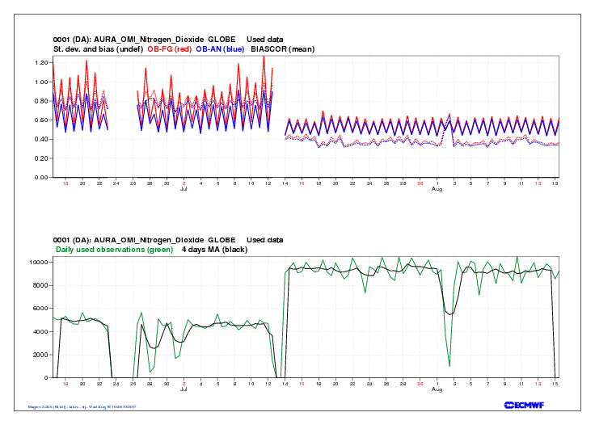
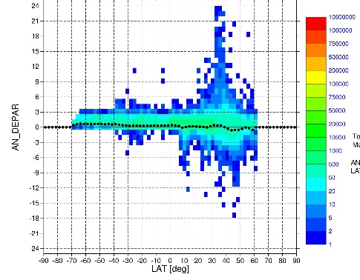
Examples of monitoring plots
Evaluate observations and departures (obs-model)
Timeseries (area-mean and Hovmoeller plots)
Geographical plots
Scatter plots
Histograms
Maps
Hovmoeller plots
Timeseries
Scatter plots
Histograms

Slide 10
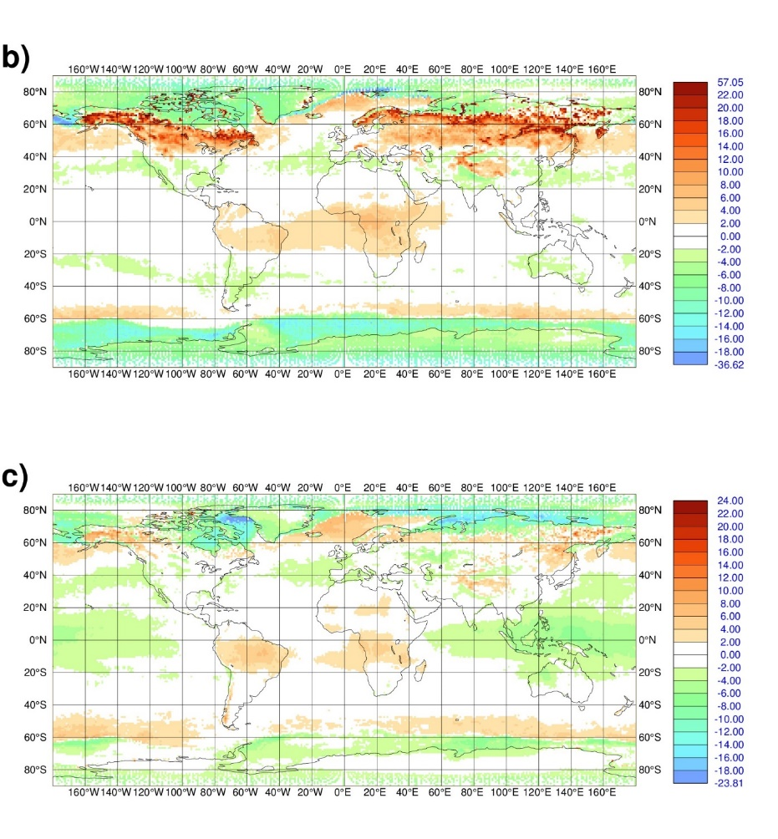
Maps of analysis departures: TROPOMI O3
Feb-April 2018
[DU]
TROPOMI TCO3 analysis departures:
dep = obs - analysis
Shown are obs – analysis TCO3
Early S5P TCO3 NRT data in 2018
Looking at departures allowed CAMS to identify problems in the data related to the surface albedo climatology used in the NRT retrievals
The retrieval has since been improved
Sep-Nov 2018
[DU]
Inness et al., 2019, ACP https://doi.org/10.5194/acp-19-3939-2019

Slide 11
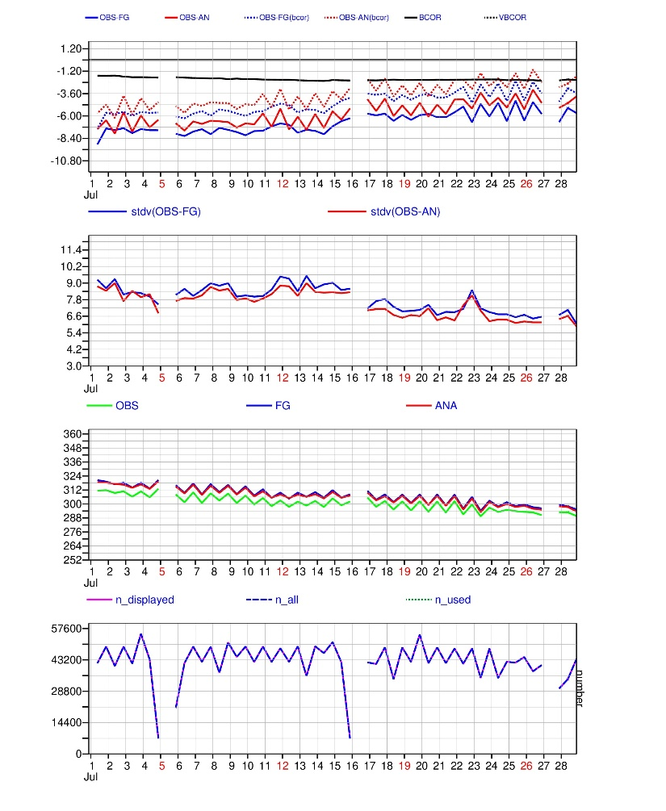
Timeseries of TROPOMI O3 departures
90-70N
TROPOMI TCO3 Algorithm upgrade to V2.1.3 on 16 July 2020
Area averaged timeseries 1-28 July 2020
Monitoring of TROPOMI TCO3 data shows reduced bias at high northern latitudes after upgrade.
Benefit of assimilation system:
Departures show differences that are not clearly visible in absolute values
We can build up statistics quickly and globally
Departures
Stdv(dep)
Obs, an, fg
Numbers

Slide 12
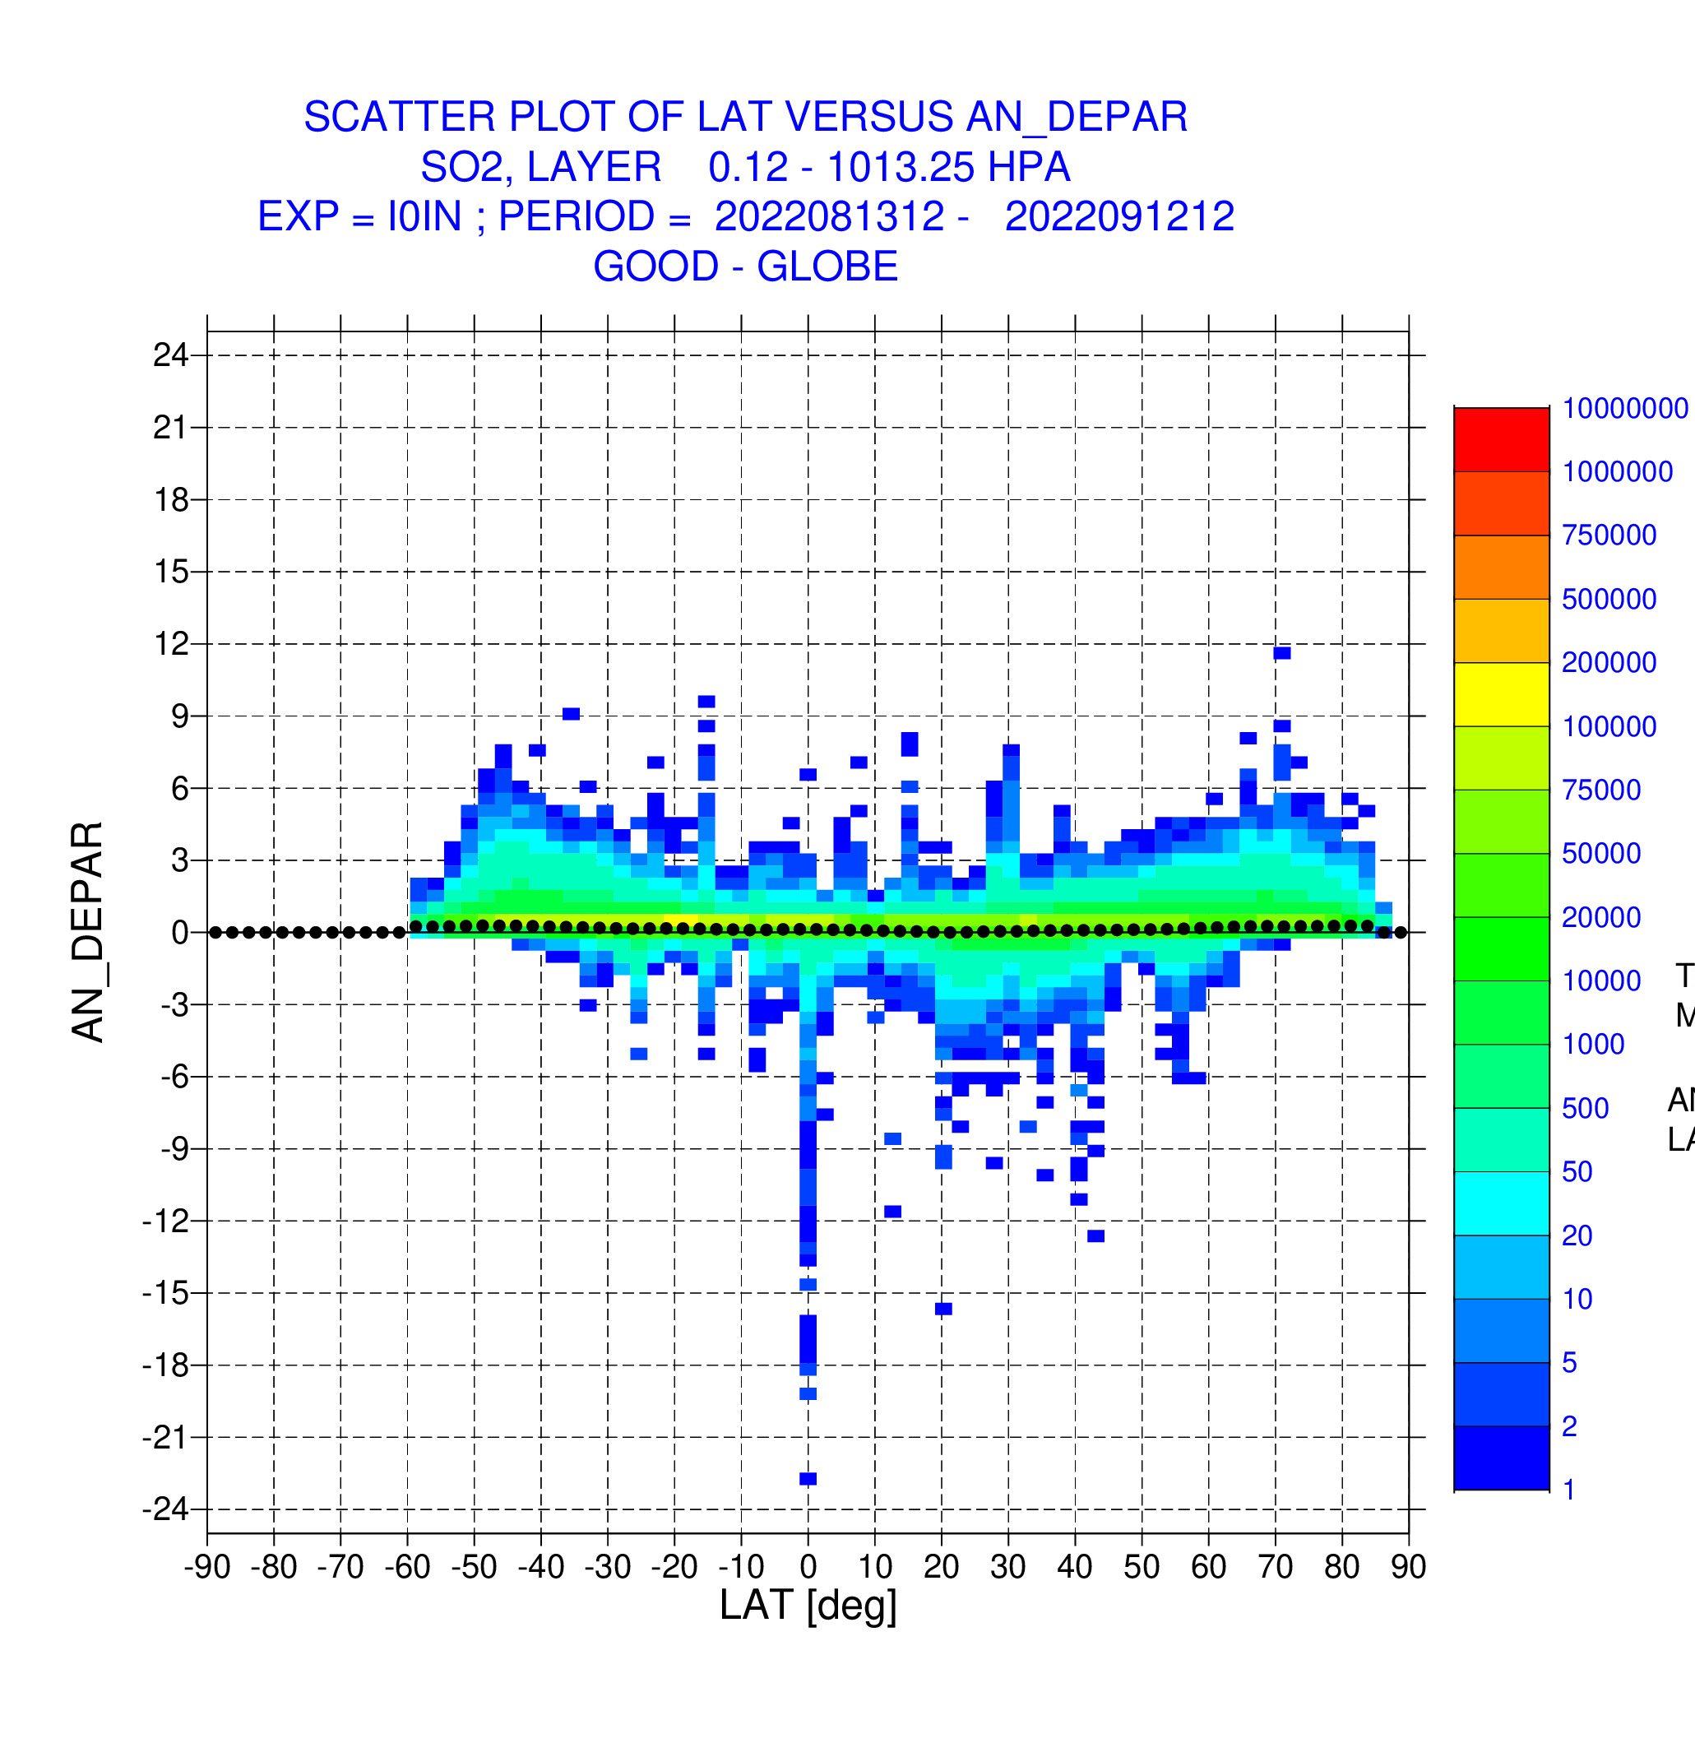
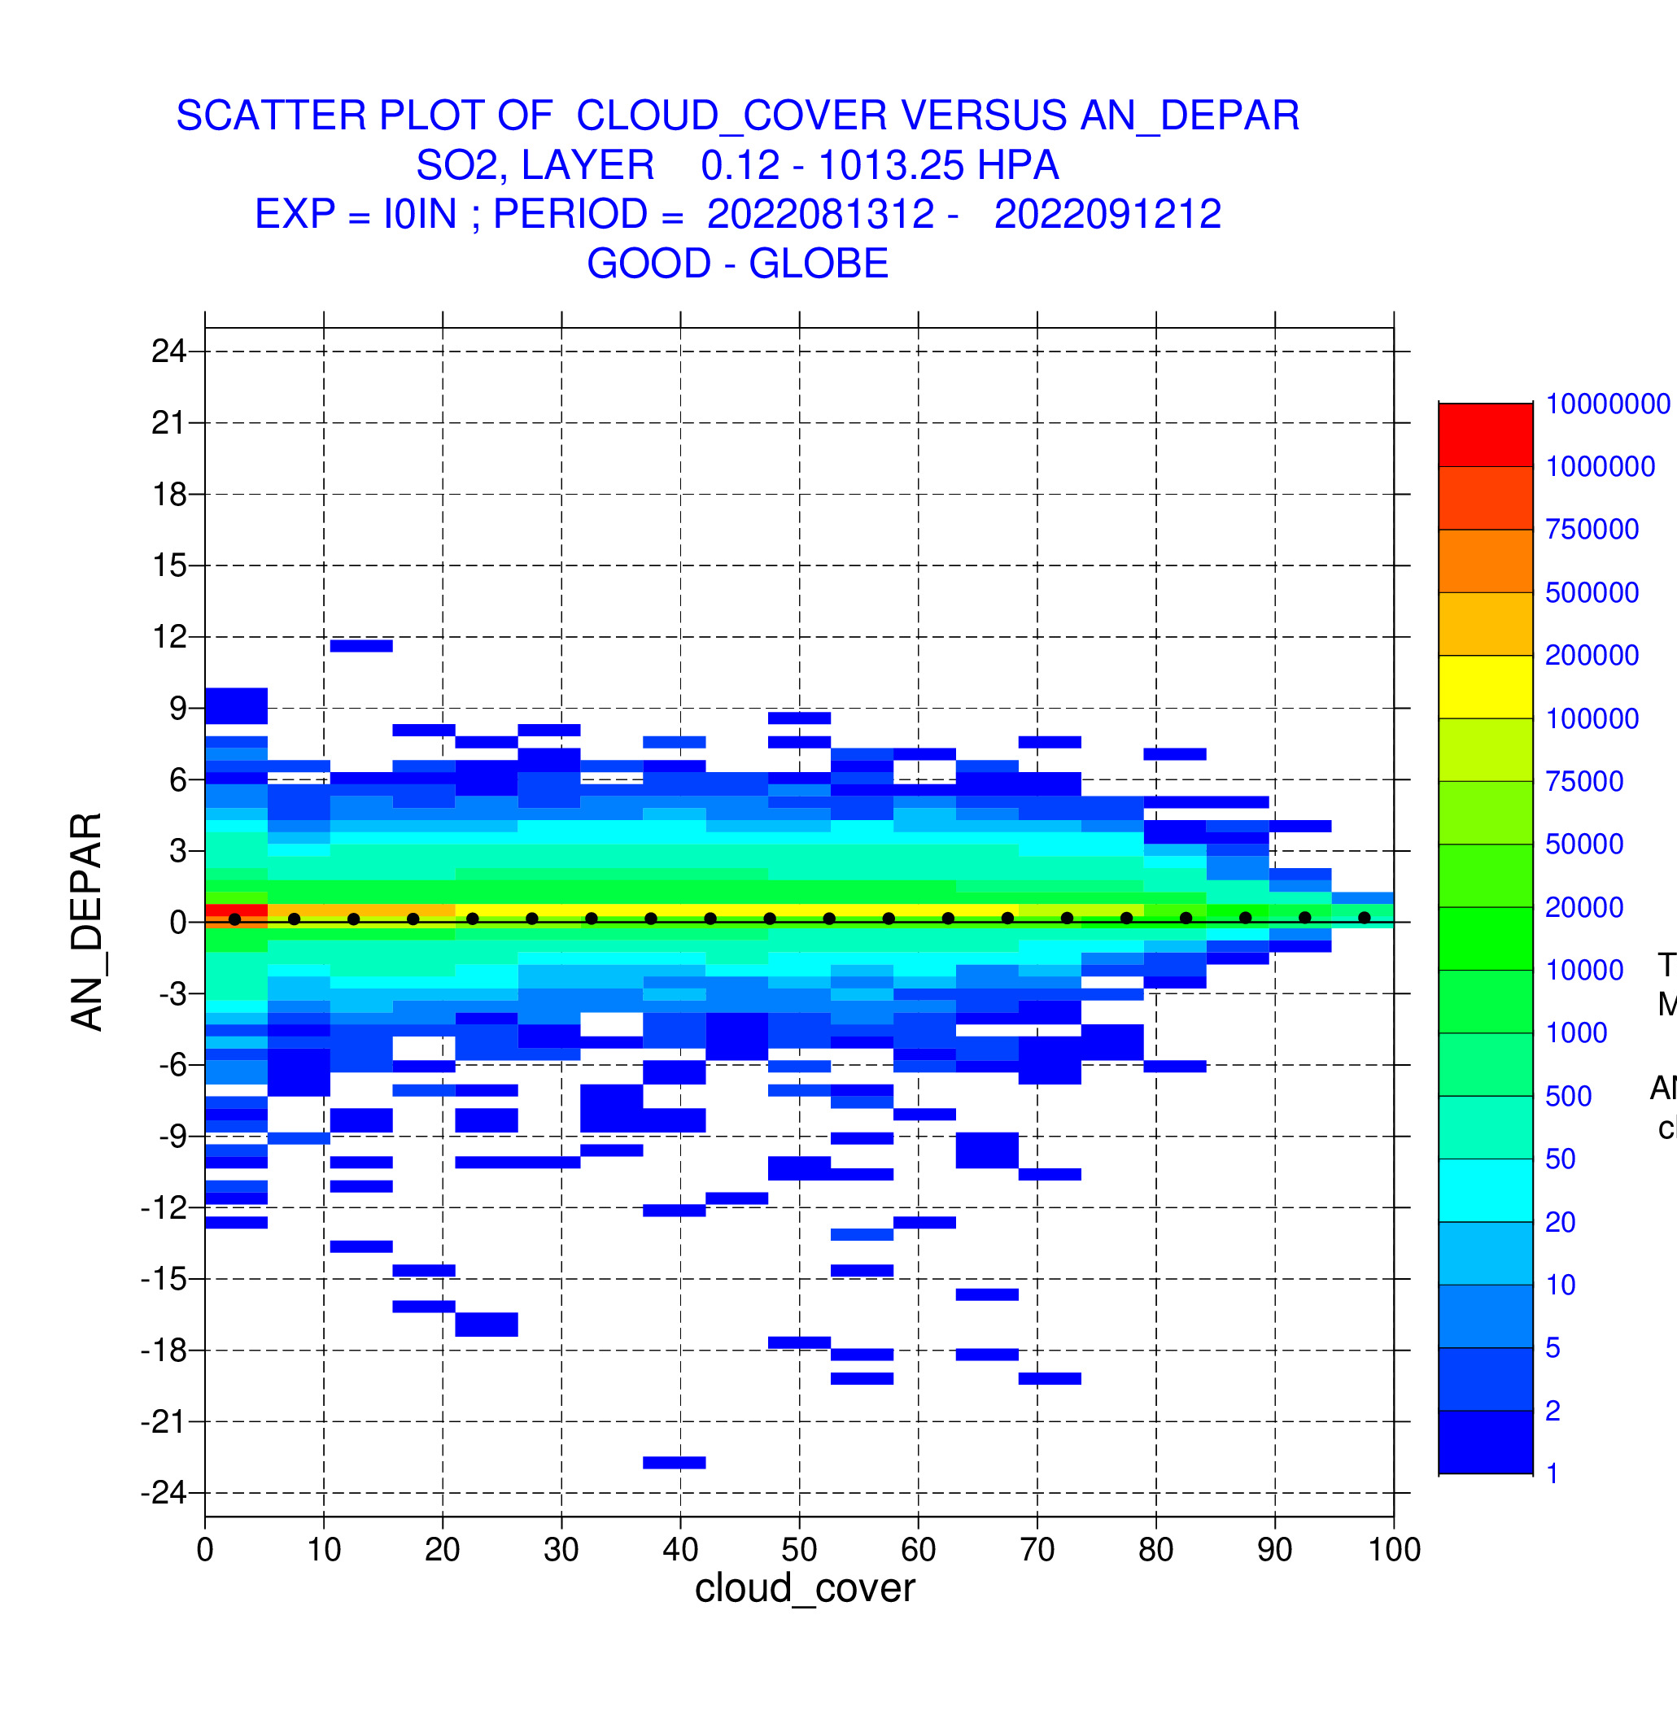
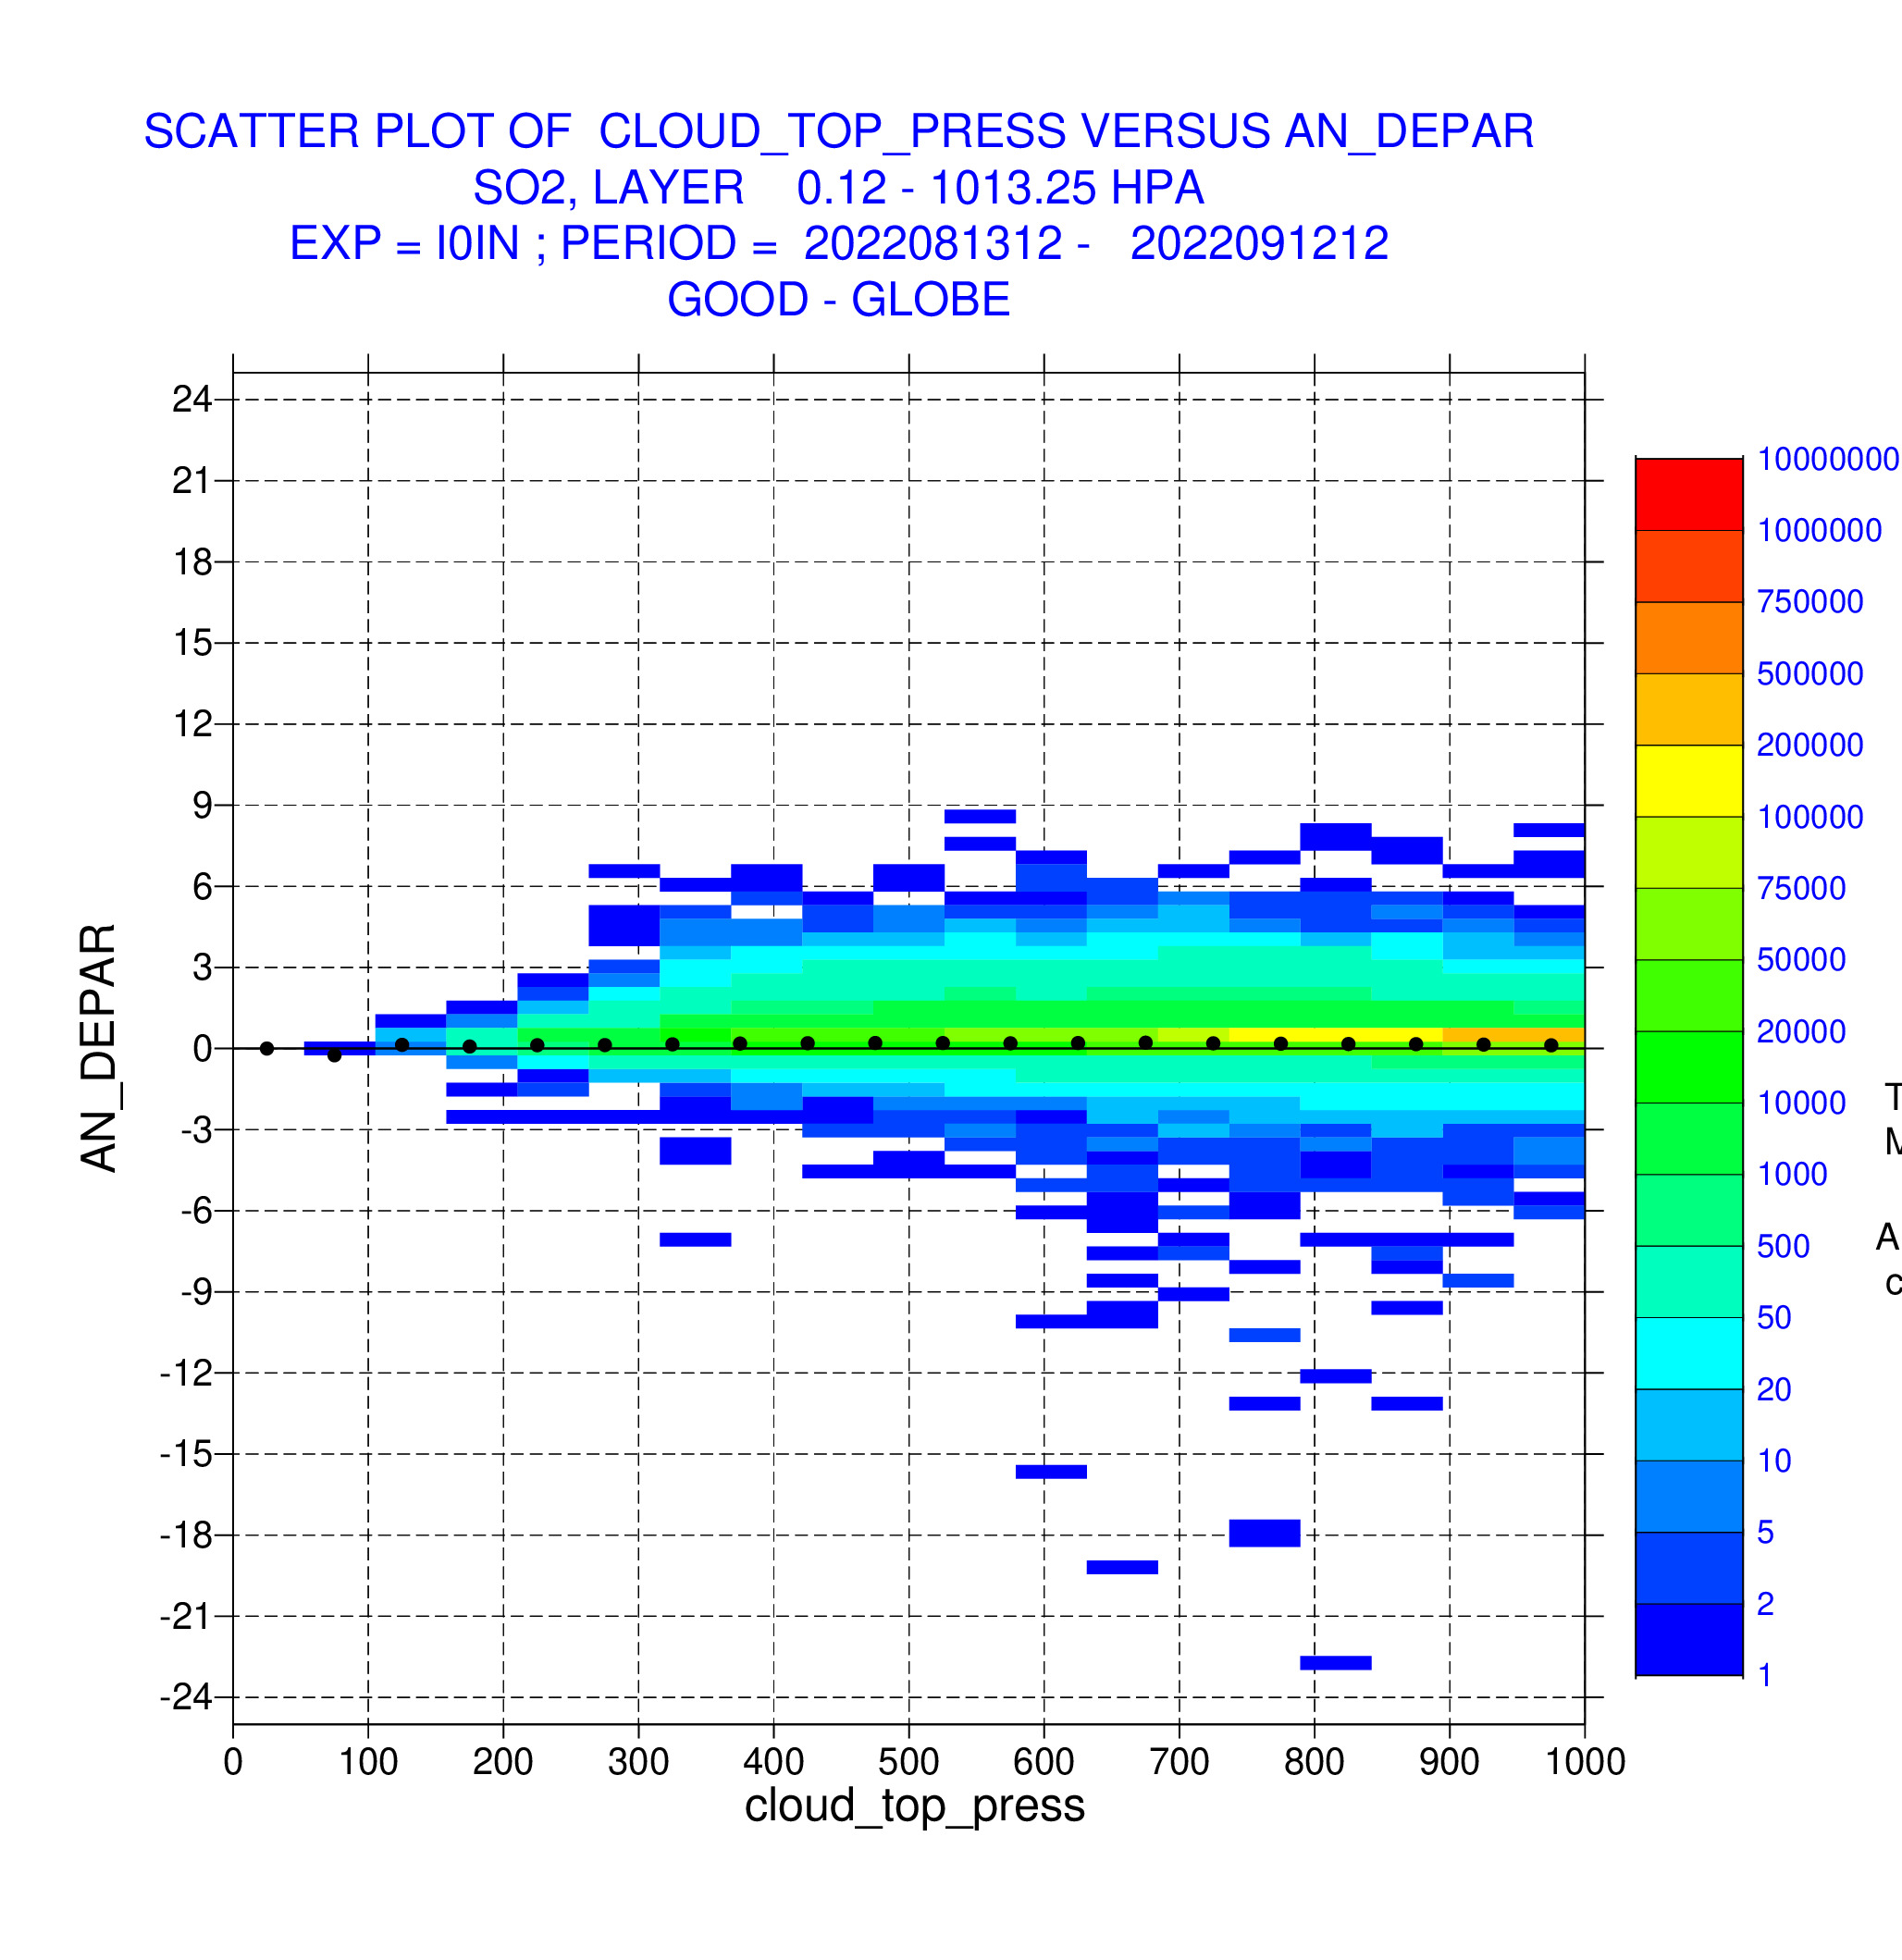
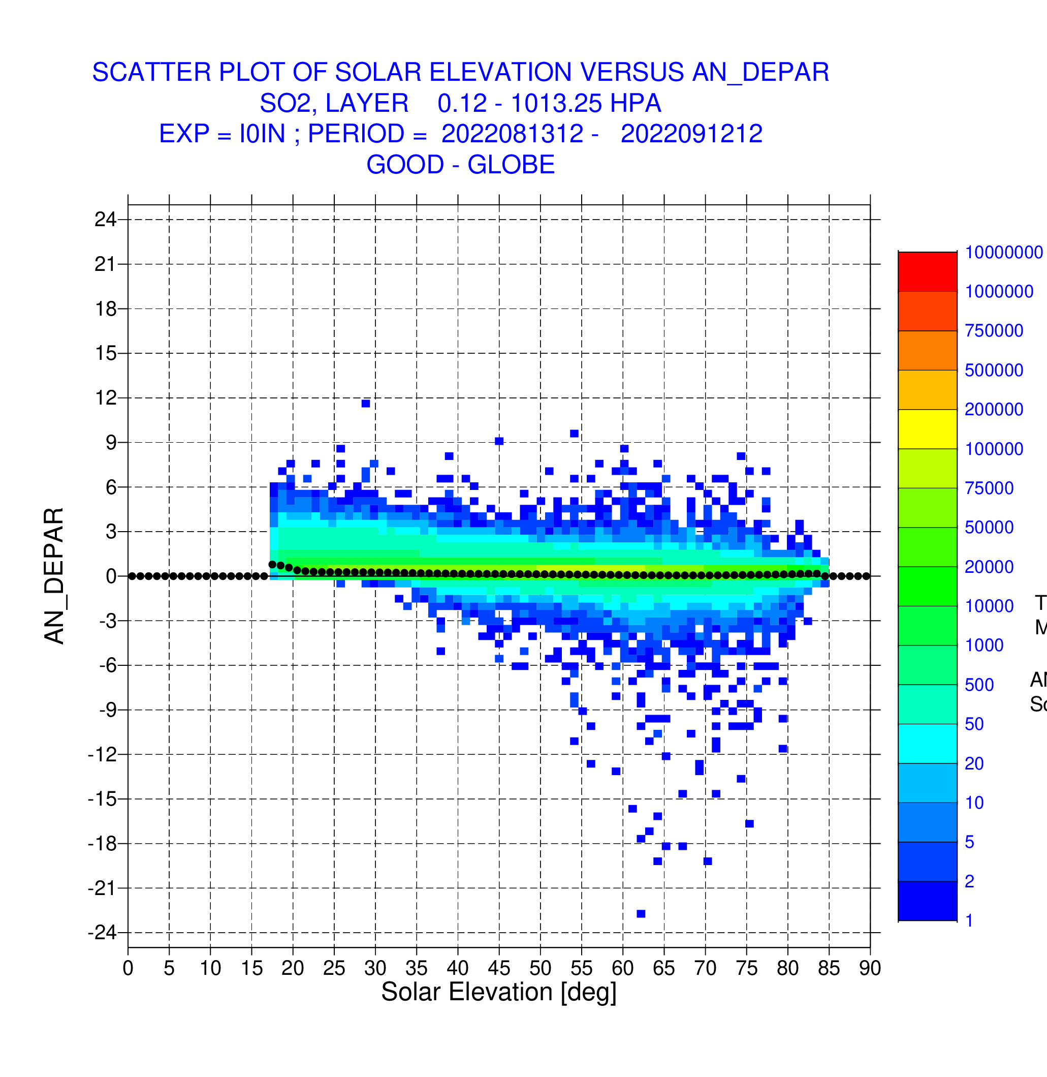
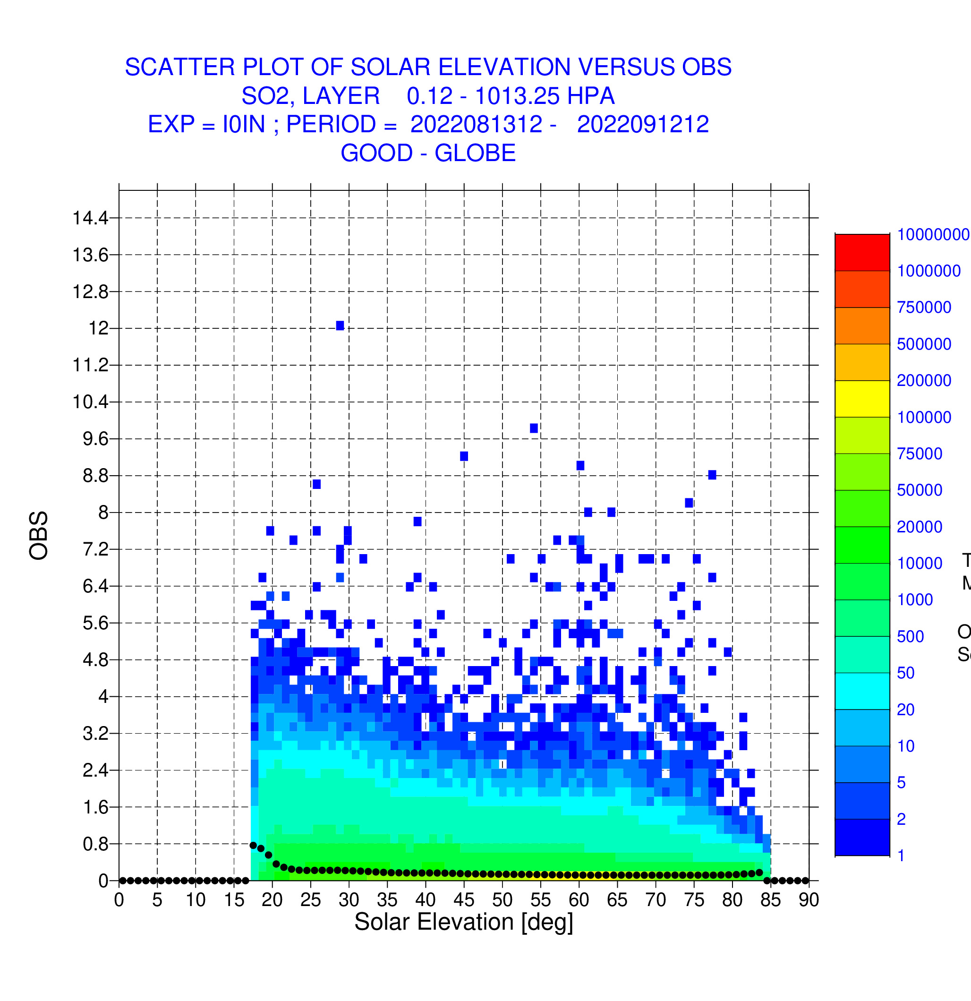
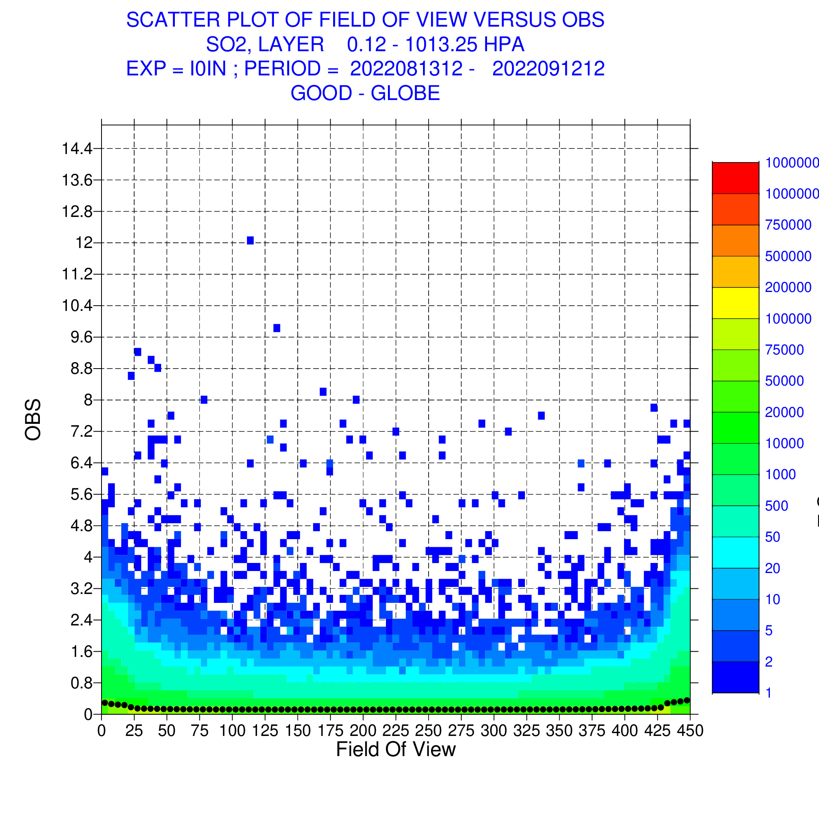
Scatterplots: TROPOMI COBRA SO2 data
Andep vs Lat
Andep vs CC
Andep vs CTP
No noticeable issues related to cloud cover and cloud top pressure
Larger andep and obs at low SOE and swath edges
Use only data with SOE>30 and rows 26-424: in line with Theys et al. (2021) plots
Andep vs SOE
Obs vs SOE
Andep vs scanPos

Slide 13
Area averaged timeseries: IASI CO
Without TROPOMI
With TROPOMI
Time
Looking at departures helps us to assess impact of newly assimilated data
IASI TCCO departures are reduced if TROPOMI CO data are assimilated too
Good agreement between IASI-B and IASI-C

Slide 14
Timeseries: GOME-2 NO2 retrievals
Unit: 10¹⁵ molec/cm²
GOME-2B and GOME-2C
GOME-2A and GOME-2C
Departures
Obs, an, fg
Monitoring allows us to check consistency between retrievals from different instruments
Here: GOME-2C NO2 values are higher than GOME-2AB and give different departures
This is more visible in the plot of departures than in the absolute obs values

Slide 15
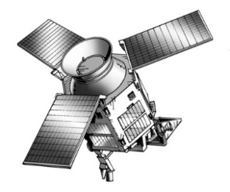
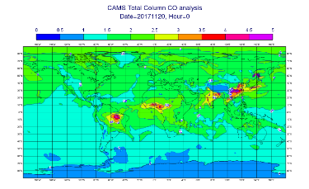
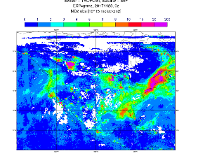
CAMS can help in CAL/VAL activities
L1b data
Downstream services and users
Retrieval teams
CAMS analyses and forecasts
L2 data
Feedback
CAMS analysis and monitoring tools
NRT assimilation
Good data
Statistics and plots
Assimilation tests

Slide 16
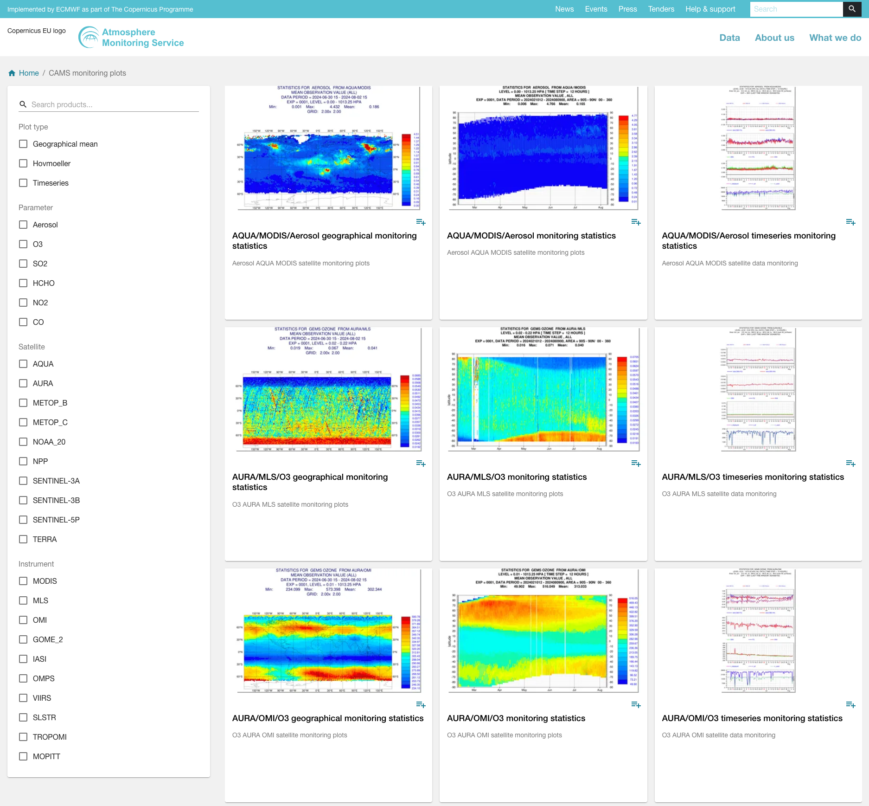
CAMS satellite monitoring page
Monitoring plots are
routinely displayed on the CAMS website
give us and the data producers timely information about any changes in the data
https://atmosphere.copernicus.eu/charts/packages/cams_monitoring/

Slide 17
Recommendations
What works well | What does not work well
Easy-to-use quality flag e.g. TROPOMI qa-flags are great | Complicated qa-instructions or bad observations that are not flagged properly. e.g. reprocessed IASI CO data are very difficult to handle
Good documentation: PUM, ATDB, validation reports | No or bad documentation
Information about obs errors, averaging kernels, a-priori | No information
All information in one file | E.g. IASI CO/ SO2 data require input from CO/SO2 files and L2 files
Netcdf, HDF5, BUFR format. Preferable to have many small files, rather than huge daily files. Consistent variable formats, missing values definitions. | BUFR format that does not contain all the information we need and was finalised years in advance
Data access: can use sftp, http, S3. Files grouped by days make acquisition easier | Random file/directory names
Consistent reprocessed datasets for use in reanalysis (e.g. NO2 from several instruments) | Inconsistencies between retrievals from different instruments
Plan for NRT data delivery | No NRT data delivery planned
Early pre-launch test data Data available asap after launch, e.g. during commissioning phase | No pre-launch test data No access to early data after launch
Notes:
if they use netcdf, the variables should be consistent, if the variable is float the max min etc and other attributes should have to proper type to avoid

Slide 18
Summary
The CAMS data assimilation system is a powerful tool to provide feedback on data quality
New data are monitored first and only assimilated once quality is established
Departures (obs – model) provide useful information about data quality
Valuable feedback to data providers
Early provision of test data and ATBD/PUM important to allow CAMS to be ready for new data
Timely delivery of data important for NRT use (<3-4 hours)
Monitoring plots available on CAMS website:
https://atmosphere.copernicus.eu/charts/packages/cams_monitoring/

Slide 19
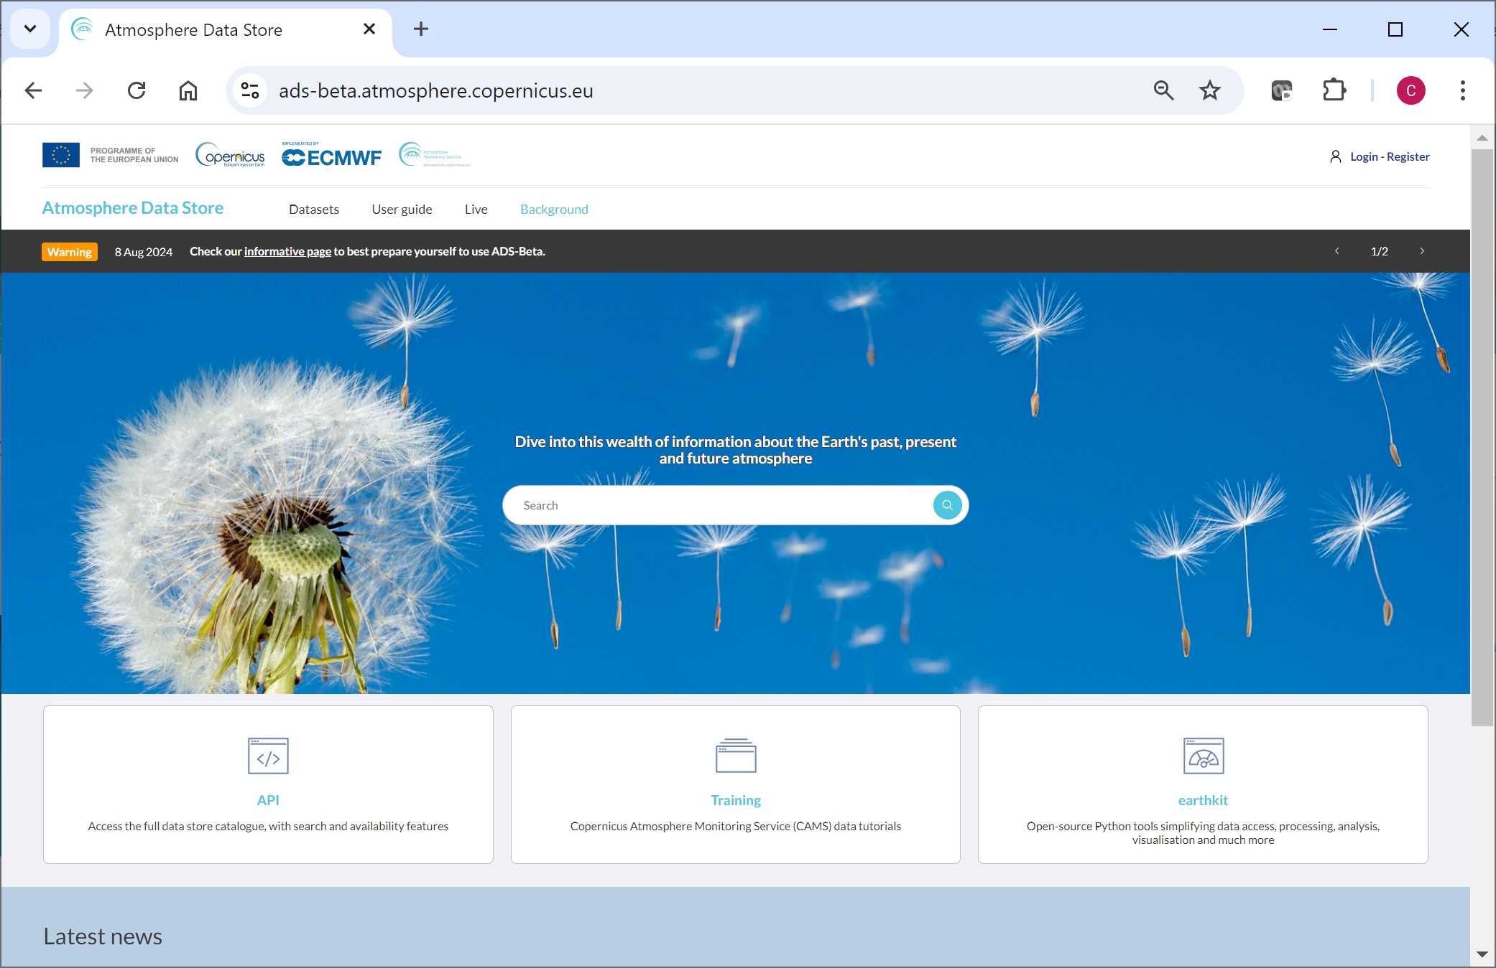
The Atmosphere Data Store (ADS)
All CAMS data are freely available: https://ads.atmosphere.copernicus.eu/
Copernicus EU
@copernicusecmwf
Copernicus ECMWF
Copernicus EU
Copernicus ECMWF
@CopernicusEU
@CopernicusECMWF
www.copernicus.eu
atmosphere.copernicus.eu
Documentation of atmospheric composition in IFS:
https://www.ecmwf.int/en/elibrary/81374-ifs-documentation-cy48r1-part-viii-atmospheric-composition
Validation reports from:
https://atmosphere.copernicus.eu/quality-assurance

