Slide 1
Sentinel-5P TROPOMI Operational Validation Status
J.-C. Lambert, S. Compernolle, A. Keppens, B. Langerock, Tijl Verhoelst (BIRA-IASB)
D. Hubert, Y. Geunes, J. Granville, O. Rasson, I. De Smedt, G. Pinardi, M.K. Sha, N. Theys, C. Vigouroux (BIRA-IASB),
A.M. Fjæraa (NILU), S. Niemeijer (s[&]t), A. Argyrouli, M. Coldewey-Egbers, K.-P. Heue, P. Hedelt, D. Loyola, R. Lutz, F. Romahn (DLR),
K.-U. Eichmann (IUP-UB), M. de Graaf, H. Eskes, D. Stein-Zweers, J. van Geffen (KNMI),
K. Garane, K. Michailidis, ML. Koukouli, A. Pseftogkas, D. Balis (AUTH),
S. Beirle, T. Wagner (MPI-C), A. Dehn, M. Alparone, C. Zehner (ESA)

Slide 2
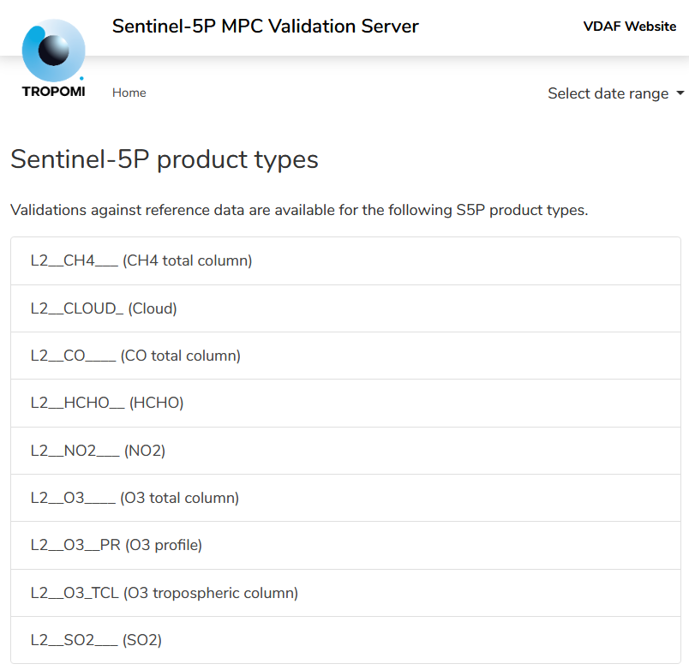
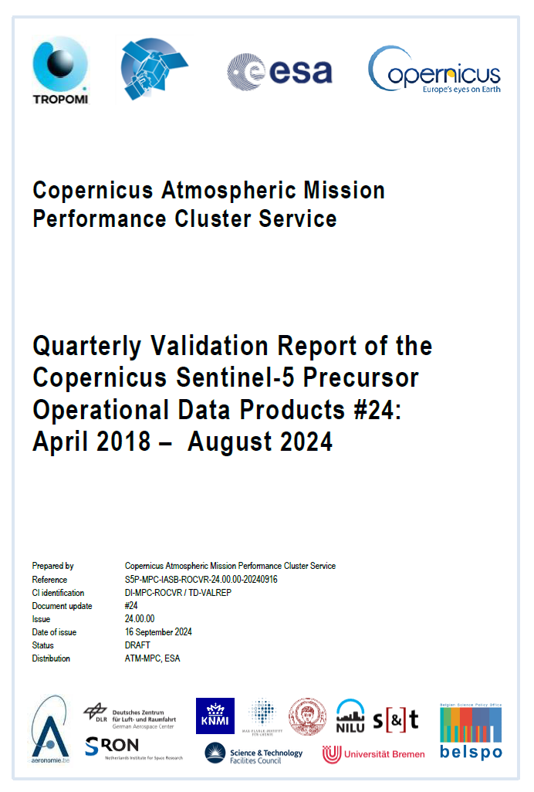
ESA/Copernicus Atmosphere Performance Cluster (ATM-MPC) Sentinel-5p Routine Operations Validation Service
Automated Validation Server
https://mpc-vdaf-server.tropomi.eu
Generation and monitoring of S5P Quality Indicators
Maintenance of S5P data quality documentation
In-depth validation and support to L1/L2 algorithm evolution (diagnostics, reprocessings)
Synthesis with S5PVT results, ECMWF/CAMS, peer-reviewed literature
Monthly VAL Team teleconference
[TD-UNCERTAINTY]
[TD-VALREP]
[TD-PRFDOCS]
Quality information in

Slide 3
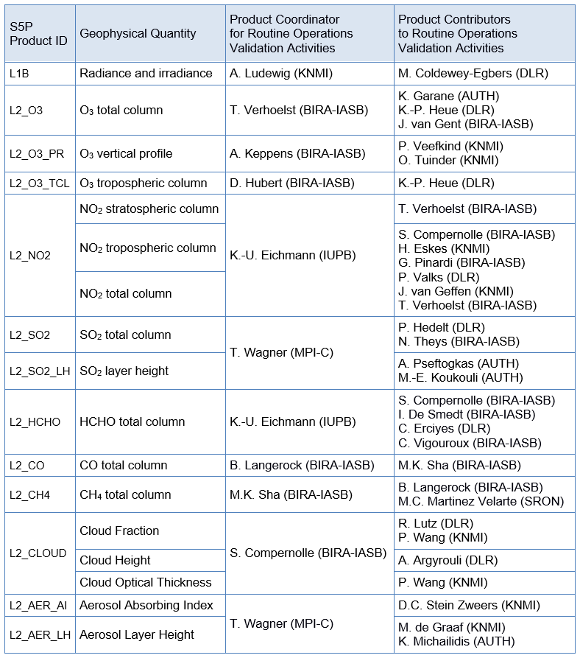
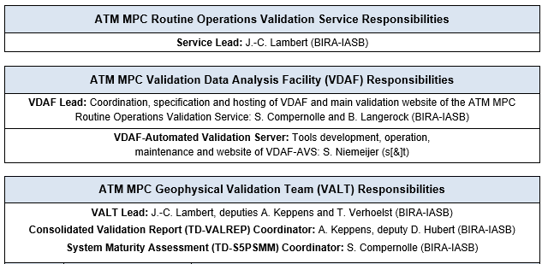
Organization
Supervised by ESA/ESRIN
+ BIRA-IASB IT support: J. Granville, Y. Geunes, O. Rasson, T. Ooms
+ EVDC support by A.M. Fjæraa and team at NILU

Slide 4
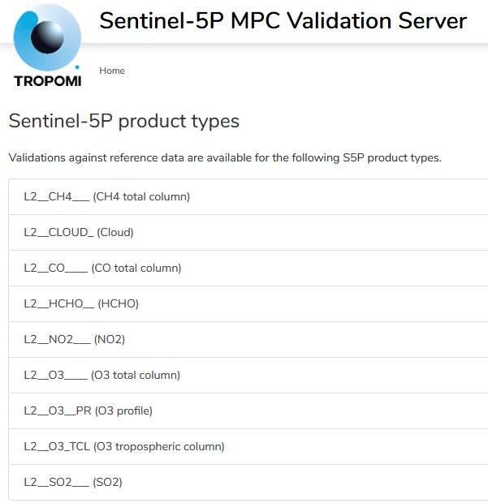
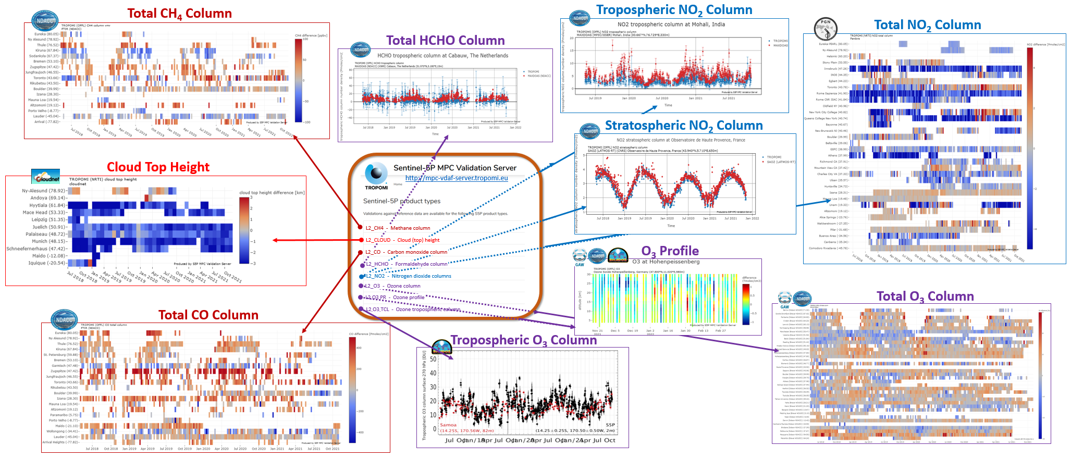
VDAF-AVS: Automated ground-based comparisons and permanent reporting of S5P TROPOMI data Quality Indicators
https://mpc-vdaf-server.tropomi.eu

Slide 5
Fiducial Reference Measurements and Other Validation Data
S5P data Product | Mission requirements Systematic Random |  | Fiducial Reference Measurements and other ground-based data sources | Satellite data sources
L1B radiance & irradiance | band dependent |  | PICS based monitoring | OMPS-NP, OMPS-NM
O₃ total column | 5% | 2.5% | Brewer, Dobson, ZSL-DOAS, PGN | OMI, GOME-2
O₃ vertical profile | 30% | 10% | ozonesonde, DIAL (strato+tropo) | OMI, GOME-2
O₃ tropospheric column | 25% | 25% | ozonesonde | OMI, GOME-2
NO₂ stratospheric column | 10% | 0.5 e15 | NDACC ZSL-DOAS | OMI, GOME-2
NO₂ tropospheric column | 50% | 0.7 e15 | NDACC MAX-DOAS | OMI, GOME-2
NO₂ total column | - | - | PGN | OMI, GOME-2
SO₂ total column SO₂ layer height | 30% - | 30% - | MAX-DOAS, PGN - | OMI, OMPS-NP IASI-B, IASI-C, CALIPSO
HCHO total column | 80% | 1.2 e16 | MAX-DOAS, NDACC FTIR, PGN | OMI, GOME-2
CO total column | 15% | 10% | NDACC FTIR, TCCON, COCCON | GOSAT-2, OCO-2
CH₄ total column | 1.5% | 1% | NDACC FTIR, TCCON, COCCON | GOSAT-2, OCO-2
Cloud Fraction | 20% | 0.05 | FRM not available | VIIRS, OMI, GOME-2
Cloud Height (pressure) | 20% | 0.5 km | CLOUDNET lidar/radar | VIIRS, OMI, GOME-2
Cloud Optical Thickness | 20% | 0.05 | FRM not available | VIIRS, OMI, GOME-2
Aerosol Absorbing Index | 1 AAI | 0.1 AAI | FRM not available | OMI, OMPS-NP
Aerosol Layer Height | 100 hPa | 50 hPa | EARLINET lidar | CALIPSO, VIIRS, GOME-2
ESA FRM Programme
Monitoring Networks
Colour code: automated production of S5P QIs by the VDAF-AVS manual data collection and/or validation
FRM not available, quality evaluation mainly via diagnostics and satellite data intercomparisons

Slide 6
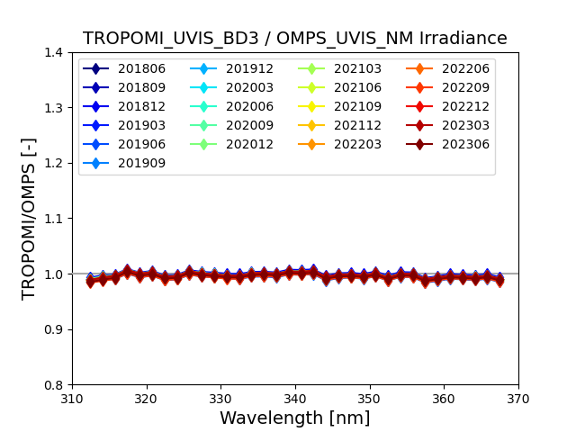
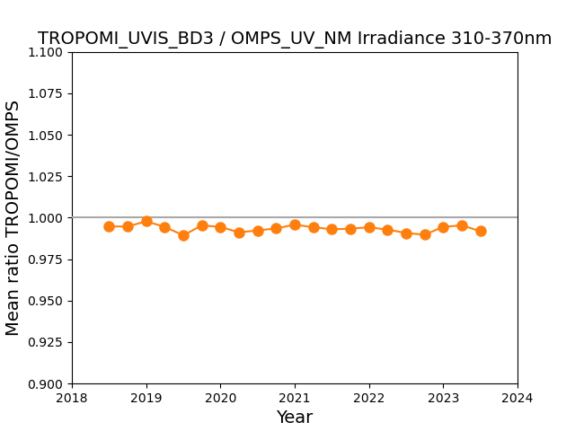
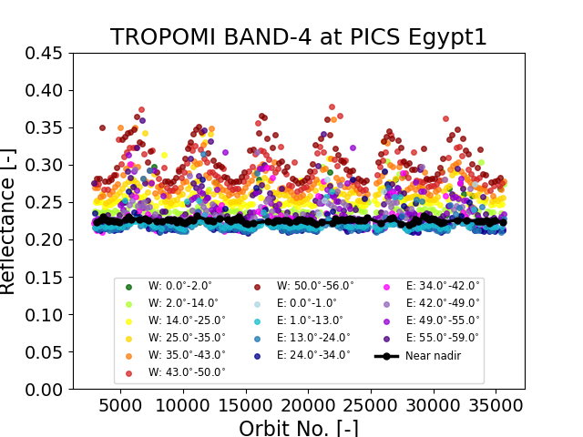
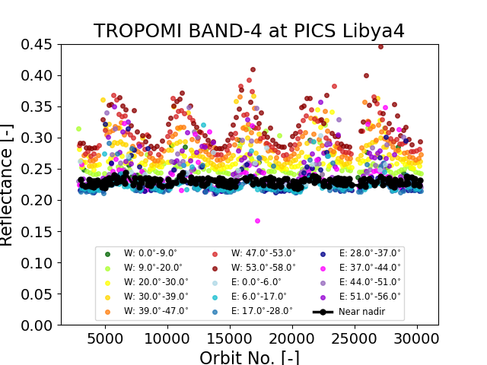
L1B_RA/IR Radiance/Irradiance Validation Antje Ludewig (KNMI) and Melanie Coldewey-Egbers (DLR)
S5P_BD3/OMPS 310-370nm
S5P_BD3/OMPS 2018-2023
Status of validation activities
Comparison of L1B_IR irradiance in band 1 (270-300nm), band 2 (300-330nm), and band 3 (310-370nm) with measurements from OMPS-NP/-NM
PICS-based analysis of long-term stability using L1B_RA reflectance measurements in band 4 (cloud-free scenes) over ~20 CEOS Pseudo-Invariant Calibration Sites (Saharan Desert and Arabian Peninsula) extended until 06/2024
Key validation results
TROPOMI L1B_IR irradiance v02.01.00 in good agreement with OMPS-NP and OMPS-NM and stable
Analysis of long-term stability of L1B_RA v02.01.00. Reflectance over PICS stable over time
S5P L1B v02.01.00 reflectance over CEOS PICS

Slide 7
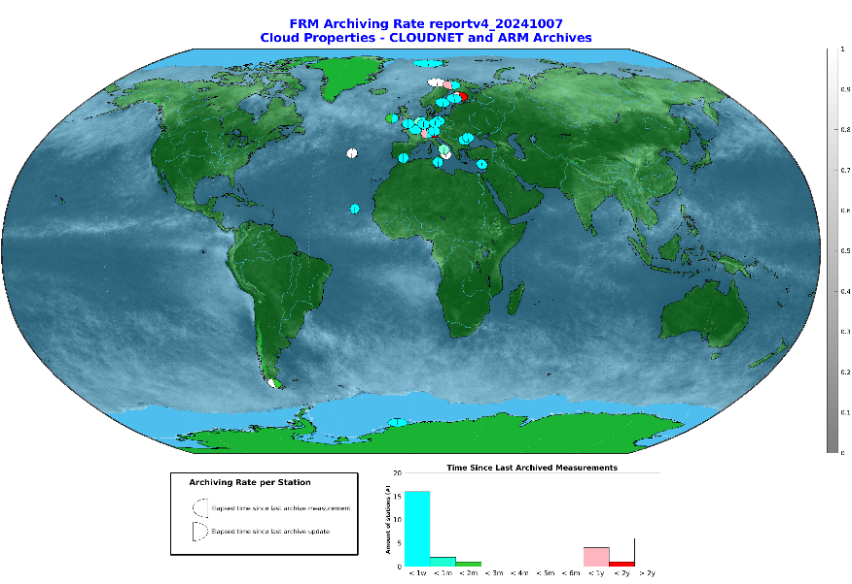
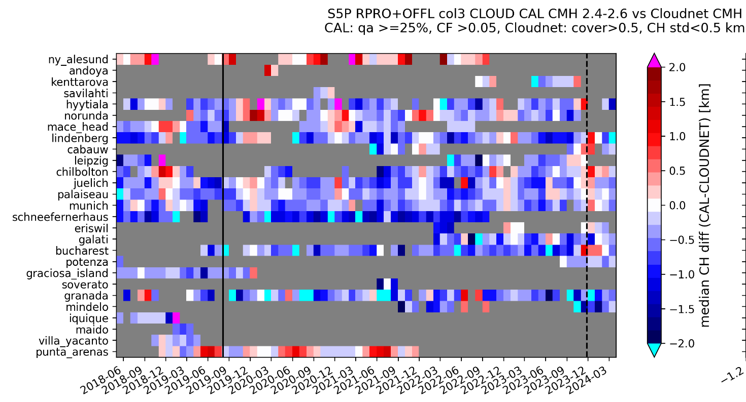
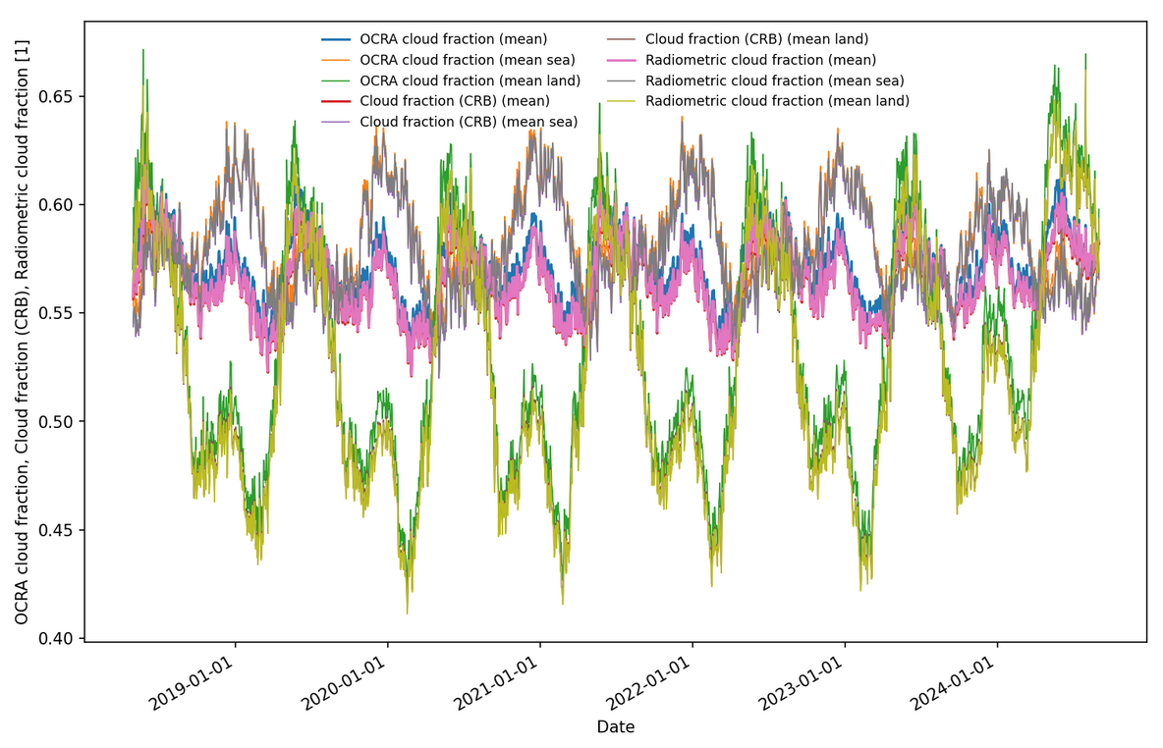
Cloudiness has significant effects on the accuracy of trace gas retrievals ⇨ Validation of retrieved cloud parameters as influencing quantities S. Compernolle (BIRA-IASB), A. Argyrouli, R. Lutz (DLR), M. Sneep, P. Wang (KNMI)
Vs. ACTRIS-Cloudnet networks of cloud lidars & radars
L2_CLOUD Lidar/radar
Cloud parameters scrutinized
Top and mean heights, fractional cover, optical thickness
Processors: OCRA/ROCINN CAL & CRB, FRESCO
Validation particulars
Low/middle cloud fraction with focus on AQ and O₃ retrievals
Vs. OPERATIONAL network ACTRIS-Cloudnet
Vs. satellites: OMI, VIIRS
Effects of S5P OCRA cloud fraction version changes
V2.6.1

Slide 8
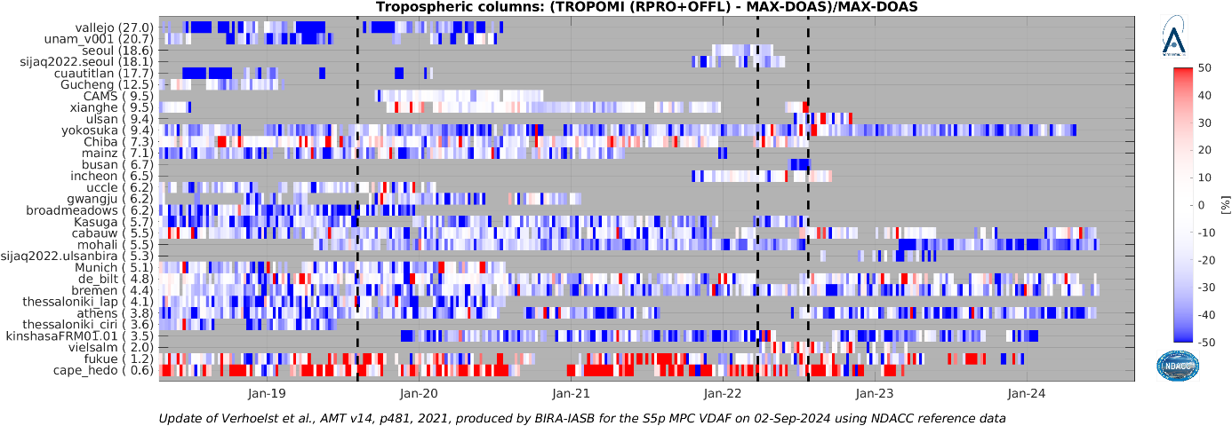
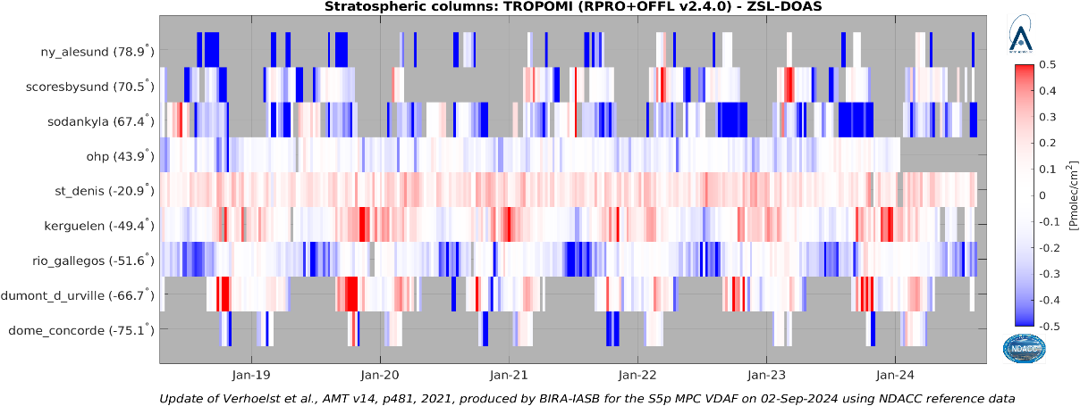
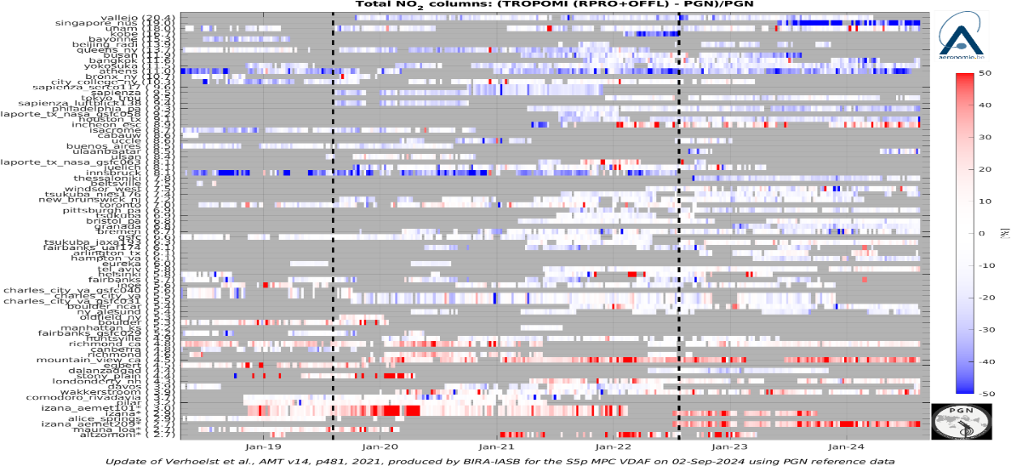
NO₂ and HCHO Validation vs. NDACC FTIR, NDACC DOAS and PGN K.-U. Eichmann (IUPB), S. Compernolle, G. Pinardi, I. De Smedt, T. Verhoelst and C. Vigouroux (BIRA-IASB), H. Eskes, J. van Geffen (KNMI)
S5P vs. MAXDOAS ⇨ tropospheric NO₂
S5P vs. NDACC FTIR HCHO
S5P vs. NDACC ZSL-DOAS ⇨ stratospheric NO₂
S5P vs. MAXDOAS HCHO
S5P vs. PGN HCHO
S5P vs. PGN ⇨ total NO₂

Slide 9
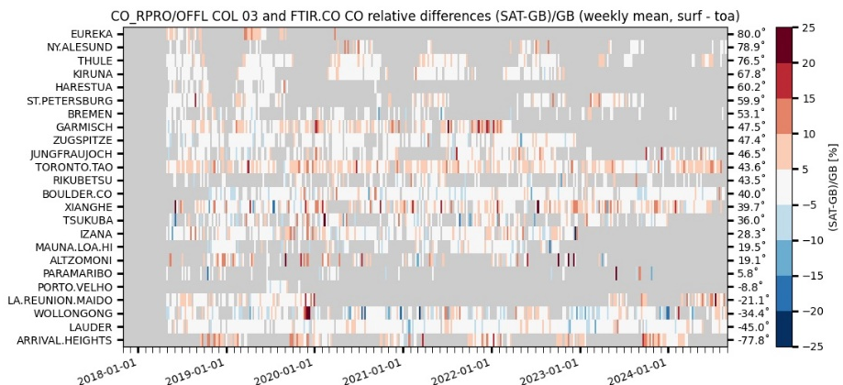
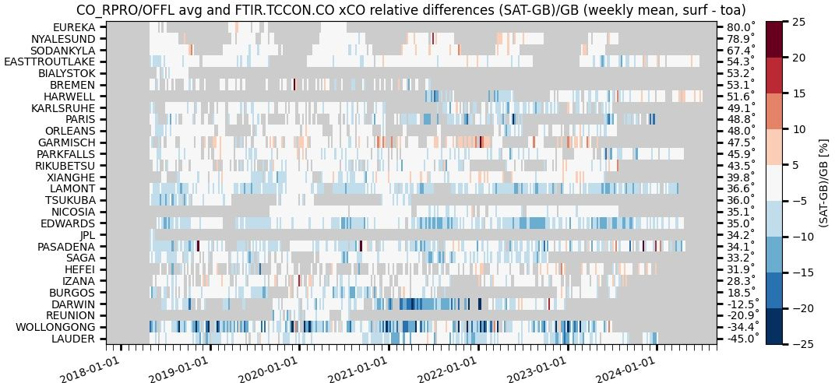
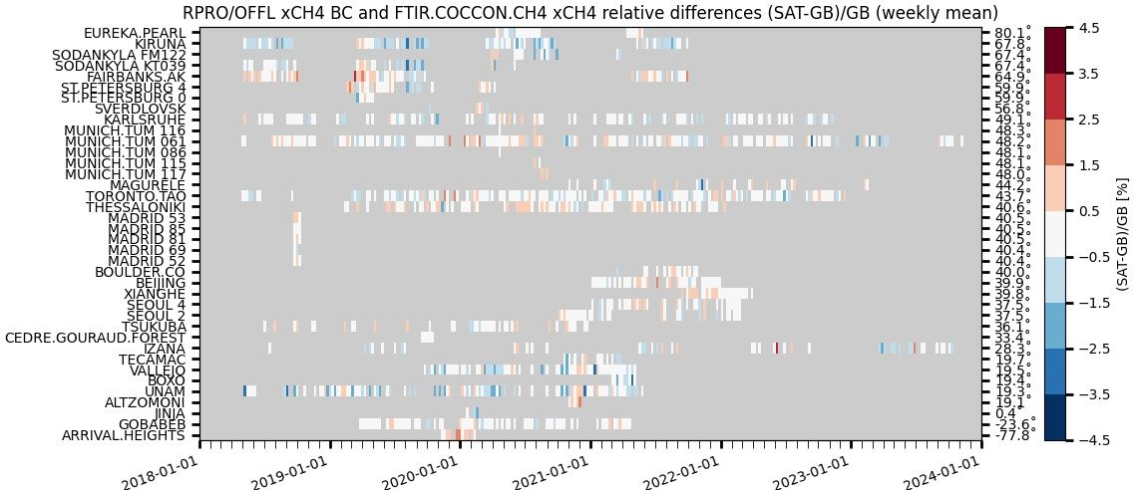
CV-2/5/6: Networks Sustainability and Tailoring
CO and CH₄ validation vs. 3 FTIR monitoring networks
B. Langerock and M.K. Sha (BIRA-IASB)
Performance of ATM-MPC Sentinel-5P CH₄ and CO validation relying on the operational capabilities/timeliness of the 3 FTIR monitoring networks
NDACC FTIR : automated validation channel in ATM-MPC Automated Validation Server (https://mpc-vdaf-server.tropomi.eu).
Validation protocols based on published experience with HALOE,
MOPITT, SCIAMACHY, MIPAS, ACE-FTS, IASI, GOSAT, OCO…
TCCON FTIR : manual validation channel in ATM-MPC. ESA contract for operations support to be placed; EUMETSAT FRM Roadmap and CO2M ITT in progress
COCCON FTIR : manual validation channel in ATM-MPC, EVDC data collection and automation in progress (ESA FRM4GHG 2023-2027), EUMETSAT FRM Roadmap and CO2M ITT
S5P CO images courtesy B. Langerock
Automated collection of observations from 17
NDACC FTIR stations
through EVDC =>
automated production of S5P Quality Indicators
TCCON GGG2020 data
released 26 April 2022
No/limited data submitted
between early 2021 and GGG2020 release.
Collection of permanent
and campaign based
observations
~17 COCCON stations
to contribute in the
future

Slide 10
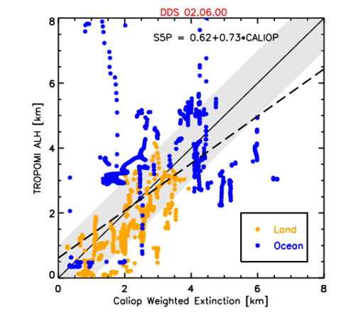
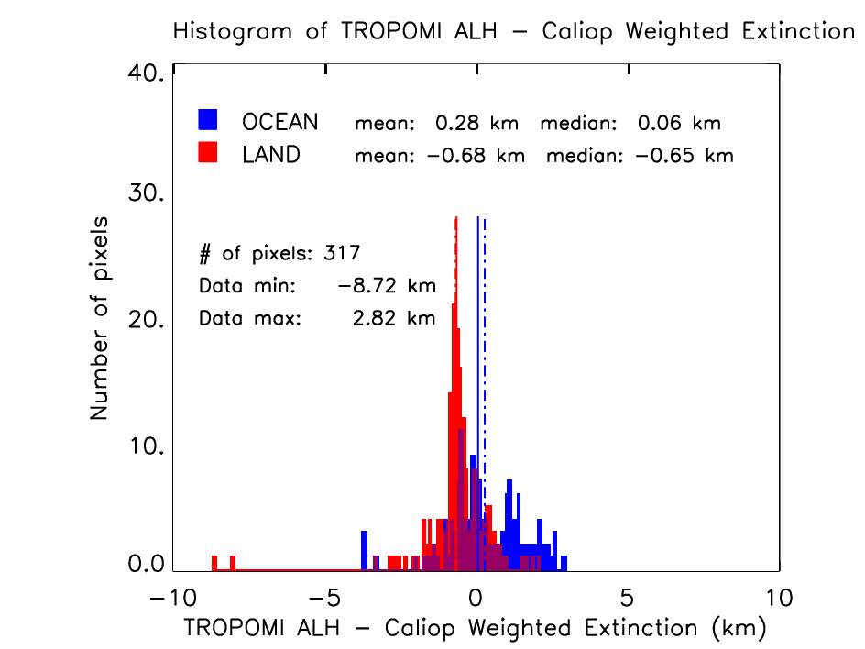
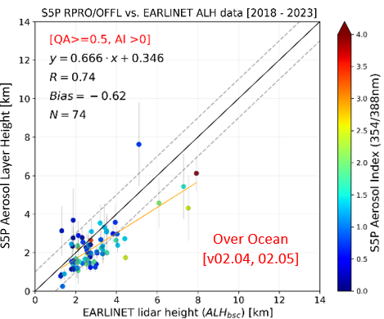
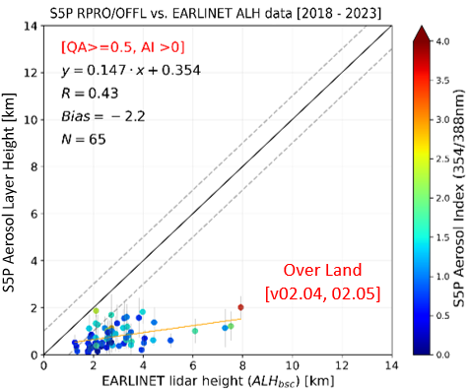
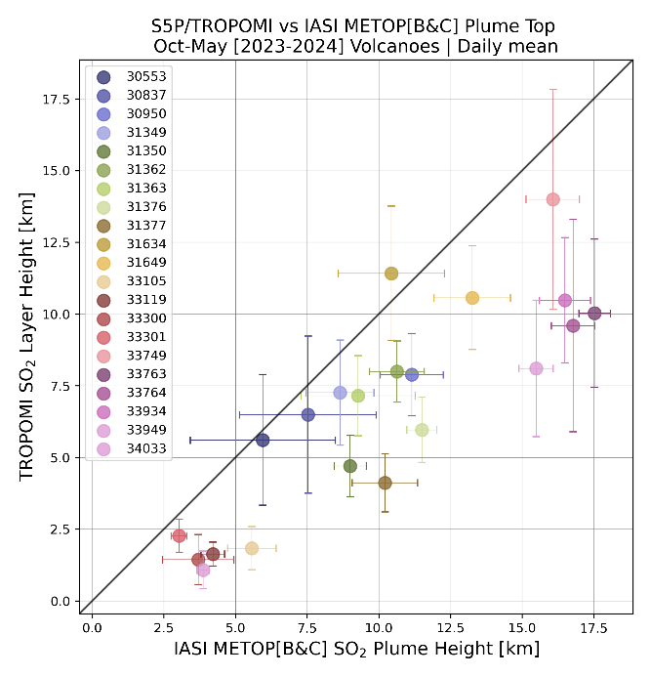
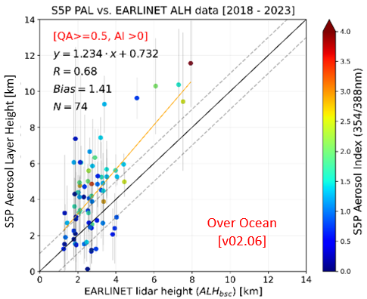
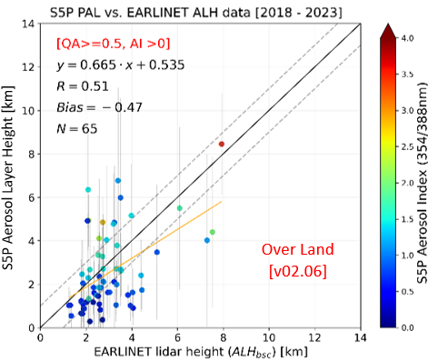
Aerosol and SO₂ Layer Height Validation
T. Wagner (MPI-C), M. de Graaf (KNMI), A. Pefstogas, K. Michailidis , ML. Koukouli (AUTH)
S5P Aerosol Layer Height vs. CALIPSO / CALIOP
S5P Aerosol Layer Height evolution vs. EARLINET aerosol lidars
Over Land Surface
Over Ocean Surface
old
old
S5P SO2 Layer Height vs. IASI-A/B
New activity
S5P TROPOMI vs. MetOp-B/C IASI SO₂ Layer Height during volcanic eruptions of Sep-Nov 2023. Mean SO2_LH difference ~2.5km.
new
new

Slide 11
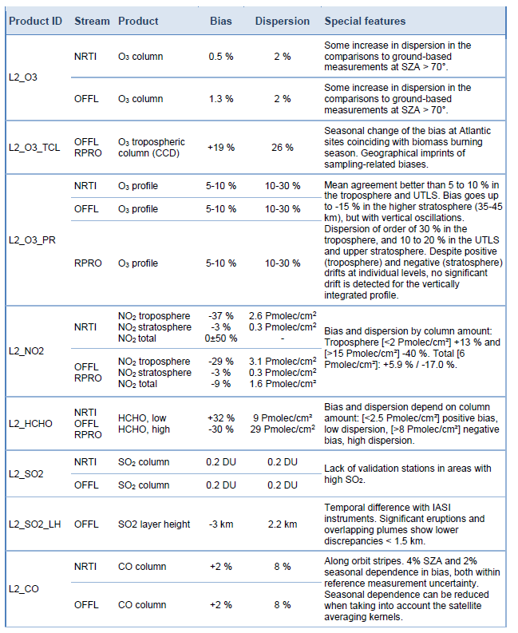
Summary of S5P Quality Indicators and Open Issues
As of September 2024. Validation results for L1 v02.01.00 and L2 up to v02.06.01
Available publicly and updated frequently on http://mpc-vdaf.tropomi.eu

Slide 12
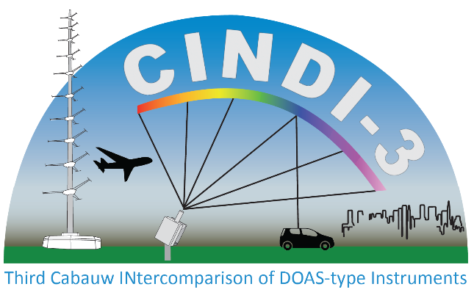
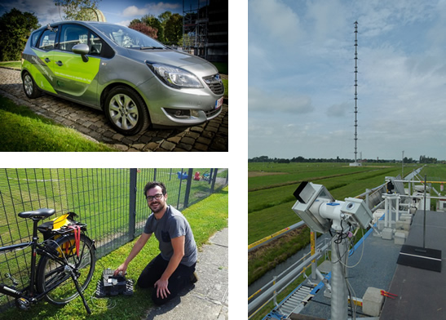
The Third Cabauw INtercomparison of DOAS-like Instruments (CINDI-3)
Coordinators: M. Van Roozendael (BIRA-IASB), A. Apituley (KNMI), K. Kreher (BKS)
Semi-blind intercalibration and intercomparison campaign with external referee
to intercalibrate AQ and ozone instruments and intercompare measurements
to get NDACC & ACTRIS-CREGARS certification for new instruments
to assess and improve (CEOS-)FRM maturity for the validation of Sentinel-5P TROPOMI and Aura OMI and for the CEOS Air Quality & O₃ satellite constellations
Status
Took place in Cabauw from 21 May to 24 June 2024
Over 100 researchers from 16 countries, 44 instruments
Stationary MAX-DOAS and PGN UV-VIS observations complemented with O₃ and aerosol lidars, NO₂ and O₃ sondes, long-path DOAS & in-situ instruments
Mobile measurements around Cabauw, De Bilt and Rotterdam using instruments mounted on cars, bikes and the RBINS Belgian research aircraft
Campaign data analysis in progress

Slide 13
Conclusion
S5P TROPOMI data products in good health
Continuous development of new validation channels, methods, operationalization of data streams…
Strong dependence on FRM availability and timeliness
S5P TROPOMI operational validation =
Pathfinder for operational validation systems in development for Sentinel-4/5 and CO2M, and for facility-scale missions
Important source of feedback to FRM networks: quality, network deployment, sustainability, timeliness…
Test bed for CEOS-FRM Maturity Assessment Framework and other WGCV activities

Slide 14
Thank you !

