Slide 1
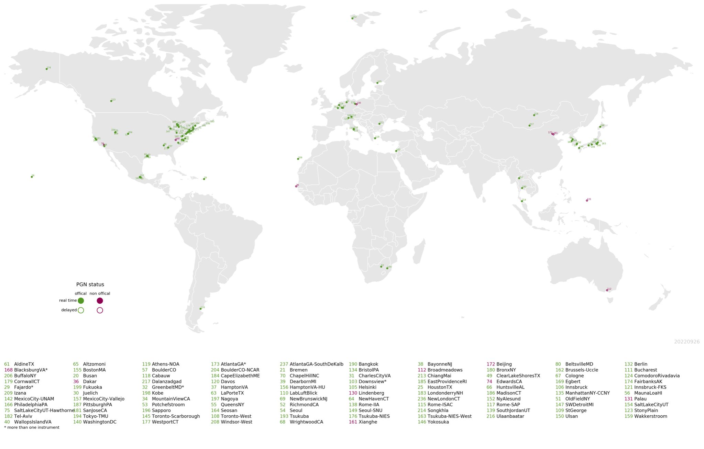
Validation and support of space-based measurements with the Pandonia Global Network of ground-based spectrometers
Thomas Hanisco¹, Nader Abuhassan^{1,2,3}, Stefano Casadio⁴, Alexander Cede^{1,3,5}, Limseok Chang⁶, Angelika Dehn⁴, Barry Lefer⁷, Elena Lind¹,Apoorva Pandey^{1,2}, Bryan Place^{1,3}, Alberto Redondas⁸, James Szykman⁹, Martin Tiefengraber⁵, Luke Valin⁹, Michel van Roozendael¹⁰, and Jonas von Bismarck⁴
¹NASA Goddard Space Flight Center, Greenbelt, Maryland, USA
²University of Maryland Baltimore County, Maryland, USA
³SciGlob, Columbia, MD, USA
⁴Earth Observation Ground Segment Department, ESA / ESRIN, Frascati, Italy
⁵LuftBlick, Innsbruck, Austria
⁶National Institute of Environmental Research, Incheon, Korea
⁷NASA Headquarters, Washington, DC, USA
⁸AEMET- Meteorological State Agency, Spain
⁹EPA Research Triangle Park, Charllotte, NC, USA
¹⁰BIRA-IASB, Brussels, Belgium
15-October, 2024
CEOS AC-VC meeting

Slide 2
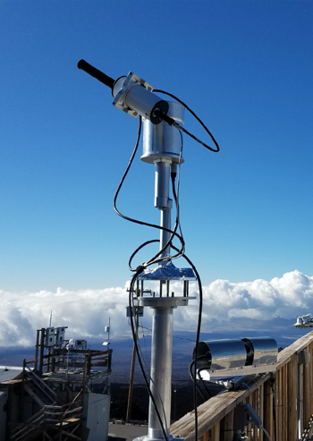
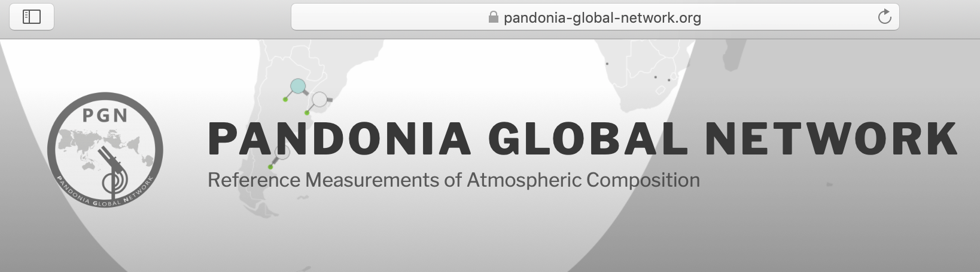
Pandonia Global Network: Reference measurements of O₃, NO₂, and HCHO
Calibration and Quality Assurance:
  Laboratory and Field calibration of instruments
Network operation
  Remote monitoring and repair of instruments
Retrieval
  Production of O₃, NO₂ and HCHO Columns/Profiles
The PGN operates 175+ Pandora instruments
https://www.pandonia-global-network.org/
Thomas.Hanisco@nasa.gov, alexander.cede@luftblick.at

Slide 3

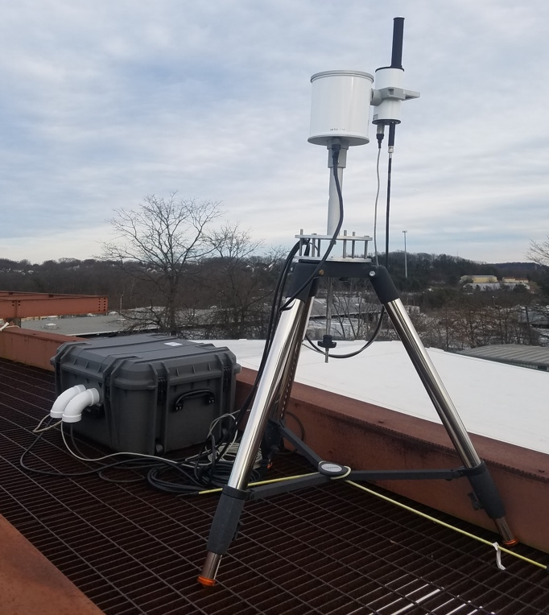
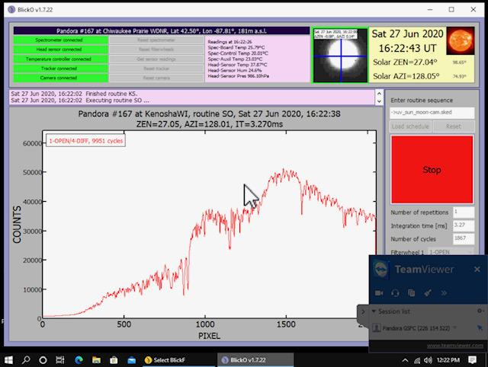
Instrumentation
Pandora is a ground-based sun/sky/moon viewing spectrometer system
The sensor head (light collector) is mounted on a 2-axis tracker.
Sun/sky/moon-light is directed to the input of a ccd spectrometer with a fiber optic cable.
Control electronics for semi-autonomous operation in all-weather conditions
Pixels (wavelength) and Counts (intensity) are used to derive trace gas abundance
Head
Sensor
Dual-axis
tracker
Electronics
Enclosure
Fiber Optic Cable

Slide 4
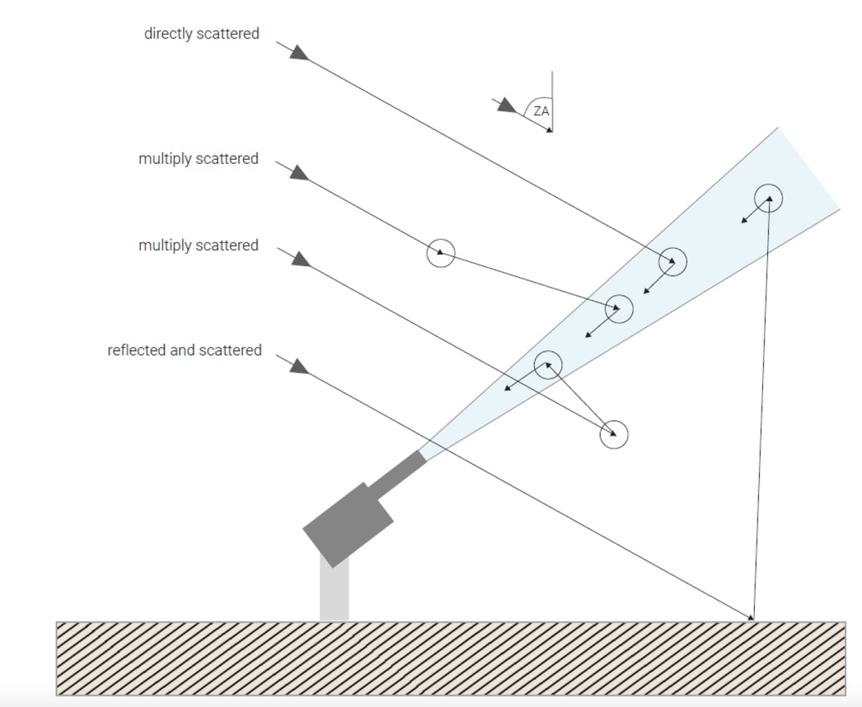
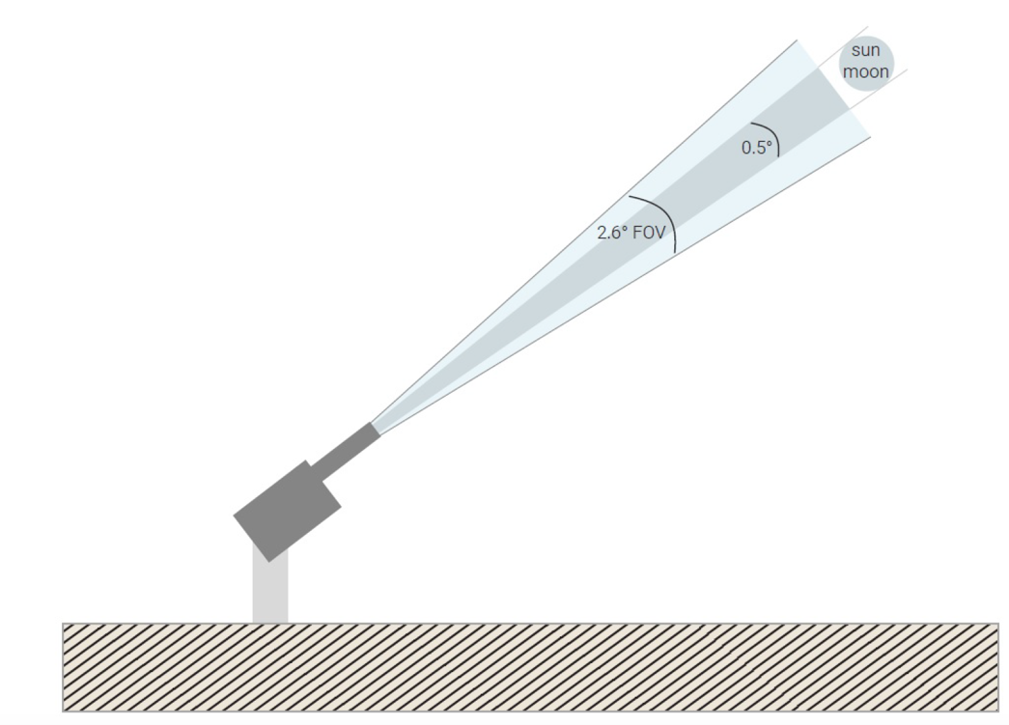
Pandora measurements
Direct sun: mostly BEER’s Law.
Total absorption used to derive the column abundance between the instrument and the top of atmosphere
MAX-DOAS: multiple angle BEER’s Law
Differential measurements used to derive the abundance at multiple elevations

Slide 5
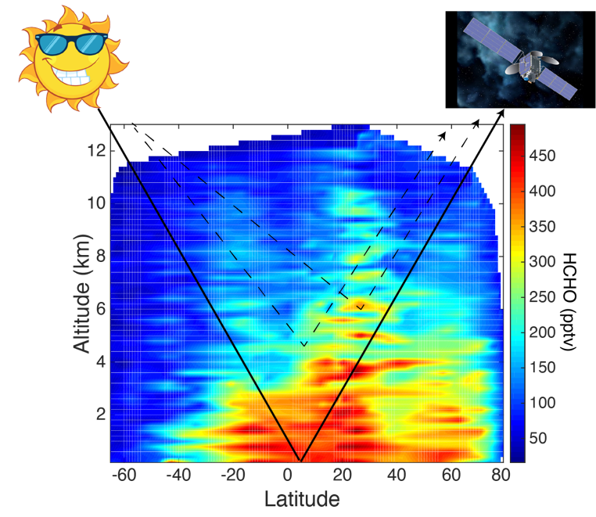
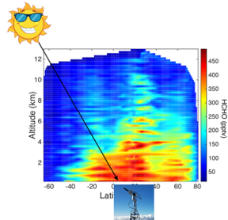
Motivation
NASA Satellites measure sunlight reflected from the earth’s surface and scattered from the atmosphere. This is complicated and requires assumptions (a priori) that are not always correct. Even harder with Geostationary!
Pandora provides direct sun with lower sensitivity to scattered light.
MAX-DOAS profiles can be used to validate the a priori assumptions.

Slide 6

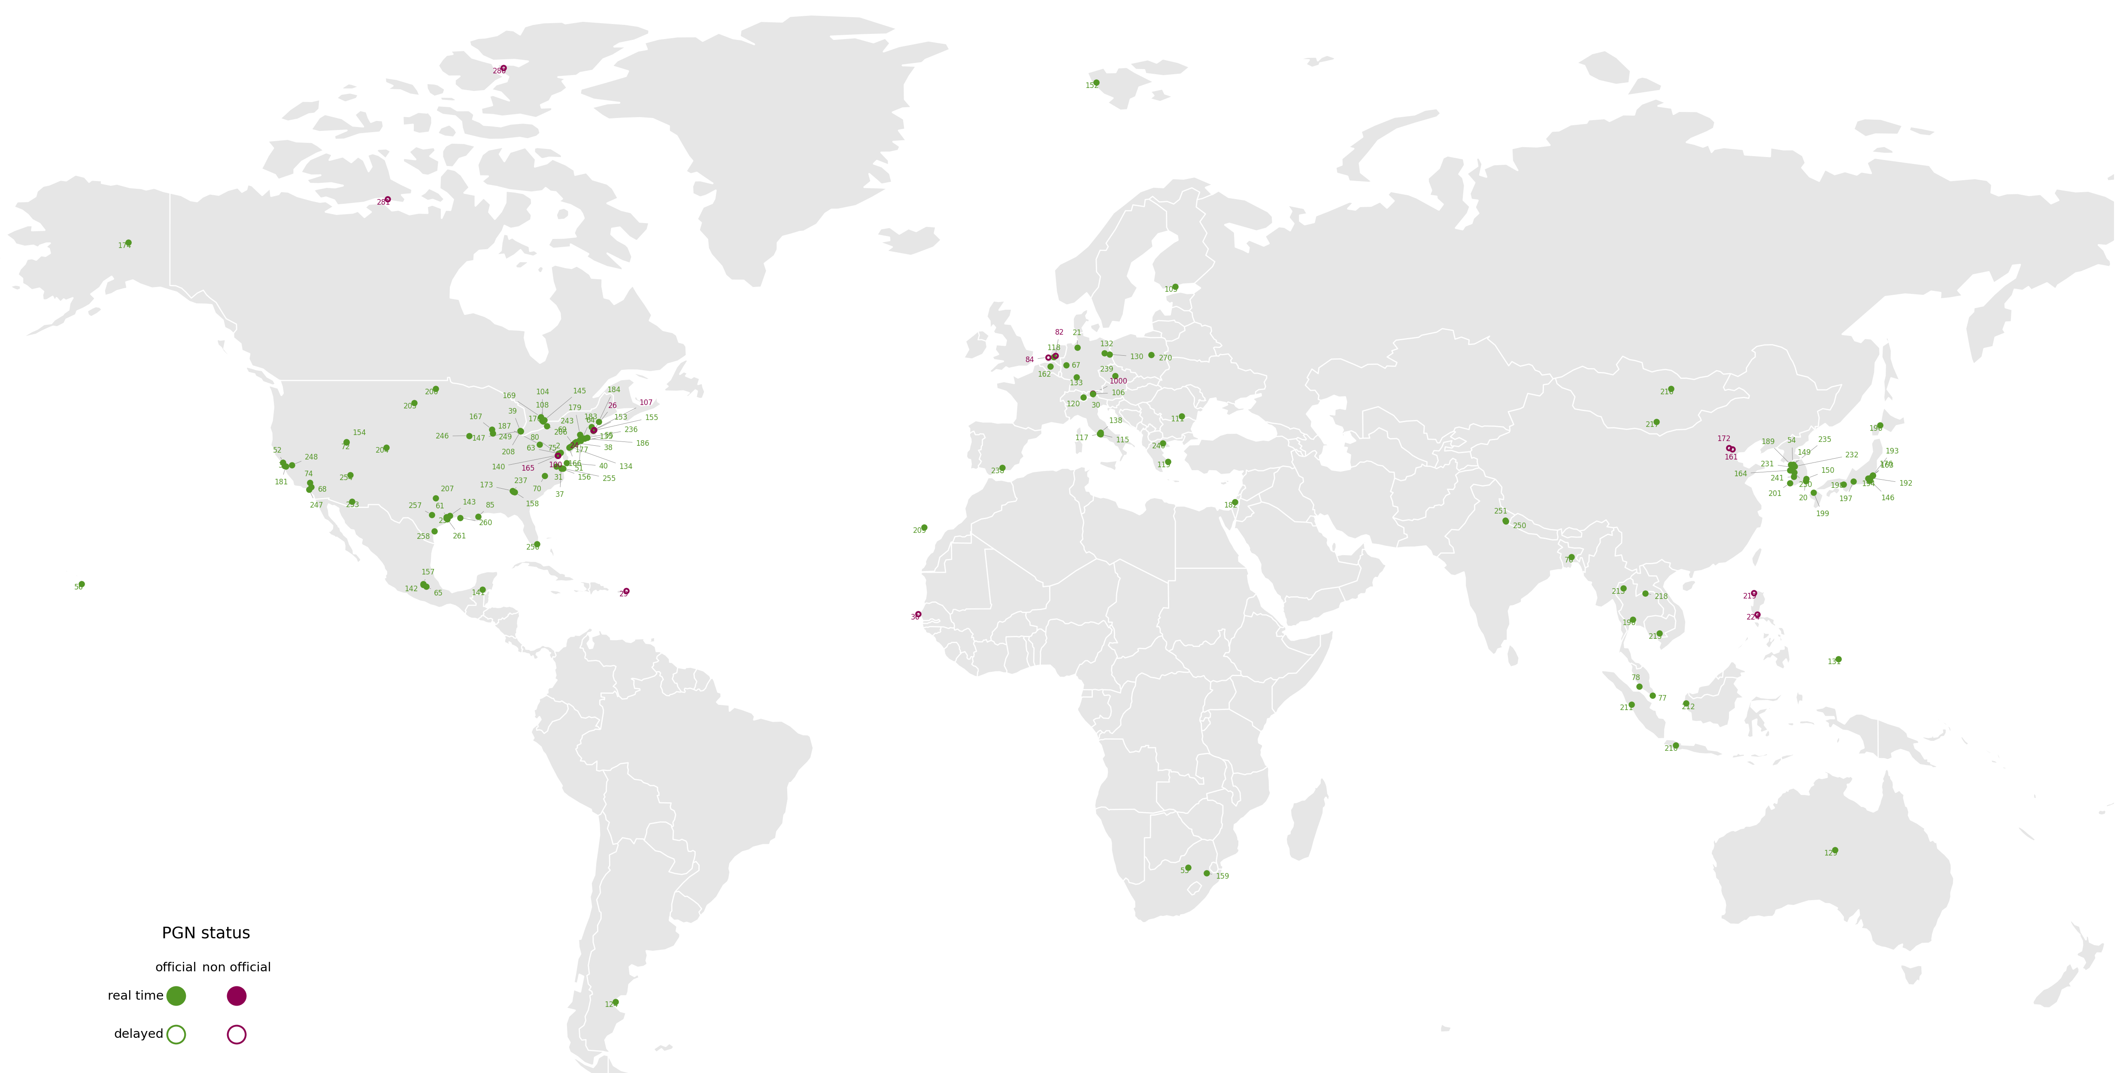
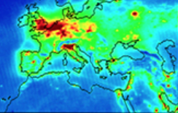
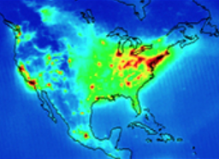
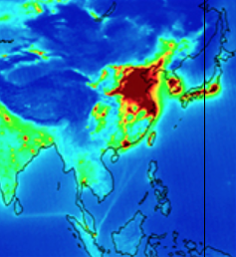
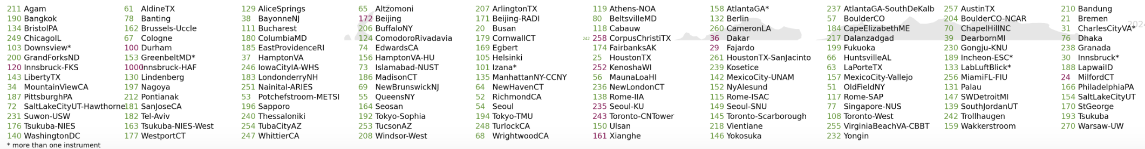
Pandonia Global Network
SENTINEL-4
            175 Official instruments
            Unofficial
            Adding 30/year
TEMPO
GEMS
Notes:
Buenos Aires and Rivadiva, Antarctica Trollhausen, Ann Marie Fjaera NILU

Slide 7
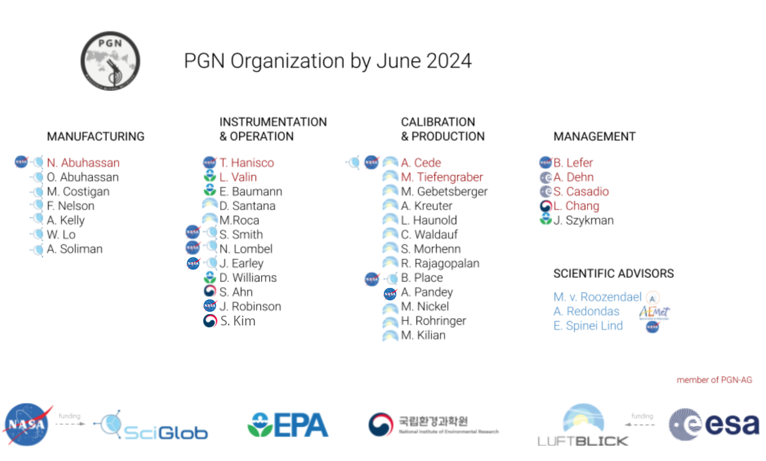
Notes:
Added Actris not up to date

Slide 8
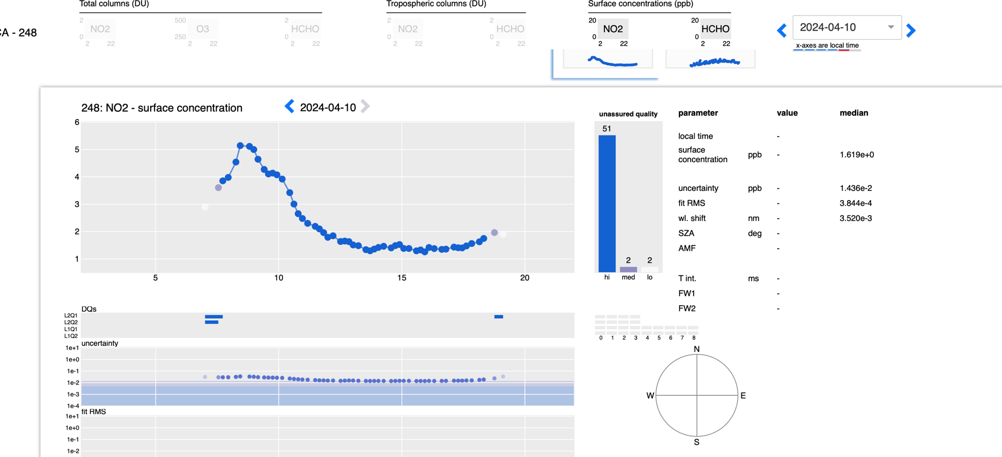
PGN Real Time Data: BlickV http://blickv.pandonia-global-network.org/
Stan State - 248
All products are available for download on BlickV.
Quality assured total column NO₂ and O₃ are archived at the EVDC.
“Out of the Box” MAX-DOAS products provided without a field calibration.
8
8
8

Slide 9
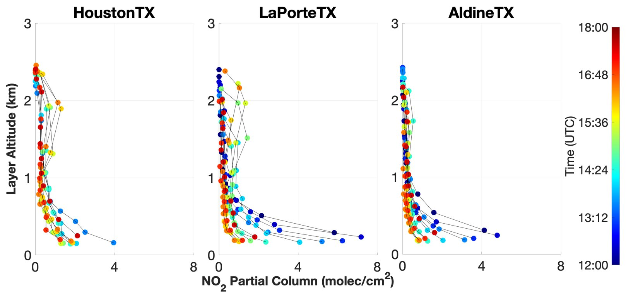
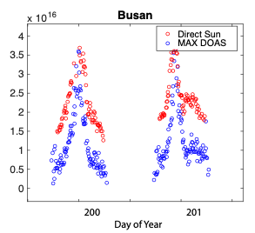
Data quality
Direct sun NO₂ and O₃ are “validation quality”. These products have been validated with airborne (DISCOVER-AQ), balloon (O₃ sonde), and ground remote (Brewers). High quality data is on the EVDC.
Profiles (MAX-DOAS) of NO₂ and HCHO and direct sun HCHO are not fully understood.
NO₂
HCHO

Slide 10
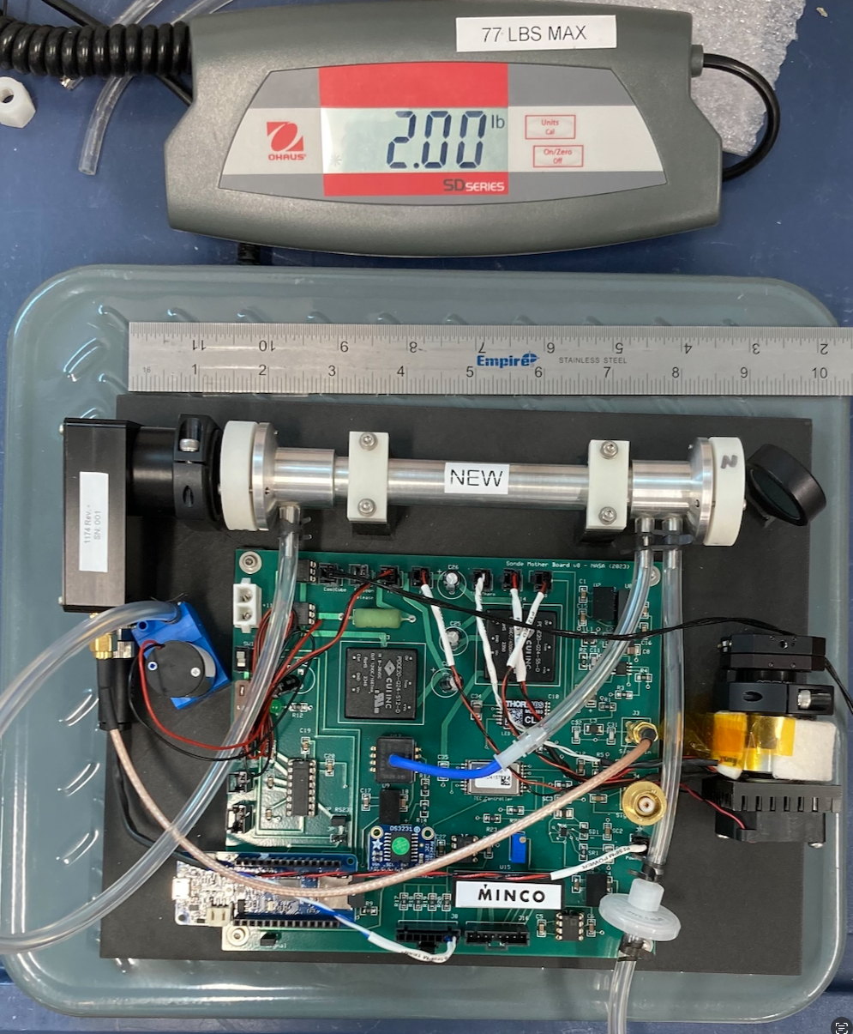
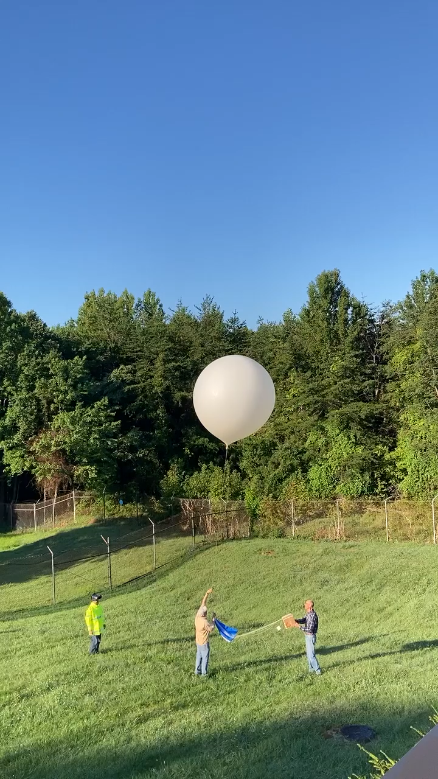

Validation of MAX-DOAS products: NO₂
Airborne, balloon and ground-based in situ comparisons to MAX-DOAS NO₂.
Measurements of NO₂ columns are robust but our understanding of the spatial distribution needs improvement.
Bryan Place NASA/SciGlob

Slide 11
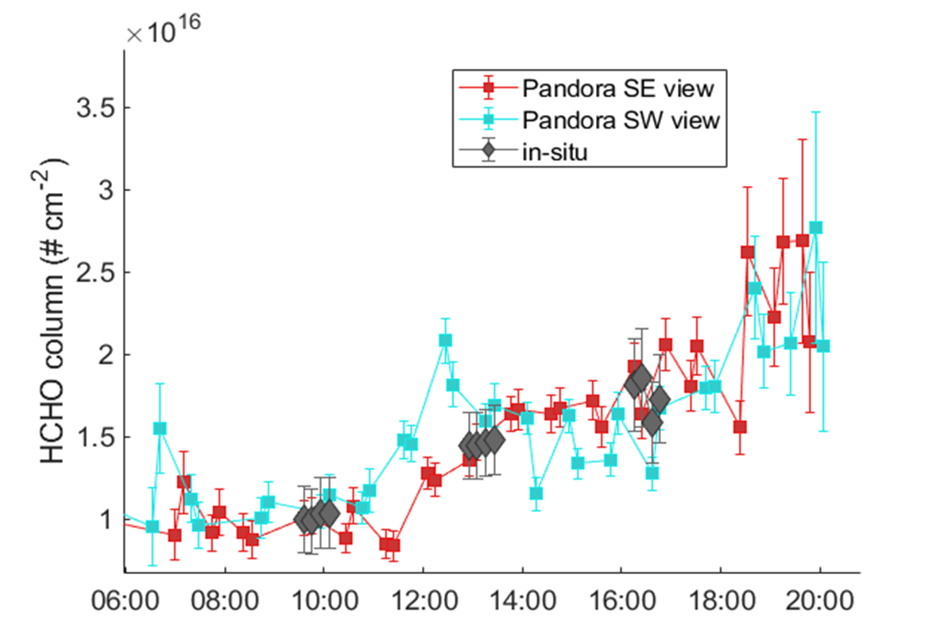
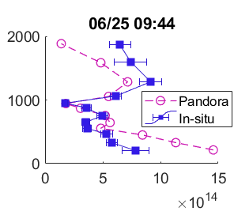
Validation of MAX-DOAS products: HCHO
NASA (SARP) and EPA (ALEGROS) airborne in situ profiles over Pandora sites in 2024. More flights planned for 2025.
MAX-DOAS Consistently agrees well with the in situ
Altitude (m)
HCHO partial column (mol/m²)
Apoorva Pandey, Poster 49

Slide 12







Expansion programs
Leverage other agencies and objectives
  For example, the United Nations UNESCO funded 23 instruments to be managed by KOICA and NIER in southeast ASIA.
EPA 25+ instruments
NASA IPMSI – 13 instruments
NASA Satellite needs Working Group (SNWG) - Hard to reach rural and developing nation sites
  10 US department of Agriculture rural sites
  10 US State Department embassy locations
NOAA starting investment with interest for GEO-XO.
  Installed at Essex, Maryland MDE site in June 2024
Notes:
Shobha Kondragunta at NOAA Bojan Bokov at Eumetsat

Slide 13
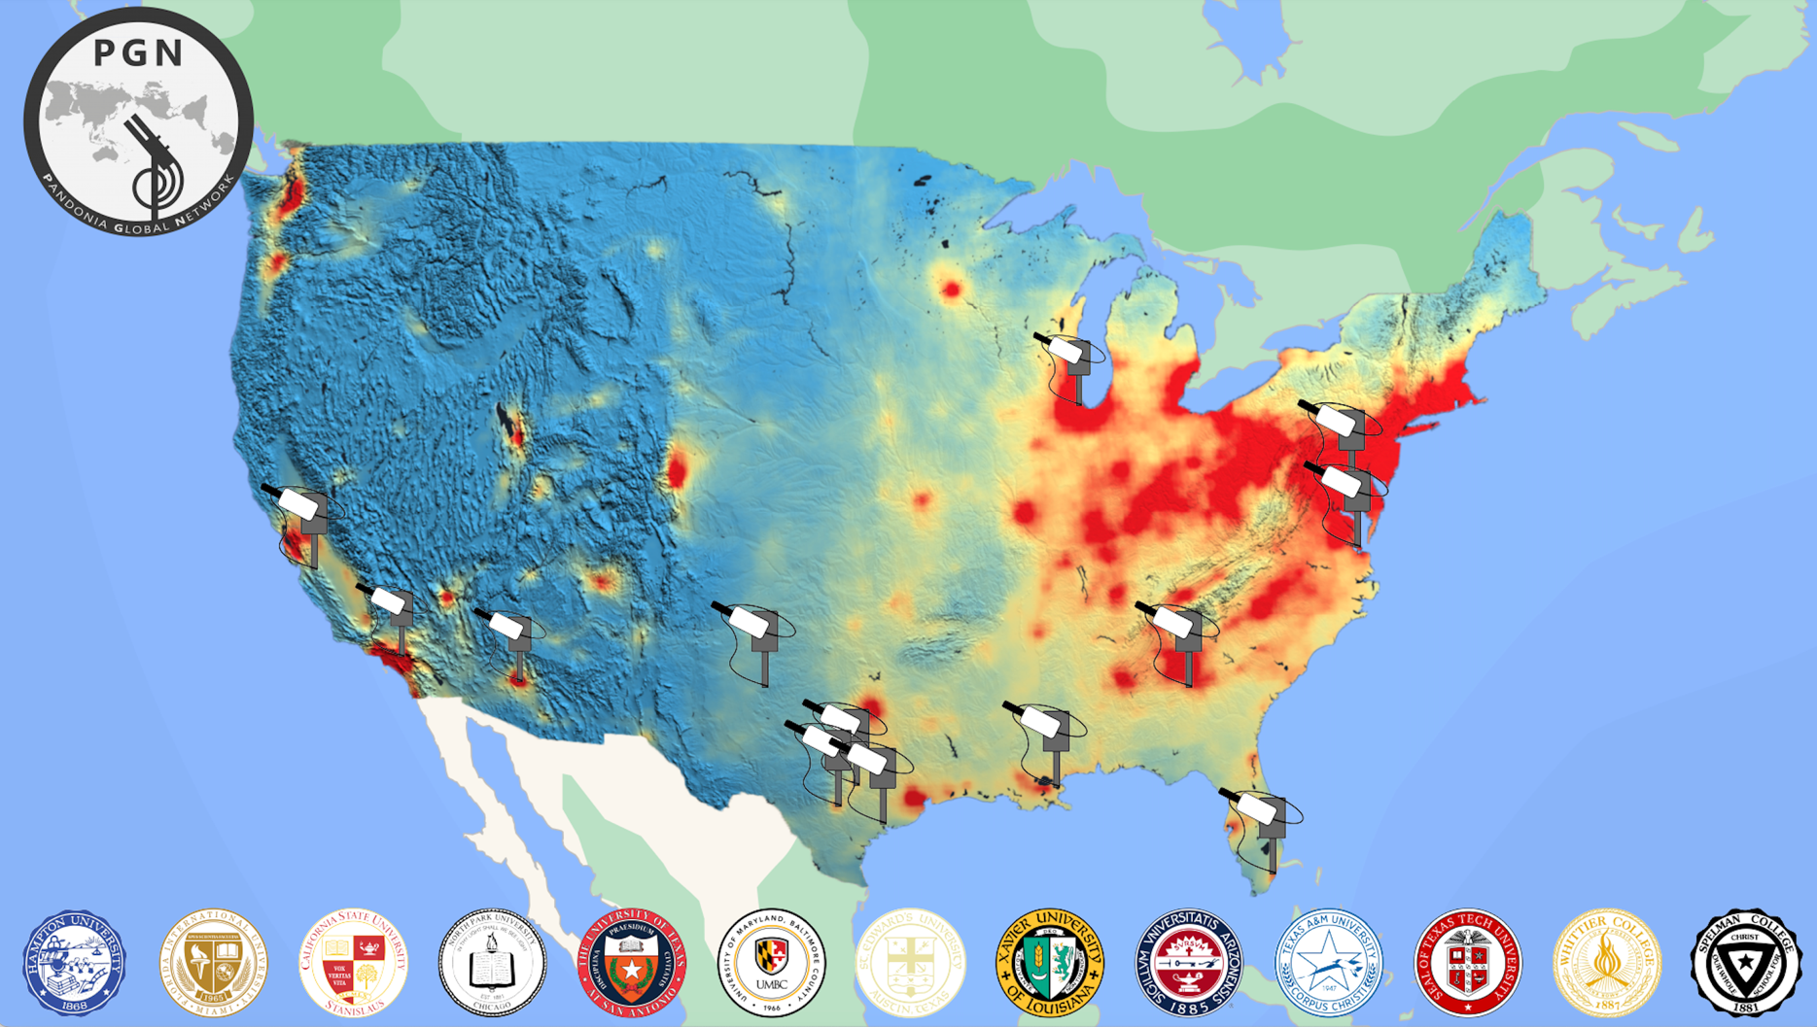
Increasing Participation in Minority Serving Institutions (IPMSI)
Pandoras added in 2023-2024 at 13 institutions
Expand in areas with limited measurement resources
Create a cohort of motivated PI’s with 5 years funding
90+ instruments in the TEMPO FOV

Slide 14
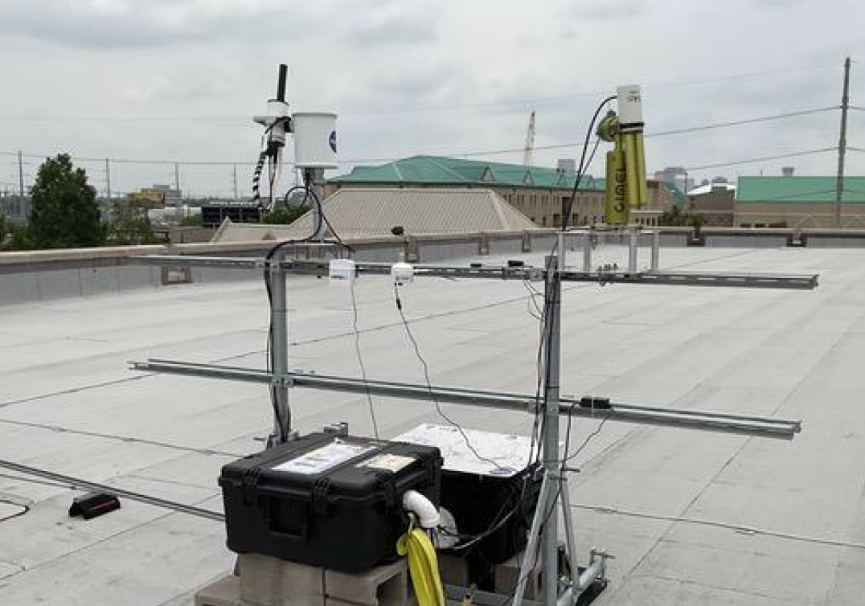
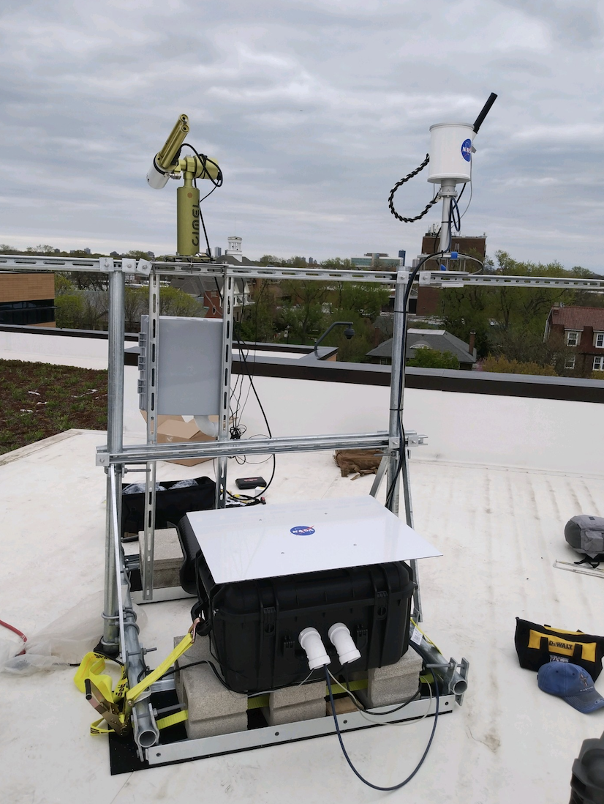
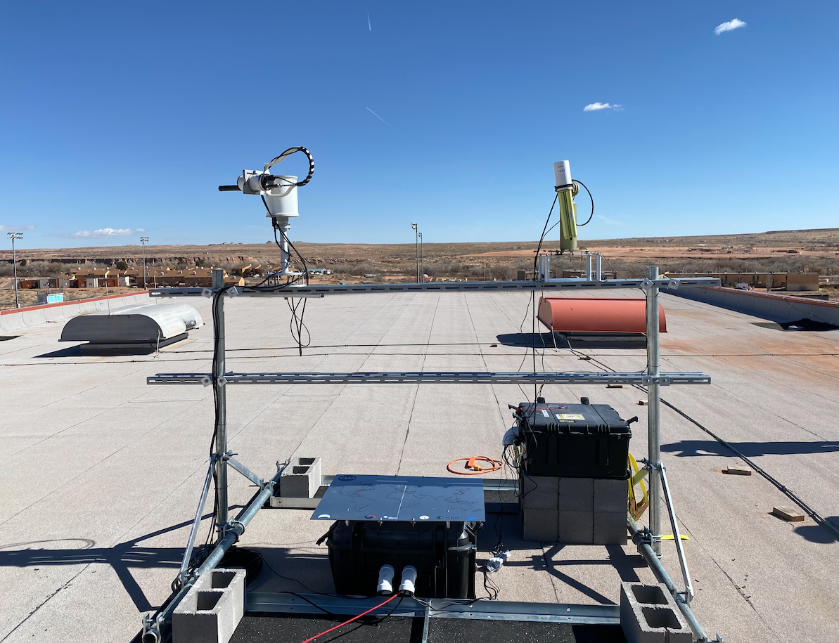
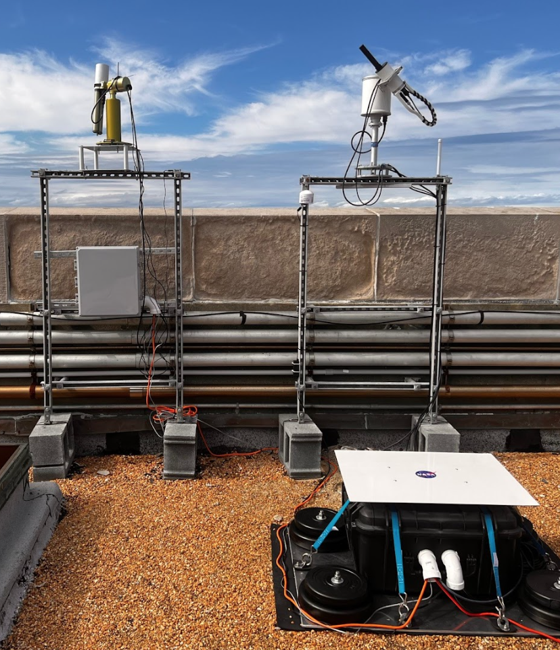
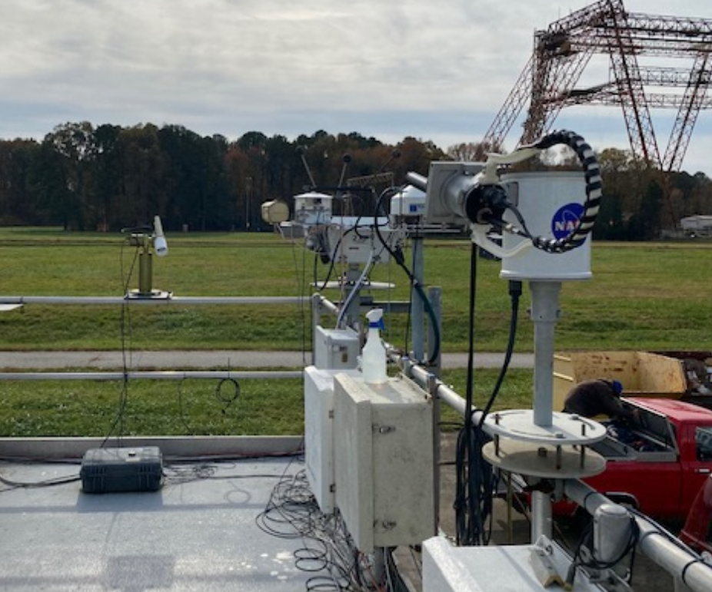
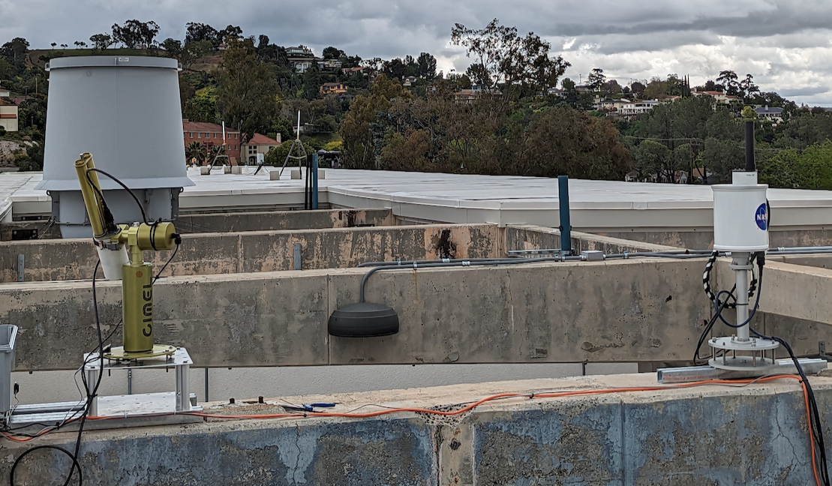
Colocated Pandora and Cimels
Chicago, IL
Tuba City, AZ
New Orleans, LA
Whittier, CA
Chesapeake Bay Bridge
Langley, VA

Slide 15
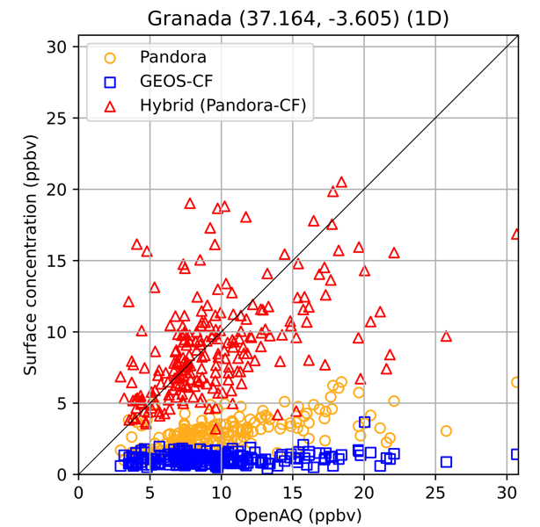
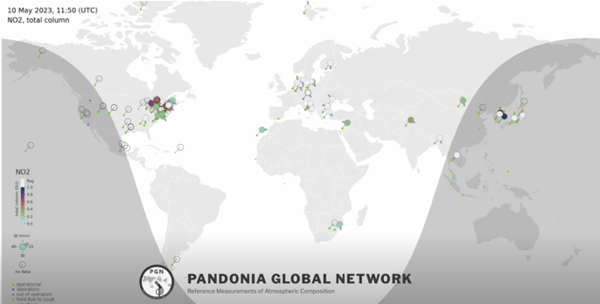
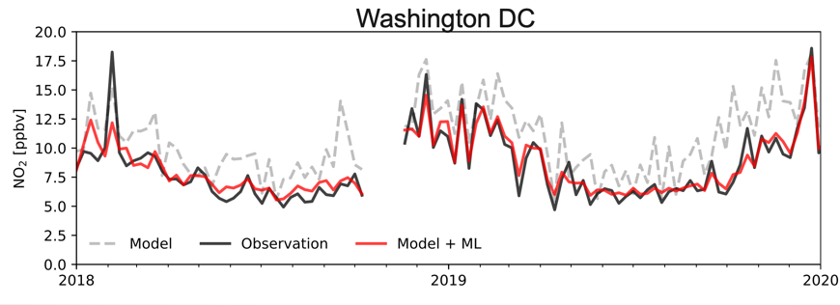
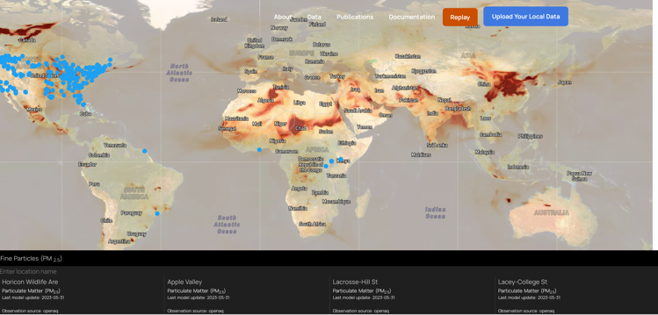
SNWG: Produce localized NO₂ forecasts by combining PANDORA observations with GEOS model output
Pandora observations
PGN +
GEOS_CF trop columns -> Surface concentration
GEOS-CF model output + machine learning
Adapt ML method developed for surface observations (Christoph Keller et al., ACP 2021)
Method is limited to locations with at least 1 year of historical data
PI Emma Knowland, GMAO

Slide 16
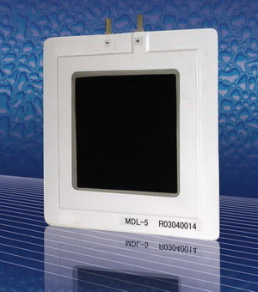
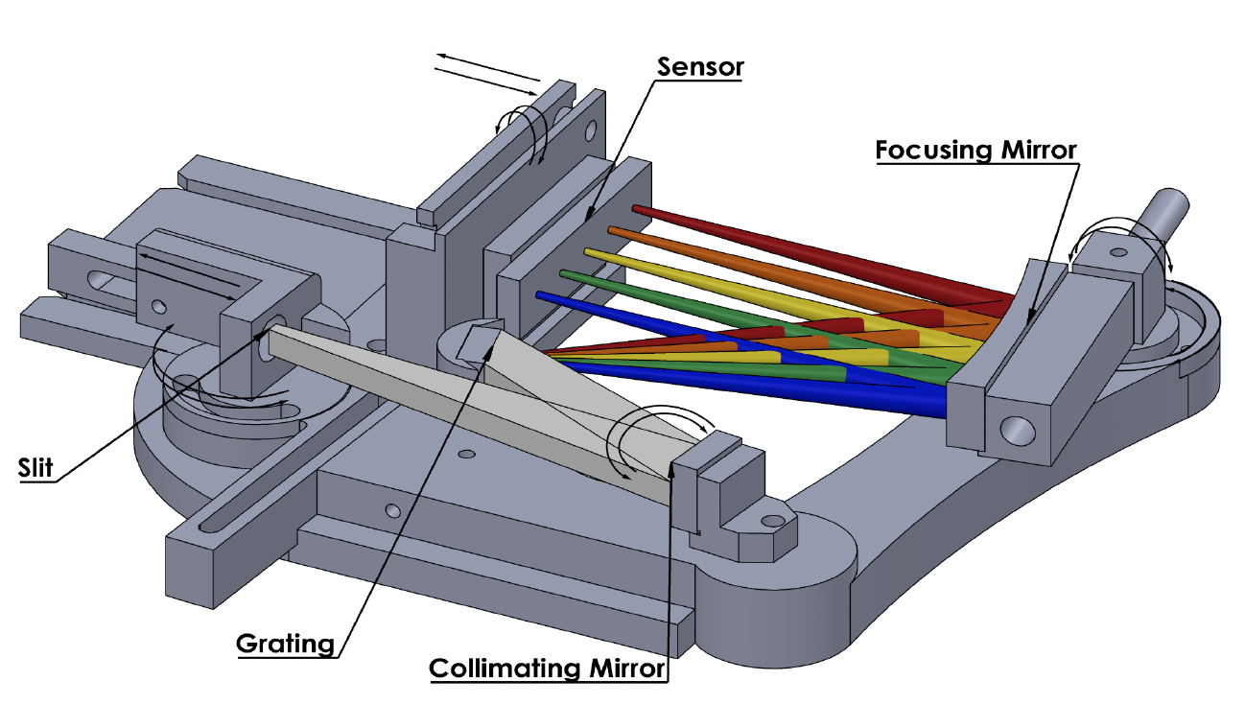
Instrumentation & Technology
Delrin -> Nylon in sensor head. Complete
Upgraded tracker. Complete
  Still working on trackers with brakes
Upgraded sensor head cables on all new instruments/repairs.
New optical diffusers in all new instruments/repairs.
Dehumidifier in spectrometer box
  Humidity is still #1 failure mode
  All new NASA instruments have the dehumidifier
Custom spectrometer development through NASA SBIR
  Low stray light
  Temperature controlled detector
  Fiber adapter
New PAN-C all in one in GSFC lab for calibration
Electrolytic membrane dehumidifier
SciGlob NASA SBIR Ph-II Spectrometer prototype

Slide 17
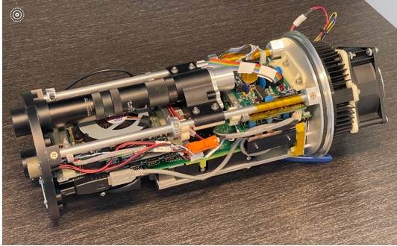
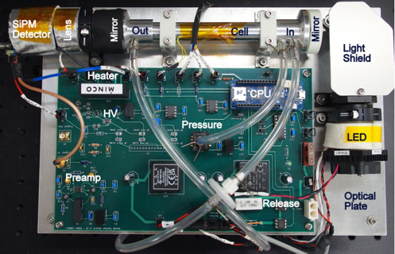
Pan-C NASA SBIR
THANKS!
Optical NO₂ Sonde
(HCHO and O₃ in development)
20 x 25 x 4 cm, 1 kg, 6W
100 ppt/s
Bailey et al., AMT, https://doi.org/10.5194/amt-17-5903-2024

