Slide 1
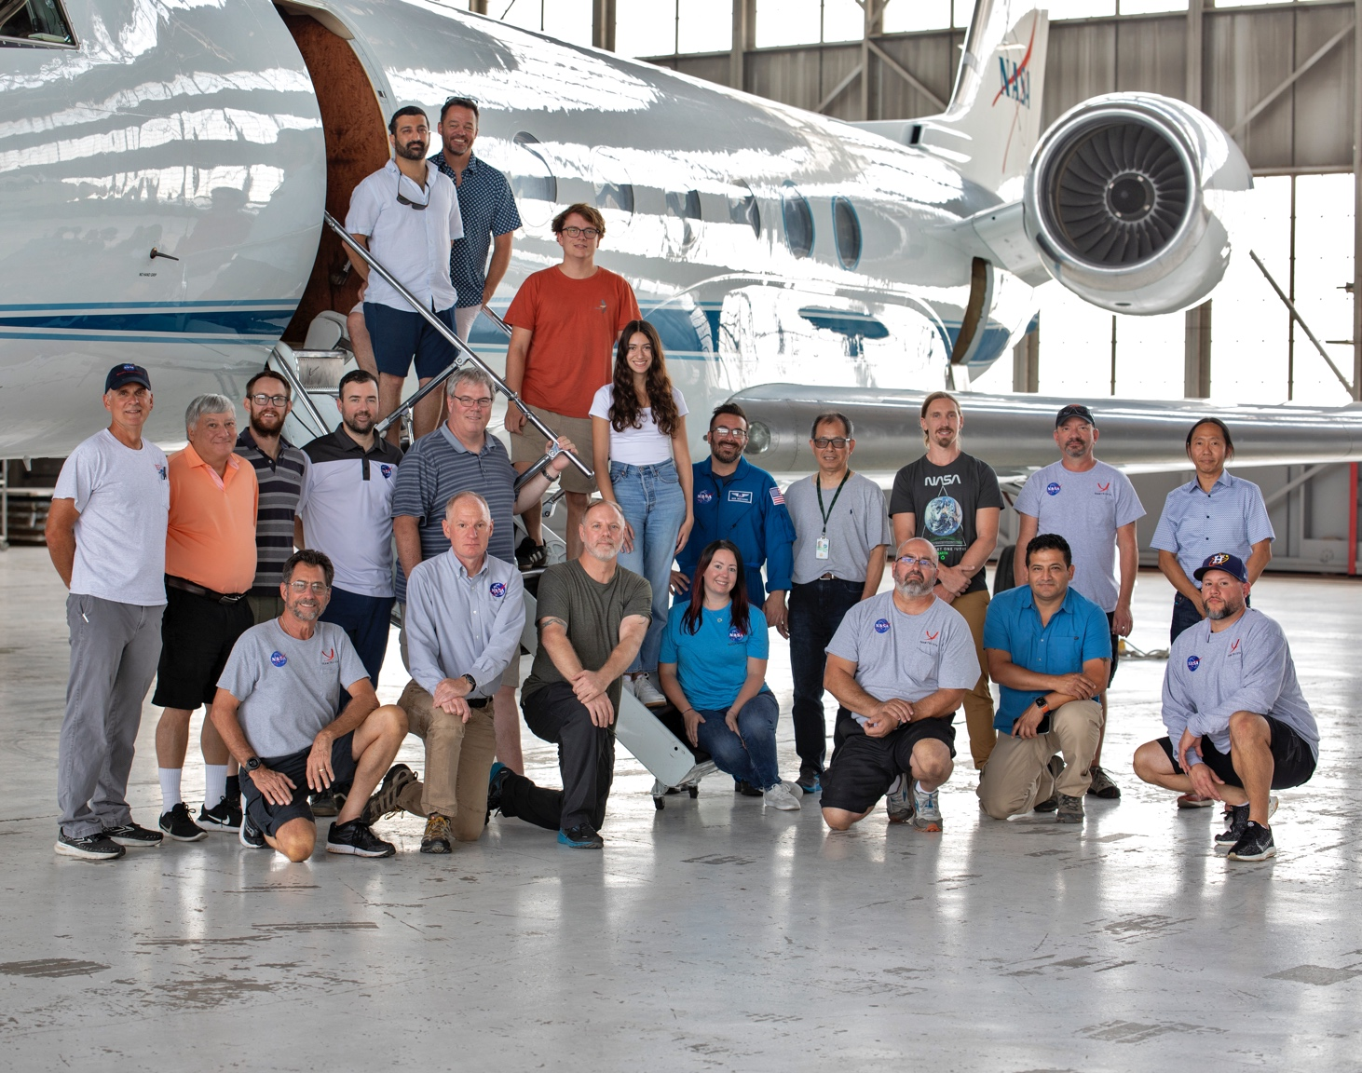
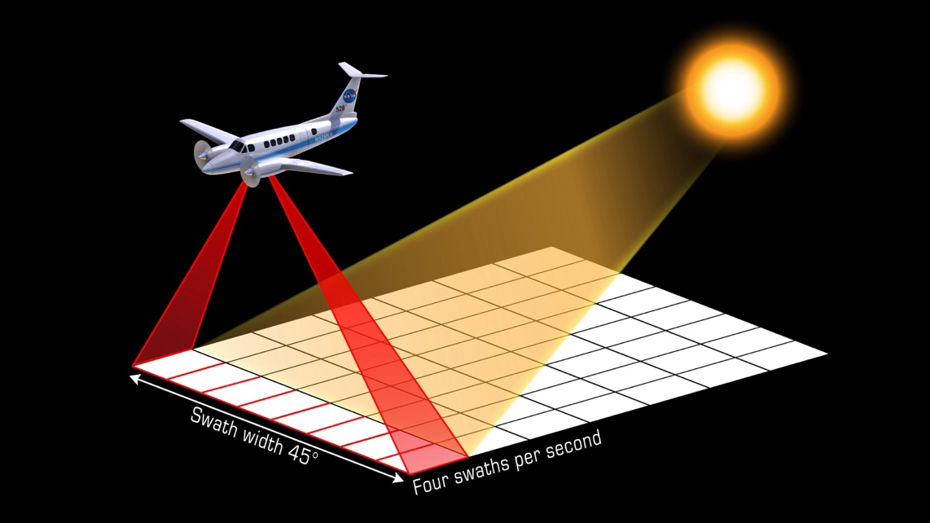


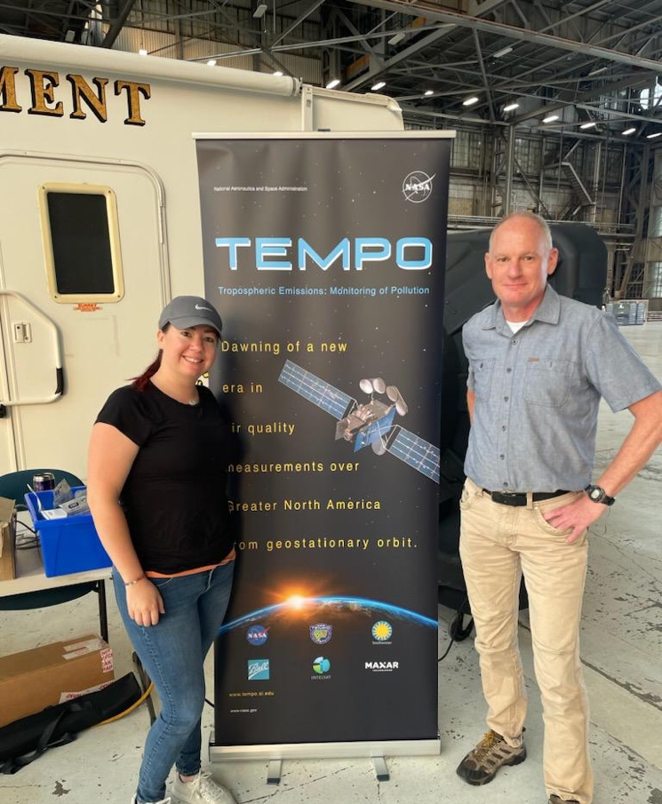
Synergistic TEMPO Air Quality Science
Presented by Laura Judd, NASA LaRC
Contributions from:
Rich Ferrare, Amin Nehrir, Rory Barton Grimley—LaRC
Scott Janz & John Sullivan—GSFC
Daniel Jensen & Fernando Chouza—JPL
Jerrold Acdan—University of Wisconsin

Slide 2

2 PGN
1 TOLNet
6 PGN
9 PGN
4 TOLNet
2 PGN
3 TOLNet
Above shows maps of the geographical regions/dates sampled in June-August 2023 during STAQS.
2 PGN
3 TOLNet
Purpose: To integrate TEMPO satellite observations with traditional air quality monitoring to improve understanding of air quality science for increased societal benefit
STAQS data are publicly available at the QR code above.
The NASA DC8 for NOAA AEROMMA and GCAS on the Gulfstreams flew together all flight days except 2.
Notes:
Red dates are those that coincide with TEMPO data.

Slide 3
2 PGN
1 TOLNet
6 PGN
9 PGN
4 TOLNet
2 PGN
3 TOLNet
Above shows maps of the geographical regions/dates sampled in June-August 2023 during STAQS.
Platform | Instruments | Parameters | Sampling Strategy included Raster patterns over city of interest
JSC GV (123.4 hours) | GCAS | Column NO₂ and HCHO
 | HSRL2 | Profiles aerosol characteristics/ozone and mixed layer heights
LaRC G-III (147.3 hours) | HALO | Column methane + HSRL aerosol characteristics and mixed layer heights
 | AVIRIS-NG (swapped for GCAS after Aug 15) | Many—but the primary for this mission being methane and CO2 emissions estimates
STAQS data are publicly available at the QR code above.
Notes:
Red dates are those that coincide with TEMPO data.

Slide 4
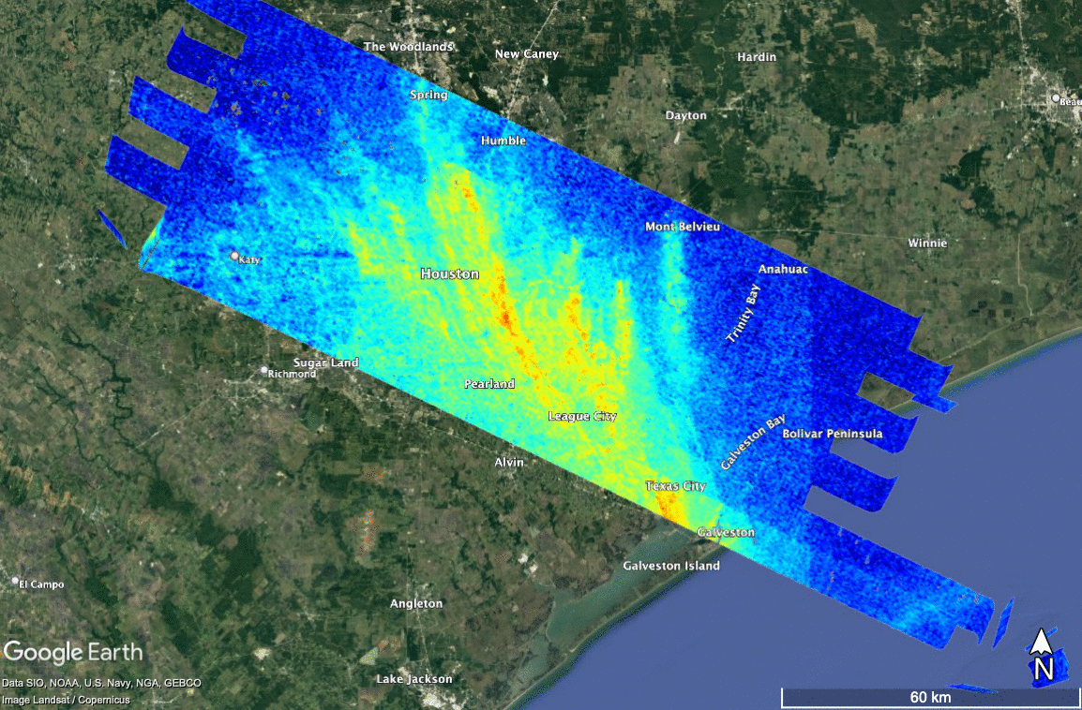
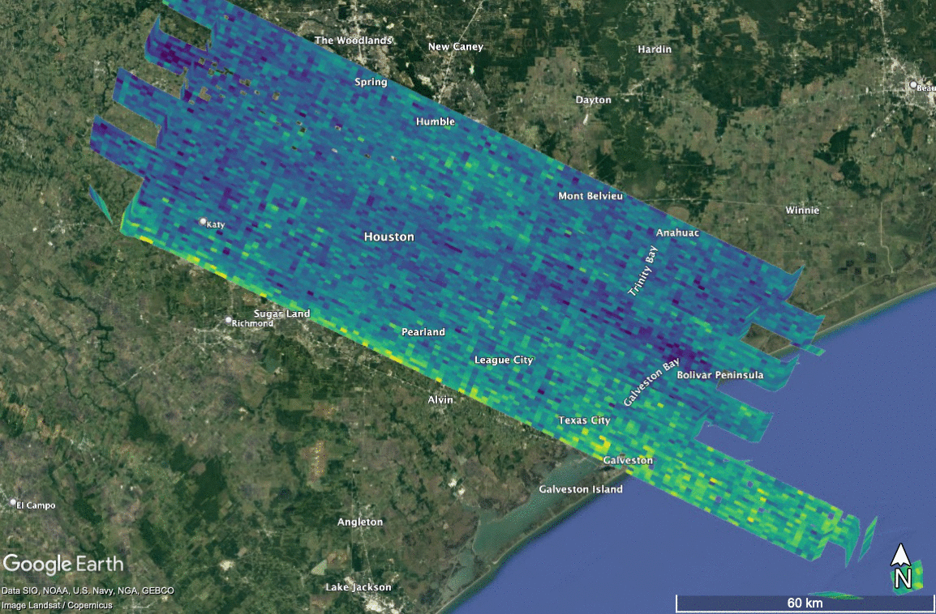
GEOCAPE Airborne Simulator (GCAS)
GCAS is an airborne UV-VIS pushbroom spectrometer meant to satellite measurements like those from TEMPO, GEMS, TROPOMI
Data Products:
NO₂ column density: 250 m x 550 m
  Has a nearly 1:1 relationship with the PGN Pandora observations (within 25% according to DS).
  Comparisons indicate a slight high bias in GCAS of ~1E15 like due to reference assumptions.
HCHO column density: 750 m x 1250 m
  PGN correspond in magnitude with GCAS HCHO but with poor correlation. Results differing dramatically between direct-sun and sky scan comparisons.
Contacts: Scott Janz—scott.j.janz@nasa.gov
Laura Judd—laura.m.judd@nasa.gov

Slide 5
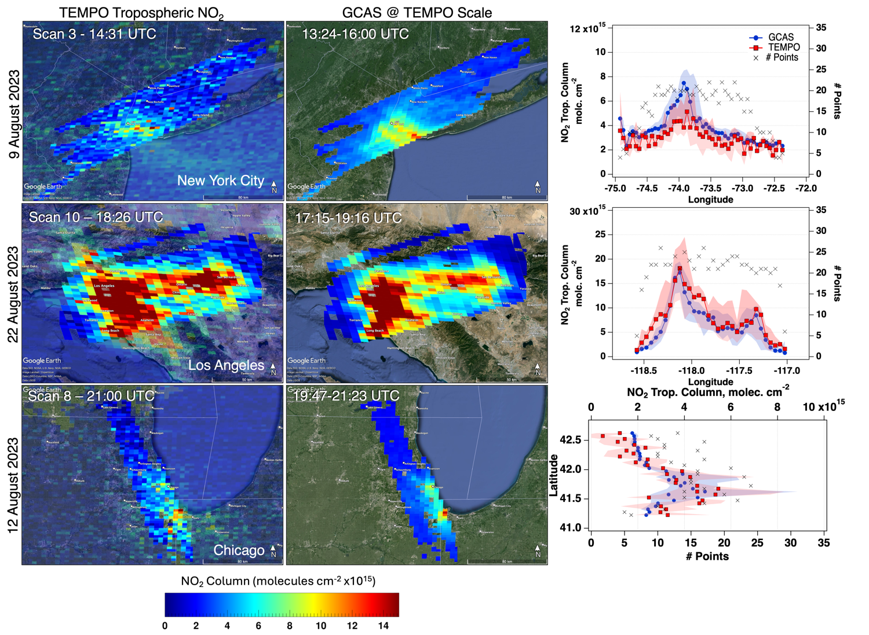
TEMPO
Validation
PSPI NO2-01: Distinguish high NO₂ urban areas from nearby rural areas for three select urban-rural scene combinations.
Notes:
If you’ve looked at the TEMPO validation document, All results are centered around these PSPIs. Product specific performance indicators. This talk is centered around how GCAS addresses some of them indicators.

Slide 6
If only looking at the precision < 1e15
NYC:r2=0.52 n=1328 m=0.68
Chicago: r2=0.65 n=884 m=0.74
Toronto: r2=0.49 n=264 m=0.66
California: r2=0.83 n=4151 m=1.04
PSPI NO2-07: Assess bias, precision, and uncertainty of the tropospheric NO₂ product over areas of interest using data gathered during targeted field campaigns.
High bias, I think is due to the cloud retrieval these days, but in need of further investigation.
Colored points represent the density cloud of individual pixel coincidences in each regional domain.
Coincidence criteria:
+/- 30 minutes
GCAS > 75% mapped TEMPO Pixel
TEMPO qa=0
TEMPO cloud effective fraction < 0.15
White dots represent the median of each dataset for all pixels mapped in a TEMPO scan with the interquartile ranges represented by the black bars.
Statistic represent all coincidences
(not individual overpasses)
SC r²=0.89
SC r²=0.68
SC r²=0.61
SC r²=0.71

Slide 7
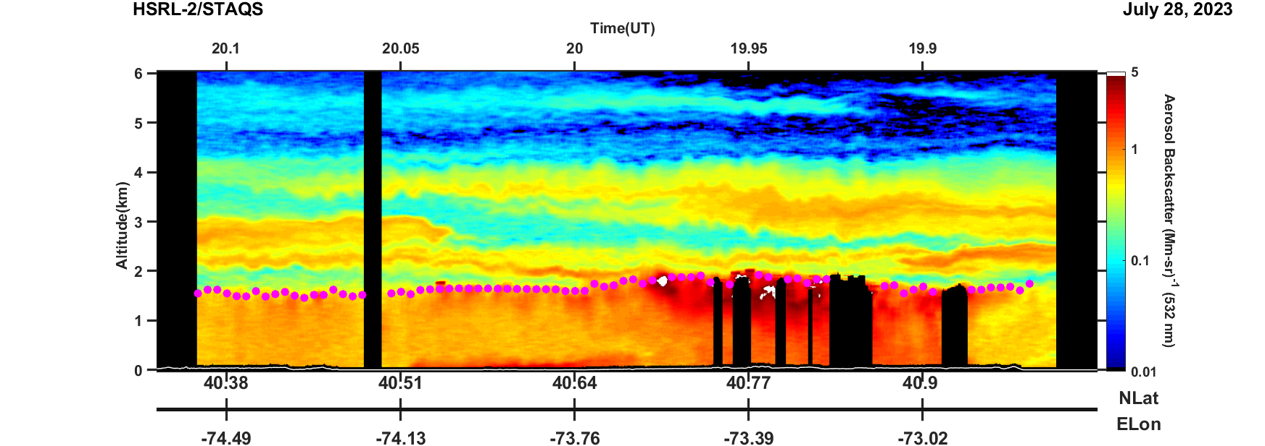
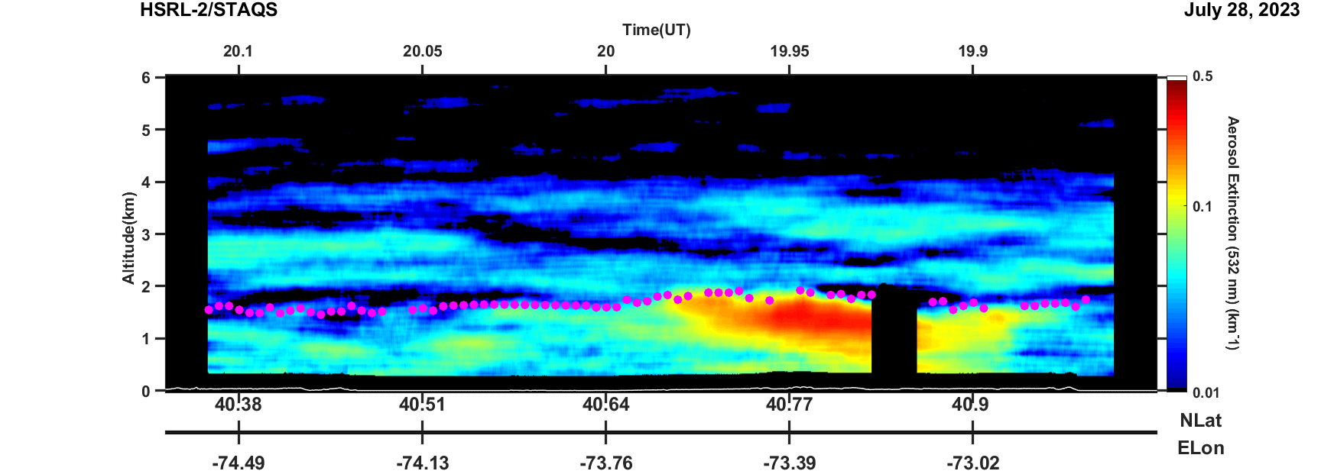
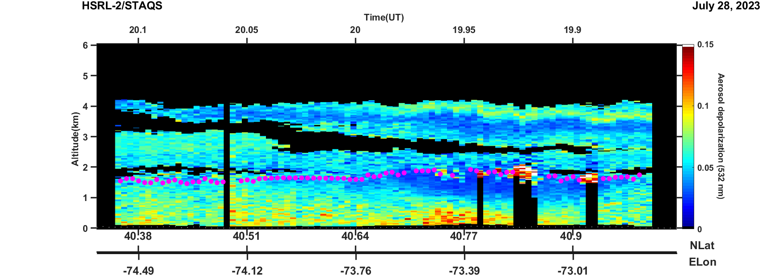
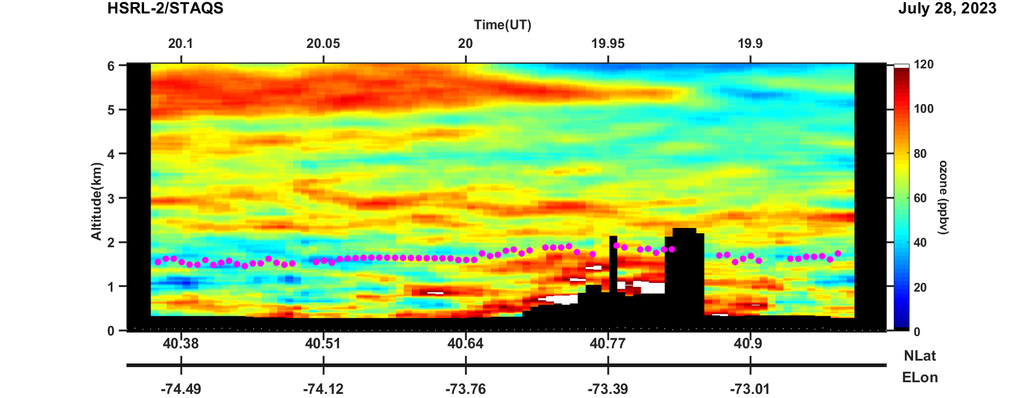
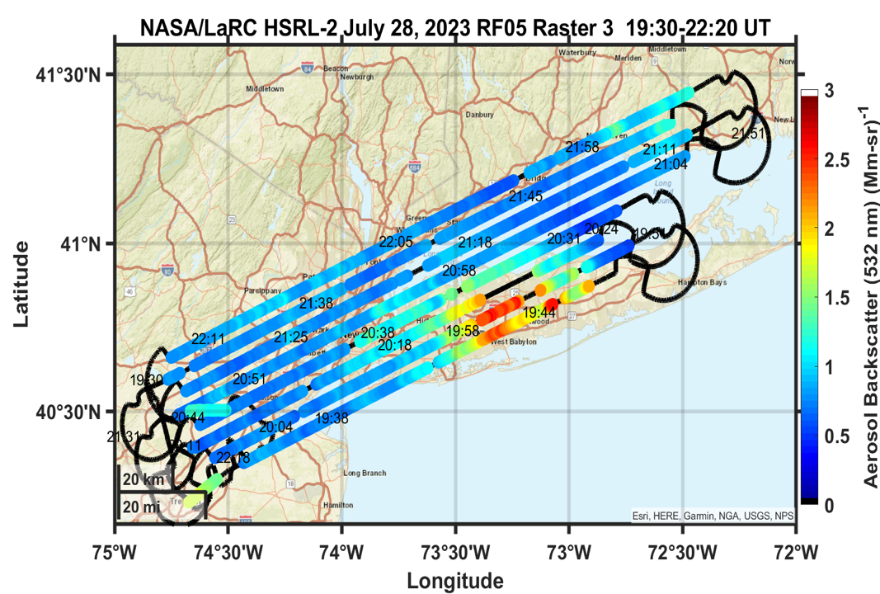
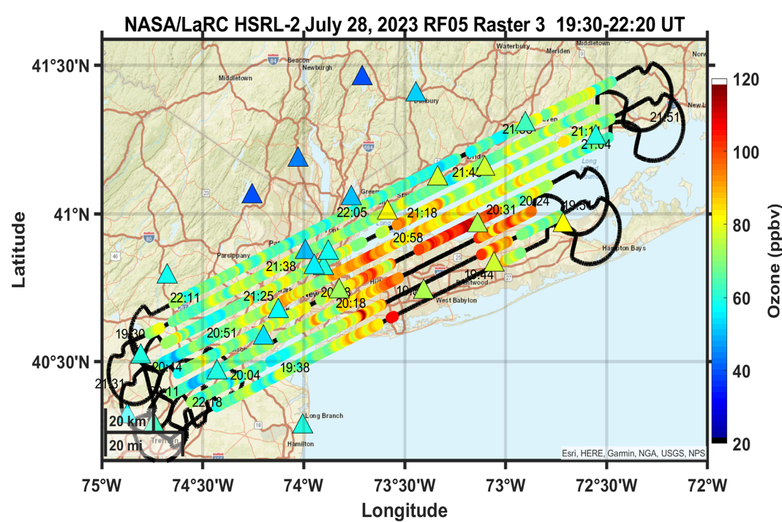
High Spectral Resolution Lidar - 2 (HSRL2)
HSRL2 is a nadir-viewing airborne high spectral resolution lidar (HSRL) designed to measure aerosol properties as well as ozone profiles.
HSRL2 flew with GCAS during STAQS.
Aerosol Extinction
Aerosol Backscatter
Aerosol Depolarization
Ozone
Data Products
Aerosol Products at 355, 532, and 1064 nm
  Backscatter
  Depolarization
  Extinction/AOT
  Aerosol Type (e.g., smoke, dust, urban, marine,…)
Ozone profile
Surface weighted ozone/aerosol products
Mixed layer heights
~ 200 km (15 min)
Near surface aerosol backscatter
Near surface ozone
Contacts: John Hair– Johnathan.W.Hair@nasa.gov
Taylor Shinger— taylor.j.shingler@nasa.gov

Slide 8
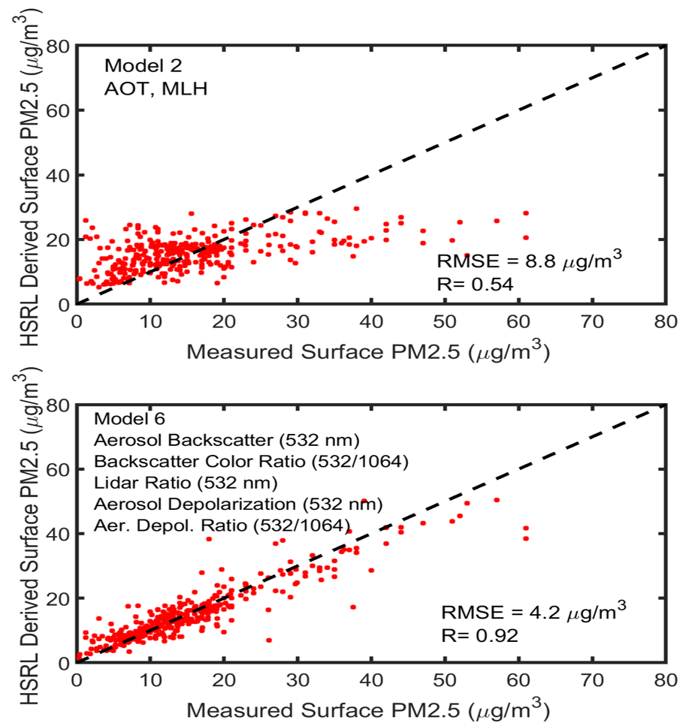
Airborne HSRL measurements are used with machine learning algorithms to derive surface (and profile) PM_{2.5} concentrations
We used hourly surface PM_{2.5} measurements within 10 km and 15 minutes of near-surface airborne HSRL measurements to train machine learning models to derive surface PM_{2.5} from airborne HSRL measurements
Measurements from four NASA/LaRC airborne HSRL systems acquired during 172 flights between 2010-2024 (including STAQS) were used to train models
Approximately 1400 measurements used to train algorithms (80% of data)
Approximately 360 measurements then used to test algorithms (20% of data)
Exponential Gaussian Process Algorithms consistently gave best performance (lowest root-mean-square errors, highest correlations)
Models that used only aerosol optical thickness (AOT) and mixed layer height (MLH) performed poorly
Models that used multiple HSRL measurements of aerosol extensive and intensive parameters performed well
Credit: Rich Ferrare (LaRC)
Poor performance
Good performance

Slide 9
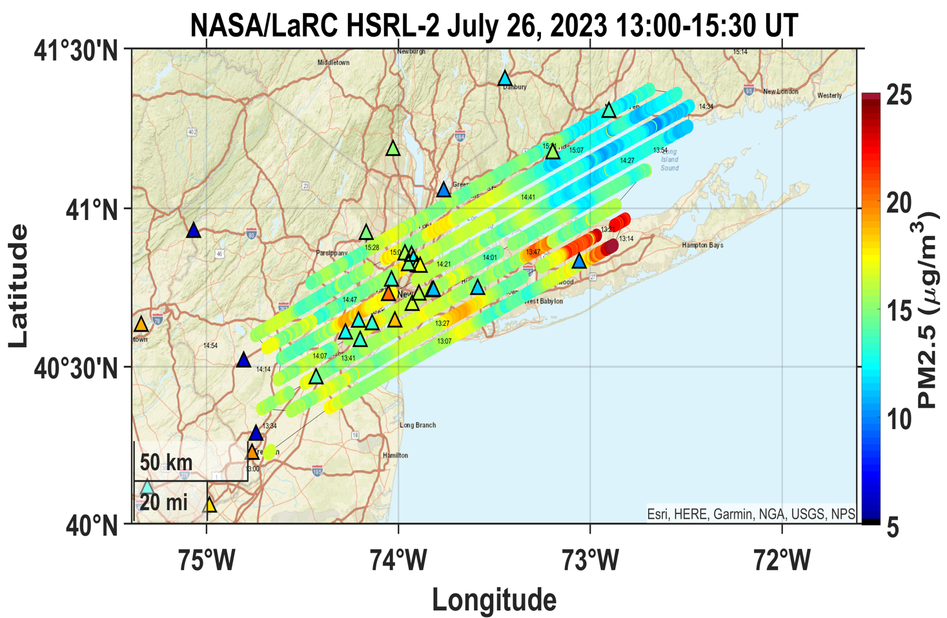
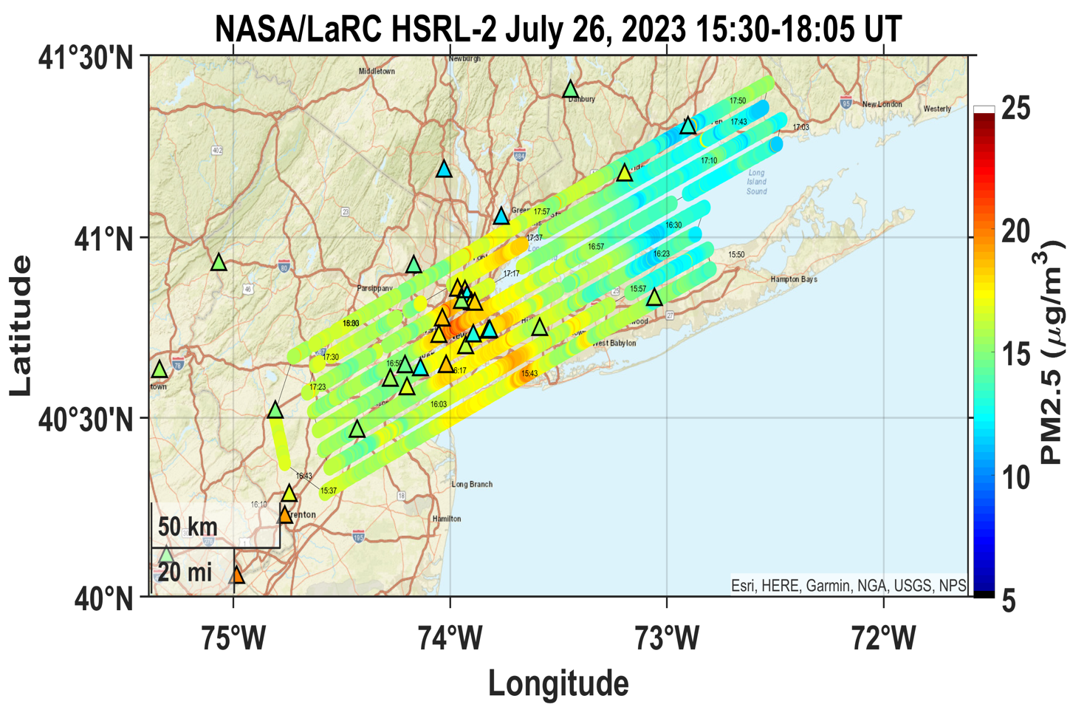
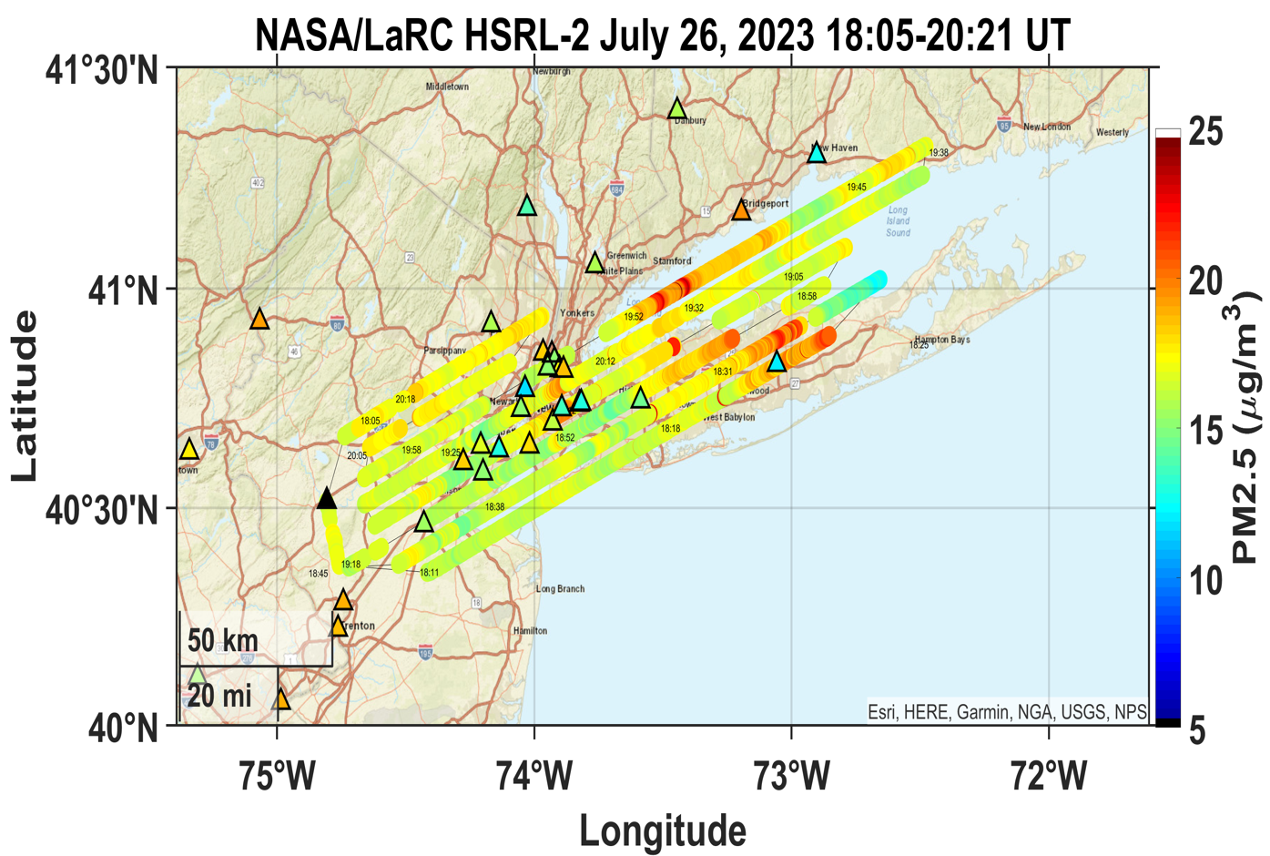
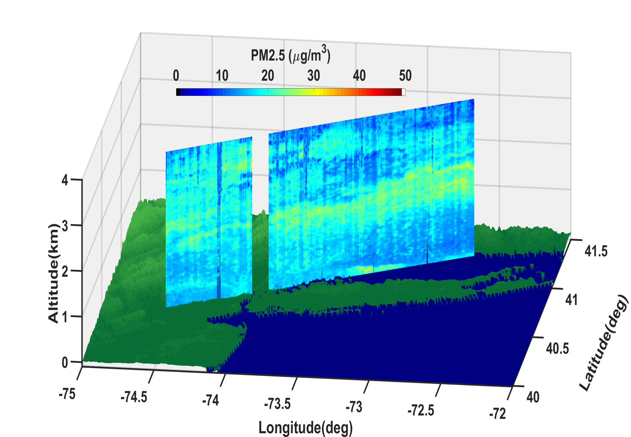
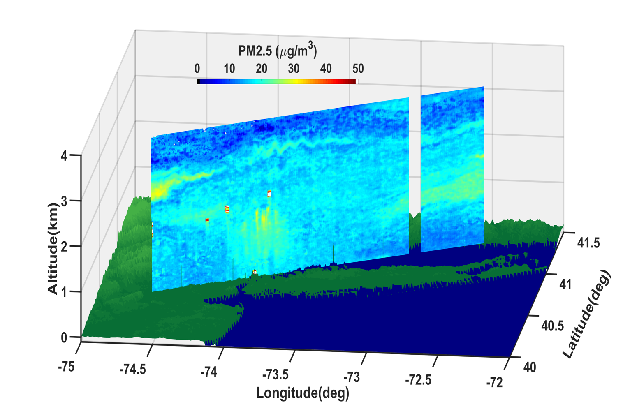
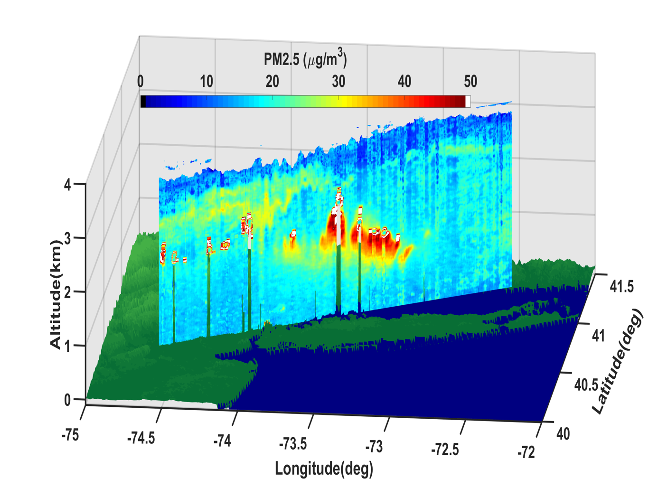
Spatial/Temporal/Vertical Variability of PM_{2.5} derived from HSRL-2 measurements over New York City on July 26, 2023 during STAQS
Credit: Rich Ferrare (LaRC)
Surface PM_{2.5}
(morning)
Surface PM_{2.5}
(midday)
Surface PM_{2.5}
(afternoon)
PM_{2.5} (14:15-14:28 UT)
PM_{2.5} (16:45-17:05 UT)
PM_{2.5} (19:22-19:40 UT)

Slide 10
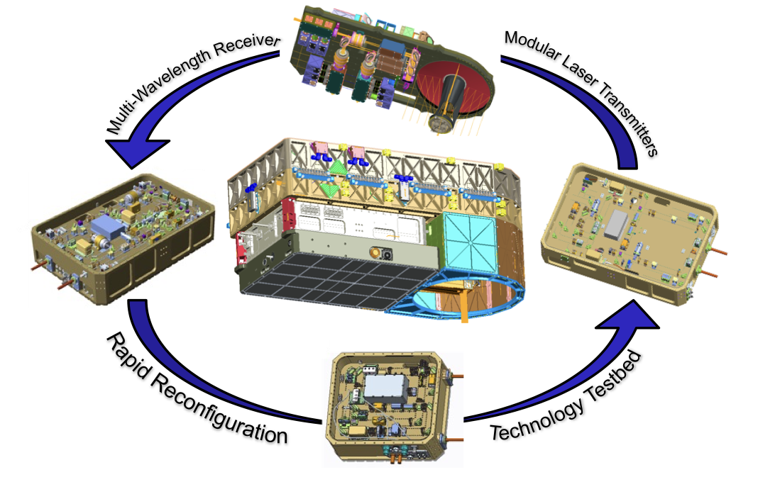
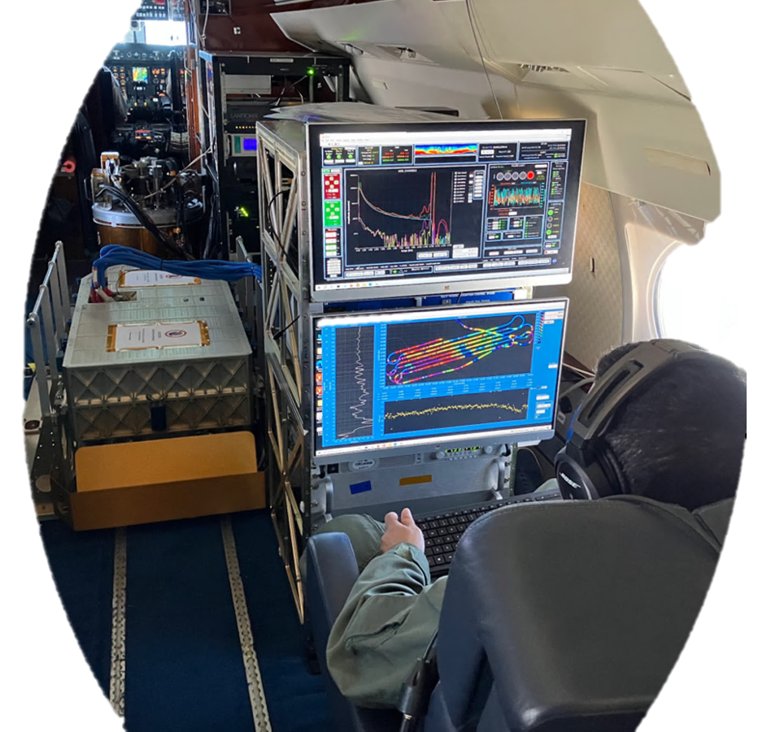
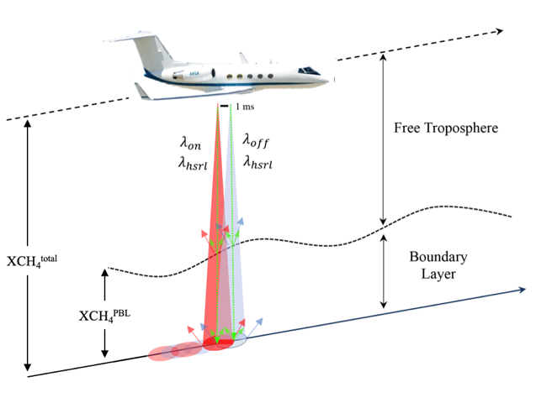
HALO – Cross-Cutting DIAL and HSRL
H₂O Differential Absorption Lidar
HALO on G-III
Relative Humidity (DIAL)
H₂O DIAL
HSRL
CH₄ IPDA
HSRL
Aerosol Optical Properties (HSRL)
CH₄ IPDA, H₂O DIAL, Doppler Winds, HSRL
4𝜆 935 nm water vapor differential absorption lidar (DIAL)
  Carroll et al. 2022, AMT
2𝜆 1645 nm methane integrated path DIAL (IPDA)
  Barton-Grimley et al. 2022, AMT
532 nm high spectral resolution lidar (HSRL), 1064 nm backscatter
  Hair et al. 2008, Applied Optics
CH₄ Integrated Path Differential Absorption (IPDA)
STAQS Co-Leads:
Amin Nehrir (amin.r.nehrir@nasa.gov)
Rory Barton-Griley (rory.a.barton-grimley@nasa.gov)
Notes:
HALO is a cross-cutting lidar that supports 5 of the 6 NASA Earth Science Focus areas between methane, water vapor, and aerosol/cloud measurements. HALO has three configurations, water vapor/HSRL, methane/HSRL, and third configuration which has h20, ch4 and additional winds. CH4/HSRL which was flown for STAQS.
Third configuration with combined combined water vapor. Methane and winds coming online in the next two years
To-date, focus has been directed towards better quantifying strong CH4 point sources, but regional diffuse fluxes are still the largest contributor to the anthropogenic CH4 budget . HALO is the only lidar in the world with capability for HSRL and CH4 DIAL to measure both diffuse fluxes across different environments and point sources.

Slide 11
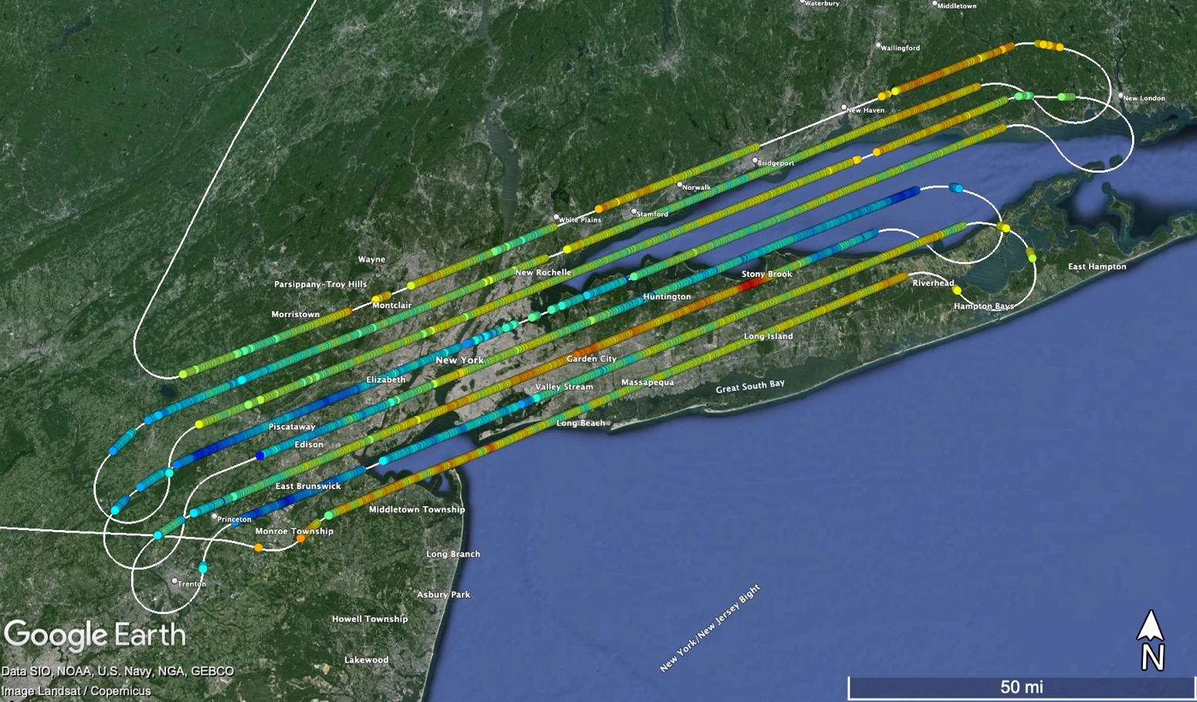
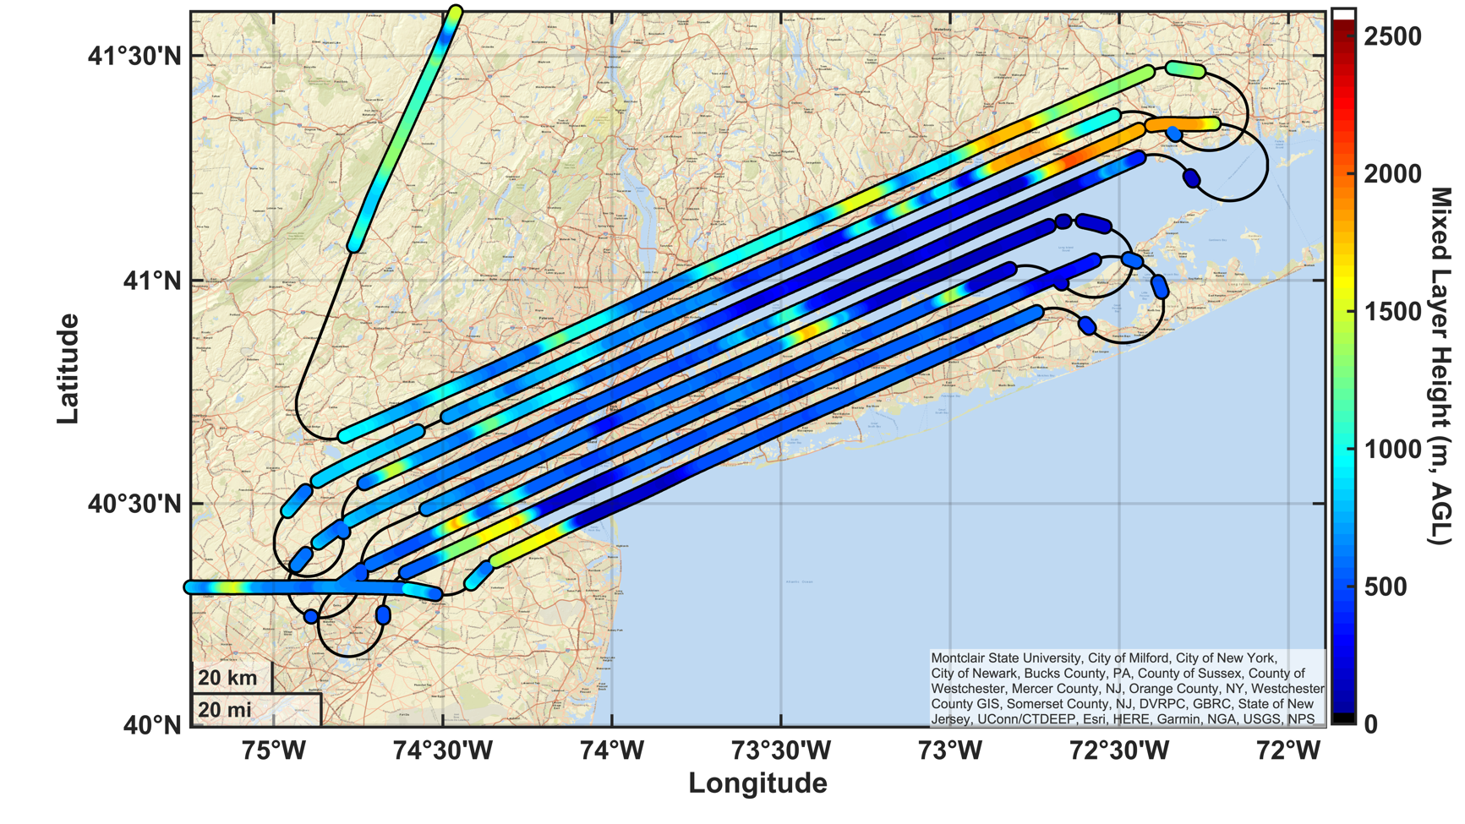
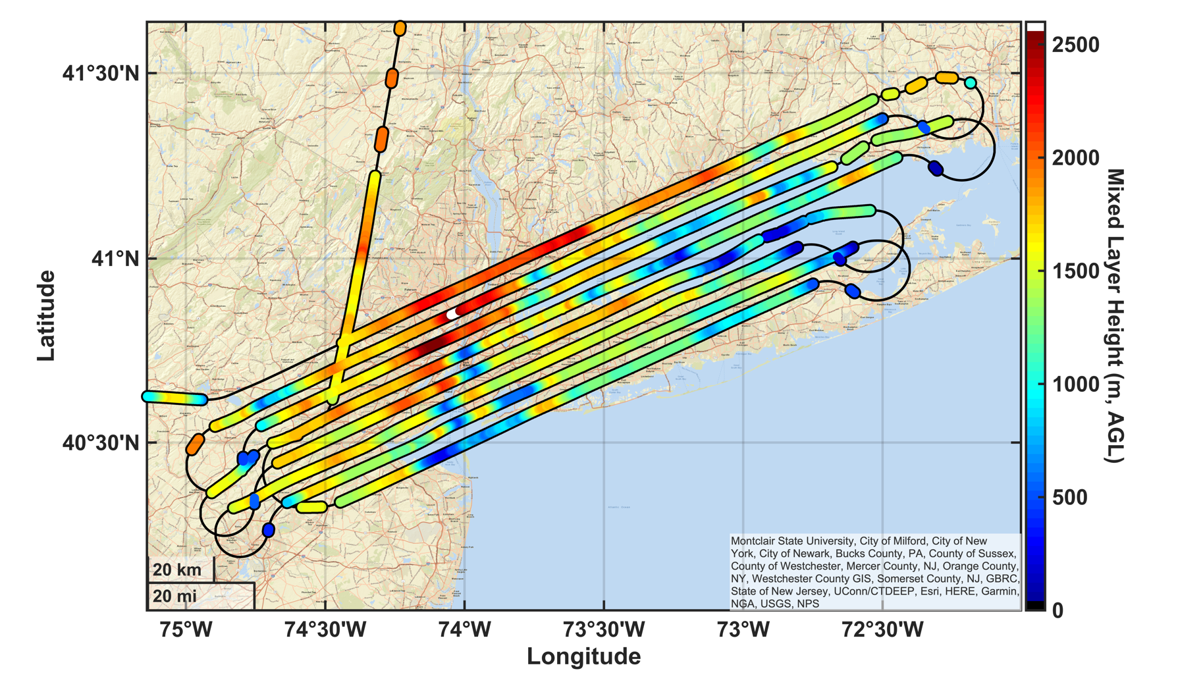
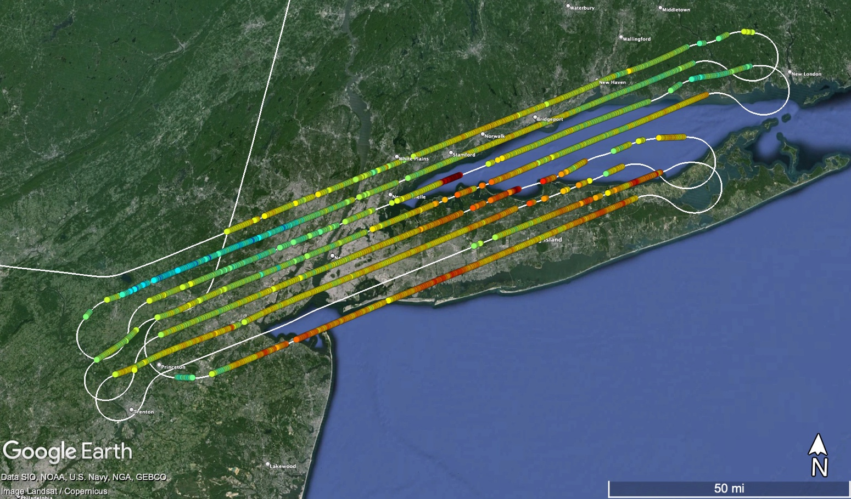
STAQS – New York AM/PM Flights – City Enhancement
Broad city scale enhancements observed between AM and PM flights
Many small point sources identified from landfills, power plants, and wastewater plants
Good correlation with in-situ CH₄ DC-8 observations
AM - XCH₄
AM – Mixing Layer Height
PM - XCH₄
PM – Mixing Layer Height

Slide 12
STAQS – New York AM/PM Flights – Point Sources
Broad city scale enhancements observed between AM and PM flights
Many small point sources identified from landfills, power plants, and wastewater plants
Good correlation with in-situ CH₄ DC-8 observations
AM - XCH₄
DC-8 in-situ
DC8 CH₄ Data – C/O NOAA CSL– AEROMMA 2023
PM - XCH₄

Slide 13
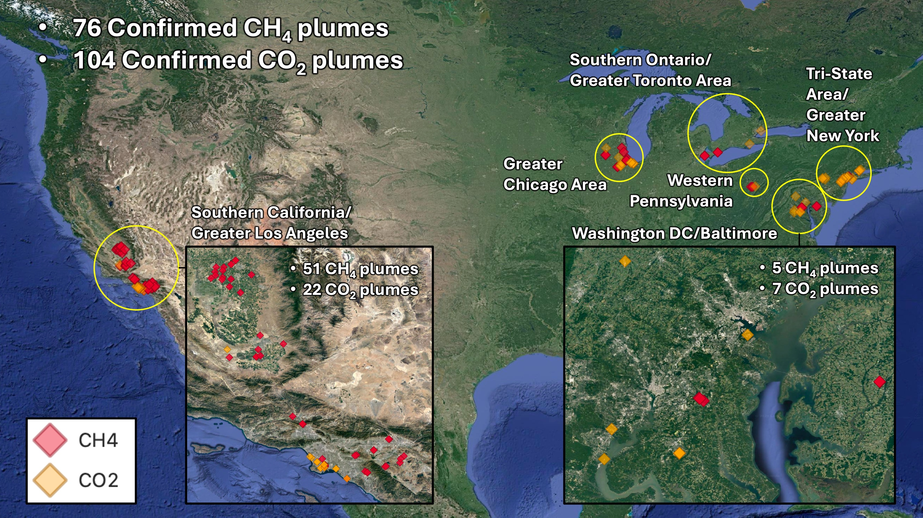
AVIRIS-NG
AVIRIS-NG is an airborne VIS-SWIR imaging spectrometer retrieving methane/CO₂ emissions using an iterative matched filter technique.
Emission rate estimates from the noted plumes below and imagery will be publicly available soon.
Credit: Daniel Jensen, JPL
Contacts: Daniel Jensen—daniel.j.jensen@jpl.nasa.gov
Andrew Thorpe—andrew.k.thorpe@jpl.nasa.gov

Slide 14
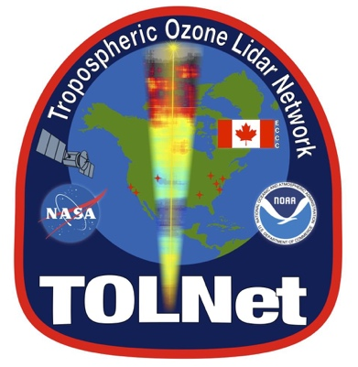
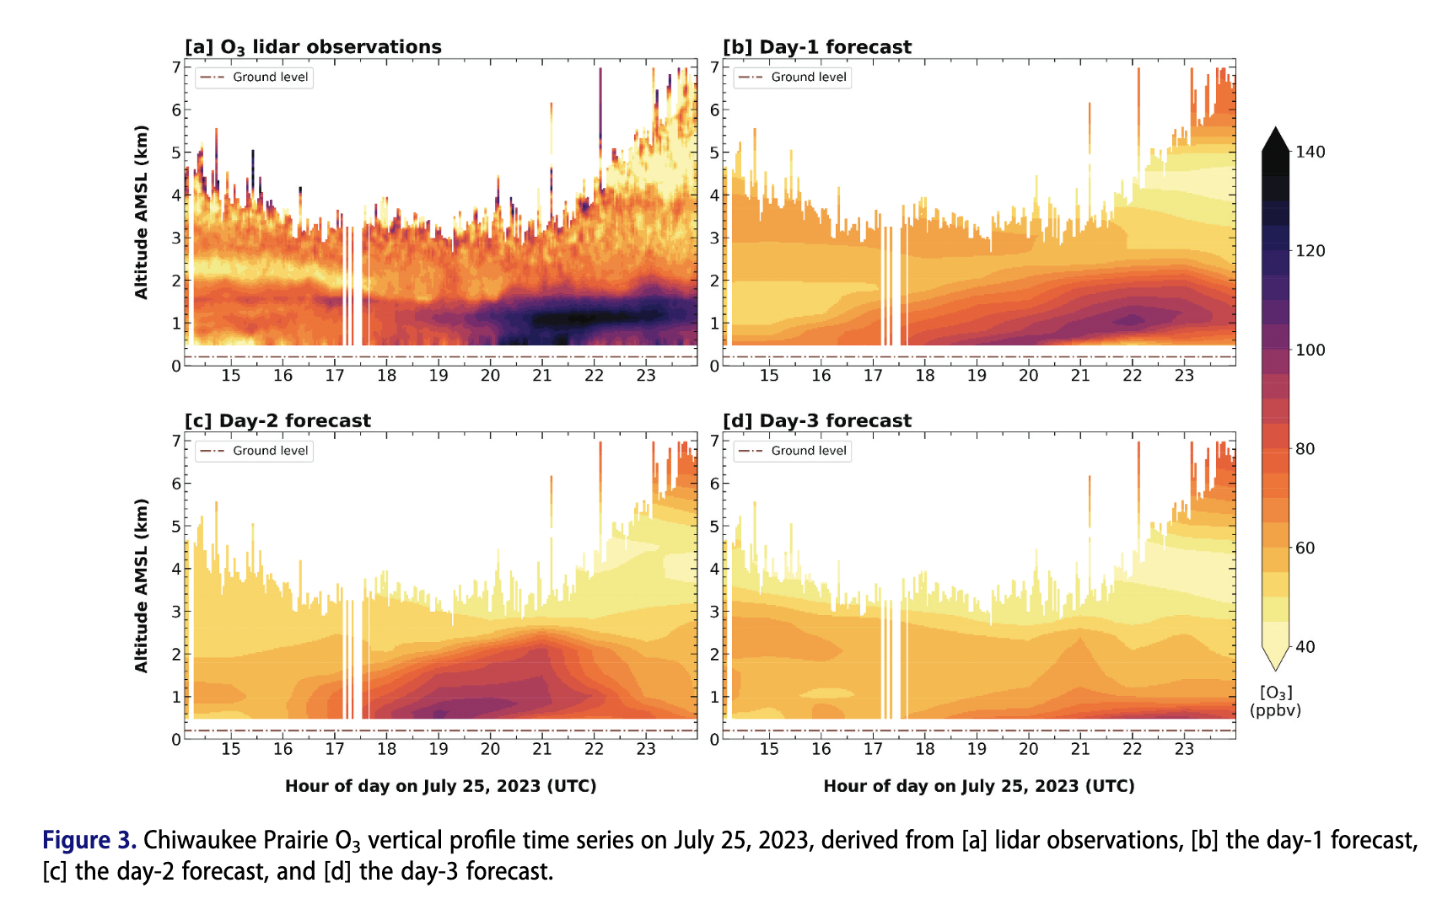
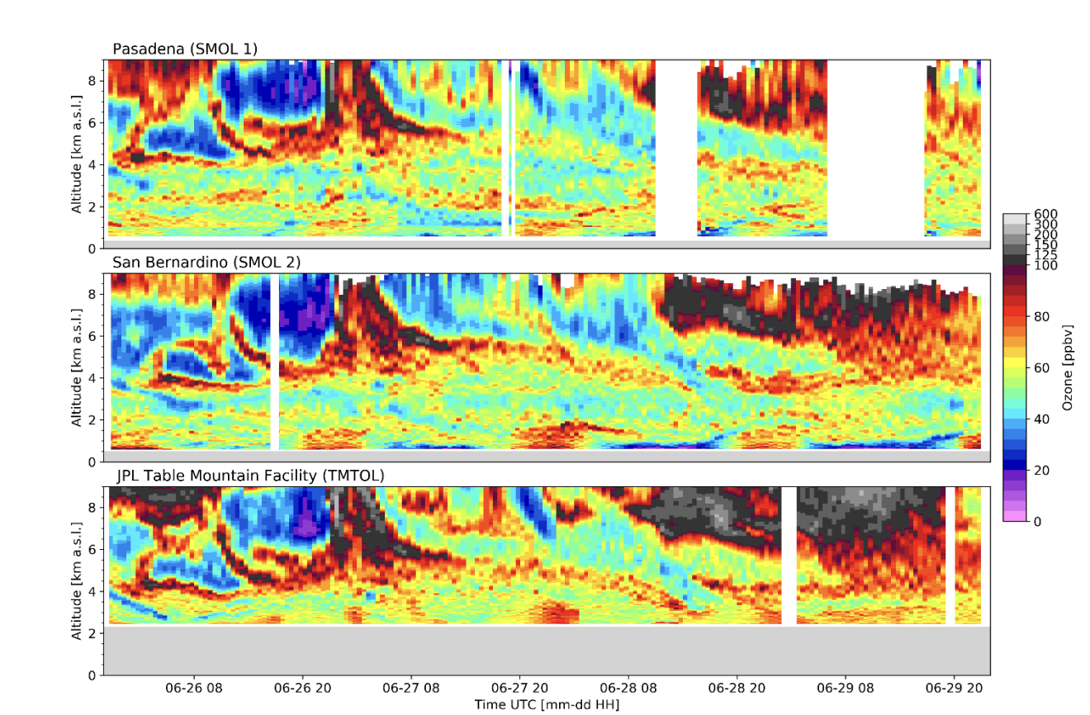
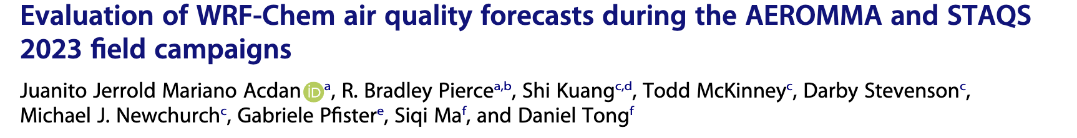

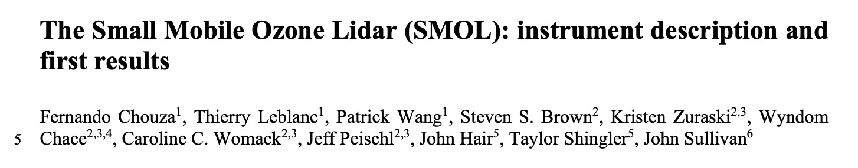

Tropospheric Ozone Lidar Network (TOLNET)
8 Lidars in three major domains!
Contributions to model evaluation
New compact system deployed and tested!
Contact: Jerrold Accdan—acdan@wisc.edu
Contact: John Sullivan –john.t.sullivan@nasa.gov
Fernando Chouza—keil@jpl.nasa.gov
Notes:
SMOL:
affordable differential absorption lidar (DIAL) system covering all altitudes from 200 m to 10 km. a.g.l
The comparison with airborne in-situ and lidar measurements show very good agreement, with systematic differences below 10 % throughout most of the measurement range.

Slide 15

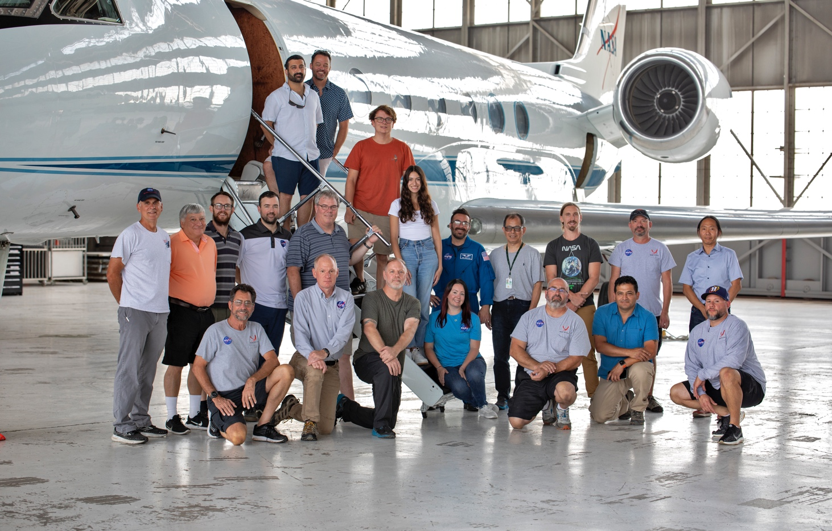
STAQS data are publicly available at the QR code and will eventually be findable through Earthdata Search through ASDC
Thanks for listening!
Feel free to contact me at
Laura.m.judd@nasa.gov

Slide 16
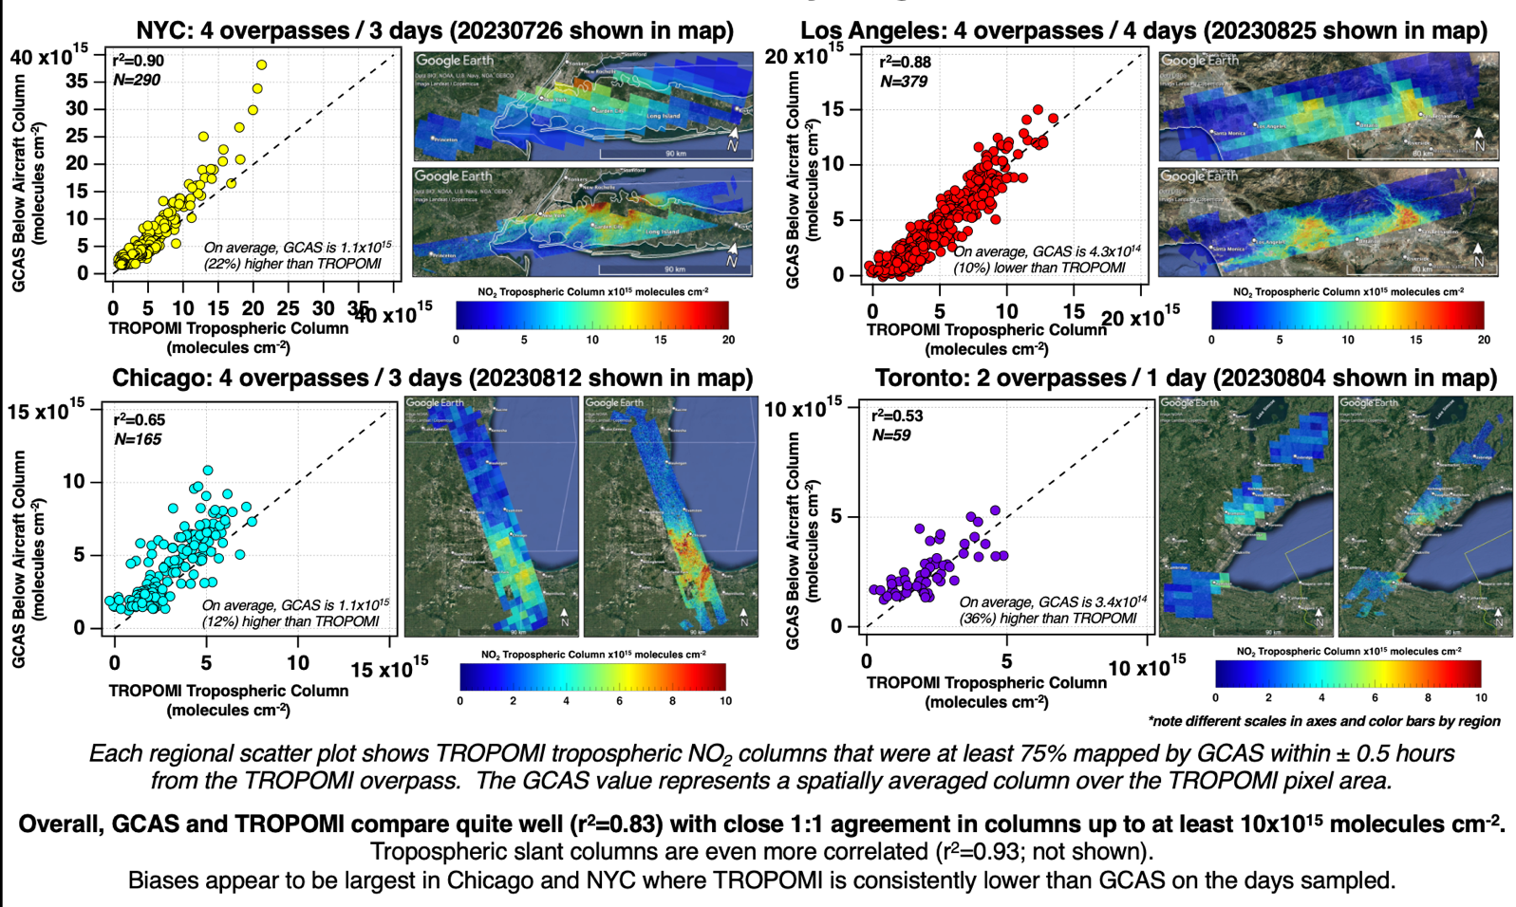
Satellite Validation: TROPOMI with STAQS GCAS NO₂
Notes:
This slide shows application of methods developed for TROPOMI validation in Judd et al. 2020 (https://doi.org/10.5194/amt-13-6113-2020) to STAQS data in four different cities and with TROPOMI’s updated NO2 product (v2.5).
Maps show an example overpass of coincident data. GCAS, as you can see, is more spatially refined.
The scatter plot represents the spatially degraded GCAS data to the TROPOMI pixel footprint.
TROPOMI and GCAS correlate extremely well. The only major offsets occur over very polluted scenes in NYC (previously seen as well). Higher scatter in Chicago may be attributed to increased cloud coverage during those flight days, but more investigation may be needed.

