Slide 1
AC-VC-20
CINDI-3 Intercalibration and Certification Campaign
Michel Van Roozendael, BIRA-IASB,
Presented by Tijl Verhoelst
Agenda Item 2.11
AC-VC-20
15-18 October 2024
College Park, MD, USA

Slide 2
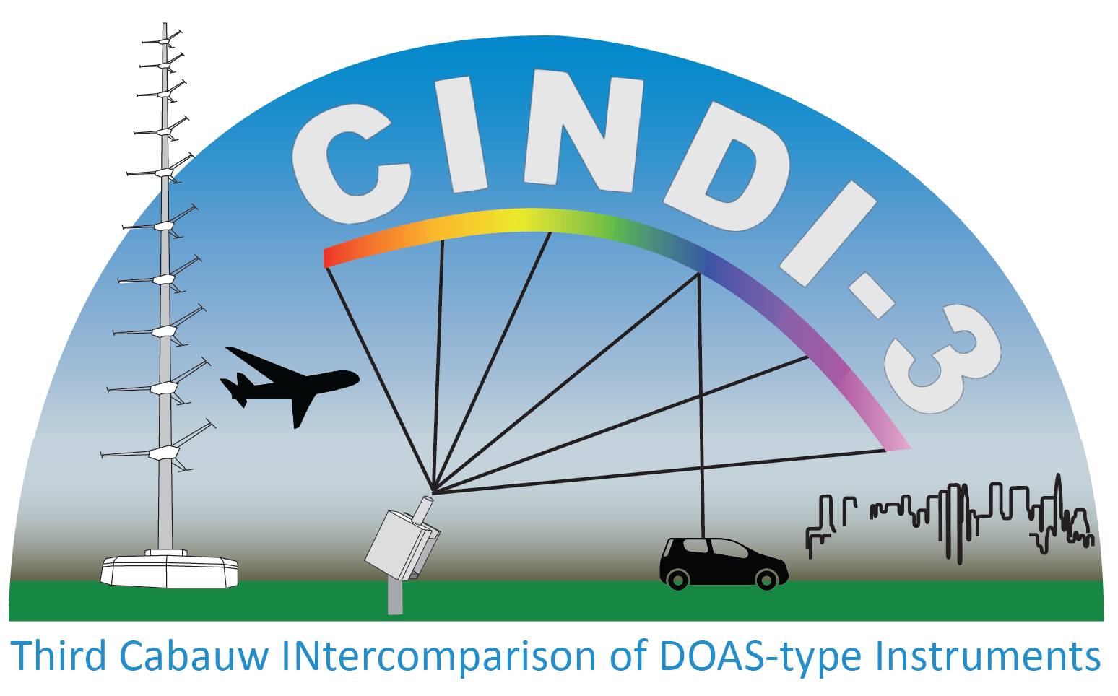
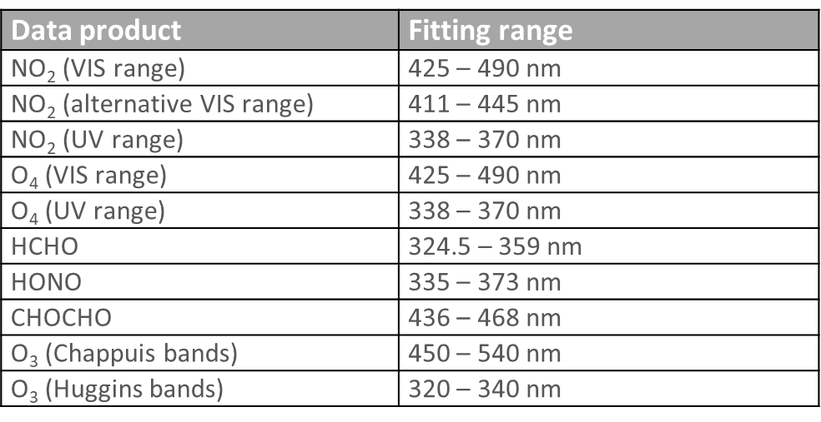
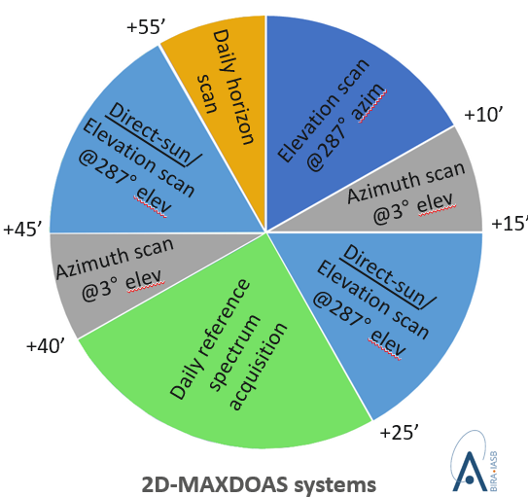
CINDI-3 (May 21 – June 21, 2024)
CV-24-01
The Third Cabauw INtercomparison of DOAS-like Instruments (CINDI-3)
Semi-blind intercalibration and intercomparison campaign with external referee
to intercalibrate instruments and assess mutual consistency of measurements
to get NDACC and ACTRIS-CREGARS certification for new instruments
to assess and improve FRM maturity for validation of CEOS Air Quality and Ozone satellite constellations
Observation protocol
Additional species: CHOCHO and HONO

Slide 3
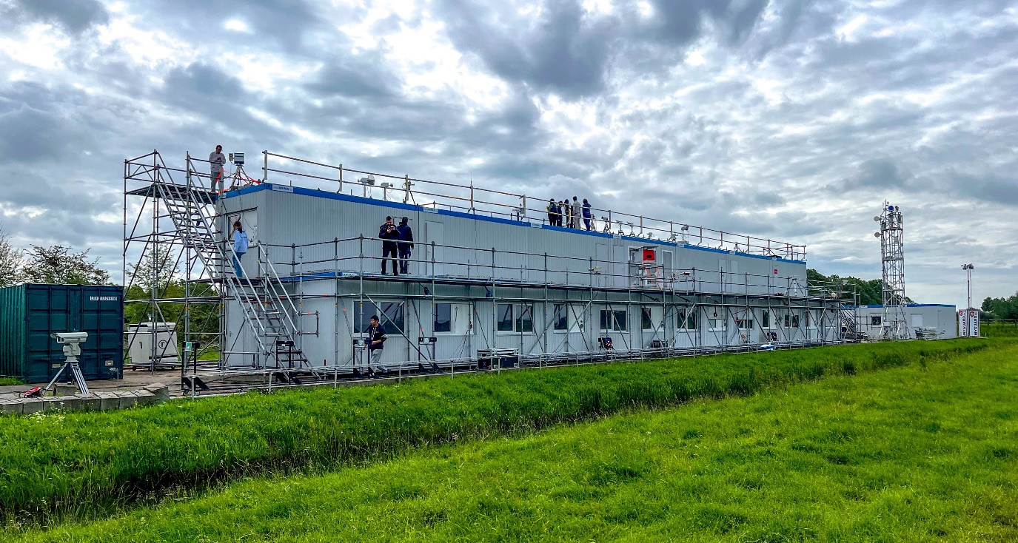
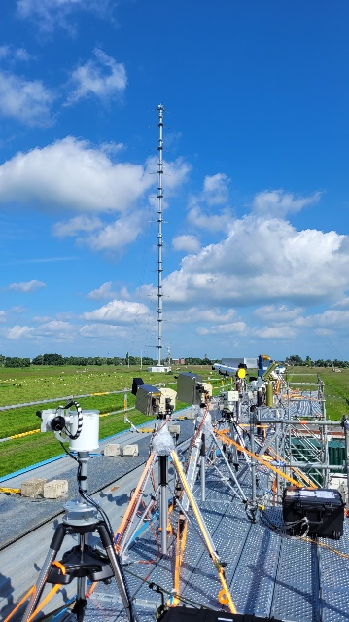
CINDI-3 (May 21 – June 21, 2024)
CV-24-01
Cabauw, The Netherlands
Overview
35+ UV-VIS MAX-DOAS instruments intercompared, from 16 countries
60+ instruments deployed
100+ participants
FRM4DOAS central processing applied to 50% of participating instruments
Airborne deployment for NO₂ mapping and profiling
Data analysis in progress
UV-Vis intercalibration campaign organized as part of NDACC and ACTRIS CREGARS topical center, with additional ESA support.

Slide 4
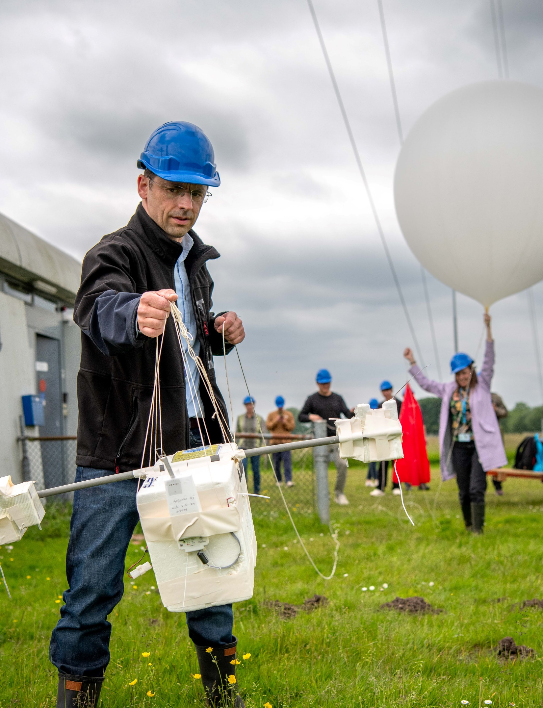
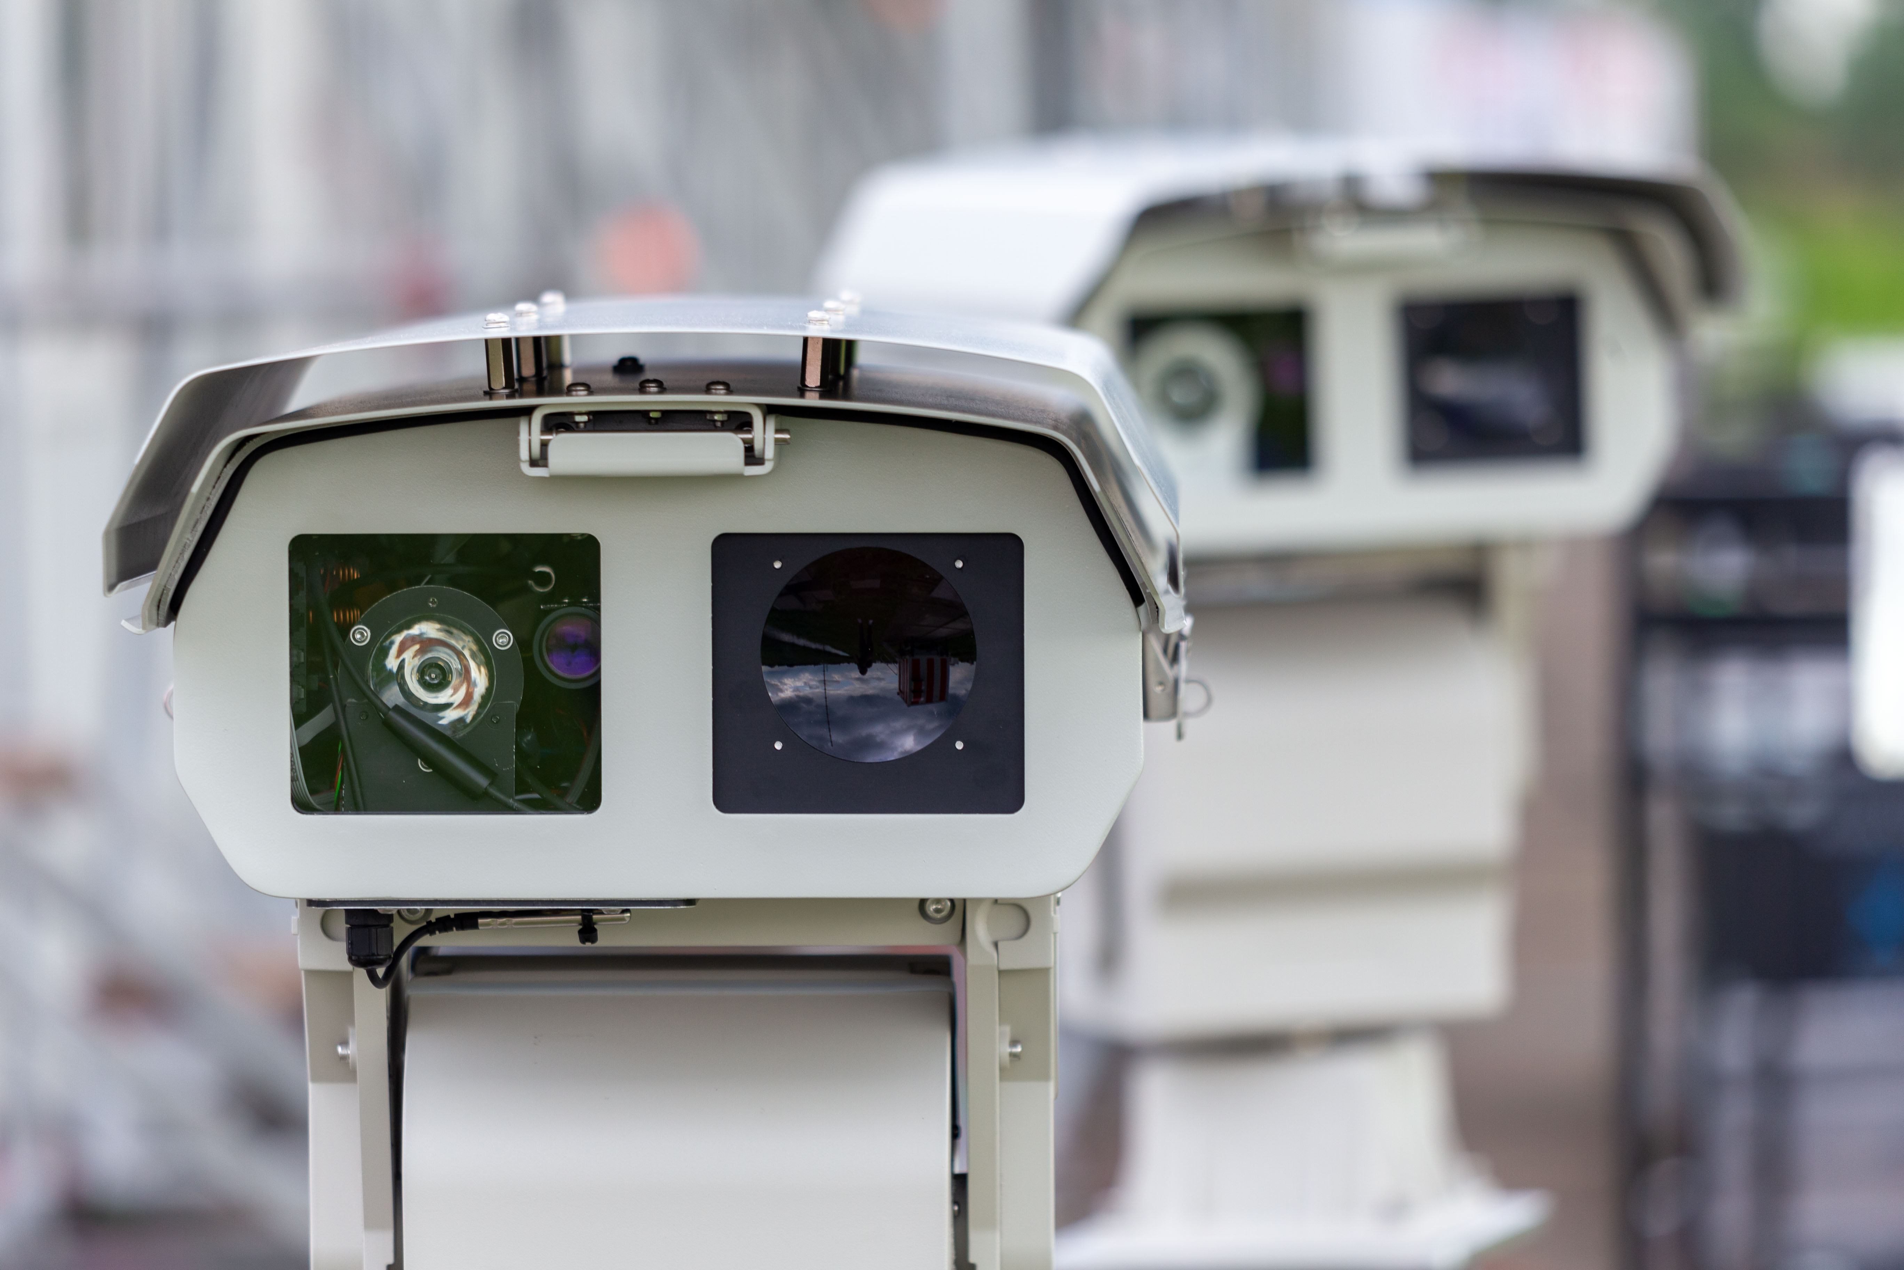
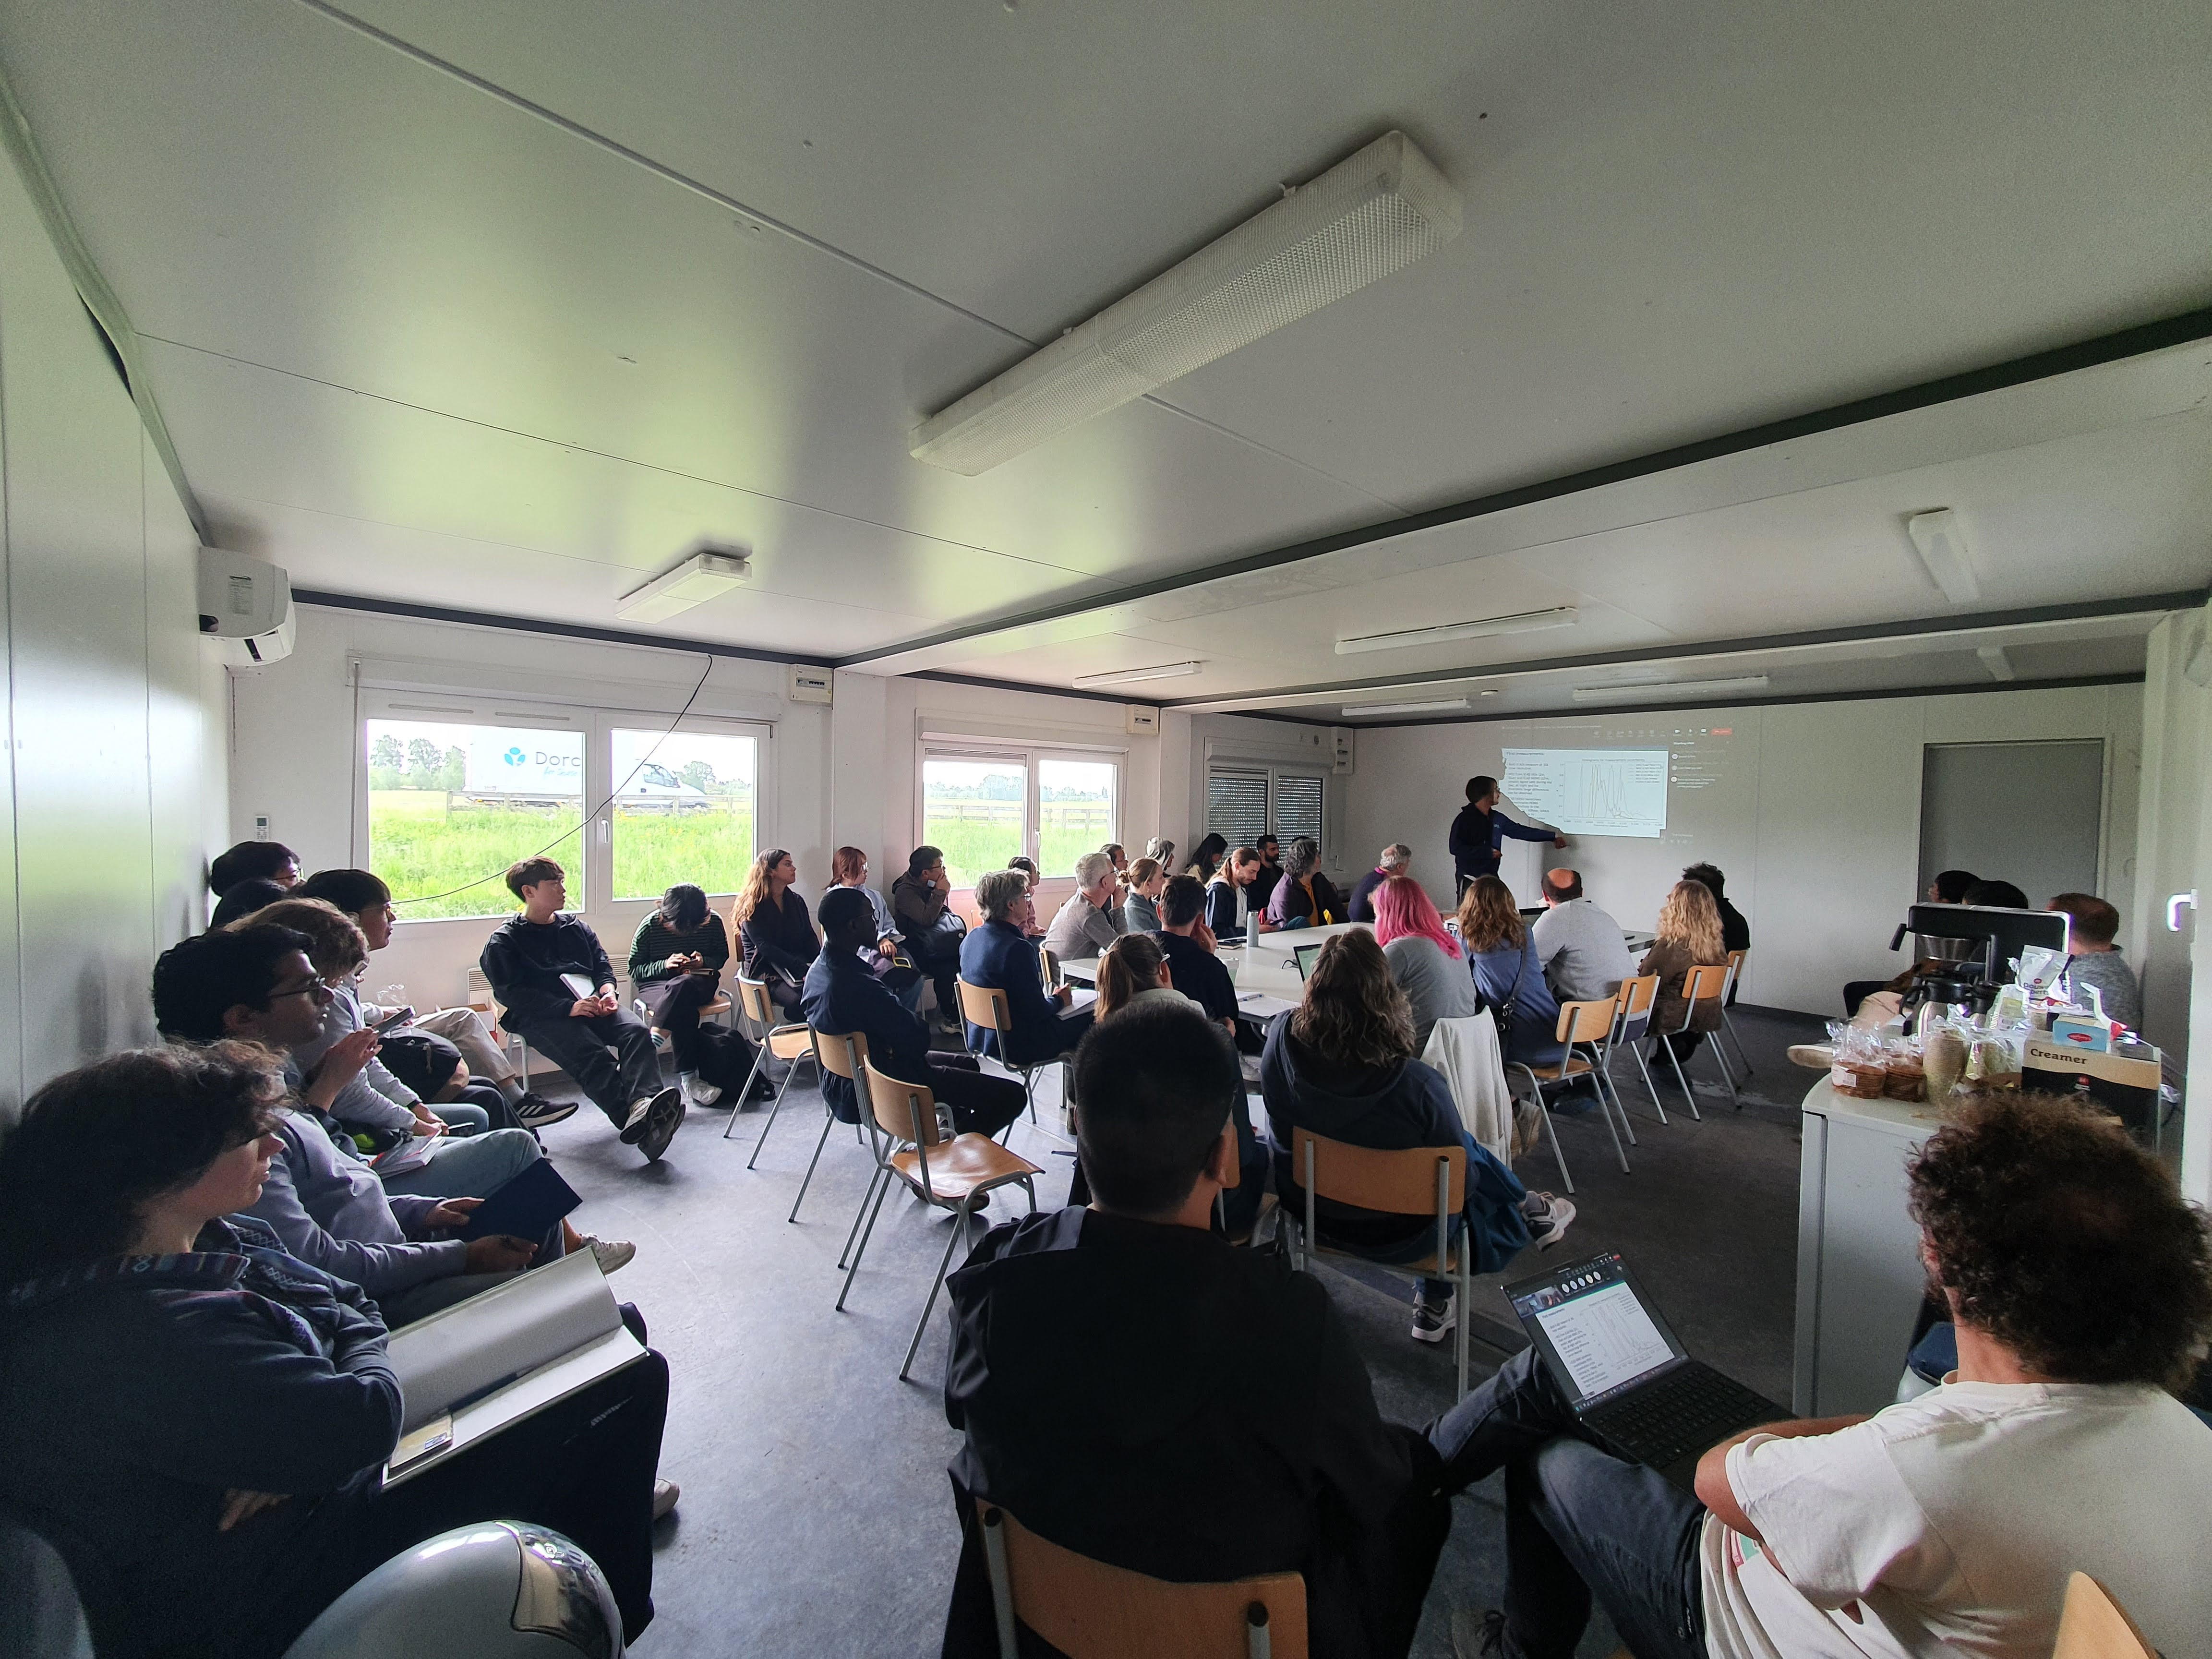
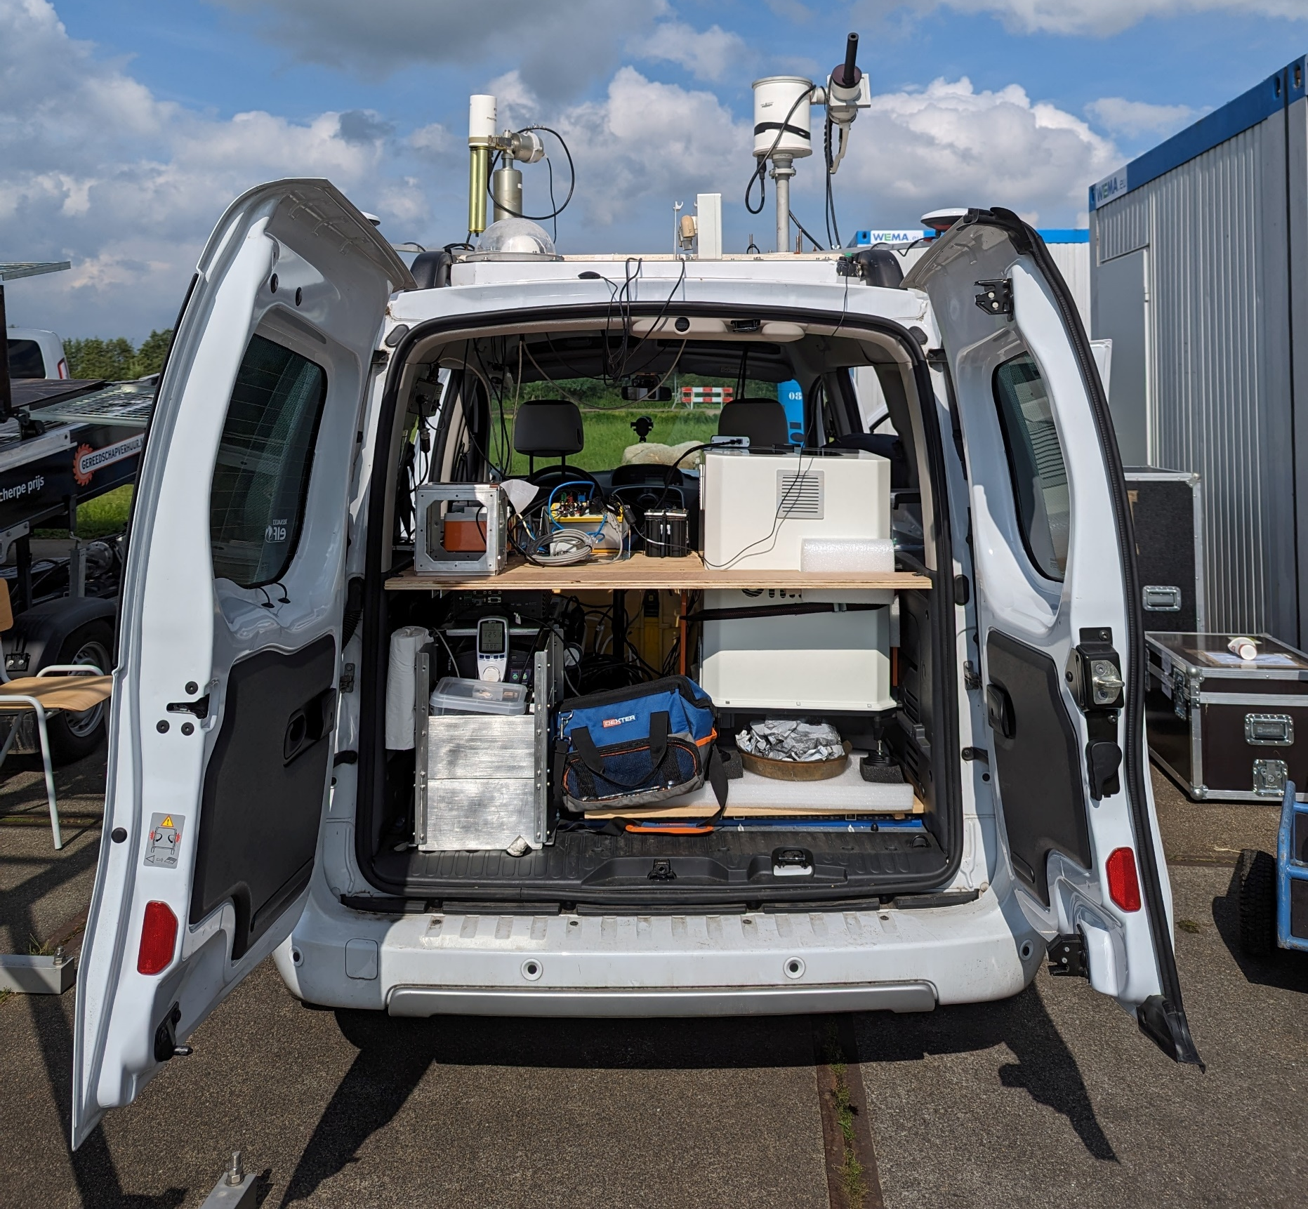
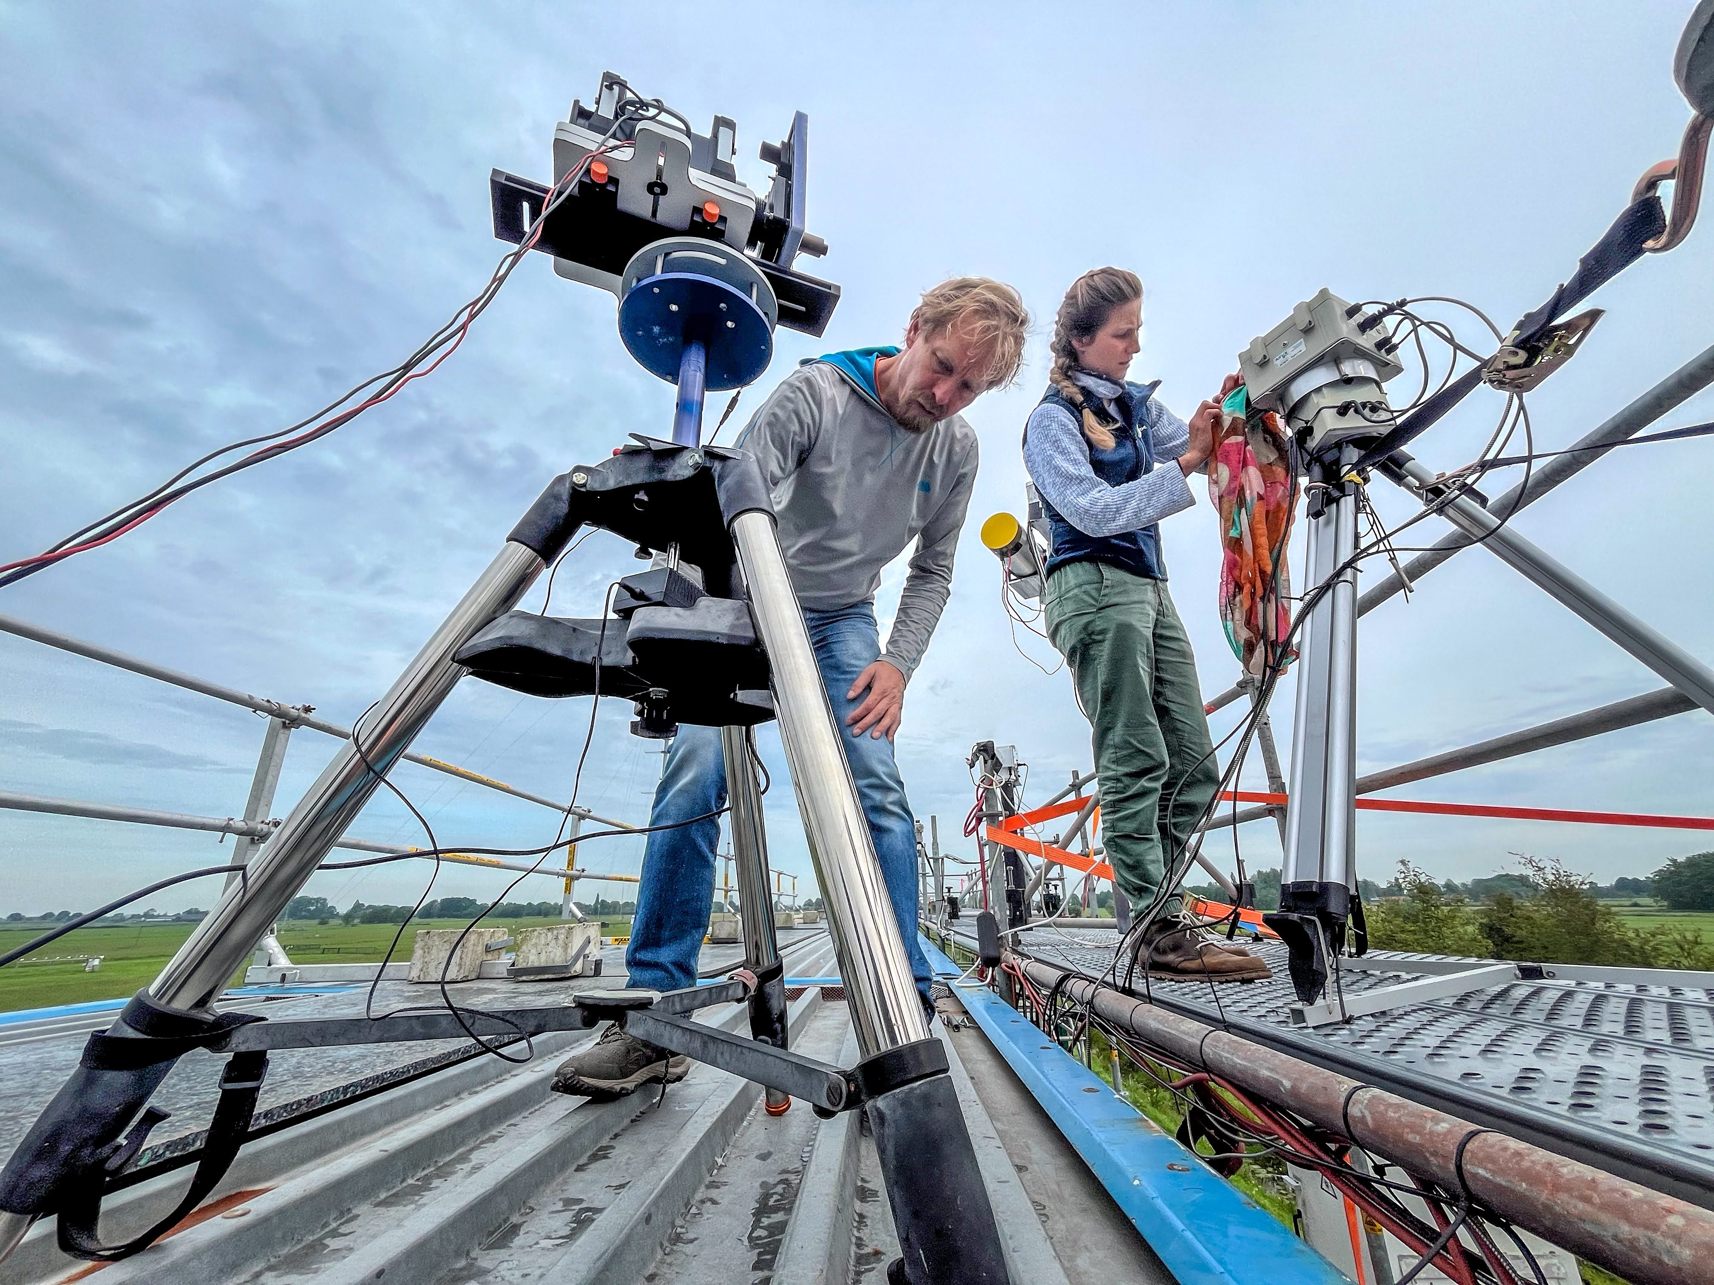
Overview
35+ UV-Vis DOAS instruments of (MAX)DOAS, SAOZ and Pandora types intercompared for NO₂, HCHO, O₄, O₄, CHOCHO, HONO, BrO and O₃ slant column measurements
In-field calibration setup by Luftblick/NASA applied to all UV-Vis instruments
Interactive semi-blind data evaluation with daily briefs
Comprehensive set of ancillary measurements: aerosol and tropospheric O₃ lidars, Brewer and aerosol sunphotometers, NO₂ and O₃ sondes, in-situ instruments, long-path DOAS, etc.
Mobile measurement setup for NO₂ (carDOAS) and aerosols (MAMS)
Airborne mapping and vertical profiling of NO₂ in Cabauw and Rotterdam area using Belgian coast-guard research aircraft (operator RBINS)
Post-campaign data analysis in progress

Slide 5
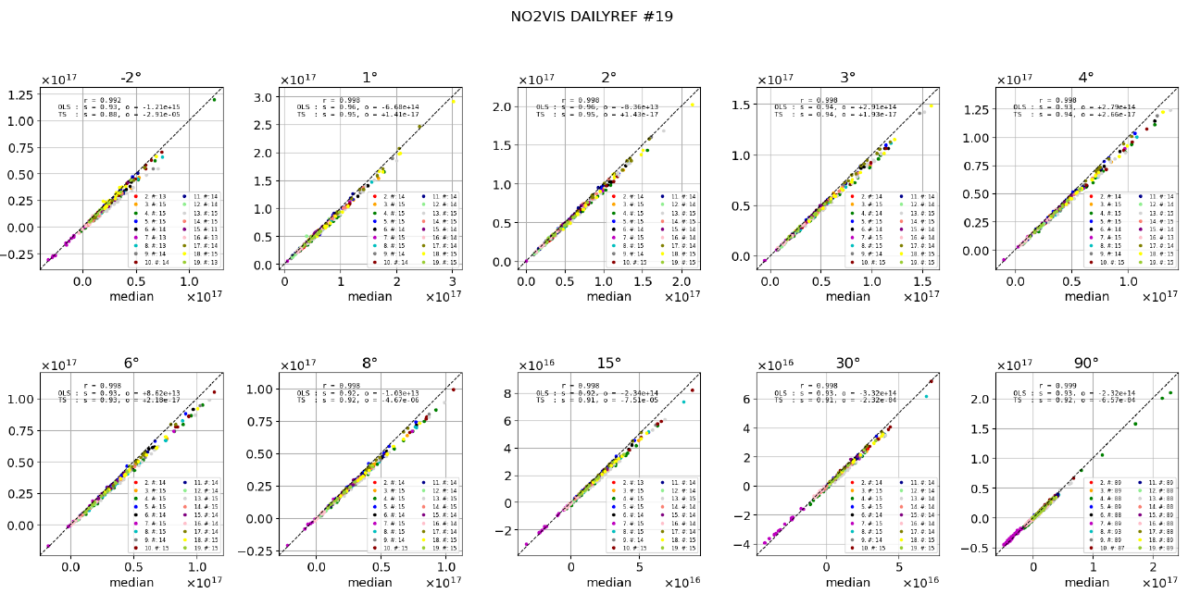
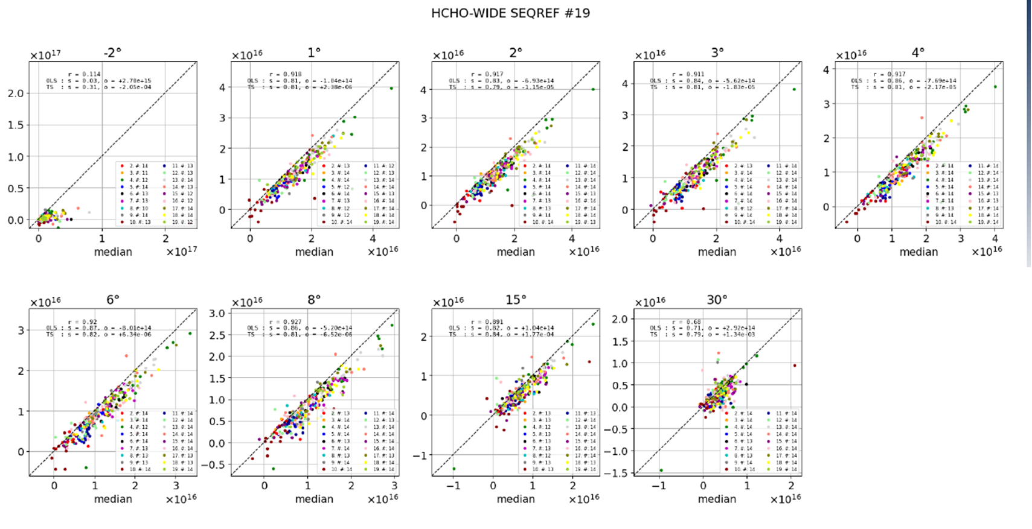
Data evaluation in progress
CV-24-01
Regression analysis against median values from all measurements

Slide 6
CEOS-FRM test cases
CV-23-01
CEOS-FRM maturity assessment framework elaborated by WGCV, presented last year at AC-VC-19/ACSG in Brussels
FRM4DOAS pilot (test case by M. Van Roozendael)
ESA project tailoring MAX-DOAS measurements to satellite validation needs
Scattered UV-visible sunlight, central processing, archival NDACC DHF
NO₂, O₃, HCHO, BrO, OClO, SO₂…
PGN pilot (test case by S. Casadio)
Pandonia Global Network, sponsored by ESA, NASA, PGN-Asia…
Pandora development and analysis LuftBlick
Direct Sun, total columns, central processing, archival PGN
Started with NO₂, expanding to HCHO, O₃ and SO₂, later lunar NO₃

Slide 7
Conclusion
CINDI-3 campaign successful
Data analysis in progress in several WGs, series of campaign-based papers planned
FRM4DOAS maturity assessment by Van Roozendael et al. (as well as FRM4GHG by M.K. Sha) submitted to Remote Sensing SI ‘Copernicus Sentinels Missions Calibration, Validation, FRM and Innovation Approaches in Satellite-Data Quality Assessment’
NDACC Symposium 2025 Celebrating 35th Anniversary of the Network, Virginia Beach, VA, USA, end October 2025 (TBC)

Slide 8
Thank you !

