Slide 1
Overview of the PEGASOS Project for the Evaluation of the Operational GEMS L2 Products
Ronny Lutz¹, Diego Loyola¹, Claus Zehner², Won-Jin Lee³, Hyunkee Hong³, Jhoon Kim⁴ and the PEGASOS team
¹German Aerospace Center, ²European Space Agency, ³National Institute of Environmental Research, ⁴Yonsei University
CEOS AC-VC, NOAA, 15-18 October 2024

Slide 2

Pegasos overview

Slide 3





PEGASOS consortium
Product Evaluation of GEMS L2 via Assessment with S5P and Other Sensors
DLR
  German Aerospace Center
AUTH
  Aristotle University of Thessaloniki
BIRA-IASB
  Royal Belgian Institute for Space Aeronomy
IUP-UB
  University of Bremen
ESA - ESRIN

Slide 4
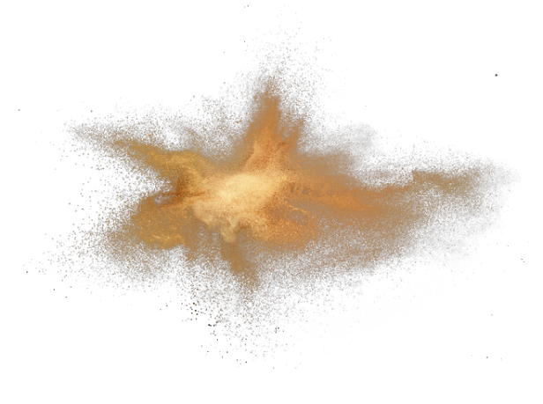





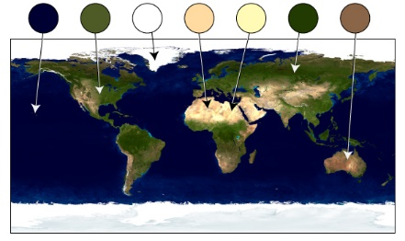
GEMS L2 products evaluated by PEGASOS
Ozone
total
tropospheric
profile
Sulfur
dioxide
total
Aerosols
index
layer height
Clouds
fraction
height
Nitrogendioxide
total
Formaldehyde
total
Surface properties
BRF
used for the comparisons:
space-borne: TROPOMI, OMI, GOME-2, IASI, VIIRS, CALIOP, AMI
ground-based: Dobson, Brewer, Ozonesondes, FTIR, MAX-DOAS, PGN, NDACC

Slide 5
Some highlights

Slide 6
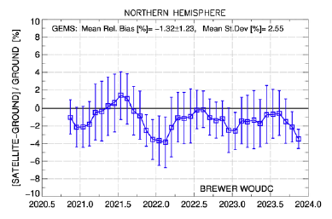
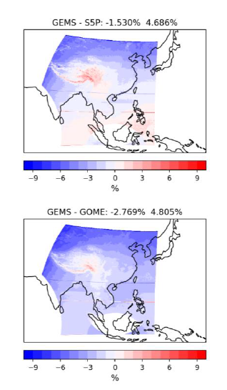
Ozone (total) Team: K. Garane, T. Verhoelst, K.-P. Heue, S. Compernolle
Results:
3 years of GEMS O3T v2.0 data showed:
Mean relative bias w.r.t. gr-based stations and other satellite missions: -2 %
Pearson correlation coefficient ≥ 0.85 (0.97 – 0.99 for the PGN co-locations), showing a very good agreement between GEMS and the reference measurements
North – South gradient with an annual cycle:
  Very good agreement during spring, summer and autumn months (± 1%).
  During winter months and for higher latitudes GEMS underestimates total ozone by up to -4%.
Hemispherical time-series of the mean relative bias (%) of the GEMS O3T observations w.r.t. ground-based reference measurements from Brewer stations within the GEMS FOV.
The mean percentage difference between the O3T observations from GEMS and other satellite missions (left:S5P, right: GOME2C), over the GEMS FOV.

Slide 7
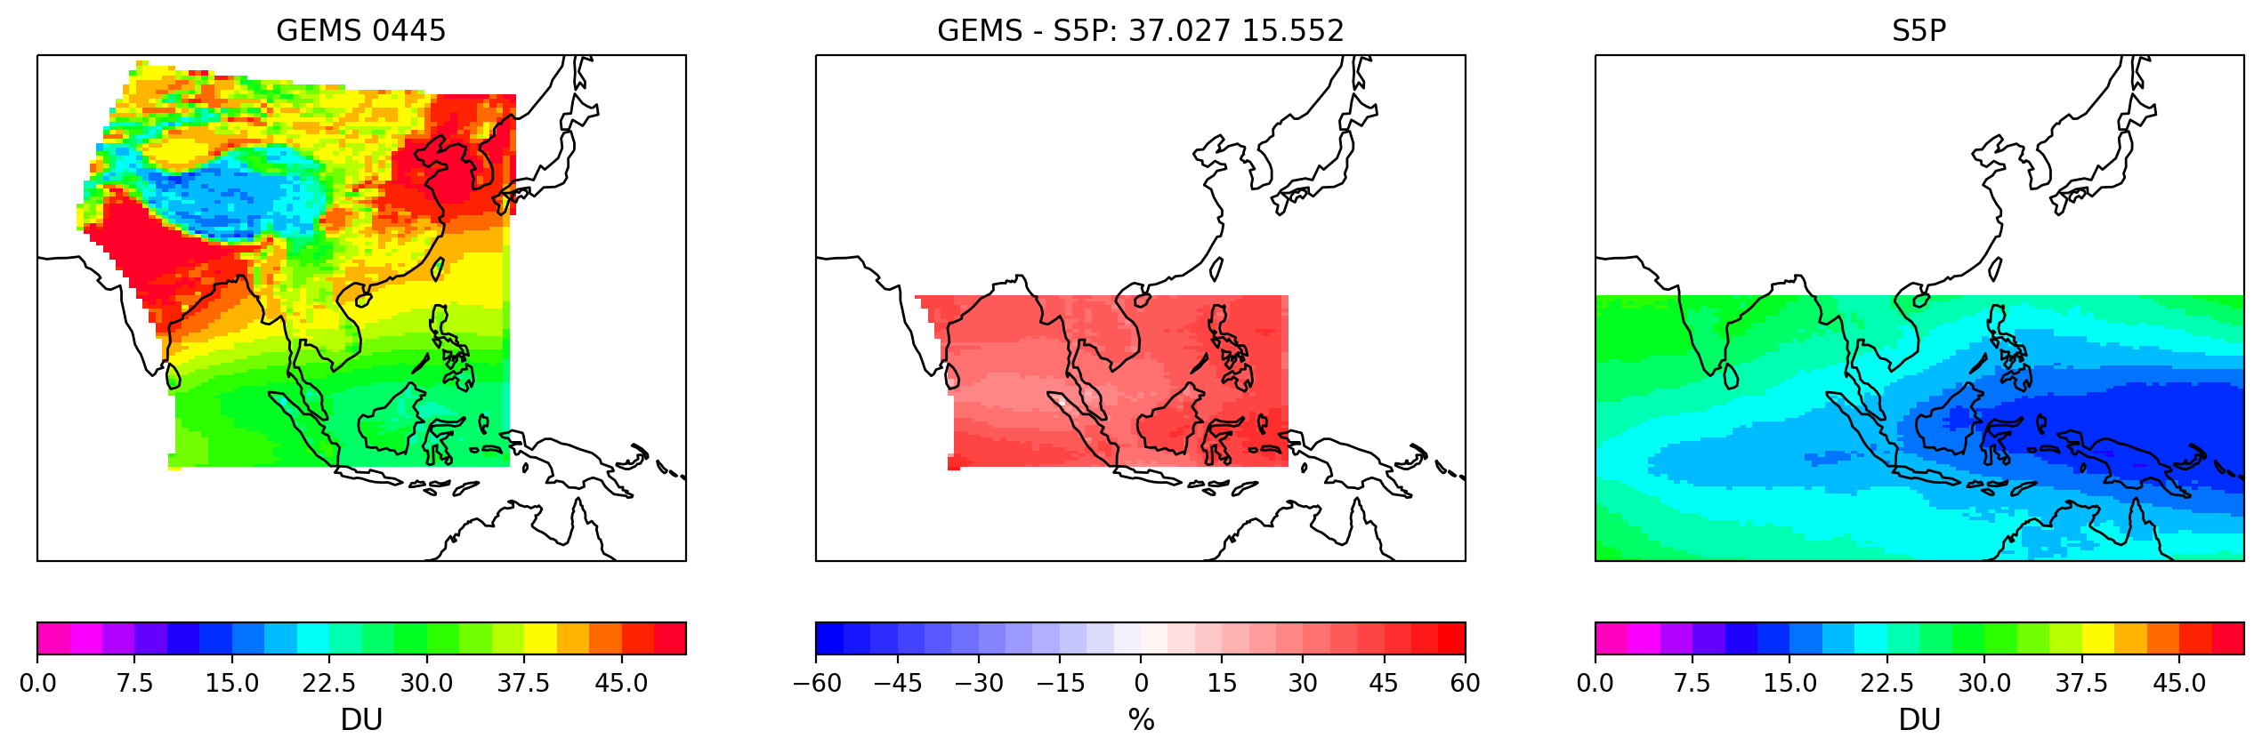
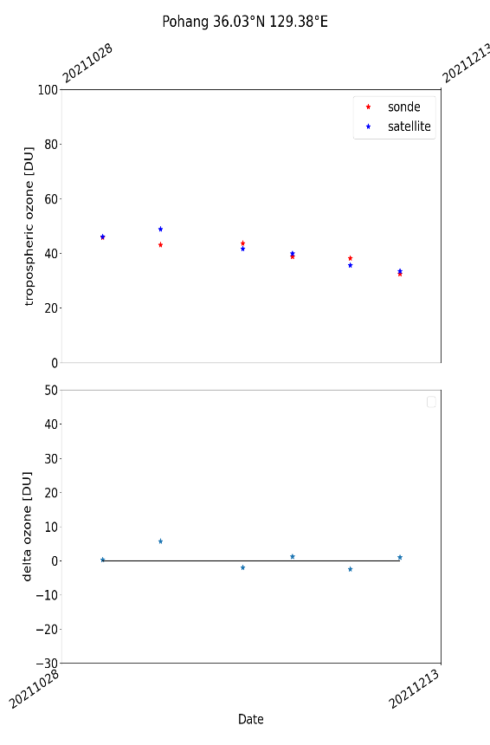
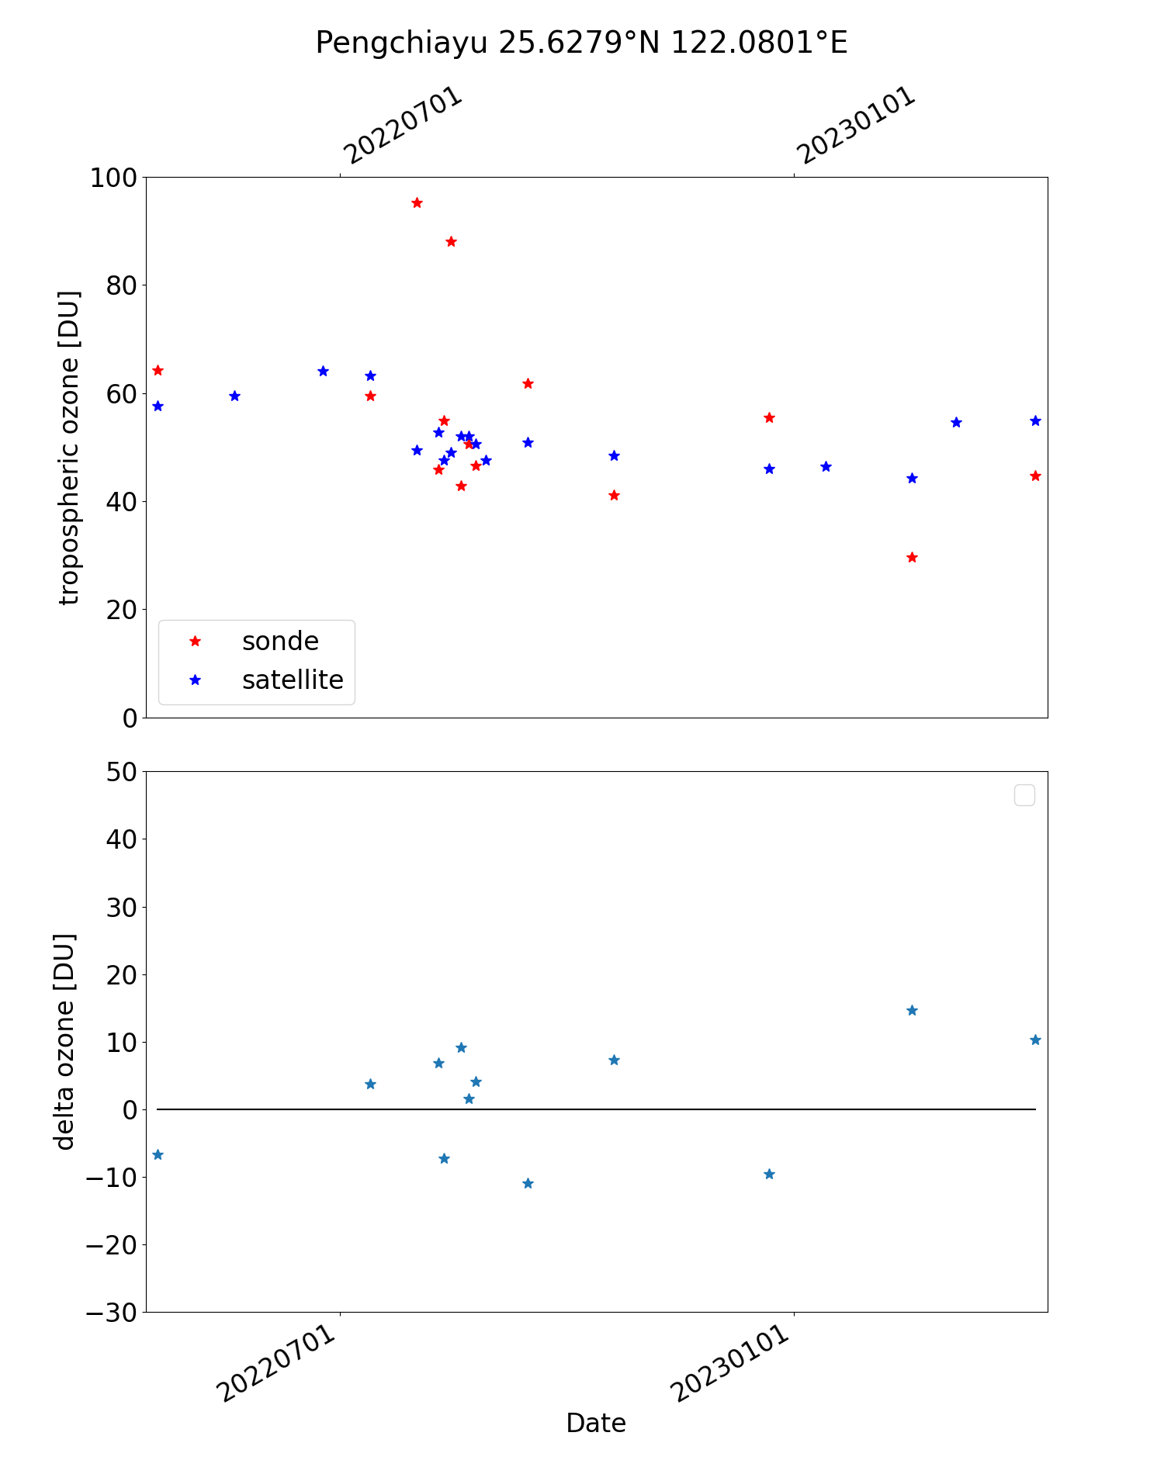
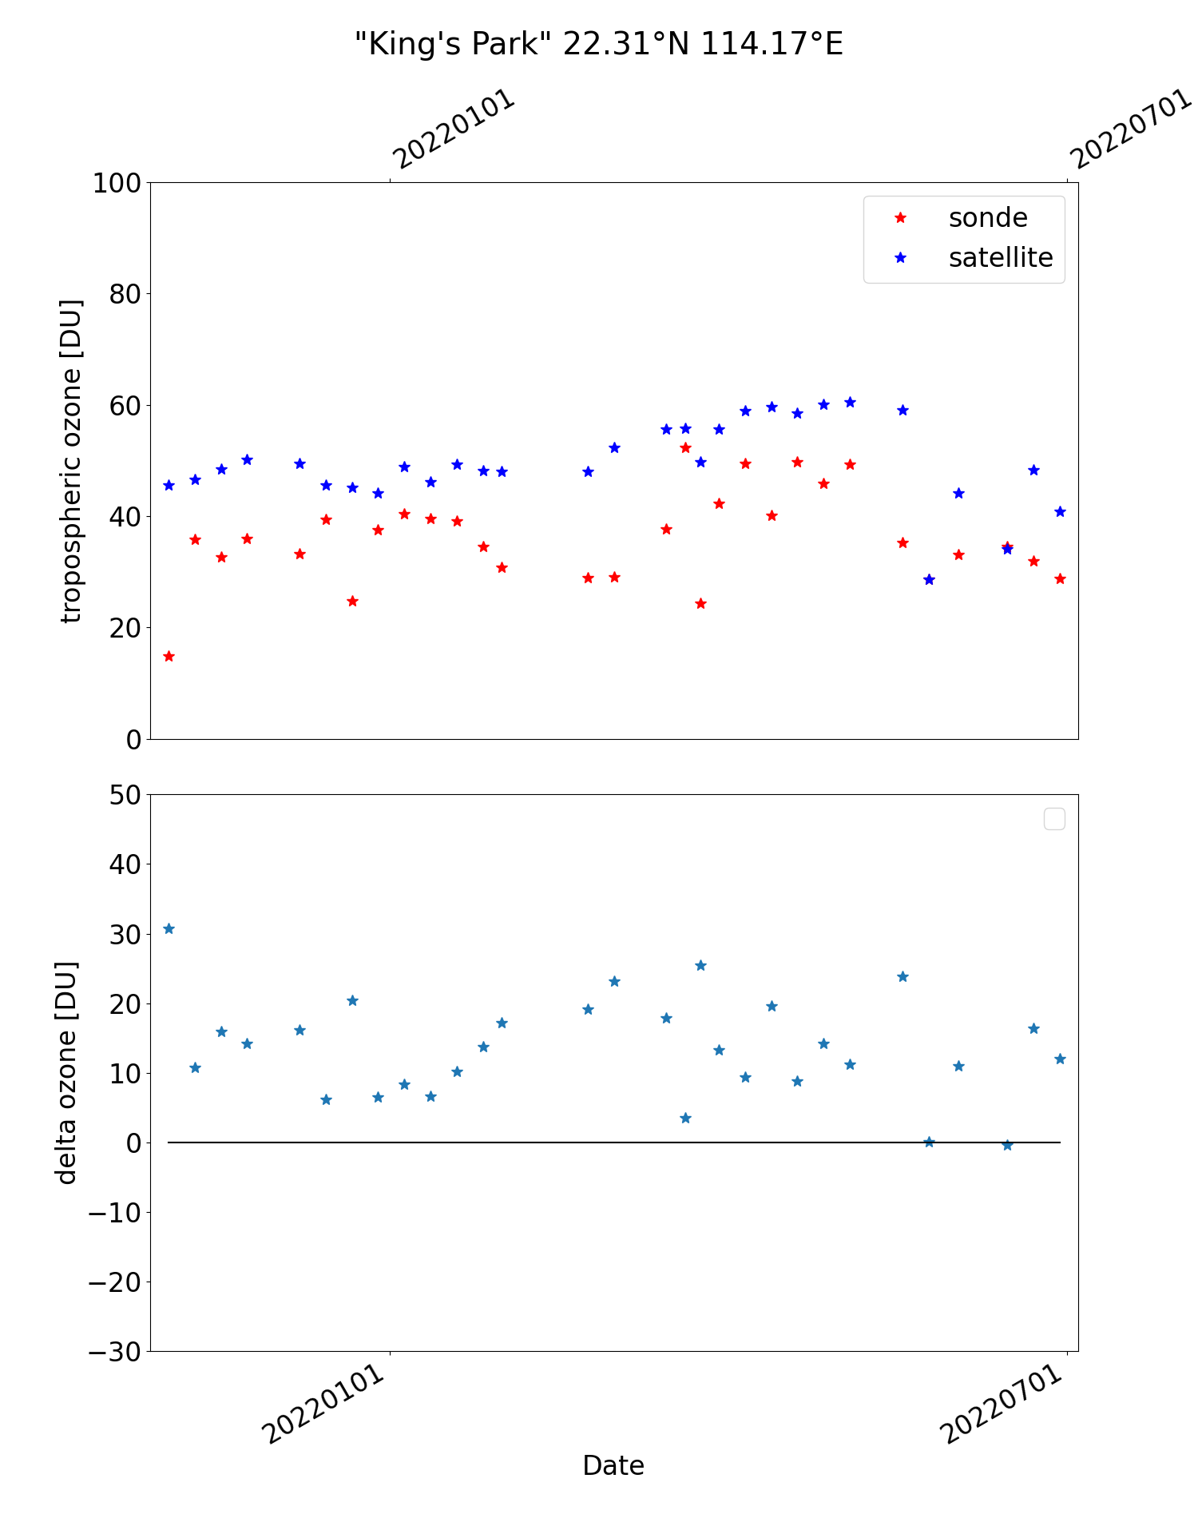
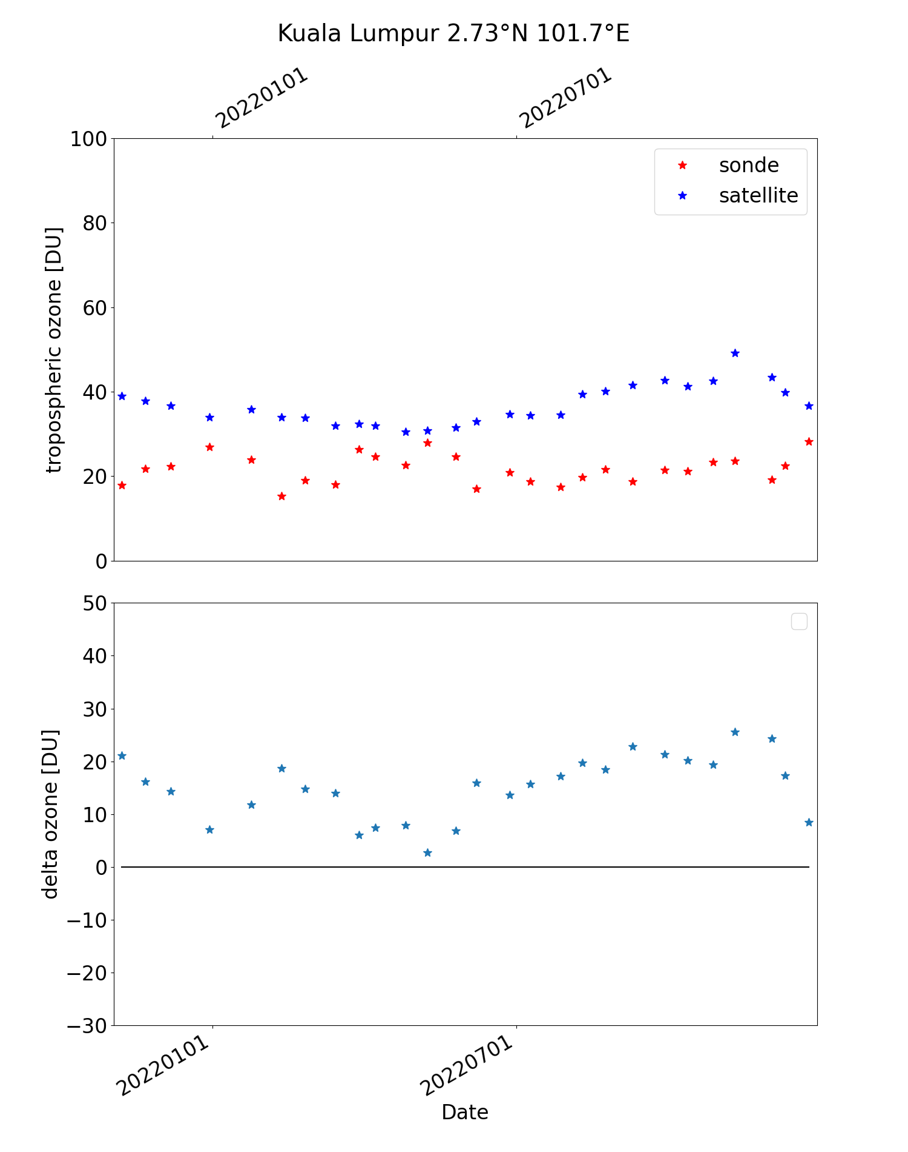
Ozone (troposheric) Team: K.-P. Heue, D. Hubert
Results:
Based on version 2.0
Bias 30-40% relative to S5P and GOME_2
  Within the tropics (up to 20°S)
  Confirmed by sondes in Hong Kong and Kuala Lumpur
Lower bias over Korea relative to sondes

Slide 8
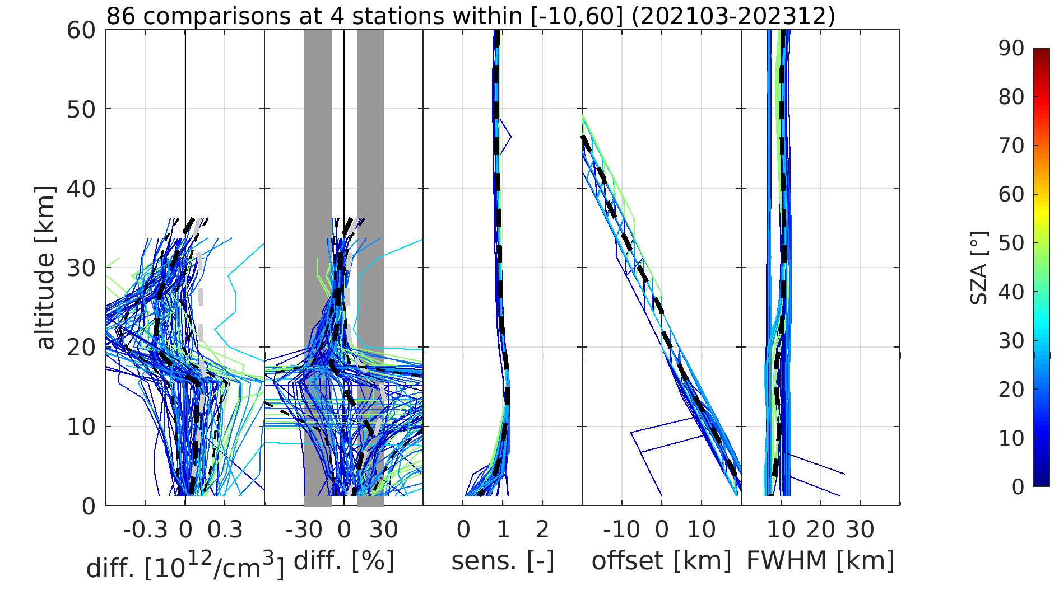
Ozone (profile) Team: A. Keppens, D. Hubert, J.-C. Lambert
Results:
GEMS O3P v3 information content:
Mostly off-diagonal sensitivity
DFS ~1.5 from lower stratosphere (15-30 km)
5-10 km effective vertical resolution (FWHM)
GEMS O3P v3 uncertainty:
Order of 5-10 % negative bias and
10 % dispersion in lower stratosphere
10-20 % positive tropospheric bias & dispersion (increase in UTLS)
AK smoothing systematically reduces tropospheric uncertainties
Clear effect of clouds and SZA / VZA
GEMS L2 v3 ozone profile data in comparison with vertically smoothed ozonesonde data from four stations (2021/03 – 2023/12)

Slide 9
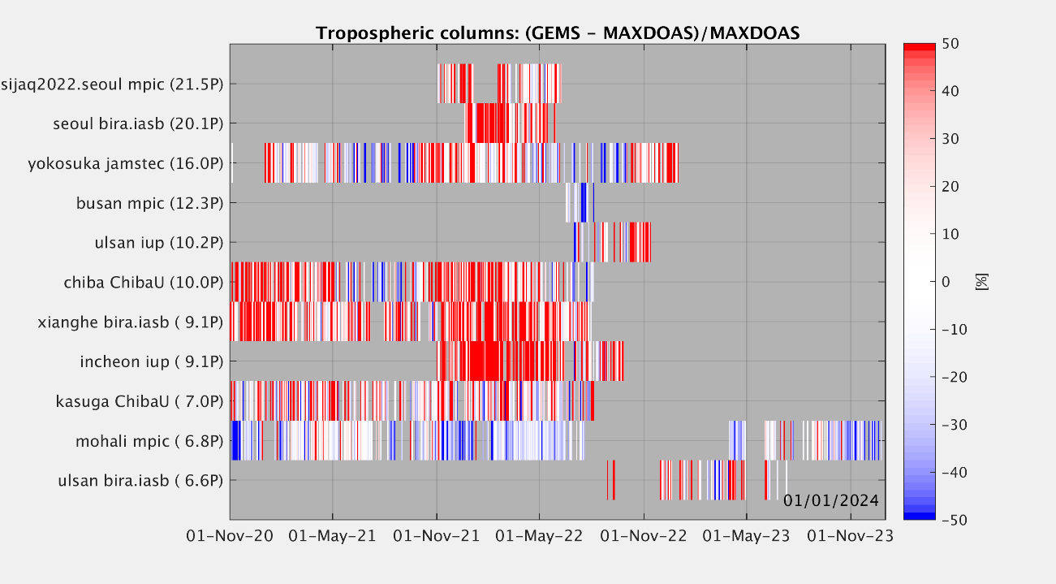
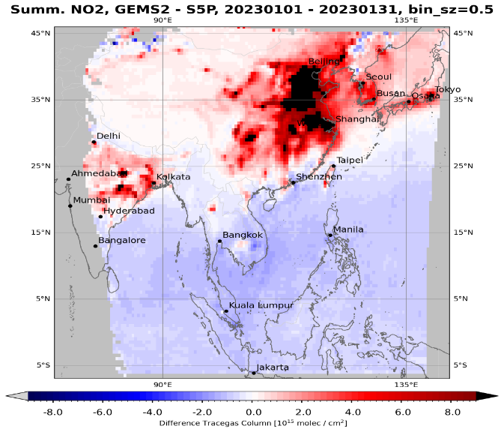
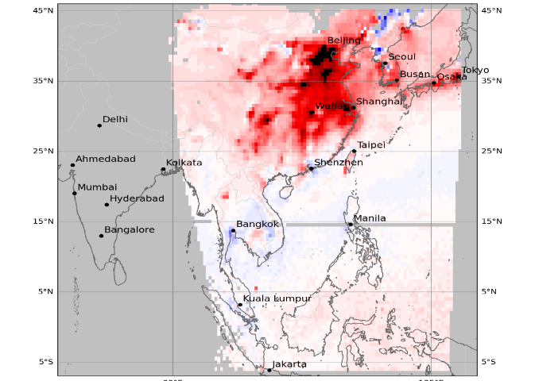
Nitrogendioxide Team: K.-U. Eichmann, G. Pinardi, S. Compernolle, T. Verhoelst
Results:
MAX-DOAS (11 stations) tropospheric NO2 (V2): median bias 2.3 Pmolec/cm² (23.3%) and network dispersion 3.9 Pmolec/cm² (34%).
PGN (5 stations) total NO2 (V2): median bias ~5 Pmolec/cm² (30 %) and network dispersion 7 Pmolec/cm² (50%).
GEMS total NO2 (V2) versus TROPOMI: low bias in South and over Ocean, TROPOMI low bias in North and polluted areas
GEMS total NO2 (V3) preliminary checked: NO2 improved -> negative GEMS bias over Ocean removed and high bias over polluted scenes reduced.
Time-series of relative differences (GEMS V2) at the different MAX-DOAS stations (Nov 2020 to end 2023).
V2
V3
Comparison of GEMS - TROPOMI total NO2 differences for version 2 and 3 for January 2023.

Slide 10
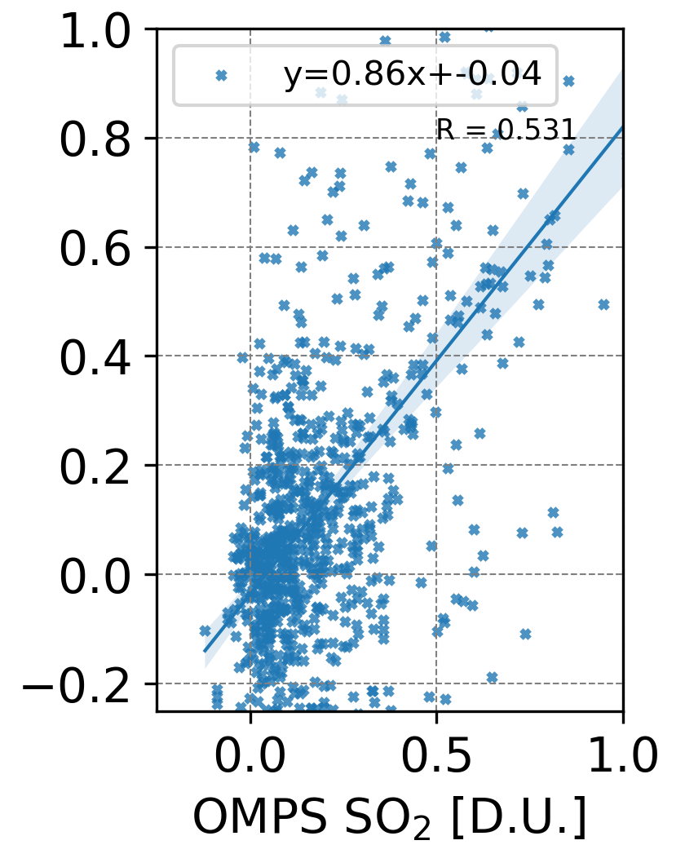
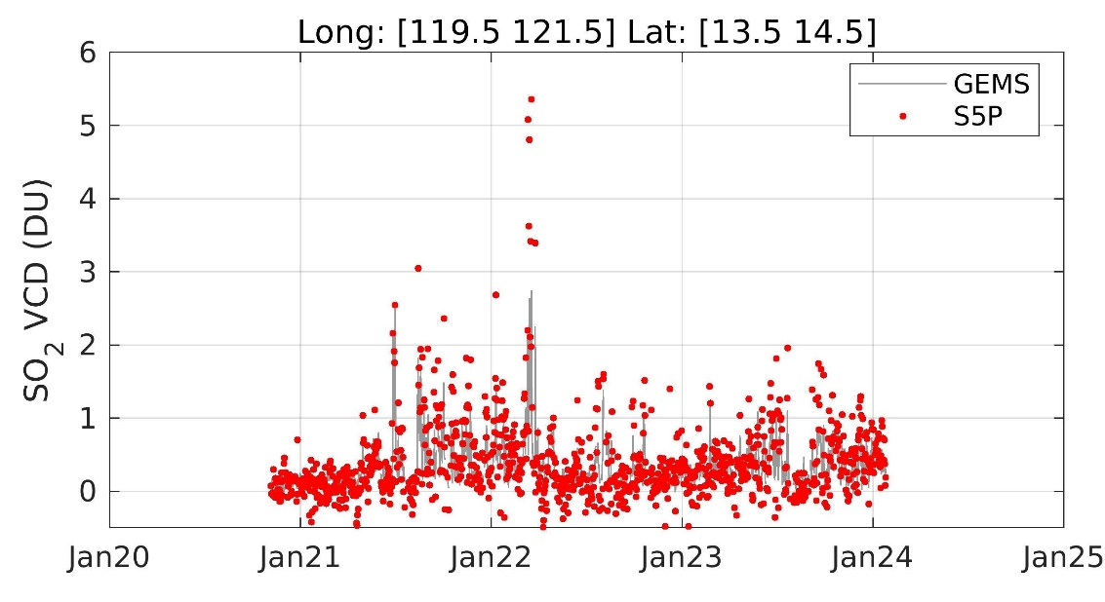
Sulphurdioxide Team: M.-E. Koukouli, N. Theys
Power plants
Results:
Performed daily, monthly & seasonal comparisons of GEMS v2.0 with OMI/Aura, OMPS/NPP & S5P/TROPOMI SO₂
For regions with low viewing angles (mostly volcanoes), similar patterns are observed. GEMS v2.0 VCDs agree with other sensors within 50% (even better for SCDs).
For large viewing angles (India and North China), comparison is less conclusive as several artefacts are present in the GEMS data.
Taal Volcano, Indonesia.
Left: Scatter plot of the L3 spatiotemporal collocated GEMS v2.0 and OMI/Aura SO₂ VCD over Power Plant locations in the GEMS FOV.
Right: Timeseries over the continuously outgassing Taal volcano in Indonesia for GEMS v2.0 and S5P.

Slide 11
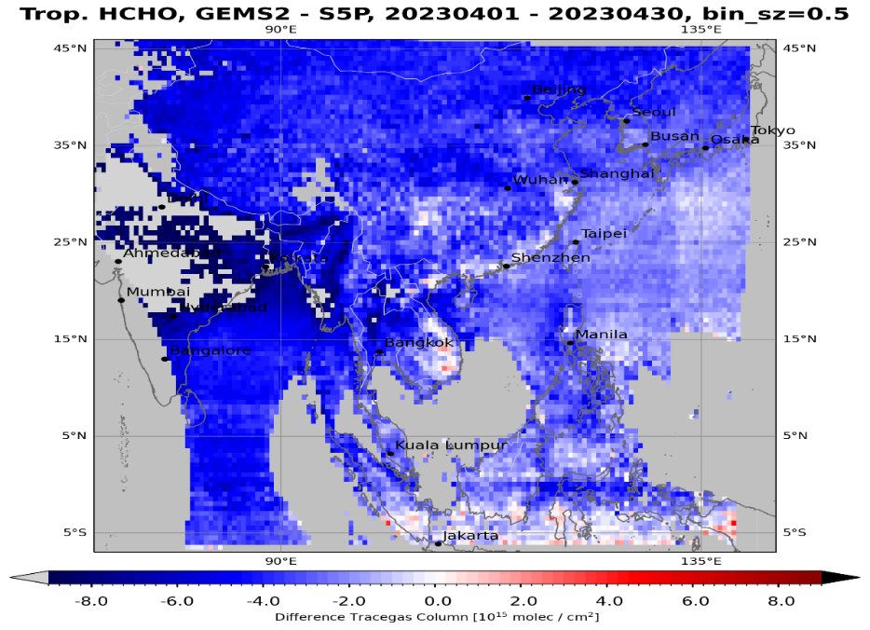
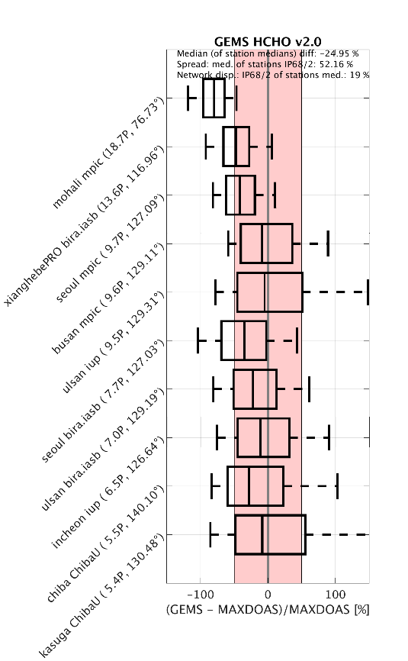
Formaldehyde Team: K.-U. Eichmann, I. de Smedt, C. Vigouroux, G. Pinardi, S. Compernolle, T. Verhoelst
Results:
TROPOMI: V2 GEMS HCHO has a low bias with a more negative bias towards the West. Overall bias < -60 %, dispersion 3 Pmolec/cm².
FTIR (4 stations): V2 GEMS median bias < -67%, dispersion < 5.6 Pmolec/cm²
MAX-DOAS (10 stations): V2 GEMS median bias -25%, dispersion 2.7 Pmolec/cm²
Monthly mean HCHO differences of GEMS V2 and TROPOMI (April 2023).
Box-whisker plots of GEMS V2 median HCHO [%] at MAX-DOAS sites.
GEMS mean HCHO (V2) bias for the 4 FTIR sites.

Slide 12
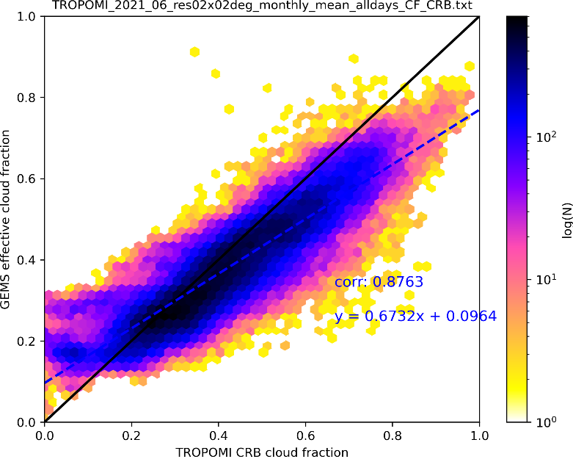
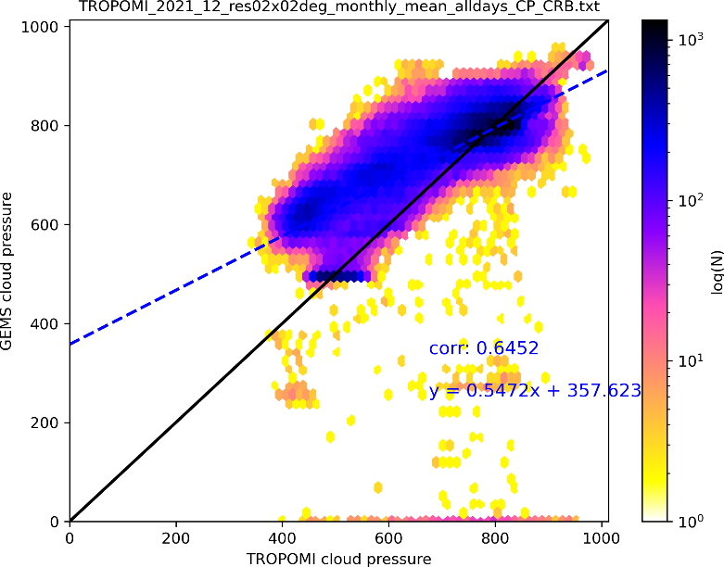
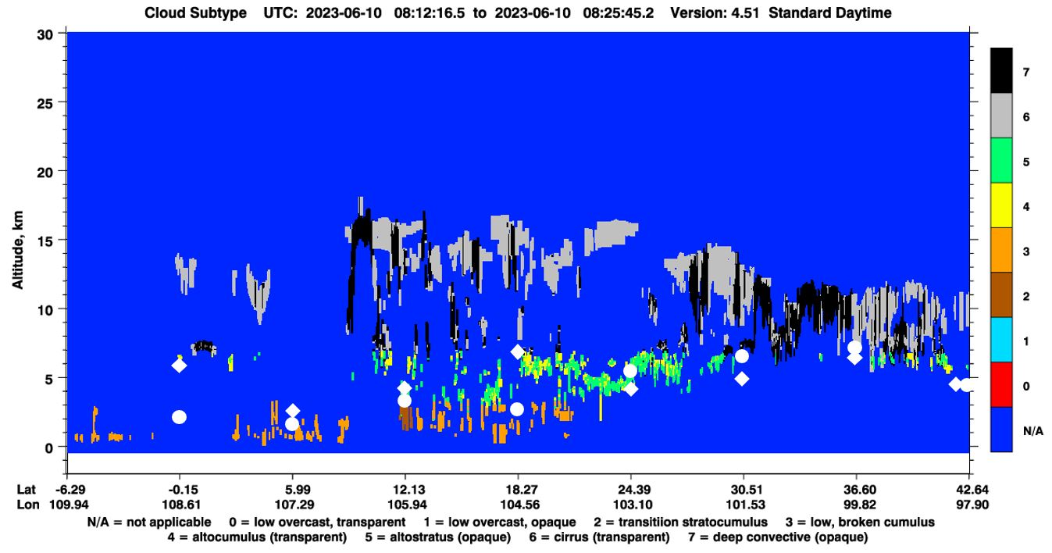
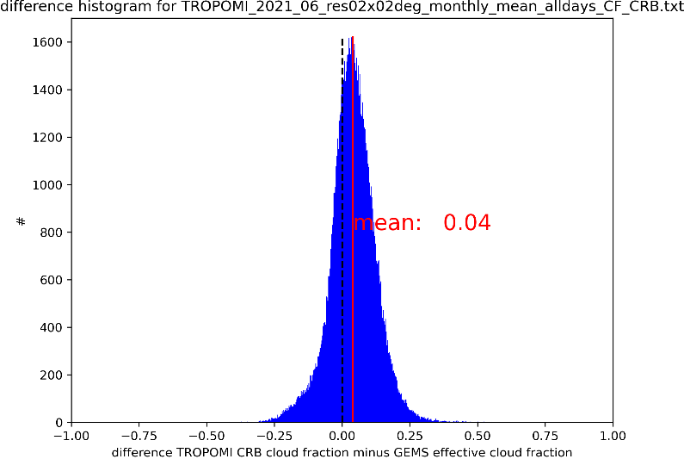
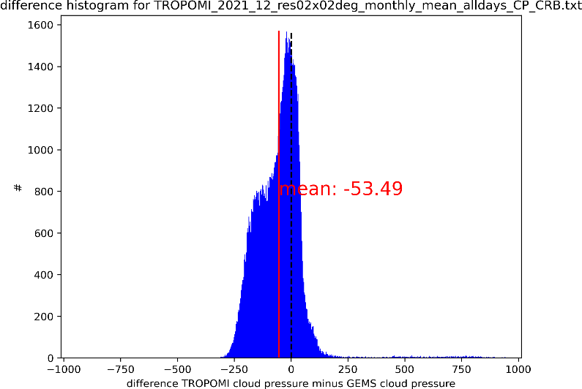
Clouds Team: R. Lutz, D. Loyola
Results:
comparisons based on: TROPOMI, CALIOP
good agreement for cloud fraction: corr: 0.87, mean diff: 0.04
ok agreement for cloud pressure: corr: 0.65, mean diff: -50 hPa
deviations appear over bright surfaces, for low cloud coverages and extreme viewing zenith angles
Comparison with TROPOMI/S5P cloud fraction (left) and cloud pressure (right) for June and December 2021.
Comparison with CALIOP on 10 June 2023.

Slide 13
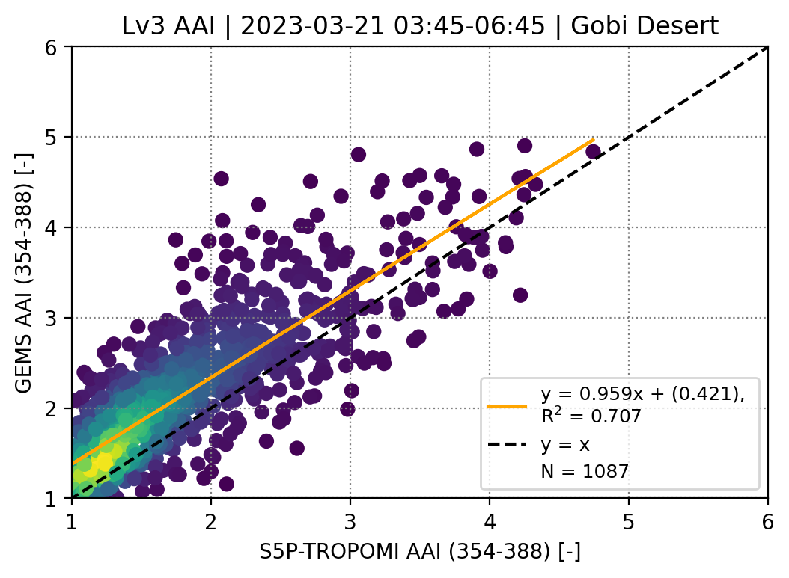
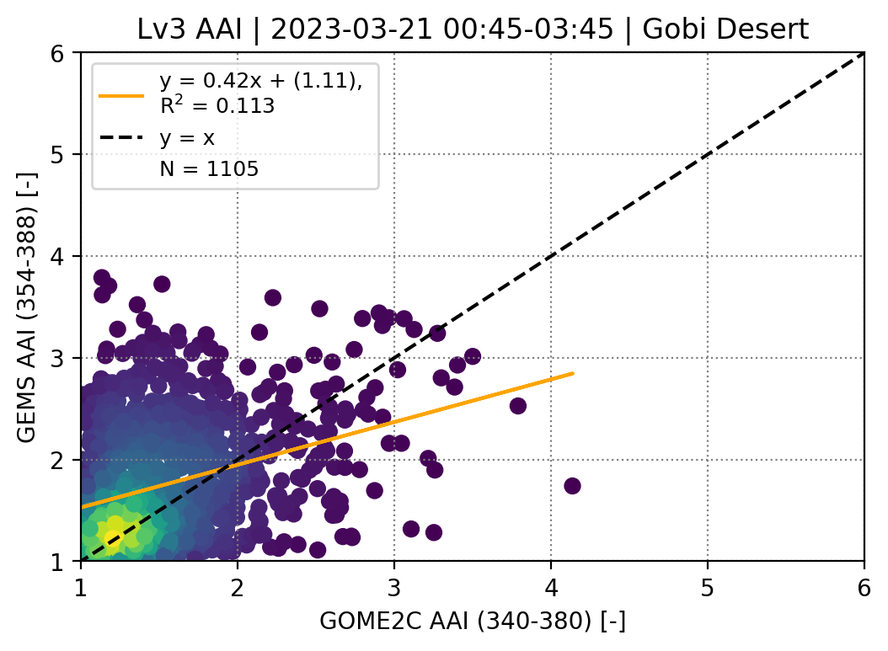
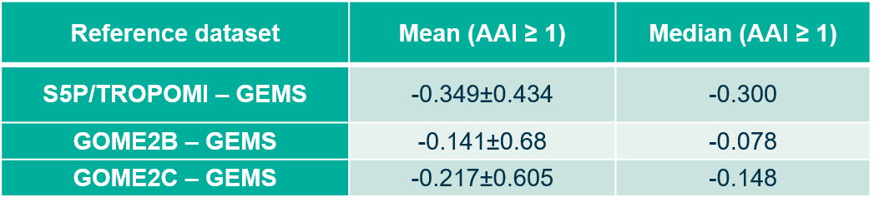
Aerosols (index) Team: P. Fountoukidis, M.-E. Koukouli, D. Balis
Results:
Sat-to-Sat comparisons between
  S5P/GEMS
  GOME-2B/GEMS
  GOME-2C/GEMS
Overestimation of the AAI by GEMS
The comparisons have a high dependency in both the event and/or the sensor
Results for the satellite-to-satellite comparisons between the spatio-temporal collocated AAI datasets (upper panel). The mean and median of the distributions of the absolute differences between the datasets (lower panel)

Slide 14
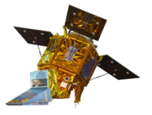


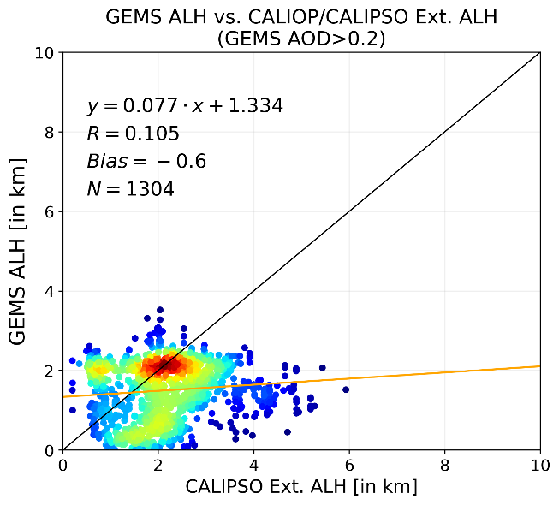
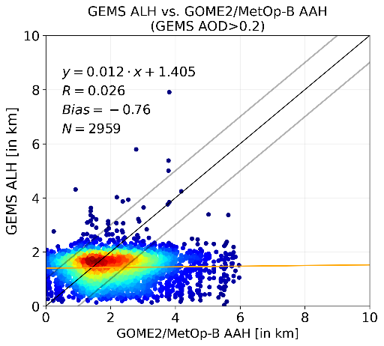
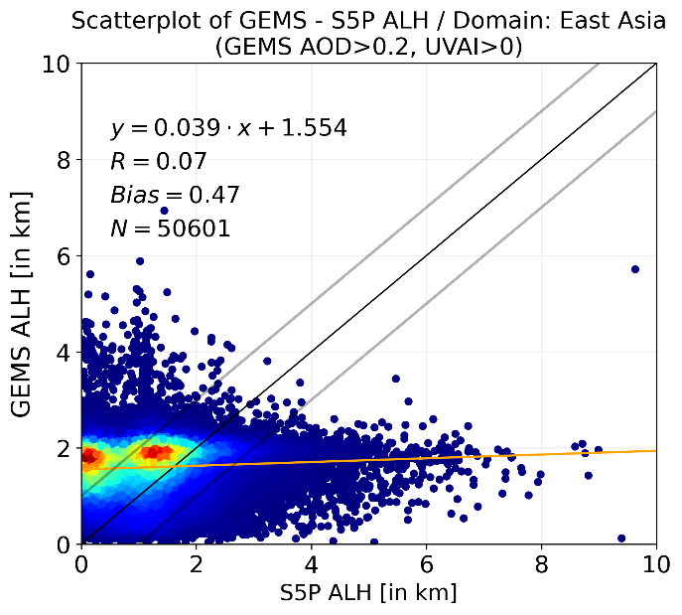
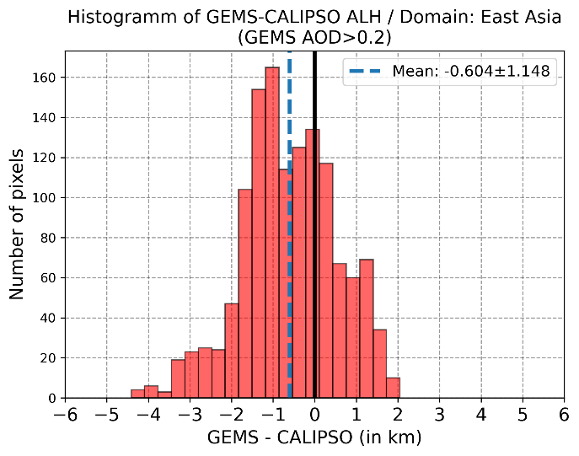
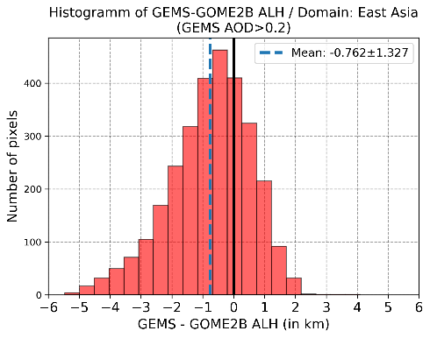
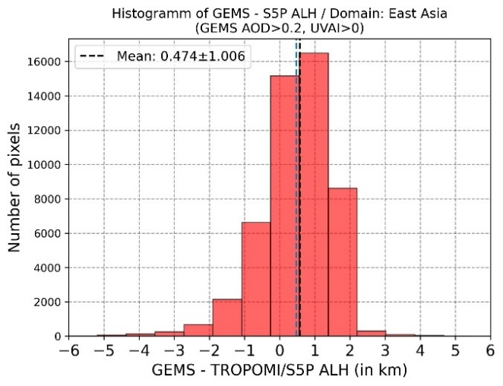
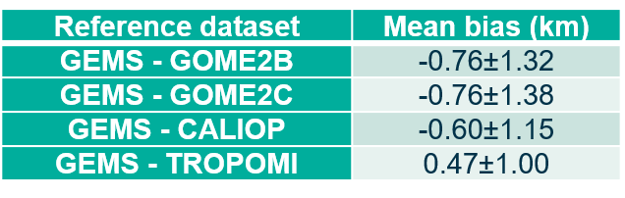
Aerosols (layer height) Team: K. Michaelidis, M.-E. Koukouli, D. Balis
Results:
Sat-to-Sat comparisons between
  S5P/GEMS
  GOME-2B/GEMS
  GOME-2C/GEMS
  CALIPSO/GEMS
L2 GEMS v2.0 Aerosol datasets, from Nov. 2021 to Dec. 2023 have been used.
GEMS ALH product is strongly associated to the AOD levels.
GEMS ALH has a smaller flexible range than that of TROPOMI, GOME-2 and CALIPSO.

Slide 15
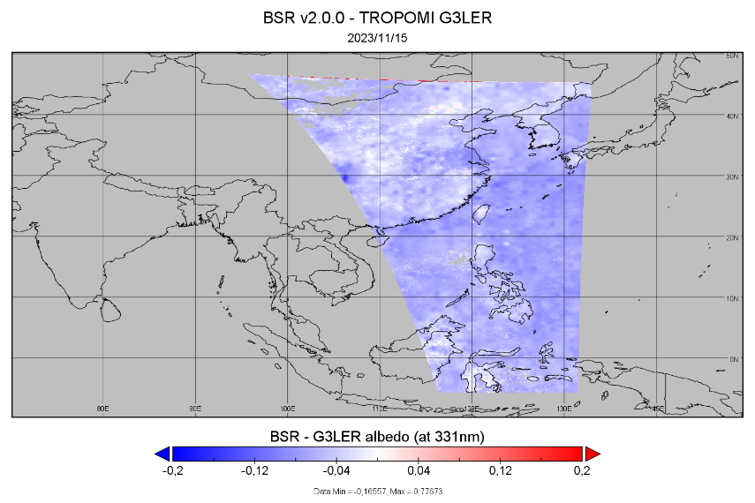
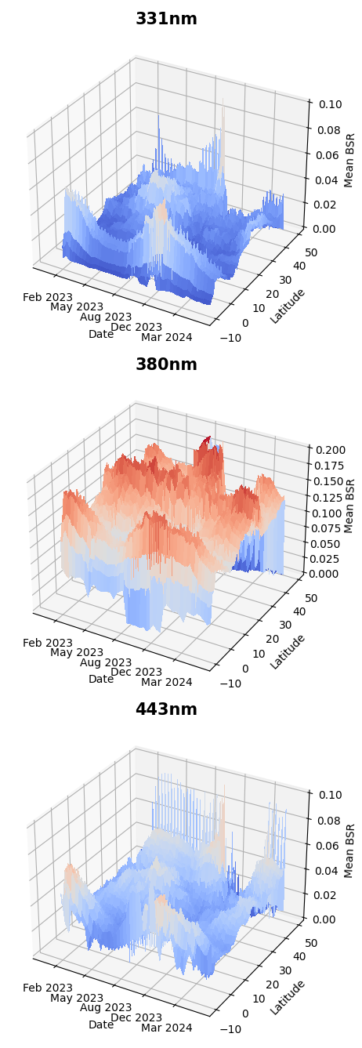
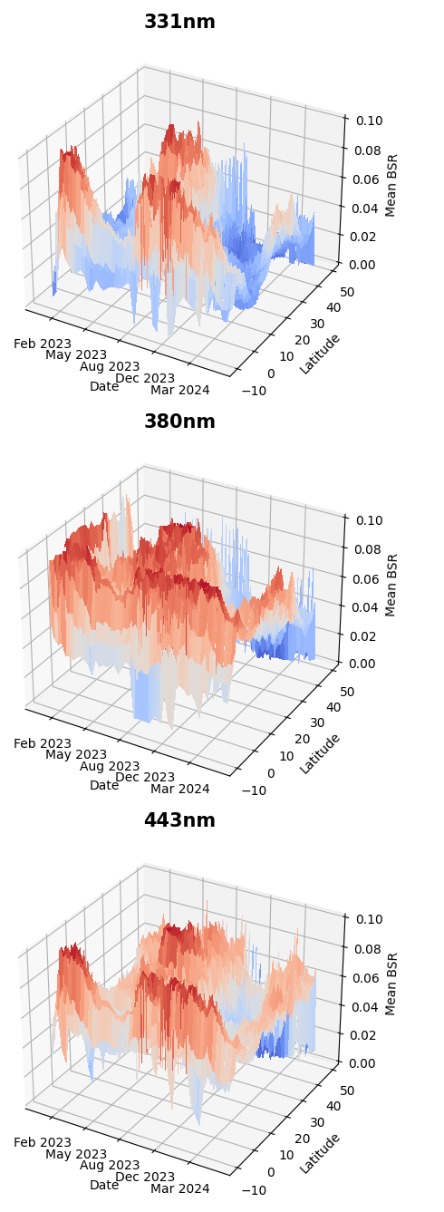
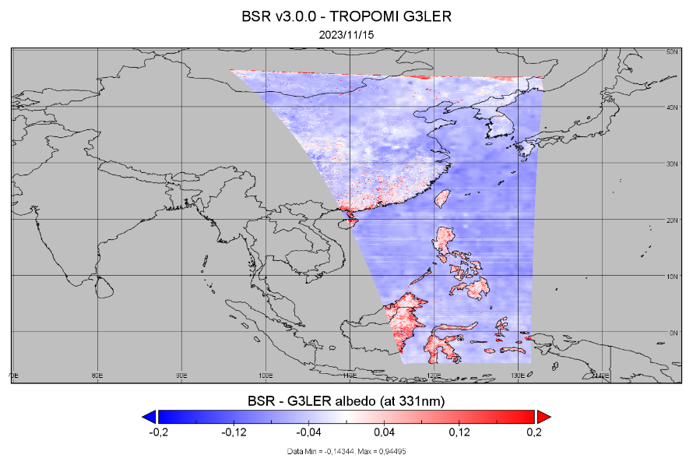
Surface Properties Team: P. Hedelt
v2.0.0
v3.0.0
Results:
3 years of GEMS BSR v2.0 data showed:
Reasonable agreement of monthly averaged surface albedo with DLER climatologies only for few wavelengths
380nm surface reflectance shows significant higher surface albedo compared to DLER.
Analysis of zonal mean showed significant seasonal North-South dependence at all wavelengths and a significant bias as 380nm.
Mean surface albedo at 331nm (O₃ fitwindow) shows slightly lower albedo wrt to TROPOMI G3_LER surface albedo.
Preliminary analysis of v3.0.0 data shows better agreement across wavelengths, and overall higher albedos. The seasonal N-S dependency is still present. Also direct comparison shows positive bias over land.

Slide 16
Project status

Slide 17
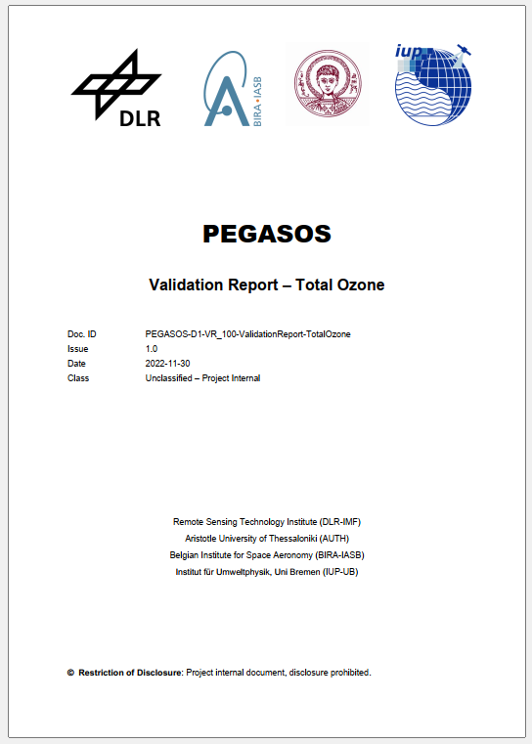
Project Timeline
Kick-Off:
June 2022
Milestone 1:
Jan 2023
Milestone 2:
Sep 2023
Milestone 3:
Feb 2024
Milestone 4:
Sep 2024
Evaluation Report v1:
Dec 2022
Evaluation Report v2:
Aug 2023
Evaluation Report v3:
Feb 2024
Evaluation Report v4:
Sep 2024
Intermediate Evaluation reports (v1-v3) are not public and only shared with the GEMS team.
Feedback from the GEMS colleagues on the reports is well appreciated
Final Evaluation reports (v4) will be published on the ESA website.

Slide 18
outlook

Slide 19
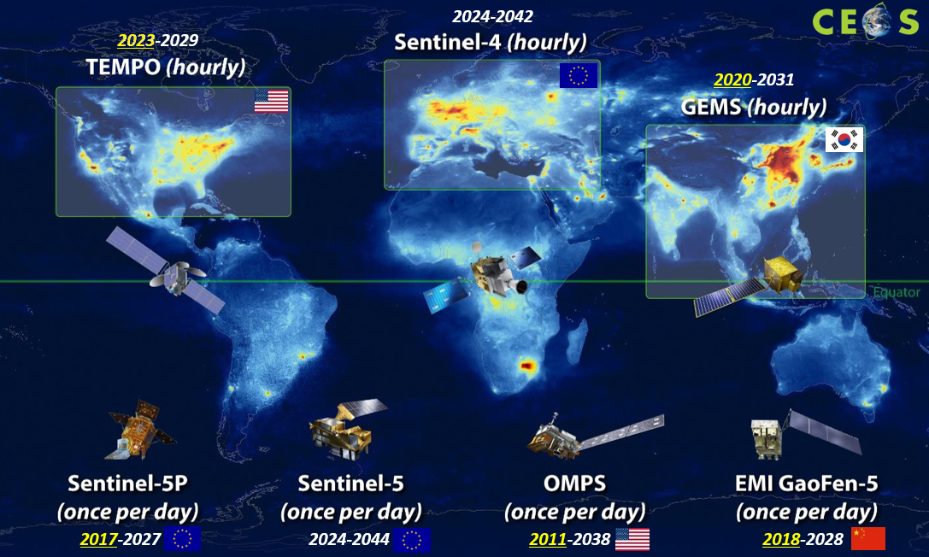
PEGASOS project will be extended
Next phase:
two more years
GEMS data version 3
inclusion of TEMPO data
limited number of products
image courtesy: CEOS

Slide 20
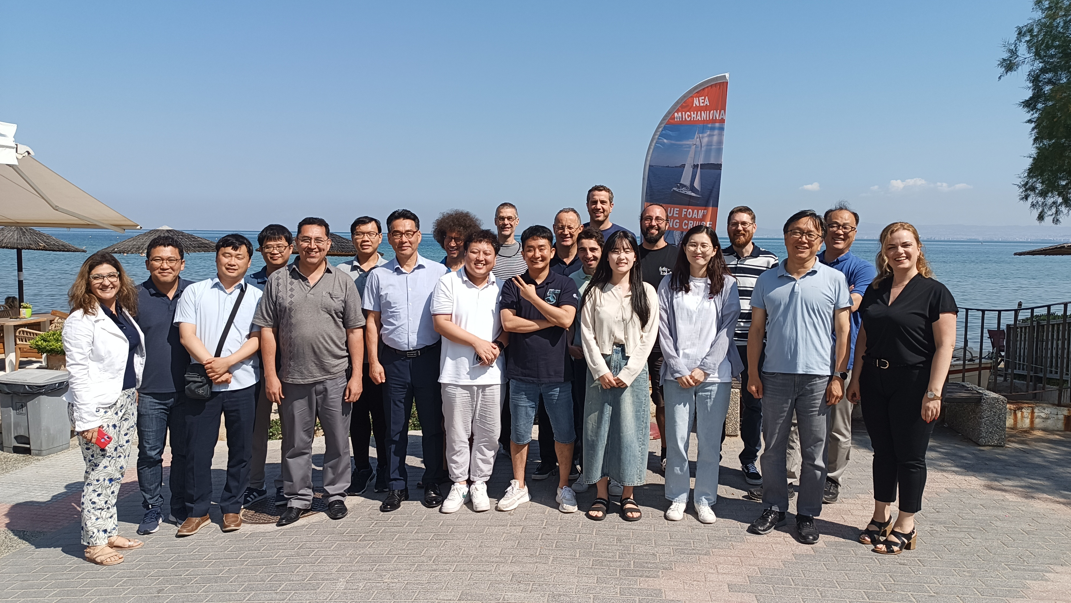
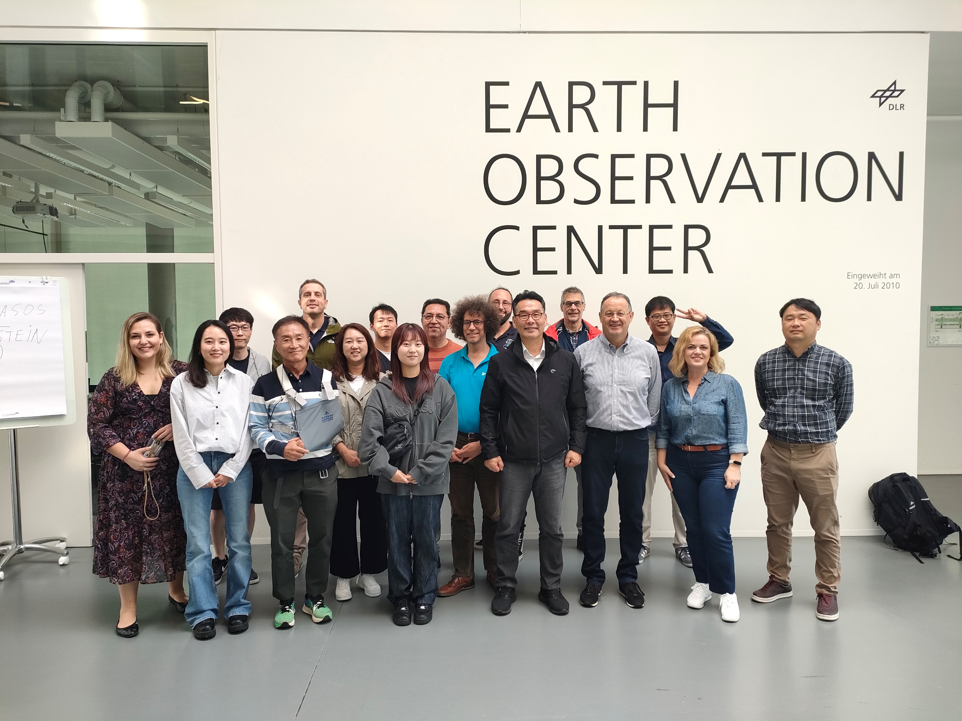
Credits to the GEMS team
THANKS to Jhoon Kim, Won-Jin Lee, Hyunkee Hong and the GEMS L2 team!
PEGASOS meeting in June 2023, Greece
PEGASOS meeting in September 2024, Germany

