Slide 1
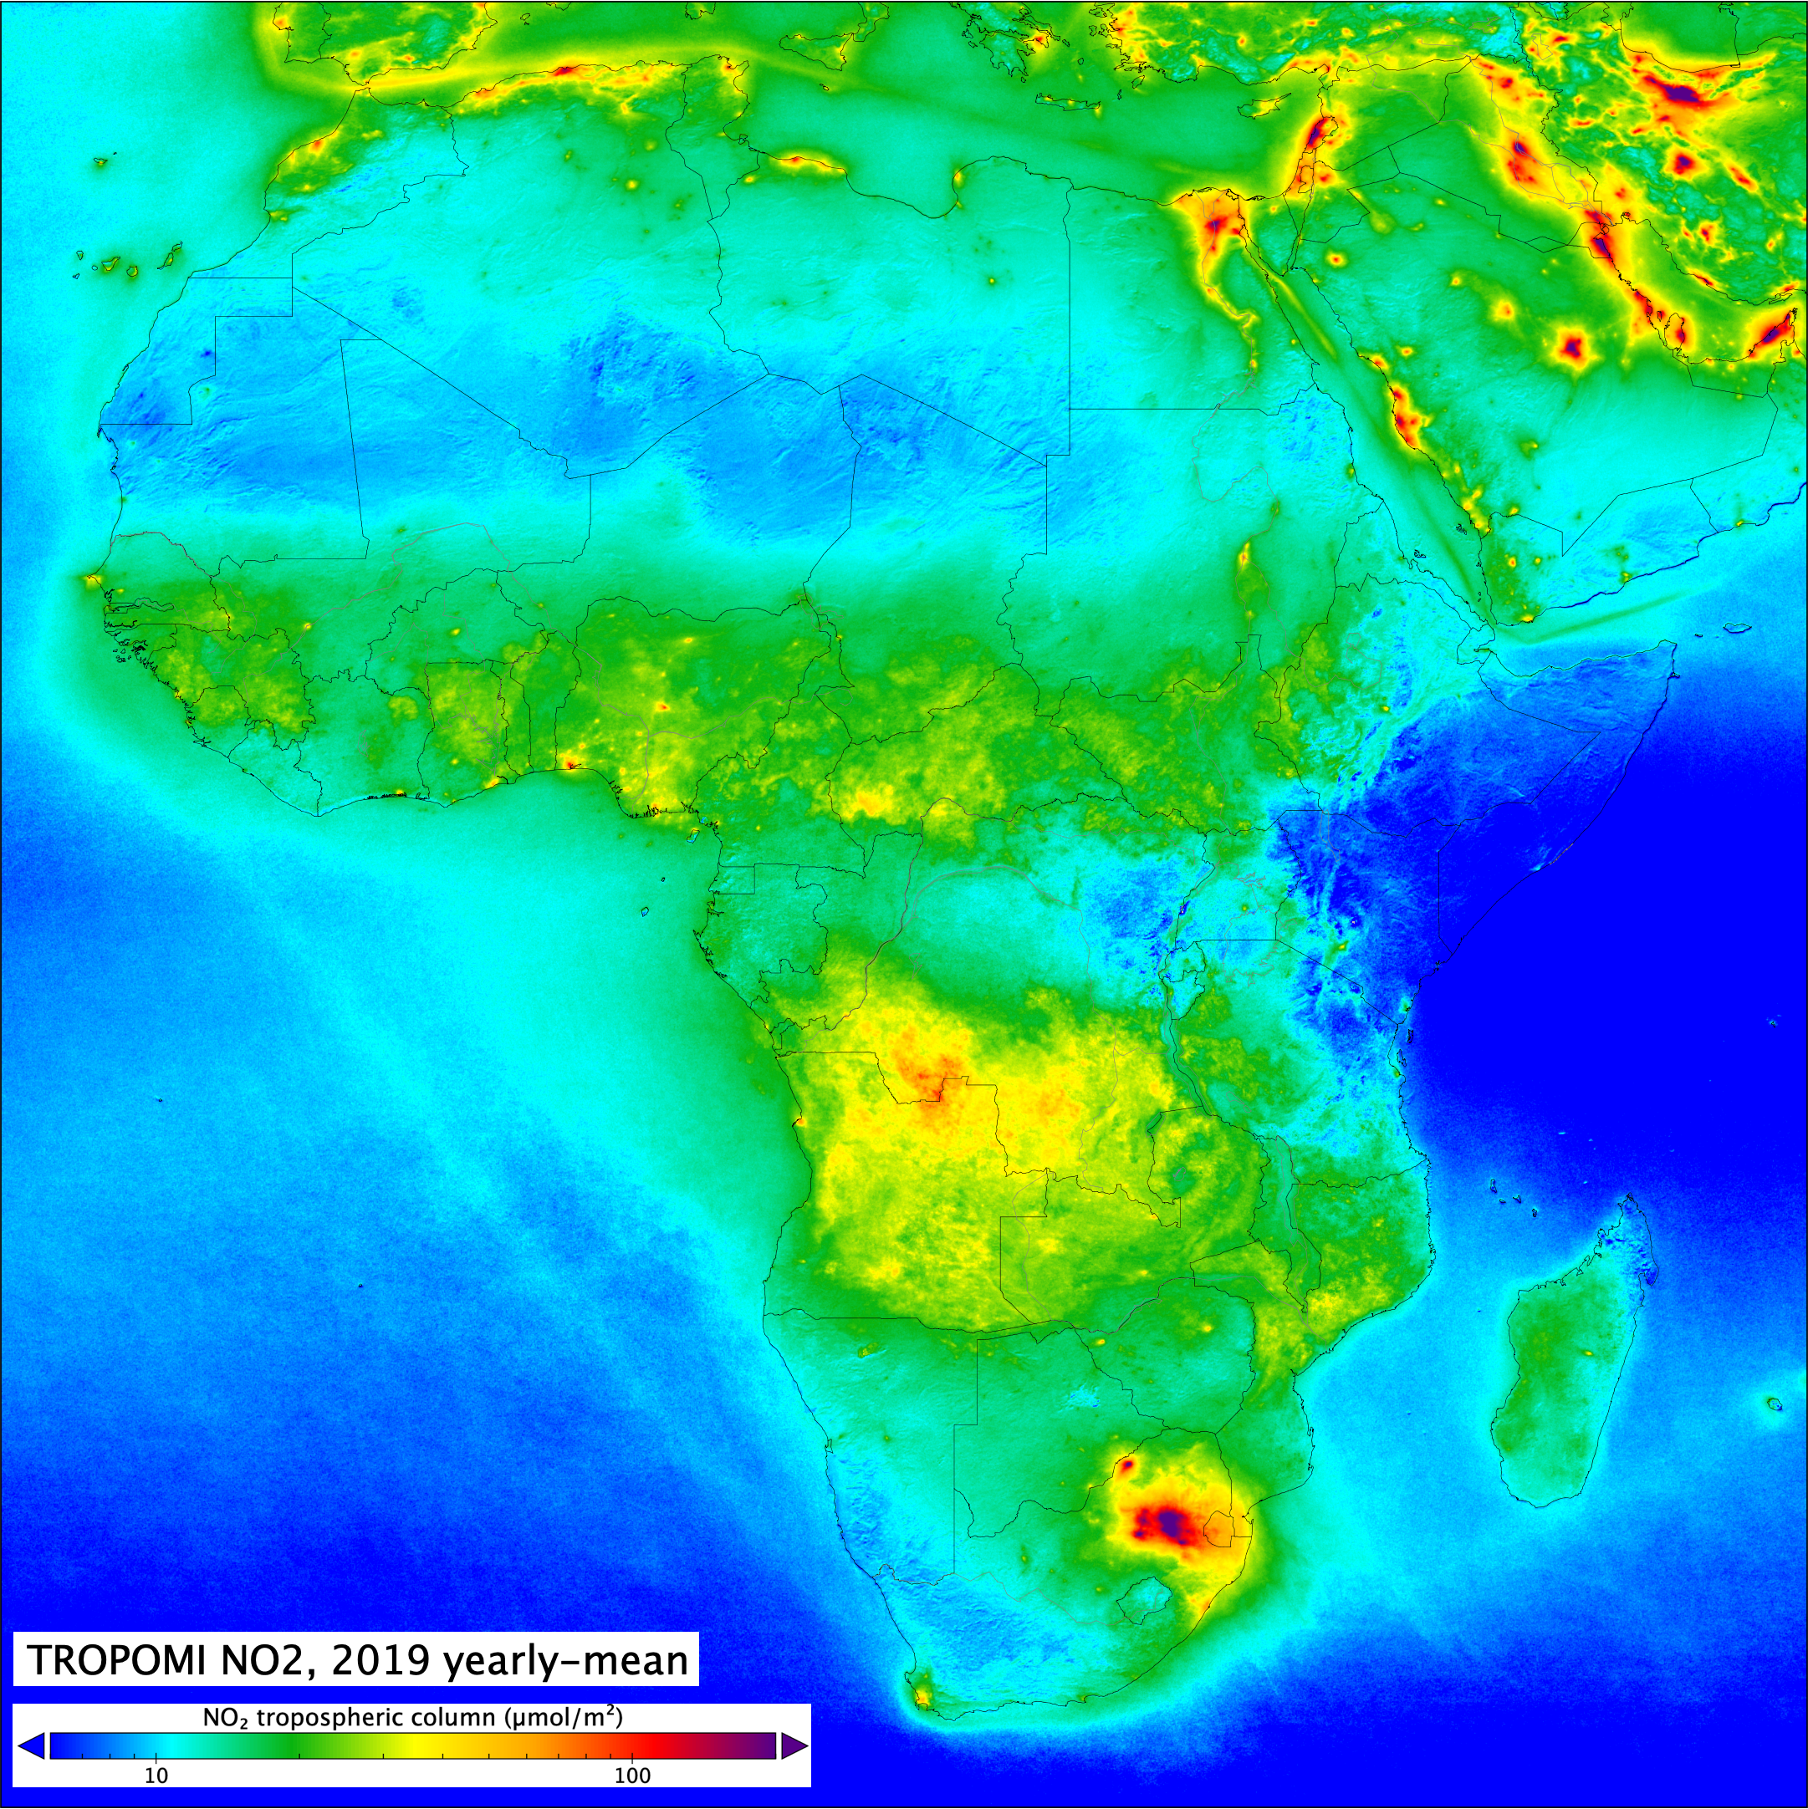

Studying Air Pollution and Climate Change on the African Continent
Pieternel F. Levelt, Eloise A. Marais, Wenfu Tang, Sara Martinez-Alonso, David Edwards, Helen Worden, Henk Eskes, Pepijn Veefkind, Steve Brown, Collins Gameli Hodoli, Allison Felix Hughes, Oman Emam, Barry Lefer, Drobot Sheldon, Dan Westerfelt.
ACVC CEOS Meeting, Washington DC, October 15, 2024
Prof. Dr. Pieternel Levelt, NSF NCAR ACOM Director
OMI Principal Investigator (NASA Eos Aura)
TROPOMI scientific initiator (ESA sentinel-5 precursor)
KNMI, TU Delft
Courtesy, Henk Eskes, KNMI
Prof. dr. Pieternel Levelt, NSF NCAR ACOM, KNMI, TU Delft
Atmospheric Chemistry and Observations Laboratory - Director

Slide 2
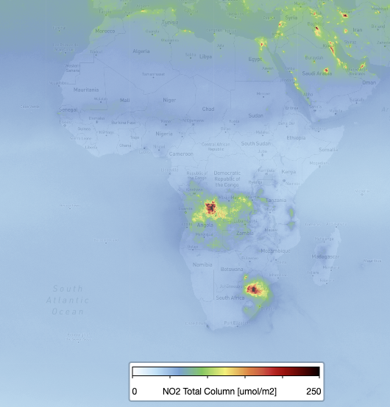
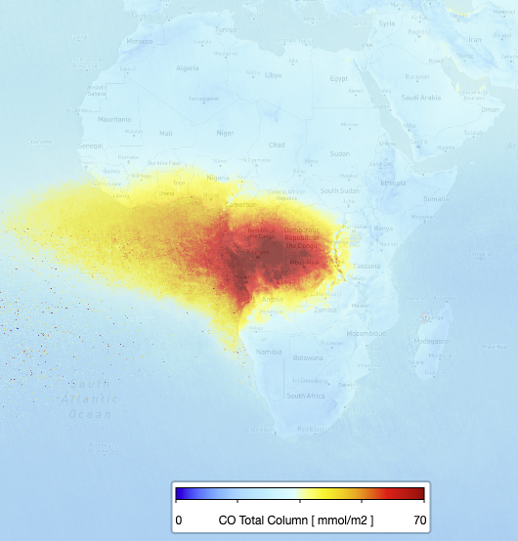
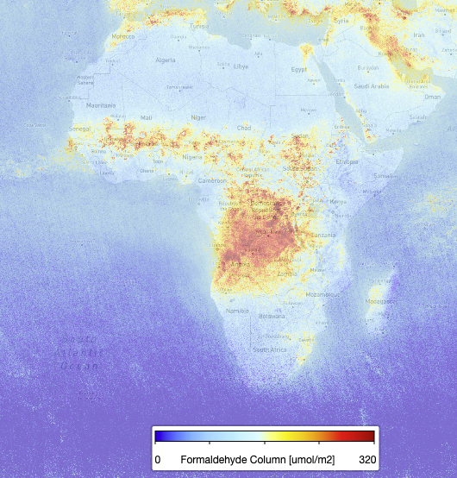
Africa
NO₂
CO
Fossil fuel
Biomass Burning
Population is expected to double in 2050
(2.5 billion) and triple in 2100 (3.8 billion)
4th industrial revolution: will lead to huge increase in air pollutants and greenhouse gases
All pollution sources are present in Africa:
NO₂ – fossil fuel combustion
CO – biomass burning
HCHO – Biogenic Emissions
UVAI – Sahara Dust
There is a lack of groundbased measurements over Africa
There is a lack of emission estimates over Africa
There is an urgent need for new capability for air quality management for health and environment
HCHO
UVAI
Biogenic Emissions
Sahara Dust
Image Courtesy : Pepijn Veefkind, KNMI
TROPOMI air pollution measurements
Africa, July 2019
Prof. dr. Pieternel Levelt, NCAR ACOM
Atmospheric Chemistry and Observations Laboratory

Slide 3
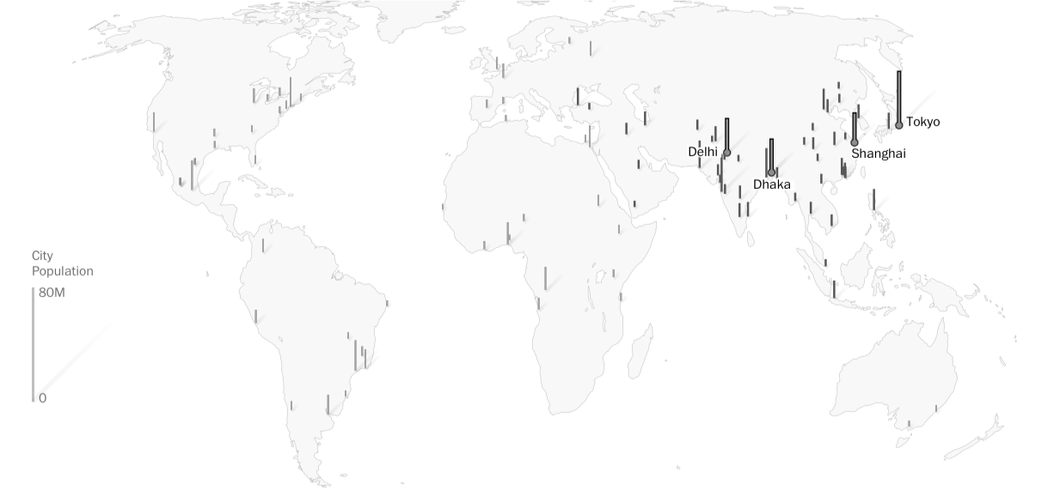
100 Largest Megacities 2025
Prof. dr. Pieternel Levelt, NSF NCAR ACOM, KNMI, TUDelft
Atmospheric Chemistry and Observations Laboratory
Source: Washington Post, 2021

Slide 4
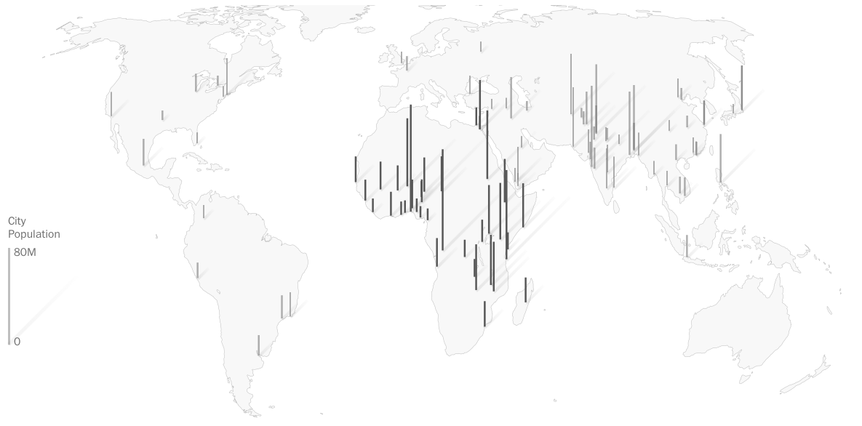
100 Largest Megacities 2100
Prof. dr. Pieternel Levelt, NSF NCAR ACOM, KNMI, TUDelft
Atmospheric Chemistry and Observations Laboratory
Source: Washington Post, 2021

Slide 5
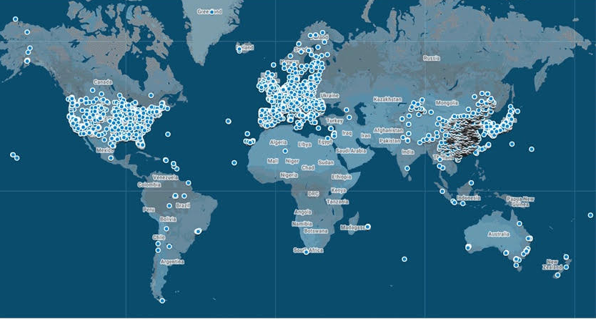
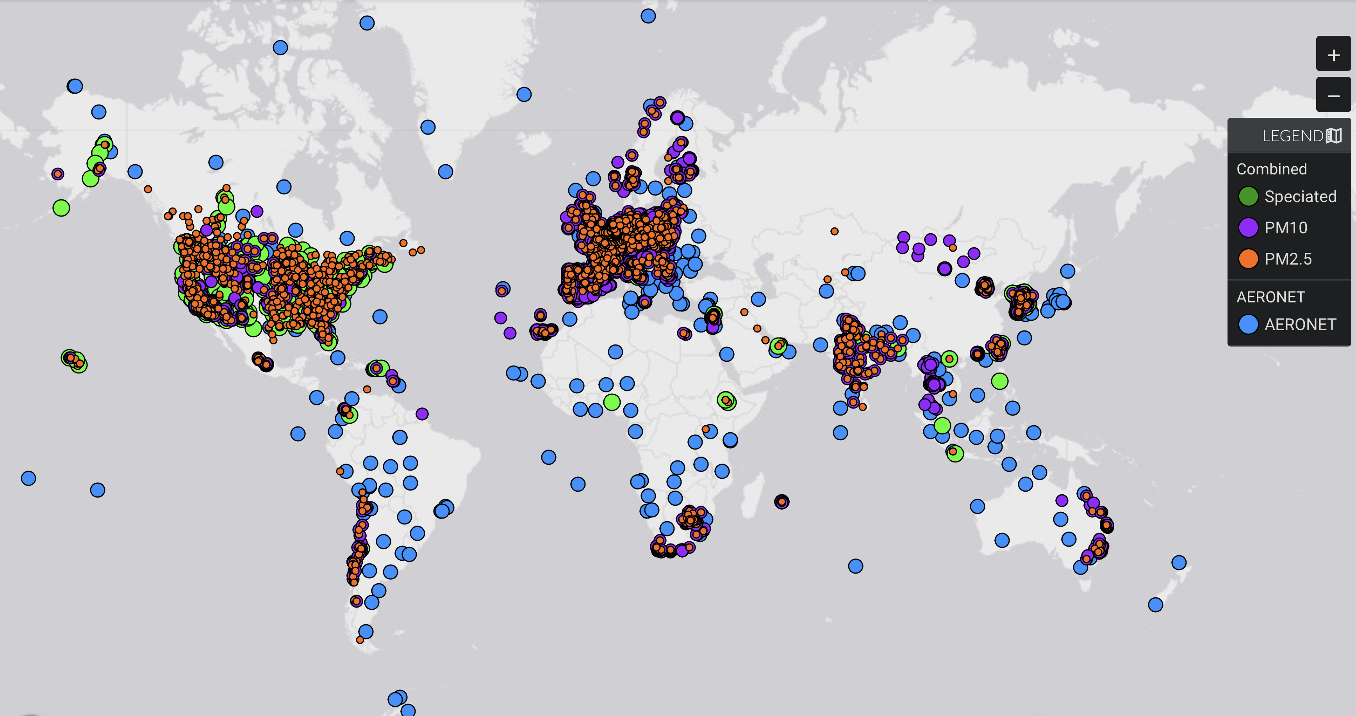
Severe Lack of reliable ground based observations in the Global South
Ozone Monitoring sites
(TOAR and Open AQ)
Aerosol Surface Monitoring sites
(MAIA Data Visualization Tool)
Prof. dr. Pieternel Levelt, NSF NCAR ACOM, KNMI, TUDelft
Atmospheric Chemistry and Observations Laboratory

Slide 6
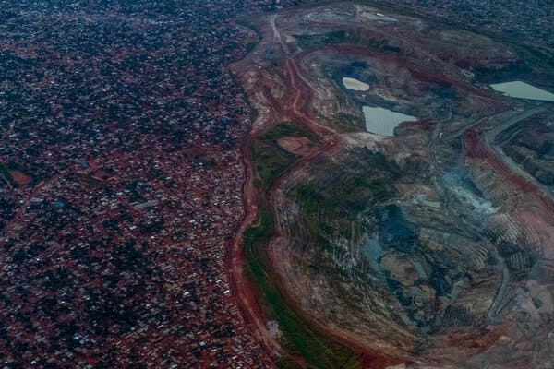
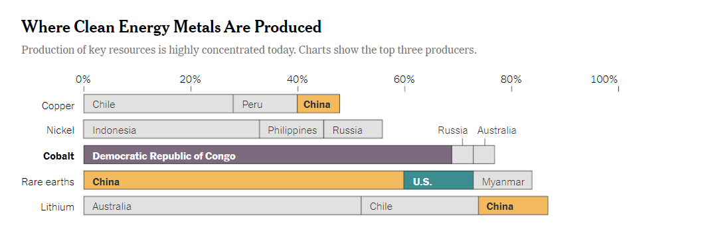
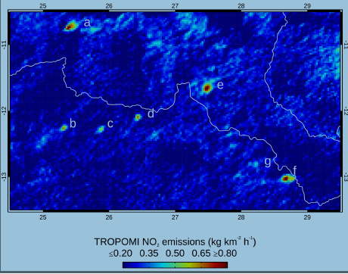
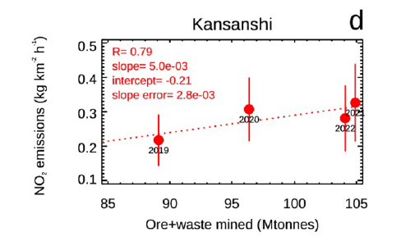
Emissions from metal mining in Africa
(New York Times 2021)
NOx Emissions follow Production
Martinez-Alonso et al., JGR 2023, NCAR ACOM
Prof. dr. Pieternel Levelt, NSF NCAR ACOM, KNMI, TU Delft
Atmospheric Chemistry and Observations Laboratory

Slide 7

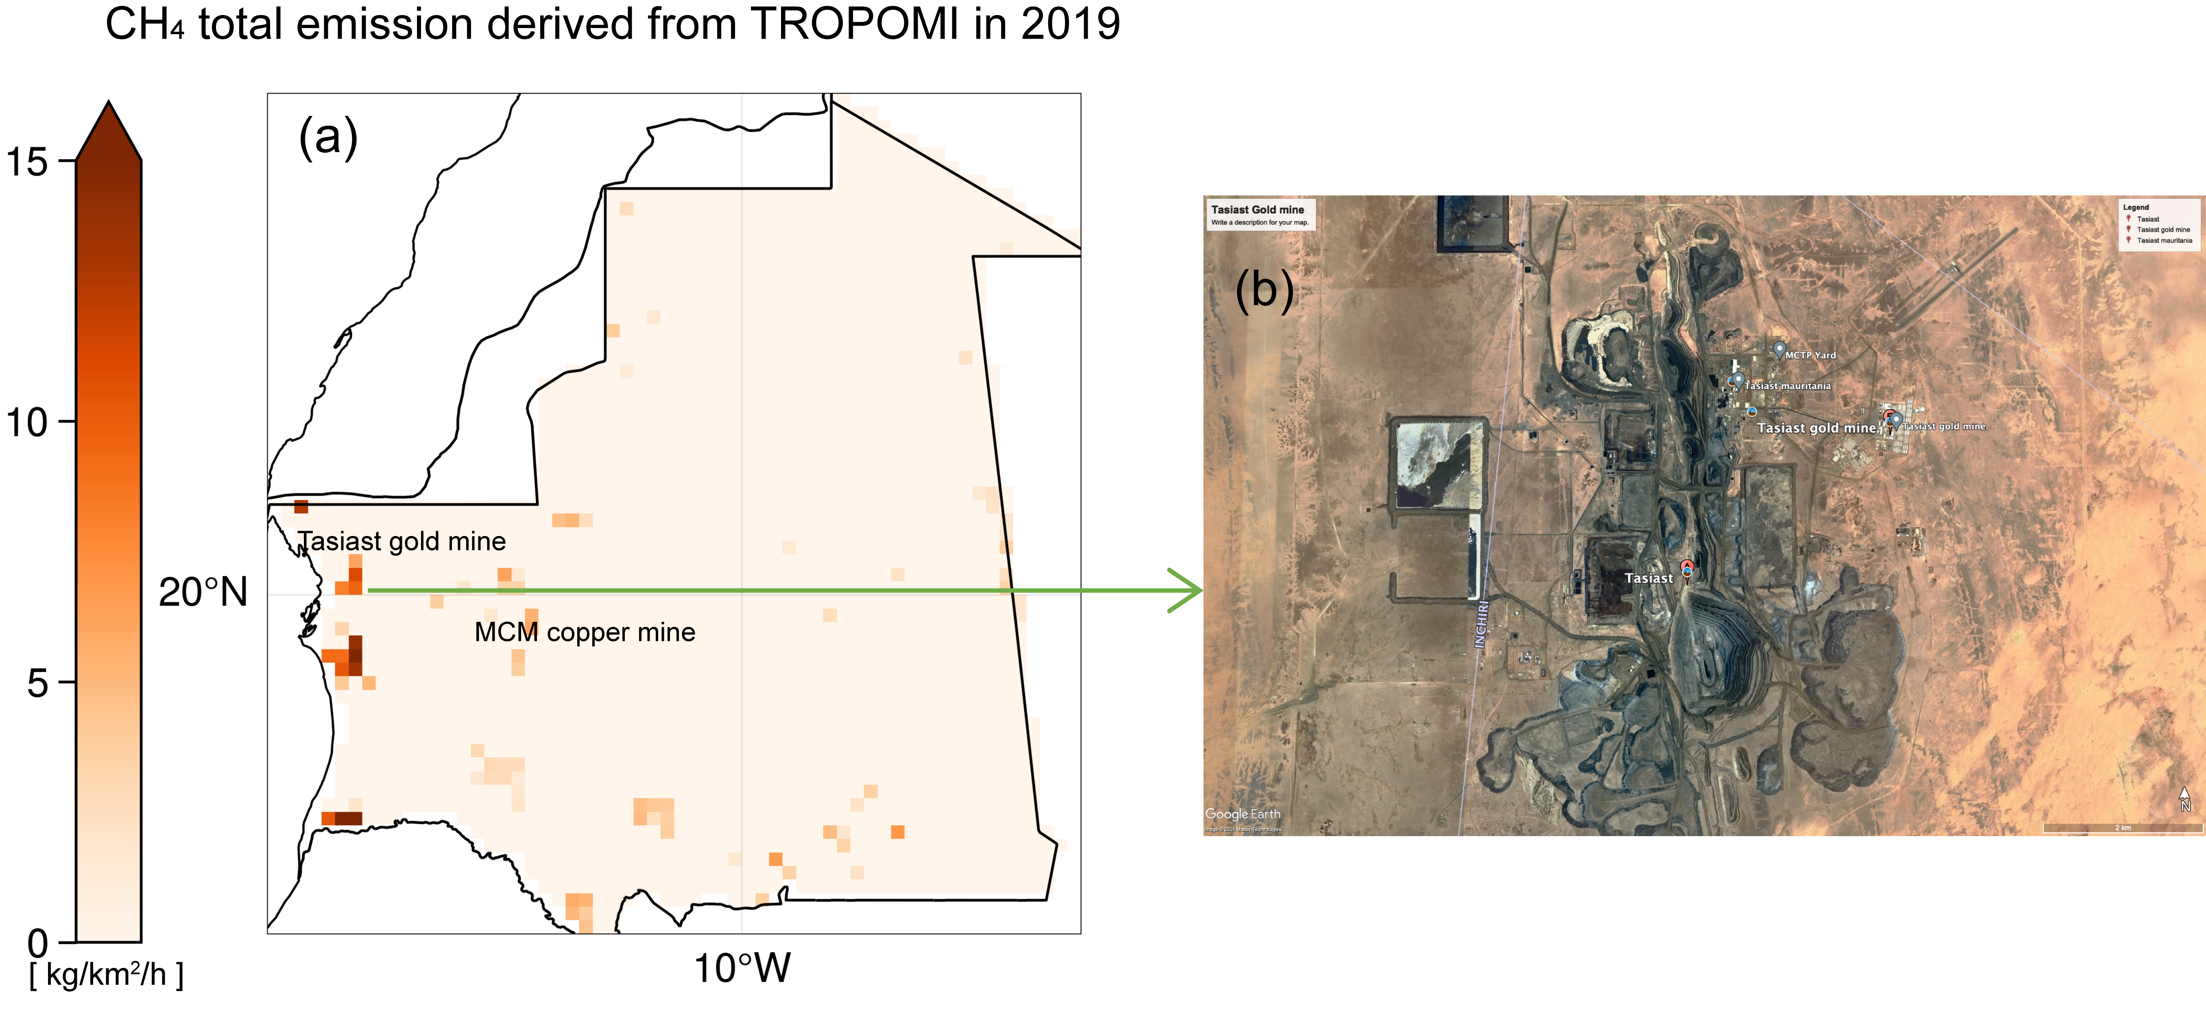
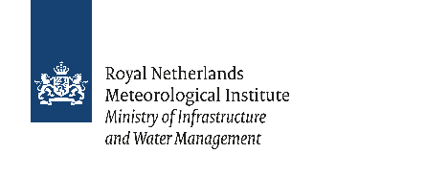


IMProved Atmospheric emissions using Low-earth satellites over Africa (IMPALA)
ESA-project performed by KNMI and BIRA-IASB
Example: Country analysis of Mauritania
TROPOMI derived emissions can reveal missing sources in bottom-up emission inventories.
Slide courtesy: Ronald van der A et al
Prof. dr. Pieternel Levelt, NSF NCAR ACOM, KNMI, TU Delft
Atmospheric Chemistry and Observations Laboratory

Slide 8
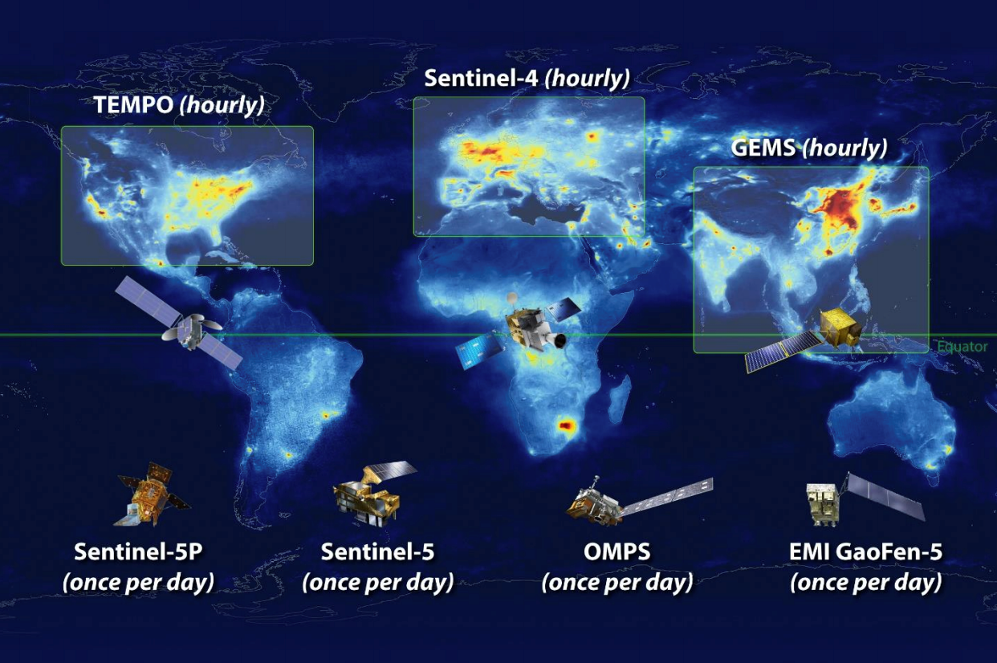
Global Atmospheric Chemistry Constellation
TROPOMI
Prof. dr. Pieternel Levelt, NSF NCAR ACOM, KNMI, TU Delft
Atmospheric Chemistry and Observations Laboratory

Slide 9
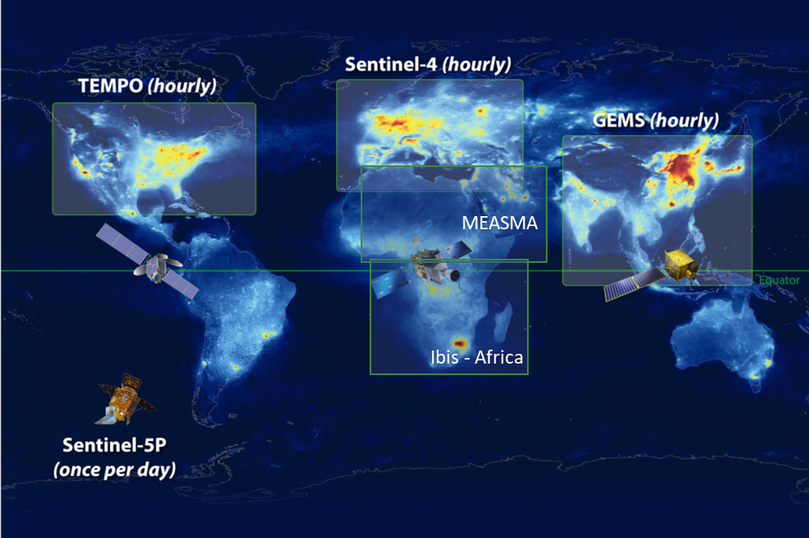
Global Atmospheric Chemistry Constellation
Global Atmospheric Chemistry Constellation
Global Atmospheric Chemistry Constellation
TROPOMI
We need to add Geostationary Satellites over the Global South- Africa
See also statement of the World Economic Forum
https://www.weforum.org/agenda/2023/01/davos23-air-pollution-accountability-satellites-data-transparency/
Driving air pollution accountability and action via data transparency – January 11, 2023
GEO
Field of Regard for MEASMA: GEO over Middle East and North Africa
Field of Regard for MEASMA: GEO over Middle East and North Africa
Prof. dr. Pieternel Levelt, NSF NCAR ACOM, KNMI, TU Delft
Atmospheric Chemistry and Observations Laboratory

Slide 10

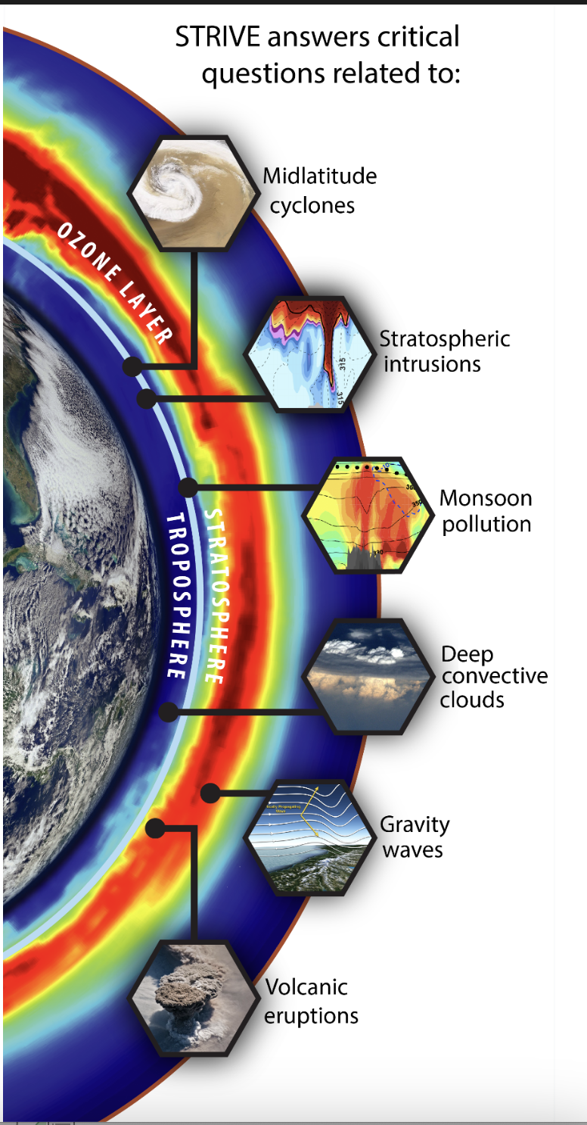
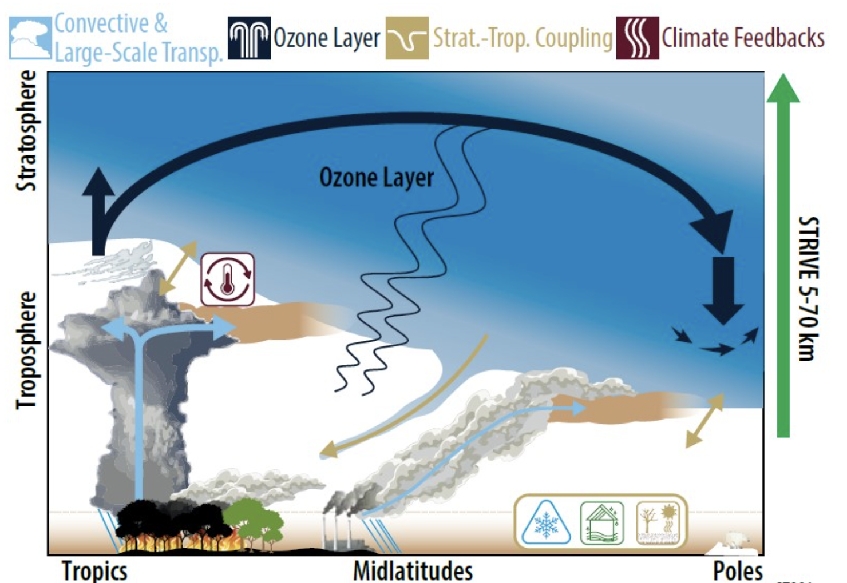
STRIVE PI: Lyatt Jaeglé, University of Washington
STRIVE co-PI’s: Alex Turner and Qiang Fu, University of Washington
Phase A Contribution NCAR ACOM is to develop Prototype retrieval algorithms for the ALICE instrument
Prof. dr. Pieternel Levelt, NSF NCAR ACOM, KNMI, TU Delft
Atmospheric Chemistry and Observations Laboratory
Notes:
STRIVE is a mission focused on measuring stratosphere-troposphere response (5-70 km) vertically-resolved light explorer ALICE. The mission was selected for PHASE A in NASA’s Earth Science Mission proposals. The PI from STRIVE is Lyatt Jaegle, here at the university. ACOM is developing the prototype retrieval algorithms for the ALICE instrument on board of STRIVE. Products are amongst others: Temperature, ozone, H2O, CO2, CH4, N2O, CFC’s, …. STRIVE will measure crucial trace gases related to the recovery os the ozone layer, volcanic eruptions like the recent Hunga Tunga, Monsoon Pollution, and several dynamic related processes like midlatitude cyclones, deep convective clouds, gravity waves and stratospheric intrusions

Slide 11
ALICE data processing flow
Key:
Data sets & Storage
Processing &
Algorithms
Analyses
INPUT
OUTPUT
L0 Data:
Observations, onboard calibration,
S/C ephemeris
L1 Radiances
DAAC
L2 vertical profile retrievals
Pre-calculated Radiances/
Jacobians
L3 maps
L0-1
Geolocation, Radiance Calibration,
Pixel QA
L1-2
Fast Profile Retrieval
L2-3
2D- gridding
3D
Tomography
SCIENCE APPLICATIONS
Pre-launch Calibration Data
Pixel Mask
L2 Retrieval validation
L3 intercomparisons
Radiance models and other available data
L1 Radiance
Validation
Updated On-board processing
In situ profiles
Models &
Reanalyses
Helen Worden et al., NCAR ACOM
Prof. dr. Pieternel Levelt, NSF NCAR ACOM, KNMI, TU Delft
Atmospheric Chemistry and Observations Laboratory

Slide 12
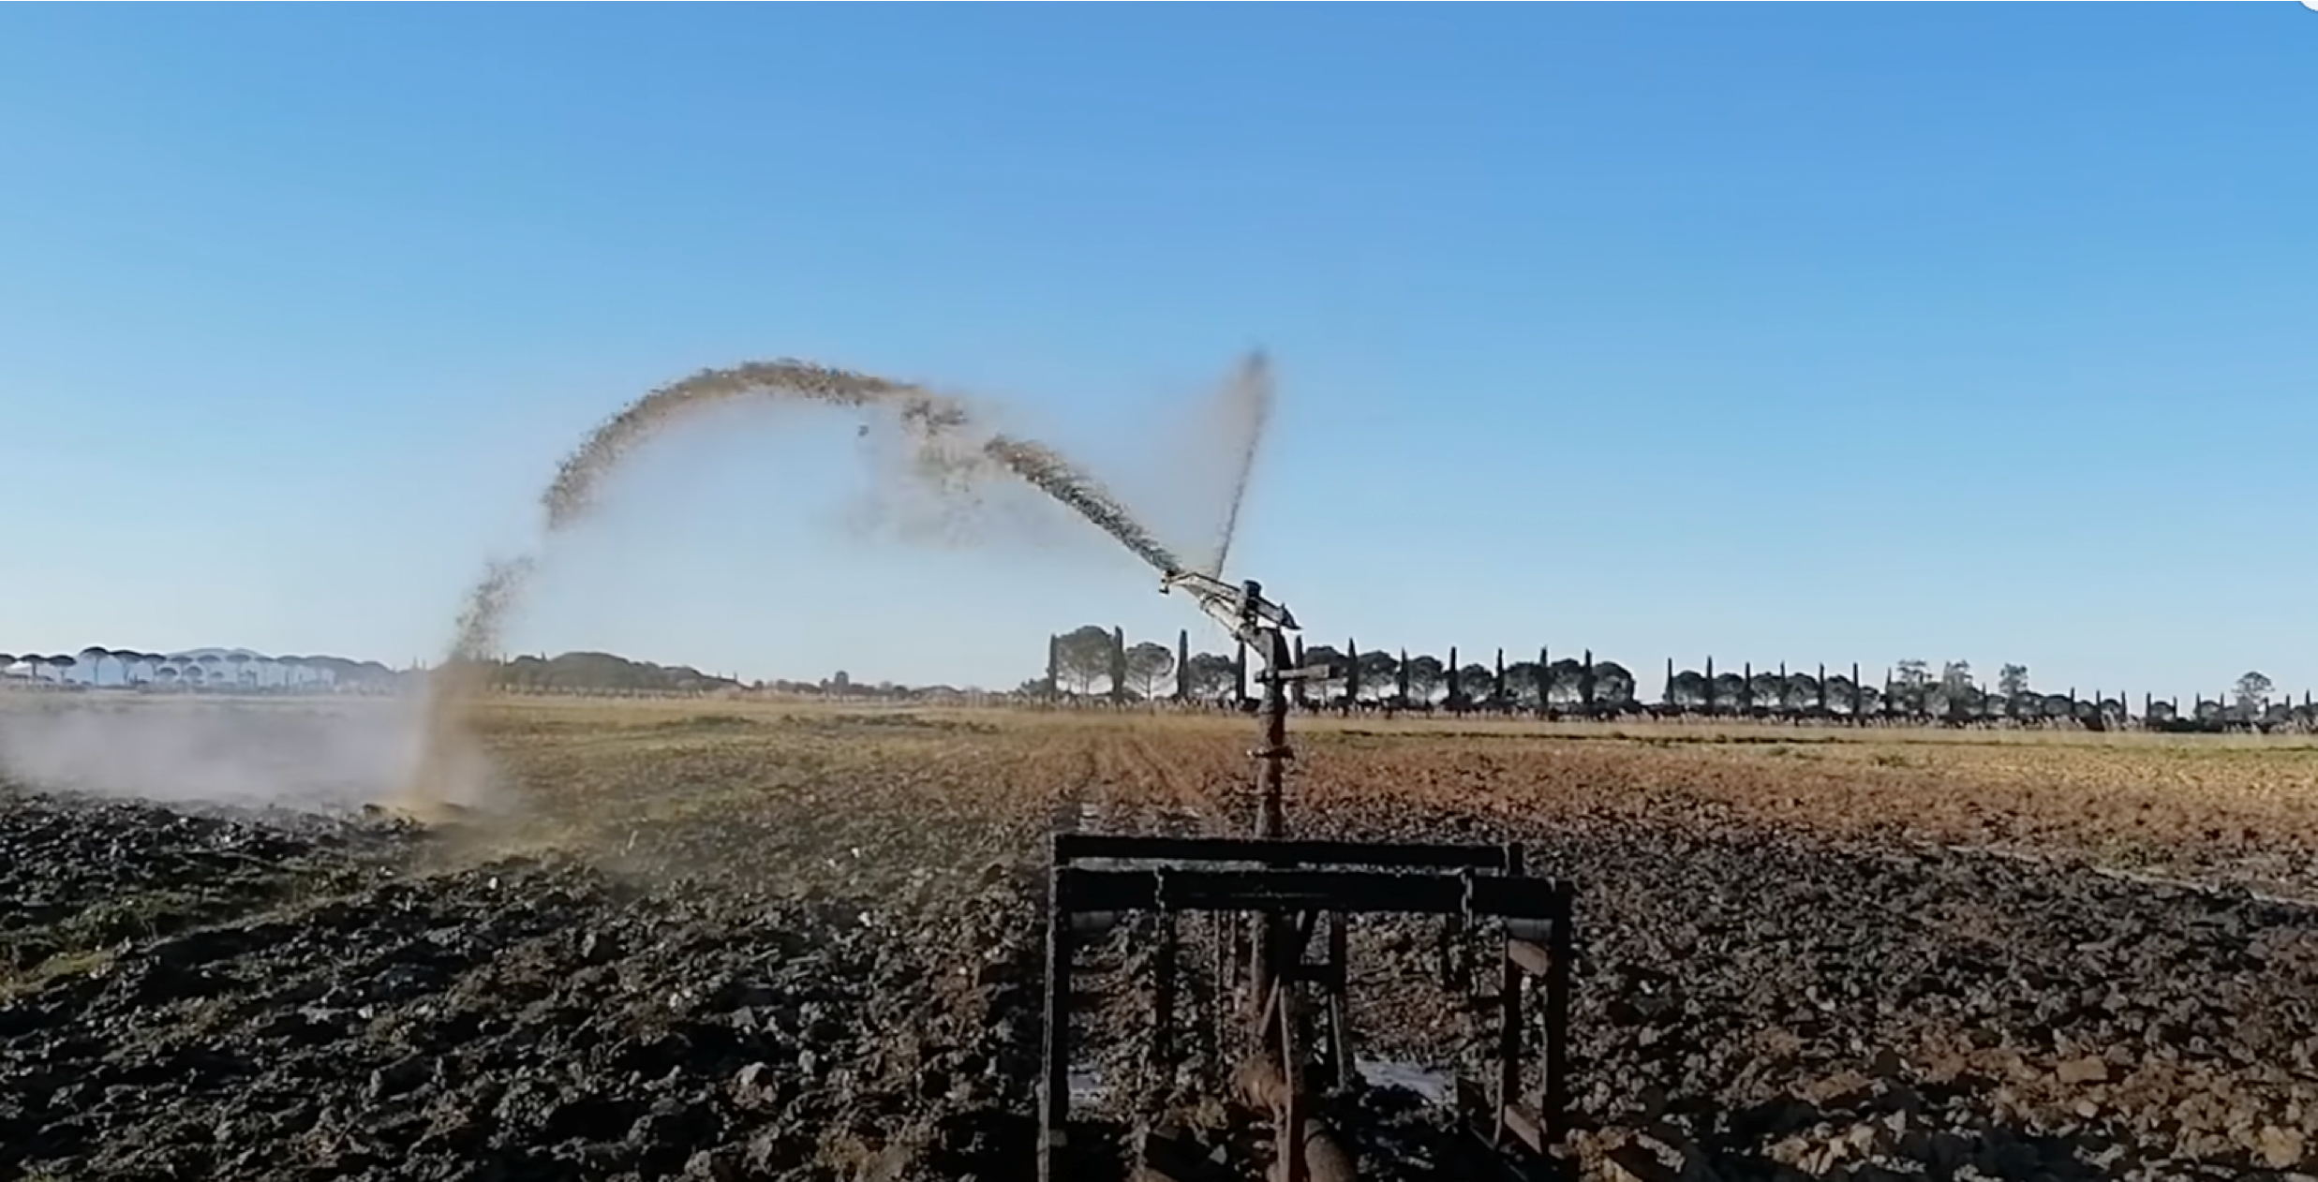
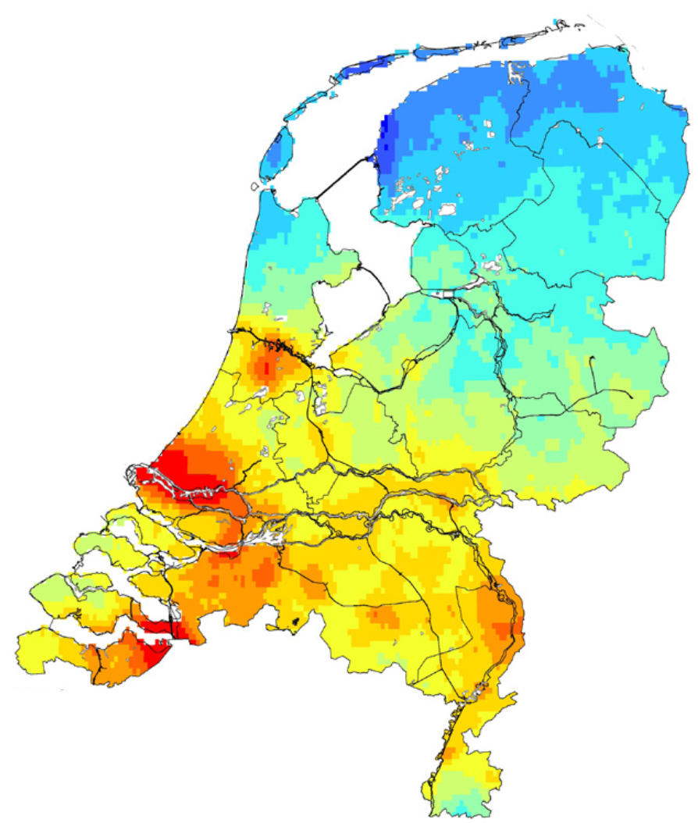
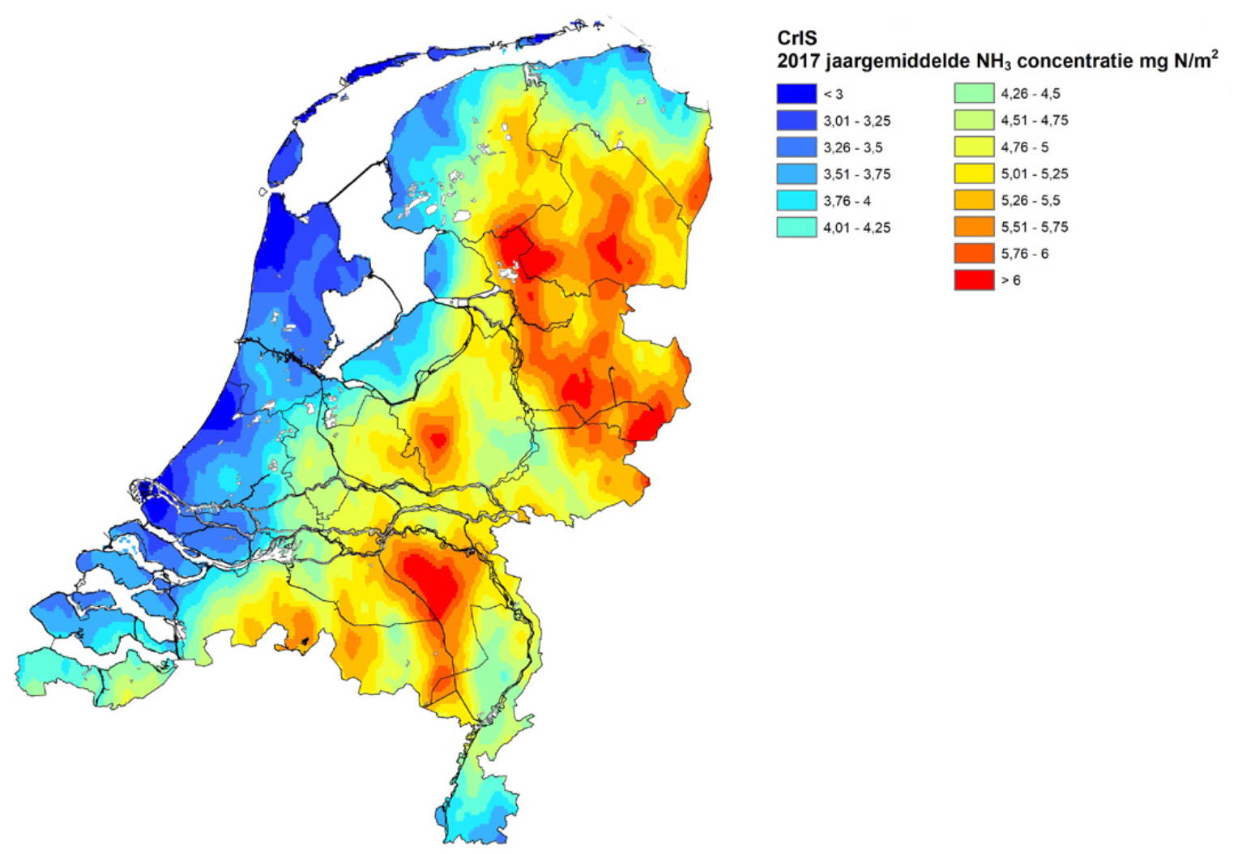
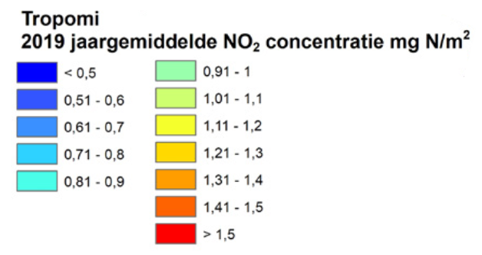
Nitrogen Cycle : measuring Ammonia and NOx on farm scale resolution from space (500x500 m²)
With NITROSAT: an Earth Explorer ESA mission pre-feasibility study
Imaging FTIR and Push broom UVVIS
Lead-Investigator: Pierre Coheur (ULB); co-Lead Investigator Pieternel Levelt (KNMI, TUD, NCAR)
Lieven Clarisse(ULB), Martin van Damme (ULB), Henk Eskes (KNMI), Pepijn Veefkind (KNMI, TUDelft), Ben Veihelman (ESA Science); ESA Engineering proposing Team, Nitrosat Mission Advisory Group , Nitrosat Scientific Study Team
Mission Objectives
TROPOMI
NO₂
CrIS
Ammonia
Quantify the emissions of NH₃ and NO_{x} on the landscape scales, and to attribute the relative contributions of natural, industrial, agricultural, fire, transport and household sources.
Quantify the contribution of reactive nitrogen to air pollution.
Constrain the atmospheric dispersion and surface deposition of reactive nitrogen and its impacts on ecosystems and the carbon cycle.
Reduce uncertainties in the contribution of reactive nitrogen to climate forcing via a better understanding of gas phase chemistry, secondary aerosol formation and interactions between biogeochemical cycles.
Photo Credit: Franco Miglietta

Slide 13
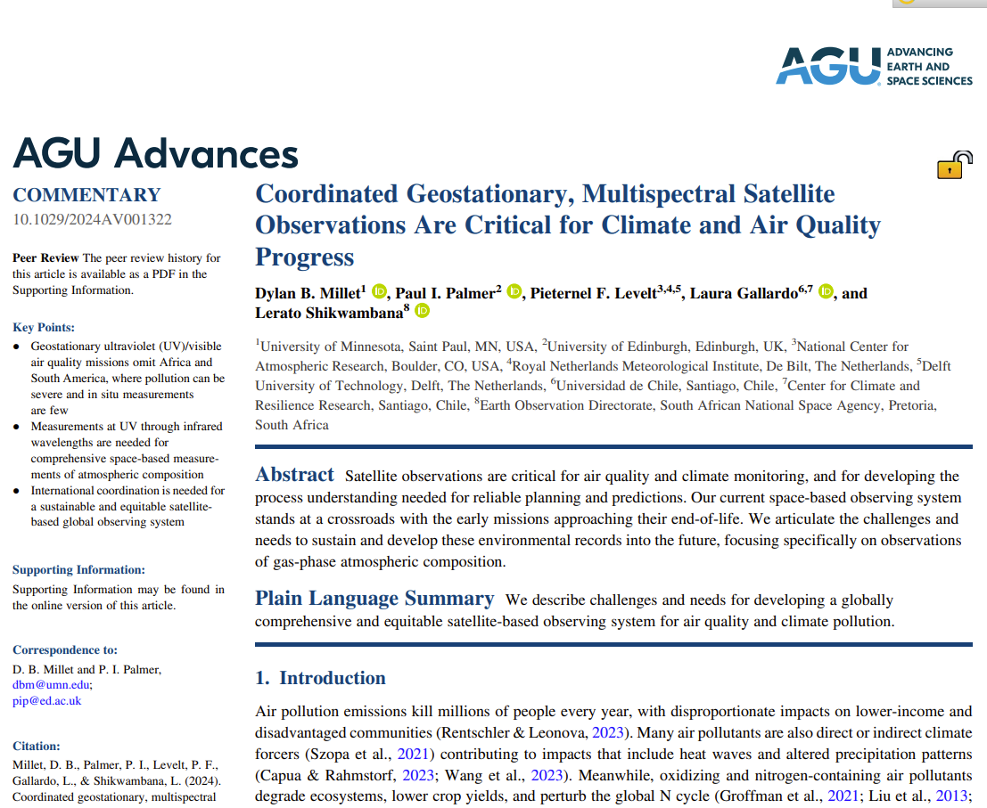
Summary
GEO’s over the Global South
Commentary in AGU Advances (Dylan Millet et al.), 2024
2 initiatives for GEO’s over Africa (Measma & Africa GEO)
Initiate CEOS scientific concept paper: GEOs over the Global South
Currently we are trying to form science teams : focus on scientists from the Global South – interest? Please send me an email.
Townhall Meet Africa GEO at AMS with leaders in the field and cross disciplinary
STRIVE Phase A
Potential follow on for MLS
ESA Earth Explorer Nitrosat
not selected in this round, however we will continue to pursue
Pieternel Levelt, levelt@ucar.edu
Prof. dr. Pieternel Levelt, NSF NCAR ACOM, KNMI, TU Delft
Atmospheric Chemistry and Observations Laboratory

Slide 14
backup

Slide 15
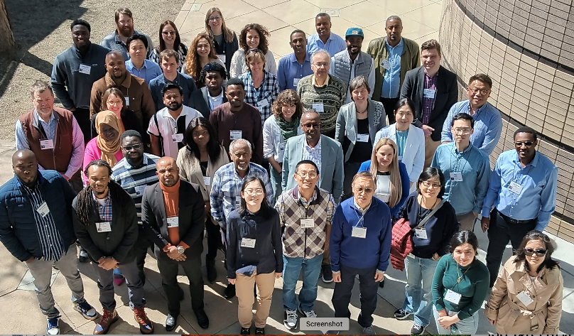
Summary Africa
Population is expected to triple in 2100 (now 1.1 billion, becomes 3.8 billion)
4th industrial revolution: huge increase in air pollutants & green house gases
5 workshops on Africa last years:
Advancing air quality and carbon science in Africa (Ben Gaubert, NCAR ACOM– March 2021)
Lorentz Workshop ‘ The power of TROPOMI to bridge Science and Policy’ (Pieternel Levelt and Marleen Dekker KNMI& Leiden Univ- April 2022)
Workshop on a pilot design for air quality in Africa(Solomon Bililing – June 2022)
Workshop on AQ in Africa , in Kigali - Africa (Solomon Bililing et al – Jan 2023)
IGAC: Long standing tradition with Africa subgroup, including scientists from Africa
NCAR & KNMI could contribute: Ground based monitoring, modelling, flight campaigns, laboratory , satellite observations
Investigate Potential for GEOstationary satellite over the Global South and Africa, working on a GEO Science Team with USA, European and African scientist representation, several science meetings focused on GEO capability.
UCAR/NCAR initiative ‘Accelerating environmental sustainability solutions in Africa: a UCAR initiative’, Workshop at NCAR, Boulder CO, (Wenfu Tang et al – March 21-22, 2024)
Pieternel Levelt, levelt@ucar.edu
Prof. dr. Pieternel Levelt, NSF NCAR ACOM, KNMI, TU Delft
Atmospheric Chemistry and Observations Laboratory

Slide 16
Current activities in the international space community
Perspective in AGU Advances (Dylan Millet et al.), 2024
There are 2 initiatives for GEO’s to measure over Africa
  Measma (Omar Emam , Raid Suleiman et al)
  Africa GEO (Pieternel Levelt et al)
Currently we are trying to form science teams : focus on scientists from the Global South – interest? Please send me an email.
2024 presentations: EGU 2024 (Vienna) GEOXO meeting (Washington DC) , OMI-TROPOMI STM (NCAR-ACOM, Boulder, CO)
Coming AGU & AMS 2024/2025:
  Townhall Meet at AMS with leaders in the field and cross disciplinary (last year we had a townhall at AGU 2023)
  Abstracts AGU 2024 and AMS 2025 (Levelt et al.)
ACVC/CEOS meeting October 14-18, 2024 in Washington DC, presentation - start of scientific concept paper for the need of GEOs over the Global South (interested?- please contact me)
Ball Aerospace Corporate talks to private funders and foundations
Pieternel Levelt, levelt@ucar.edu
Prof. dr. Pieternel Levelt, NSF NCAR ACOM, KNMI, TU Delft
Atmospheric Chemistry and Observations Laboratory

Slide 17
CO
NO₂
Biomass Burning over Africa
as measured by TROPOMI
CO and NO₂
April 2020
April 2020
Biomass burning in tropical Africa
June 2020
June 2020
Power plants near Johannesburg
Slide courtesy: Pepijn Veefkind, KNMI
Oct. 2020
Oct. 2020
Prof. dr. Pieternel Levelt,
NSF NCAR ACOM, KNMI, TU Delft

Slide 18
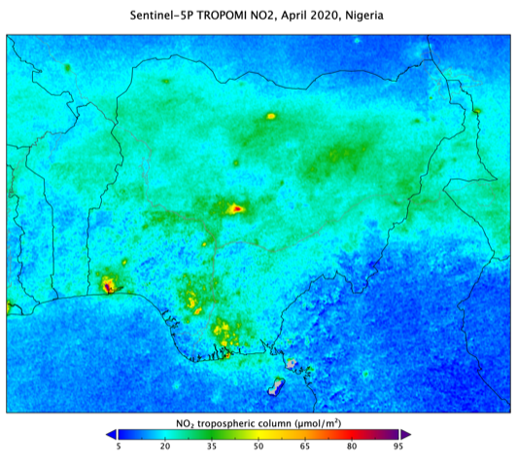
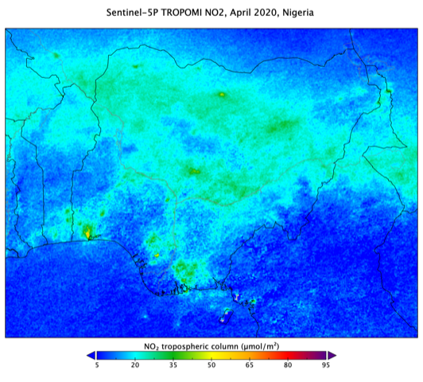
TROPOMI NO₂ measurements over Africa: COVID lockdown
TROPOMI NO2 yearly mean 2019
Nigeria,TROPOMI NO₂ , April 2019
Nigeria, TROPOMI NO₂ , April 2020
Courtesy: Henk Eskes, KNMI
Prof. dr. Pieternel Levelt, NSF NCAR ACOM, KNMI, TUDelft
Atmospheric Chemistry and Observations Laboratory
Henk Eskes, KNMI

Slide 19
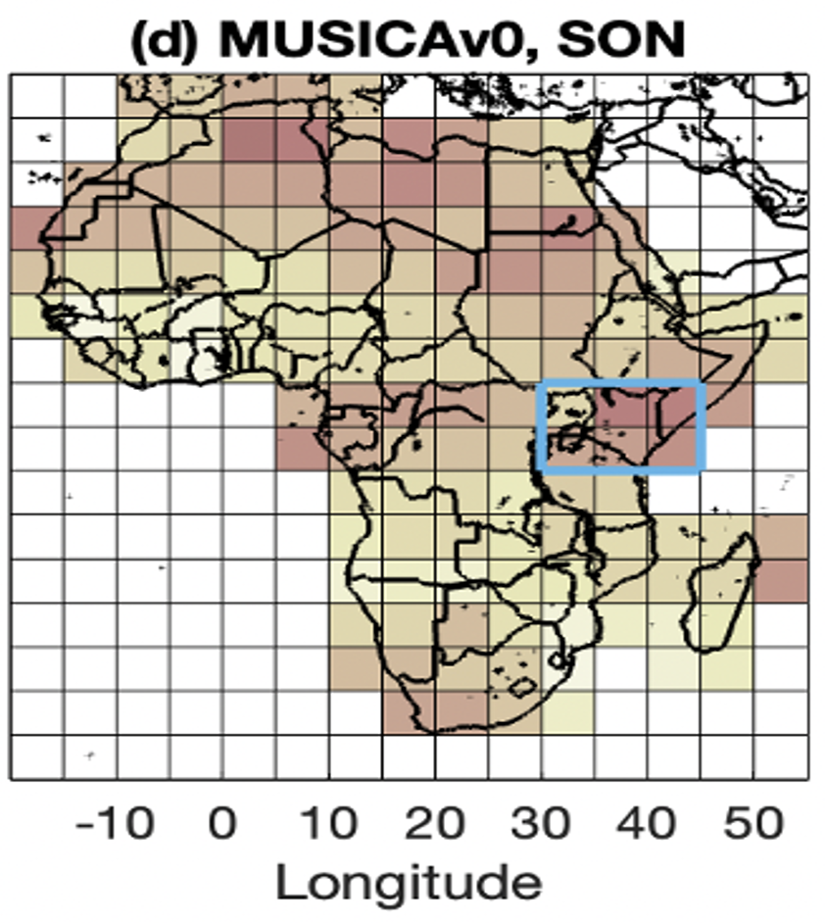
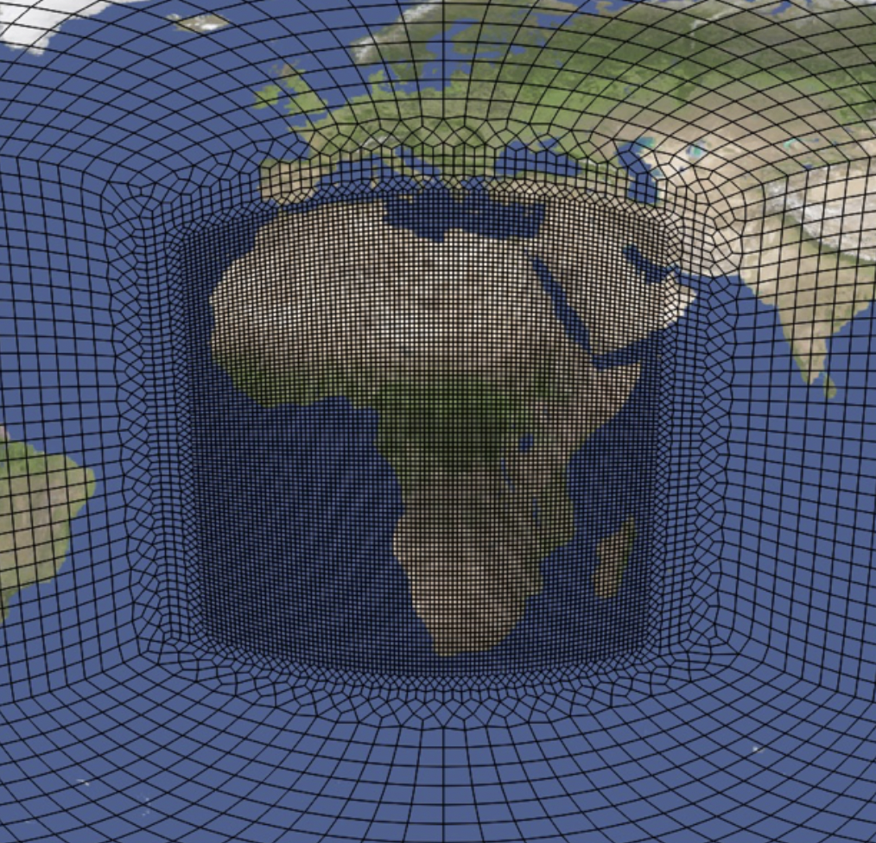

Air Quality Modelling over Africa using MUSICA
We quantify model-satellite discrepancies over Africa with MUSICAv0.
The highlighted East Africa region has the largest model-satellite discrepancies.
A field campaign there can help understand model-satellite discrepancies and improve model predictability.
MUSICAv0 grid for Africa:
MUSICA-satellite discrepancies:
Better agreement
for CO, NO2, HCHO, AOD
Worse agreement
For CO, NO2. HCHO. AOD
Aircraft campaign
East Africa?
Wenfu Tang et al., GMD 2023, NCAR ACOM
Prof. dr. Pieternel Levelt, NSF NCAR ACOM, KNMI, TU Delft
Atmospheric Chemistry and Observations Laboratory

Slide 20
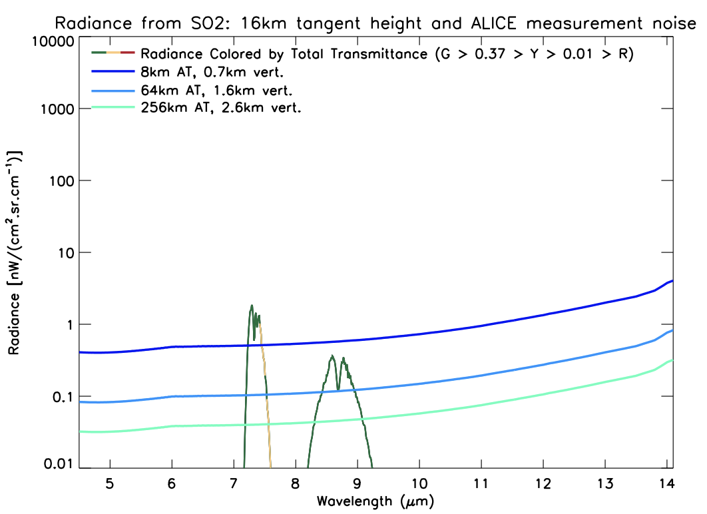
ALICE measurements and data products
Primary Species:
CO₂ (Temperature)
O₃
H₂O
CH4
N₂O
CFC-11, 12
HNO₃
NO₂
ClONO₂
H₂SO₄
CO
HCN (in plumes)
thin cirrus/PSC
Secondary Species:
Research products
N₂O₅
HCFC-22
CCl₄
OCS
SF₆
SO₂ (in plumes)

Slide 21
Nitrogen Cycle : measuring Ammonia and NOx on farm scale resolution from space (500x500 m²)
With NITROSAT: an Earth Explorer ESA mission pre-feasibility study
Lead-Investigator: Pierre Coheur (ULB); co-Lead Investigator Pieternel Levelt (KNMI, TUD, NCAR)
Lieven Clarisse (ULB), Martin Van Damme (ULB), Henk Eskes (KNMI), Pepijn Veefkind (KNMI and TUD), Cathy Clerbaux (LATMOS, France), Michel Van Roozendael (BIRA-IASB, Belgium), Frank Dentener (JRC, Italy) , Jan Willem Erisman (Leiden University, The Netherlands), Martijn Schaap (TNO, The Netherlands; TU Berlin, Germany), Mark Sutton (CEH, United-Kingdom)
TROPOMI
NO₂
Synchronized imaging of NH₃ and NO₂ at a spatial resolution of 500 x 500m² and a
Bi-monthly revisit time for detecting seasonal impacts
CrIS
Ammonia
NH₃
Infrared imaging Fourier Transform Spectrometer
900-1000 cm⁻¹ spectral range
0.625 cm⁻¹ spectral sampling
NeDT < 0.38 K
NO₂
Visible Imaging Pushbroom Spectrometer
<405-500 nm spectral range
0.5 nm spectral resolution
SNR 600-800 (cloud free)

