Slide 1

CEOS AC-VC Meeting
IR Sounder Status
H. Worden (NSF NCAR)
C. Clerbaux (LATMOS & ULB)
D. Millet (U. Minnesota)
K. Bowman, V. Payne, T. Wang (JPL)

Slide 2
Terra/MOPITT and Aqua/AIRS Status
Terra/Aqua/Aura have completed final IAMs and are now have drifting equator crossing times.
Based on power generation, estimated times for end of science are:
  Aura End of Science – May 27, 2026 (requires Over-guide approval)
  Aqua End of Science – August 26, 2026 (In-guide)
  Terra End of Science – February 24, 2027 (In-guide)
  On August 11, MOPITT experienced failure of the MWIR PMC-2 (channel 7) with sensitivity in the upper troposphere. Sensitivity in the lower troposphere remains good in the MWIR and the SWIR observation was not impacted. MOPITT will continue producing vertical profiles and columns; AK describes the reduced sensitivity.
Notes:
IAM = inclination adjust maneuver

Slide 3
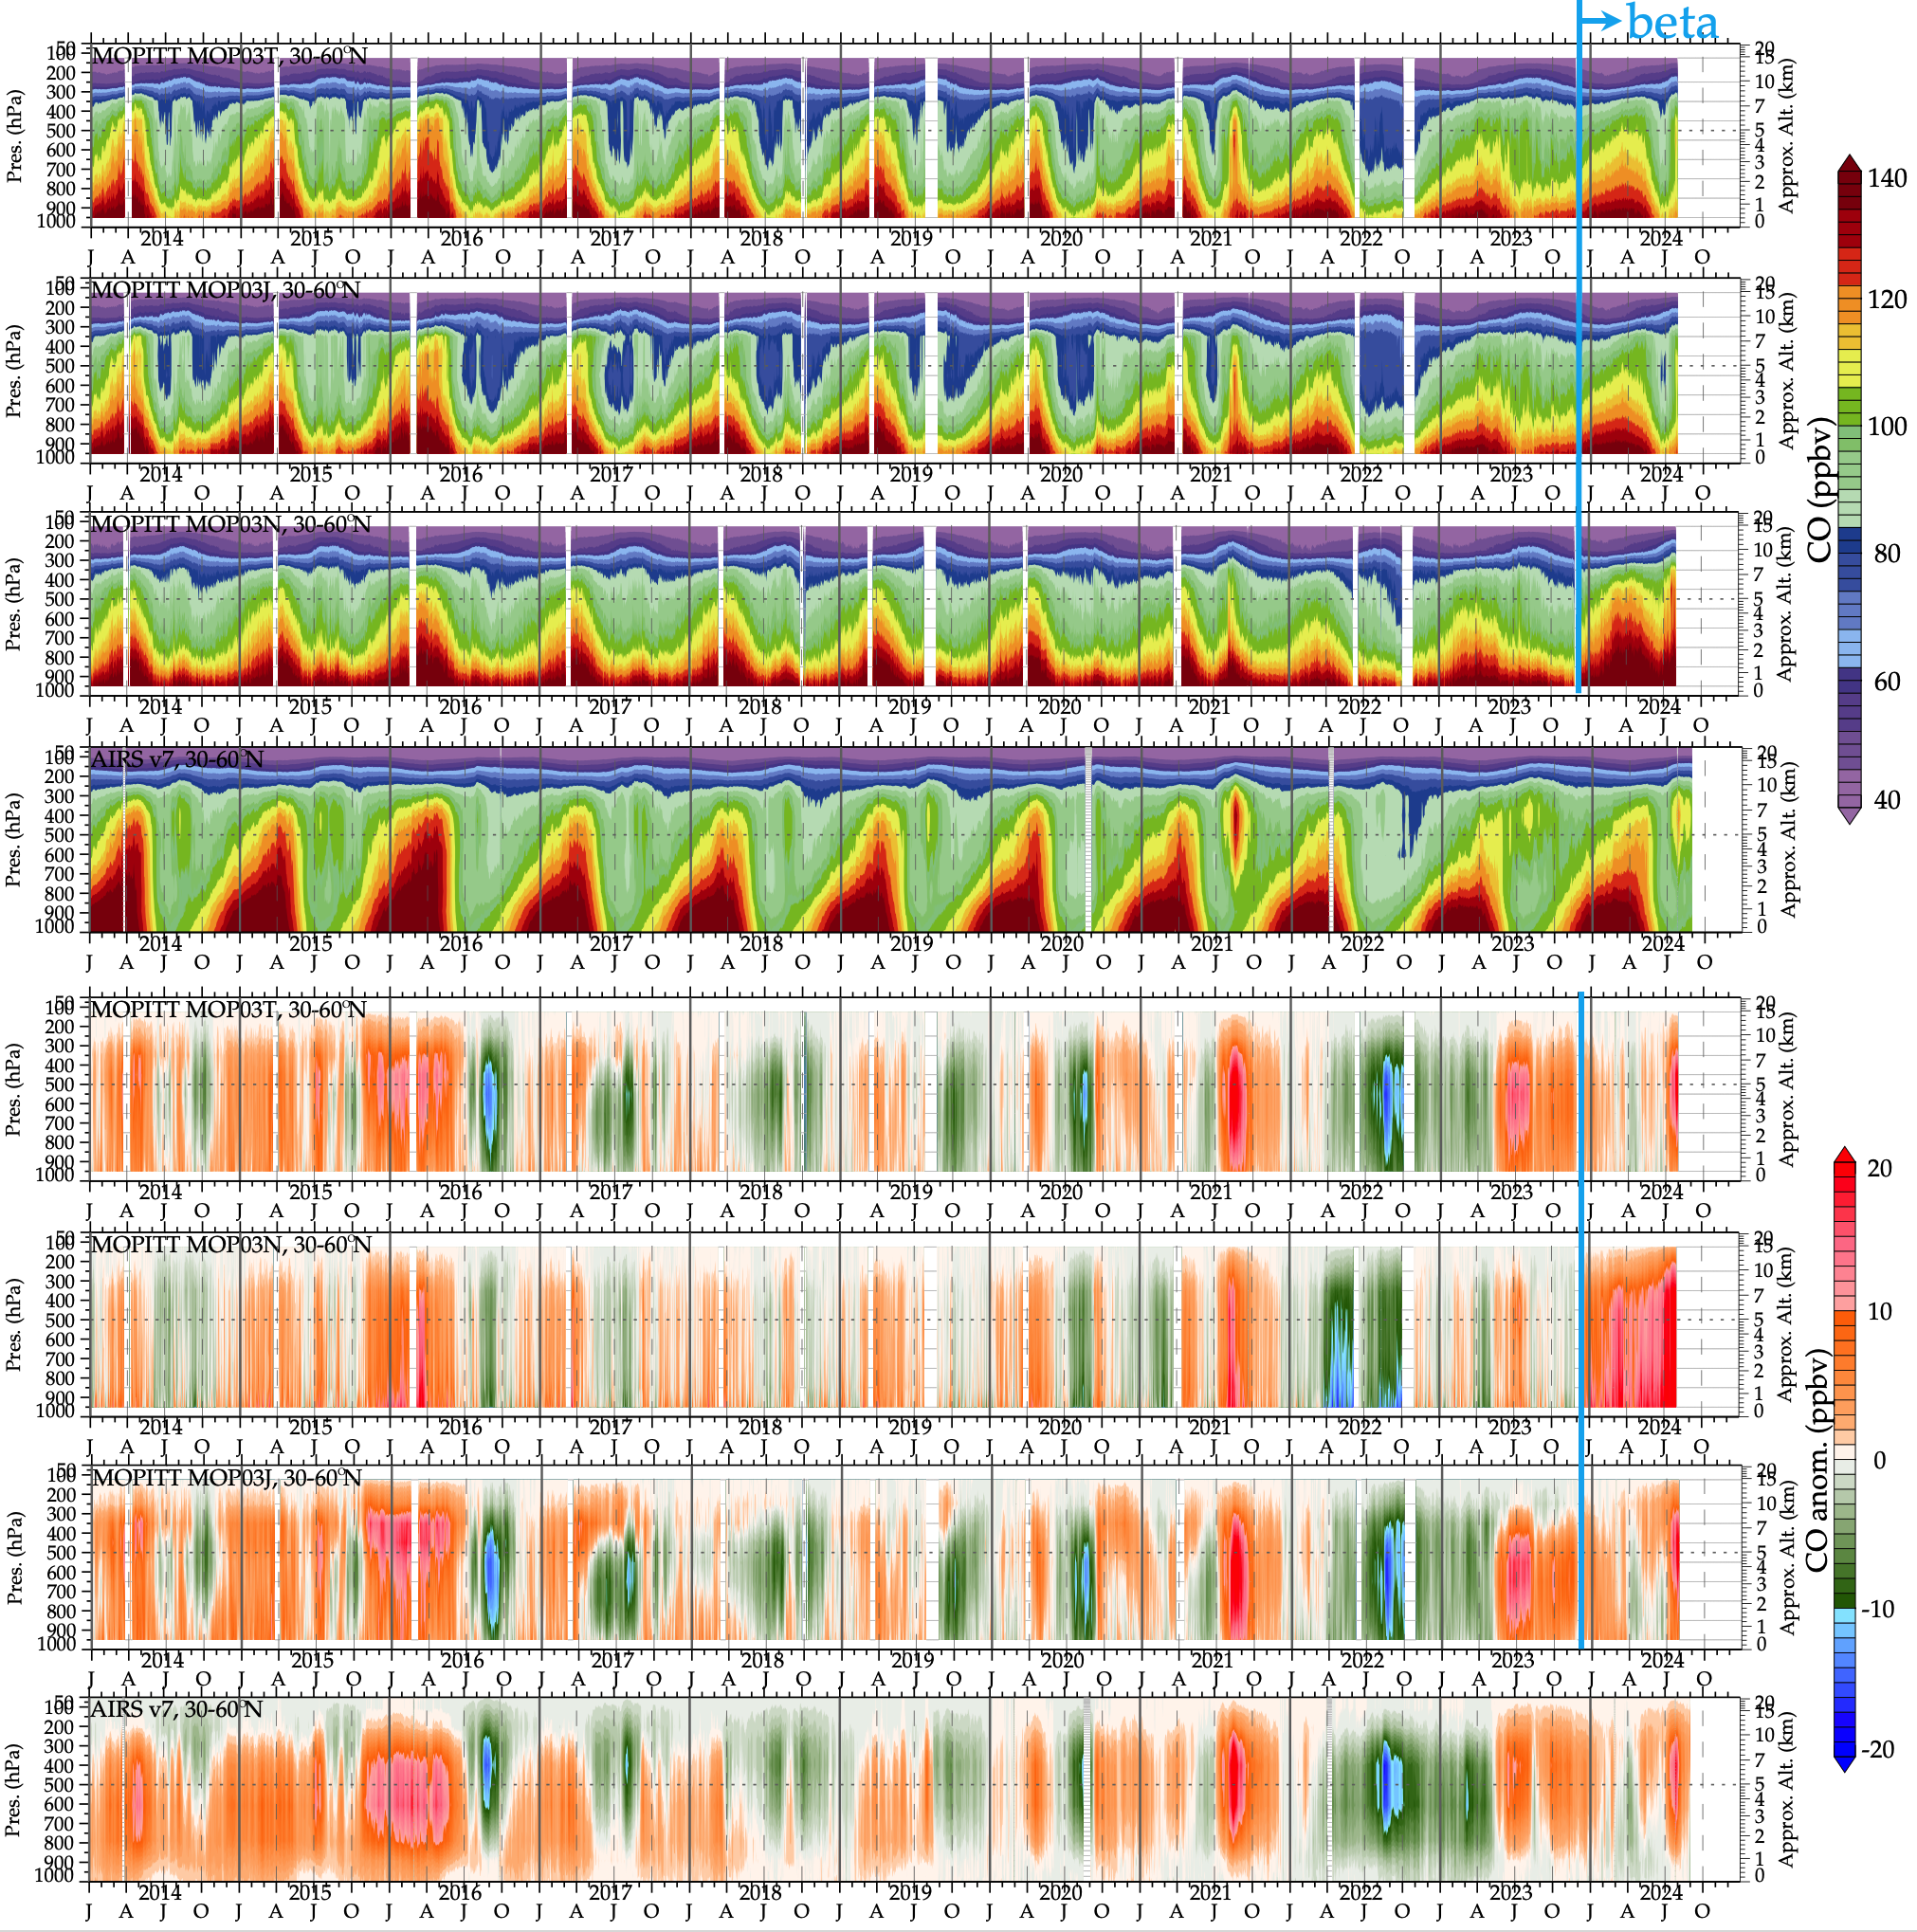
MOPITT and AIRS comparison of anomalies
(courtesy of W. Tang, JPL)

Slide 4
IASI - 5 slides best of
Cathy Clerbaux for the LATMOS & ULB Teams

Slide 5
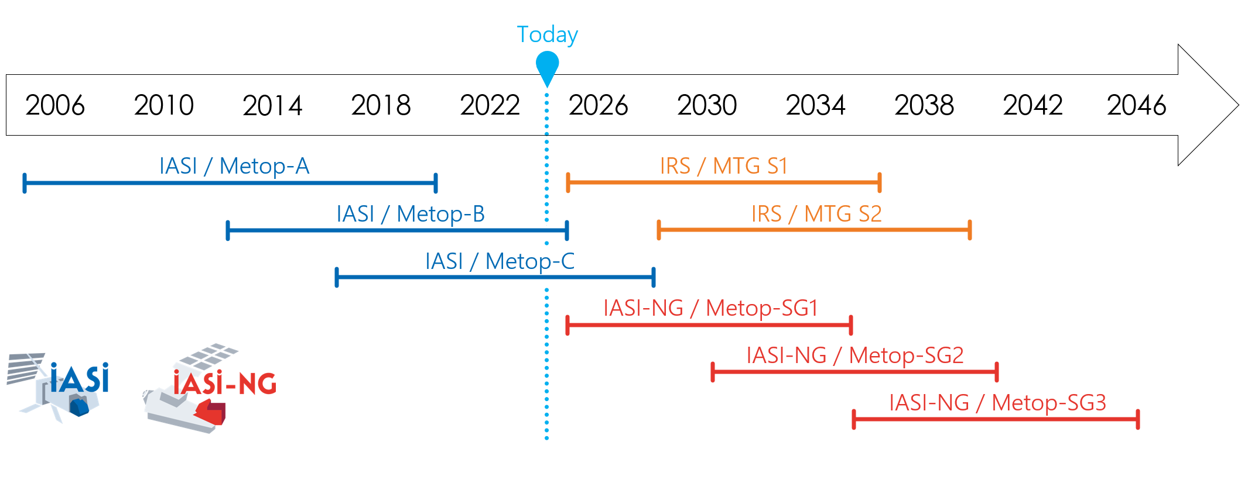

Slide 6
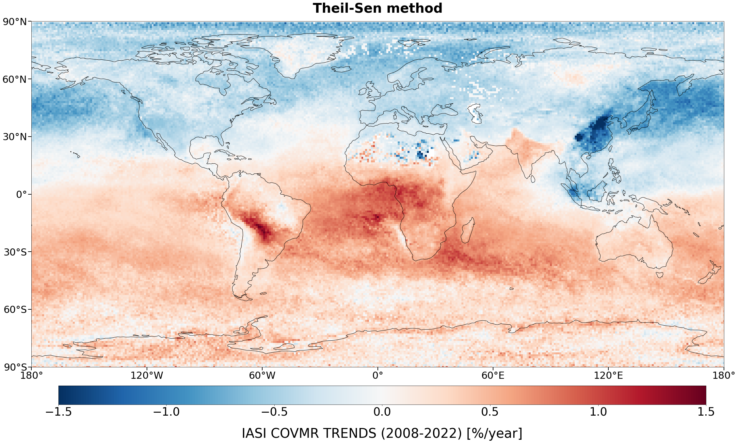
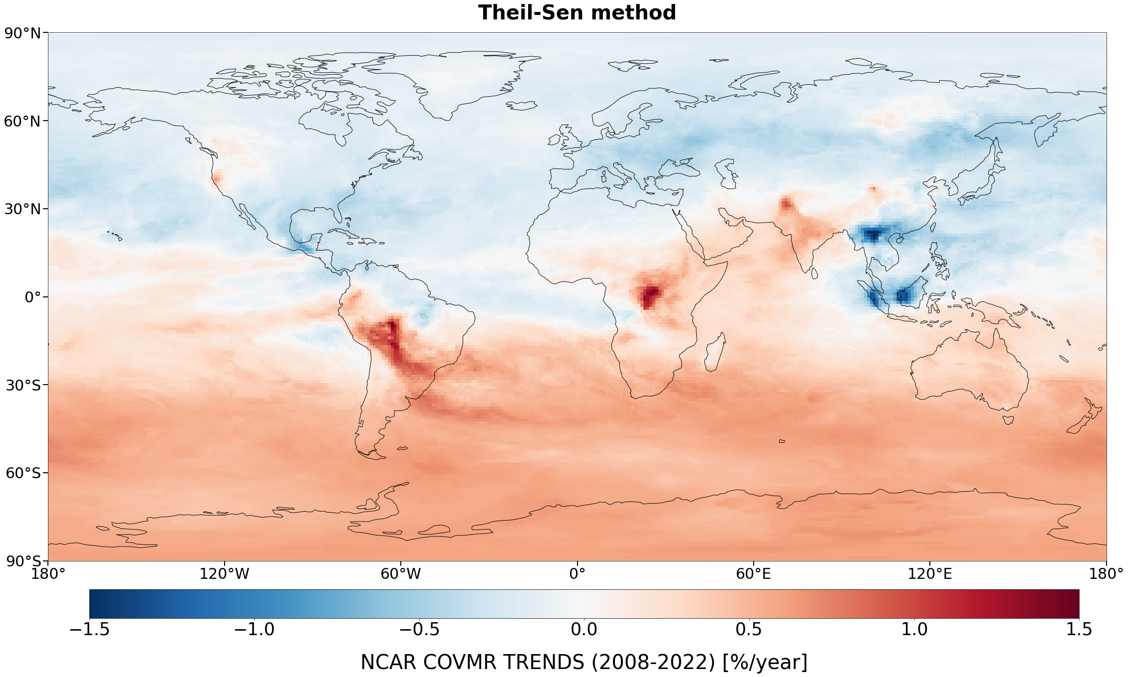
CO-trends
Musica model (NCAR)
CAMS-GLOB-ANTv5.3 + FINNv5.2, 2008-2022
IASI total columns 2008-2022

Slide 7
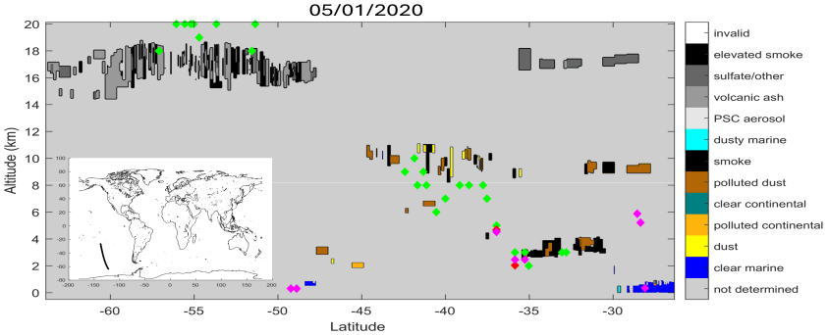
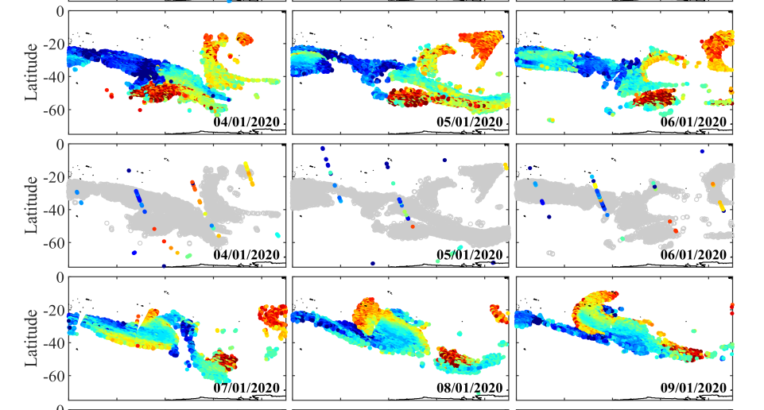
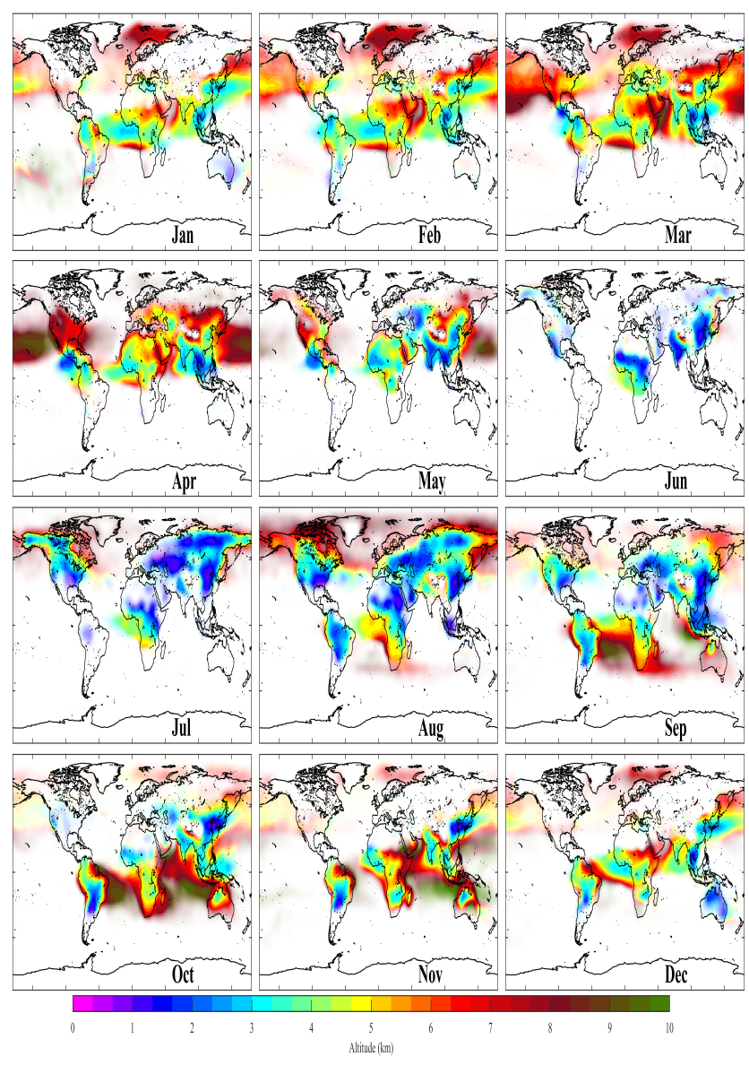
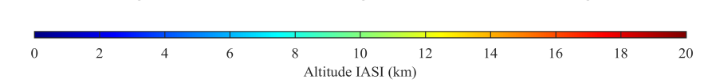
CO-altitude
For large columns, represents the peak altitude of CO
Very few satellite products are available capable of tracking plume altitude (both anthropogenic and biomass burning plumes)
Prototype product for IASI has been developed (Lecomte et al., 2024)
IASI
Example climatology of retrieved altitudes showing both fire plumes and anthropogenic pollution
Example retrievals from the January 2020 fires

Slide 8
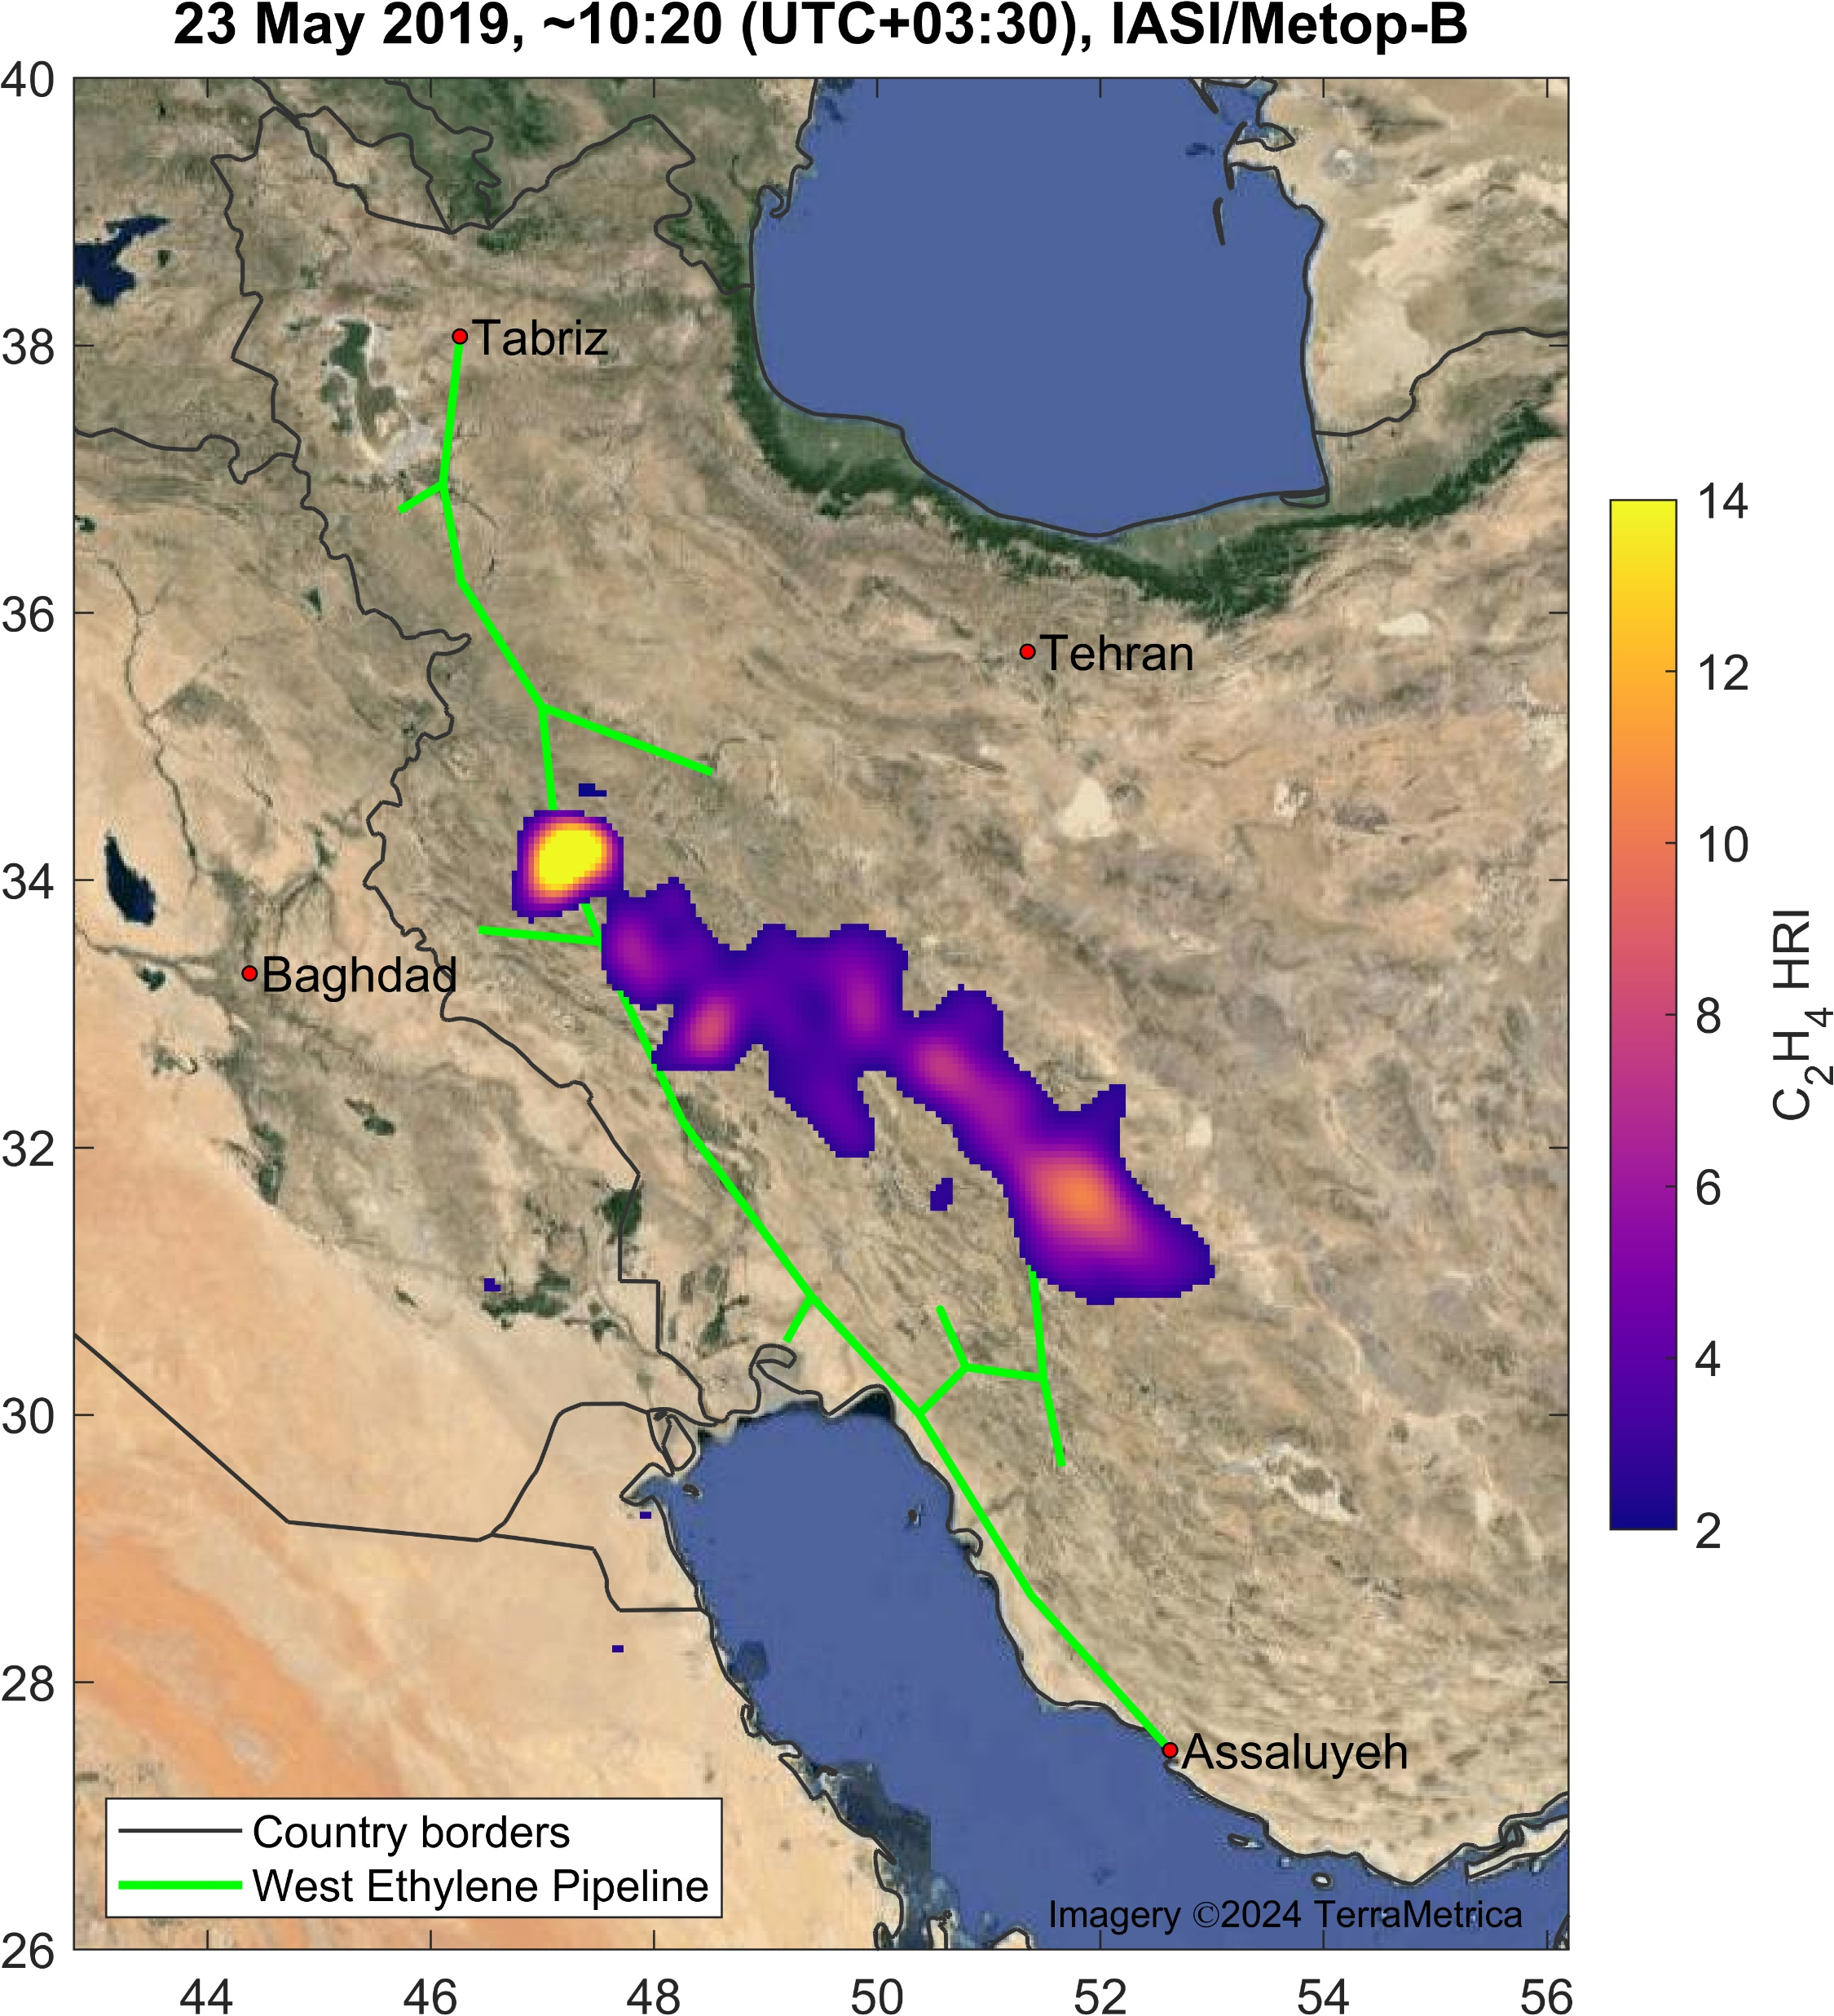
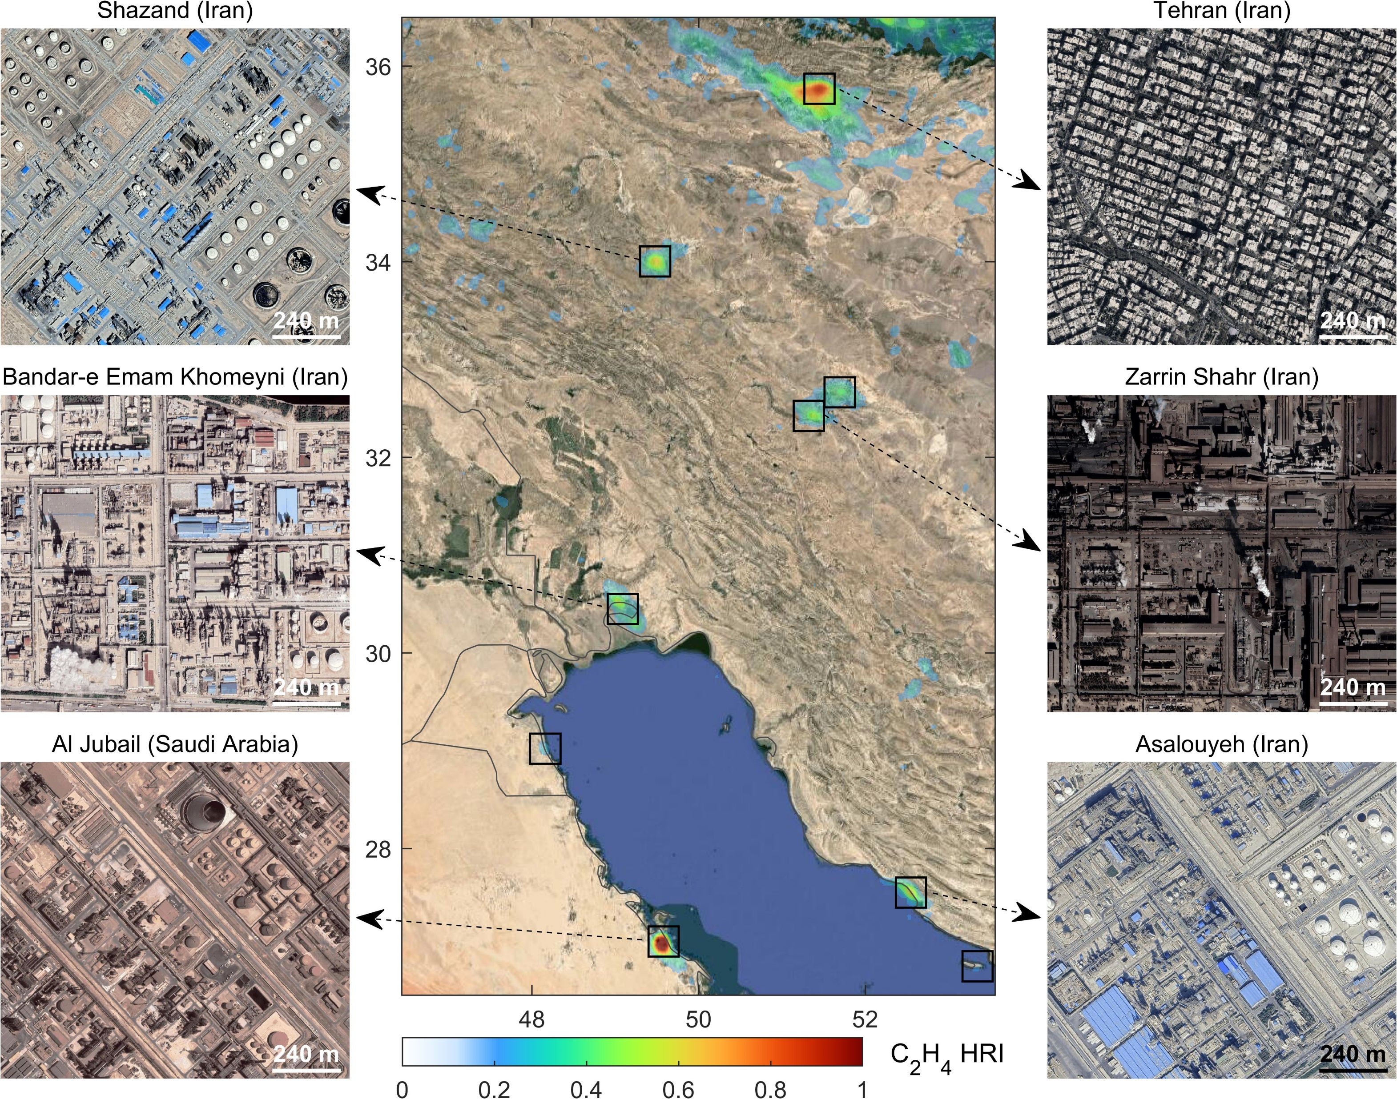
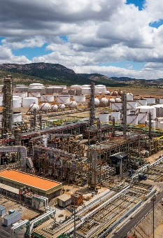
New retrievals : Ethylene C₂H₄
Fire tracer allowing to track transport and study chemistry of biomass burning plumes
Emitted also by a variety of different industries (see figure below)
Product is based on a fast retrieval scheme and proven heritage from IASI (Franco et al., 2022)
Tracking pipeline leaks C₂H₄ in Iran,
7 major leaks tracked by IASI since 2012 when the pipeline was build
C₂H₄ emissions from petrochemical hubs

Slide 9
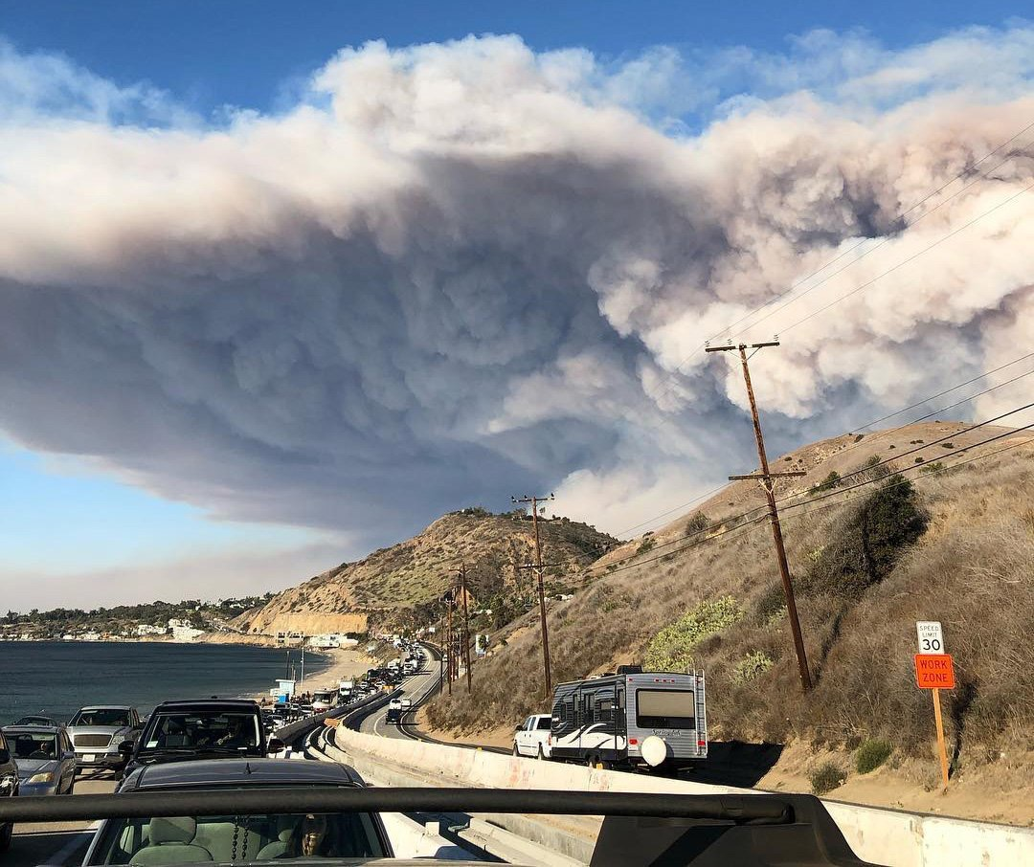
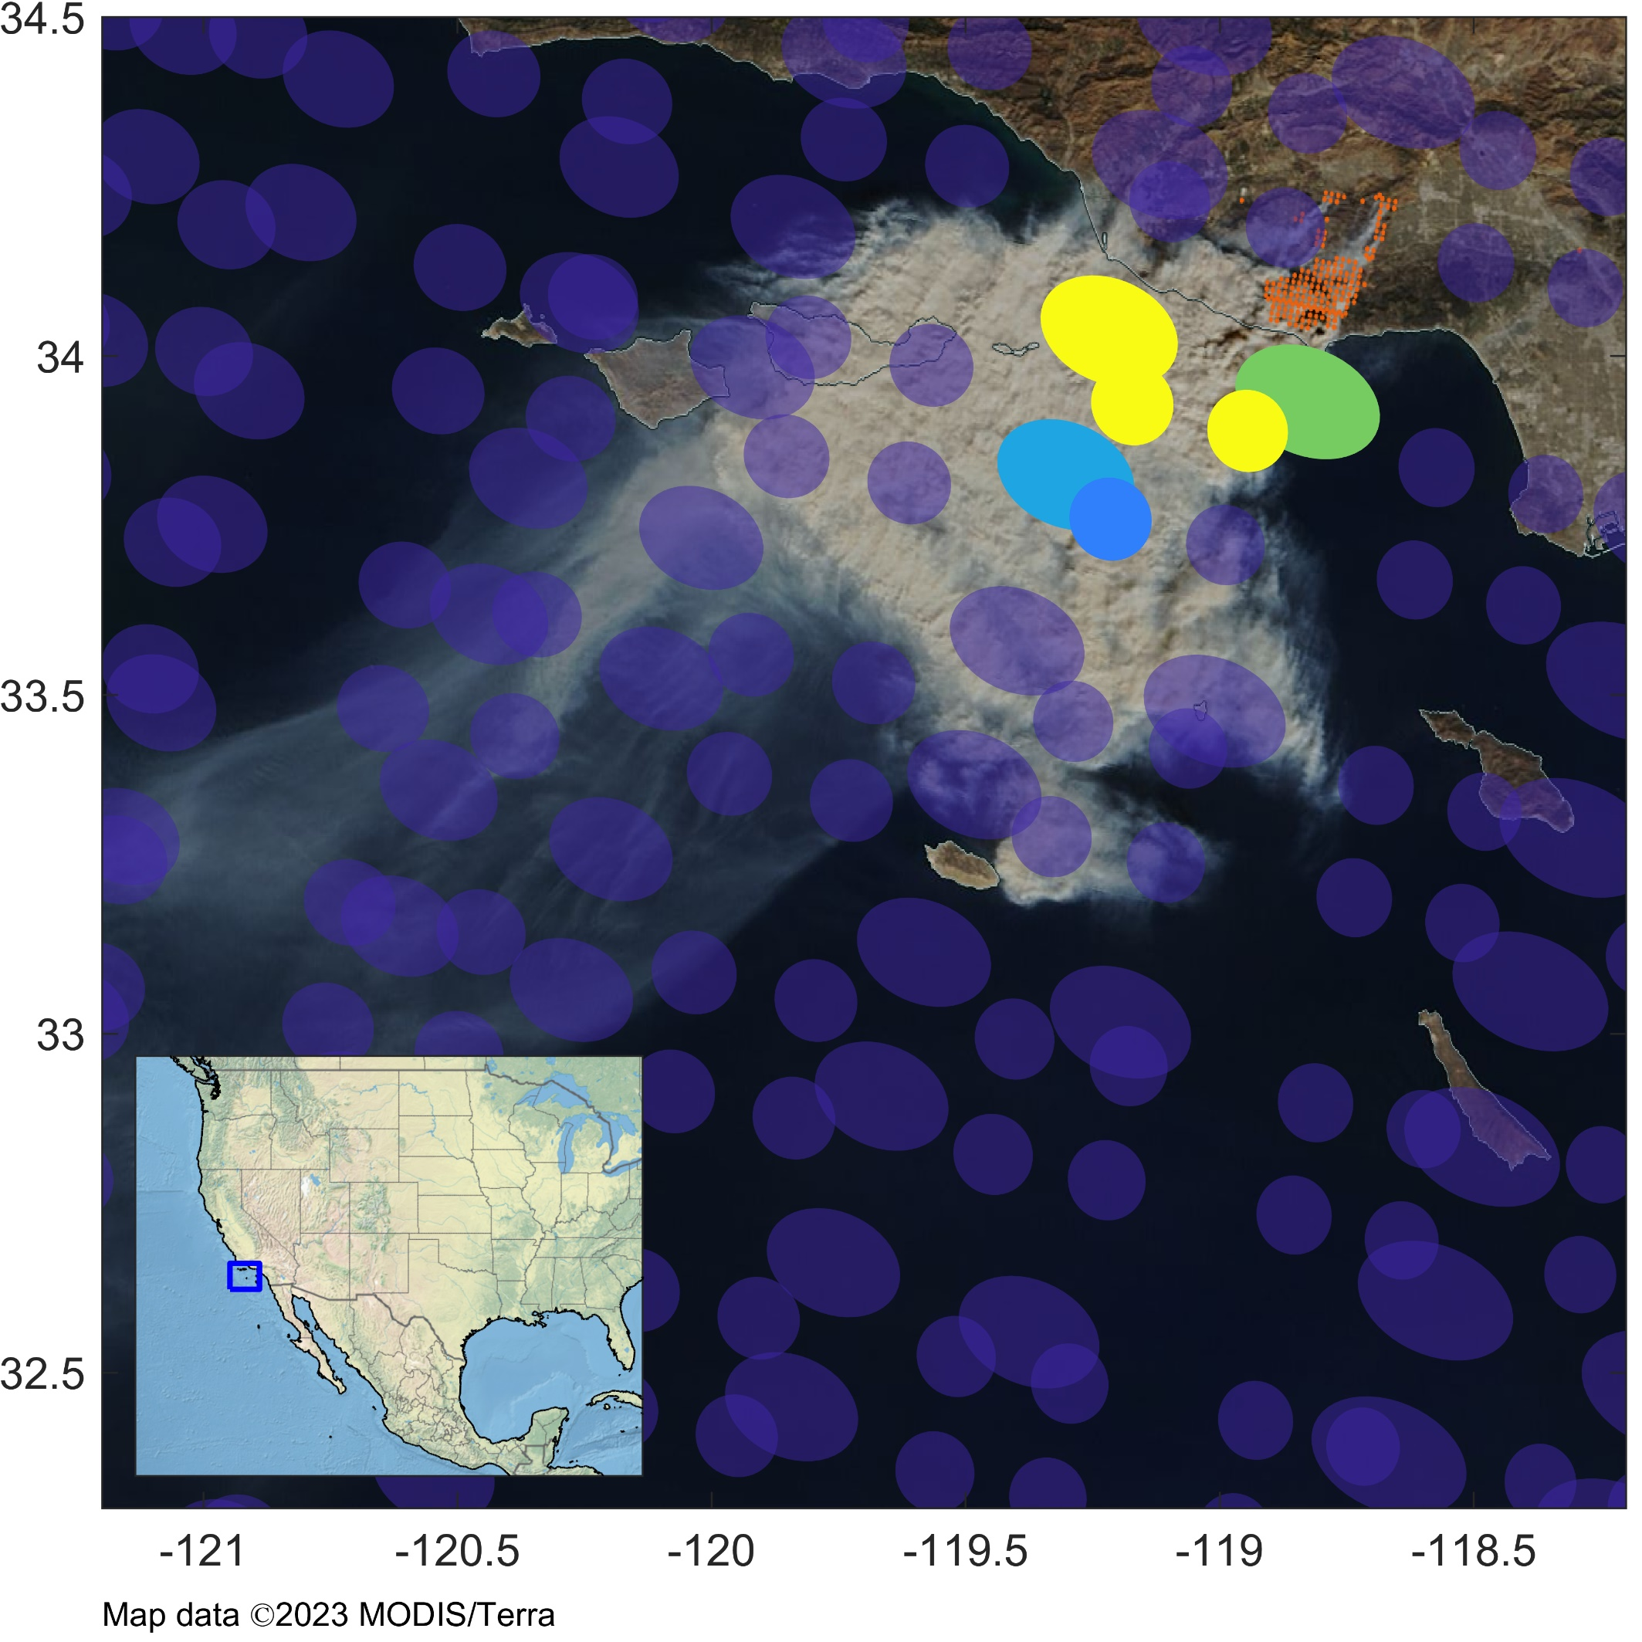
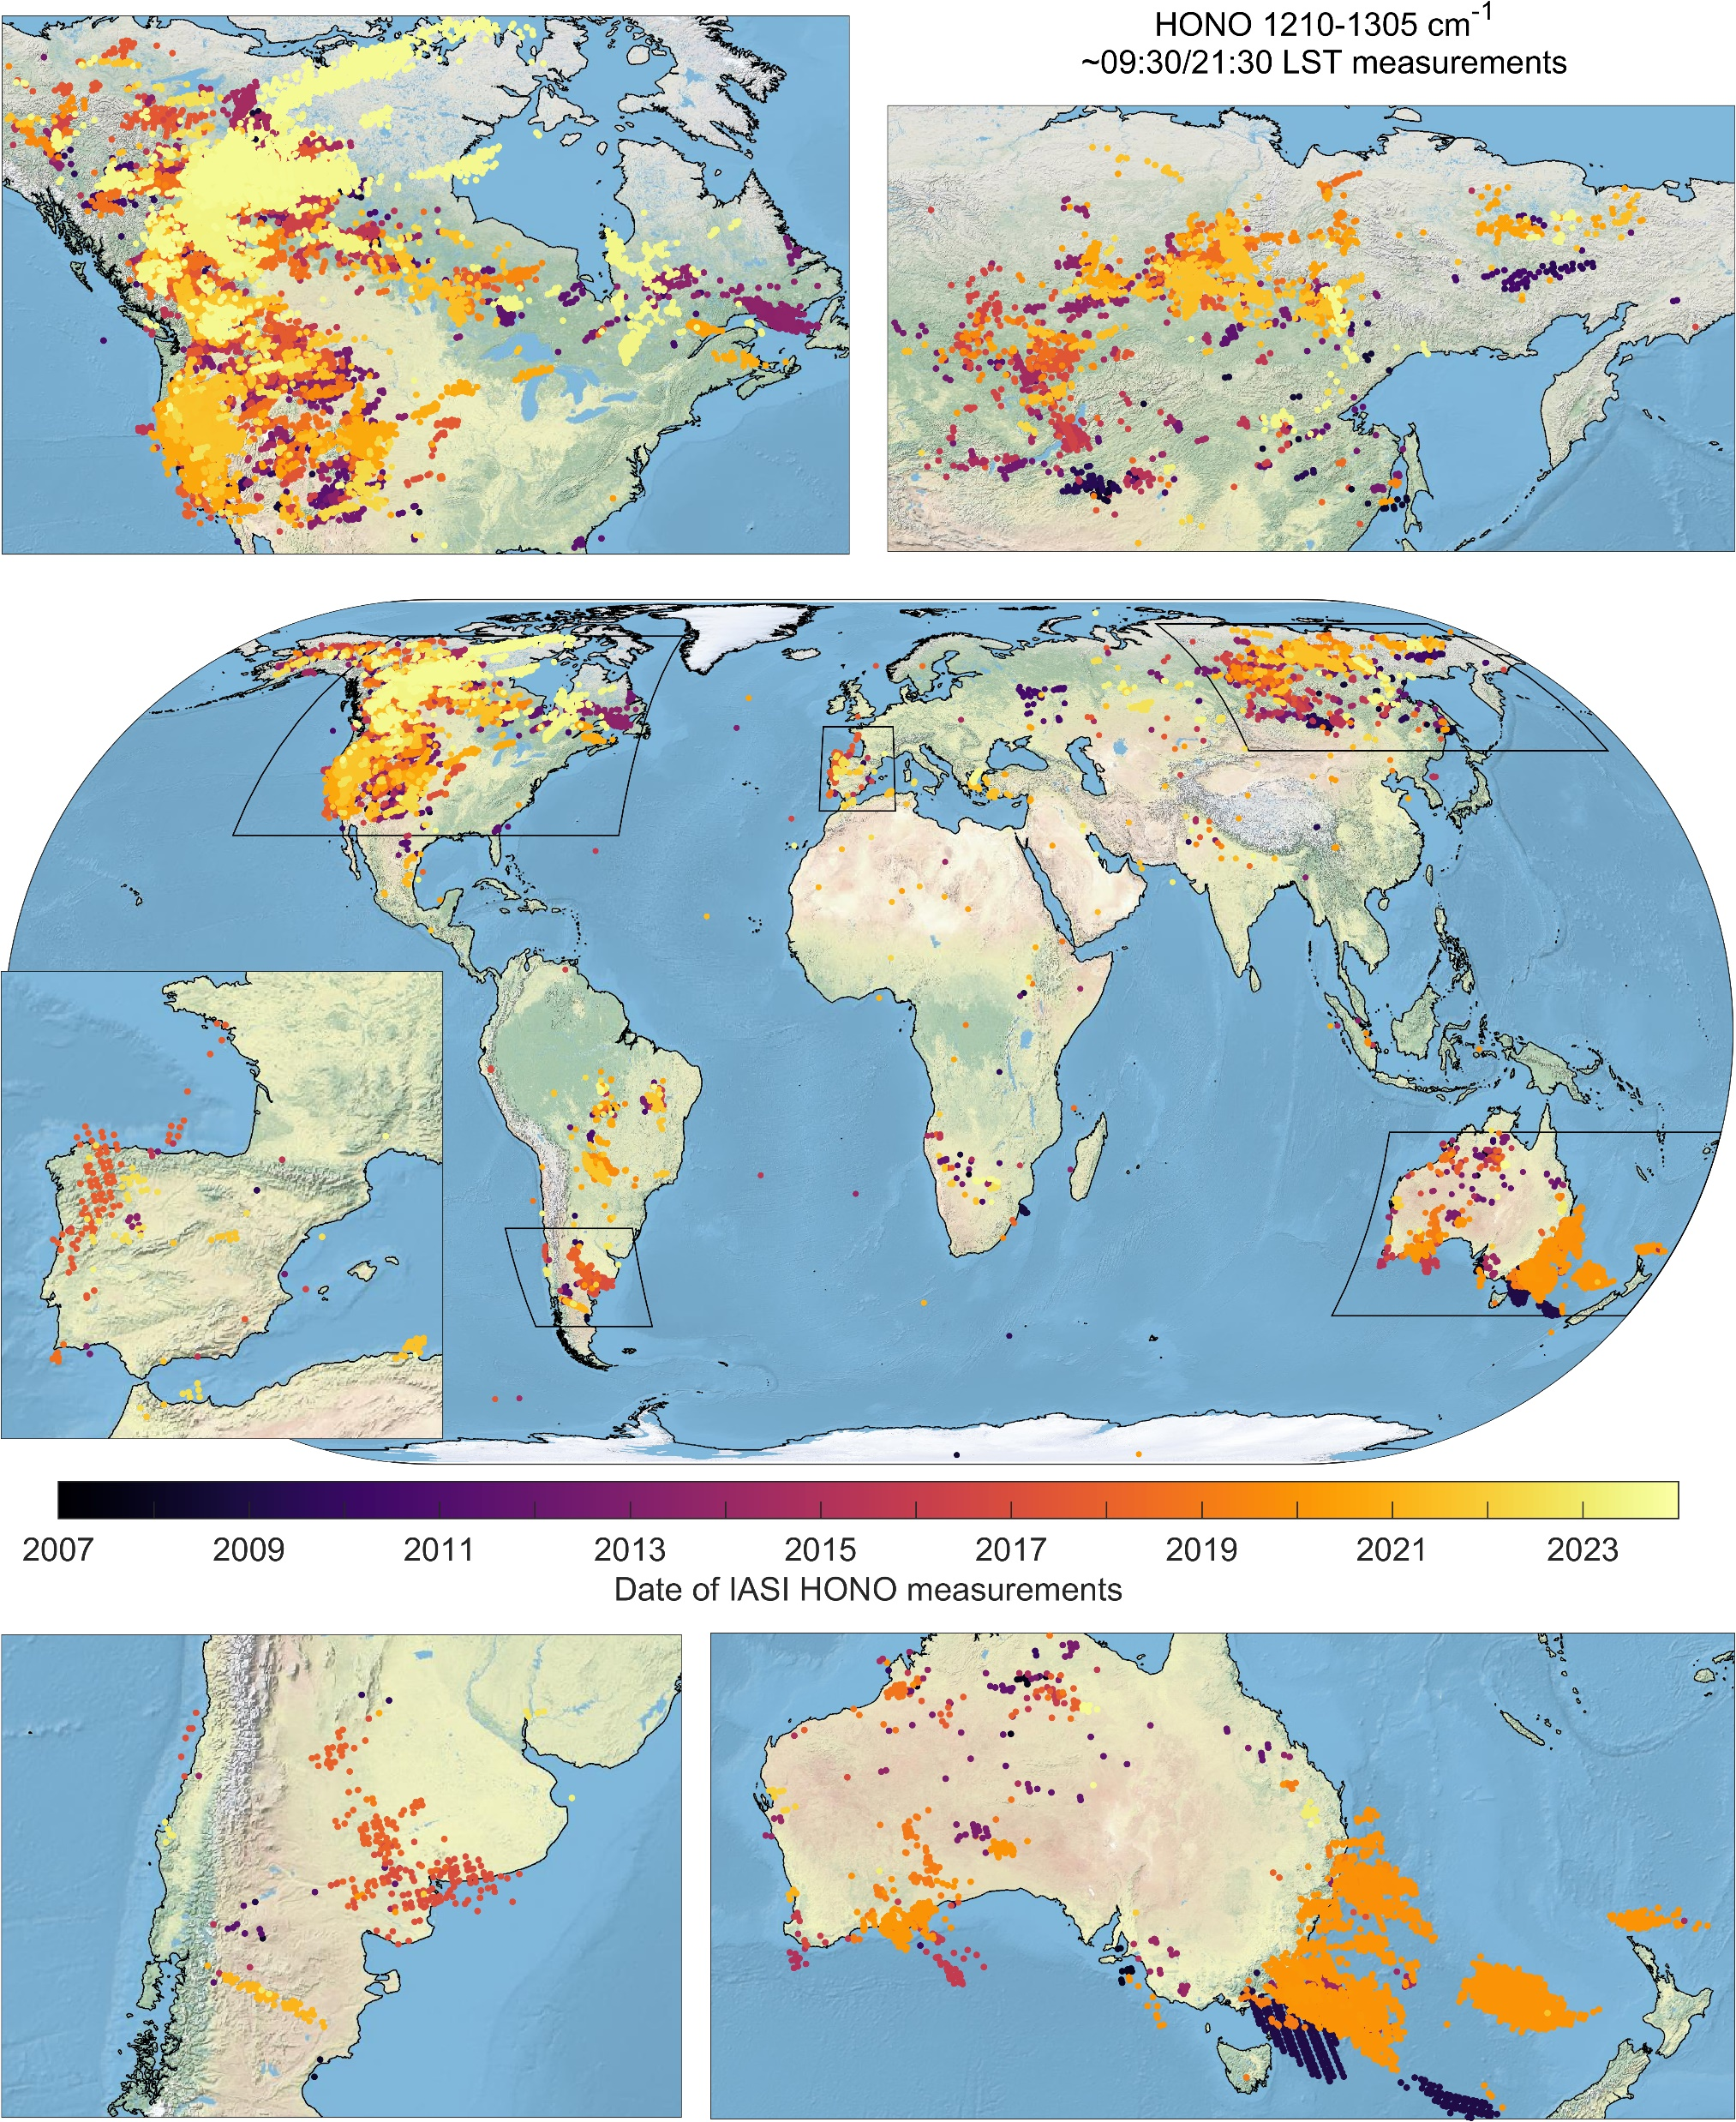
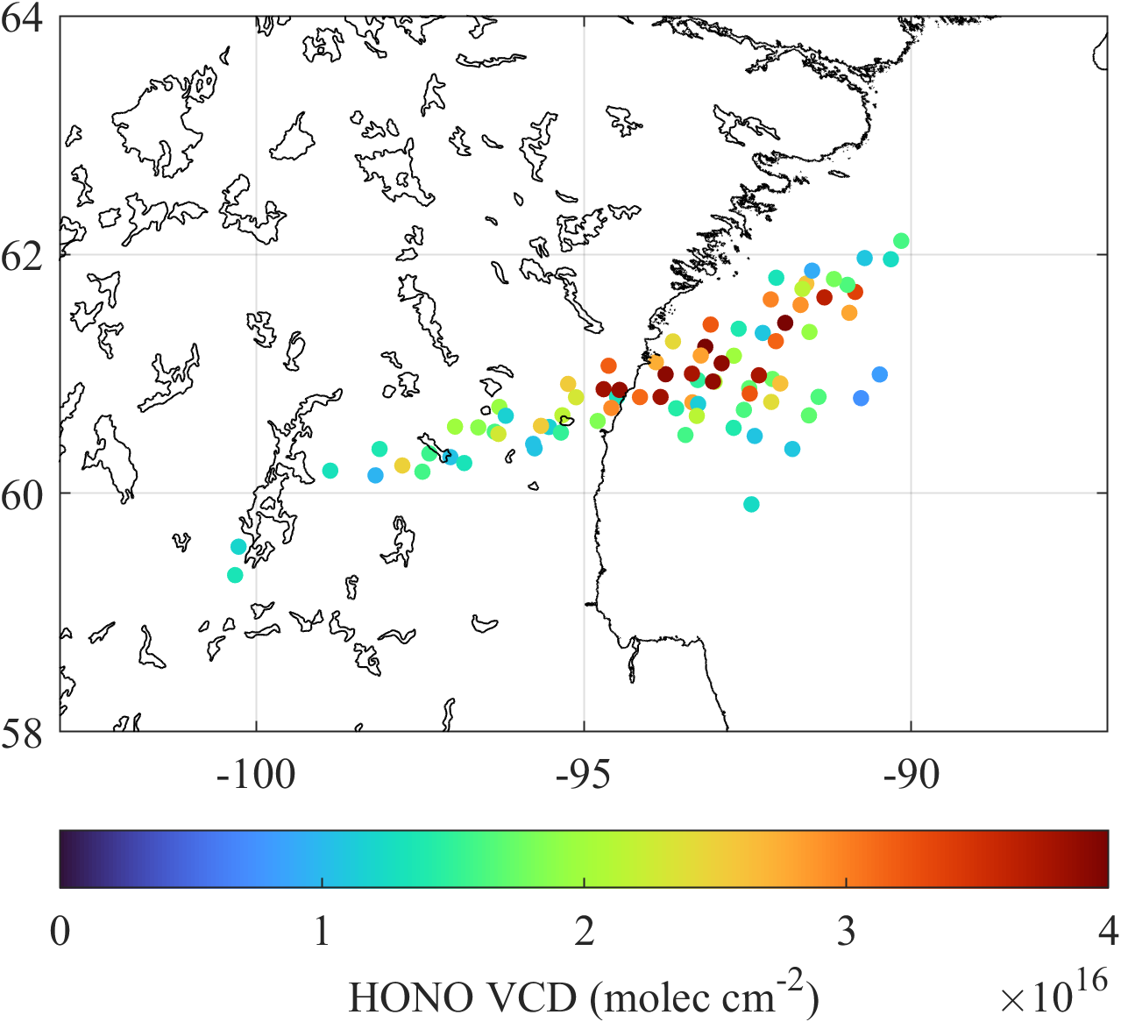

Woolsey Fire
California
8 November 2018
New retrievals : Nitrous acid retrieval (HONO)
Key precursor of atmospheric oxidant and key role in tropospheric O₃ production
Short-lived fire tracer allowing to study chemistry of biomass burning plumes
Retrieval product is based on a fast retrieval scheme and proven heritage from IASI (Franco et al., 2024)
High-resolution infrared data allows measuring HONO both during day and night, complementing measurements from TROPOMI (midday only)
HONO detection in fresh fire plumes (2007-2024)

Slide 10
SNPP/CrIS and JPSS/CrIS DATA STATUS
University of Minnesota products from Millet et al.
TROPESS (JPL) products from Bowman et al.

Slide 11
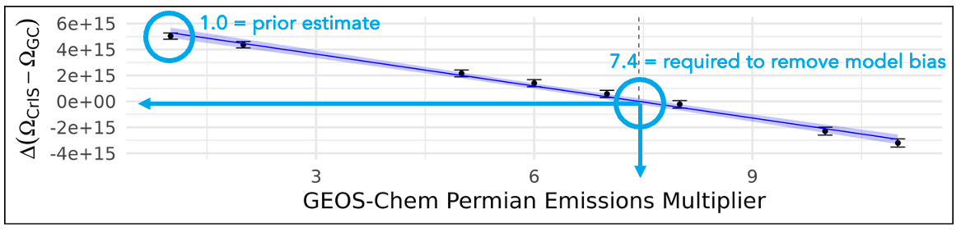
CrIS ethane measurements reveal strong ethane enhancements over fossil fuel production regions
The CrIS data show that the Permian fossil fuel production basin in Texas & New Mexico stands out globally with the largest persistent ethane enhancements on the planet
Sensitivity simulations imply that the modeled basin-wide ethane flux needs to be scaled up 7× to match 2019 CrIS observations
Sensitivity simulations imply that the modeled basin-wide ethane flux needs to be scaled up 7× to match 2019 CrIS observations:
Brings ethane:methane emission ratio (19%) into agreement with in-situ constraints
Permian basin alone then accounts for 4-7% of total global fossil-fuel ethane source
→ Brings ethane:methane emission ratio (19%) into agreement with in-situ constraints
→ Permian basin alone then accounts for at least 4-7% of total global fossil-fuel ethane source
Brewer et al., Nature Communications, 2024]
Notes:
Ethane lifetime ~2 months, mainly O&G, contributes to PAN. Have to scale GEOS-Chem emissions by 7 to match top down.

Slide 12
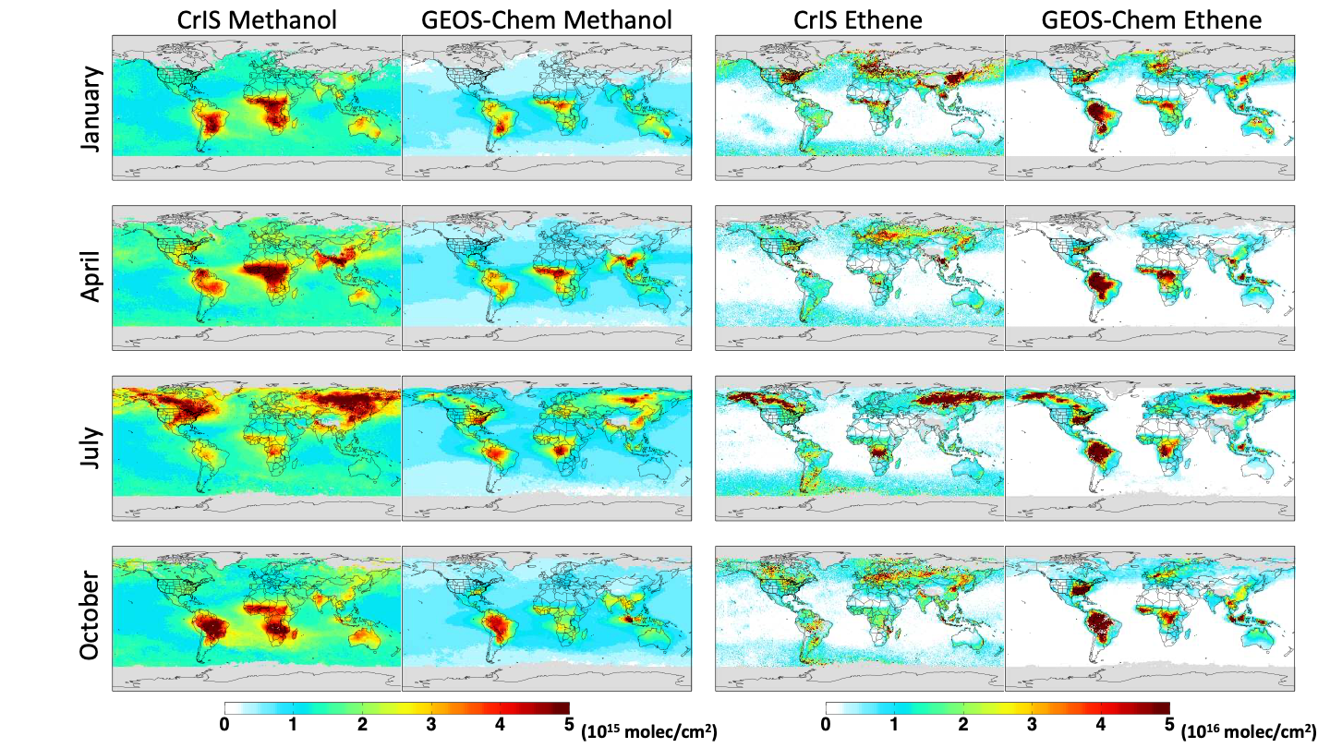
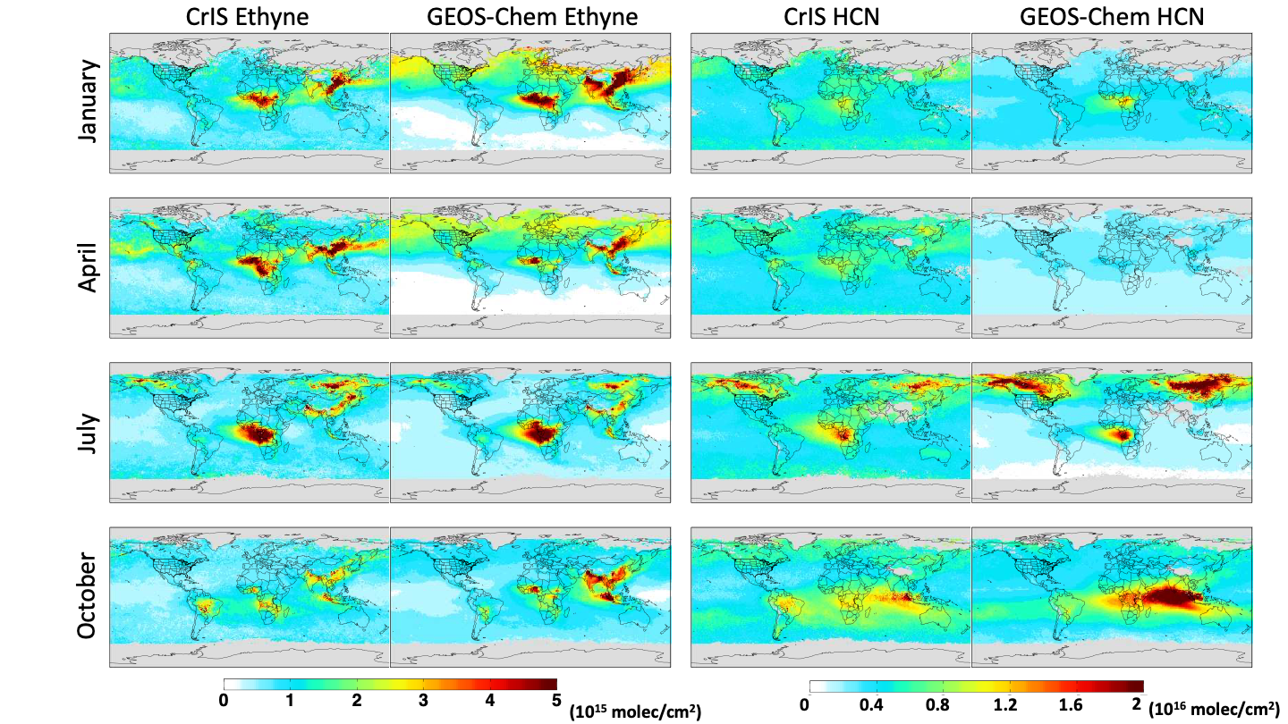
Other VOC measurements from CrIS: Tracers for understanding biogenic, pyrogenic, anthropogenic emissions and changes over time
[Wells et al., in revision, 2024]
Notes:
Lifetimes 13d Methanol, 1d Ethene, 2 weeks Ethyne, 5 mo. HCN

Slide 13
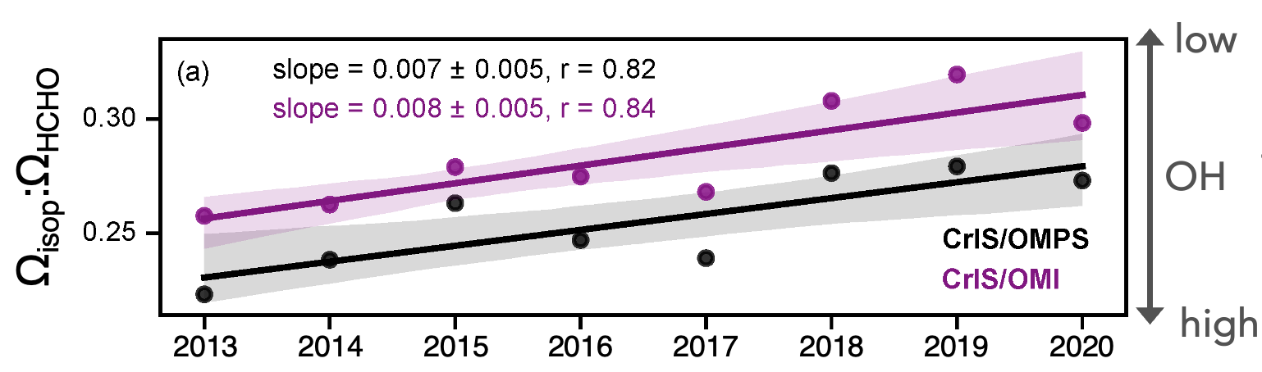
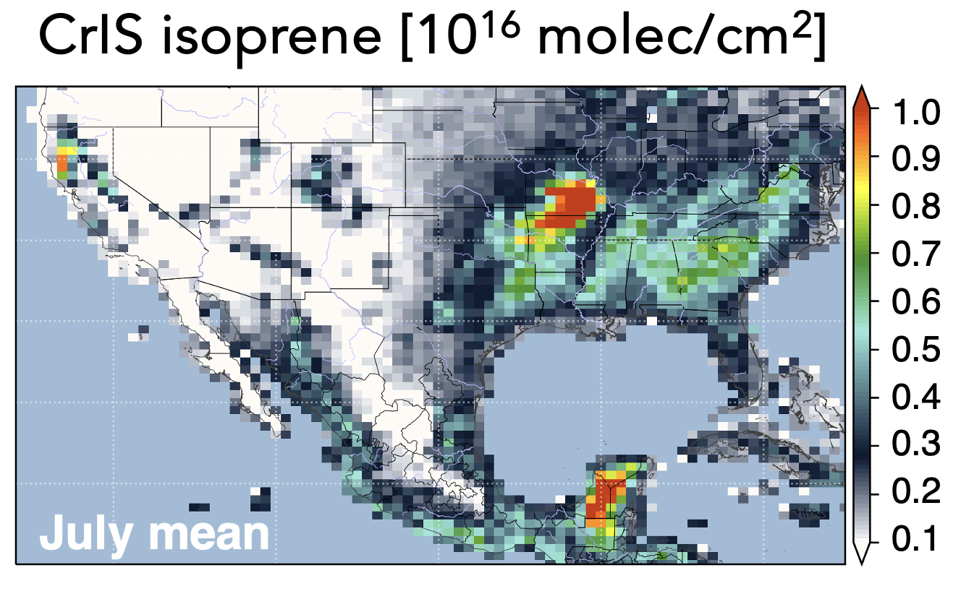
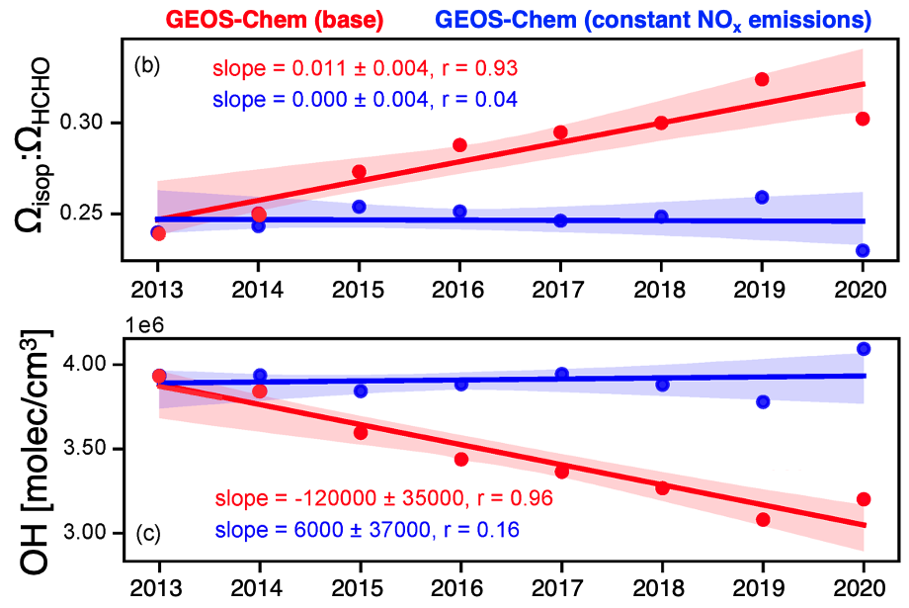
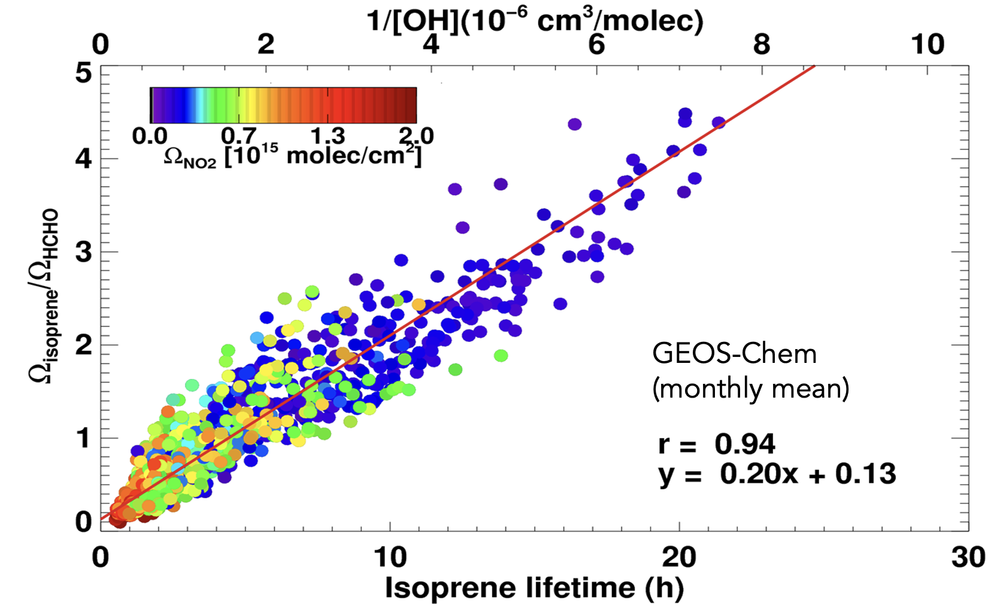
Declining OH over the Southeast US
Together, space-borne isoprene and formaldehyde observations provide a proxy for tracking atmospheric OH over source regions
Satellite obs reveal multi-year Ω_{isop}:Ω_{HCHO} trend over US Southeast
➔ Decreasing OH
→ Corroborating the model-predicted trend.
OH trend driven by decreasing anthropogenic NO_{x} source
Total OH decline: 8x10⁵ molecules cm⁻³
(21% of summer daytime peak)
[Wells et al., Nature, 2020]
[Shutter et al., Science Advances, 2024]
Notes:
Isoprene highly reactive with OH, HCHO more buffered (photochemical loss) so ratio of conc. Isoprene to formaldehyde (using CrIS and OMPS or OMI) is a proxy for isoprene lifetime or OH amount

Slide 14
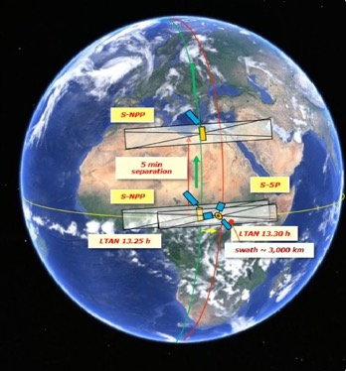
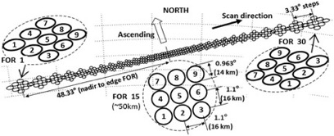

Suomi NPP CrIS and S5P/TROPOMI
CrIS is a TIR FTS instrument making daily measurements in three separate bands (650-1095 cm⁻¹, 1210-1750 cm⁻¹, 2155-2550 cm⁻¹)
TROPOMI is a UV-SWIR imaging spectrometer making daily measurements in a number of spectral bands, from 270-2380 nm.
CrIS ground track illustration taken from Han et al., 2013. MUSES algorithm allows FOV thinning to reduce processing overheads.
TROPOMI ground track illustration taken from Veefkind et al., 2012.
© 2022 California Institute of Technology. Government sponsorship acknowledged.
Notes:
Here we introduce CrIS and TROPOMI. CrIS was launched in 2011 while TROPOMI was launched in 2017.
CrIS is a FTS TIR instrument, with a wide spectral band capable of retrieving many trace gases. CrIS has daily global coverage, making measurements in the style of the figure on the left.
TROPOMI is a imaging spectrometer, making measurements in the form of the figure on the right. TROPOMI is a UV-SWIR instrument, and retrieves many of the same trace gases as CrIS (e.g. O3, CO and CH4) but is dependent on daylight. TROPOMI also has daily global coverage.
KEY TAKEAWAY: HIGH VOLUMES OF DATA FROM BOTH INSTRUMENTS, WITH CROSS OVERS IN SPECIES BUT NOT IN SPECTRAL BANDS

Slide 15
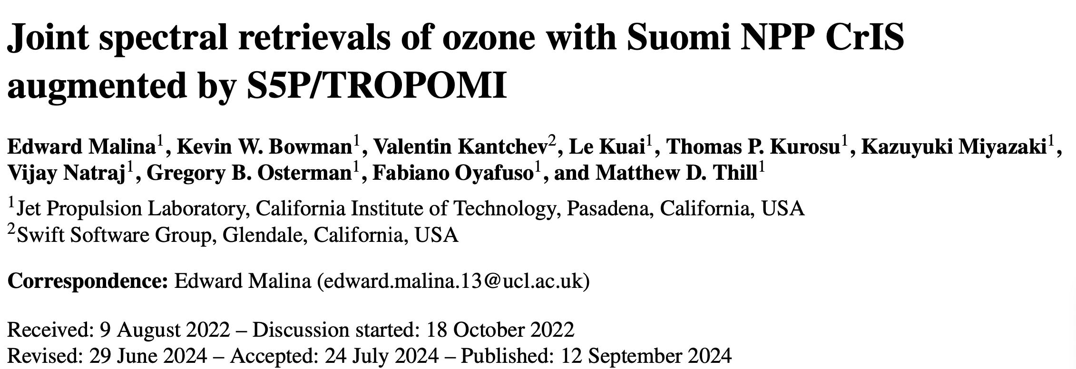
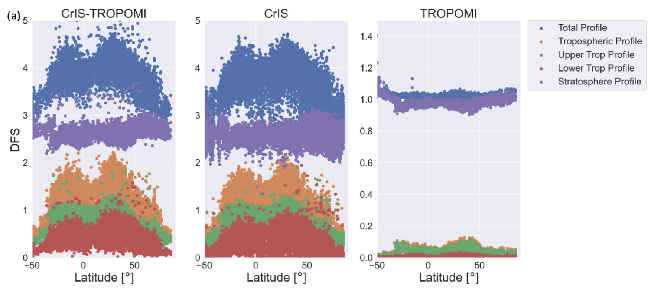
Joint CrIS/TROPOMI ozone
TROPESS joint CrIS/TROPOMI O3 retrievals have been demonstrated on.
  Current limitations with UV calibration--limited to UV3
Collaborating with SRON on joint CrIS/TROPOMI CO
Expected delivery of limited O3 products in late FY25.

Slide 16
Cross Comparisons: CrIS/TROPOMI and CAMS Global Reanalysis (August 2020)
While in generally good agreement, CAMS shows about 20% less variability than
CrIS/TROPOMI ozone with structural differences in the tropics.
© 2022 California Institute of Technology. Government sponsorship acknowledged.

Slide 17
CONCLUSIONS
MOPITT & AIRS still adding to long term global records of CO
IASI continues the satellite CO record and new products C2H4 and HONO (in fires/industry) are being developed using Neural Network based fast retrievals
CrIS data being used with ML fast retrievals to understand multiple VOC concentrations and emissions
Ratio of isoprene to formaldehyde (using CrIS and OMPS or OMI) is a proxy for isoprene lifetime or OH amount
Multispectral O3 with CrIS and TROPOMI looks promising
NH3 from AIRS and CrIS used for trends and emission estimates

Slide 18
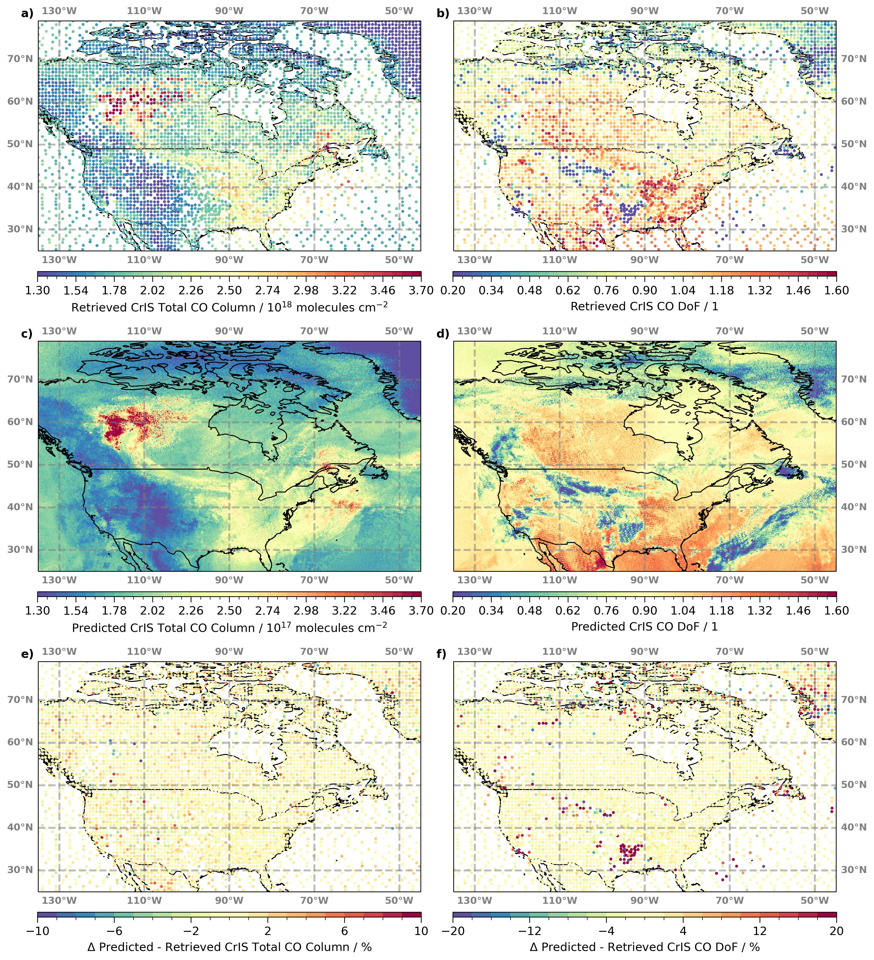
Fusing Machine Learning and TROPESS OE retrievals
TROPESS processing captures the global spatial correlations in concentrations, but does not fill in all the spatial details
Given continuous training with radiances and OE products, ML can predict both the OE retrievals and retrieval diagnostics (precision, AKs, DoF)
Example of CrIS total CO column predictions on 10 June 2024:
$→$ Filling in the gaps (see panel a)
$→$ Process $\sim 2$ orders of magnitude more column concentrations per species

Slide 19
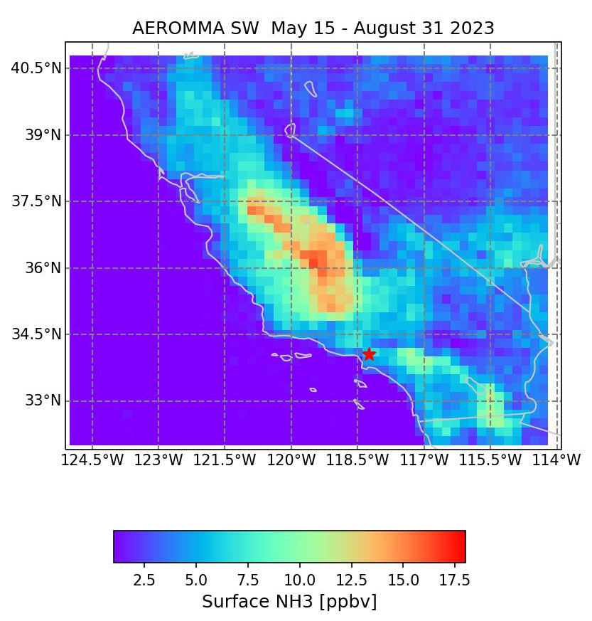
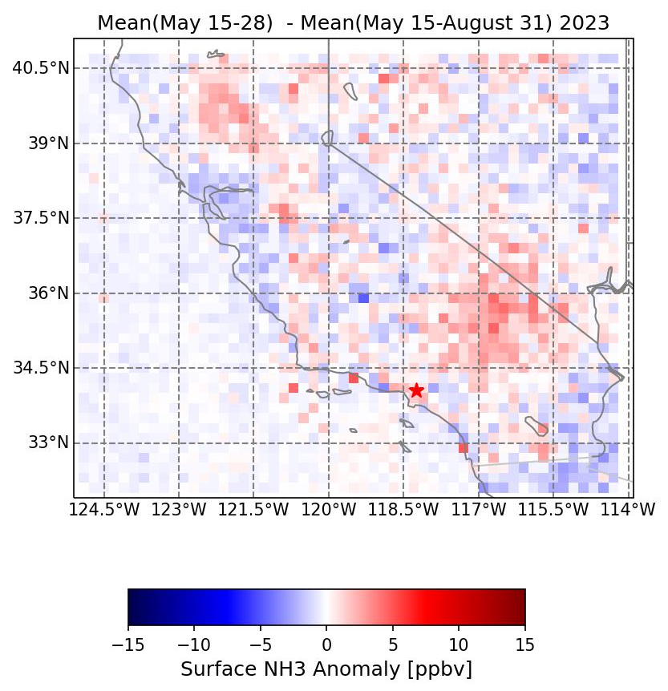
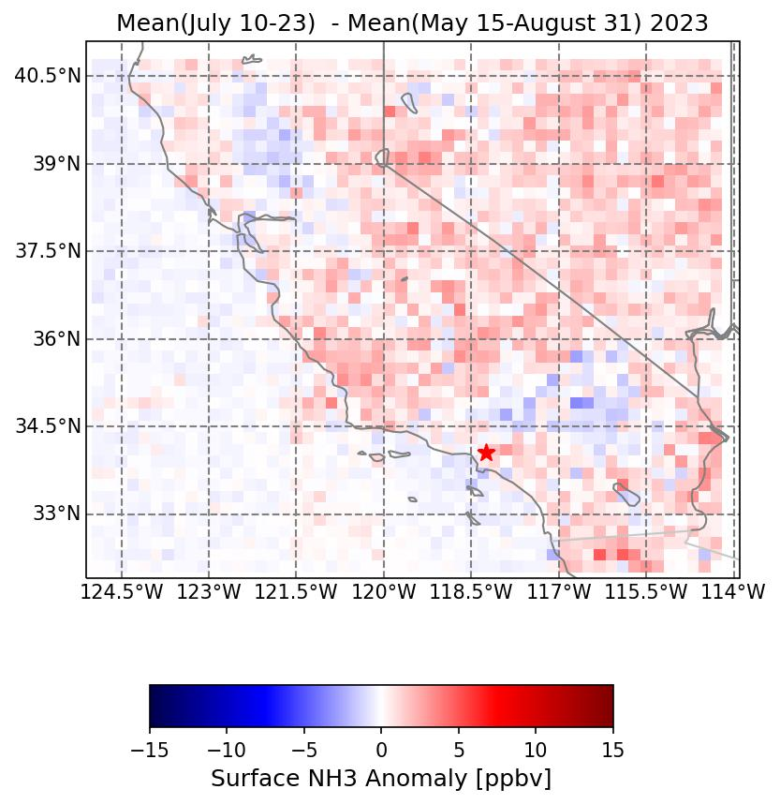
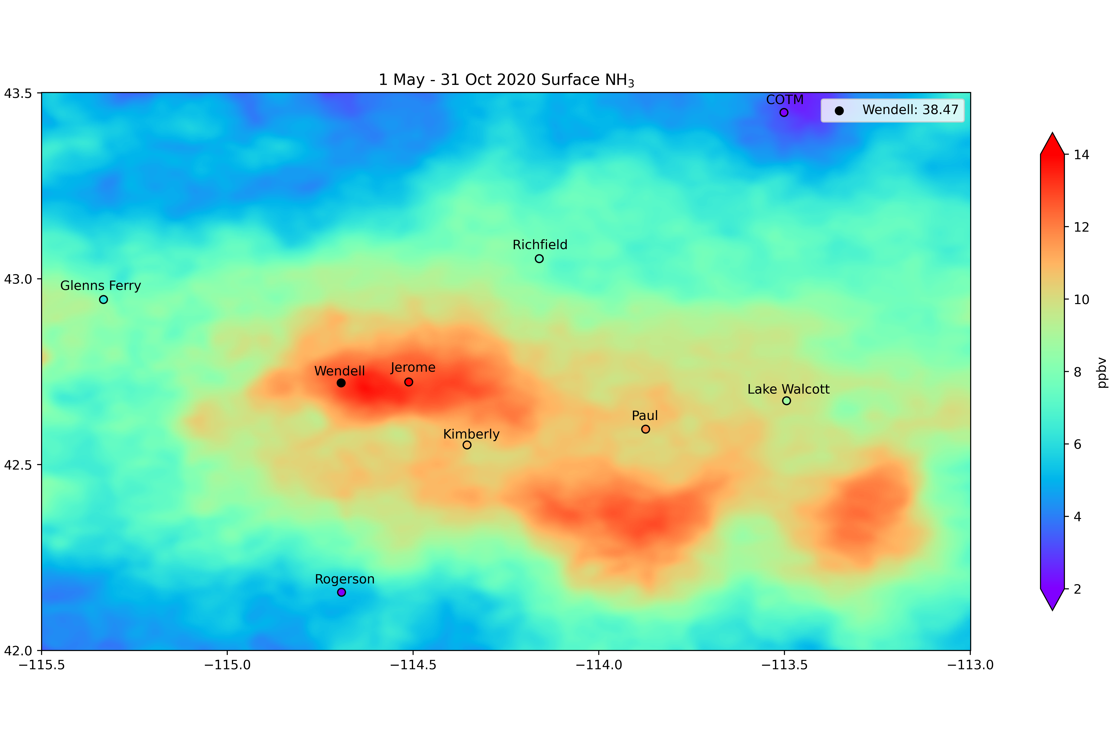
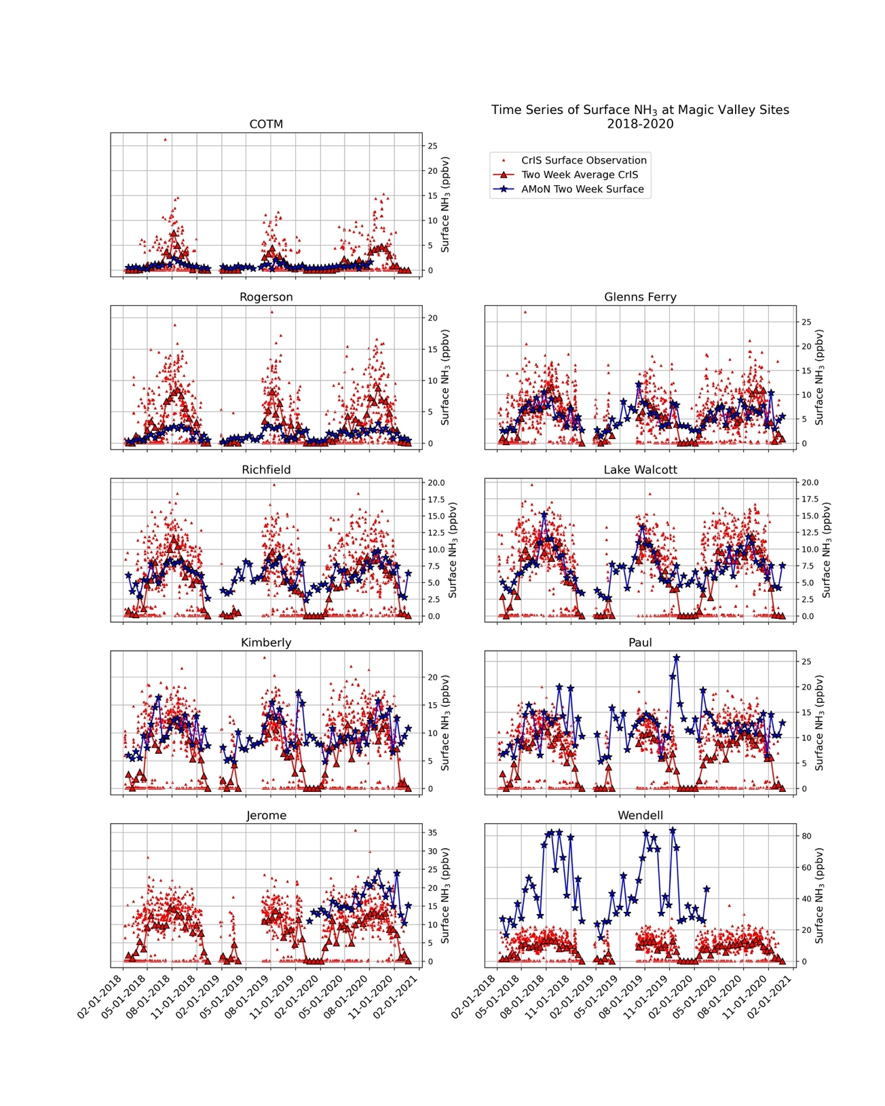
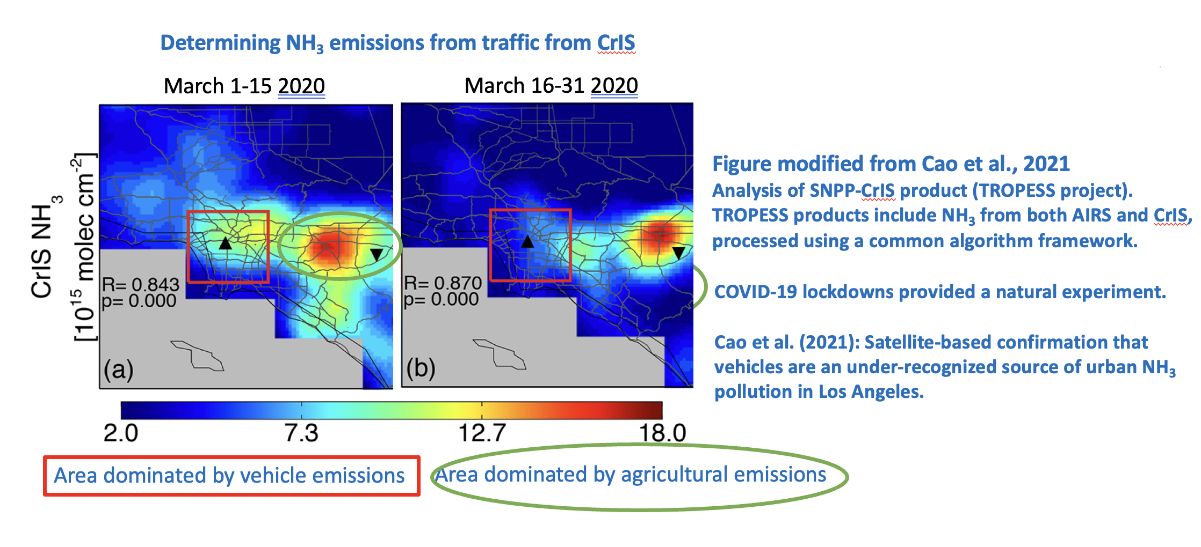
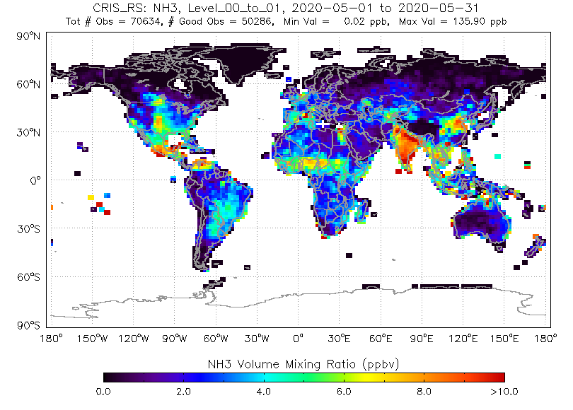
CrIS NH₃ captures temporal and spatial variability over the Idaho Magic Valley
AEROMMA: CrIS NH₃ provided temporal and spatial context
Cady-Pereira et al., 2024, AMT
Two week anomalies show large variability, possibly driven by temperature and/or clouds, but these differences are correlated over multiple areas
May 2020 CrIS surface NH₃ mean

Slide 20
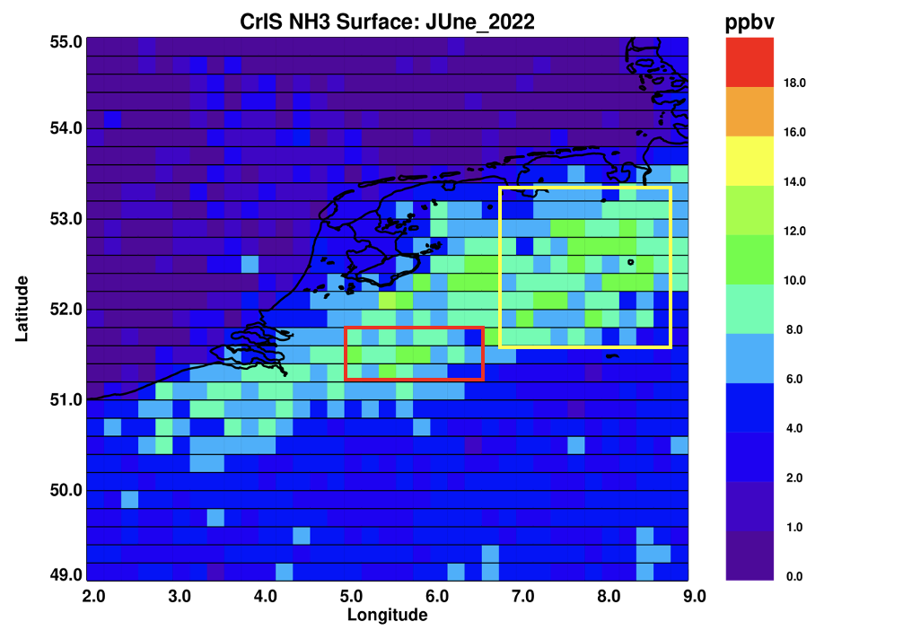
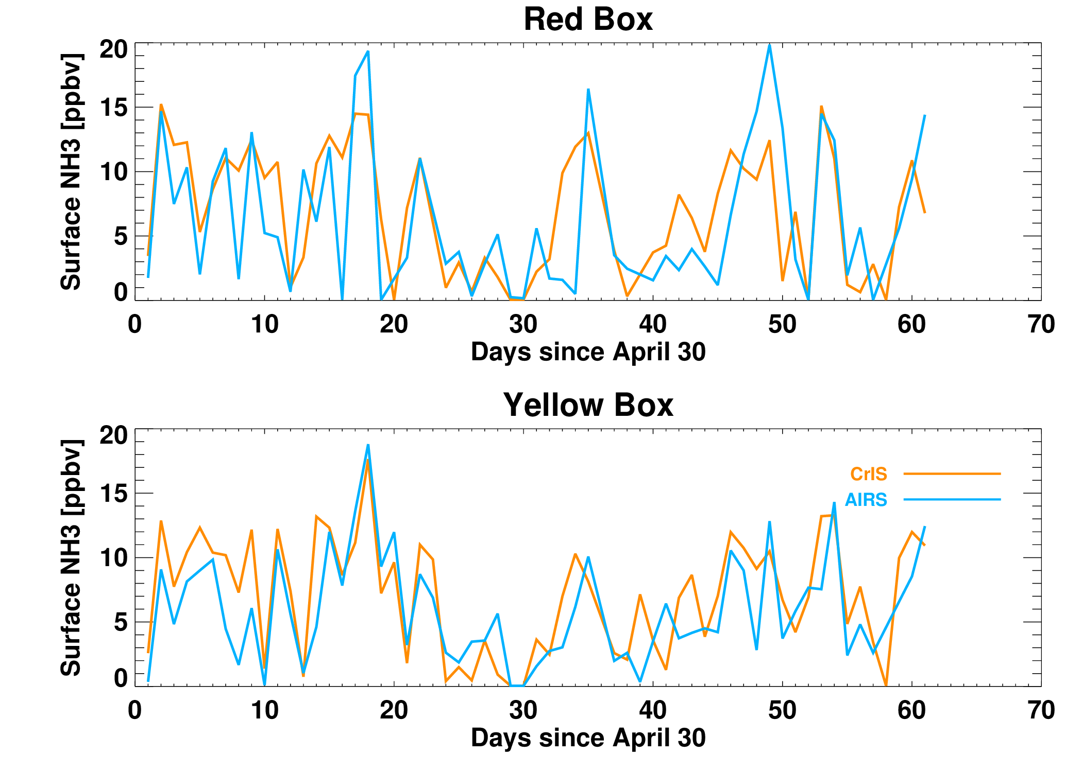
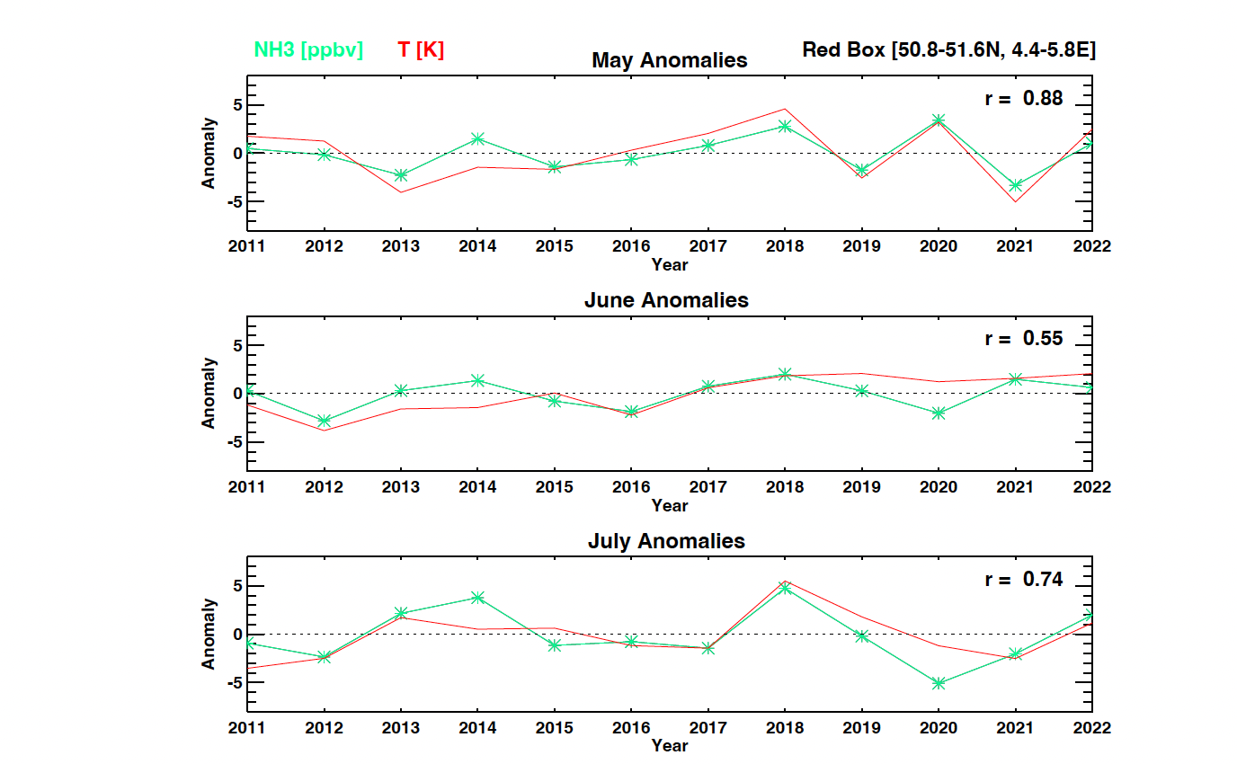
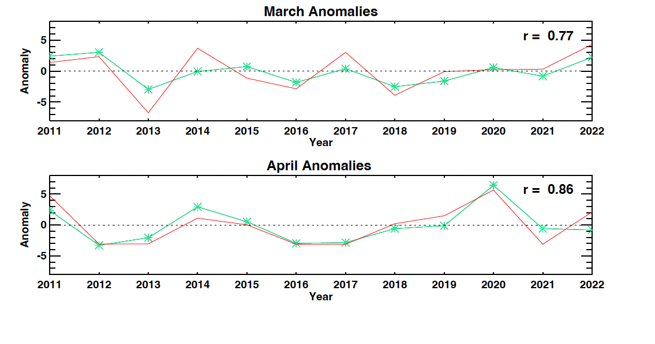
Investigating the use the long AIRS record to examine trends in NH₃- first case: NW Europe
CrIS and AIRS are 53% correlated in the red box and 75% correlated in the yellow box
Peak concentrations are present at similar times in both boxes: weather and/or agricultural practices controlling emissions?
NH₃ and surface temperature are moderately to highly correlated in spring/early summer
Correlations are strongest in months with fertilizer application

Slide 21
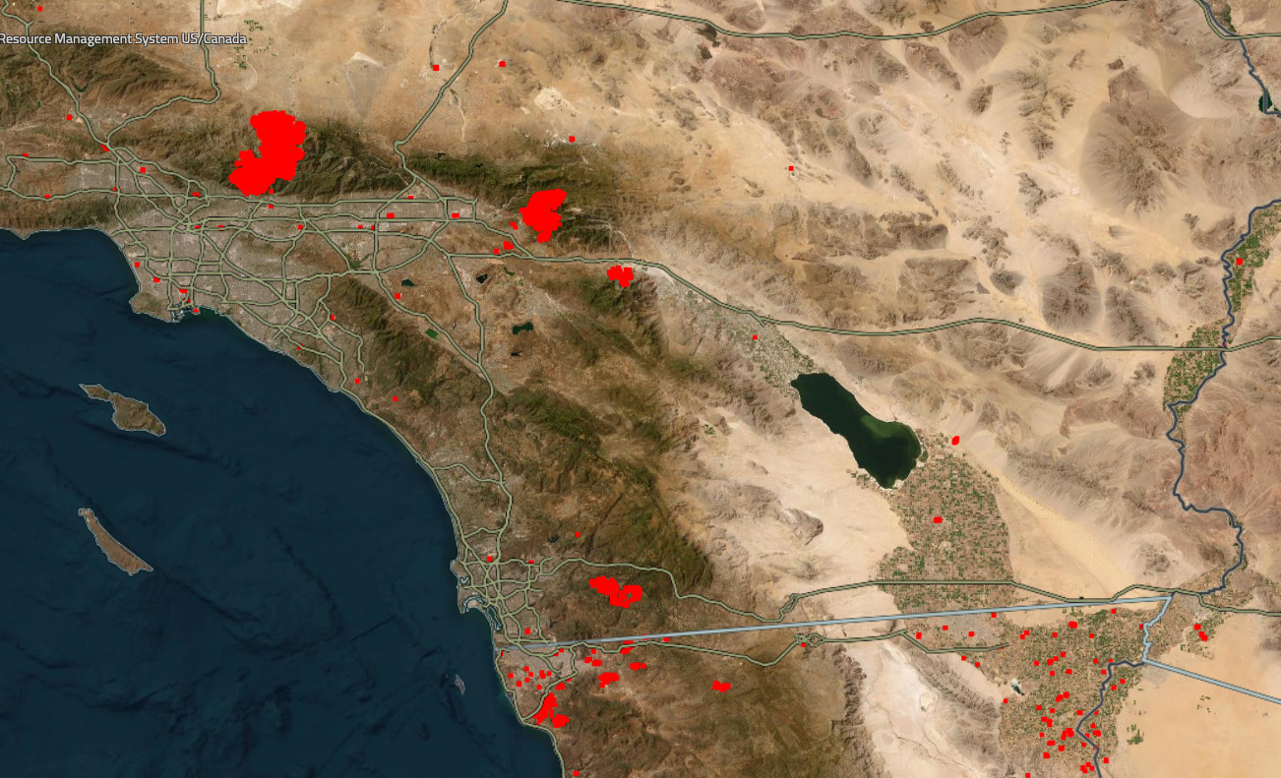

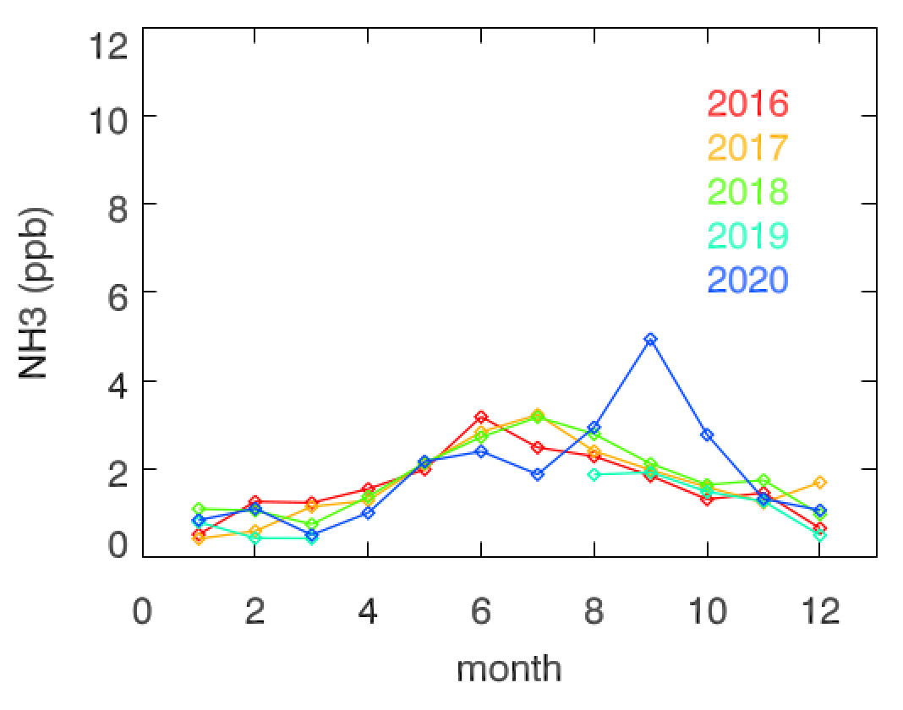
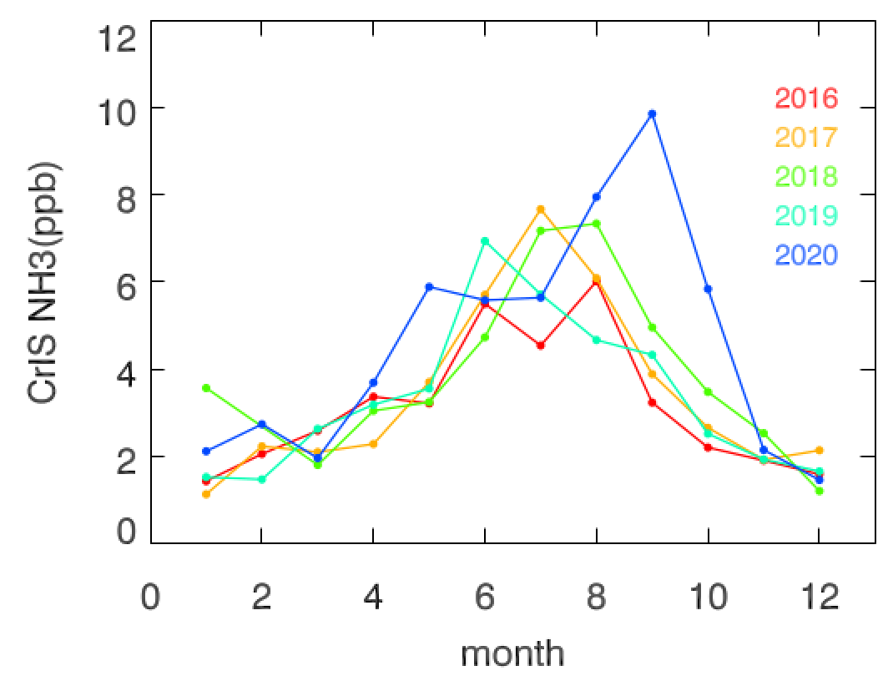
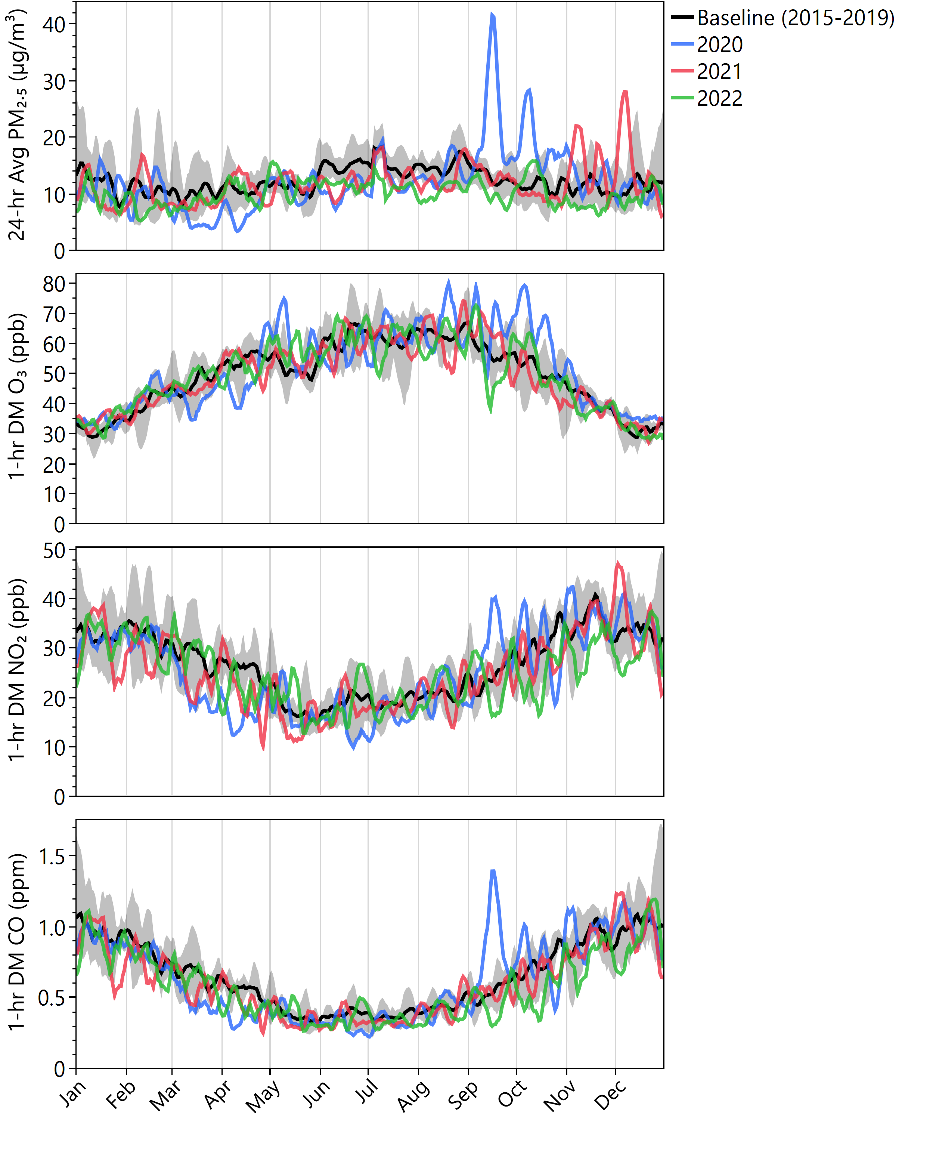
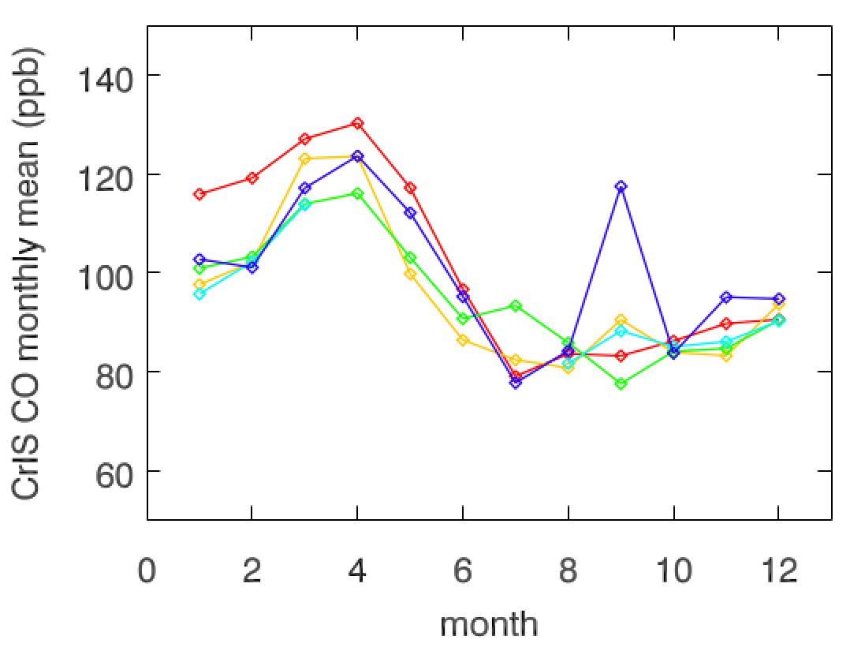
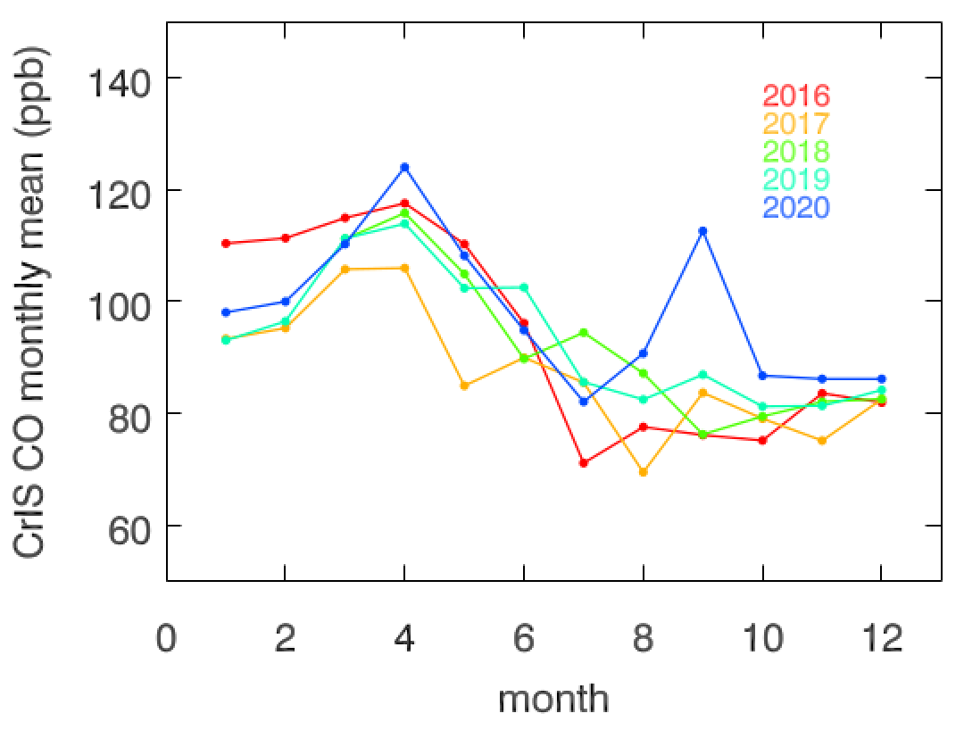
Two weeks since fires start: 09/05 – 09/18, 2020
Ammonia Emissions from 2020 Wildfire over Southern California observed from TROPESS CrIS products
3
2
LA basin
Imperial Valley
1
NH3
at surface
CO at 500 hPa

Slide 22
MOPITT and AIRS comparison (courtesy of W. Tang, JPL)

