Slide 1
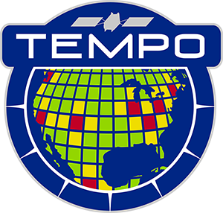
Tropospheric Emissions:
Monitoring of Pollution
TEMPO: Overview and Status
Caroline Nowlan
Center for Astrophysics | Harvard & Smithsonian
Xiong Liu, Kelly Chance, Gonzalo González Abad, Chris Chan Miller, Heesung Chong, John Davis, Jean Fitzmaurice, Weizhen Hou, John Houck, Raid Suleiman, Junsung Park, Huiqun Wang, Aaron Naeger, James Carr, Barron Henderson, Luke Valin, James Szykman, Jerry Ziemke and the TEMPO Team
CEOS AC-VC Meeting
October 15, 2024

Slide 2
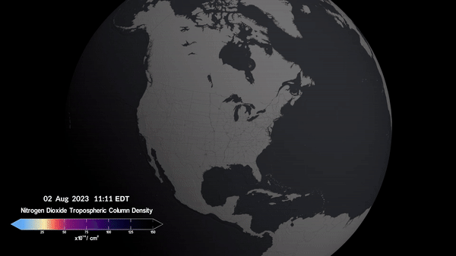
Tropospheric Emissions: Monitoring of Pollution
Hourly daytime air pollution measurements over North America
NASA’s first Earth Venture Instrument (EVI), selected in 2012
Led by Smithsonian Astrophysical Observatory (SAO) in partnership with NASA LaRC
Geostationary orbit
→ High temporal resolution
→ High spatial resolution
Baseline data products:
NO₂, HCHO, O₃ (total and profile)
Credit: NASA’s Scientific Visualization Studio

Slide 3
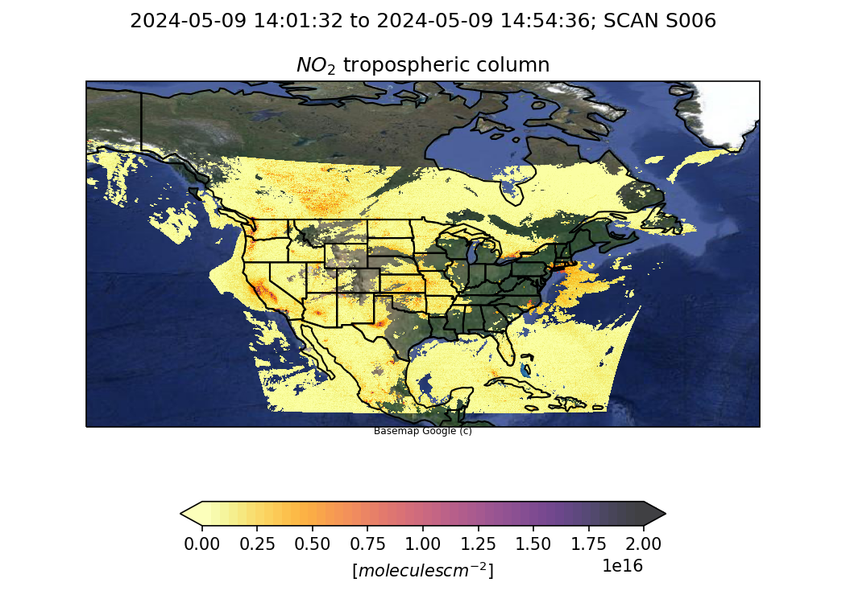
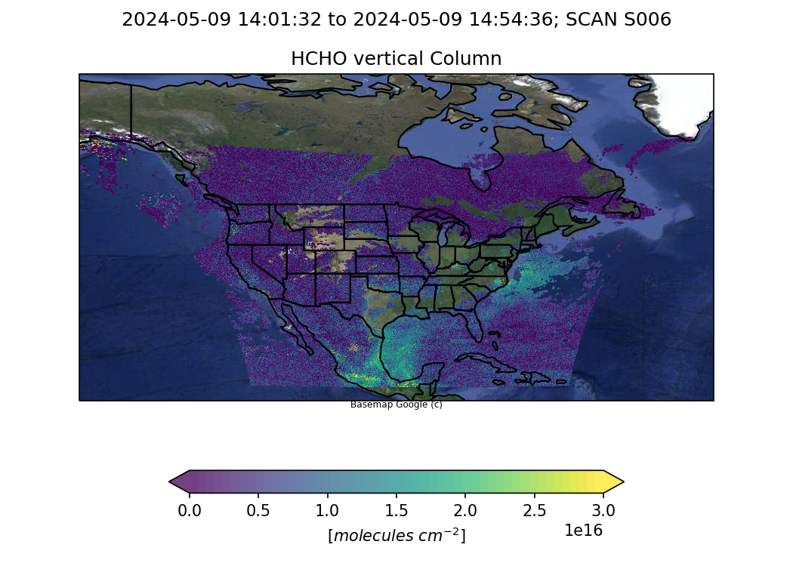
TEMPO Timeline
Date | Details
7 April 2023 | Launch
June-July 2023 | TEMPO power on + dry-out, cool down, etc.
2 August 2023 | First light
19 October 2023 | Nominal operations
June 2025 | Baseline mission ends
September 2026 | First extended mission ends
Public Release | Date | Details
V01 | February 2024 | Limited 3 weeks released
V02 | February 2024 | Level 1 (spectra) released
V03 | May 2024 | L1 updated, Level 2/3 NO₂, HCHO, total O₃
V04 | June 2025 | Release ozone profile, update L1 + trace gases

Slide 4
TEMPO Products
Level | Product | Developer
L1 | Irradiance ^{NRT} | SAO
 | Radiance ^{NRT} | SAO
 | Radiance (twilight – city lights) | SAO
L2 | Clouds ^{NRT} | SAO
 | NO₂ ^{NRT} | SAO
 | HCHO ^{NRT} | SAO
 | O₃ (total) | SAO
 | O₃ (profile) | SAO
 | TEMPO/GOES-R synergy aerosol product ^{NRT} | NOAA
 | C₂H₂O₂ | SAO
 | H₂O | SAO
 | BrO | SAO
 | SO₂ ^{NRT} | NASA GSFC
 | UVAOD | NASA GSFC
 | Aerosol layer height | U. Iowa
 | UVB | SAO/NASA GSFC
Baseline Products
NRT Products
Satellite Needs Working Group Cycle 3
Enhanced Products
Satellite Needs Working Group Cycle 4
Research Products
Ocean color
Vegetation
SIF
City lights/lighting types
HNO₂
IO
NO₃
Surface albedo
Surface concentrations
Emissions
4

Slide 5
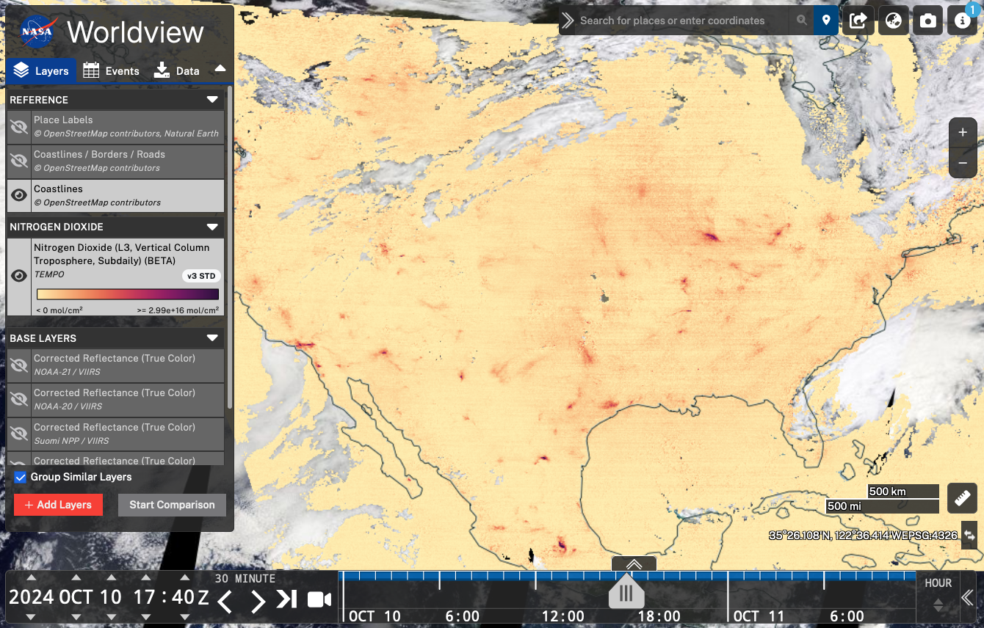
Using TEMPO Data
TEMPO data is publicly available through NASA’s Atmospheric Science Data Center
V3 download metrics (May-Sept 2024)
782 TB
48M files
1M+ image requests (Worldview etc.)
NASA Webinar recording for new users: https://youtu.be/meySKqVuVT0?si=uiLTRXsgtKIGS_OT

Slide 6
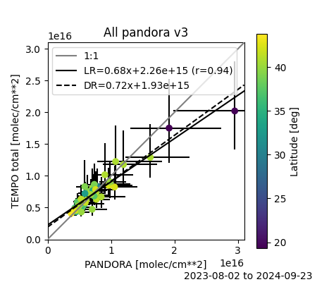
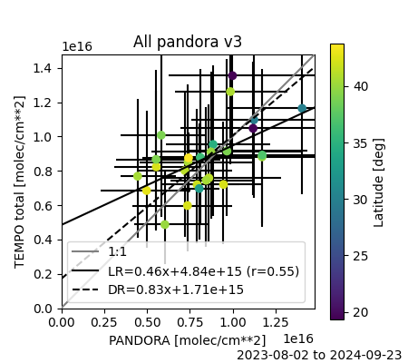
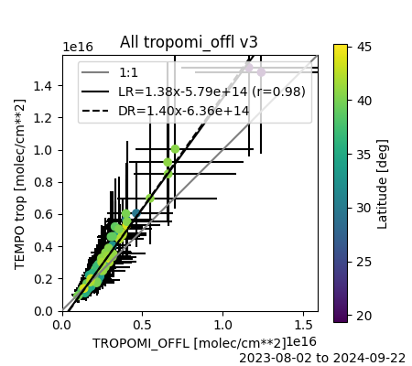
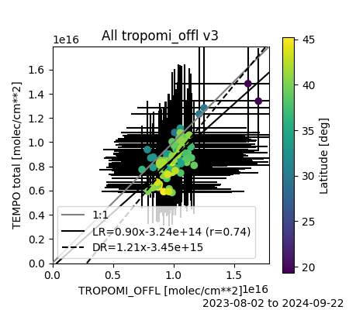
Trace Gas Validation
NO₂
HCHO
Pandora
Pandora
TROPOMI
TROPOMI
[Credit: Barron Henderson, Luke Valin, Jim Szykman]
* TROPOMI comparisons are for Pandora locations + ozone non-attainment areas

Slide 7
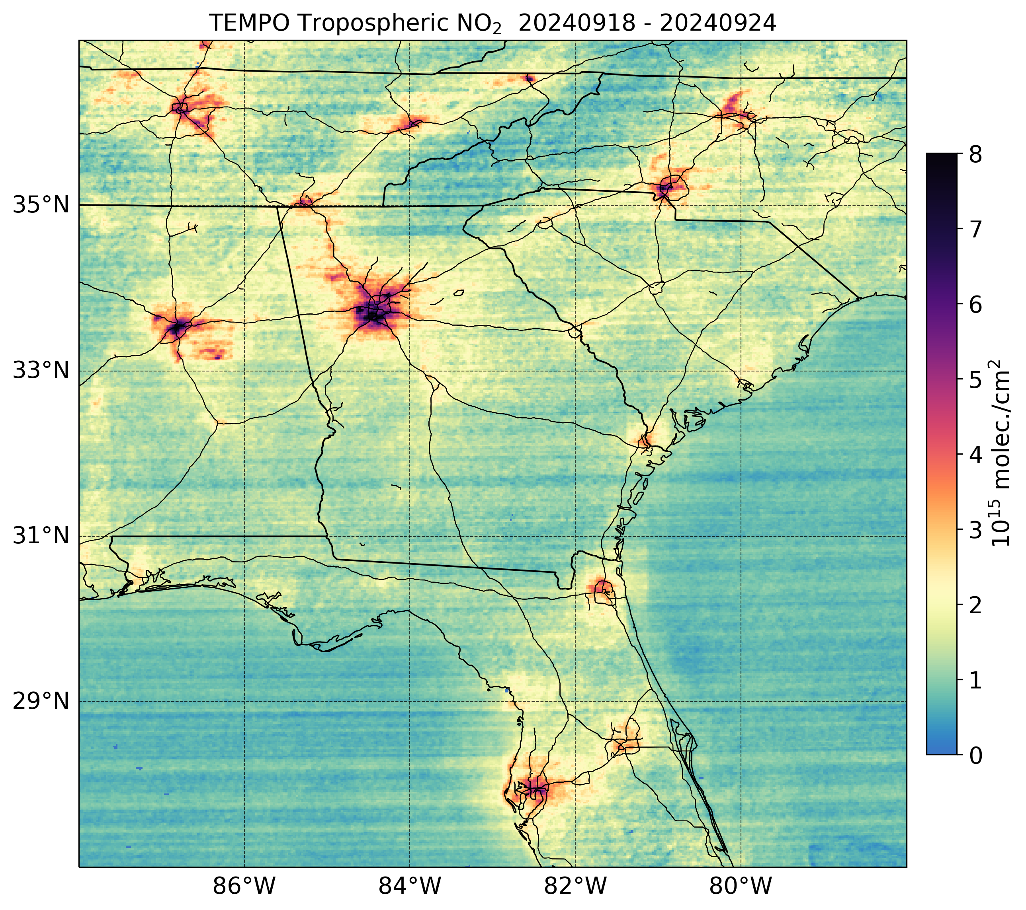
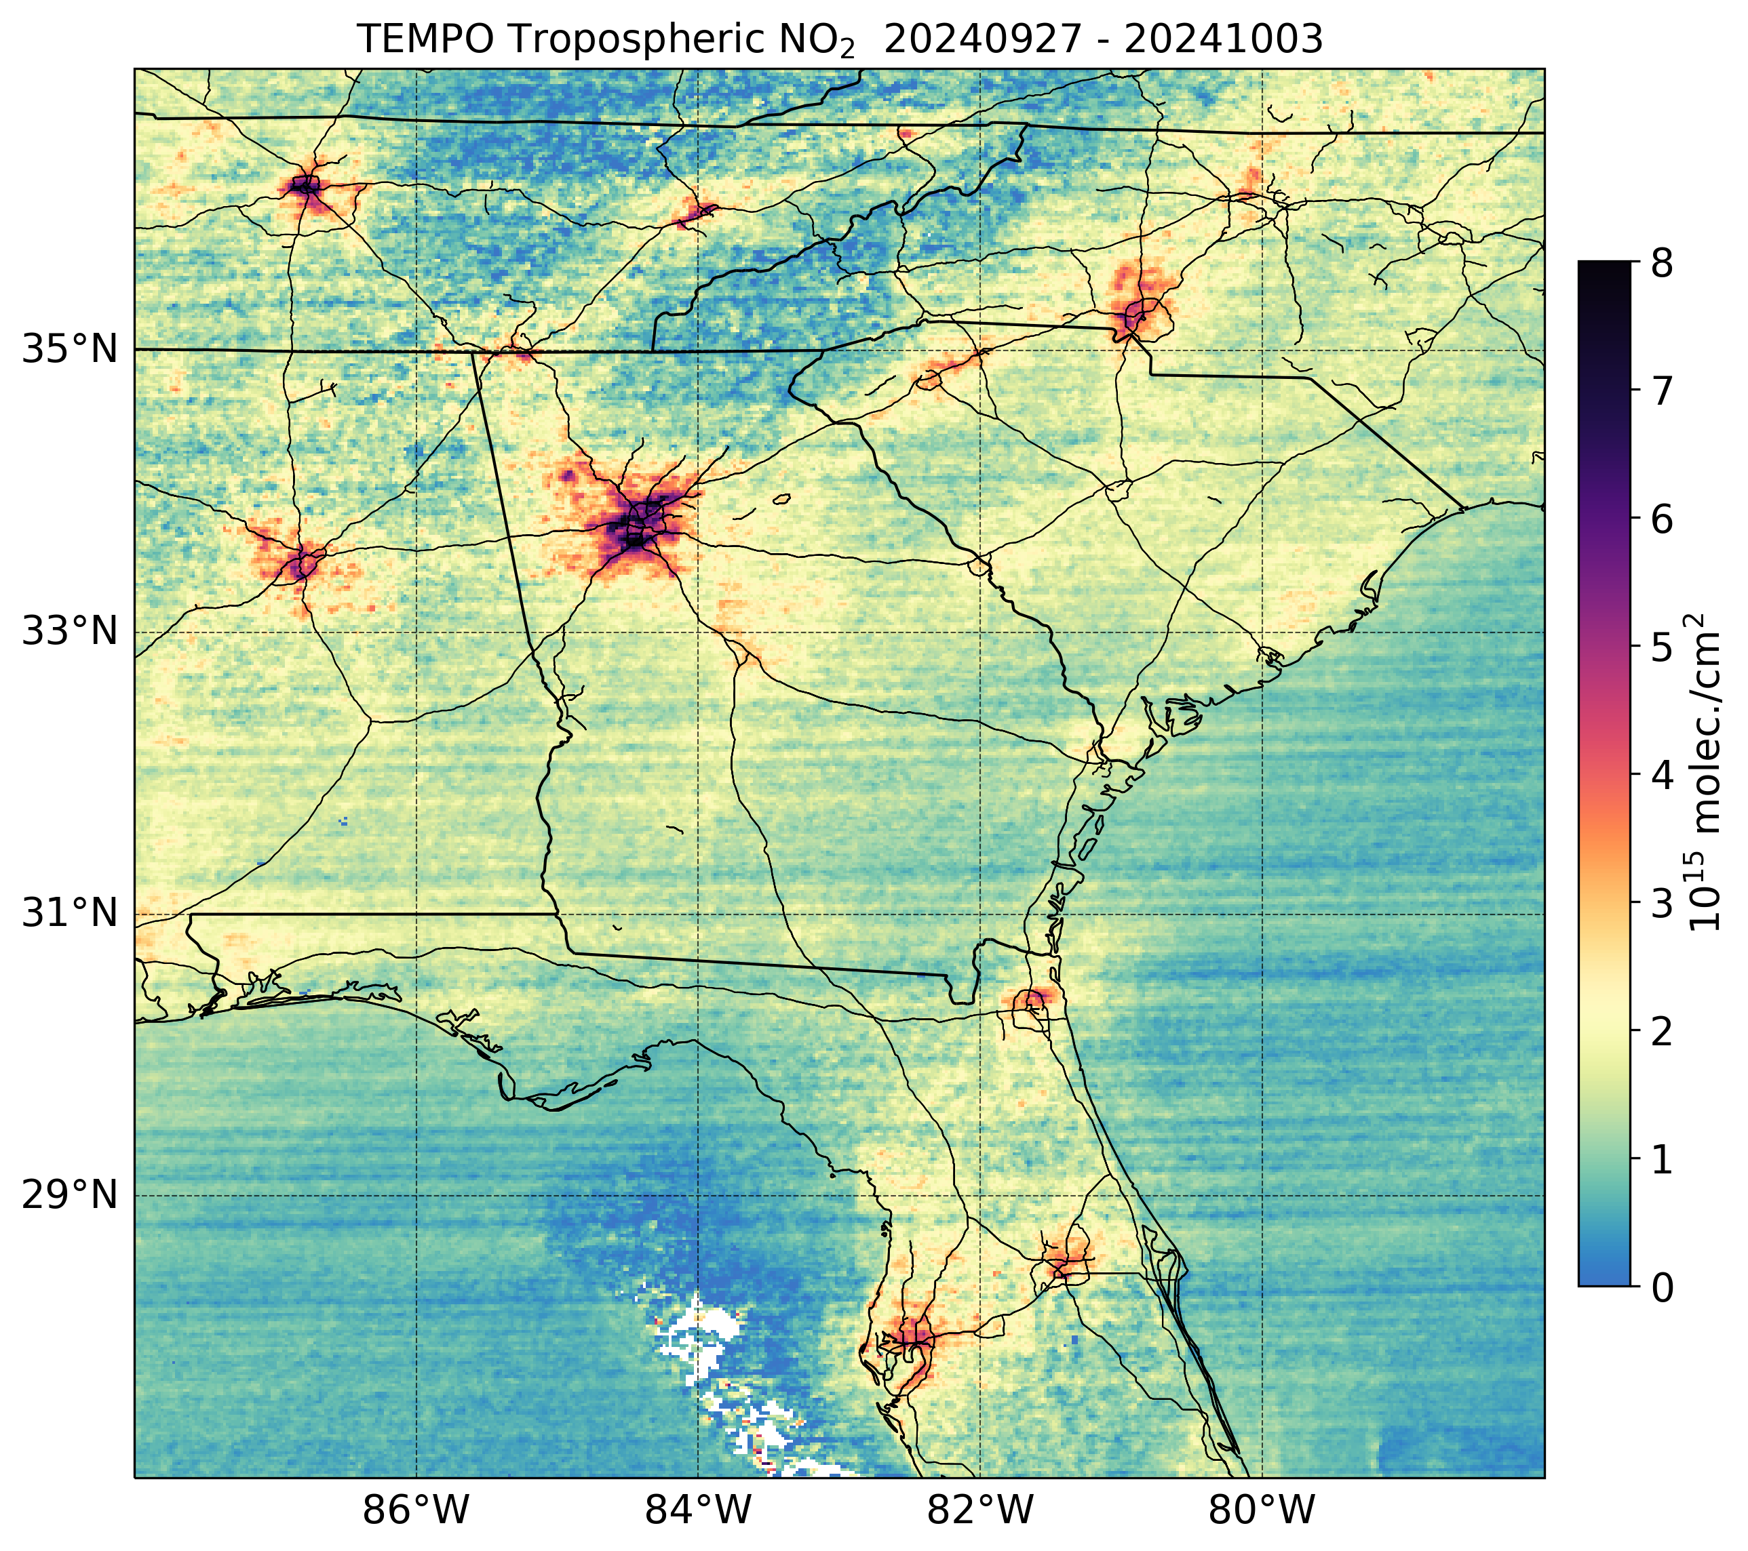
NO₂ and Hurricane Helene
Before Helene
After Helene
Decreases seen in NO₂ in Savannah (GA), Jacksonville (FL), Raleigh-Durham (NC)
[Credit: Aaron Naeger]

Slide 8
July 2024 Formaldehyde
08 -12 UTC
18 -20 UTC
12 -16 UTC
20 -24 UTC
[Credit: Gonzalo González Abad]
Notes:
Update with real Worldview data

Slide 9
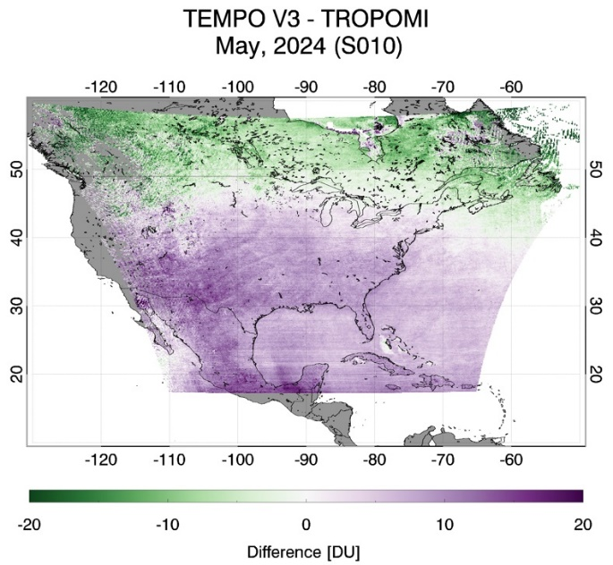
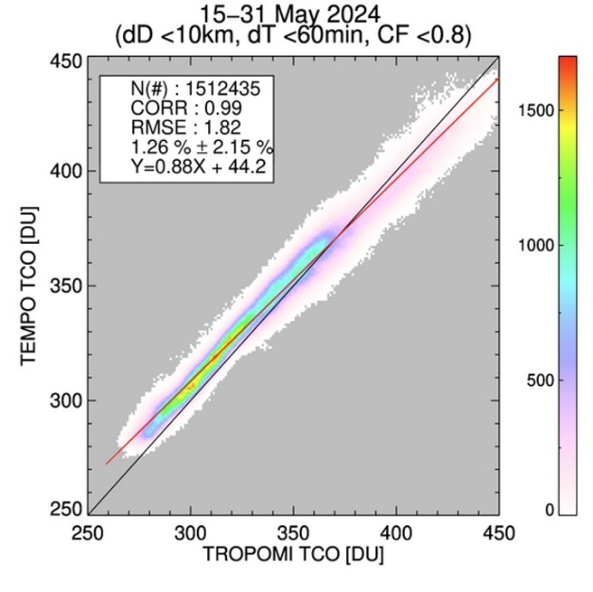
Total Ozone Validation
[Credit: Jerry Ziemke]

Slide 10
Summary and Outlook
TEMPO operations are nominal
NO₂, HCHO, total O₃ publicly available
Expect validation report soon and trace gas upgrade from “beta” to “provisional” status
Priorities for V04:
Radiances → improve absolute calibration, include polarization correction
NO₂, HCHO, cloud → improve surface albedo, cloud fraction bias, HCHO background correction, NO₂ de-striping
Total O₃ → latitude-dependent bias
Continued development and release of O₃ profile product
Near real-time products expected middle of 2025
Many more TEMPO products to come!
Acknowledgements: Funding from NASA (TEMPO, NNL13AA09C; SNWG TEMPO NRT, 80MSFC24CA004)

