Slide 1
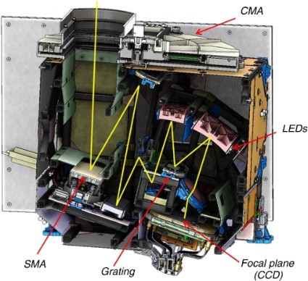
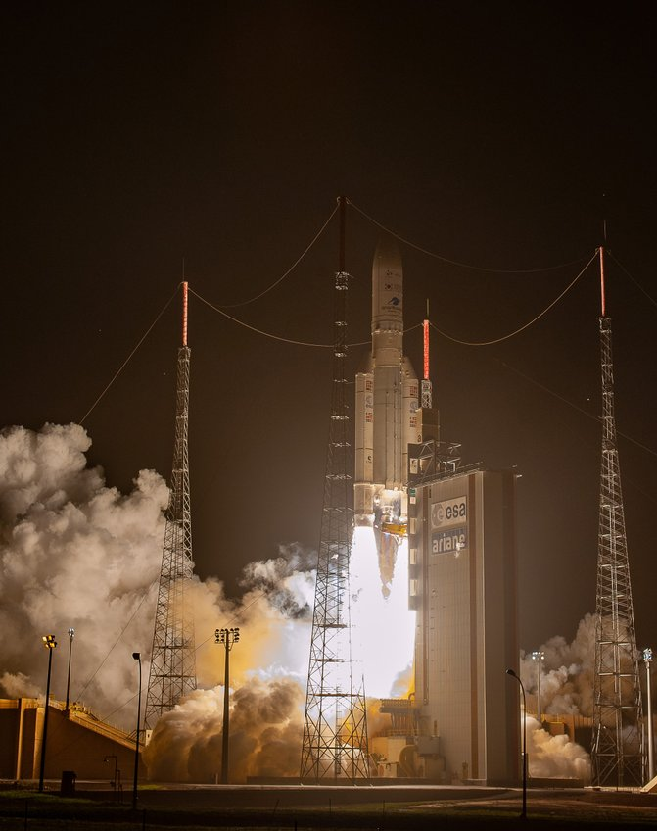
GEMS Status
CEOS AC-VC, College Park, MD, Oct 15-18, 2024
Jhoon Kim,
Yonsei Lee Youn Jae Fellow Professor of Atmospheric Science,
Yonsei University, Korea
M-H Ahn, R. Park, H. Lee, J. H Kim, Y.-S. Choi, S. S. Park, C. H. Song, K.-M. Lee, K. Han, C.-K. Song, U. Jeong, S.-W. Kim, Y. Jung,
M.S. Yoo, D. Lee, W.-J. Lee, J. Yoon, H. Hong, W. Choi, L. Chang, Y. Kim, K.-J. Moon;
D. H. Ko, S.-H. Lee; Y. Cho, H. Chong, S. Go, H. Cha,
Y. Chai, S. Lee, M. Kang, M. Eo, J. Bak, K. Baek, D.S. Choi; H.-A. Kwon, J. Yang, J. Park, K. M. Han, H. Choi, E. Lee, G. Kim, Y. Cha;
X. Liu, K. Chance, D. Jacob, B. Lefer, J. Al-Saadi, S. Kondragunta,
P.K. Bhartia, M. Newchurch,
J.P. Veefkind, B. Veihelmann, A. Richter, N. They, C. Zehner, R. Lutz, GEMS Science Team, and Cal/Val Team

Slide 2
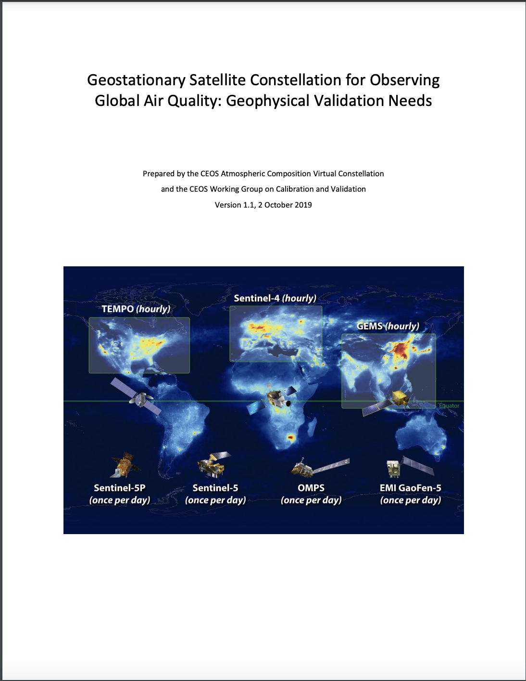
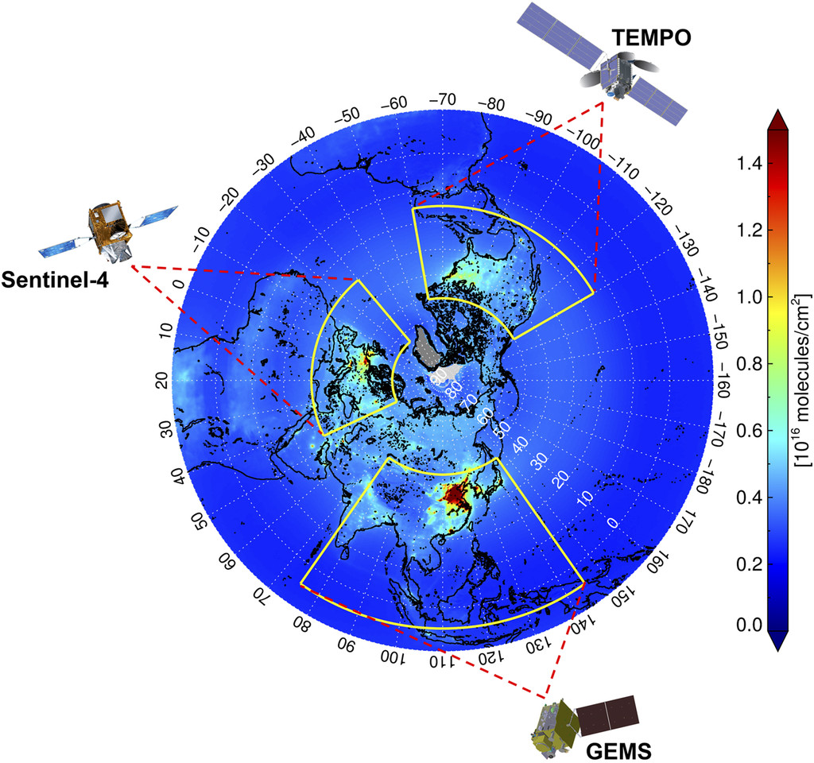
GEO Constellation of Air Quality Observation
(2023-)
+ ABI
(2025-)
UVN
+ FCI
CEOS AC-VC (2019)
Background image:
10-year average NO₂
column density
from OMI (2005-2014)
Kim et al.(BAMS 2020)
(2020- )
+ AMI + GOCI-2

Slide 3
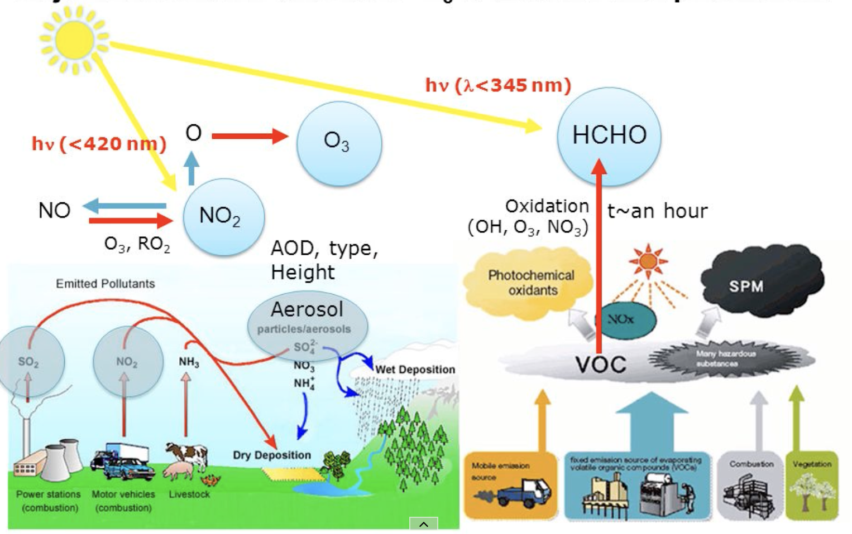
GEMS – Air Quality Observation over Asia in High Spatio-temporal Resolution
System Attributes | Requirements
Lifetime | >10 years
Field of Regard | N/S rng: 45°N-5°S E/W rng: 75°E-145°EOrbital pos.: 116.2°E - 128.2°E
Ground Sampling Distance | 3.5 km × 7.7 km (N/S × E/W) at Seoul, Korea
Spectral range | 300 to 500 nm
Spectral Resolution | < 0.6 nm
Products | AOD, AEH, AI-UV & Vis, O3, NO2, SO2, HCHO, CHOCHO, Cld (CRF, ECP), Surface, UVI, BrO, H2O, HONO
CHOCHO
H₂O
NIER/KARI
GEMS
(2020-present)
BrO
HONO
Daily operation since Nov 2020
Ver.2 data release in Nov., 2022
Updated ver. data release in 2024
Clouds
(ECF, CCP)
SO₂
NO₂

Slide 4
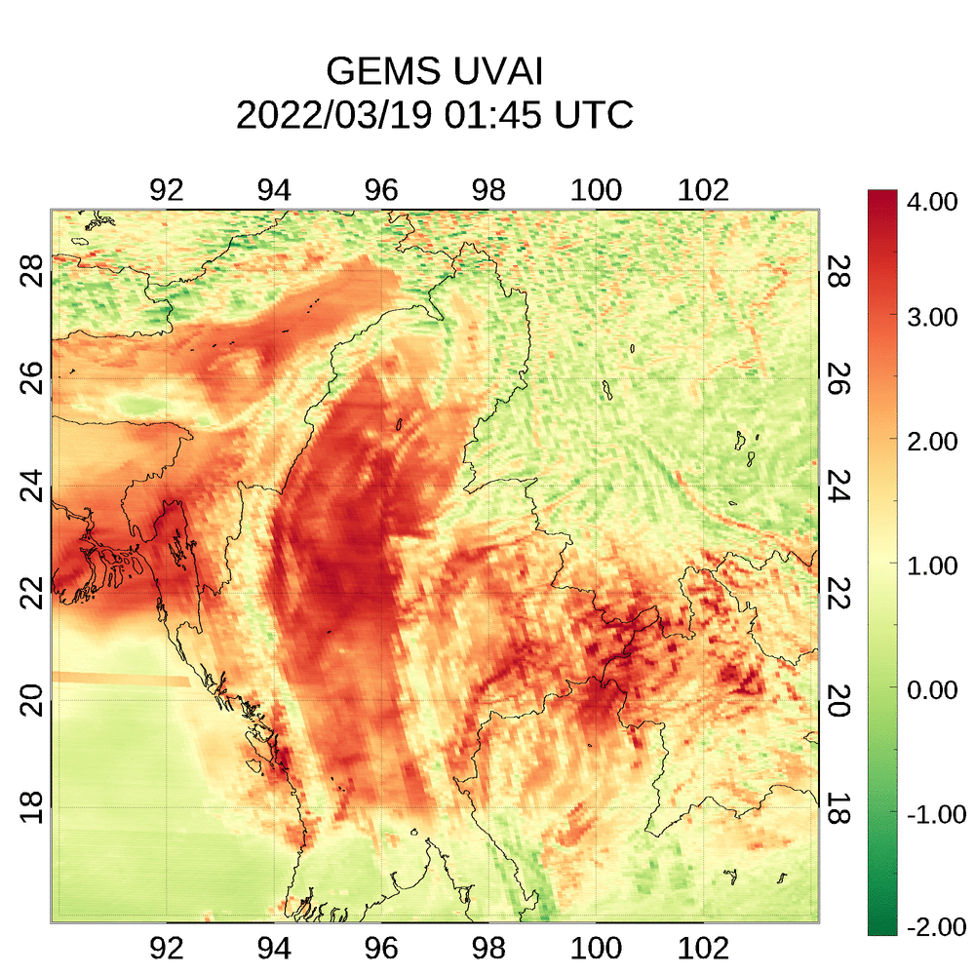
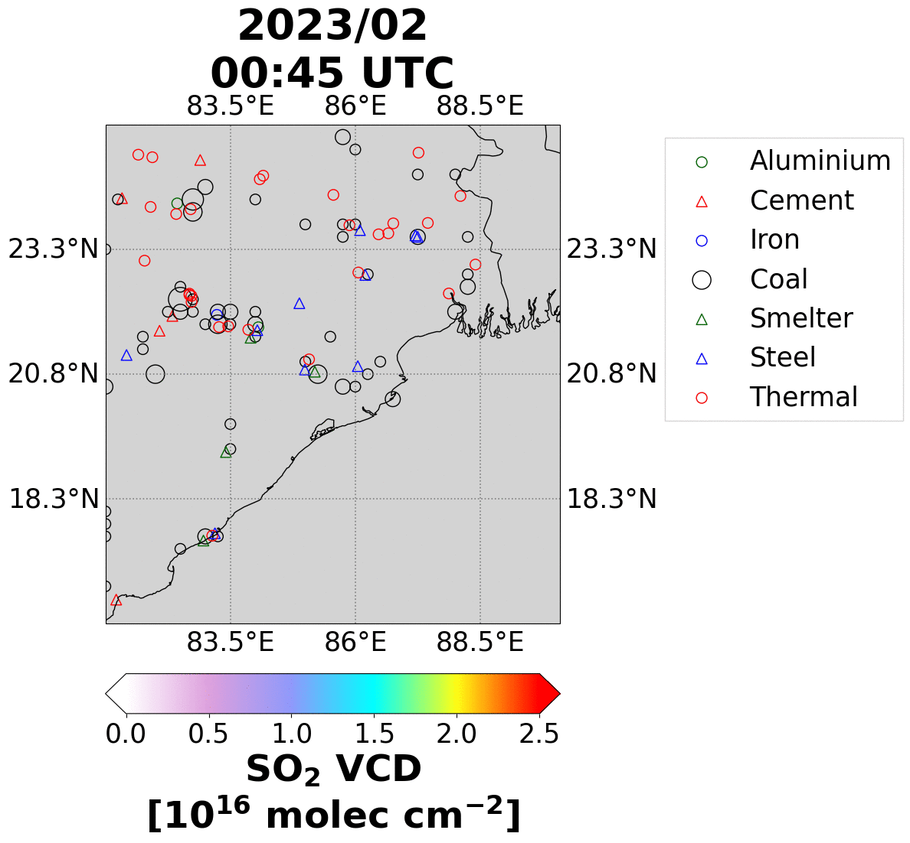
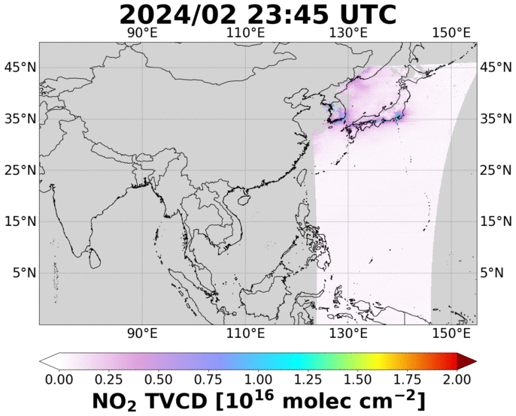
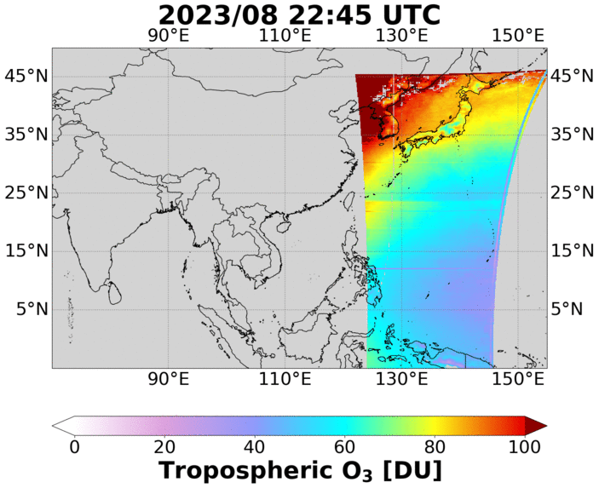
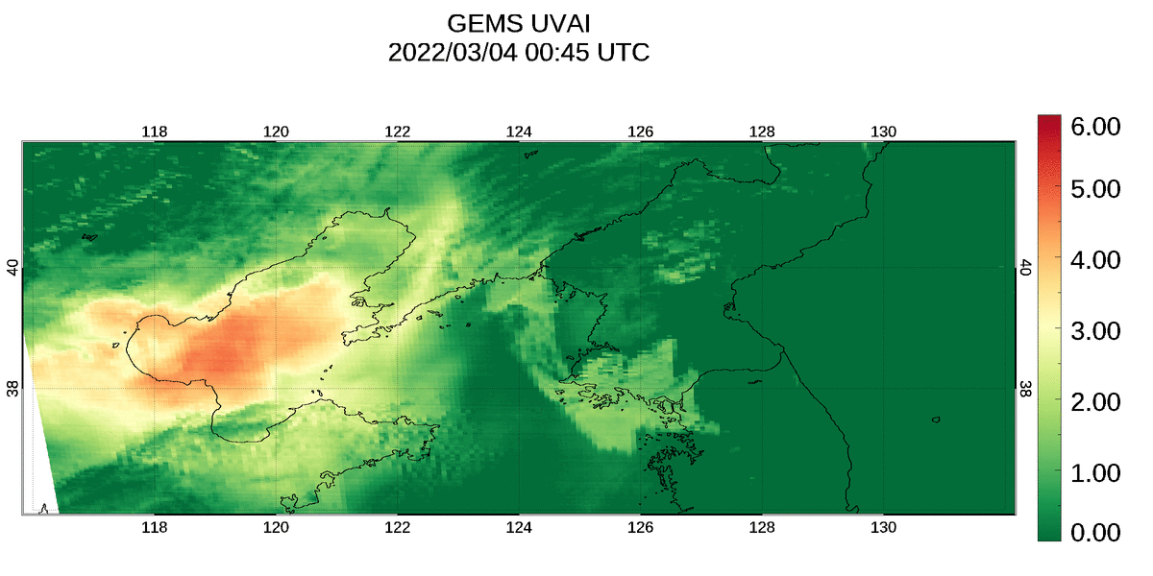
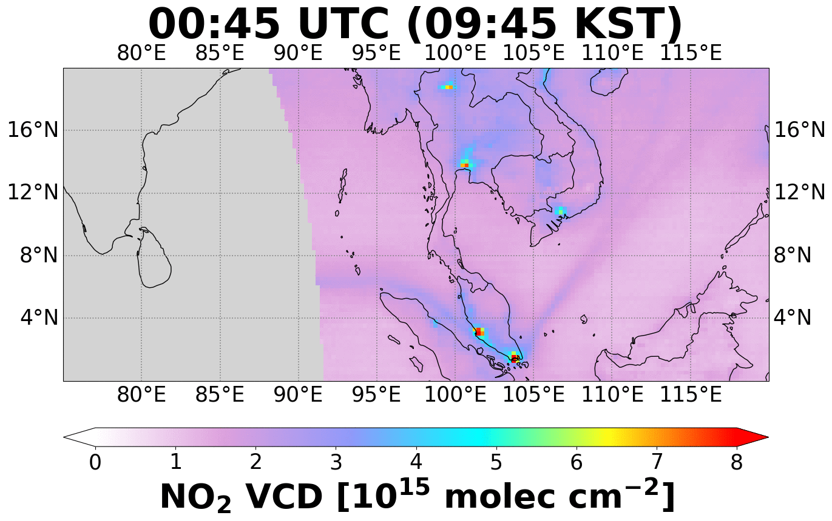
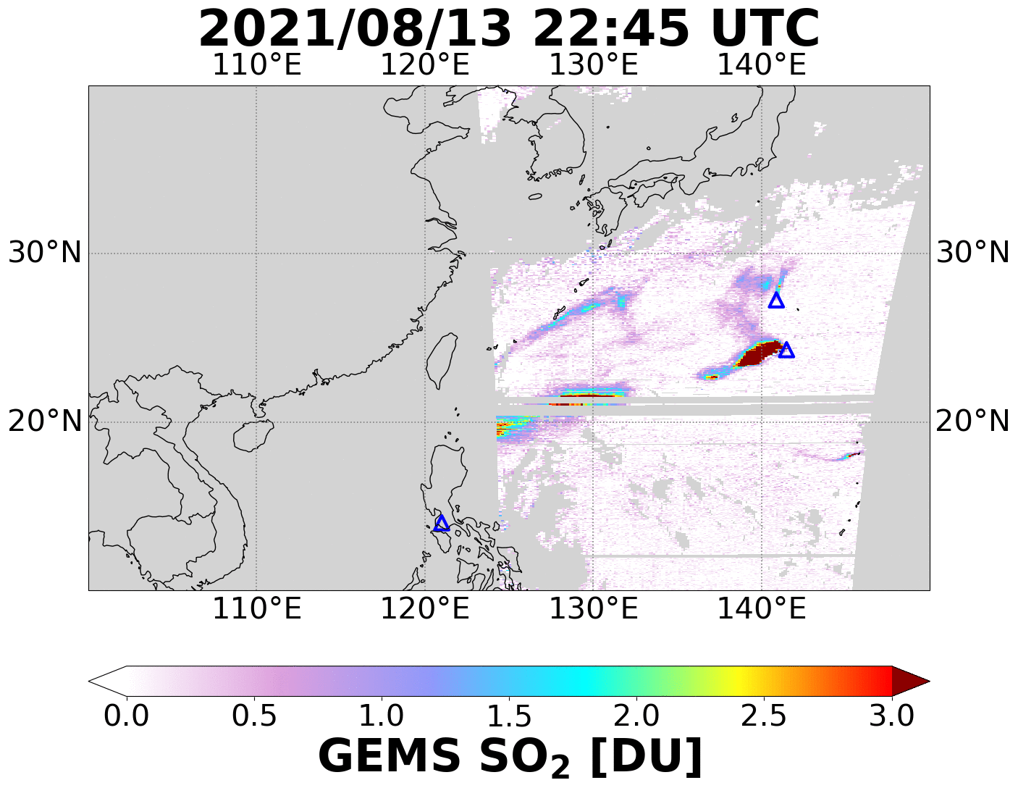
GEMS Data Products
Urban Emission
Wildfires
Trop Ozone
Coal PP & Smelters
UV Aerosol Index
Dust & Wildfires
Ship Track Emission
Volcanic Eruption
Aerosol Optical Depth

Slide 5
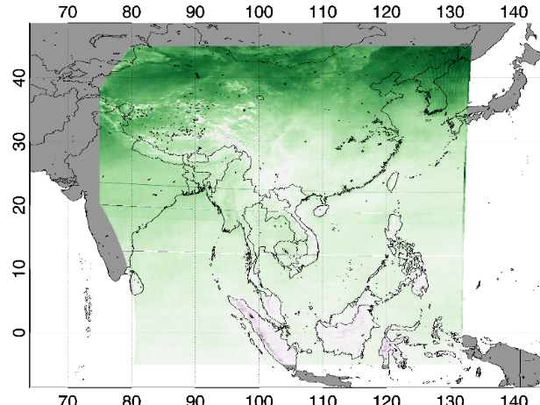
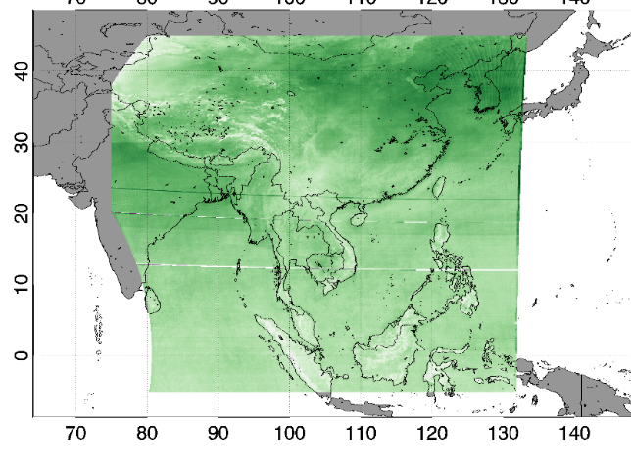
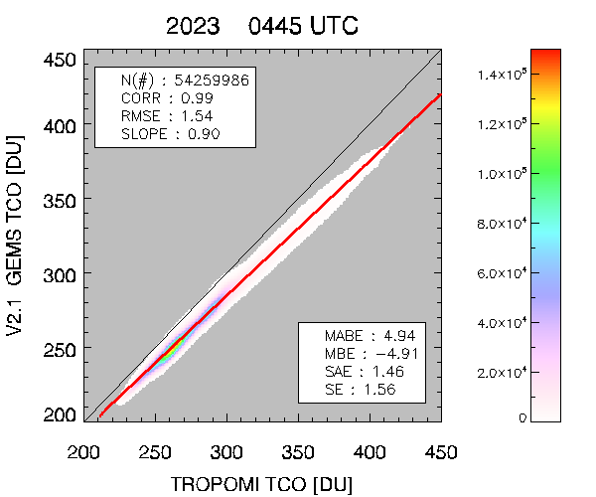
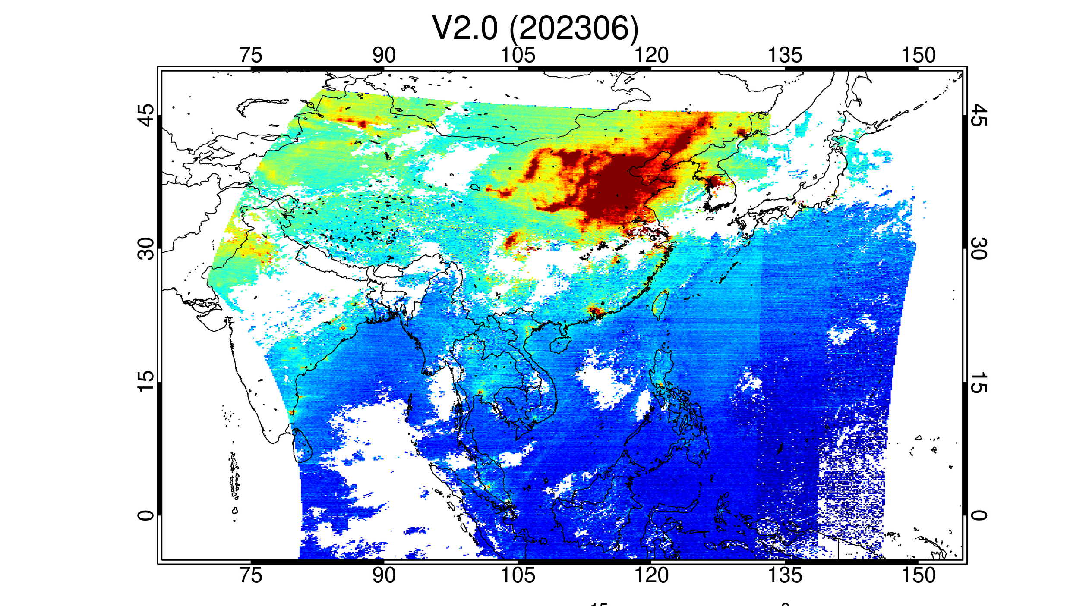
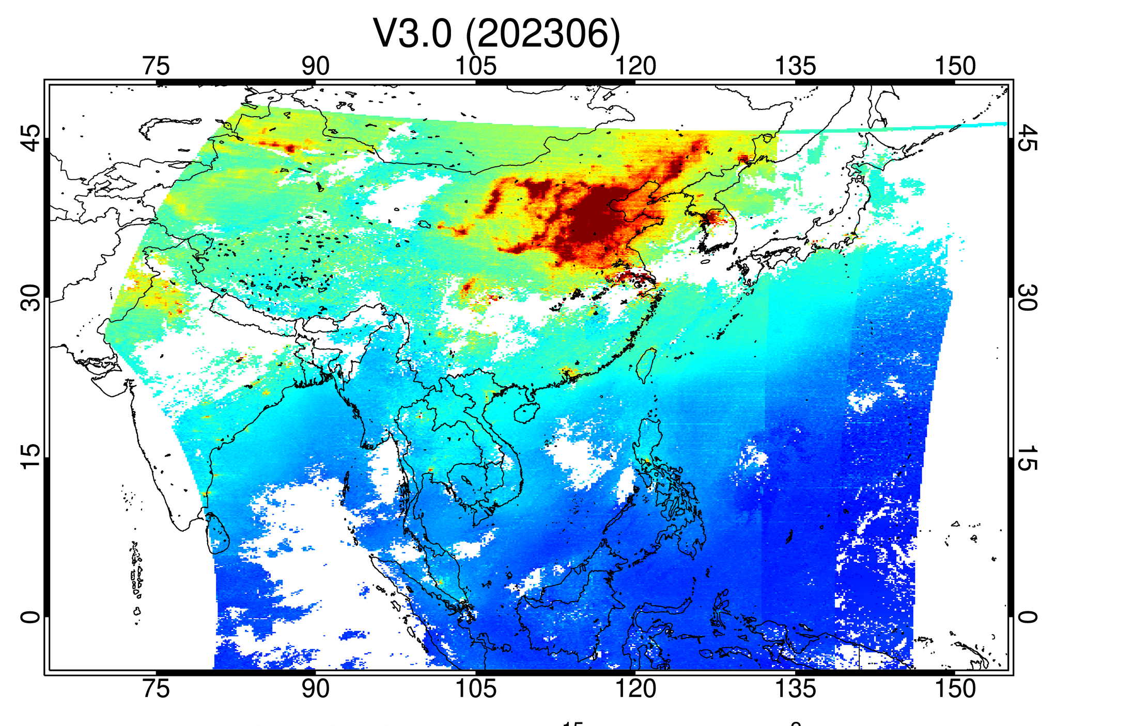
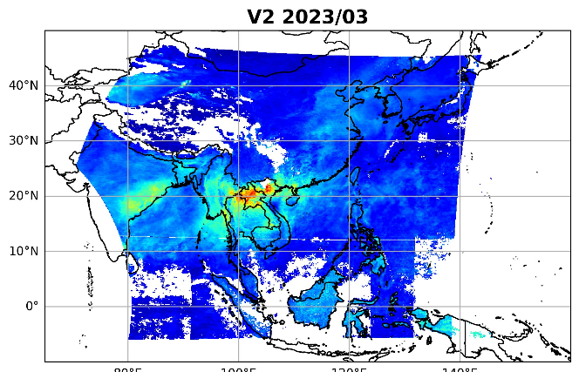
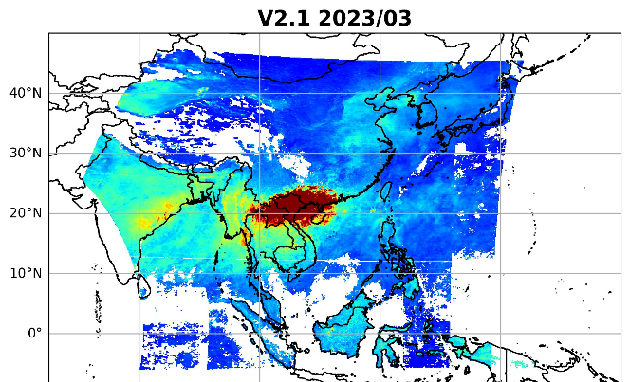
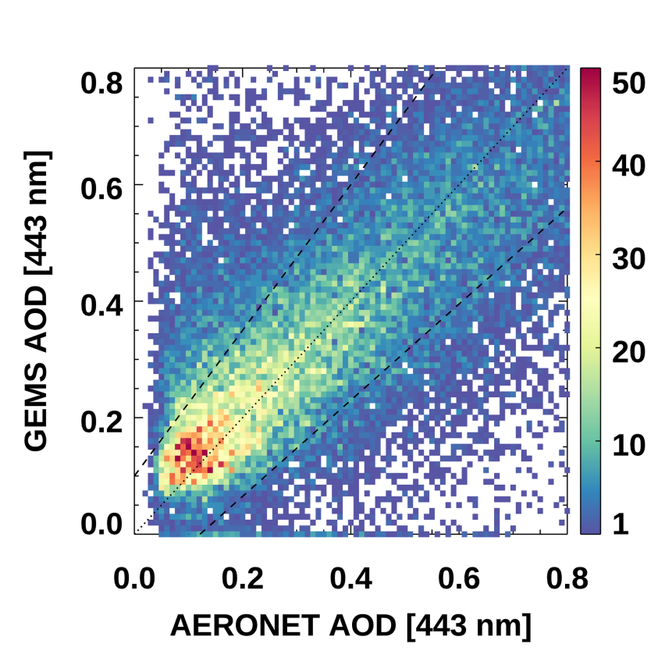
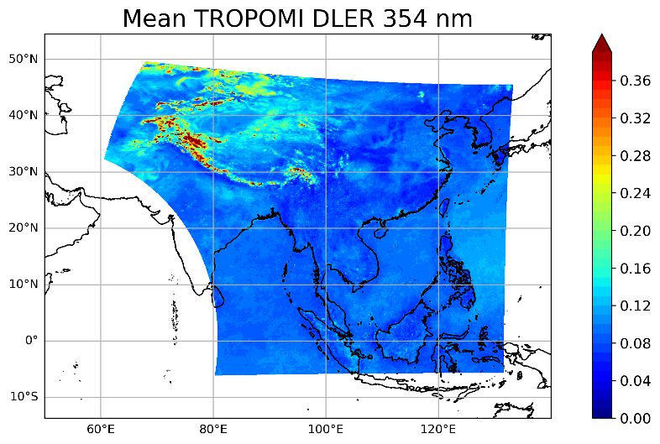
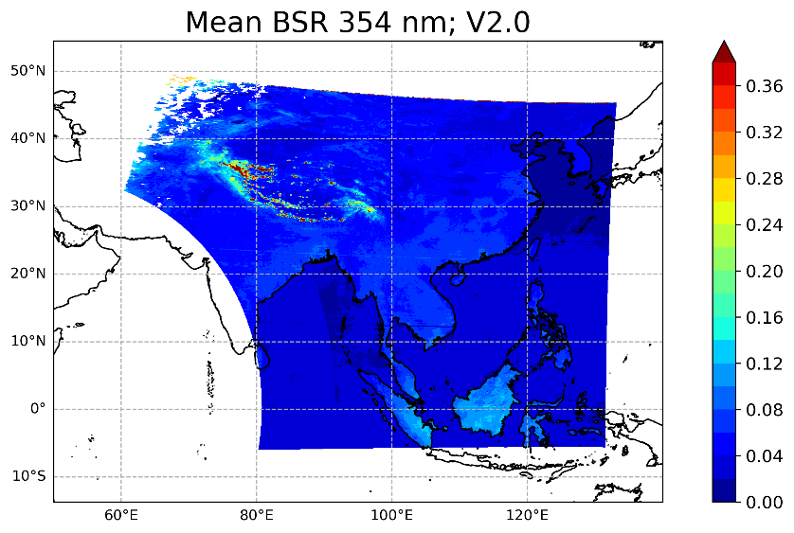
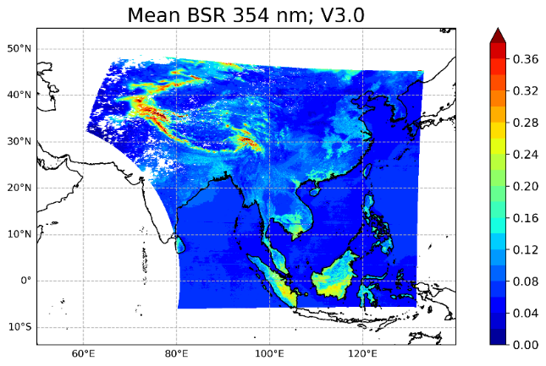
Update to version 3 (some prod in v 2.1)
Prod | V2 Issue | Update details | TROPOMI V2 V3 Val | Remark
Trop O3 | Overestimation | Fitting window, Optimize L1 cal Data (Spectroscopy, Met, Solar Ref)
Total O3 | Underestimation | LUT Data (CLD) |  | v2.1
NO2 | Overestimation Profile shape Tropopause height | AMF S-T separation smoothing Data (AOD, O3T, CLD, BSR)
SO2 | Stripe (High conc) Noise (Low conc) | Slit Function (2x2 pixel binning) SO₂ profile |  | v2.1
HCHO | average model conc Underestimation(West) | Variable background correction Data (BSR)
CHO CHO | average model conc | Background correction Data (BSR, CLD)
AOD | Underestimation ALH at 2km | Extend LUT, Background AOD, AI Min LER composite to 3 years |  | v2.1
CLD | ECF: Overestimation CCP: lower-layer | LUT, interpolation Clear sky CCP as sfc P, Data (SFC)
SFC | Underestimation <400nm Overestimation @380nm | Interpolation in rad & irr Option handling for IRR, Modification

Slide 6
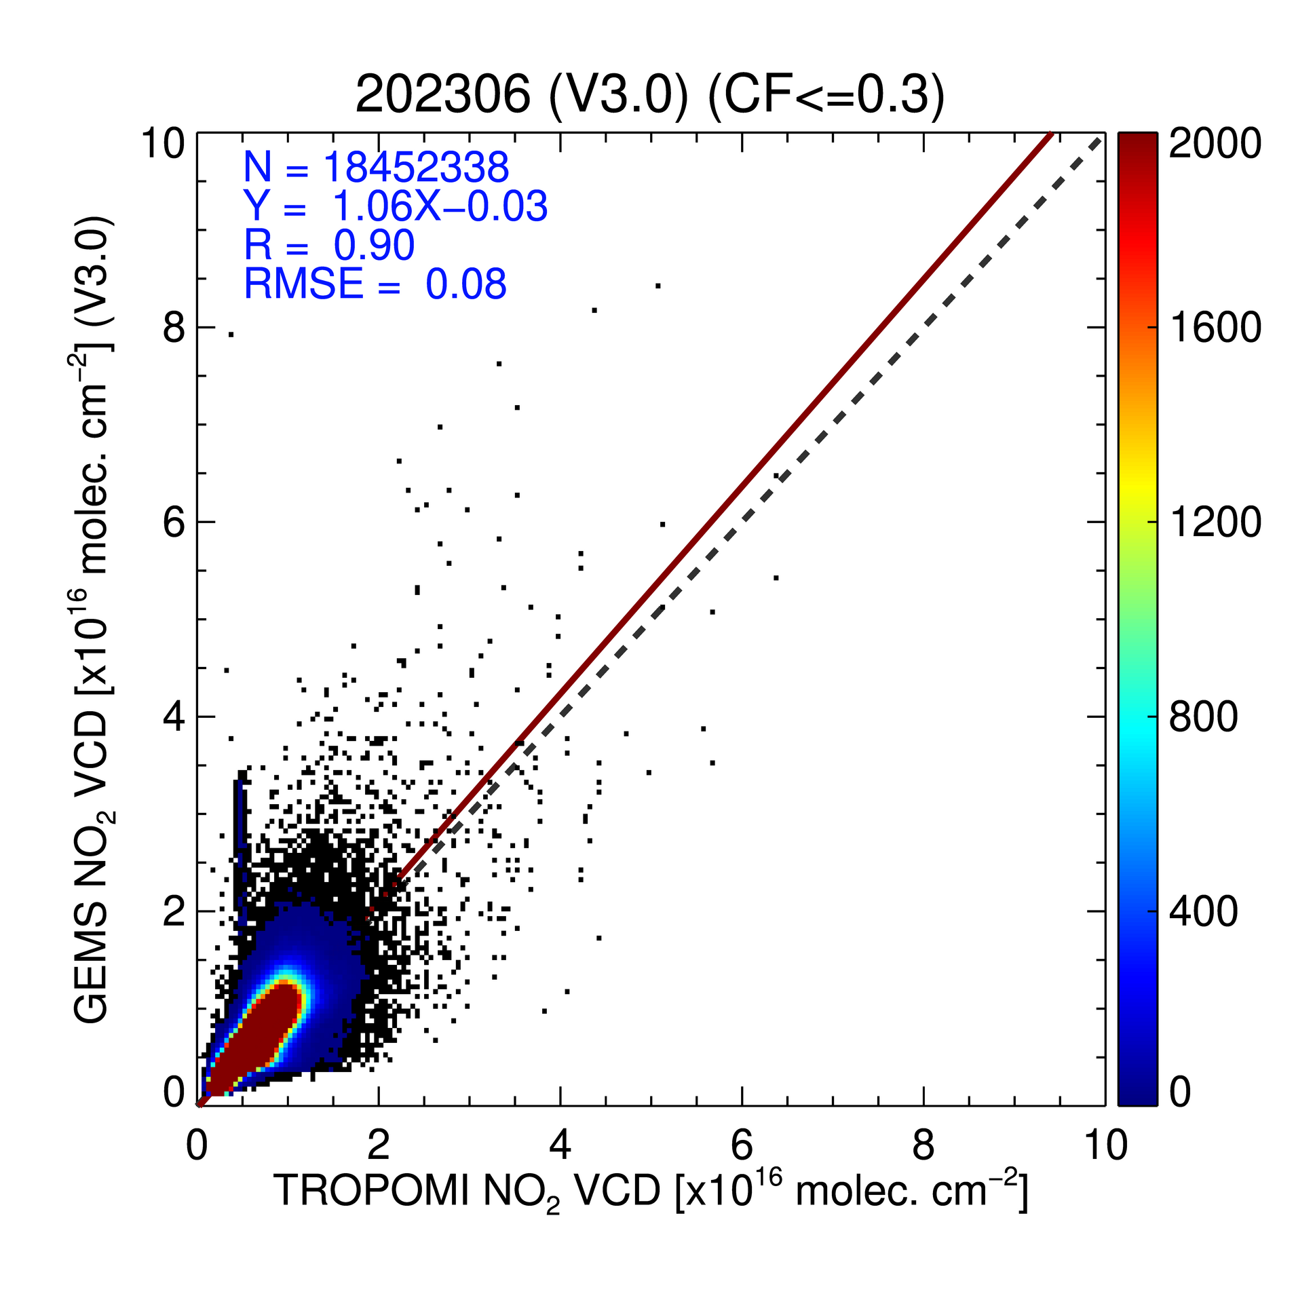
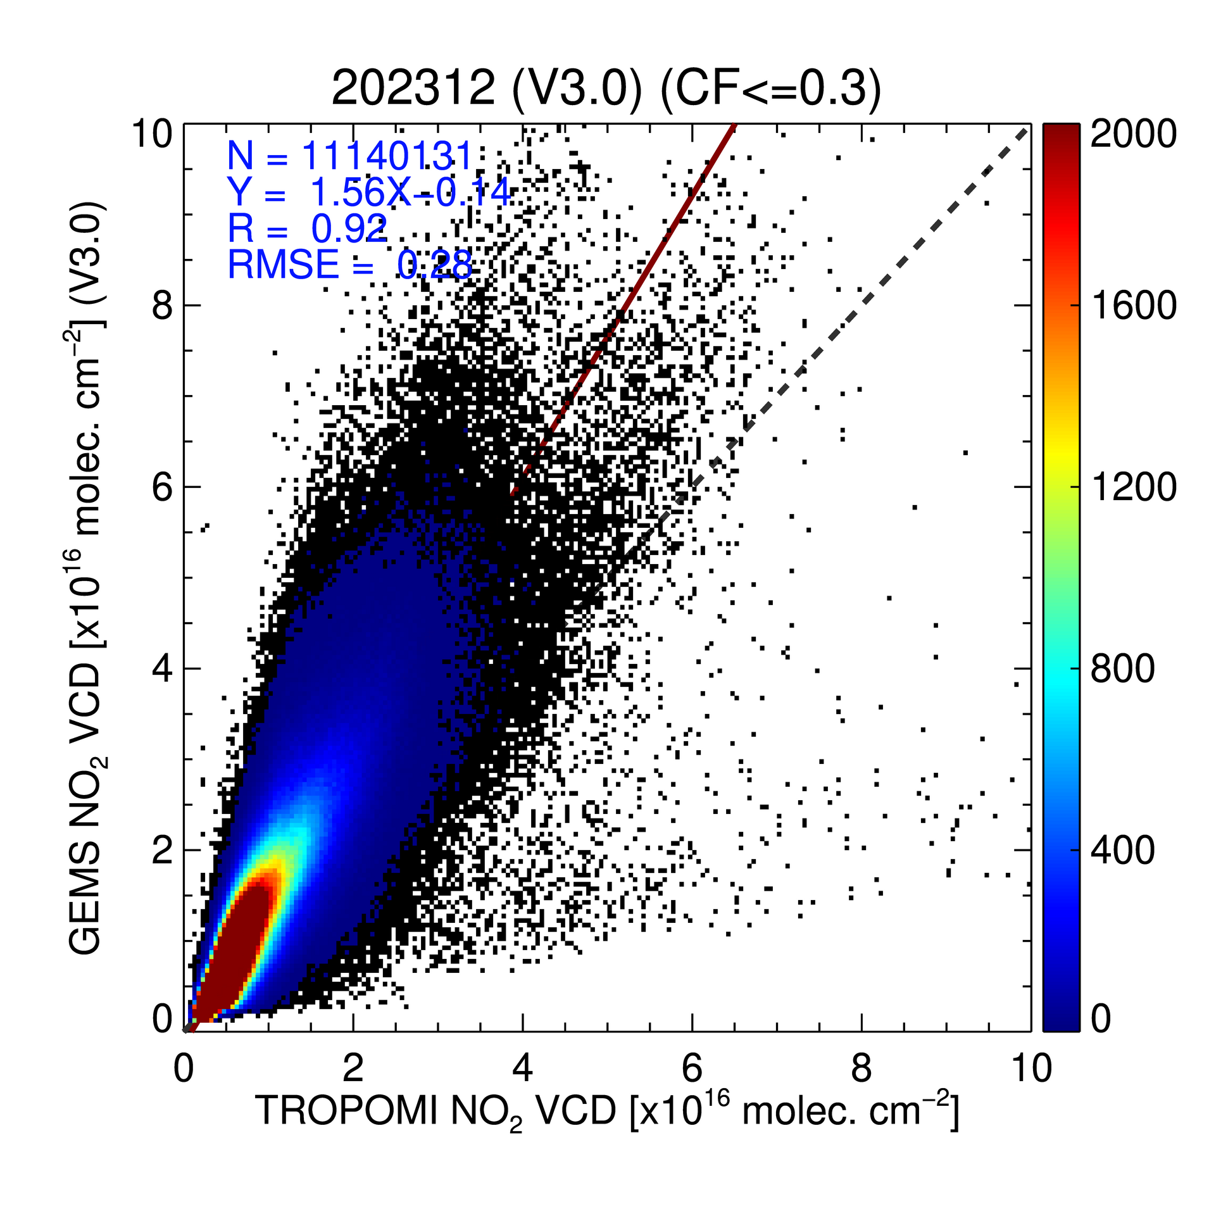
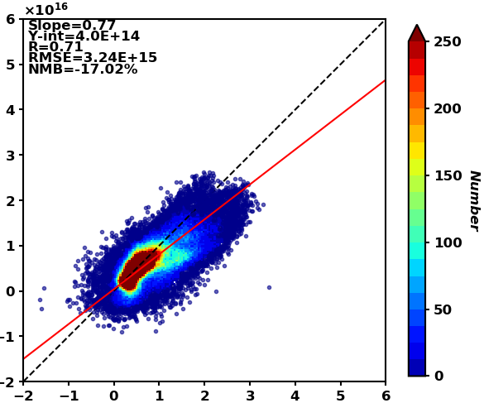
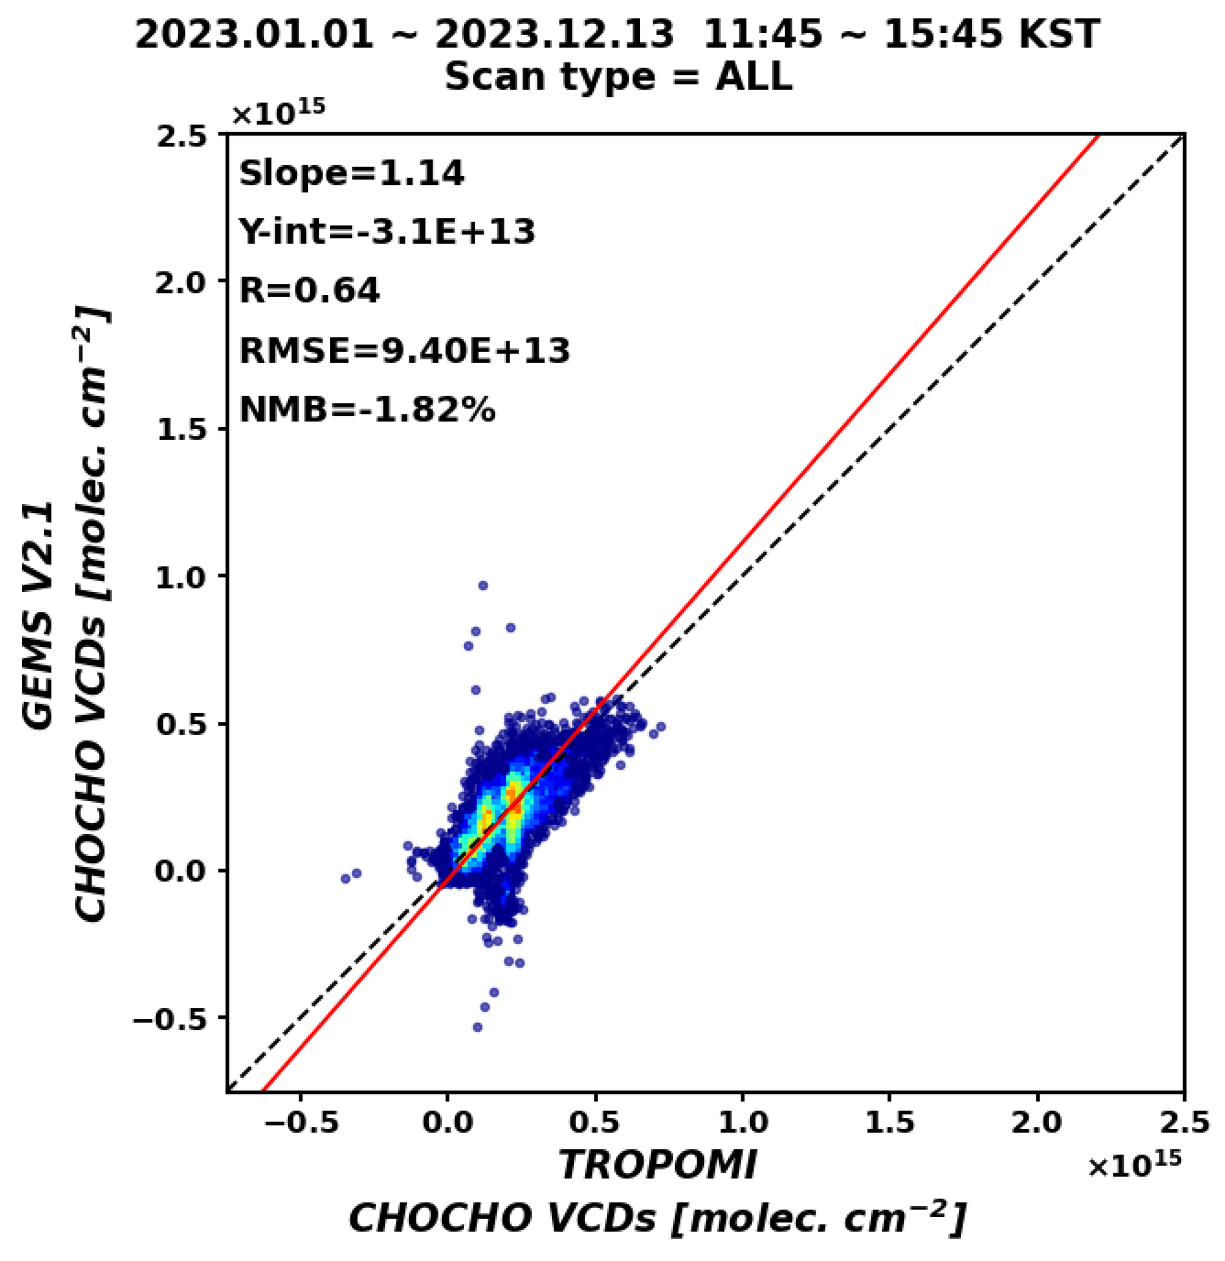
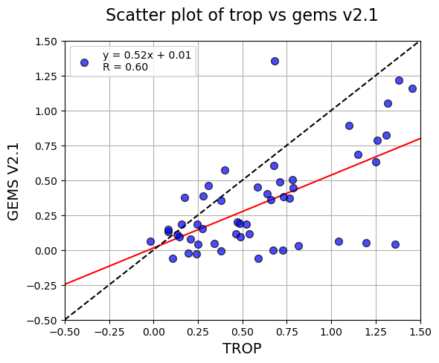
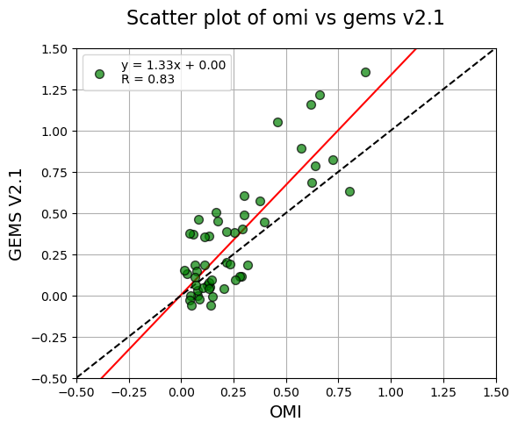
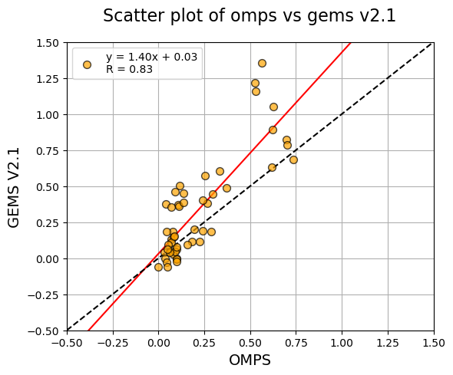
Presentation by L. Chang; R. Lutz
Gas Products Validation
NO₂ v3
O₃ v2.1
Slope=0.90
R=0.99
HCHO v3 [x10¹⁶]
Slope =1.06
R=0.90
2023/06
2023/12
Slope =1.56
R=0.92
GEMS v3 NO₂ VCD
GEMS v2.1 O₃ TCO
GEMS v3 HCHO VCD
TROPOMI NO₂ VCD [x10¹⁶ molec. cm⁻²]
TROPOMI TCO [DU]
TROPOMI HCHO VCD
[molec. cm⁻²]
Prod. Lead: H. Lee
Prod. Lead: Jae Kim
SO₂ v2.1
CHOCHO v3 [x10¹⁵]
Slope =0.52
R=0.60
Slope =1.33
R=0.83
Slope =1.40
R=0.83
GEMS v2.1 HCHO VCD
GEMS v2.1 SO₂ VCD
TROPOMI CHOCHO VCD
[molec. cm⁻²]
TROPOMI SO₂ VCD [DU]
OMI SO₂ VCD [DU]
OMPS SO₂ VCD [DU]
Prod. Lead: R. Park
Notes:
CHOCHO) TROPOMI와 2023년 1년 전체 검증, R은 v2.0에 비해 감소(0.72->0.64), NMB는 증가(-9.48%->-1.82%)
O3) TROPOMI와 2023년 0445 UTC 데이터만 검증
NO2) TROPOMI와 2023년 12월과 6월 데이터 검증
HCHO) GEMS(varying background concentration). 2023년 3월 11:45 ~ 15:45 KST
SO2) 2022년 1월~ 12월 데이터 검증

Slide 7
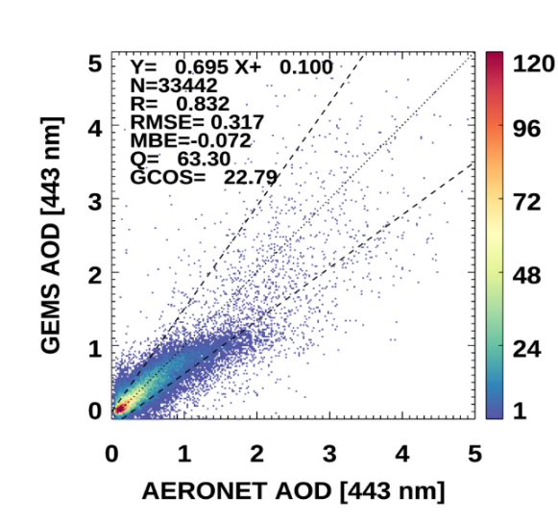
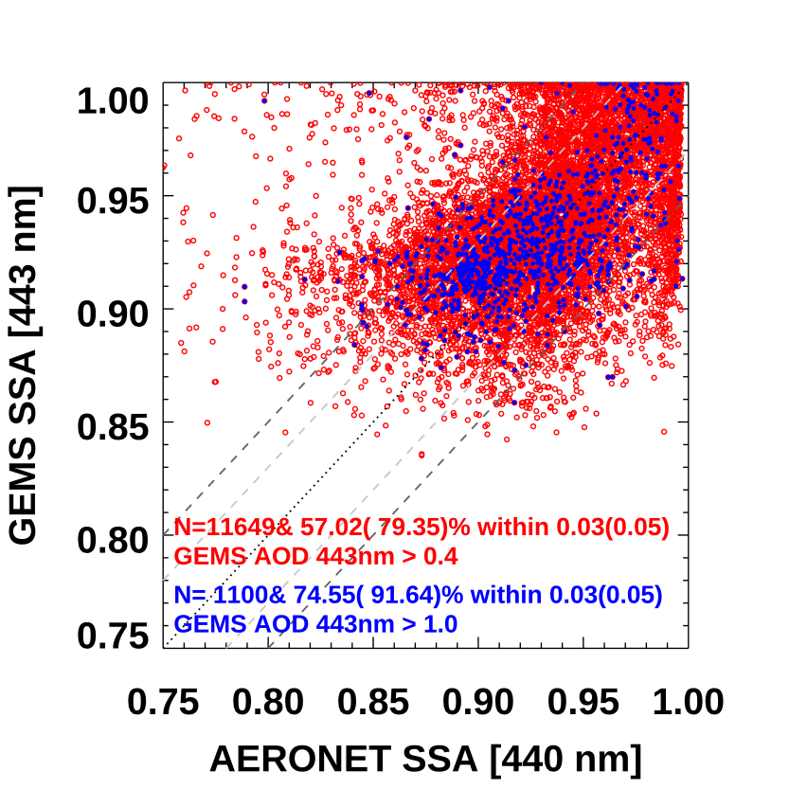
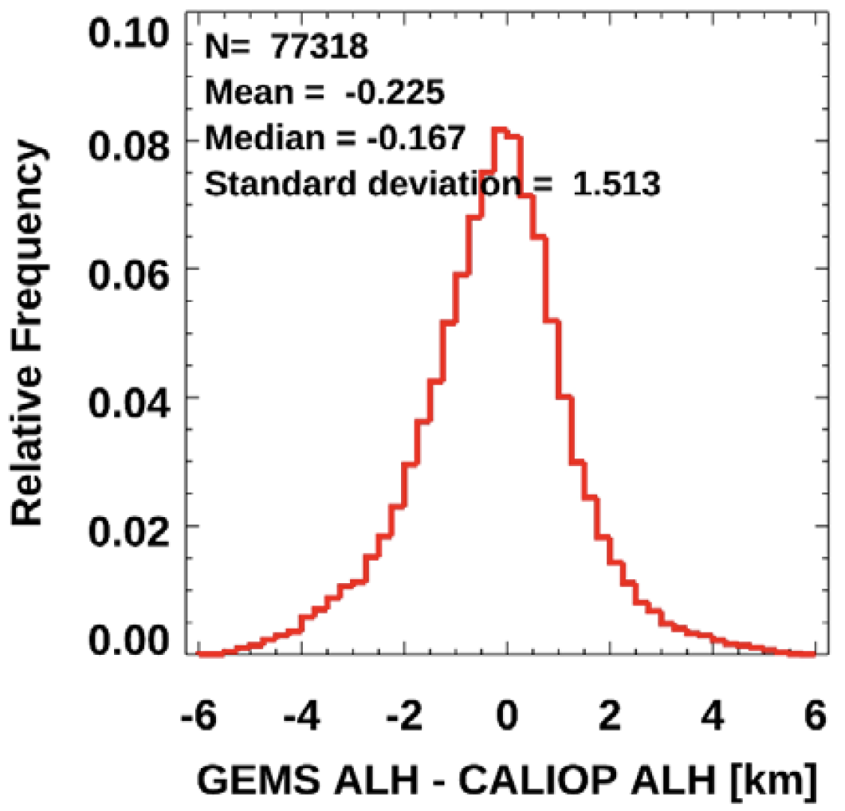
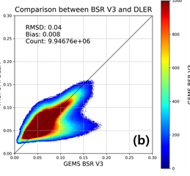
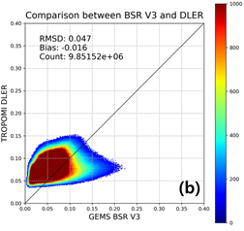
Presentation by L. Chang; R. Lutz
Aerosol, Cloud & SFC Validation
AOD v2.1
R=0.832
RMSE: 0.317
SSA v2.1
ALH v2.1
GEMS Cloud v3
R=0.77 ~ 0.70
RMSE: 0.16 ~ 0.20
GEMS AOD [443nm]
GEMS SSA [443nm]
GEMS AEH v2.1
AERONET AOD [443nm]
AERONET SSA [443nm]
GEMS ALH
BSR 440nm
BSR 380nm
GEMS v3 ECF
TROPOMI DLER
GEMS BSR v3
TROPOMI ECF
Notes:
AOD) 2023년 1월 1일~ 2024년 5월 31일
SSA) 2023년 1월 1일 ~ 2024년 5월 31일
AEH) 2023년 1년 데이터를 통해 TROPOMI ALH와 비교 검증시, v2.1에서 더욱 정규분포에 가까운 모습을 보임
BSR) 23년 3, 6, 9, 12월 자료 유효운량의 과소산출 440nm과 380 nm에서 검증
ECF) GEMS v2와 TROPOMI 검증 결과에서 크게 개선되지 않음, 다만 23년 3, 6, 9, 12월 자료를 사용하면서 v3에서는 유효운량의 과소산출을 확인할 수 있고 ECF<0.2인 경우 그 정도가 더 큼

Slide 8
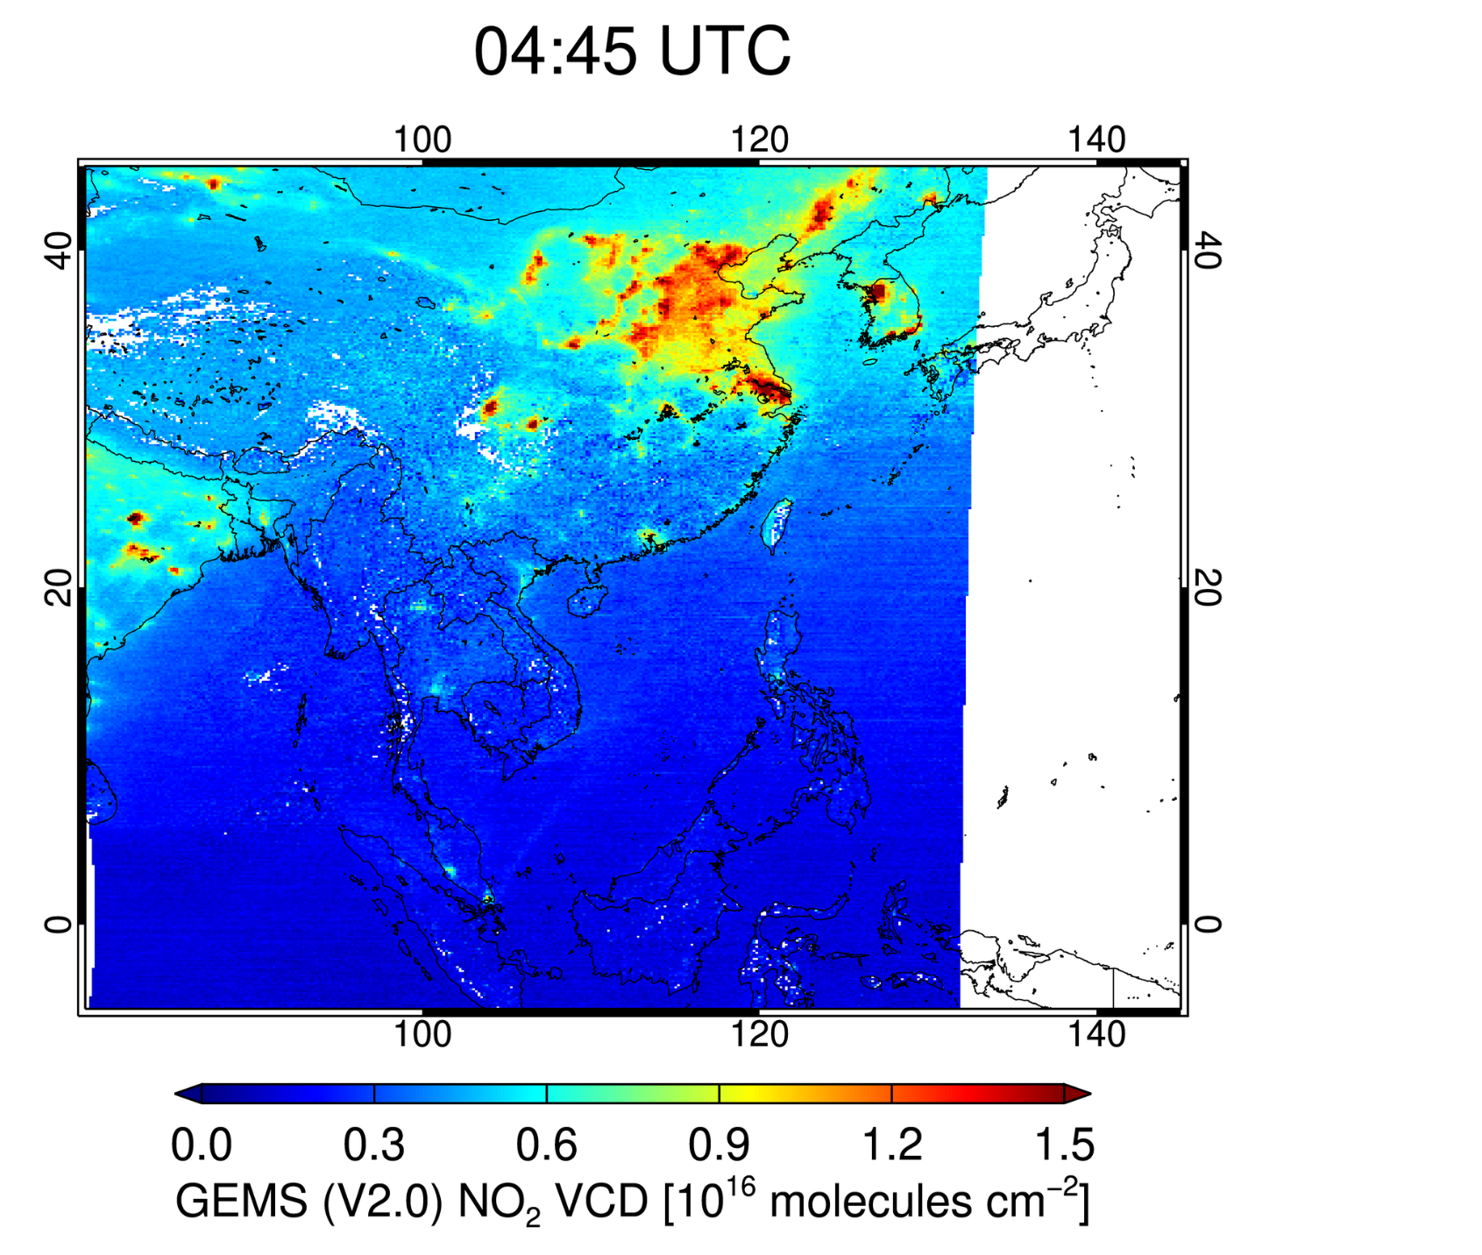
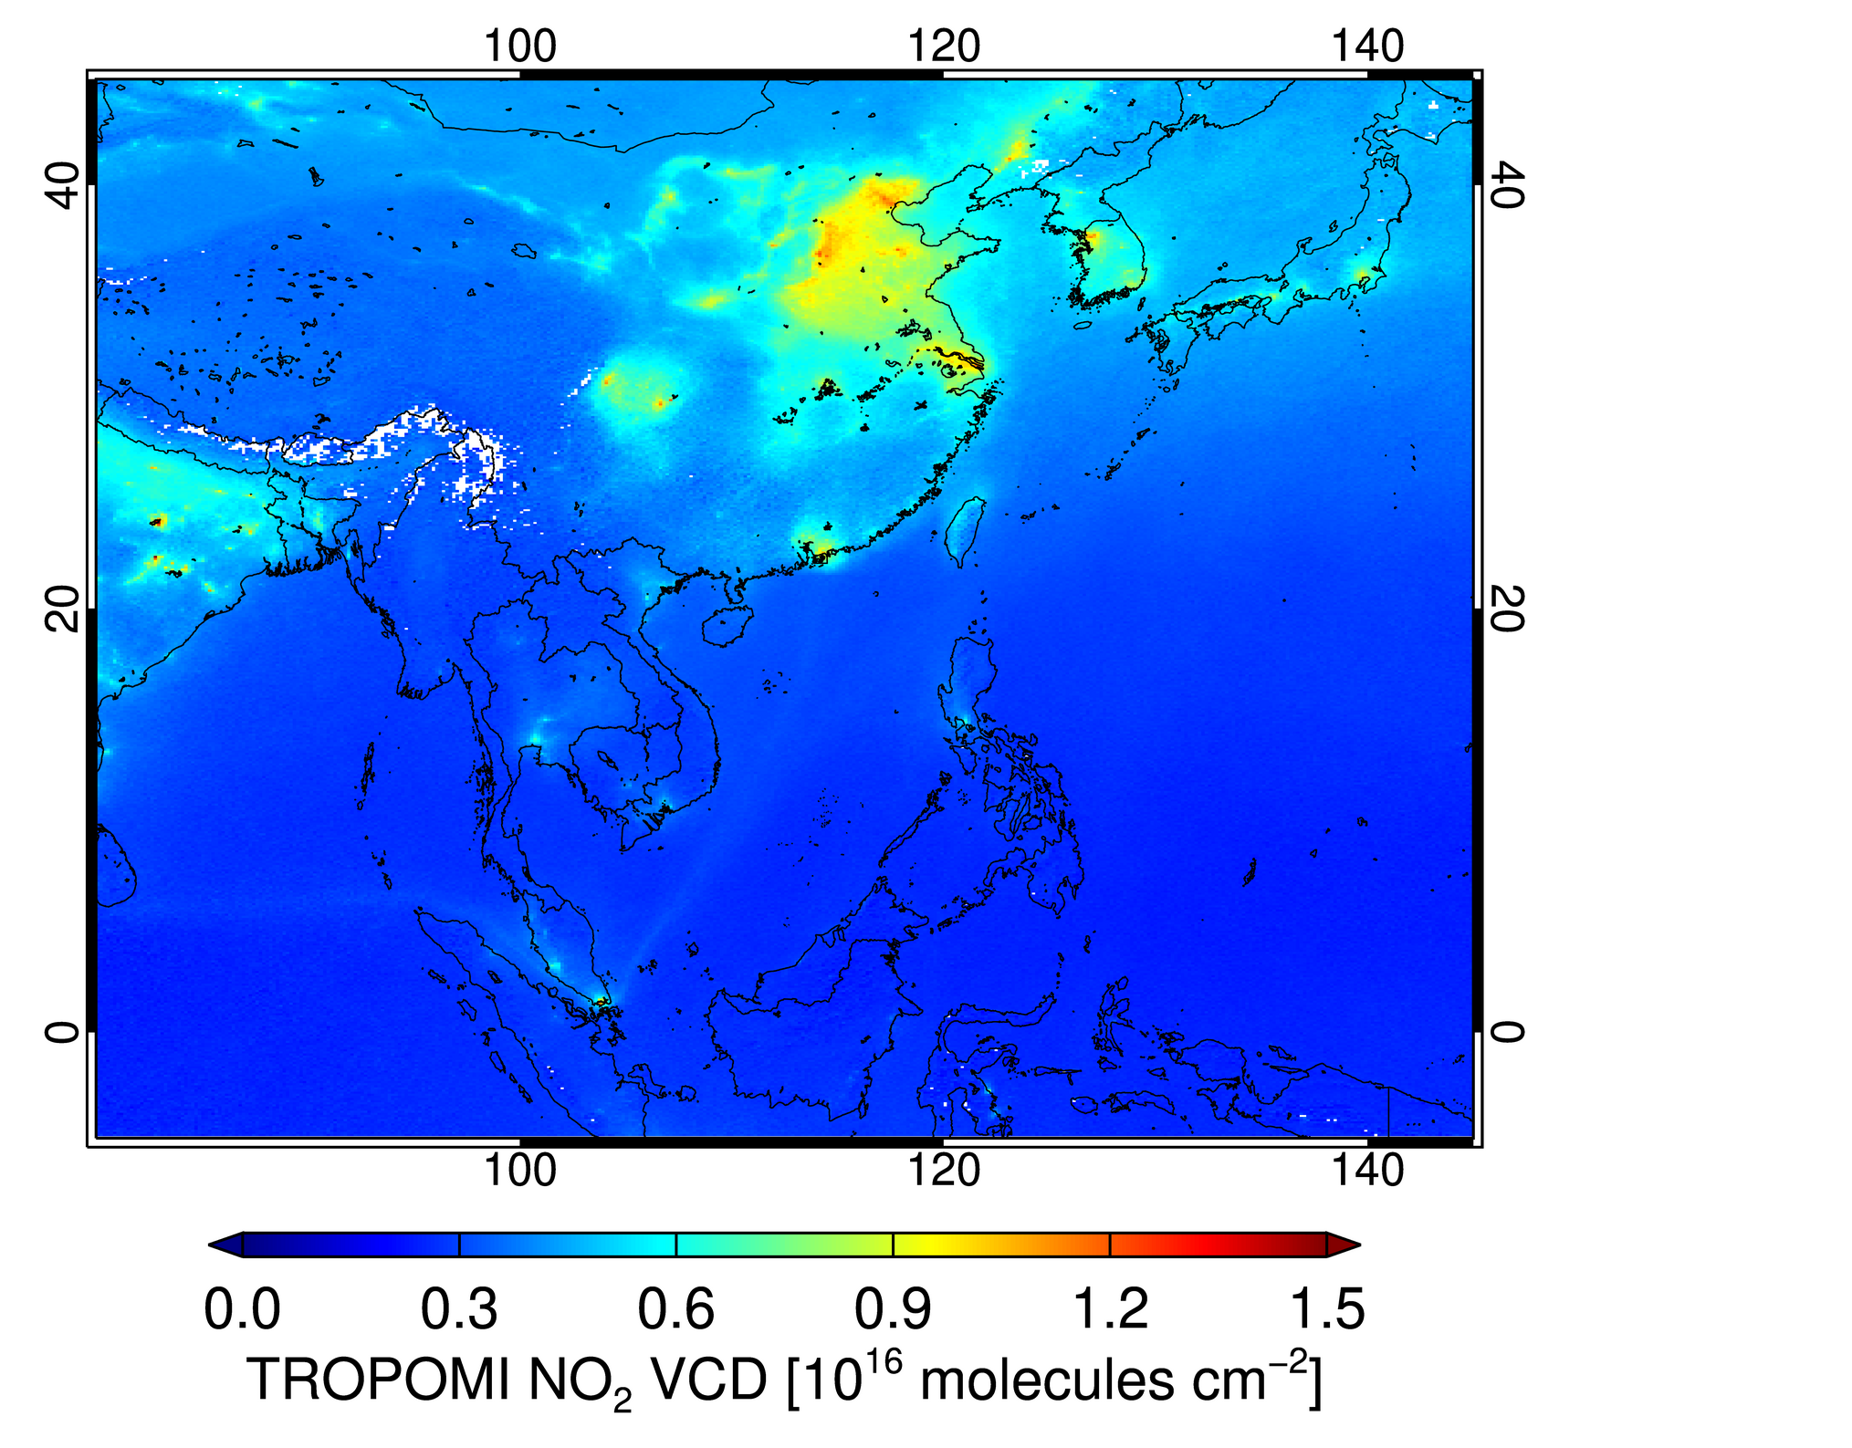
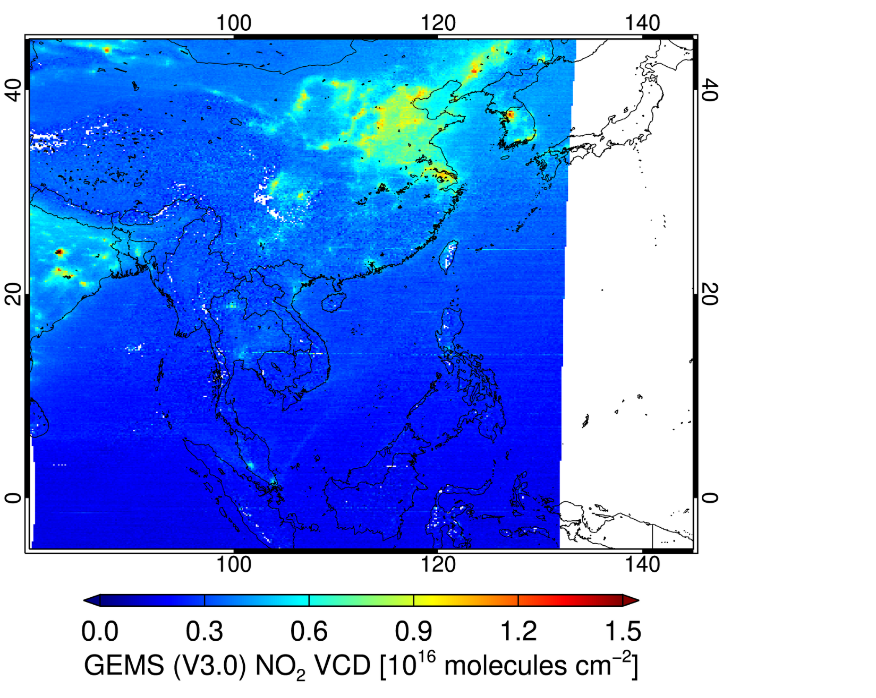
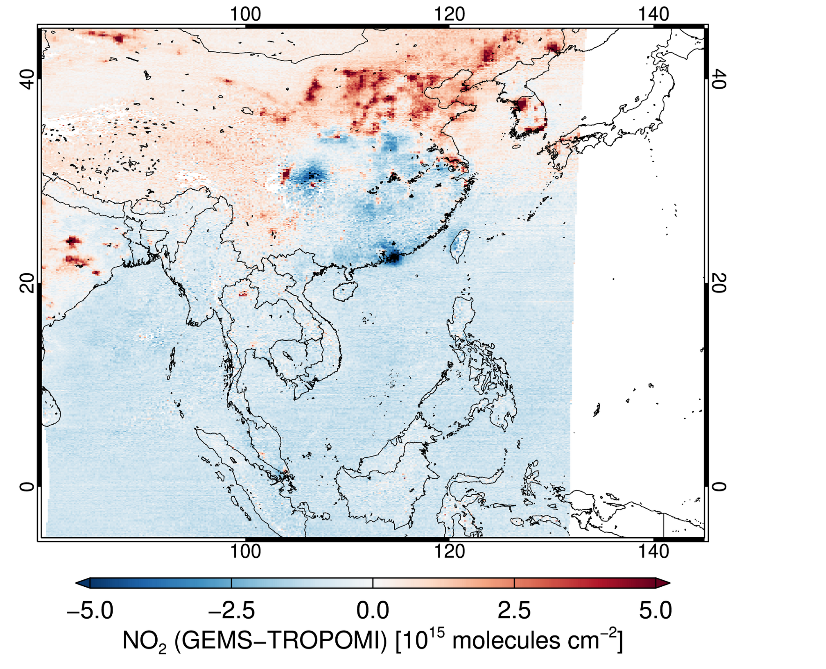
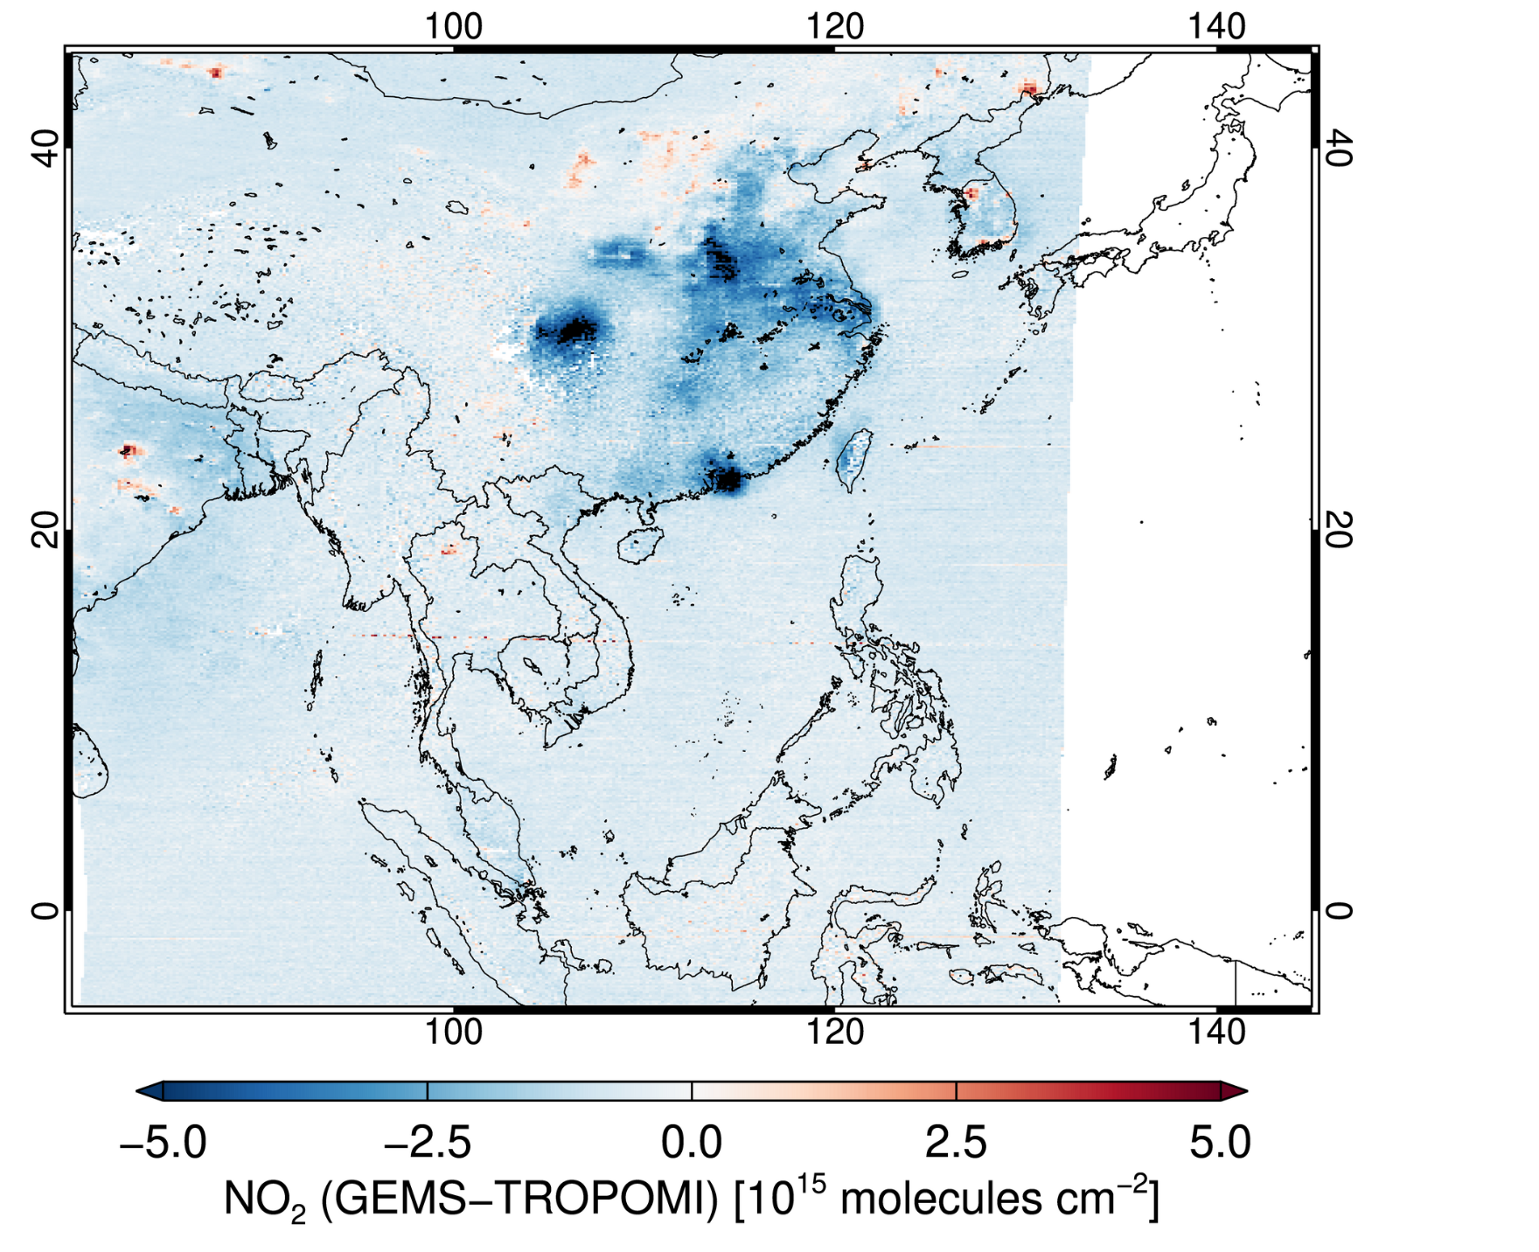
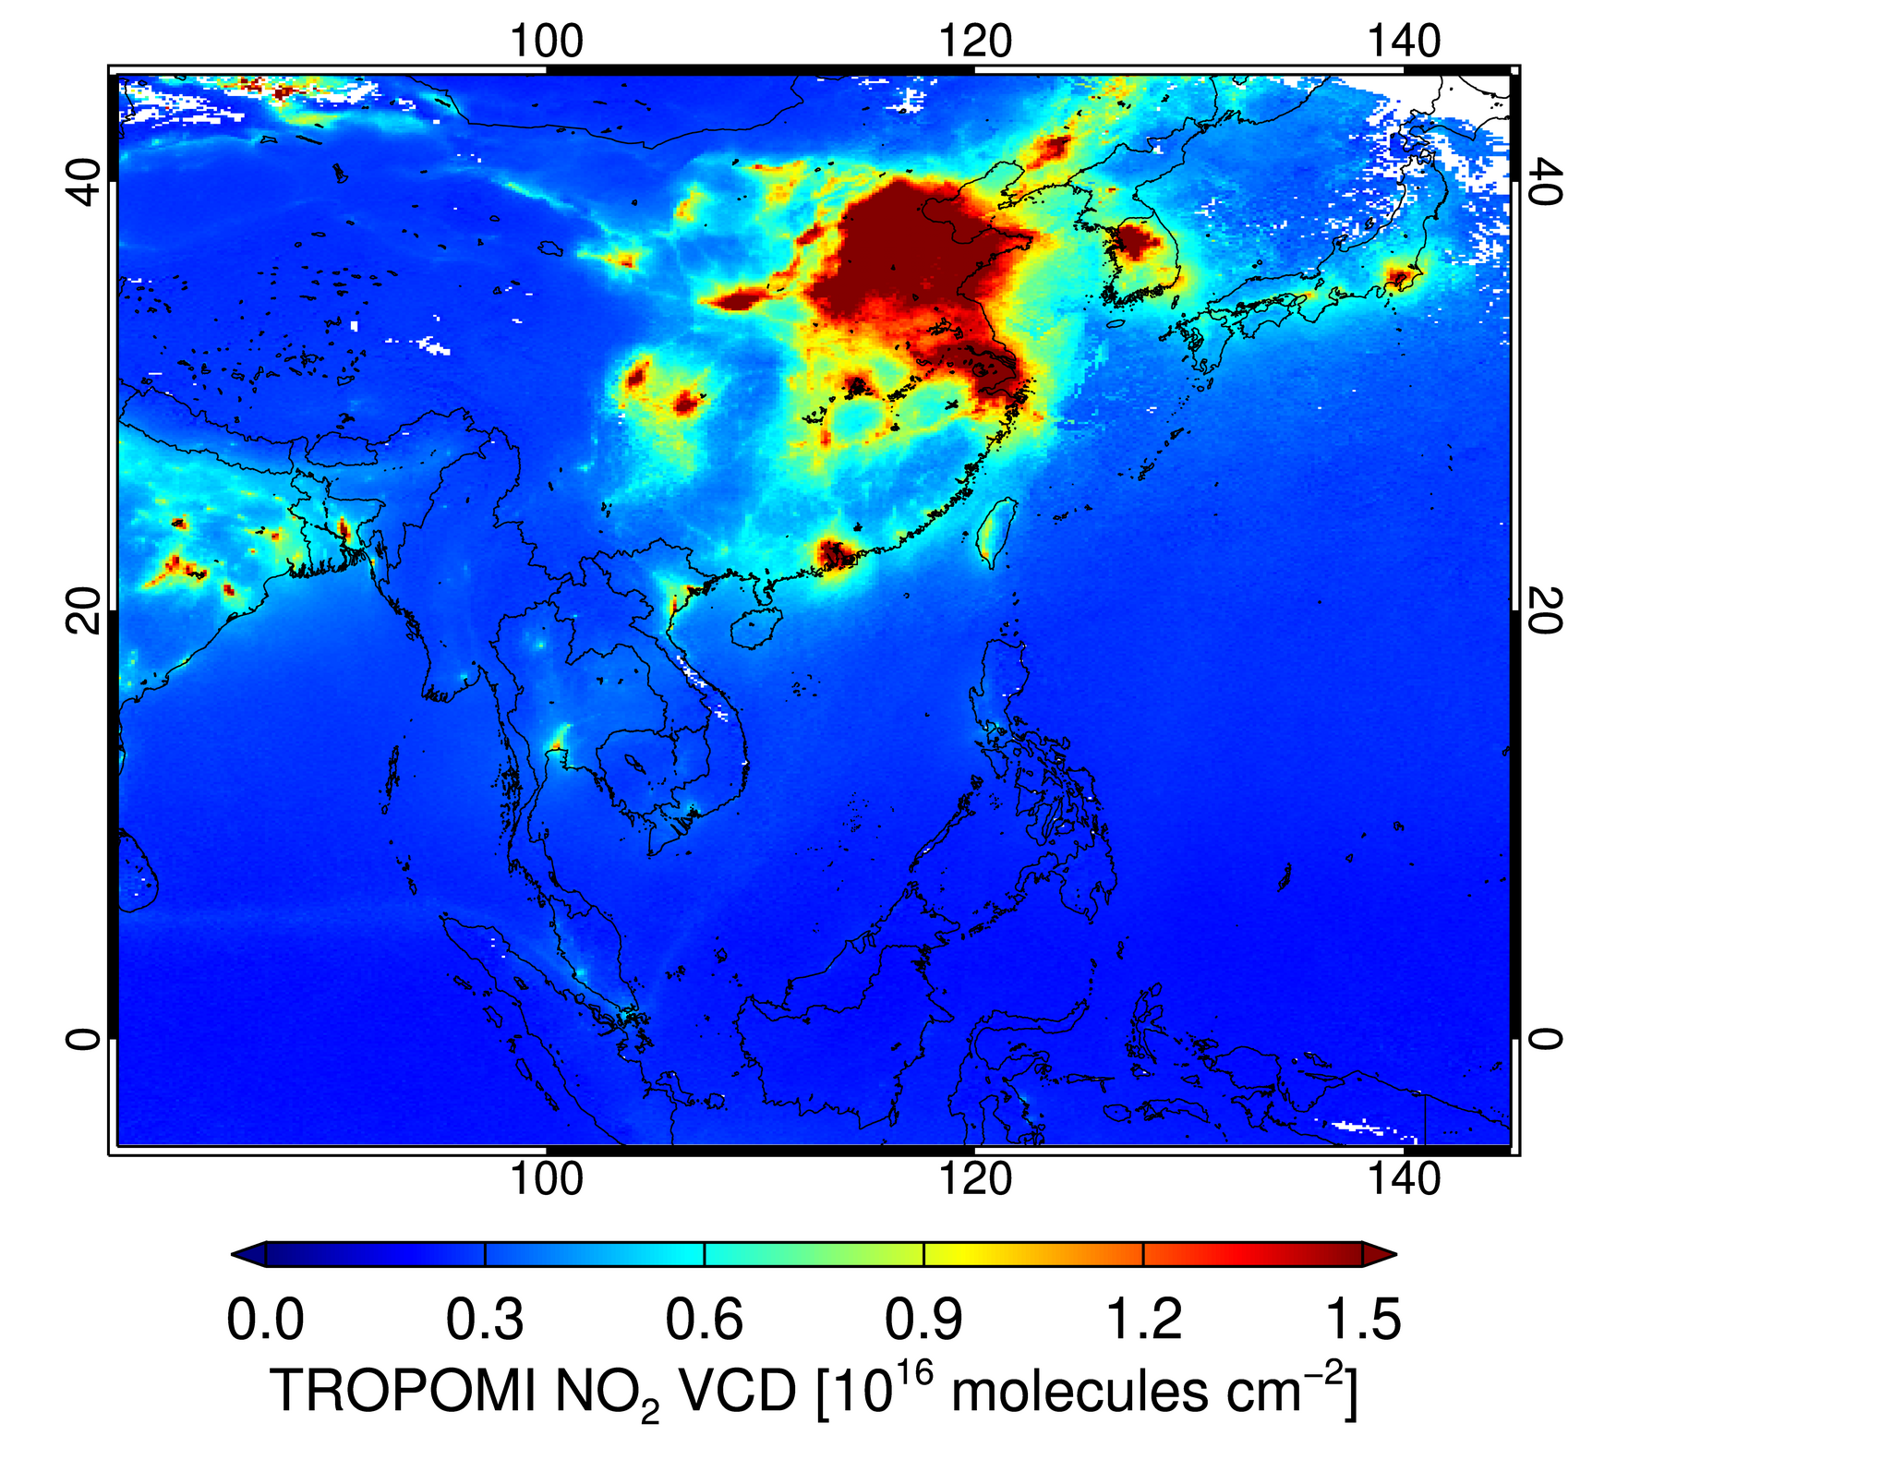
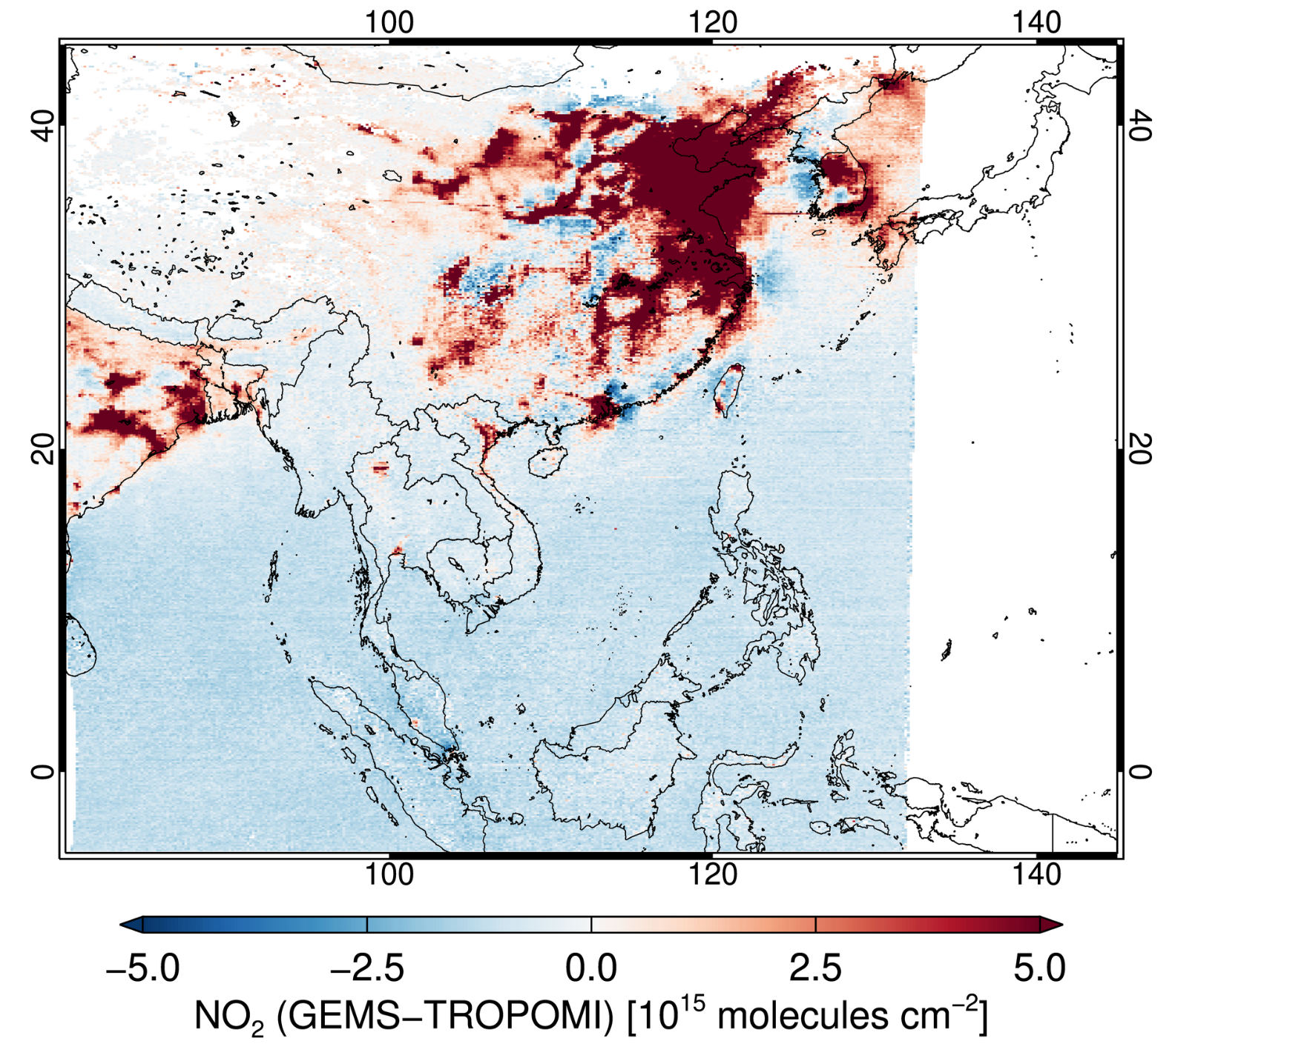
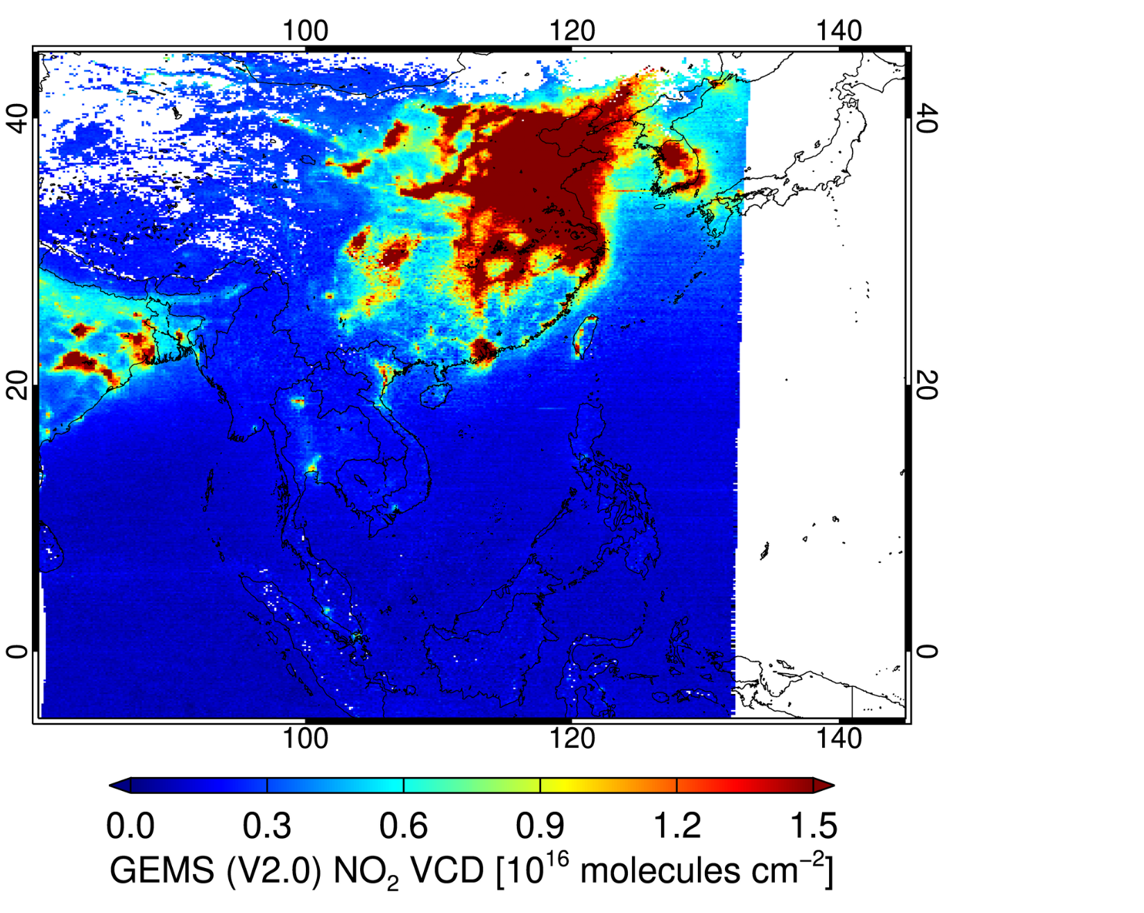
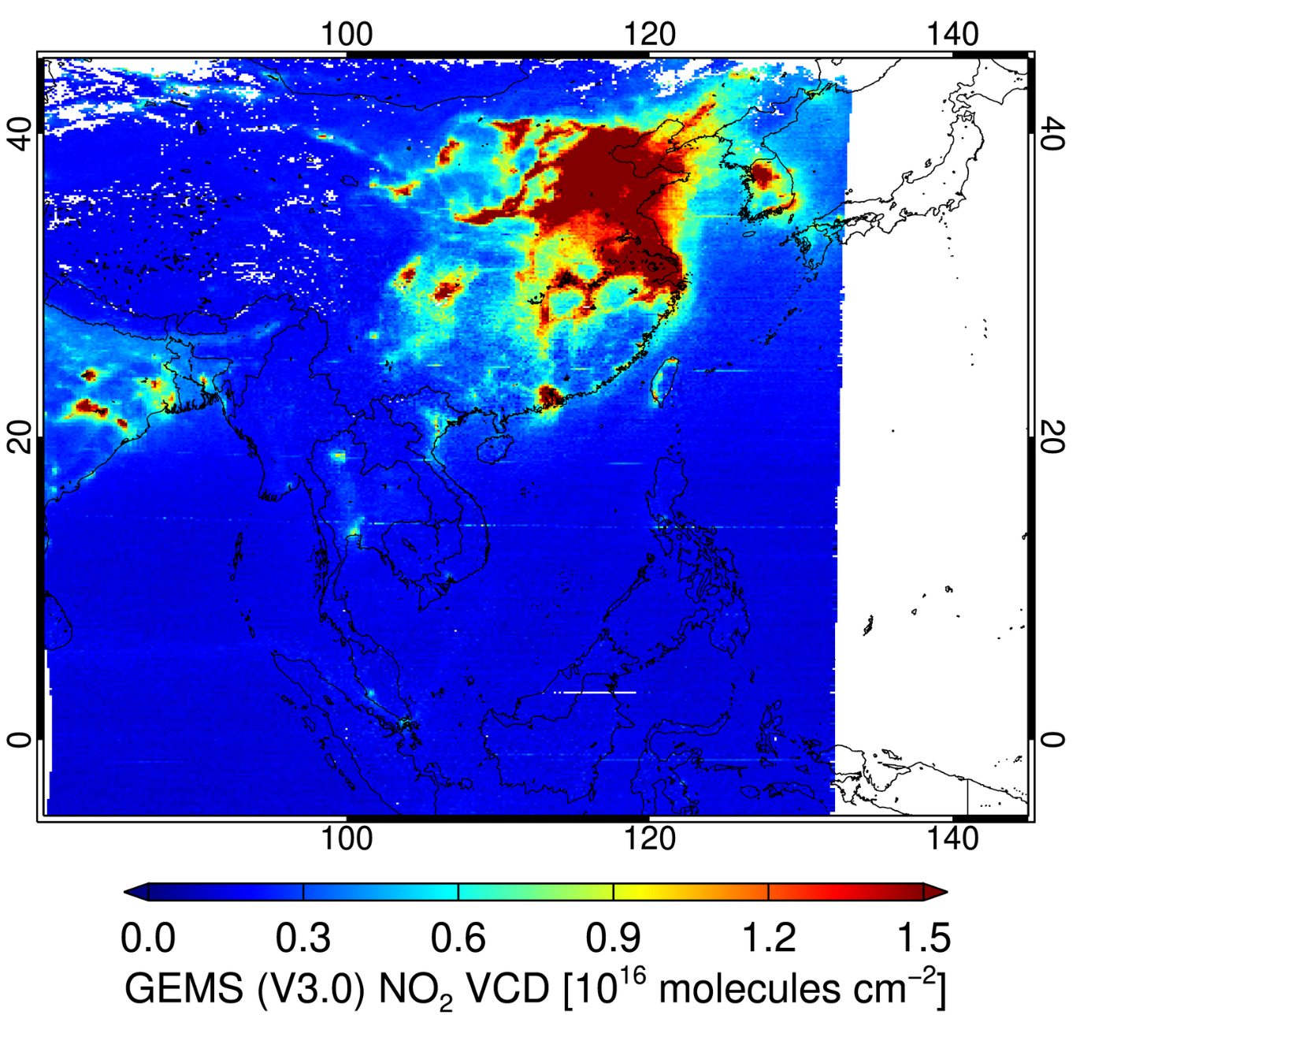
GEMS Total NO₂ V2.0 and V3.1 vs. TROPOMI
Difference [%]
(V2.0-TROPOMI)
Difference [%]
(V3.1-TROPOMI)
GEMS
(04:45)
TROPOMI
GEMS (V2.0)
GEMS (V3.1)
June 1-15,
2023
Difference (GEMS-TROPOMI) of Total NO₂
[10¹⁵ molec/cm²]
Total NO₂ VCD [10¹⁶ molec/cm²]
December 1-15,
2023
Prod. Lead: Hanlim Lee / Y. Jung

Slide 9
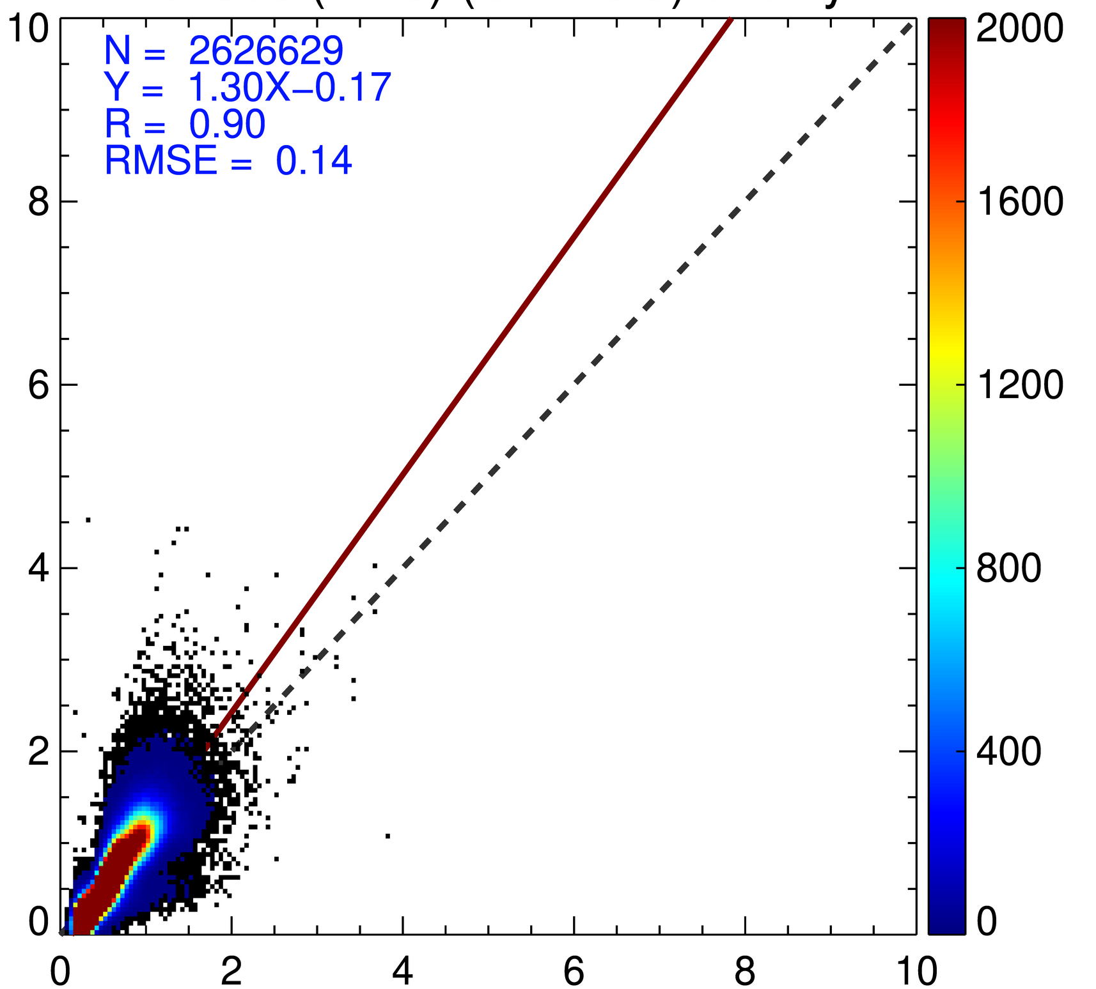
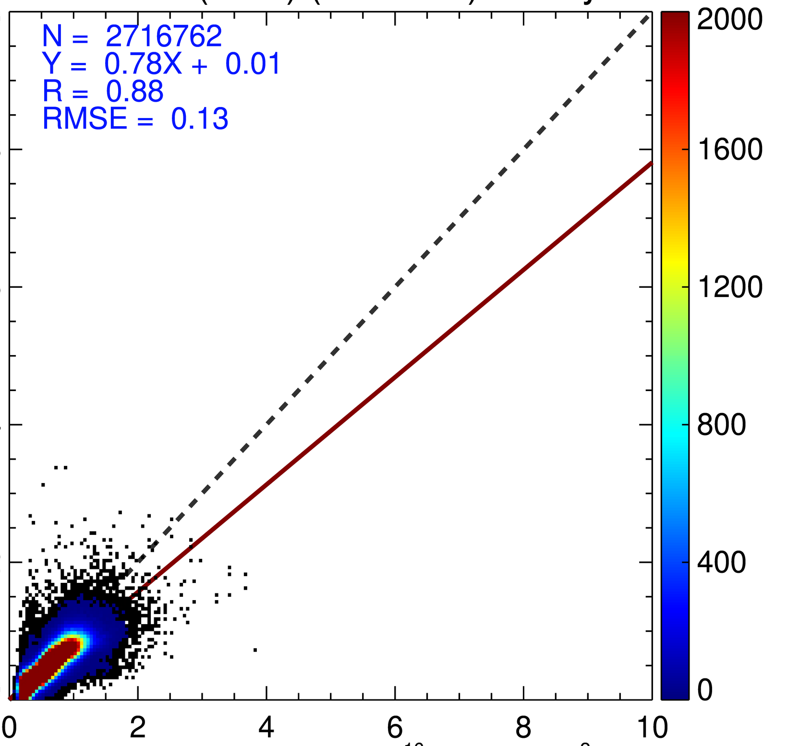
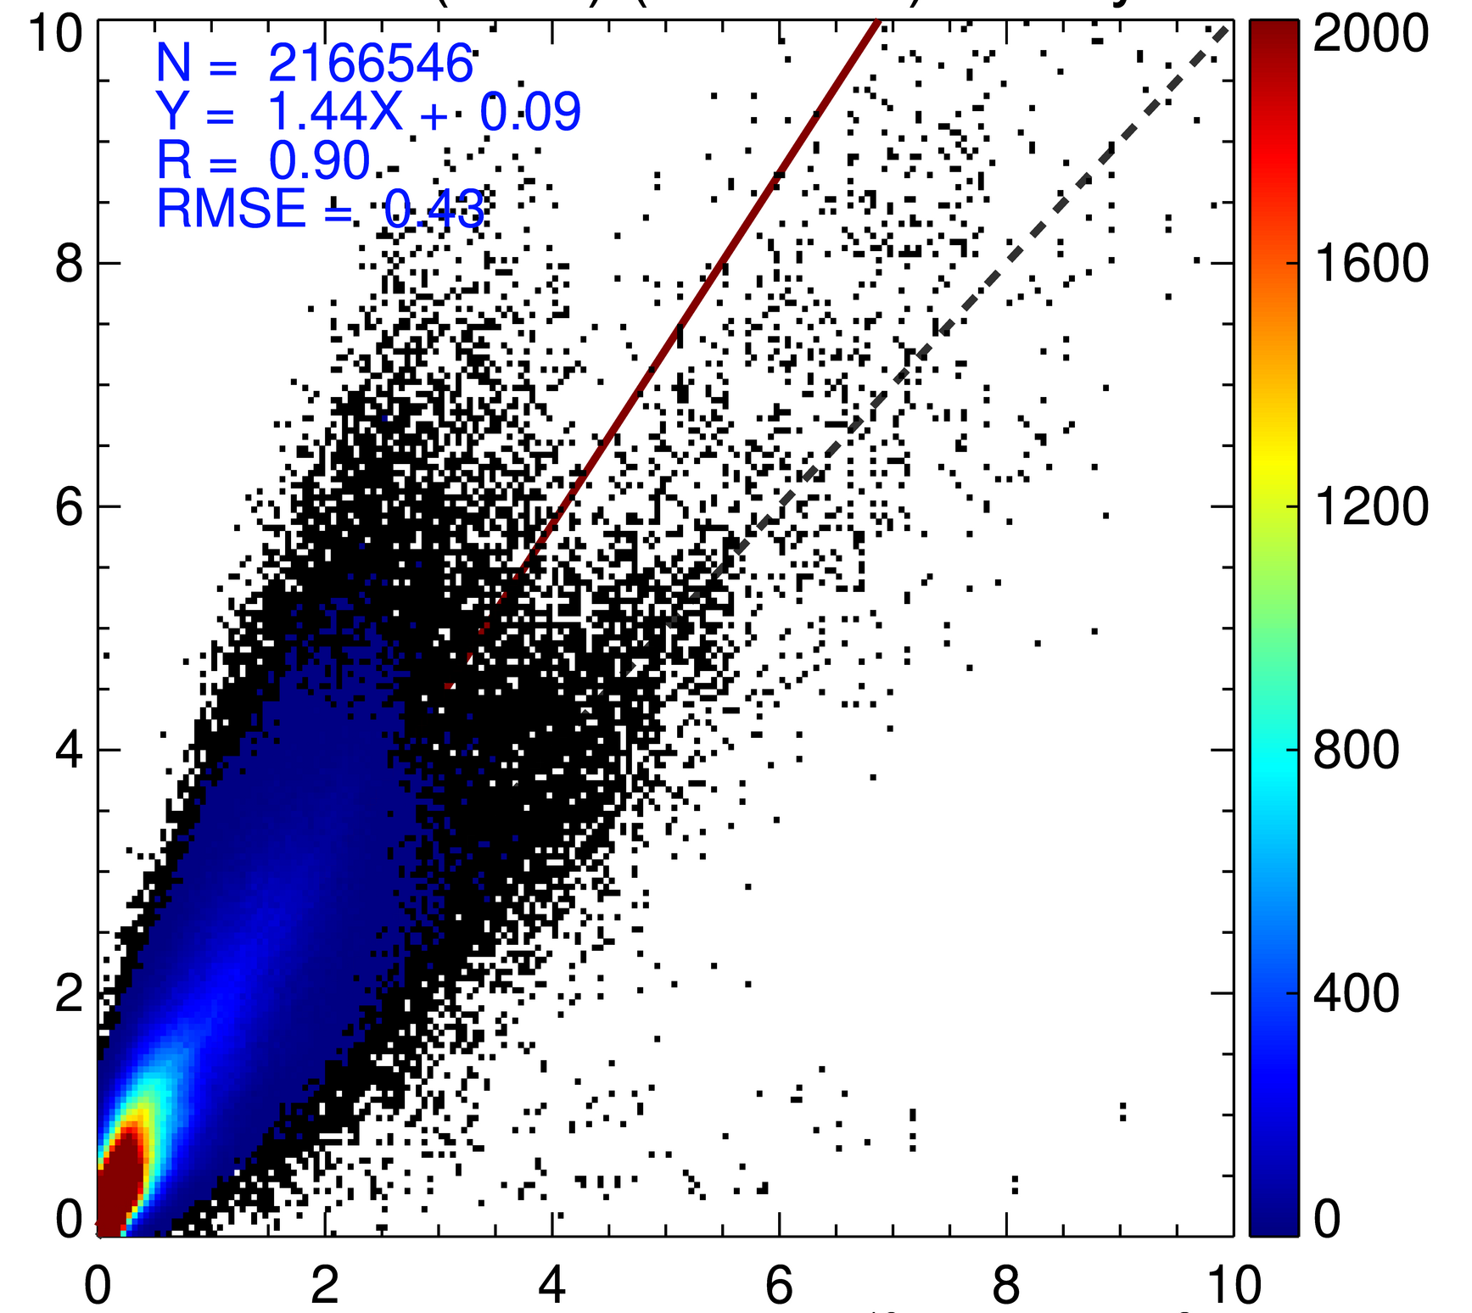
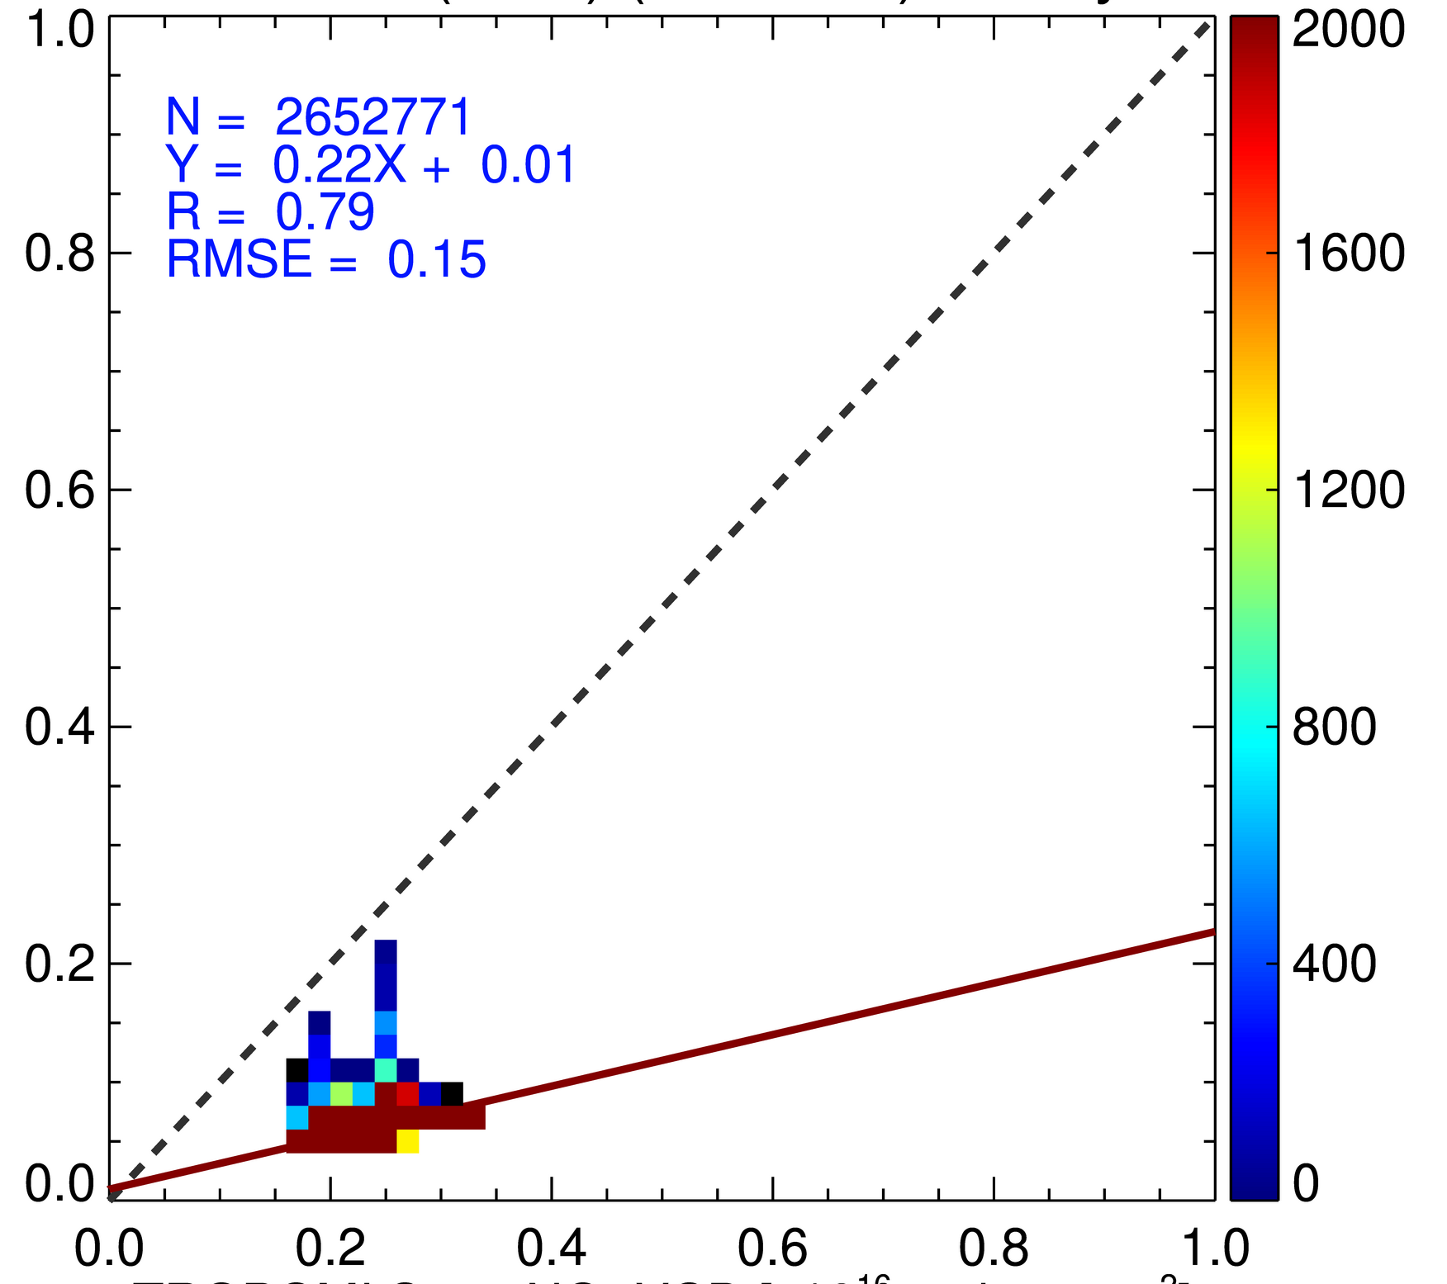
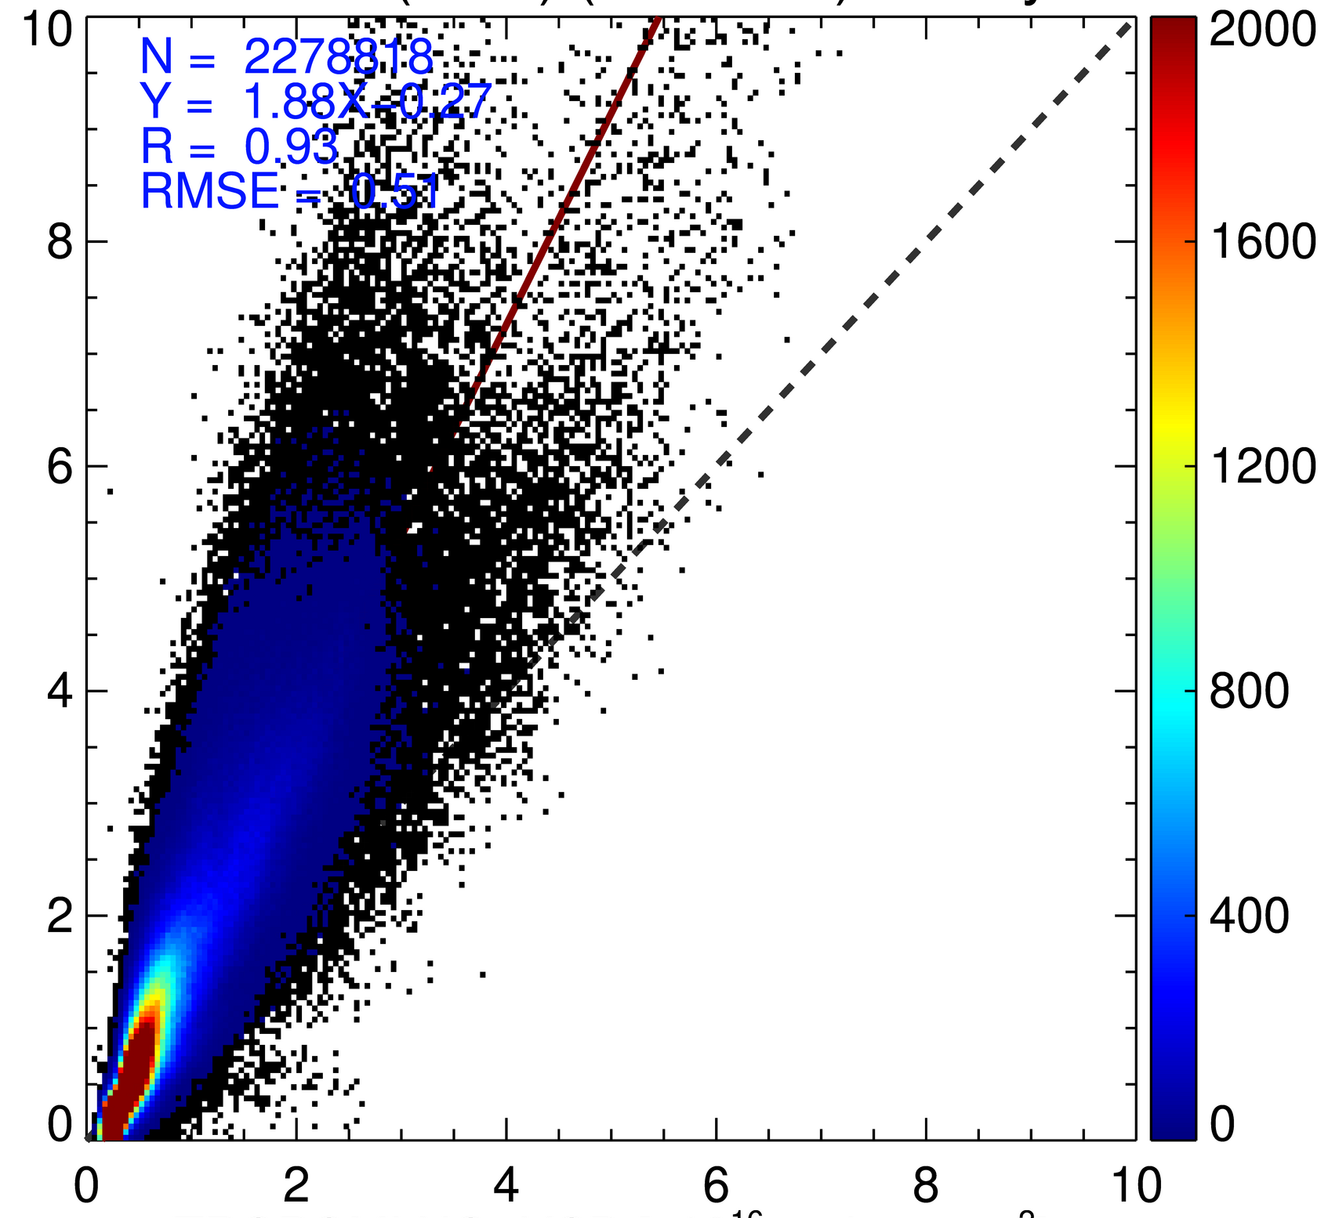
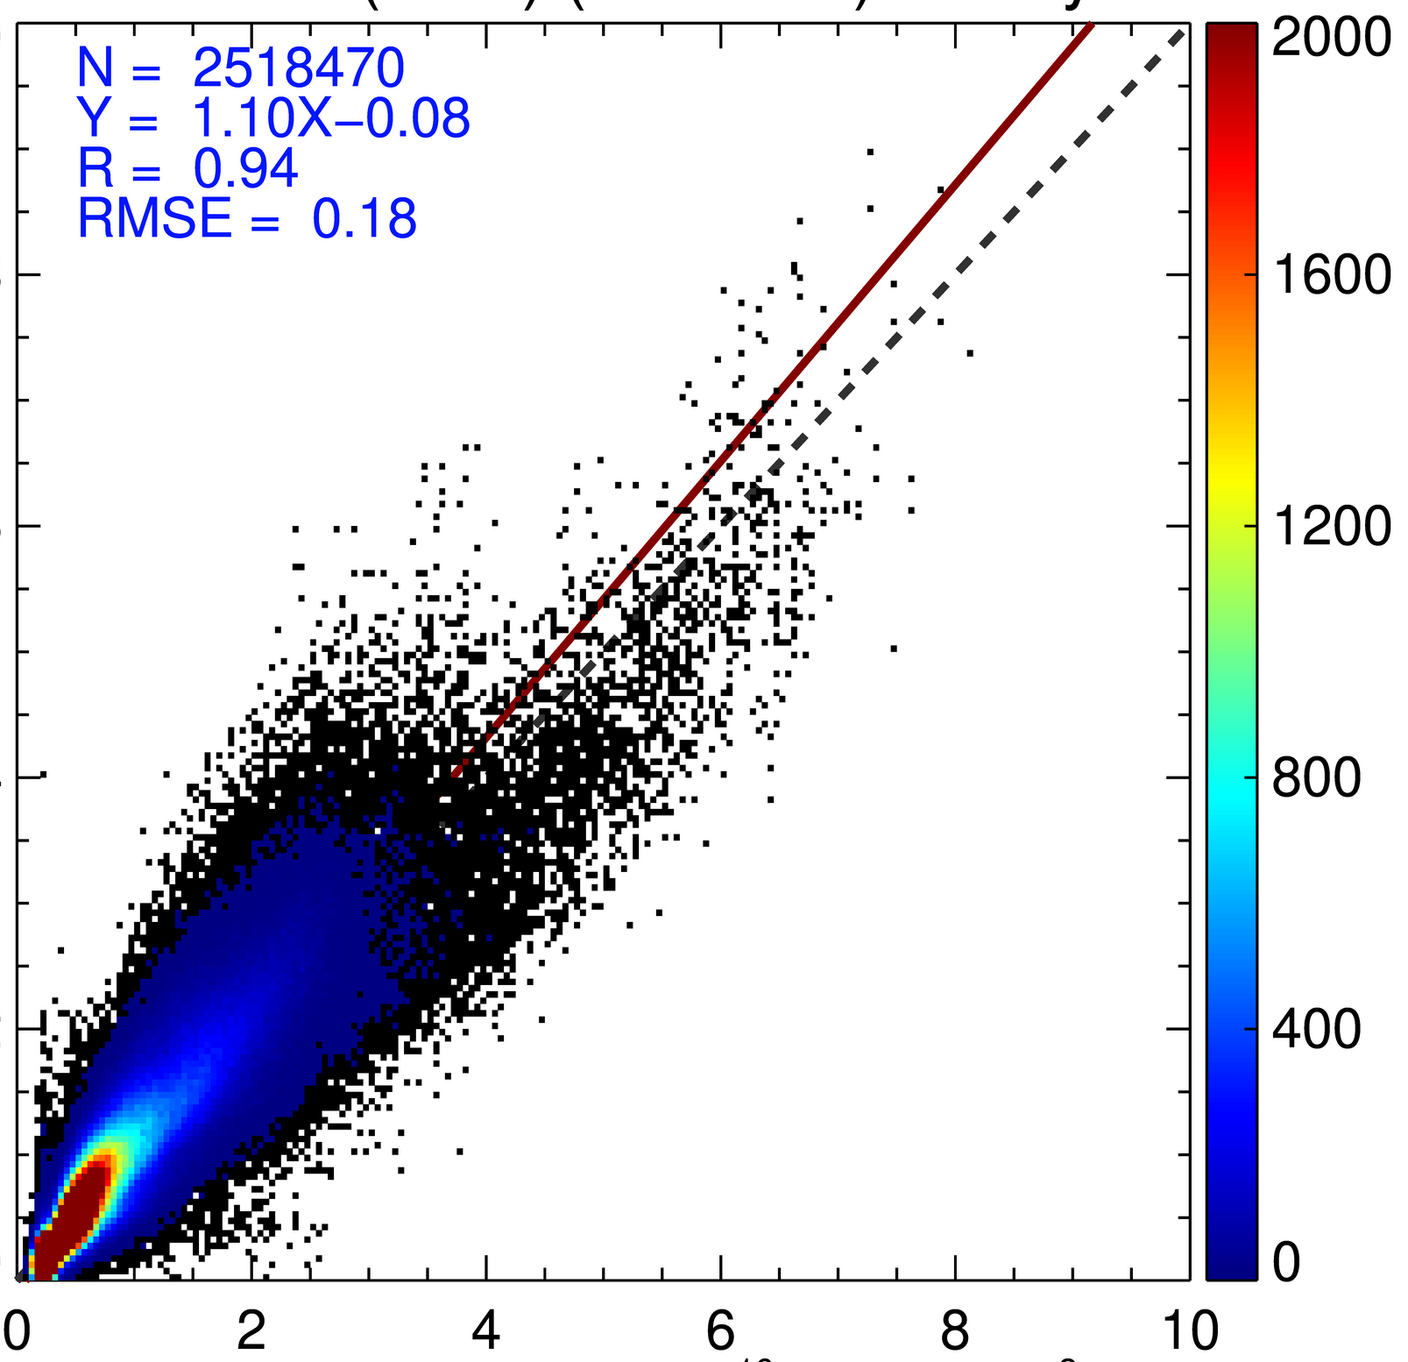
GEMS NO₂ V2.0 and V3.1 vs. TROPOMI
Slope (R) | 2023/03 |  | 2023/06 |  | 2023/09 |  | 2023/12
 | V2.0 | V3.1 | V2.0 | V3.1 | V2.0 | V3.1 | V2.0 | V3.1
Tropo- sphere | 1.25 (0.87) | 0.70 (0.89) | 1.16 (0.79) | 0.42 (0.71) | 1.37 (0.78) | 0.47 (0.64) | 1.44 (0.90) | 0.91 (0.91)
Strato- sphere | 0.22 (0.88) | 1.49 (0.89) | 0.27 (0.94) | 1.42 (0.95) | 0.24 (0.89) | 1.63 (0.92) | 0.22 (0.79) | 2.01 (0.80)
N=2626629
Y=1.30-0.17
R=0.90
RMSE=0.14
N=2716762
Y=0.78+0.01
R=0.88
RMSE=0.13
Jun
1-15,
2023
V2.0
V3.1
Tropospheric NO₂
(Dec 1-15, 2023)
Stratospheric NO₂
(Dec 1-15, 2023)
Filtering criteria :
SZA<70º, VZA<70º, CF<0.3
N=2166546
Y=1.44X+0.09
R=0.90
RMSE=0.43
N=2652771
Y=0.22X+0.01
R=0.79
RMSE=0.15
GEMS Total NO₂ VCD [10¹⁶ molec/cm²]
Dec
1-15,
2023
V2.0
V2.0
V2.0
V3.1
GEMS Tropo NO₂ VCD[10¹⁶ molec/cm²]
N=22788818
Y=1.88+1.27
R=0.93
RMSE=0.51
N=2518470
Y=1.10X-0.08
R=0.94
RMSE=0.18
N=2655970
Y=0.91X+0.02
R=0.91
RMSE=0.18
N=2715898
Y=2.01-0.23
R=0.80
RMSE=0.05
Prod. Lead: Hanlim Lee / Y. Jung
TROPOMI Total NO₂ VCD [10¹⁶ molec/cm²]
Slope (R) | 2023/03 |  | 2023/06 |  | 2023/09 |  | 2023/12
 | V2.0 | V3.1 | V2.0 | V3.1 | V2.0 | V3.1 | V2.0 | V3.1
Total NO2 | 1.58 (0.93) | 0.89 (0.92) | 1.30 (0.90) | 0.78 (0.88) | 1.58 (0.88) | 0.87 (0.88) | 1.88 (0.93) | 1.10 (0.94)
V3.1
V3.1
Updated fitting
S/T separation
GEMS prod use
TROPOMI Tropo NO₂ VCD [10¹⁶ molec/cm²]

Slide 10
GEMS AOD, SSA
Aerosol – post-processing
AOD
VZA,
Z,
UVAI,
RAA,
SZA…
V2.1
Post-processing
GEMS-AERONET
ML
Corrected
GEMS
ALH
[Cho et al., AMT, 2024]
SSA
V2.1
Post-processing

Slide 11
New products of GEMS
H2O
BrO
HONO
Nishinoshima
GEMS
Taal
Fukutoku-Okanoba
TCWV [kg m⁻²]
TROPOMI
TCWV [kg m⁻²]
TROPOMI
GEMS

Slide 12
After applying BTDF-corrected Irradiance
 | Stripe issue | Overestimation/Underestimation | Note
O₃ Total | X | - | The negative bias has shifted to a positive bias Absolute value of the bias has decreased
O₃ Profile | O | overestimation | Stripe issue in the 10-30° N If the irradiance offset is not applied, it results in an overestimation of tropospheric O₃
SO₂ | O | - | The stripe issue has increased in the ranges of 15-30° N and around 0° N
NO₂ | O | - | The stripe issue still exists NO₂ VCDs have decreased over high NO₂ areas
HCHO | X | - | Increase in HCHO VCDs of over 8% in Jan and Fab is expected to improve the underestimated winter values Decrease in HCHO VCDs in the south and increase in the north
CHOCHO | O | overestimation | Stripe issue Increase in winter, where there was an issue of CHOCHO overestimation
AOD | X | bias | Overestimation of AOD due to a degradation issue
AEH | X | - | Overestimation of AEH has decreased AEH output range is more stable
SFC | X | - | The stripe issue that occurred when using KNMI has been reduced The low BSR calculated with KNMI has stabilized to reliable values when using BTDF IRR
CLD | O | - | Stripe issue does not occur with ECF, but occurs with CCP Stripe issue in CCP mainly occurs in the lower layers and appears regardless of latitude
Notes:
GEMS irr 사용보다 BTDF-corrected IRR을 사용했을 때 더 좋은 결과를 보이는 산출물에
연두색 표시를 했습니다.

Slide 13
Summary
Air Quality
H₂O
_{hv}
_{aerosols}
BrO
O₃
HONO
NO₂
HCHO
in successful operation
since 2020
SO₂
CHOCHO
Diurnal variations – Conc & Spatial
Industry
Urban
Rural
Fire
07:45 (LT)
08:45 (LT)
09:45 (LT)
10:45 (LT)
11:45 (LT)
12:45 (LT)
13:45 (LT)
14:45 (LT)
15:45 (LT)
2.0
Seoul
[10¹⁶ molecules/cm²]
0.0
Park et al.(submitted)
Diurnal variations - Temporal
Long-term trends for AM, noon, & PM
Validations
3.0

Slide 14
Acknowledgements
Thank you
for all your contribution,
dedication,
and
support !

Slide 15
Plan of GK series for Atmospheric Composition
 | ‘10 |  |  |  | ‘15 |  |  |  | ‘20 |  |  |  | ‘25 |  |  |  | ‘30 |  |  |  | ‘35 |  |  | ‘40
Environmental
AQ |  |  |  |  |  |  |  |  |  |  | GEMS (UV-VIS 1000 ch, 3.5x 7.7 km, 1 hr) |  |  |  |  |  |  |  |  |  |  | GEMS 2 (UV-NIR 2000 ch, 4.5 x 4.97 km, 1 hr)
GHG |  |  |  |  |  |  |  |  |  |  |  |  |  |  |  |  |  | GHG(L, x5) 1.6 um FPI
Meteorological
Imag | MI (5 ch, 1/4 km, 1hr) |  |  |  |  |  |  |  |  | AMI (16 ch, 0.5/2 km, 10 min) |  |  |  |  |  |  |  |  |  |  |  | AMI 2 (18 ch, 0.25/1 km, 2 min)
IRS |  |  |  |  |  |  |  |  |  |  |  |  |  |  |  |  |  |  |  |  |  |  |  |  | IR Sounder
Oceanic
OC | GOCI (412 – 865 nm, 8 ch, 500 m, 1 hr) |  |  |  |  |  | GOCI 2 (380 – 865 nm, 13 ch, 250 m, 1 hr) |  |  |  |  |  |  |  |  |  |  | GOCI 3 (380 – 1030 nm, 16 ch, <250 m, < 1 hr)

