Slide 1
Sentinel-5P Mission Status
7 years in orbit!
AC-VC #20 Oct. 2024
Pepijn Veefkind, Principal Investigator
Claus Zehner, Mission Manager
TROPOMI NO₂

Slide 2
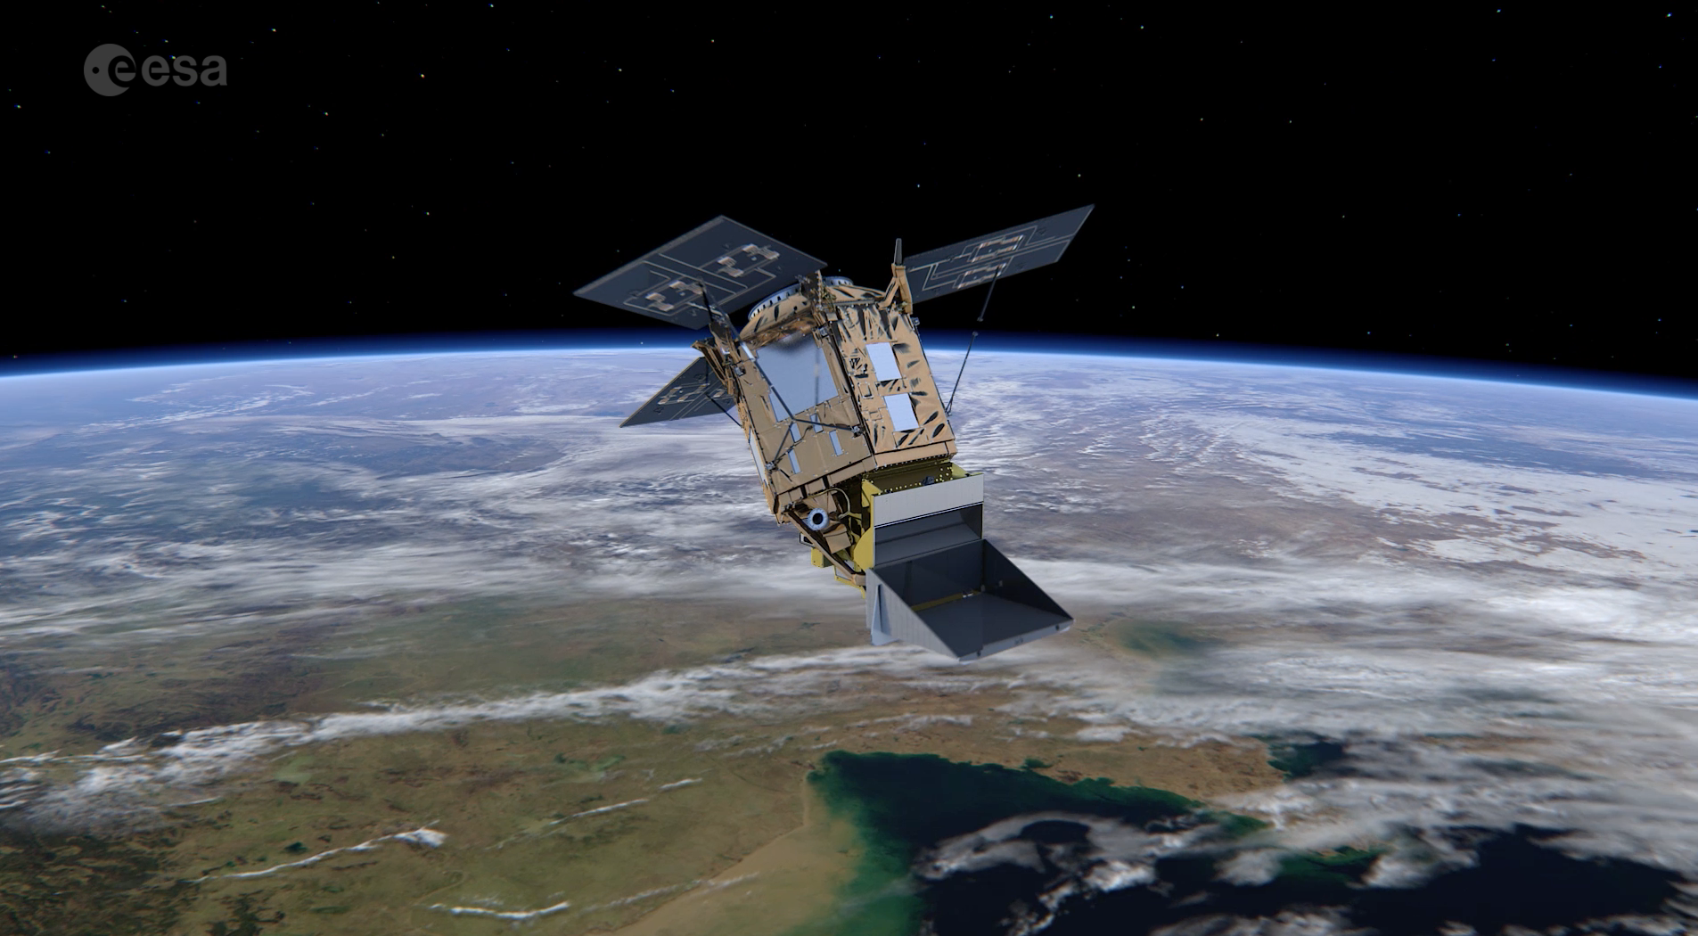
Sentinel-5 Precursor:
first atmospheric Sentinel Mission
Launched: 13 October 2017, Plesetks
Launcher: Rockot
Main Payload: TROPOMI (co-funded by The Netherlands and ESA) - Hyper-spectral push-broom imaging spectrometer, 4 spectrometers with 2D detectors with 4000 spectral channels
Orbit: Altitude of 820 km, 227 orbit repeat cycle
Daily Global Coverage: 13:30 ascending node crossing time
Spatial Sampling: 5.5 x 3.5 km (mission requirement: 7 x 7 km)
Mission Control: ESOC
TROPOMI Mission Planning: KNMI
Ground Stations: Svalbard (NOR) and Inuvik (Canada)
Operational Data Processing: DLR (on behalf of ESA)
Mission Design Life Time: ~7 years
National co-funding during Routine Operations (e.g. on Algorithm Development/QA Monitoring): Belgium, Germany, and The Netherlands
Key User: Copernicus Atmospheric Monitoring Service (ECMWF)

Slide 3
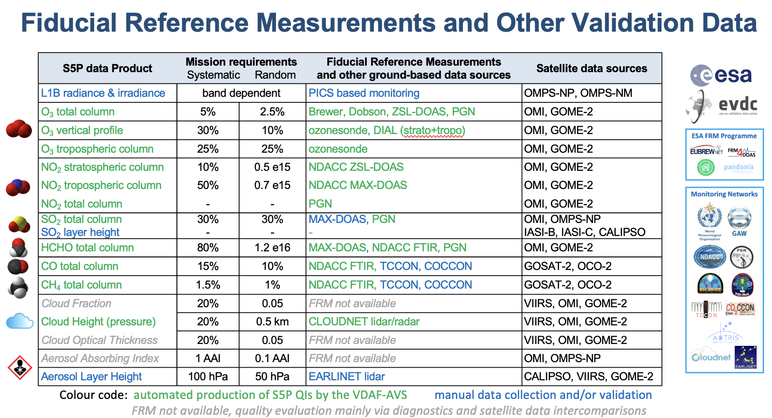
ATM- MPC Level 2 Operational Products
Courtesy, ATM- MPC
BIRA-IASB

Slide 4
ATM-MPC Processor Development Status
CURRENTLY OPERATIONAL
Level 1
[L1b RAD & IRRAD]
V2.1.0
(RPRO, completed in 2022)
from 2018/04/30
V2.1.0
2022/07/20
V2.4.0
2022/07/20
V2.5.0
2023/03/15
CURRENTLY OPERATIONAL
UPCOMING RELEASE
NL-L2
[NO2, CH4,
CO, AAI,
ALH, O3_PR]
V2.4.0
(RPRO, completed 2022/2023)
from 2018/04/30
V2.6.0
2023/11/29
V2.7.1
2024/09/11
V2.8.0 2024/11/13
[C++ CH4, …]
UPAS
[O3 (NRT&OFFL),
O3_Tropo, CLOUD,
SO2, HCHO]
CURRENTLY OPERATIONAL
UPCOMING RELEASE
V2.4.1
(RPRO, completed 2022/2023)
from 2018/04/30
V2.4.1
2022/07/20
V2.5.0
2023/07/20
V2.6.1
2023/11/29
V2.7.0 2024/11/13
[SO2 COBRA, …]
CURRENTLY OPERATIONAL
V1.3.0
(RPRO, completed)
from 2018/04/30
V2.0.1
2023/11/29
V2.0.3
2024/09/11
SNPP
CLOUD
V1.3.0
2021/07/01
Documents accessible at:
https://sentiwiki.copernicus.eu/web/s5p-products

Slide 5
Level 1Band In-Flight Calibration
UV
Improvements to the radiometric calibration and straylight correction for the UV spectrometer.
Correction for a sharp detector feature for the UVIS detector.
Routine updates to correct for optical degradation.
UVIS
NIR
SWIR
http://mps.tropomi.eu

Slide 6
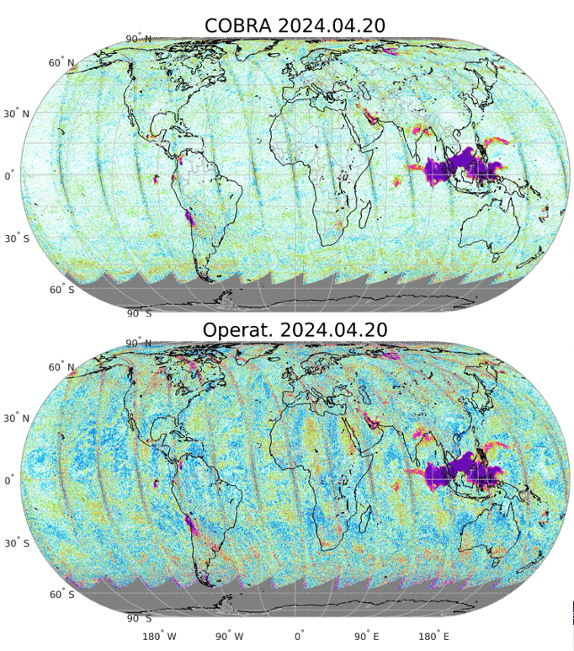
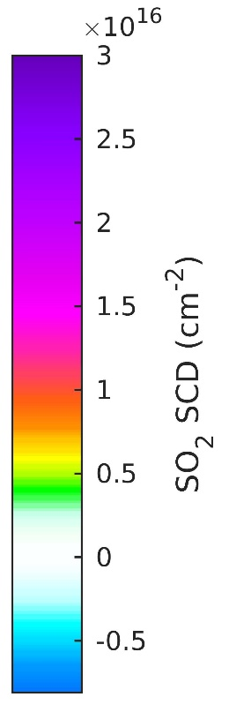
Level 2 Evolution Highlights
S5P SO₂ COBRA
SO₂ Layer Height
Cloud Mask for CH₄
Aerosol Layer Height
Courtesy ATM-MPC, Nicolas Theys

Slide 7

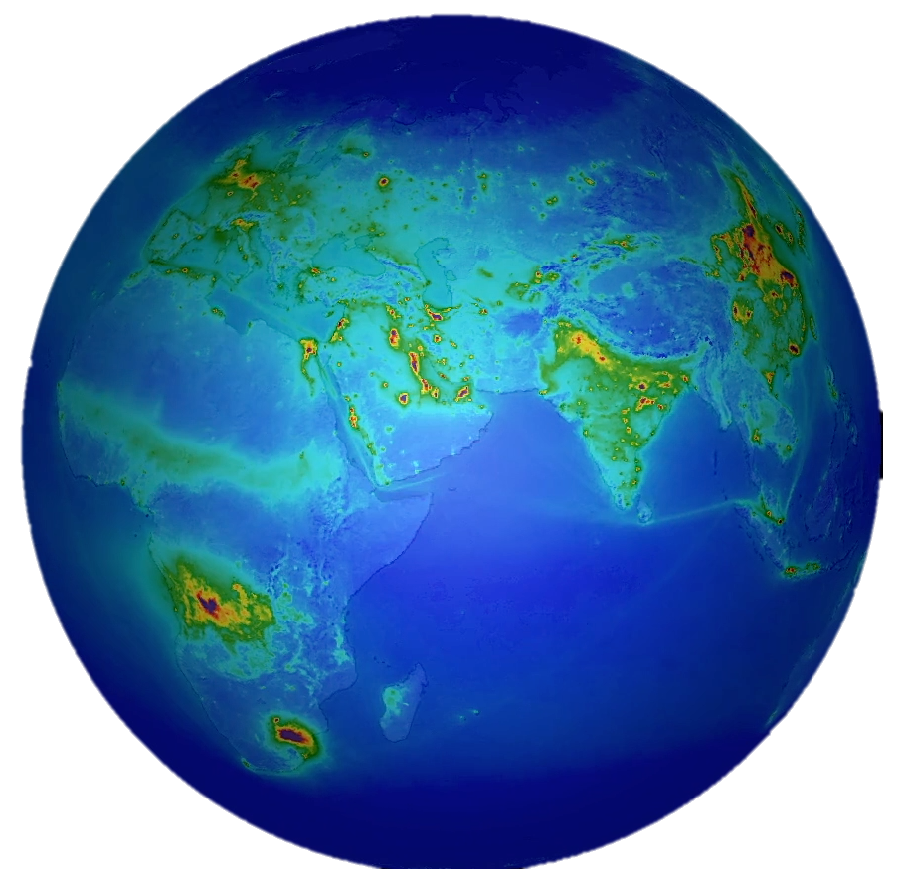
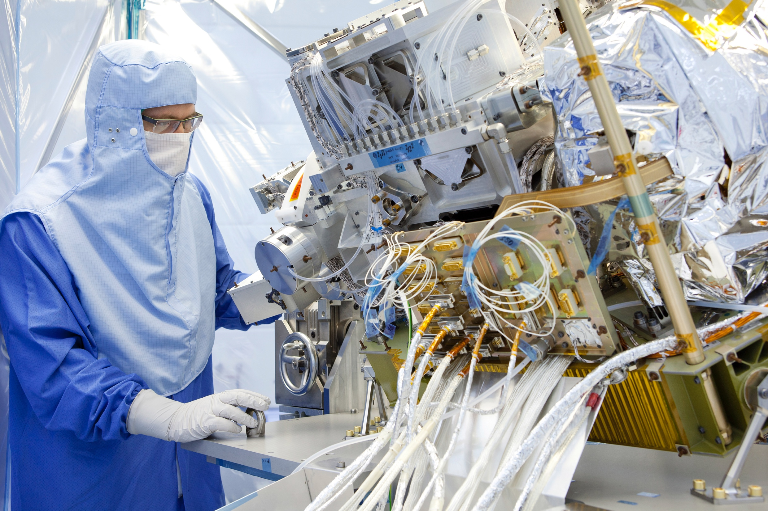
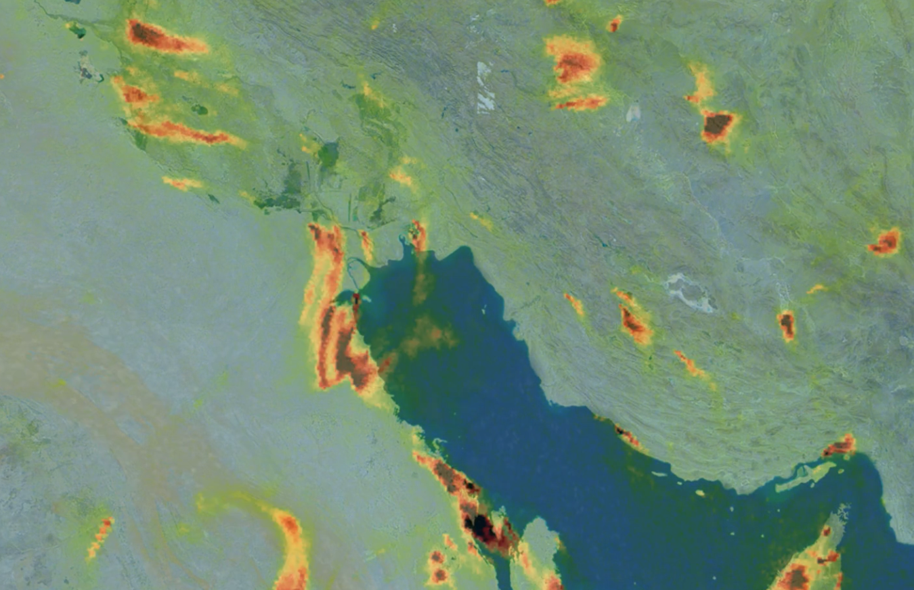
TROPOMI Data Availability
Copernicus Dataspace
Operational L1 and L2 data
https://dataspace.copernicus.eu
S5P-PAL
Scientific L2 and L3 data
https://data-portal.s5p-pal.com
TEMIS
Regional and gridded NO2 data
https://www.temis.nl
NASA
Operational L1 and L2 data
https://www.earthdata.nasa.gov/sensors/tropomi
... and …
Google Earth Engine
https://geoservice.dlr.de
https://terrascope.be/en

Slide 8
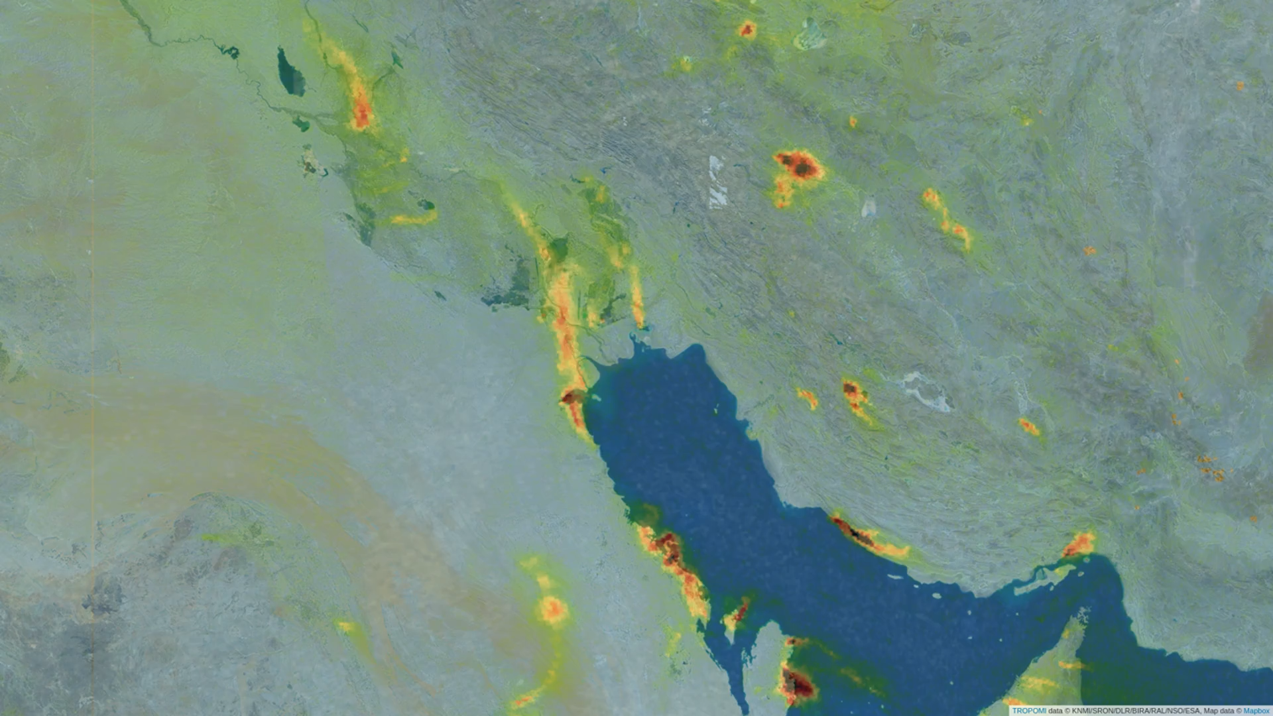
NO₂ tropospheric column density
May-August 2022
KNMI

Slide 9

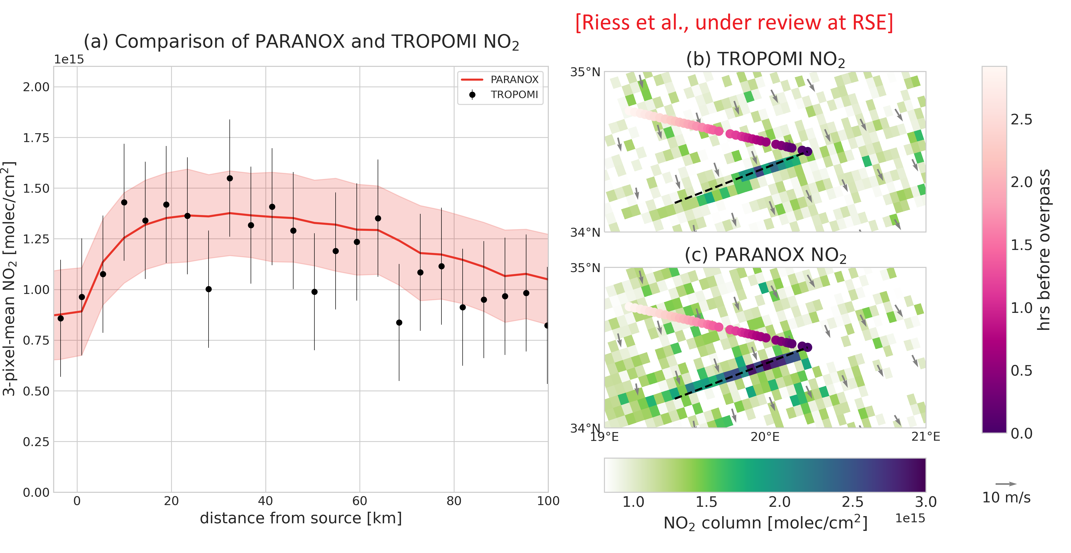
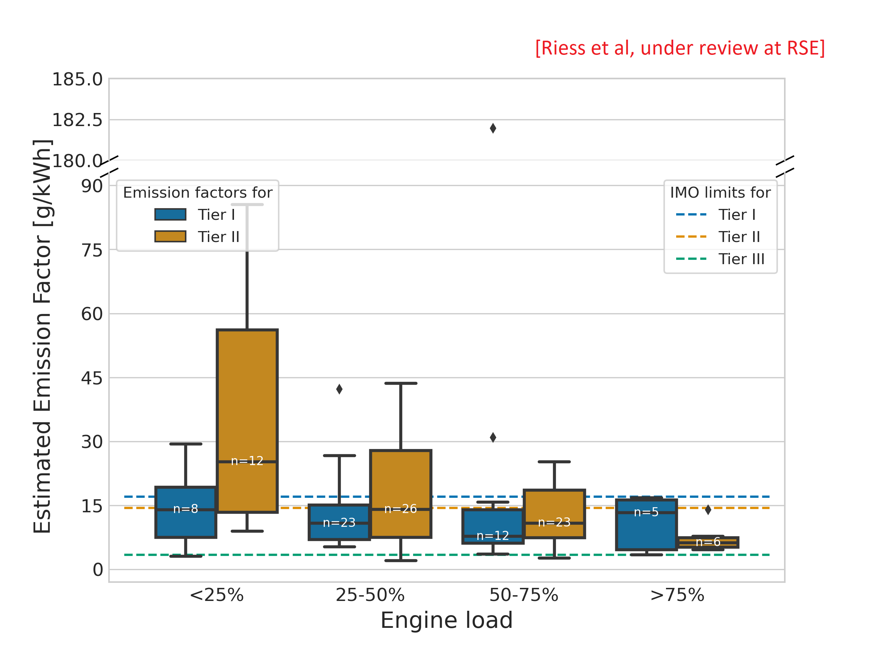

Data Applications
Riess et al, submitted RSE, 2024
WUR | ILT | KNMI

Slide 10
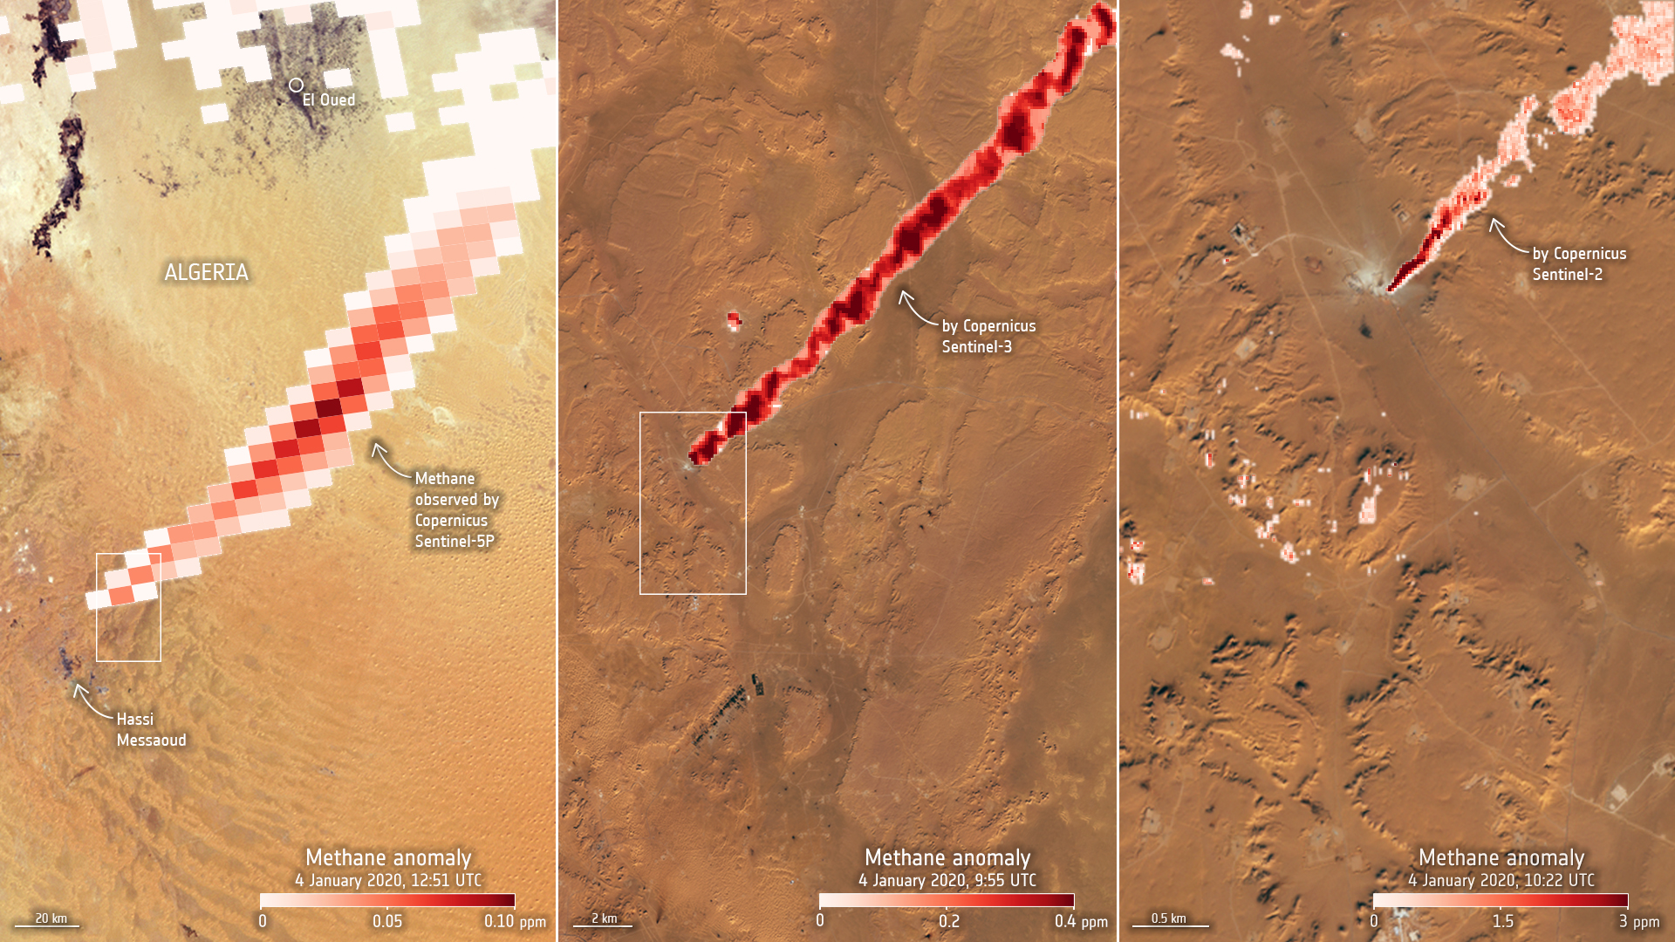
3 Sentinels to detect Methane Emissions
S5P
S2
S5P
https://www.esa.int/Applications/Observing_the_Earth/Copernicus/Trio_of_Sentinel_satellites_map_methane_super-emitters

Slide 11
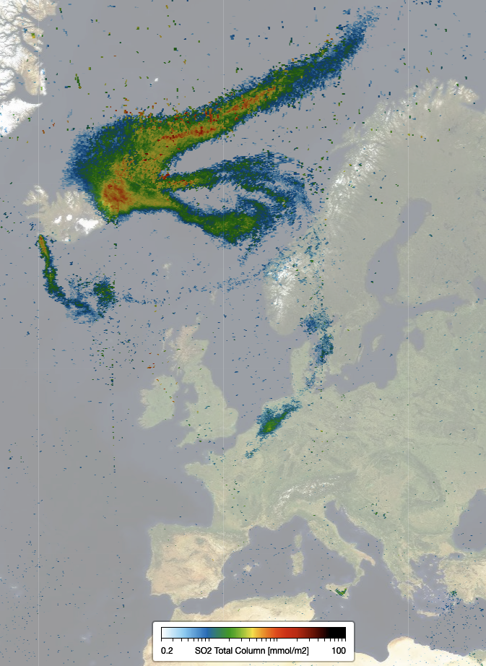
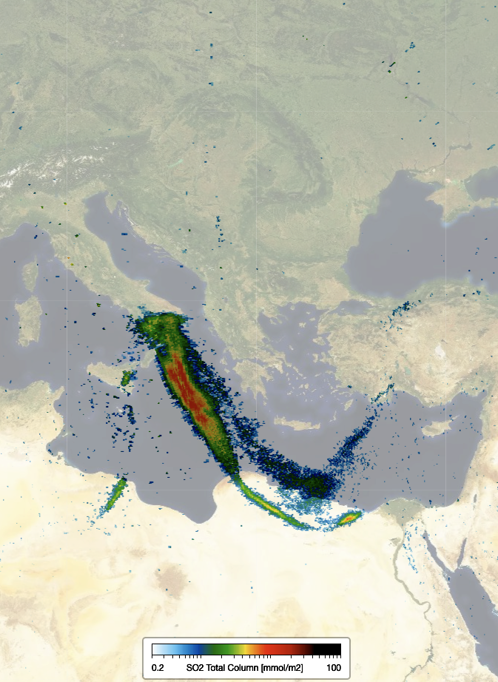
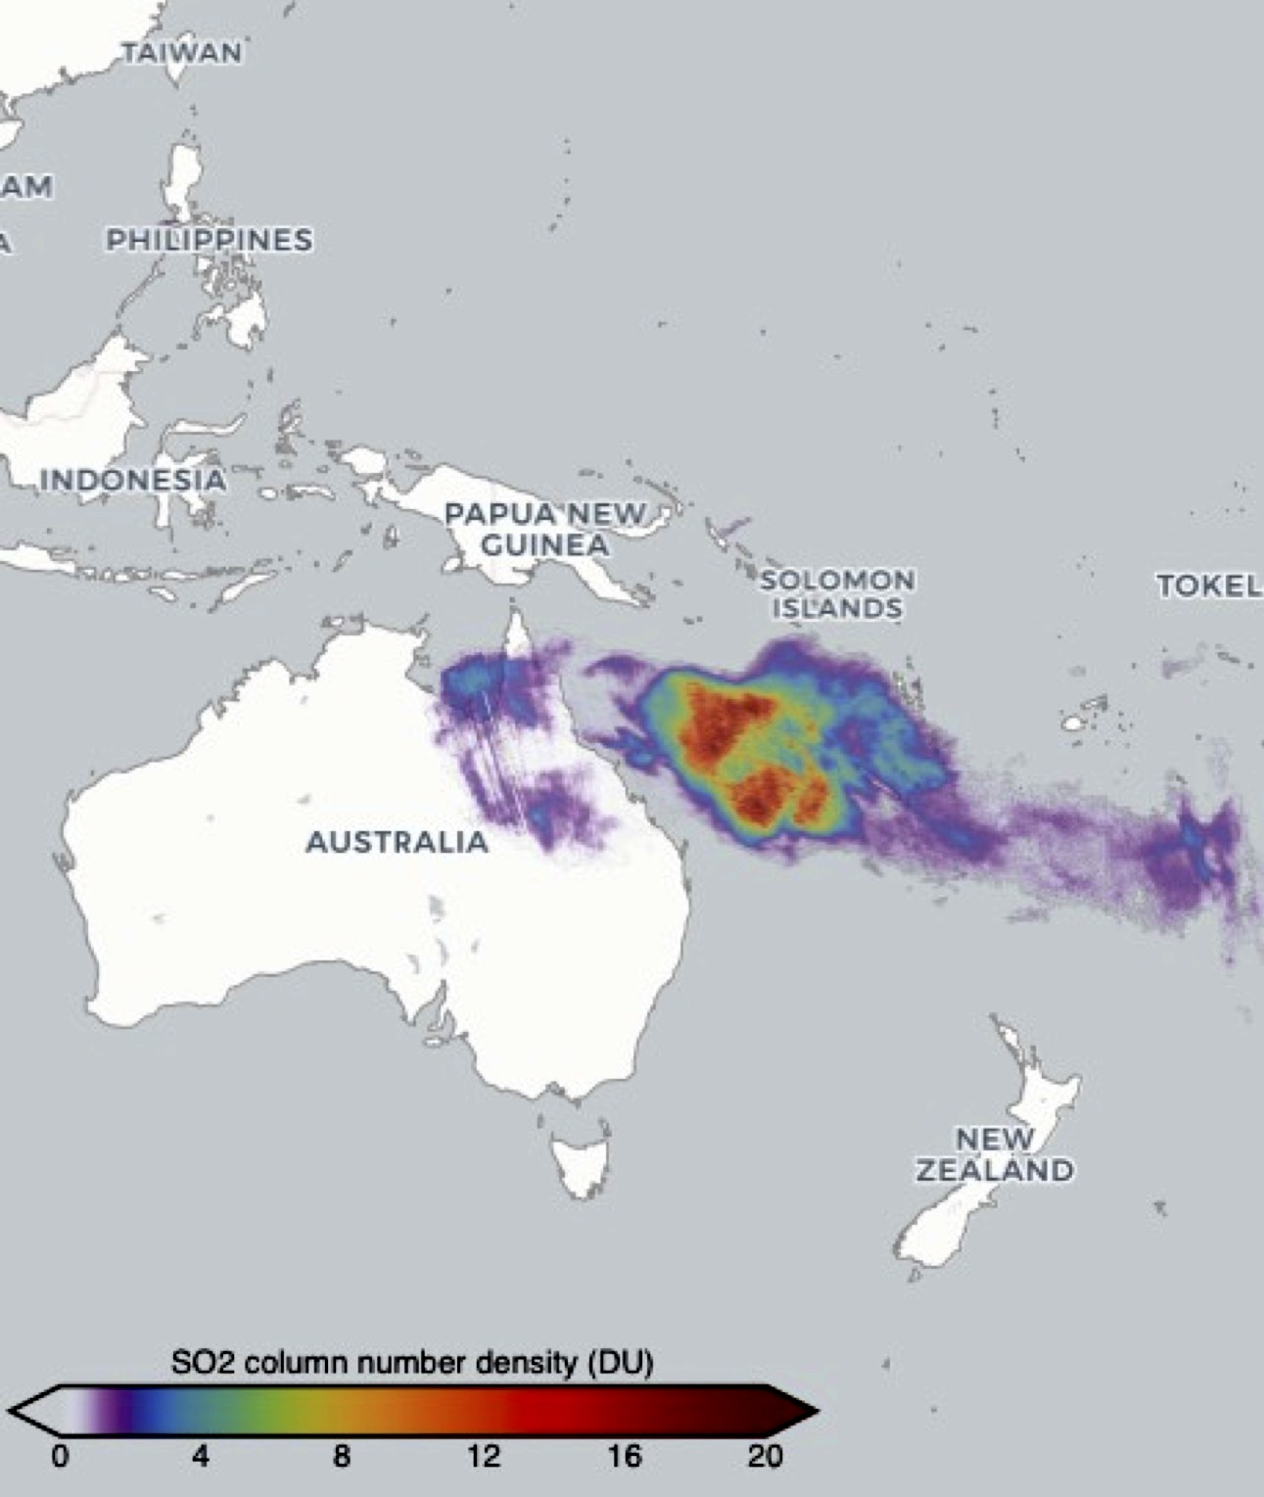
25-Aug-2024
16-Aug-2024
17-Jan-2022

Slide 12
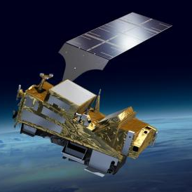
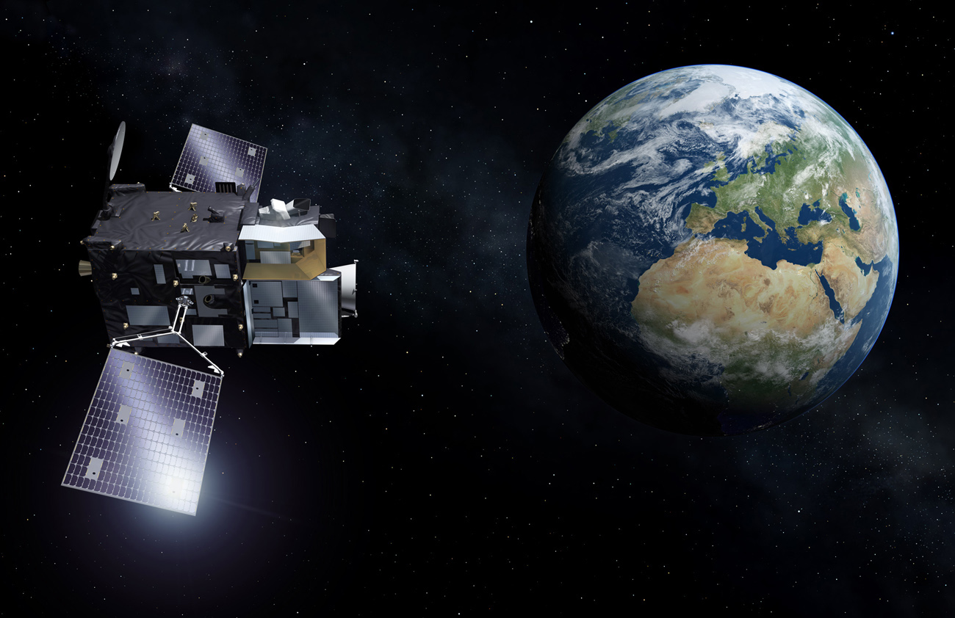
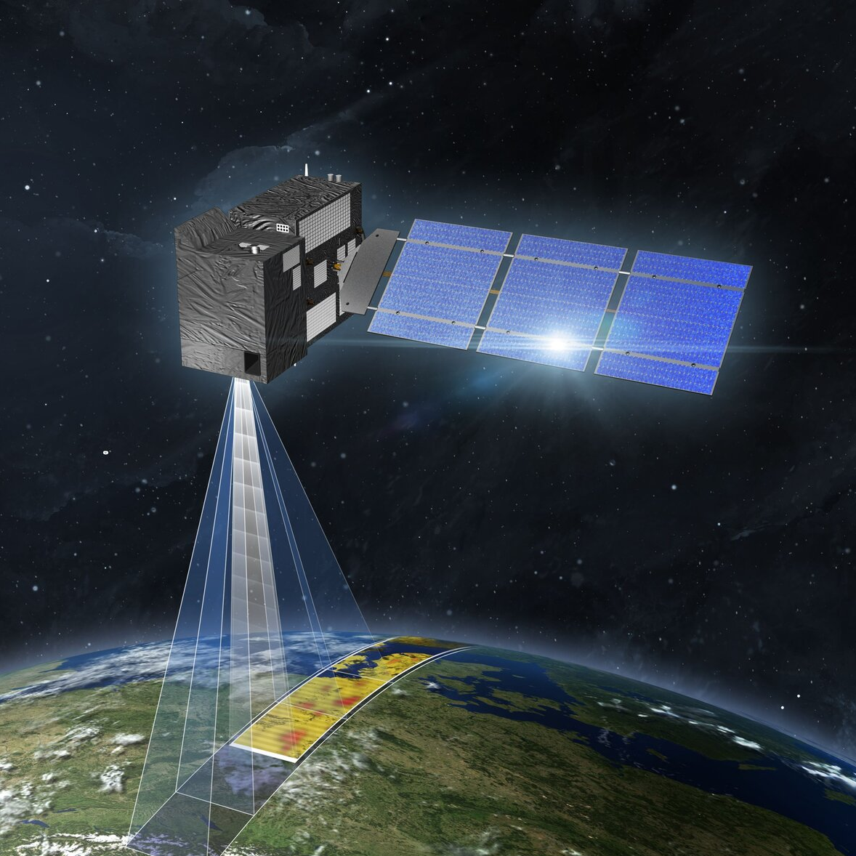
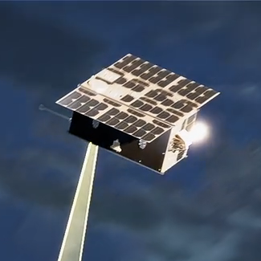
Metop SG
Sentinel 4
S5/UVNS (Tropomi like)
IAIS-NG
3MI
Metimage
No earlier than2025
Morning orbit
S4/UVN
Resolution ~8x8 km²
Geostationary over Europe
No earlier than 2025
On MTG-S with IRS
CO2M
TANGO
EU Copernicus programme
CO₂, CH₄, NO₂, Sif
Resolution 2x2 km²
Swath width ~270 km
Launch 2026
Constellation of 3 identical satellites
ESA scout programme
CO₂, CH₄, NO₂
Resolution 300x300 m²
Targets 30x30 km²
2 cubesats flying in formation
No earlier than 2027

Slide 13


S5P is performing excellent
… no technical limitations for extending the mission lifetime until 2035 …
All operational products are timely produced
and routinely validated
Research data products are produced offline and disseminated, including Level 3 products.

Slide 14


Slide 15
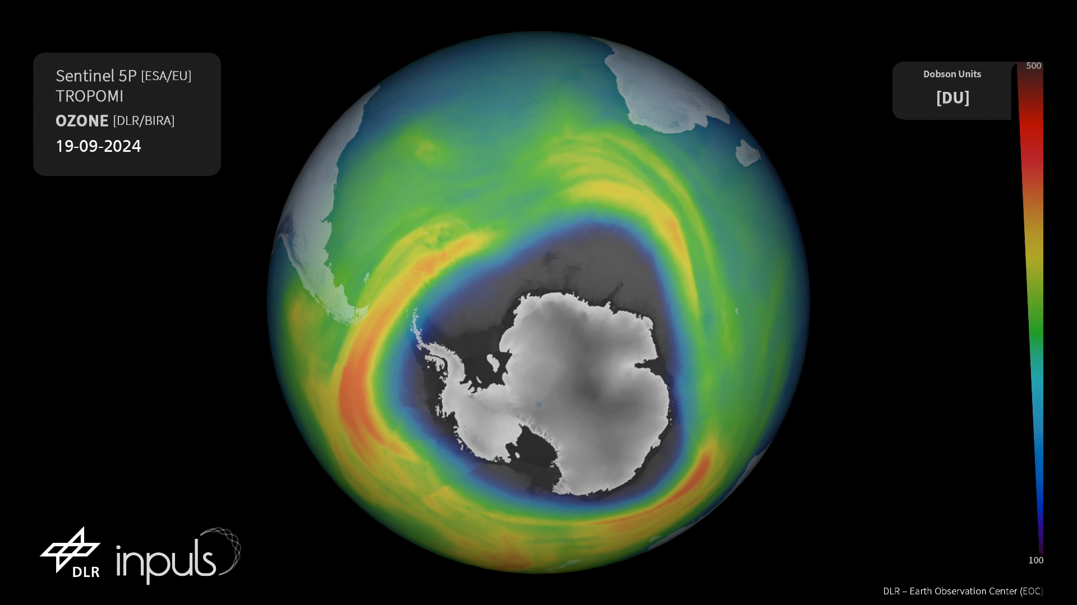
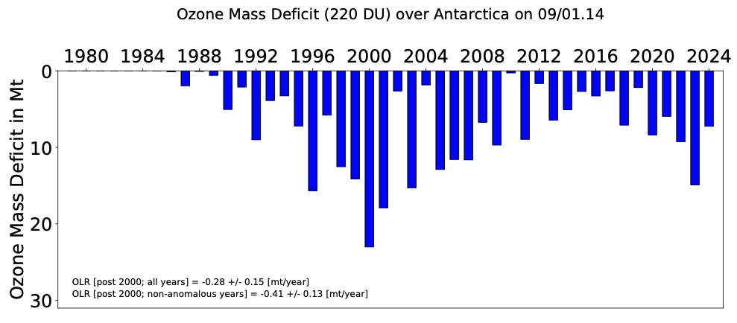
Notes:
https://atmos.eoc.dlr.de/inpuls/visualization/

