Slide 1
Committee on Earth Observation Satellites
Proposal for AC-VC #18 in Brussels
14-18 March 2022 (TBC) co-hosted by BIRA-IASB and BELSPO
at the Royal Institute of Natural Sciences
Contacts: Jean-Christopher Lambert, Nathalie Kalb,
and Michel Van Roozendael
Royal Belgian Institute for Space Aeronomy (IASB-BIRA)

Slide 2
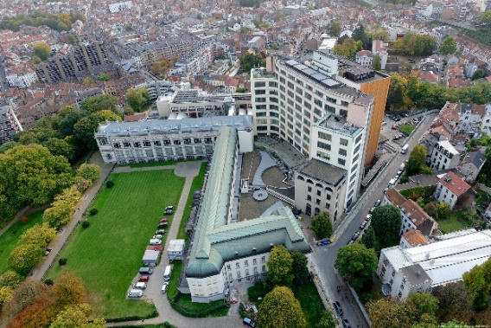
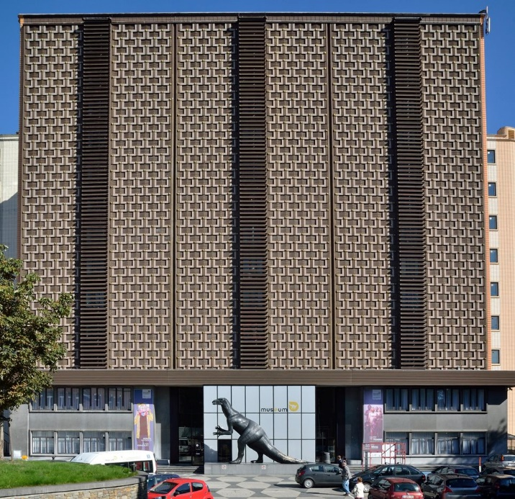
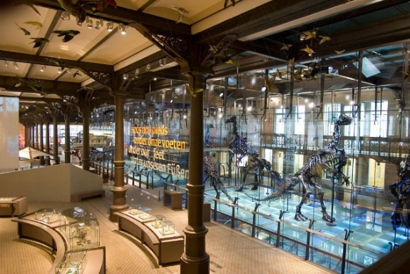
Venue: Royal Belgian Institute of Natural Sciences Rue Vautier 29, 1000 Brussels, Belgium

Slide 3
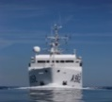
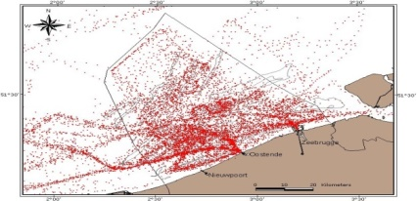
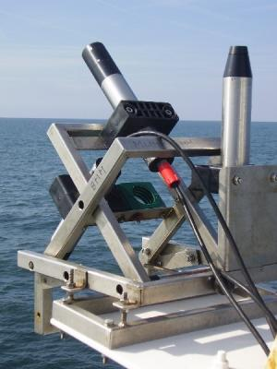
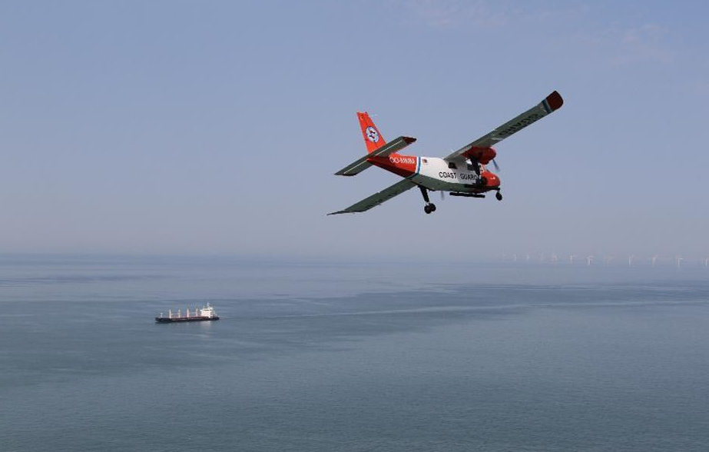
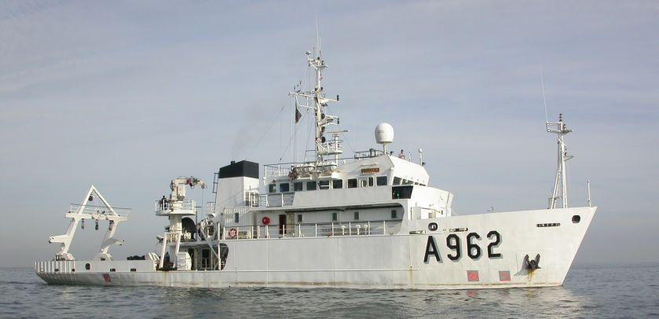
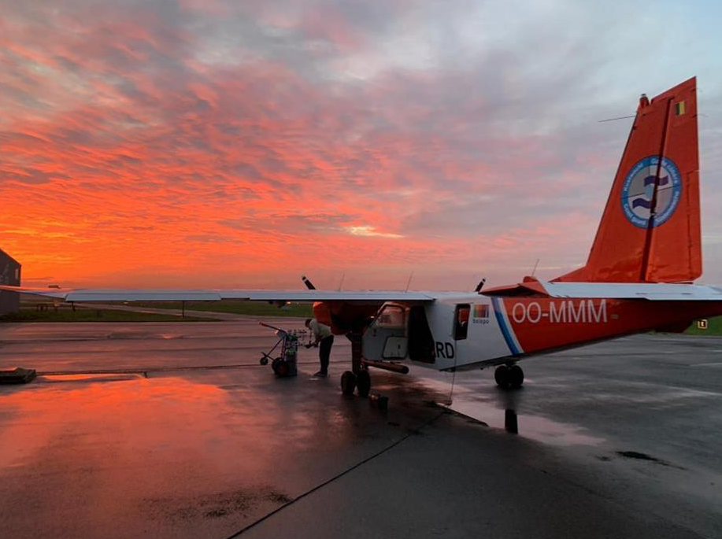
Royal Belgian Institute of Natural Sciences A CEOS WGCV Partner
North Sea marine survey
Physical, chemical and meteorological parameters over North Sea
Belgian Maritime Data Centre (BMDC), SeaDataNet member
Ship-, aircraft- and shore-based
WaterHypernet for water (ocean, lake…) colour
IRSN/MUMM North Sea measurements

Slide 4
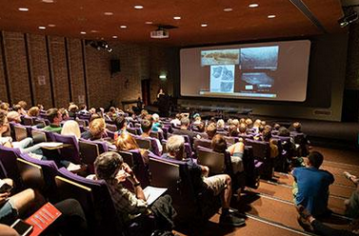
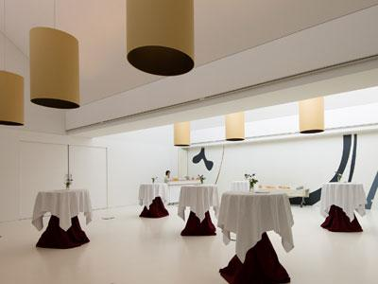
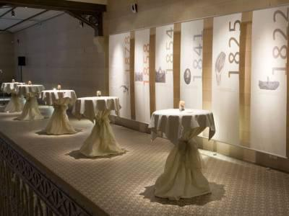
Meeting Facilities
Auditorium
150 seats
VIP Room (lunch)
180 m² - 150 standing
Dinosaur Mezzanine
250 m² - 200 standing
Smaller Meeting Rooms

Slide 5
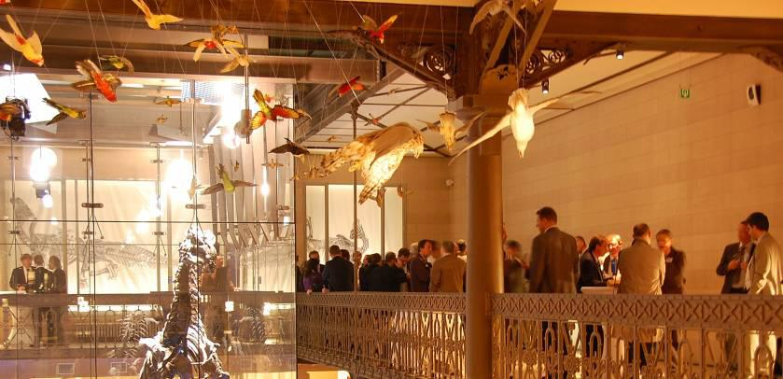
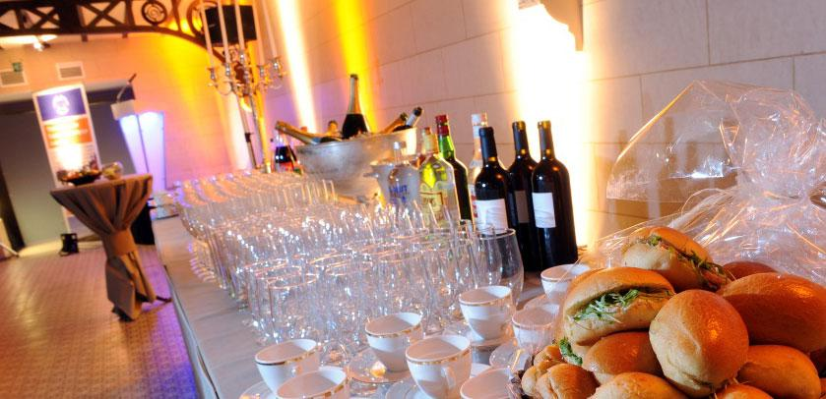
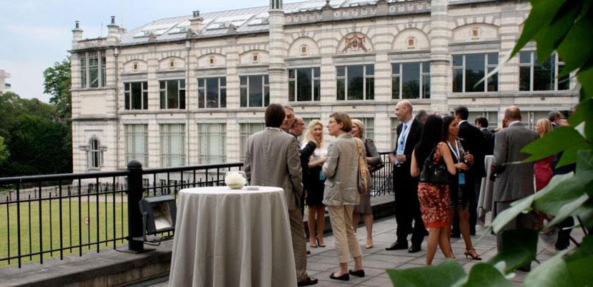
Catering

Slide 6
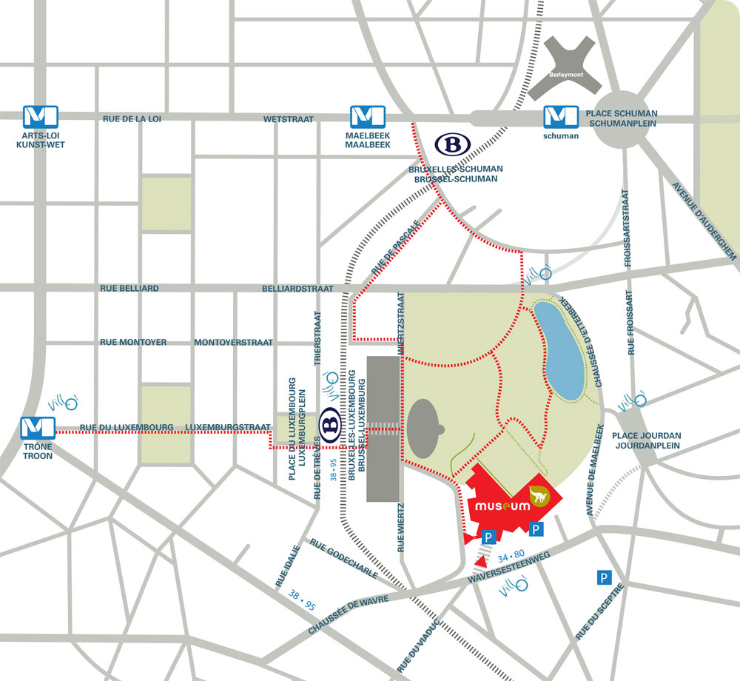
Location
In the heart of the European quarter
Direct connections to Brussels Airport
Walking distance from train and metro stations
Hotels, restaurants, pubs…

Slide 7
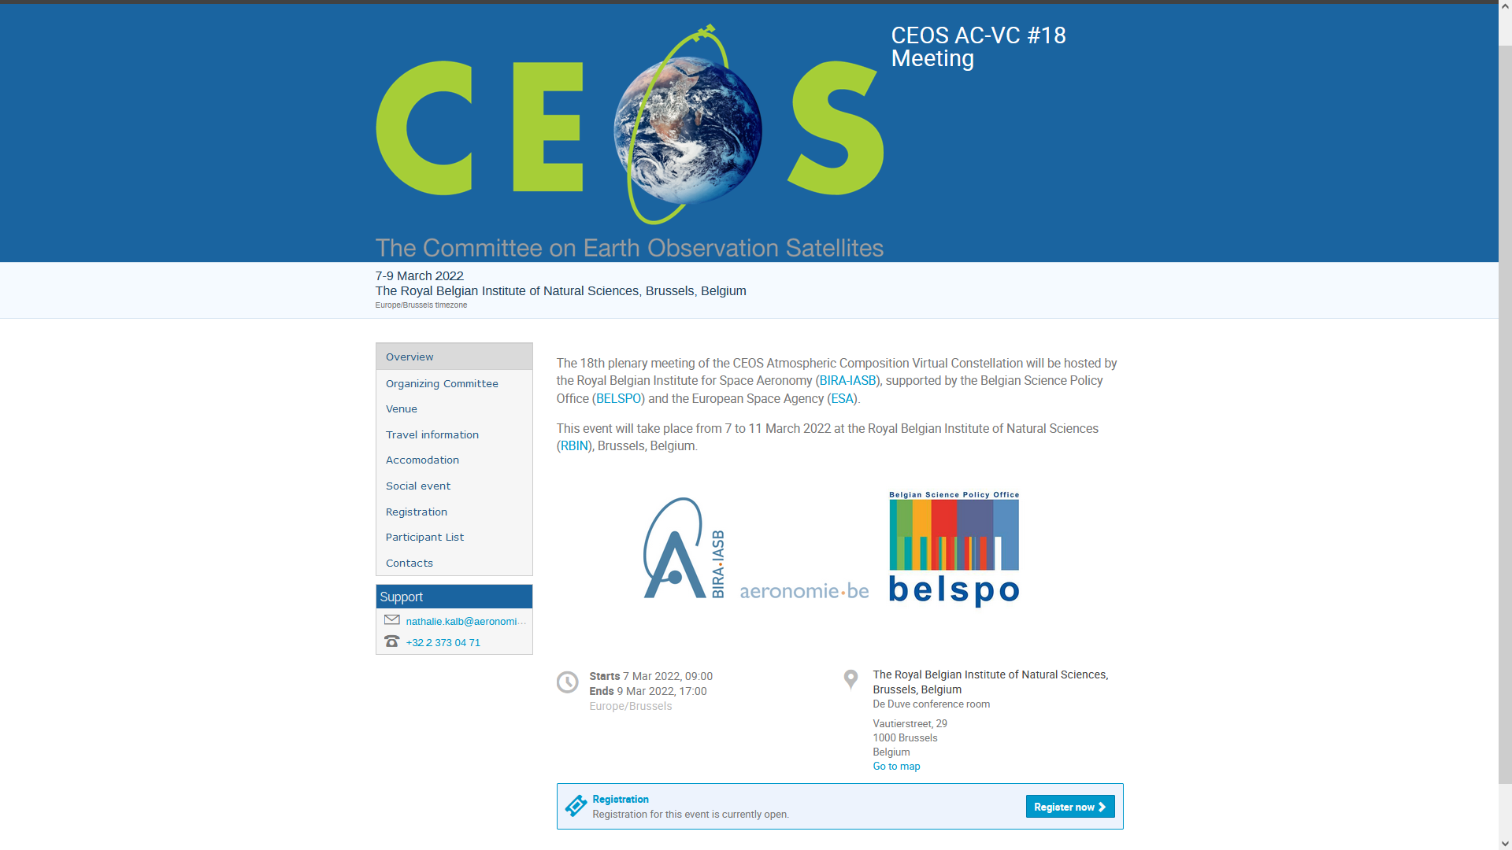
14-18 March 2022 (TBC)

Slide 8
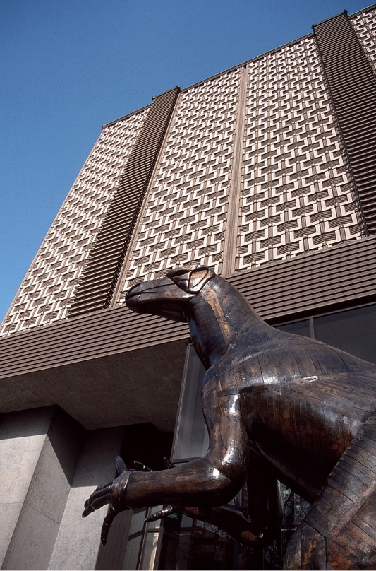
AC-VC-18
We look forward to welcoming you
in Brussels in Spring 2022 !

