Slide 1
DLR INPULS Project
D. Loyola (DLR-IMF)
CEOS AC-VC #17
June 11th, 2021

Slide 2
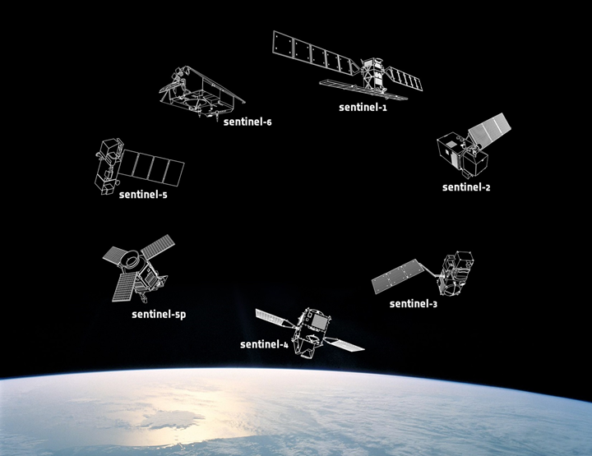
Innovative Products for Analyses of Atmospheric Composition
Copernicus Sentinels

Slide 3
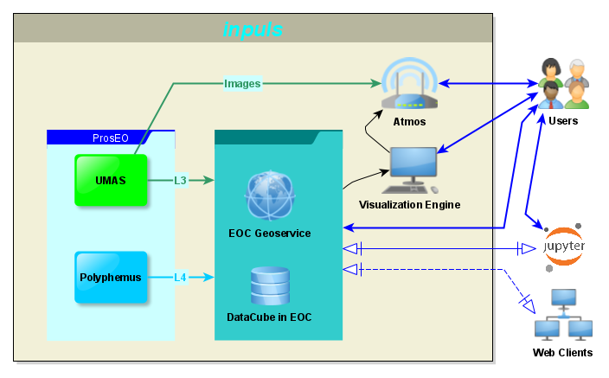
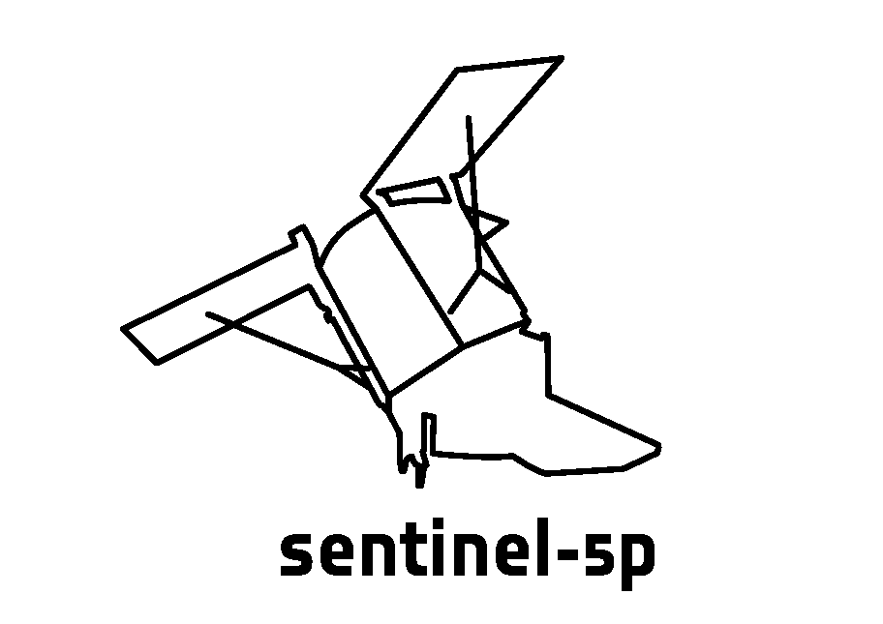
INPULS Overview

Slide 4
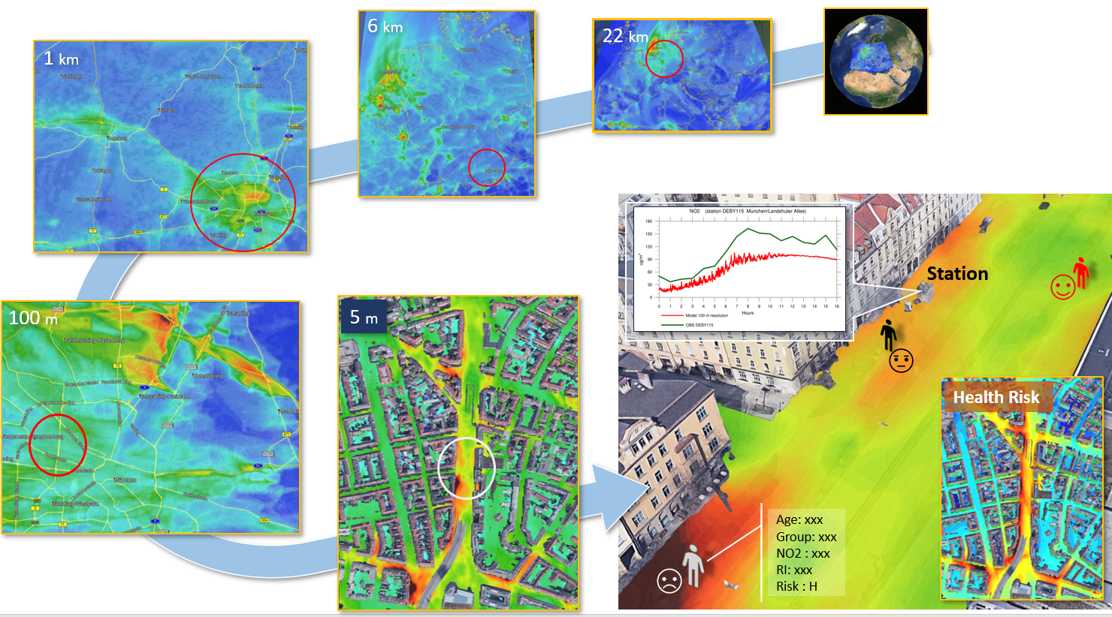
Assimilated AC products over Germany with 1x1 km² resolution
CAMS/ECMWF
Polyphemus/DLR
Earth observation
Multi-nesting
Urban dispersion
E. Khorsandi, 3.12, AC-VC #17

Slide 5
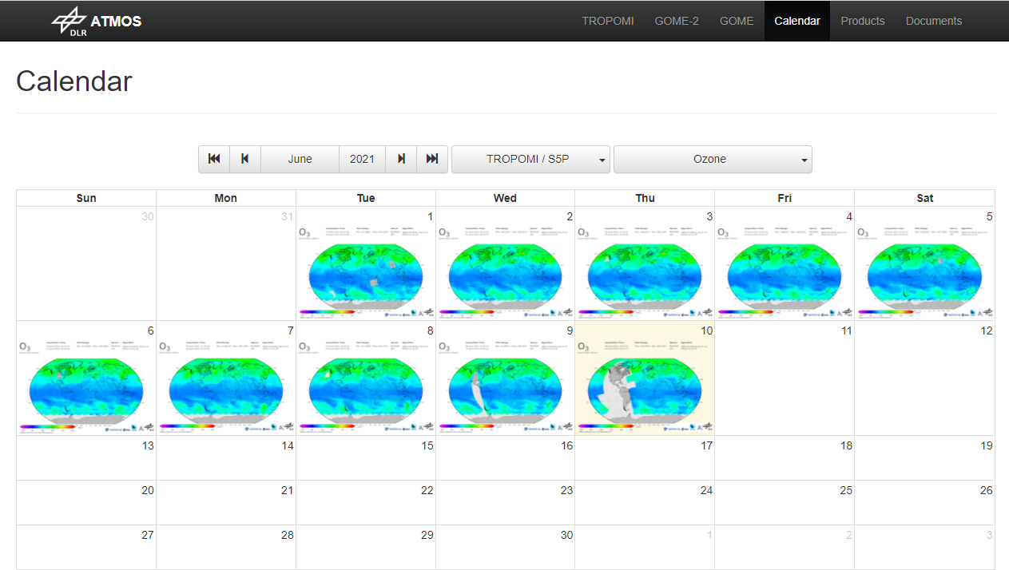
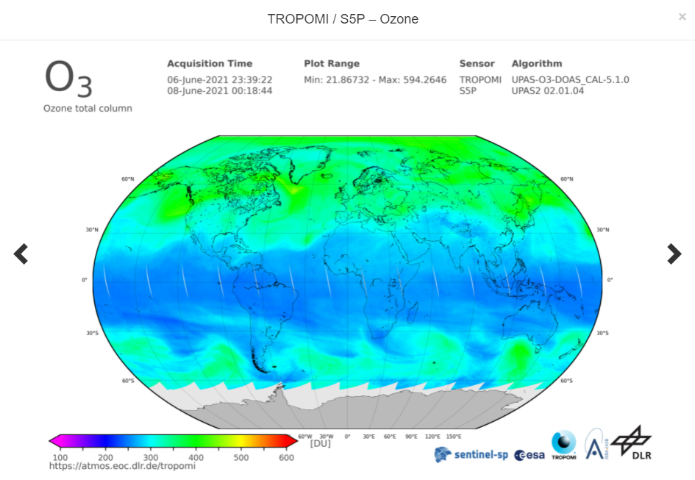
Atmos Image browsing: https://atmos.eoc.dlr.de/tropomi

Slide 6
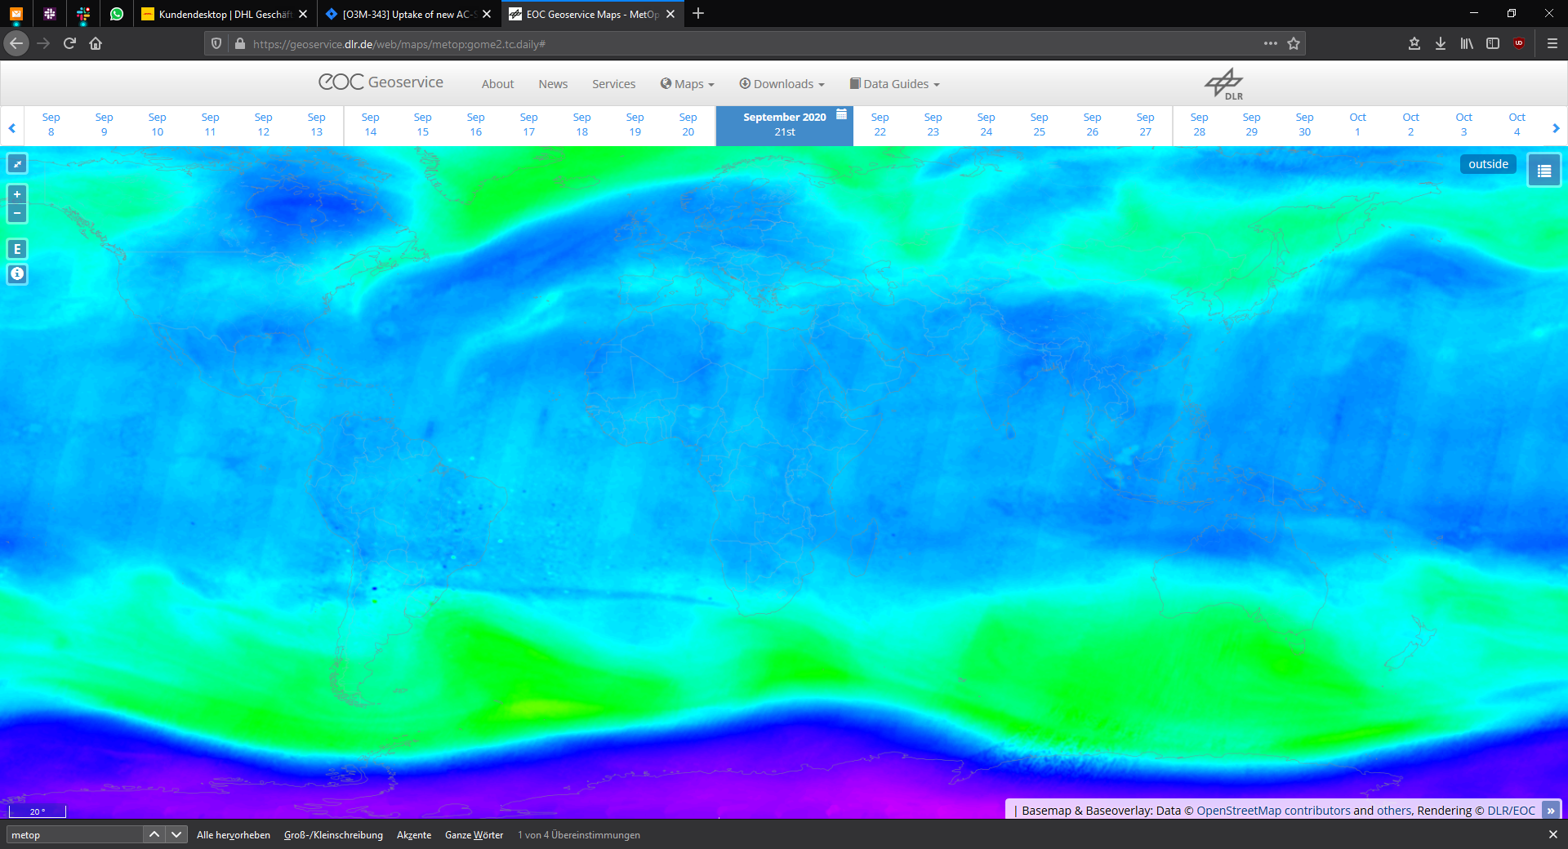
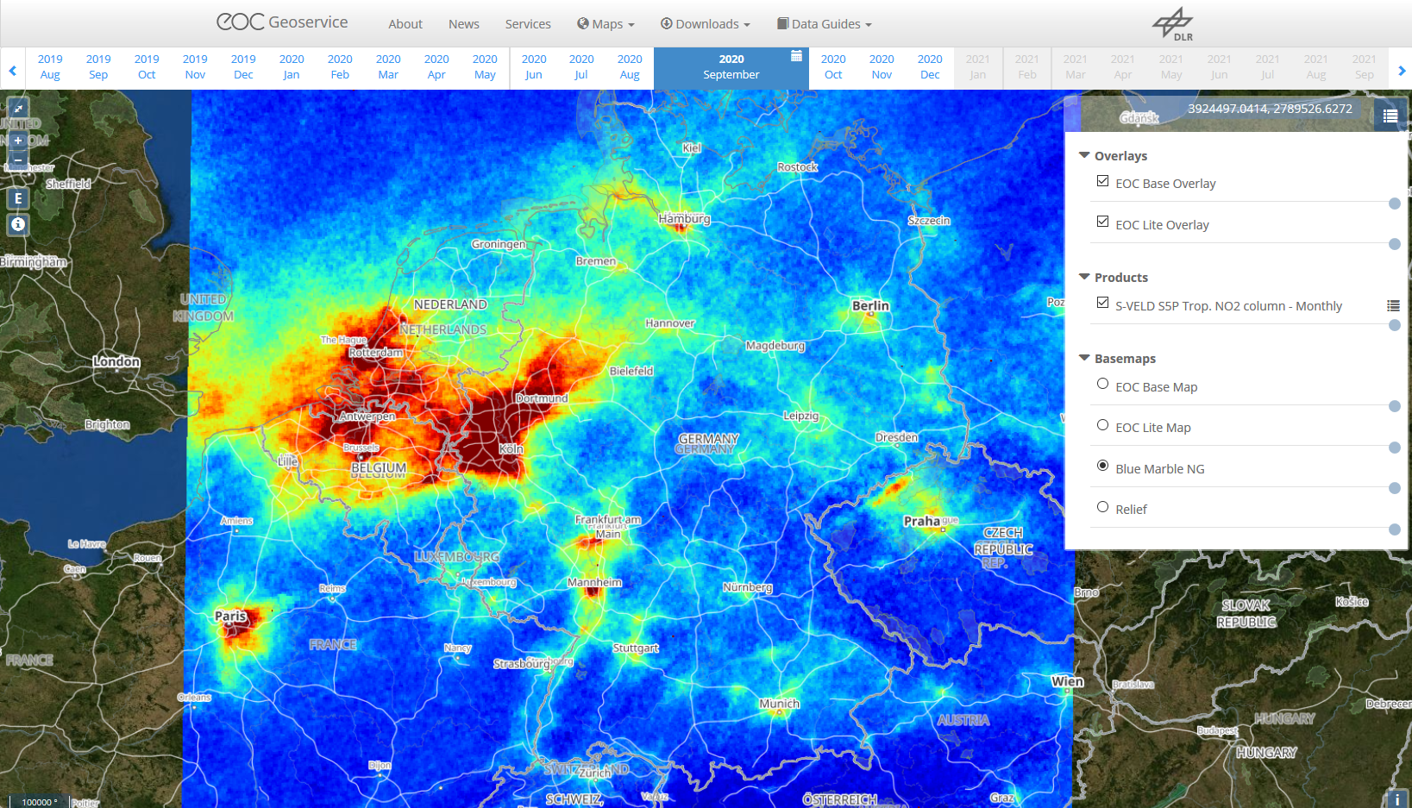
EOC Geoservice access via standardized OGC protocols (WMS, WCS, WFS and WMTS)
GOME-2 total ozone
(combined MetOp-B and –C) in 21.09.2020
TROPOMI/S5P
Tropospheric NO₂
https://geoservice.dlr.de/web/maps/de:sveld:monthly

Slide 7
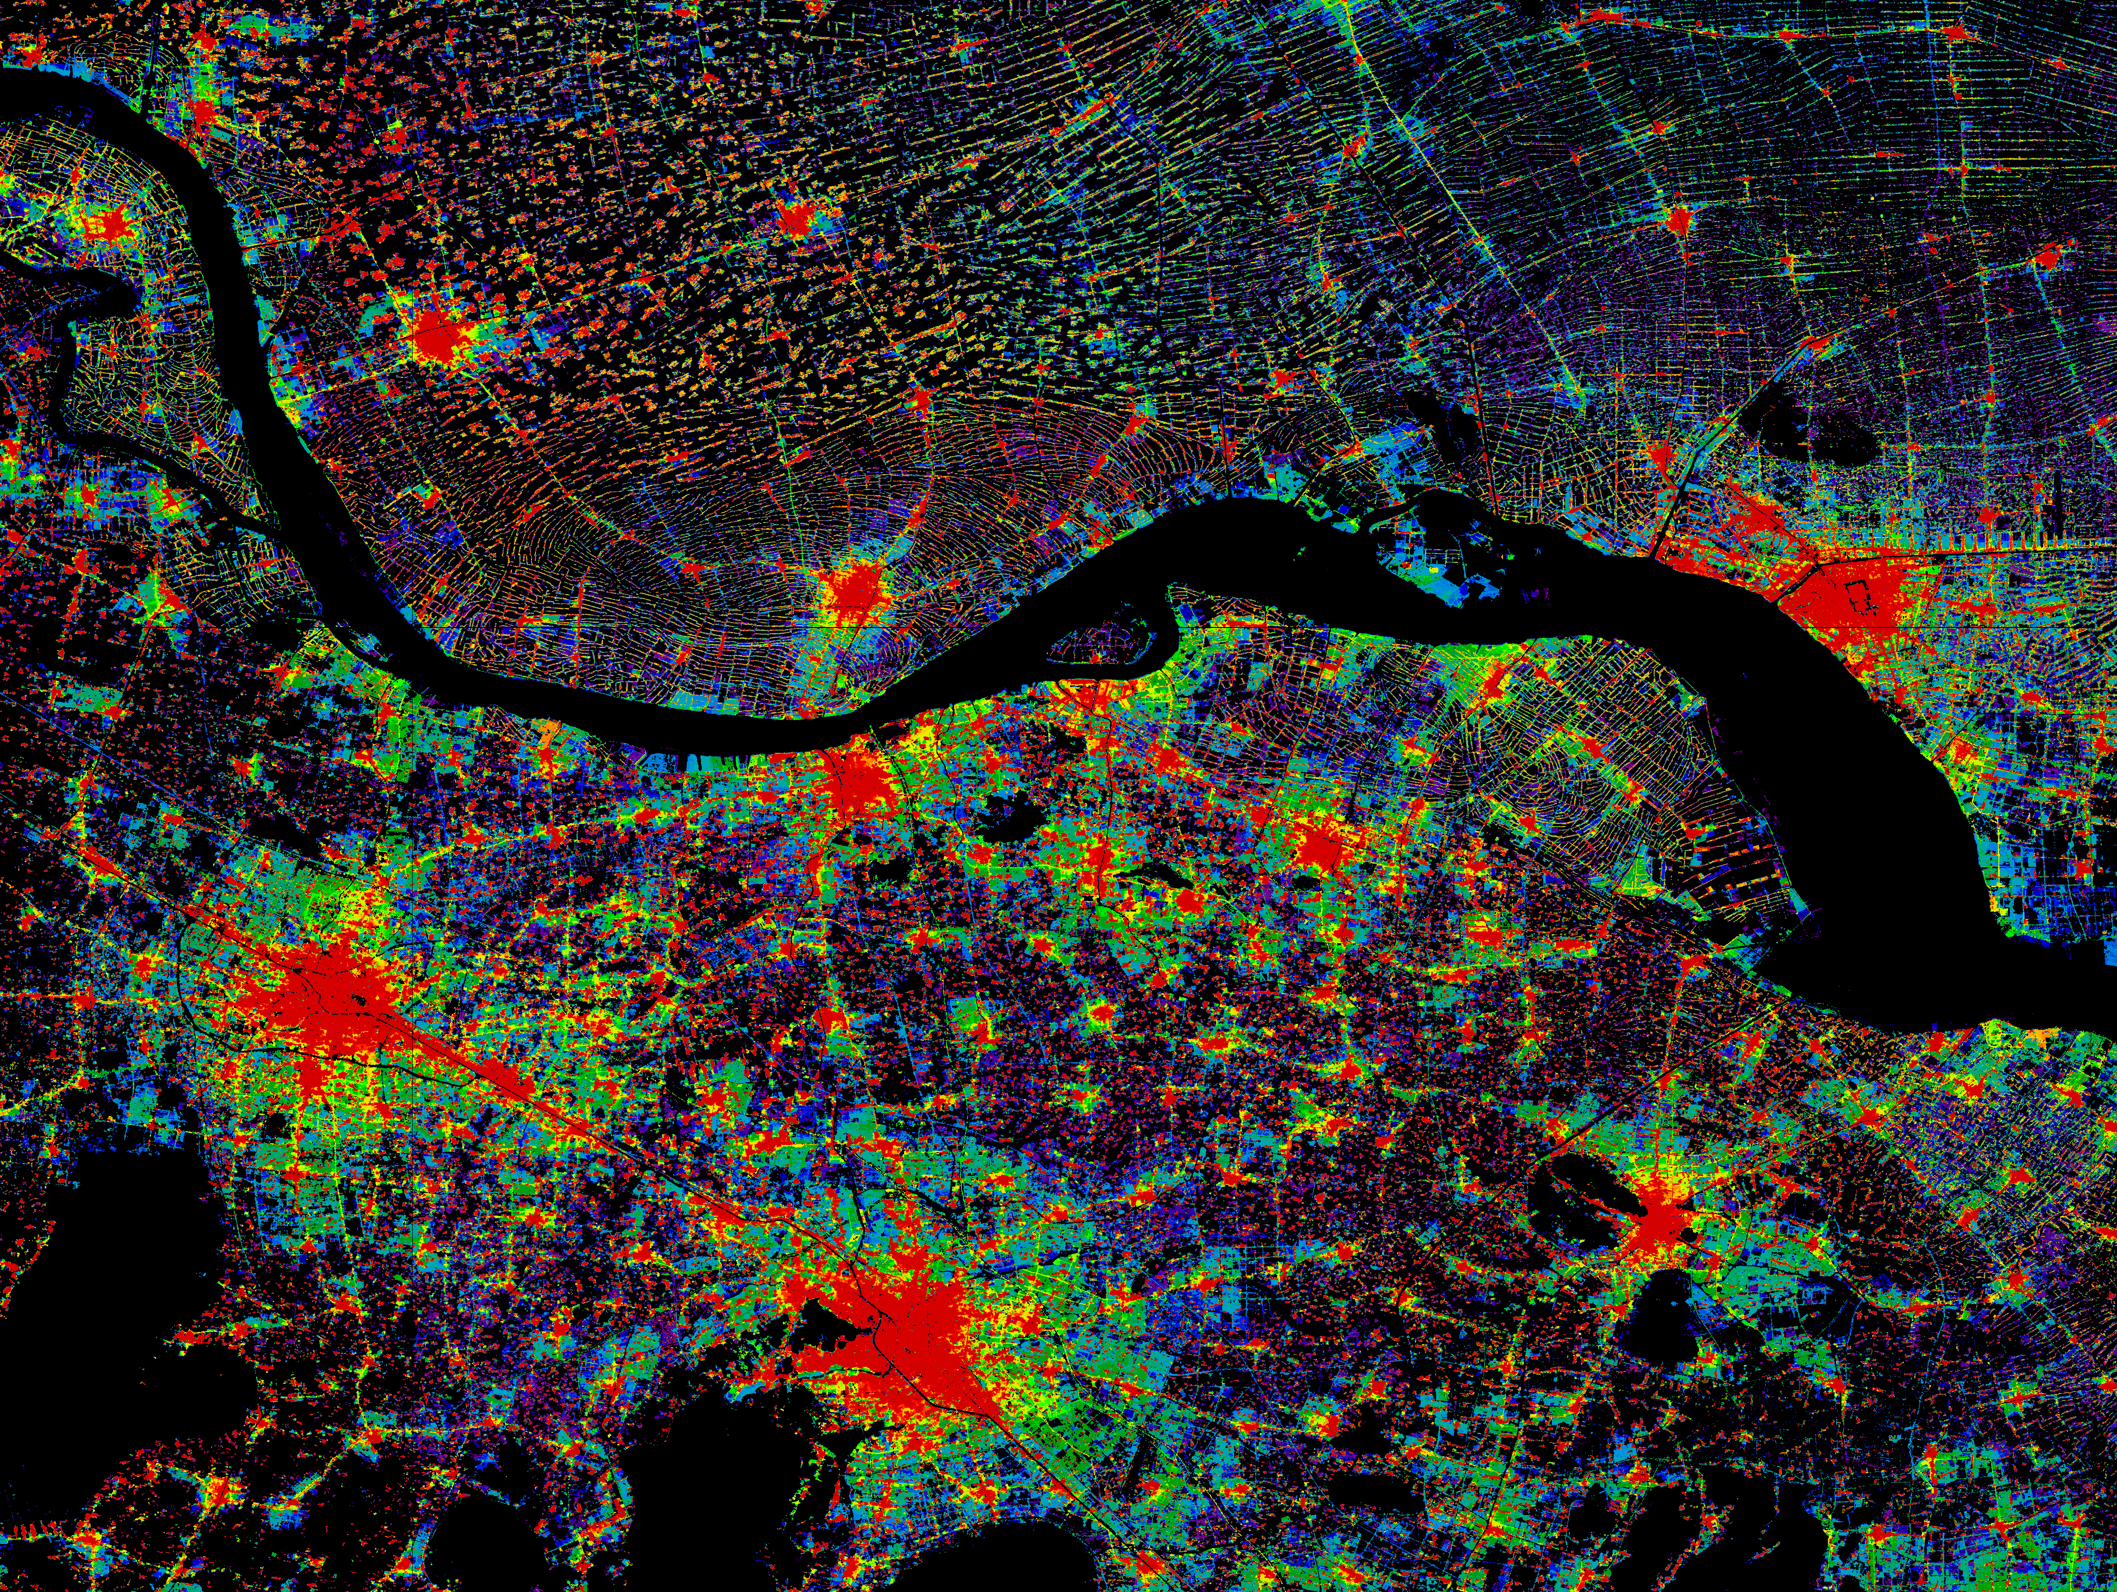
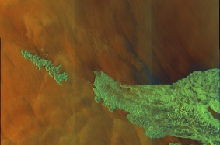
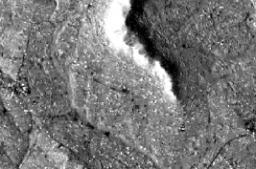
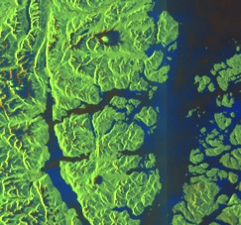
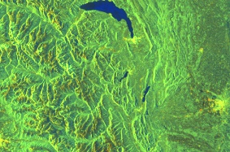
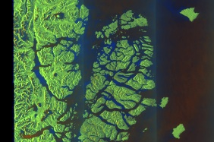
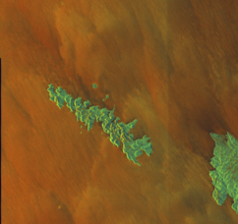
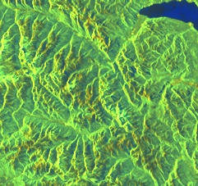
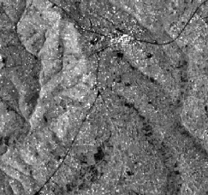
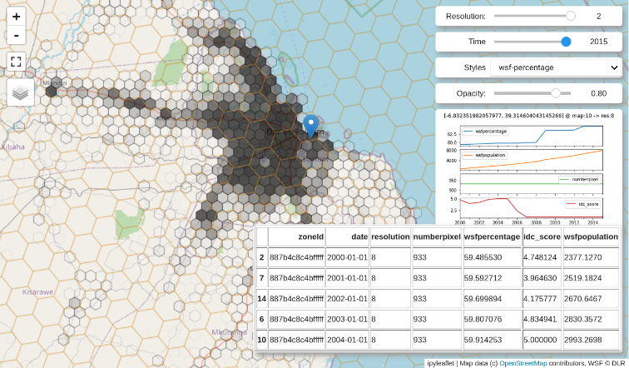
EOC DataCube for fast server side provision of Analysis Ready Data (CEOS ARD)
Innovative Interfaces:
Data Analysis and Processing API (DAPA)
Discrete Global Grid System (DGGS)
Sentinel Products
EOC DataCube (Timeseries)
Icons: Cogwheel by Eddy Wong, CC-BY-2.0, jet engine by Arthur Shlain, CC-BY-2.0 and user by Alice Design, CC-BY-2.0.

Slide 8
Visualization Engine – La Soufrière vulcan eruption

