Slide 1
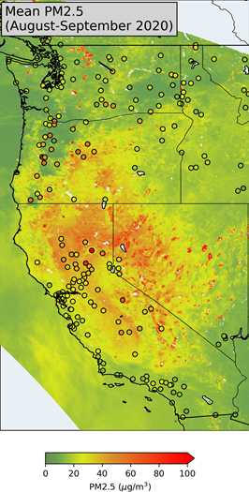
NOAA GOES-16/17 Advanced Baseline Imager Aerosol Products Update
GOES-16/17 ABI Aerosol Imagery and Products
GeoColor
Dust RGB
Fire RGB, hot spots, fire radiative power
L2 Aerosol Optical Depth
L2 Aerosol Detection (smoke/dust)
Tailored Derived surface PM2.5 for NWS applications
The primary archive to access ABI data files is NOAA’s Comprehensive Large Array-Data Stewardship System (CLASS)
Registration (free!) is required to order data
NOAA’s Big Data Program (BDP) is providing a new, easier way to access ABI data files in the “cloud”!
Product latency 20 minutes after observations are made

Slide 2
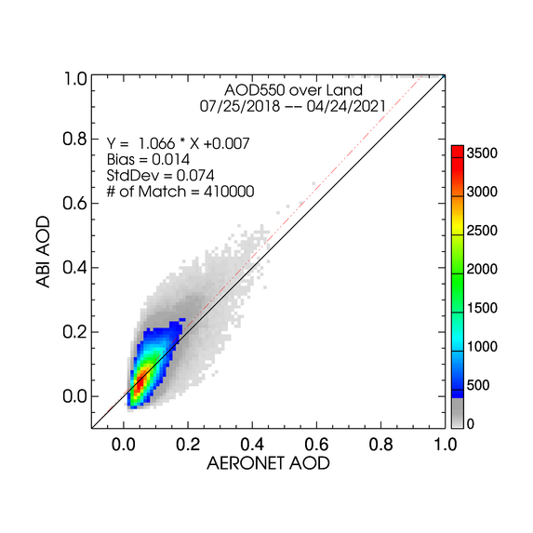
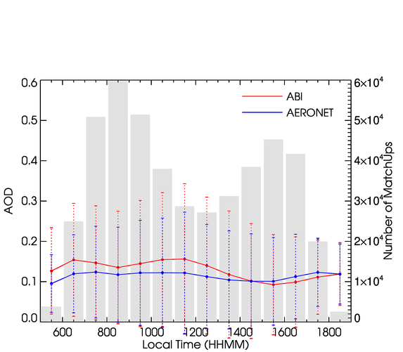
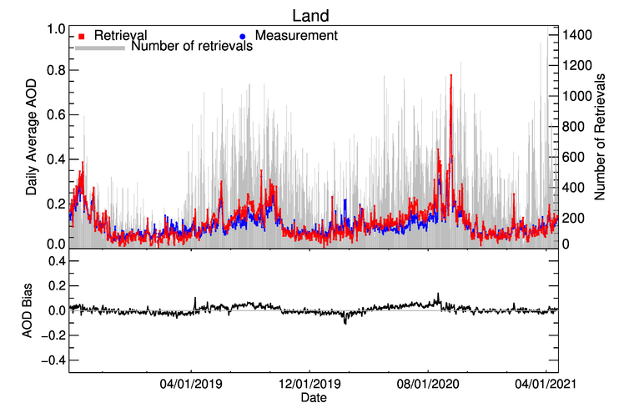
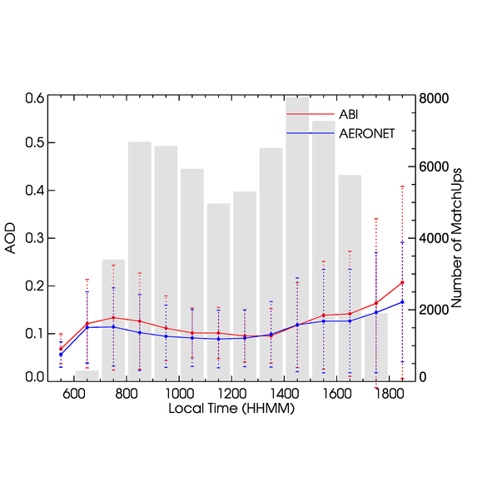
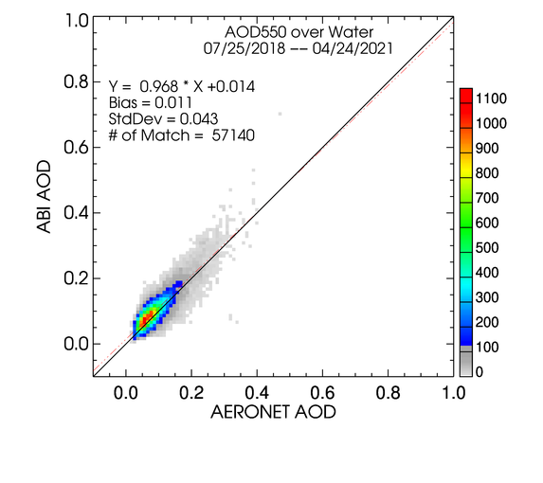
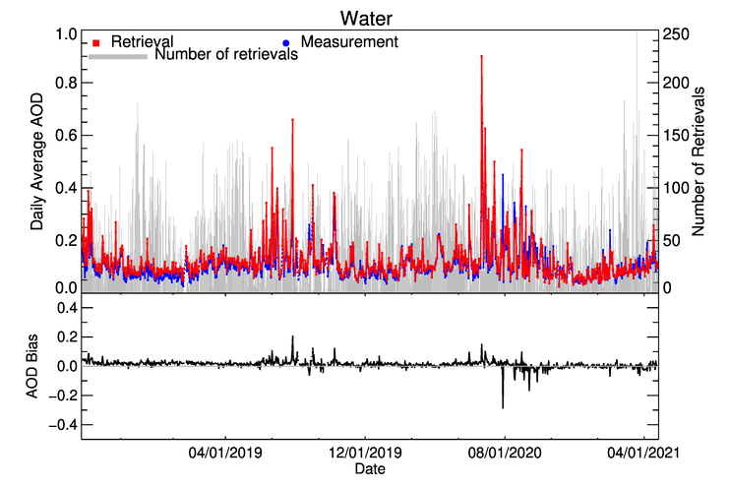
AOD: GOES-16 vs. AERONET
Land
07/25/2018 – 04/24/2021
Can this be improved?
Water
Mi Zhou (IMSG) and Istvan Laszlo (NOAA)
Notes:
The GOES-16 AOD is evaluated with AERONET since provisional maturity on July 25, 2018. Here show the scatter-plot with overall statistics, daily average time-series plot and overall diurnal variation.
The AOD over water can describe the similar diurnal pattern as in AERONET measurement. However, the diurnal discrepancy is larger for AOD over land. This can be improved by updating the spectral land surface relationship as shown in the next slide.

Slide 3
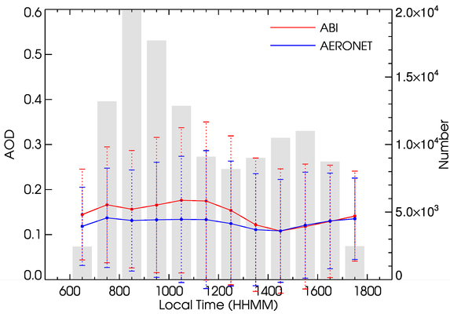
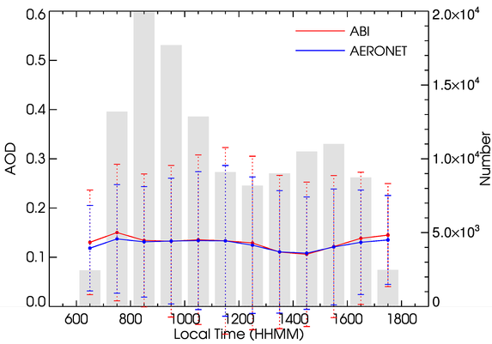
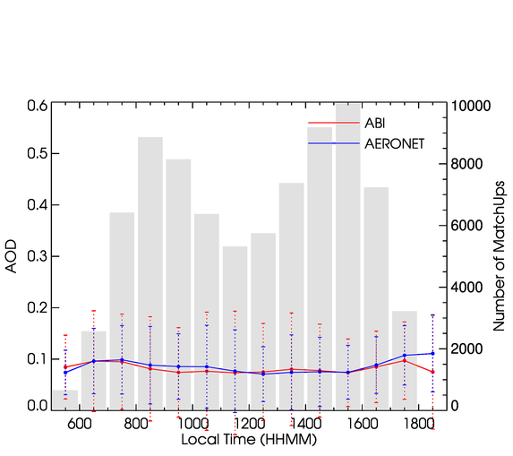
Operational
w/ Updated SfcRefl
Improving Land Surface Spectral Relationships
Previous
– test position (89.5°W) training data
– $ρ_{0.47|0.64}=\text{f} \left(θ_{s}\right)×ρ_{2.25},$
Updated
– operational position (75.2°W) training data
– ${ ρ}_{0.47|0.64}$= $\text{f}$($θ_{s}$, Θ, $θ_{v})$ $×$ $ρ_{2.25}$
– separately for solar azimuth angle ≤ or > 50°.
07/25/2018 – 12/31/2019
Updated SfcRefl in Operational AOD on 10/23/2020
Mi Zhou (IMSG) and Istvan Laszlo (NOAA)
10/24/2020 – 04/24/2021
Notes:
Previous relationship calculates 0.47 and 0.64 µm surface reflectance from 2.25 µm as a function of solar zenith angle.
Updated relationship calculates 0.47 and 0.64 µm surface reflectance from 2.25 µm as a function of solar zenith angle, scattering angle and view zenith angle; and fitted for solar azimuth angle ≤ or > 50°, respectively.
Local run test showed the improvement in AOD diurnal variation with the updated surface relationship in comparison with operational product for 07/25/2018 – 12/31/2019.
This updated surface relationship was implemented in the operational AOD product on 10/23/2020. The G16 AOD over land demonstrate a good agreement with AERONET since then (10/24/2020 – 04/24/2021).

Slide 4
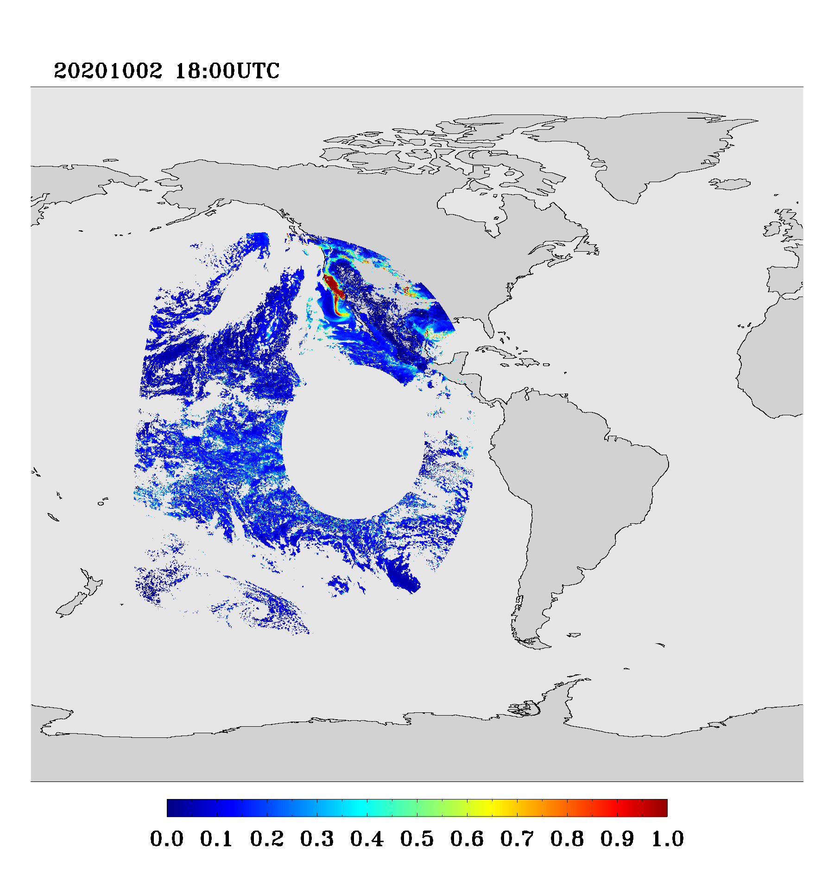
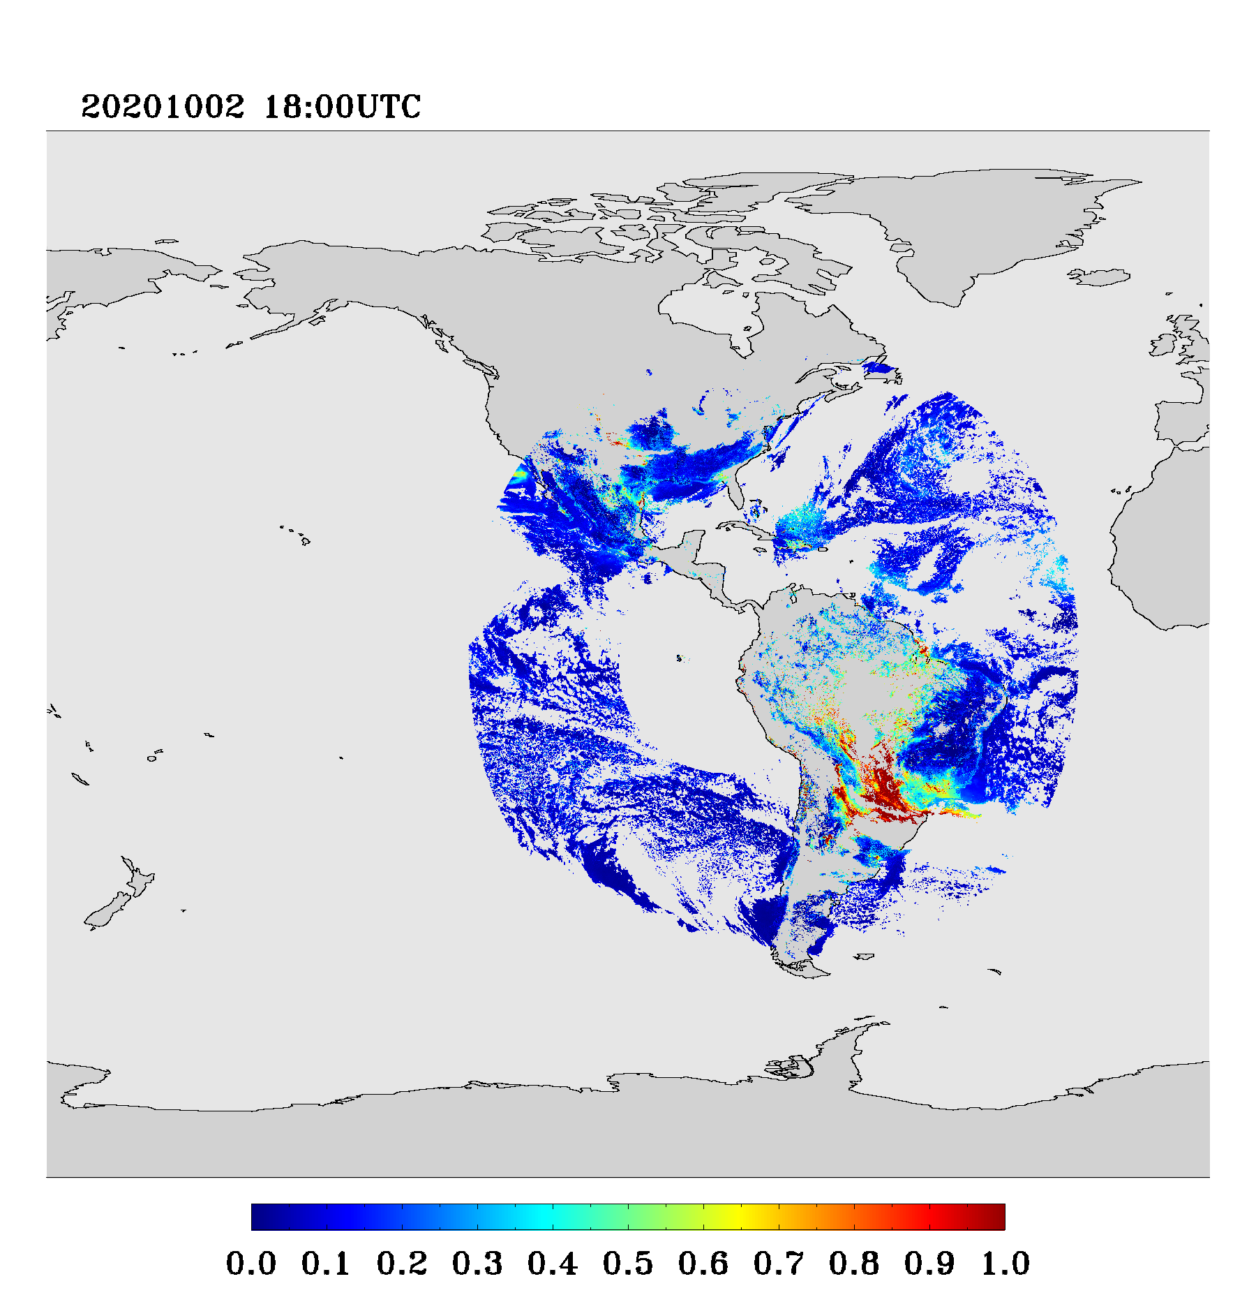
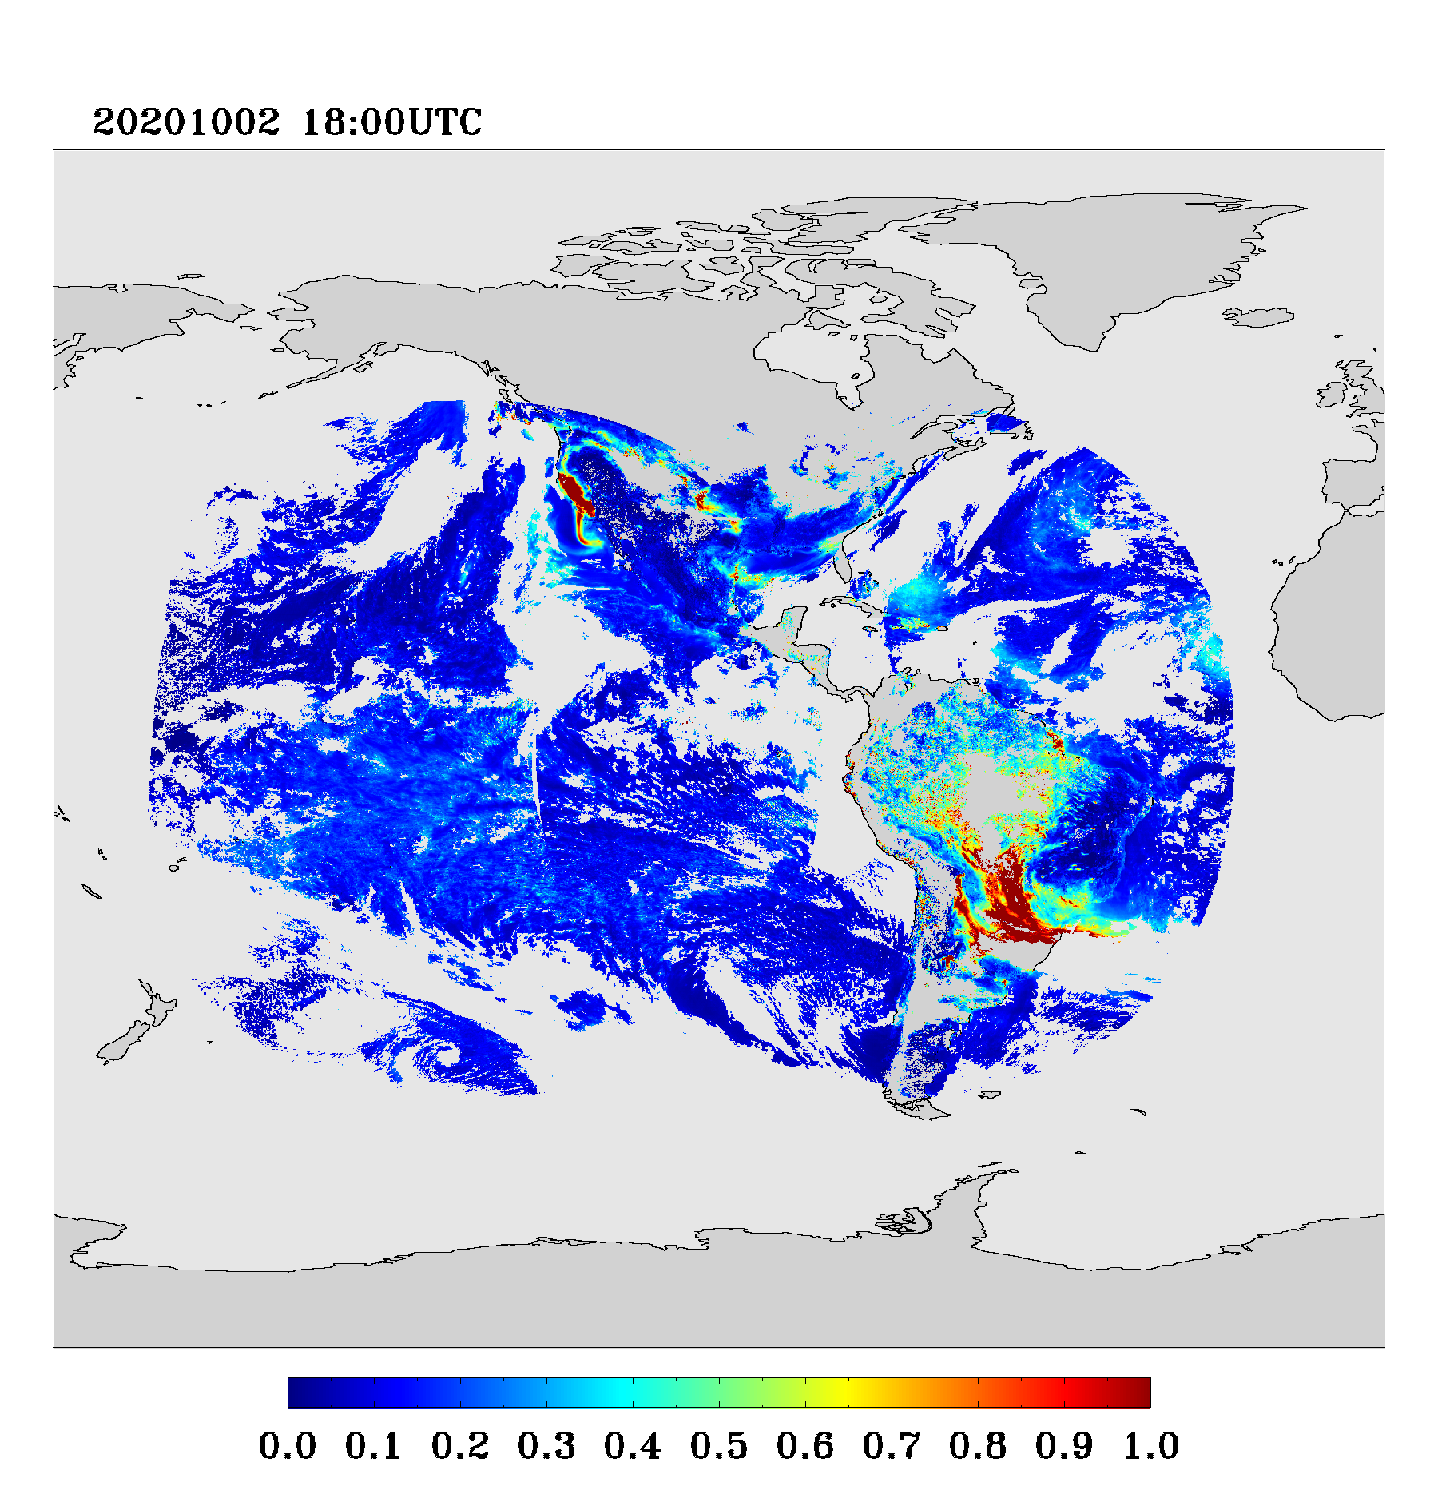
ABI Level 3 AOD product
GOES -17 L2 AOD
GOES -16 L2 AOD
ABI L3 AOD
The ABI Level 3 (L3) AOD product is being generated on a regular 0.1° x 0.1° grid every three hours.
ABI L3 AOD uses the operational full-disk Level 2 GOES-16 and GOES-17 AOD products; and L3 Dust_AOD and Smoke_AOD combines L2 AOD product with smoke and dust flags in the L2 Aerosol Detection Product.
ABI L3 AOD can expand spatial coverage and fill some gaps in L2 AOD product.
Mi Zhou and Pubu Ciren (IMSG); Istvan Laszlo and Shobha Kondragunta (NOAA)
Notes:
ABI L3 AOD at 18 UTC uses GOES-16 and GOES-17 AODs in the time window of (17, 19] UTC, therefore the spatial coverage is different from GOES-16 plus GOES-17 AOD at 18 UTC.

Slide 5
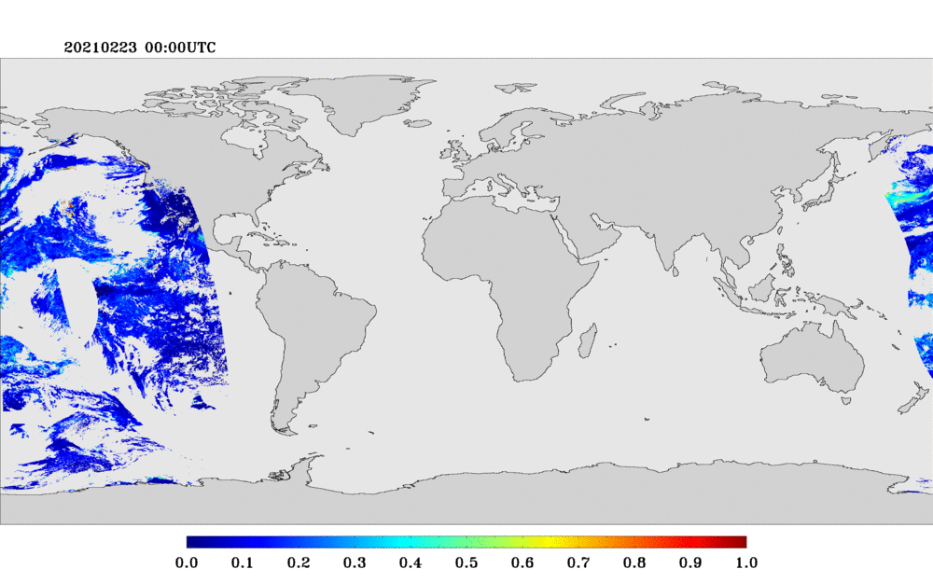
Merged-GEO-LEO AOD
Merged-GEO-LEO
The Merged-GEO-LEO AOD has been generated every hour with 1-hour temporal and 0.1° by 0.1° spatial average using NOAA operational GOES-16, GOES-17, SNPP and NOAA20 AOD product.
It uses a standard-deviation based weight to merge ABI and VIIRS AOD products for high, medium, and low quality, respectively. The ABI/VIIRS AOD is the arithmetic average of (G16, G17)/(SNPP, NOAA20).
Medium+High Quality AOD
Hongqing Liu & Mi Zhou (IMSG) and Istvan Laszlo (NOAA)

Slide 6
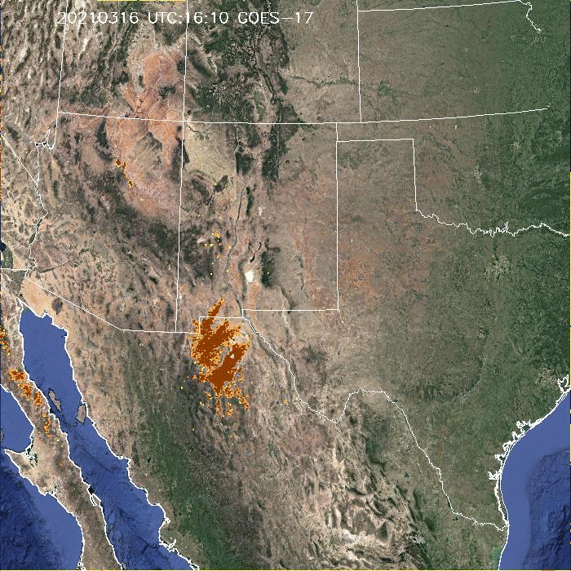
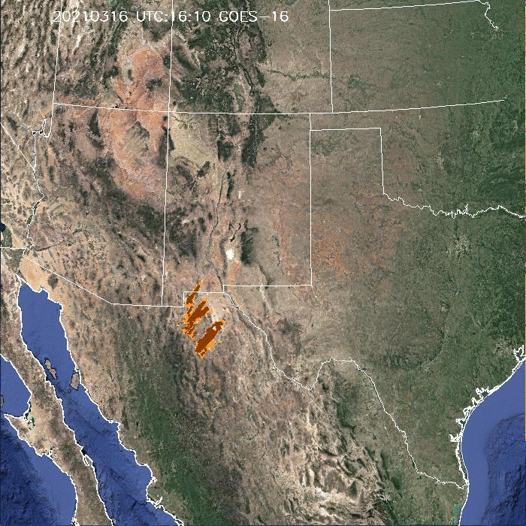
ABI Dust Detection Product
Pubu Ciren and Shobha Kondragunta (NOAA)

Slide 7
Diurnal Bias in Geostationary Satellite AOD
Bias correction most likely needed for geostationary satellite AODs
NOAA found diurnal bias in its ABI AOD product as well as NASA version of the ABI AOD product (Figure above shows an example for NASA version of ABI AOD)
NOAA developed an empirical bias correction algorithm (Zhang et al., 2020) that can be applied universally to any geostationary AOD retrieval
NOAA applies the bias correction to AOD prior to using it in deriving surface PM2.5 product for user applications
Hai Zhang (IMSG) and Shobha Kondragunta (NOAA)

