Slide 1
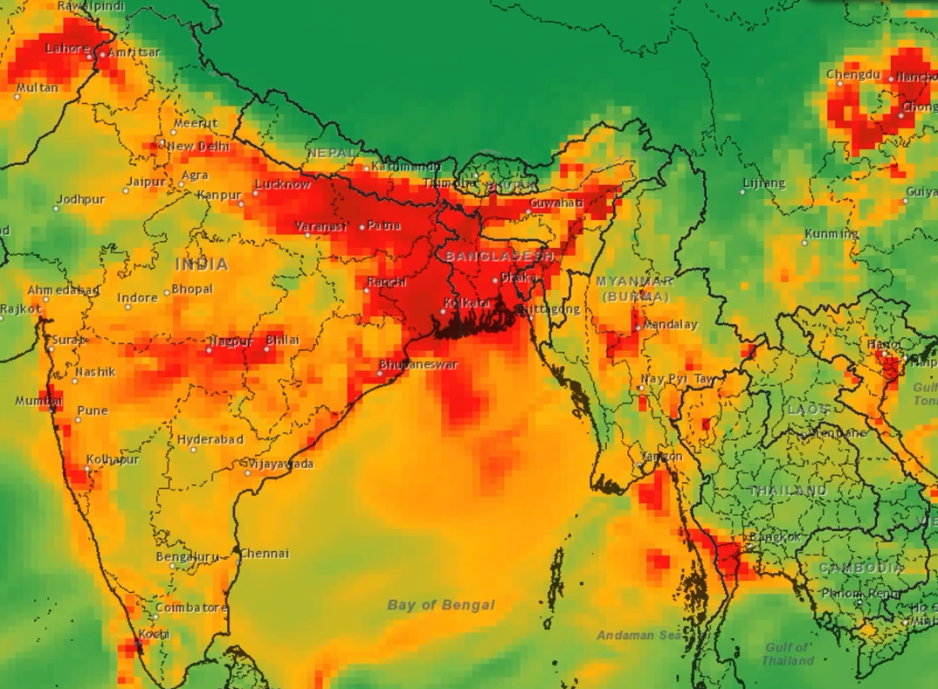
Towards Near-Real-Time Surface PM2.5 Monitoring from Space: A Two-decade-long Journey
Pawan Gupta (USRA/MSFC)
CEOS Atmospheric Composition Virtual Constellation AC-VC-17, June 07-11, 2021
Notes:
Good afternoon everyone, thanks Shobha for invite.
I will be talking briefly about PM2.5 estimation efforts over last two decade and some example efforts by our team over past few years.

Slide 2
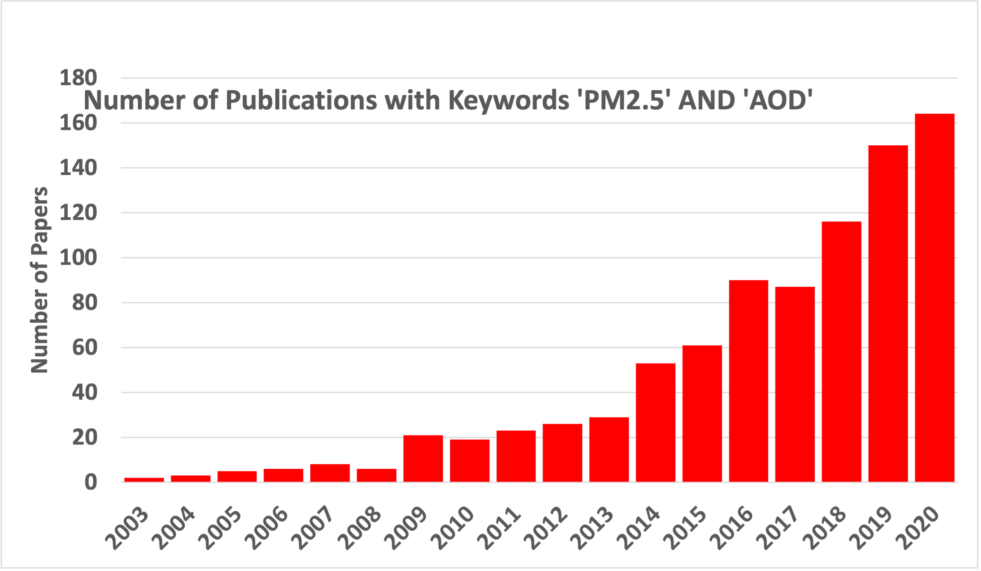
Particulate Matter (PM) from Satellite
Kaufman and Fraser, 1983, Fraser et al., 1984
  AOD and Sulfate from GOES-VISSR
Wang and Christopher, 2003, Chu et al., 2003
  AOD & PM2.5 (and PM10) relationship
Liu et al., 2004, van Donkelaar et al., 2006
  Used CTM to scale AODs to PM2.5
Gupta and Christopher, 2009
  Used Artificial Intelligence to convert AOD to PM2.5
van Donkelaar et al., 2010, 2015, 2019
  Global Product – Annual Mean
Shaddick et al., 2017, 2018
  Bias corrected annual PM2.5 data for WHO, SDGs
Hai and Kondragunta, 2021 – hourly/daily from VIIRS & GOES-R
Web of Science
Research on AOD to PM2.5 conversion is growing exponentially, but we only have annual mean global products and no daily or sub daily operational global products from satellites.
Notes:
So, here I have listed some important paper which started the whole discussion about estimating PM2.5 from satellite observations. This not a complete list and I apologies if I missed some important ones.
- Long before MODIS launch, Kaufman and Fraser started thinking about using satellite for AOD and even chemical composition using older generation of GOES imagers.
- But, it was these two papers from Jun Wang and Sundar Christopher from UAH & Allen Chu from Goddard published papers within two weeks which in my knowledge reported quantitative relationships between AOD and PMs.
- Then soon after Yang Liu proposed to use CTM to scale AOD to obtained PM2.5 which was later adopted by van Donkelaar and Randall’s group to create annual mean global PM2.5 products, which has been used extensively in health and population exposure studies
– As a student, I did my dissertation by using artificial intelligence to bring meteorology and satellite observations which provided improved skills compared to traditional two variable method at daily scales.
In the last five years, annual mean numbers have been further bias corrected using ground data and adopted by WHO in it’s global air quality evaluation as well as by UN for Sustainable development goals
Most recently, GOES and VIIRS data are begin to used by NOAA to get NRT PM2.5 products over US.
So, as you can see that over the years, research is growing exponentially but we only have few regional research/experiment daily/sub daily product out there. There is huge demand of operational global daily PM2.5 data sets from all around the world. Currently, it has been left on the end-user to convert AOD to PM2.5 which is not an easy task.

Slide 3
Almost Two Decades of Research and Learning
Satellite Aerosol
Observations
Statistical Approach (LR, GWR, NN, ML)
Model Scaling
(GEOS Chem, GEOS, CAMS)
Data Assimilation
(GEOS, CAMS)
Hybrid Approach
Land Cover +
Weather Data
Required Ground data
Yearly
Hourly
hourly to yearly
Hourly, Daily
PM_{2.5} Mass Concentration
(μg m⁻³)
Review Article
Hoff and Christopher, 2009
Li et al., 2020
Lee, 2020
Notes:
Over the years, many different methods were evaluated including statistical, machine learning and geophysical modeling to convert AOD into PM2.5
- This is summary or broad classification of various methods remote sensing community has developed over the years.
- In addition to AOD from satellites, land cover data and meteorological variables play a critical role and have been used extensively.
Among all, statistical modeling including various types of regressions and machine learning have shown most promising results at daily and sub daily scales. But development of these model need ground PM2.5 measurements to train the models.
Model scaling on the other hand has advantage of using Chemical Transport Models to define AOD/PM2.5 ratios and then satellite AODs are used to scale with it. This approach does not required ground data to estimate PM2.5 but often method estimates PM2.5 which are more reliable when averaged over longer time interval such as year.
Of course satellite AODs have been used to constrain columnar loading in the regional and global models through data assimilations and it provide up to certain level of improvements
Due to pro and cons of each approach, the community is moving more towards hybrid approach where combinations of method are used to estimate best possible surface concentrations. I will provide some examples later of this hybrid approach.
These are few review articles which outline the problem and potential pathways to move forward.

Slide 4
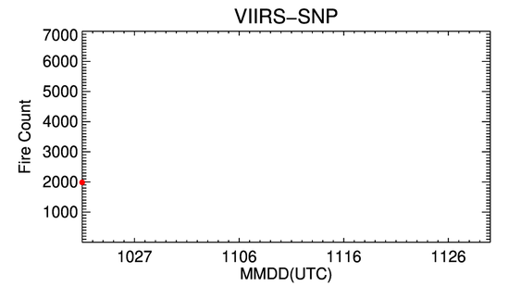
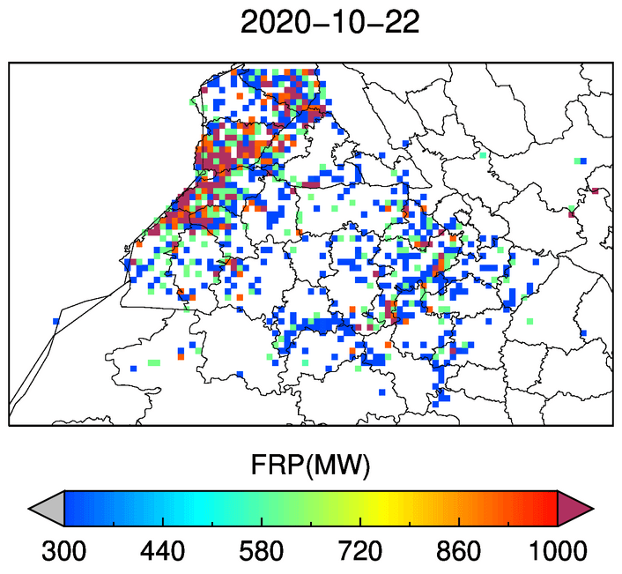
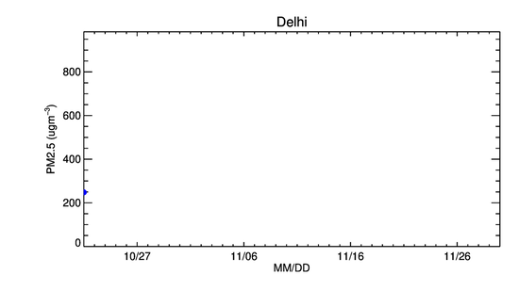
Northern India 2020 Agricultural Burning Season
Number of fire incidents in four states in Northern India
Fire Intensity (FRP)
Surface Air Quality Downwind of Fires in New Delhi
Supported by NASA ROSES program: The Science of Terra, Aqua, and Suomi NPP
Notes:
Here is an example of agriculture burning in northern India.
As we know, rise residuals burning occurs every years in northern India during post monsoon season.
The the map shows the daily fire radiative power from fire detected by VIIRS on SNPP during late oct and nov 2020.
The top panel shows daily number of fire incident detected by VIIRS in four states of India and bottom panel shows the surface PM2.5 downwind of fires in New Delhi during the same period. It is apparent that air quality conditions in Delhi and other parts of the country get affected by smoke transport from these fires. Highest fire count coincident with high PM2.5 concentration but there other factors which also play a role.

Slide 5
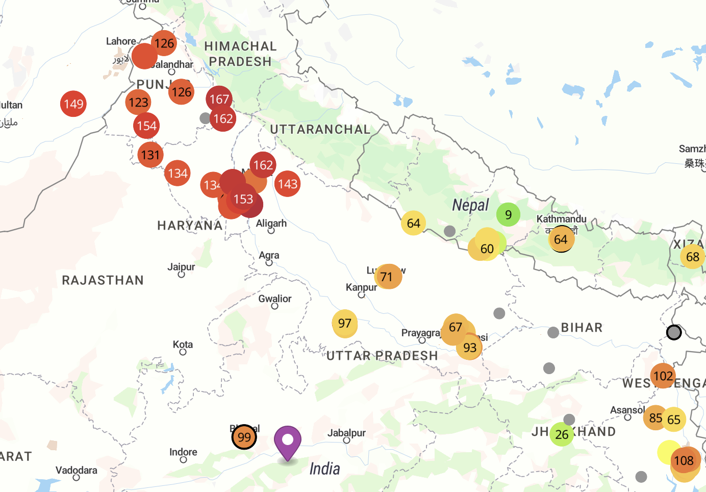
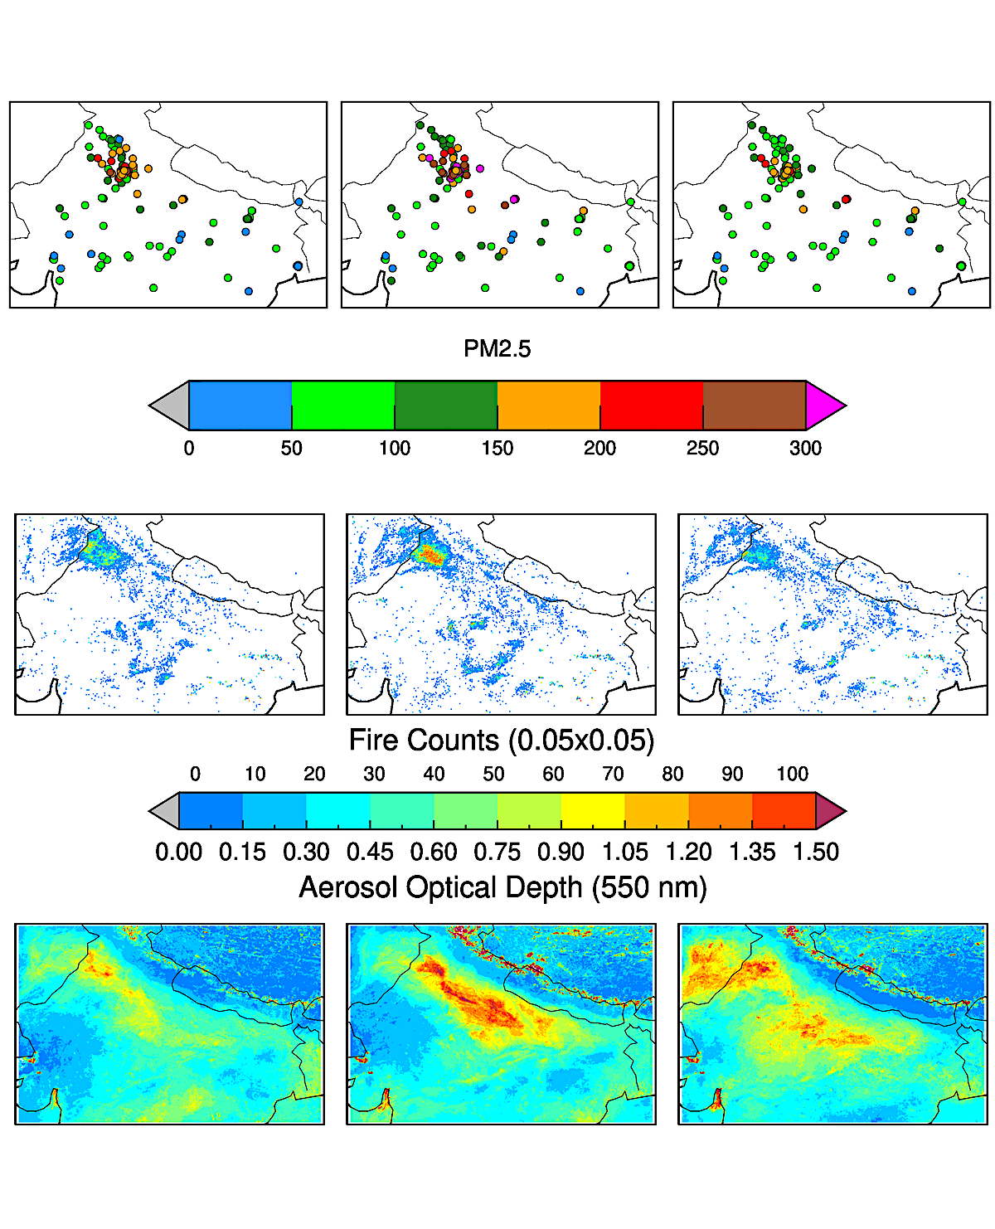
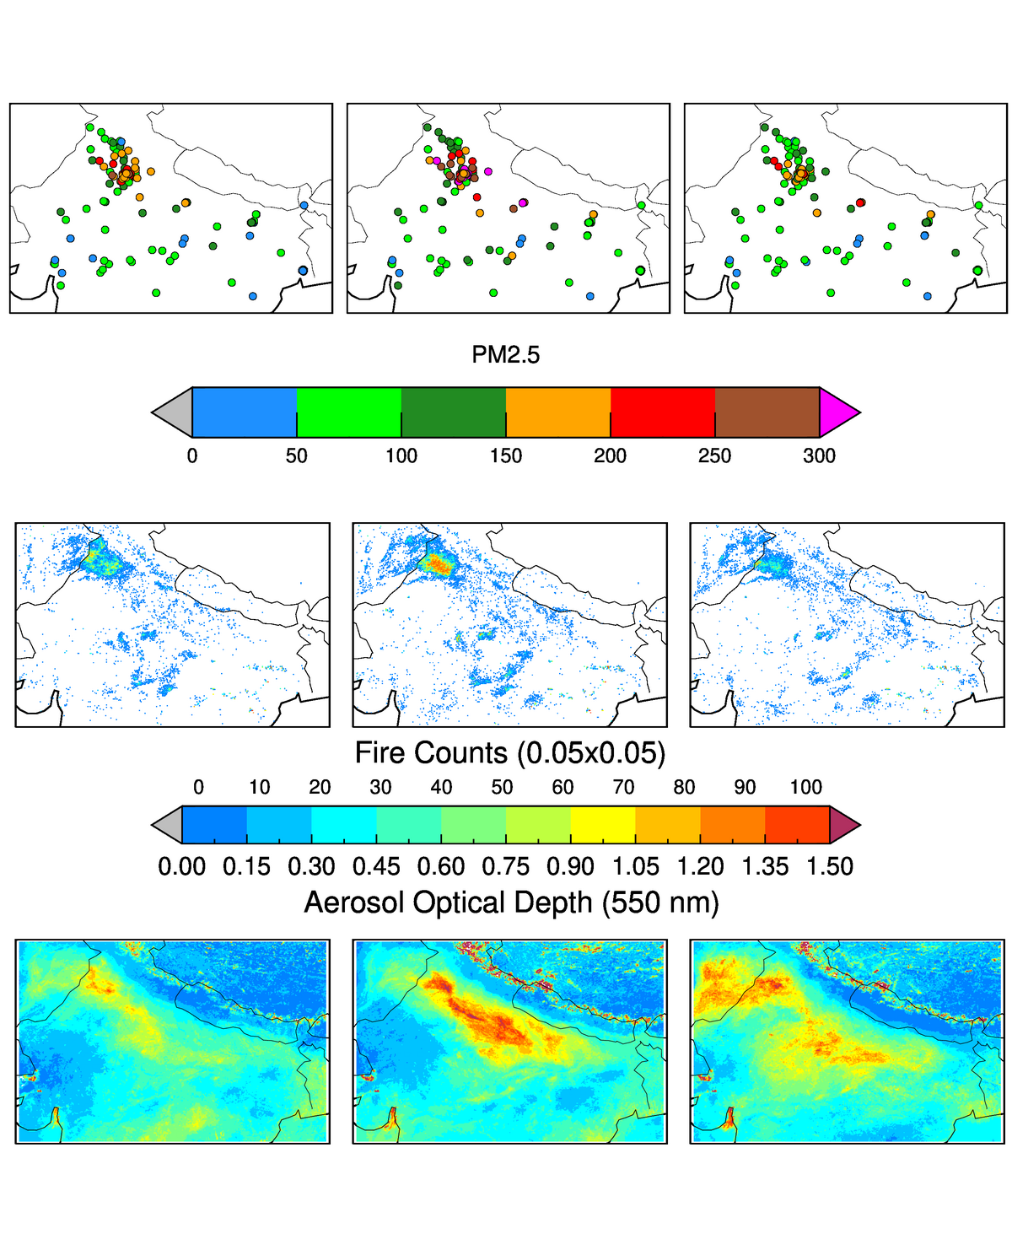
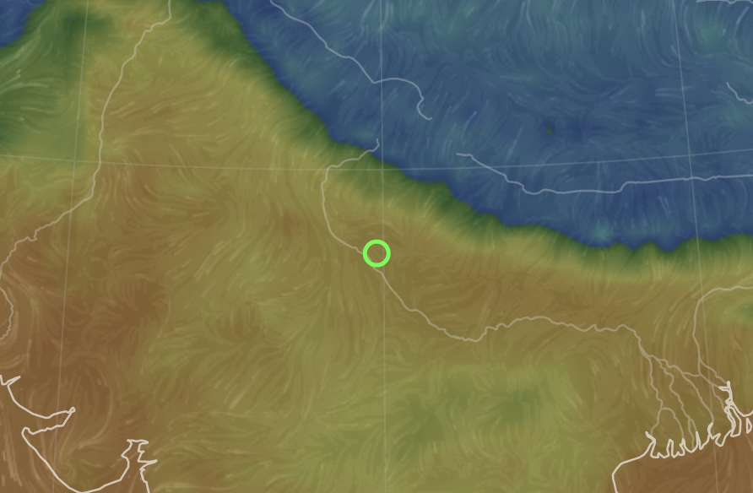
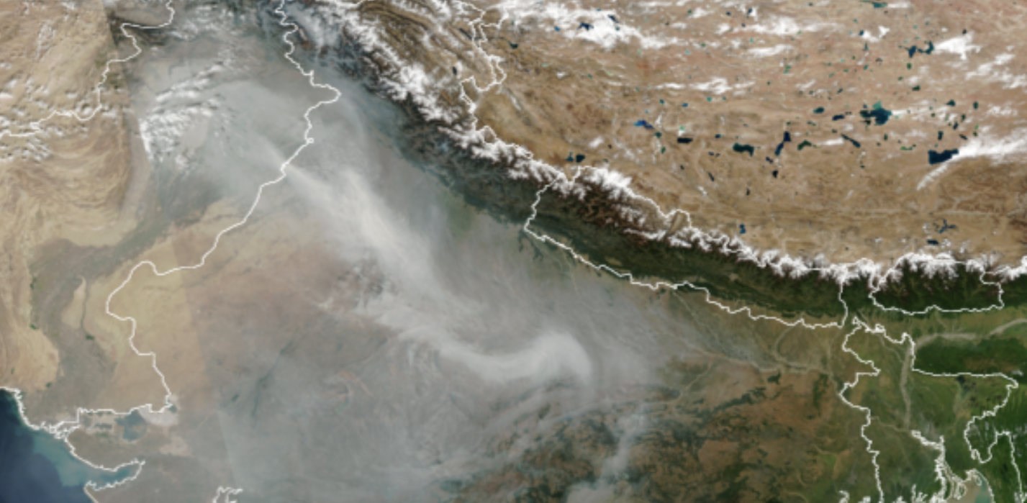
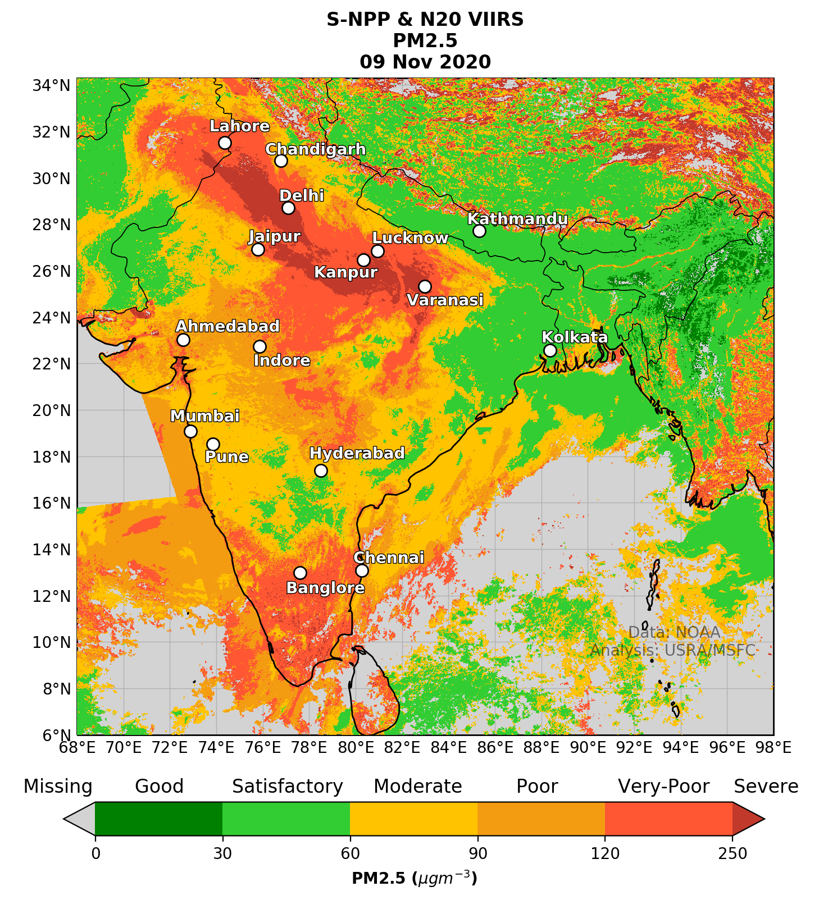
Northern India 2020 Agricultural Burning Season
ML
Surface
Fires
Aerosols
Weather
VIIRS-SNPP
Daily PM2.5 (µgm⁻³)
November 9, 2020
https://www.firesandaq2020.info/
Supported by NASA ROSES program: The Science of Terra, Aqua, and Suomi NPP. VIIRS NRT data provided by NOAA
Notes:
Past year, we organized a weekly community forum to provide near real time analysis of fires and air quality using satellite observations. The analysis and processed data are provided through a web portal.
For this effort, we designed a simple ML model to generate daily PM2.5 maps while combining fires and aerosols data from two VIIRSs sensors. We also used GEOS forecasted meteorological fields and surface measurements from reg as well as low-cost sensors to train our models.
In this example, RGB from Nov 9th is shown and corresponding daily mean PM2.5 is mapped for that day. The resulting maps does capture spatial patterns as seen by RGB. Due to small nature of these fires and relatively calm weather conditions during this time of the year, most smoke from these fires are expected to stay within boundary layer.

Slide 6
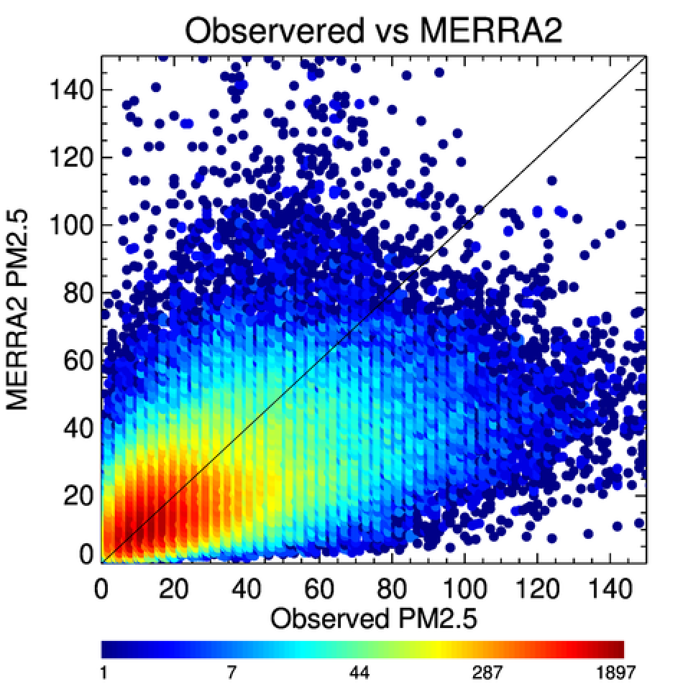
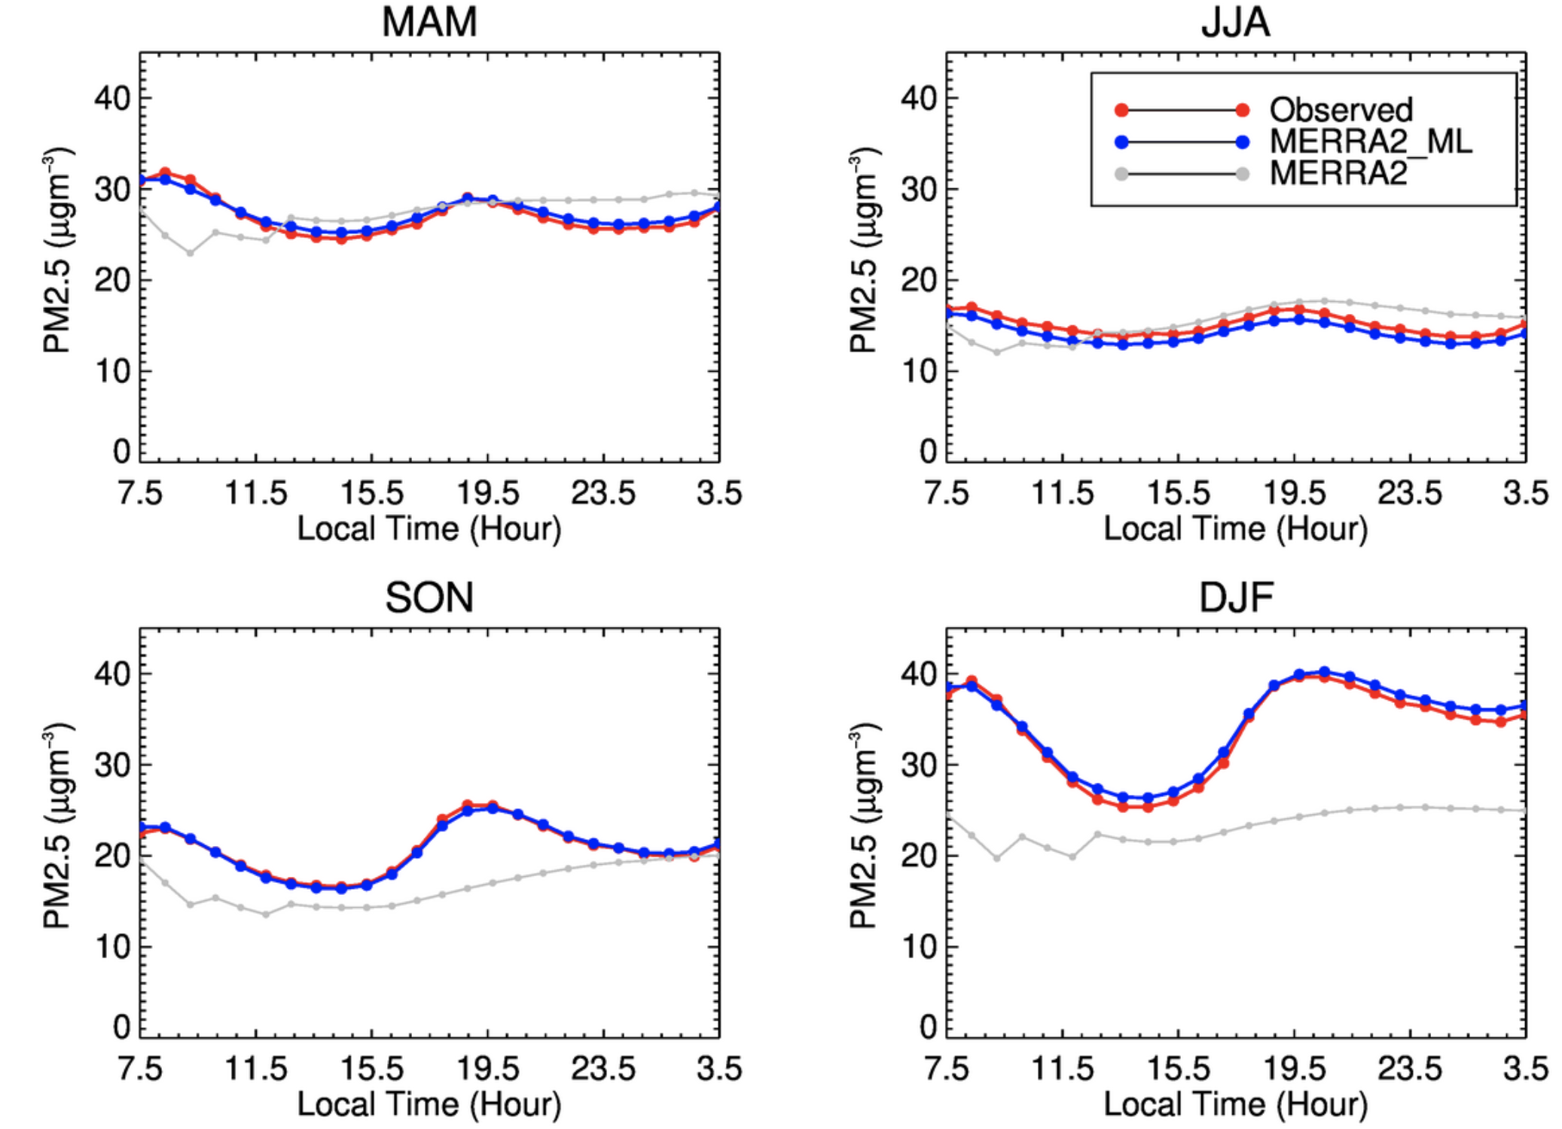
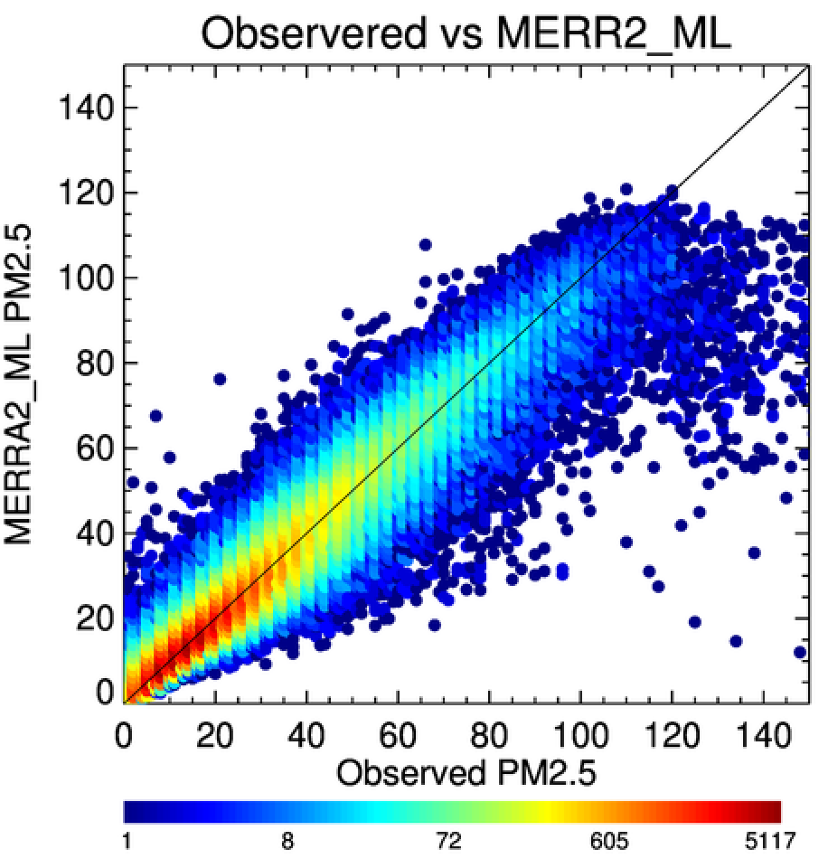
MERRA2 + Machine Learning – Thailand Air Quality
Without ML Correction
R=0.53
Slope=0.38
RMSE=16.7
Ensembled ML Model
Ground Data
Model Outputs
Seasonal Mean Diurnal Cycle
N=266094
With ML Correction
R=0.95
Slope=0.95
RMSE=5.90
Gupta et al., 2021, under review
Supported by NASA ROSES program: The Science of Terra, Aqua, and Suomi NPP and NASA SERVIR
Notes:
- In another example of estimating hourly PM2.5 in Thailand.
- Here we used machine learning models to bias derive PM2.5 using MERRA2 reanalysis data sets. We used ground PM2.5 from over 50 stations in Thailand to train the model.
The top panel scatter plot shows the inter-comparison of MERRA2 PM2.5 estimated using aerosols components provided in MERRA2 data.
The bottom scatter plot shows the comparison of ML model using inputs of meteorology and aerosols from MERRA2.
As apparent from the statistics, ML model provide excellent correlation and slope close to 1. There are underestimations at higher concentration, which is typical of any statistical model limited by data distribution.
We also looked diurnal cycle and found that ML derived PM2.5 captures seasonal mean diurnal cycle very well as compared to raw merra2 data.

Slide 7
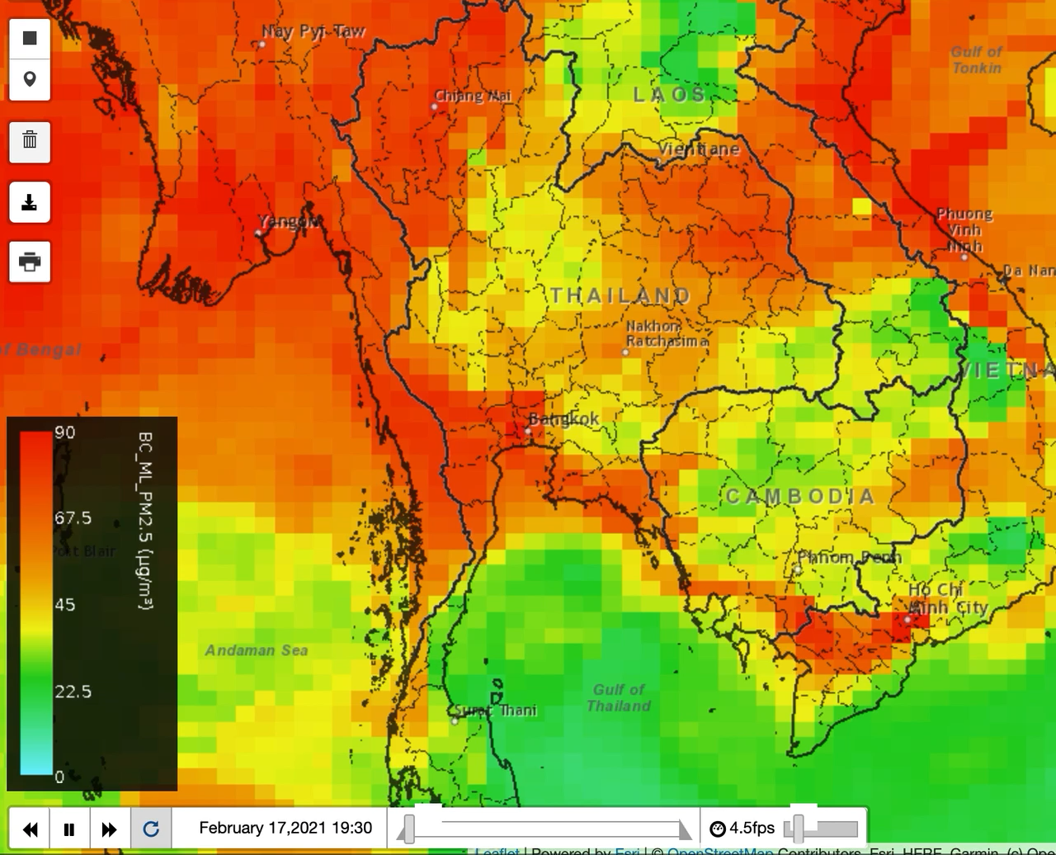
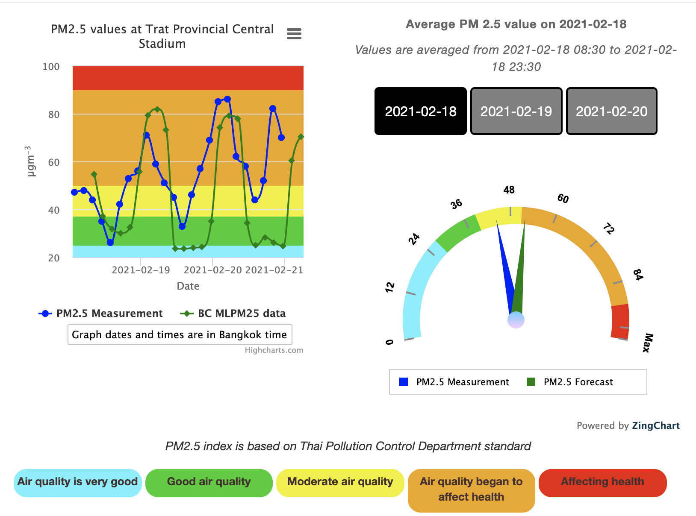
Air Quality Explorer
https://tethys.servirglobal.net/apps/mkaqx/
Forecast is initiated on Feb 18th
https://aqatmekong-servir.adpc.net/en/
Real-time Validation with Ground Measurement
GEOS + ML PM2.5 (µgm⁻³)
Supported by NASA ROSES program: The Science of Terra, Aqua, and Suomi NPP and NASA SERVIR. Adopted by Thai Pollution Control Dept.
Notes:
This method is finally applied on GEOS forecasted fields to provide 3 hourly PM2.5 forecasts for Thailand and implemented into web applications with real-time validation capabilities and currently adopted by Thai Pollution control department. This work is done in partnership with NASA SERVIR program.

Slide 8
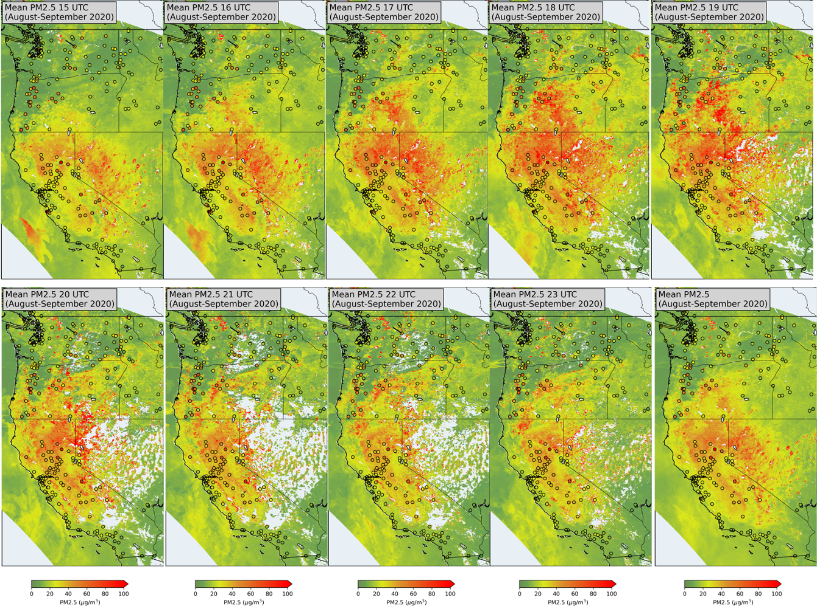
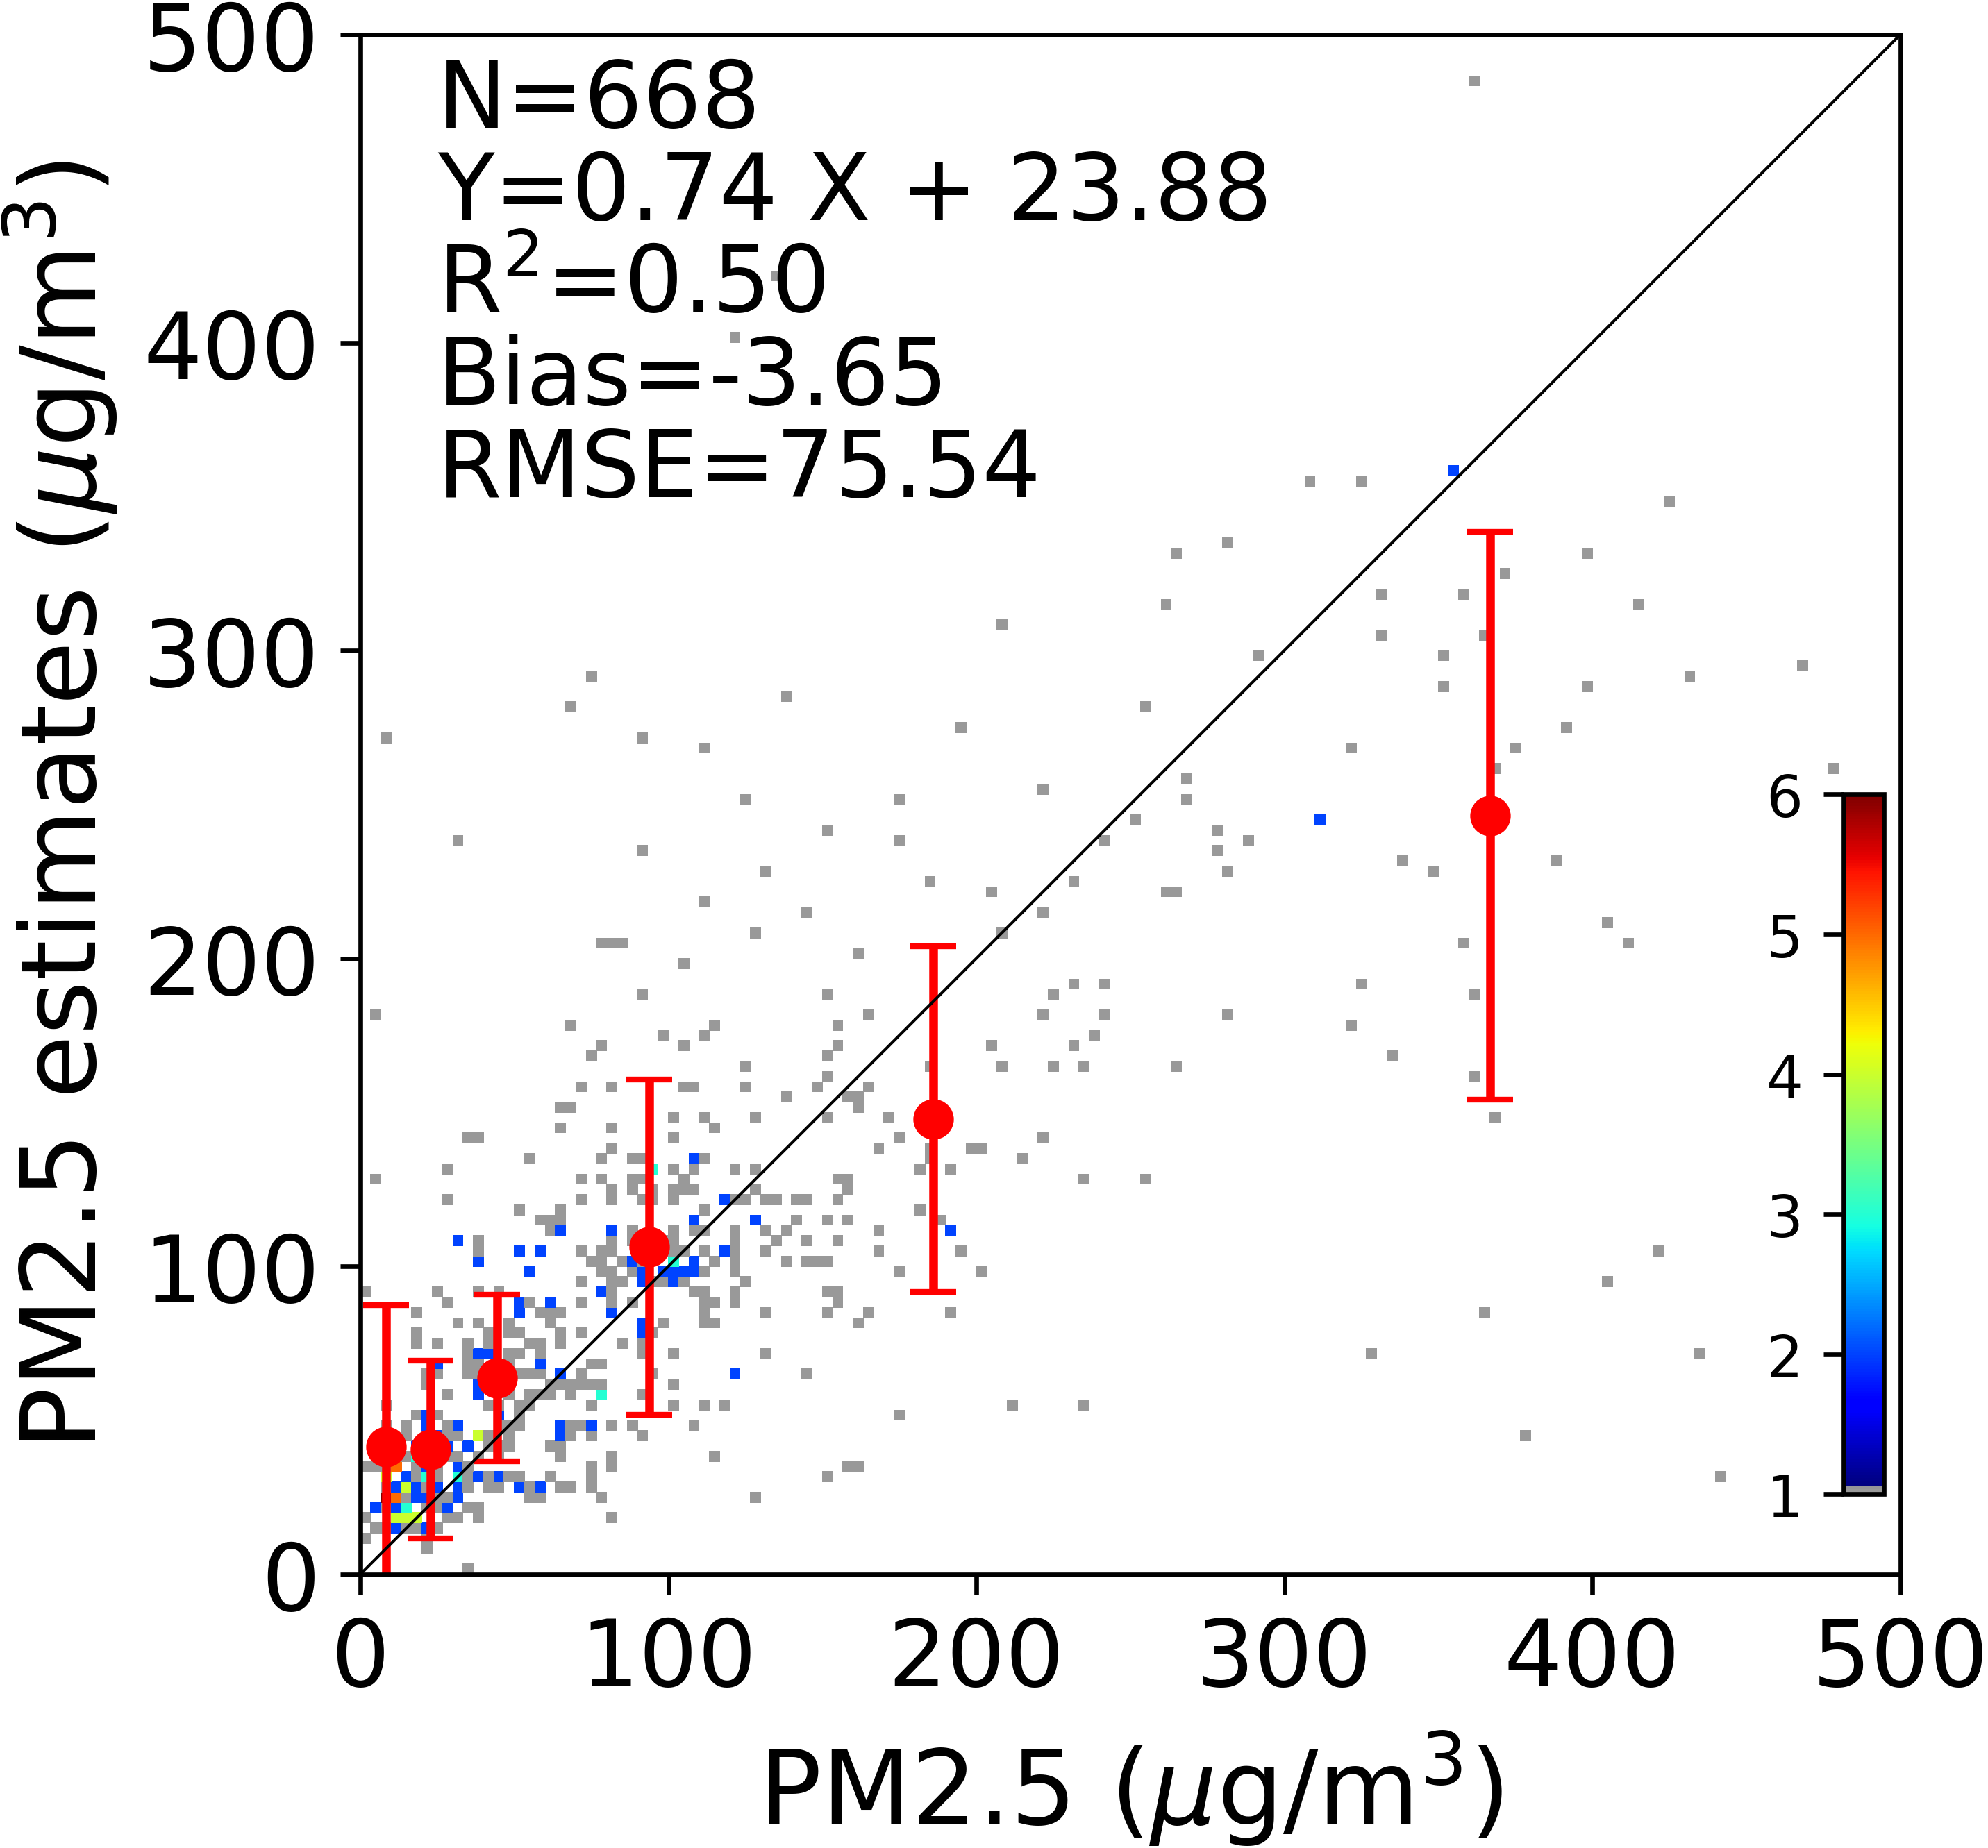
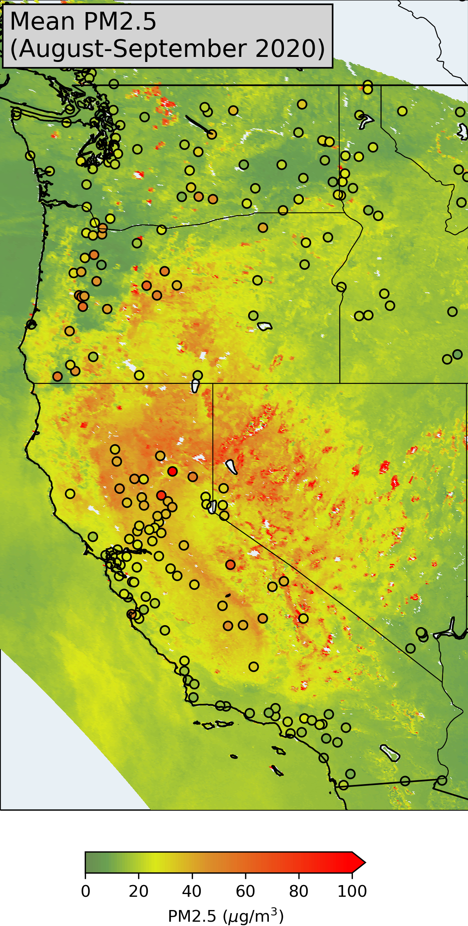
GOES-R Near Real-Time PM2.5 – Towards hourly mapping
NOAA GWR algorithm: Zhang, H., & Kondragunta, S. (2021). Daily and hourly surface PM2.5 estimation from satellite AOD. Earth and Space Science, 8, e2020EA001599. https://doi.org/10.1029/2020EA001599
Slide courtesy: Shobha Kondragunta
Notes:
- In another example, NOAA team is using GOES-R and VIIRS to generate hourly and daily PM2.5 data over CONUS using GWR models
– This sequence of images shows GOES-R derived hourly PM2.5 maps during fire season in 2020. And the last map shows daily mean map.
The validation of this data sets for about 10 days in July 2020 is shows with mixed results. But, seeing these kind of estimates in near real time is exciting and estimation accuracies are expected to improve in time.

Slide 9
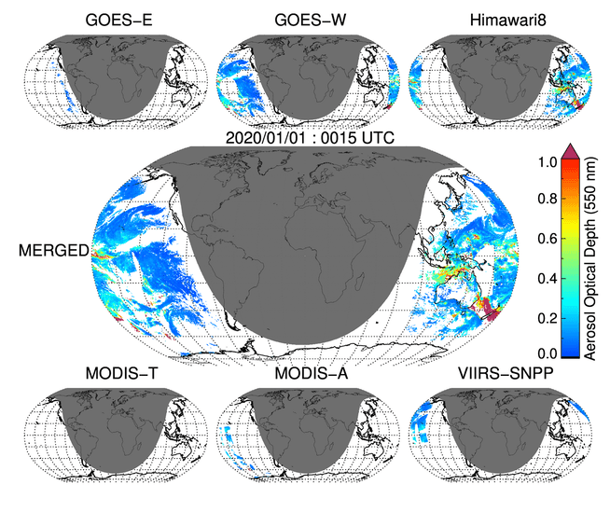
Breaking Temporal Barrier: Synergy of LEO & GEO
Looking into the future
  In this project (NASA MEaSUREs, PI – Robert Levy) dark target aerosol algorithm is implemented on six LEO and GEO sensors globally over both land and ocean. The retrieved aerosol properties are produced from all the six sensors as level 2 data products. The individual aerosol retrievals from each sensors then fused to produce a level 3 gridded data sets at 30 minutes temporal resolution for the sunlit part of the earth.
Product like this (and many others) is an opportunity and challenge to develop new algorithms to break the temporal barrier in monitoring surface air quality
30 minutes loop Jan 1 to Jan 5, 2020
Notes:
And this is the last slide.
Finally with the launch of Himawari and GOES-R series, we started breaking the temporal barrier in monitoring surface air quality.
So, what can we expect in the future in term of aerosol data availability from space for surface air quality applications
Here is an example where under NASA MEASURES project, we are running MODIS dark target aerosol retrieval consistently on three LEO and three GEO sensors and using combining the data into consistent gridded format in 30 minute interval globally. Aerosols product like this and many others provide an excellent opportunity and challenge to develop new algorithm for operational global PM2.5 data sets.

