Slide 1

Space-based Perspective on the Effects of COVID-19 Lockdowns on Fine Particulate Matter Concentrations
Randall Martin
with contributions from
Liam Bindle, Matthew Cooper, Melanie Hammer, Erin McDuffie, Aaron van Donkelaar
Michael Brauer (UBC), Michael Garay (JPL), Christina Hsu (GSFC), Ralph Kahn (GSFC), Olga Kalashnikova (JPL), Robert Levy (GSFC), Alexei Lyapustin (GSFC), Steve Schwartz (PNNL), Andrew Sayer (GSFC)
CEOS Virtual Seminar
10 June 2021

Slide 2
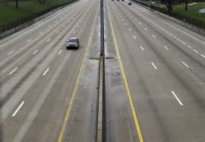


Pronounced Changes in Activity Patterns During COVID-19 Lockdowns
What are the Effects of Lockdowns on PM_{2.5}?

Slide 3
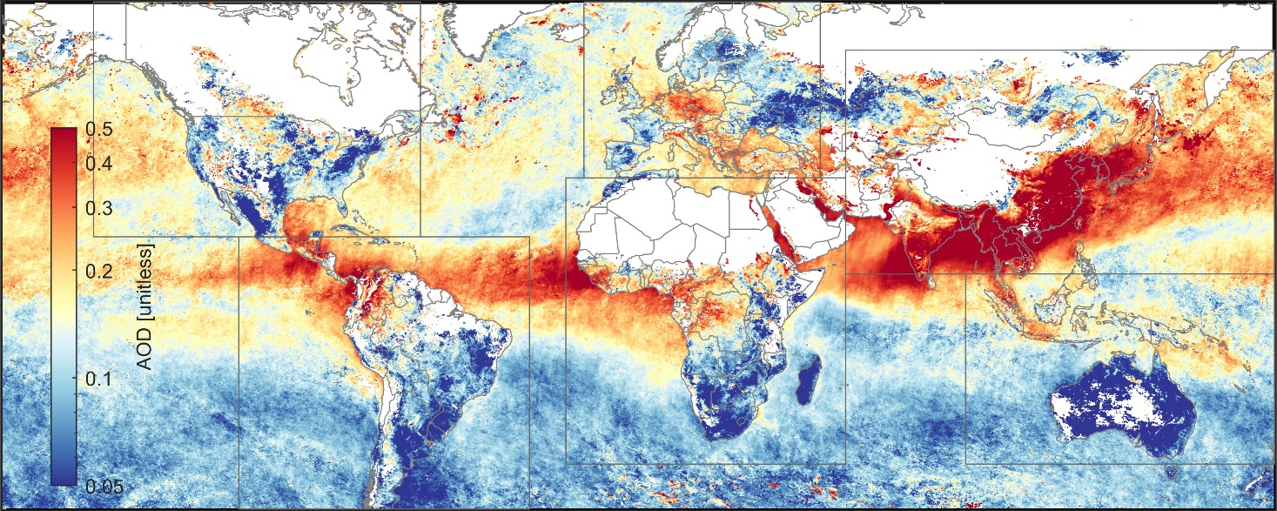
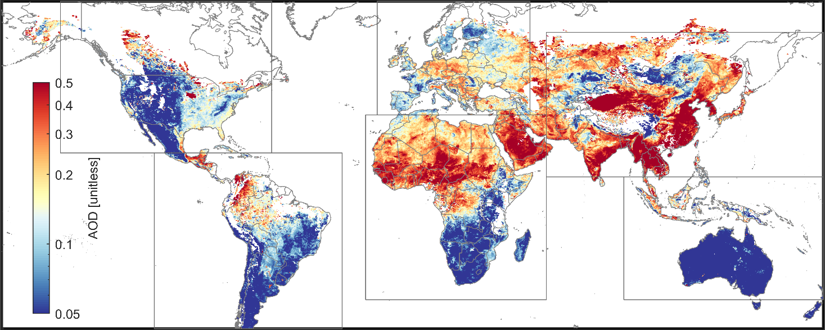
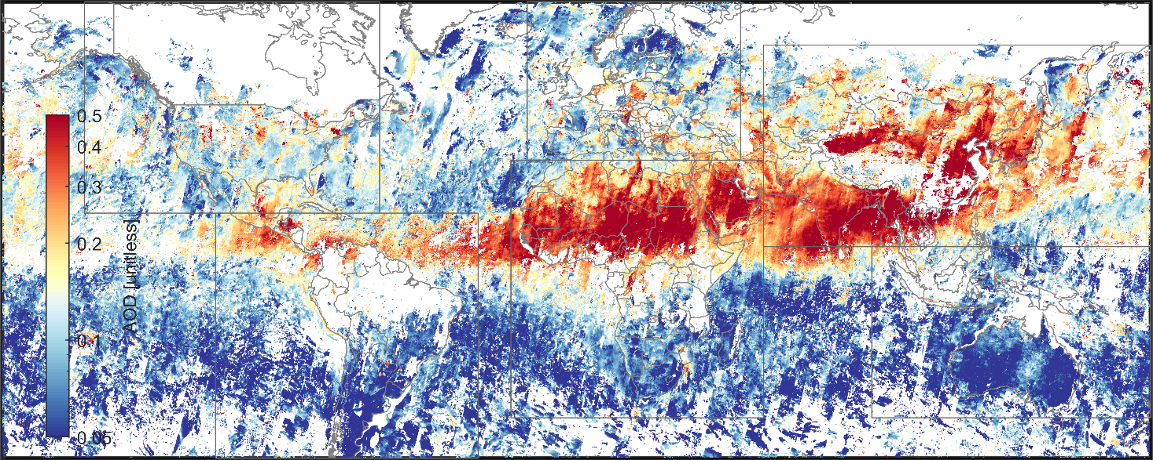
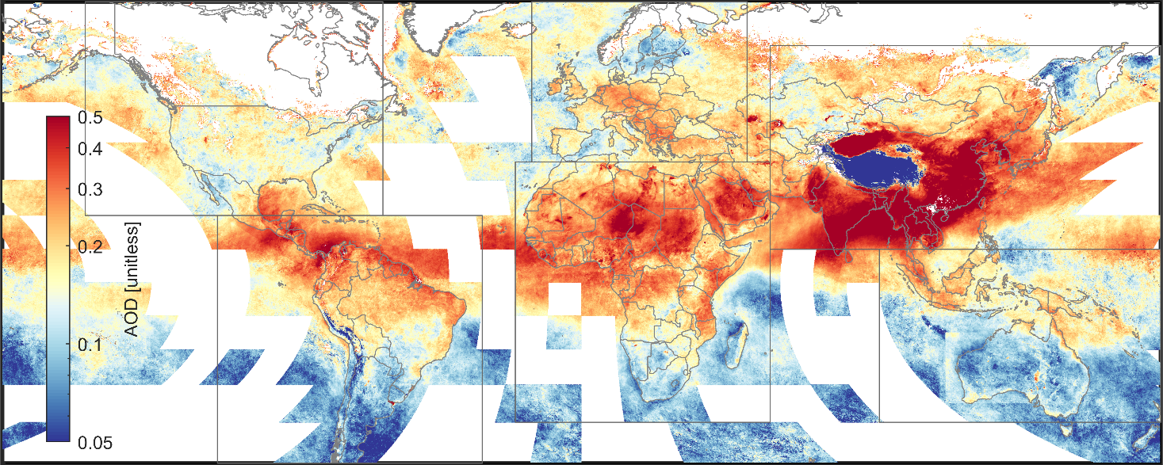
Different AOD Datasets Have Different Strengths
Differences result from instrumentation, methodology and sampling
Dark Target
Deep Blue
MISR
MAIAC
Mean AOD for April 2014

Slide 4

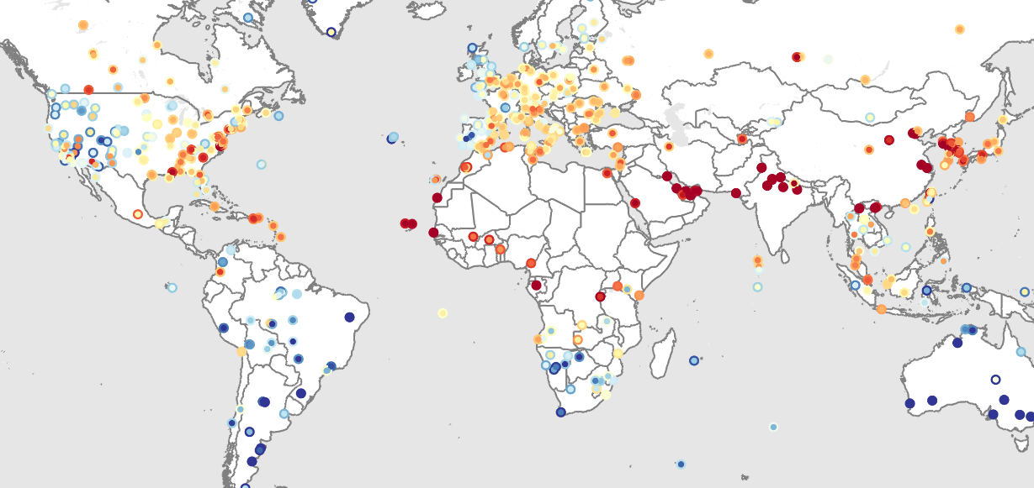
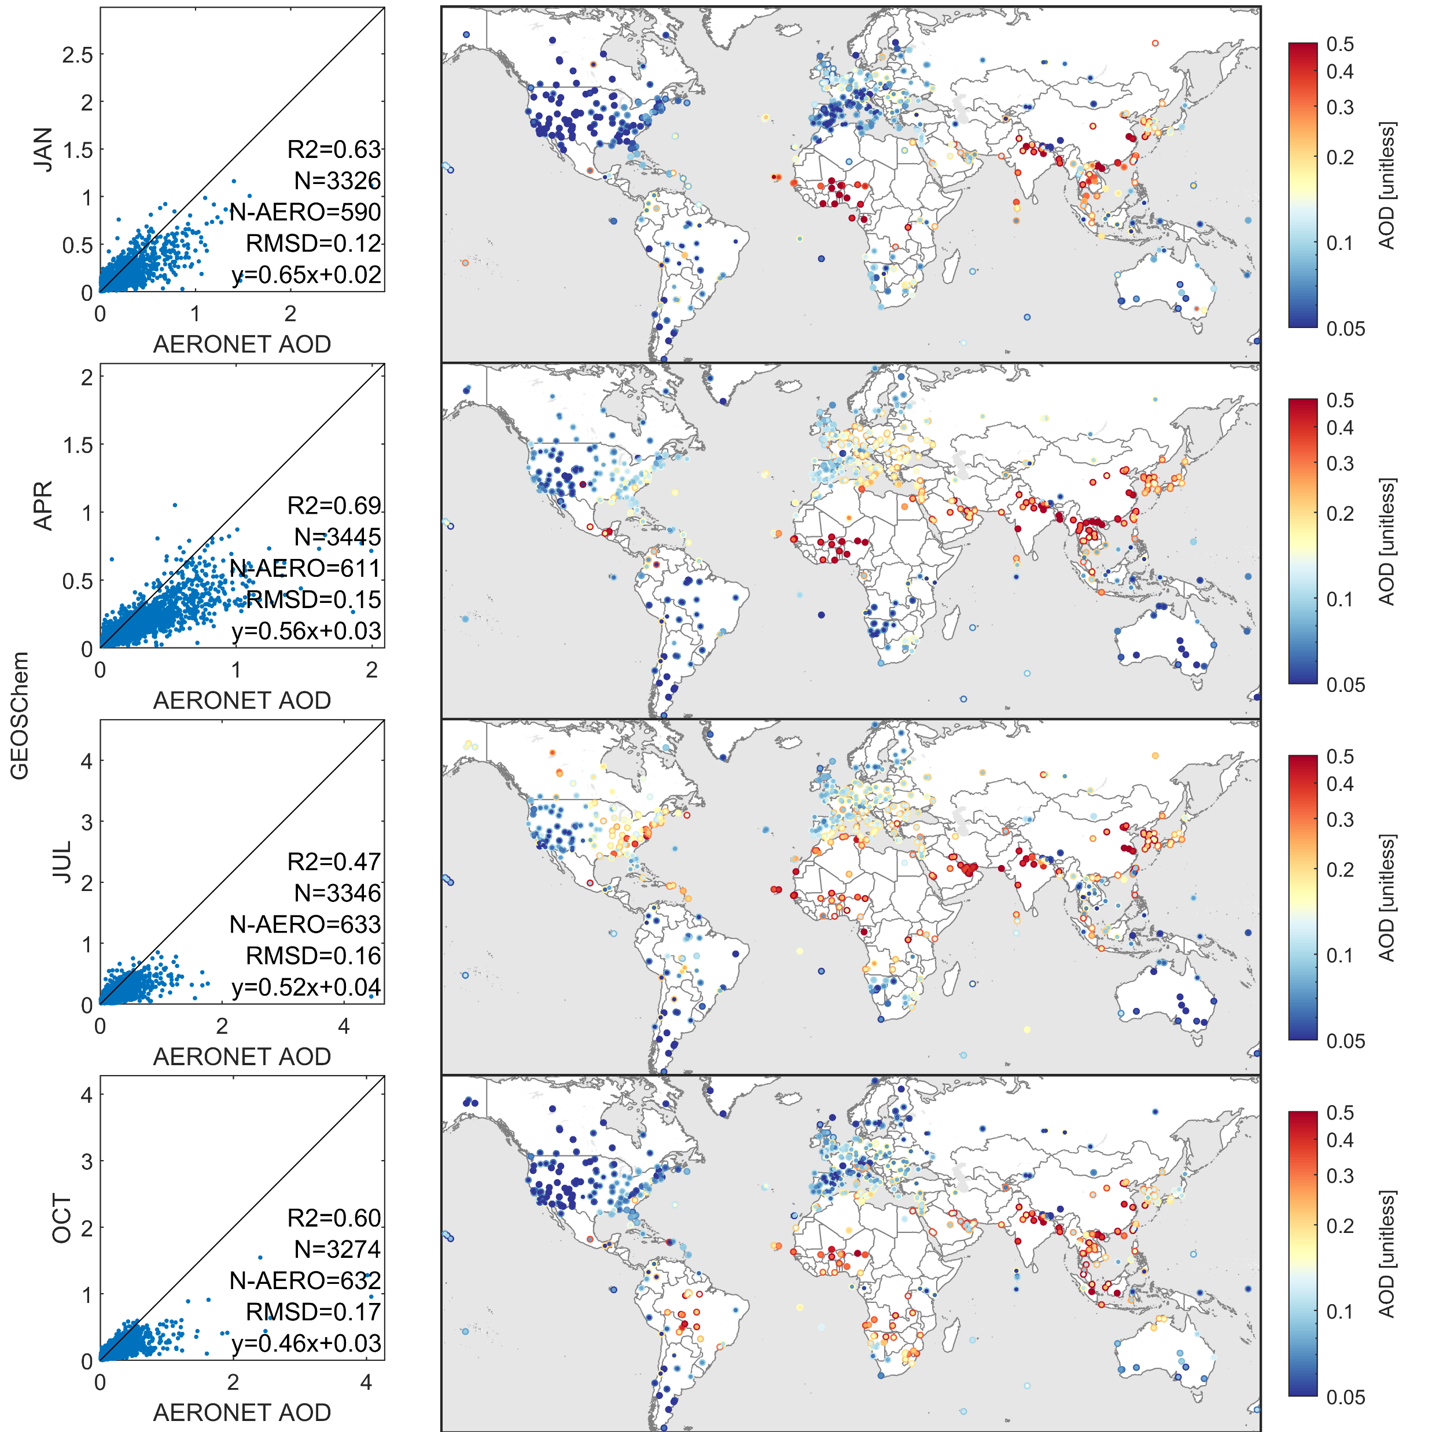
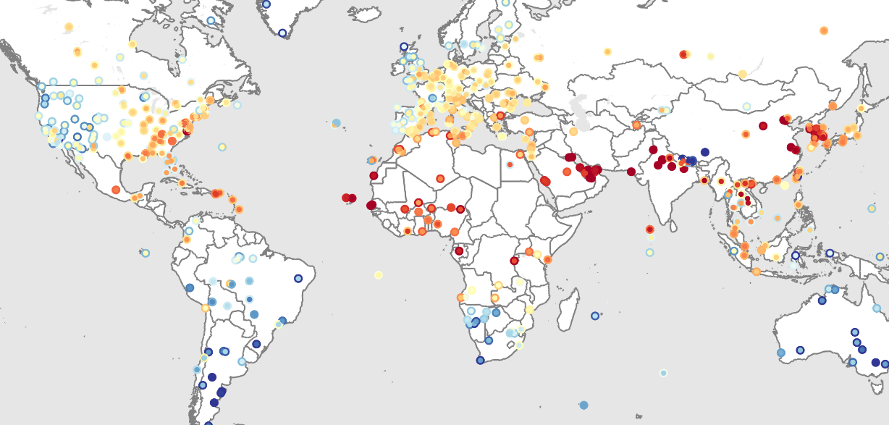
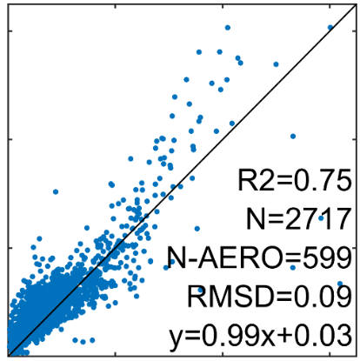
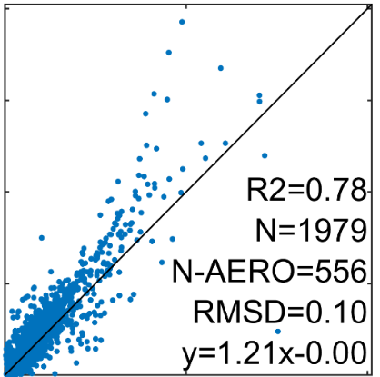
Apply AERONET for Consistent AOD Evaluation
Global network of sun photometers
> 25 years of data
High accuracy (AOD within ±0.01)
Standard data source for AOD validation
0.5
0.4
0.3
0.2
0.1
0.05
AOD [unitless]
Dark Target
July
0.5
0.4
0.3
0.2
0.1
0.05
2.0
1.5
1.0
0.5
0
1.5
1.0
0.5
0
MAIAC (MODIS Terra)
vs.
AOD [unitless]
Dark Target (MODIS Terra)
Satellite AOD
0 0.5 1.0 1.5
0 1.0
July
AERONET
MAIAC
AERONET
AERONET
van Donkelaar et al. 2016; Hammer et al., 2020

Slide 5
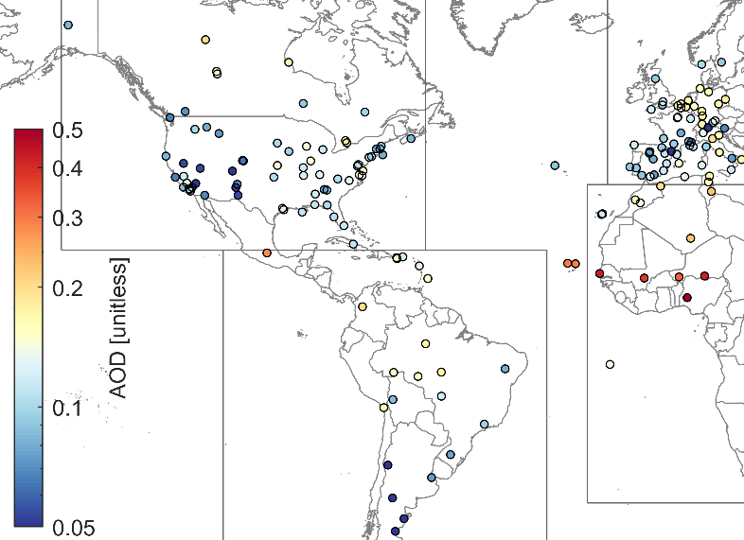
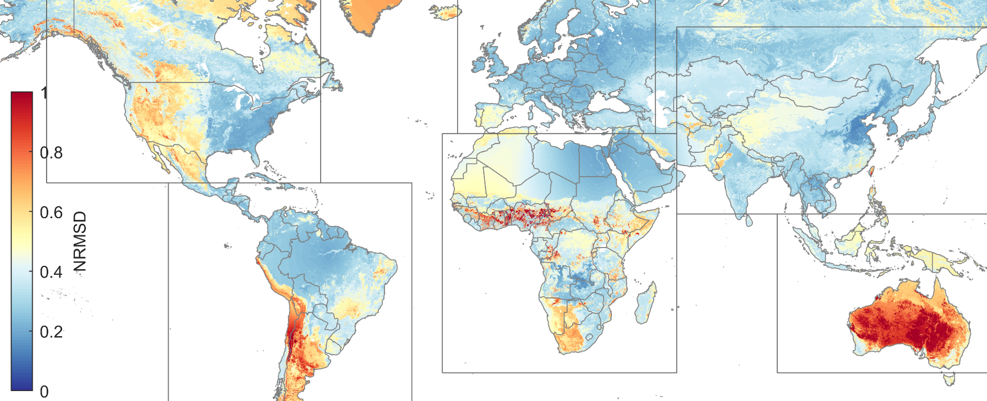
Leverage Surface Reflectance for Insight into Uncertainty at Unmonitored Locations
For any location on earth, which points are relevant?
2.0
1.5
1.0
0.5
0
Surface reflectance is a major uncertainty source for remote sensing
?
Dark Target (MODIS Terra)
→ Separate AERONET comparisons by:
    Land Type (>50% per classification)
    Normalized Difference Vegetation Index
0 1.0 2.0
AERONET
Weight AERONET-Satellite AOD subset comparisons using:
  Land type
  Distance
  Season
Specifically,
W_{GWR} = LandTypePercent × Distance⁻² × Temporal Distance⁻²
Dark Target
July 2005
Number of months between the month of interest and observed month
van Donkelaar et al. 2016; Hammer et al., 2020

Slide 6
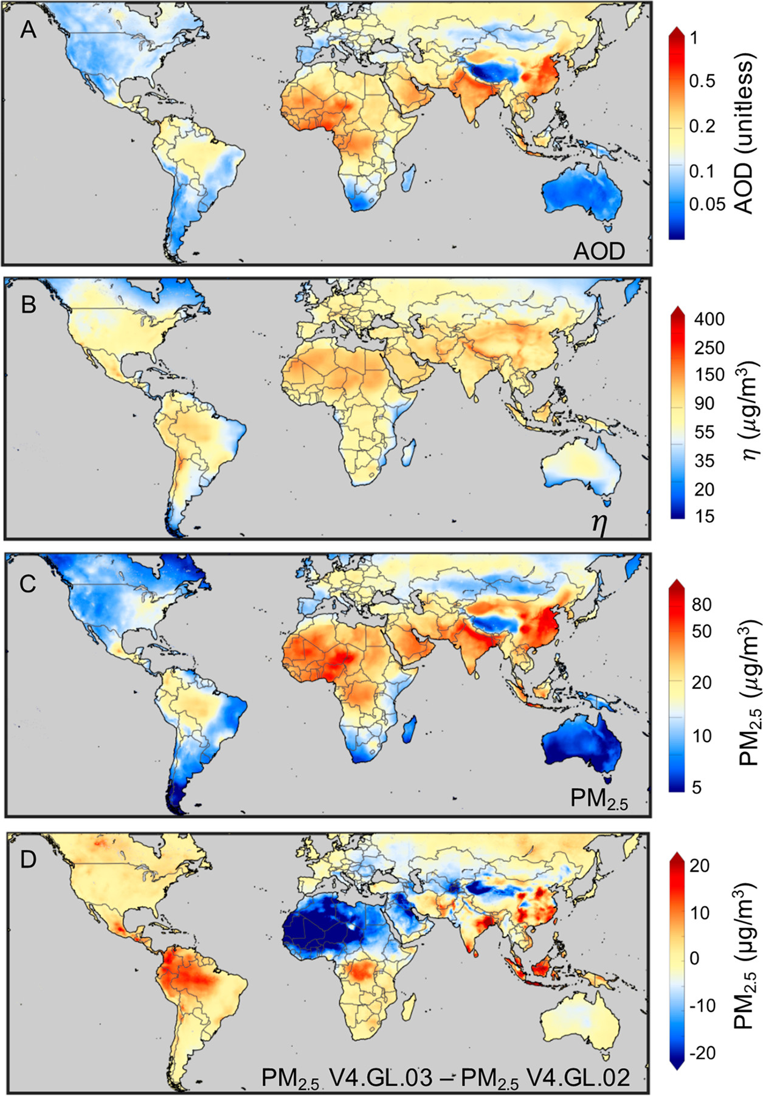

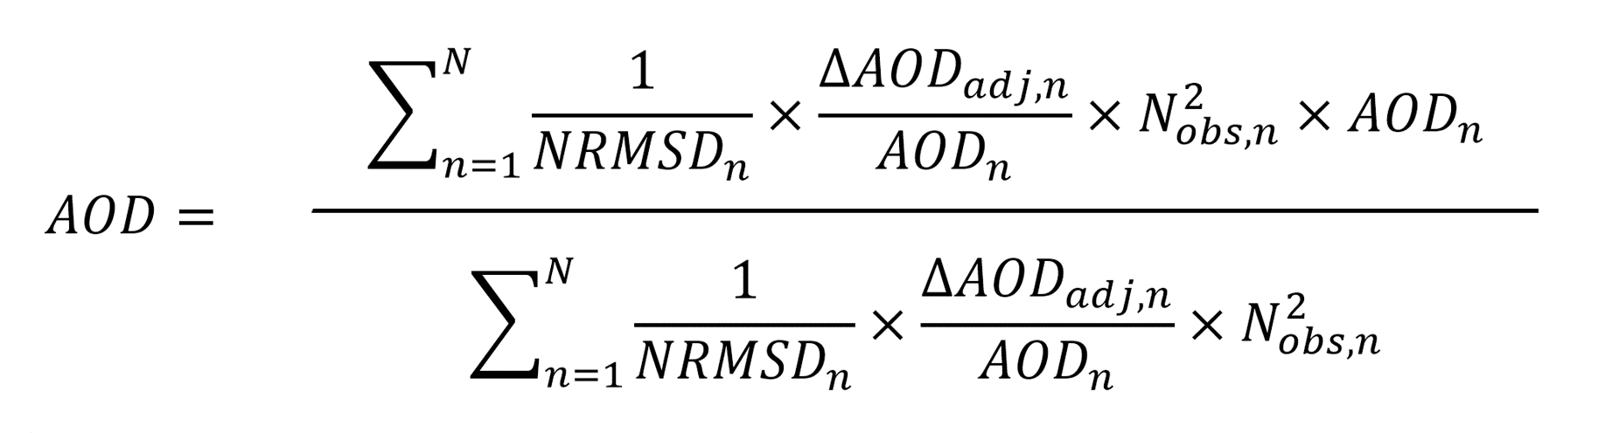
Generation of Monthly Ensemble AOD Datasets
Dark Target (MODIS Terra & Aqua)
Deep Blue (MODIS Terra & Aqua)
MAIAC (MODIS Terra & Aqua)
MISR (Terra)
GEOS-Chem simulation
AOD
Combined AOD
Combine all AOD sources weighted by NRMSD⁻¹, bias correction⁻¹, data density:
-1
-1
For Feb-Apr 2018-2020, satellite observations comprise 89% of population-weighted AOD
Hammer et al., ES&T, 2020; Sci Adv in press

Slide 7
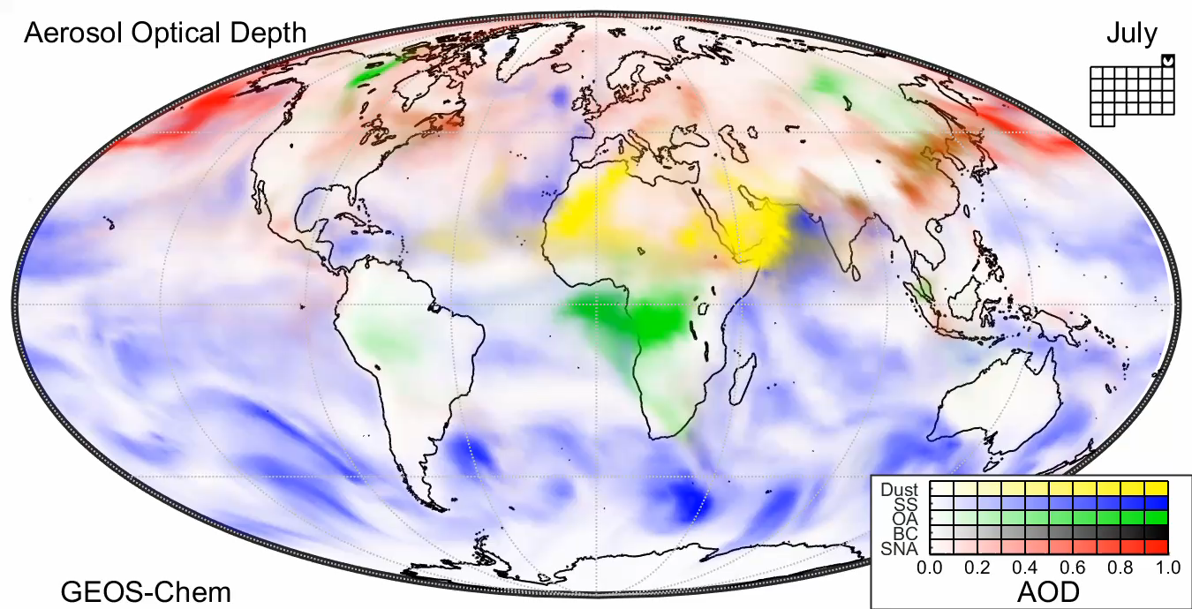

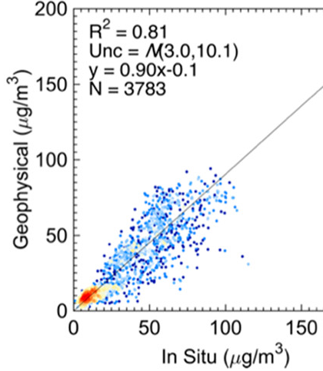
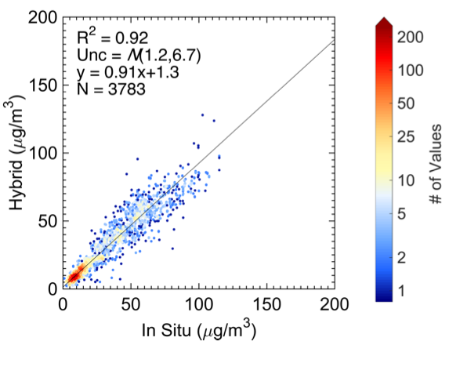
Apply Chemical Transport Model (GEOS-Chem) to Calculate Solution to PM_{2.5} = f(x,y,t,AOD)
Simulate suite of processes relating AOD&PM_{2.5}: e.g. aerosol vertical profile, mass scattering efficiency, hygroscopicity, relative humidity, chemical composition, diurnal variation, irregular sampling
Detailed aerosol-oxidant model
50-100 tracers, 100’s reactions
Assimilated meteorology
Geophysical
+Statistical (Hybrid)
R²=0.81
R²=0.92
PM_{2.5} = f(x,y,t)·AOD
vertical structure
aerosol type
meteorology
diurnal effects
Out-of-sample
cross-validation (10-fold 10%)
f(x,y,t)
2015
Statistical Fusion with Ground-Based Monitors Explains 11% of Variance
Hammer et al., ES&T, 2020

Slide 8
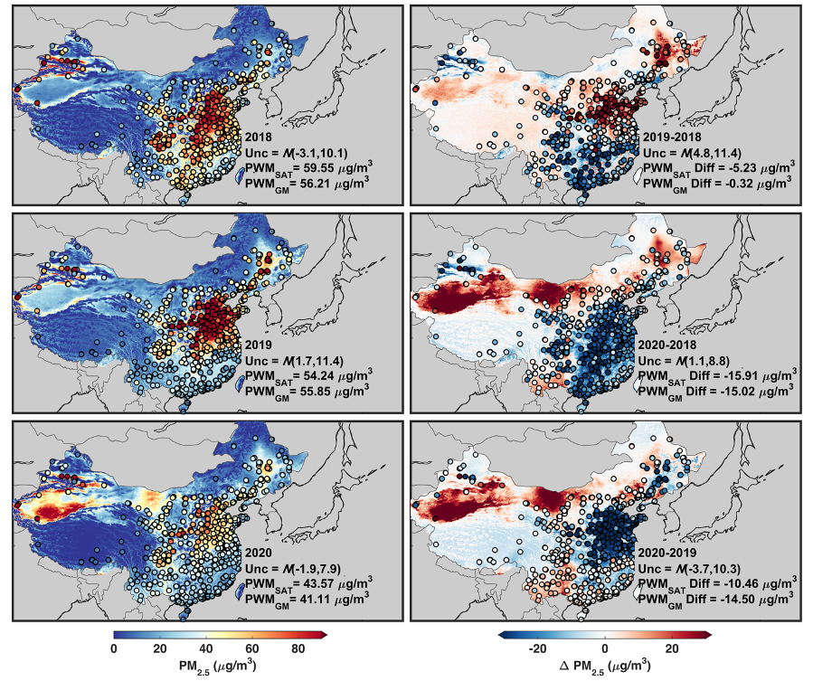
Some Evidence of Unusual PM_{2.5} Reduction in Eastern China
Data for February
Filled circles indicate in situ obs
Background satellite-derived PM_{2.5}
Hammer et al., Science Advances, in press

Slide 9
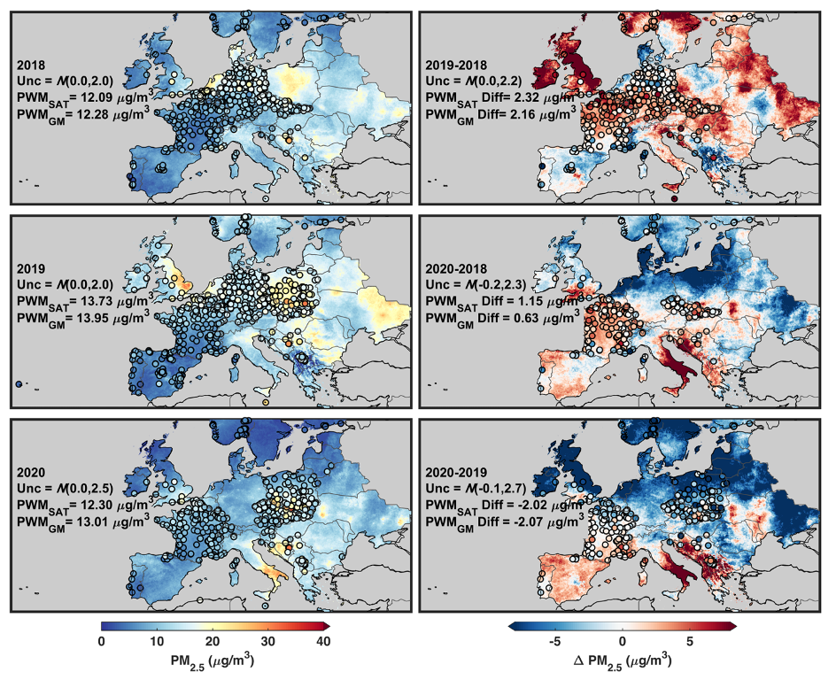
Reductions in PM_{2.5} During Lockdowns Less Clear
Data for April
Filled circles indicate in situ obs
Background satellite-derived PM_{2.5}
Hammer et al., Science Advances, in press

Slide 10
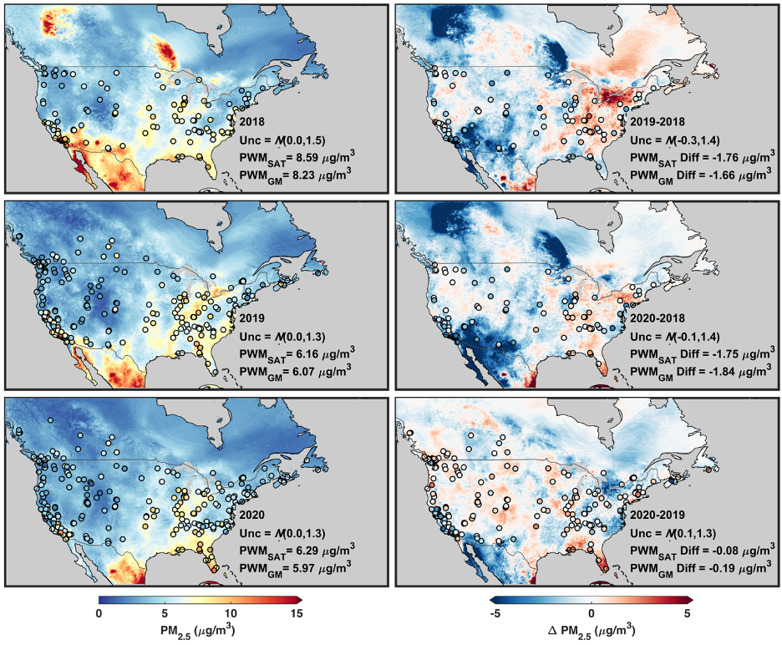
Reductions in PM_{2.5} During Lockdowns Less Clear
Data for April
Filled circles indicate in situ obs
Background satellite-derived PM_{2.5}
Hammer et al., Science Advances, in press

Slide 11
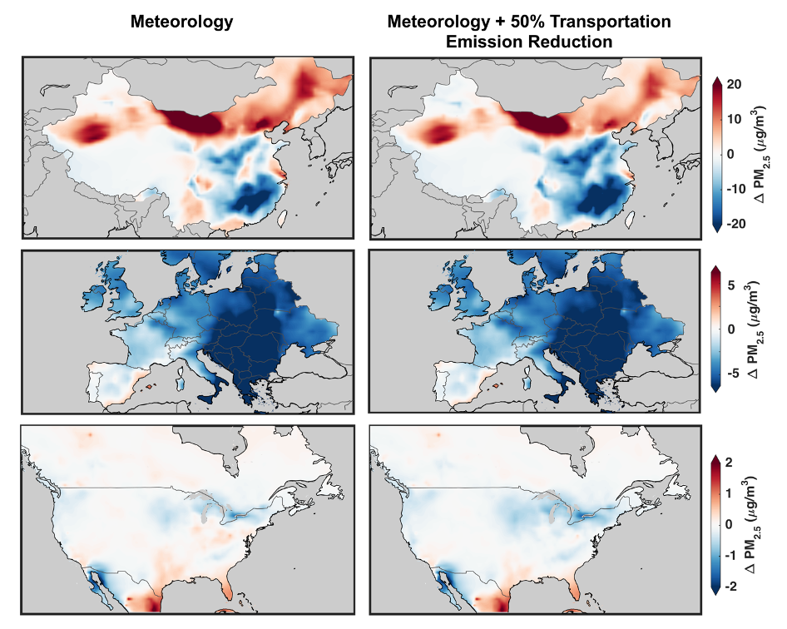
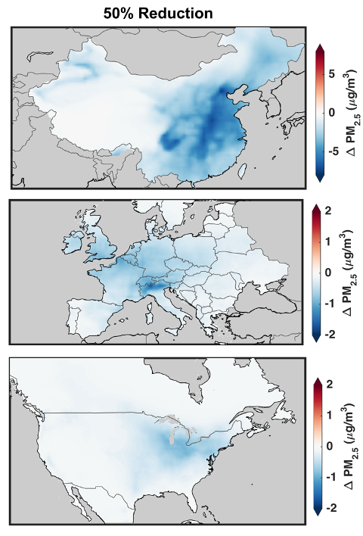
Meteorology is Primary Driver of Interannual Variation
Transportation Emissions Have Additional Contribution
GEOS-Chem Calculation of Sensitivity to Meteorology (2020-2019) & Transportation
50% Transportation Reduction
February
Reductions in NO_{x} Emissions Have Competing Effects of Reductions in Nitrate and Increases in Sulfate
April
April
Hammer et al., Science Advances, in press

Slide 12
Reinforces Conclusions About the Many Sources of PM_{2.5}
High Coal Fraction
High Biofuel Fraction
High Crustal Fraction
High Biofuel Fraction
McDuffie et al., Nature Comm., in press

Slide 13
Conclusions
Satellite observations of AOD offer timely information about the response of PM_{2.5} to rapid changes such as COVID lockdowns
Increasing consistency of global satellite-derived PM_{2.5} concentrations with ground-based measurements
Offers insight into effects of activity patterns on PM_{2.5}
Strong contributions of meteorology upon monthly PM_{2.5} during lockdowns need to be considered

