Slide 1
Monitoring air quality from geostationary satellite:
Perspectives from modeling and ground-based measurements to understand the AOD-PM_{2.5} relationship at sub-daily time scale
Mian Chin | NASA GSFC
Huisheng Bian | UMBC / NASA GSFC
Alex Coy | Cornell University (was at Montgomery Blair High School)
Qian Tan | BAER Inc. / NASA Ames
Tianle Yuan | UMBC / NASA GSFC
Xiaohua Pan | ADNET / NASA GSFC
Hongbin Yu | NASA GSFC
Zhining Tao | USRA / NASA GSFC
Dongchul Kim | USRA / NASA GSFC
Gao Chen | NASA LaRC
Acknowledgement: NASA Earth Science Program support, AERONET and surface PM2.5 network observations

Slide 2
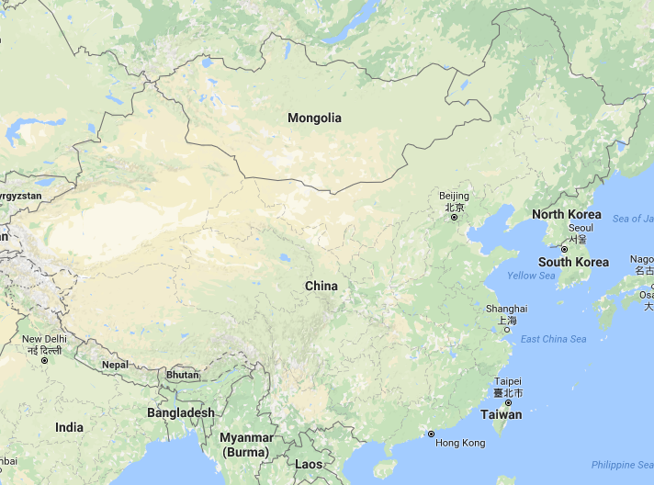
Collocated AOD and PM_{2.5} observations
Column AOD: AERONET, hourly mean during the day
Surface PM_{2.5}: EPA sites over the US, China Enviornmental Monitoring Center over China,hourly mean day and night
Co-location criteria: AOD and PM_{2.5} sites < 4 km apart
Sites are chosen for at least having one-year AOD and PM_{2.5} observations available
Beijing:
AERONET AOD: CAMS
CEMC PM2.5: Guanyuan
(1 km apart)
GSFC:
AERONET AOD: GSFC
EPA PM2.5: PG County
(3.9 km apart)
Fresno:
AERONET AOD: Fresno_2
EPA PM2.5: Fresno
(0.1 km apart)
Houston:
AERONET AOD: U. Houston
EPA PM2.5: Harris County
(2.9 km apart)

Slide 3
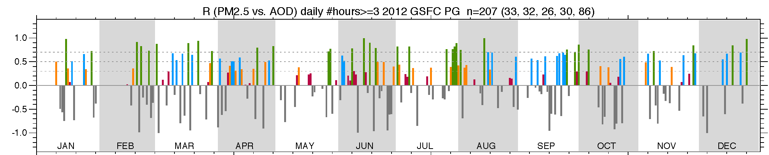
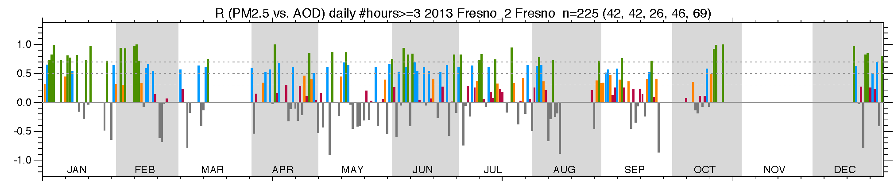
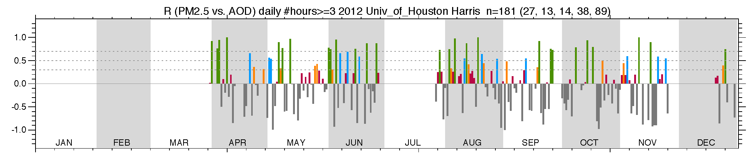
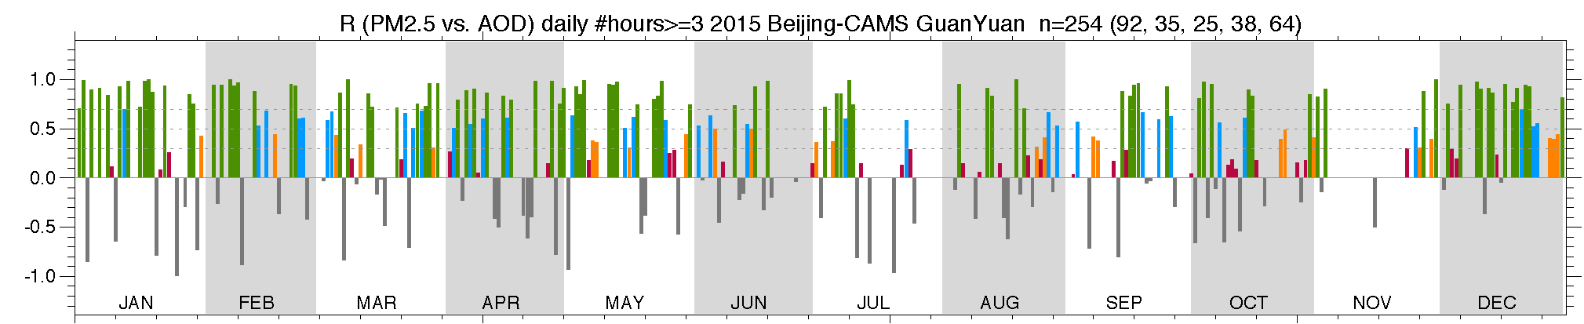
Observations and model simulations show that column AOD and surface PM_{2.5} are poorly correlated on diurnal time scales, meaning that it is not feasible to directly use the geostationary satellite observed AOD for estimating surface PM_{2.5}
GSFC, 2012
GSFC, 2012:
Total available days: 207
16% ( 33): R ≥ 0.7
15% ( 32): 0.5 ≤ R < 0.7
13% ( 26): 0.3 ≤ R < 0.5
14% ( 30): 0.0 ≤ R < 0.3
42% ( 86): R < 0.0
R (AOD-PM2.5)
At the U.S. sites, AOD and PM2.5 are correlated with R ≥ 0.7 only in 15-20% days but are anticorrelated in 30-50% days.
In Beijing, 36% days they are correlated with R ≥ 0.7 and 25% days they are anticorrelated.
Fresno, CA, 2013
Fresno, 2013:
Total available days: 225
19% ( 42): R ≥ 0.7
19% ( 42): 0.5 ≤ R < 0.7
11% ( 26): 0.3 ≤ R < 0.5
20% ( 46): 0.0 ≤ R < 0.3
31% ( 69): R < 0.0
R (AOD-PM2.5)
Houston, TX, 2012
Houston, 2012:
Total available days: 181
15% ( 27): R ≥ 0.7
7% ( 13): 0.5 ≤ R < 0.7
8% ( 14): 0.3 ≤ R < 0.5
21% ( 38): 0.0 ≤ R < 0.3
49% ( 89): R < 0.0
R (AOD-PM2.5)
Beijing, China, 2015
Beijing, AOD-PM2.5, 2015:
Total available days: 254
36% ( 92): R ≥ 0.7
14% ( 35): 0.5 ≤ R < 0.7
10% ( 25): 0.3 ≤ R < 0.5
15% ( 38): 0.0 ≤ R < 0.3
25% ( 64): R < 0.0
In Beijing, 36% days they are correlated with R ≥ 0.7 and 25% days they are anticorrelated.
R (AOD-PM2.5)

Slide 4
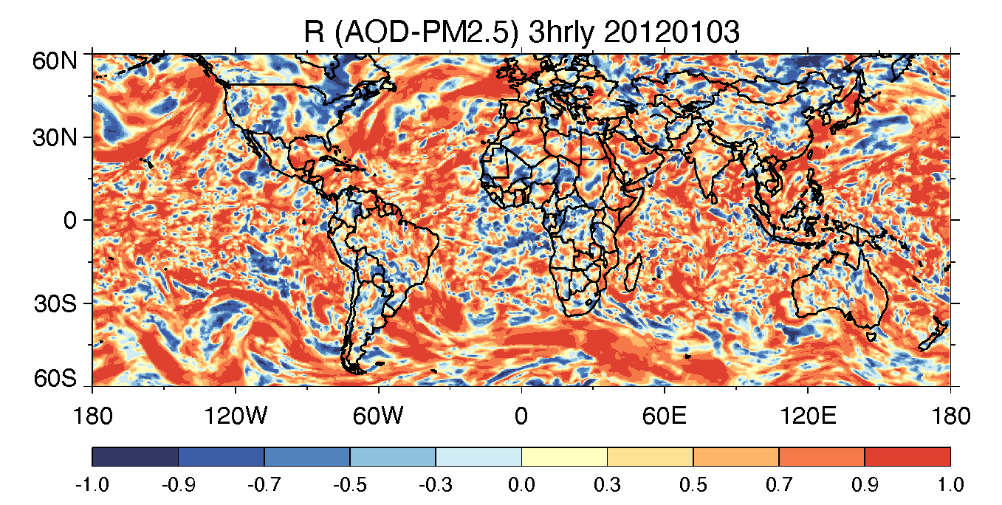
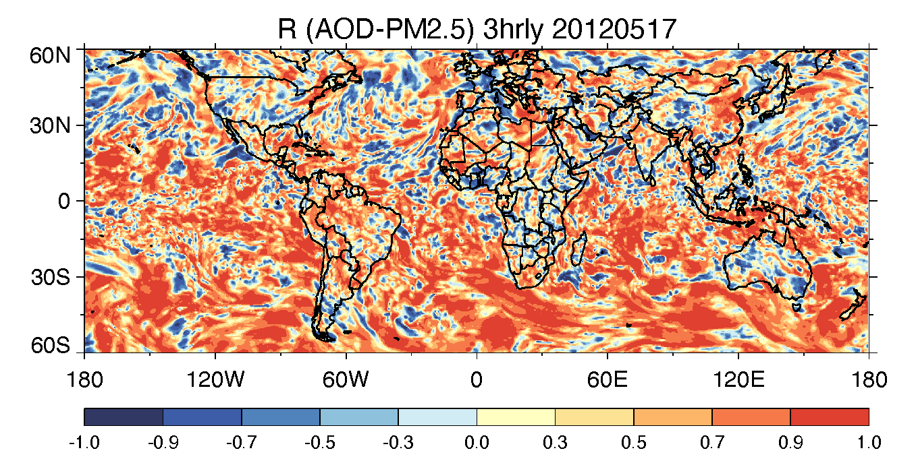
GEOS model simulation of AOD and PM_{2.5} at 3-hourly output also show poor correlations between them at diurnal time scale
Because the consistent processes determining the AOD and PM_{2.5} in the model, we examine the GEOS output for “good” and “bad” AOD-PM_{2.5} correlation days to explain their relationship
We use several variables from the GEOS model to perform multi-variable regression to estimate the 3-hourly PM_{2.5} concentrations from AOD and compare them with model simulated “true” values

Slide 5
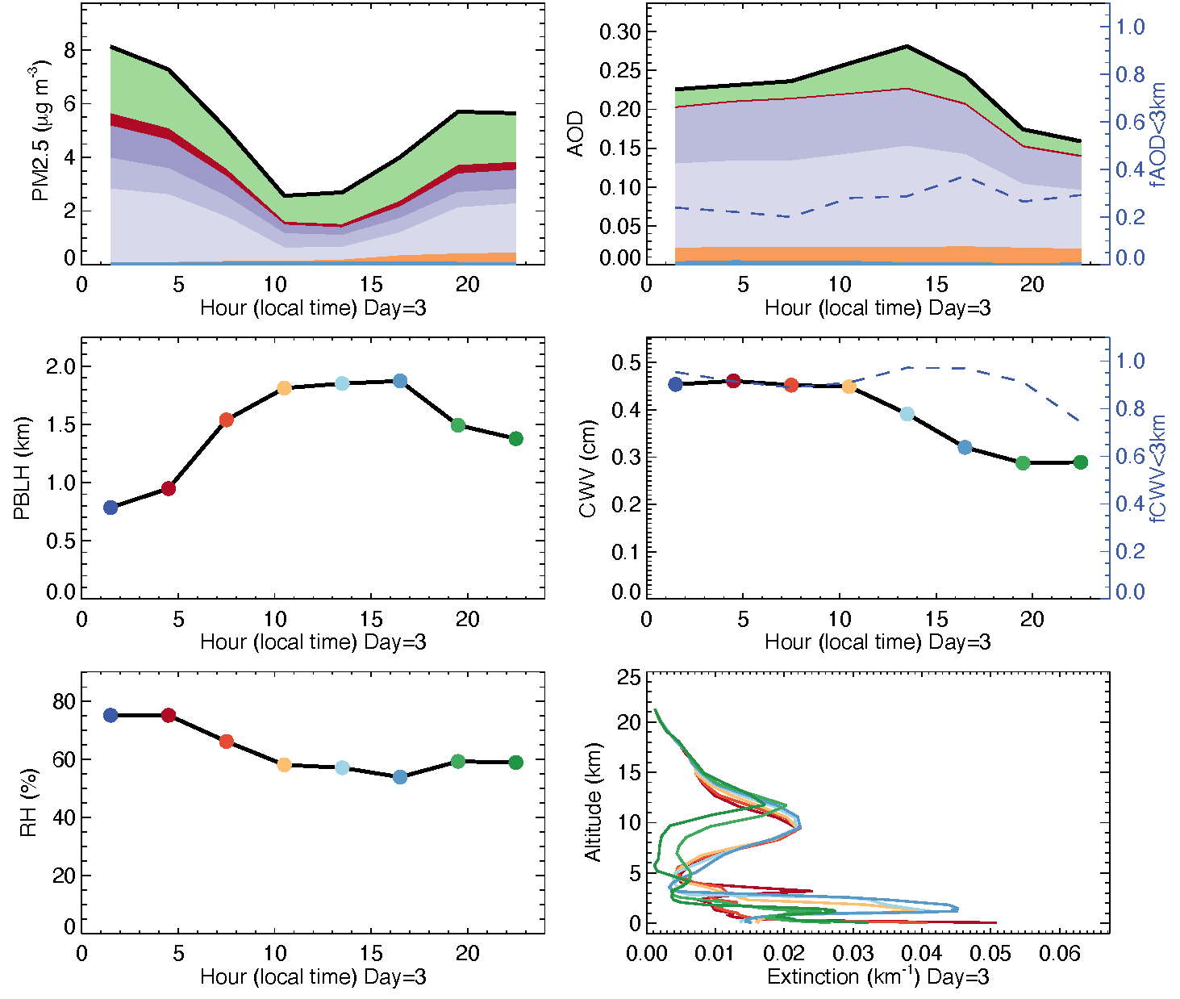
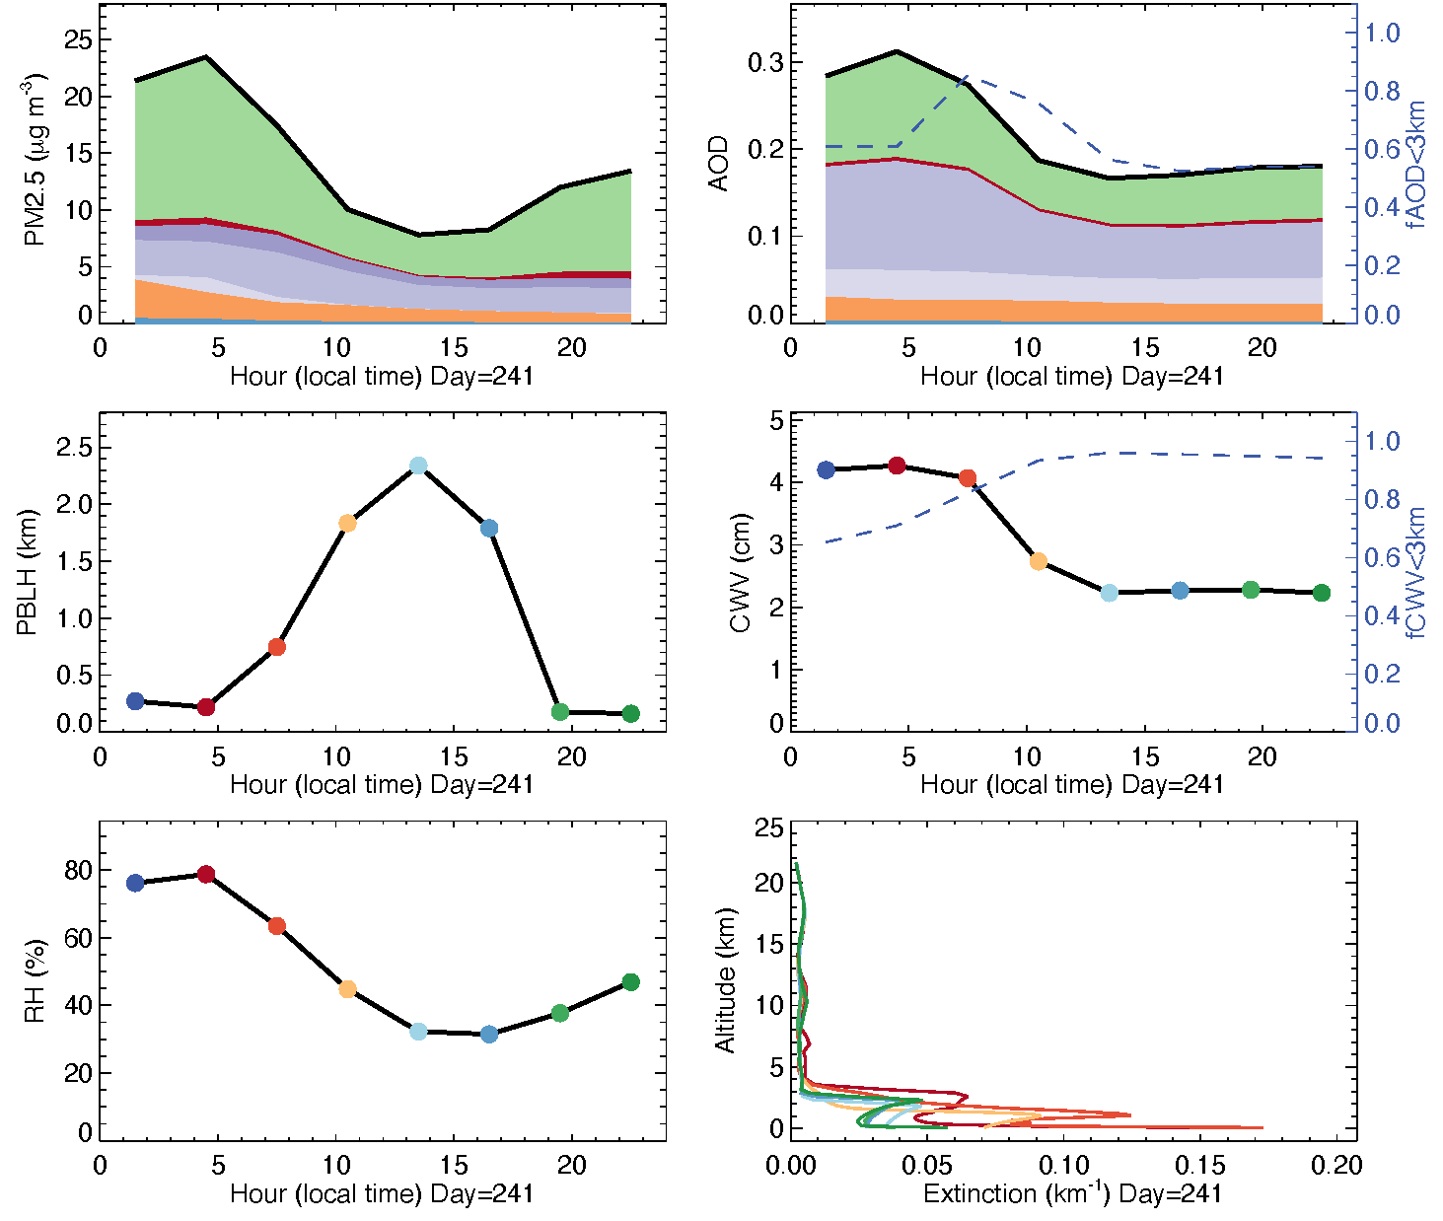
Examination of aerosol compositions, vertical profiles, and some meteorological fields to explain the AOD-PM_{2.5} relationship in two different days, one with R= -0.90 and one with R = +0.98, GEOS simulation
1. GSFC, 2012-01-03 (R_{AOD-PM2.5}= -0.90)
2. GSFC, 2012-08-29 (R_{AOD-PM2.5}= +0.98)
(a)
PM_{2.5} composition
(b)
AOD composition
Total
(a)
PM_{2.5} composition
(b)
AOD composition
OA
BC
NH₄⁺
SO₄⁼
NO₃⁻
DU
SS
+1
+1
+1
+1
(c)
PBL height
(d)
Column water vapor
02:30
(c)
PBL height
(d)
Column water vapor
05:30
08:30
11:30
14:30
17:30
20:30
22:30
+1
+1
+1
+1
(e)
Surface layer RH
(f)
Aerosol extinction vertical profile
02:30
(e)
Surface layer RH
(f)
Aerosol extinction vertical profile
05:30
08:30
11:30
14:30
17:30
20:30
23:30
+1
+1
Aerosol compositions of PM_{2.5} and AOD are quite different
~30% of total AOD below 3 km with different temporal variation from aerosols aloft -> AOD variations are not in-sync with PM_{2.5}
Aerosol compositions of PM_{2.5} and AOD are similar
55-80% of AOD below 3km -> both AOD and PM_{2.5} temporal variations are controlled by the aerosol below 3 km

Slide 6
Select several “observable” variables from the GEOS model for multi-variable regression to estimate the 3-hourly PM_{2.5} concentrations from AOD and compare them to the “true” simulated PM_{2.5} values at different places with various aerosol regimes
AOD, CWV, and AE are available from AERONET and mostly available from satellite retrievals
Surface RHs can be obtained from local weather stations
PBLH can be obtained from ceilometer or lidar data, although limited
ALHe (or similar quantity) can be retrieved from satellite (e.g., O₂-A or O₂-B)
MEEs is rarely observed, but may obtained from publicly accessible reanalysis data
Note: estimated PM_{2.5} is from the multivariable linear fitting, although in reality the relationships are not linear
Multivariable regression of 3-hour GEOS output for 2012: | Multivariable regression 3-hourly GEOS output for 2012:
1 | PM_{2.5} = f (AOD)
2 | PM_{2.5} = f (AOD, CWV)
3 | PM_{2.5} = f (AOD, CWV, AE)
4 | PM_{2.5} = f (AOD, CWV, AE, RHs)
5 | PM_{2.5} = f (AOD, CWV, AE, RHs , PBLH)
6 7 | PM_{2.5} = f (AOD, CWV, AE, RHs, PBLH, ALHe) PM_{2.5} = f (AOD, CWV, AE, RHs, PBLH, ALHe, MEEs)
Estimate accuracy increases
Observability decrease
Ground weather station
Ground ceilo-meter
Satellite
Publicly available reanalysis
Satellite
CWV = column water vapor; AE = Angstrom exponent; RHs = relative humidity at surface; PBLH = planetary boundary layer height; ALHe = effective aerosol layer height; MEEs = mass extinction efficiency at surface

Slide 7
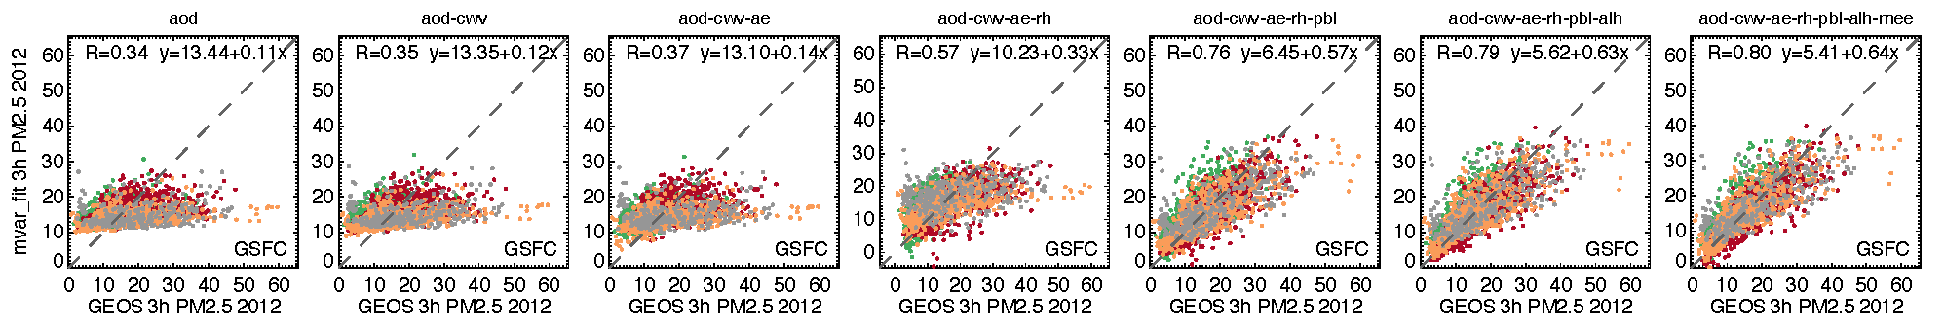
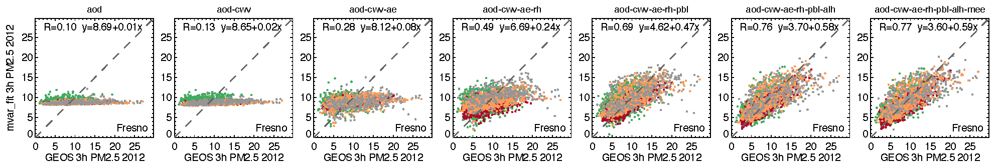
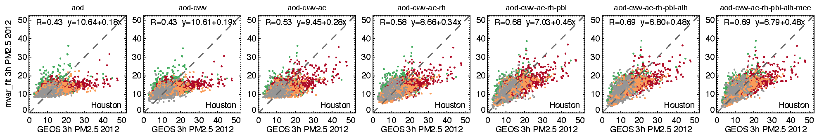
Estimated PM_{2.5} from multi variable fitting vs. GEOS-calculated PM_{2.5} at US sites
PM2.5 =
5 f(AOD, CWV, AE. RHs,
PBLH)
6 f(AOD, CWV, AE. RHs,
PBLH, ALHe)
7 f(AOD, CWV, AE. RHs,
PBLH, ALHe, MEEs)
1 f(AOD)
2 f(AOD, CWV)
3 f(AOD, CWV, AE)
4 f(AOD, CWV, AE. RHs)
DJF
MAM
JJA
SON
DJF
MAM
JJA
SON
DJF
MAM
JJA
SON

Slide 8
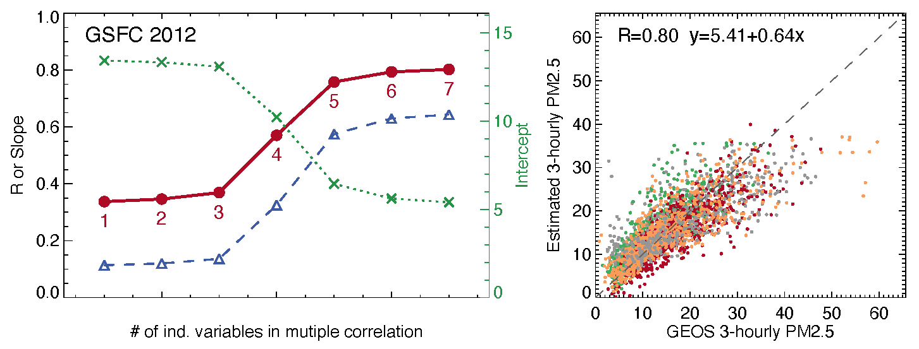
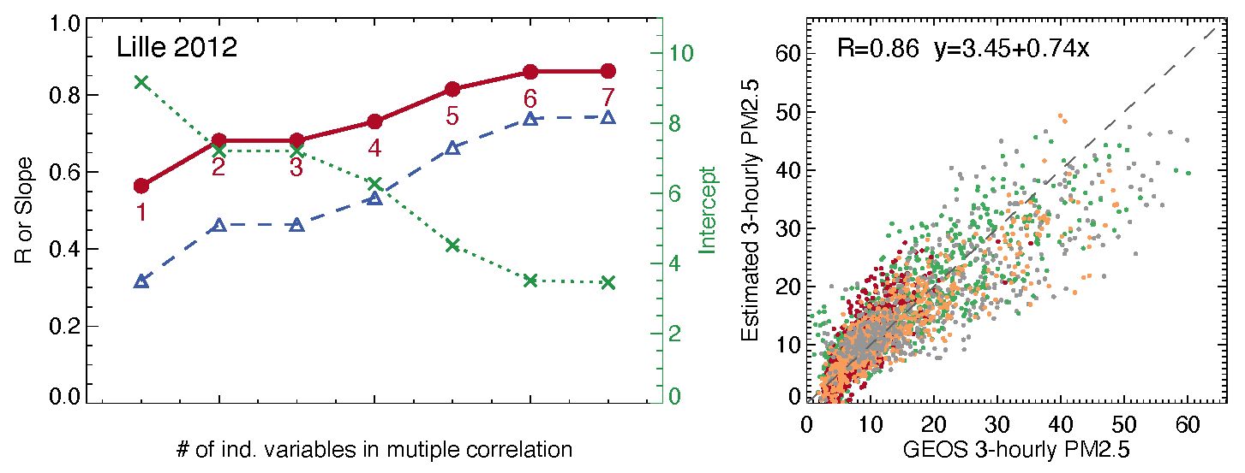
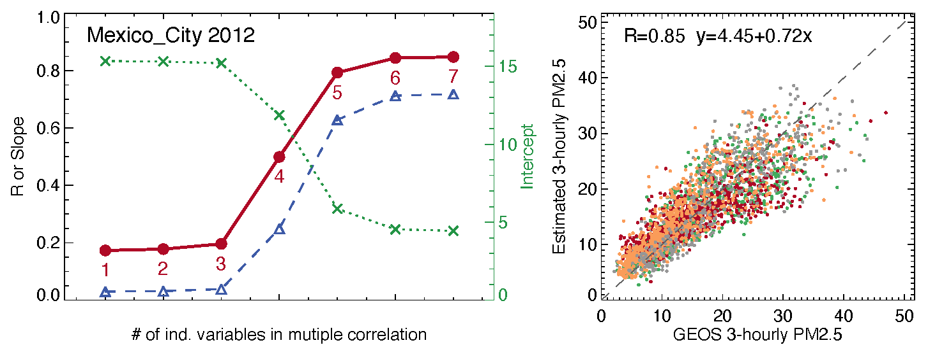
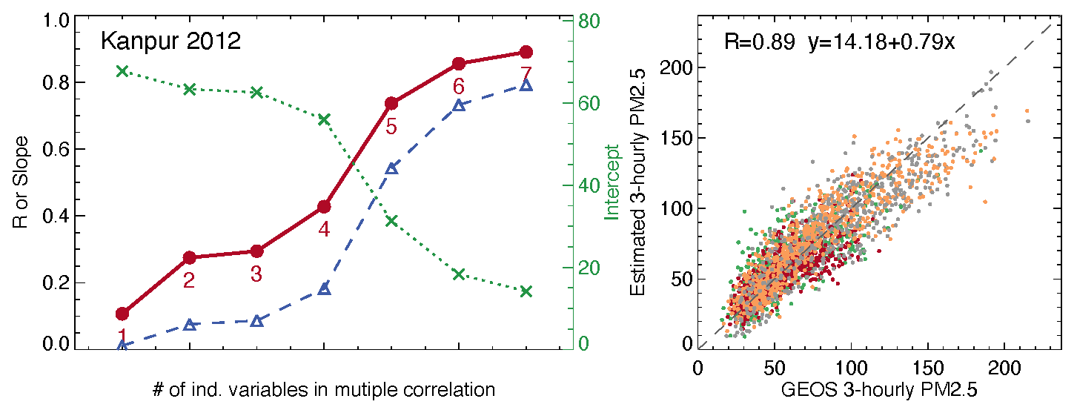
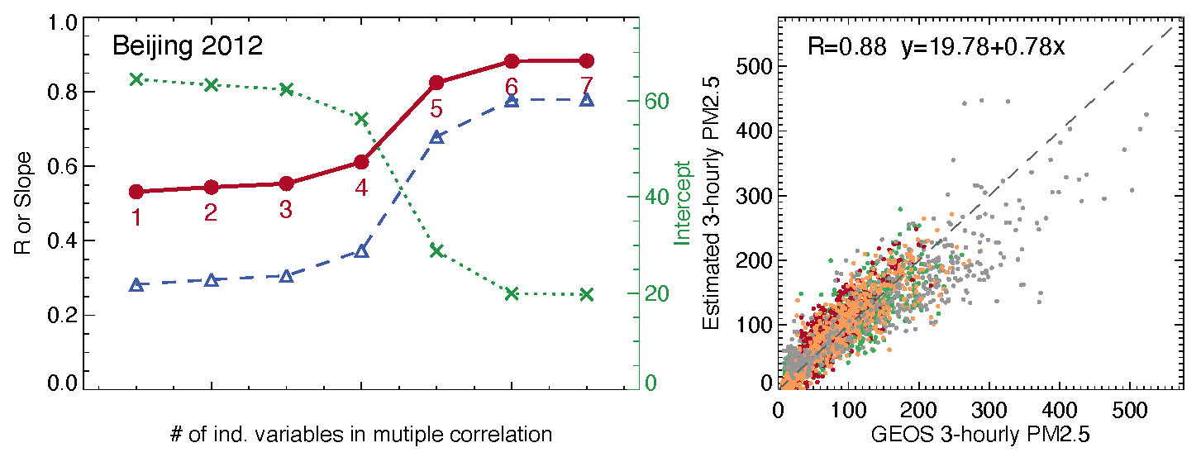
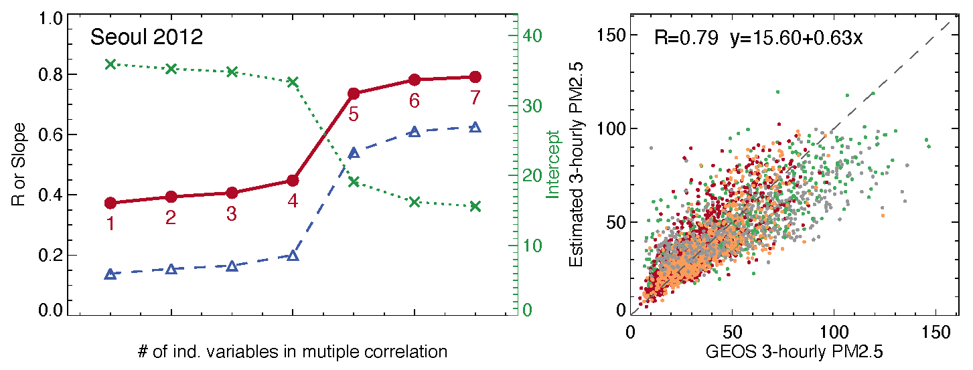
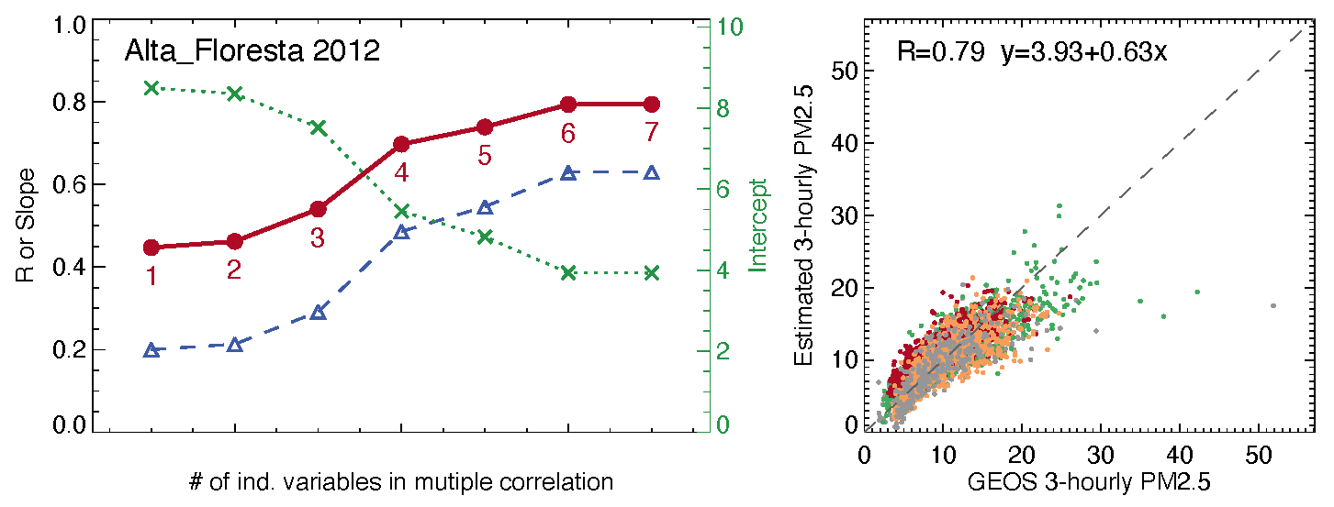
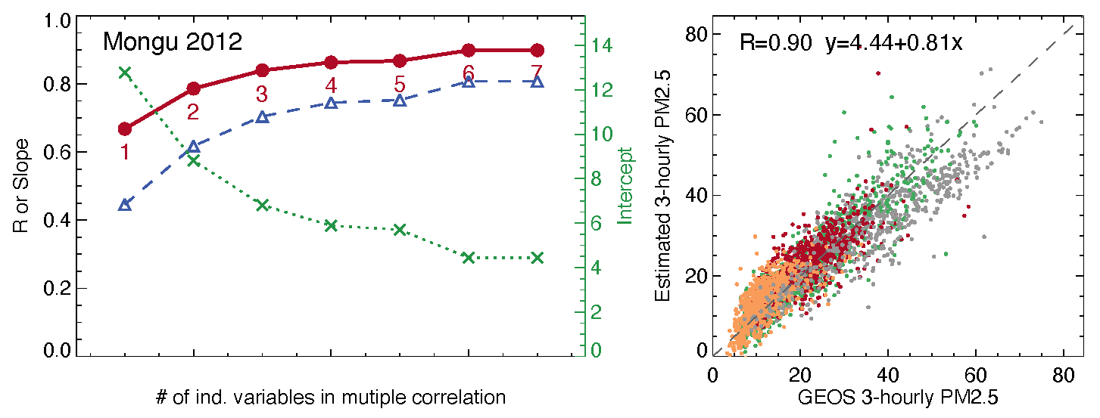
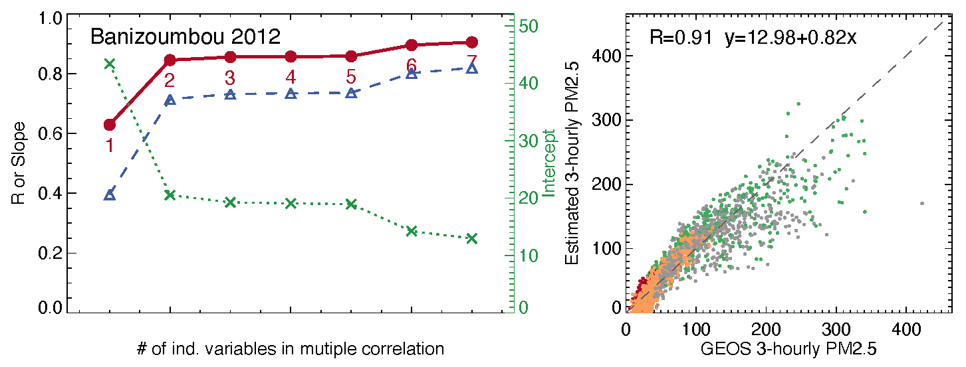
How does the multi-variable regression fitting work in different aerosol regimes in various places in the world? – It is generally robust spatially, temporally, although sensitivities to different variables vary
a
y = a + bx
R
b
USA, pollution
Europe, pollution
Mexico, pollution
India, pollution
China, pollution
Korea, pollution
Brazil, smoke
Zambia, smoke
Niger, dust
PM_{2.5} = f (1 AOD, 2 CWV, 3 AE, 4 RHs , 5 PBLH, 6 ALHe, 7 MEEs)

Slide 9
Conclusions
Observations from collocated AOD and PM_{2.5} measurements shows that it is not feasible to directly convert geostationary satellite observed diurnal AOD to diurnal PM_{2.5}
However, our modeling analysis suggests that it is possible to “retrieve” diurnal PM_{2.5} from GEO satellite diurnal AOD data with much improved accuracy if additional ancillary variables (observable) are included in the retrieval (e.g., via multi-variable regression fitting)
  Additional variables included in our analysis: CWV, AE, RHs, PBLH, ALHe, MEEs
Such method seems to be temporally and spatially robust across seasons and aerosol regimes, although sensitivity to different variables varies

