Slide 1
The GAW Aerosol Lidar Observation Network (GALION):
Towards Global Lidar Profiling from Surface Networks
Judd Welton
GALION co-chair
GALION Steering Group:
EARLINET: Lucia Mona, CNR Italy (co-chair)
Gelsomina Pappalardo, CNR Italy
ADNET: Nobuo Sugimoto, NIES Japan
Atsushi Shimizu, NIES Japan
LALINET: Eduardo Landulfo, IPEN Brazil
NDACC Lidar: Thierry Leblanc, JPL USA
MPLNET: Judd Welton, NASA USA
The goal:
Surface lidars provide a means of determining the fraction of column AOD within the boundary layer.
Advanced lidars can also provide a means of separating fine mode AOD.
Co-location of surface lidars with more in-situ sampling sites will improve our understanding of translating AOD to PM2.5
The challenges:
Lidar data must be high quality and more easily obtained globally. We must increase the number of co-located lidars and in-situ sites.

Slide 2
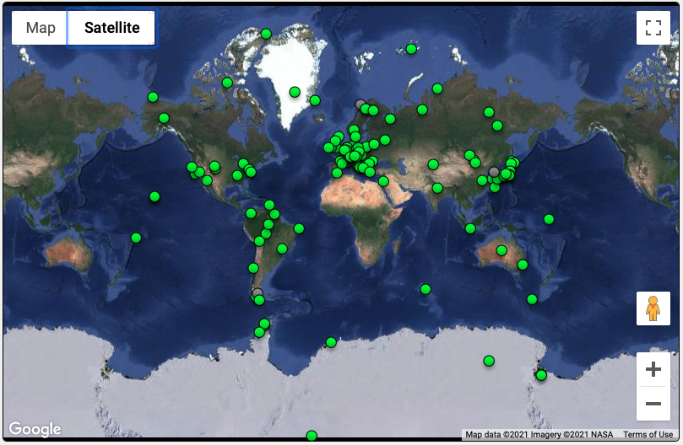
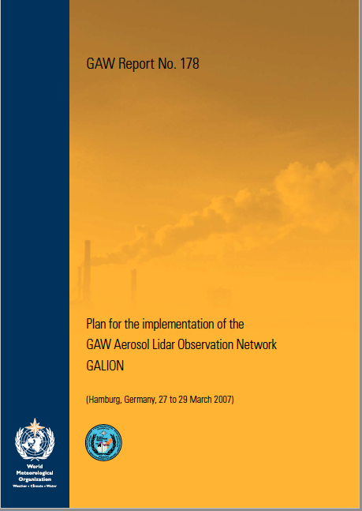
GALION: Introduction
WMO GAW Aerosol Lidar Observation Network (GALION):
A lidar network of networks organized through the WMO Global Atmospheric Watch (GAW) program.
See GAW Report 178 (2008)
Original GALION Networks:
EARLINET
ADNET
CIS-LINET
LALINET
CORALNET
CREST
MPLNET
NDACC Lidar
GALION Sites: From WMO OSCAR* (active and inactive)
regional
global
* OSCAR database is still being updated, many sites not included yet
Objectives: provide long term, coordinated lidar network profiling of aerosol properties to support the following
climate research and assessment
air quality assessment and forecasting
Plume monitoring for special events
Satellite cal/val and synergistic research
Global coverage is only achievable by combining efforts of individual lidar networks

Slide 3
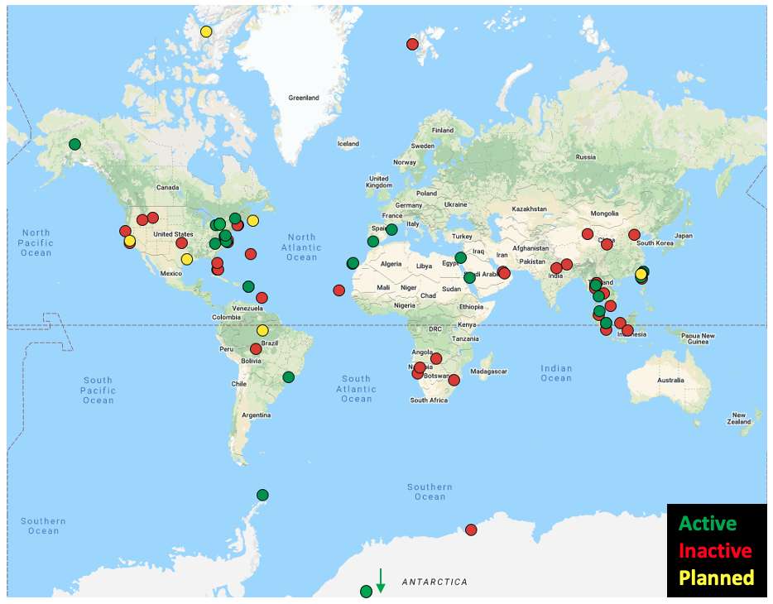
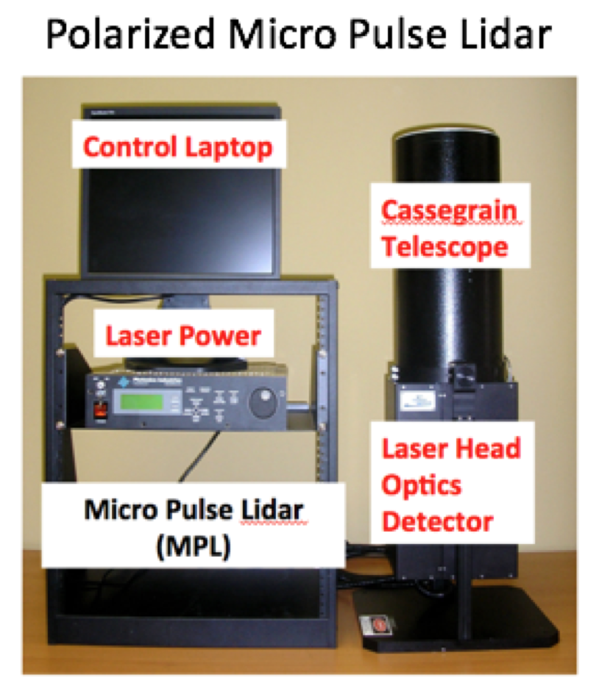
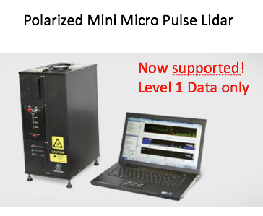
NASA Micro Pulse Lidar Network – MPLNET
Global Backscatter Lidar Network: 2000 - current
76 sites total (25 active, 51 inactive). 27 countries, 45 partners.
6 more planned sites
Continuous (day/night) operations
97% of network co-located with AERONET
Created using AERONET model: federated network with centralized and standardized calibration, processing, distribution. Same open data policy (with co-authorship offer).
Instrumentation:
Micro Pulse Lidar (NASA developed, commercial since 1995)
Eye safe, green backscatter lidar. Polarized in early 2000s
Entire network has polarized MPL since ~2016
MPLNET Sites: 2000 - current
Data Products:
NRB: Lidar signals; volume depolarization ratios; diagnostics
CLD: Cloud heights; thin cloud extinction and optical depths; cloud phase
AER: Aerosol heights; extinction, backscatter, and depolarization ratio profiles; lidar ratio
PBL: Mixed Layer Top and estimated AOD
L1 and L1.5 products available in NRT, QA screen applied at L1.5 and L2
L3 products in development (created from L2 data)
https://mplnet.gsfc.nasa.gov

Slide 4
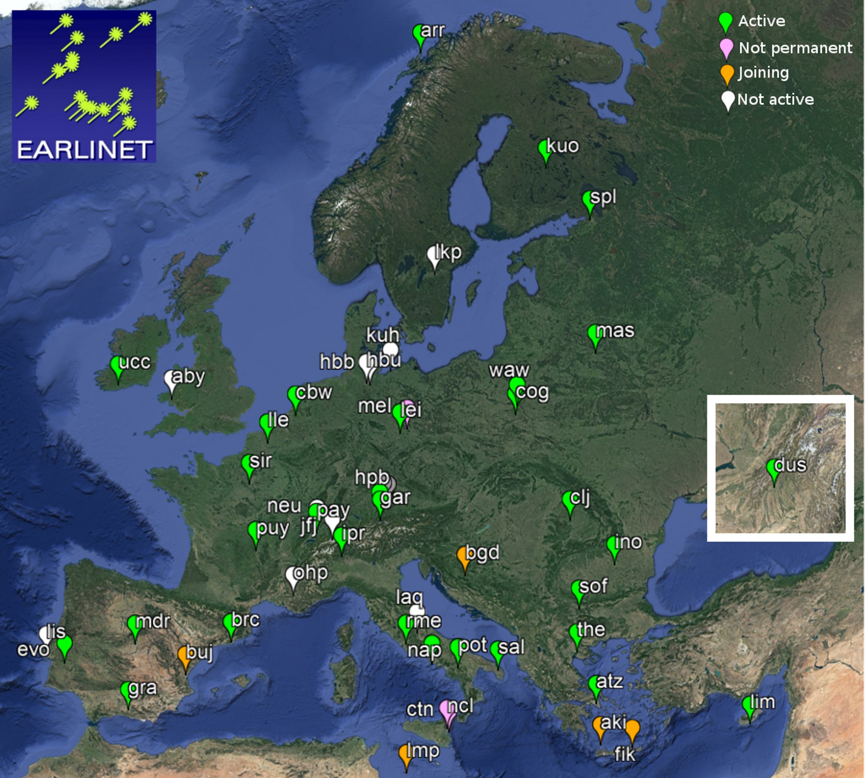
European Aerosol Research LIdar NETwork – EARLINET/ACTRIS
mainly based on Raman lidar systems, able to provide vertical profiles of aerosol extinction and backscatter coefficients without significant assumptions.
most of the stations at different wavelengths
in some cases coupled to measurements of the linear particle depolarization ratio
EARLINET is since 2011 integrated in ACTRIS (Aerosol, Clouds, and Trace gases Research Infrastructure)
https://www.earlinet.org/

Slide 5
Asian dust and aerosol lidar observation network – AD-Net
96 profiles / day, vertical resolution = 30 m
532 nm attenuated backscatter coefficient + depolarization ratio (up to 18 km) & extinction coefficient (with fixed lidar ratio S1 = 50sr, up to 9 km)
Available in figures and netCDF at: https://www-lidar.nies.go.jp/AD-Net/
References: Shimizu et al., Opt. Eng. (2017) doi:10.1117/1.OE.56.3.031219
Contact: shimizua@nies.go.jp
#Realtime data sharing is not applicable to lidars in China

Slide 6
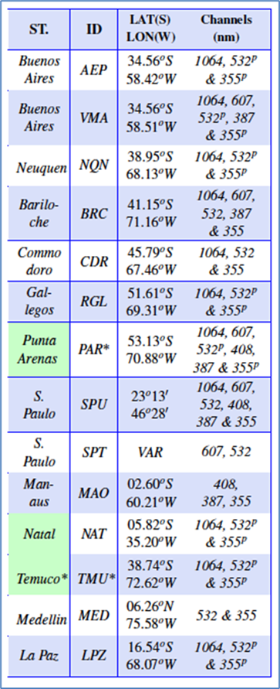
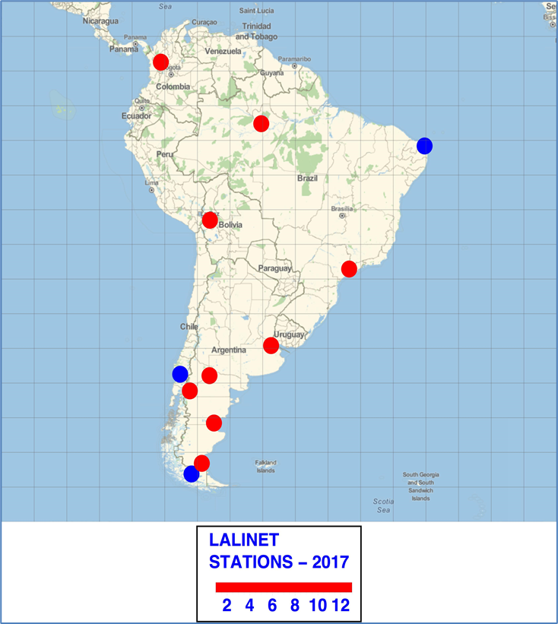
Latin America LIdar NETwork – LALINET
https://lalinet.org
Measurements of 1064 nm, 532 nm and 355 nm from elastic and multi-wavelength lidar systems in order to retrieve backscatter, extinction, lidar ratio profiles, plus backscatter and extinction Ansgtrom Exponent and Color ratio.
LALINET: The First Latin American–Born Regional Atmospheric Observational Network
https://doi.org/10.1175/BAMS-D-15-00228.1

Slide 7
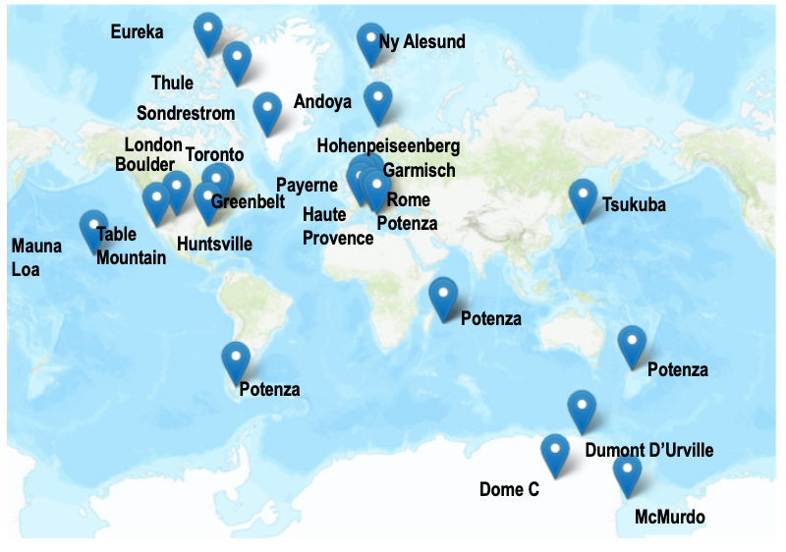
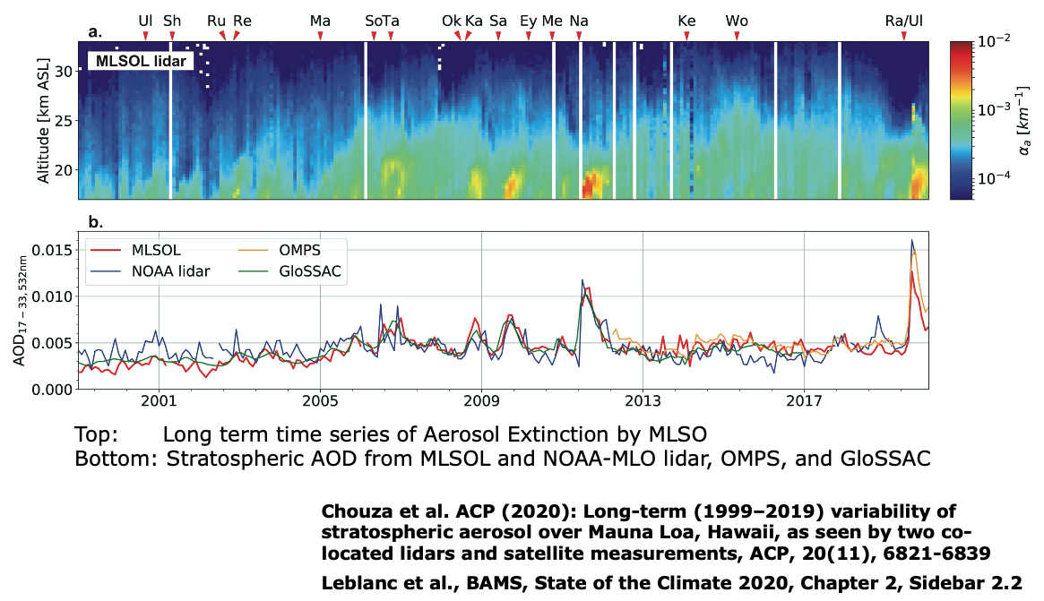
Network for the Detection of Atmospheric Composition Change – NDACC
NDACC Sites | Aerosols | Ozone | Temperature | Water Vapor | Wind
All times (active and inactive) | 20 | 15 | 15 | 15 | 1
In operation today (active) | 10 | 10 | 10 | 10 | 1
NDACC provides a measure of stratospheric AOD contribution to total column
Courtesy of Thierry Leblanc, Jet propulsion Laboratory, California Intitue of Technology
Long-term monitoring of atmospheric composition
http://www.ndacc.org

Slide 8
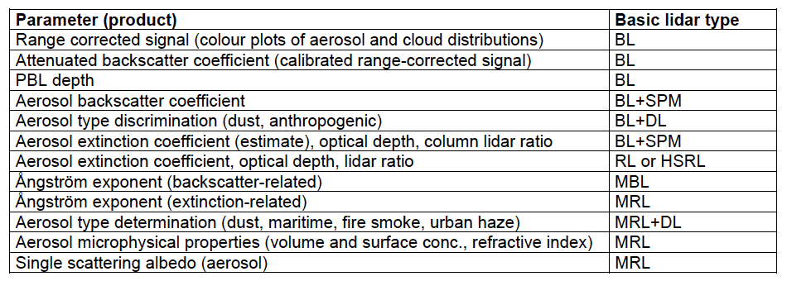
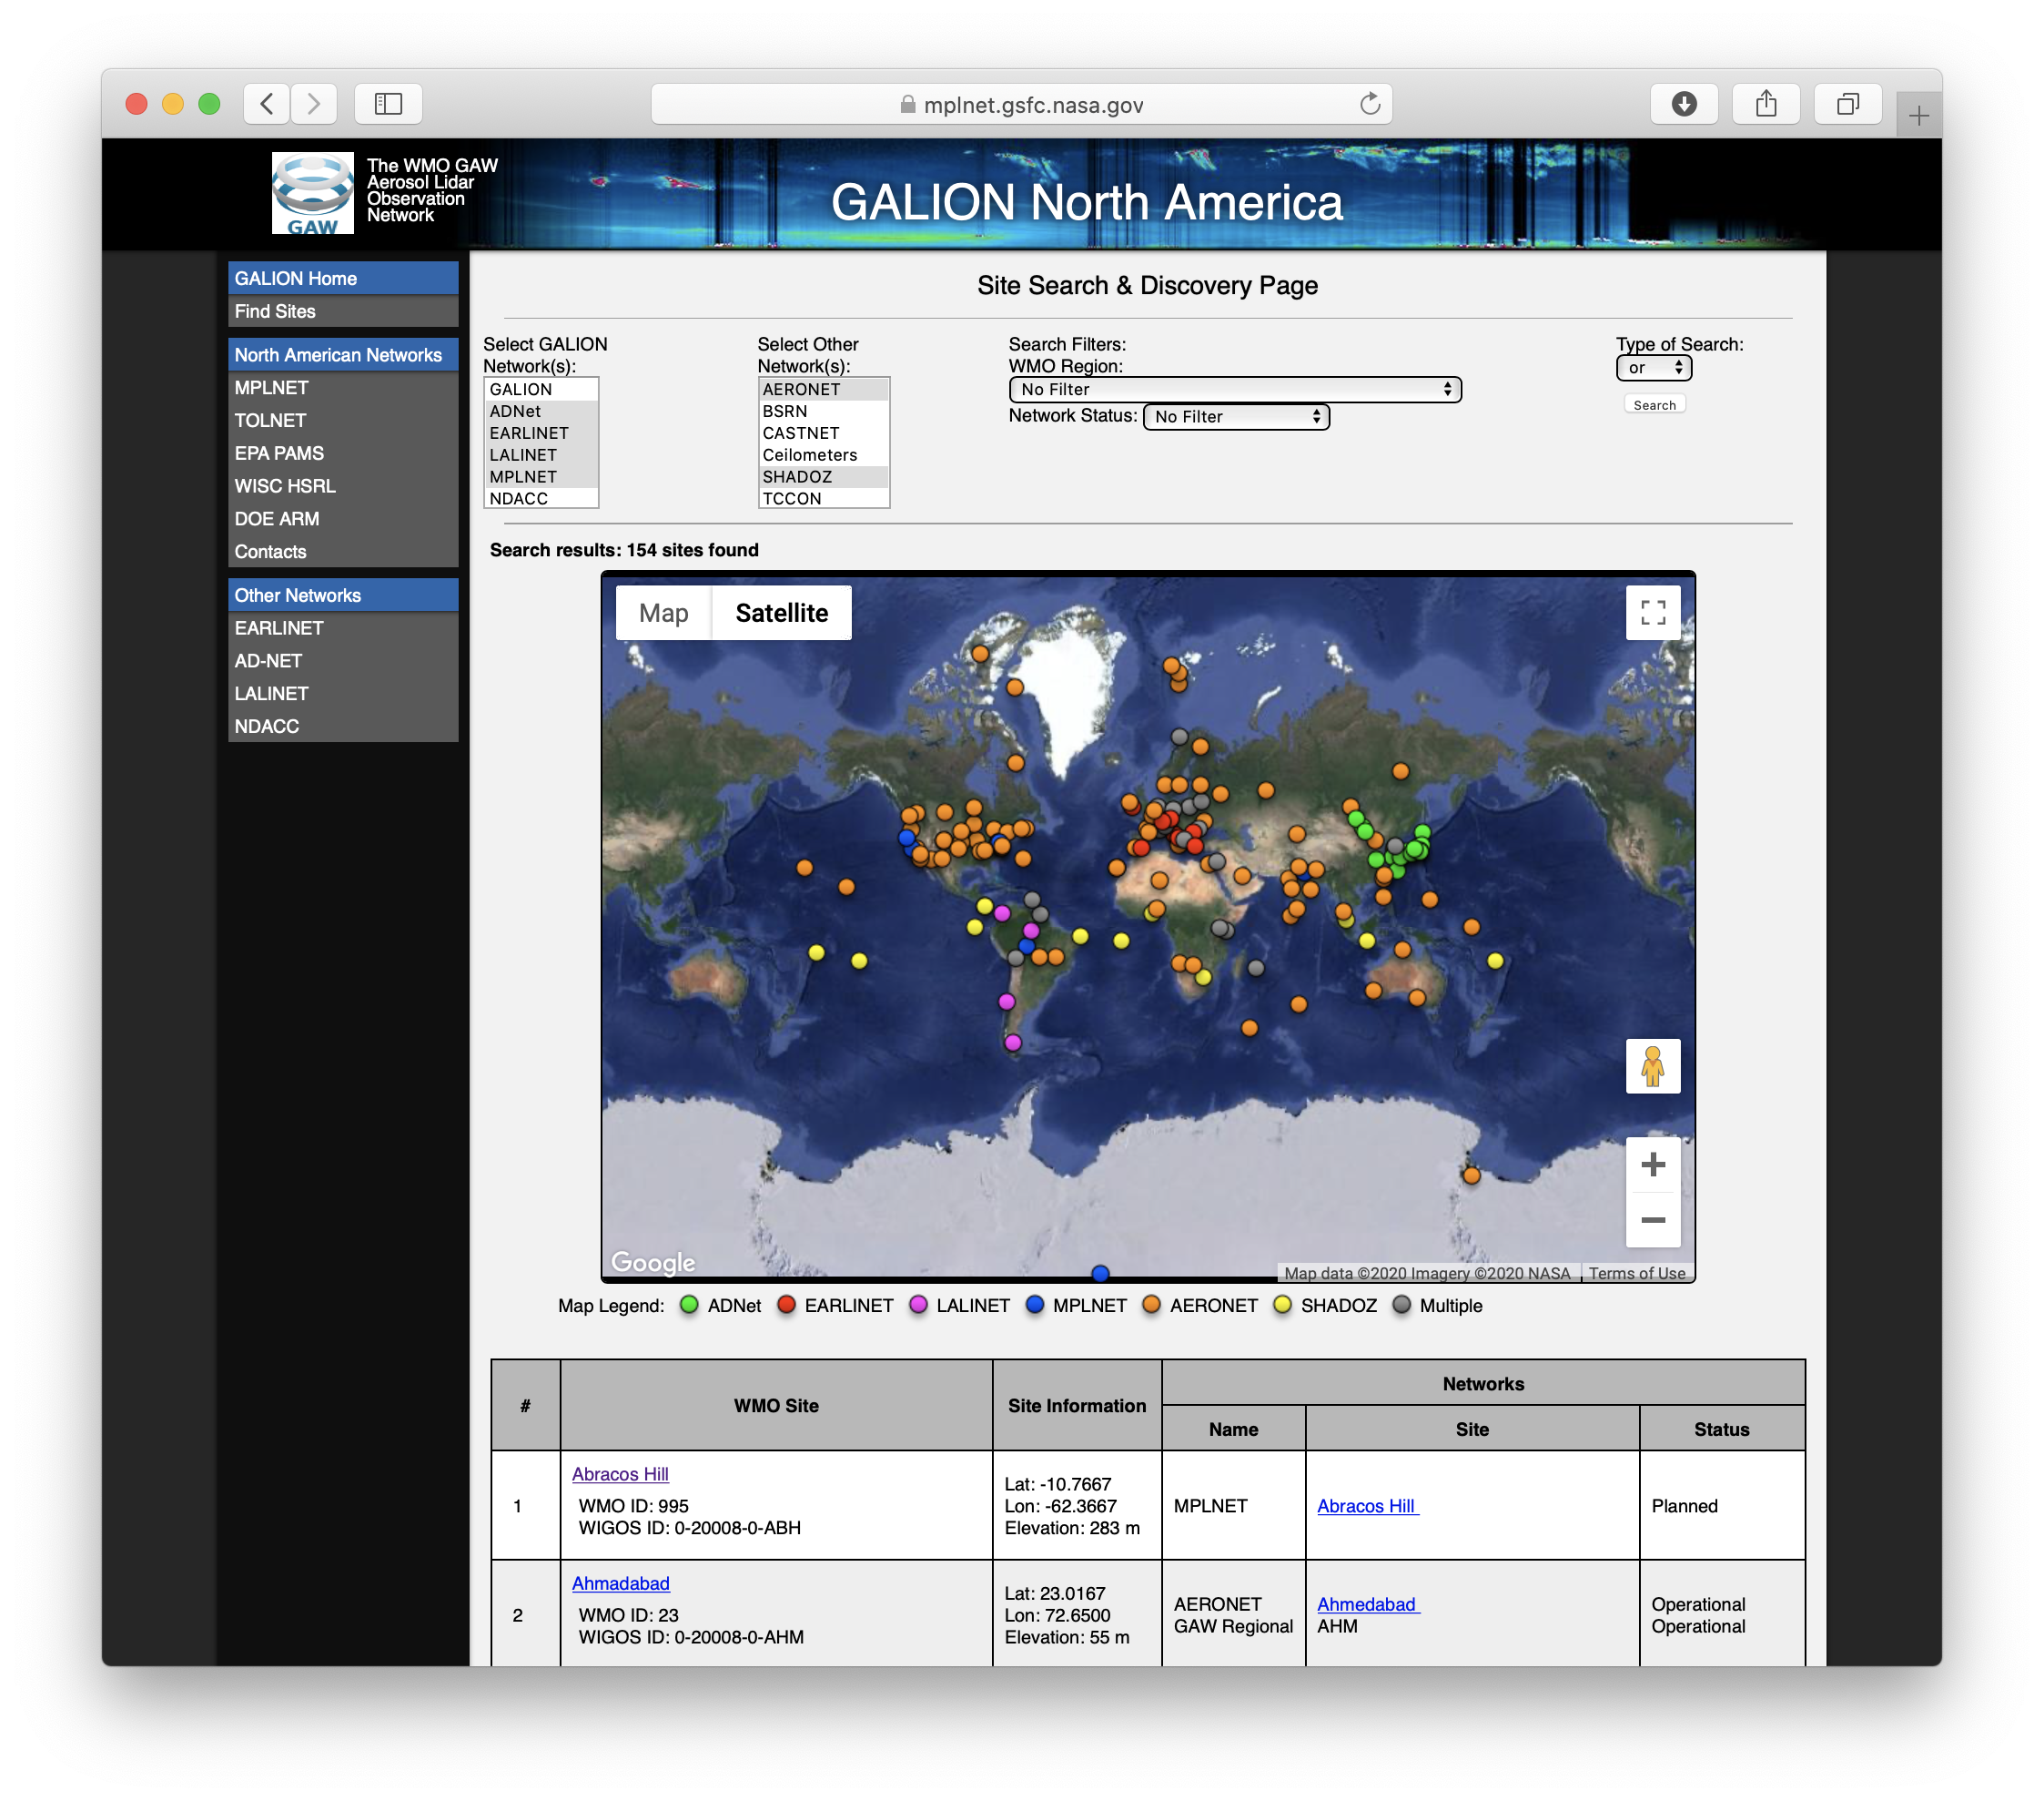
GALION: Operations and Working Groups
GALION operations:
Due to the variety of lidar instruments and processing systems throughout the contributing networks, it was decided to target a minimum of 2 observations per week.
Monday and Thursday around sunset
Some networks are continuous 24/7
Aerosol Observation Requirements and Data Variables
Products provided from a given site are dependent upon the capability of the onsite lidar and network.
BL: Backscatter lidar SP: Sunphotometer
DL: Depolarization RL: Raman lidar
HSRL: High Spectral Resolution Lidar M: Multi-wavelength
This system accommodates a tiered approach to data quality based on lidar capability and external observations. e.g. Extinction from BL+SPM vs RL or HSRL.
GALION Data Center in Development
Front end at WMO, content / data using a distributed approach across networks
Beta Search & Discovery Tool
Utilizing OSCAR metadata
but tailored to lidar search criteria
Allows integrated searching of not only GALION lidar sites, but other networks as well
Tool to help address coverage gaps and improve co-location with other network observations such as in-situ sampling
Working groups:
Methodology
Technologies
Quality Assurance
Data collection and dissemination
Applications (including Air Quality)

Slide 9
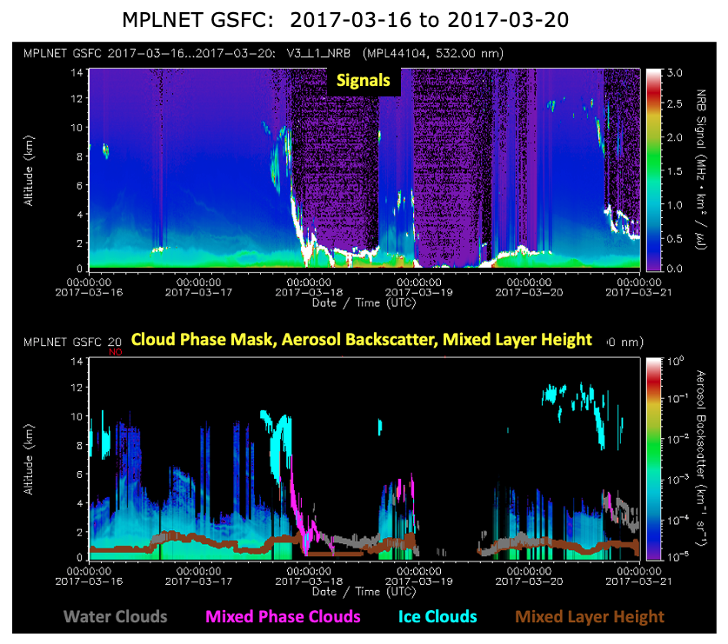
GALION: Examples of Lidar Network Applications Related to Air Quality
MPLNET Plans:
Focus on PBL Products over past 15 years
Mixed Layer Height Product tested in Version 2 (2006 – 2015)
Mixed Layer Product operational in Version 3
Includes both mixed layer AOD and column AOD
Exploit Diurnal Capability of Long-term MPLNET Data
Level 3 Products in Development
Objective: go from instantaneous L2 profiles to monthly, seasonal, annual, and decadal diurnal climatologies
Standard L3 product files will be monthly diurnal averages for full product suite (NRB, CLD, AER, PBL)
Ongoing Development
New Light Precipitation Product in Operational Testing (deposition and ACI)
Developing a new layered aerosol height and properties algorithm
MPLNET L3 Decadal Examples: 2010-2020 GSFC

Slide 10
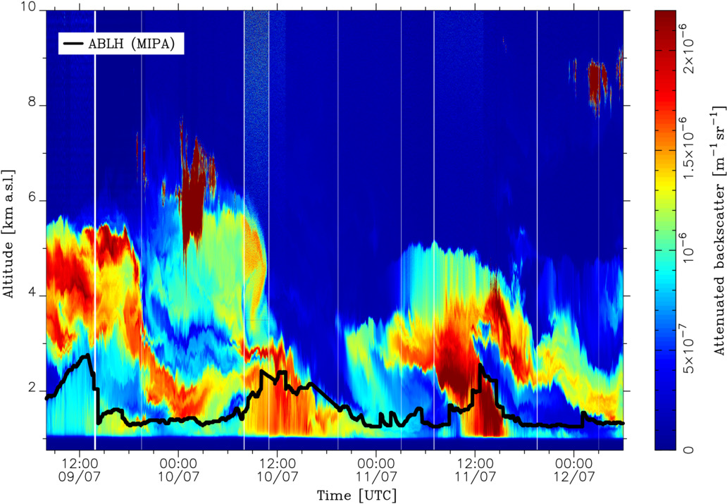
GALION: Examples of Lidar Network Applications Related to Air Quality
EARLINET Plans:
PBL identification
New lidar only method based on AI techniques
Vivone et al., ACP 2021
Comparison with other techniques identification
link with PROBE COST action activities http://www.probe-cost.eu
Aerosol typing
development of methodology for high resolution and low resolution typing
Important for air quality management in EU regulations
Layered Products vs Profile
Layering integrated products under implementation : like AOD and integrated backscatter for each layer
Layering intensive products under implementation: for each layer quantities like angstrom exponent (size related), particle depolarization (shape related) and lidar ratio (absorbing related )will be reported
These layer products are currently being investigated for COVID-19 special observation period : https://www.earlinet.org/index.php?id=covid-19

Slide 11
GALION: Conclusion
GALION lidar networks provide high quality profile data useful for AQ Applications
Harmonization of goals, standards, and cooperation through GALION
New data center will offer easier lidar search and discovery capability
Tools to improve co-location with other networks and address coverage gaps
The variety of lidar types across GALION networks provide a means of apportioning aerosol extinction and AOD between the boundary layer, troposphere, and stratosphere.
AQ Applications
Common emphasis on improved PBL profiling and related products (break from profiles to layer identification)
Increase in number of sites capable of continuous observations
Advanced lidar sites can provide aerosol typing and microphysical properties
Many GALION networks already work with the WMO SDS-WAS and ICAP projects (aerosol forecasting)
WMO GAW program will release new implementation plan soon
GALION is preparing our plan
Reorganize and revitalize our working groups, with emphasis on Applications

