Slide 1
Ground Monitoring of Aerosols:
Low-Cost PM_{2.5} Sensors
Andrea Clements, Ph.D.
Center for Environmental Measurement and Modeling
U.S. Environmental Protection Agency
June 10, 2021
Disclaimer: The views expressed in this presentation are those of the authors and do not necessarily represent the views or policies of the U.S. Environmental Protection Agency. Any mention of trade names, products, or services does not imply an endorsement by the U.S. Government or the U.S. Environmental Protection Agency. The EPA does not endorse any commercial products, services, or enterprises.

Slide 2
Outline
Introduction to Low-Cost Air Sensors
Major Take-Aways About PM_{2.5} Air Sensors
Summary of US EPA’s Work With PurpleAir Sensors
Available Resources

Slide 3

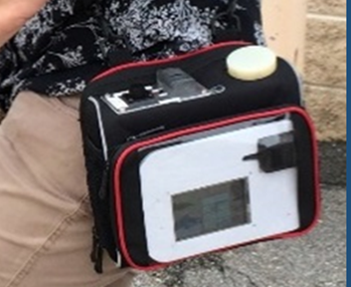
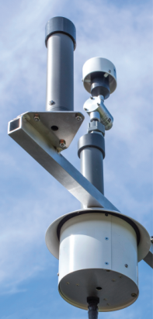
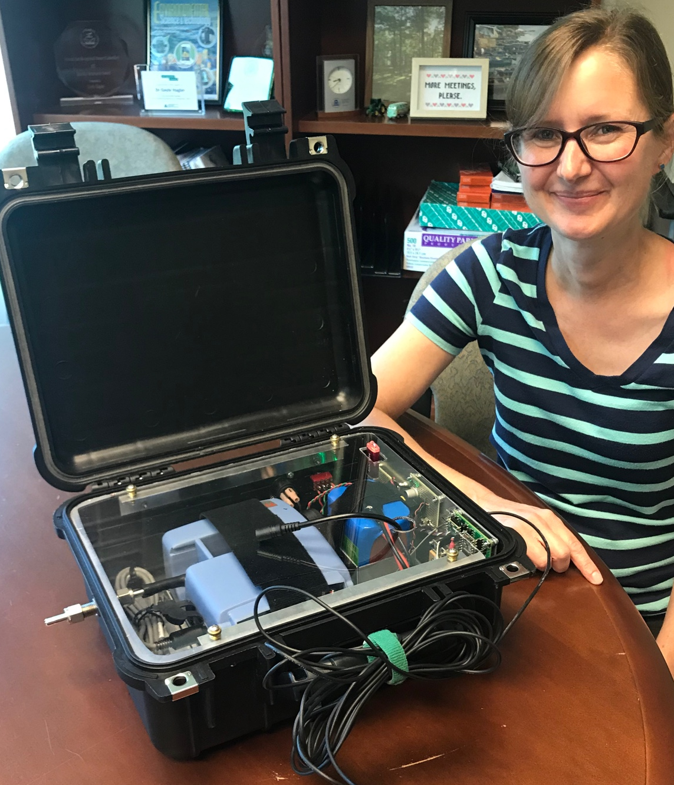
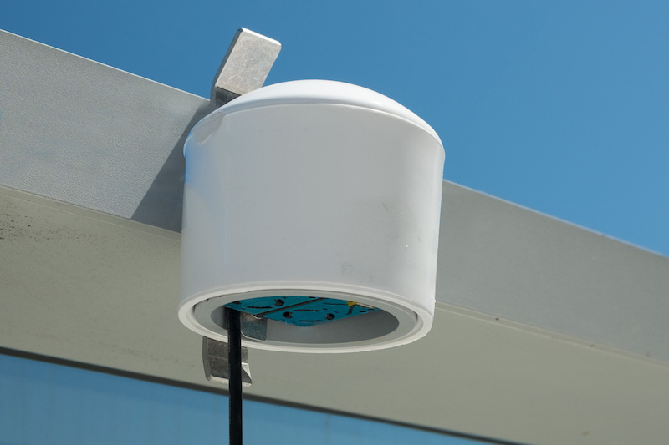
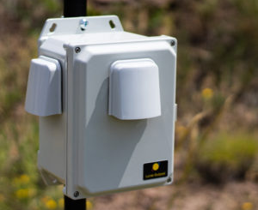
Introduction to Low-Cost Air Sensors
Generally, air sensors
  Are smaller, lower in cost, more portable, and easier to use than Federal Reference or Equivalent Method (FRM/FEM) instruments used for regulatory monitoring
  Demonstrate highly variable data quality
    Sensors for some pollutants demonstrate consistent performance while others do not
    Not as accurate as FRM/FEM data and need data cleaning and correction
  Not appropriate for regulatory grade monitoring but may be useful for non-regulatory, supplemental, and informational monitoring (NSIM) applications

Slide 4
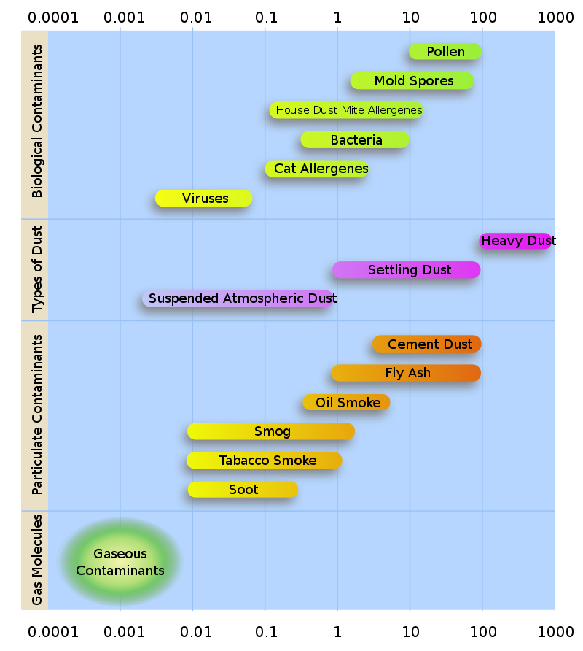
Major Take-Aways about PM_{2.5} Air Sensors
PurpleAir Detection Window
  Unlike regulatory instruments, sensors often lack status indicators or quality control procedures
  Sensors typically return real-time data at fairly high time resolution (e.g., data every minute)
  Most sensors use an optical detection approach
    A small range of particle sizes is observed; generally sensors cannot reliably detect particles smaller than 0.5 μm or larger than 2.5 μm
    Assumptions are made to turn observations of particle number into an estimated concentration
    Mass scattering efficiency can vary by particle size and by composition including moisture
Fine PM
Coarse PM
Wild/Rx Smoke
Image source: Wikipedia

Slide 5
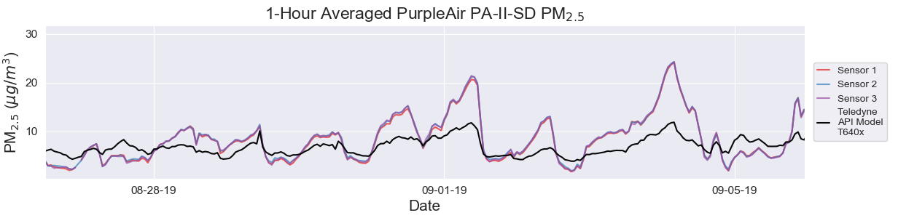
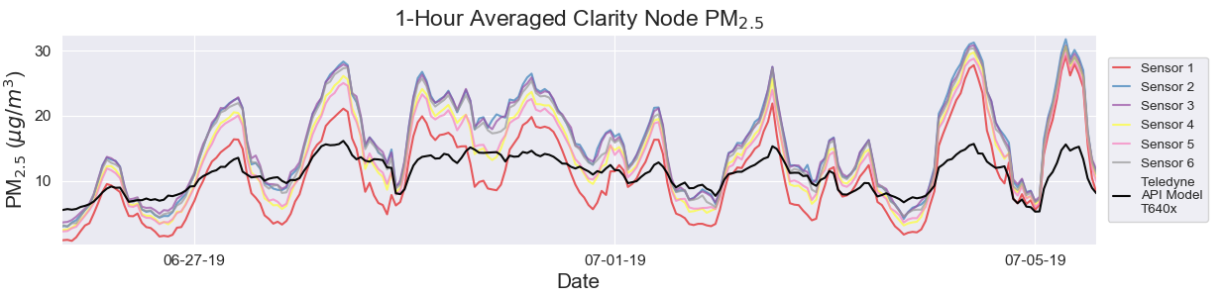
Major Take-Aways about PM_{2.5} Air Sensors
  Sensors typically track the ups and downs of PM_{2.5} simultaneously with regulatory monitors; however, absolute concentrations may be biased high or low
  There is wide variation in precision (or agreement between sensors of the same make/model); data corrections may be needed to compare data from two similar sensors
  Short-term spikes, spurious data, and/or baseline shifts may occur; creating longer term averages and/or data cleaning procedures can improve data quality
Tight agreement (precision)
More variable agreement (precision)

Slide 6
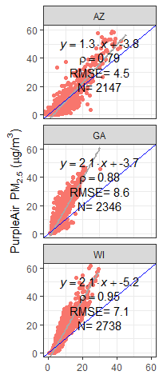
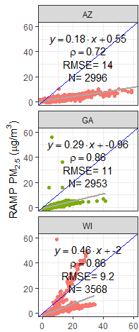
Major Take-Aways about PM_{2.5} Air Sensors
  Sensor lifespans are still unknown
  Many PM_{2.5} sensors use identical internal sensor components; even so, different sensor packages may produce different data quality
    Sensor orientation and housing may influence results (e.g. may keep sensor warmer and dryer)
    All rely on some form of a mathematical approach to convert from an optical signal to a mass concentration
    Some may incorporate other on-board sensors (temperature, relative humidity) to adjust the data
    Some may make data adjustments on the manufacturer’s server
T640 FEM PM_{2.5} (µg m⁻³)
T640 FEM PM_{2.5} (µg m⁻³)

Slide 7
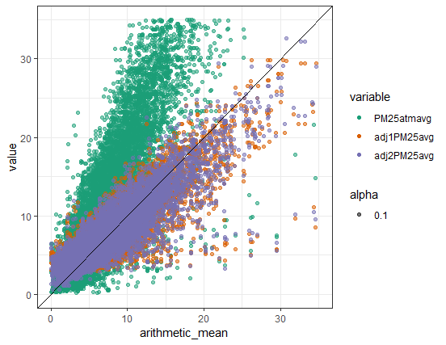
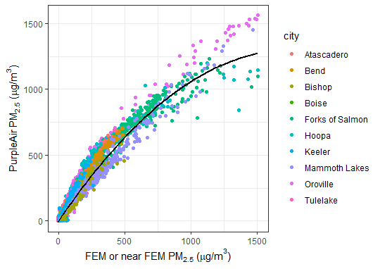
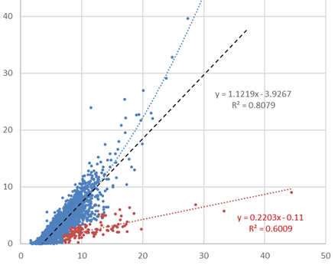
Major Take-Aways about PM_{2.5} Air Sensors
U.S. Ambient Concentrations
When comparing PM_{2.5} sensor and FRM/FEM measurements
  Linear corrections may be suitable for most sensors at lower ambient concentrations (common in the U.S.)
  The relationship between sensor and FRM/FEM measurements may change over a large concentration range
  Large shifts in aerosol properties (e.g., seasonal dust source) often changes the relationship between sensor and FRM/FEM reference measurements
PurpleAir PM_{2.5} (µg m⁻³)
High Concentration Wildfire Smoke
Raw (cf=atm)
Linear
T+RH
FEM or FRM PM_{2.5} (µg m⁻³)
Dust Impacts in Phoenix
Low coarse fraction
PurpleAir PM_{2.5} (µg m⁻³)
High coarse fraction
T640 FEM PM_{2.5} (µg m⁻³)

Slide 8
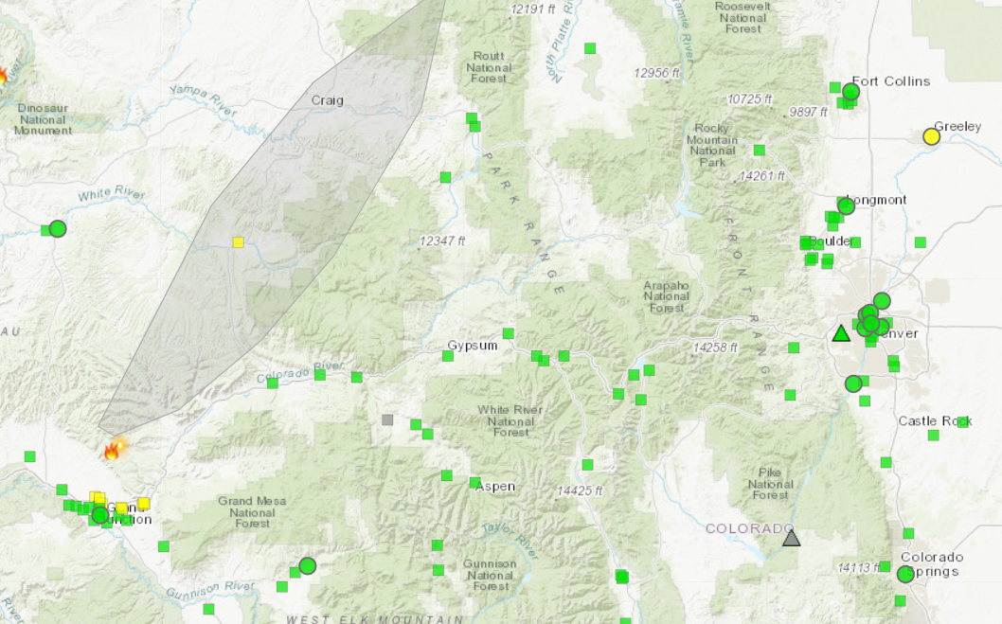
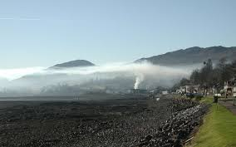
Motivation for USEPA’s Work With PurpleAir Sensors
Sensors can add information where it’s needed most
  For wildfire smoke monitoring, supplemental data are needed due to the high spatial variability of smoke impacts and in rural areas that lack air monitoring
PurpleAir sensors are widely used by the public
  Publicly available crowdsourced data has been widely reported by the media, discussed with local air monitoring agencies, and evaluated by a variety of groups
  Evaluations revealed the raw data was often biased high
  Several “conversions” are available on the public PurpleAir map but there is widespread confusion about which most appropriate for a given area or concentration range
Additional Information in Remote Mountainous Areas Image source: https://maps.airfire.org/ara/
Image source: http://nwcg.gov

Slide 9
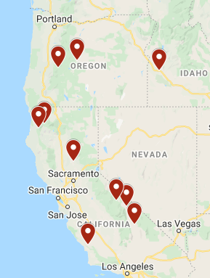
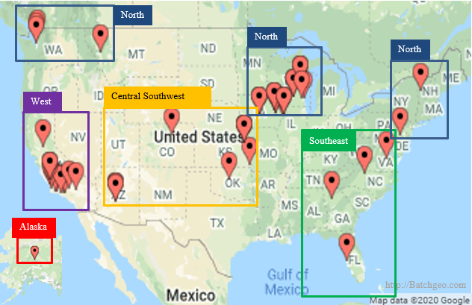
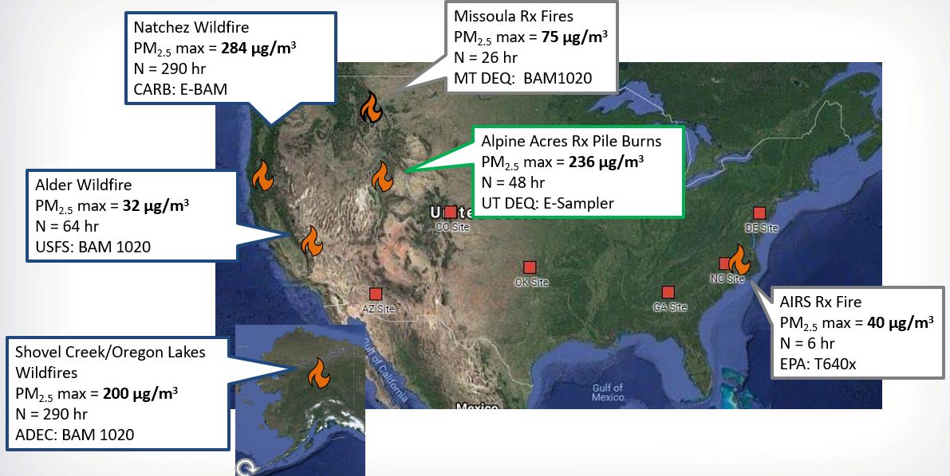
Field Testing of PM_{2.5} Data From PurpleAir Sensors
Ambient Collocations
Sensors were collocated with FRM, FEM, or temporary monitors across the country
  Typical ambient conditions were sampled in several NOAA climate regions spanning several seasons with the help of state/local/tribal agency partners
  Smoke impacted conditions were sampled from fresh and aged prescribed and wildfire burns with several fuel types
  Higher concentrations were sampled from several locations during 2020 wildfires
2020 Extreme Smoke Impacted Sites
Publications:
Holder et al. 2020, https://doi.org/10.3390/s20174796
Barkjohn et al. 2020, https://doi.org/10.5194/amt-2020-413
Smoke Impacted Collocations

Slide 10
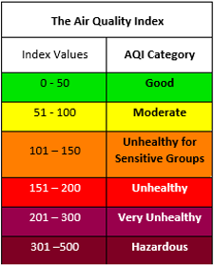
Development of the Extended U.S.-Wide Correction for PM_{2.5} Data from PurpleAir Sensors
Work led to development of a U.S.-wide correction equation for PurpleAir PM_{2.5} data
  Goal to develop a single model to be applied to all crowdsourced PM_{2.5} data from PurpleAir sensors
  Model must reduce bias and error across the concentration range using, at most, a two-piece equation
  Accurate NowCast AQI determination is a key metric
  Performance in areas not represented in the model is key so consistent performance on withheld datasets is important
  A less complex model is also less likely to overfit the data
Low Concentration PA_{cf_1} ≤ 343 µg m⁻³ | PM_{2.5} = 0.52 x PA_{cf_1} - 0.086 x RH + 5.75
High Concentration PA_{cf_1} > 343 µg m⁻³ | PM_{2.5} = 0.46 x PA_{cf_1} + 3.93 x 10⁻⁴ x PA_{cf_1}² + 2.97
PA_{cf_1} = PurpleAir PM_{2.5} from the higher of the 2 correction factors (cf) currently labeled as cf_1

Slide 11
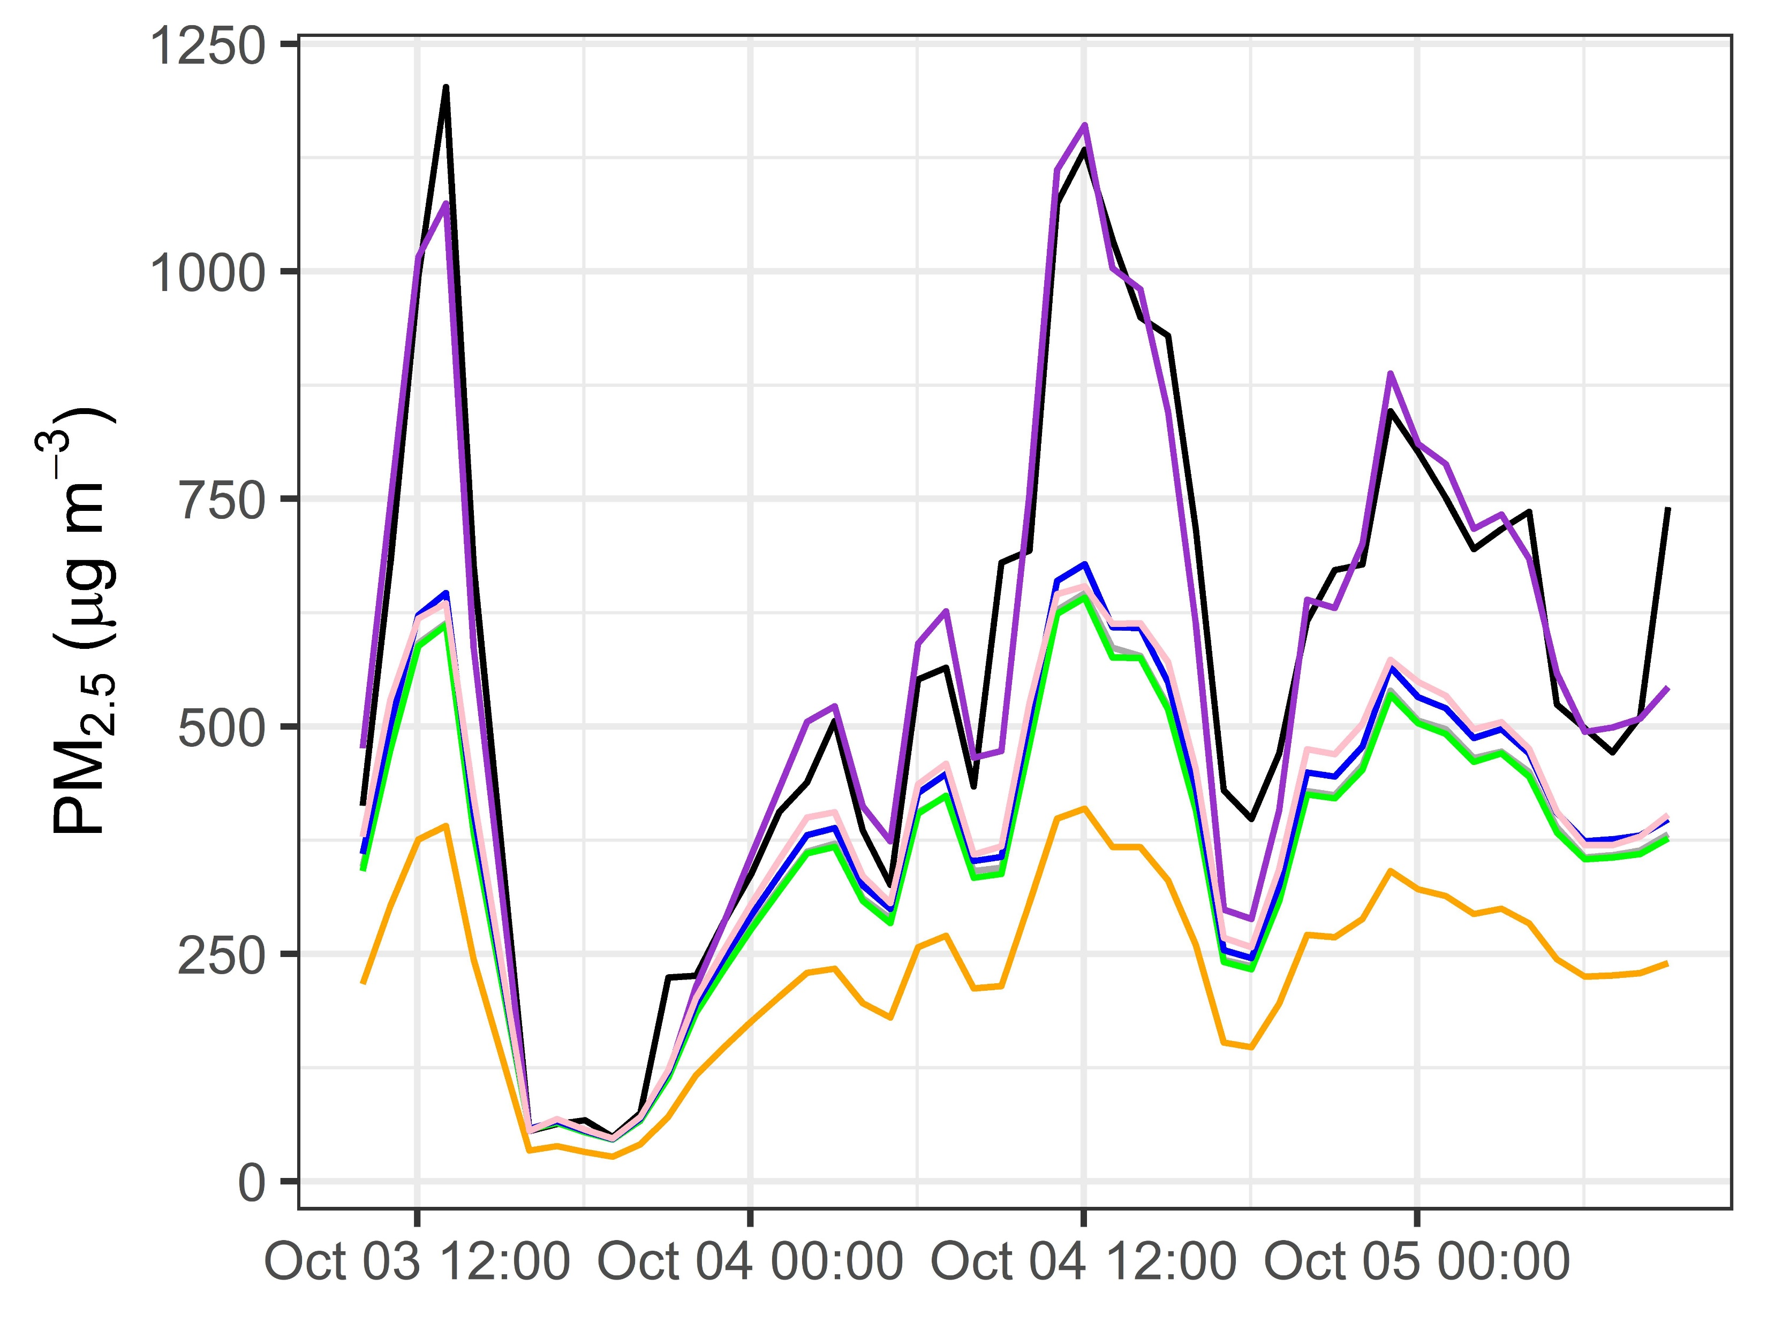
Application of the Extended U.S.-Wide Correction Improves PM_{2.5} Estimates
Example: 1-hr 2020 averaged data from Forks of Salmon (CA)
The extended U.S.-wide correction yields better agreement between sensor and reference concentrations
  Better agreement over the full range of concentrations
  Evaluation at Air Quality Index (AQI) breakpoint suggests the bias ≤±8% and error ≤± 20%
  Other corrections available on PurpleAir.com¹ look very similar to the old US-wide correction except the LRAPA² correction which underestimates above 60 µg m⁻³
Monitor
PurpleAir
Extended correction
Old U.S.-wide correction
Wood
smoke
AQ&U
LRAPA
Cf_alt*3
¹Cf_alt*3 may soon be added. Details: https://doi.org/10.1016/j.atmosenv.2021.118432
²LRAPA – Lane Regional Air Protection Agency

Slide 12
Resources
U.S. EPA Air Sensor Toolbox - https://www.epa.gov/air-sensor-toolbox
  Performance evaluations done by EPA and other organizations
  Sensor Performance Targets and Test Protocols Reports
  Technical Details About Air Sensor Data on the Fire & Smoke Map
  Air Sensor Research Overview
  Conferences, Workshops, and Webinars
  Reports and Publications
  Air Sensor Guidebook
  Collocation Guide
  Educational resources
Andrea Clements
clements.andrea@epa.gov
U.S. Environmental Protection Agency

Slide 13
Supplemental Slides
U.S. Environmental Protection Agency

Slide 14
Estimating Performance for other PM_{2.5} Sensors
Consider existing evaluation results conducted under ambient (field) and controlled (laboratory) conditions
  South Coast Air Quality Management District’s Air Quality Sensor Performance Evaluation Center (AQ-SPEC)
  U.S. EPA Office of Research and Development (ORD)
  Europe’s Joint Research Center (JRC)
  Airparif’s AIRLAB Microsensors Challenge
U.S. EPA recently released two reports that outline recommended performance testing protocols, metrics, and target values for air sensors for ozone (O₃) and fine particulate matter (PM_{2.5}) sensors
  Provide a consistent approach for performance testing and reporting results to help users identify sensors that meet their needs
14

Slide 15
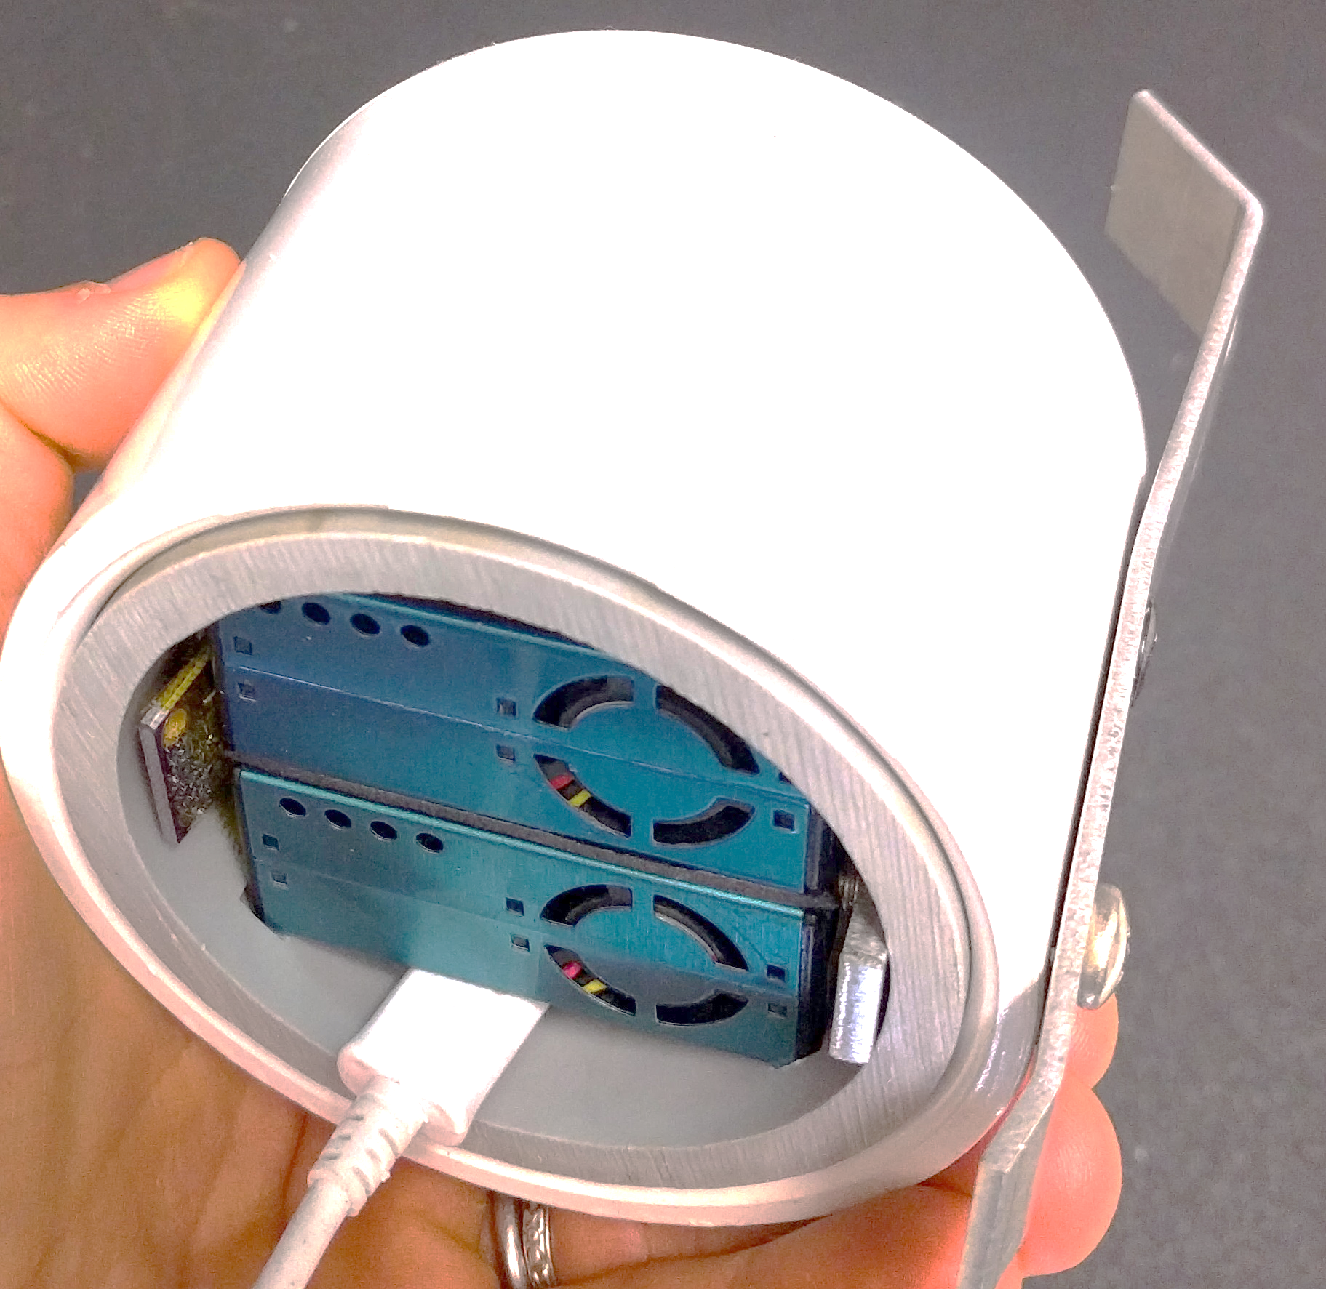
Overview of PurpleAir Sensors
PurpleAir Data Hardware
  2 Plantower PMS5003 PM sensor (channels A & B)
  BME280 pressure, temperature, humidity sensor
  Sample for alternating 10-second intervals
  Generate 2-minute averages
    Previously 80-second averages
PurpleAir Data Outputs
  Reports estimated Particulate Matter
  concentrations (PM₁, PM_{2.5}, PM₁₀)
  Reports internal temperature (T) and relative humidity (RH)
PurpleAir Data Storage
  Streamed to the PurpleAir cloud via WiFi
    Public – displays on the public PurpleAir map
    Private – displays only when the owner is logged in; data can be download/viewed only with owner permission
  Stored locally on a microSD card (PA-II-SD model only)
A & B channels
PurpleAir underside view
User supplies information at registration
  Name
  Location
  Indoor/Outdoor
  Public/Private

