Slide 1



S5P-TROPOMI AER_LH Product
Global aerosol layer height
M. de Graaf, S. Nanda, P. Veefkind, M. Sneep, M. ter Linden
Overview
Recent improvements
Validation
Issues and future improvements
CEOS Atmospheric Composition Virtual Constellation AC-VC-17 | 7-11 June 2021 | M. de Graaf et al. – Aerosol Layer Height

Slide 2
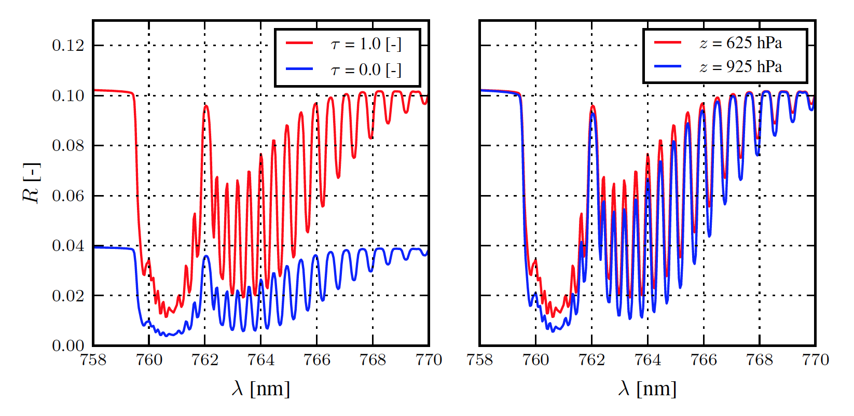
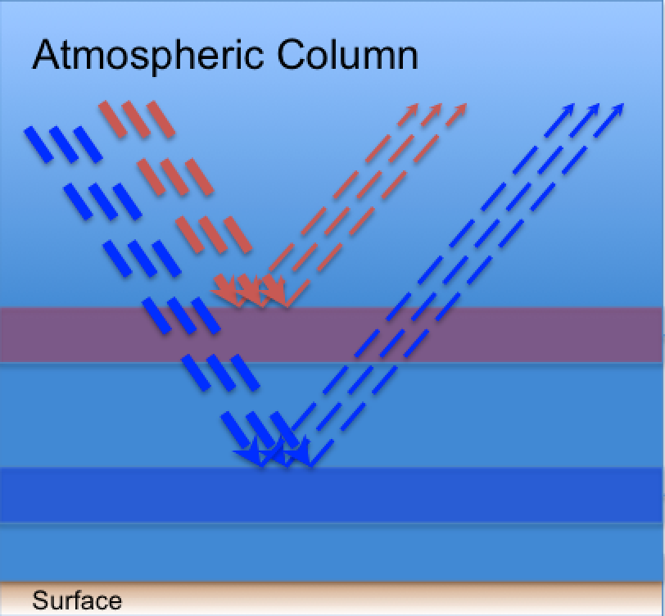
ALH algorithm
TROPOMI ALH is based on
O2-A band retrieval of scattering layer height
Forward model based on NN
Optimal Estimation
One homogenous layer, fixed 100 hPa thickness, fixed aerosol model (WA)
Fitted is mid-layer pressure (z_{p}) and τ

Slide 3
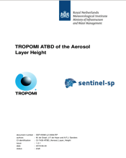
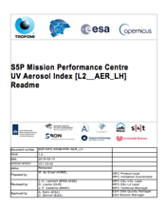
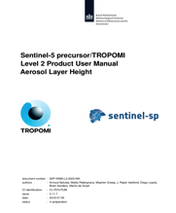
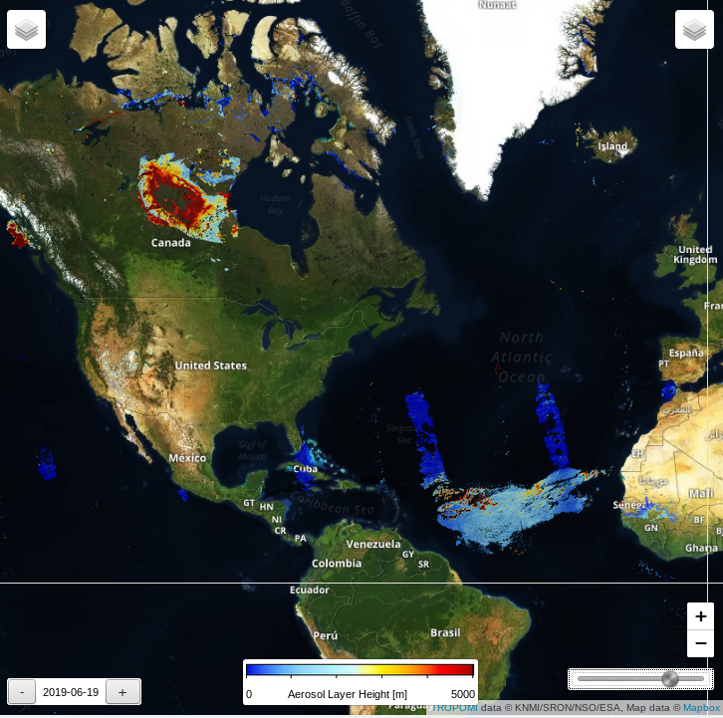
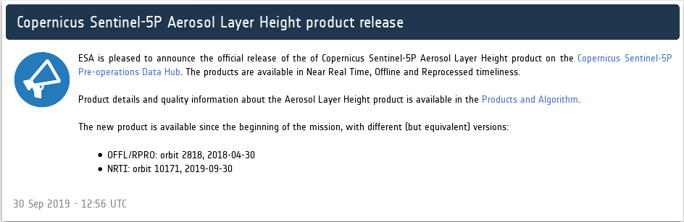
Wildfire smoke
TROPOMI ALH is available
globally, land and ocean, cloud screened
within 3 hrs of sensing
for absorbing aerosol layers
Sunglint
Desert Dust
TROPOMI AER_LH
released Sept. 30, 2019
CEOS Atmospheric Composition Virtual Constellation AC-VC-17 | 7-11 June 2021 | M. de Graaf et al. – Aerosol Layer Height

Slide 4
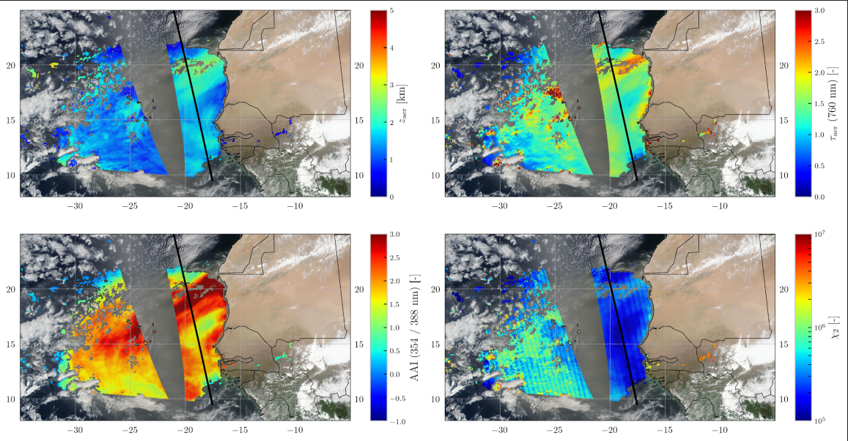
2018 - 06 - 01

Slide 5
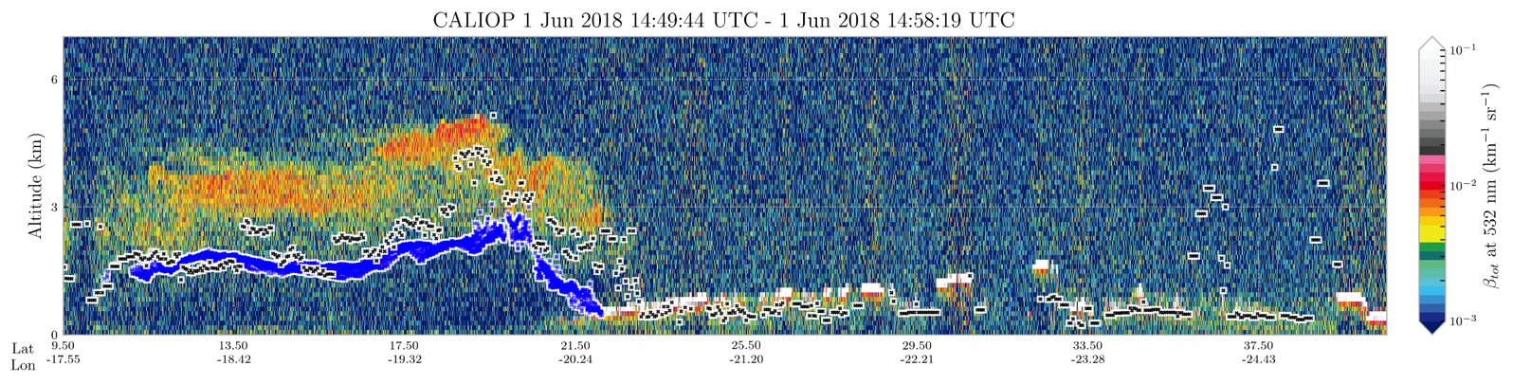
2018 - 06 - 01
Tropomi ALH
Caliop weighted ext.
CEOS Atmospheric Composition Virtual Constellation AC-VC-17 | 7-11 June 2021 | M. de Graaf et al. – Aerosol Layer Height

Slide 6
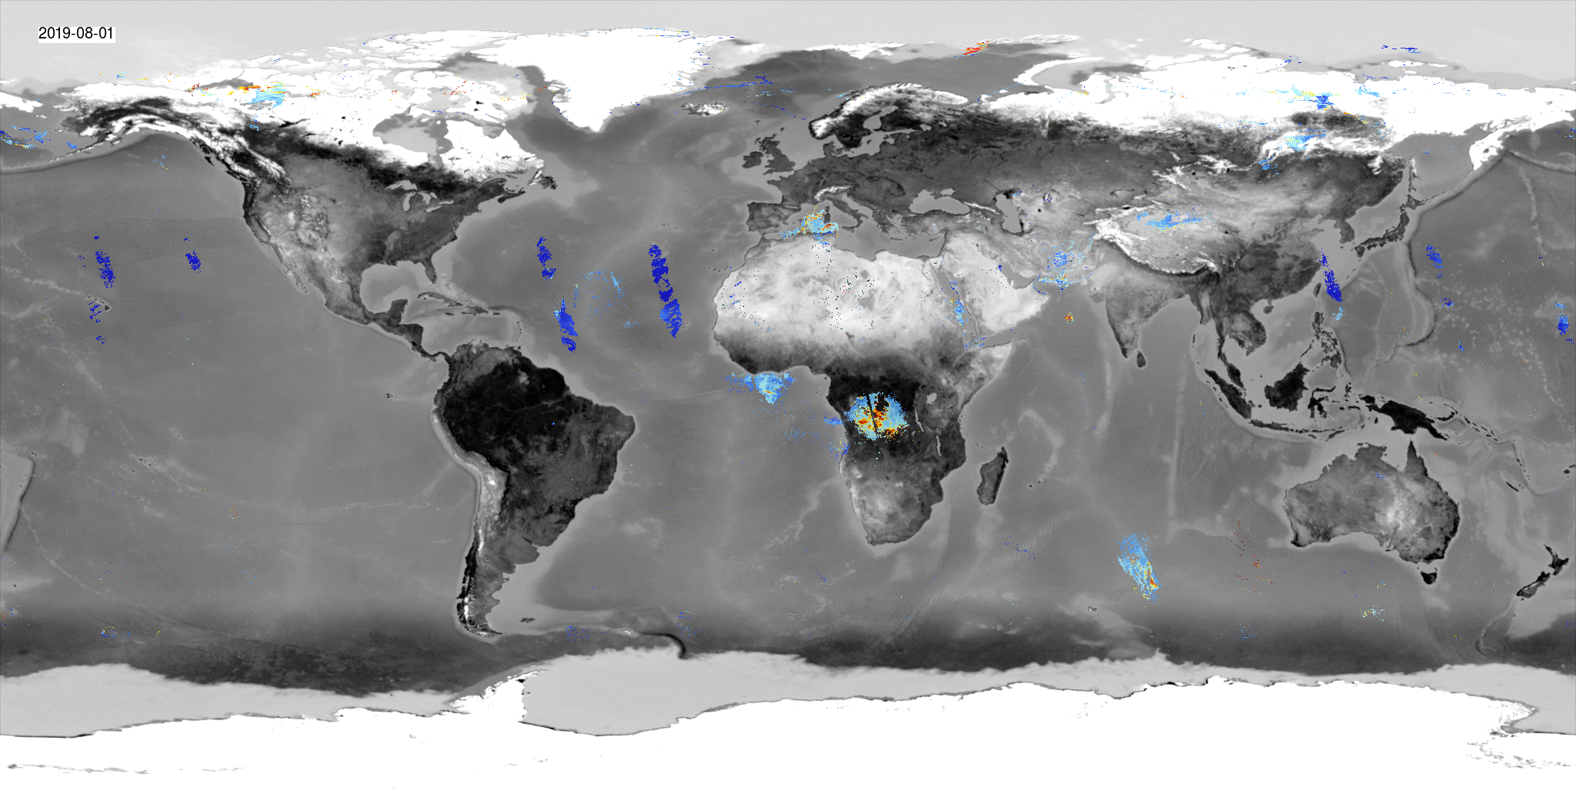
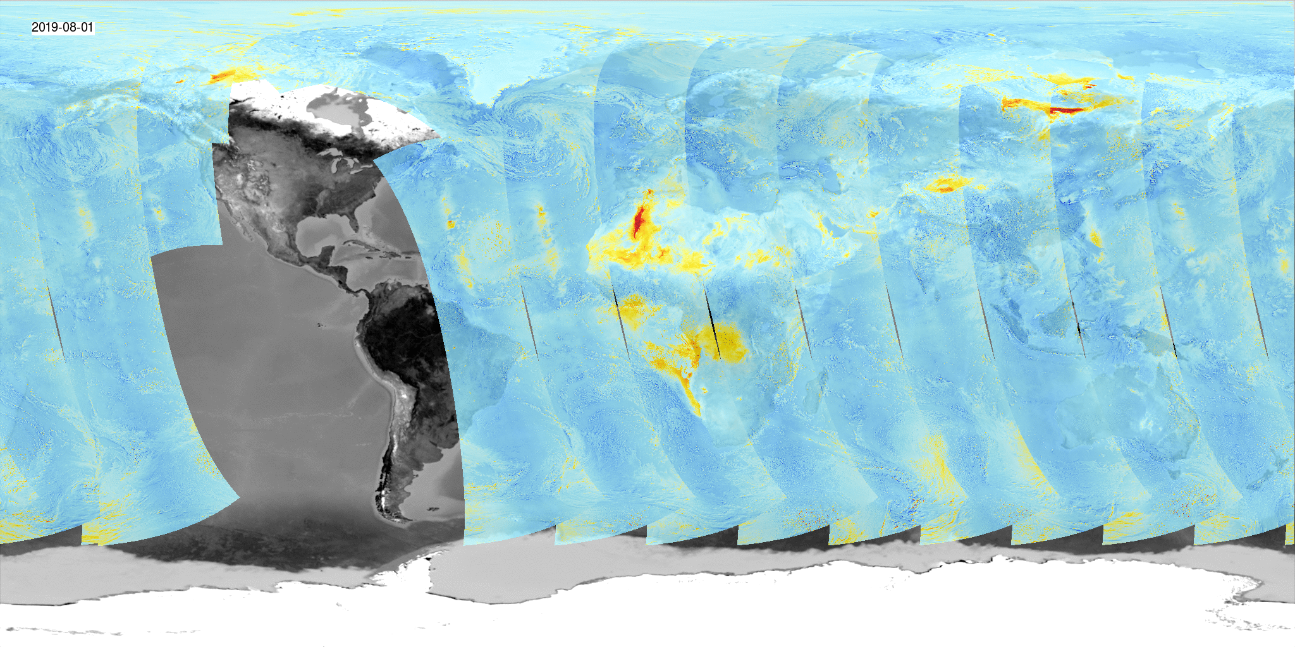
Siberian wildfire
smoke
Desert dust
Sunglint
African wildfire smoke
ALH
August 2019
ALH and AAI
show absorbing aerosol events
AAI

Slide 7
Upcoming version 2
CEOS Atmospheric Composition Virtual Constellation AC-VC-17 | 7-11 June 2021 | M. de Graaf et al. – Aerosol Layer Height

Slide 8
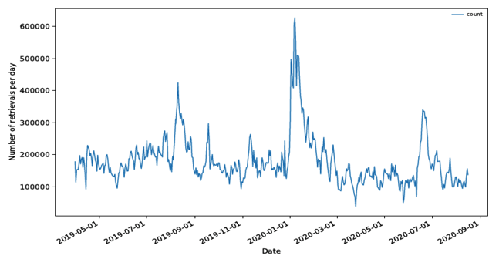
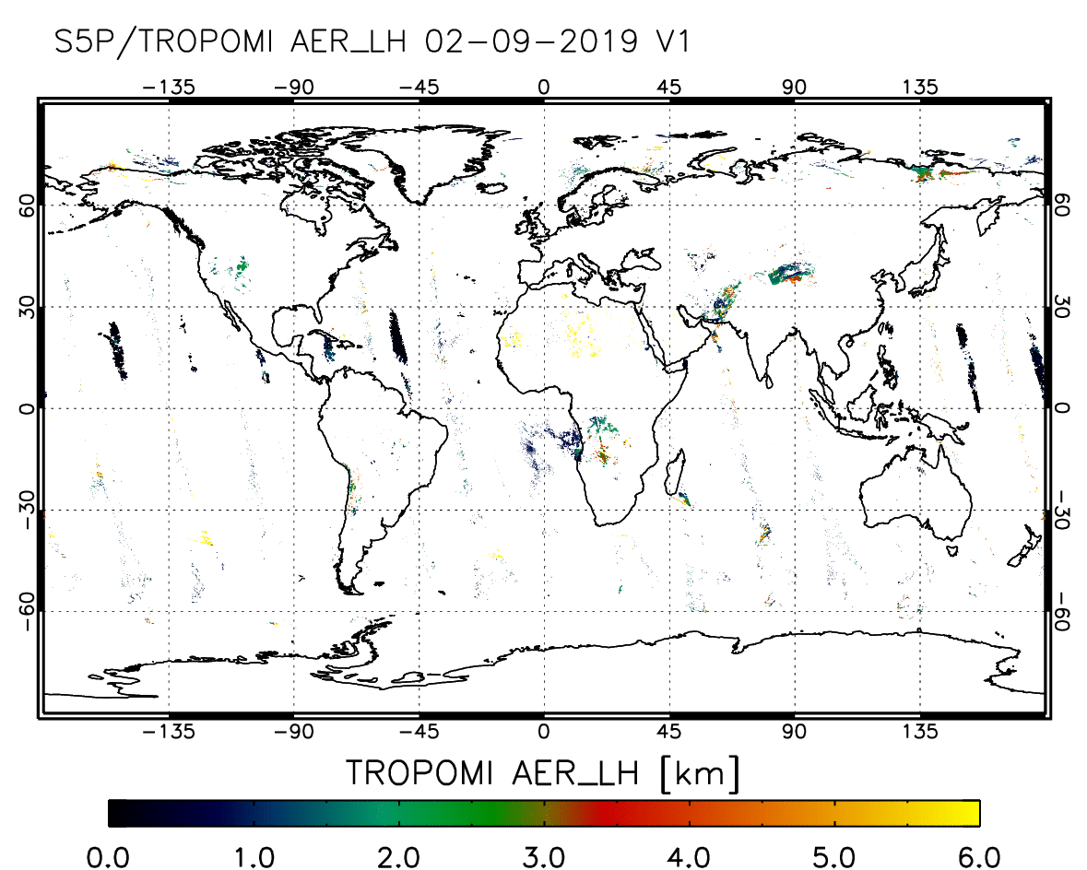
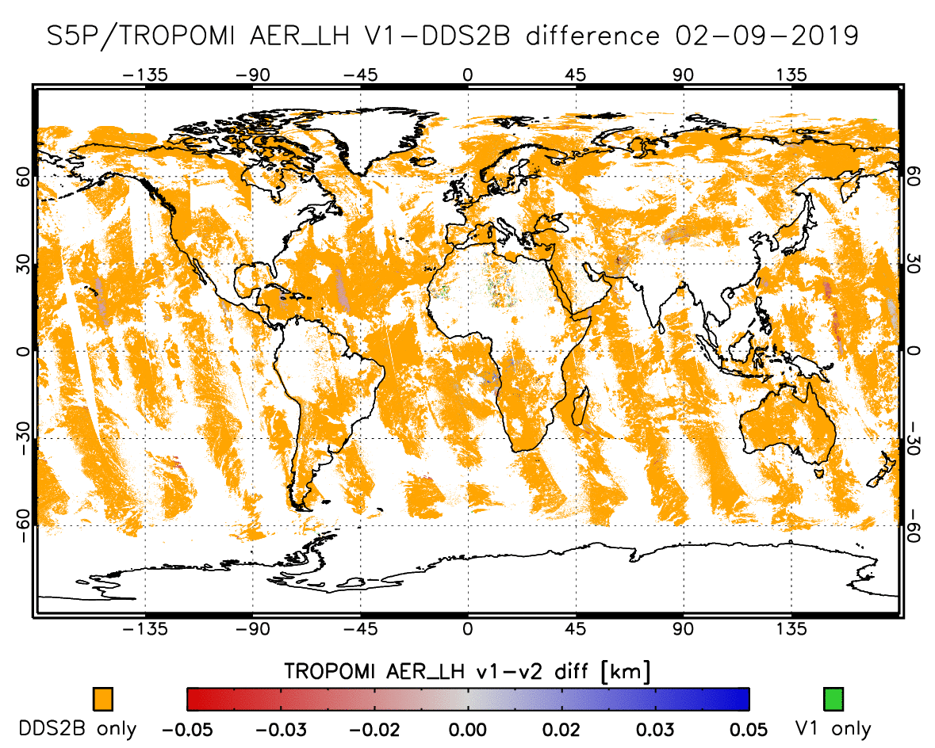
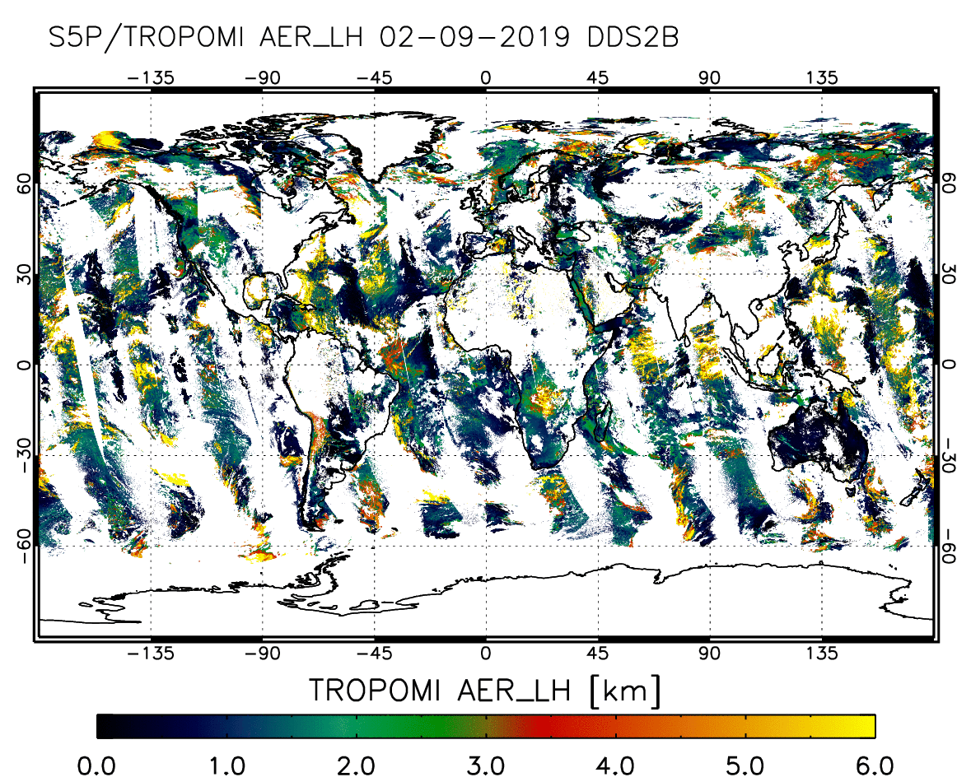
Aussie fires
ALH is currently only processed for pixels wih AAI>0 (plumes of absorbing aerosols)
v1 problems:
AAI is degrading
non-absorbing aerosols are not processed
Need for strict filtering is gone since the introduction of NN-very fast processing
cloud mask filtering makes more sense for all aerosol products
v2:
Filtering only on clouds and sunglint
number of pixels with AAI > 0
V1 -- V2
V1
V2
V2 only

Slide 9
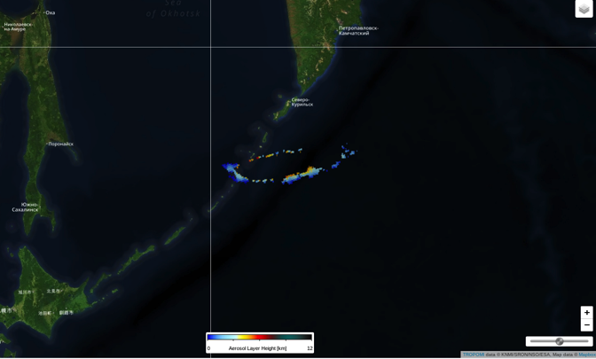
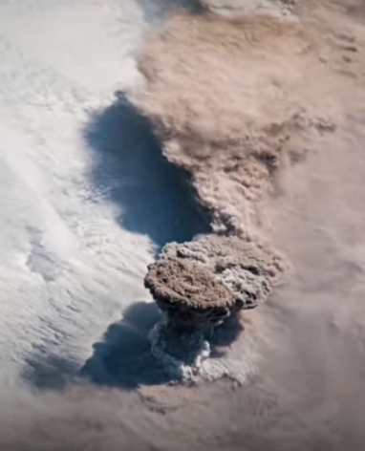
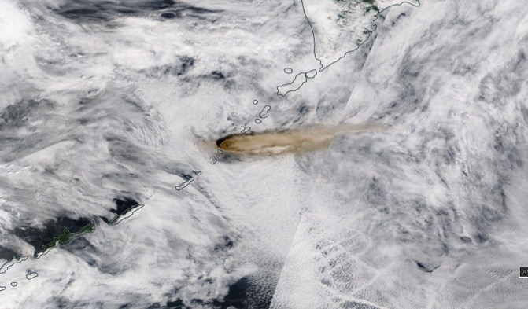
No retrieval due to
cloud filter
Plumes filtered as clouds:
Cloud filter is off for AAI>1
ALH
ISS digital camera
VIIRS RGB
Raikoke (Russia) eruption 22 June 2019

Slide 10
Validation
CEOS Atmospheric Composition Virtual Constellation AC-VC-17 | 7-11 June 2021 | M. de Graaf et al. – Aerosol Layer Height`

Slide 11
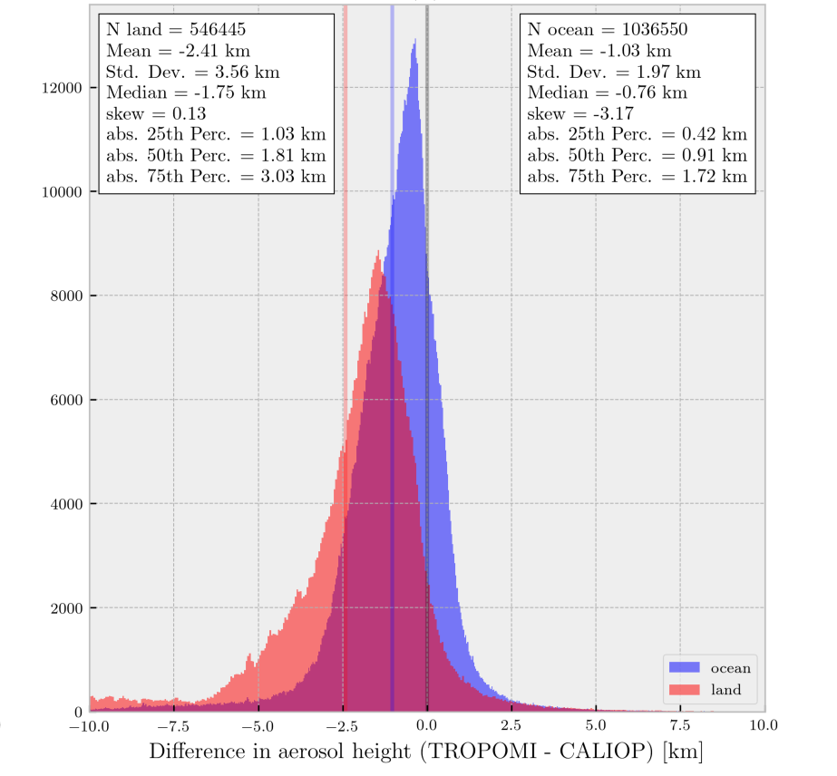
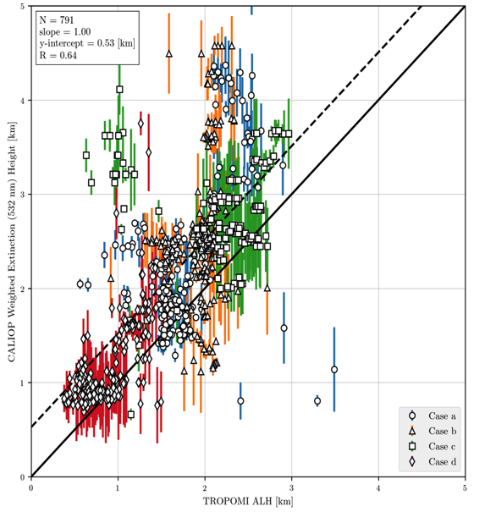
TROPOMI vs. CALIOP ALH
All colocated pixels May '18-March '19
4 selected events
collocation:
< 100 km
< 5 hrs
Nanda et al., AMT, 2019
CALIOP weighted ext.
Ocean
land
TROPOMI ALH

Slide 12
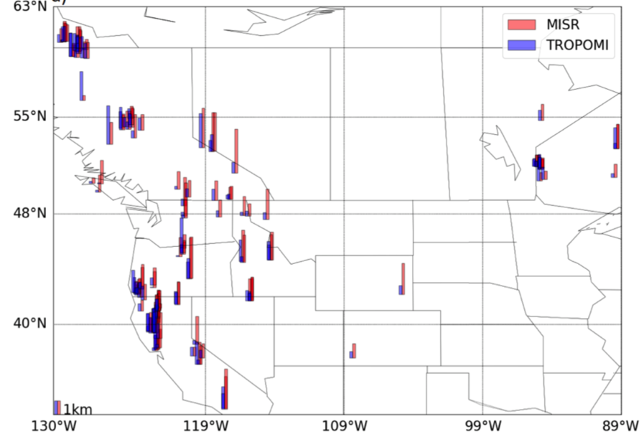
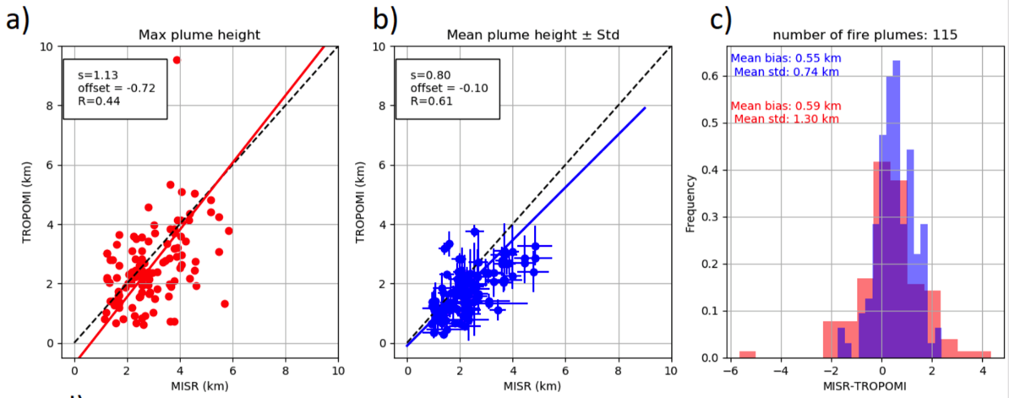
TROPOMI vs. MISR ALH for fire plumes
Courtesy:
D. Griffin,
Environment & Climate Change Canada
Griffin et al., AMT, 2019
TROPOMI
TROPOMI
MISR
MISR
MISR – TROPOMI

Slide 13
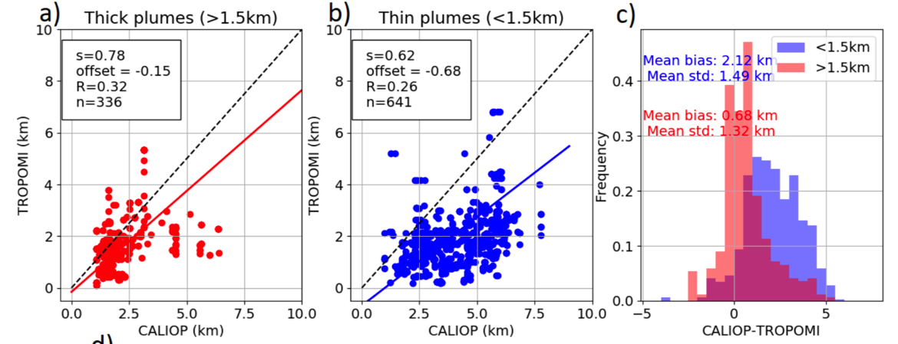
TROPOMI vs. CALIOP ALH for fire plumes
Courtesy:
D. Griffin,
Environment & Climate Change Canada
Griffin et al., AMT, 2019
TROPOMI
TROPOMI
CALIOP
CALIOP
CALIOP– TROPOMI

Slide 14
ALH validation conclusions
ALH is a centroidal layer height.
Multiple layers cannot be detected, but an average height is retrieved
±0.6 km lower than MISR plume height, very close to expectations
Lower than Caliop, as expected
ALH is more accurate for thicker plumes (> 3km CALIOP and TROPOMI < 50 m!)
Thin plumes and high altitude plumes may be missed.
High surface albedo biases ALH low
Fire plume heights were not found to depend on fire classification, fire power, or scattering geometry.
CEOS Atmospheric Composition Virtual Constellation AC-VC-17 | 7-11 June 2021 | M. de Graaf et al. – Aerosol Layer Height

Slide 15
Issues and future improvements
CEOS Atmospheric Composition Virtual Constellation AC-VC-17 | 7-11 June 2021 | M. de Graaf et al. – Aerosol Layer Height

Slide 16
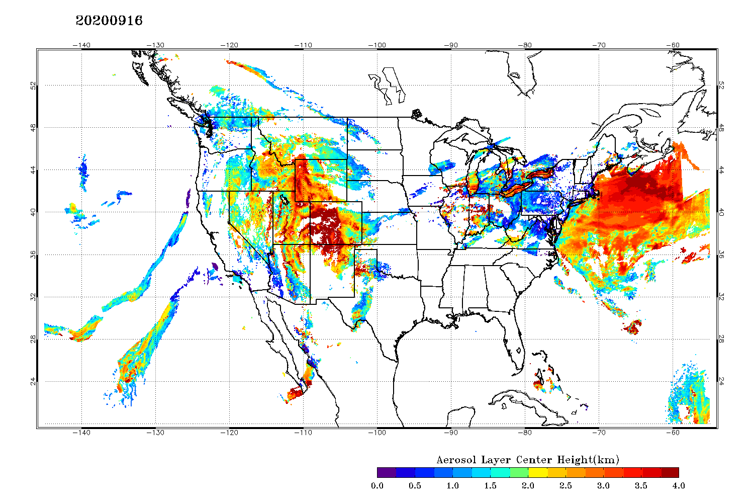
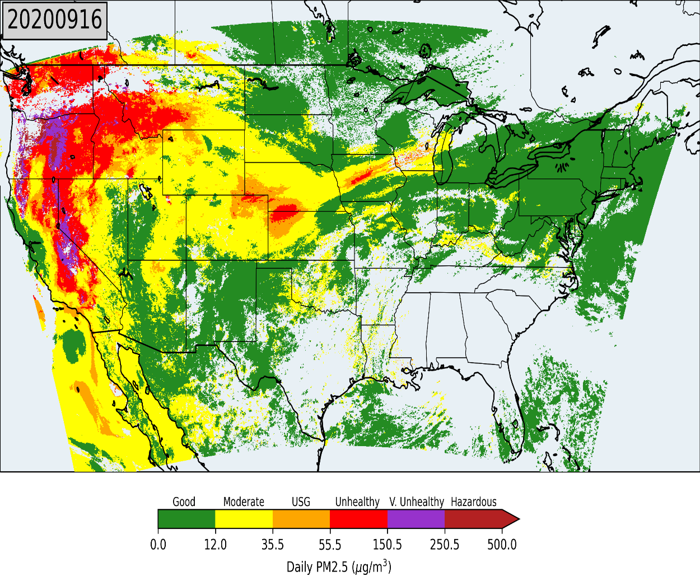
land/sea contrasts and high surface albedo bias

Slide 17
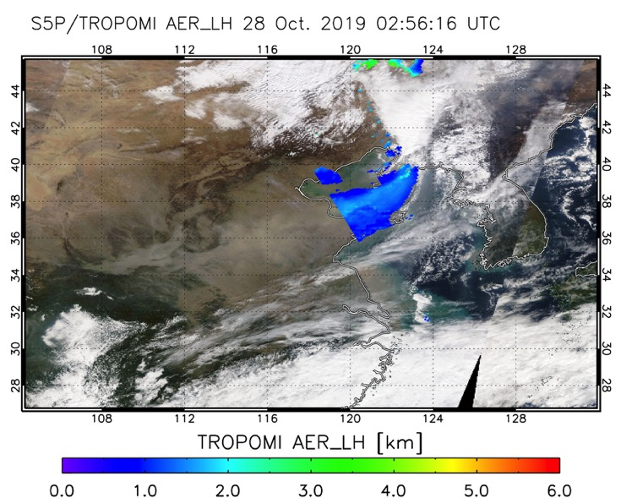
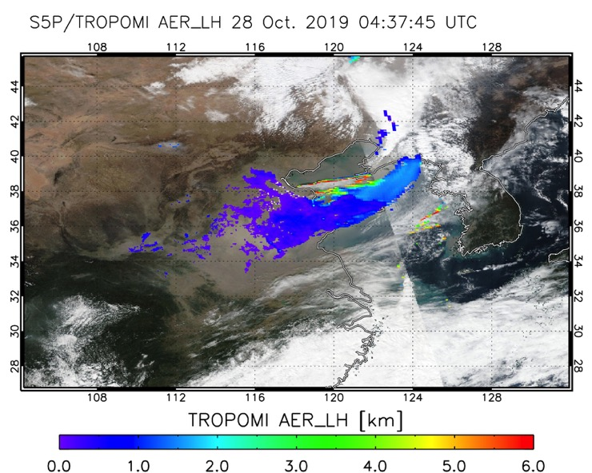
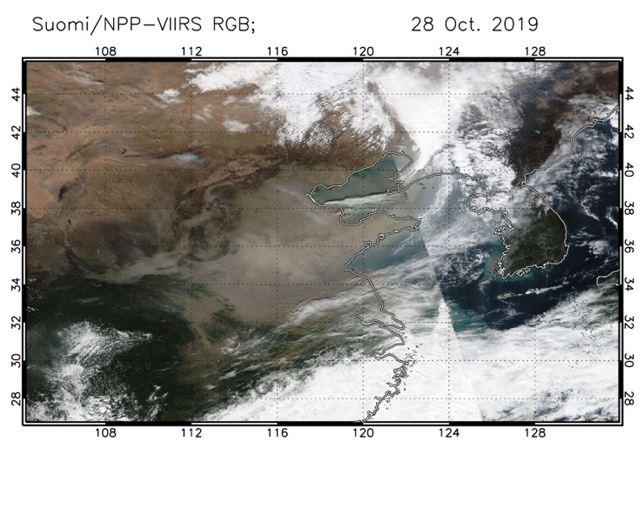
(Angular) surface effects
Polluted dust in China,
Oct 2019
CEOS Atmospheric Composition Virtual Constellation AC-VC-17 | 7-11 June 2021 | M. de Graaf et al. – Aerosol Layer Height`

Slide 18
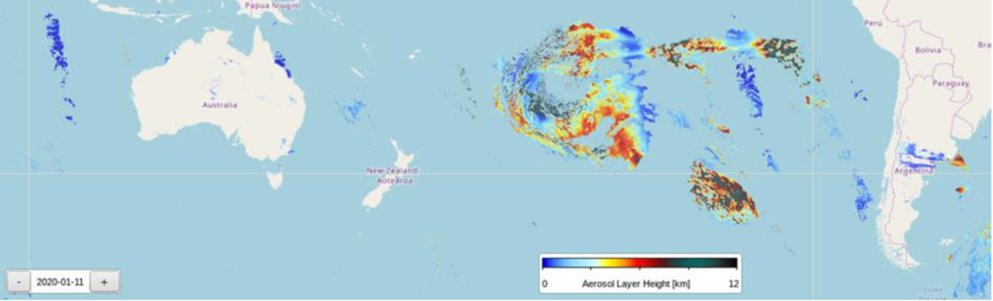

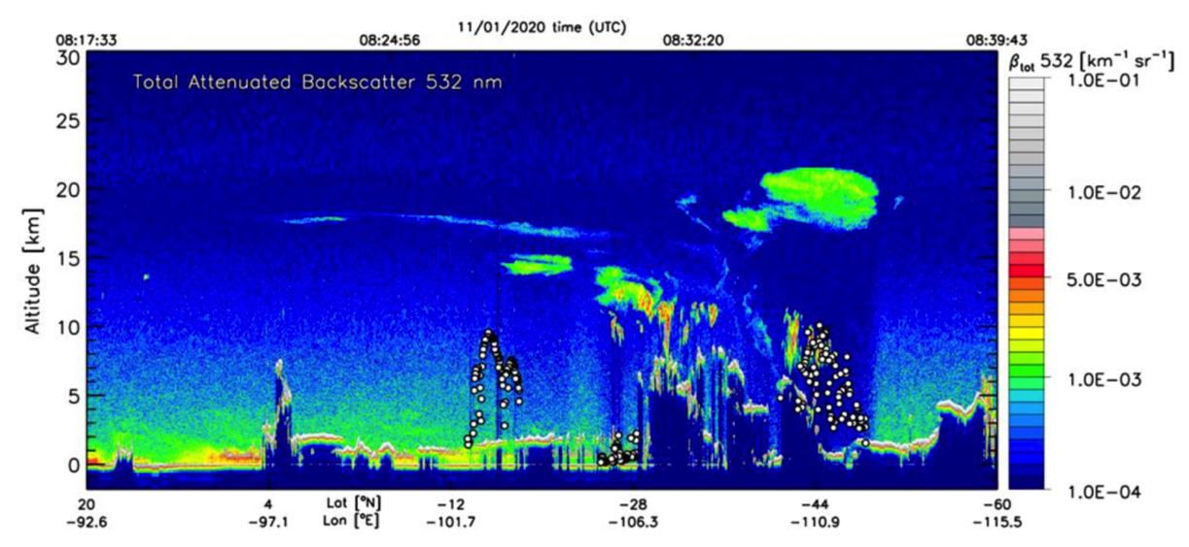
calipso track
upper altitude limit
ALH on 11 Jan 2020
Smoke from fires in
New South Wales reached
up to 25 km!
TROPOMI ALH was
never > 12 km
smoke
Tropomi ALH

Slide 19
Version 2.0 will released soon
Improved cloud screening, global coverage
Future plans:
Fit surface albedo
Use improved (D)LER when available
Use AOT for plume selection when available
CEOS Atmospheric Composition Virtual Constellation AC-VC-17 | 7-11 June 2021 | M. de Graaf et al. – Aerosol Layer Height

