Slide 1
Aerosol Centroid Layer Height:
New algorithm development and applications
Jun Wang
College of Engineering
University of Iowa
CEOS Atmospheric Composition Virtual Constellation AC-VC-17
June 2020

Slide 2
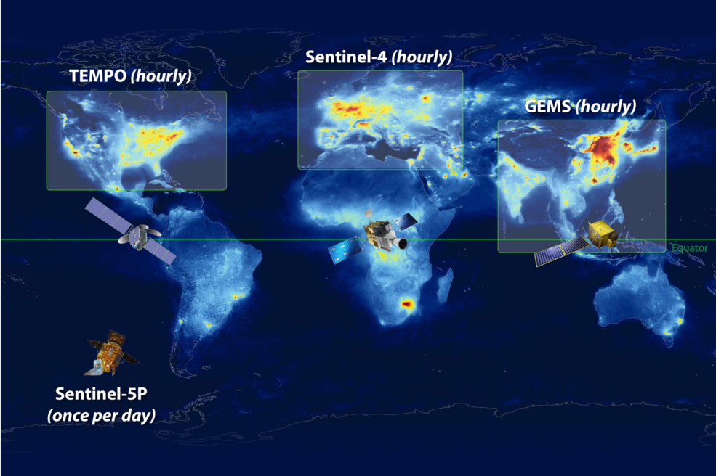
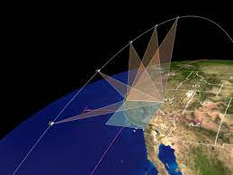
GEO constellation for Aerosol Layer Height mapping in the coming decade
Operational ALH
from O2 B-band (?)
Operational ALH from O2 A-band
2023
2022
2021
Operational ALH from O2-O2 band
ALH from multi-angle O2 A?
Operational ALH retrieval from O2 A-band
MAIA

Slide 3
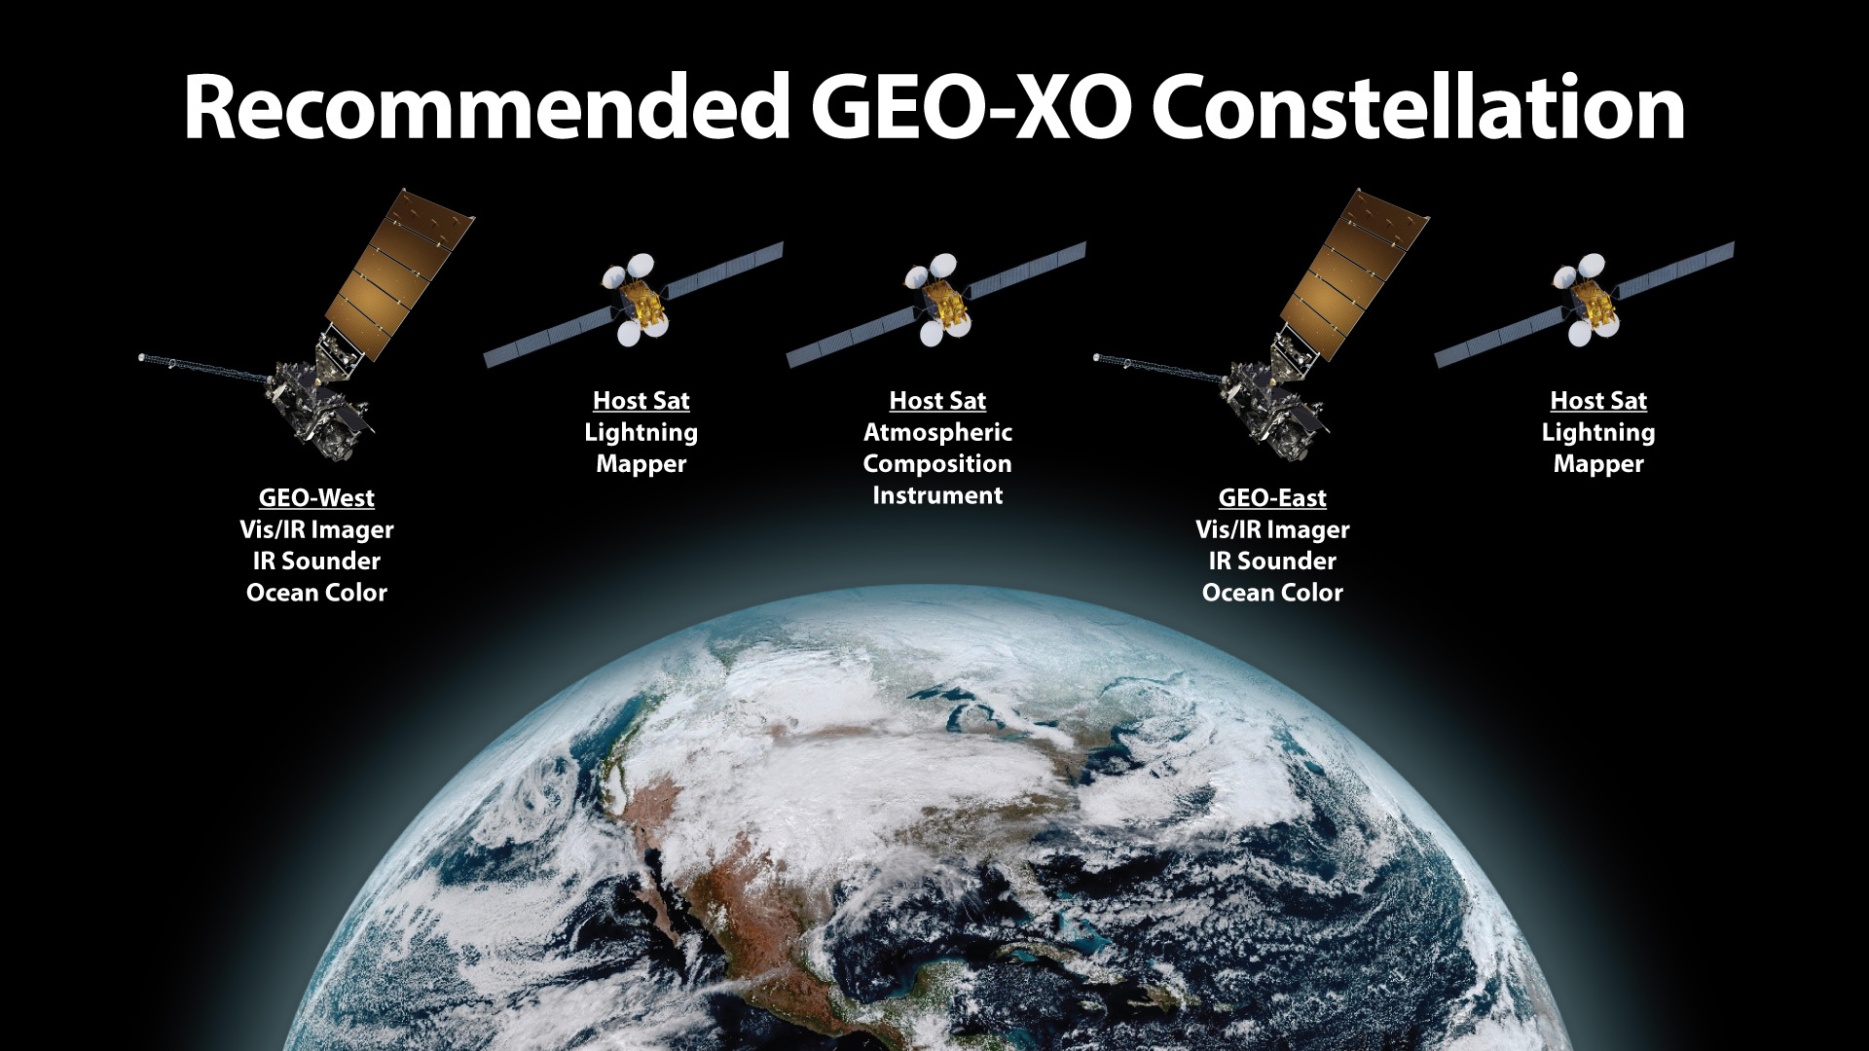
Geostationary and Extended Orbits (GEO-XO) in 2030s
Hourly ALH !
https://www.nesdis.noaa.gov/GEO-XO
Now in formulation

Slide 4
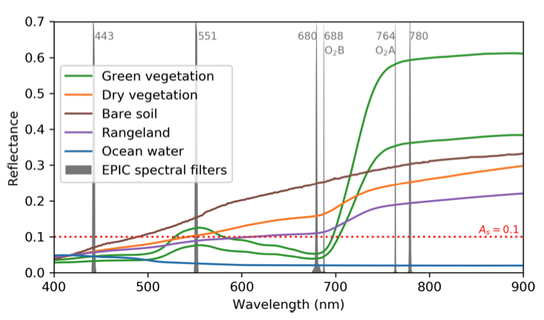
Advantages of O2 B-band
Xu, Wang, et al., 2019, AMT
Blue band
O2-O2 477 nm
O2 B-band has moderate absorption, stronger than O2-O2 at 477 nm and weaker than O2 A. O2 B-band also has very low surface reflectance, comparable if not lower than blue bands, due to Chlorophyll-a absorption.

Slide 5
New Development/Results with primary use of TROPOMI O2 B-band
Deriving Aerosol Optical Centroid Height (AOCH) and AOD by primarily using 420, 680, and 688 nm
Surface reflectance from MODIS climatology and ASTER/USGS spectral reflectance library
Aerosol optical properties derived from AERONET climatology (varying with region)
Quasi-Gaussian distribution for the shape of aerosol vertical extinction profile
Compared with CALIOP data for many many cases
Chen, Wang, et al., 2021, in revision.

Slide 6
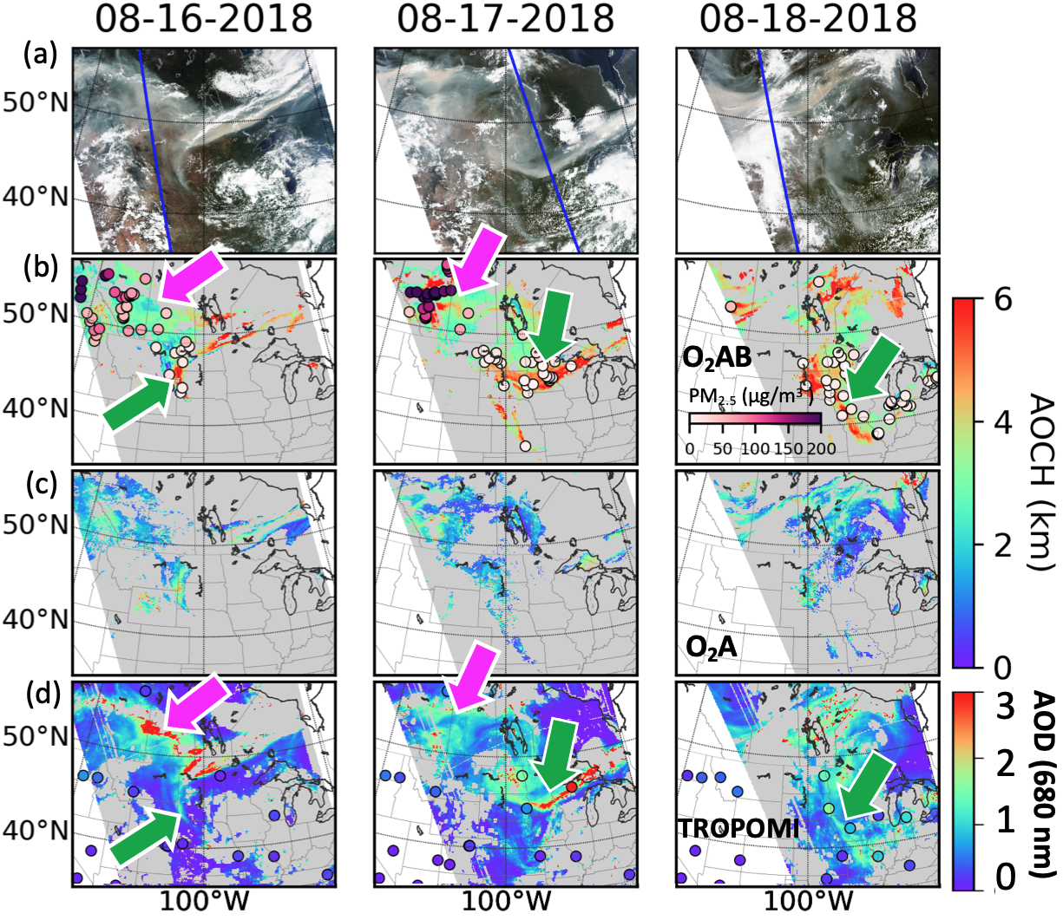
Case Demonstration
Air quality forecast is needed by the state & local communities to make advisories & decisions for mitigating public exposure to air pollution.
Exceptional event analysis requires “satellite imagery of plume with evidence of the plume impacting the ground”.
This study
This study
KNMI
TROPOMI standard
This study
Chen, Wang, et al., in revision.

Slide 7
Improvement on prediction and analysis
Aerosol layer height is one of the most needed information air quality mangers wants (based on HAQAST group discussion on air quality forecast in smoke conditions).
MERRA-2 false alarm!
MERRA-2 Corrected by AOCH!
Chen, Wang, et al., in revision!.

Slide 8
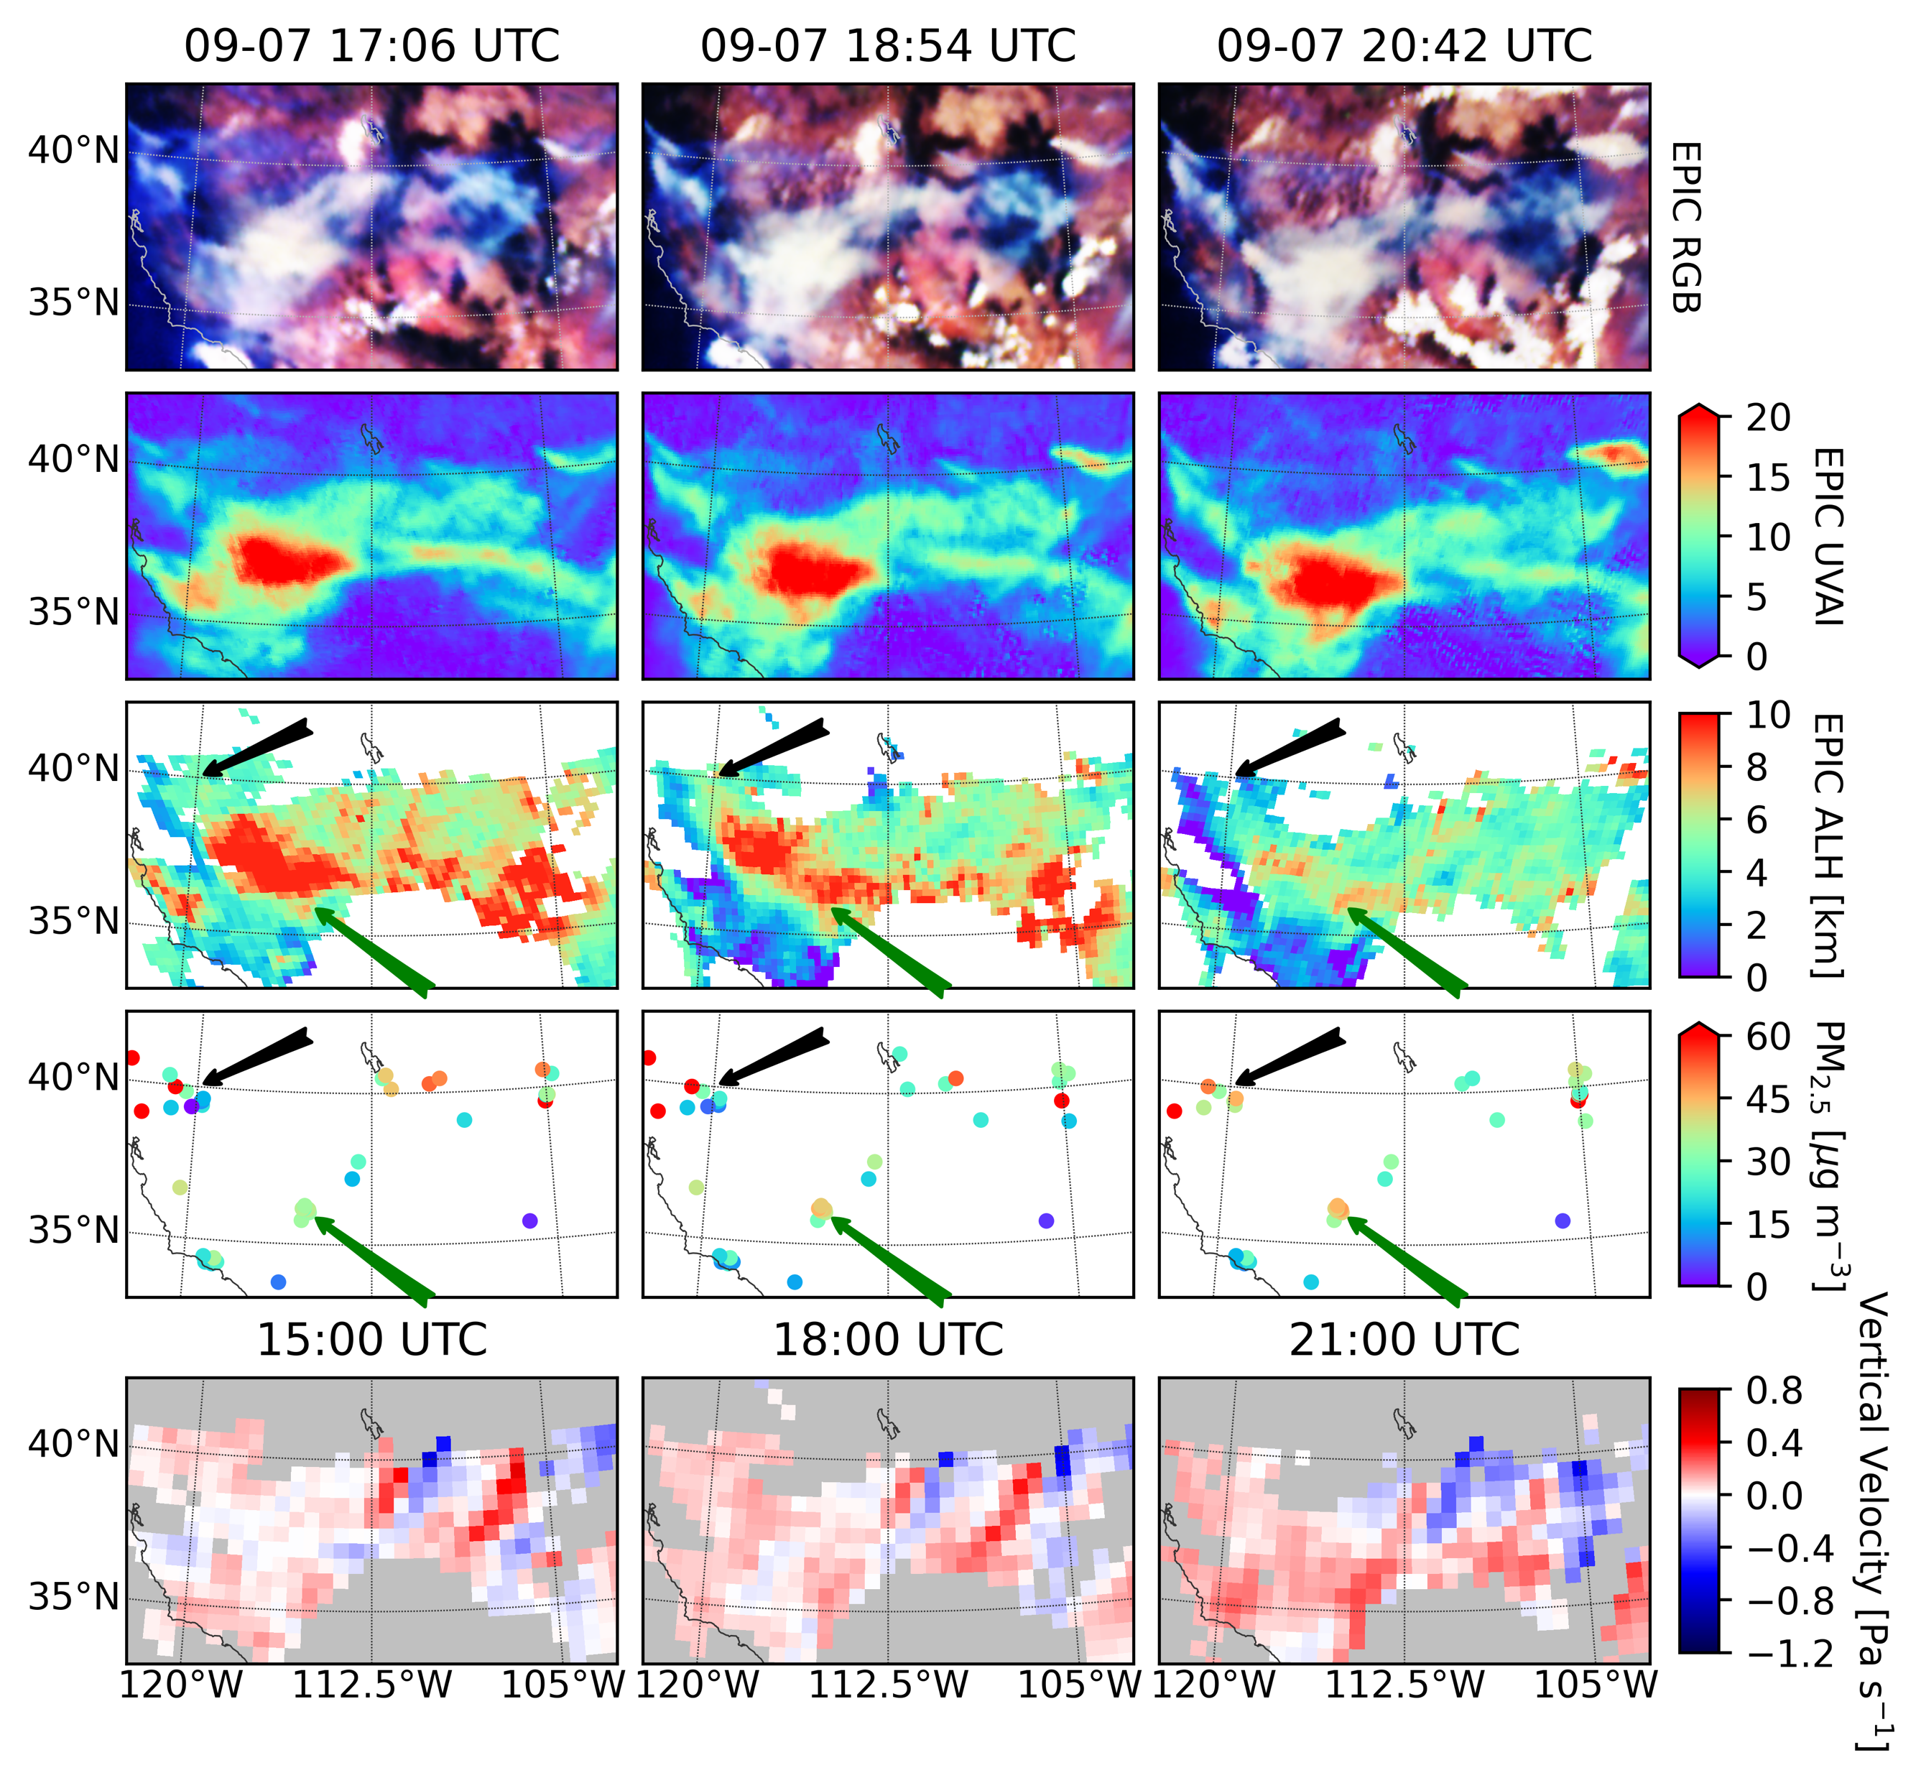
Hourly AOCH
2020
Provide quantitative information of aerosol layer vertical motion.
Northwest:
low AOCH → high PM2.5
Southwest
High AOCH → low PM2.5
Lu, Z. et al., 2021; in prep. In collaboration with Shobha Kondragunta @ NOAA

Slide 9
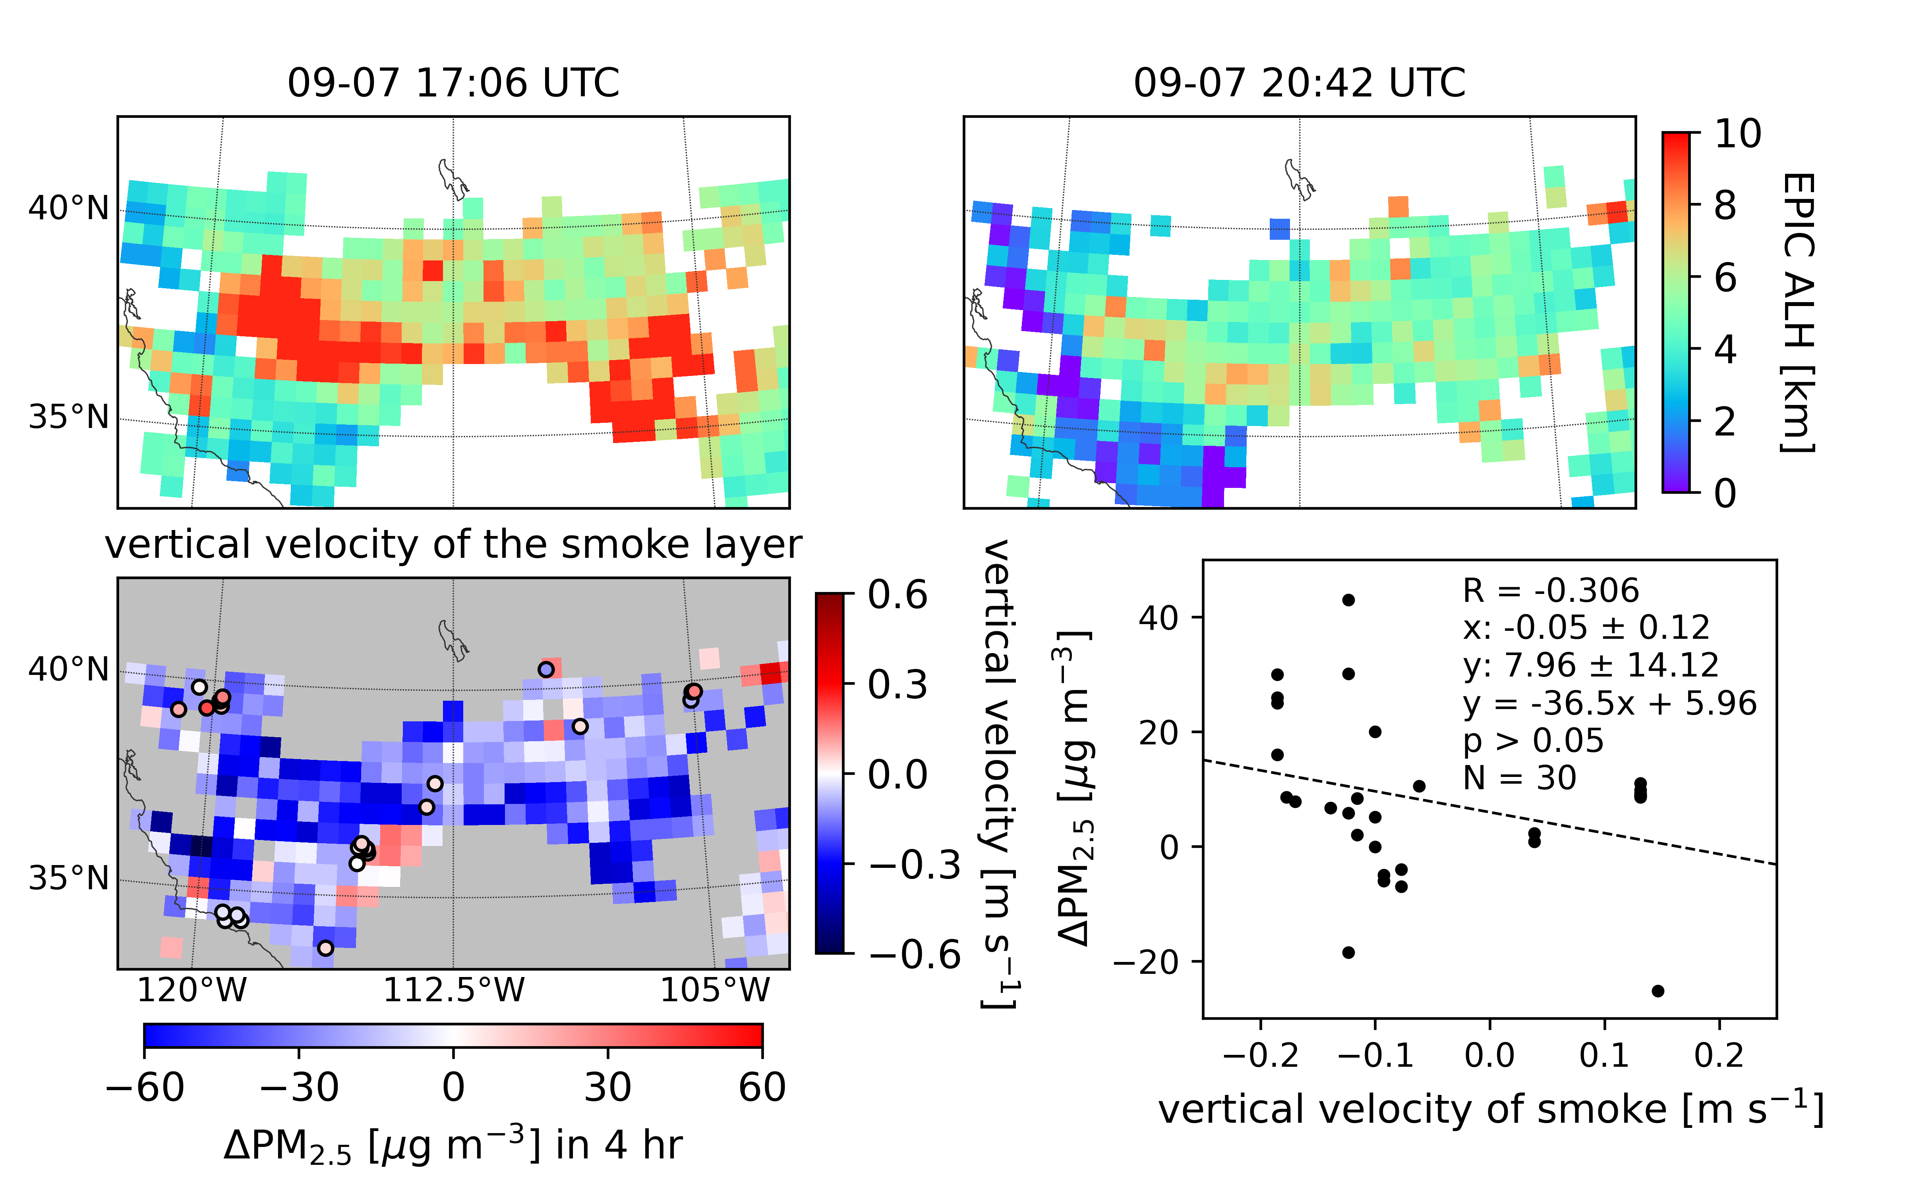
𝚫ALH/𝚫t vs. 𝚫PM2.5 /𝚫t corresponds well spatially
Lu, Z. et al., 2021; in prep. In collaboration with Shobha Kondragunta @ NOAA

Slide 10
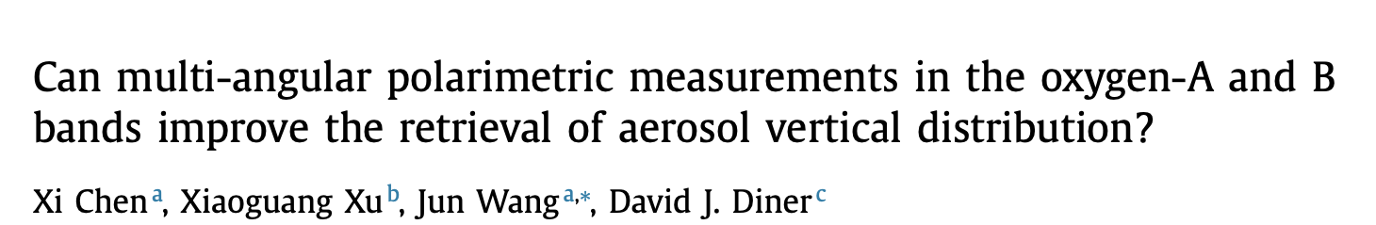
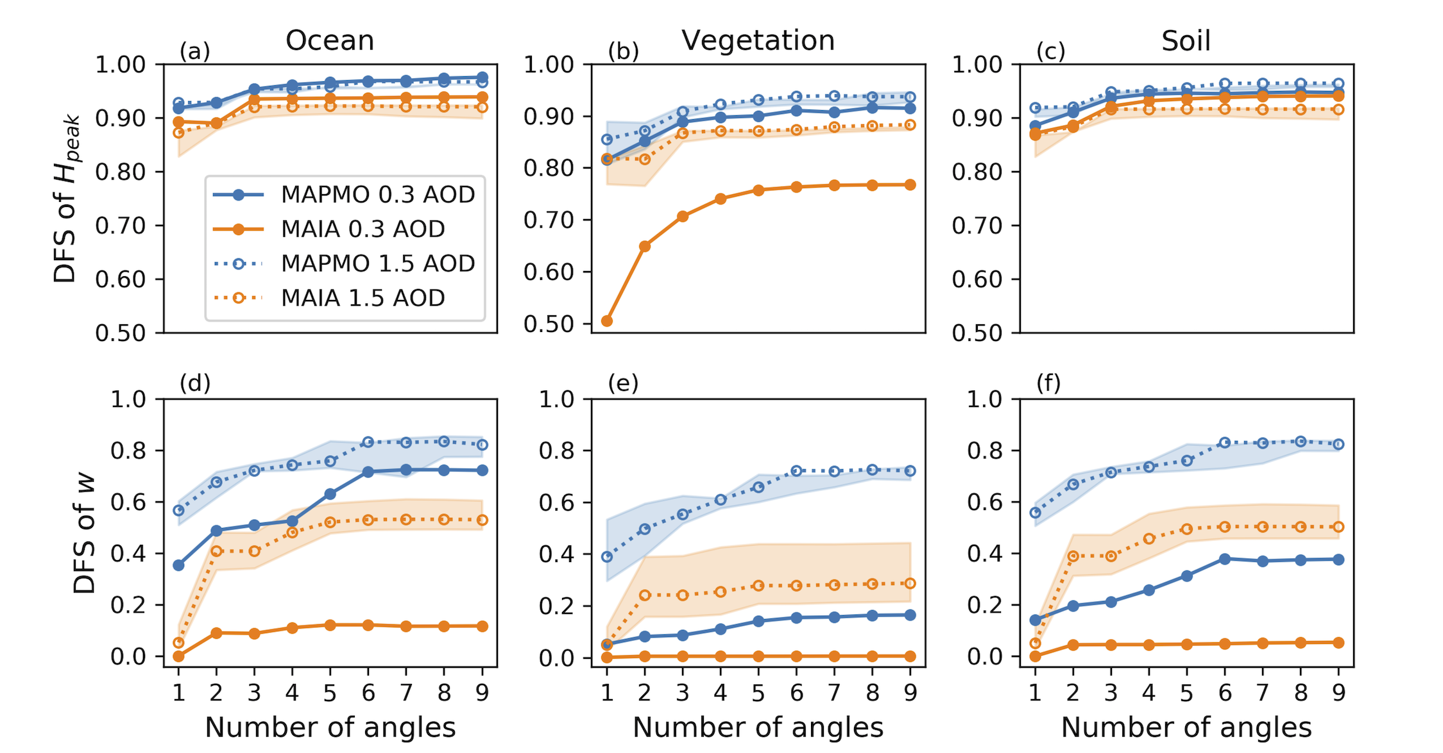
JQSRT, 2021
MAIA has multiple-angle O2 A-bands, which has the potential for retrieving two piece of information of aerosol vertical distribution
Theoretical study show that multiple-angle measurement of polarization in both O2 A- and B-bands can lead to further improvement at all surfaces

Slide 11
Summary and outlook
Virtual constellation is on the rise to provide 3D description of aerosol pollutants, with good hourly spatial converge, especially from passive sensors on geo. platform.
Detailed profiling or active sensing of the diurnal variation of aerosols, at both day and night, currently doesn’t exit, and is strongly needed for bridging and validation of ALHs from multiple passive sensors.

Slide 12


Thank you !
Zhendong Lu
Univ. of Iowa
MRUI: Multidisciplinary University Research Initiative
Applied sciences, ACMAP, MAIA, TEMPO, DSCOVR
C4, GEO-XO program
Xi Chen
Univ. of Iowa

Slide 13
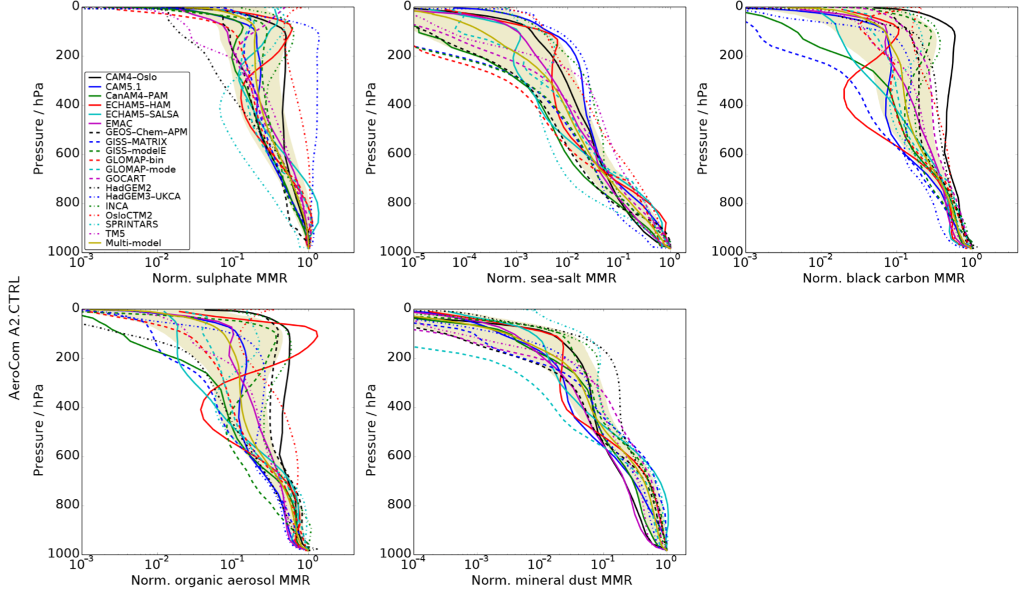
Large uncertainty in aerosol vertical profile
sulfate
sea-salt
black-carbon
Annual and global mean normalized shape of aerosol vertical profile
organic carbon
dust
Kipling et al., 2016;
ACP. AeroCOM-II

Slide 14
Validation with MODIS and CALIOP data
AOD is in good agreement with MODIS; nearly no bias.
Retried ALH has bias of 0.1 km. RMSE of 0.45 km.
Xu et al., 2018

Slide 15
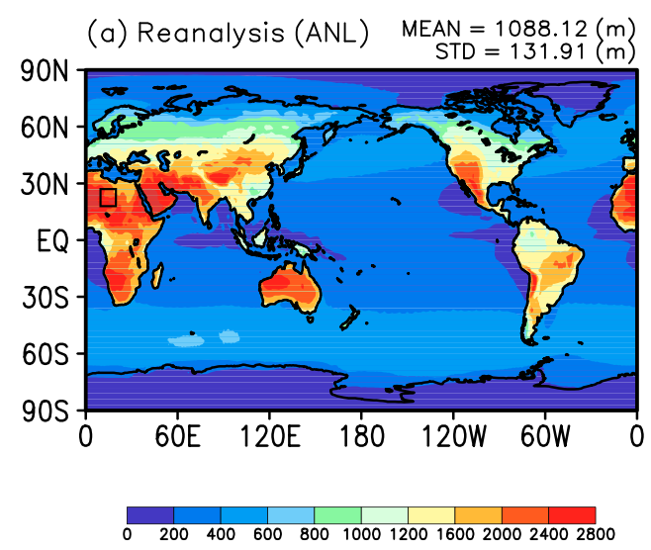
PBLH diurnal amplitude
Shin et al., 2018. Journal of Climate, 31(13), 5071-5087.

Slide 16
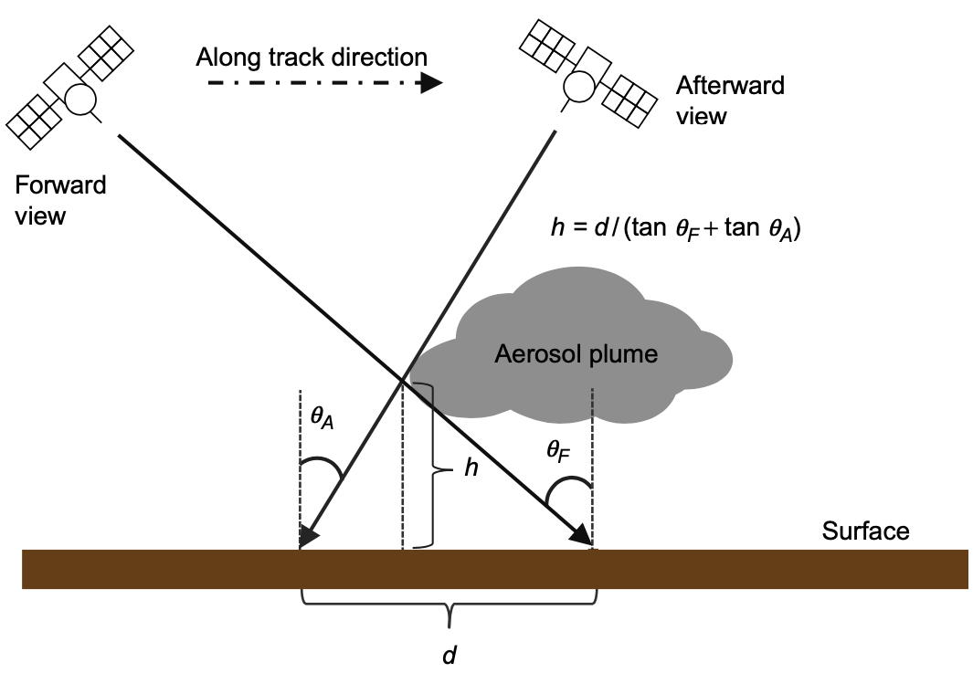
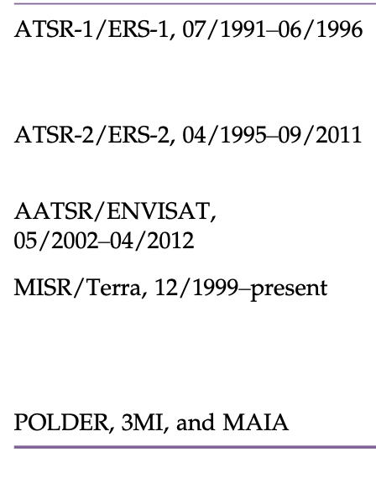
Stereo Photogrammetry
Instruments with dual/multiview capability
2022
Xu et al., 2018.
Advantages: pure geometric approach; less affected by calibration
Requirements/limitation: accurate georeferencing; texturally rich features (e.g., heterogenous plumes)

