Slide 1
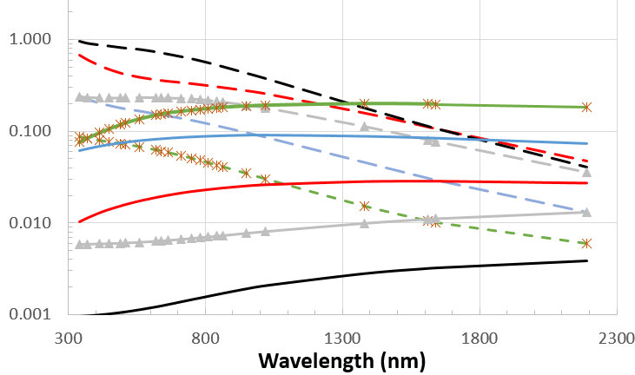
CEOS Atmospheric Composition Virtual Constellation AC-VC-17: Air Quality Aerosol
Mission Updates - Polarimeters: 3MI
A very specific information content
Extraction of aerosol properties
1) Spectral
Multi-directional spectro-polarimetry = measurement of the polarized phase function. Allows:
Better distinction of fine and coarse modes:
AODfine, AODcorse, fine mode fraction, size distribution
Additional aerosol characteristics:
Aerosol model/type, Refractive indices, shape (non-sphericity), Aerosol absorption, single scattering albedo
2) Directional
3) Polarisation
→ Performance strongly varies with the geometry of acquisition (Fougnie et al., 2020)
3MI on EPS-SG
14 views, 12 bands (410-2130nm) (Fougnie et al., 2018)
Metop-SG platform @9:30ECT. Launch < April 2024
Aerosol retrieval will rely on the GRASP approach (Dubovik et al, 2011)
Multi-sensor Aerosol Product (MAP = 3MI+Metimage+Sentinel5+IASI-NG): The synergy with other sensors from the platform will in addition allow:
Aerosol layer height, aerosol absorbing index, ash/dust discrimination
This characterisation of aerosol properties will support the Air Quality Monitoring at the global & regional scale

