Slide 1
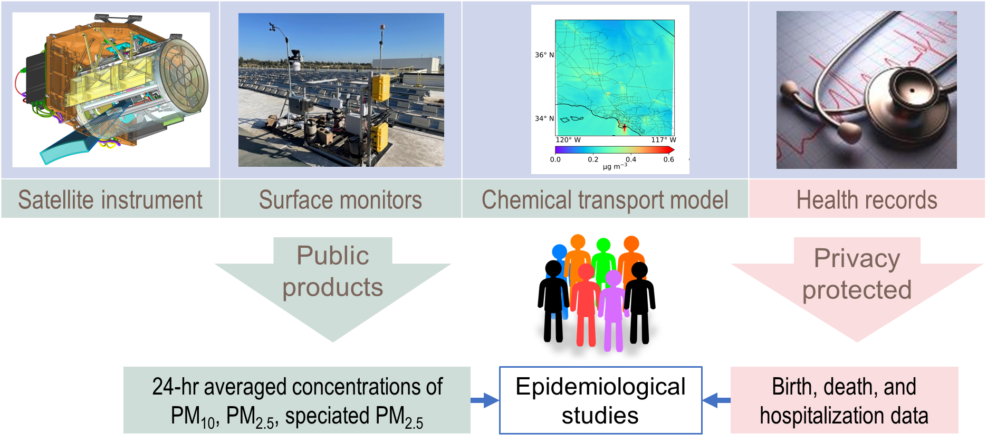
The first competitively-selected NASA satellite mission with applications/societal benefit as its primary objective.
Will be hosted on the General Atomics OTB-2 spacecraft, scheduled for late 2022 launch. Baseline mission = 3 years.
14 bands including 3 polarimetric bands, 1 km resolution
12 PTAs for aerosol optical and gap-filed PM2.5 species retrievals (PTA size ~ 350 km x 420 km)
20-30 STAs with aerosol optical retrievals
The Multi-Angle Imager for Aerosols
Yang Liu, PhD

