Slide 1

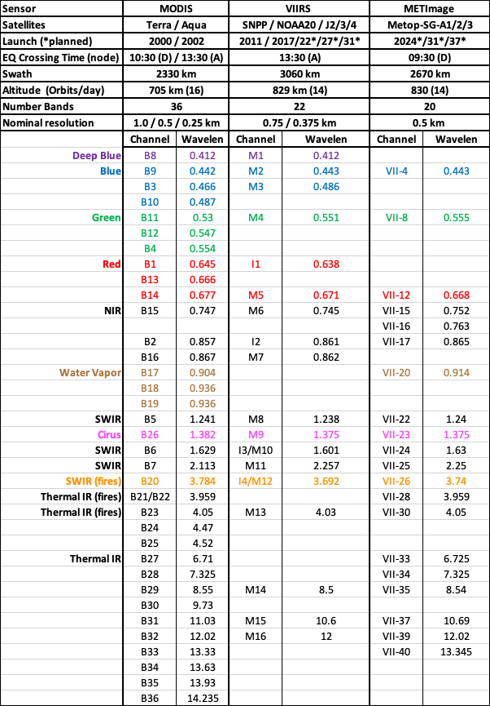
Update on LEO-imagers for Aerosols
MODIS VIIRS METImage
Robert Levy (NASA/Goddard)
with contributions from many
3 LEO sensors (MODIS, VIIRS and METImage)
  On 4 current satellites (Terra, Aqua, Suomi-NPP and NOAA20)
  On future satellites (JPSS-2,3 and 4 and Metop-SG-A1, 2 and 3)
  Polar-orbiting, low earth orbit (LEO)
Many algorithms → Many products
In slide deck:
  Status of twin MODIS including constellation exits
  Status of twin VIIRS
  Dark Target algorithm/product updates (MODIS & VIIRS)
  Deep Blue algorithm/product update (MODIS & VIIRS)
  MAIAC update (MODIS)
Program of Record for NASA’s Decadal Survey Missions

Slide 2
Update on LEO-imagers for Aerosols
Robert Levy (NASA/Goddard)
with contributions from many :

Slide 3
Outline
3 LEO sensors (MODIS, VIIRS and METImage)
  On 4 current satellites (Terra, Aqua, Suomi-NPP and NOAA20)
  On future satellites (JPSS-2,3 and 4 and Metop-SG-A1, 2 and 3)
  Polar-orbiting, low earth orbit (LEO)
Many algorithms → Many products
In slide deck:
  Status of twin MODIS including constellation exits
  Status of twin VIIRS
  Dark Target algorithm/product updates (MODIS & VIIRS)
  Deep Blue algorithm/product update (MODIS & VIIRS)
  MAIAC update (MODIS)
Program of Record for NASA’s Decadal Survey Missions

Slide 4
Three sensors
MODIS VIIRS METImage
Similar swath width (~2300-3000 km)
Similar spatial resolution (~0.5 km)
Similar spectral range (VIS/NIR/SWIR/TIR)
Spectrally: MODIS > VIIRS > METImage
VIIRS missing key water vapor and IR bands

Slide 5
Status of MODIS:
After 21+ years, MODIS on Terra appears to be in nominal operations
  Onboard calibration has been an issue since 2003, due to mechanical failure of solar diffuser (SD) door.
  MODIS Characterization Support Team (MCST) relying more heavily on ground-based vicarious calibration and pseudo-invariant desert targets
  Some recent issues with onboard data storage, so some data loss at night near poles (not an issue for day-time aerosol retrieval).
After 19+ years, MODIS on Aqua also in nominal operations.
  SD door mechanical operation also becoming a concern.
  Some recent issues with data formatter, so direct broadcast data used instead
(from Daniel Link talk presented at Feb 2021 MODIS Calibration meeting).

Slide 6
MODIS calibration and constellation “exits”:
Aqua
Before Constellation Exit
Continue nominal calibration schedule
SRCA full-orbit radiometric – October 2021
Aqua Pitch Maneuver – September 23, 2021
End of Constellation calibration panel
Constellation Exit – January 4, 2022
After Constellation Exit
Start of Extended Mission calibration panel (SD/SDSM, SRCA, PV Ecal)
Continue nominal calibration schedule
SRCA low mode radiometric
Terra
Before Constellation Exit
Continue nominal calibration schedule
SRCA full-orbit radiometric – May 2022
Investigate Opening SD Screen – June 2022
End of Constellation calibration panel
Constellation Exit - Fall 2022
After Constellation Exit
Start of Extended Mission calibration panel (SD/SDSM, SRCA, PV Ecal)
Continue nominal calibration schedule
Ongoing studies for assessing how post-constellation “drifting” orbits impacts products.
For aerosols, concerns inclide 1) changing distributions of Solar Zenith angles (and clouds). 2) Increasing darkness drifting toward dusk/dawn 3) performance of sensor?, 4) shifting sampling if diurnal cycle? 5) ?
How long post-constellation? Impacts versus cost issues.
(from talk presented by Daniel Link at Feb 2021 MODIS Calibration meeting).

Slide 7
Status of VIIRS:
After 10+ years, VIIRS on Suomi-NPP appears to be in nominal operations
After 3+ years, VIIRS on NOAA-20 also in nominal operations.

Slide 8
Before talking about aerosols…
Recent MODIS/VIIRS Science team meetings had ‘discussions’
  How long after ‘end-of-constellation’ should MODIS be operational (usefulness versus cost)?
  Now that NOAA-20 is operational and JPSS-2 will be launched next year, what should happen to Suomi-NPP? (keep running? Move orbit? Something else?)
  You will see a bit of the effort within the aerosol slides, but from a long-term record perspective, how do we synthesize the multiple datasets? (differences in calibration/wavelengths/etc). What would happen as European MetIMAGE joins the mix? Should there a unified “Level 1” dataset that we all use?
  Collection 7? Data will be in NetCDF format. When should C7 start in relation to end-of-missions? Should C7 include VIIRS as well?

Slide 9
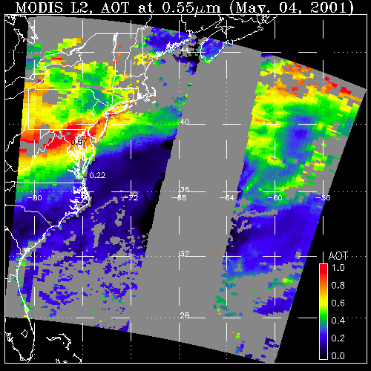
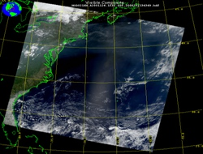
Now about aerosols
What a sensor observes
Attributed to aerosol (AOD)
May 4, 2001; 13:25 UTC
Level 1 “reflectance”
May 4, 2001; 13:25 UTC
Level 2 “product”
Retrieval Algorithm
LAND
OCEAN
GLINT
AOD
1.0
0.0
Separate logics over land, bright land and ocean
Retrieve: AOD (at 0.55 μm), spectral AOD (AE), Cloud-cleared reflectances, diagnostics, quality assurance

Slide 10
Dark Target algorithm/product updates
PI = R. Levy (NASA/GSFC)

Slide 11
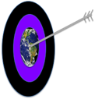
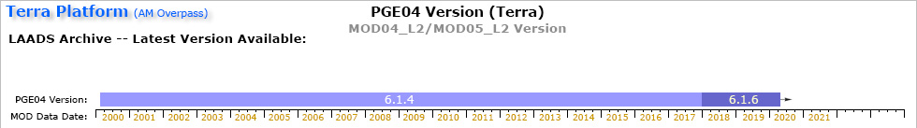
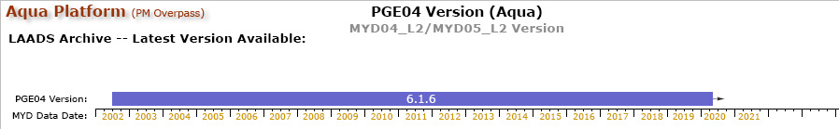
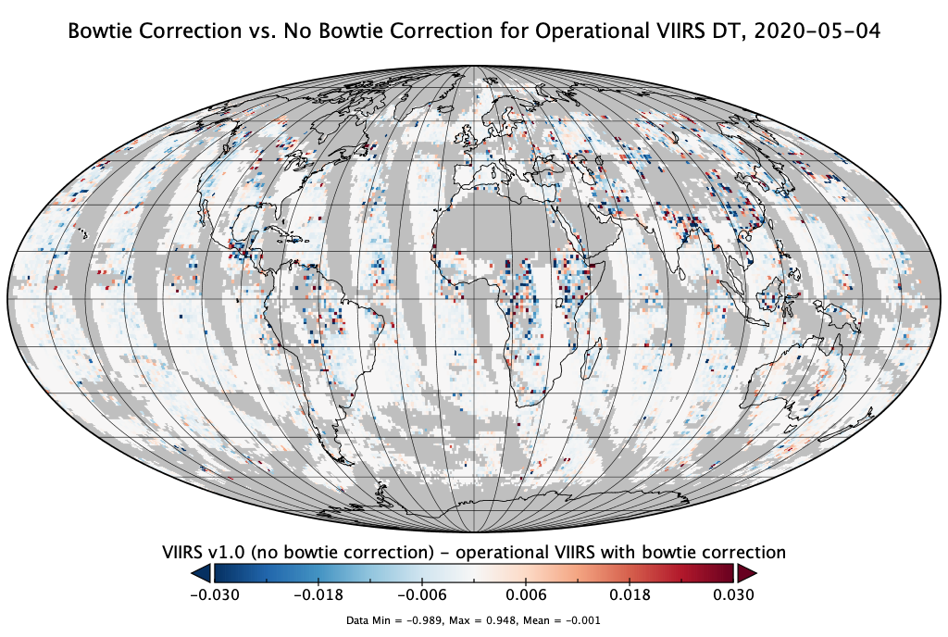
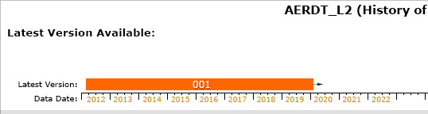
Update on the Dark-Target aerosol retrieval project
R. Levy¹, S. Mattoo², V. Sawyer², Y. Zhou³, Y. Shi³, M. Kim⁴, R. Kleidman², P. Gupta⁵, Z. Zhang⁶, S. Gassó⁷, L. Remer⁸
¹GSFC/613, ²SSAI/613, ³UMBC/613, ⁴NPP/613, ⁵USRA/MSFC, ⁶ADNET/610, ⁷ESSIC/613, ⁸JCET/UMBC
MODIS: C6.1 continuing with no known new issues (MxD04_L2 product)
VIIRS: Beta Version 1.1 in LAADS archive 5111 (bow tie correction from Version 1).
NRT/Worldview versions of both MODIS and VIIRS
  Now use GFS “forecast” valid at t=T
https://atmosphere-imager.gsfc.nasa.gov/
VIIRS/SNPP

Slide 12
Dark Target funding sources (how we cobble together for MODIS and VIIRS)
Senior Review: Terra/Aqua algorithm maintenance (MODIS)
  Ensures DT is running on MODIS (C061), fix bugs, MsWG calibration
  Global view of aerosol ‘trends’
  Ensured ‘Beta’ version for VIIRS (001) would be available
  Near Real Time (NRT)
  No major new science or improvements
MEaSUREs: (Making Earth Science Data Records for Use in Research Environments):
  Porting DT to Geostationary and creating merged GEO/LEO
  Creating ‘The Package’: modularizing the DT algorithm
  Revisit over-land surface reflectance assumptions/parameterization
  GEO-LEO also now part of C. Hsu’s project (DT/Deep Blue merge)
Terra Aqua SNPP Science: Levy group lead or participation (through 2020, ROSES-2020 is ‘pending’)
  Heavy aerosol retrieval (Smoke/Dust/Haze)
  Non-spherical dust over ocean
  Consistent aerosol models (join with UV observations, like VIIRS/OMPS)
  Trends of aerosol and fires over India
PACE: Unifying DT, DB and OMI aerosol retrieval algorithms for OCI.
Etc: Participation in A-CCP/AtmOS, GOES-R project science, Goddard’s internal funding

Slide 13
Some recent papers

Slide 14
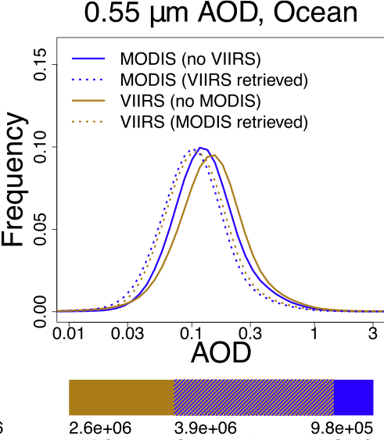
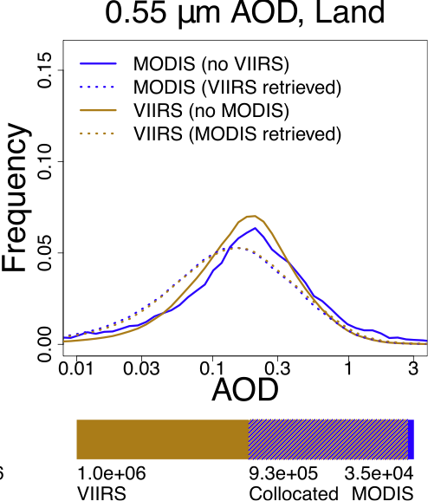
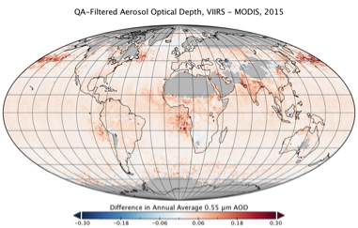
Using VIIRS SNPP to continue MODIS for a Climate Data Record
Virginia Sawyer, Robert C. Levy, Shana Mattoo, Geoff Cureton,Yingxi Shi, Lorraine Remer
Version 001: Compared to MODIS Aqua DT:
Values of aerosol optical depth (AOD) are highly correlated with MODIS Aqua, and nearly identical where both sensors retrieve on the same day
VIIRS is offset higher than MODIS because of solo-sensor retrievals
Solo-sensor retrievals skew higher than collocated retrievals for both MODIS and VIIRS, but by different amounts for each sensor, and also by different amounts over land vs. ocean
Most solo-sensor retrievals come from VIIRS rather than MODIS, because wider swath and finer resolution = more retrieved area per day
Sawyer, V., et al., 2020. "Continuing the MODIS Dark Target Aerosol Time Series with VIIRS." Remote Sensing, [10.3390/rs12020308]

Slide 15
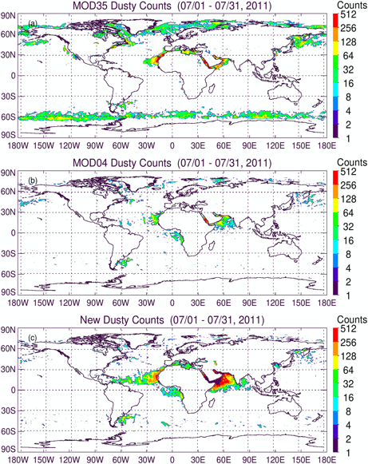
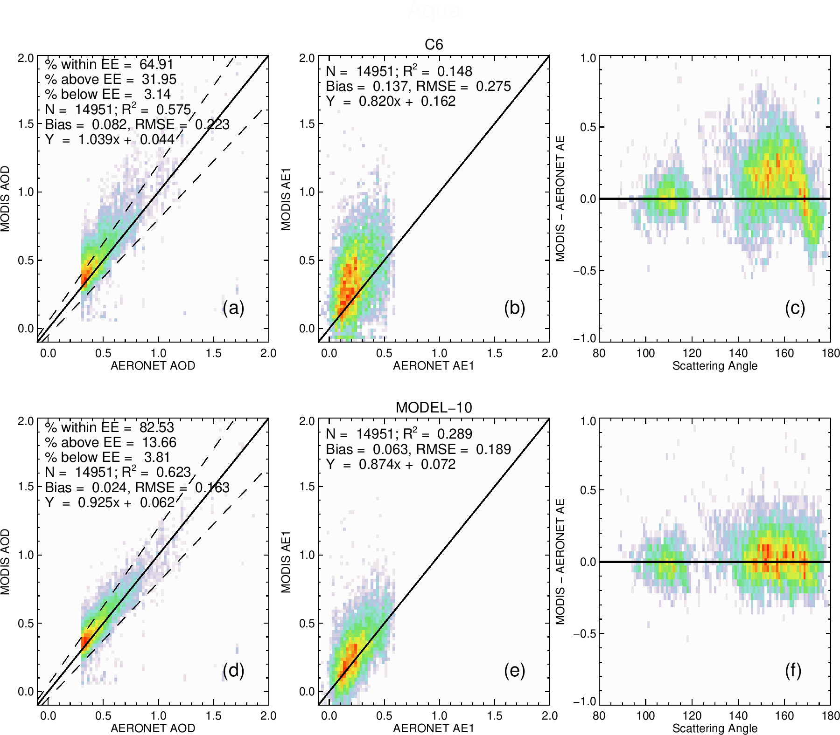
Dust detection and dust model for DT ocean algorithm
Yaping Zhou, Robert C. Levy, Shana Mattoo, Lorraine A. Remer, Yingxi Chen, Reed Espinosa, Chenxi Wang
Dust detection:
Dust retrieval
The DT algorithm for dust over ocean has long-standing biases due to assuming spheres, instead of non-spheres. Solution is:
Detect ‘likely’ dust using series of visible/NIR/IR tests.
Apply non-spherical model (collection of spheriods)
Result is improved (AOD), fine mode fraction (FMF) and angstrom exponent (AE).
AOD Error vs ScatAngle
AOD
AE
MOD35
Dust Flag
C6
AOD> & AE<
new
New Dust Flag
- Zhou, Y., et al. Dust Aerosol Retrieval over the Oceans with the MODIS/VIIRS Dark Target algorithm. Part I: Dust Detection (http://dx.doi.org/10.1029/2020EA001221)
- Zhou, Y. et al. Dust Aerosol Retrieval Over the Oceans with the MODIS/VIIRS Dark Target algorithm. Part II: Non-Spherical Dust Model (http://dx.doi.org/10.1029/2020EA001222).

Slide 16
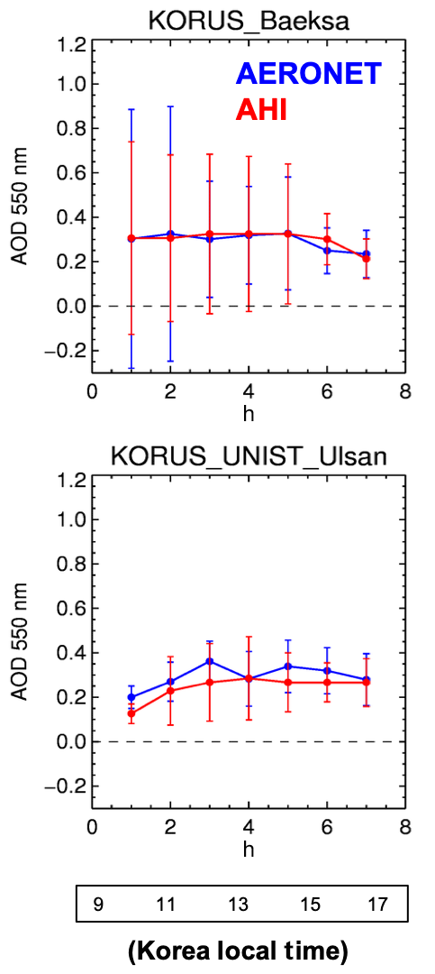
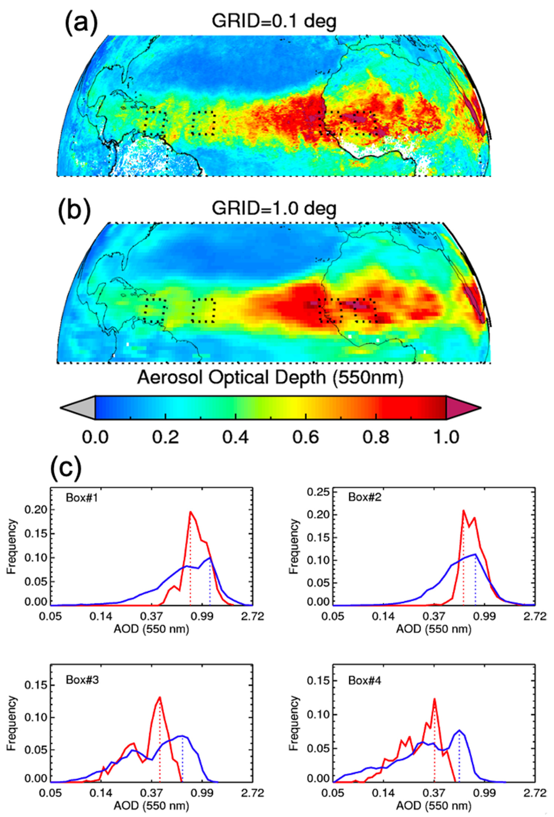
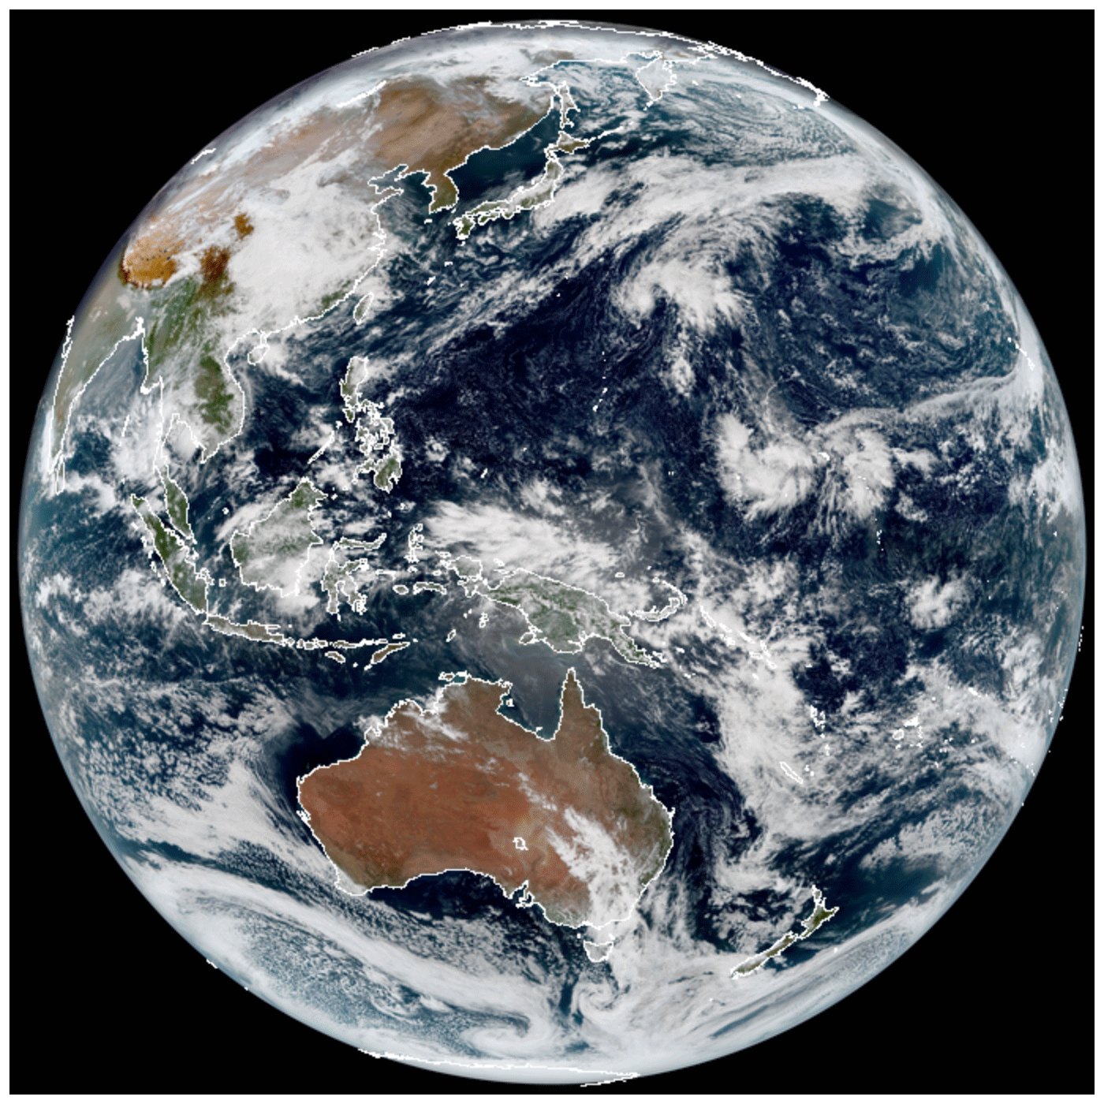
Towards integration of GEO and LEO
Pawan Gupta, R. Levy, S. Mattoo, S. Christopher, L. Remer, R. Holz, A. Heidinger, et al.
What resolution should we compare products?
Using GEO to study diurnal cycle
HRG (0.1°)
AOD
C6 (1.0°)
AOD
Monitor dust transport across the Atlantic Ocean during June 2018.
Time
- Gupta, P., et al., 2020. "High-Resolution Gridded Level 3 Aerosol Optical Depth Data from MODIS." Remote Sensing, 12 (17): 2847 [10.3390/rs12172847]
- Gupta, P., et al. 2019. "Retrieval of aerosols over Asia from the Advanced Himawari Imager: Expansion of temporal coverage of the global Dark Target aerosol product." Atmos. Meas. Techniques, [10.5194/amt-12-6557-2019]

Slide 17
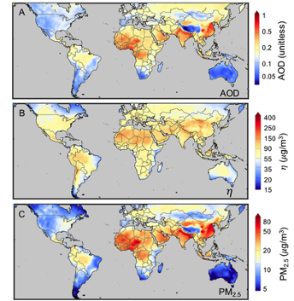
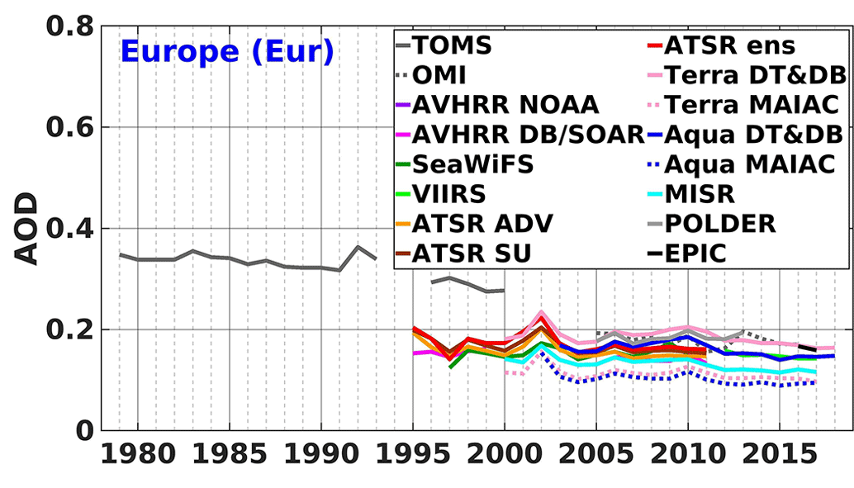
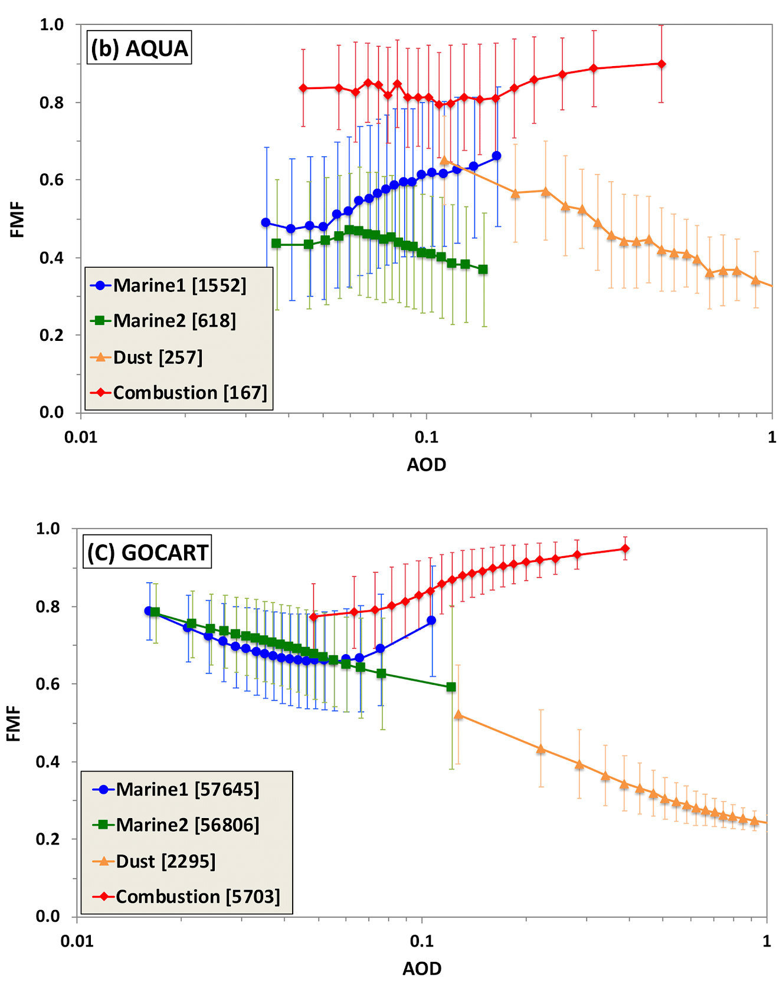
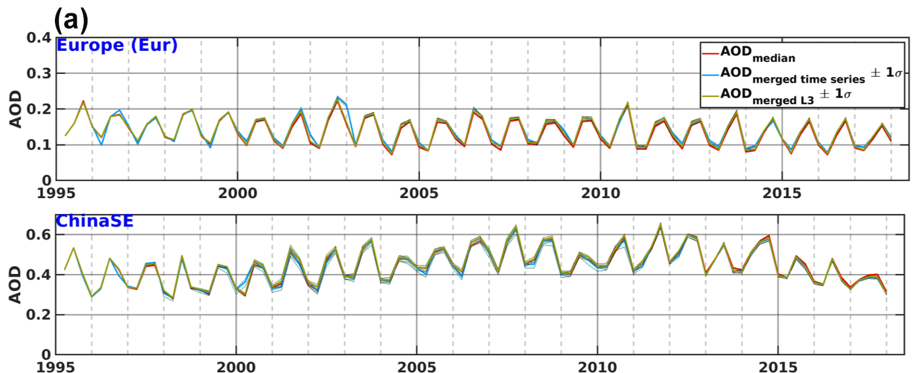
Doing ‘science’ with the DT products
Using satellites + models to estimate PM2.5
Using satellites + statistics for climatology
FMF versus AOD to determine aerosol ‘type”
AOD
MODIS
PM2.5 / AOD
Merged products
PM2.5
for 1998-2018
CAM5
- Hammer, M. S., et al., 2020. "Global Estimates and Long-Term Trends of Fine Particulate Matter Concentrations (1998–2018)." Environmental Science & Technology, [10.1021/acs.est.0c01764]
- Sogacheva, L., et al., 2020. "Merging regional and global aerosol optical depth records from major available satellite products." Atmos. Chem. Phys, [10.5194/acp-20-2031-2020]
- Yu, H., et al., 2020. "Interannual variability and trends of combustion aerosol and dust in major continental outflows revealed by MODIS retrievals and CAM5 simulations during 2003–2017." Atmos. Chem. Phys, [10.5194/acp-20-139-2020]

Slide 18
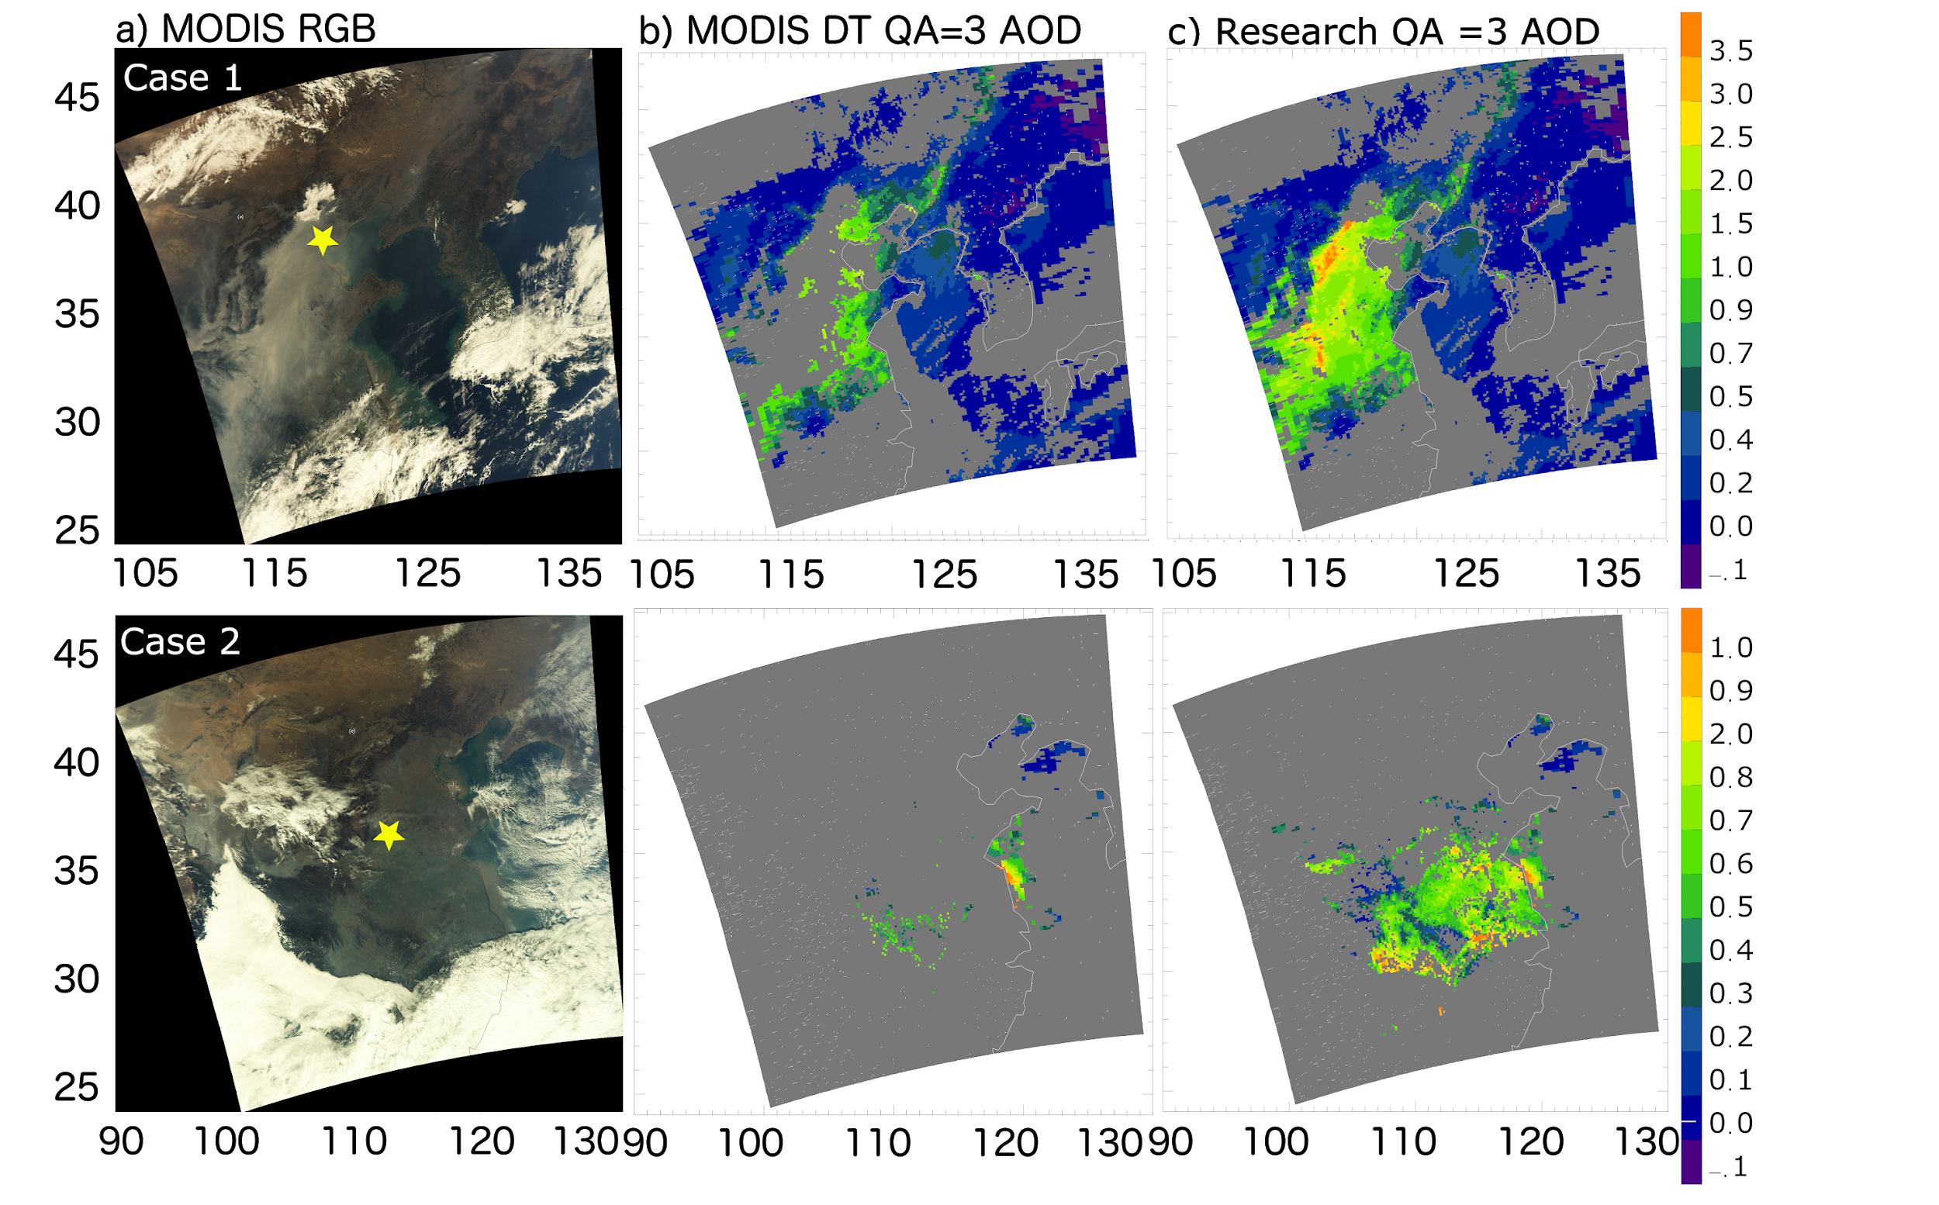
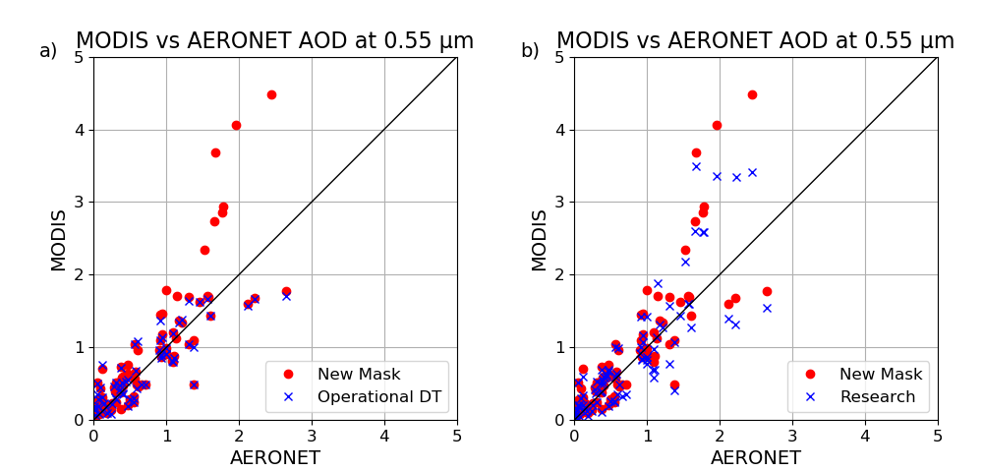
A Dark Target research aerosol algorithm for MODIS observations over eastern China: Increasing coverage while maintaining accuracy at high aerosol loading
Yingxi R. Shi, Robert C. Levy, Leiku Yang, Lorraine A. Remer, Shana Mattoo, and Oleg Dubovik
DT algorithm fails over heavy haze, such as over Beijing and northeast China during Winter season. Fix by:
Improving ‘inland water mask’ and ‘snow mask’
Updating assumptions compared to C6.1
  aerosol at H<1km instead of H=2km
  SSA ~ 0.95 instead of 0.9
Combine masking and aerosol assumptions
Result is much greater coverage of high AOD cases
Shi et al., Atmos. Meas. Tech., 14, 3449–3468, 2021
https://doi.org/10.5194/amt-14-3449-2021
Similar (but different details) for recovering intense smoke over Southeast Asia
Shi et al., Atmos. Chem. Phys., 19, 259–274, 2019
https://doi.org/10.5194/acp-19-259-2019
New mask versus C6.1; New retrieval versus New mask

Slide 19
In Progress

Slide 20
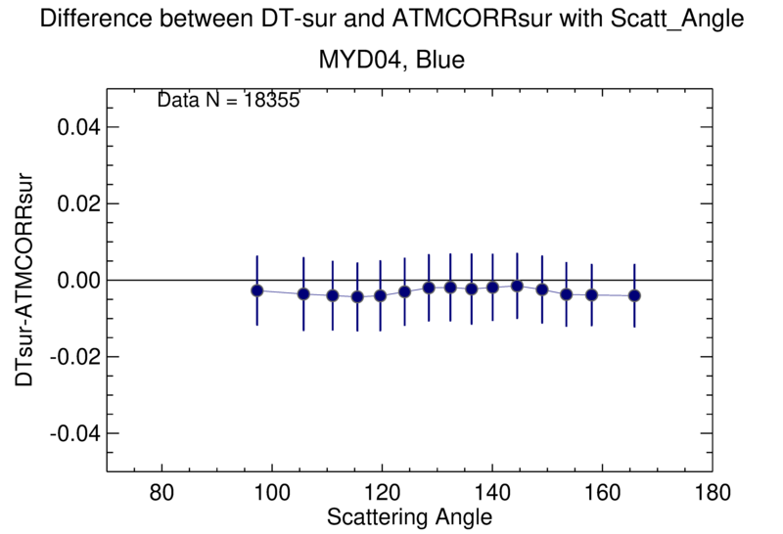
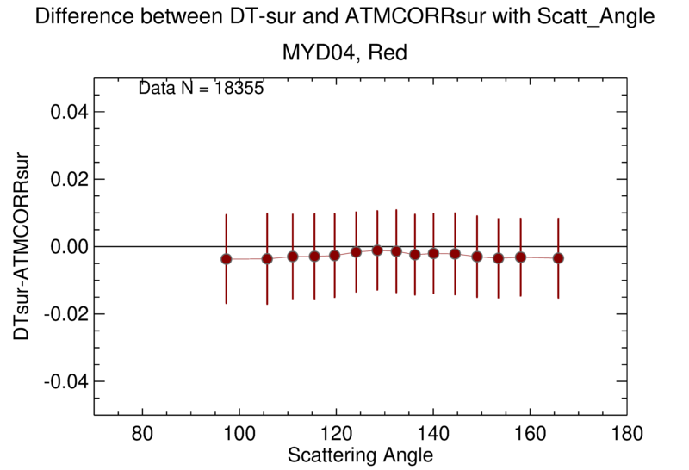
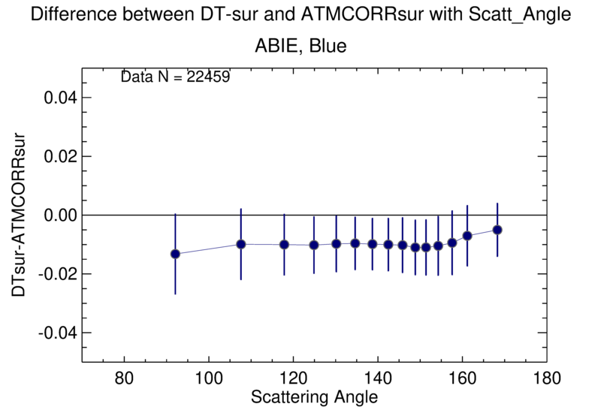
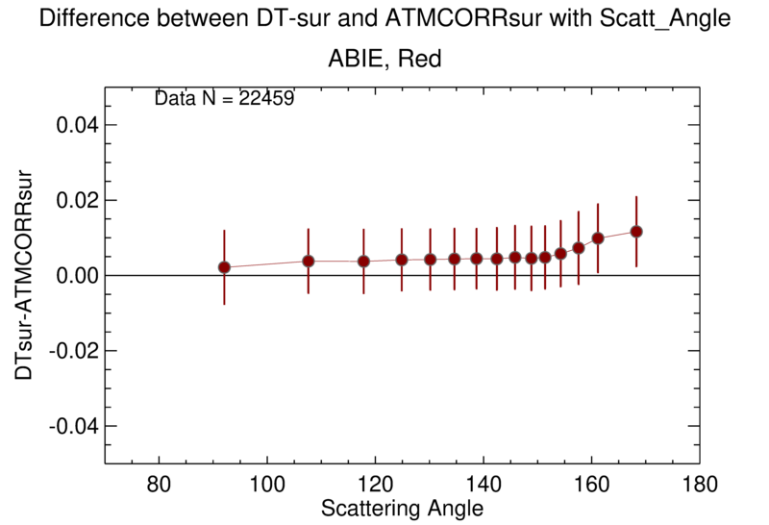
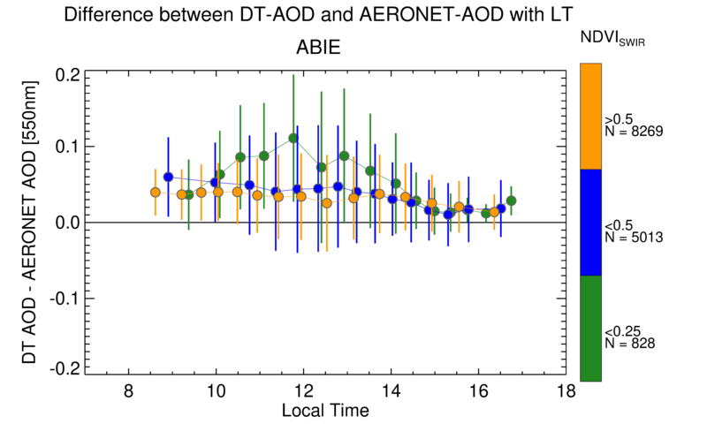
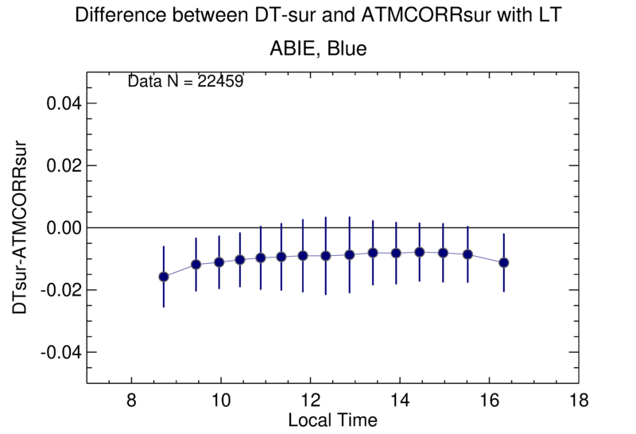
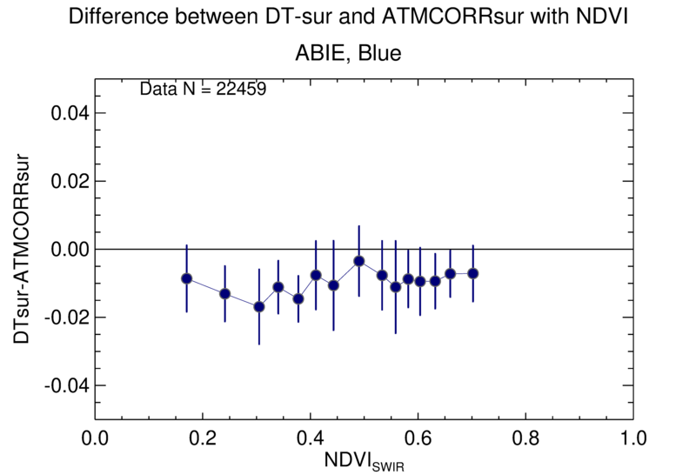
An evaluation of the DT surface reflectance (MODIS, VIIRS and GEO)
Mijin Kim (postdoc), Robert C. Levy, Lorraine A. Remer, and Shana Mattoo
Differences between DT surface reflectance and the atmospherically-corrected reflectance
Identify the issues in the current surface reflectance parameterization process, and investigate the improvement of DT algorithm.
MODIS (Global)
ABIE DT product showed higher error in surface reflectance than the MODIS DT products, and revealed a change with scattering angle and NDVI_{SWIR} also.
Underestimation in surface reflectance corresponds to the overestimation of AOD.
Diurnal variations were found in both errors in surface reflectance and AOD.
Accordingly, we are investigating a new SR parameterization.
ABI-East

Slide 21
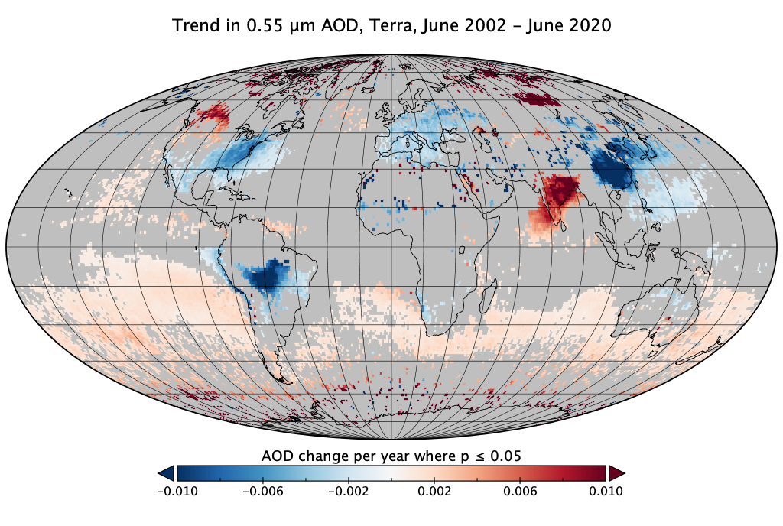
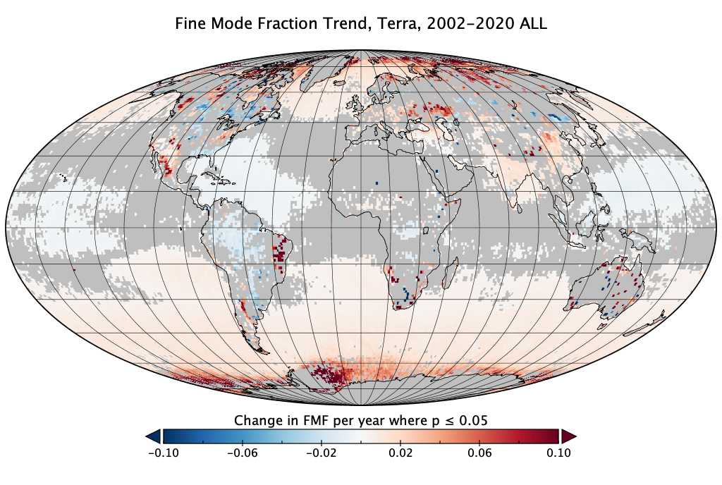
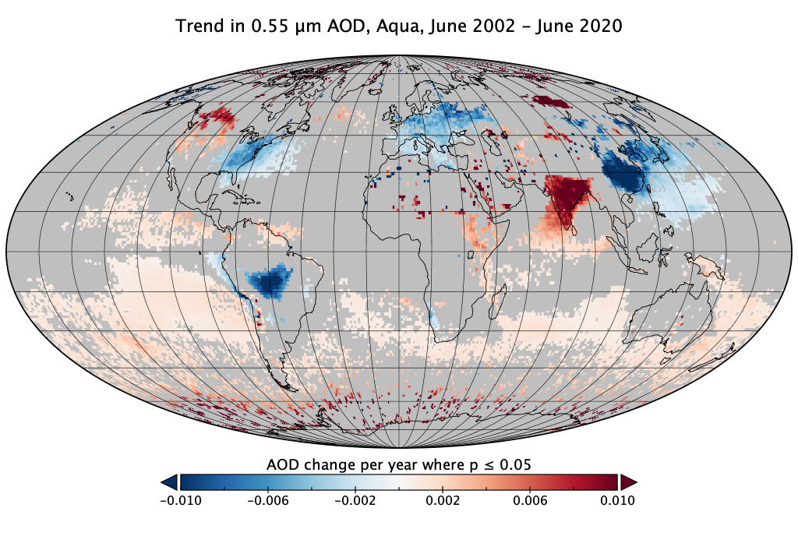
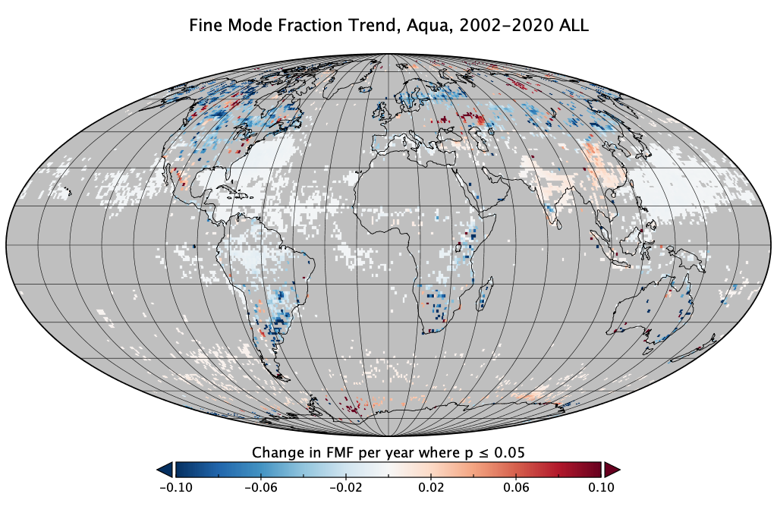
Consistency of Trends from Terra and Aqua MODIS
Virginia Sawyer, R. Levy, S. Mattoo, et al.,
After all the updates and calibration and such, how consistent are ‘Trends’ from Terra and Aqua MODIS? (2002-2020)
Terra
AOD
change per year
FMF
change per year
Aqua
AOD very consistent but FMF has trends. Spectral calibration drift?

Slide 22
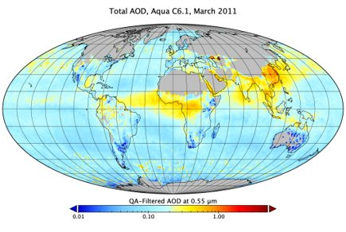
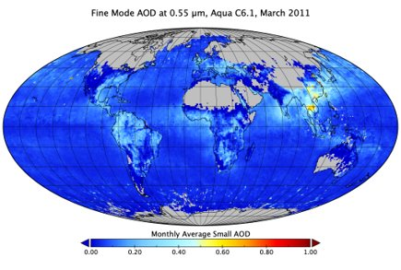
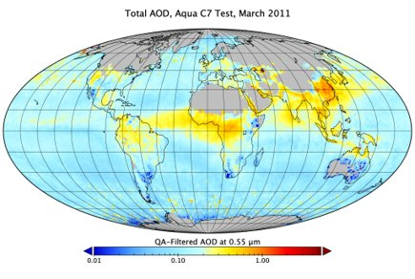
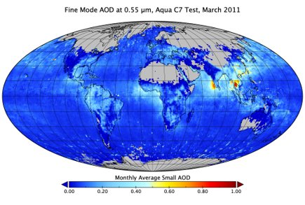
“The Package”: Onwards toward C7
Shana Mattoo, V. Sawyer, et al.
As we have ported DT from MODIS to VIIRS and other sensors, how do we ensure that MODIS code doesn’t become obsolete? We also want DT code to be flexible
C6.1
AOD
Fine Mode AOD
“The Package”

Slide 23
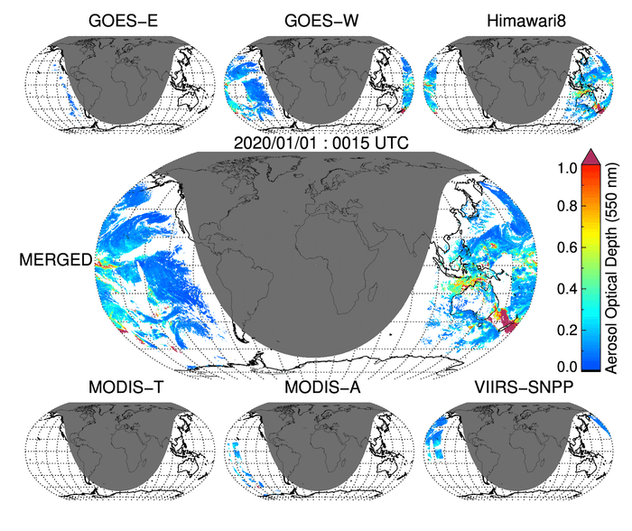
Creating a joint LEO-GEO aerosol product
Pawan Gupta, R. Levy, Y. Shi, S. Mattoo, L. Remer, R. Holz, J. Wei
MODIS-A – QA/QC – 0.25x0.25 - 30 minutes
MODIS-T – QA/QC – 0.25x0.25 - 30 minutes
VIIRS-NPP – QA/QC – 0.25x0.25 -30 minutes
ABI_EAST – QA/QC – 0.25x0.25 -30 minutes
ABI_WEST – QA/QC – 0.25x0.25 -30 minutes
AHI_H8 – QA/QC – 0.25x0.25 -30 minutes

Slide 24
Status of MODIS and VIIRS DarkTarget
MODIS Collection 6.1 (MxD04) available from 2017 - present
  All data reprocessed (2000 – 2017) use ‘reprocessed’ calibration for L1B,
  >2017 data use ‘step-forward’ calibration for L1B
  Data available in HDF4 format, scripts to convert to NetCDF4.
  Provides ‘reflectance’ information for data assimilation
  Includes Dark-Target / Deep Blue (DT/DB) merge product
  Includes 3 km resolution product (MxD04_3K)
  We are funded for “maintenance”
VIIRS Version 1.1 Dark-Target (‘AERDT_VIIRS_SNPP’): 2011-present.
  All data (2011-present) use ‘step-forward’ calibration (no de-trending applied)
  DT Data available in NetCDF4. All output parameters same as MODIS
  Deep Blue already (‘AERDB’) available since early 2019.
  Currently, no DT/DB merge, but maybe in future?
  Testing on NOAA-20 (‘AERDT_VIIRS_N20’).
  Develping Level 3 (and high-resolution gridding)
  We were not funded for VIIRS, but are leveraging other funds (including LEO-GEO)
Data available on LAADS
https://ladsweb.modaps.eosdis.nasa.gov/missions-and-measurements/science-domain/aerosol/

Slide 25
Near and Far Future
Finalize ‘the package’ (general modular code) that reports in NetCDF (S. Mattoo)
Under Senior Review ‘maintenance’ we intend to:
  Continue validation (Y. Shi)
  Continue looking at trends (V. Sawyer)
  Finish adding dust-detection/non spherical dust over ocean (Y. Zhou)
  Revisit our list of reported SDS’s (balance of information versus file size/confusion)
  Add calculations for ‘true’ Fine Mode Fraction over land (re-do LUTs)
Dark Target “science” in discussion (pending results of ROSES 2020?)
  Implement Heavy aerosol retrieval over Beijing and other region (Y. Shi)
  Revisit surface reflectance assumptions (M. Kim)
  Revisit spatial variability structure for cloud/surface masking (R. Kleidman)
  Include uncertainties (Jacobians, ensemble, error propagation, etc. )
  Machine learning exercises? Cloud/smoke detection/masking?
Collaborative science (leveraging other work)
  Integrate with GEO imagers (my MEaSUREs project, with P. Gupta, Jennifer Wei, )
  Integrate with Deep Blue (new GEO funding with C. Hsu)
  Joint UV-VIS/NIR retrieval (e.g. OMPS + VIIRS, led by S. Gassó)
  Unified UV-VIS-NIR-SWIR retrieval (e.g OCI on PACE, led by L. Remer)

Slide 26
Deep Blue algorithm/product updates
PI = C. Hsu (NASA/GSFC)

Slide 27
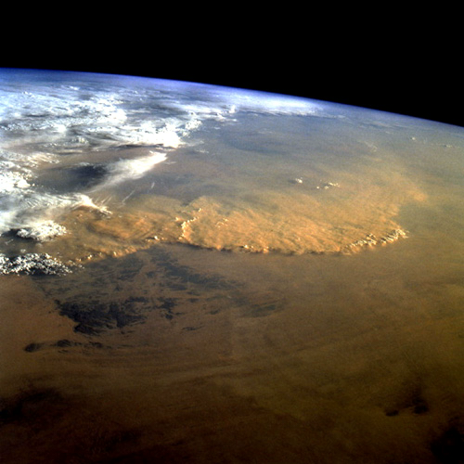
Status Update and New Aerosol Products From MODIS and VIIRS Using Deep Blue Aerosol Algorithm
Photo taken from Space Shuttle:
Fierce dust front over Libya
N. Christina Hsu (PI), Jaehwa Lee, Vincent Kim, William Heinson, and Andrew Sayer (collaborator)
Climate and Radiation Laboratory
NASA Goddard Space Flight Center, Greenbelt, Maryland USA

Slide 28

Multi-Sensor Long-Term Deep Blue Aerosol Products
Science Objectives:
Our primary goal is to produce consistent long-term aerosol climate data record using multiple satellite sensor data from AVHRR (historic) to SeaWiFS and MODIS (EOS-era) to VIIRS (JPSS-era) as well as latest GEO sensors (such as AHI and ABI) for diurnal cycle
Our VIIRS and GEO aerosol products are generated based upon Deep Blue algorithm (over land) (previously applied to AVHRR, SeaWiFS and MODIS) and SOAR algorithm (over ocean) (applied to AVHRR and SeaWiFS)
Status of the VIIRS Deep Blue aerosol products:
Standard VIIRS L2 and L3 Version 1 Deep Blue products have been operational and available at LAADS since late 2018.
NRT VIIRS Deep Blue products also officially became operational in 2019 via LANCE. The imagery is now available at Worldview.
VIIRS Version 1.1 Deep Blue algorithm is finalized and the products will be available at DAAC soon. Compared to V1.0, the changes made in V1.1 include the improvement of AOD retrieval during the extreme fire events and a few minor bug fixes.
Preparation of implementing new aerosol product retrieval such as aerosol height and AOD retrieval over cloud in the VIIRS V2.0 algorithm has started.

Slide 29
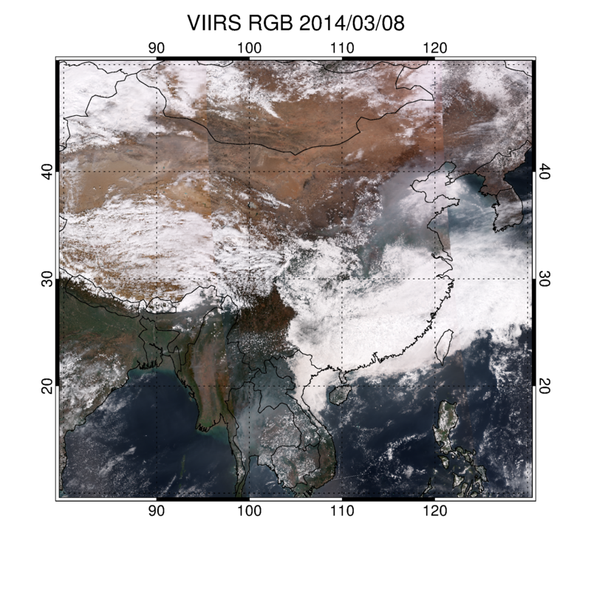
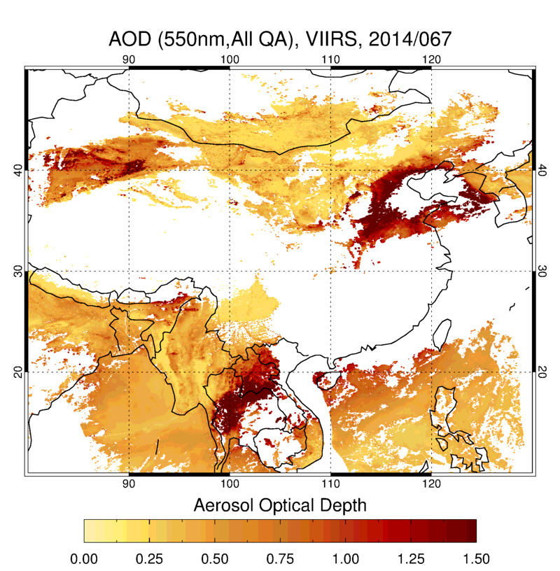
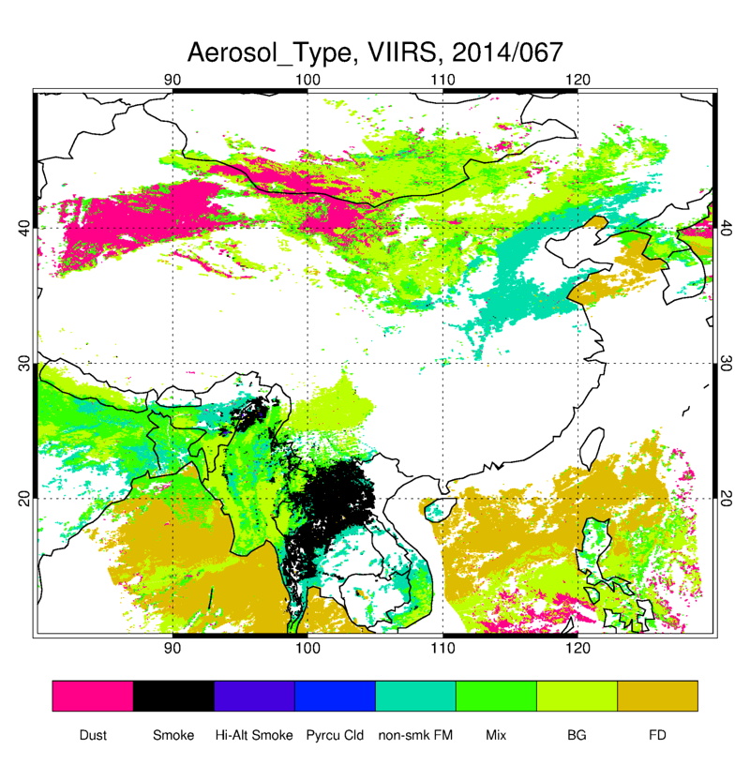
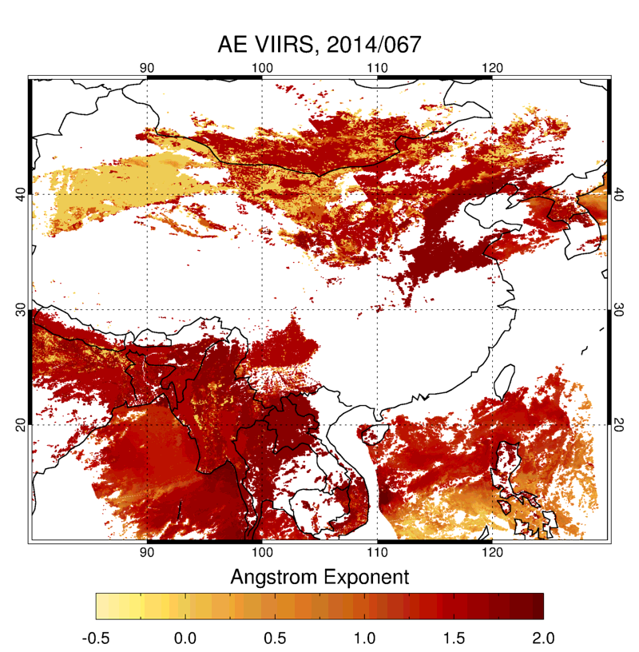
Adding Aerosol Type Product into the Deep Blue Data Suite
VIIRS RGB image 3/8/2014
AOD at 0.550 µm
Aerosol Type
Angstrom Exponent
Dust
Urban/Industrial
Smoke
Ds
Smk
HS
Py
NSFD
Mix
BG
FD
By taking advantage of the spectral curvature approach due to the light absorption of biomass burning smoke aerosols at the blue wavelengths, we are able to distinguish smoke aerosols from other fine mode aerosols such as urban/industrial aerosols;
Aerosol type information is derived by combining this smoke mask with retrieved AOD and Angstrom Exponent.

Slide 30
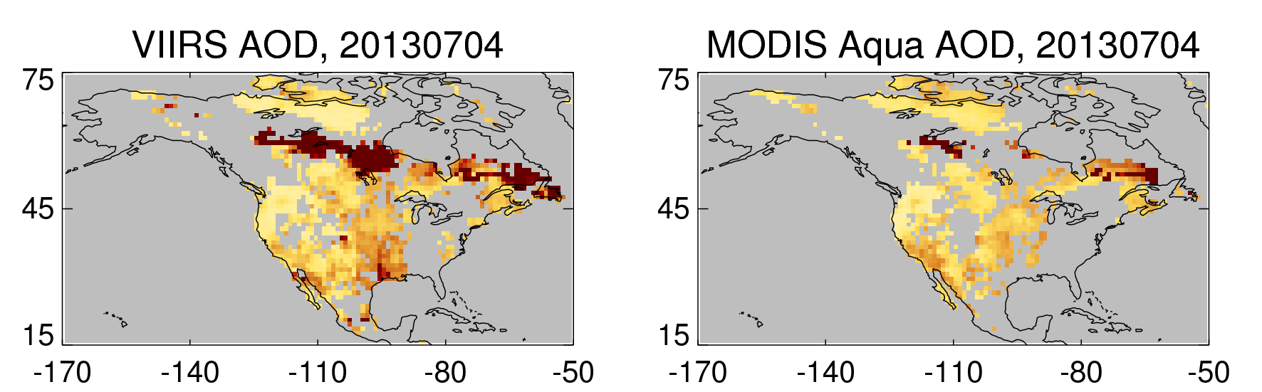
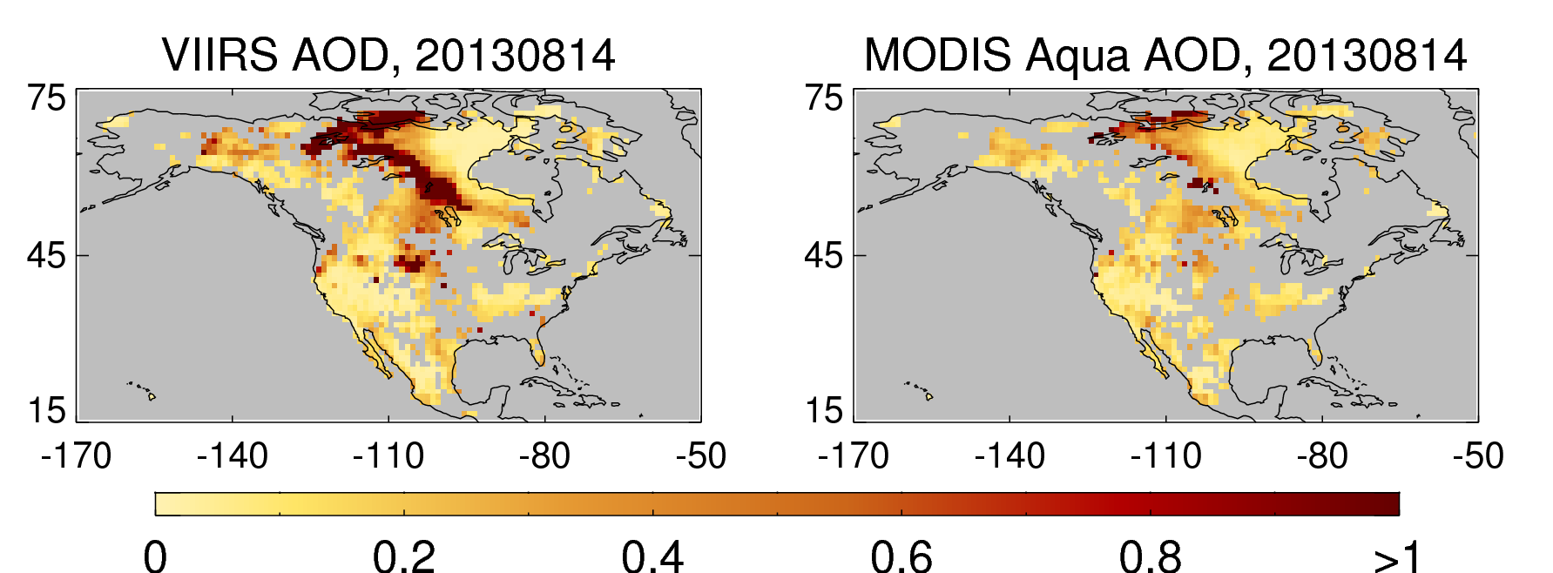
For extreme events, improved VIIRS heavy smoke/cloud detection scheme significantly increases the spatial coverage of the retrieved AOD compared to MODIS C6 over major smoke plumes

Slide 31
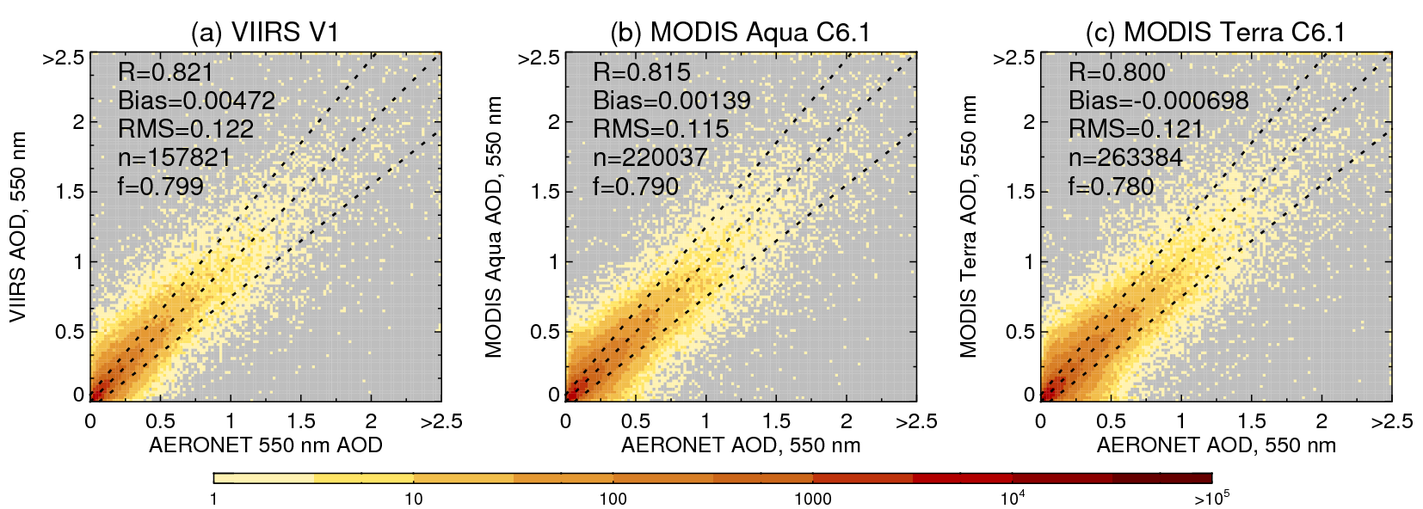
Comparisons of VIIRS, MODIS/Terra, MODIS/Aqua over-land products with AERONET
The performances of the VIIRS V1, MODIS/Aqua C6.1, and MODIS/Terra C6.1 Deep Blue AOD product against the AERONET on global scale are comparable. The percentage of the data that fall within the expected error of ±(0.05+20%) is slightly better for VIIRS V1 (~80%), compared to MODIS C6.1 (78% for Terra and 79% for Aqua).
References: 1. Hsu et al., 2019, JGR, “VIIRS Deep Blue Aerosol Products over Land: Extending the
EOS Long-Term Aerosol Data Records”.
2. Sayer et al., 2019, JGR, “Validation, stability, and consistency of MODIS Collection
6.1 and VIIRS Version 1 Deep Blue aerosol data over land”

Slide 32
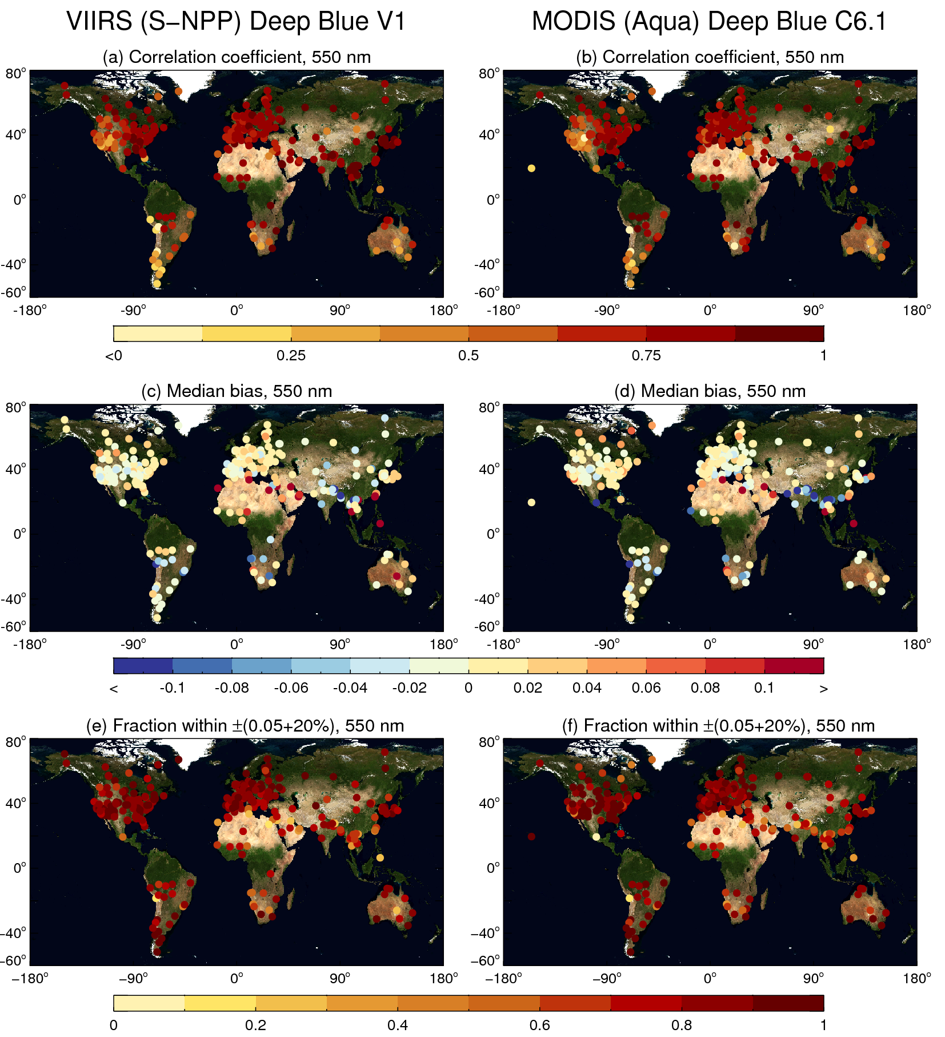
Site-by-Site Comparisons of VIIRS and MODIS/Aqua over-land products with AERONET

Slide 33

Constructing Consistent Long-Term Aerosol Climate Data Record
Time Series of Monthly Mean AOD from Multi-satellite Deep Blue data at select AERONET sites
This comparison shows multi-year (2002-2018) quantitative consistency of the VIIRS AOD in comparison with our heritage MODIS and SeaWiFS results, as well as AERONET validation data.
These VIIRS AOD data are generated using corrected VIIRS L1B files after we assessed the calibration of S-NPP VIIRS against MODIS Aqua and developed a cross-calibration correction for VIIRS, which was shown to decrease the uncertainty in retrieved AOD and make VIIRS results more comparable to MODIS .

Slide 34
New Deep Blue Aerosol Layer Height from VIIRS and OMPS-NM
An operation-ready Aerosol Single-scattering albedo and Height Estimation (ASHE) algorithm has been implemented in the VIIRS Deep Blue aerosol algorithm suite to provide the height of absorbing aerosols from synergistic use of VIIRS and OMPS, both onboard the S-NPP satellite. With extensive spatial coverage, the data set can contribute to better understanding of the effects of aerosol layer height on long-range transport and surface air quality. The data product will be available as part of the Version 2 VIIRS Deep Blue products.
August 2012-2018
AOD > 1.0
Publication: Lee, et al., 2020, Aerosol layer height with enhanced spectral coverage achieved by synergy between VIIRS and OMPS-NM measurements, IEEE Geo. and Remote Sens. Lett., doi: 10.1109/LGRS.2020.2992099.

Slide 35
Summary
Big Thanks for the supports from Atmosphere SIPS, LAADS and LANCE, standard and NRT VIIRS DB aerosol products are now available operationally, including daily imagery on Worldview.
The reprocessing of VIIRS Version 1.1 Deep Blue products is complete at SIPS and the products will be available at DAAC soon. Compared to V1.0, the changes made in V1.1 include the improvement of AOD retrieval during the extreme fire events and a few minor bug fixes.
Preparation of implementing new aerosol product retrieval such as aerosol height and AOD retrieval over cloud in the VIIRS V2.0 algorithm has started.
Efforts of backporting all the improvements made in VIIRS to MODIS Collection 7 are also underway.

Slide 36
MAIAC algorithm/product updates
PI = A. Lyapustin (NASA/GSFC)
MAIAC is processed as a “land” product with different schedule than “atmosphere”
New MAIAC version (MODIS) for Collection 6.1 beginning within next few months
Improved regional aerosol models to correct low bias at high AOD

Slide 37

Aerosol products as “Program of Record (PoR)”
The 2017 Decadal Survey (DS) suggested to NASA a mission that would research the relationship between aerosols, clouds, convection and precipitation (ACCP; https://vac.gsfc.nasa.gov/accp/ ).
Now in formulation, this mission has been initially defined as the Atmosphere Observing System (AtmOS). Nominal launches of a two-part LEO system are in 2027 and 2031.
AtmOS objectives include observation/understanding of air quality processes and aerosol type.
In addition to having state-of-the-art observing capabilities on its own, AtmOS will be joined by some of the operational AC/VC sensors described this week. LEO imagers (VIIRS and METImage) are part of this PoR.
PoR observations will help inform AtmOS science, both as Level 2 products to constrain/context and Level 1 observations for joint inversion.
VIIRS and and METImage will also help to meet objectives for the near-future Plankton, Aerosol, Cloud, ocean Ecosystem (PACE) mission (launch in 2022?): https://pace.oceansciences.org/home.htm
Nominal meteorological satellite system in mid 2020s (some of which are AC/VC)

Slide 38
Conclusion
3 LEO sensors (MODIS, VIIRS and METImage)
  On 4 current satellites (Terra, Aqua, Suomi-NPP and NOAA20)
  On future satellites (JPSS-2,3 and 4 and Metop-SG-A1, 2 and 3)
  Polar-orbiting, low earth orbit (LEO)
Many algorithms → Many products
In slide deck:
  Status of twin MODIS including constellation exits
  Status of twin VIIRS
  Dark Target algorithm/product updates (MODIS & VIIRS)
  Deep Blue algorithm/product update (MODIS & VIIRS)
  MAIAC update (MODIS)
Program of Record for NASA’s Decadal Survey Missions

