Slide 1
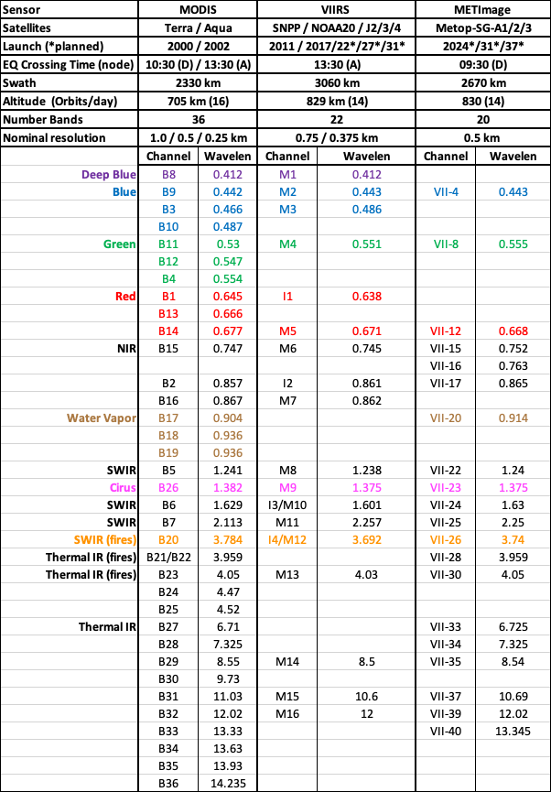
Update on LEO-imagers for Aerosols
MODIS VIIRS METImage
Robert Levy (NASA/Goddard)
with contributions from many
3 LEO sensors (MODIS, VIIRS and METImage)
On 4 current satellites (Terra, Aqua, Suomi-NPP and NOAA20)
On future satellites (JPSS-2,3 and 4 and Metop-SG-A1, 2 and 3)
Polar-orbiting, low earth orbit (LEO)
Many algorithms → Many products
In slide deck:
Status of twin MODIS including constellation exits
Status of twin VIIRS
Dark Target algorithm/product updates (MODIS & VIIRS)
Deep Blue algorithm/product update (MODIS & VIIRS)
MAIAC update (MODIS)
Program of Record for NASA’s Decadal Survey Missions

