Slide 1
Impacts of horizontal resolution on global chemical data assimilation of satellite measurements for tropospheric ozone and its precursors
Takashi Sekiya (JAMSTEC)
In collaboration with: Kazuyuki Miyazaki (NASA JPL), Koji Ogochi (JAMSTEC), Kengo Sudo (Nagoya U.), Masayuki Takigawa (JAMSTEC), Henk Eskes, Folkert Boersma (KNMI)
2021/6/9
CEOS AC-VC-17 meeting

Slide 2
Motivation
Integration of satellite observations for multiple species using data assimilation (DA) provides comprehensive constraints on emissions and concentrations.
Global DA approximately at 50 km resolution can produce globally-consistent analyses of chemical concentrations and emissions down to a scale relevant for megacities over different regions of the world.
Global DA system
Regional DA system
This study
Constrain the whole troposphere
Coarse resolution
Resolve urban areas
Limited area coverage
Globally-consistent analysis
Capture megacity, but not resolve
Zhang et al. (2019)
Liu et al. (2017)

Slide 3
Motivation
TROPOMI instrument on Sentinel-5P satellite measures tropospheric NO₂ with high resolution of 7 x 3.5 km² and improved signal-to-noise ratio.
Systematic evaluation of values obtained from this advanced satellite instrument are needed.
Trop. NO₂ SCD error
TROPOMI
OMI
OMI
TROPOMI
(van Geffen et al., 2018, TROPOMI ATBD of NO2)
This study investigates
1) impacts of increasing horizontal resolution from 2.8° to 0.56° and
2) impacts of assimilating TROPOMI instead of OMI on global chemical DA.

Slide 4
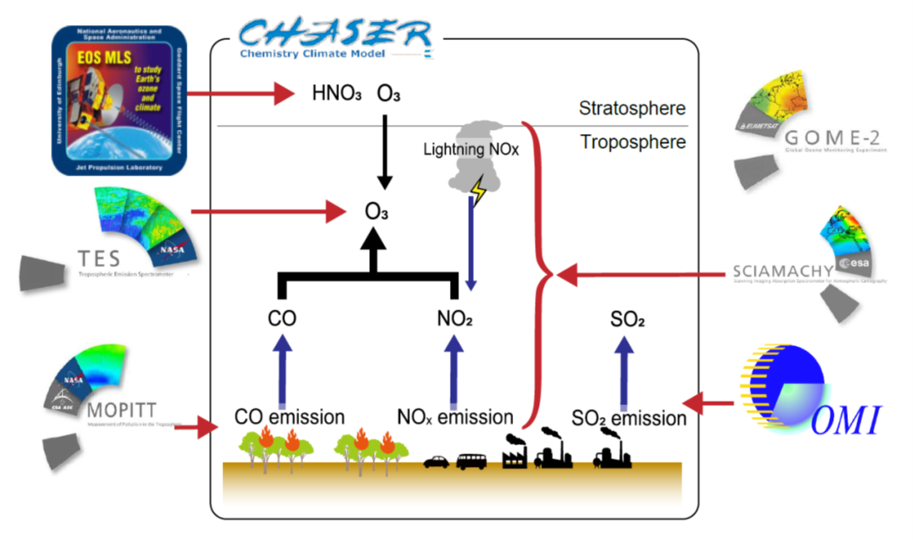
Data assimilation system based on EnKF
Multiple satellite observations for July 2008 were integrated using multi-constituent DA system.
Three horizontal model resolutions were tested to investigate impacts of horizontal resolution on chemical DA.
 | Period | Horizontal resolution
1 | June 22-July 21, 2008 | 0.56°
2 |  | 1.1°
3 |  | 2.8°
(Miyazaki et al., 2019, 2020,
Sekiya, Miyazaki et al., 2021, JAMES)

Slide 5
Surface NOx emission estimates
July 2008
Validation using independent in-situ observations
(AirBASE, AQS, NIES, & Hong Kong EPD)
at selected large urban areas (i.e., large populated
cities).
Region | RMSE [ppbv]
 | DA | Model (w/o DA)
Europe | 1.54 | 2.29
The US | 2.75 | 8.27
East Asia | 2.28 | 9.22
The developed DA system at 0.56 resolution provides globally consistent information on NOx emissions on a megacity scale.
The 0.56°-resolution DA reproduces surface NO2 concentrations at large urban areas.
(Sekiya, Miyazaki et al., 2021, JAMES)

Slide 6
Impact of resolutions on NOx emission estimates
July 2008
Lower emission estimates at higher resolution over polluted areas
Increasing model resolution to 0.56° influences domain (2.8°) total emission estimates, depending on emission source strength.
Total NO_{x} emission estimates over strong source areas were 15% lower at 0.56° resolution than at 2.8° resolution.
(Sekiya, Miyazaki et al., 2021, JAMES)

Slide 7
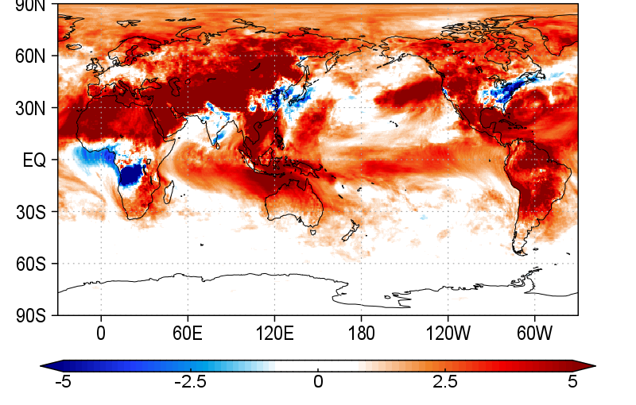
Impact of NOx emissions on surface ozone
July 2008
Surface ozone: Model using top-down (at 0.56°) vs. a priori emissions
Validation using independent in-situ observations
(EBAS, CASTNET, EANET, WDCGG).
Region | RMSE [ppbv]
 | Top-down at 0.56 res. | A priori
Europe | 12.0 | 12.2
The US | 15.3 | 15.7
East Asia | 12.1 | 17.1
[ppbv]
Model resolution significantly affects surface ozone through surface NOx emission estimates.
The agreements with independent in-situ observations are improved by using NOx emission estimates at 0.56° resolution.

Slide 8
Comparison of TROPOMI and OMI NO₂ DA
We compare impacts of assimilating TROPOMI and OMI NO2 on global chemical DA during boreal spring 2018.
The DA calculations for two different sensors are performed to investigate impacts of TROPOMI and OMI NO₂ on chemical DA.
 | Period | Assimilated obs.
TROPOMI DA | April-May 2018 | TROPOMI v1.2
OMI DA |  | OMI QA4ECV v1.1
(Miyazaki et al., 2019, 2020,
Sekiya, Miyazaki et al., 2021, JAMES)

Slide 9
Comparison of TROPOMI and OMI NO₂ DA
Relationship between super-observation errors and RMSE reductions against assimilated observations due to DA.
April-May 2018
TROPOMI super-observation error
TROPOMI DA RMSE reductions
Polluted regions
r = -0.36
RMSEs are largely reduced by DA, especially over polluted regions where super-observation errors are small.
The RMSE reductions are negatively correlated with super-observation errors.
(Sekiya, Miyazaki et al., in prep.)

Slide 10
Comparison of TROPOMI and OMI NO₂ DA
April-May 2018
Super-observation errors
RMSE reductions w.r.t. assimilated obs.
Lower super-observation errors in TROPOMI retrievals than those in OMI retrievals increase RMSE reductions w.r.t. assimilated observations
suggesting improved self-consistency of tropospheric NO₂ analysis in TROPOMI DA.
(Sekiya, Miyazaki et al., in prep.)

Slide 11
Summary
Impacts of increasing horizontal resolution from 2.8° to 0.56° and assimilating TROPOMI NO₂ on chemical DA have been investigated.
Increasing horizontal resolution decreases surface NO_{x} emission estimates over polluted areas and affects ozone concentration analysis.
Assimilating TROPOMI NO₂ data improves self-consistency of global tropospheric NO₂ analysis, compared to assimilating OMI NO₂.
Global multi-constituent DA system at 0.56° resolution will be used to evaluate added values of new constellations of LEO and GEO satellites consistently at various spatial scales from megacity to global.

Slide 12
Back-up slides

Slide 13
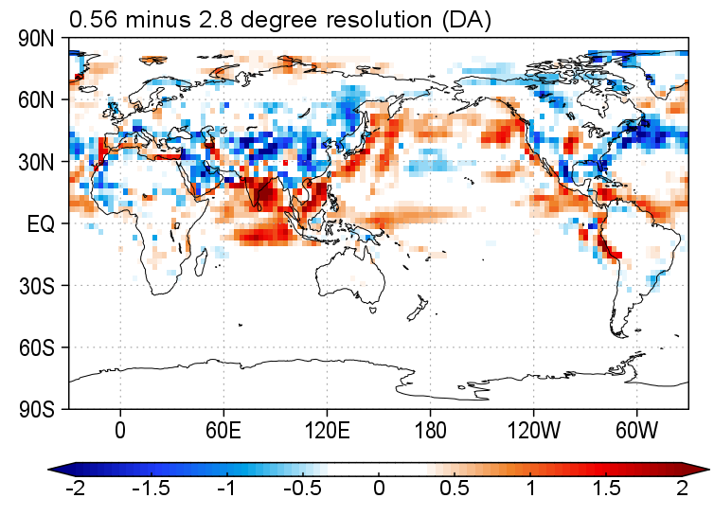
OH conc. in LT
0.56 minus 2.8 degree resolution

Slide 14
Impact on surface ozone analysis
July 2008
Surface ozone
Validation using independent in-situ observations
(EBAS, CASTNET, EANET, WDCGG).
Region | RMSE [ppbv]
 | 0.56deg | 2.8deg
Europe | 12.68 | 13.77
The US | 12.86 | 18.42
East Asia | 14.39 | 14.81
SH | 9.40 | 14.20
Model resolution affects surface ozone through surface NOx emission estimates as well as small-scale model processes, and the assimilation of ozone satellite observations.
The agreements with surface ozone obs. are improved at 0.56° resolution.
(Sekiya, Miyazaki et al., 2021, JAMES)

