Slide 1
Use of ozone retrievals in the CAMS system and steps to include new datasets
Antje Inness (ECMWF)

Slide 2
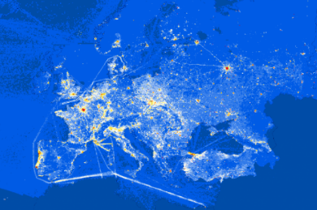
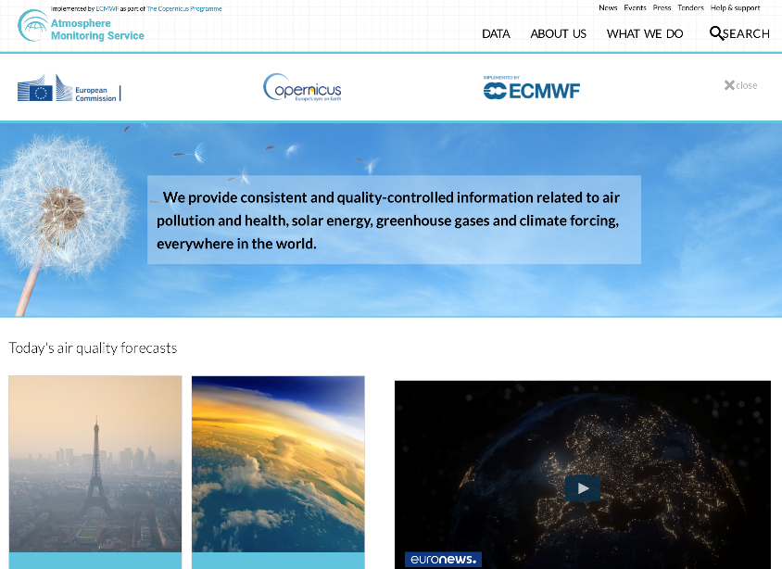
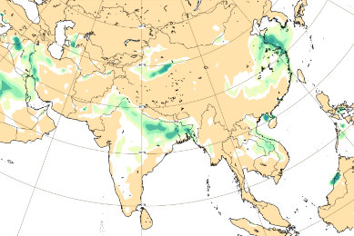
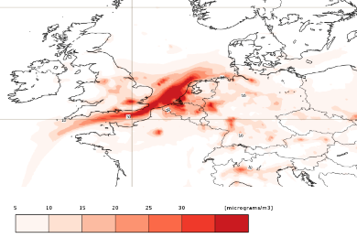
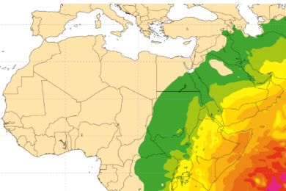
What the Copernicus Atmosphere Monitoring Service has to offer
The CAMS portfolio includes Earth Observation based information products about:
past, current and near-future (forecasts) global atmospheric composition;
the ozone layer;
air quality in Europe;
emissions and surface fluxes of key pollutants and greenhouse gases;
solar radiation;
climate radiative forcing.
Quarterly validation reports of global and regional outputs.
https://atmosphere.copernicus.eu

Slide 3
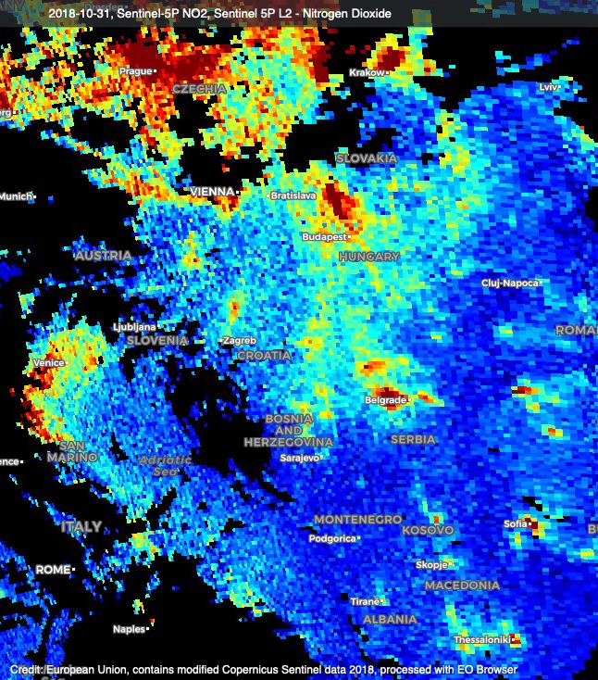
Why is CAMS needed?
Observations are essential, but direct use is generally limited:
gaps in space and time
observed quantities may not be directly relevant (vertical column vs surface concentration)
can be complex and numerous
What CAMS does:
blend observations (satellite and non satellite) with model to provide a consistent 3D state
forecasts, a few days ahead
reanalyses over past years or decades
Example: NO₂ tropospheric column from Copernicus Sentinel-5P (31/10/2018)

Slide 4
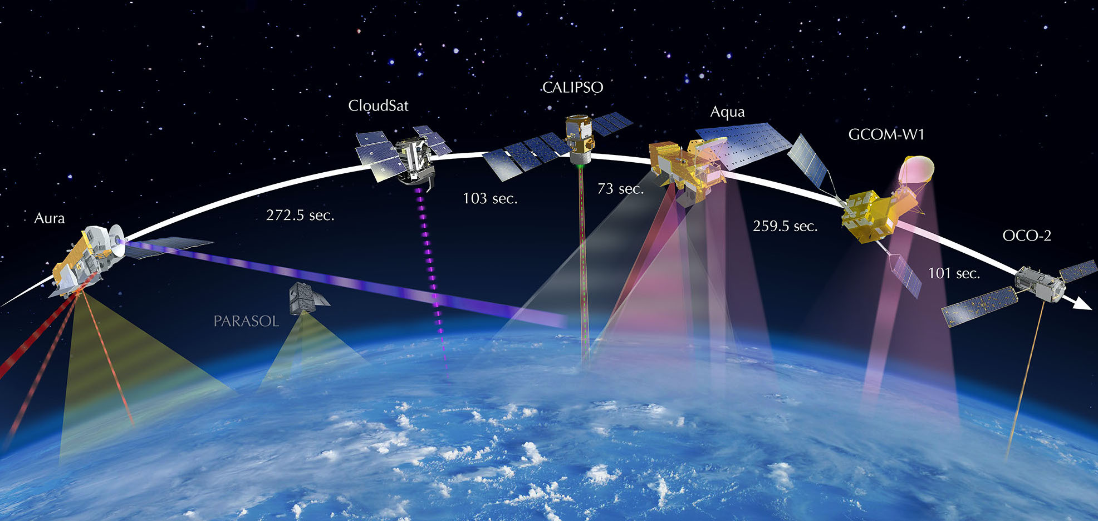
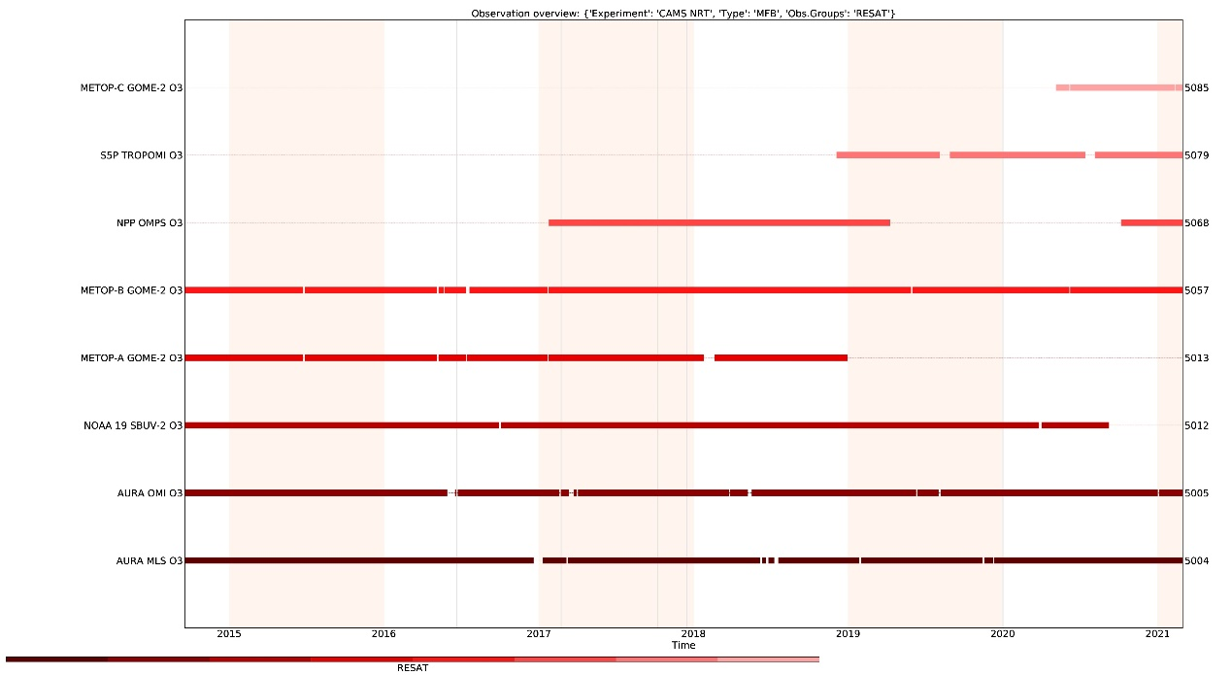
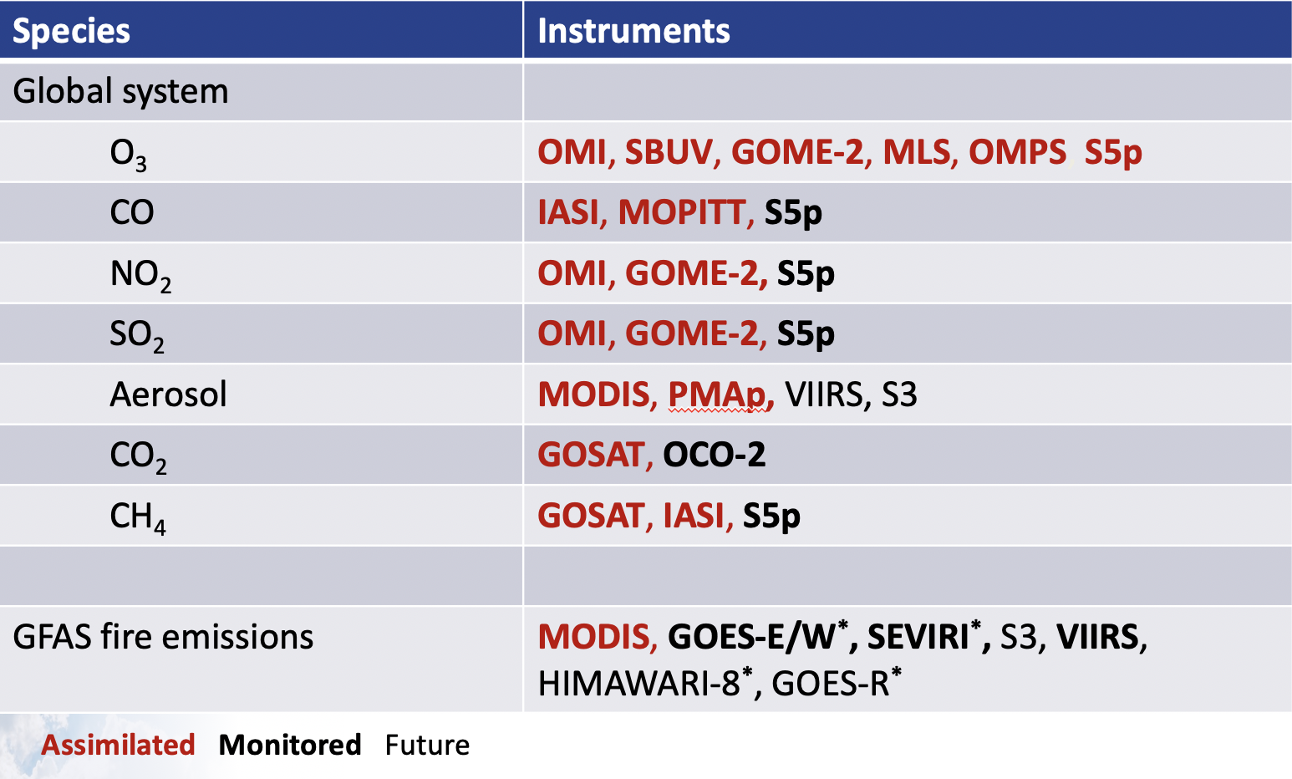
Ozone data used in CAMS NRT system
NRT O3 retrievals
GOME-2C
TROPOMI
OMPS NPP
GOME-2B
GOME-2A
SBUV NOAA-19
OMI
MLS
S5p
CAMS uses Earth Observation data from many satellites for atmospheric composition and weather.
2015 2016 2017 2018 2019 2020 2021

Slide 5
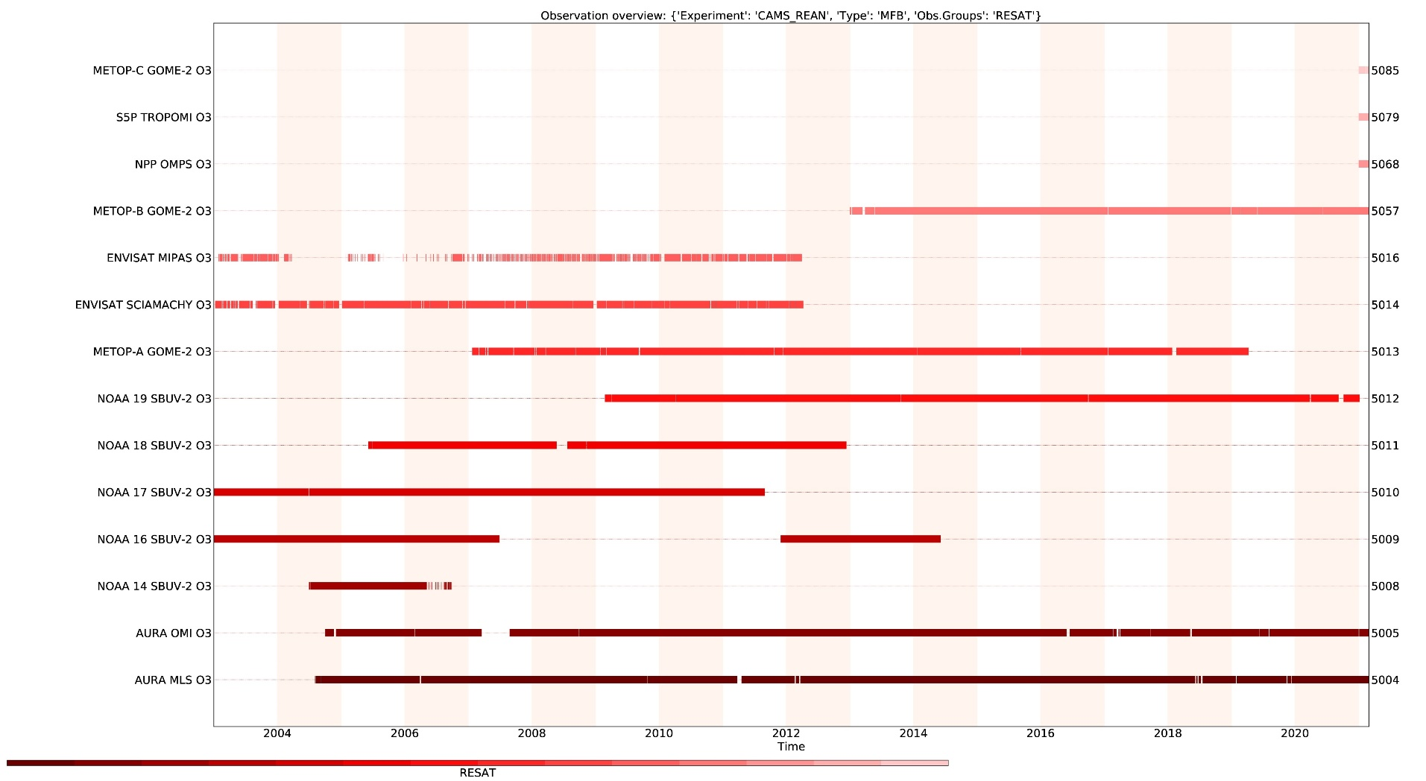
Ozone data used in the CAMS reanalysis
GOME-2C
TROPOMI
OMPS NPP
GOME-2B
MIPAS
SCIAMACHY
GOME-2A
SBUV NOAA-19
SBUV NOAA-18
SBUV NOAA-17
SBUV NOAA-16
SBUV NOAA-14
OMI
MLS
Reanalysis data set going back to 2003
Limb profile data MLS and MIPAS

Slide 6
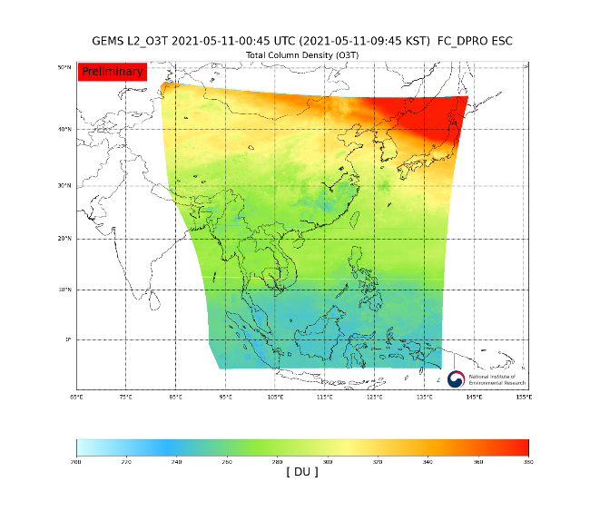
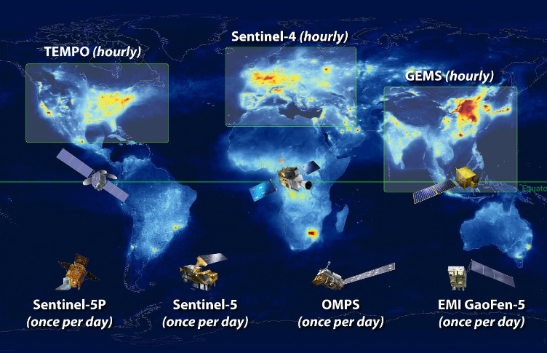
Preparation for new data
Sentinel-5
Sentinel-4, GEMS, TEMPO
Example of GEMS TCO3
New experience to use geostationary data
Data volume/ resolution will be a challenge
Already some experience with super-obbing for S5P
From https://nesc.nier.go.kr/product/view

Slide 7







Observation data flow
Converter can already be prepared with test data (important to have final data format)
EUMETCast
Ingestion & processing
(SAPP)
Analysis & forecast
(CCA/CCB)
internet
Converter: Read S5P netcdf data and convert into BUFR
Include the S5P BUFR data into CAMS model
S5p monitoring statistics and feedback to retrieval teams
Acquisition (ECPDS)
Data storage (DHS)
GTS

Slide 8
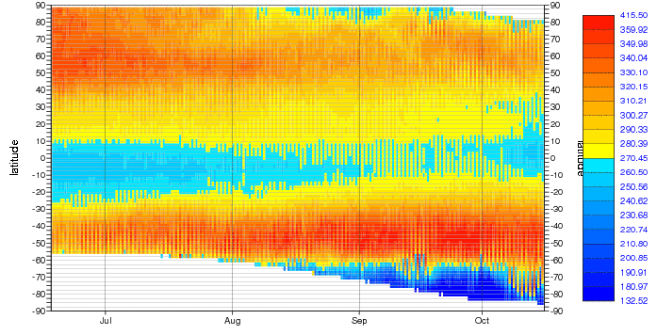
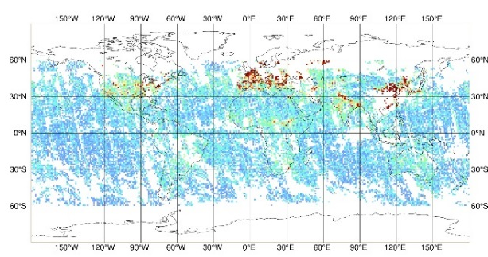
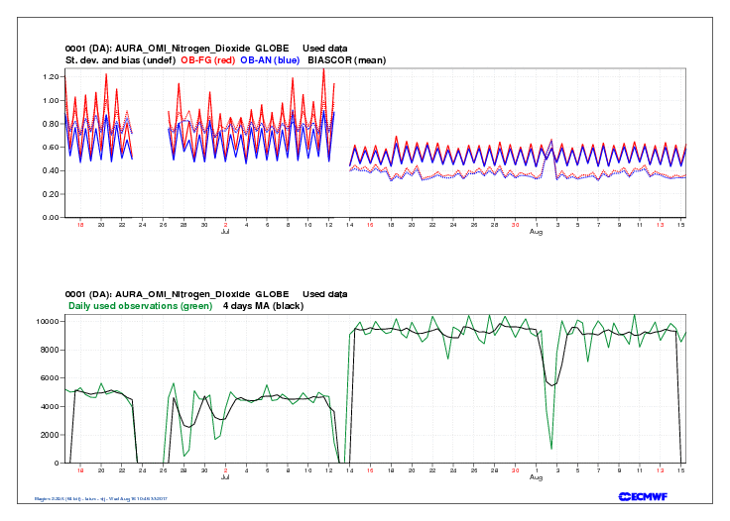
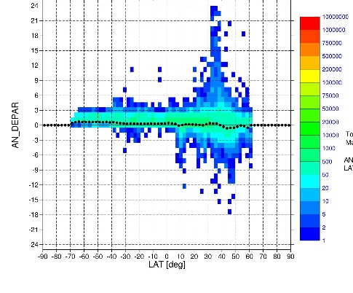
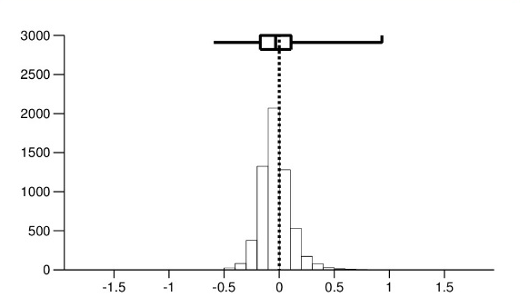
Examples of monitoring plots
Analyse observations and departures (obs-model)
Timeseries (area-mean and Hovmoeller plots)
Geographical plots
Scatter plots
Histograms

Slide 9
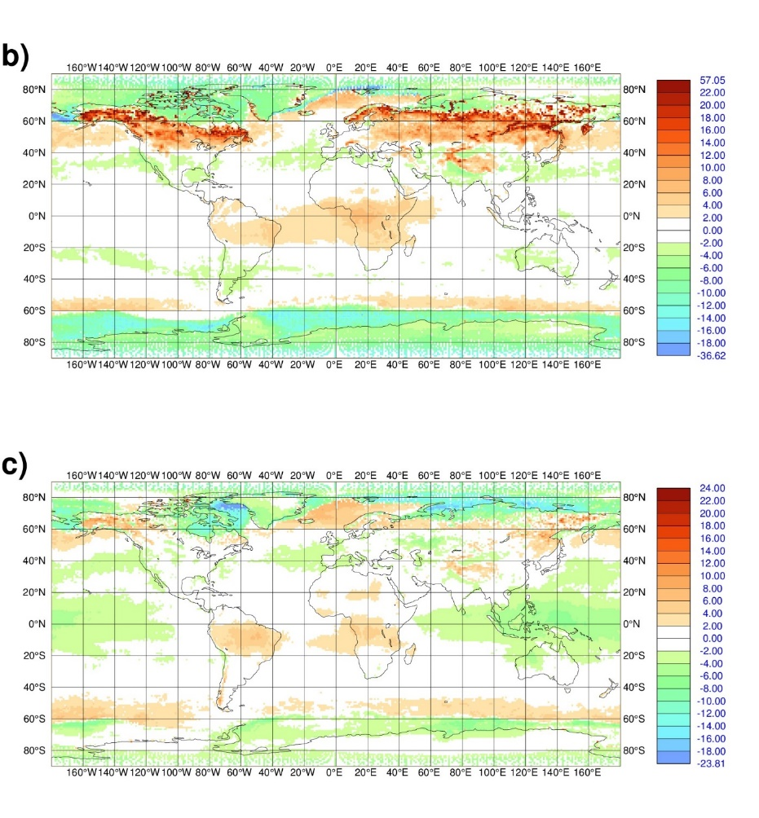
Example 1: Maps of analysis departures
Feb-April 2018
[DU]
TROPOMI O3 analysis departures
Shown are obs – analysis
Early S5P TCO3 NRT data in 2018
Looking at departures allowed CAMS to identify problems in the data related to the surface albedo climatology used in the NRT retrievals
The retrieval has since been improved
Sep-Nov 2018
[DU]
Inness et al., 2019, ACP https://doi.org/10.5194/acp-19-3939-2019

Slide 10
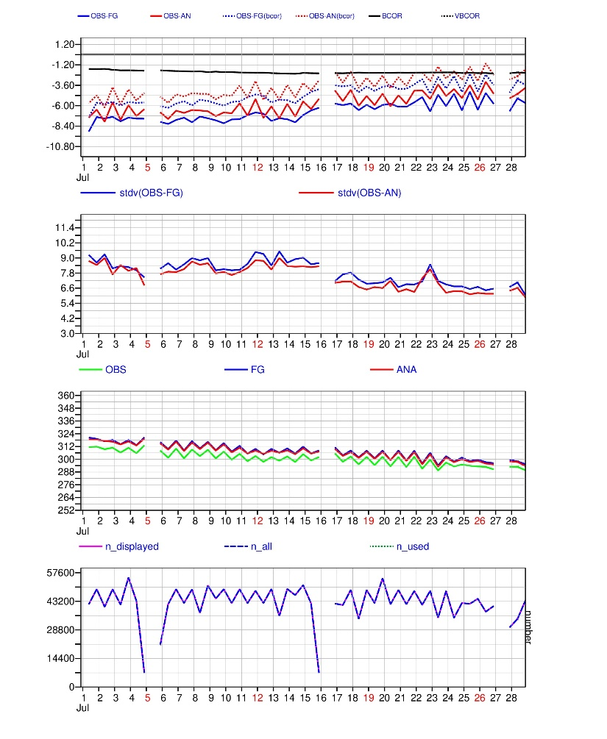
Example 2: Timeseries of departures
90-70N
TROPOMI TCO3 Algorithm upgrade to V2.1.3 on 16 July 2020
Area averaged timeseries 1-28 July 2020
Monitoring of TROPOMI TCO3 data shows reduced bias at high northern latitudes after upgrade.
Benefit of assimilation system:
  Departures show differences that are not clearly visible in absolute values
  We can build up statistics quickly and globally
Departures
Stdv(dep)
Obs, an, fg
Numbers

Slide 11
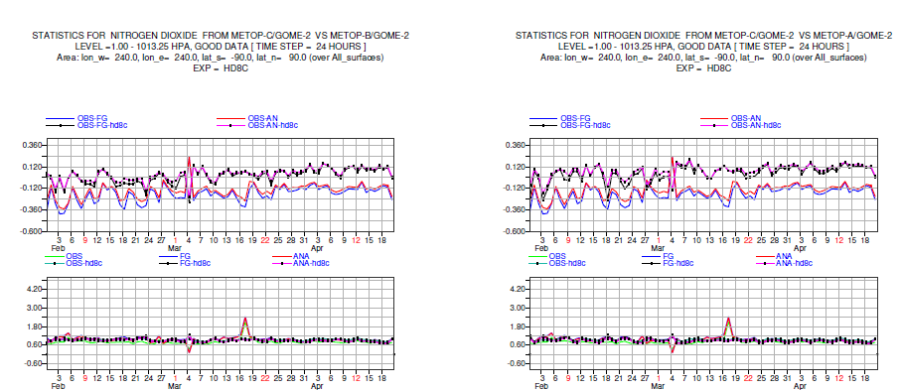
Example 3: GOME-2 NO2 retrievals
GOME-2C
GOME-2A
GOME-2B
Monitoring allows us to check consistency between retrievals from different instruments
Here: GOME-2C NO2 values are higher than GOME-2AB and give different departures
Unit: 10¹⁵ molec/cm²

Slide 12
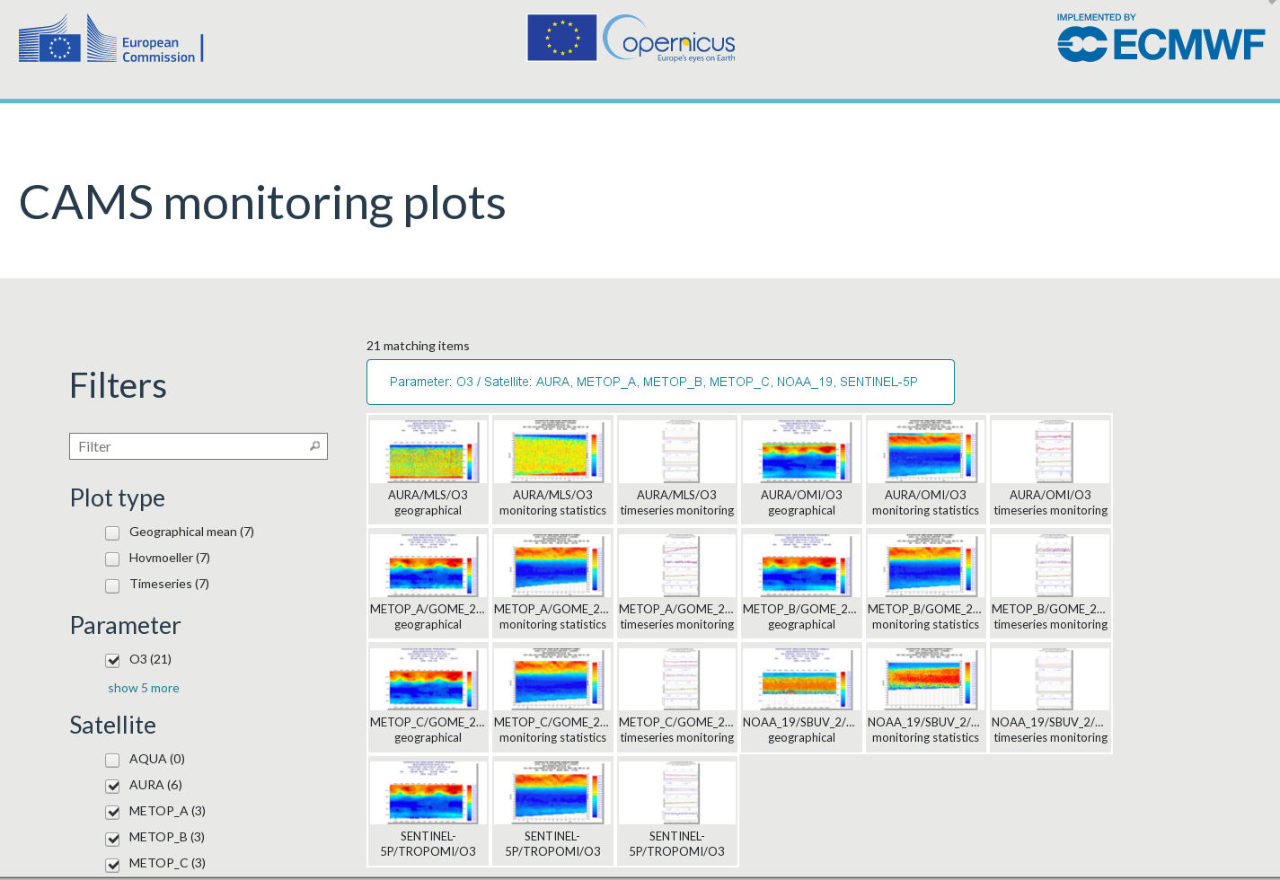
CAMS routine monitoring page
Monitoring plots are
routinely displayed on the CAMS website
give us and the data producers timely information about any changes in the data
https://atmosphere.copernicus.eu/charts/cams_monitoring/

Slide 13
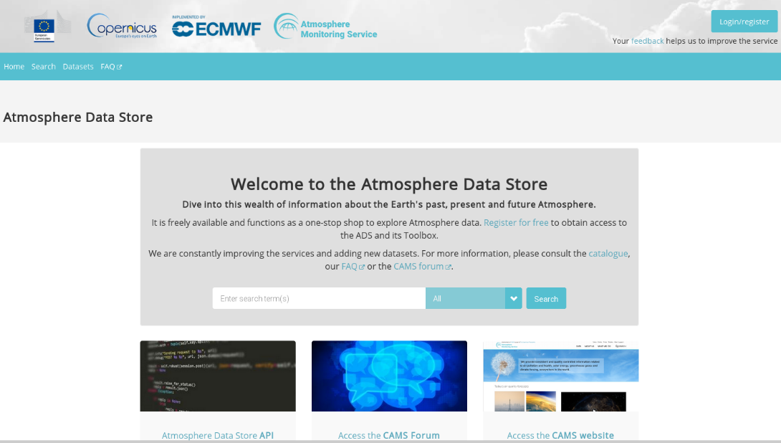
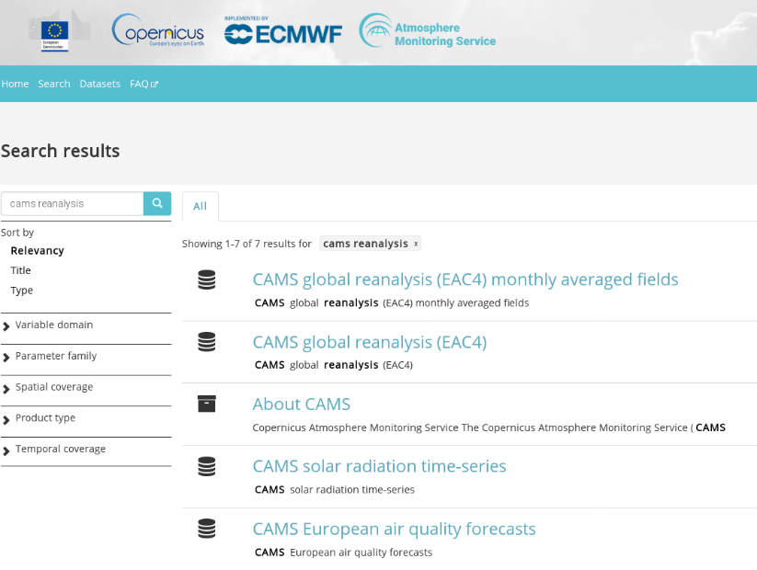
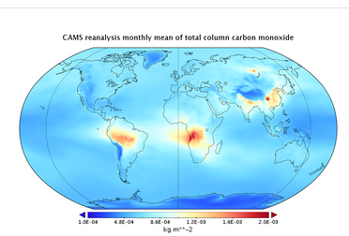
The Atmosphere Data Store (ADS)
All CAMS data are freely available
Based on CDS
https://atmosphere.copernicus.eu/data
https://atmosphere.copernicus.eu

