Slide 1





Ground- and satellite-based Assessment of Tropospheric Ozone Data Records
VC-20-01
Tropospheric Ozone from Satellites
D. Hubert, A. Keppens, J.-C. Lambert, T. Verhoelst, S. Compernolle,
K.-P. Heue, D. Loyola, F. Romahn
ROYAL BELGIAN INSTITUTE
FOR SPACE AERONOMY
CEOS AC-VC #17, remote conference, June 7-11, 2021

Slide 2
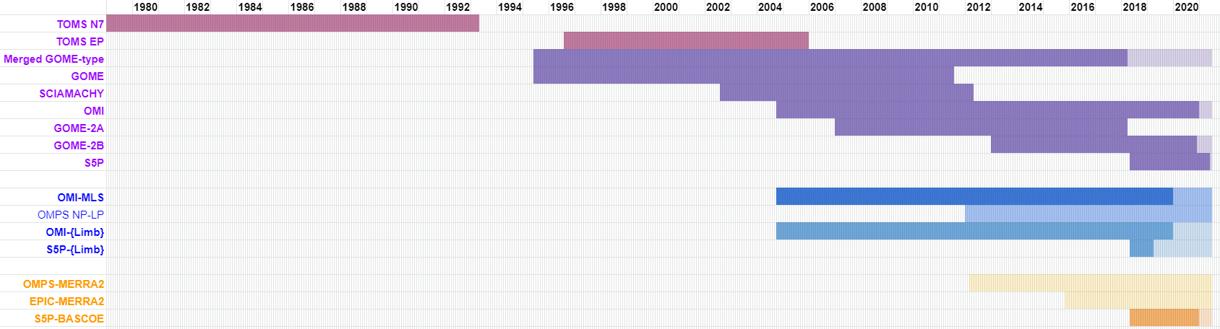
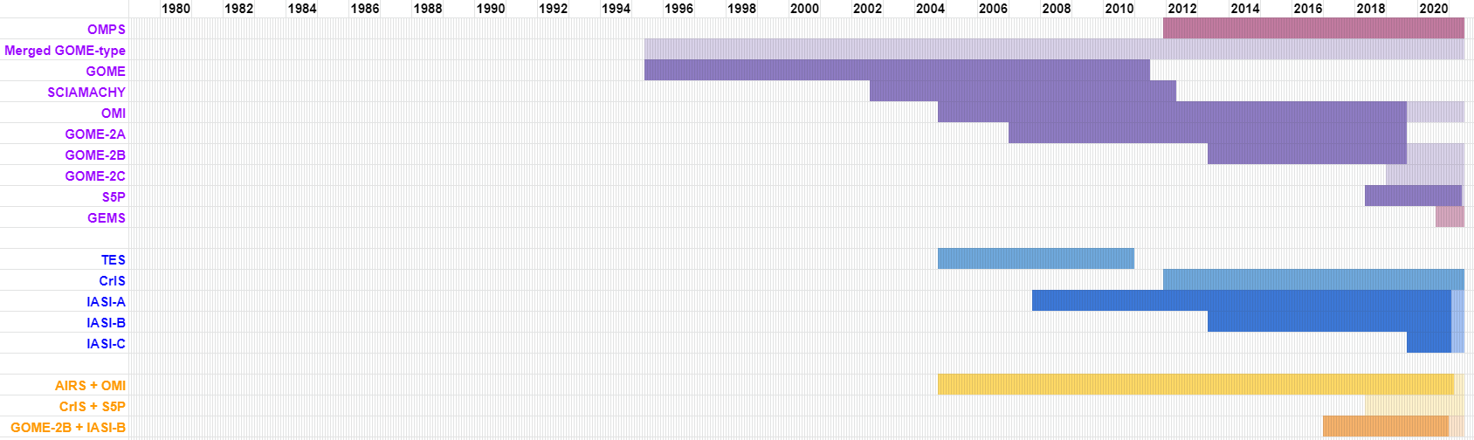
VC-20-01: Available tropospheric ozone satellite records
Residual technique (UV-VIS sensors)
Convective Cloud Differential
Nadir - Limb
Nadir - Reanalysis
Profile retrieval
UV-VIS
IR-NIR
VIS+IR synergy

Slide 3
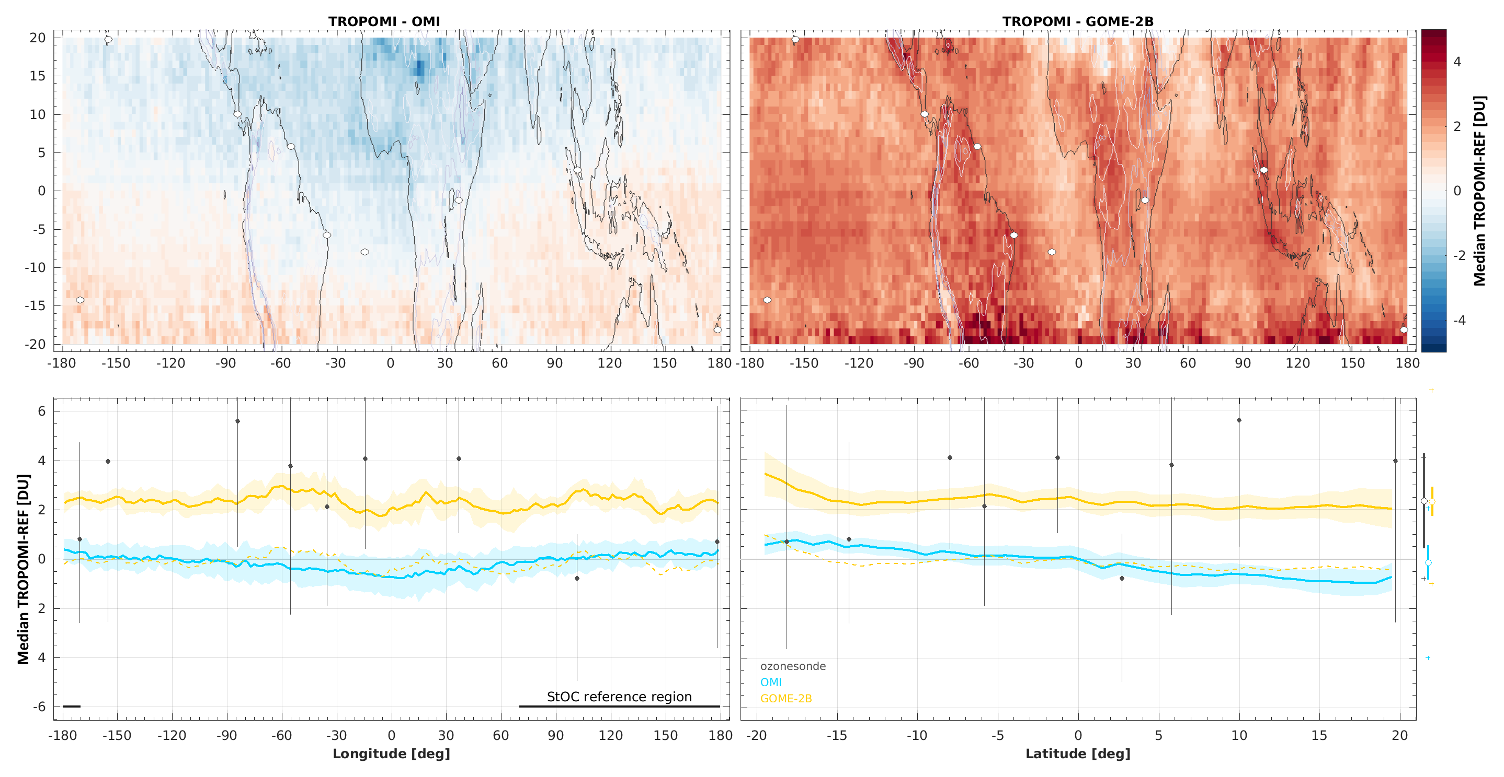
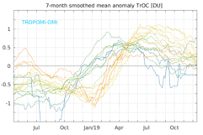
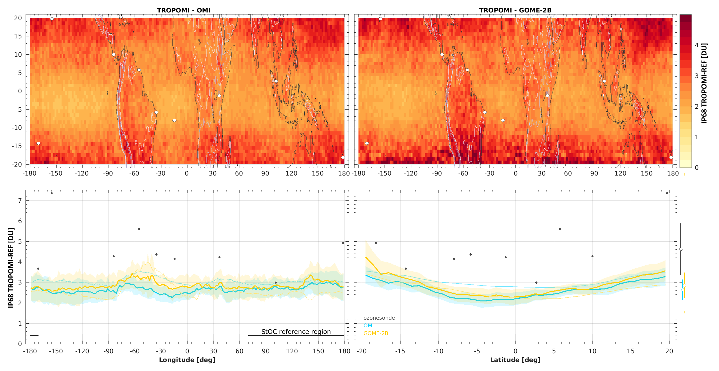
Ground-based validation : goals
Validate satellite data quality and their dependences
Understand differences between satellite products
Improve single-sensor data records
Assist development of multi-sensor merging schemes
CEOS VC-20-01
Bias : spatial structure
Bias : temporal structure
Dispersion : spatial structure

Slide 4


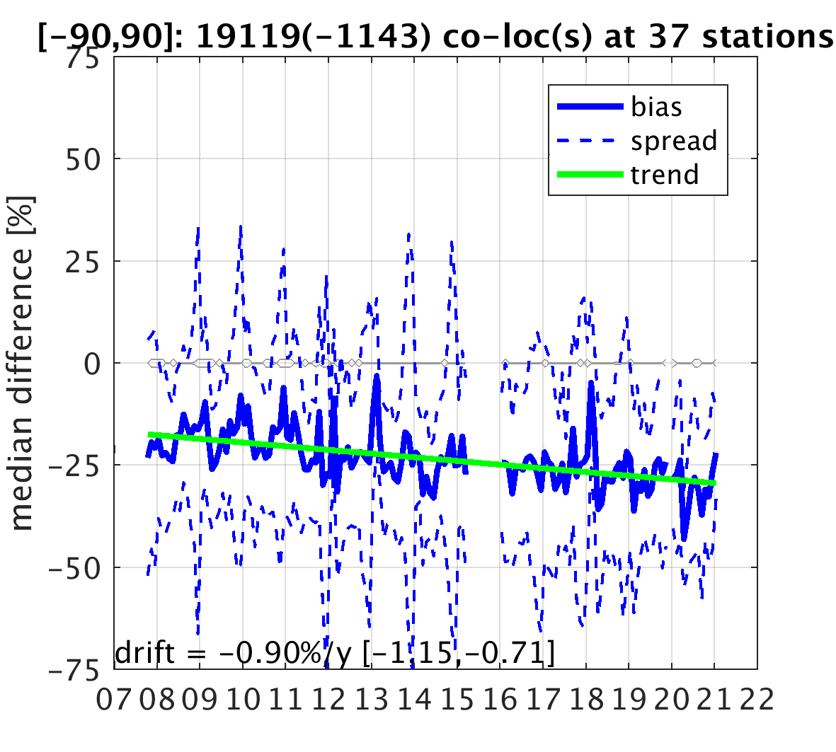
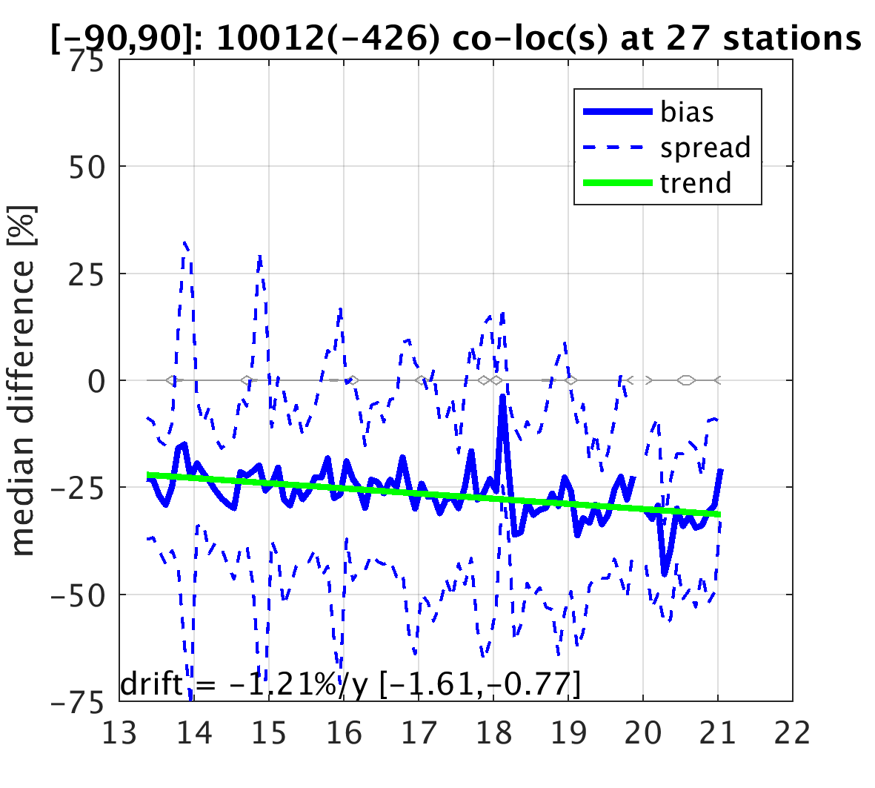



IASI sensors versus ozonesonde network
IASI-A (0-6 km)
IASI-B (0-6 km)

Slide 5
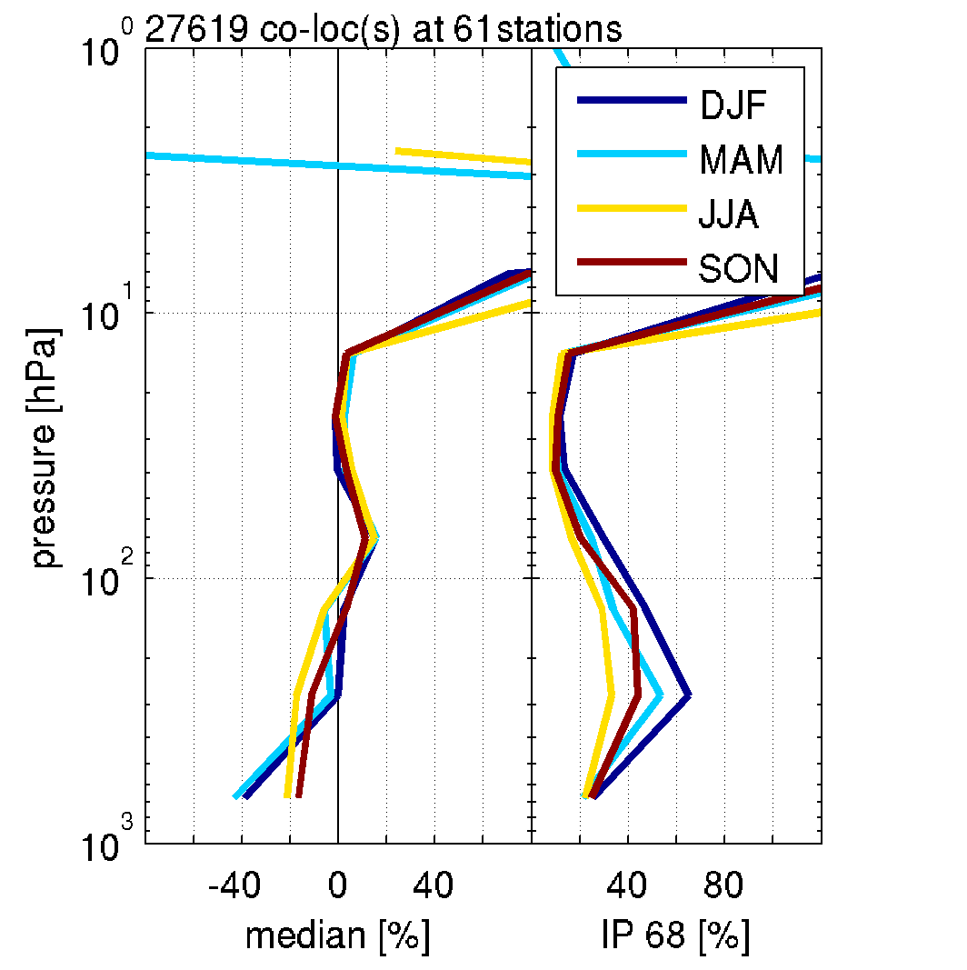
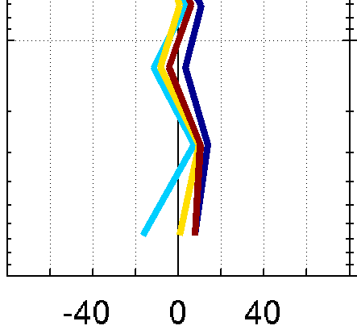
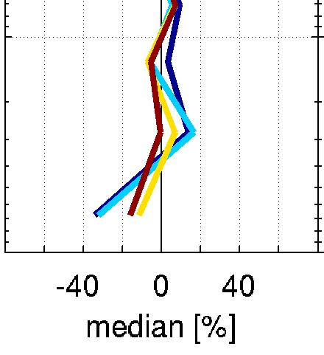
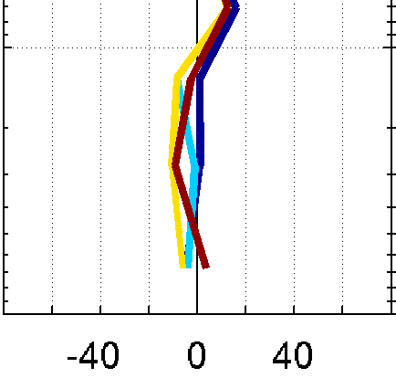
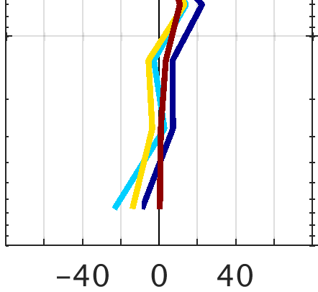
GOME-type sensors versus ozonesonde network
GOME
(1995-2011)
SCIAMACHY (2002-2012)
OMI
(2004-2019)
GOME-2A (2007-2019)
GOME-2B (2014-2020)

Slide 6
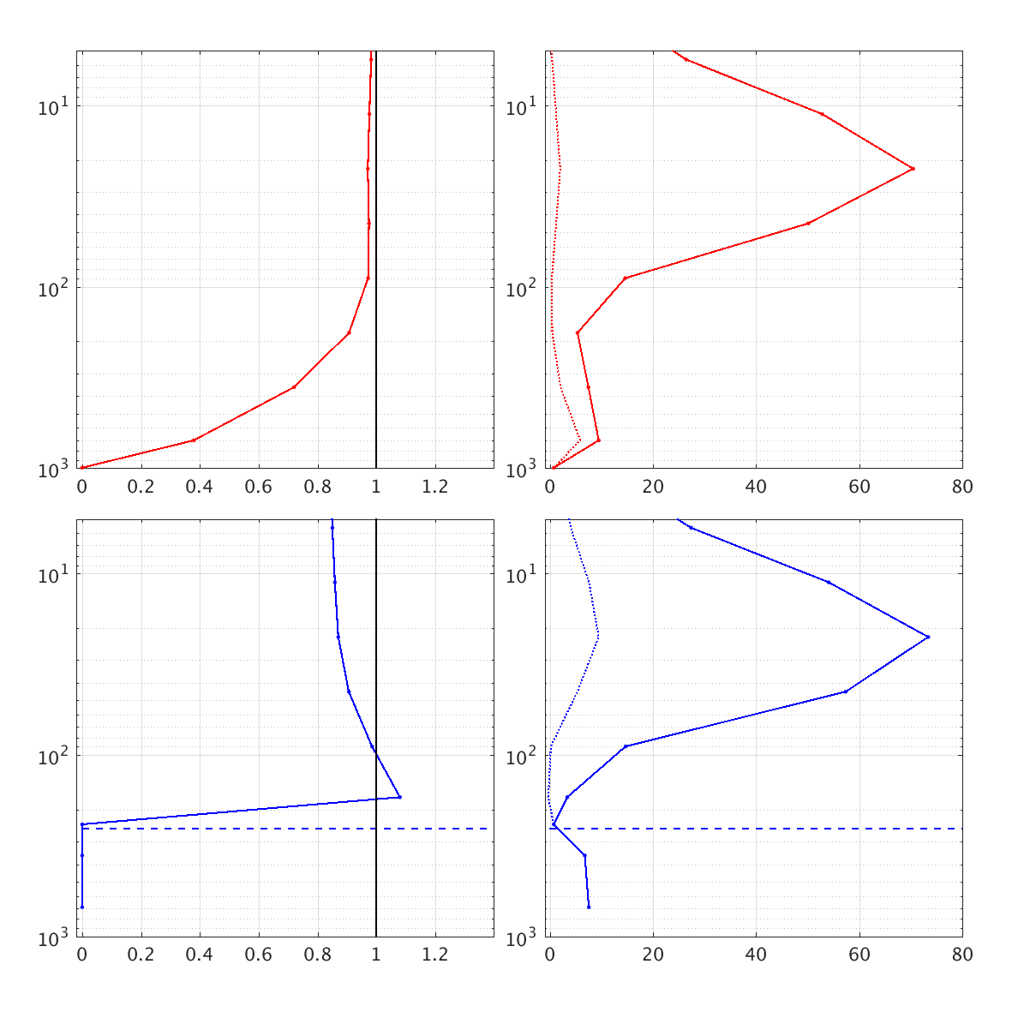
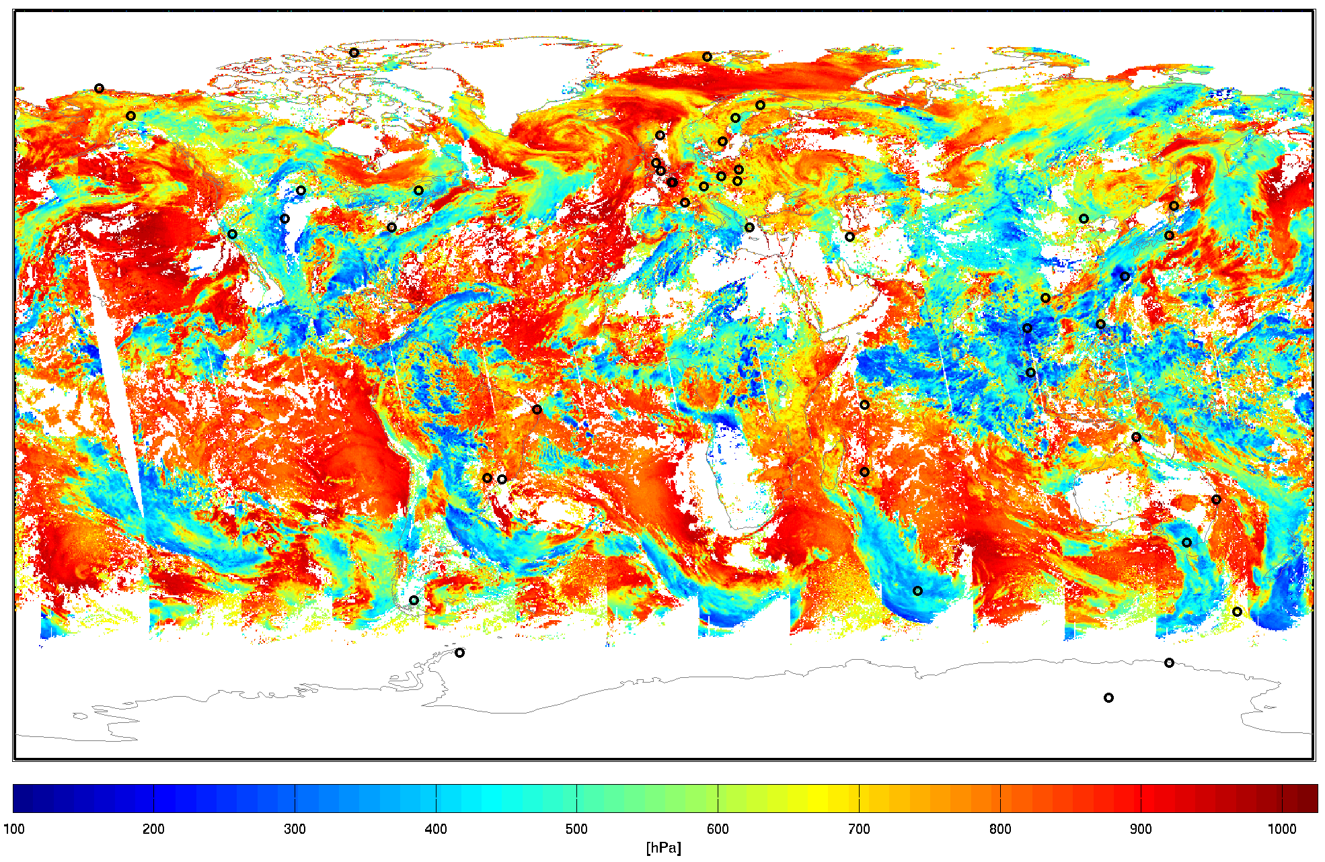
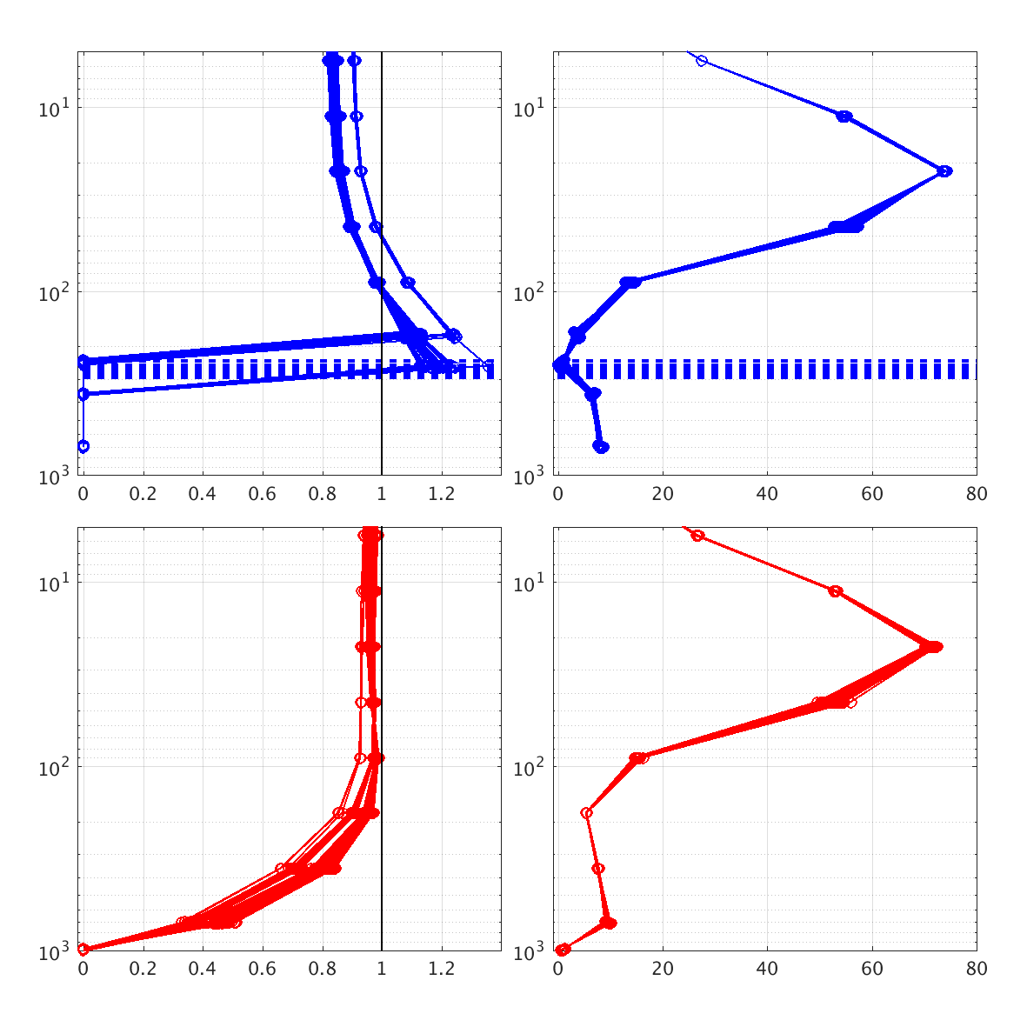
Gap for residual data : vertical smoothing diagnostics
S5P OFFL total O3 (100 pixels)
S5P OFFL total O3 (1 pixel)
S5P OFFL cloud top pressure (CRB) 5 June 2021
AK
Apriori [DU]
AK
Apriori [DU]
Cloud-free
Convective cloud
cloud top

Slide 7


Validation of subtle data quality features
Bias
Dispersion
Dispersion single-site comparisons (3-5 DU)
Dispersion across network (~2 DU)

Slide 8
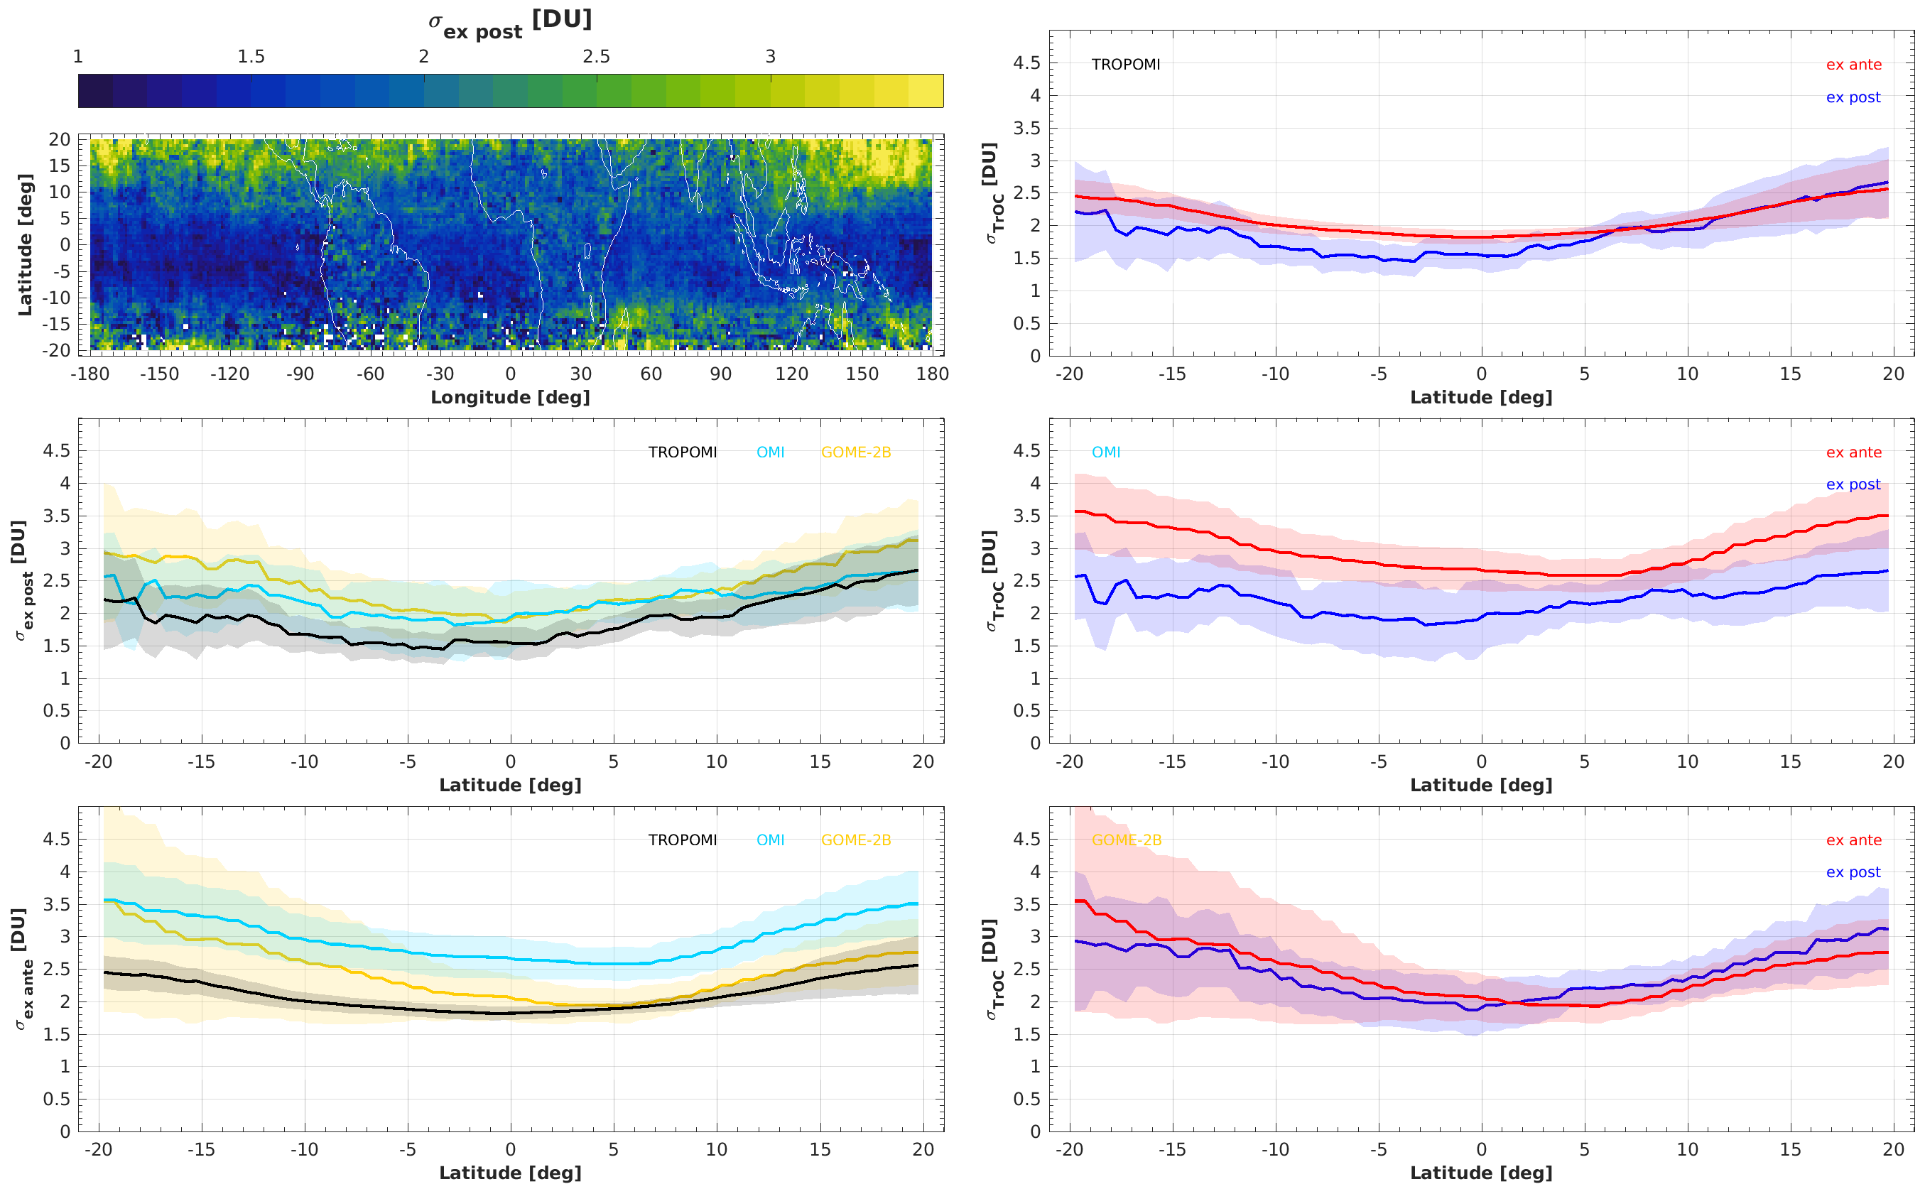
Improve constraints on satellite random uncertainty
Analysis of co-located triplets (Stoffelen et al., 1998)
reduces term due to geophysical variability
singles out precision of individual sensors
reported
observed

Slide 9
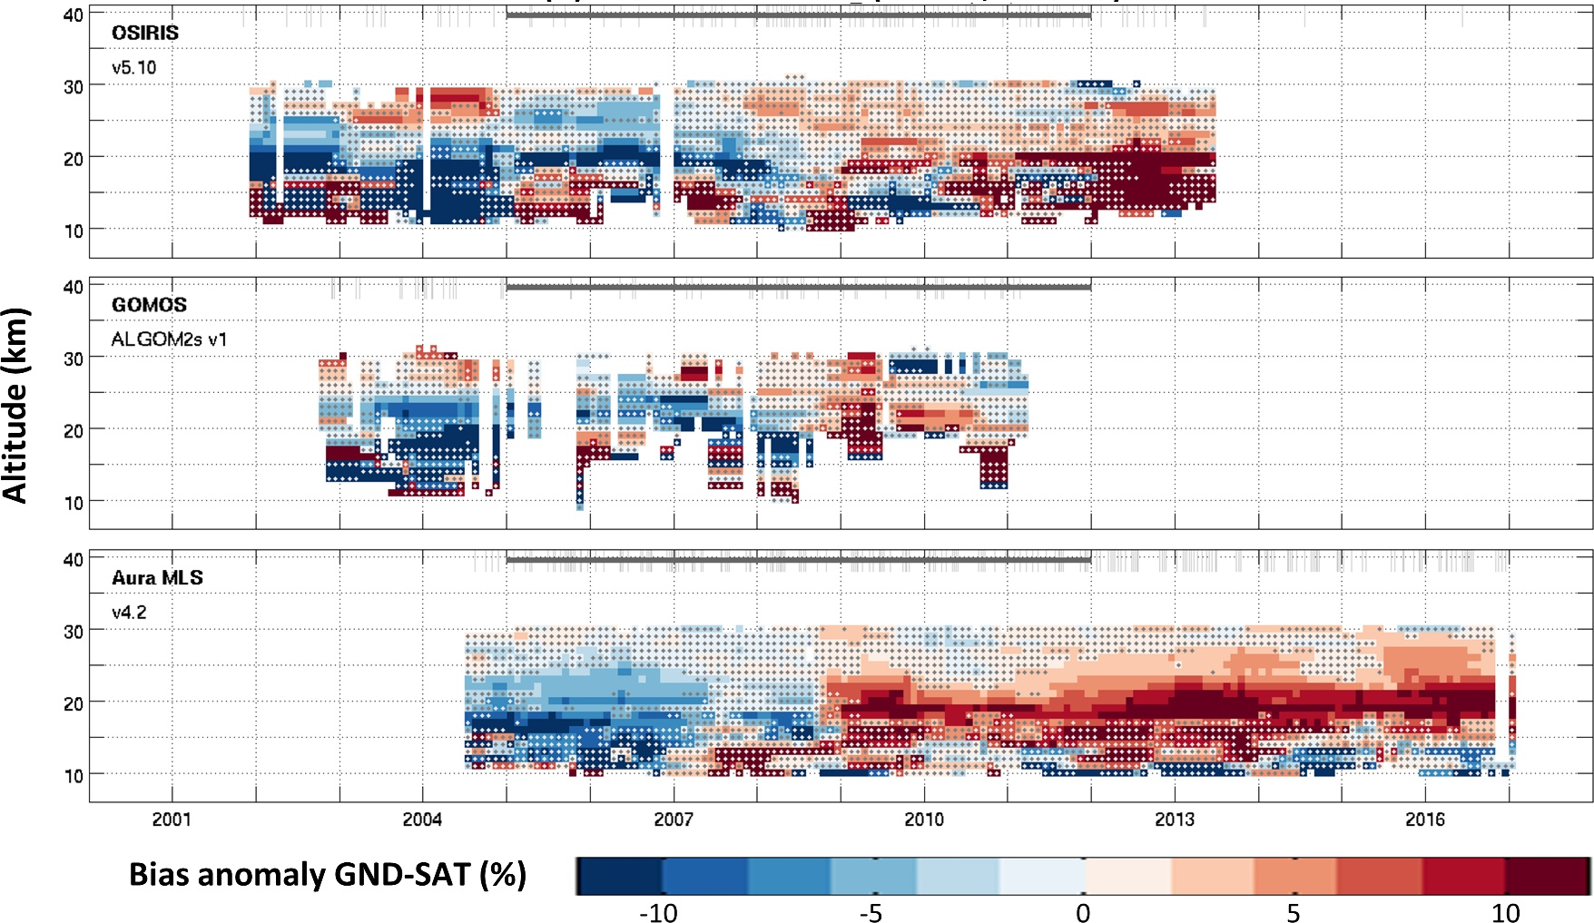

Feedback to ground-based community
Limb O3 profile versus sonde at one site
Use (complementary) satellite data records as transfer standard
Identify artefacts in ground-based record
  temporal inhomogeneities
  spatial inhomogeneities

Slide 10
Outlook
Continuous interaction with TOAR-II SOWG & HEGIFTOM (GB networks)
Satellite contributors: please submit data to BIRA by September 2021
January 2022: Progress meeting
April-May 2022: Report of results at AC-VC-18
Q3/Q4 2022 and later: further interactions with TOAR-II

Slide 11
BACKUP SLIDES

Slide 12
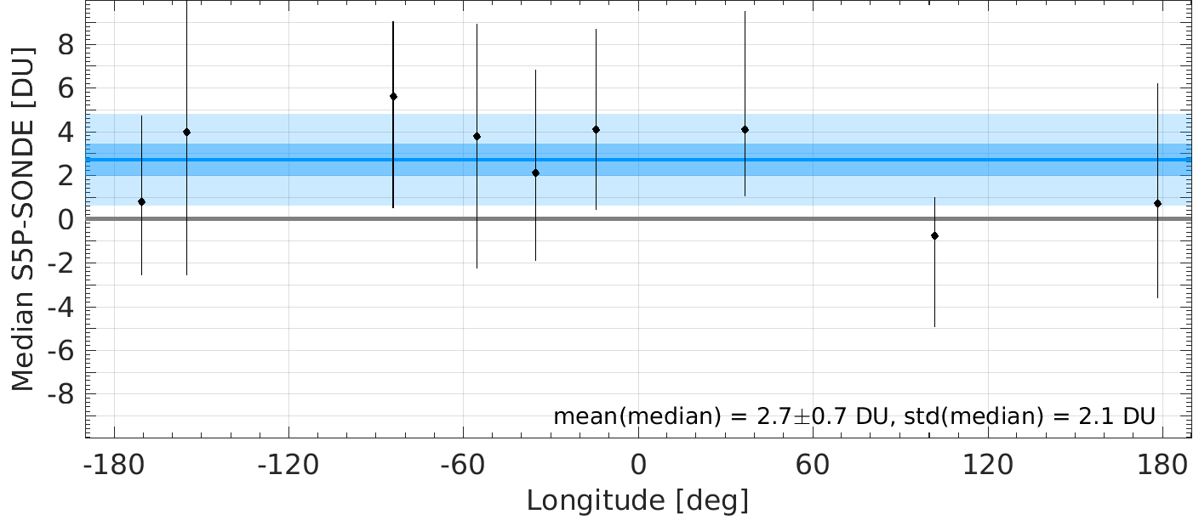
Ground-based validation : challenges
Dispersion single-site comparisons (3-5 DU)
Overall calibration network
Dispersion across network (~2 DU)

Slide 13
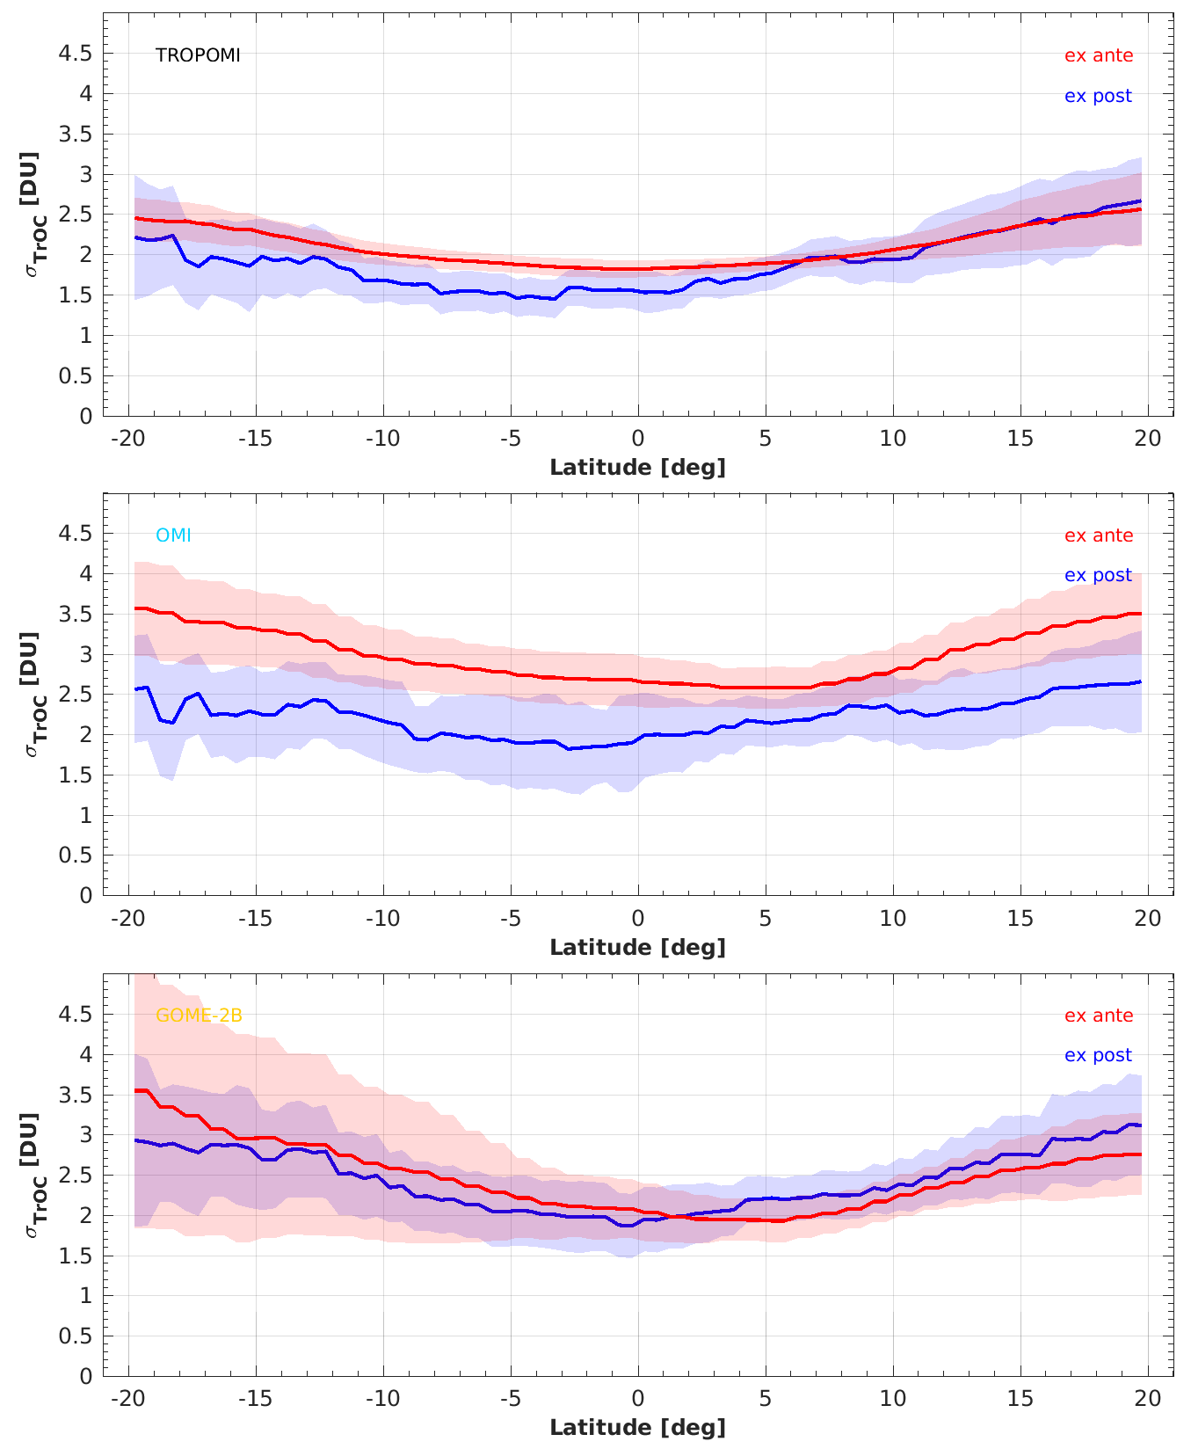
Validating reported random uncertainty
Constraints on derived random uncertainty (ex post) can validate reported uncertainty (ex ante)
TROPOMI & GOME-2B ex ante random uncertainties are accurate
OMI ex ante random uncertainties are too conservative

