Slide 1
S5P/TROPOMI HCHO and NO₂ validation using ground based and airborne instruments
M. Van Roozendael¹, F. Tack¹, I. De Smedt¹, G. Pinardi¹, T. Verhoelst¹, S. Compernolle¹, J.-C. Lambert¹, A. Merlaud¹, F. Hendrick¹, M. Kumar Sha¹, A. Cede², M. Tiefengraber², K. Lange³, A. Richter³, T. Wagner⁴, T. Ruhtz⁵, A. Nemuc⁶, D. Schuettemeyer⁷
¹BIRA-IASB, ²Luftblick, ³IUP-Bremen, ⁴MPIC, ⁵FUB, ⁶INOE, ⁷ESA
Notes:
Overview of recent activities in Europe on the validation of TROPOMI NO2 and HCHO products, using ground based and airborne instruments

Slide 2
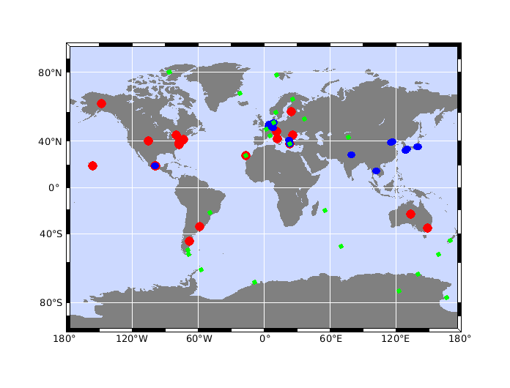
Quality assessment of three years of Sentinel-5p TROPOMI NO₂ data
Tijl Verhoelst¹, Steven Compernolle¹, Gaia Pinardi¹, José Granville¹, Jean-Christopher Lambert¹, Kai-Uwe Eichmann², Henk Eskes³, Sander Niemeijer⁴, Ann Mari Fjæraa⁵, Andrea Pazmino⁶, Ariane Bazureau⁶, Florence Goutail⁶, Jean-Pierre Pommereau⁶, Alexander Cede^{7,8}, and Martin Tiefengraber⁸
(1) BIRA-IASB, (2) IUP, (3) KNMI, (4) s[&]t, (5) EVDC (NILU), (6) CNRS-LATMOS, (7) NASA GSFC, (8) Luftblick & Uni. Of Innsbruck
Correlative measurements used as reference:
Stratospheric column: 26 ZSL-DOAS (12 SAOZ + 14 other)
Tropospheric column: 25 MAX-DOAS
Total column: 30 PGN
ZSL-DOAS = Zenith Scattered Light DOAS (Differential Optical Absorption Spectroscopy) at twilight
SAOZ = network of automated ZSL-DOAS (Système d’Analyse par Observation Zenitale)
MAX-DOAS = Multi-Axis DOAS
PGN = Pandonia Global Network (i.e. direct-sun spectrometers)
Verhoelst et al. (2021): https://amt.copernicus.org/articles/14/481/2021/
Notes:
We start with NO2. In a paper recently published in AMT, Verhoelst et al. have used a comprehensive data base of correlative measurements to assess stratospheric, tropospheric and total NO2 columns.
This is based on a total of about 80 stations combining zenith-sky, MAX-DOAS and Pandora instruments.

Slide 3
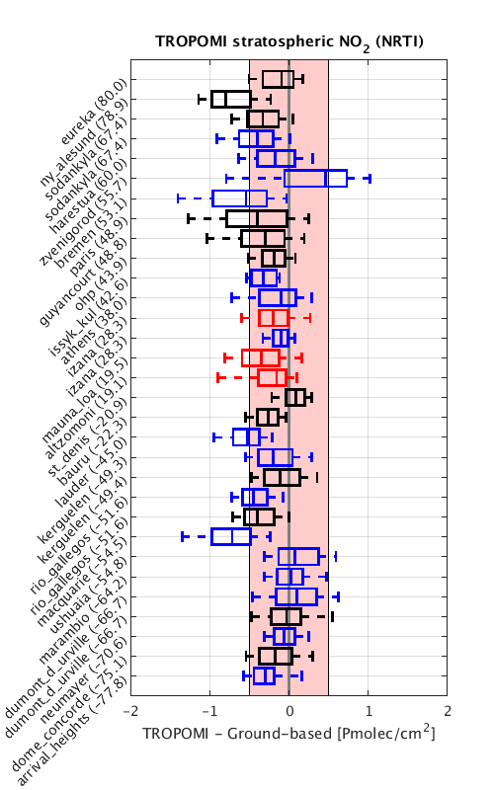
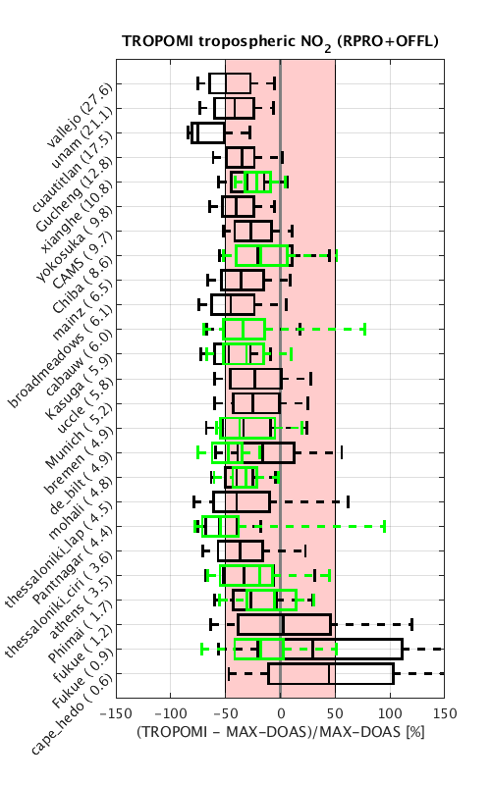
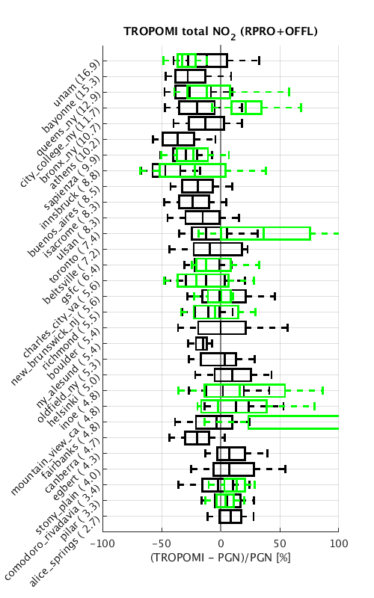
Quality assessment of three years of Sentinel-5p TROPOMI NO₂ data
Tijl Verhoelst¹, Steven Compernolle¹, Gaia Pinardi¹, José Granville¹, Jean-Christopher Lambert¹, Kai-Uwe Eichmann², Henk Eskes³, Sander Niemeijer⁴, Ann Mari Fjæraa⁵, Andrea Pazmino⁶, Ariane Bazureau⁶, Florence Goutail⁶, Jean-Pierre Pommereau⁶, Alexander Cede^{7,8}, and Martin Tiefengraber⁸
(1) BIRA-IASB, (2) IUP, (3) KNMI, (4) s[&]t, (5) EVDC (NILU), (6) CNRS-LATMOS, (7) NASA GSFC, (8) Luftblick & Uni. Of Innsbruck
Comprehensive and homogeneous effort by MPC and AO team NIDFORVAL
Strato: 26 ZSL-DOAS
Tropo: 25 MAX-DOAS
Total: 30 Pandora’s
Up to v1.3
From v1.4
Stratosphere: minor negative mean difference (<7%)
Troposphere: -30% mean difference (multiplicative w.r.t. tropo column)
Total: -20% mean difference at sites with significant tropospheric column
v1.4 tends to increase tropospheric columns at polluted sites, reducing the bias and improving consistency with OMI (see also van Geffen et al., this session, and Eskes et al., AMT in prep., 2021)
NRTI and OFFL are on average very consistent (<2% difference)
SAOZ
Other ZSL-DOAS
Mountain PGN
Verhoelst et al. (2021): https://amt.copernicus.org/articles/14/481/2021/
Notes:
This was a comprehensive effort from the Mission Performance Center and from scientists involved in the NIDFORVAL project.
Results are summarised here, for stratospheric, tropospheric and total columns of NO2.
Stratospheric results are sorted according to latitude, good general agreement with a small negative bias
Tropospheric and total column results are sorted according to the NO2 columns. What we see is that the bias scales with the tropospheric column and is approximately in the range of -30%.
We have also tested the new v1.4 where cloud effects are better corrected. First results show an improvement, but more data are needed to draw more robust conclusions.

Slide 4
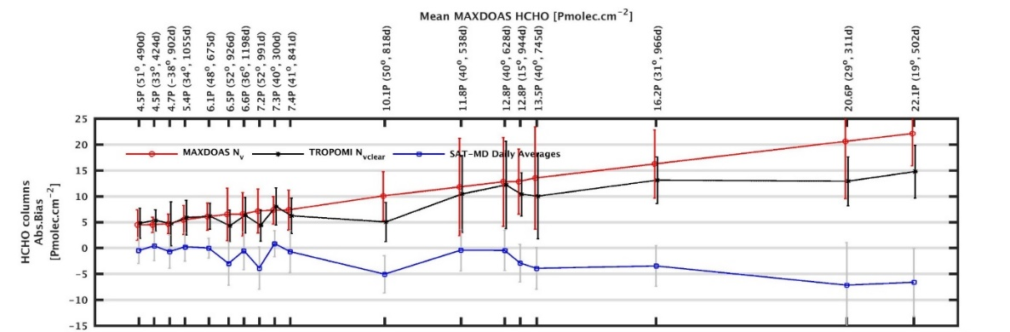
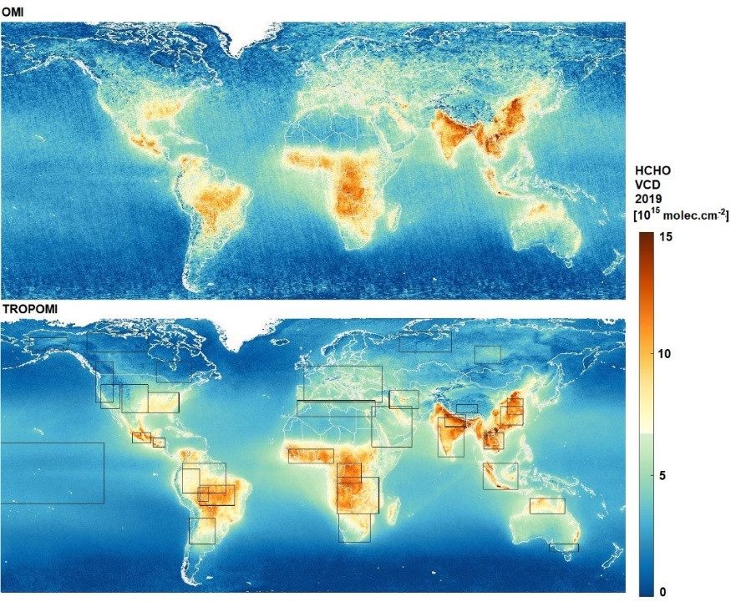
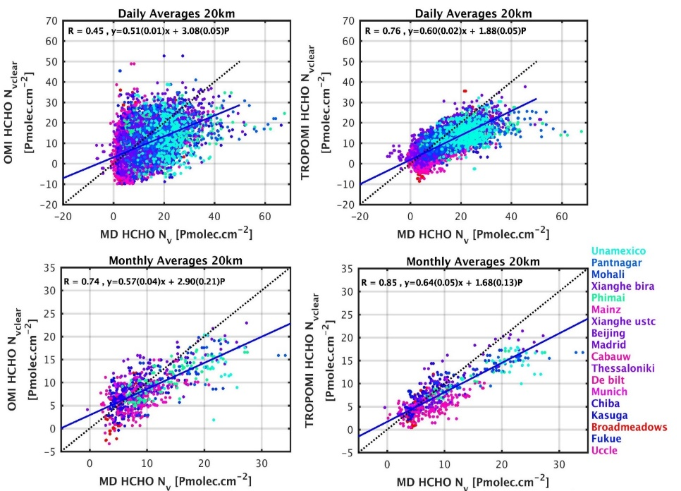
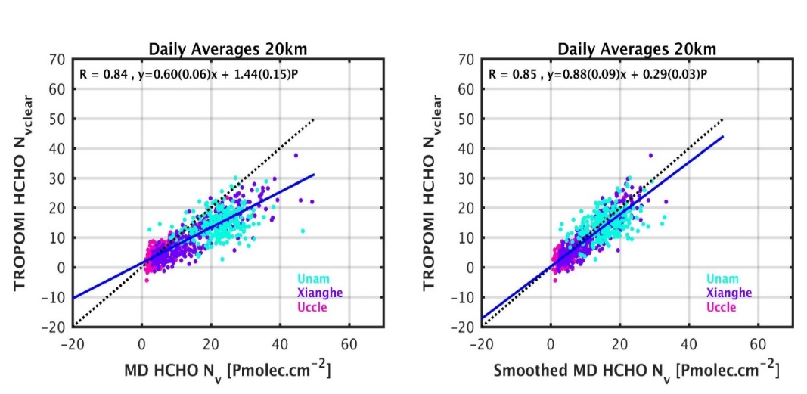
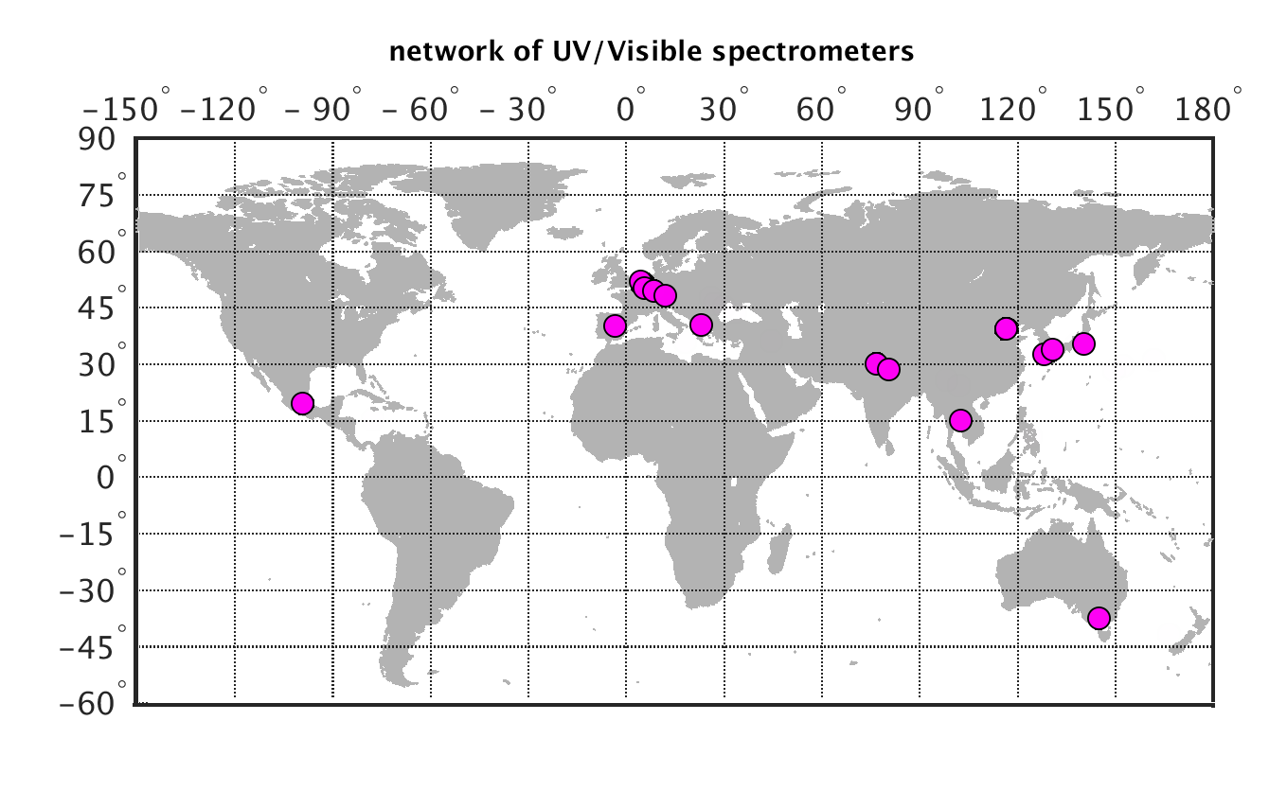
Comparative assessment of TROPOMI and OMI HCHO columns against MAX-DOAS data
MAX-DOAS HCHO column
De Smedt et al. (2021): https://acp.copernicus.org/preprints/acp-2021-378/
1-year average (2019)
3 years of TROPOMI data
10 years of OMI data
MAX-DOAS @ 18 sites (retrievals non harmonised)
Co-location (20km, +/-3h), quality filtering (QA>0.5)
TROPOMI
bias
OMI
OMI
bias
OMI
TROPOMI
MAX-DOAS profiles smoothed by TROPOMI AKs
TROPOMI
TROPOMI
18 MAX-DOAS sites
Notes:
Another recent study by De Smedt et al. focuses on HCHO validation, using MAX-DOAS data at 18 sites. This study also investigates the consistency between OMI and TROPOMI data
Like for NO2, we see that the bias depends on the HCHO column, and is very consistent for both sensors. These results are consistent with those previously obtained using FTIR data.
For a limited number of sites, HCHO profiles are retrieved from MAX-DOAS observations, which allows to apply the satellite AKs.
Results show that after smoothing a much better agreement is found. This suggests that the a-priori HCHO profile shape information used in the retrieval is not good enough.

Slide 5
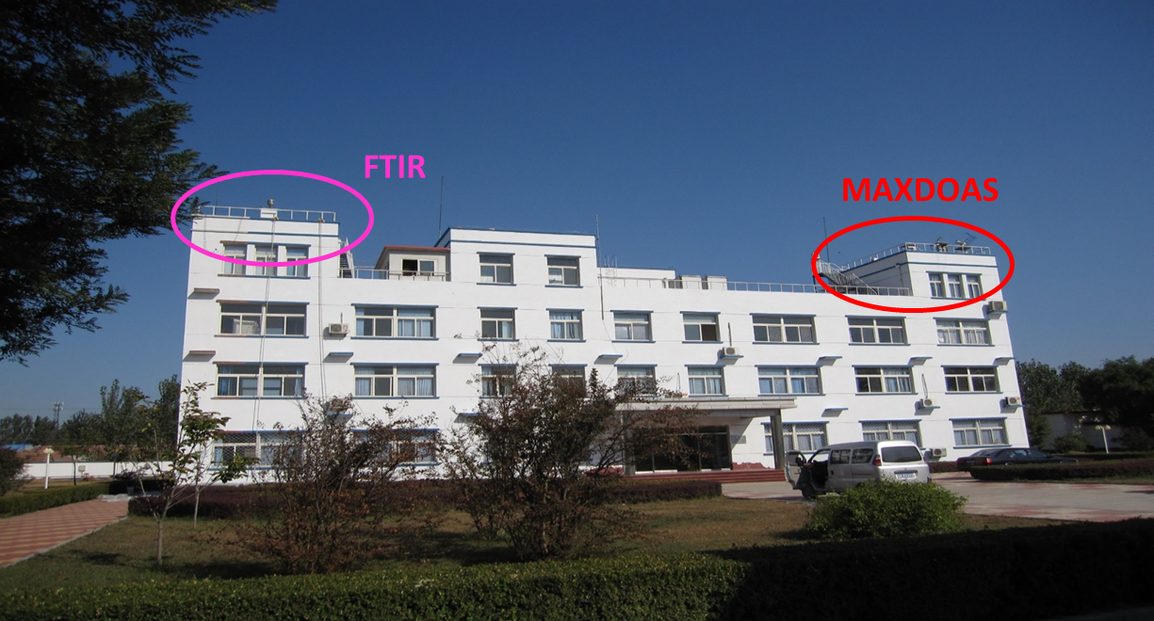
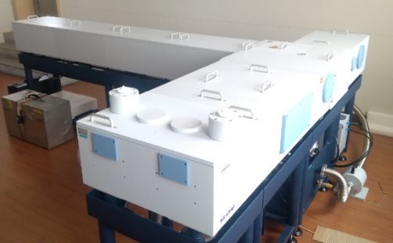
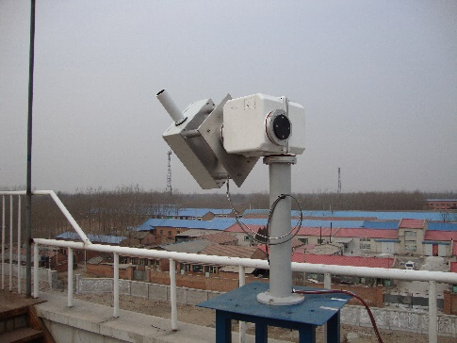
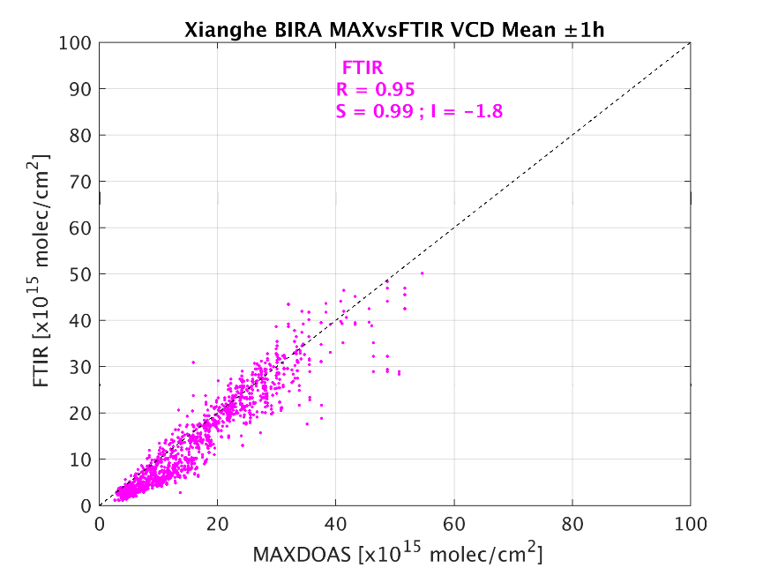
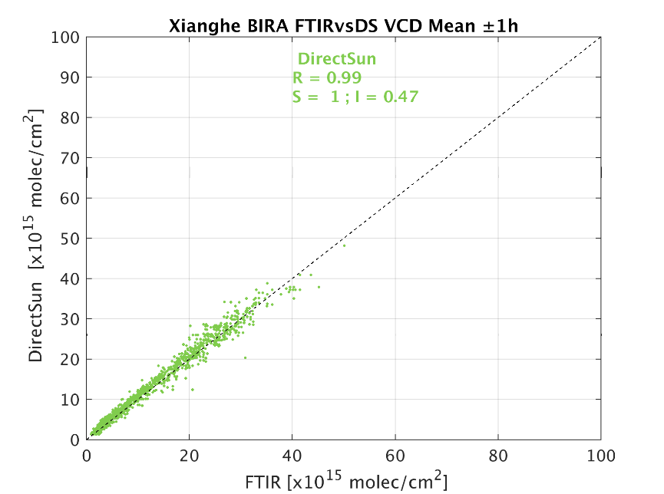
Assessment of the consistency between MAX-DOAS, direct-sun UV and FTIR HCHO column measurements in Xianghe, China
G. Pinardi, F. Hendrick, C. Vigouroux, B. Langerock, M. Zhou, C. Hermans, T. Wang*, P. Wang*, M. Van Roozendael
Xianghe site (China, 39.75° N, 116.96°E)
Instrument | Time Period and sampling | Retrieval details
MAX-DOAS including direct-sun mode | (Since 2010) 2017-2021 gap between 7/2018 and 10/2019 | bePRO OEM retrieval Clémer et al., 2010; Vlemmix et al., 2015
FTIR | Since 06/2018 | Vigouroux et al., 2018
Good consistency between MAX-DOAS and FTIR, but larger deviations at small and large columns
Excellent agreement between FTIR and direct-sun UV measurements -> shows that HCHO spectroscopy is consistent in UV and IR spectral ranges!
* IAP/CAS, Beijing, China
Notes:
At one of the MAX-DOAS sites, we have about one year of simultaneous HCHO measurements using MAX-DOAS, FTIR and direct-sun UV techniques, allowing to check the consistency of the different techniques.
MAX-DOAS and FTIR measurements are in good general agreement but there are occasional deviations that require more attention
FTIR and direct-sun UV are in excellent agreement, which demonstrates that the HCHO spectroscopy is consistent in UV and IR ranges.

Slide 6
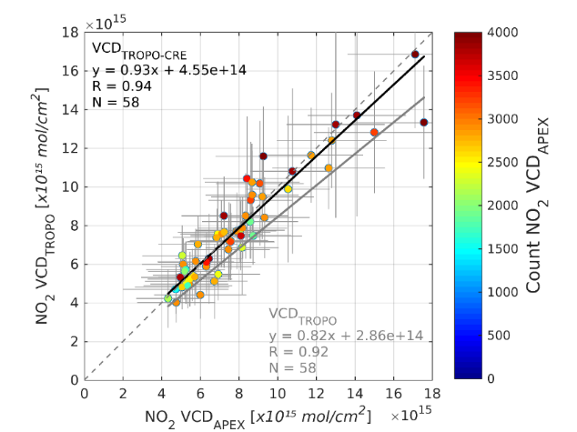
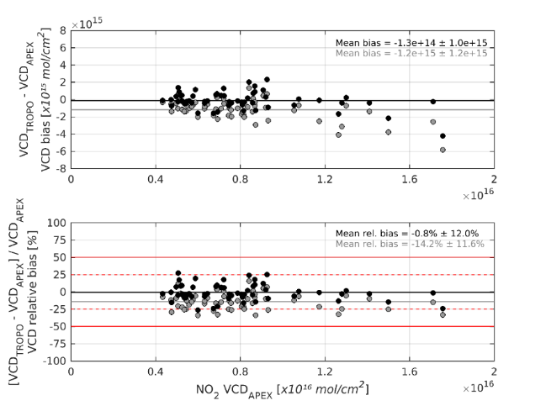
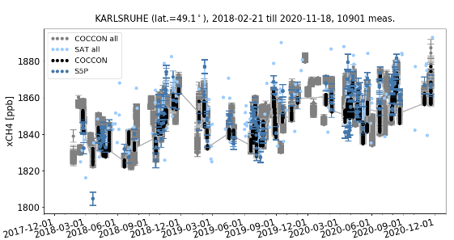
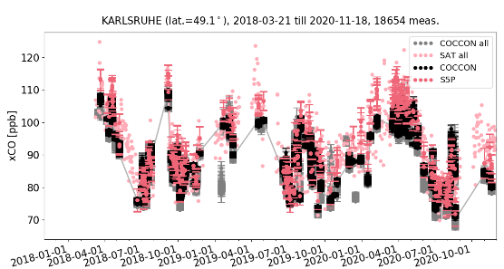
Sentinel-5p Validation Campaigns – Planned Activities in 2021-2022
Validation requirements
F. Tack, A. Merlaud, M. K. Sha, M. Van Roozendael, A. Nemuc, D. Schuettemeyer, C. Zehner and the S5P campaigns team
L2 product accuracy + precision
Temporal validation
Algorithm parameter
Special validation requirements
Spatial validation
Coordinated validation
S-5p tropospheric NO₂ validation based on airborne APEX remote sensing
Airborne UV-VIS
S-5p CO and CH₄ validation based on ground-based COCCON FTS
Airborne IR
Airborne UV-VIS & IR
Ground-based IR
S5PVAL-DE-RUHR
S5PVAL-DE-BERLIN
S5PVAL-RO
S5PVAL-BE
NET-Sense
MAGIC
ACCLIP
S5PVAL-KOLKATA
S5PVAL-PORTOVELHO
COCCON
NO₂
SO₂
HCHO
CO
CH₄
Notes:
Moving to airborne activities, there is a range of S5P validation campaigns planned for the next 2 years.
This includes airborne deployments with a focus on short lived AQ gases (NO2 but also SO2 and HCHO)
And some specific ground-based deployments, with a focus on CO and CH4

Slide 7
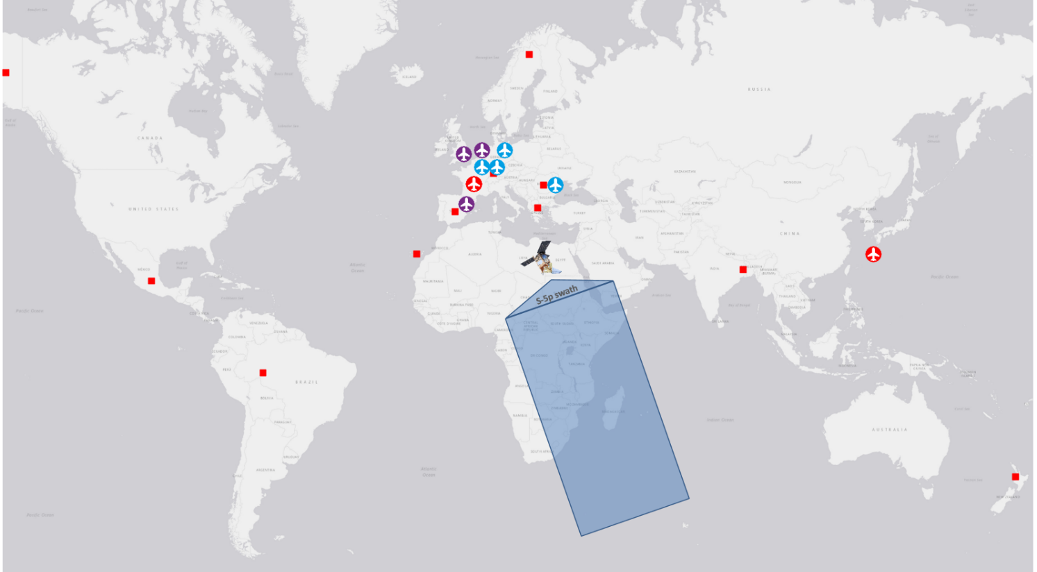
Campaign name | Campaign type | Campaign measurement frequency | Status
S5PVAL-DE-RUHR | Airborne mapping + ground-based | Limited in time (7 flights in total) | Finished – September 2020
S5PVAL-DE-BERLIN | Airborne mapping | Recurrent (12 flights/year) | Ongoing
S5PVAL-RO | Airborne mapping + sounding | Recurrent (12 flight/year) | Ongoing
S5PVAL-BE | Airborne mapping | Limited in time (4 flights in total) | Planned - Summer 2021 (2 weeks)
S5PVAL-KOLKATA | Ground-based | Long-term deployment (1 year) | Planned – start in October 2021
S5PVAL-PORTOVELHO | Ground-based | Long-term deployment (1 year) | Ongoing
COCCON | Ground-based | Distributed campaigns | Finished / ongoing
NET-Sense | Airborne mapping | Limited in time | Planned - Summer 2021 (4 weeks)
MAGIC | Airborne sounding + ground-based | Recurrent (yearly) | Finished – May 2018 Finished – June 2019 Finished – September 2020 Planned – August 2021
ACCLIP | Airborne sounding | Limited in time | Postponed – Summer 2022
https://s5pcampaigns.aeronomie.be
Notes:
This shows an overview of the planned activities and their timing.
Airborne mapping flights are planned in Germany (Ruhr and Berlin area), in Romania and in Belgium
Interestingly, some of these deployments are planned to be recurrent so, to increase statistics and cover different seasons
Then we have ground FTIR deployments in India, Brazil and a number of COCCON sites
And also some contribution from larger scale campaigns, also bringing data for S5P validation

Slide 8
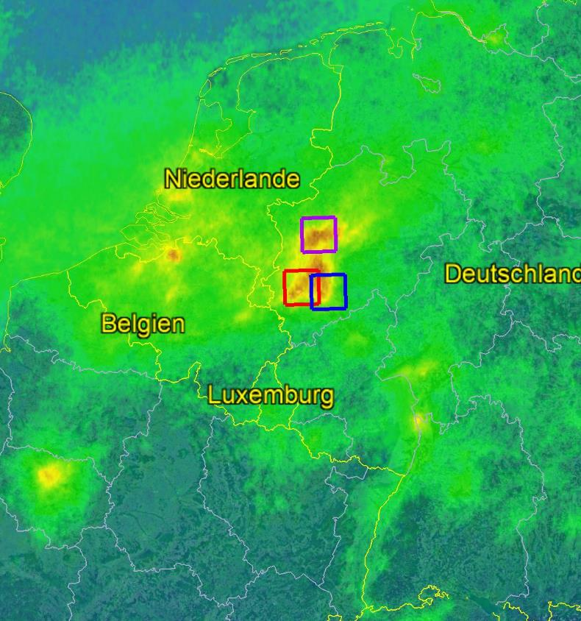
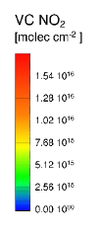
Sentinel-5P-VAL-DE-Ruhr Campaign
K. Lange, A. Carlos Meier, A. Richter, A. Schönhardt, J. P. Burrows, M. Van Roozendael, T. Wagner, T. Ruhtz, D. Schüttemeyer, and the S5p-VAL-DE-Ruhr campaign team
Sentinel-5P VC NO₂ 1 – 30 September 2020
Validation of Sentinel-5P products (NO₂, HCHO and SO₂) using different instruments and observation geometries
Campaign activities took place in North Rhine-Westphalia, a pollution hotspot in Europe
Urban character & large industrial emitters
Seven flight days from 12 - 18 September 2020
One flight per day
Two flights during the weekend
Five flights during the week
Three flights in the Duisburg flight sector
Two flights each in the Jülich and Cologne sector
Kezia Lange - klange@iup.physik.uni-bremen.de
Notes:
To finish some words on results from the Ruhr campaign which took place in September last year
7 flights took place from 12 to 18 September in one of the largest pollution hotspots in Europe
The campaign had a major focus on NO2, but also addressed SO2 and HCHO

Slide 9
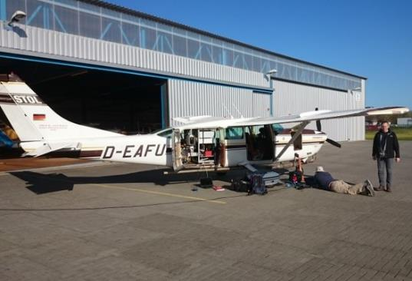
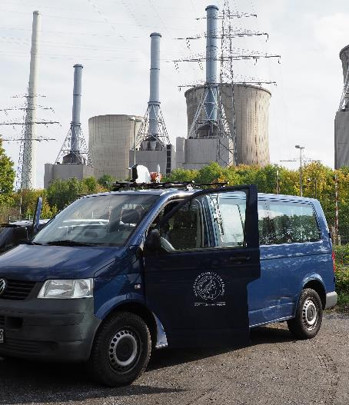
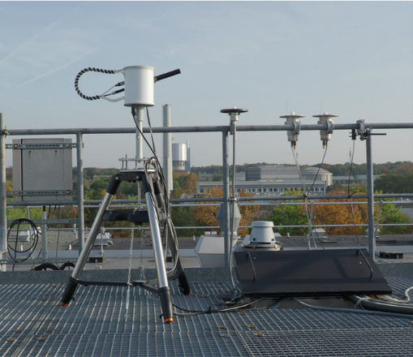
Sentinel-5P-VAL-DE-Ruhr Campaign: Instruments
Airborne DOAS measurements with imaging DOAS AirMAP & nadir pointing Avantes spectrometer AvaAir onboard of the Cessna on 7 days
Car-DOAS measurements from IUP, MPIC, BIRA on all flight days (zenith-sky only)
Stationary measurements were operational on all flight days and before/after campaign period
FUB Cessna
With AirMAP & AvaAir
Location | Instrument type
Gelsenkirchen | IUP Zenith-sky Avantes
Jülich | IUP Zenith-sky Avantes
Airport Dinslaken | BIRA SkySpec MAX-DOAS
Duisburg | IUP measurement truck (MAX-DOAS, in-situ)
Jülich | Pandora
Cologne | Pandora
MPIC car DOAS
Pandora Jülich
Kezia Lange - klange@iup.physik.uni-bremen.de
Notes:
We had:
Airborne imaging DOAS (AirMap instrument)
Car-DOAS mobile measurements from several groups
Stationary measurements at 6 locations using Pandora and MAX-DOAS instruments

Slide 10
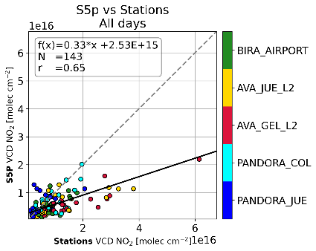
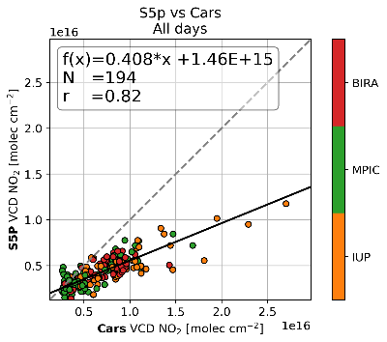
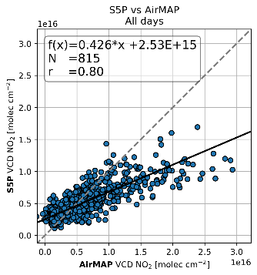
S5P-VAL-DE-Ruhr Campaign: Summary of result
7 measurement days for the validation of Sentinel-5P products in three different target areas in the Ruhr area
Stationary measurements
representativeness of the campaign period
high variability depending on wind, weekday and time of day
S5P underestimates (33% of station value)
Car DOAS measurements
high variability on the same route over one day
good agreement between the 3 car DOAS instruments
S5P underestimates (41% of car DOAS value)
Consistent measurements of AirMAP and stationary and mobile car DOAS measurements
Low bias of S5P for all target areas, with varying magnitude for different days (43% of AirMAP value )
Kezia Lange - klange@iup.physik.uni-bremen.de
Notes:
This s

