Slide 1
S5P/TROPOMI-SO₂ validation by airborne measurements during METHANE-To-Go Europe
Heidi Huntrieser, Theresa Klausner, Robert Baumann, Klaus Gottschaldt, Heinfried Aufmhoff, Alina Fiehn, Anke Roiger et al. (DLR-IPA, Oberpfaffenhofen, Germany)
& Pascal Hedelt, Diego Loyola, Ronny Lutz et al. (DLR-IMF, Oberpfaffenhofen, Germany)
& Nicola Theys (Royal Belgian Institute for Space Aeronomy (BIRA-IASB), Brussels, Belgium)

Slide 2
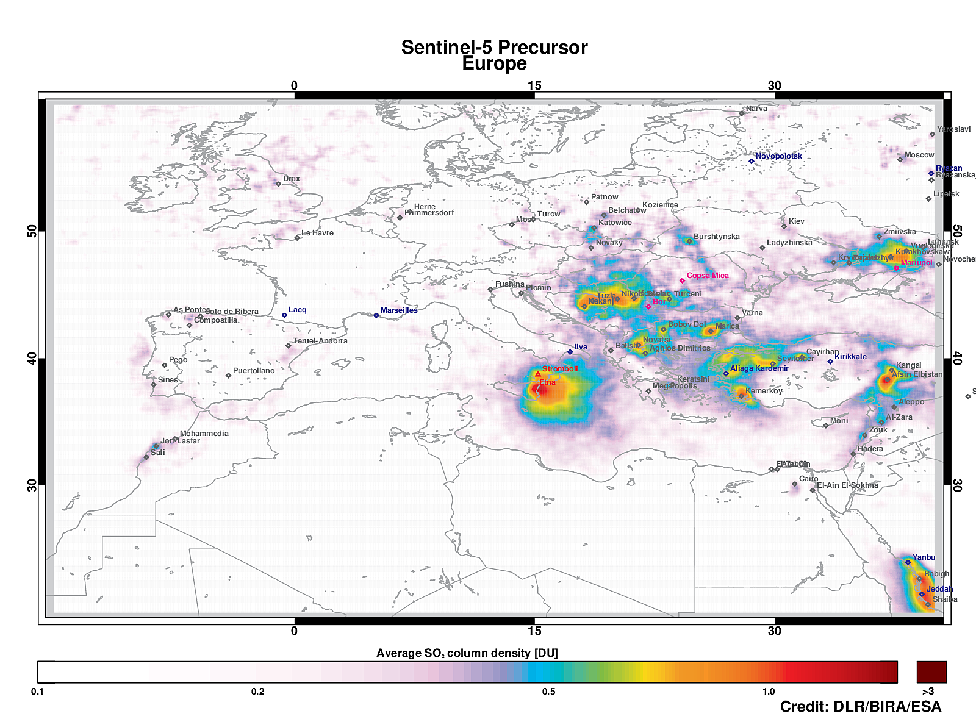
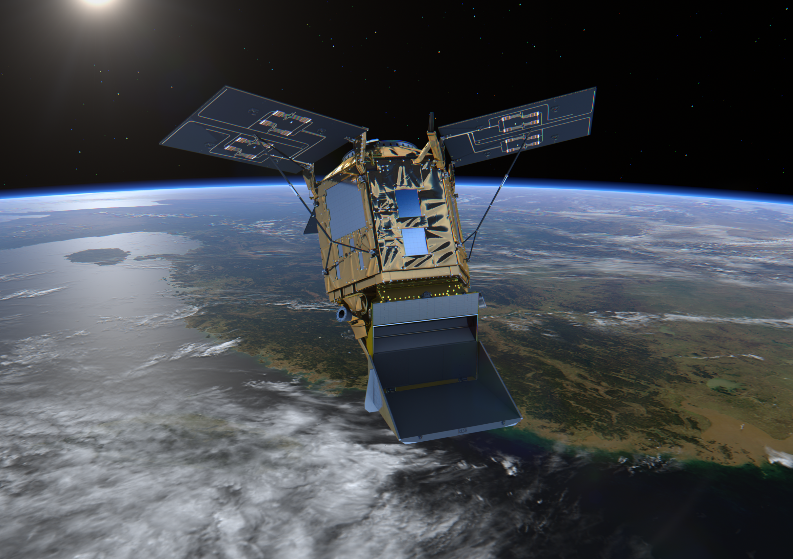
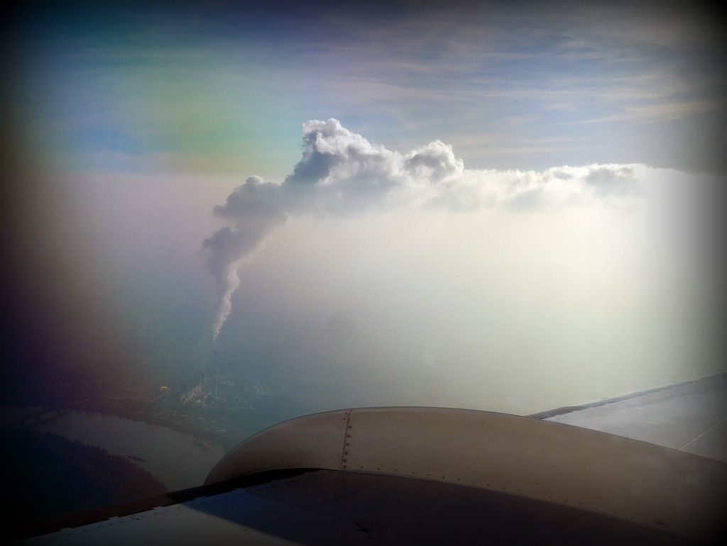
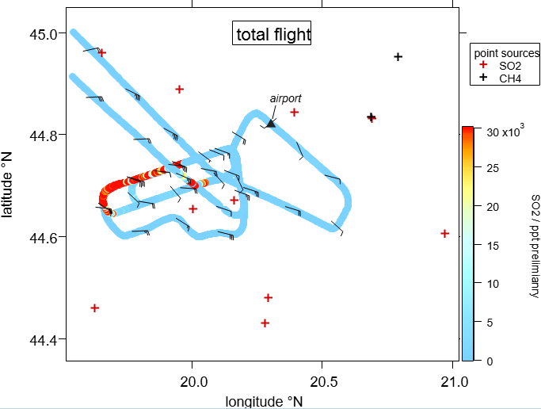
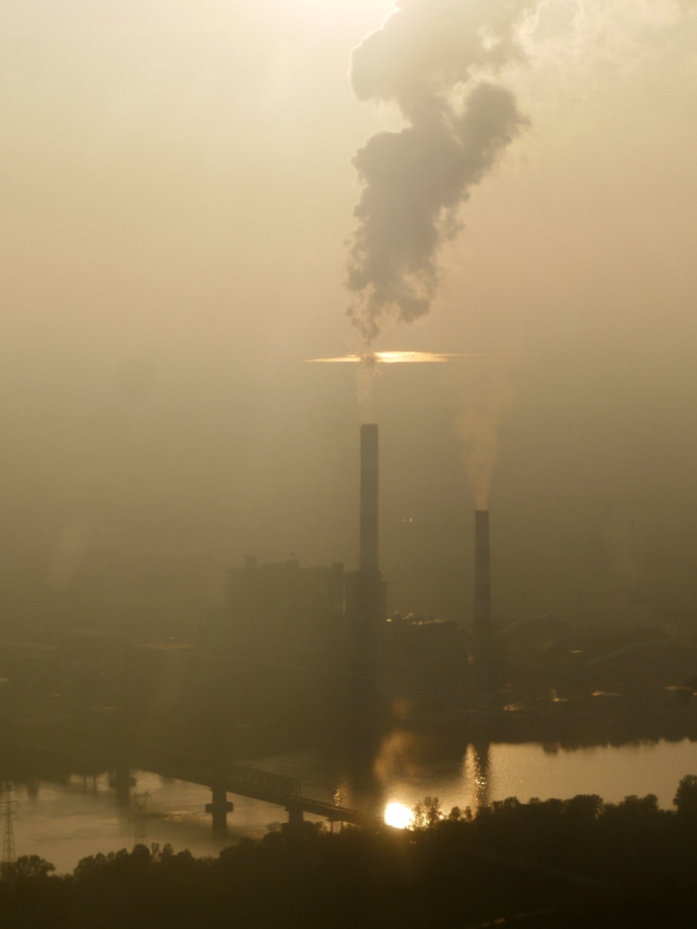
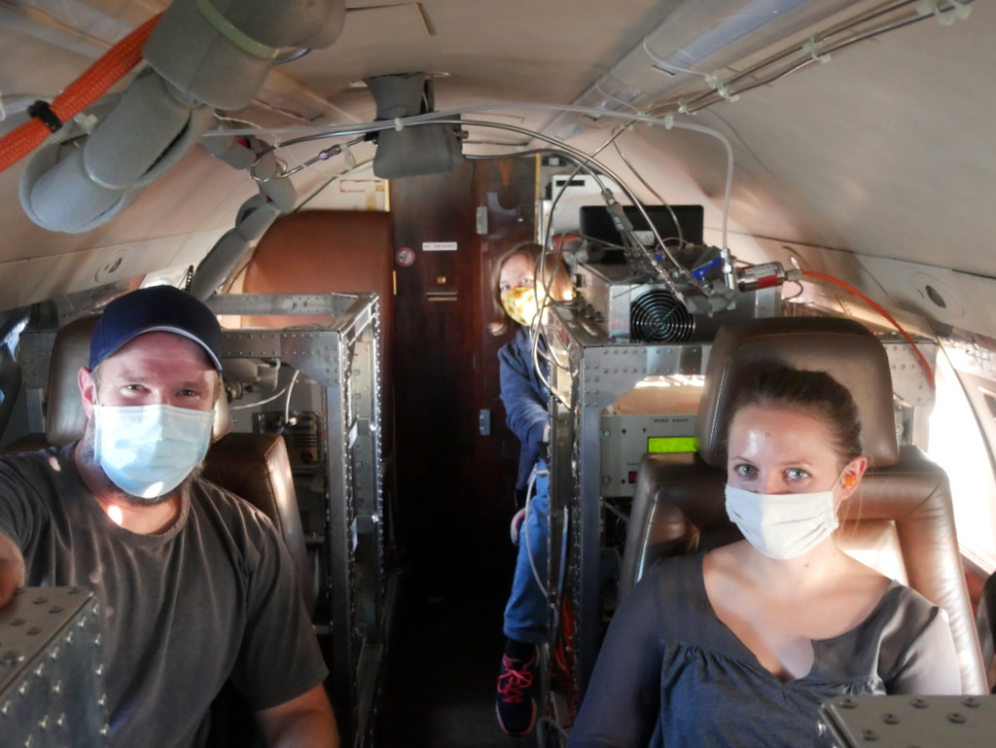
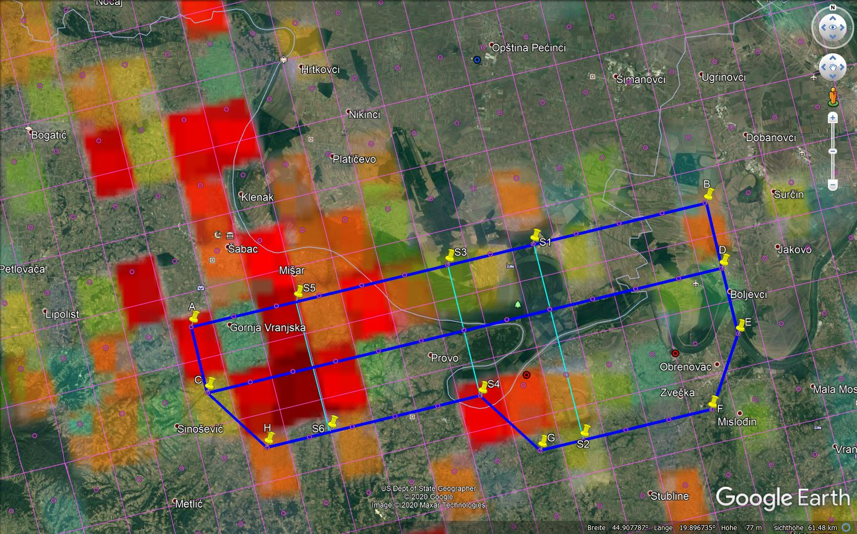
Preliminary results from the recent METHANE-To-Go airborne field experiment
Motivation: Improvement of TROPOMI-SO₂ algorithms for detection of SO₂-pollution over Europe (focus on “hot spot” areas)
Method: Validation of TROPOMI-SO₂ with in-situ airborne measurements (CIMS-SO₂) and models
First achievements: DLR-Falcon field experiment METHANE-To-Go Europe (with main focus on CH₄ and minor focus on SO₂) carried out in autumn 2020: 🡪 The very first airborne in-situ measurements of coal-fired power plants in Serbia & Bosnia (are counted among the strongest SO₂-emitting power plants in Europe)
TROPOMI-SO₂ May 2018 – Dec. 2019
The TROPOspheric Monitoring Instrument (TROPOMI) is the satellite instrument on board of the Copernicus Sentinel-5 Precursor satellite since Oct. 2017
NTA
Falcon
Falcon cabin “on the way to Serbia”
Coal-fired power plant in Serbia
Nikola Tesla A (NTA):
view from the cockpit
Falcon- and TROPOMI-SO₂ validation track 7th November 2020
https://www.dlr.de/pa/desktopdefault.aspx/tabid-2342/6725_read-70275/

Slide 3
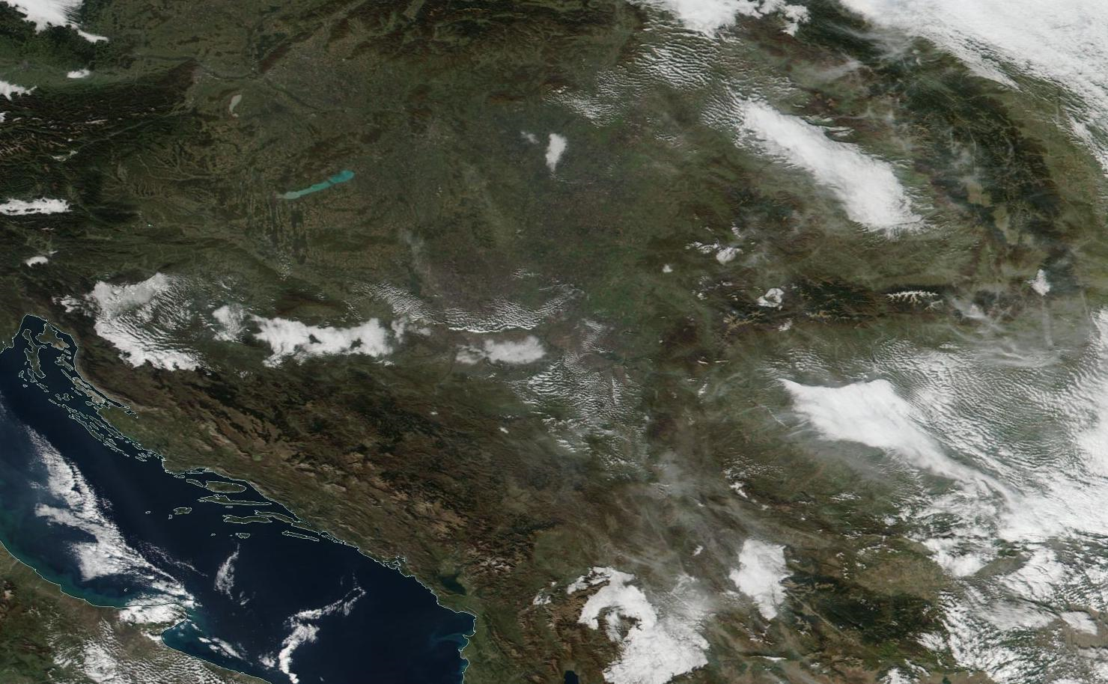
Cloud satellite image (VIIRS RGB) - Balkan - 7th November 2020
7.11.2020 at noon (TROPOMI overpass Orbit 15905 at 11:38 UTC)
Less fog in river valley
Nikola Tesla power plants
(small cloud northeast)
Smoke clouds
(aerosols may absorb at similar wavelengths as SO₂)

Slide 4
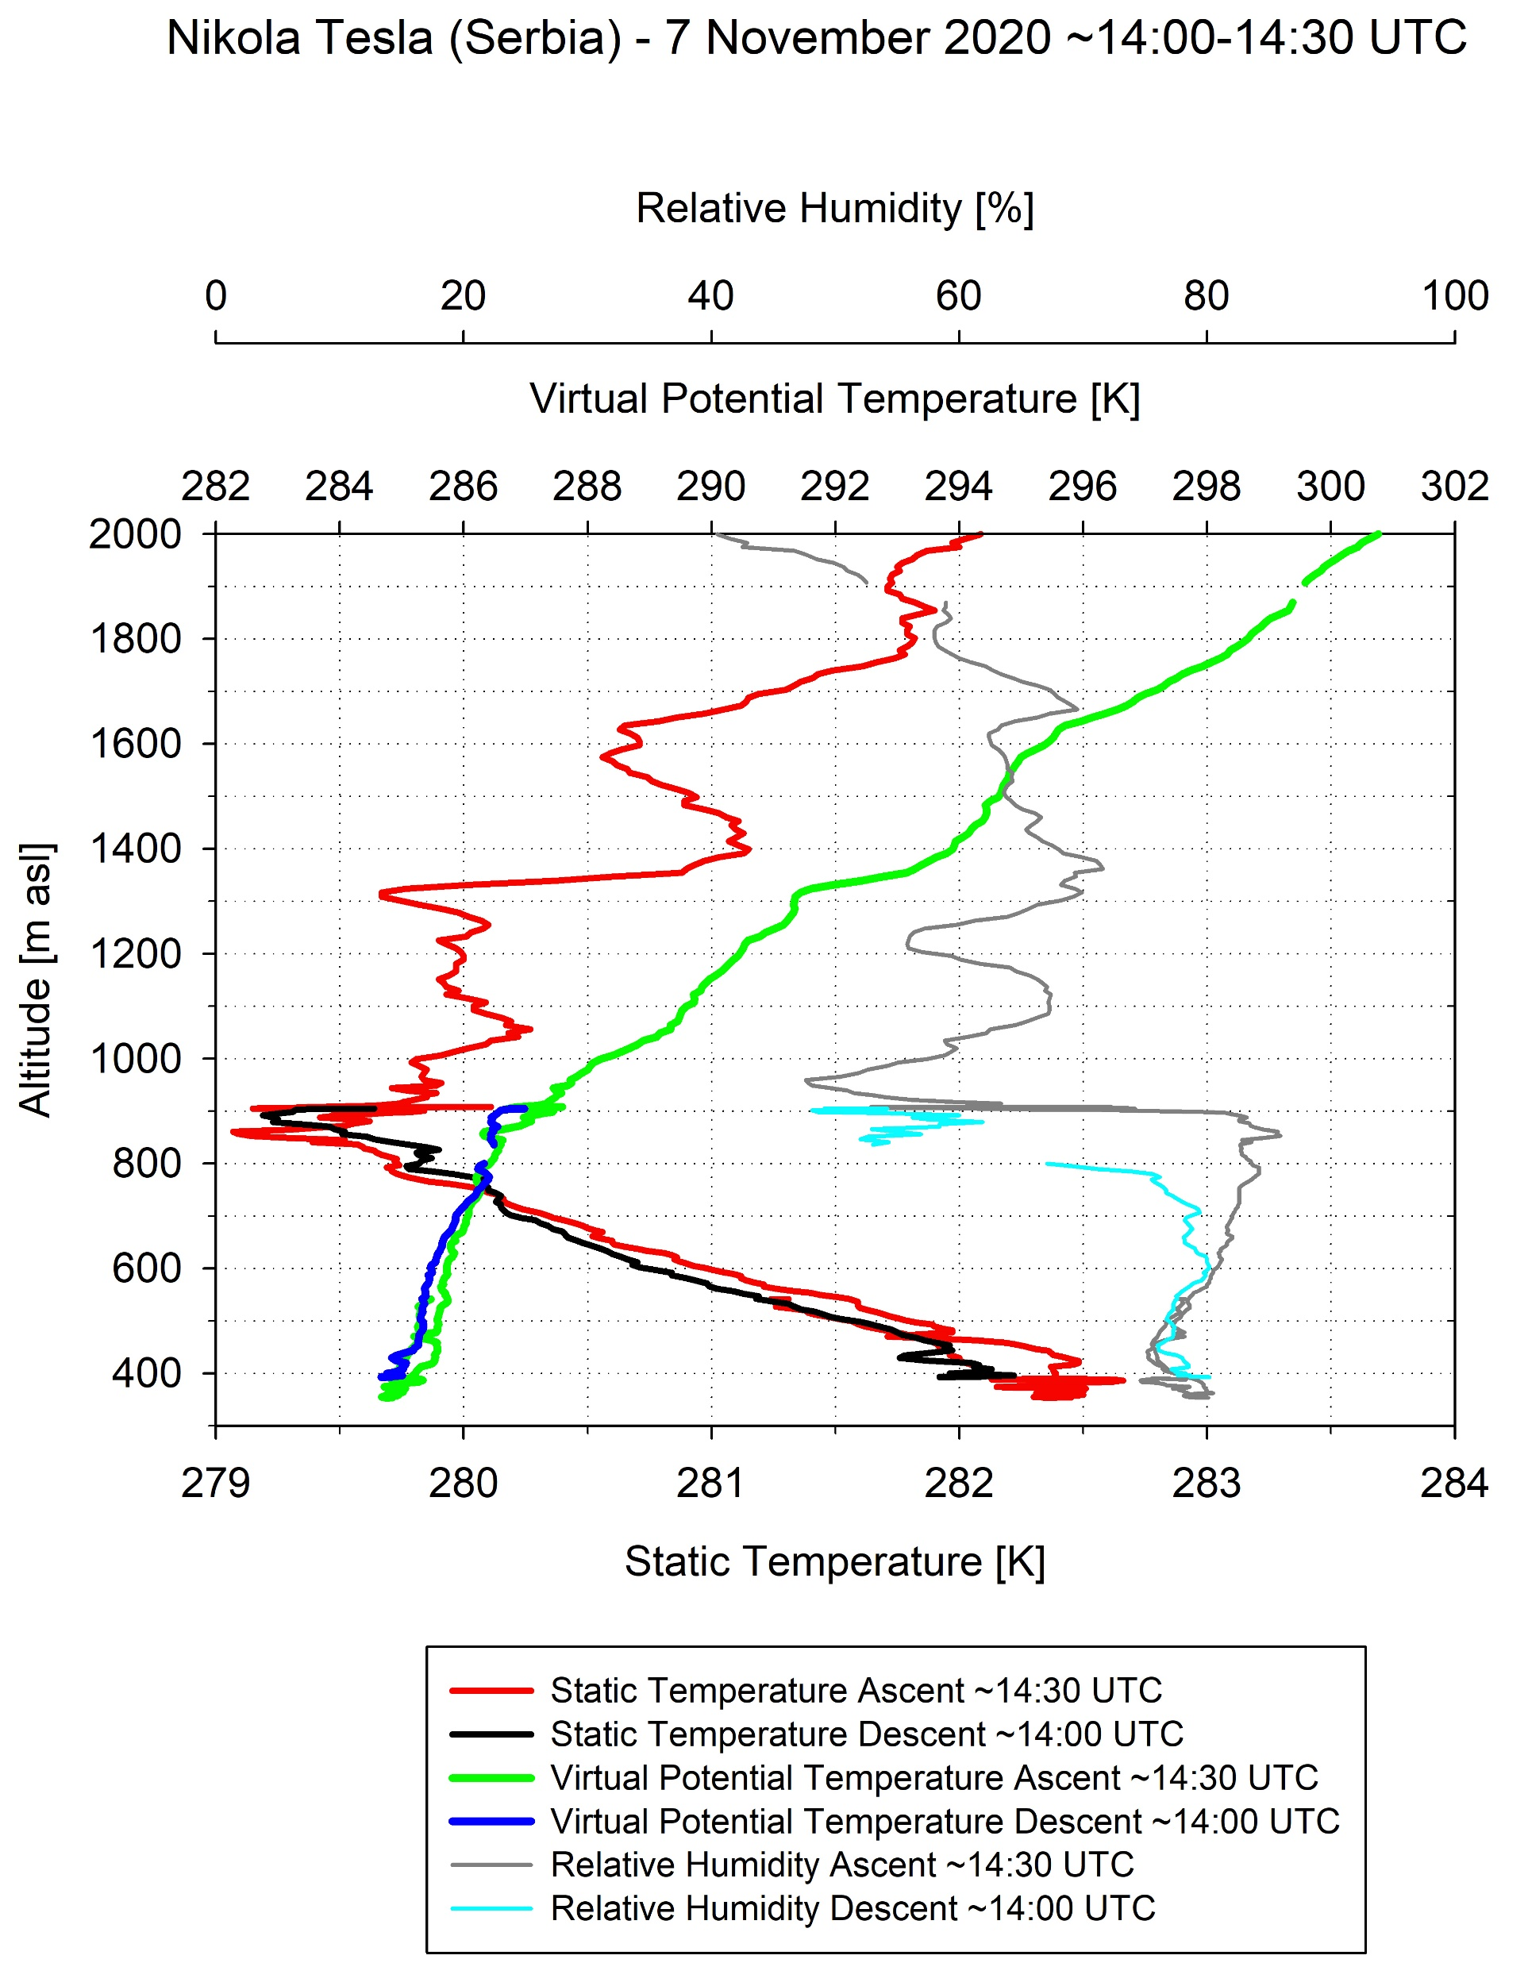
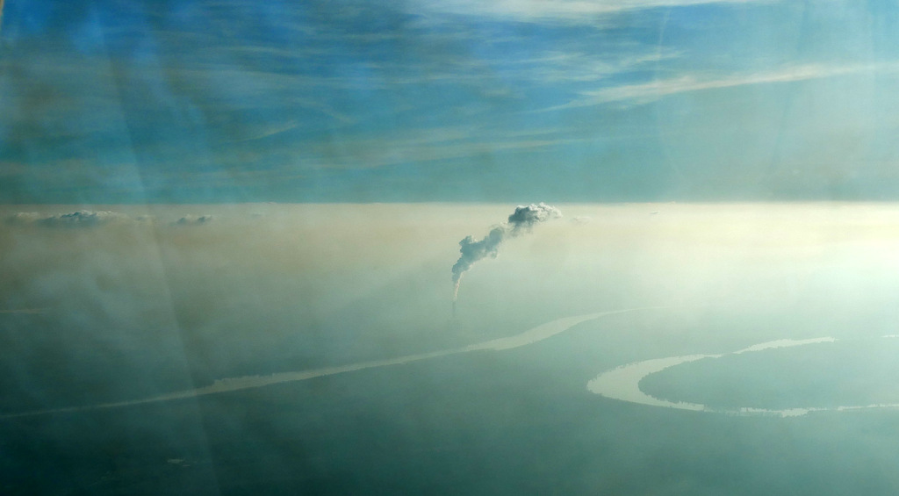
Flight to Nikola Tesla A & B – 7 November 2020 – view from the DLR-Falcon
NTB: one chimney (280 m)
at 14:07 UTC
i n v e r s i o n ~900 m
NTA: two chimneys (150/220 m) and bridge
at 14:08 UTC
inversion ~900 m
Due to inversion
🡪 good definition of vertical extension of SO₂-plume from power plants
i n v e r s i o n ~900 m
inversion ~450 m

Slide 5
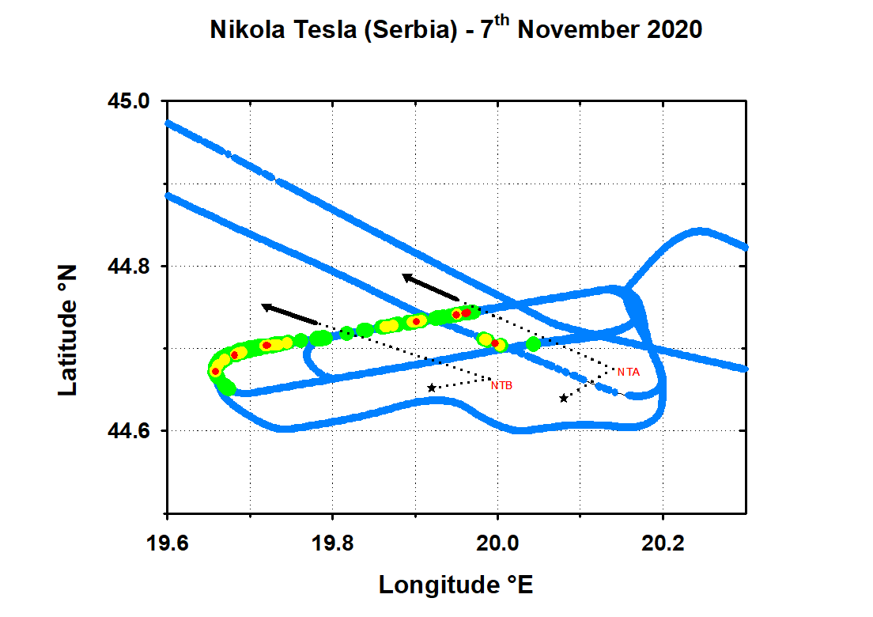
Falcon-SO₂ for case study 7.11.2020 (detailed)
NTA: Nikola Tesla A power plant
NTB: Nikola Tesla B power plant
🡪 SO₂ emissions from both power plants detectable
Falcon wind nearby power plant chimneys (~400 m):
dotted line with star-end (~north-easterly)
Falcon wind along Falcon track in plume downwind of power plants (~540/900 m):
solid line with arrow-end (~south-easterly)
Falcon SO₂ mixing ratio:
<100 ppb
100-200 ppb
200-300 ppb
300-600 ppb

Slide 6
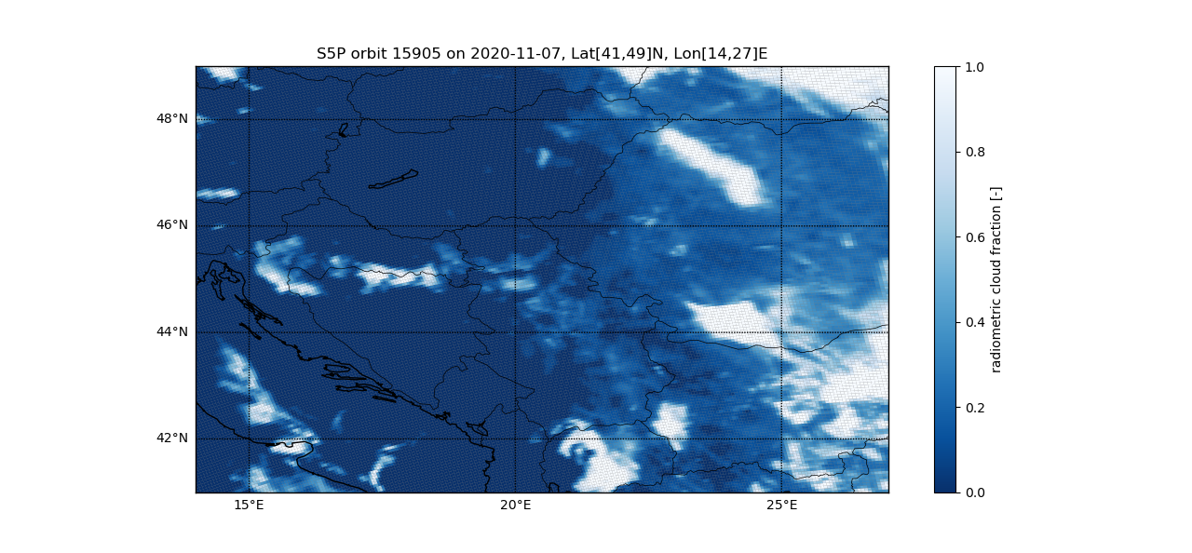
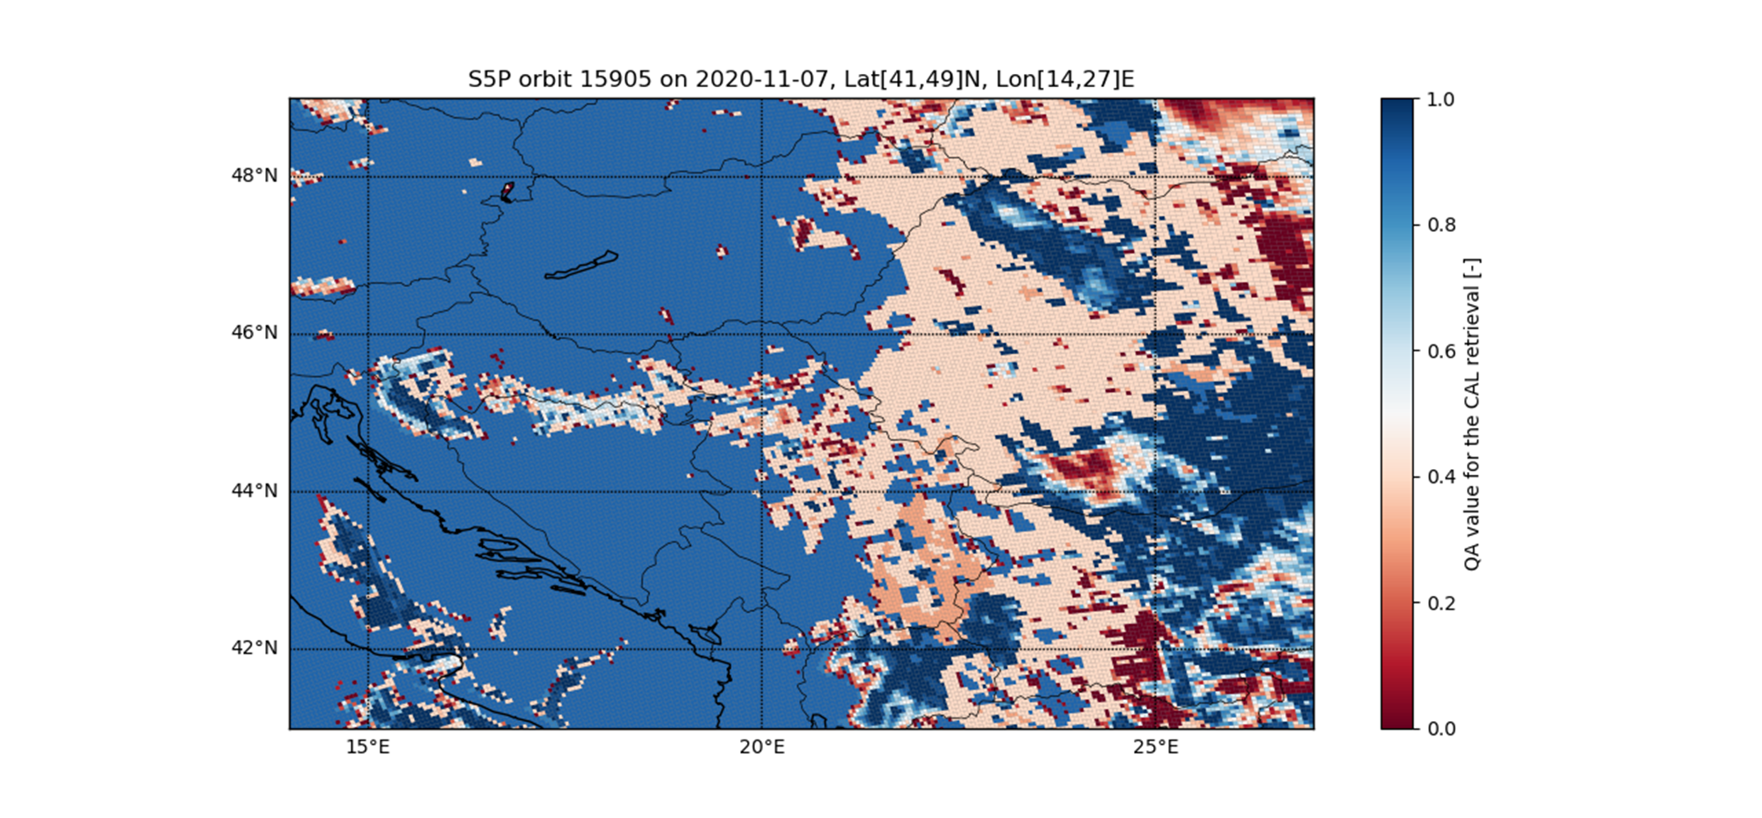
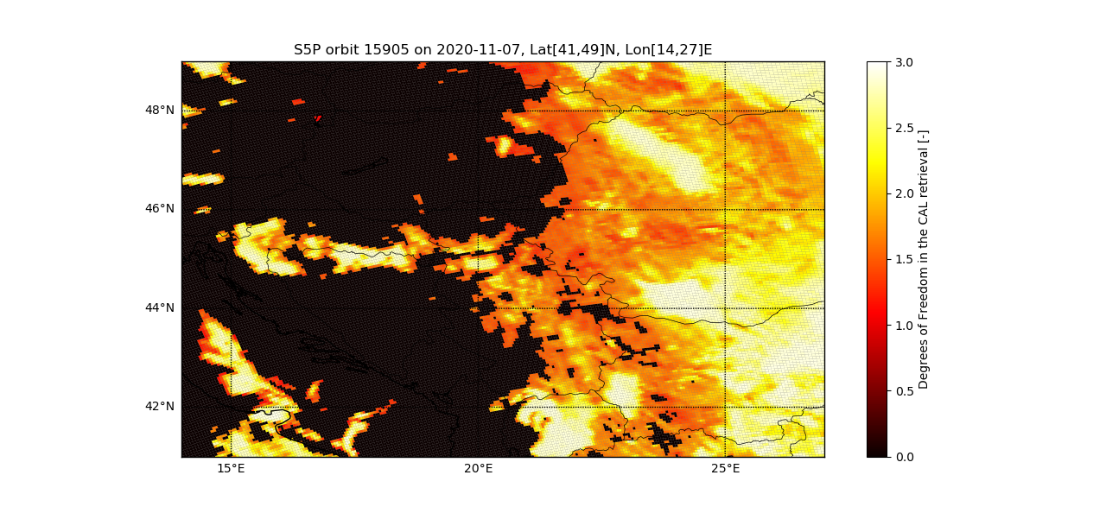
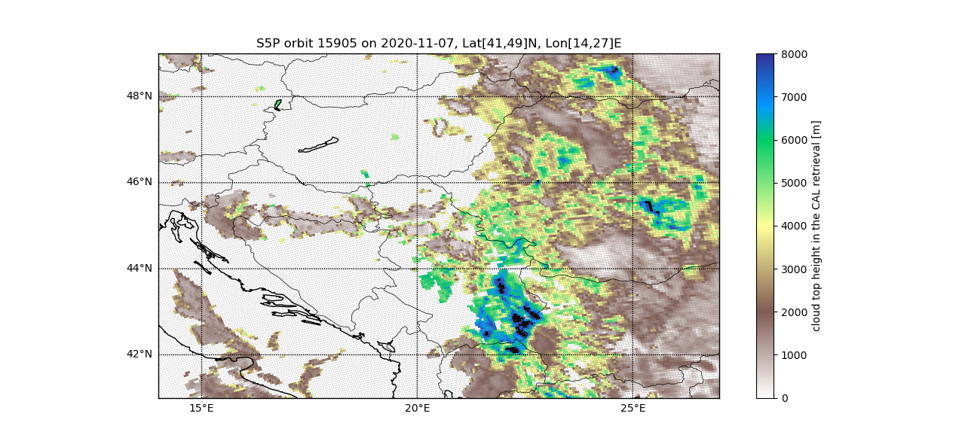
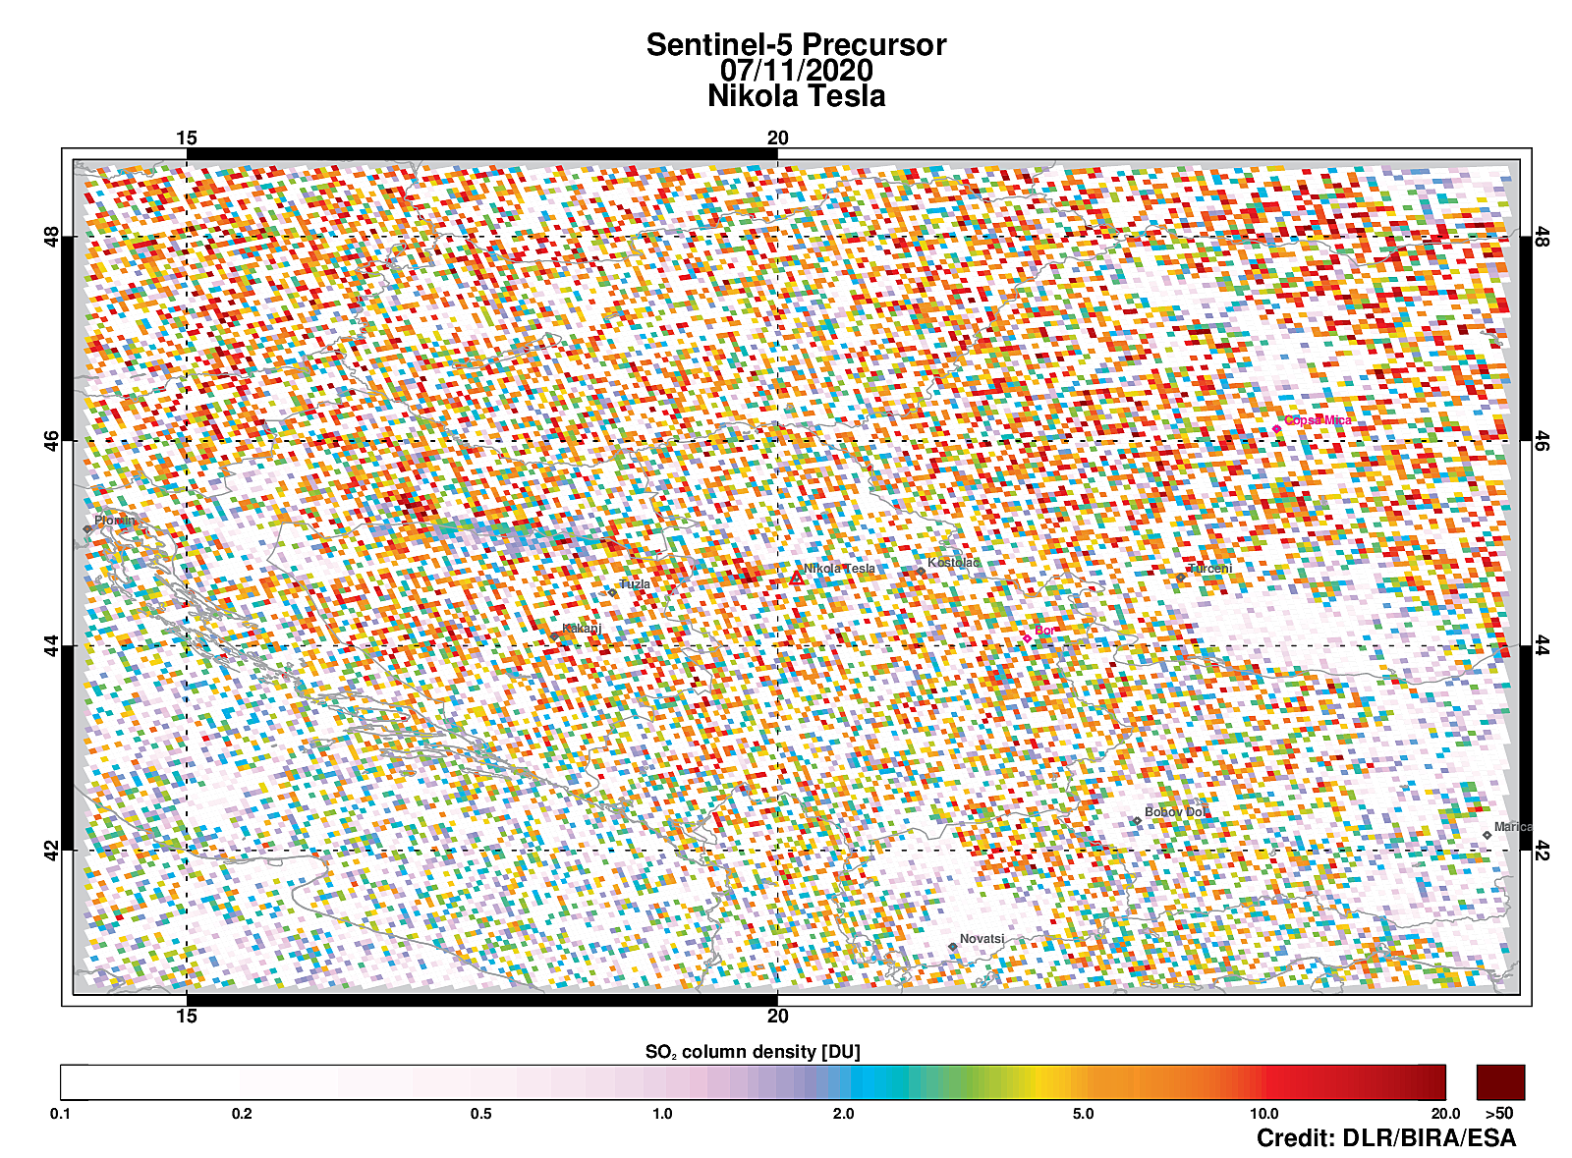
Falcon-SO₂ for case study 7.11.2020 (detailed)
TROPOMI cloud products applied (QA, CF, DoF, CTH):
+
+
+
+
rather noisy TROPOMI-SO₂ image: river valley visible
Validation?

Slide 7
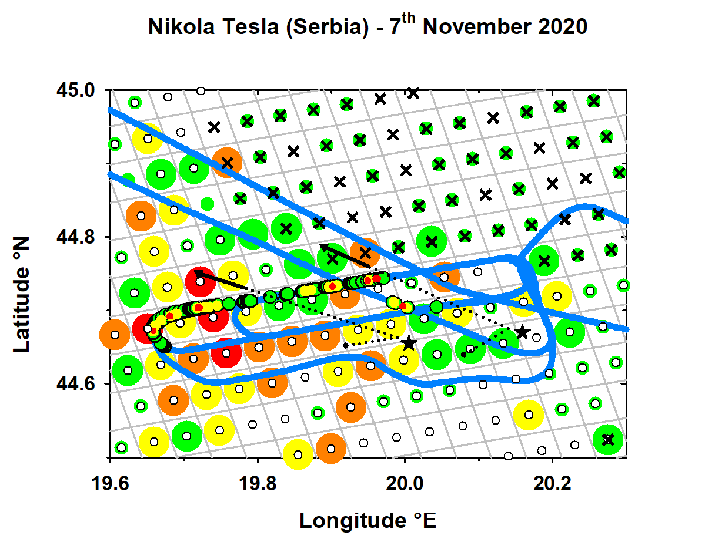
Combined TROPOMI-/Falcon-SO₂ and cloud products for case study 7.11.2020 (detailed)
Falcon-SO₂ versus TROPOMI-SO₂
+ TROPOMI cloud products
QA >=50 white circles
CF>=0.20 black crosses
(all have DoF >=2 🡪 cloud well defined🡪 CTH reliable 🡪 CTH = 1300 +/-400 m (min 483 m, max 1981 m)
TROPOMI COBRA product VCD SO₂ [DU]
0-2
2-5
5-10
10-15
>15
Besides TROPOMI Operational Product also COBRA product (N.Theys, BIRA) used: COBRA improves low SO₂ VCDs 🡪 in future: COBRA will replace the TROPOMI Operational Product
Stars indicate NTB/NTA power plants
(no true-to-scale representation of TROPOMI pixel size 3.6 x 5.6 km²)

Slide 8
Combined TROPOMI-/Falcon-SO₂ and cloud products for case study 7.11.2020 (detailed)
Falcon-SO₂ versus TROPOMI-SO₂
+ TROPOMI cloud products
QA >=50 white circles
CF>=0.20 black crosses
(all have DoF >=2 🡪 cloud well defined🡪 CTH reliable 🡪 CTH = 1300 +/-400 m (min 483 m, max 1981 m)
TROPOMI COBRA product VCD SO₂ [DU]
0-2
2-5
5-10
10-15
>15
Stars indicate NTB/NTA power plants

Slide 9
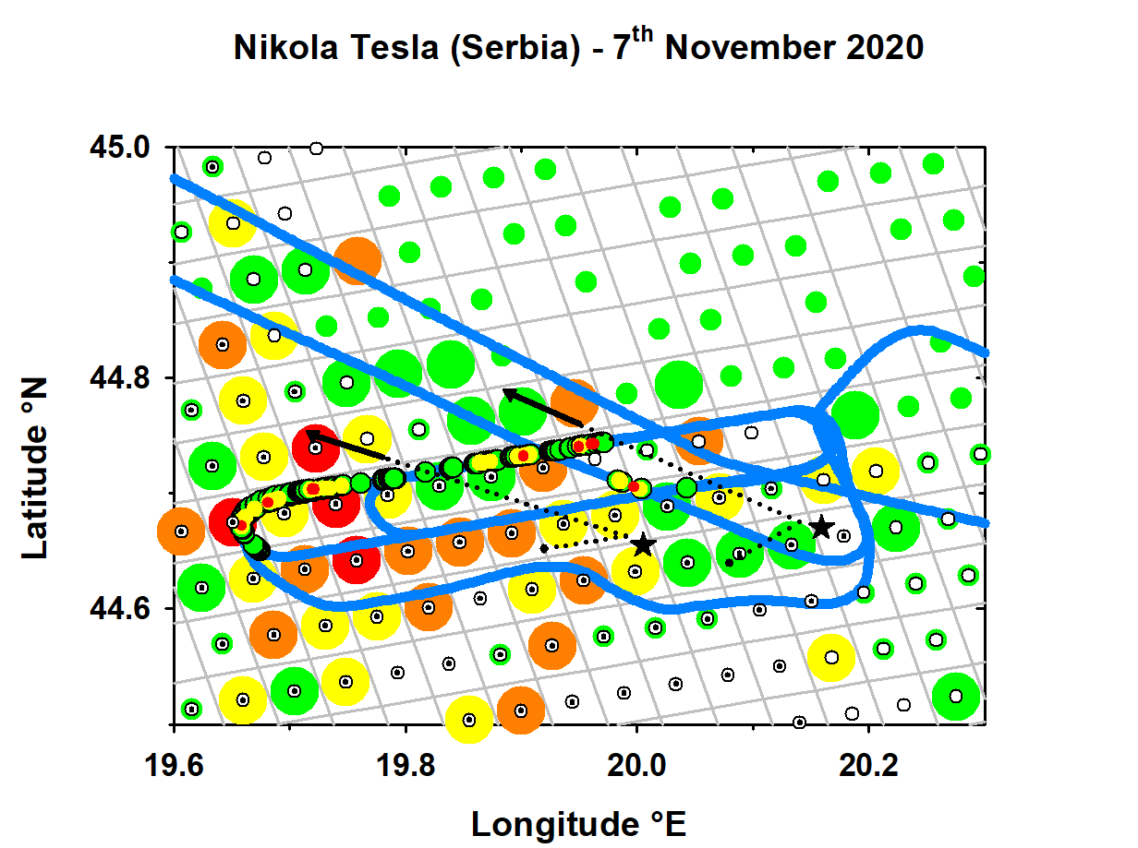
Combined TROPOMI-/Falcon-SO₂ and cloud products for case study 7.11.2020 (detailed)
Estimate VCD-SO₂ for Falcon NTB-plume
in designated area
Compare with VCD-SO₂ from TROPOMI
Operational Product & COBRA
(not perfect overlap due to ~2 h time shift)
Falcon-SO₂ versus TROPOMI-SO₂
+ TROPOMI cloud products
QA >=50 white circles
CF<=0.10 black dots
TROPOMI COBRA product VCD SO₂ [DU]
0-2
2-5
5-10
10-15
>15
Stars indicate NTB/NTA power plants

Slide 10
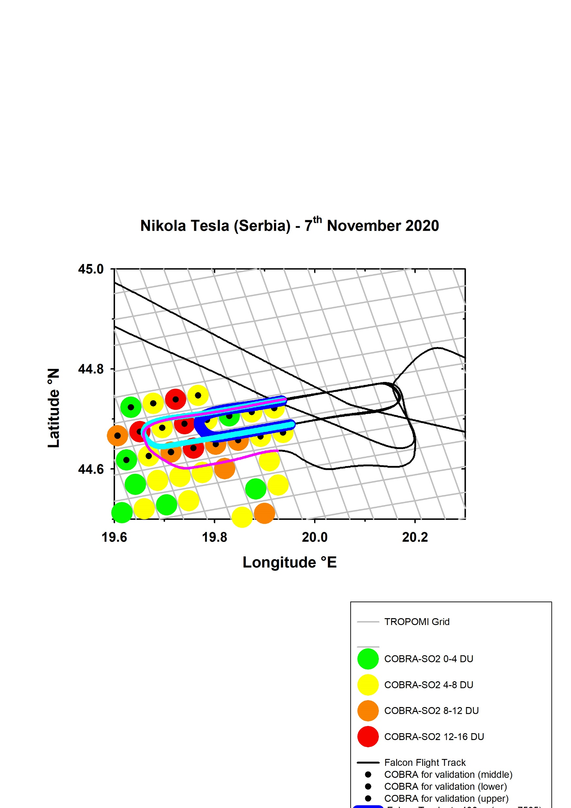
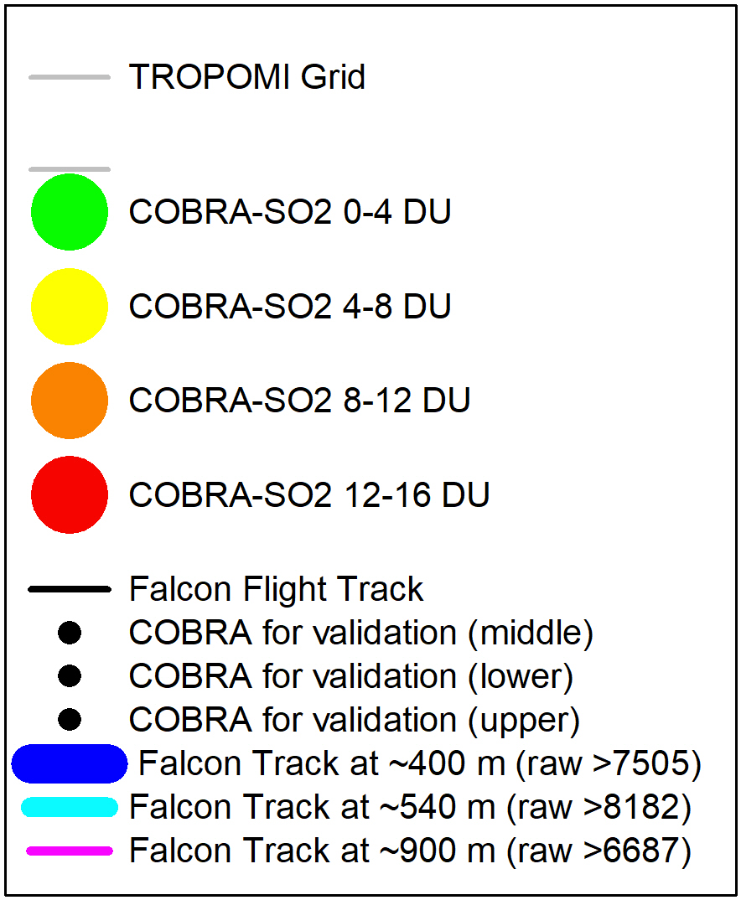
Reliable TROPOMI-SO₂ pixels for case study 7.11.2020 with Falcon altitude included
2
1
5
4
3
7
6
8
🡪 8 selected pixels for intercomparison Falcon-/TROPOMI-SO₂ (criteria: distinct Falcon-SO₂ enhancement at 2-3 vertical levels) 🡪 COBRA also indicates distinct SO₂-gradient

Slide 11
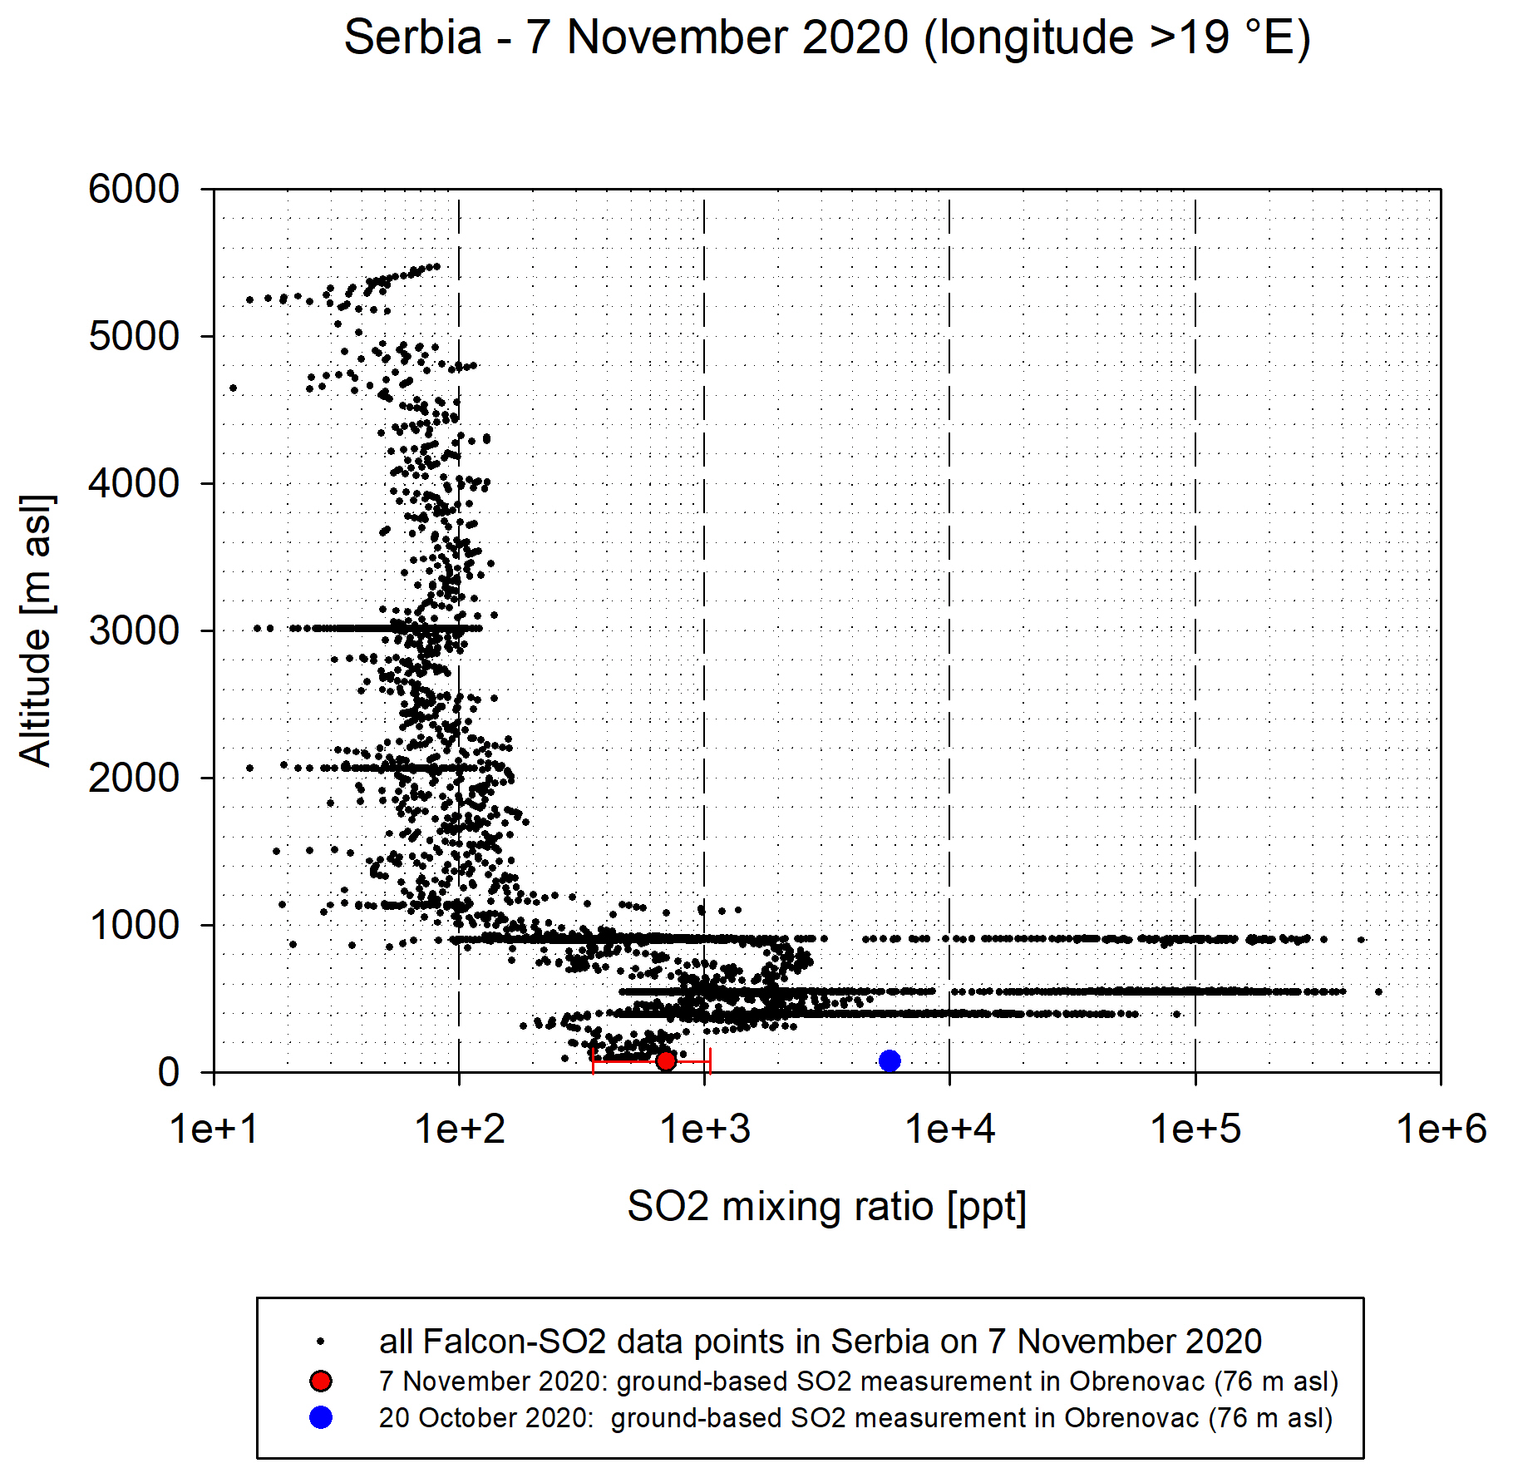
Vertical profile of Falcon-SO₂ - Serbia - 7.11.2020
The SO₂-plume from NTB probed in large detail at three different altitudes:
~400/~540/~900 m
Highest emissions were measured at ~540 m
SO₂-emissions at ground on 7th November were distinctly lower
Mainly SO₂-layer between ~400-900 m (well-defined due to inversions) contributes to observed TROPOMI-SO₂ VCD in this area

Slide 12
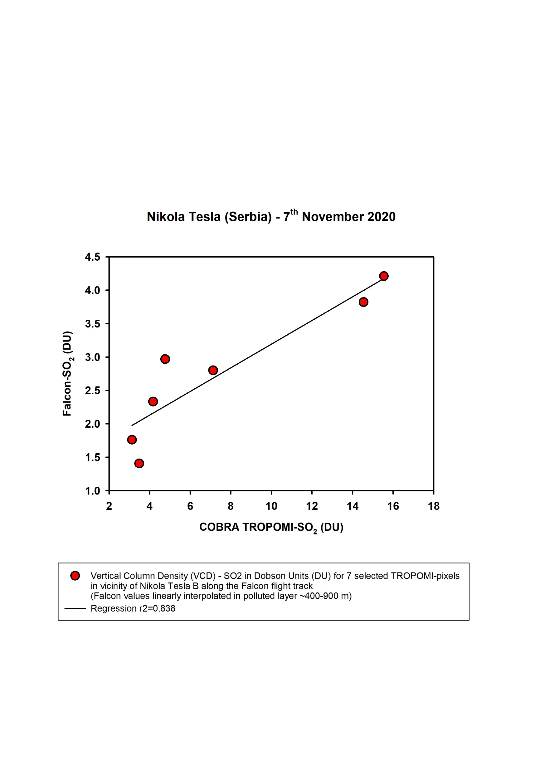
Comparison of TROPOMI-SO₂ VCD with Falcon-SO₂ VCD - 7.11.2020 Nikola Tesla case
For 7 selected TROPOMI-pixels along the validation track on 7th November over Serbia:
Average Falcon-SO₂ mixing ratio per TROPOMI-pixel determined for each of these 7 pixels & for 3 flight levels (~400/540/900 m)
Extrapolation between these flight levels & divided into vertical layers with 50 m
For each of the 7 selected TROPOMI pixels the Falcon-SO₂ mass in each of these layers was determined and summed up to estimate the VCD
Preliminary result:
Correlation rather good!
…however, mean VCD values factor ~2.5-3.0 difference (🡪 apply suitable averaging kernel)

