Slide 1
CEOS Atmospheric Composition Virtual Constellation AC-VC-17 June 08, 2021
GEMS Validation Plan,
Validation Campaign,
and Pandora Asia Network (PAN)
CK Song (UNIST), Limseok Chang (NIER), and Sang-Woo Kim (SNU)

Slide 2
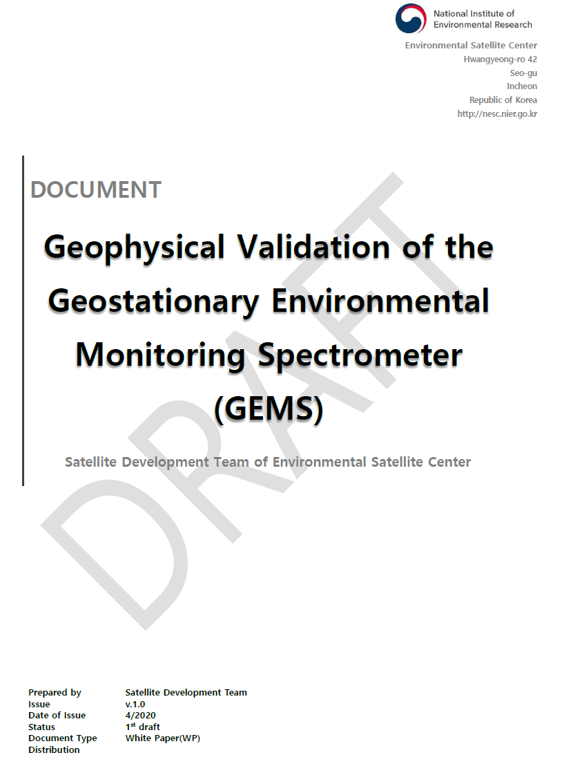
Schemes for GEMS Geophysical Validation
Needs;
Consistency between geophysical parameters derived from GEMS and correlative independent measurements within the error budgets assigned to each data set
Continuous and long term provision of consolidated quality of GEMS products in terms of accuracy and precision for the NIER services and science community
The validation activities should rely on;
    Operational ground-based measurement network
    Intensive field campaigns
    Other satellite products
    Modeling results

Slide 3
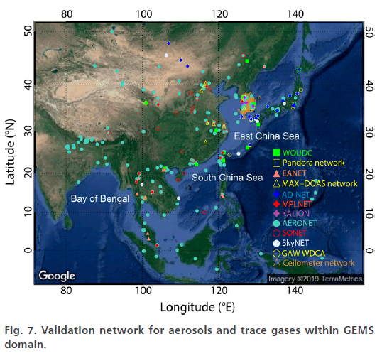
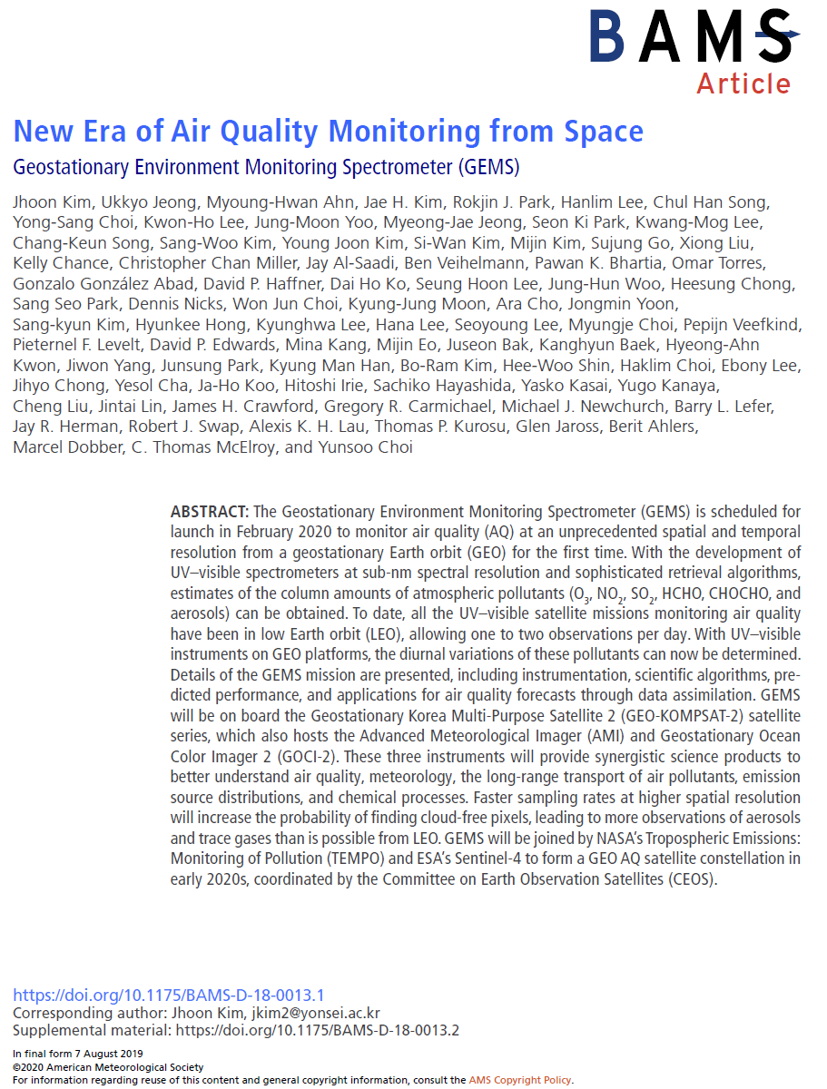
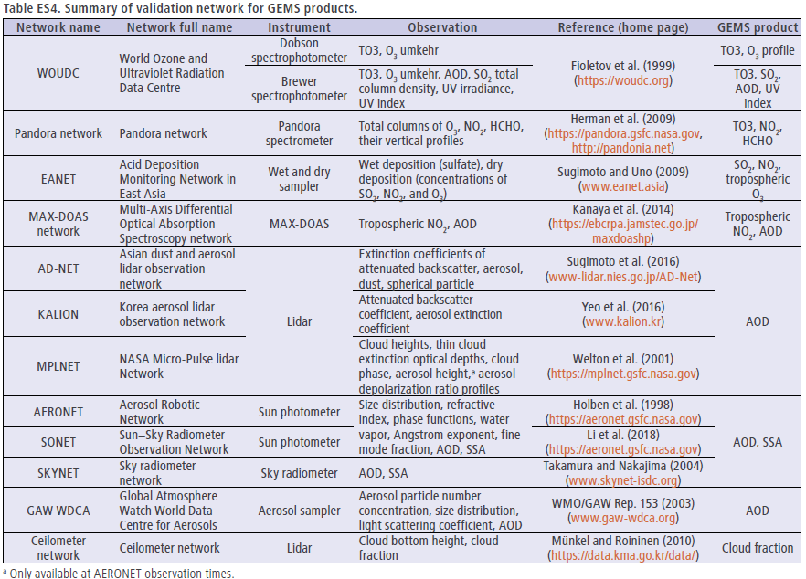
Ground-based Measurement Network
for GEMS Validation
PAN
(by Prof. S.-W. Kim)

Slide 4
Intensive Field Campaigns for GEMS Products
(by Dr. Limseok Chang)
GMAP I, II (2020~2021)
&
SIJAQ (2022~2023)

Slide 5
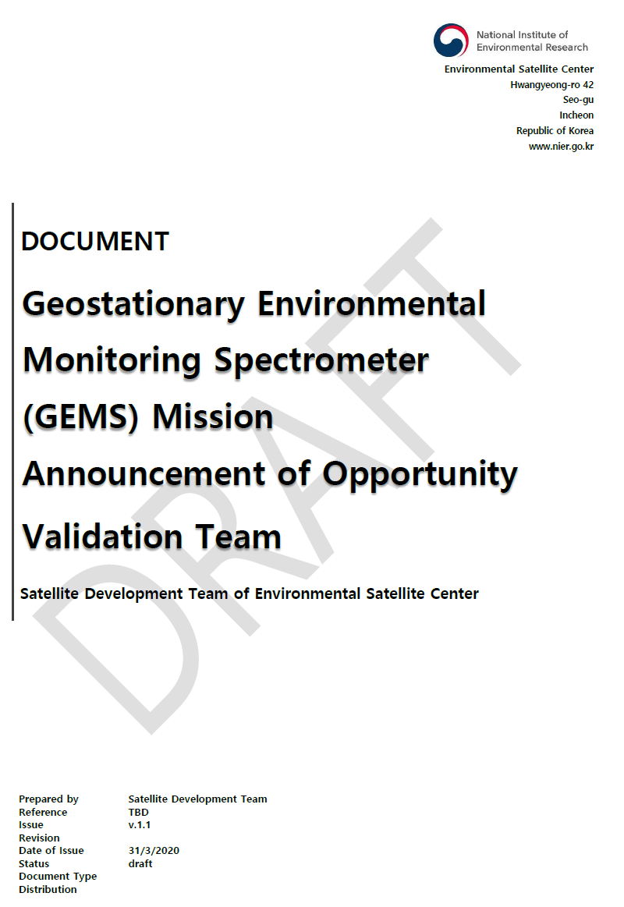
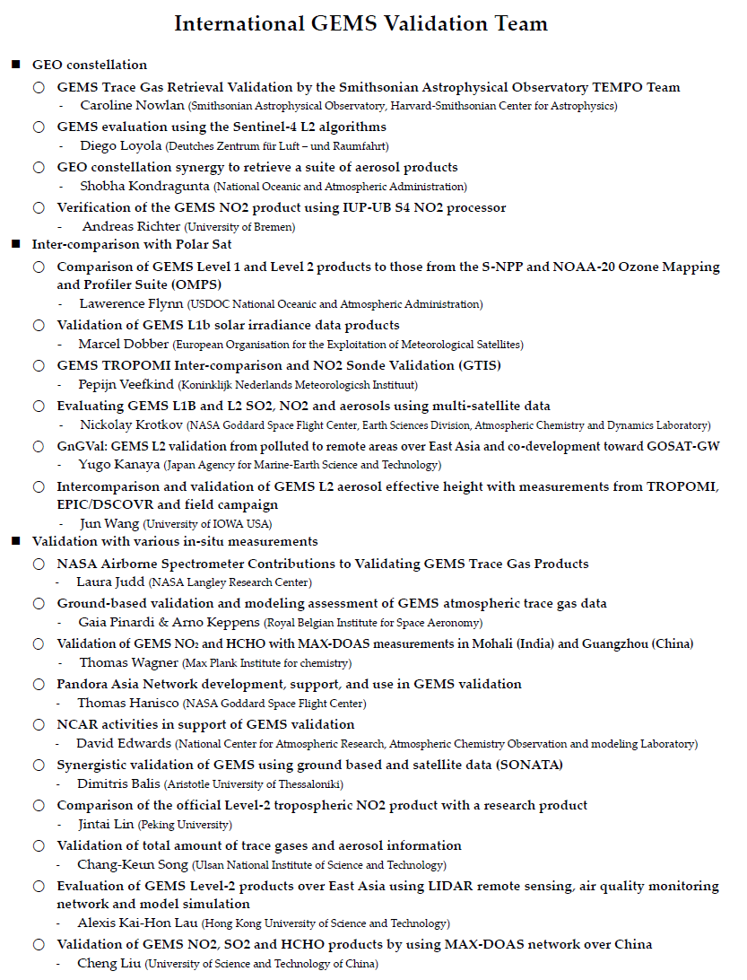
International Collaboration
for GEMS Validation
More than 20 research groups joined in International GEMS validation team !!

Slide 6
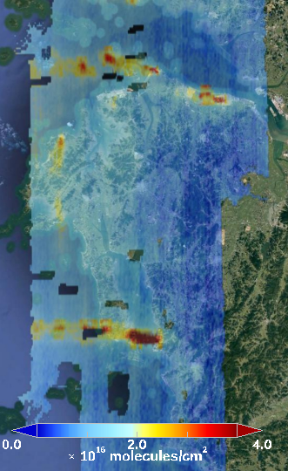
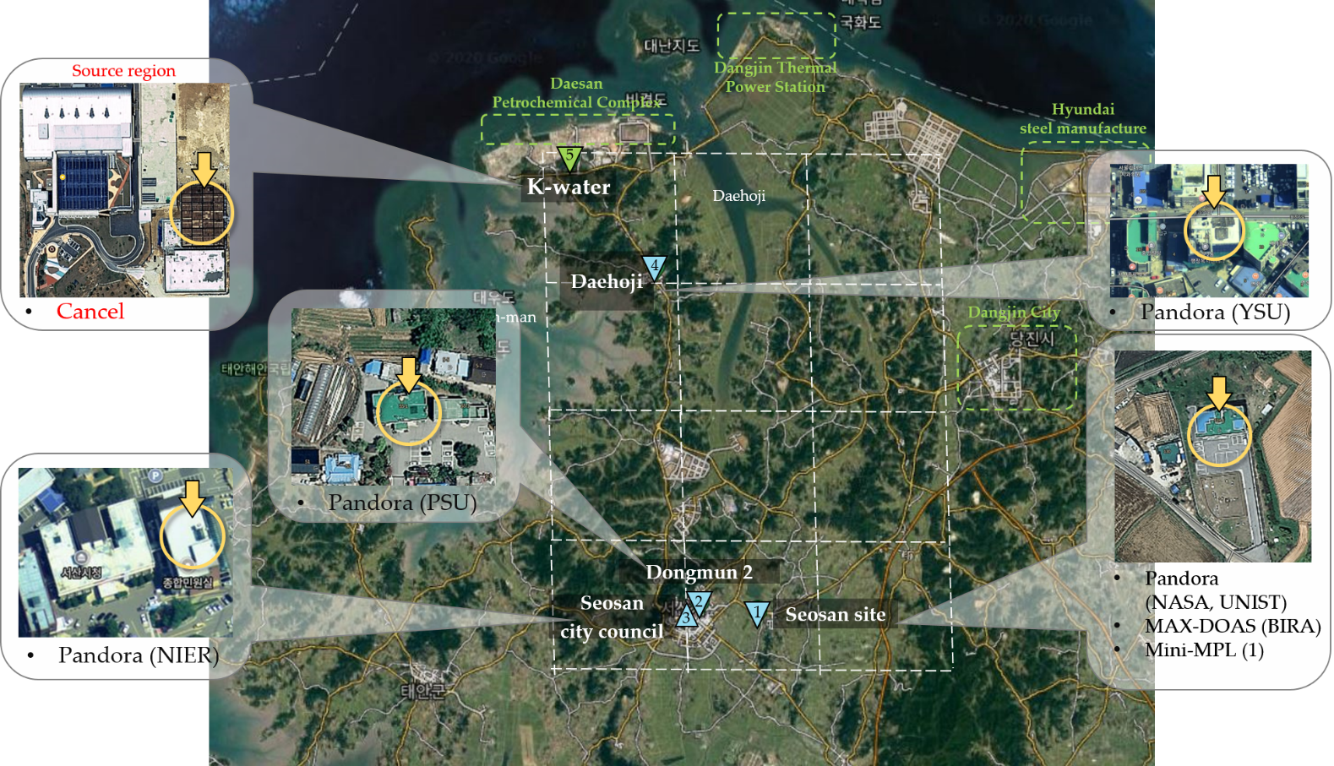
GMAP2020
overview
Seosan domain
Dangjin power plant
Daesan petrochemical complex
Seoul
Taean
power plant
NO₂ VCD during KORUS-AQ
(5, June, 2016)
Dangjin
Seosan
Boryeong
Boryeong power plant
20 km
Hong et al., 2021(to be submitted)

Slide 7
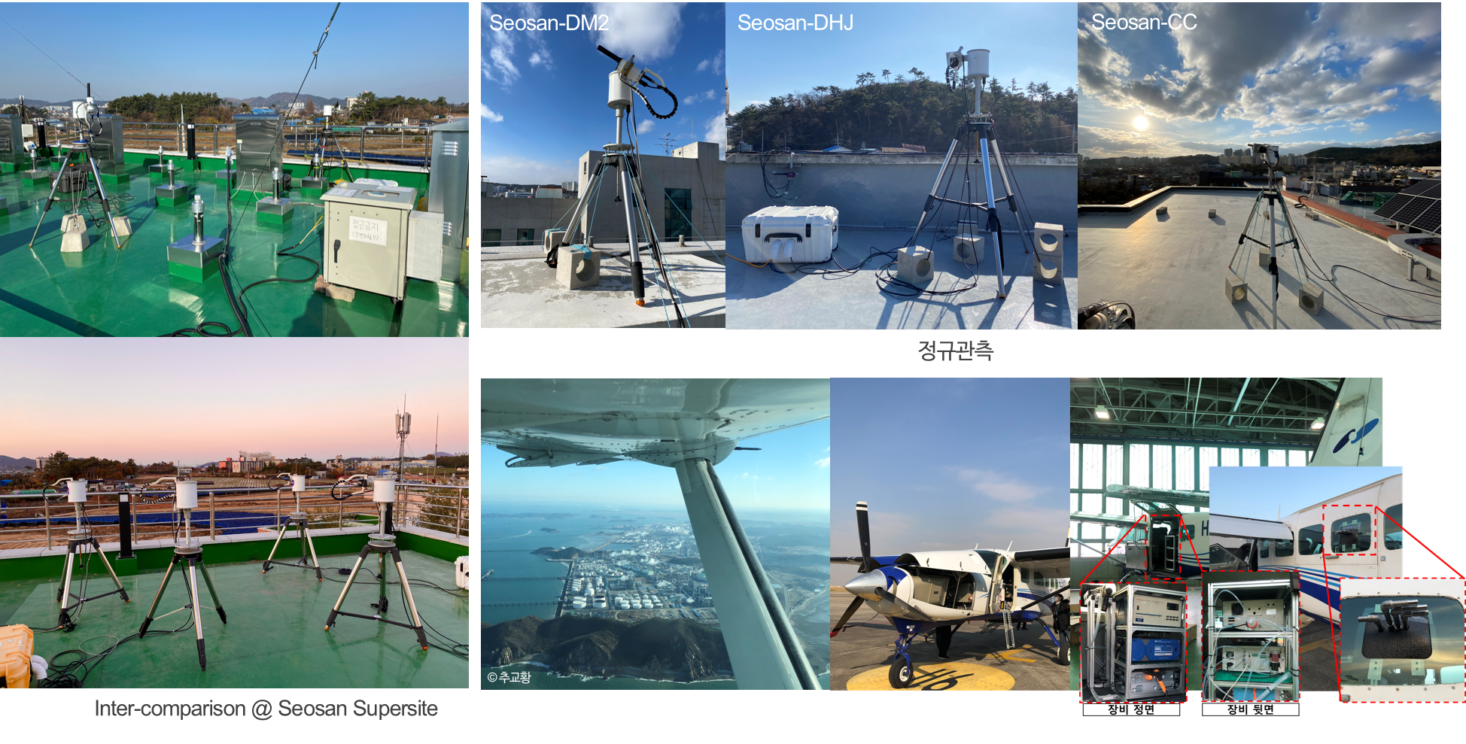
GMAP2020
overview
GMAP inter/intra pixel sites and aircraft

Slide 8
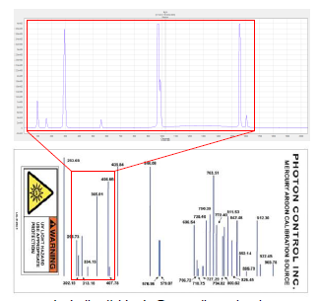
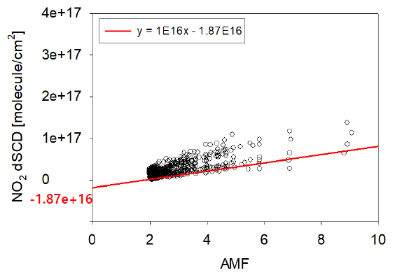
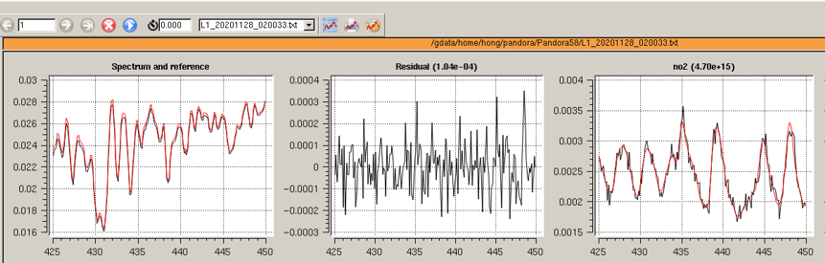
Preliminary result
Flow chart of Pandora NO₂ retrieval
start
raw data
Mercury lamp
Wavelength cal.
Get SRF
L1B data
NO2 dSCD
Langley
method
NO2 SCD
DOAS
NO2 VCD
AMF_{G}

Slide 9
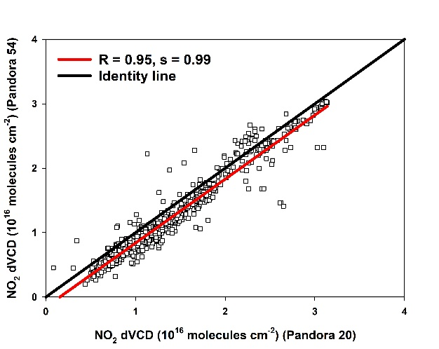
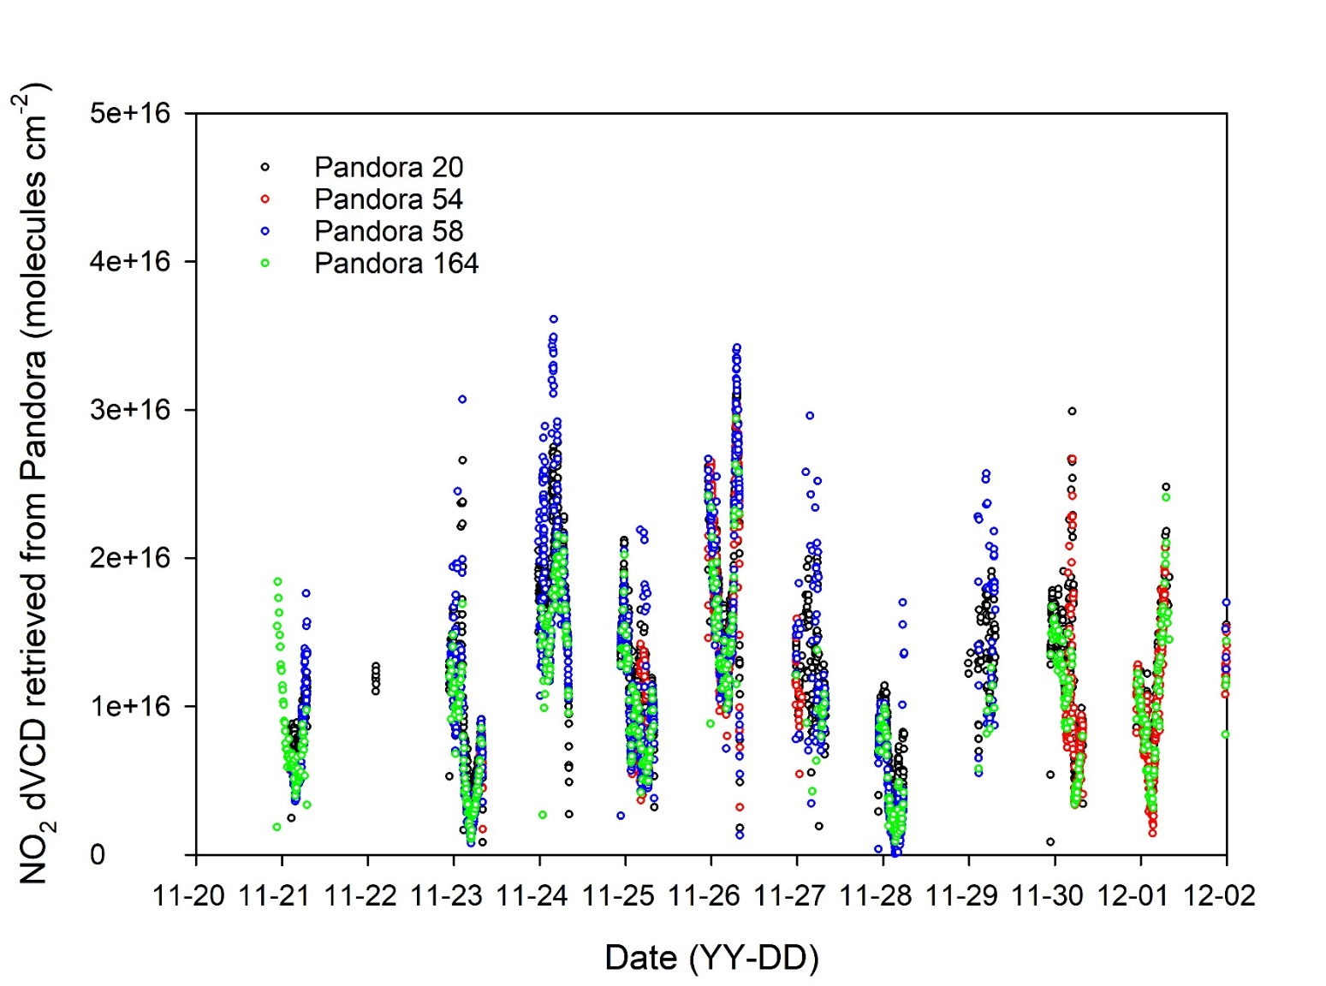
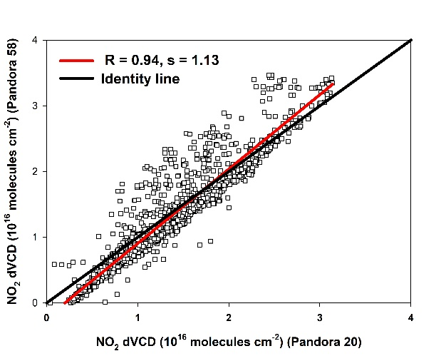
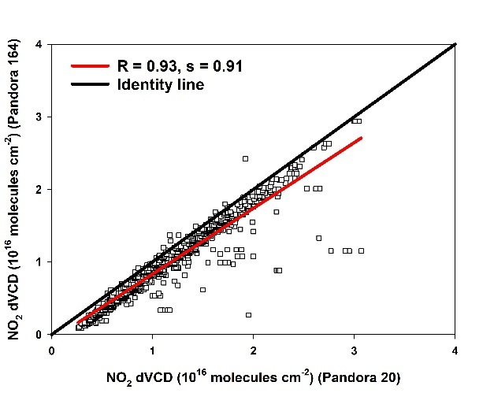
Preliminary result
The results of Pandora inter-comparison

Slide 10
Preliminary result
Comparison with GEMS NO2
Seosan-DHJ
Seosan-CC

Slide 11
Preliminary result
Comparison with GEMS NO2
Seosan Site
Seosan-DM2

Slide 12
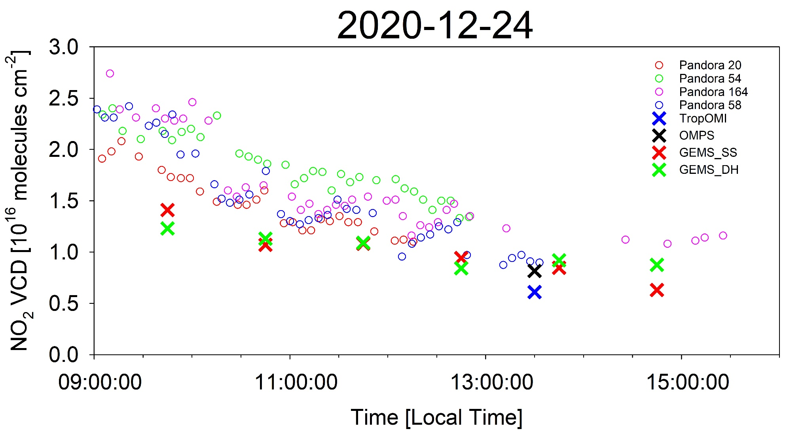
Comparison of NO2 diurnal variation between GEMS and Pandora (24 Dec. 2020)
Preliminary result

Slide 13
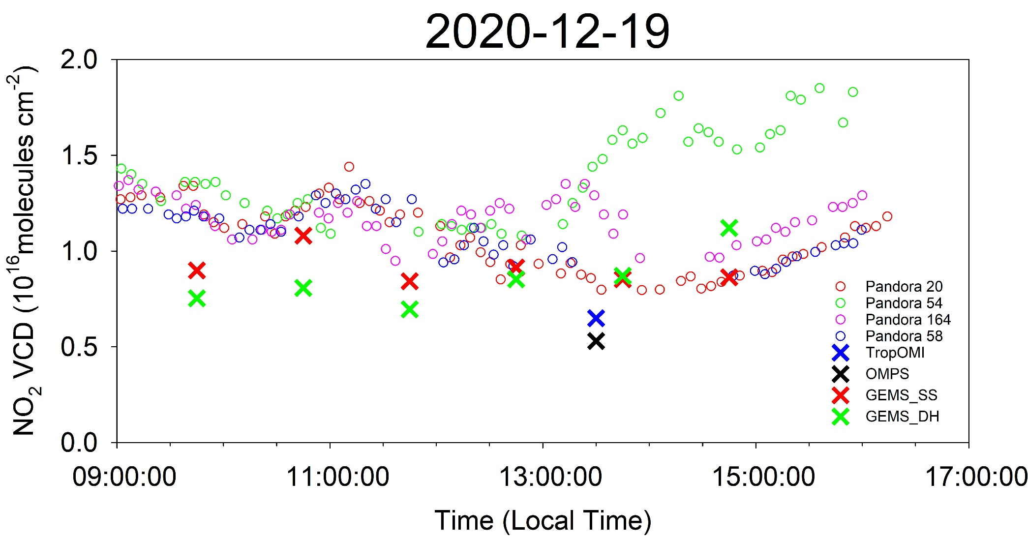
Preliminary result
Comparison of NO2 diurnal variation between GEMS and Pandora (19 Dec. 2020)

Slide 14
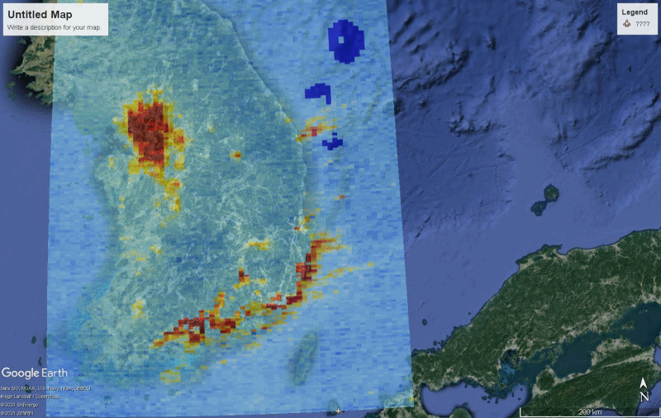

GMAP2021
Plan
GMAP2021 domain (18 Oct.~29 Nov., 2021)
30, March, 2021
10:00 ~ 15:00

Slide 15
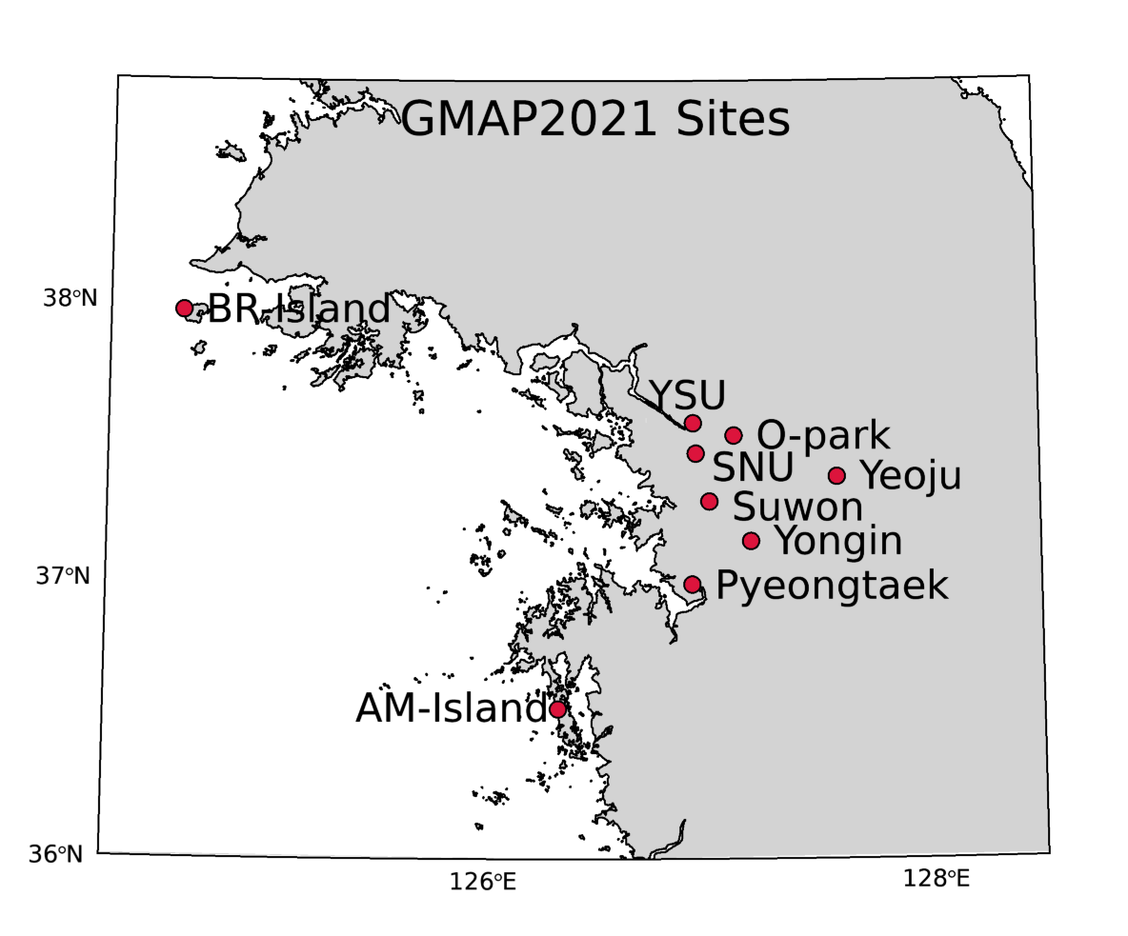
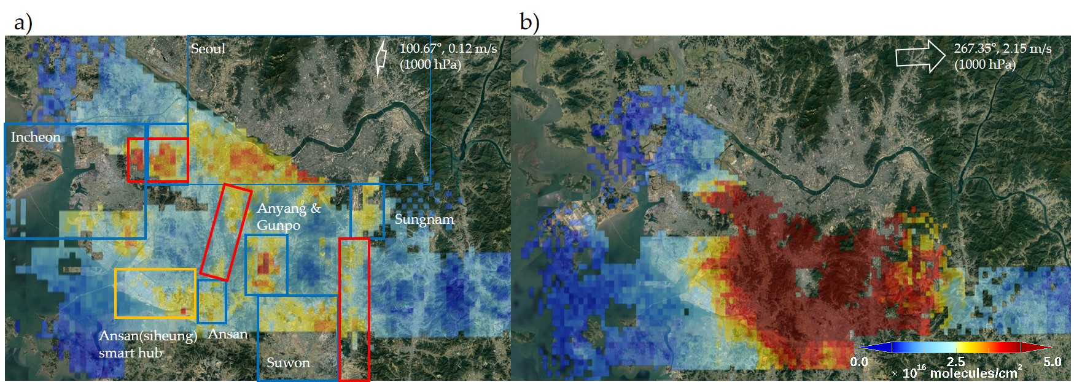
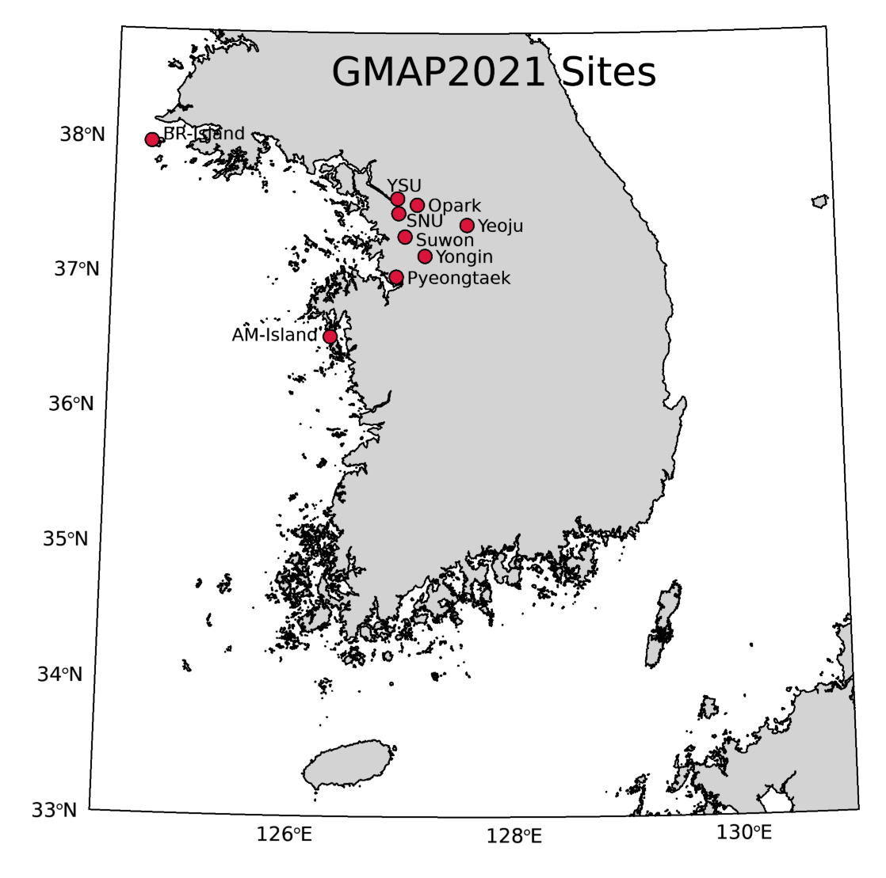
GMAP2021
Plan
Candidate sites
NIER
NO₂ VCD during KORUS-AQ at 15:00 (9, June, 2016)
NO₂ VCD during KORUS-AQ at 09:00 (9, June, 2016)

Slide 16
GMAP2021
Plan
NO₂ and O₃ sonde launching
- Simultaneous observation with Ozone & NO2 Sonde
- Ozone: ElectroChemical Concentration Cell (ECC) Sonde
10 days (twice a day- 10:00, 15:00) during GMAP (Possible to change to summer)
- Development of low-cost NO2 Sonde
- If the development is completed before the GMAP campaign, planned to observe twice a day.
Ozonesonde
sensor
~30 cm
Radiosonde
sensor
ECC
(UAHuntsville NOAA/ESRL ozonesonde manual)

Slide 17
Participating equipment (interim)
GMAP2021
Plan
Institute | Equipment
NIER | Pandora 1S: 2 Pandora 2S: 1
 | Ozone sonde (with Kongju and Yonsei Univ.)
Seoul Nat’l Univ. | Pandora 1S: 1
UNIST | Pandora 1S: 1
Yonsei Univ. | Pandora 1S: 1
Univ. of Bremen | Two channel MAX-DOAS: 1 Car-DOAS: 1
KNMI | NO2 sonde
USTC | MAX-DOAS: 1
MPIC | MAX-DOAS: 2
BIRA | MAX-DOAS: 1 Mobile-DOAS:1
NASA | GCAS and Pandora
JAMSTEC | MAX-DOAS:1

Slide 18
Pan-Asia Partnership for Geospatial Air Pollution Information (PAPGAPI) and Pandora Asia Network (PAN)
The objectives of the PAPGAPI project are to:
integrate and validate GEMS data production with reliable ground monitoring information for better understanding of air pollution, and to improve model simulations of air quality, including its forecasting and warning service
fill the data and information gap in the nation-wide monitoring of air quality
enhance national and regional capacity to undertake the comprehensive analysis of data derived from space and ground networks
promote policy dialogue and enhance the capacity for monitoring and management of air pollution at the regional and global level

Slide 19
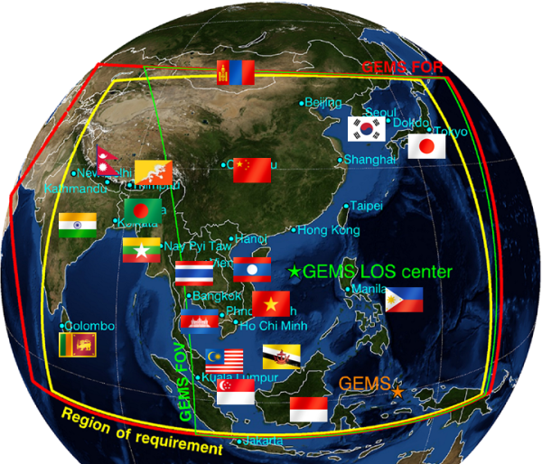
Pandora Asia Network (PAN) : Overview
The PAN is a new network of ground-based remote sensing instruments dedicated to validate the scientific products of GEMS as well as low Earth orbit (LEO) satellites.
Pandora monitors air quality and atmospheric composition in the region where it is installed, and it also serves monitoring satellite data quality for whole GEMS and LEO mission durations.
Priorities
  Expanding Pandora stations and Supporting National and International Partners, collaborating with Pandonia Global Network (PGN)
  Supporting satellite (GEMS) validation activities
  Collaborative development of new operational algorithms
  Continued collaboration with AERONET, SONET, SKYNET, KALION,AD-NET.

Slide 20


Pandora Asia Network (PAN) : Operational Structure (Planned)
PAN Annual Meeting
Science Team Meeting
Science workshop
Training school (including GEMS)
Scientific & network issues : discussion and decision
Observatory Meeting
Training site operator/manager
Status and progress report
Data collection & status
Bhutan
Cambodia
China
India
Indonesia
Japan
Korea
Malaysia
Mongolia
Nepal
Philippines
Singapore
Thailand
Vietnam
+ …
  Operational Group
Supporting Operations & Training of Local Operators
(installation, software, repair, data analysis, etc.)
  Science Advisory Group
GEMS Validation, Algorithm development, Local & Regional Air Quality & Impact Studies, etc.
NRT Data Transfer
Data
Mirroring
PAN Data Center
@ ESC/NIER
Pandonia Global Network (PGN)
Bilateral project by :

Slide 21
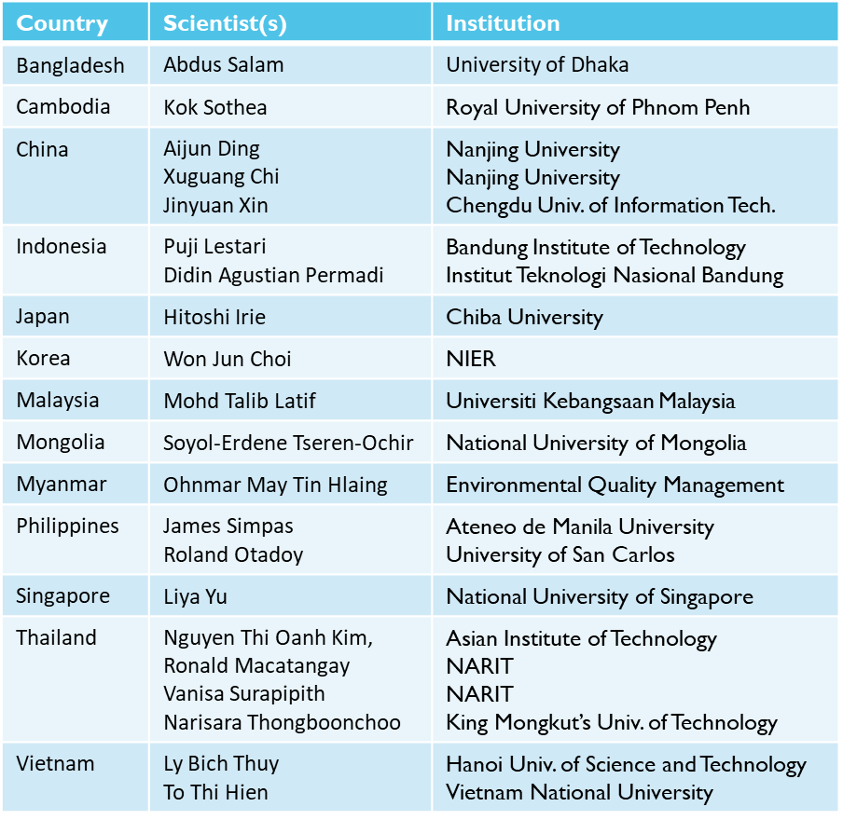
PAN Science Advisory Group (PSAG)
  PSAG co-chairs: James Crawford, NASA Langley
  Sang-Woo Kim, Seoul National University
Current PSAG membership reflects atmospheric chemistry experts from each participating country
Identified through their international reputation
Most are active with the International Global Atmospheric Chemistry (IGAC) project and its various activities such as the Monsoon Asia and Oceania Networking Group (MANGO) and Atmospheric Chemistry and the Asian Monsoon (ACAM)
As they become identified, Pandora site operators will be invited to join the PSAG.
PSAG membership will evolve as needed to benefit international collaboration and sharing of best practices.
Notes:
Introduce the current PSAG membership and how they were selected.
PSAG membership will include operators and evolve as needed to benefit international collaboration and sharing of best practices.
Introduce Thai scientists to discuss site selections.

Slide 22
Pandora Asia Network (PAN) : Site Characteristics
Various Environment
Urban
Rural
Background
Platform
Pandora only
Comprehensive Platform
Pandora
Multiple instruments
(in-suit & remote sensing)
Conventional air quality monitoring station
Weather station
* Specific recommendations for instrumentations will be made.

Slide 23
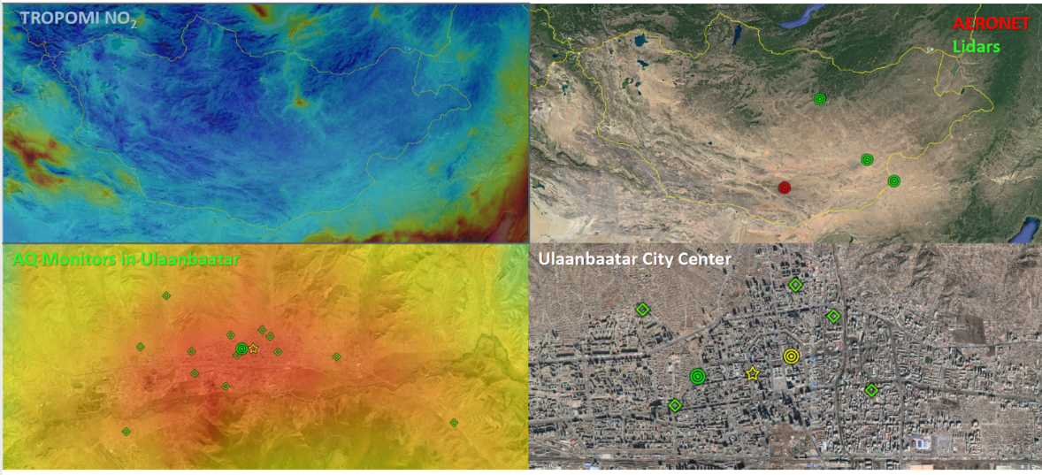
Pandora integration into the larger network of observations
Thailand
Indonesia
Mongolia
Courtesy of Jim Crawford (NASA)
Courtesy of Prof. Puji Lestari
Notes:
It is important that the Pandora Asia Network sites be evaluated to provide the best science opportunities for Thailand.
On left, there are three priority locations for Pandora sites: Bangkok, Chiang Mai in the north, and Hat Yai in the south.
Are these good locations?
A map of PCD monitors (center) shows a higher density of monitors in the three locations, which is favorable for linking satellite observations to the perspective from the ground.
A map of other relevant science sites (on the right) includes AERONET sunphotometers, lidars, and a research tower in Bangkok. These sites also support the three Pandora locations as a good choice.

Slide 24
Thank you for your listening.

