Slide 1



Tropospheric Emissions:
Monitoring of Pollution
Hosting Update for
TEMPO Science Team Meeting
Acting PM: Kevin Daugherty
Acting DPM: Crystal Fenn
June 2, 2021

Slide 2
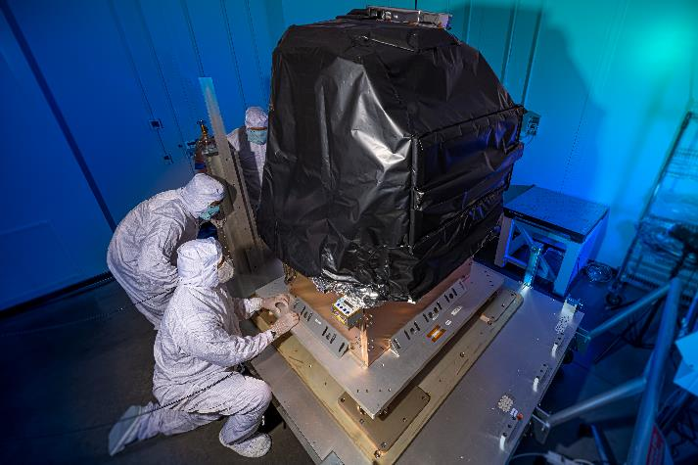
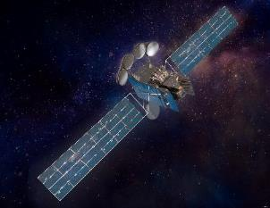
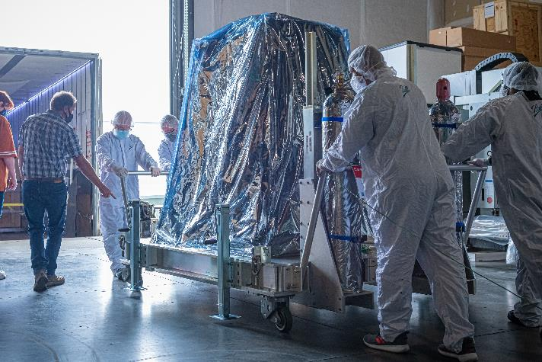
Overview
The TEMPO Instrument has been delivered to Maxar!
  Instrument is ready for integration with IS40e
The TEMPO team is working closely with our commercial host partners, Maxar Technologies and Intelsat General, to successfully integrate the TEMPO Instrument and Ground Systems
Intelsat 40e with TEMPO
TEMPO Instrument Shipment May 2021

Slide 3
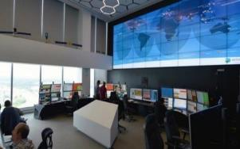
Host Services Update
NASA contracted with Maxar Technologies (formerly Space Systems Loral) in 2019
Completed multiple reviews including spacecraft and ground system design reviews, a shipment review, and a system integration review
TEMPO was delivered to Maxar Technologies in Palo Alto, CA on May 18, 2021
Intelsat SOC (Tysons Corner, VA)

Slide 4
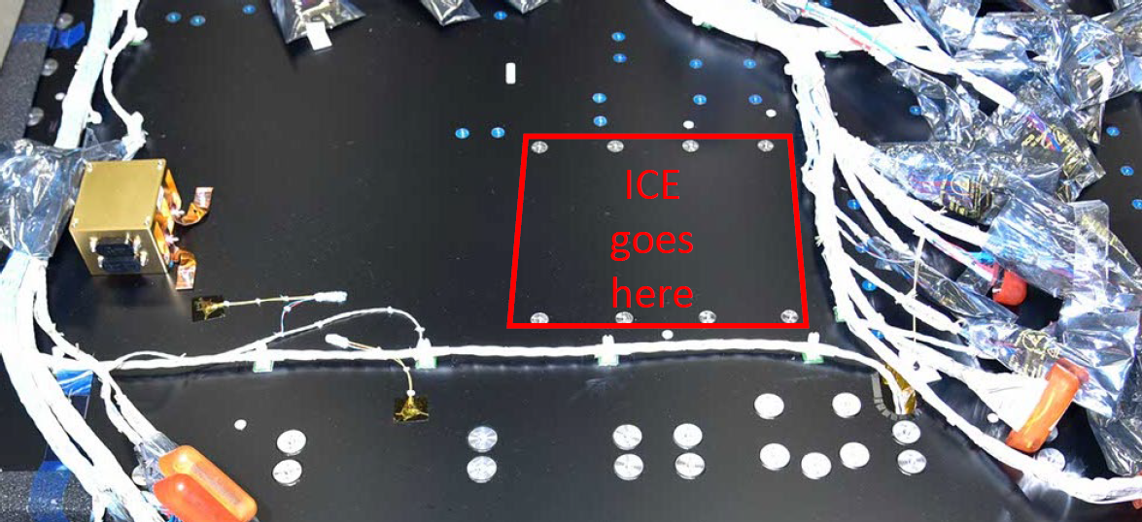
Integration and Test Schedule
TEMPO Sensor Integration – October 2021
Thermal Vacuum Testing – January-February 2022
Vibration and Acoustics Testing – March-June 2022
EMI/EMC Testing – June-August 2022
Shipment to Launch Site – October 2022
Launch – November 2022
Nominal Operations Begin – March 2023

Slide 5
Questions?

Slide 6
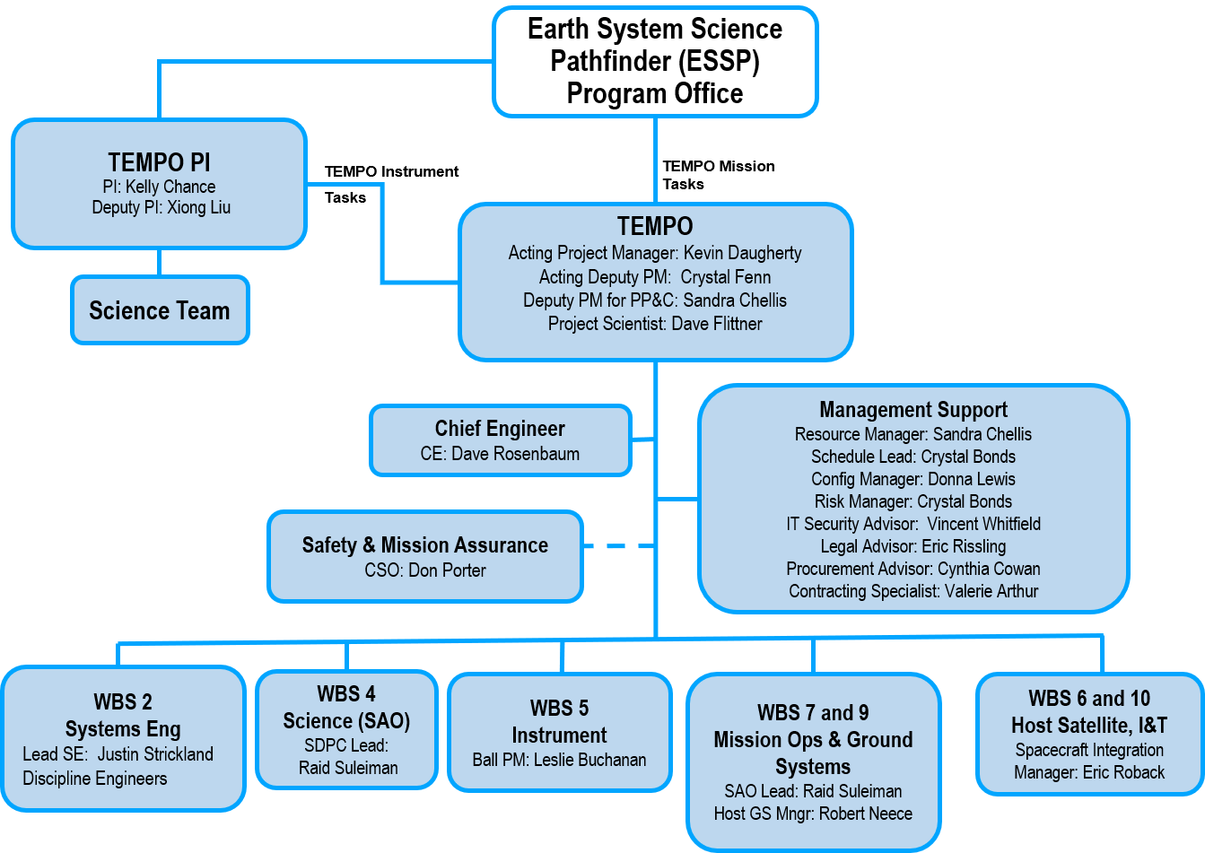
TEMPO Organization

Slide 7
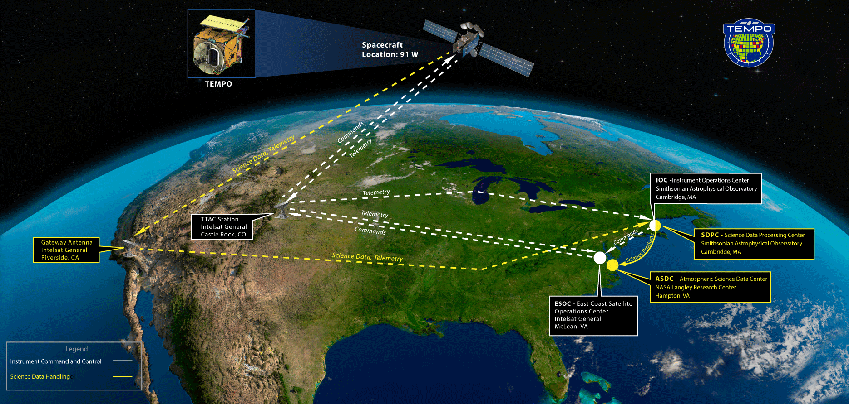
TEMPO
Operations & Data Flow Update

Slide 8
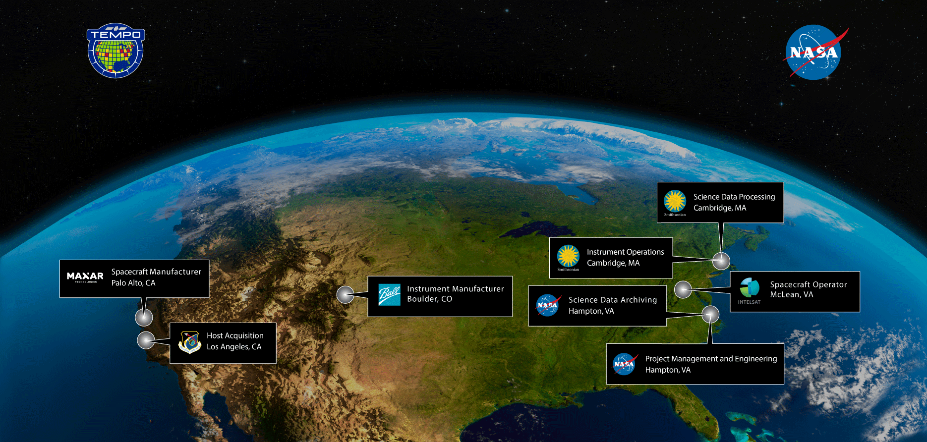
Partner Map

