Slide 1
17th CEOS AC-VC, 08 June 2021
Air Quality Observations from GEMS
- GEMS SO₂ products and application
Jeong Ah Yu and Satellite Data Analysis & Application Team
Environmental Satellite Center (ESC)
NIER, Republic of KOREA

Slide 2
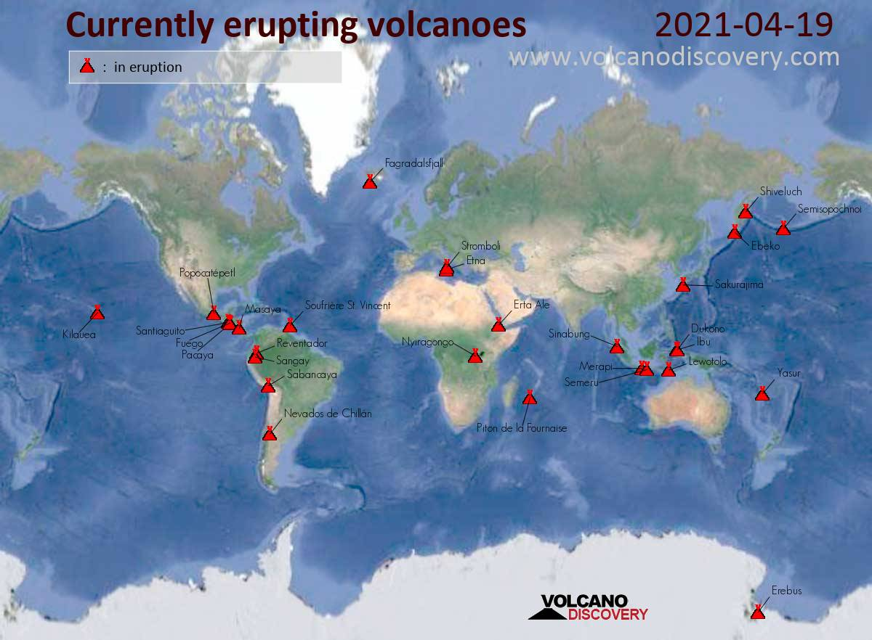
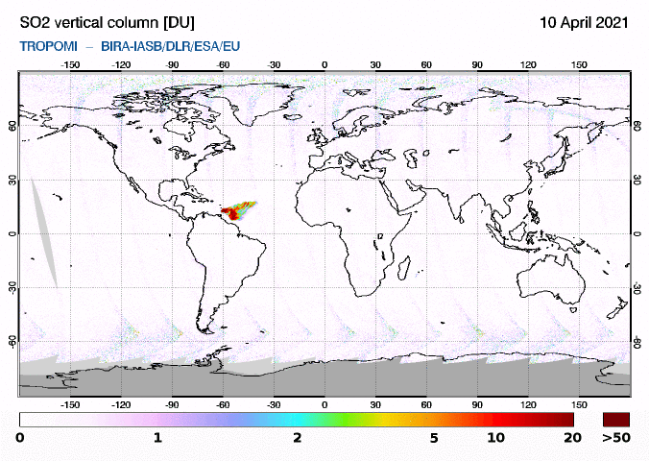
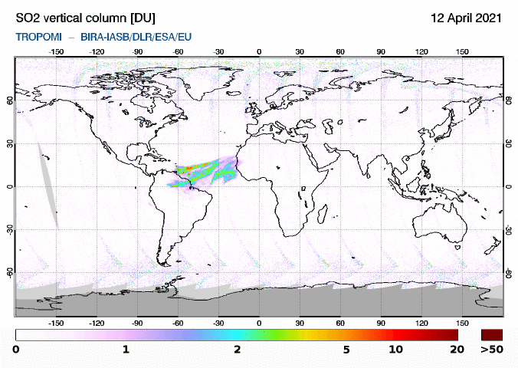
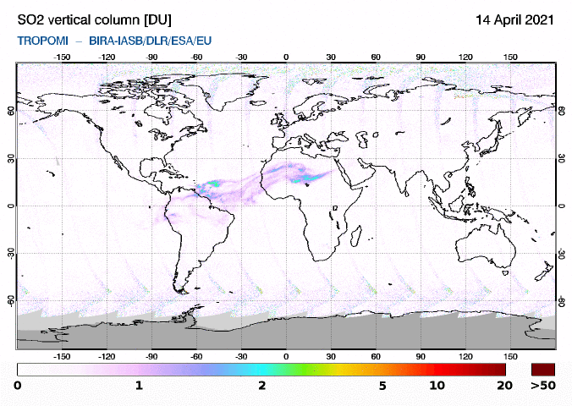
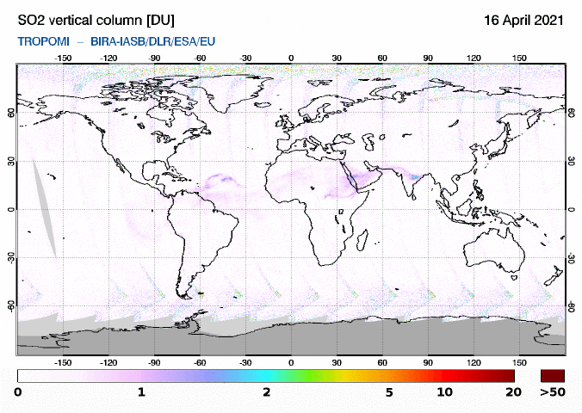
1
Overview
Currently erupting volcanoes
TROPOMI SO₂ VCD
10 APR
12 APR
14 APR
16 APR
2

Slide 3
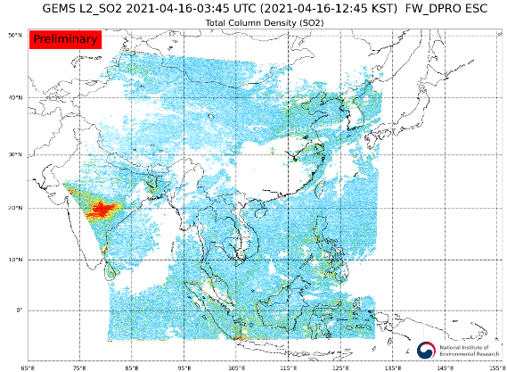
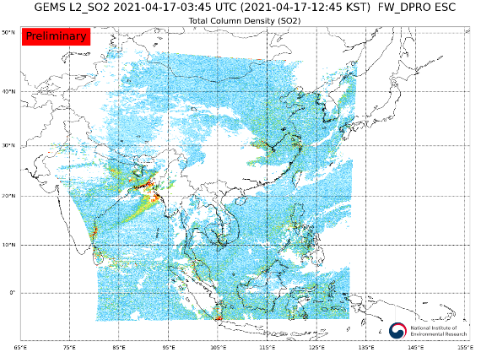
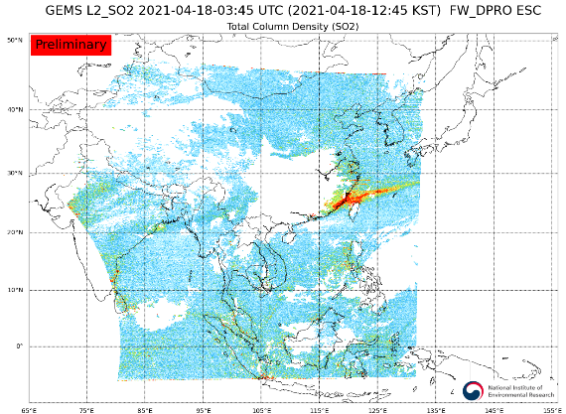
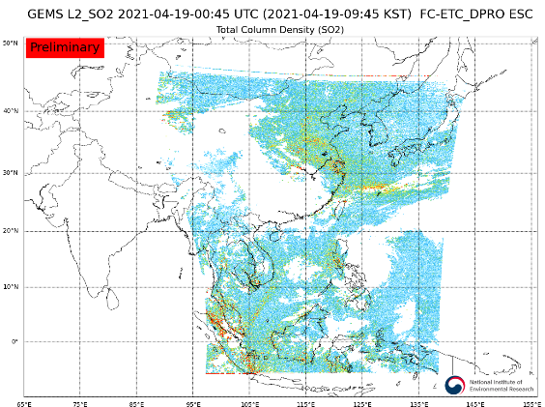
2
GEMS SO₂ products
1. GEMS L2 SO₂ VCD
12:45 | 12:45
12:45 | 09:45
16 APR
17 APR
18 APR
19 APR
3

Slide 4
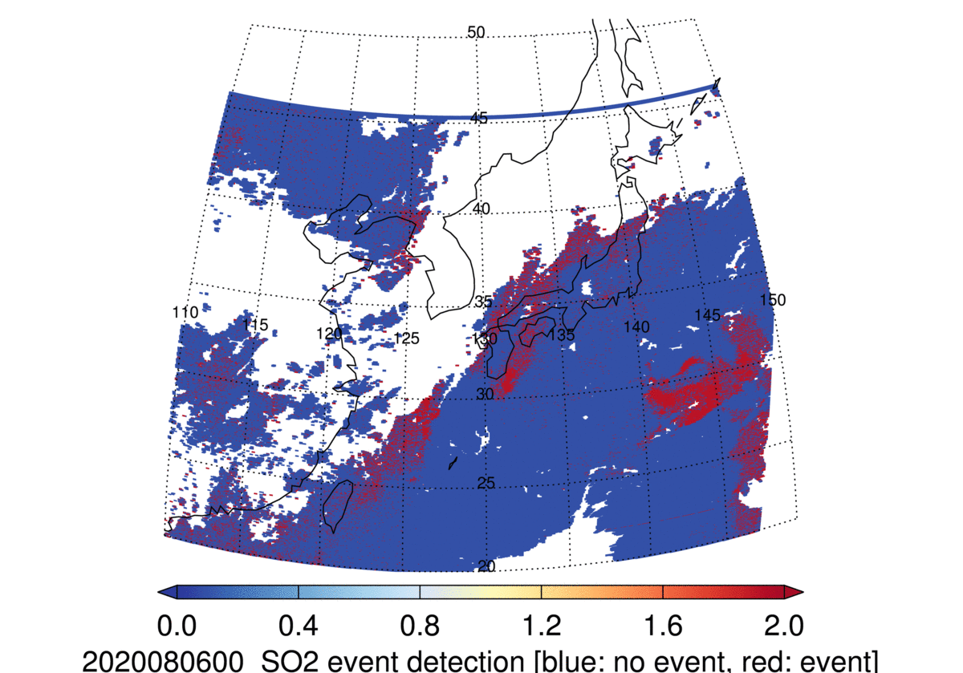
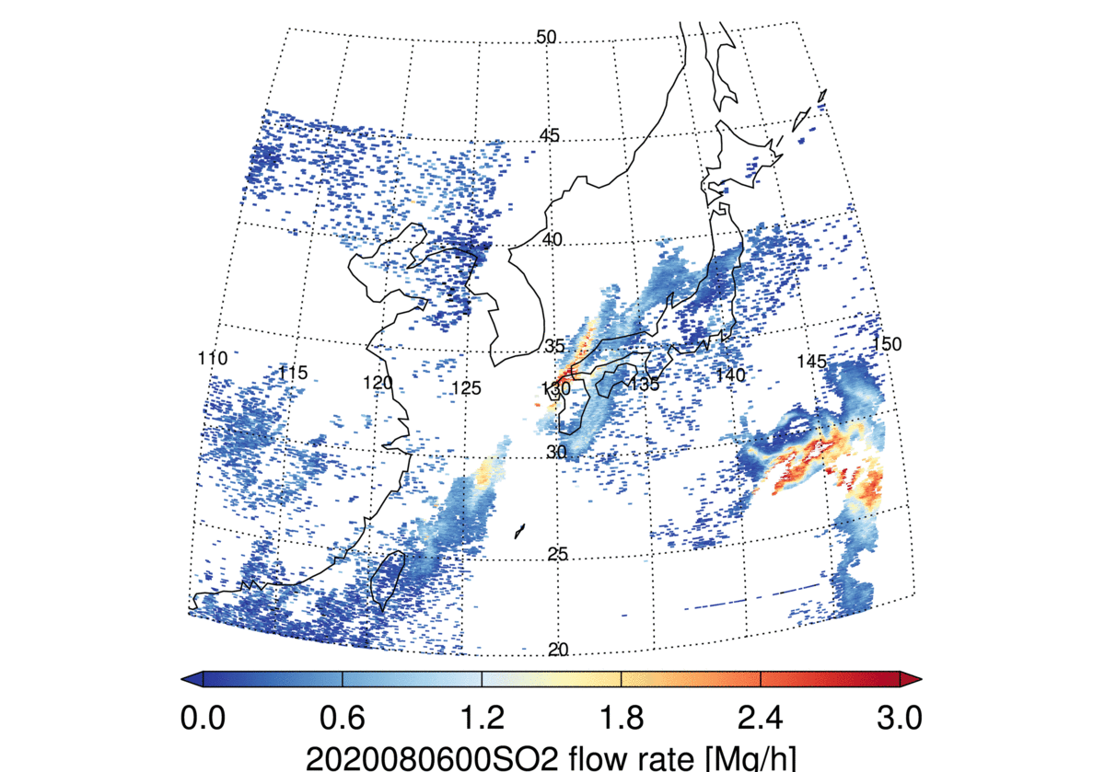
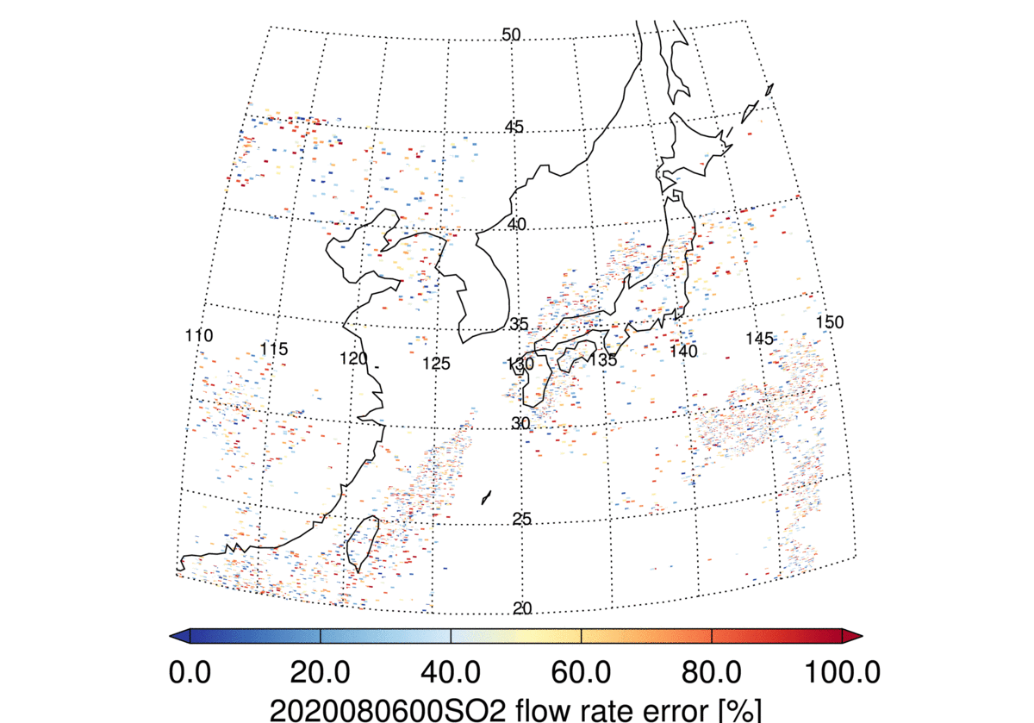
2
GEMS SO₂ products
2. GEMS LRT-SO₂ Products
[LON:110˚-150˚E, LAT:20˚-50˚N]
Event detection
Retrieved SO₂ flow rate (Mg/h)
Retrieved SO₂ flow rate error (%)
Event detection
Retrieved SO2 flow rate
[ Event / No Event ]
4

Slide 5
2
GEMS SO₂ products
GEMS LRT-SO₂ detection and flow rate calculation methods
START
GEMS L2 SO₂ VCD
LRT SO₂ Event Detection
LRT SO₂ Flow Rate Retrieval
[Condition 1]
Local SO₂ Contribution
Removal (Hot spot)
Calculate the long-range transported SO₂
Dates with the top 3% of SO₂ concentrations
UM Model
(u,v wind data)
[Condition 2]
Daily mean SO₂ concentration is three times higher than that of the previous day
Calculate the local Air mass transportation speed
Flow rate calculation
YES
HYSPLIT Model
(GFS 0.25°x0.25°
forecast data)
Long-range transported SO₂ flow rate
[Condition 3]
Error propagation equation
Backward trajectory calculations show that the air mass is transported from the major SO₂ source areas
Long-range transported SO₂ flow rate error
END
5

Slide 6
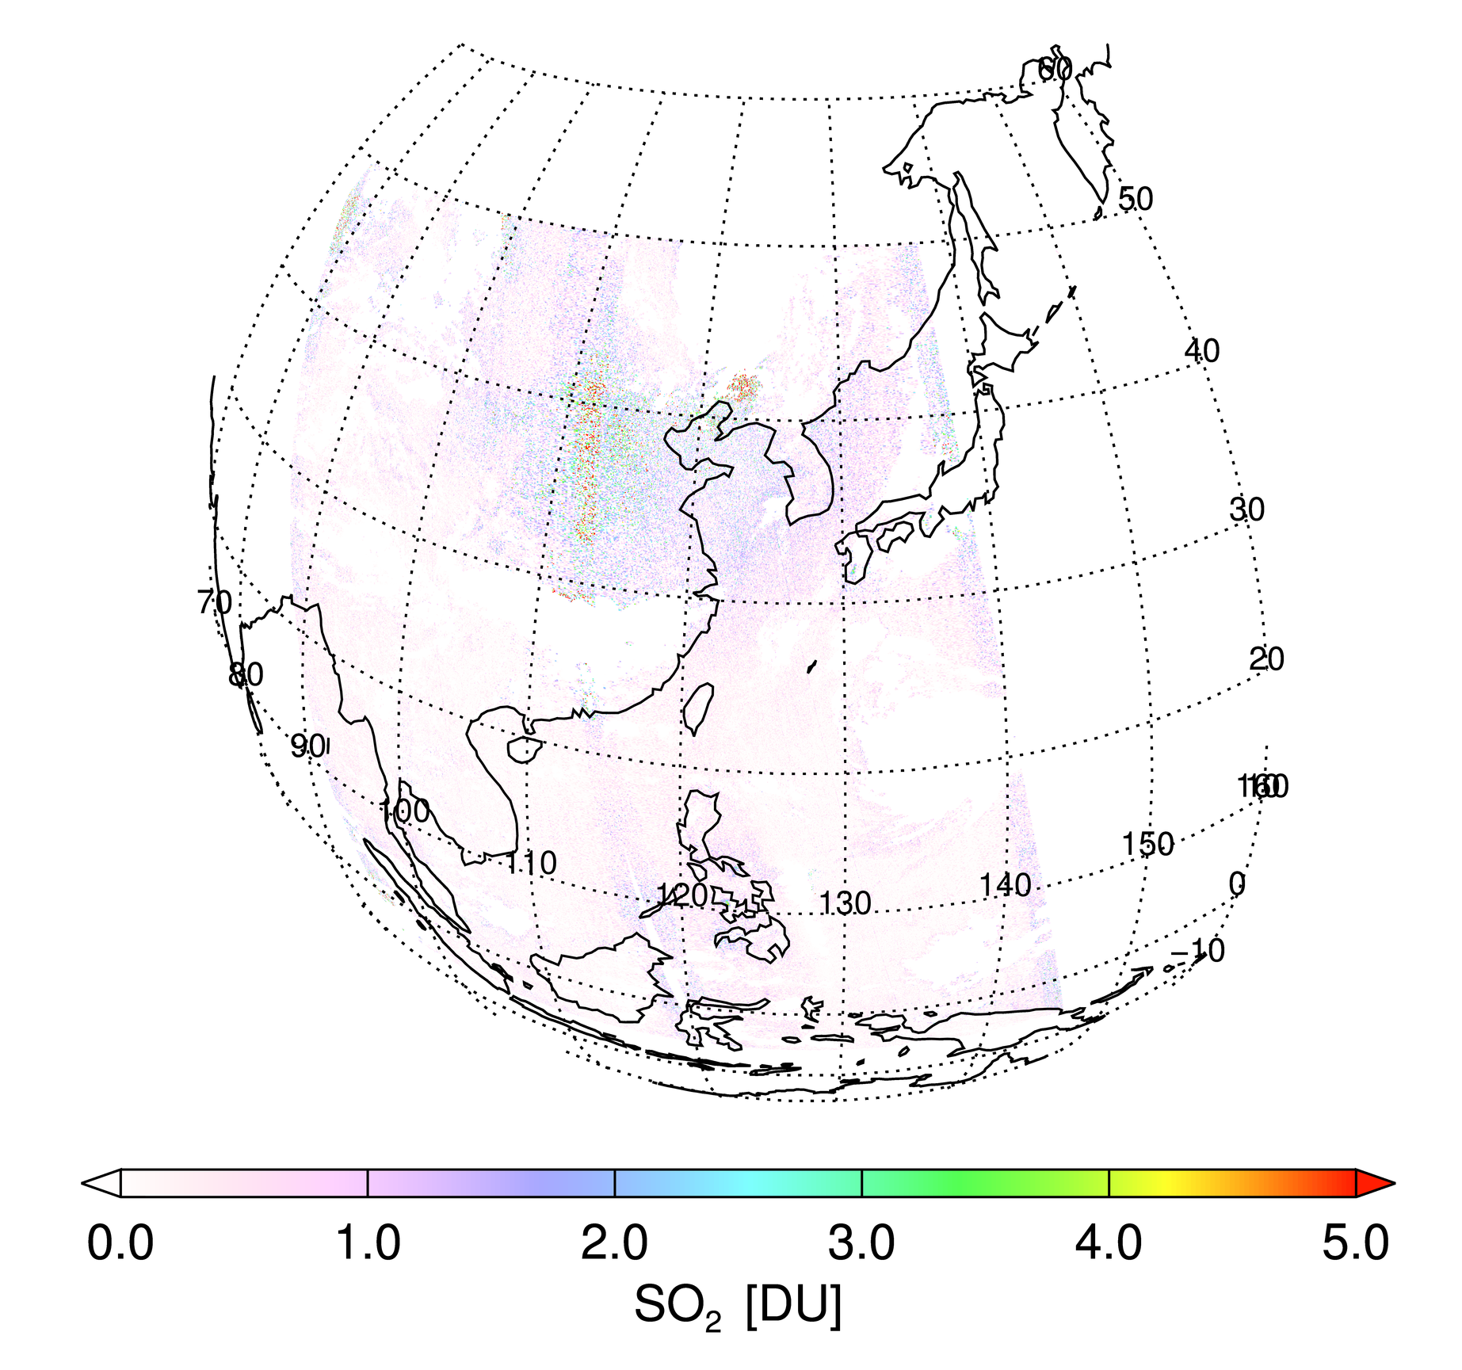
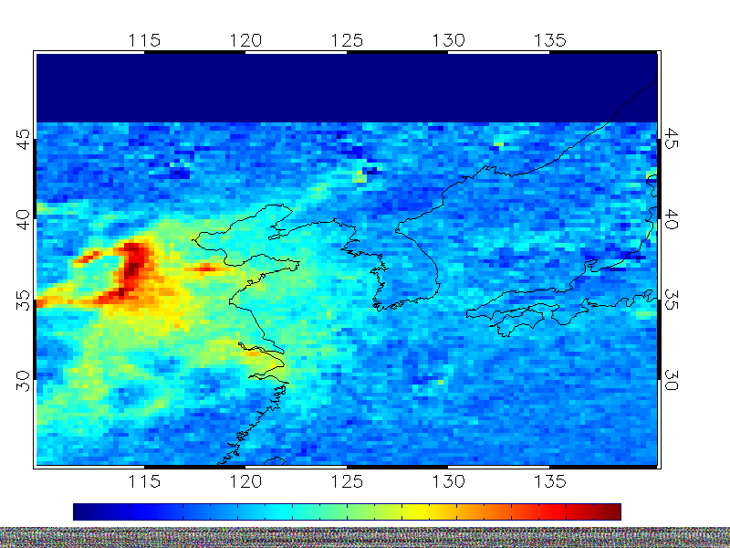
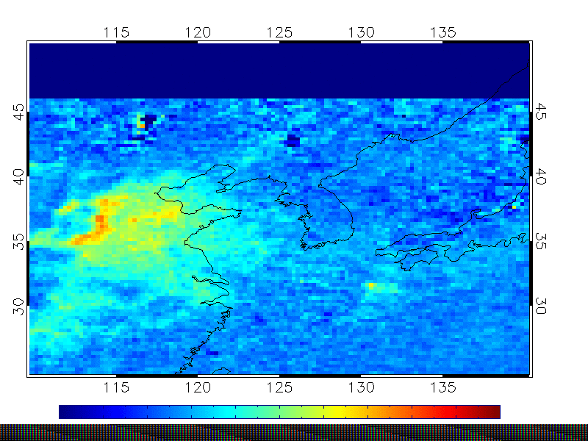
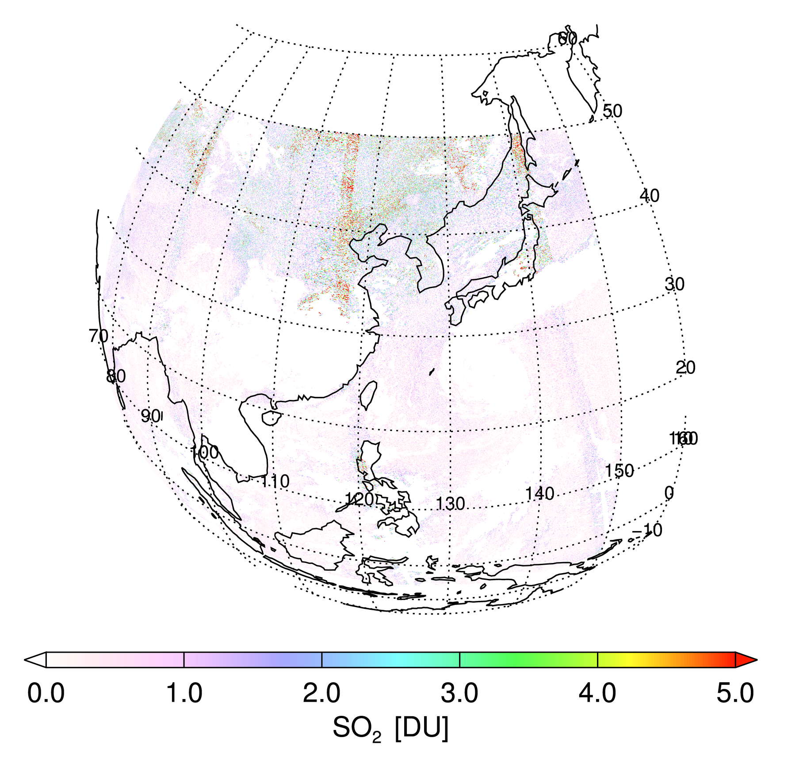
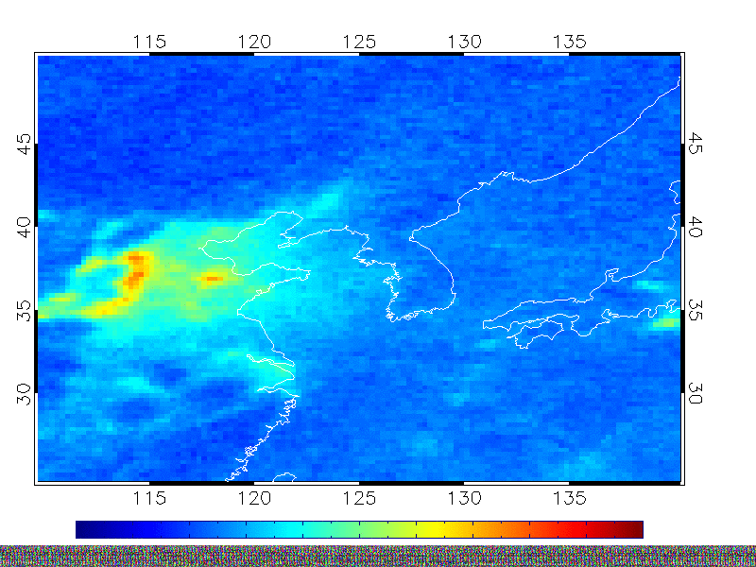
2
GEMS SO₂ products
※ Local SO₂ contribution removal (Hot spot)
TROPOMI data
OMI data
1. Monthly
January – June 2020
JAN `05-`08
JAN `09-`14
July – December 2020
2. Yearly
2005
6

Slide 7
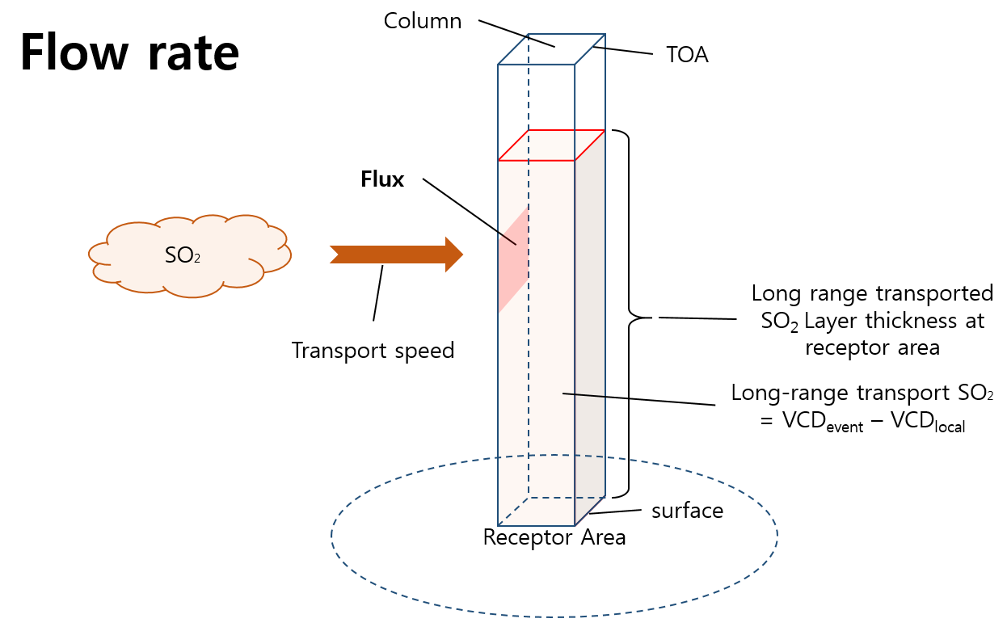
2
GEMS SO₂ products
SO₂ Flow Rate Calculation
SO₂ Flow Rate
Flow Rate and Error Calculation
$$Flow rate \left(Mg h^{−1} {GEMS grid}^{−1}\right)$$
= $Average flux (Mg {km}^{−2} h^{−1}) ×$ Cross-sectional area (km²)
$= \frac{α \left(Mg {km}^{−2}\right)}{Atmospheric Thickness \left(km\right)} × β (km h^{−1})$
Atmospheric thickness : LRT SO₂ layer thickness
$α$ : LRT SO₂ (VCD_{event} – VCD_{local})
$β$ : Transport speed
(Eq. 1) ${SO}_{2} Flow Rate$
$$= α \left(Mg {km}^{−2}\right) × β \left(km h^{−1}\right) ×GEMS grid length (km)$$
(Eq. 2) ${SO}_{2} Flow Rate Error$
$σα$ : LRT SO₂ ($α) \text{error}$
$σβ$ : Transport speed ($β$) error
7

Slide 8
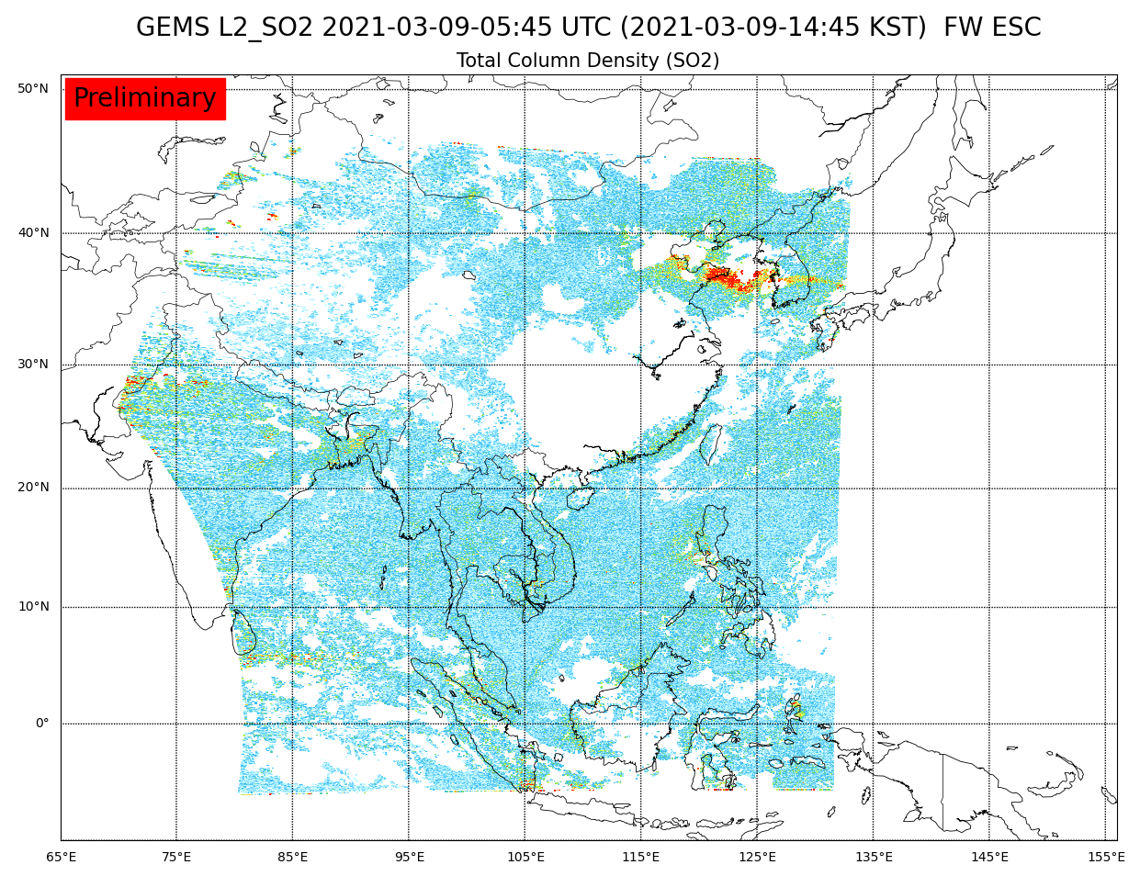
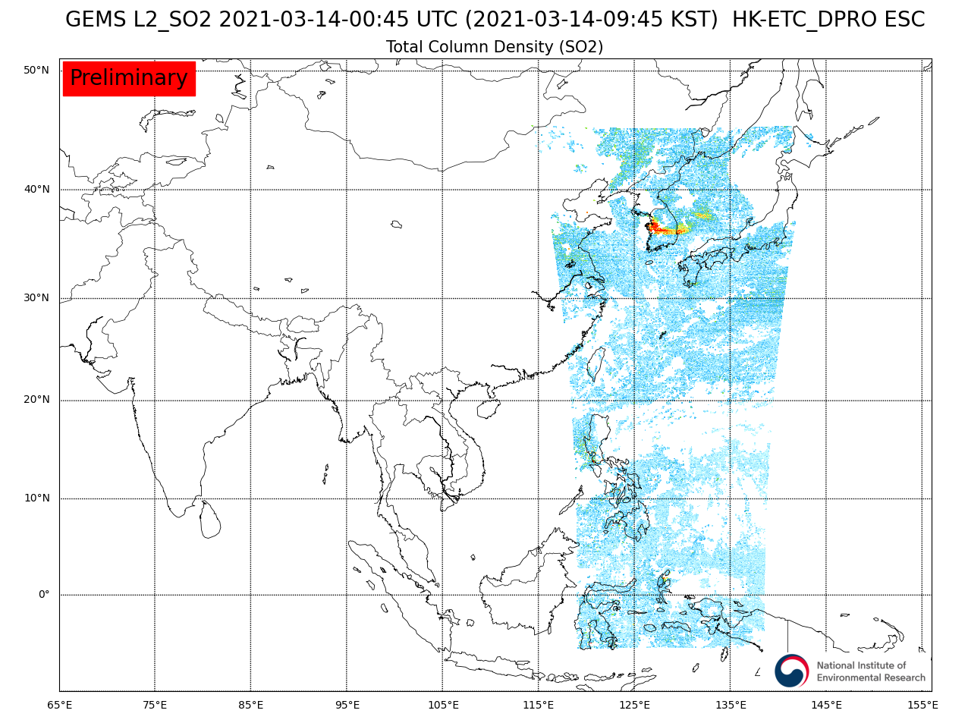
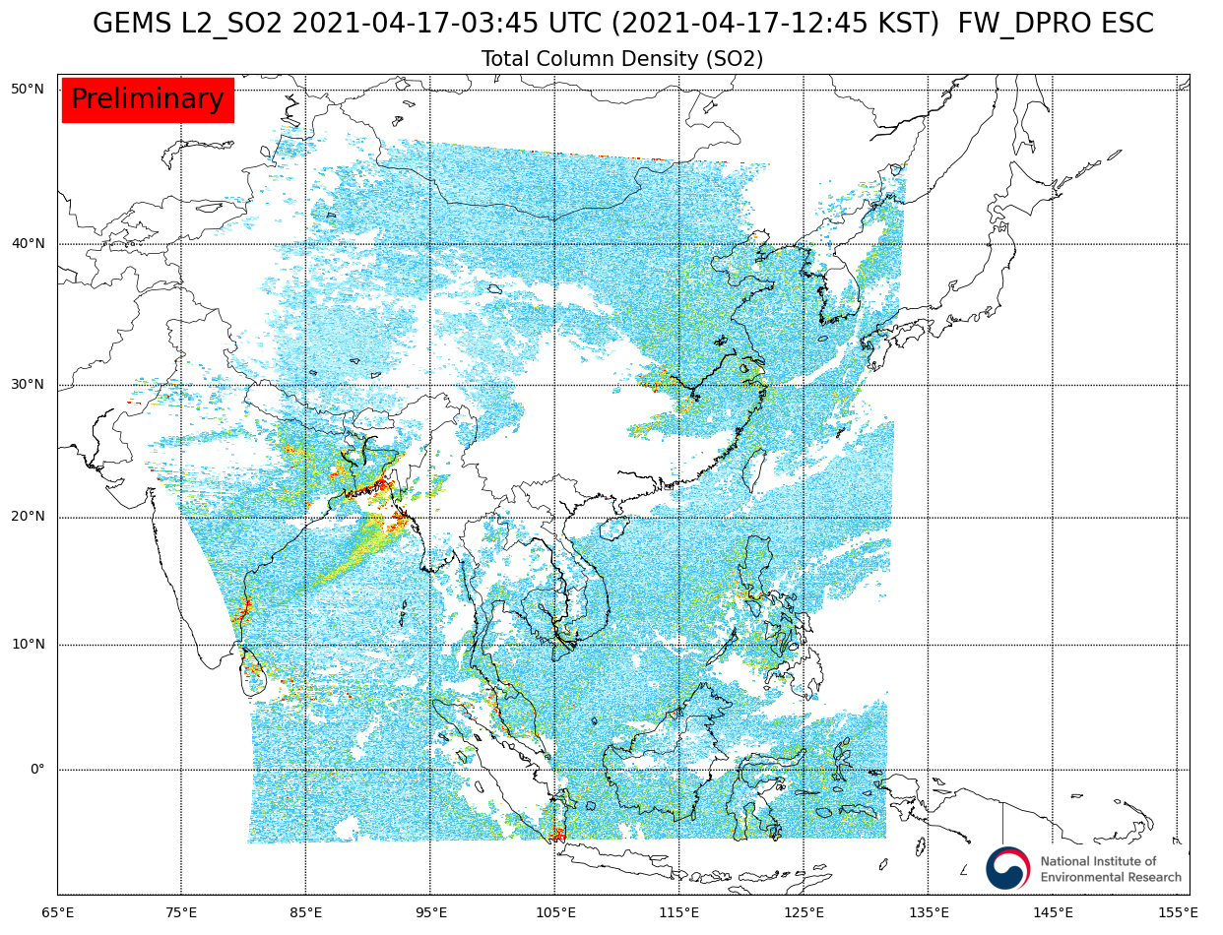
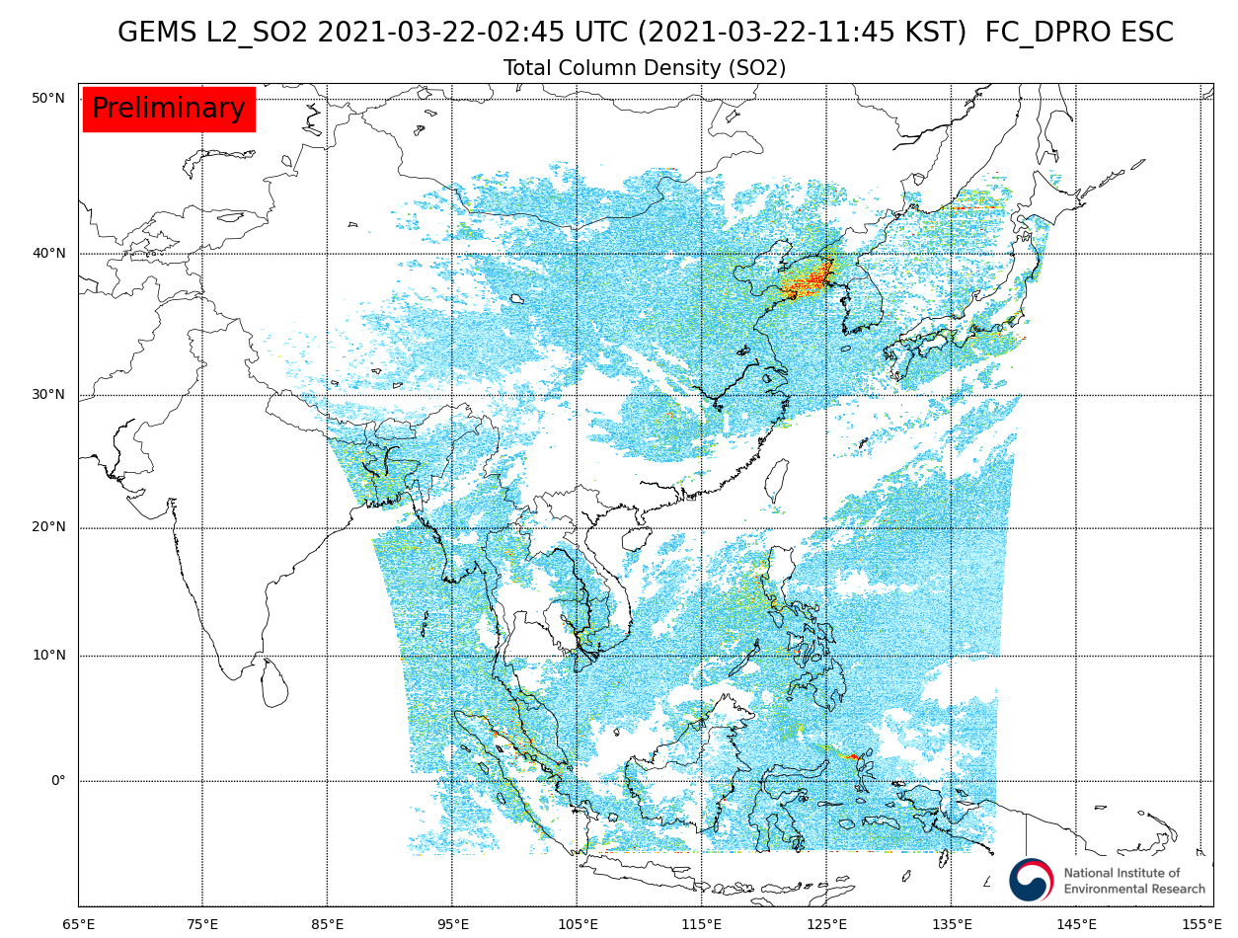
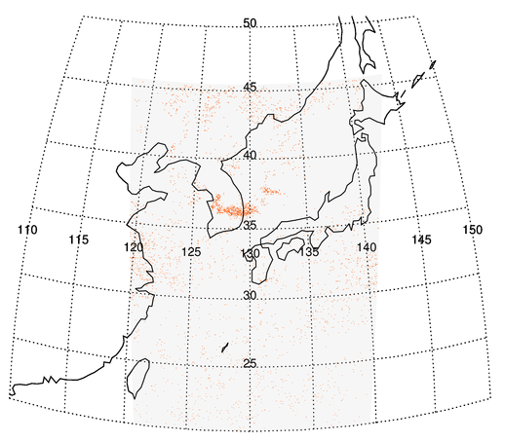
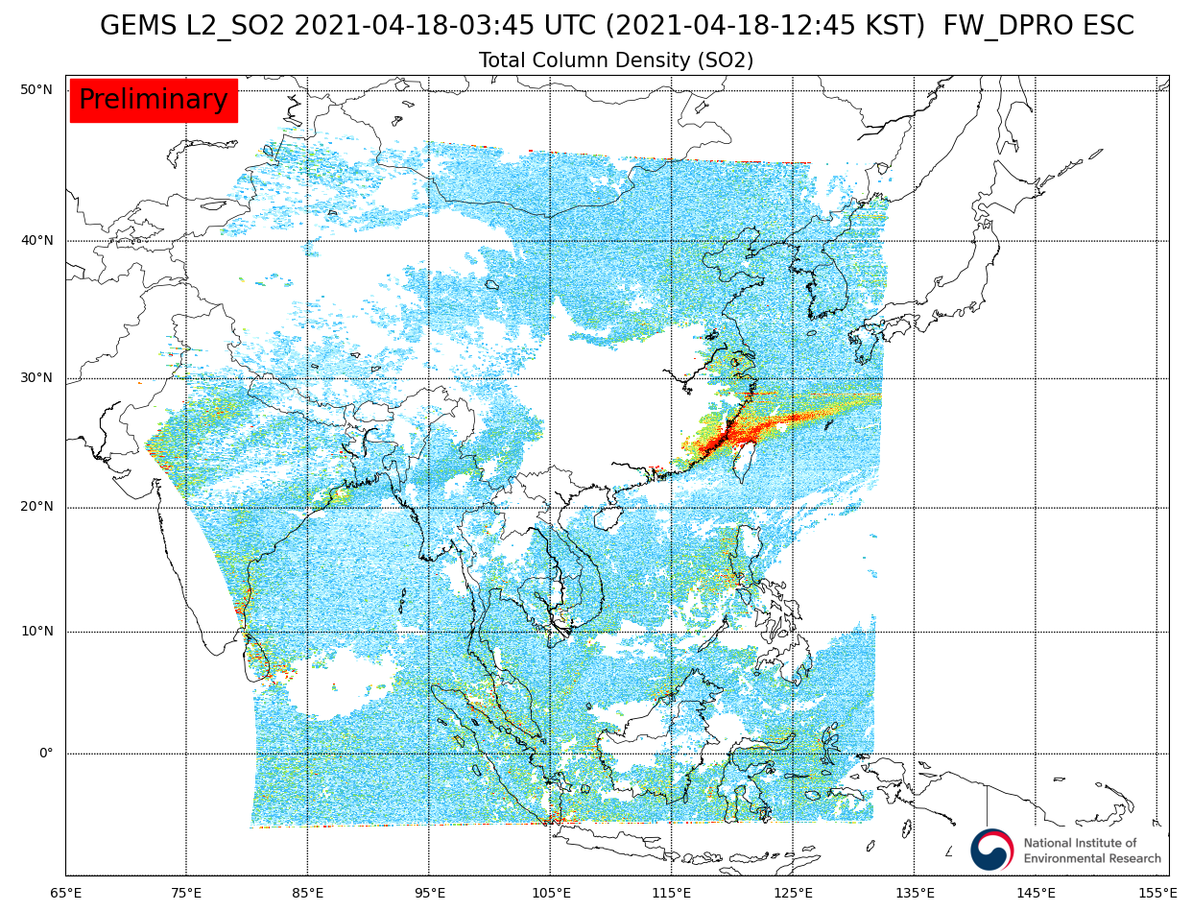
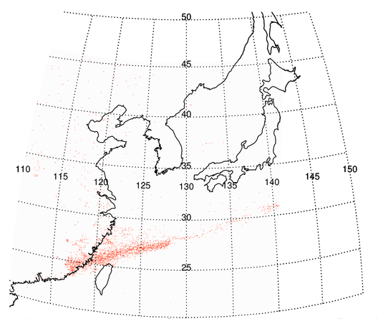
3
Application of GEMS LRT-SO₂
Volcanic Eruption (Northeast Asia)
Mt. Etna, Italy (`21.3)
Mt. Soufrière, St. Vincent & Grenadines (`21.4)
SO₂ gases from MT. Etna were transported to the Korean peninsula (2.22, 3.1-4 9-11, 14, 22)
SO₂ gas released in volcanic eruption (4.9), was transported from the Caribbean to the East-China Sea (4.19)
9 MAR
14 MAR
16 APR
17 APR
LRT Detection (14 MAR)
LRT Detection (18 APR)
22 MAR
18 APR
8

Slide 9
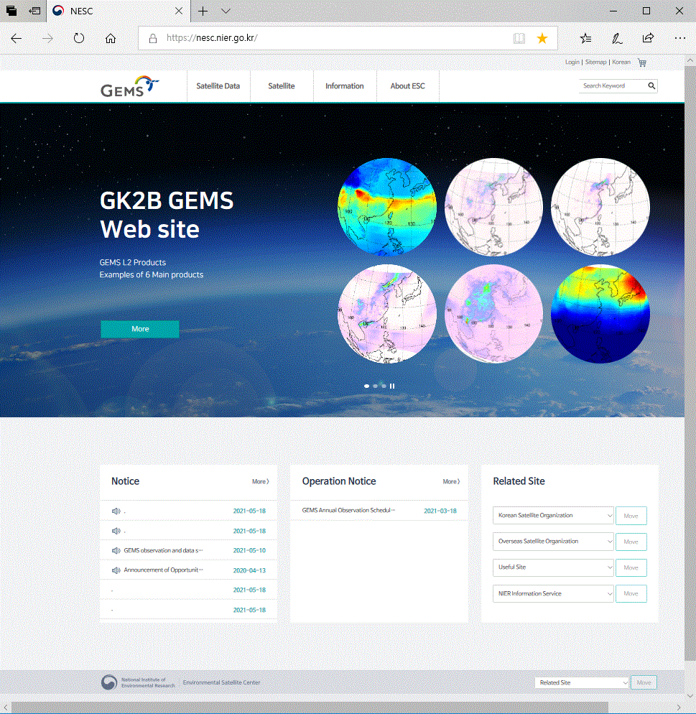
3
Application of GEMS LRT-SO₂
Volcanic Eruption Report
Receiving Info. From KMA
Monitoring SO₂ gases from GEMS
If high-level SO₂ conc. detected, provide GEMS L2 SO₂ image (1st)
LRT SO₂ monitoring & analysis
GEMS L2 SO₂ Image + LRT-SO2 products + Other Env. Satellite data
Volcanic Eruption Report (2nd)
http://nesc.nier.go.kr
9

Slide 10
Guiana Space Center
Thank you for your attention !

