Slide 1
17th CEOS AC-VC, 08 June 2021
Air Quality Observations from GEMS
- GEMS L2 images and data distribution
Jongmin Yoon
Environmental Satellite Center (ESC)
NIER, Republic of KOREA

Slide 2
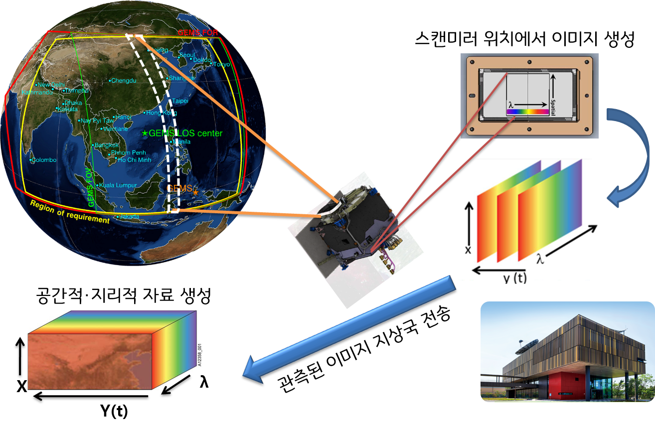
1
Overview
Targeted gases | O₃, SO₂, NO₂, HCHO, CHOCHO, and aerosol, etc.
Lifetime | 10 Years
Spatial coverage | 5,000 km × 5,000 km (5 °S – 45 °N, 75 °E – 145 °E)
Spatial resolution | 7 km × 8 km @Seoul
Revisit time | 8 times / day
Spectral range / FWHM | 300 – 500 nm / 0.6 nm
Orbit / Altitude / Longitude | Geostationary earth orbit (GEO) / 35,786 km / 128 °E
Create Image on CCD
Spatial, geographic data
Observed data Transfer
to ground station
Timeline of ESC activities
NIER IOT
`20.2.19
Launch GK-2B
`20.4
GEMS Activation
`20.7
`20.10
`21.3.22
Start Web Service
(only image, 8 products)
`20.3
Reached Geostationary Orbit
IOT of ground station
and L1/L2 algorithms
`20.11.18
First release
GEMS image
`20.5~10
Instrument IOT(KARI)
2

Slide 3
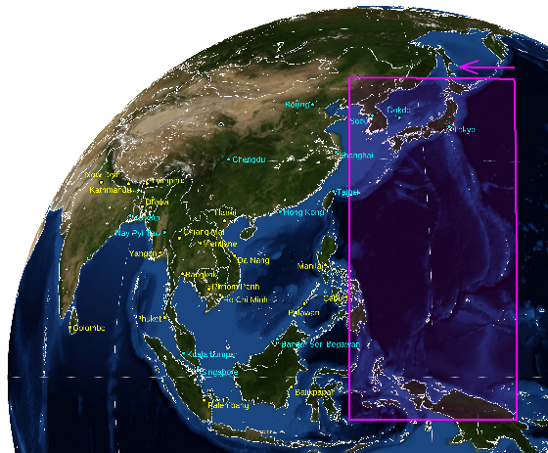
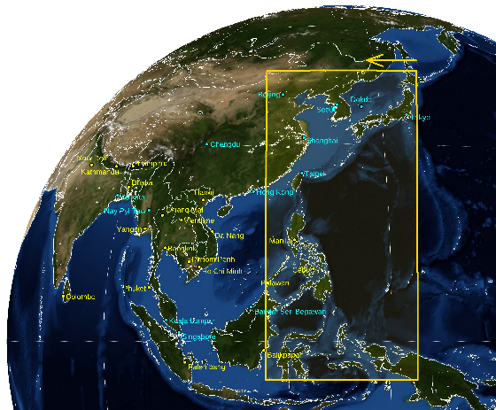
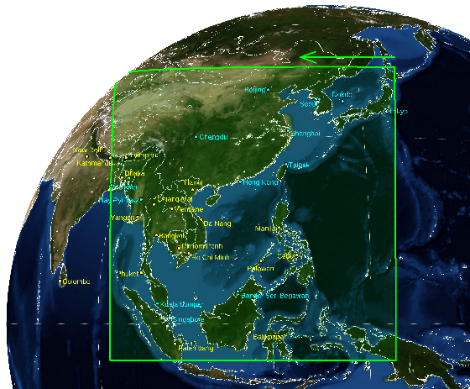
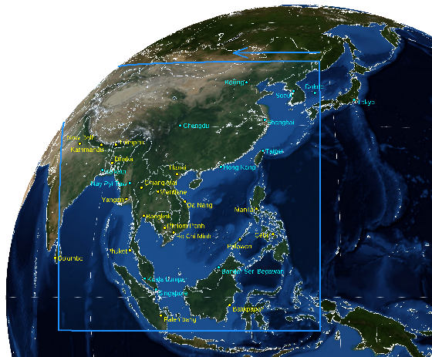
2
GEMS observation plan
GEMS monthly scan coverage (2021)
Half East(HE) | Half Korea(HK)
Full Central(FC) | Full West(FW)
month | 07:45 | 08:45 | 09:45 | 10:45 | 11:45 | 12:45 | 13:45 | 14:45 | 15:45 | 16:45
1 | - | - | HE | HK | FC | FW | FW | FW | - | -
2 | - | - | HE | HK | FC | FW | FW | FW | FW | -
3 | - | HE | HK | FC | FC | FW | FW | FW | FW | -
4 | HE | HK | FC | FC | FC | FW | FW | FW | FW | FW
5 | HE | HK | FC | FC | FW | FW | FW | FW | FW | FW
6 | HE | HK | FC | FC | FW | FW | FW | FW | FW | FW
7 | HE | HK | FC | FC | FW | FW | FW | FW | FW | FW
8 | HE | HK | FC | FC | FW | FW | FW | FW | FW | FW
9 | HE | HK | FC | FC | FW | FW | FW | FW | FW | FW
10 | - | HE | HK | FC | FC | FW | FW | FW | FW | -
11 | - | - | HE | HK | FC | FW | FW | FW | - | -
12 | - | - | HE | HK | FC | FW | FW | FW | - | -
※ Background map credit: NASA Earth observatory(https://neo.sci.nasa.gov)
3

Slide 4
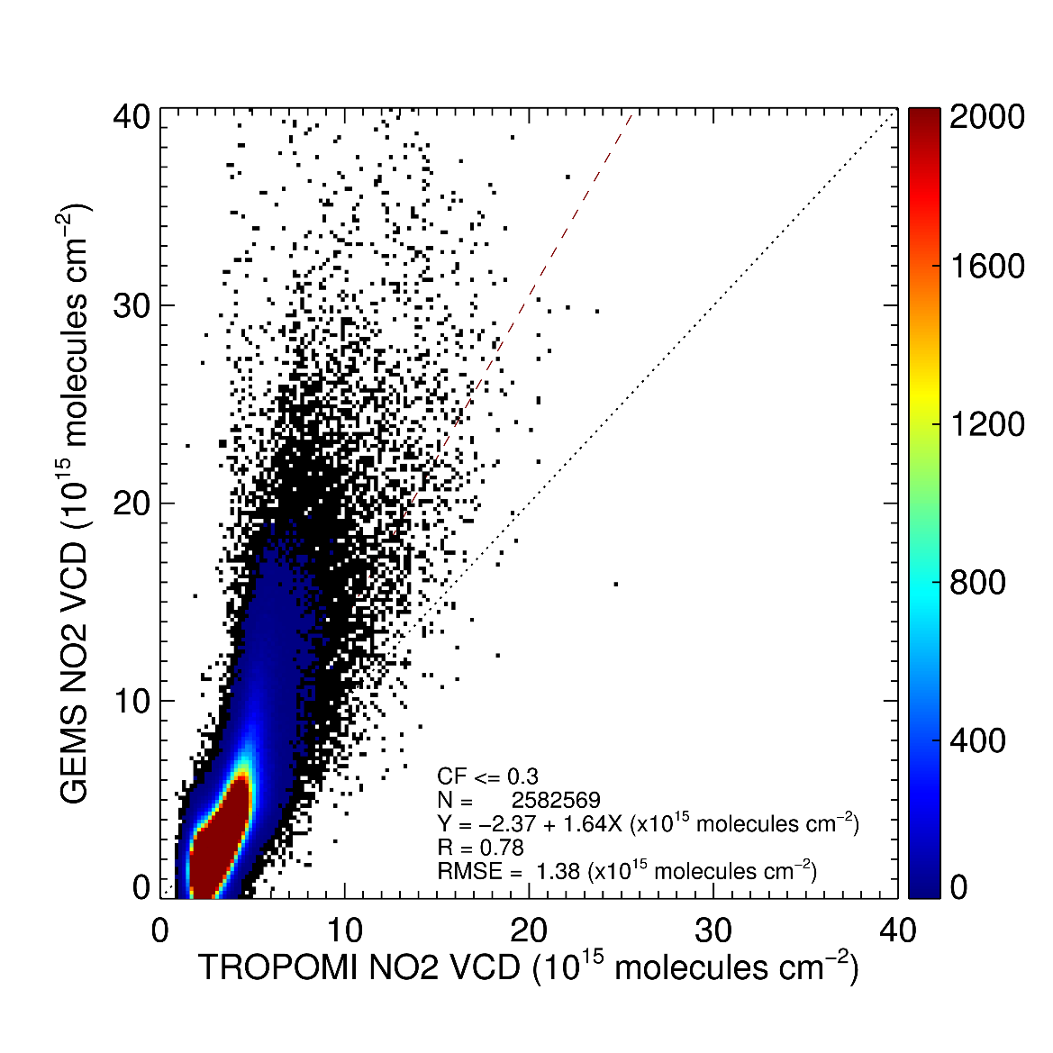
3
GEMS NO₂
GEMS VCD NO₂ (2020.9.9 10:45~14:15 KST)
Comparison with TROPOMI(`20.8.1~10.31)
※ Background map credit: Natural Earth(https://www.naturalearthdata.com)
4

Slide 5
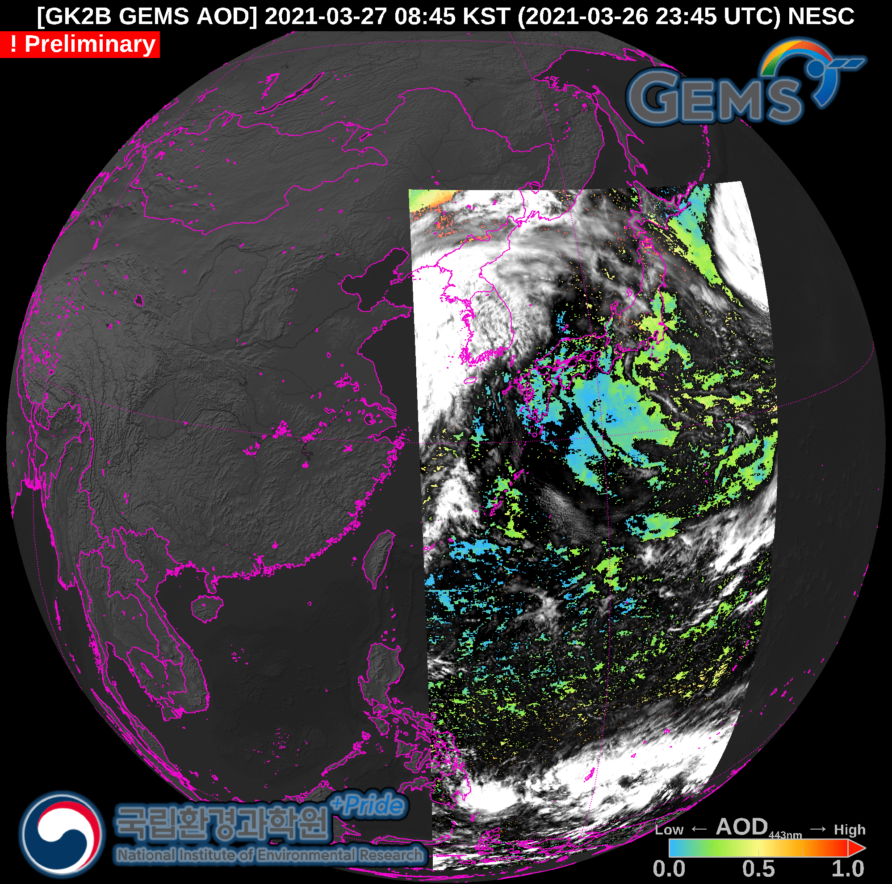
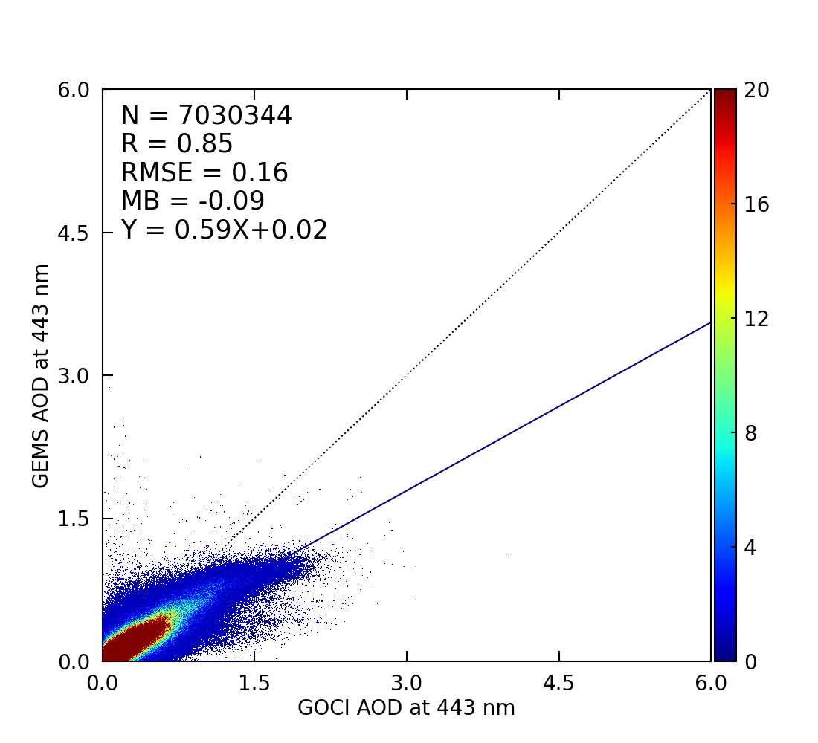
4
GEMS AOD
Comparison with GOCI(`20,12~`21.2)
5

Slide 6
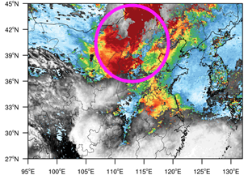
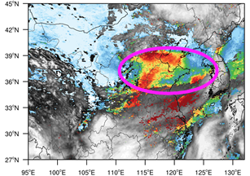
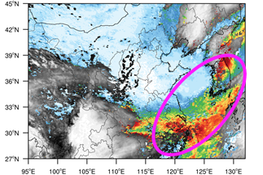
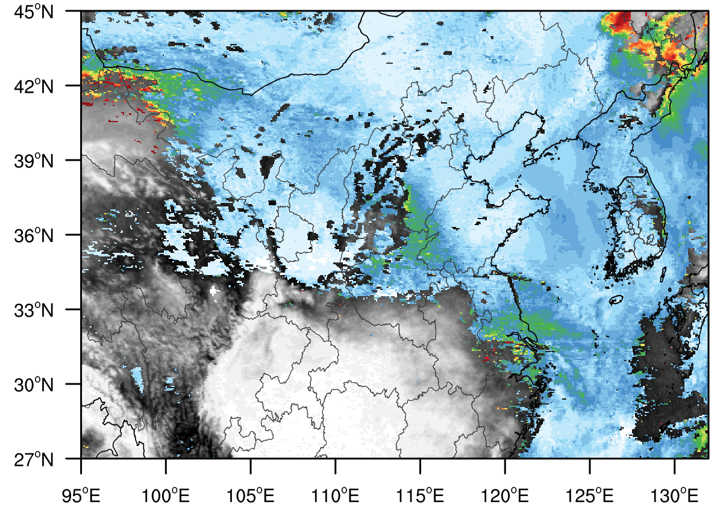
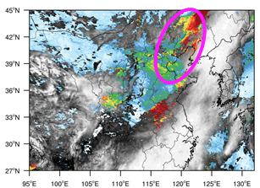
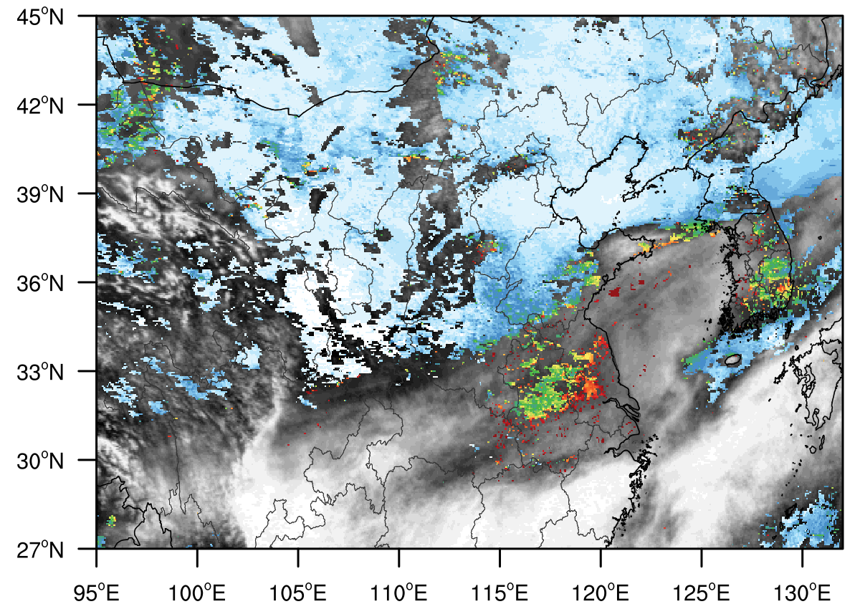
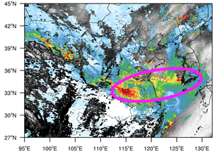
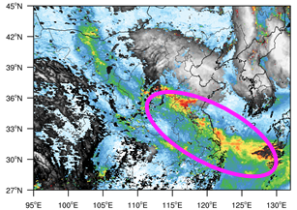
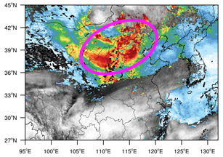
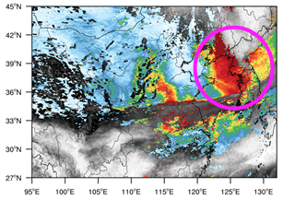
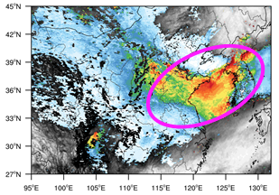
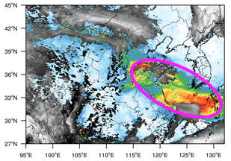
5
2021 Yellow dust events observed by GEMS
April 15
April 16
April 17
April 18
April 27
April 28
April 29
April 30
May 6
May 7
May 8
May 9
6

Slide 7
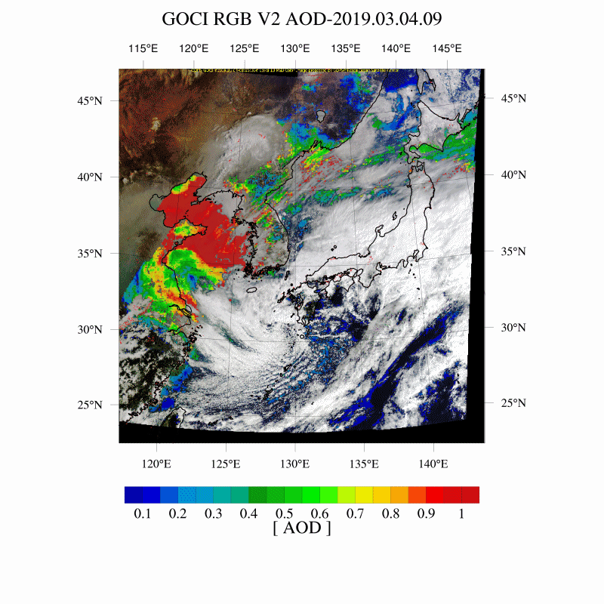
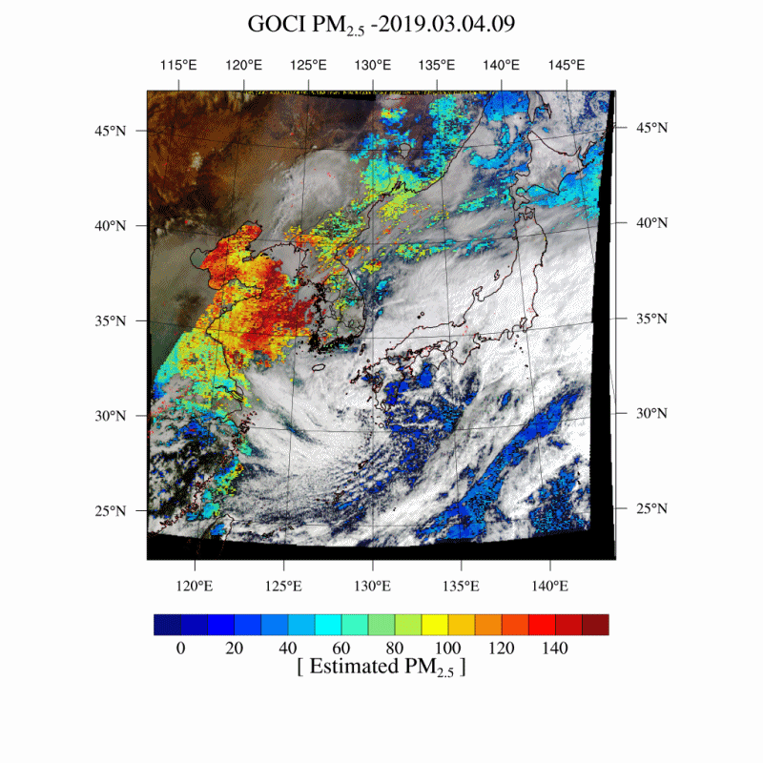
6
AI-based PM2.5 estimation from GEMS AOD
AOD
PM2.5
7

Slide 8
7
Release plan of GEMS image
No. | Products |  | Unit | Release date
1 | Aerosol | AOD | - | Mar. `21
2 |  | Single Scatter Albedo | - | Oct. `21
3 |  | Aerosol Index | - | Oct. `21
4 |  | Aerosol Effective Height | km | `22
5 | O3 | Total Ozone | DU | Mar. `21
6 |  | Stratospheric Ozone | DU | `22
7 |  | Tropospheric Ozone | DU | `22
8 | Surface reflectance | Surface Reflectance | - | `22
9 | Cloud | Cloud Centroid Pressure | hPa | Oct. `21
10 |  | Effective Cloud Fraction | - | Mar. `21
11 |  | Cloud Radiance Fraction | - | Oct. `21
8

Slide 9
7
Release plan of GEMS image
No. | Products |  | Unit | Release date
12 | VOCs | HCHO | molec/cm2 | `22
13 |  | CHOCHO | molec/cm2 | `22
14 | NO2 | Tropospheric NO2 | molec/cm2 | `22
15 |  | Total NO2 | molec/cm2 | Mar. `21
16 | SO2 | SO2 | molec/cm2 | Mar. `21
17 | UV | UV index | - | Oct. `21
18 |  | Plant response rate | - | Mar. `21
19 |  | DNA damage rate | - | Mar. `21
20 |  | Vitamin D production rate | - | Mar. `21
9

Slide 10
Guiana Space Center
Thank you and please stay for
the next GEMS presentation!

