Slide 1
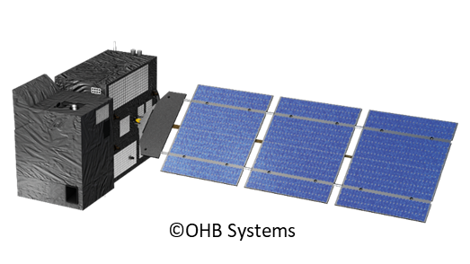
COPERNICUS CO2M MISSION
Yasjka Meijer (ESA CO2M Mission Scientist)
Ruediger Lang (EUMETSAT CO2 Project Scientist)
ESA and EUMETSAT science and project teams
CO2M Mission Advisory Group
European Commission / Copernicus

Slide 2
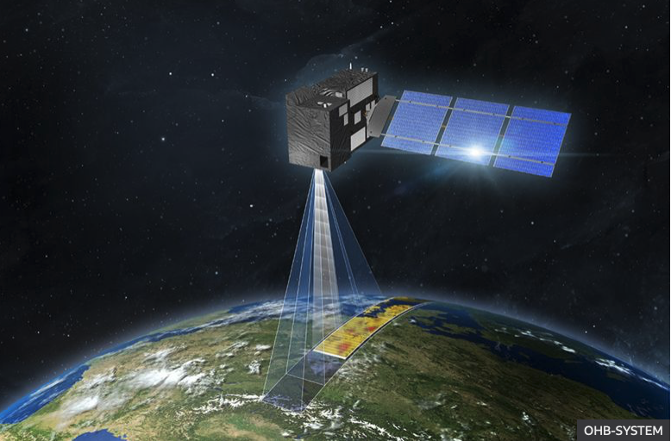
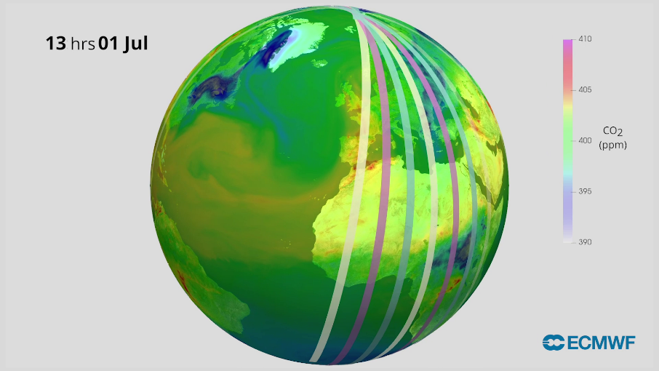
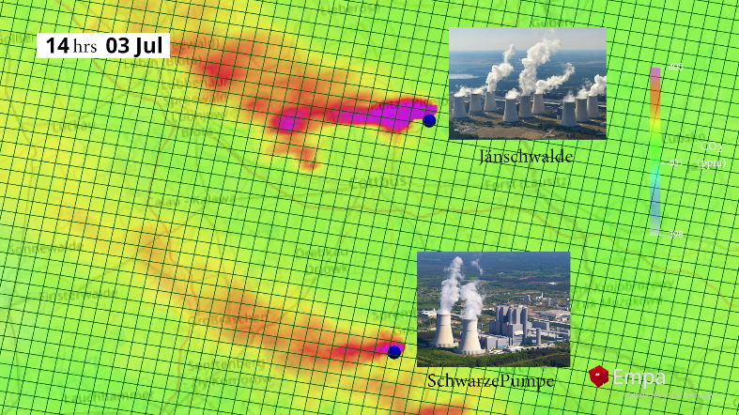
Copernicus CO2M mission – CO2M project status
CO2M Project Phase B2/C/D/E1
Kick-off of mission implementation phase: July 2020
Space Segment Requirement Review: passed 29-03-2021
System Requirement Review on-going
Programmatic decision point September 2021
Payload PDR end of 2021
Satellite PDR early 2022
Constellation of three satellites with each >250 km swath:
FAR of Protoflight Model (PFM) & Flight Model #2 October 2025
Flight Model #3 (FM3) and launch services depend on EC funding
If approved, FAR of FM3 at earliest 6 months after PFM

Slide 3
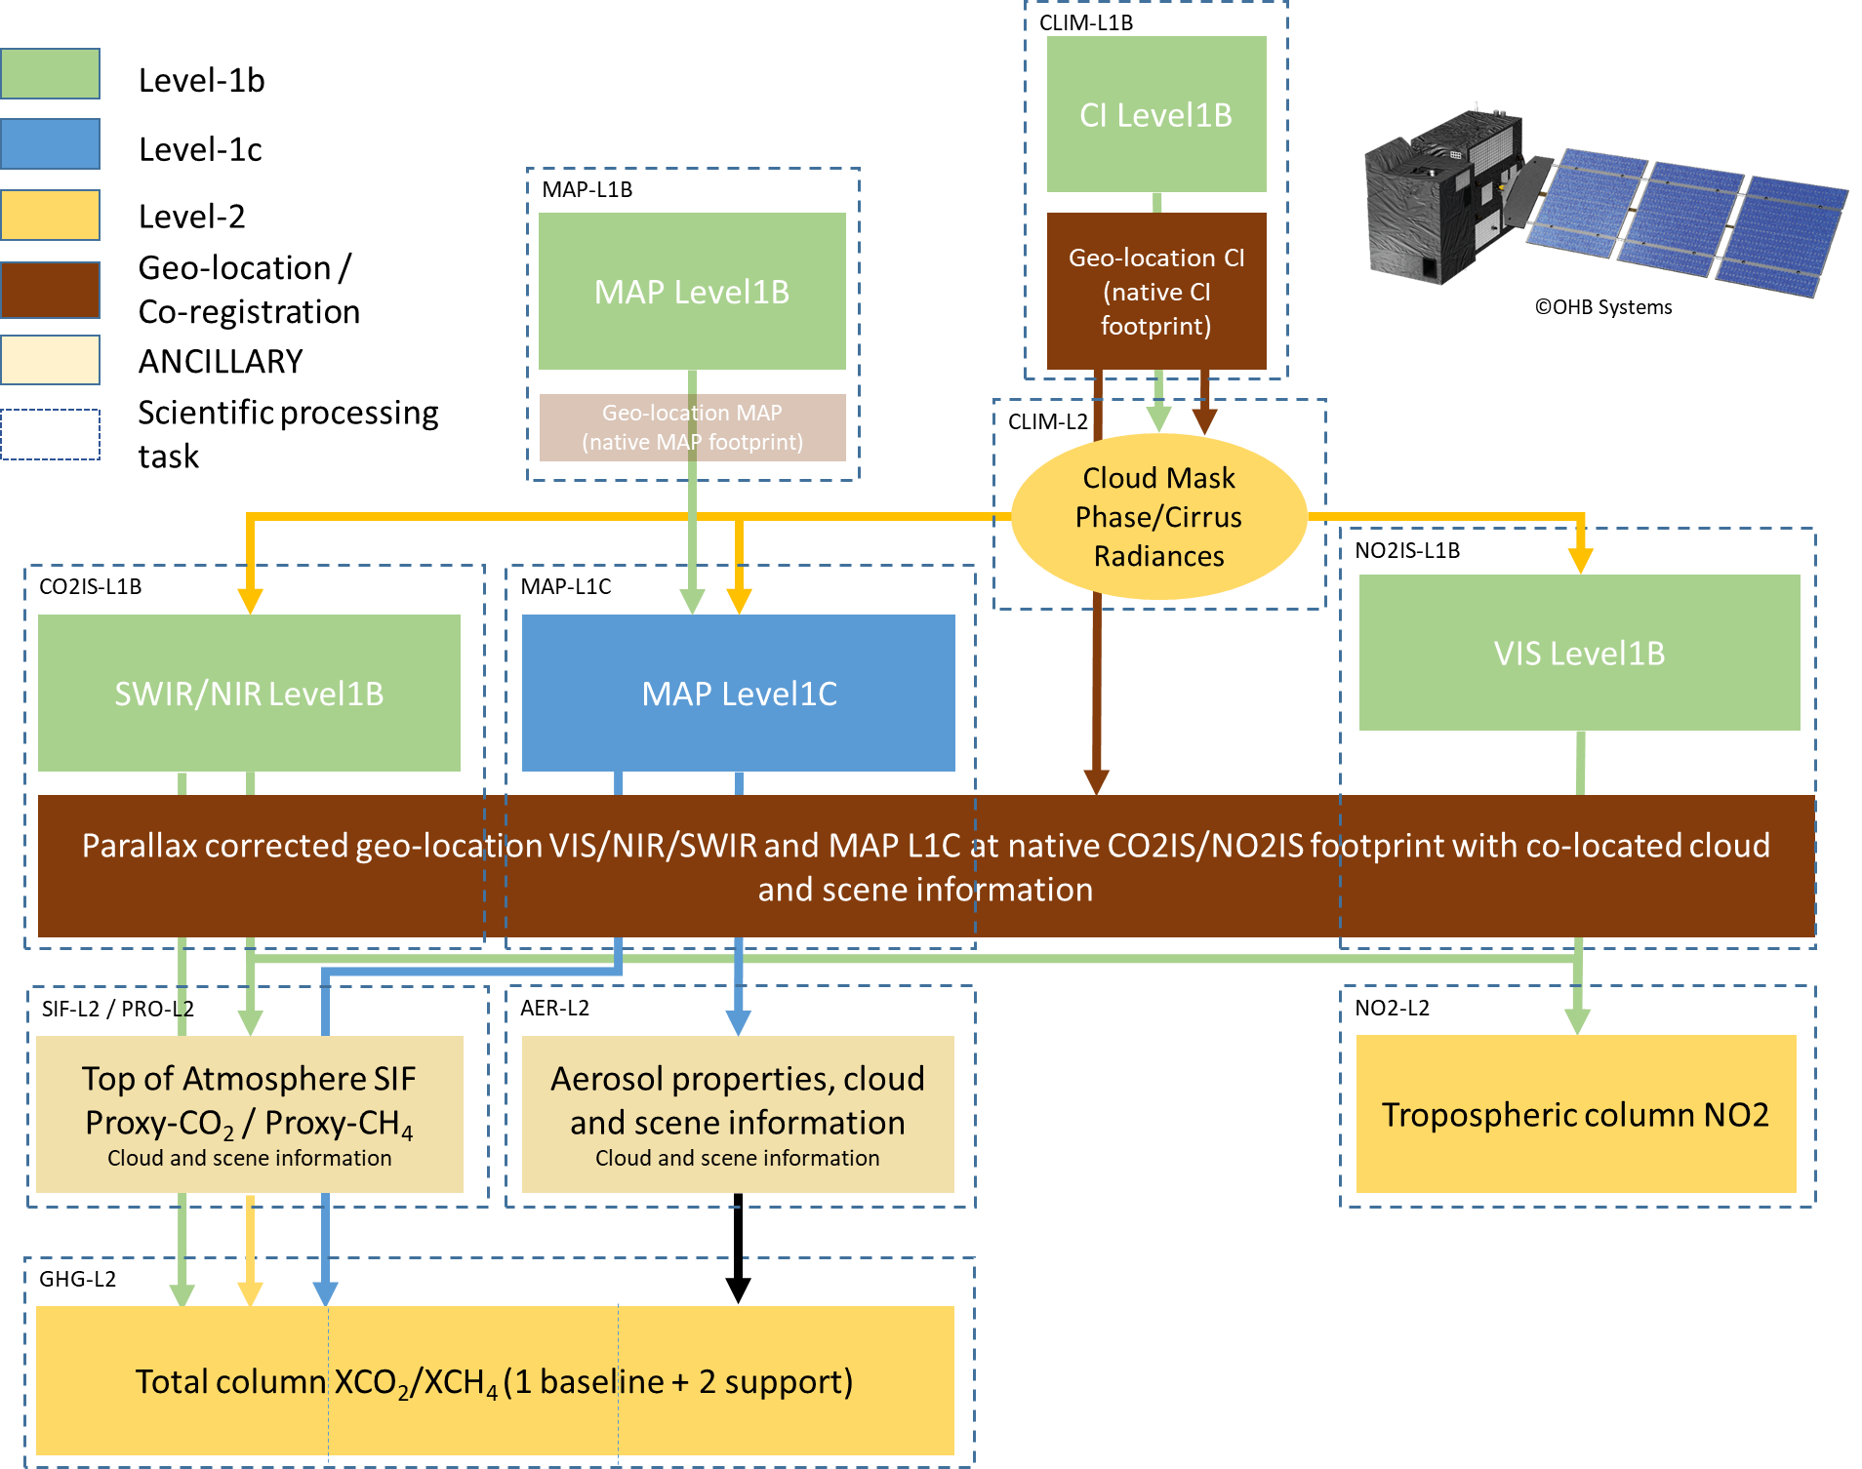
Copernicus CO2M mission – processing and products
CO2M Product Processing and Interdependencies:
CO2M Products requirements:
Product | Spatial resolution | Precision
CO2 | 4 km² | 0.7 ppm
CH4 | 4 km² | 10 ppb (est.)
NO2 | 4 km² | 1.5x10¹⁵ molec/cm²
SIF* | 4 km² | 0.7 mW m⁻² sr⁻¹ nm⁻¹
Aerosols | 16 km² | 0.05 AOD, 500 m LH
Clouds | <5% of FOV | Water & cirrus clouds
VIS band also covers CHOCHO (glyoxal)
VIS & SWIR band also covers water vapour
*Top-of-Atmosphere Solar Induced Fluorescence
Estimated amount of data (per orbit, per satellite):
Number of measurements: ~1.1 million
Number of clear sky retrievals: ~200.000
Level-1 product size: ~20 Gb
Level-2 product size: ~5 Gb
Functional processing flow in
EUMETSAT CO2M Payload Data Processing (PDP)

Slide 4
BACKUP INFO

Slide 5
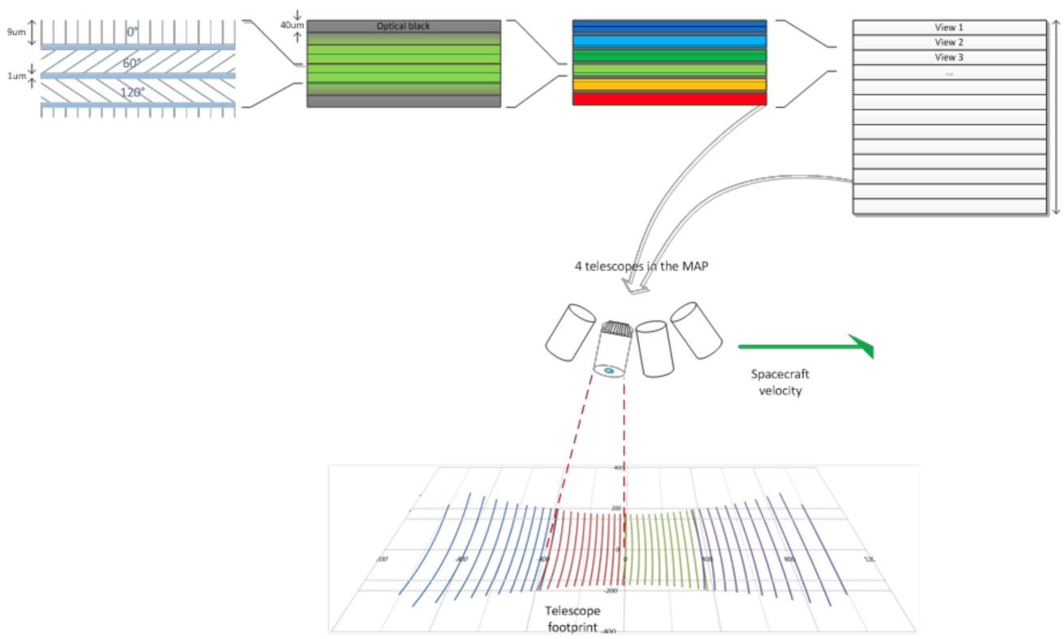
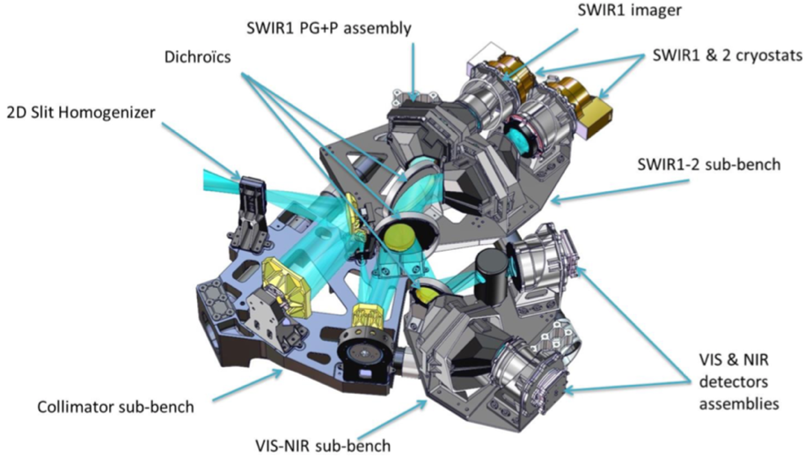
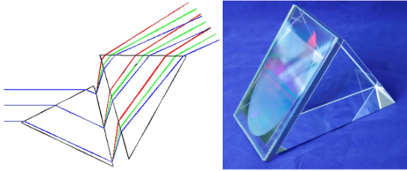
Copernicus CO2M mission – mission concept
Aerosol Multi-Angle
Polarimeter, TAS-UK
6 Bands & pol at 0º, 60º, 120º
1 Band for co-registration
12 views per camera, 4 cameras
CO₂ (CH₄) & NO₂ imaging spectrometer
TAS-F
Swath >250 km
Credit ©: TAS-UK
Credit ©: TAS-F
Cloud Imager based on Proba-V
OIP Belgium
Bands & Sampling (ALTxACT)
Band 670 nm 87mx87m
Band 753 nm 87mx87m
Band 1378 nm 376mx163m
Binning on-ground, specs @400m
Telescope | Common telescope with polarisation scrambler and 2D entrance slit homogeniser
Collimator | One reflective collimator, common for all bands
Band separation | Dichroic split of 1st VIS-NIR & SWIR, then VIS & NIR and SWIR-1 & SWIR-2
Dispersers | Prism-Grating-Prism with bonded binary structure transmission grating (!risk!)
Detectors | NGP in SWIR (!risk!) & Te2v CIS-120 in VIS & NIR

