Slide 1
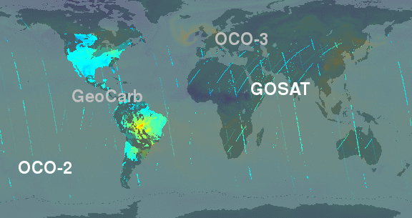
Challenges in integrating data from a growing GHG constellation Lesley Ott¹, Sean Crowell², Brad Weir^{1,3} ¹NASA GSFC, ²University of Oklahoma, ³USRA
More datasets, more challenges – longer multi-satellite record, growing constellation of satellites are good... but they present technical challenges.
Need for development of multi-instrument retrieval algorithms to minimize differences across datasets, coordinated OSSEs that focus more on the optimal combination of multiple datasets
Illustration of expected GHG coverage
Example of inversions using GeoCarb only or combination of OCO+GeoCarb to infer flux change over NA.
See S. Crowell at IWGGMS-17 for more

Slide 2
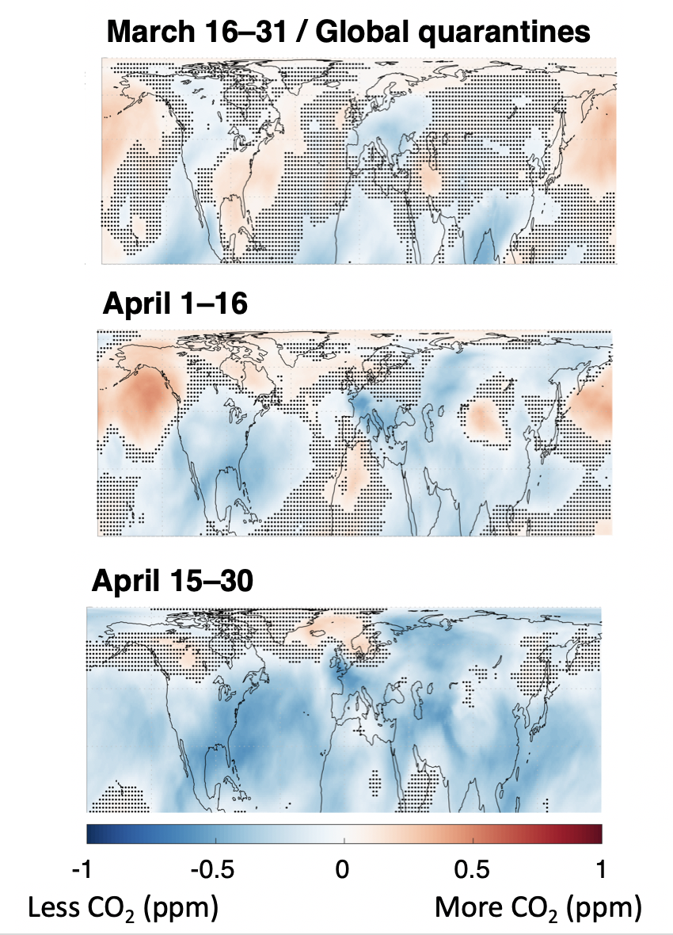
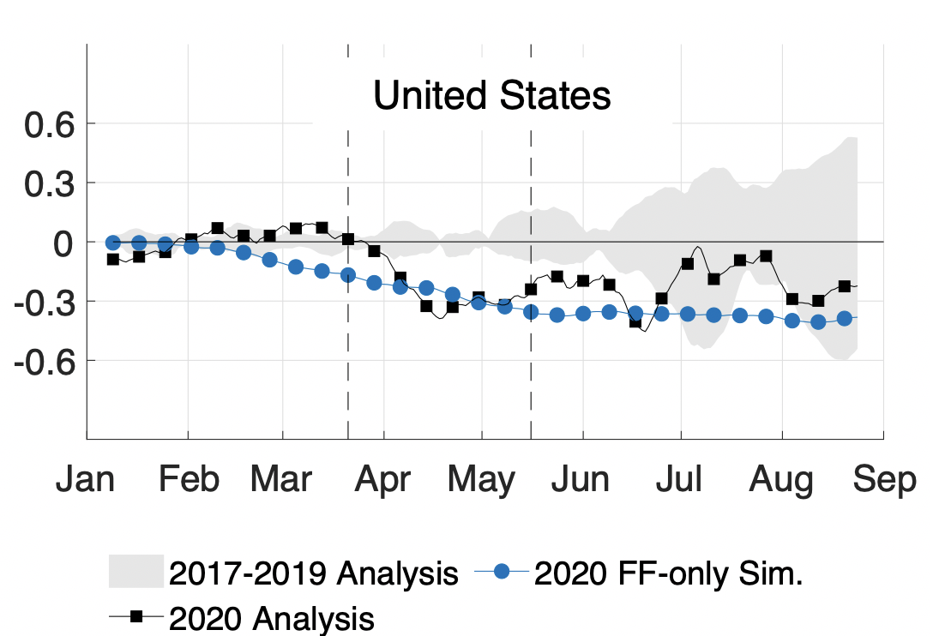
Challenges in integrating data from a growing GHG constellation (continued)
Example: COVID-19 Emissions Decreases detected in OCO L3 Data
Satellite data can contribute to monitoring, reporting, and verification in multiple ways – inversions are an important application but come with limitations in spatial scale, latency, dependence on a priori information, and substantial impacts of transport errors
Consider alternate approaches for evaluating consistency of reported emissions with atmospheric observations (see example of COVID-19 emissions decreases)
More robust quantification of transport uncertainty including coordination across modeling centers
Weir et al., 2020, in review

