Slide 1
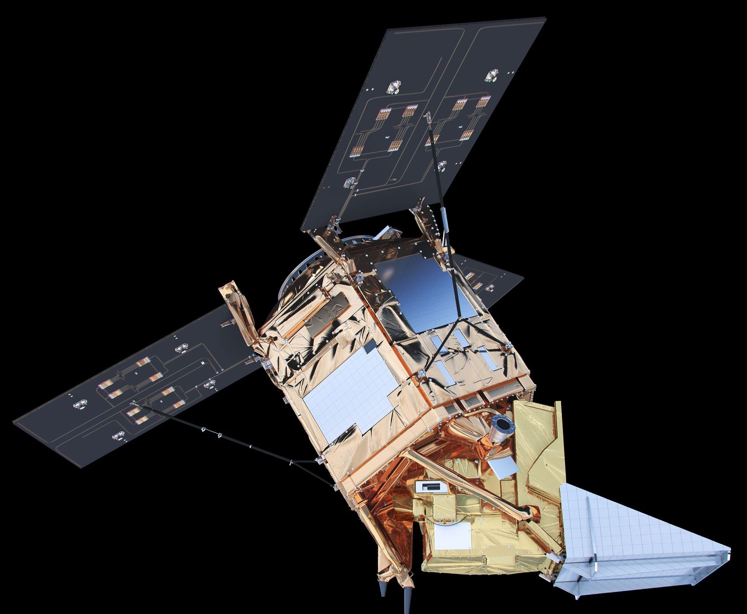
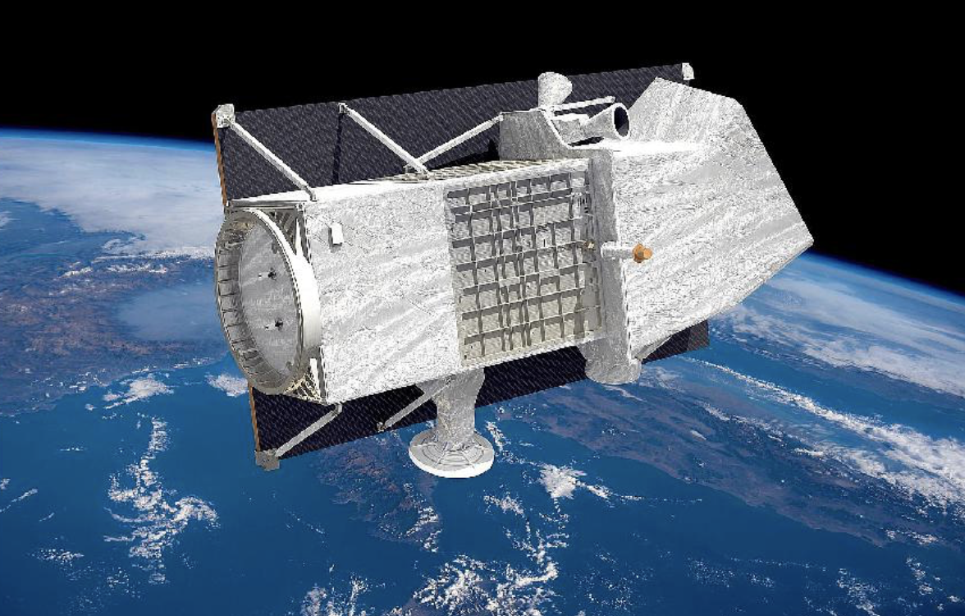
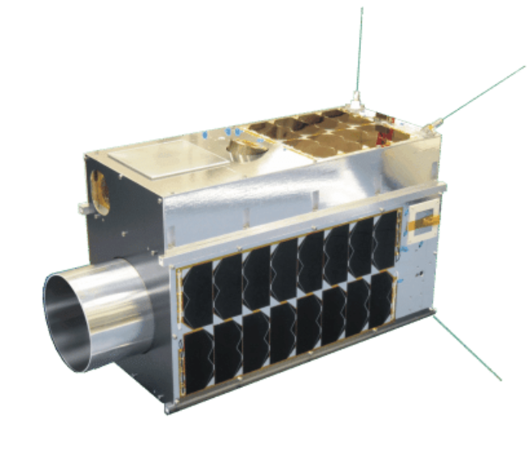
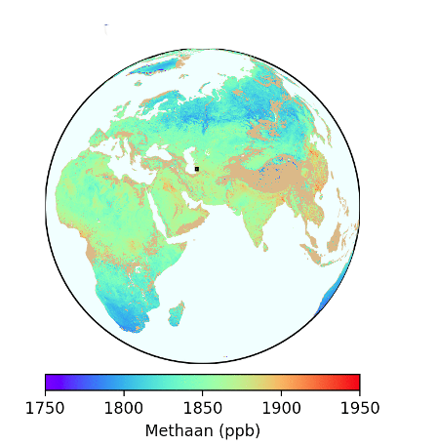
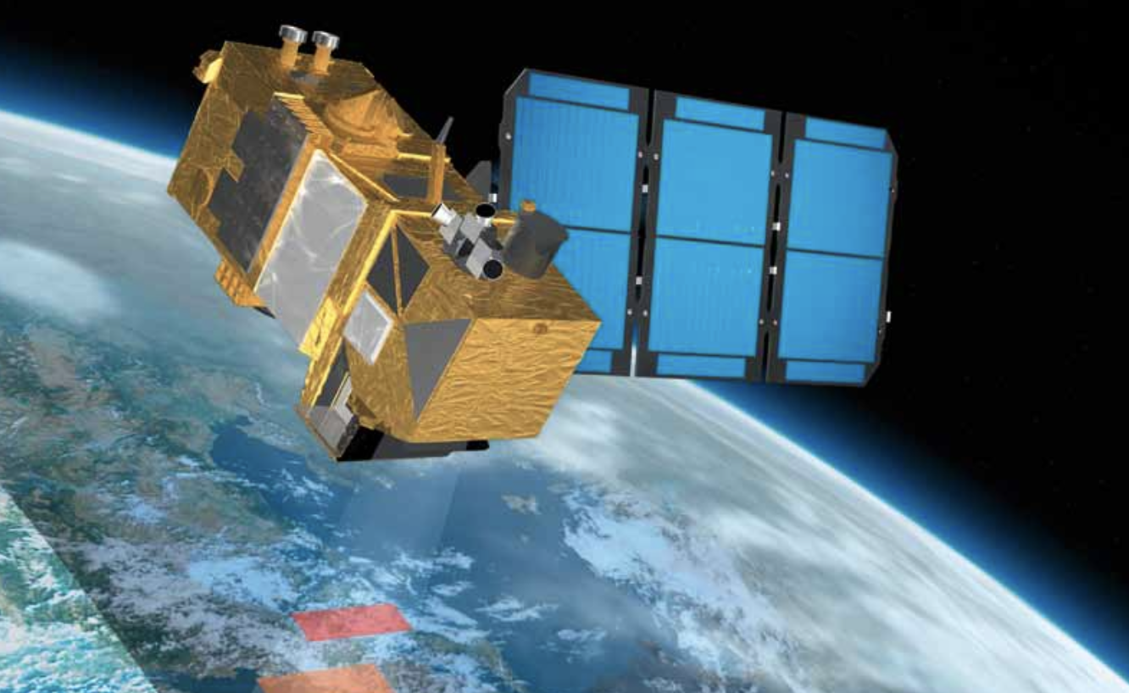
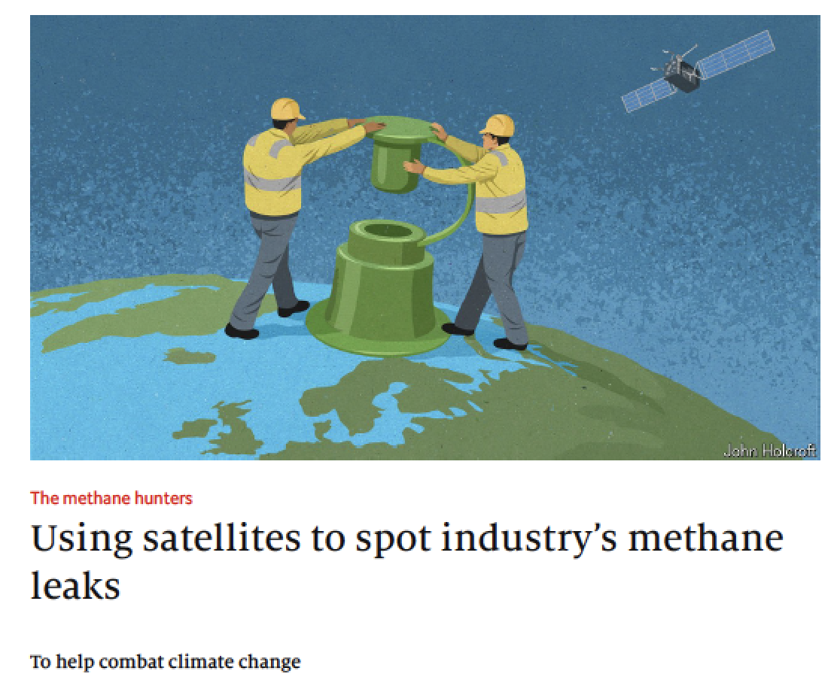
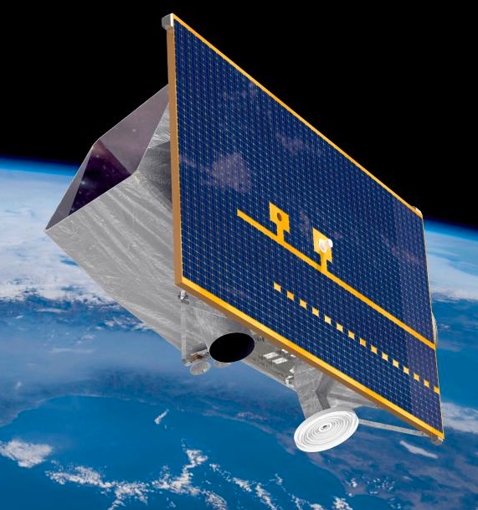
Combine TROPOMI methane with high spatial resolution instruments to detect & pinpoint super emitters globally :
GHGSat- Claire
GHGSat-Iris
PRISMA
SENTINEL-2
GHGSat-Hugo
GF5, ZY1, …
Maasakkers, Pandey, Aben et al.

Slide 2
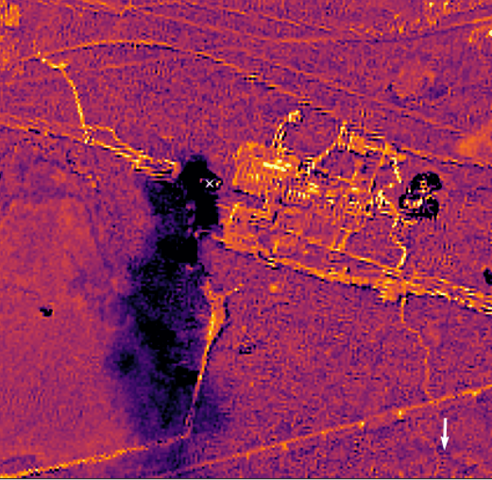
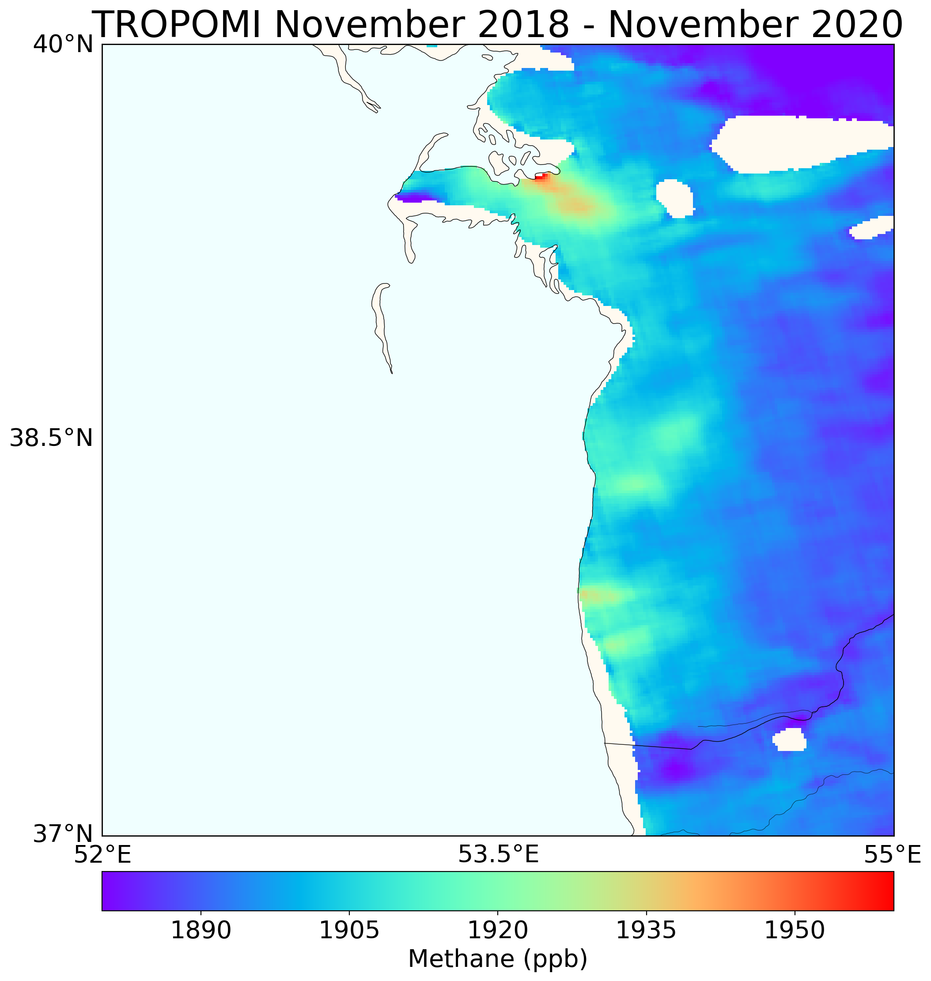
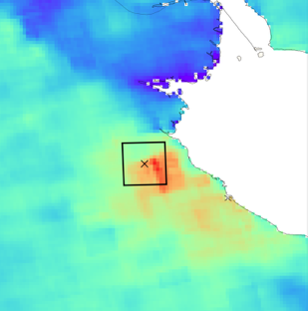
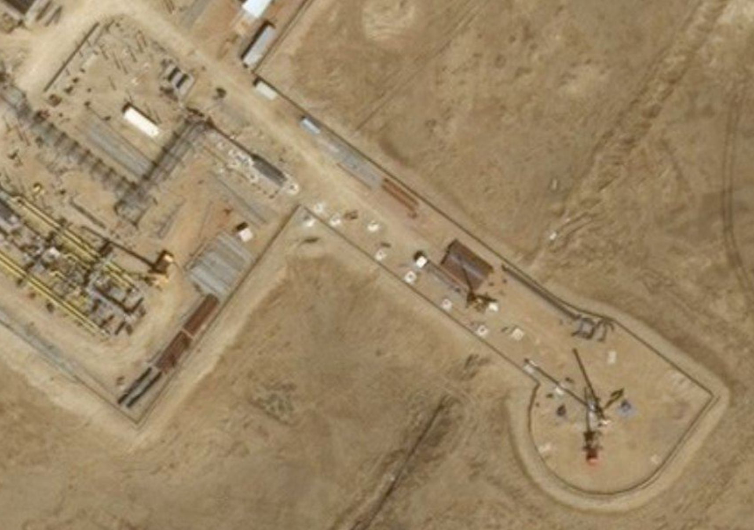
TROPOMI automated detection CH₄ super emitters ‘tip & cue’ high spatial resol. instrum. --> facility scale
Pandey / Sutar
Maasakkers, Schuit, et al, in prep.
SENTINEL-2
PRISMA
TROPOMI
SENTINEL-2
TROPOMI
Irakulis et al.
Maasakkers et al.

