Slide 1
Converting science into user-driven services
Richard Engelen & Jérôme Barré
ECMWF

Slide 2
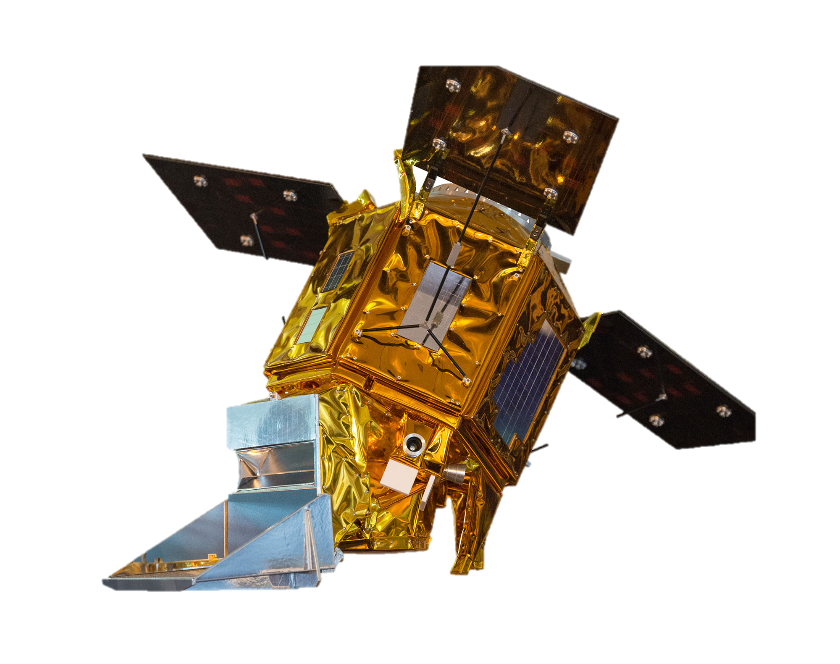
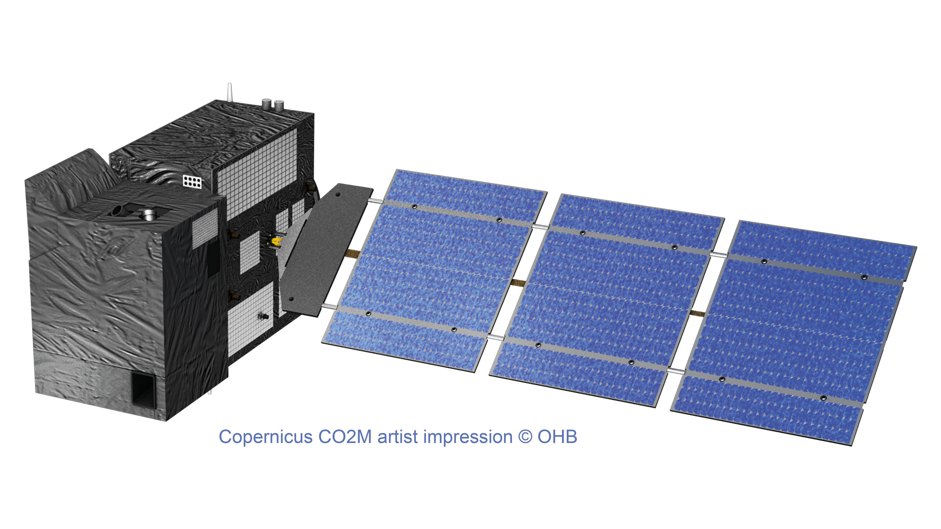

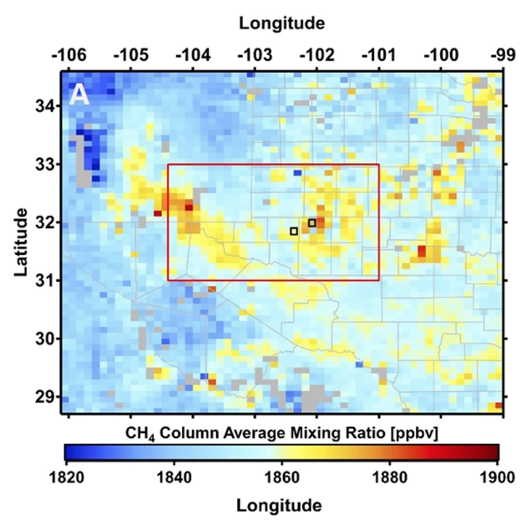
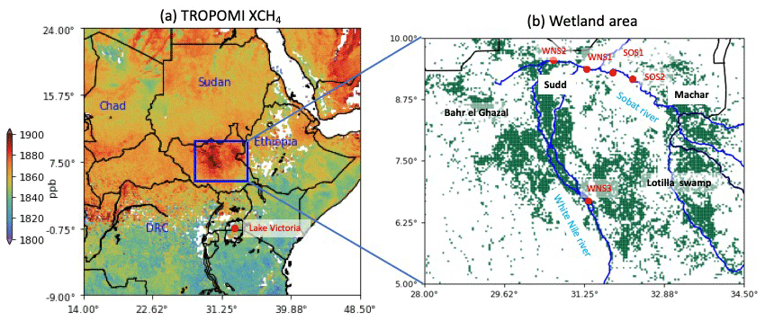
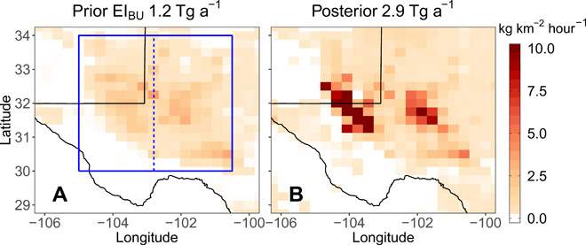
Monitoring CH4 by satellite – from Tropomi to CO2M
Various science studies in the last few years have shown very promising results. The Copernicus programme aims to consolidate these results into user-drive operational services.
Zhang et al., 2020
Pandey et al., 2021
De Gouw et al., 2020

Slide 3
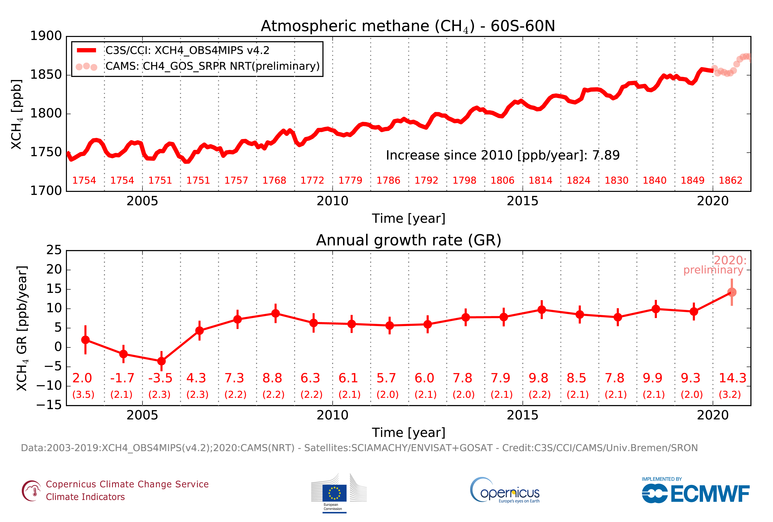
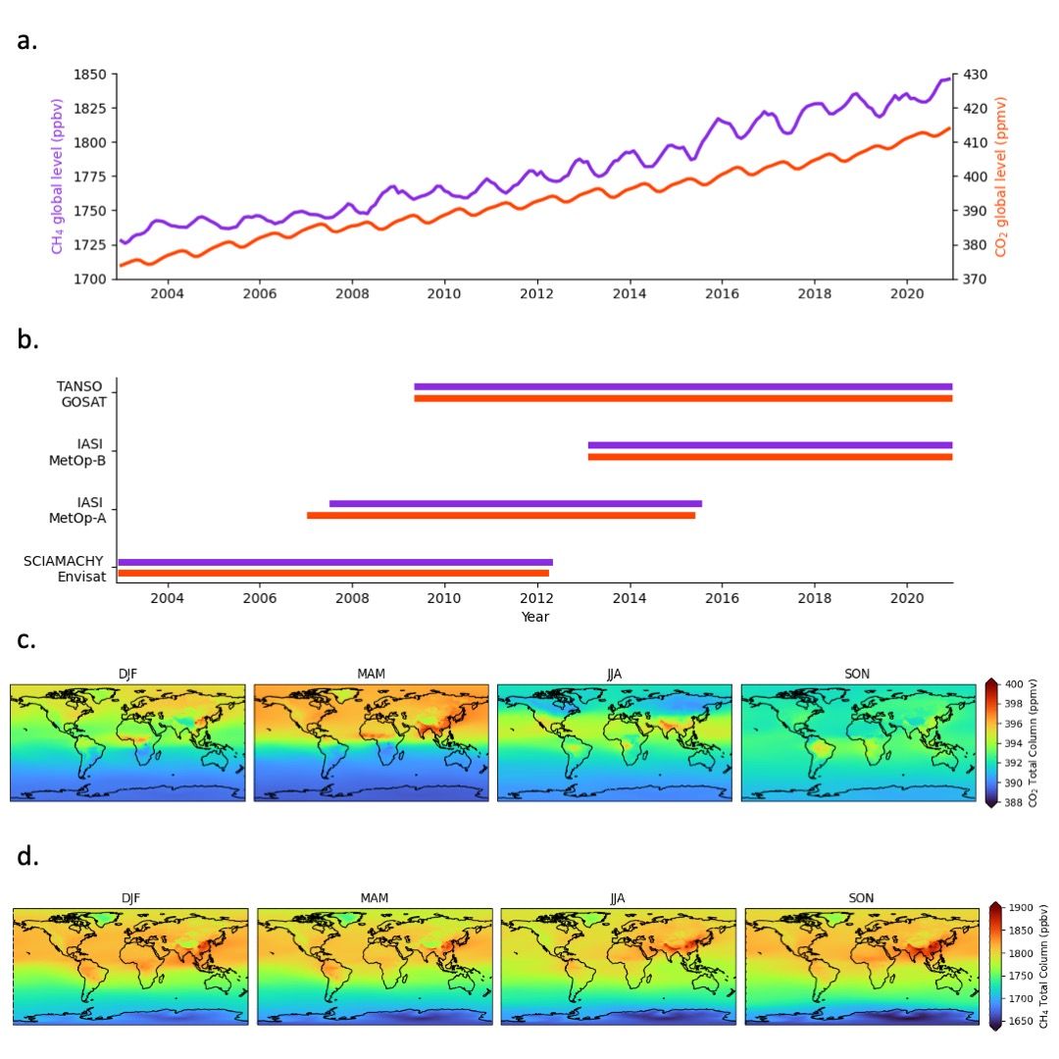
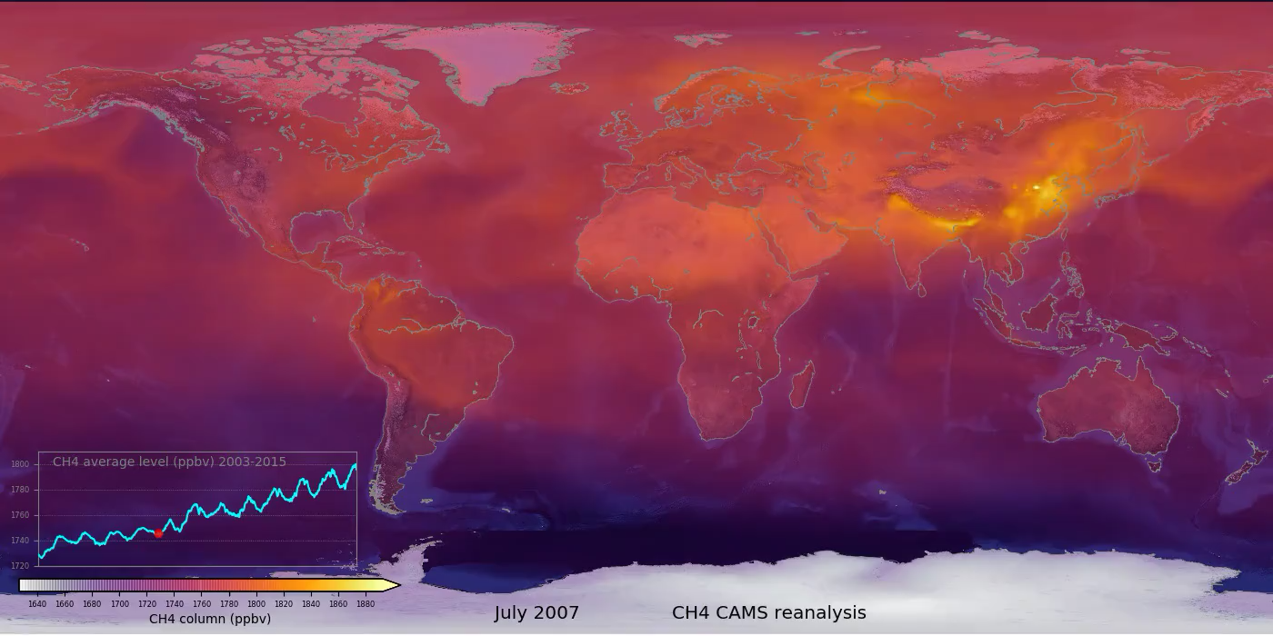
Satellite monitoring of atmospheric CH₄ - ECVs and reanalysis
CH₄
CO₂
CAMS global reanalysis
ECV data sets, often developed in ESA CCI, are consolidated in Copernicus Climate Change Service (C3S).
The Copernicus Atmosphere Monitoring Service (CAMS) uses these in atmospheric reanalyses to generate full 3D-fields of CH₄ (and other species) for the last couple of decades.

Slide 4
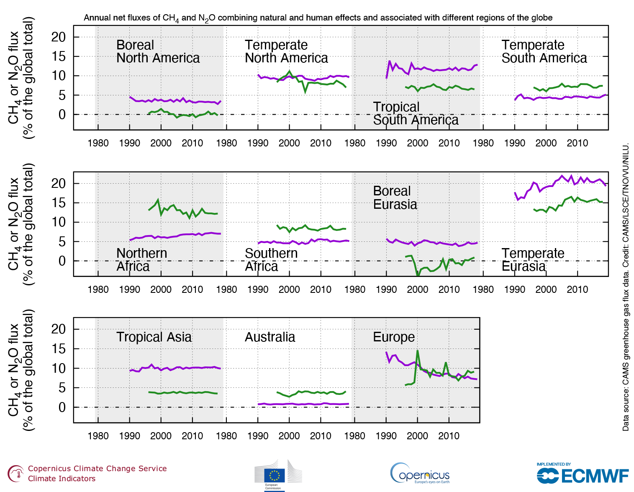
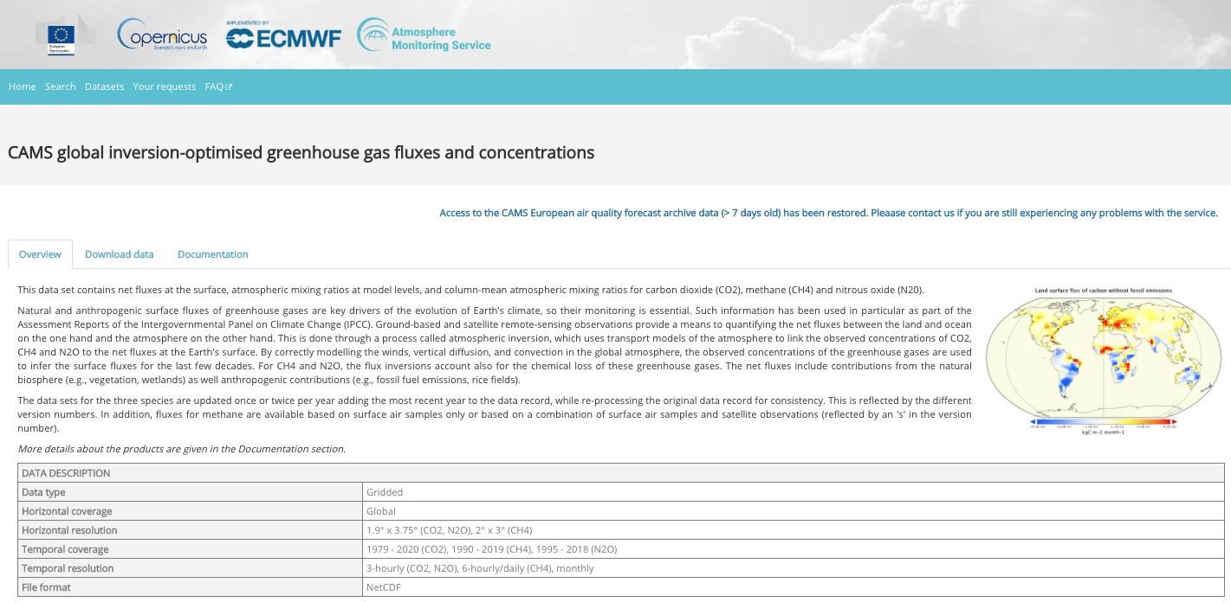
Satellite monitoring of CH₄ fluxes - atmospheric inversions
CH₄
N₂O
Access to data, documentation, and EQC through the Atmosphere Data Store
Copernicus European State of the Climate

Slide 5
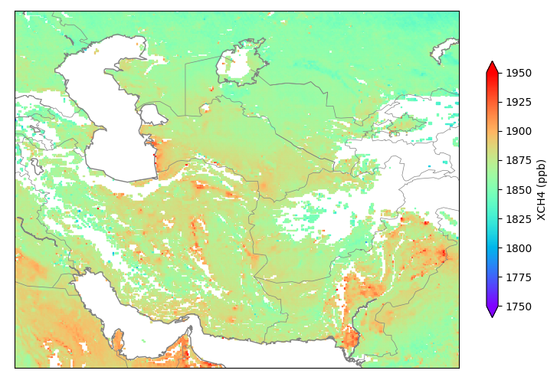
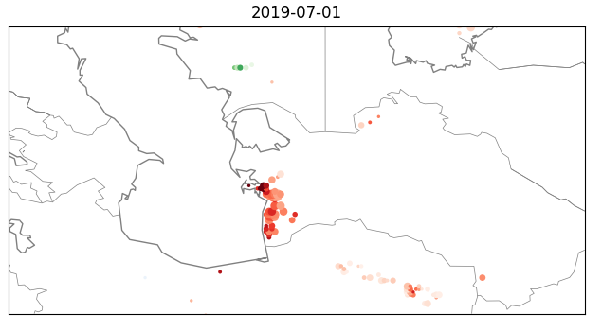
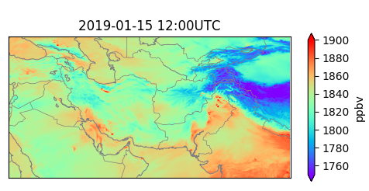
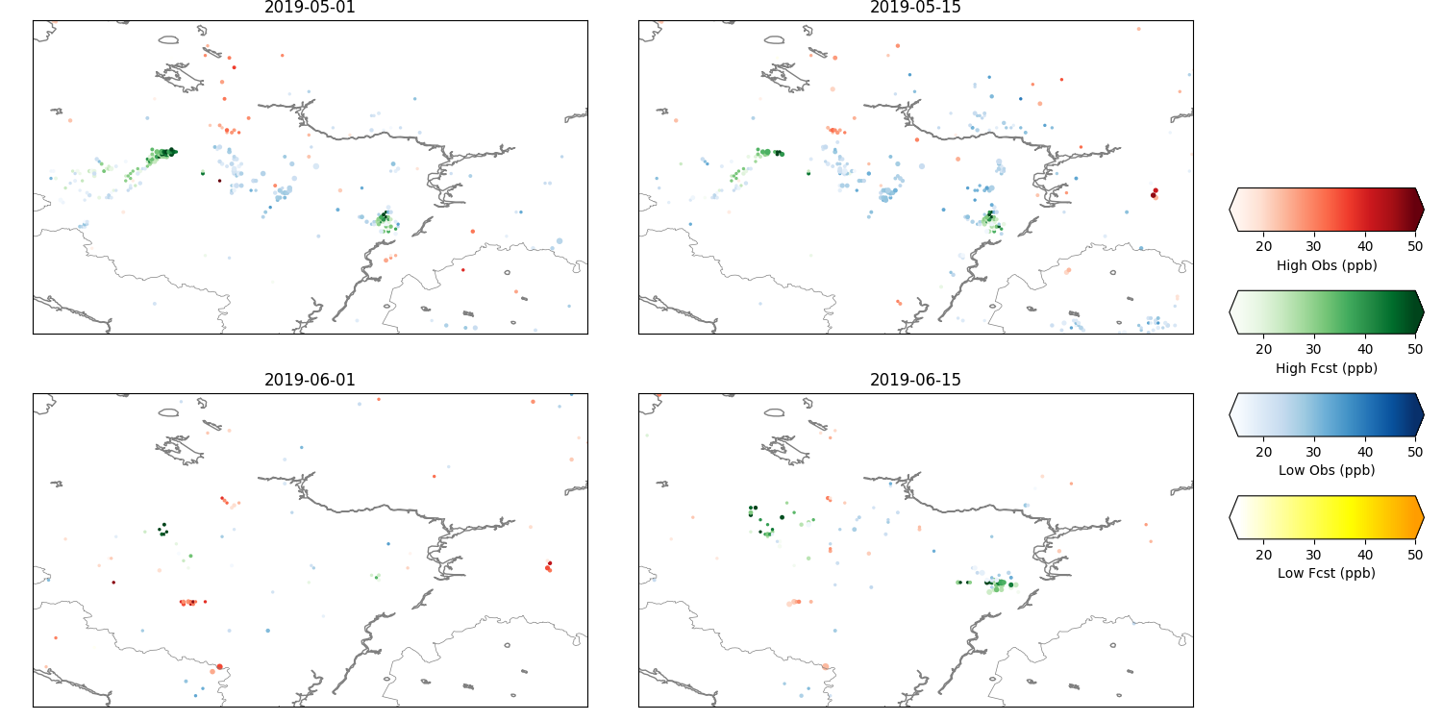
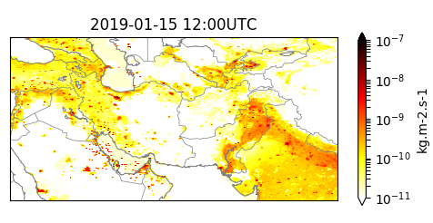
Satellite monitoring of CH₄ anomalies
Barré et al., 2021
Monitoring of CH₄ emission anomalies for EC/DG ENER
Satellite observations
Automated comparison (classification, AI..)
Observed emissions not in inventory
Model forecasts
(simulated satellite observations)
Emission inventory data
Emissions in inventory that are not observed
Where does the information from inventories not match the information from the satellite observations?

Slide 6
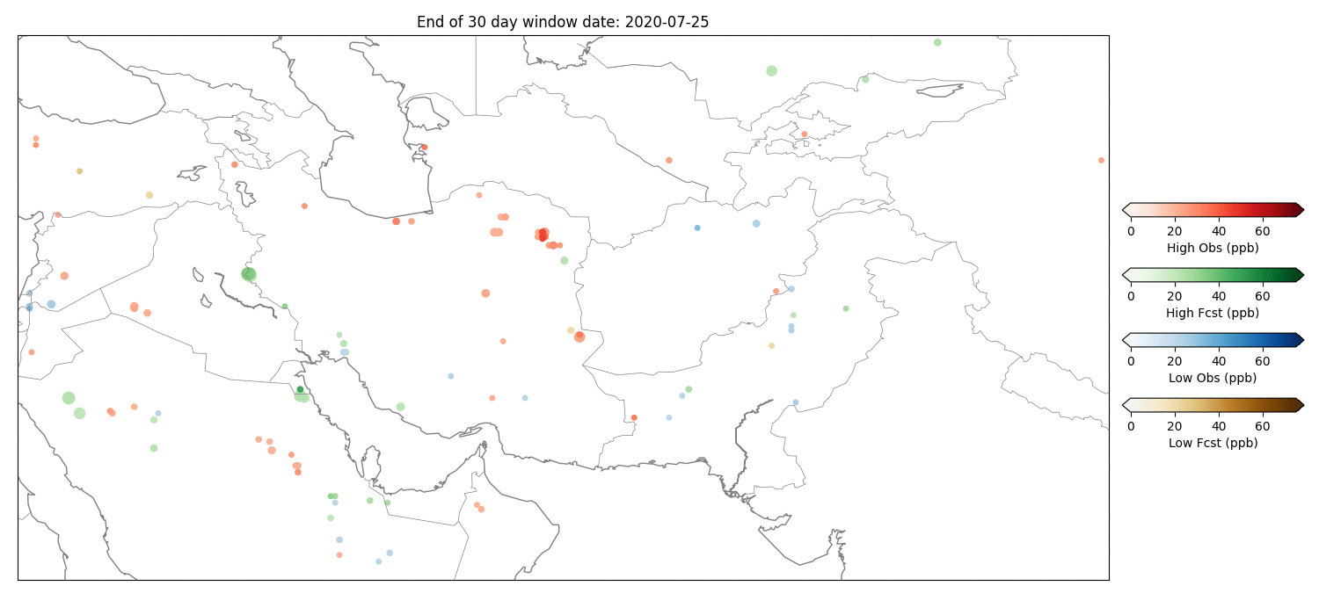
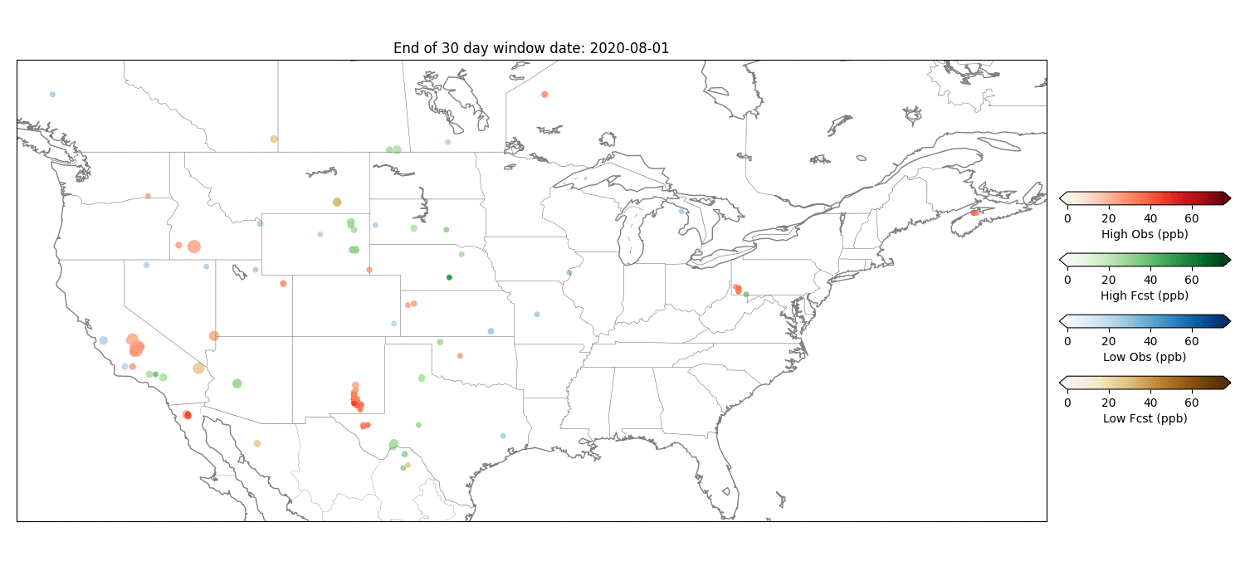
Routine anomaly maps
Barré et al., 2021
Central
Valley
Mason Town,
PA
Permian
Basin
Iraqi
Large Gas
plant
Kuwait
City
Mashhad

Slide 7
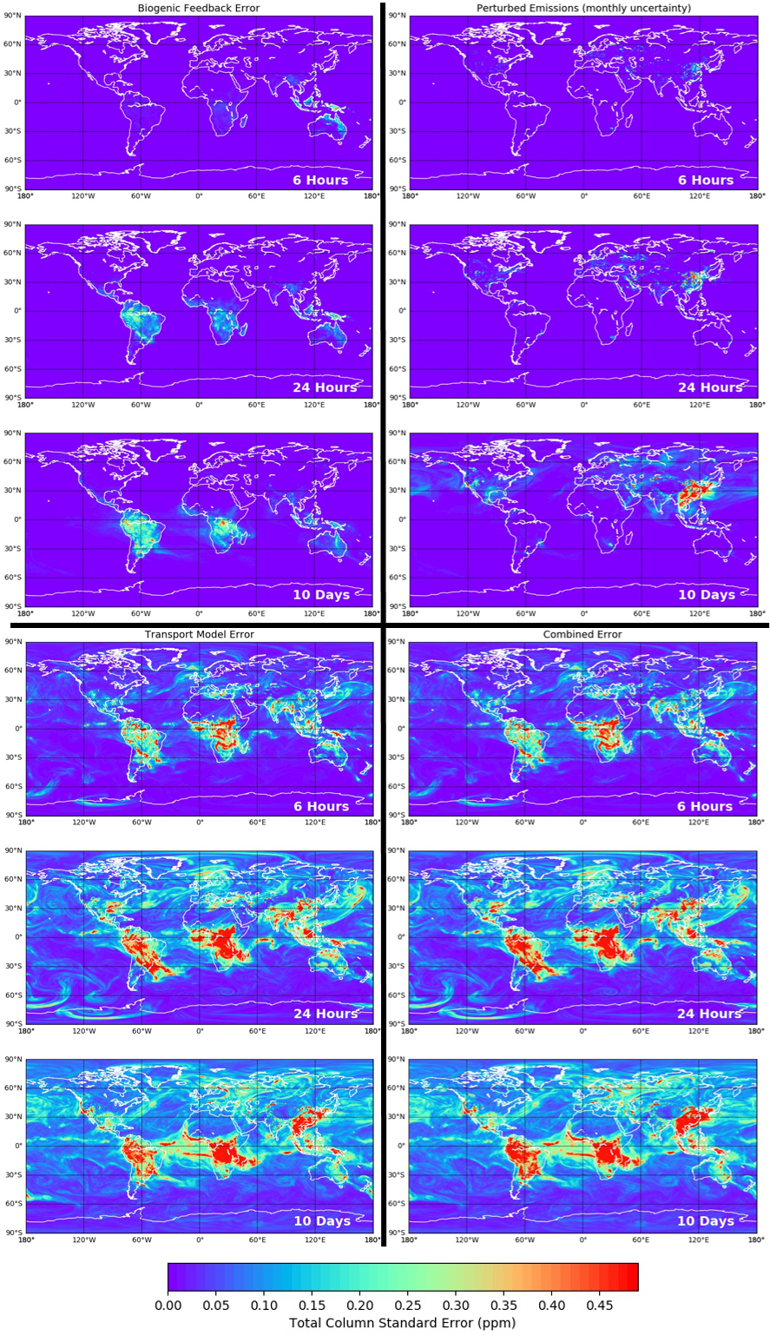
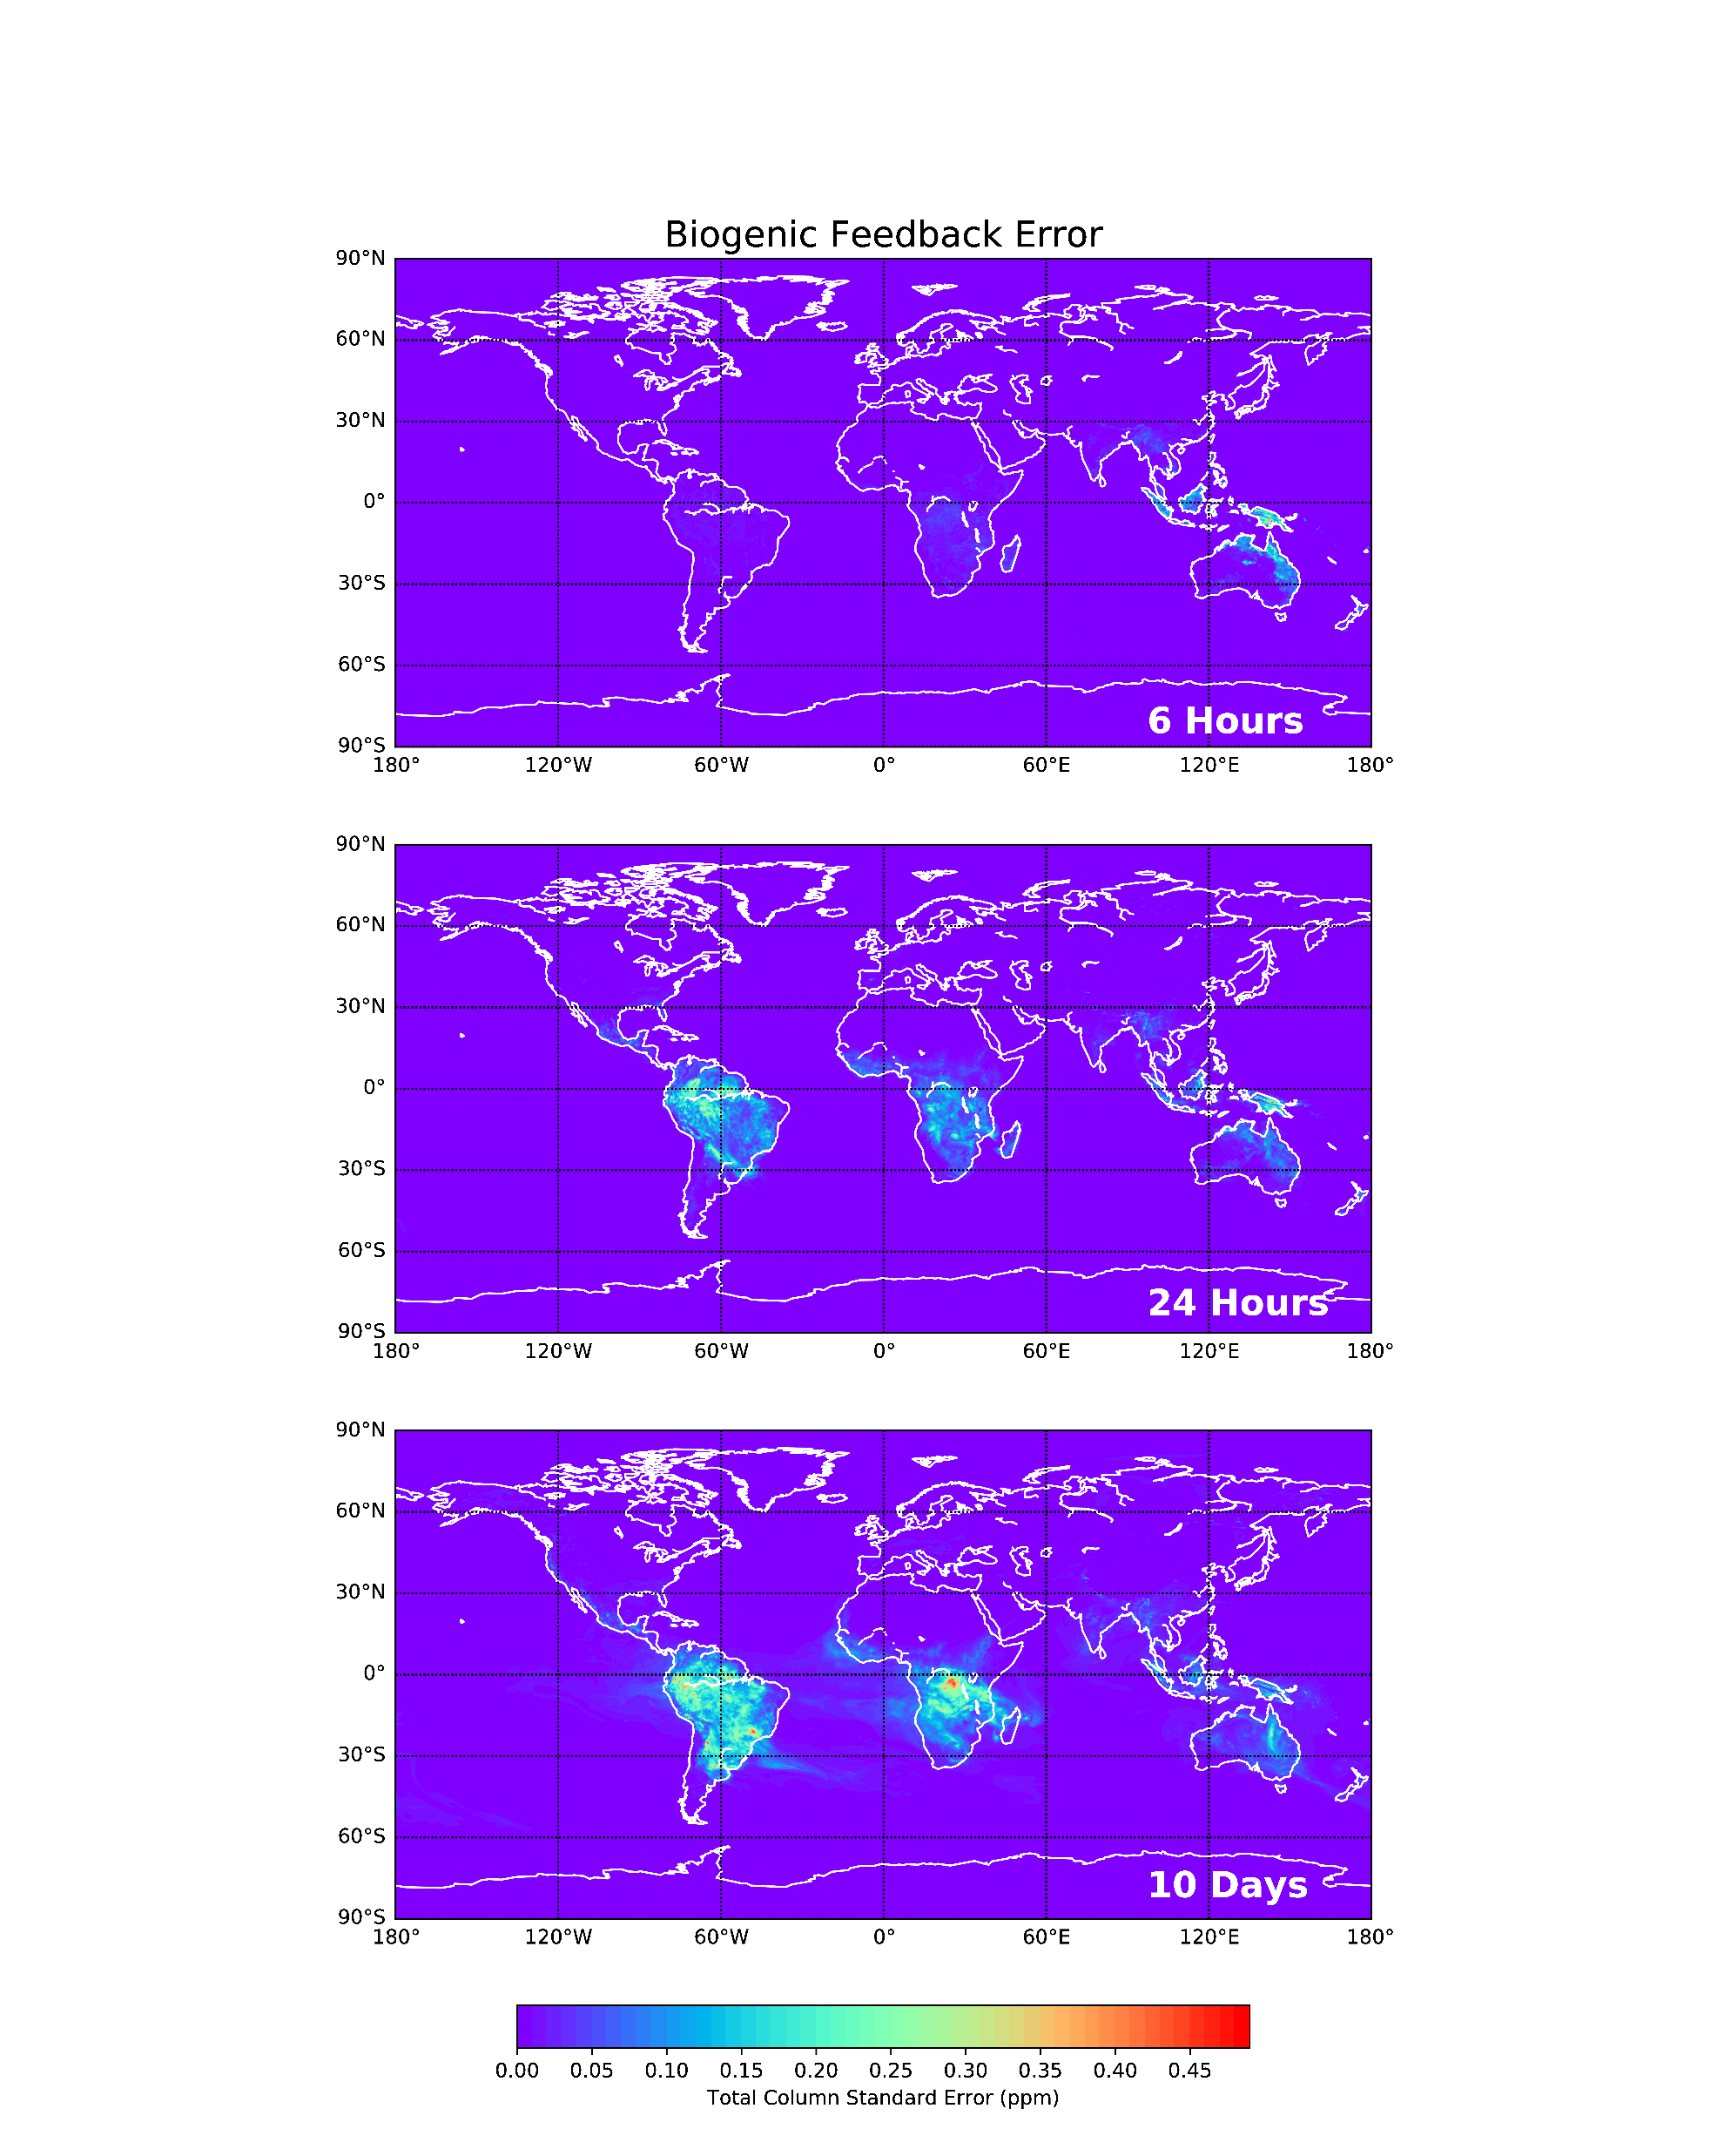
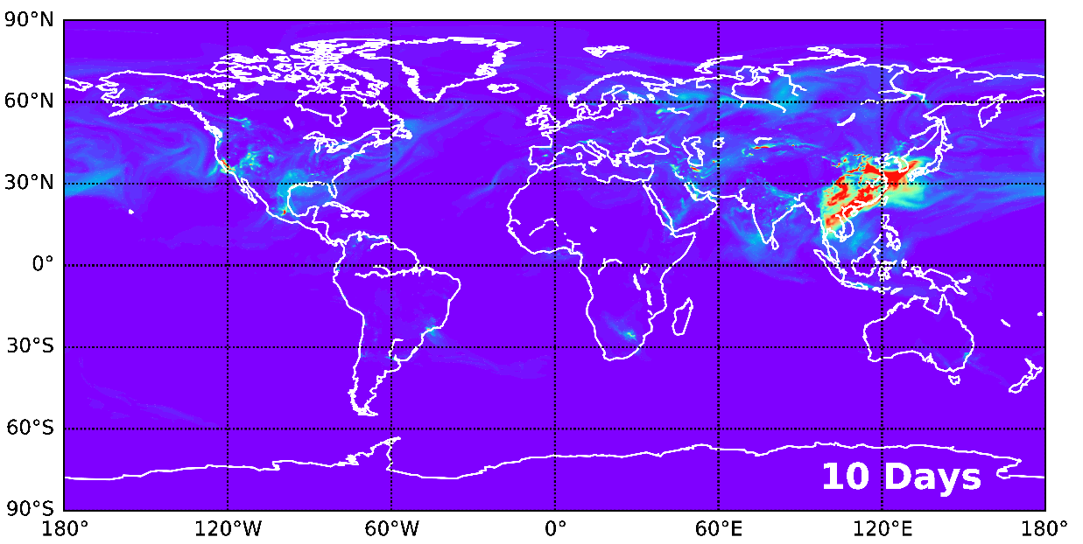
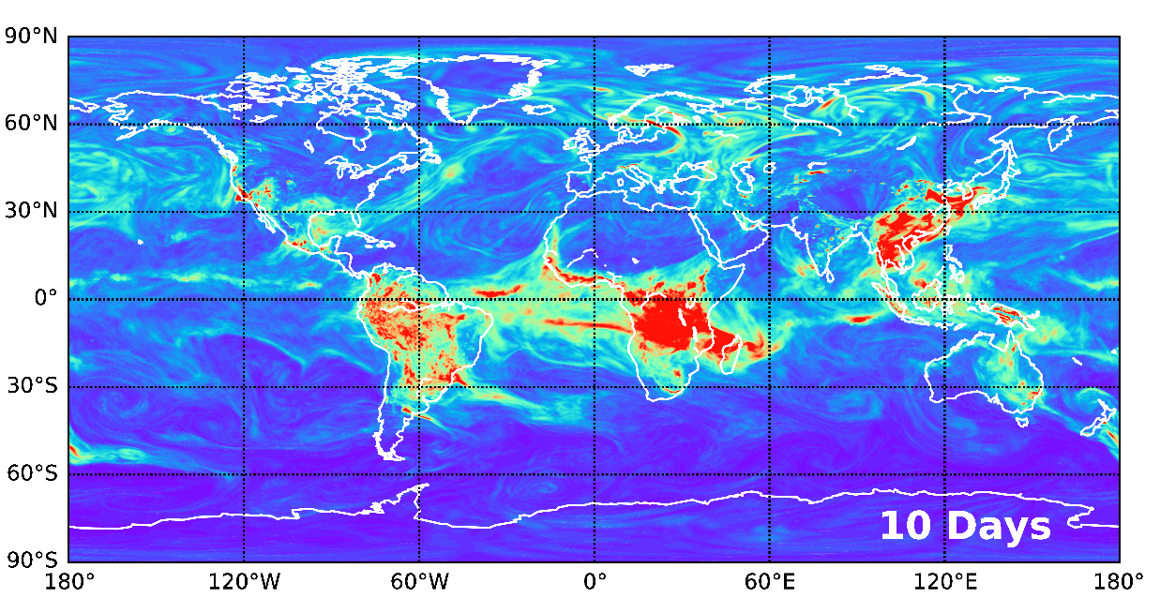

Model Error
McNorton et al., 2020
Biogenic Feedback Error
Perturbed Emissions (monthly uncertainty)
Transport Uncertainty
Combined Uncertainty

Slide 8
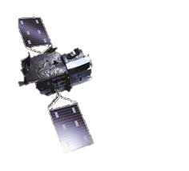
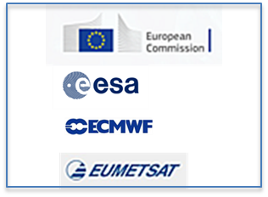
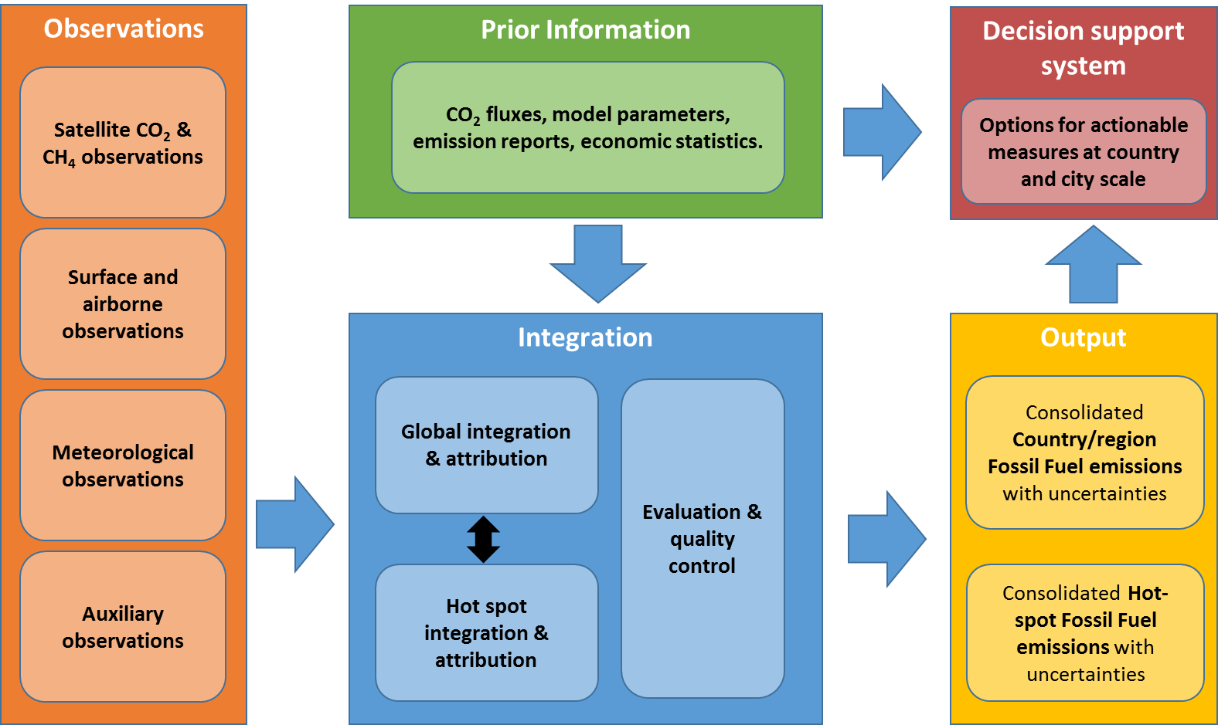



Roadmap towards operational emission estimation for GHG and AQ
2nd global stocktake
1st global stocktake
2018
2020
2022
2024
2026
2028
Prototyping activities including relevant satellite missions from international space agencies
CAMS AQ emissions in pre-operations using Sentinels and international virtual constellations
Copernicus CO₂ service in full operations using Sentinels and international virtual constellation
R&D Support Actions
Horizon 2020 & Horizon Europe

Slide 9
What we have learned so far
CH₄ is a challenge with significant uncertainties in both modelling and observations. However, bringing these together allows for using the best from both worlds.
Many case studies show very promising results. But how do we convert these into routine (operational) and actionable information to policy makers?
How do we best connect operational monitoring capabilities with more localised (commercial) assessments?
It is key to work closely with the main user communities. These can be diverse, but they all have their own specific requirements. And not all requirements can be addressed.

