Slide 1
Top-down Atmospheric Inventories of CO₂ and CH₄ to Support the Global Stocktakes
CEOS AC-VC Annual Meeting
David Crisp (Jet Propulsion Laboratory, California Institute of Technology) for the CEOS AC-VC and Joint CEOS/CGMS WGClimate Greenhouse Gas Task Team
© 2021 California Institute of Technology. US Government sponsorship acknowledged

Slide 2
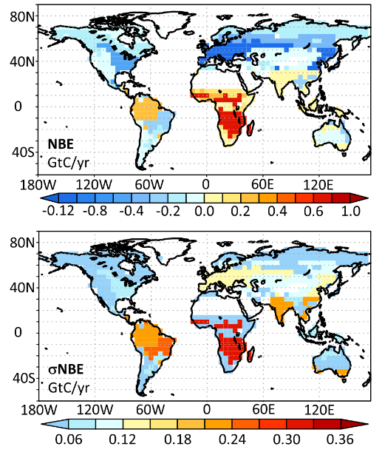
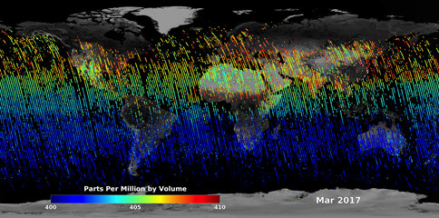
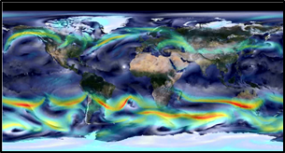
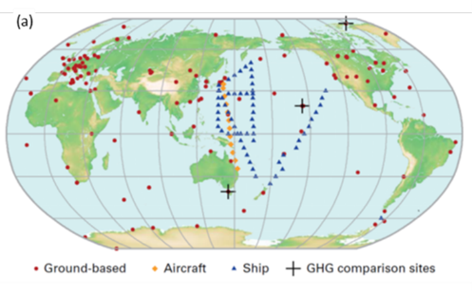
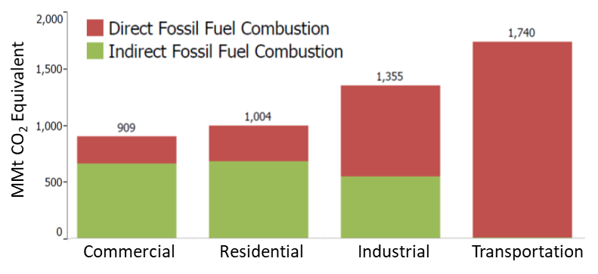
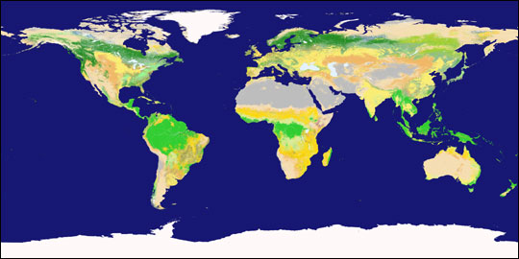
Combining Bottom-up and Top-down Inventories to Support the Global Stocktake
Atmospheric Obs.
Inversion System
Top-Down Inventories
Space-based XCO₂
Transport Model
Observations of atmospheric CO₂ and CH₄ provide an integral constraint on emissions and removals to
Track emission hot spots and rapid changes
Detect emission changes from the natural carbon cycle caused by human activities and climate change
CO₂ Flux
Inverse Model
Uncertainty
Ground-based CO₂
Bottom-Up Inventories
Provide sector-specific estimates of emissions from known sources.
Earth Observations play a critical role for tracking land use change.
Notes:
Bottom-up Inventories:
To support the 2023 Global Stocktake (GST), Parties to the Paris Agreement are compiling inventories of greenhouse gas (GHG) emissions to assess progress toward their Nationally Determined Contributions (NDCs) to emission reductions.
These inventories are based on bottom-up methods that estimate annual emissions and removals of GHGs from five sectors specified in the 2006 IPCC Guidelines for National Greenhouse Gas Inventories
- Energy, Industrial Processes and Product Use (IPPU), Agriculture, Forestry and Other Land Use (AFOLU), Waste and “Other”
These bottom-up methods usually provide accurate estimates of emissions from fossil fuel use, but can include larger uncertainties in other sectors and are restricted to managed lands. They therefore provide an imperfect and incomplete picture of GHG emissions and removals.
Top-Down Atmospheric Inventories
GHG sources and sinks can also be estimated from spatially- and temporally-resolved measurements of their concentrations using atmospheric inverse methods.
The Top-down atmospheric inventories derived from these fluxes
are not as process-specific as bottom-up inventories,
complement those methods by providing an integrated constraint on fluxes from all processes on spatial scales spanning individual large power plants or urban areas to nations or the entire globe.
Recognizing these developments, the IPCC Guidelines for National Greenhouse Gas Inventories acknowledges the value of top-down methods for quality assurance and quality control of bottom-up inventories.
Here, we describe an ongoing effort by the Joint CEOS/CGMS Working Group on Climate (WGClimate) Greenhouse Gas Task Team to work with ground- airborne, and space based atmospheric greenhouse gas measurement and modeling communities to develop top-down atmospheric CO2 and CH4 inventories to support the 2023 Global Stocktake

Slide 3
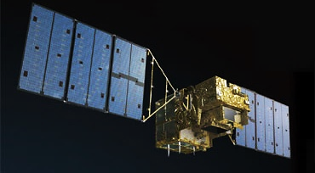
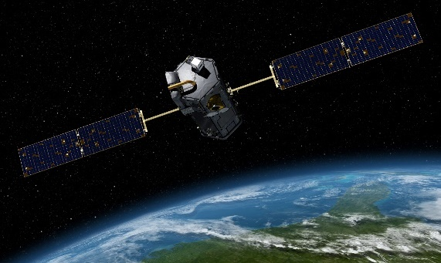
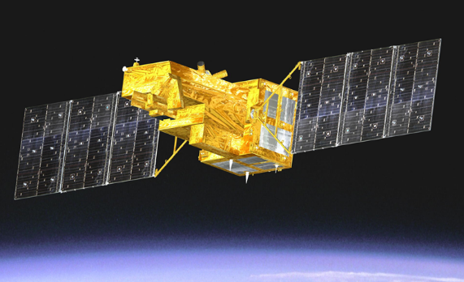
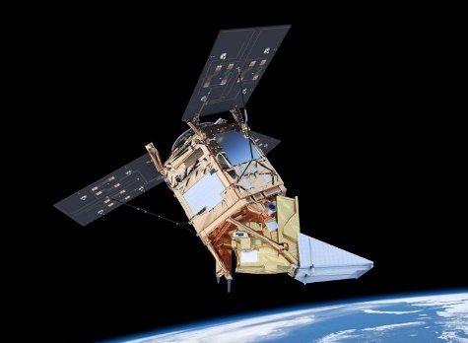
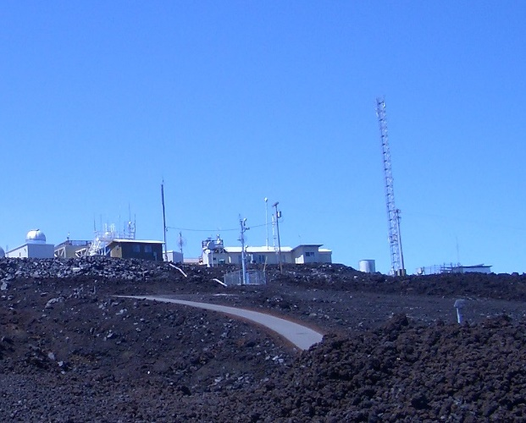
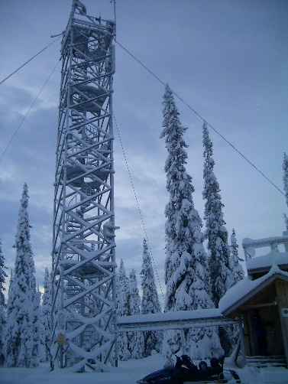
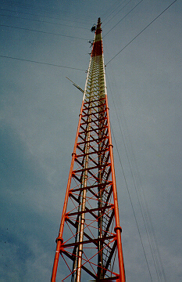
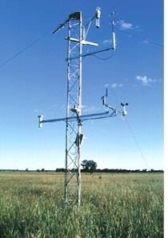
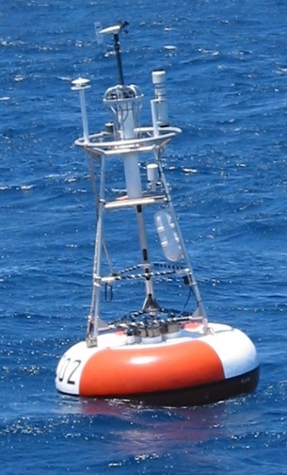
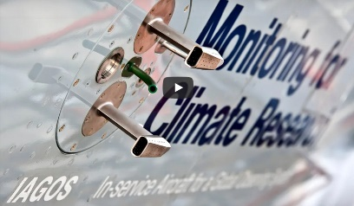
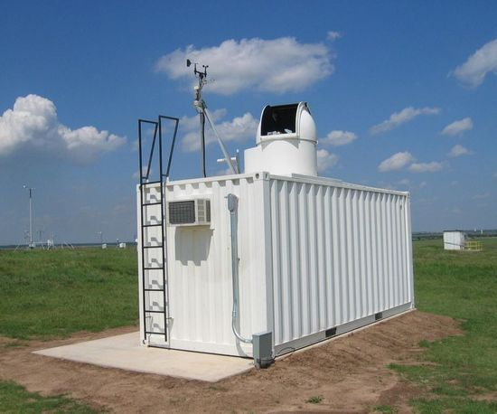
Growing Capabilities in Ground-based and Space-based Atmospheric GHG Measurements
Space-based measurements of CO₂ and CH₄ from a growing fleet of satellites are less precise and accurate but provide high spatial and temporal resolution and greater coverage of the globe.
Ground-based measurements from the WMO Global Atmospheric Watch (GAW) Network and its partners provide accurate estimates of atmospheric GHG concentrations and their trends on local and global scales.
Notes:
Coordination of Ground-based, Airborne and Space-based Observation and Modeling Communities
Ground-based and airborne in situ measurements of Greenhouse Gases
Measure all greenhouse gases tracked by the UNFCCC
Provide continuous monitoring even in persistently cloudy regions and at high latitudes during winter
Critical for validation of space-based remote sensing observations
Space-based remote sensing observations of CO₂ and CH₄
Complement in situ measurements with much greater spatial resolution and coverage
Ground-based remote sensing observation (TCCON, EM27/Sun)
Provide a critical transfer standard for harmonizing the ground-based and airborne in situ measurements with space-based remote sensing observations
Atmospheric inverse models
Essential for assimilating in situ and remote sensing observations to estimate fluxes on local to global scales
Advancing rapidly to exploit new measurement capabilities
Coordinated use of ground-based, airborne, and space based GHG measurements in inverse models is critical to the success of top-down atmospheric inventories

Slide 4
Pilot Global Top-Down Inventory Products
Objectives
Top-down products to assess completeness and consistency of total annual emissions on regional scales
Capability: CO₂ and CH₄ flux estimates with uncertainties on regional-scales (4°x5°) from global atmospheric inverse models at annual intervals from 2016 - 2020
Top-down products to support National inventory development/NDC assessment efforts
Capability: High resolution (1°x1°) CO₂ and CH₄ flux maps with uncertainties, derived from high-resolution inverse models (or downscaled from low resolution models) at monthly intervals
Inventory Products
Inventory products derived from global CO₂ and CH₄ flux maps
Optimized total emissions: Total net CO₂ and CH₄ flux and stock change (accounting for lateral fluxes)
Fossil fuel emissions: Input (not optimized) emissions with uncertainties
Non-Fossil Fuel Fluxes (AFOLU + Natural): Optimized fluxes and stock changes with uncertainties
AFOLU contributions constrained by estimates from CEOS AFOLU Team

Slide 5
Sources for the Pilot CO₂ and CH₄ Inventories
Global CO₂ Inventories (see Byrne and Baker’s presentation)
Pilot global CO₂ inventory products will be derived from flux products being developed by the OCO-2 Flux Multi-model Intercomparison Project (OCO-2 Flux MIP)
Combine in situ CO₂ measurements with space-based estimates of the column-averaged CO₂ dry air mole fraction (XCO₂) from OCO-2 v10 product to predict fluxes and stock changes
Global CH₄ Inventories (see Worden, Engelen and Barre presentation)
Pilot global CH₄ inventory products will be derived from flux products being developed by the NASA Carbon Monitoring System Flux (CMS-Flux) team
Combine in situ CH₄ measurements with GOSAT and TROPOMI products
Local Source Inventory Products
Urban-scale emission products from OCO-2, GOSAT, and TROPOMI teams are being considered for demonstration products
Products published by individual PIs are being solicited

Slide 6
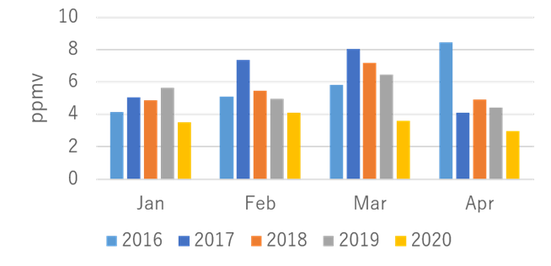
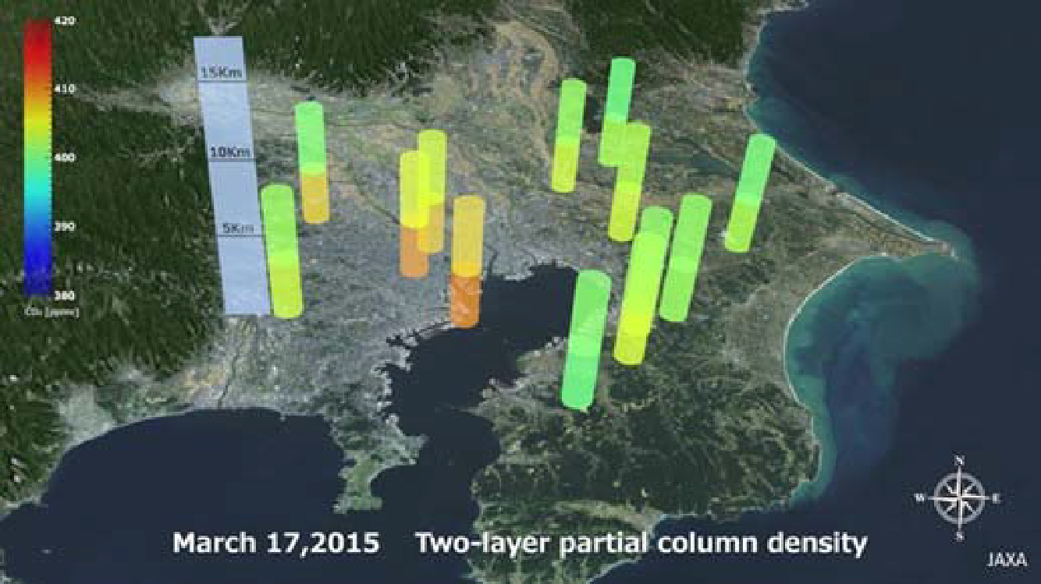
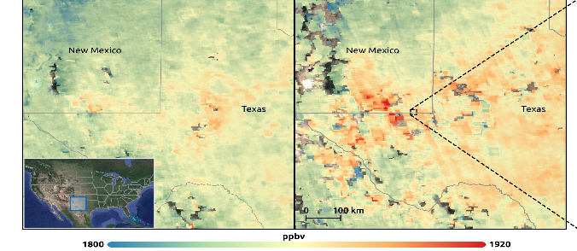
Tracking Emissions from Localized Hot Spots
GOSAT observes CO₂ over Tokyo
Pilot products are also being developed to track emissions from localized sources including large urban areas, power plants and oil fields
The GOSAT team accelerated the development of an upper/lower tropospheric product to track effects of COVID-19 lockdowns on emissions from large urban areas
The OCO-2 and TROPOMI teams are combining CO₂ and NO₂ to quantify emissions from powerplants and large urban areas
The TROPOMI team is tracking methane emissions from fossil fuel extraction, and collaborating with the GHGSat team to track intense plumes
Existing capabilities do not have the resolution or coverage needed to track all local sources, but can illustrate methods for tracking emissions from hot spots for future GST’s
Analyzed by JAXA/EORC
OCO-2 XCO₂ and TROPOMI NO₂ combined to quantify CO₂ emission by large South African power Plants
Reuter et al., ACP 2020
March-April 2019
March-April 2020
TROPOMI observes CH₄ emissions changes over Texas oil fields

Slide 7
Providing Tools and Products for Creating Interfaces and Capacity Building for Future Global Stocktakes
The primary objective of this pilot inventory activity is to provide a product that starts a conversation with the national inventory agencies, the UNFCCC, and other relevant players (IG³IS, GCOS, IPCC) to establish the utility and best practices for the use of top-down atmospheric inventories in future Global Stocktakes
While the existing atmospheric measurement and analysis capabilities are still evolving rapidly and are providing key insights into the emissions and removals of CO₂ and CH₄ by natural processes and human activities, they are not expected to fully address the requirements of the first Global Stocktake in 2023
However, these tools are adequate for generating products that illustrate the capabilities of future top-down atmospheric greenhouse gas monitoring and analysis systems and to identify
the best ground, airborne, and space-based products for building top-down inventories
the best practices for combining top-down and bottom-up inventory techniques and products
These pilot products are expected to foster the development of requirements with CEOS stakeholders (IG³IS, GCOS, IPCC, UNFCCC) and interfaces with users in the national inventory communities who will be using much more capable systems that will be coming on line to support the 2028 and future Global Stocktakes

Slide 8
Contributors
Joint Committee on Earth Observation Satellites (CEOS) / Coordination Group on Meteorological Satellites (CGMS) Working Group on Climate (WGClimate) Greenhouse Gas Task Team (GHG-TT)
CEOS Atmospheric Composition Virtual Constellation (AC-VC)
CEOS Working Group in Calibration and Validation (WGCV)
CEOS Agriculture, Forestry, and Other Land Use (AFOLU) Team
World Meteorological Organization (WMO) Integrated Global Greenhouse Gas Information System (IG3IS)
European Space Agency (ESA) TROPOMI Team
Japan Aerospace Exploration Agency (JAXA) GOSAT
NASA Carbon Monitoring System (CMS)
European Centre for Medium-Range Weather Forecasts (ECMWF)
Copernicus Atmospheric Monitoring Service (CAMS)
H2020 CoCO2 project
OCO-2 Flux MIP Team
Laboratoire des sciences du climat et de l'environnement (LSCE)
NOAA Global Monitoring Laboratory
NASA Ames Research Center
NASA Carbon Monitoring System Flux Team (CMS-Flux)
NASA Goddard Space Flight Center Global Modeling and Assimilation Office (GSFC GMAO)
NASA Jet Propulsion Laboratory (JPL)
Colorado State University (CSU)
University of Colorado
University of Maryland
University of Oklahoma (OU)
University of Toronto
Join us!

