Slide 1
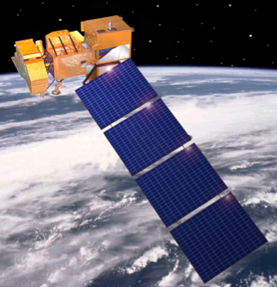

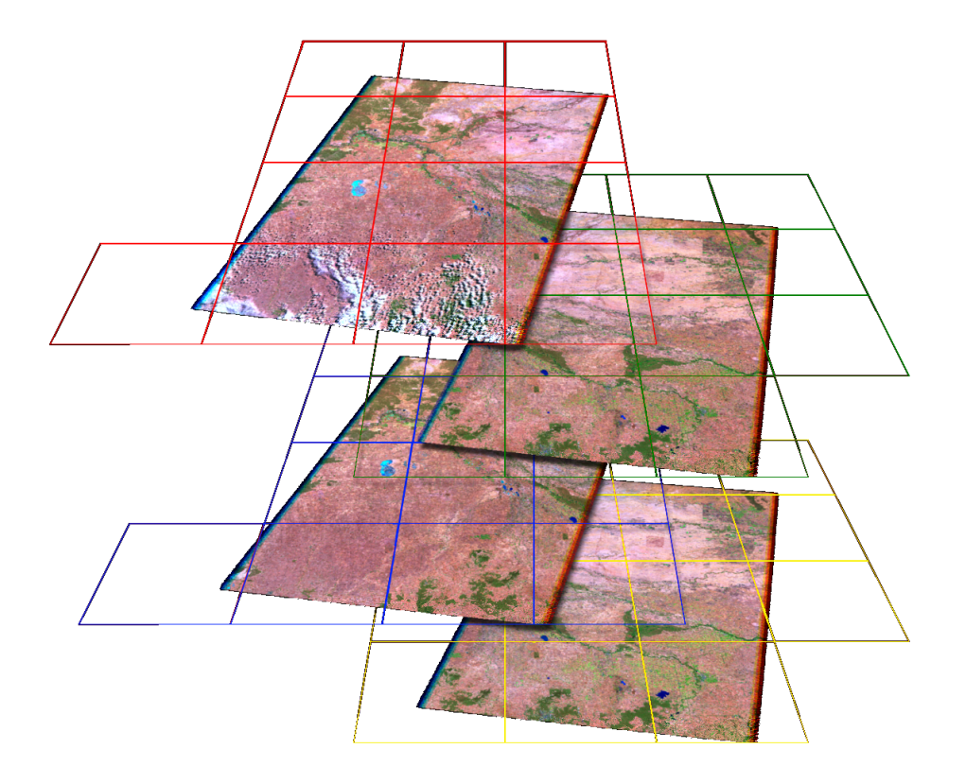
Data Cube
A flexible data architecture for large datasets supporting diverse applications
Satellite
Mission
Key Features of the CEOS Data Cube Architecture
Open Source ... Free and open to any user
Flexible deployment ... Local or Computing Cloud
Multiple data layers in one system (optical and radar). Pixels vs. Scenes.
Flexible grid projections for spatial consistency and data interoperabilty
Computationally efficient “Big Data” approaches
Reference user interface for common analyses (cloud-free mosaics, change detection).
Support for infinite applications
using flexible APIs
Proven concept in Australia
Pilot Projects in Kenya and Colombia
Processed
Data Products
Data
Cube
Reference User Interface

Slide 2
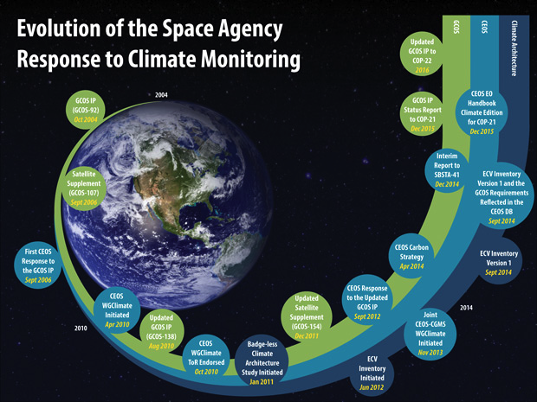

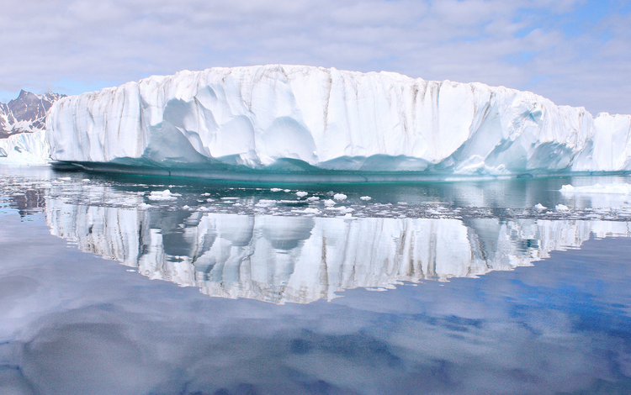

Climate Change
Satellite Data for Climate Science & UNFCCC Objectives
Putting together an Essential Climate Variable Inventory to facilitate gap assessments & improve international coordination
From publishing the CEOS Response to GCOS in 2006 to publishing a set of Strategic Actions designed to improve the international coordination & measurement of carbon from space (2015)
CEOS Agencies collaborate to improve climate monitoring & Climate Data Record availability.

Slide 3
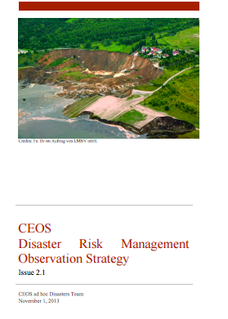
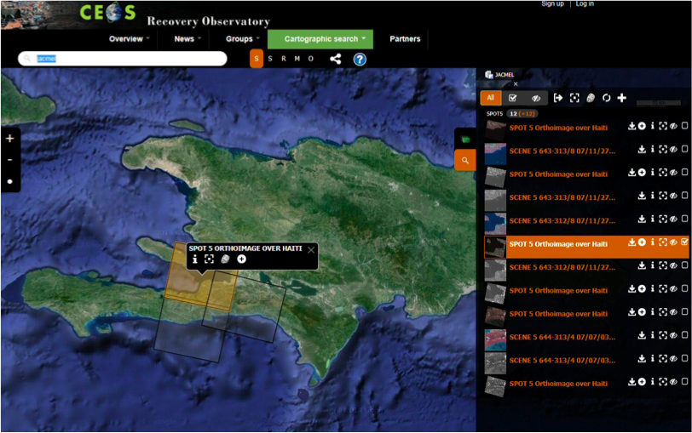
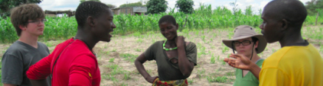

Disaster Response
Satellite Data for Disaster Management & UNISDR Objectives
Designing a Disaster Risk Management Observation Strategy for space-based flood, earthquake, & volcano measurements
Recovery Observatory: A concerted effort to make data freely available to users for ongoing recovery efforts long after disaster strikes
Pilots help affected communities access and use flood, seismic, & volcano data
CEOS Agencies improve the coordination of satellite observations for disaster management.

Slide 4
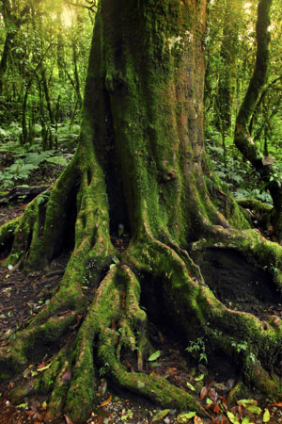


Deforestation
Satellite Data for Forest Management & UN-REDD Objectives
The CEOS Ad Hoc Space Data Coordination Group for the Global Forest Observations Initiative (SDCG for GFOI) coordinates sustained space-based observations for forest management.
Analysis-Ready Data Products
Data Cube Pilots improve data access & analysis capabilities for developing nations via flexible architecture and Open Source software.
Data Cube
Space Agency
Satellite

Slide 5
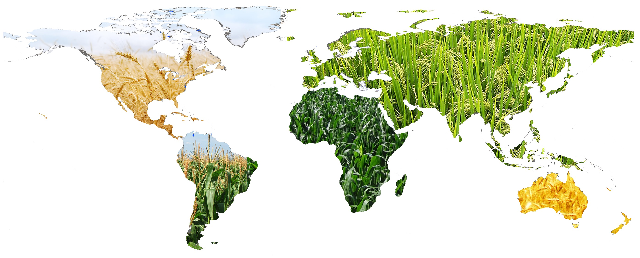

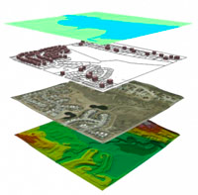


Food Security
Satellite Data Contribute to Food Security & UN-FAO Objectives
The CEOS Ad-Hoc Working Group on GEOGLAM (Group on Earth Observations Global Agriculture Monitoring Initiative) focuses on providing coordinated and sustained, space-based observations for agriculture management.

Slide 6
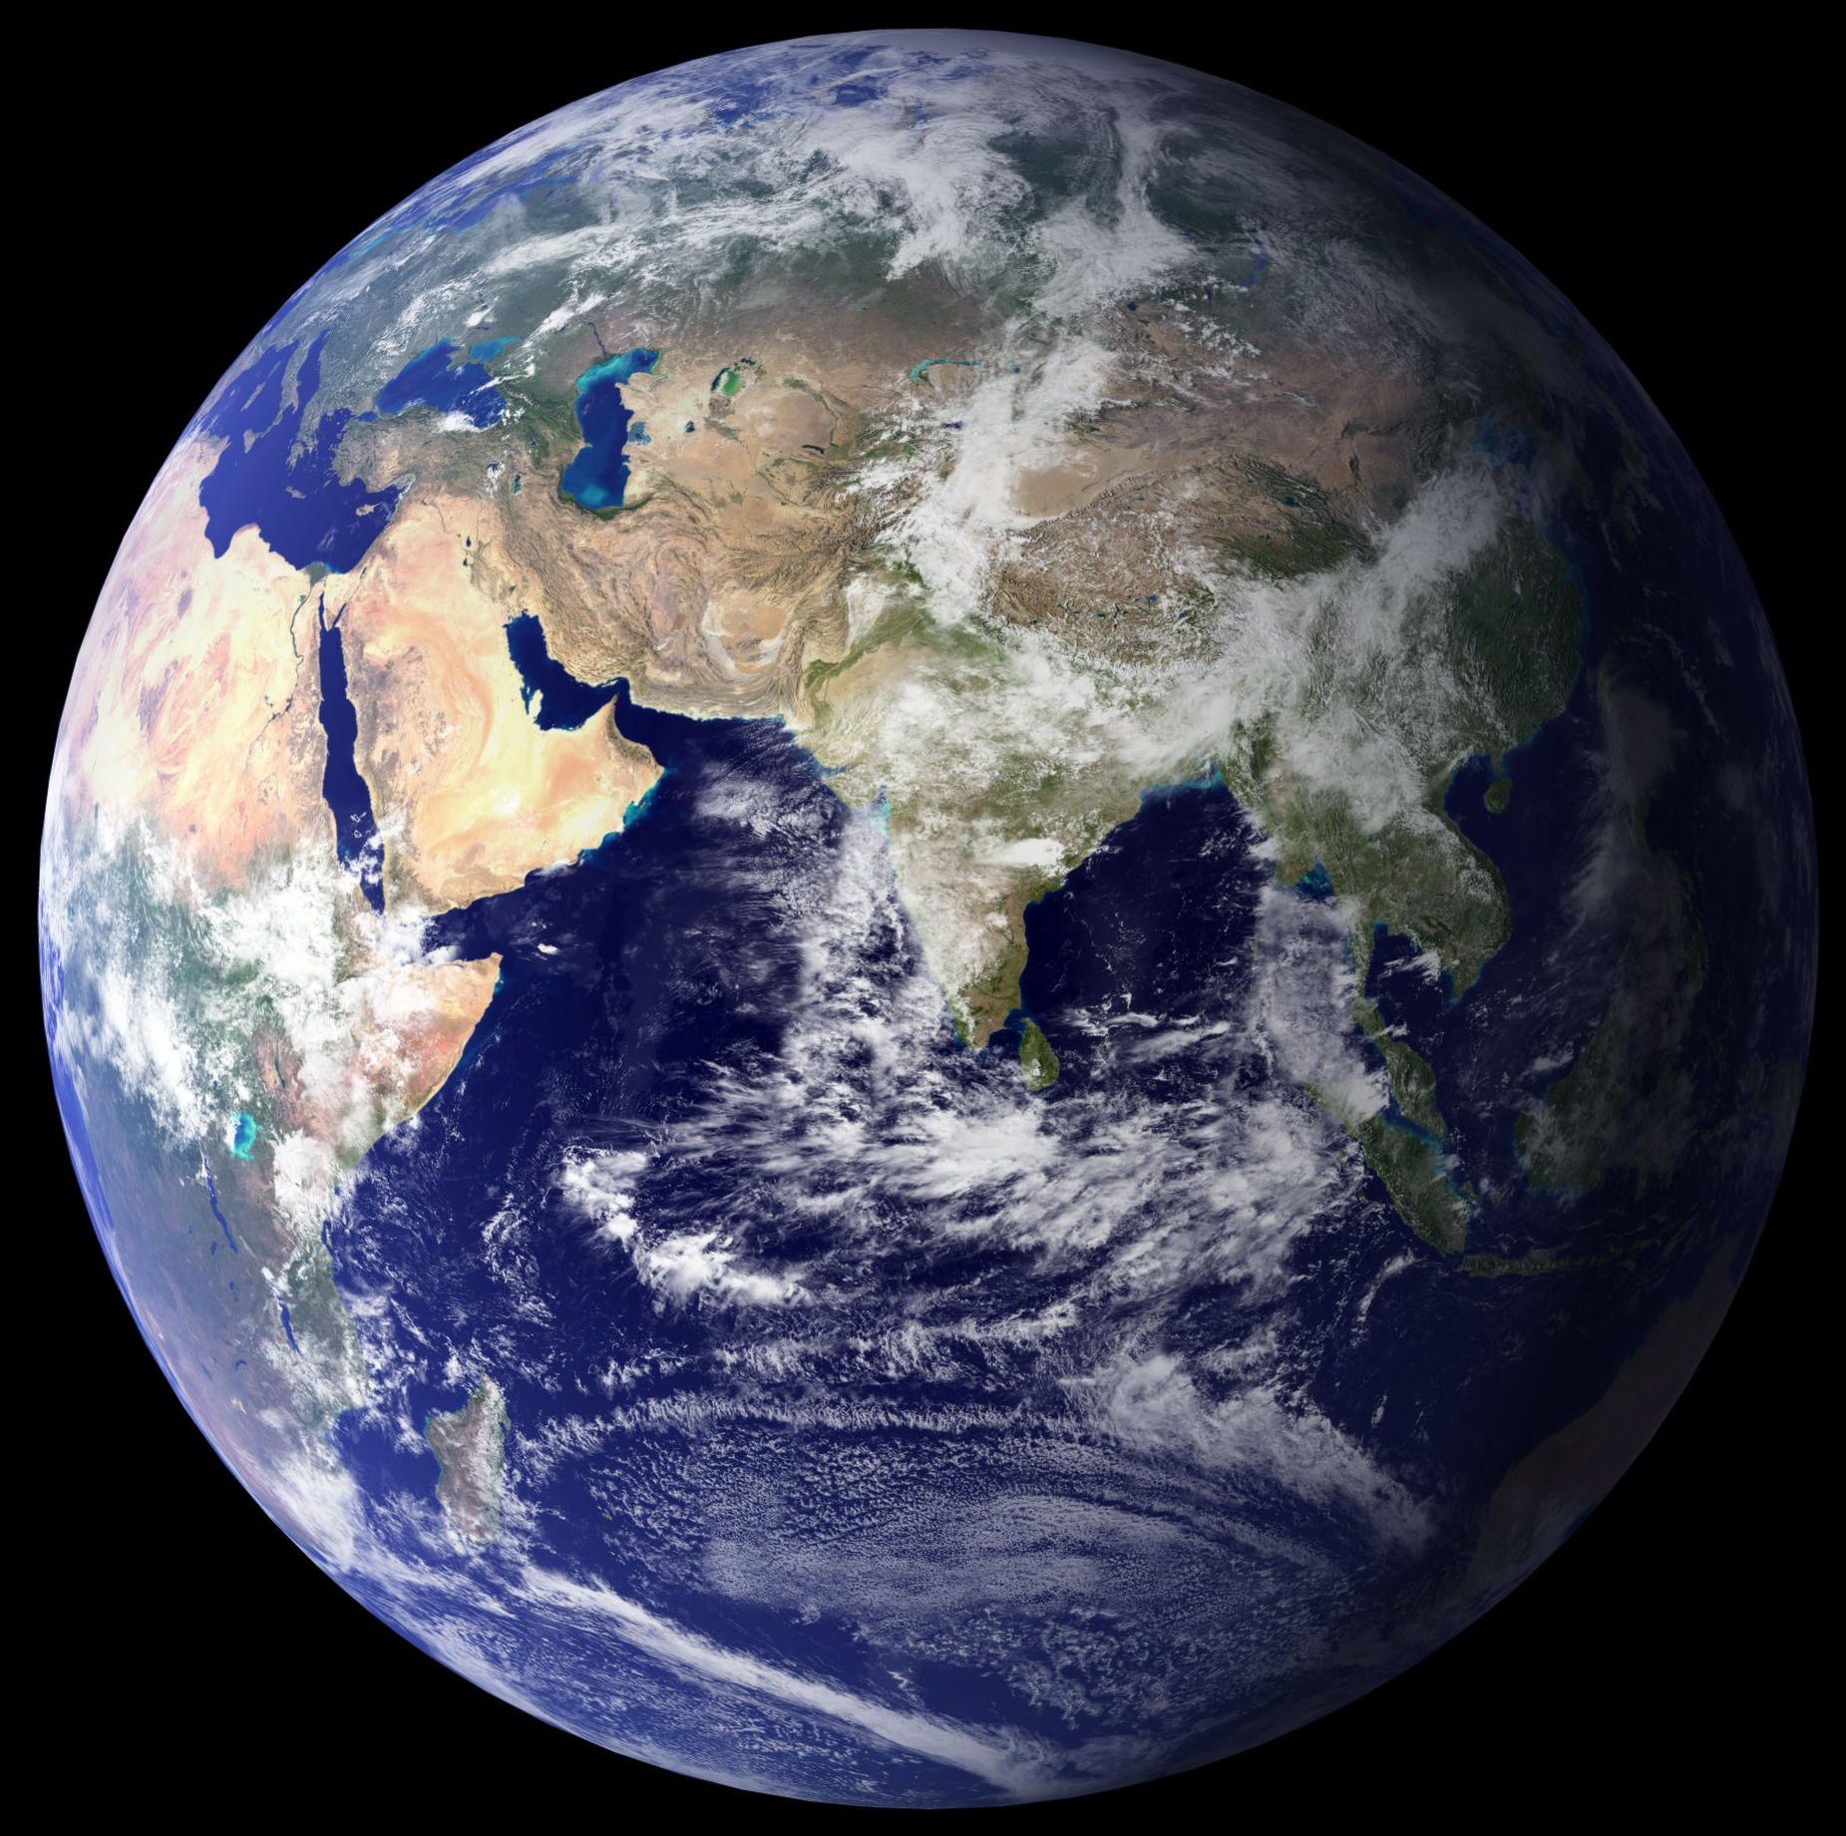
19 New Satellites!
CEOS Agencies Launch 19 New Satellites Before 2016
CEOS Agencies launched 15 new satellites since the 2014 GEO Ministerial Summit; 4 more before 2016! Data Applications Include:
Atmospheric Composition
CO₂ Sources & Sinks
Global Precipitation & Evaporation
Heliogeophysics
Land Surface Imaging & Topography
Meteorology
Ocean Monitoring & Topography
Ocean Surface Vector Winds
Soil Moisture & State
CEOS Agencies currently operate 135 satellite missions with a wide range of data applications!

Slide 7
New Open Datasets
New Release: SRTM 30-m DEM
Shuttle Radar Topography Mission (SRTM)
Global 30-m Digital Elevation Model (DEM) data. CEOS organized several capacity building/training workshops to expand the use of this data for national applications in Kenya, South Africa, and Mexico, reaching 63 people from 23 countries.

Slide 8
New Open Datasets
New Release: ALOS PALSAR 25-m Annual Mosaics
Advanced land Observing Satellite (ALOS)
Phased Array type L-band Synthetic Aperture Radar (PALSAR)
Global 25-m annual mosaics from 2007-2010 with continued data from ALOS-2 in 2014/2015. CEOS will use these mosaics in several Data Cube projects to support forestry and/or agriculture initiatives in Kenya & Colombia.

Slide 9
New Open Datasets
New Release: SPOT-5 Optical Data from 2.5 to 20-m Resolution
Satellite for Observation of Earth (SPOT-5)
All global, high-resolution (2.5 to 20-m) optical data older than five years. CEOS will use these to support R&D for its contributions to the GFOI & GEOGLAM Flagships.

Slide 10
CEOS → GEO
Recent CEOS Contributions to GEO: GEOGLAM
GEOGLAM…

Slide 11
CEOS → GEO
Recent CEOS Contributions to GEO: GEOBON
GEOBON…

Slide 12
CEOS → GEO
Recent CEOS Contributions to GEO: GFOI
GFOI…

Slide 13
CEOS → GEO
Recent CEOS Contributions to GEO: GFOI
Global Carbon Observation and Analysis System…

Slide 14
CEOS → GEO
Recent CEOS Contributions to GEO: GFOI
GEO-DARMA

