Slide 1

CEOS Communications Side Meeting
Kim Holloway
Communications Coordinator
Systems Engineering Office (SEO)
Committee on Earth Observation Satellites (CEOS)
2021 SIT Technical Workshop
September 6th, 2021

Slide 2
Agenda
Introductions
Communications Background / Overview
Introduce the New Draft Communications Strategy
Propose CEOS Communications Next Steps
Invite Feedback / Discuss

Slide 3
Introductions
Name
Agency Affiliation
CEOS Area of Involvement
Why the CEOS Communications Side Meeting?

Slide 4
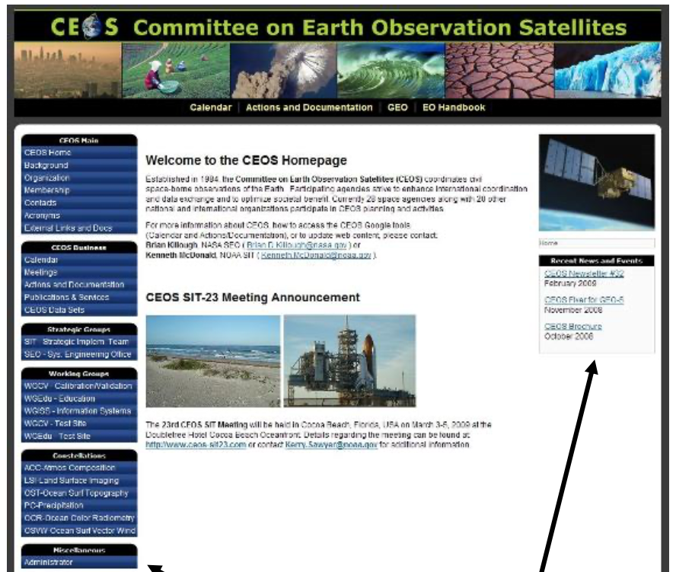
Communications Background / Overview
2009 - First CEOS website redesign
2013 – CEOS joined social media
2015 – Brand new CEOS website
2015 – New Social Media Strategy
Joined YouTube / LinkedIn
2009 CEOS Website

Slide 5


Communications Background / Overview
2021 Branding Guidelines – inspired us
How is our Comms Strategy working?
How is it defined?
How can it improve?

Slide 6
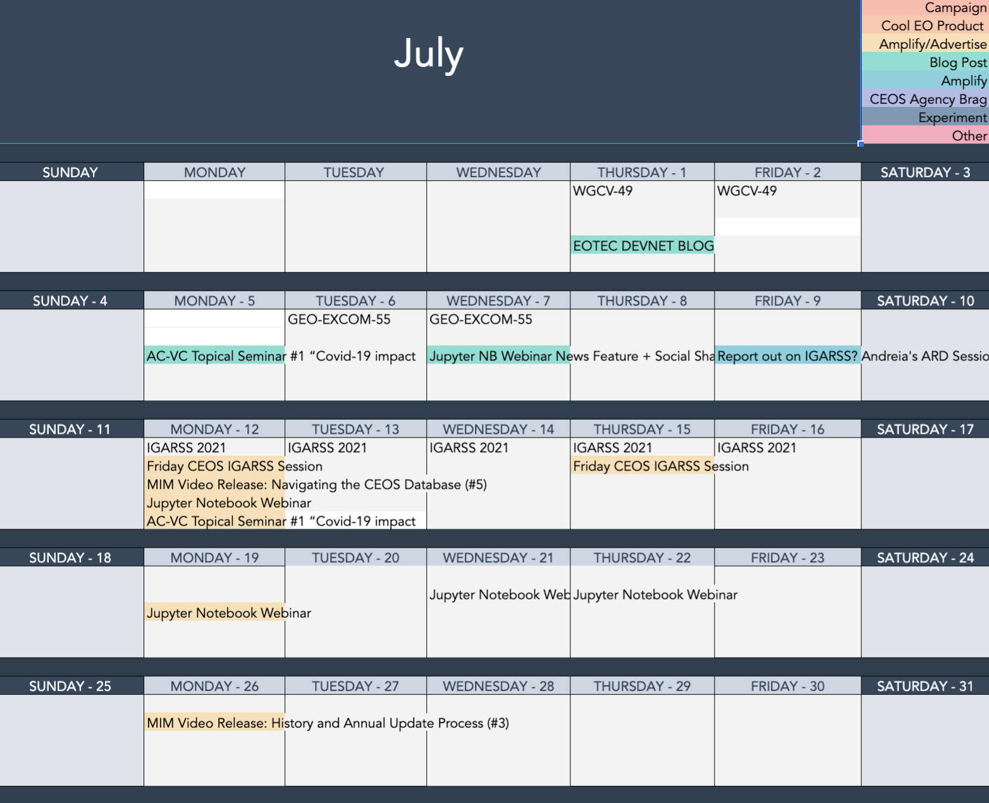
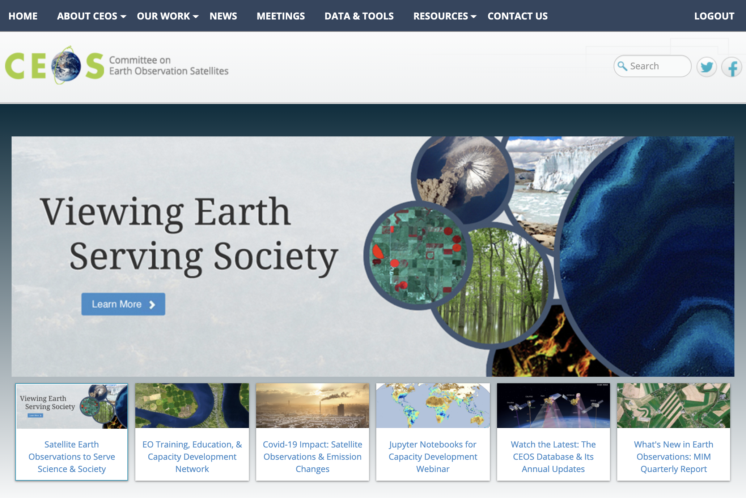
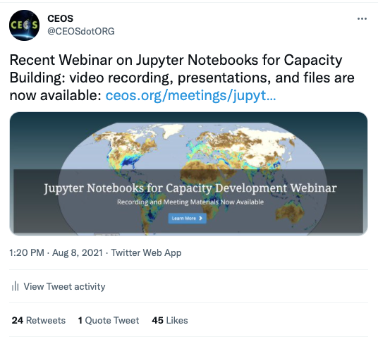
CEOS Content Lifecycle
Planning
Publishing
Sharing

Slide 7
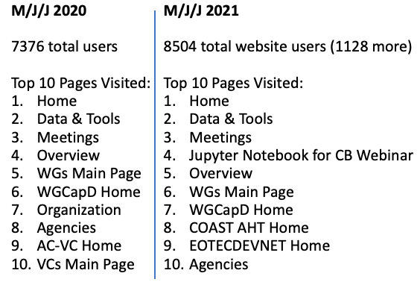
Sharing CEOS Content
May – June – July | 2020 vs 2021
1000+ more individual users
Top 3 pages remain the same
Our new content showed up
People are paying attention

Slide 8

The Draft CEOS Communications Strategy
Help people and organizations more easily discover and benefit from CEOS work.
Notes:
Draft Strategy Document:
https://docs.google.com/document/d/1cVN76sycI8HlKjZaK6HfmO4NTjP3aSgERUkUH8klgGk/edit?usp=sharing

Slide 9
Next Steps: Website Enhancements
Make CEOS Stories a more dynamic, engaging homepage space
Up-front access to WG, VC, AHT pages
Reorganized menus
Data & Tools redesign

Slide 10
Next Steps: Menu Reorganization
Home
About Us
Our Groups
News
Data & Tools
Meetings
Contact Us
Our Agencies
Overview
Organization
Governing Documents
Work Plan & Deliverables
Working Groups
Virtual Constellations
Ad Hoc Teams
Other Activities
News & Stories
Key Documents & Publications
Branding Guidelines
File Management (Internal)

Slide 11
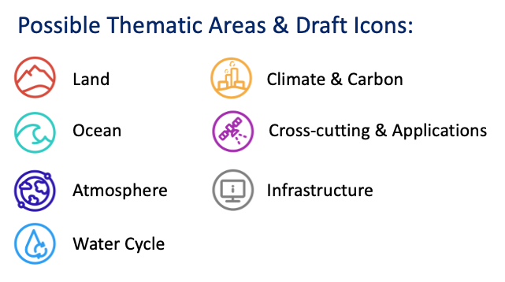
Next Steps: Standardized Themes

Slide 12
Let’s Discuss!
Notes:
Draft Strategy Doc:
https://docs.google.com/document/d/1cVN76sycI8HlKjZaK6HfmO4NTjP3aSgERUkUH8klgGk/edit?usp=sharing

Slide 13
==========================

Slide 14
Perceived Problems / Proposed Solutions:
Implement a visually stunning, rotating banner on the CEOS Homepage to highlight important CEOS News, Stories, and Publications
Create a dedicated, thematically organized CEOS webpage for accessing older CEOS News, Stories, and Publications (CEOS Newsletters to be shared and archived here, with some articles to be shared more dynamically in a blog-like/news format.)
Consolidate externally hosted CEOS website content into the centrally located CEOS website for consistent branding across the organization (& solve the problems those pages addressed)
Dedicate prominent space on the CEOS Homepage to promote the CEOS WGs/VCs/AHTs
Streamline CEOS menus and navigation to optimize content discoverability
Collaboratively plan and publish CEOS website and social media content using a shared content calendar
Provide training and support to help the CEOS community benefit from our communications resources (Proposed 2021 SIT TW Side Meeting)
Maybe: Agree on a consistent set of thematic icons to help users easily identify relevant CEOS content
Notes:
We have also identified several ways to improve the reach and impactfulness of our website and social media efforts. Just a few examples:
More prominently highlighting CEOS activities and achievements on the CEOS homepage and a new, dynamic CEOS News page
Providing up-front access to increase the visibility of our CEOS Working Group, Virtual Constellation, and Ad Hoc Team pages
Upgrading our high-traffic Data & Tools page to ensure that visitors have quick access to the CEOS resources they value
Maintaining a shared editorial calendar to lan ahead for original content we’ll create to showcase CEOS work to the world

Slide 15
Content Calendar Collaboration / Planning:

Slide 16
Content Calendar Implementation – Analytics
M/J/J 2020
7376 total users
Top 10 Pages Visited:
Home
Data & Tools
Meetings
Overview
WGs Main Page
WGCapD Home
Organization
Agencies
AC-VC Home
VCs Main Page
M/J/J 2021
8504 total website users (1128 more)
Top 10 Pages Visited:
Home
Data & Tools
Meetings
Jupyter Notebook for CB Webinar
Overview
WGs Main Page
WGCapD Home
COAST AHT Home
EOTECDEVNET Home
Agencies

Slide 17
Next Steps
Continue collaboratively populating the content calendar (it’s working, but I need more content ideas)
Communicate these plans to the broader CEOS community, if necessary – at SIT TW? Side Meeting proposed for training, as George suggested.
Meet with SEO web development team to begin implementation on a development site
Publish next communications strategy draft and distribute to comms team for comments before sharing with broader CEOS community.
Maybe: Agree on a consistent set of thematic icons to help users easily identify relevant CEOS content

Slide 18
Discussion

