Slide 1

CEOS Data Cubes
Helping Countries Improve the Use of Satellite Data
Material for the AGU Data Cube Poster
October, 2016
Brian Killough
CEOS Systems Engineering Office (SEO)
NASA Langley Research Center

Slide 2
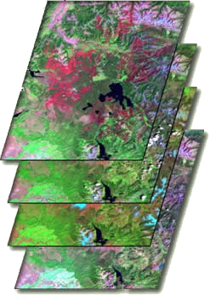

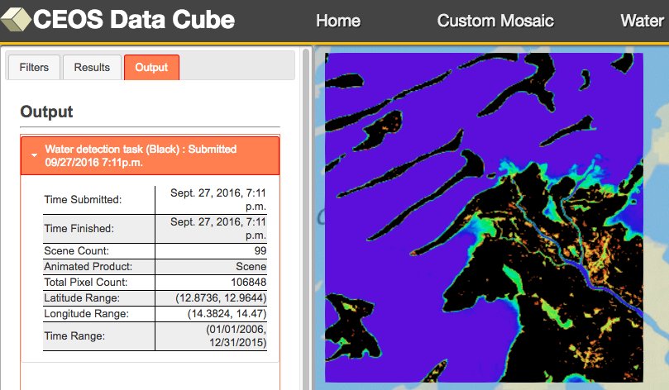
CEOS Data Cubes
An open source data platform for the future
The Data Problem ... Global users lack the knowledge and infrastructure to support the growing volumes of satellite data which can support critical decisions
Data Cubes ... Traditional scene-based data can be put into time-series multi-dimensional (space, time, data type) stacks of spatially aligned pixels that are ready for immediate analysis
Proven concept ... Initially developed in Australia and planned for the future Landsat archive, CEOS is evolving the open source Data Cube platform into a global resource that is compatible with multiple datasets and can be deployed locally or on the cloud
Computational efficiency ... The Data Cube platform takes advantage of modern computing technologies (e.g. cloud computers, parallel processing, APIs).
Infinite applications ... The Data Cube platform reduces data preparation time, allows time series analyses, and increases interoperability of multiple datasets to support an infinite number of applications
Prototypes ... Currently being tested in Colombia and Switzerland with plans for Africa and the Balkans.
http://www.ceos-cube.org

Slide 3
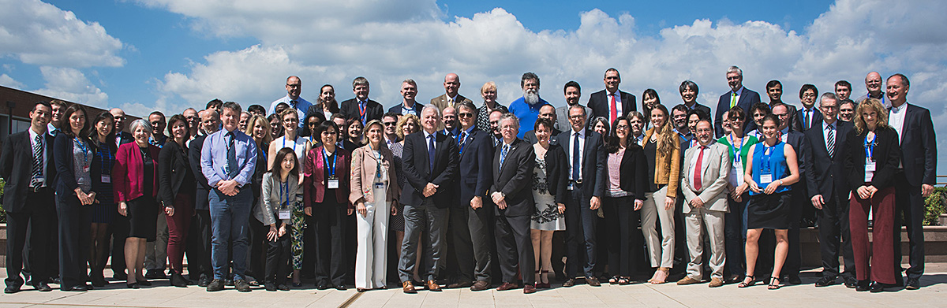
What is CEOS?
www.ceos.org
The Committee on Earth Observation Satellites (CEOS) serves as a focal point for international coordination and data exchange to optimize societal benefit from space-based Earth observations. CEOS represents 22 countries through its 31 space agencies and 28 associate members.

Slide 4


The latest trends in international satellite data
Free and open data
Growing data volumes
Improved computing technologies
Open source software
Pre-processed products

Slide 5
CEOS Data Cube Platform
Application Tools
GIS Tools: ArcGIS, QGIS
CEOS User Interface
Python Notebooks
Common Applications
Cloud Filtering (custom mosaics)
Change Detection
(CCDC, BFAST, PCA, LandTrendr)
Water (WOFS, TSM water quality, Coastal Erosion)
Applications
API
Open Source connection to Data Cube content
Ingestion Process
Satellite Data
Climate Data
Ground Data
Data Cubes
(NetCDF format)

Slide 6
Advantages of the CEOS Data Cube
Free and Open ... Open source software, CEOS Agency contribution
No data loss ... No scene-based screening required, all pixels used
No processing ... Based on analysis-ready data products
Spatial consistency ... Allows for user-defined nested grids
Data interoperability ... Multiple aligned datasets in one system
Efficient ... Less input-output (I/O) and smaller storage
Faster ... Faster temporal and spatial analyses
Allows automation ... Data download and ingestion can be automated
Improved capacity building .. Simple architecture and methods
Flexible deployment ... Local or Remote (e.g. Data Hub, Cloud)
Flexible platform ... APIs allow infinite applications and users
End-to-End solution ... Use one or more components

Slide 7

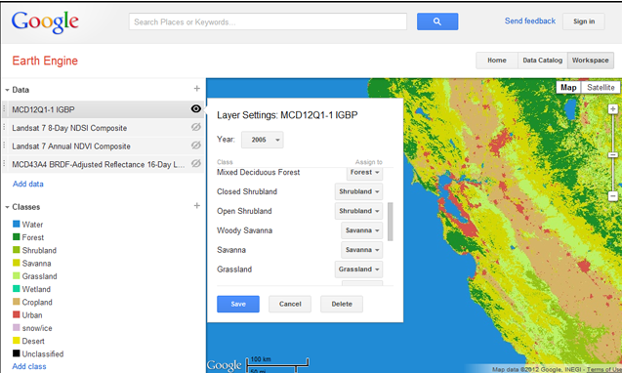
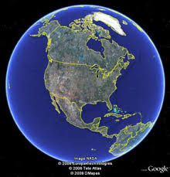
Why not use
Google Earth Engine?
PROS
Free, open, global datasets
Powerful analysis tools for Javascript and Python
Datasets are growing daily ...
Adding Sentinel-1 and Sentinel-2 recently
CONS
Commercial dependency ... Will it be sustained for the future?
Limited time and spatial scales
Cloud-based computing only ... No options for hubs or local computing solutions. Users go to the data for analyses and downloads are not encouraged.
Google “owns” all of the data. Some users prefer control and ownership.
Missing datasets .. You get what Google offers.
Inability to use multiple interoperable datasets (space or ground), as they may not be available or not prepared in common grid formats.

Slide 8
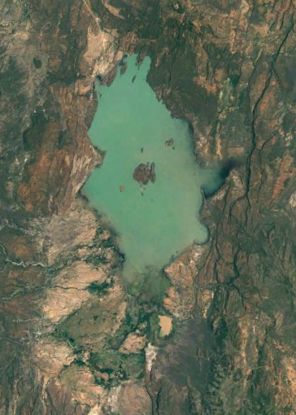
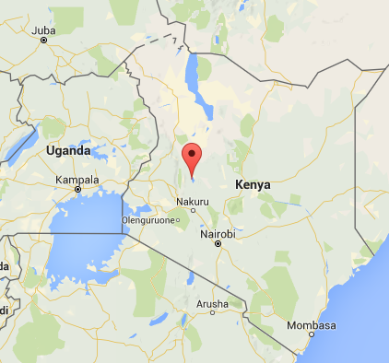
Water Detection Demo
Kenya
Lake Baringo National Park

Slide 9
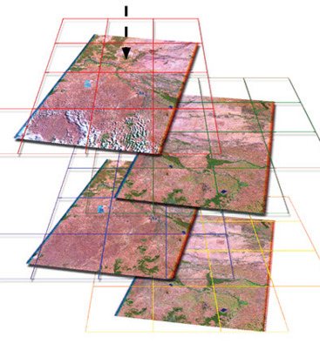
Preparation and Analysis
Data Preparation
Landsat 7, January 2005 to April 2016
169 original scenes
1x1 degree Data Cube “stack” with annual
storage unit “chunks”
3710 x 3710 x 169 = 2.3 billion pixels total
37 GB NetCDF data volume
Data Analysis
3.5 GHz Intel processor (4-core), 64GB RAM, Linux computer
Modified Australian water detection algorithm uses multiple Landsat bands for 97% accuracy
1-2 minutes for an annual analysis and ~30 minutes for a full time series (11+ years) analysis

Slide 10
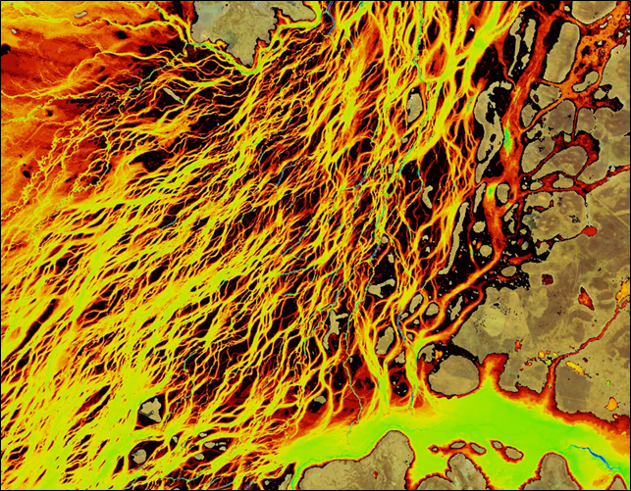
Australian WOFS Algorithm
WOFS = Water Observations from Space
Braided river network of Coopers Creek in Queensland, Australia
Blue = permanent water
Red/Yellow = infrequent flood events
CEOS has implemented the 23-step WOFS algorithm to produce results similar to those shown here
Braided river networks and flood extent is very difficult to map with traditional methods

Slide 11
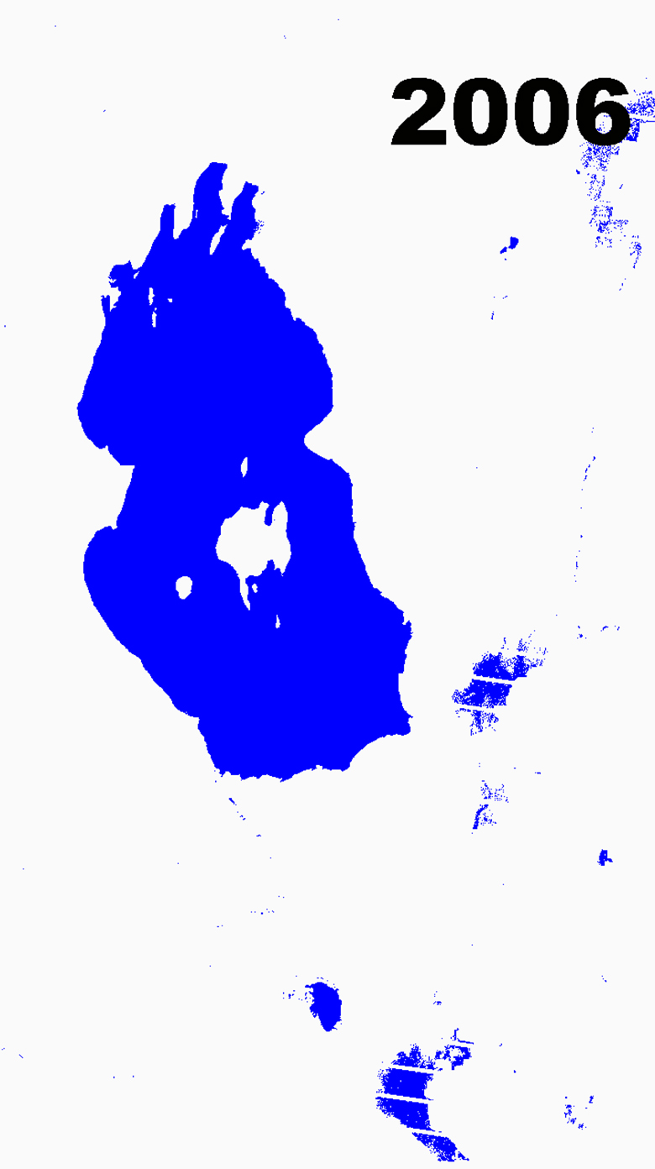
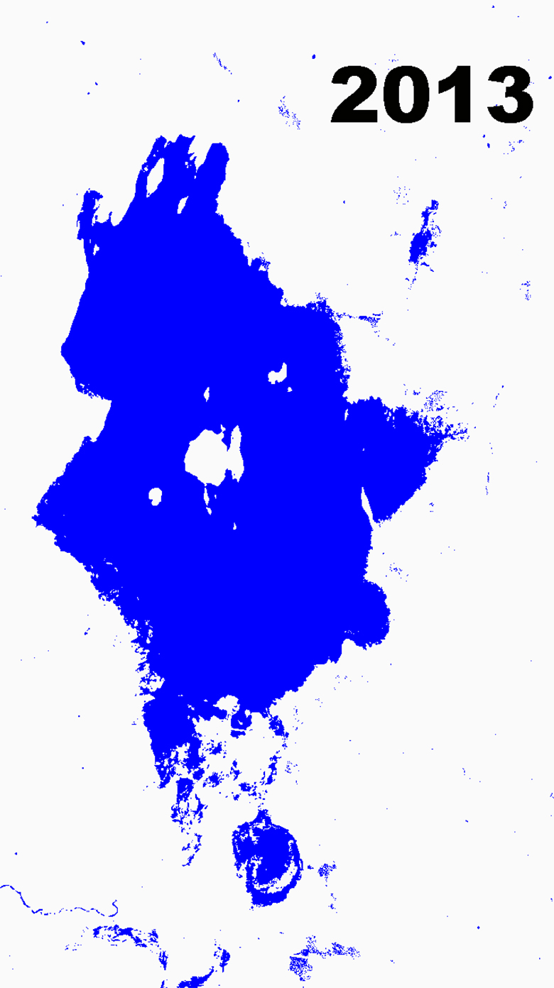
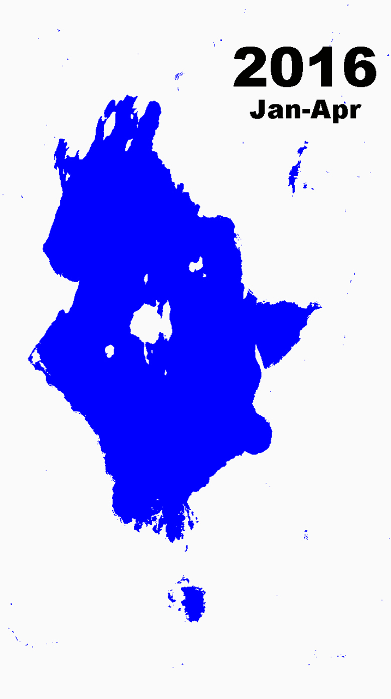
Annual Water Extent
Extreme droughts in the Baringo region in 2009 had severe impacts on pastures and farming
Extreme floods displaced 600 families and swept away livestock near Lake Baringo in 2013
4 months of dry season data resulted in little water detected outside the lake boundary

Slide 12
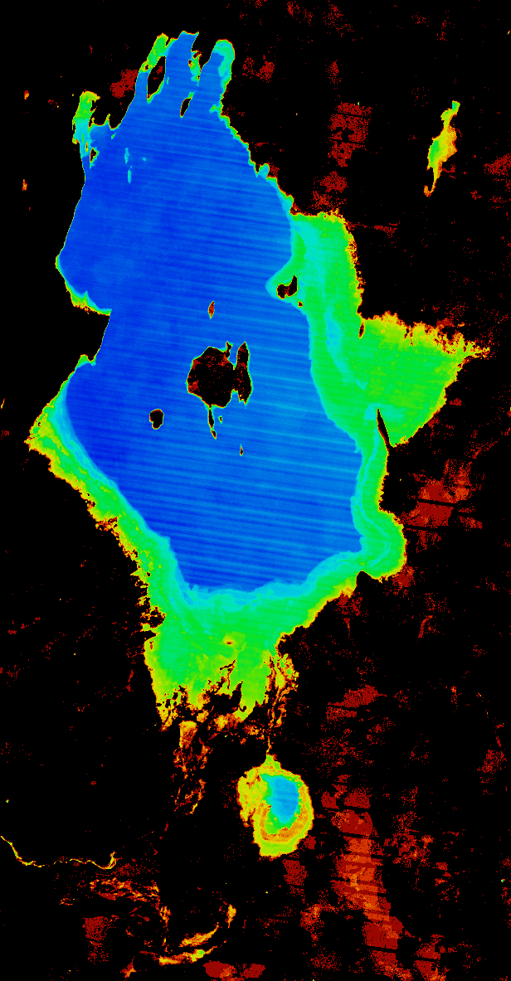

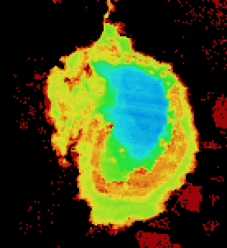
Lake Baringo, Kenya
11-year Time Series Results
The final product shows the percent of observations detected as water over the 11-year time series (water observations / clear observations).
Blue = frequent water
Red/Yellow = infrequent flood events
Flood risk can be easily inferred from the analysis results. 30-meter Landsat resolution allows detailed assessments that are far better than MODIS (250-m).

Slide 13
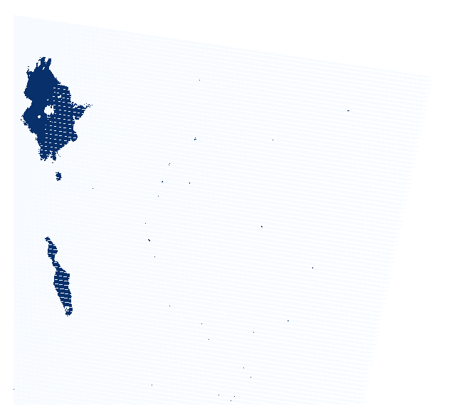
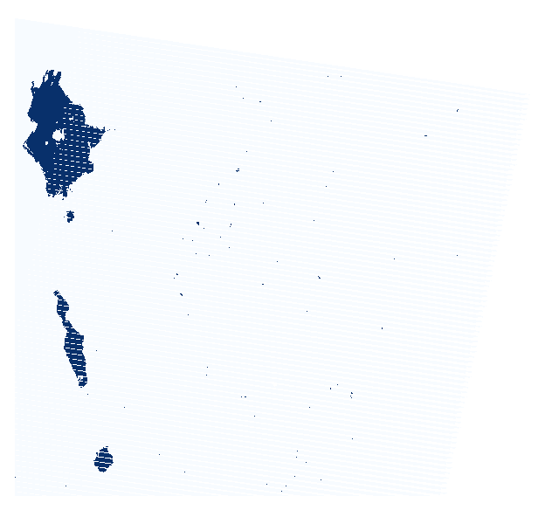
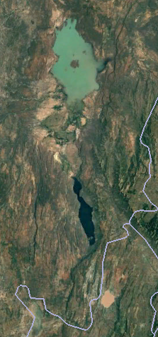
WOFS vs. CFmask
WOFS
CFmask
The WOFS algorithm is able to detect water in places where CFmask (common land-cloud quality mask from USGS) cannot detect water.
Lake Solai (detected by WOFS but not CFmask) is a salt water lake in the Rift Valley Province of Kenya. The lake is known to be contaminated and difficult to detect from space.
Lake Solai
Landsat 7 scene from January 4, 2015 south of Lake Baringo

Slide 14
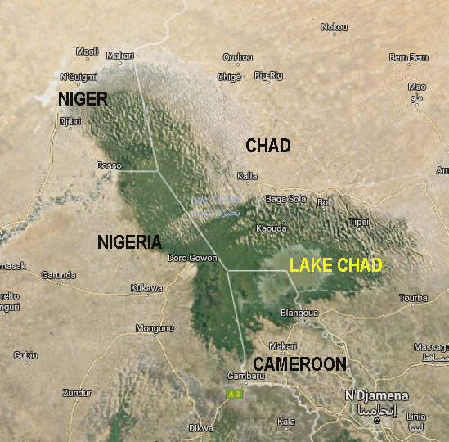
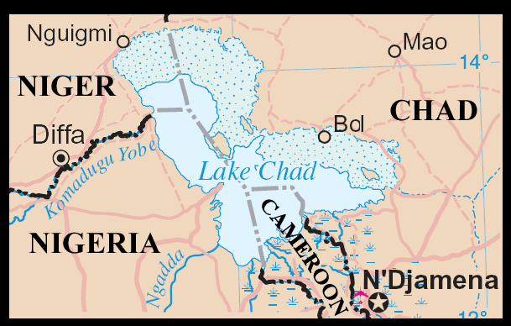
Lake Chad, Africa
Water Detection Demonstration
Historically large and shallow lake has shrunk by 95% from 1963 to 1998 due to increased population demand (reference United Nations). Provides water to 68 million people in 4 bordering countries. 90% of the lake’s water is provided by the Chari River in Cameroon.
Annual rainy season (May-June) gives rise to floods (Aug-Sept) which fill the lake (Oct-Jan) before evaporation during the dry season (Feb-Mar).

Slide 15
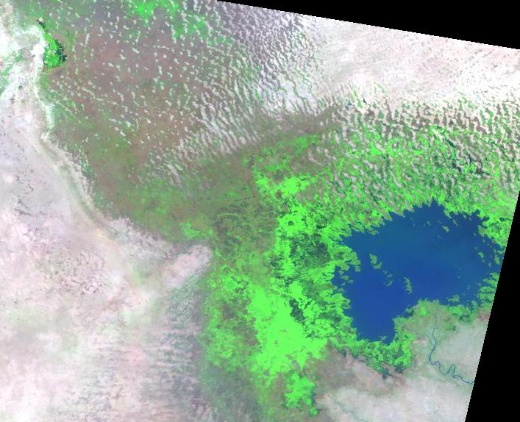
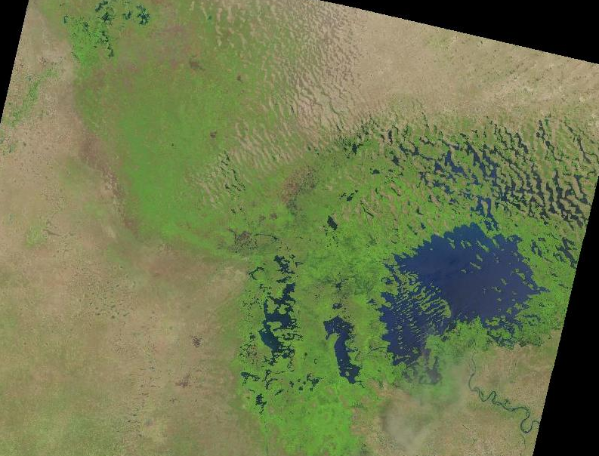
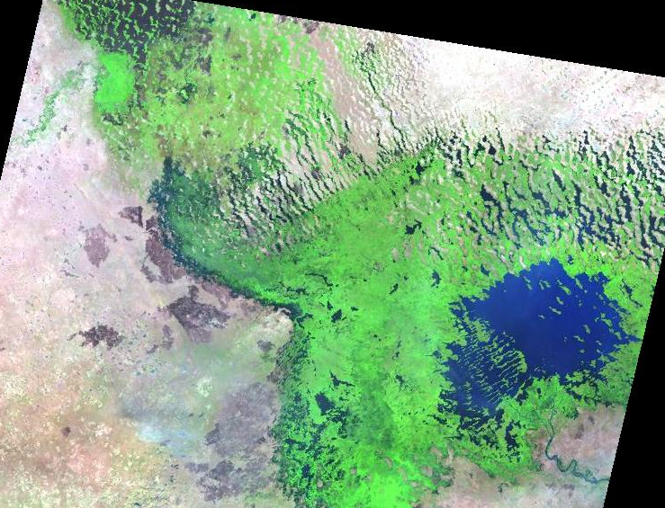
History of Lake Chad
October 1984 – Landsat 5
Drought period shows dry north basin
September 2016 – Landsat 8
Recent satellite image clearly shows the Chari River inlet (right) and the complicated shallow water areas. Much of the lake is a water-vegetation mixture, which is difficult to detect with common water algorithms, but possible with WOFS.
October 1999 – Landsat 7
Rainy period shows expanded vegetation

Slide 16
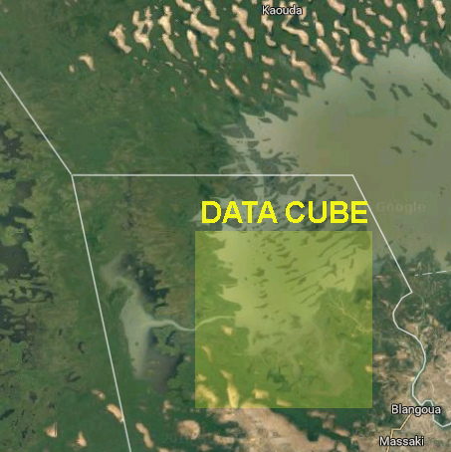
Preparation and Analysis
Data Preparation
Southern section of Lake Chad in Cameroon
including the Chari River inlet
Landsat 7, January 2006 to December 2015
Path-Row = 185-51, 10 years, 99 original scenes
0.25 x 0.25 degree Data Cube “stack”
906 x 923 x 99 = 82 million pixels total
1.2 GB NetCDF data volume
Data Analysis
1.2 GHz Intel processor (8-cores), 66GB RAM, Linux computer
Modified Australian water detection algorithm (WOFS) uses multiple Landsat bands for 97% accuracy
38 seconds for a full time series (10 years) analysis

Slide 17
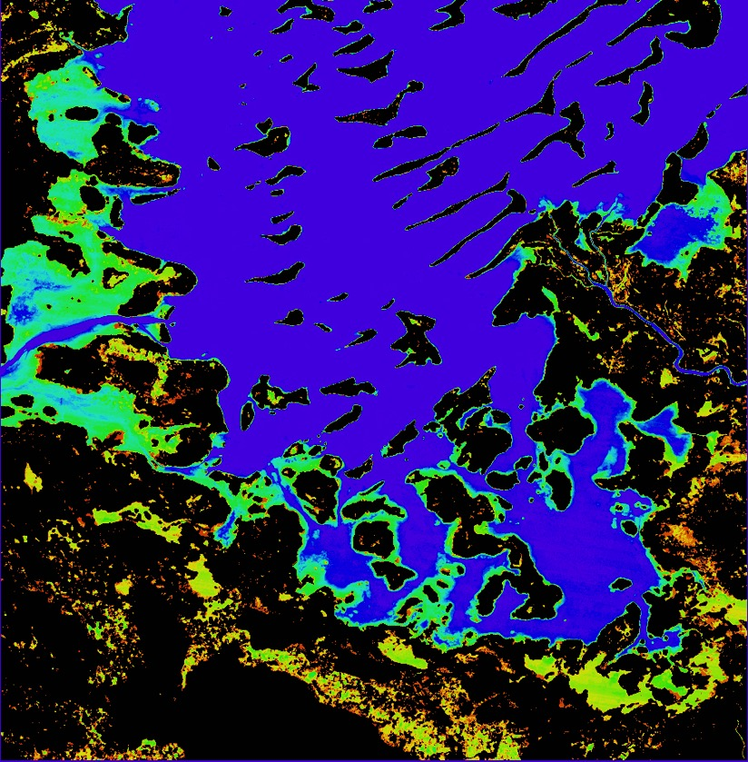
Lake Chad, Cameroon, Africa
10-year Time Series Results
The product shows the percent of observations detected as water over the 10-year time series (water observations / clear observations).
Purple/Blue:
Frequent water
Red/Yellow:
Infrequent water and/or flood events
The lake extent varies in the western region near Nigeria. Low areas in the south experience infrequent flooding.

Slide 18
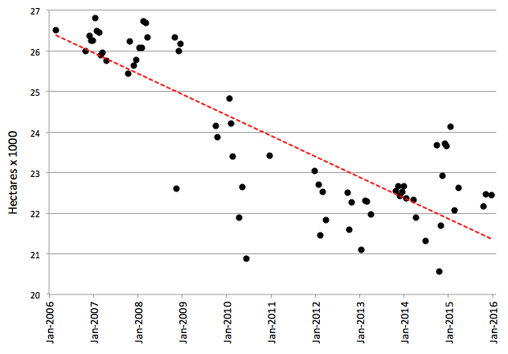
Lake Chad, Cameroon, Africa
Statistical Analysis
The results show the observed water area over 10 years for the full analysis region.
A distinct drop in water area is seen after 2008, which was a known drought period.
The RED trendline shows an average water area loss of 1.4 hectares per day over 10 years

Slide 19
Protoypes
Colombia – The government (IDEAM) and university (Andes) have made considerable progress in learning how to create and use Data Cubes! A complete country-level Landsat Data Cube (25,000 scenes back to year 2000) will be ready by 2017. Land change detection and water detection are the primary application needs. Future plans will add many more datasets and applications.
Kenya – Recent changes in the government have caused uncertainty in the plans for a Data Cube project in 2017. Australia and Clinton Foundation have terminated their work.
Lake Chad, Africa – Considerable interest from World Bank in using a Data Cube for time series analysis of land and water in the Lake Chad region. Possible project to begin in mid-2017, pending approval.
Asia Mekong – Investigating possible project with SERVIR and JAXA to serve Data Cubes to the Mekong region.
Balkans – Recent proposal submitted to World Bank to develop a Data Cube to support multiple applications in Albania. Proposed project to begin in mid-2017.
Switzerland – SEO approached by UNEP GRID Geneva and the Univ. of Geneva to develop a Data Cube pilot project. Significant computing and programming resources exist, so little effort is needed to get them started.

Slide 20
Applications
Cloud Filtering – High priority need of most optical data users. SEO has developed a custom mosaic user interface and is working on concepts for QGIS plugins.
Change Detection – Major benefit of time series Data Cubes. Working on implementations of CCDC (Chris Holden) and BFAST (Jan Vebersselt). Also working with Chris Holden (Boston Univ.) on QGIS tool plugin updates for CCDC.
Water Management – High priority need of GEO and World Bank. Australia developed WOFS (Water Observation from Space) algorithm and SEO has implemented in Python and in a user interface tool. Plans to add Total Suspended Matter (TSM) and CDOM for water quality.
Agriculture – Interest from GEOGLAM for Rangelands (RAPP) project. SEO is developing a fractional cover demo over Colombia.
Disasters – Interest from SERVIR team to implement the SLIP-DRIP algorithm for automated detection of landslides. Multiple integrated datasets (e.g. MODIS, SRTM) in a Data Cube could have major impact.

Slide 21
Architecture Tasks
Analysis-Ready Data – Continued work with CEOS LSI-VC to develop plans for sustained production and access to ARD for Data Cubes.
Ingestors – Need to develop new ingestors for MODIS, SRTM, SPOT-5, ALOS, Climate Data, and other datasets to support new version-2 Data Cube.
User Interface Tools – Continued development of the custom mosaic tool and water detection tool. Adding fractional cover tool for agriculture.
GIS Tool Integration – Continued development of interface tools to use Data Cubes with common GIS tools, such as QGIS and ArcGIS.
Cloud Computing – Continued testing of cloud-based services (e.g. Amazon) to deploy, host and analyze Data Cubes.
Regional Hubs – Continued work with SERVIR to explore opportunities for Data Cube hosting to support regional applications

Slide 22
Other Data Cubes
The concept of a Data Cube is not new. Many local scientists use Data Cubes to package their data for time series analyses. The “new” concept is that CEOS would like to globalize a common infrastructure.
USGS Land Change Monitoring Assessment and Projection (LCMAP) initiative is planning a CONUS Data Cube. They will use a Cassandra database and a REST user interface based on their available computing infrastructure. USGS will start with a CONUS (USA only) cube and then eventually move to a global distribution of data in cube format. Their global delivery will be many years away …
Australian Geoscience Data Cube (AGDC) is focused on Australia applications and designed to utilize the National Computing Infrastructure (NCI) high performance computing facility. Their focus is only the Australia region with no plans for global expansion.

