Slide 1

CEOS Data Cube Report
Agenda Item #7
September 13, 2017
CEOS SIT Technical Workshop
Frascati, Italy (ESA-ESRIN)
Brian Killough
CEOS Systems Engineering Office
NASA Langley Research Center

Slide 2
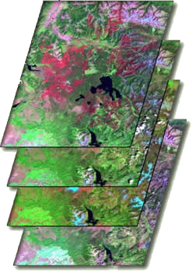

What are Data Cubes?
Data Cube = Time-series multi-dimensional (space, time, data type) stack of spatially aligned pixels ready for analysis
Proven concept by Australia with plans for global implementation
Analysis Ready Data (ARD) ... Dependent on pre-processed products to reduce the burden on users
Open source software approach allows free access, promotes expanded contributions, and increases data usage.
Unique features: exploits time series, increases data interoperability, and supports many new applications.
TIME
Data Cubes are a popular topic … “The Data Cube Manifesto” (Peter Baumann, EU) and “The Six Faces of the Data Cube” (Peter Strobl, EC)

Slide 3
Benefits of Data Cubes
Expanded use of CEOS satellite data … expanded user base
Reduced processing burden .. dependency on ARD
Enhanced interoperability ... improved by MRI
Efficient time series analyses
Free and open access
Flexible deployment (local or cloud)
Use of a common architecture
Community development and sharing … via GitHub
Our goal is NOT to sell a product or distribute a tool. Our goal is to provide a SOLUTION that has VALUE and increases the IMPACT of satellite data.

Slide 4

Open vs. CEOS Data Cubes
The ODC initiative is larger than CEOS.
The Open Data Cube (ODC) initiative was established by CEOS, with a goal to create and foster an open “community” of contributors.
The ODC uses a common architecture among the various implementations so that all users can share tools and applications.
The CEOS Data Cube (CDC) is one “implementation” of the ODC. Similarly, Digital Earth Australia (DEA) and USGS Land Change Monitoring, Assessment, and Projection (LCMAP) are implementations.
The CDC goal is to focus on building global capacity to utilise satellite data and contribute to global initiatives (e.g. UN-SDG, GFOI, GEOGLAM) through the use of Data Cubes.

Slide 5

CEOS Data Cube Vision
A solution supporting CEOS objectives …
  Build capability of users to apply CEOS satellite data
  Supporting priority CEOS/GEO agendas and SDGs
CEOS Agencies wanting to participate …
  Through provision of CEOS Analysis Ready Data (ARD) products
  Contributing to development and uptake of solutions
Customer focused …
  Training materials and easy installation/maintenance
  A brand that people know and trust
  An active community of users
Scalable solution …
  Operational Data Cubes in 20 countries by 2022
  Key partners (e.g. GEO, World Bank) supporting data cube projects

Slide 6
The “Road to 20” Operational Data Cubes by 2020
Operational
Under Development
Under Review or Expressed Interest
3 operational, 4 under development, 22 under review = 29 total

Slide 7
The “Road to 20” Highlights
Colombia has an operational Data Cube since Dec 2016 with over 25,000 historic Landsat images. They continue to expand the user base, applications and datasets. The Colombia Data Cube won the National Environmental Award of Colombian Society of Engineers in May 2017 and has been approved by the Colombia Government into 2018.
Switzerland has an operational Data Cube since July 2017 with over 4,000 historic Landsat images. They have received Swiss government approval and developed a new website (swissdatacube.org). Their future plans include expanded datasets (Sentinel) and increased applications with both government and university involvement.
Vietnam is slowly making progress by establishing pilot cubes in several regions using a new high performance computing system. Their focus is on forests, rice, and water applications. VNSC is hosting an internal Data Cube Workshop on Sept 17.
Taiwan is making progress on a local HPC installation through support from CSIRO. Their focus is forests and water applications.
Uganda has received support from the U.K. to install a demo cube for the Karamoja region on a cloud (AWS). They have made rapid progress with little CEOS support.
See the “Road to 20” document on the ODC website for more!

Slide 8
Other Highlights
Plans are in place to leverage the experience of several operational implementations to expand the presence of Data Cubes …
  Switzerland >>> Georgia, Moldova
  U.K. >>> Solomon Islands, Vanuatu, Nauru
  Taiwan >>> Hondurus
We are making progress with World Bank to support the deployment of a Data Cube in Uruguay to support an agriculture and water quality project with direct links to DINAMA (UN-SDG statistical agency).
4 Data Cube side events are planned for GEO-17 on Oct 23-24. Each 1.5 hour segment will have a different Data Cube topic. Please attend!
Future outreach opportunities at Pecora-20 (USGS) and IGARSS-2018 (July in Valencia, Spain).

Slide 9
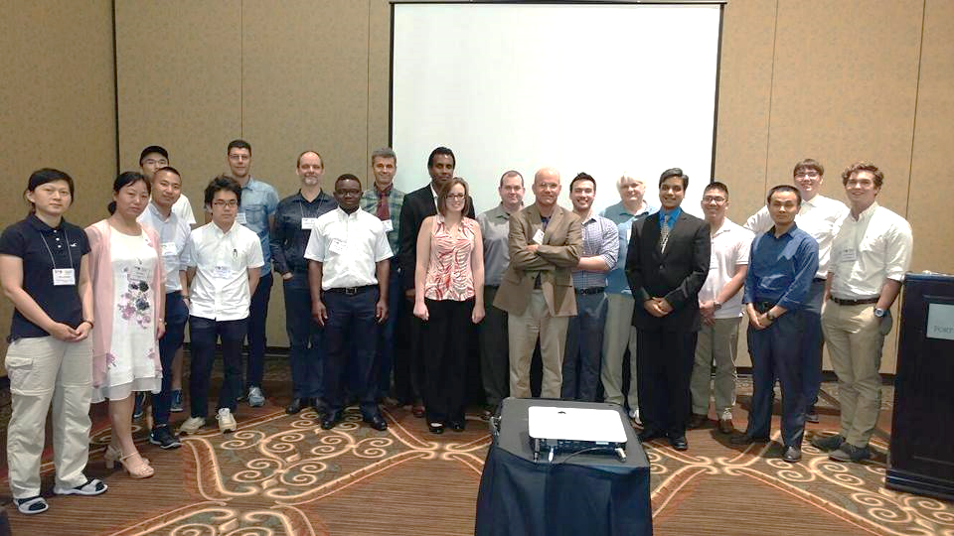

ODC Progress
We have established an “ODC Partners” group which includes representatives from the NASA-SEO, GA, CSIRO, USGS, and UK-Catapult.
We have established an “ODC Steering” group which include technical representatives from NASA-SEO, GA, CSIRO, and USGS.
We have established a new website http://opendatacube.org
We have developed “white papers” for the ODC and CDC that describe the goals of each initiative and an ODC governance document for code management.
We conducted the first ODC Workshop at the recent IGARSS conference in Fort Worth, Texas, USA in July.
We are planning the 2nd Annual
ODC Technical Meeting in
Canberra, Australia on Feb 14-16, 2018.

Slide 10
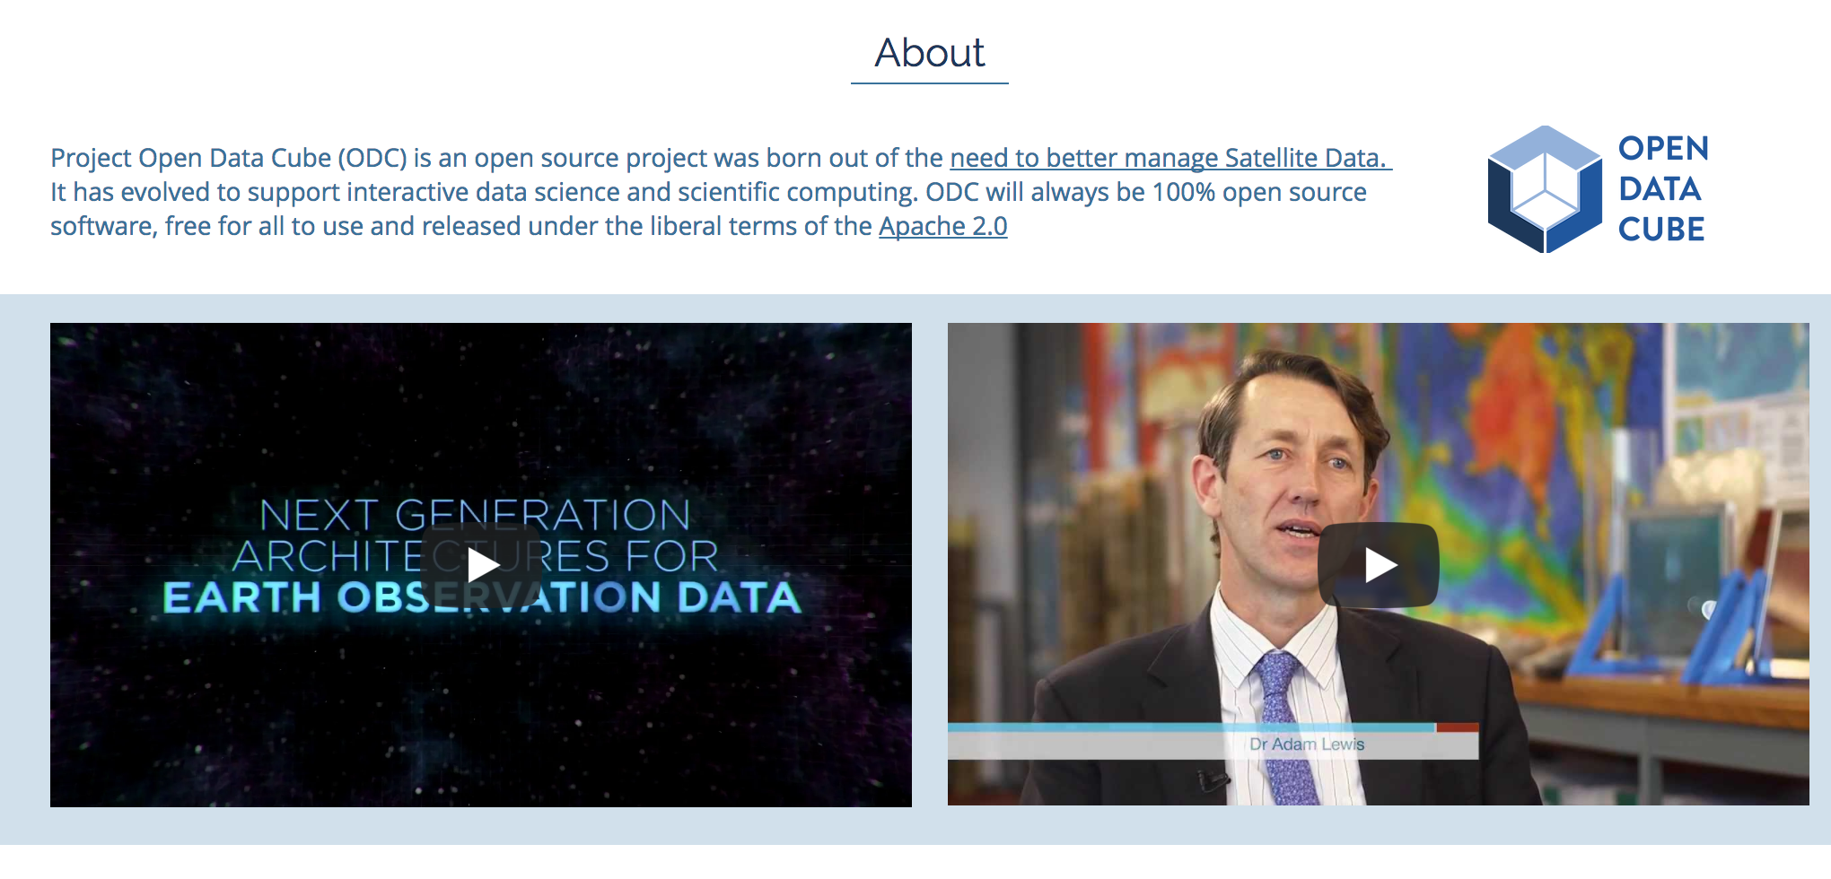
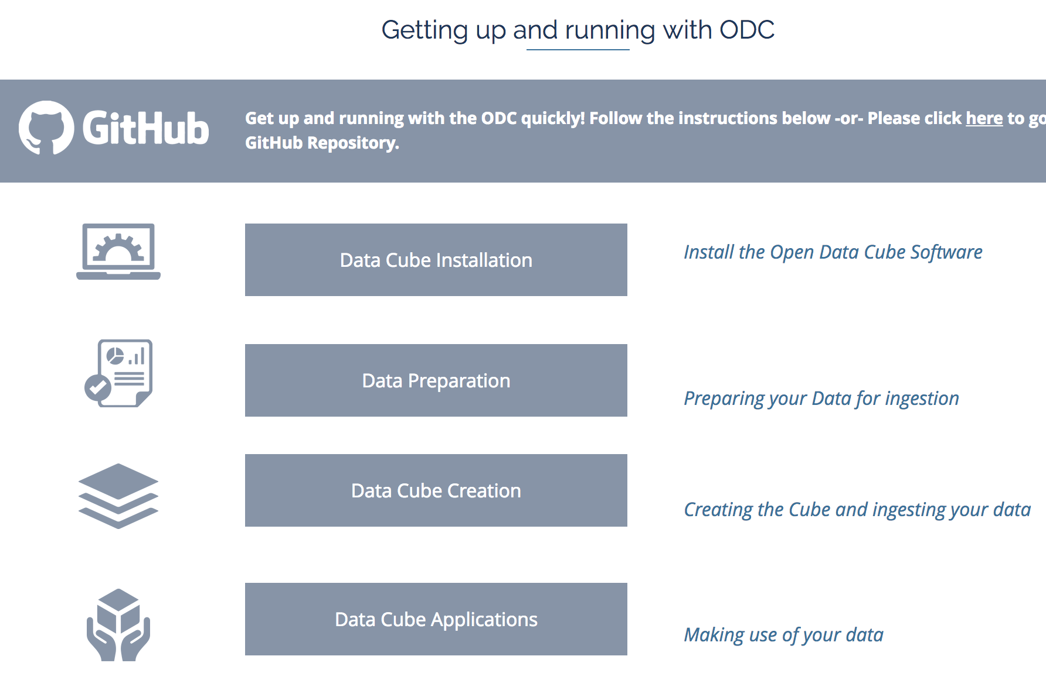
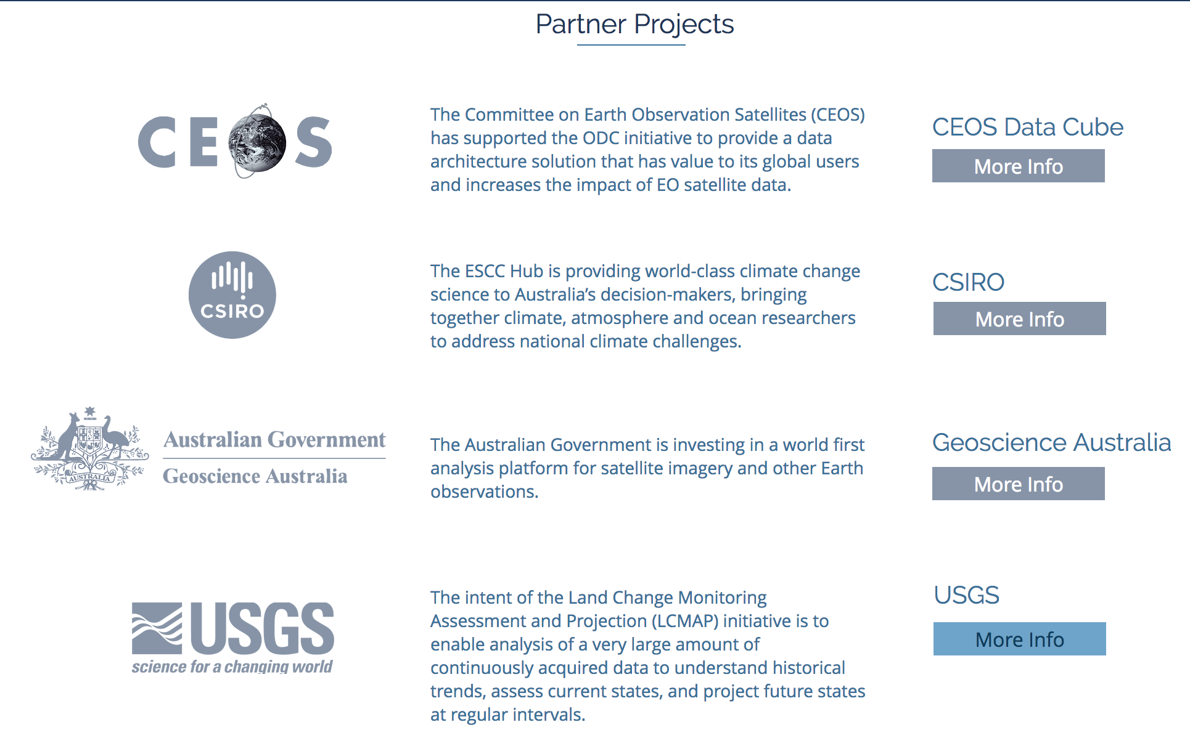
CDC Progress
The CDC has established detailed content to support Data Cube deployments
https://www.opendatacube.org
Installation – system requirements, installation guide
Data Preparation – ARD guidance, data acquisition guidance
Data Cube Creation – ingestors for all popular datasets
Applications – AWS cloud demo, Python notebooks, growing list of algorithms (water and land)
User Forum – discussion groups for user support

Slide 11
Lessons Learned
Through our initial country interactions, we have learned a number of lessons …
Country users should have some Python programming skills
It is important to clearly understand country needs and to guide them toward the needed satellite data and application tools
It is important to maintain consistent customer communication (both face-to-face and remote) to sustain deployment progress and build trust
It is important to utilise relationships with investment banks (e.g. World Bank) and GEO to increase access to country contacts and facilitate deployment
The ODC community needs to continue to grow and expand to build confidence towards desired outcomes and to build the supply of open source tools and applications

