Slide 1
Data Cube Support to
GFOI Early Warning
Brian Killough / NASA, CEOS SEO
SDCG-12, September 4, 2017
Session 1
Agenda Item 7

Slide 2
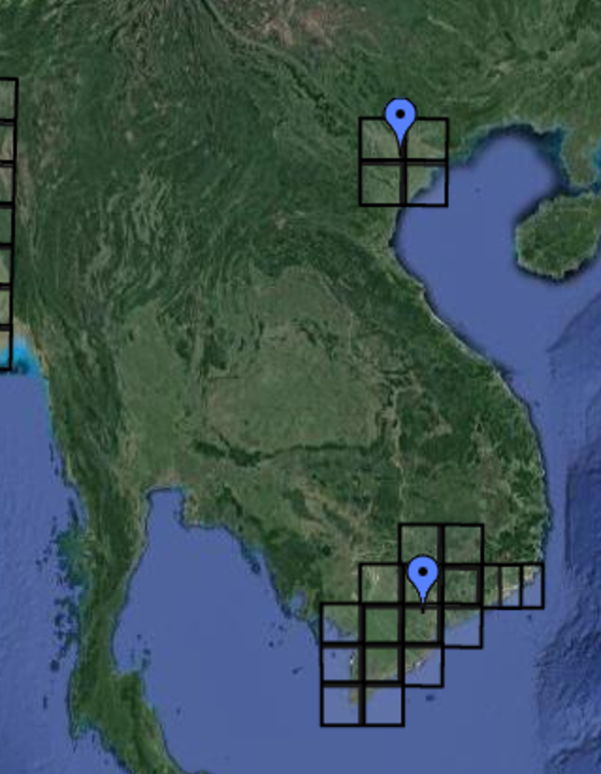
GFOI Alert Demo Case Study
Objective: To demonstrate a deforestation alert tool that utilizes diverse moderete resolution datasets and a Data Cube infrastructure.
Location: Vietnam (TBD). In order to take advantage of the current Vietnam HLS test sites, the following locations are suggested (see figure on the right). It is expected that the final selected site will be of high interest to the Vietnam Forest Inventory and Planning Institute (FIPI).
Datasets: Several analysis-ready datasets are needed, including: Landsat 7/8, Sentinel 1/2, Harmonized Landsat-Sentinel (HLS), ALOS/ALOS-2 PALSAR and Radarsat.
Change Detection Algorithms: The identification of potential deforestation sites will be determined by various land change detection algorithms, including:
  JJ-FAST (applied to PALSAR) from JAXA
  PyCCD (initially only Landsat, but plans to test with other datasets)

Slide 3
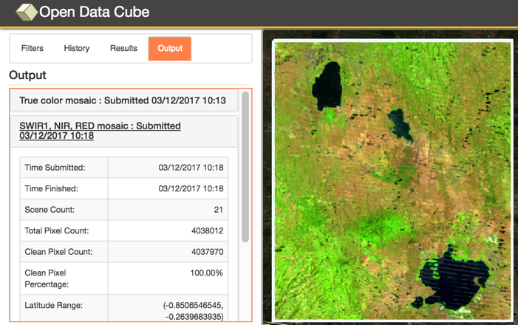
Existing Data Cube pilots
The CEOS Data Cube initiative has established over 16 sample Data Cubes in South America (Colombia, Uruguay), Africa (Kenya, Ghana, Chad) and Asia (Vietnam, Bangladesh).
Most Data Cubes are Landsat 7/8, but new Sentinel-1 and ALOS/ALOS-2 Data Cubes exist in Vietnam.
The CCDC change detection algorithm has been adapted to run on the Data Cube (now called PyCCD) using Landsat data. CEOS plans to test this code with Sentinel-1 in the coming months.
Using a Data Cube for an Early Warning Alert system has some advantages. The solution could be commonly applied to anyone with a Data Cube and the results controlled locally. In addition, it is computationally efficient to run time series analyses.

Slide 4
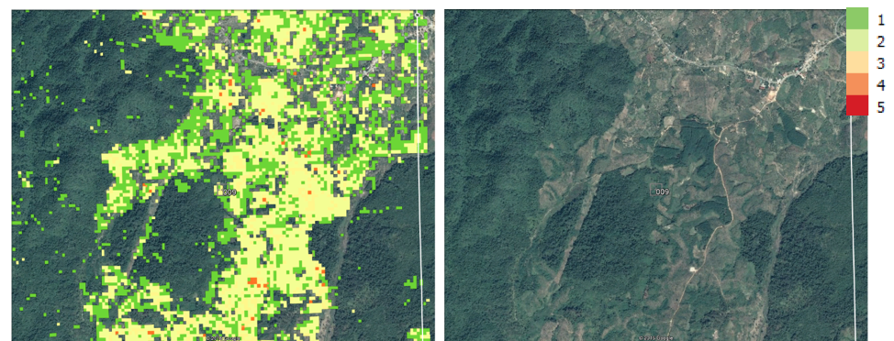
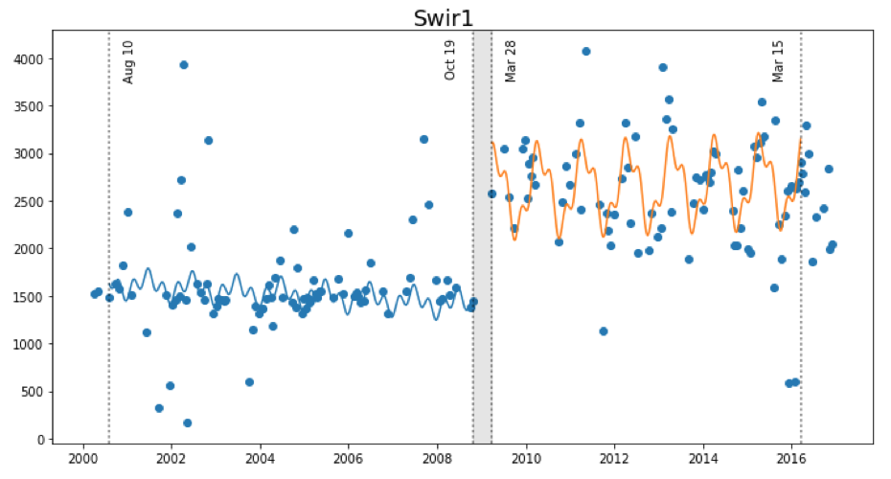
Land Change Detection
CCDC (Zhu and Woodcock, 2012) was converted to Python by USGS and recently tested by the SEO on the Vietnam Data Cube. We now call this“PyCCD”.
PyCCD time series model fits 7 bands to 6 weighted SINE and COSINE functions in order to find “breaks” that equate to potential land change.

Slide 5
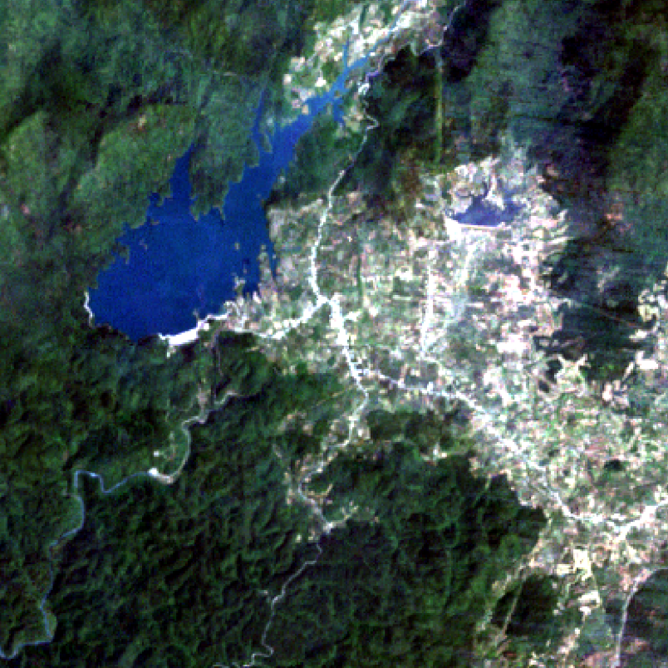
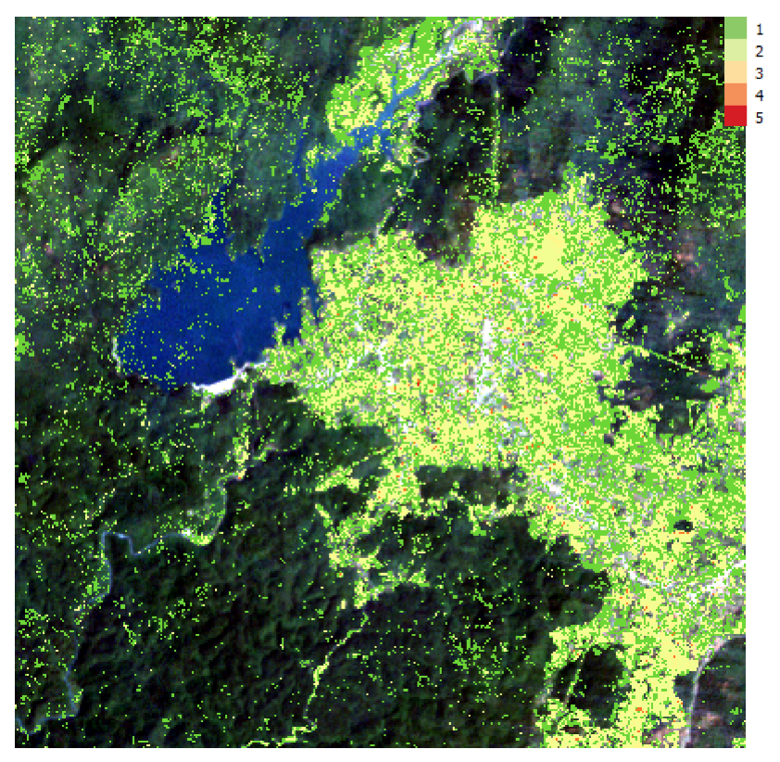
Vietnam Land Change
Bediaye, Vietnam – Data Cube Median Mosaic (left), PyCCD Results (right)
2000 to 2016, 192 Landsat scenes

Slide 6
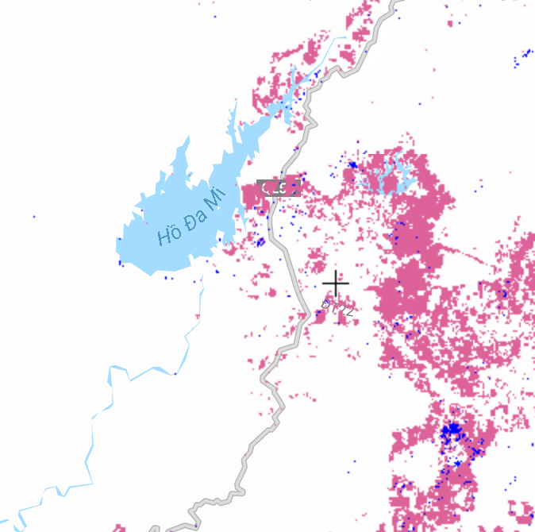
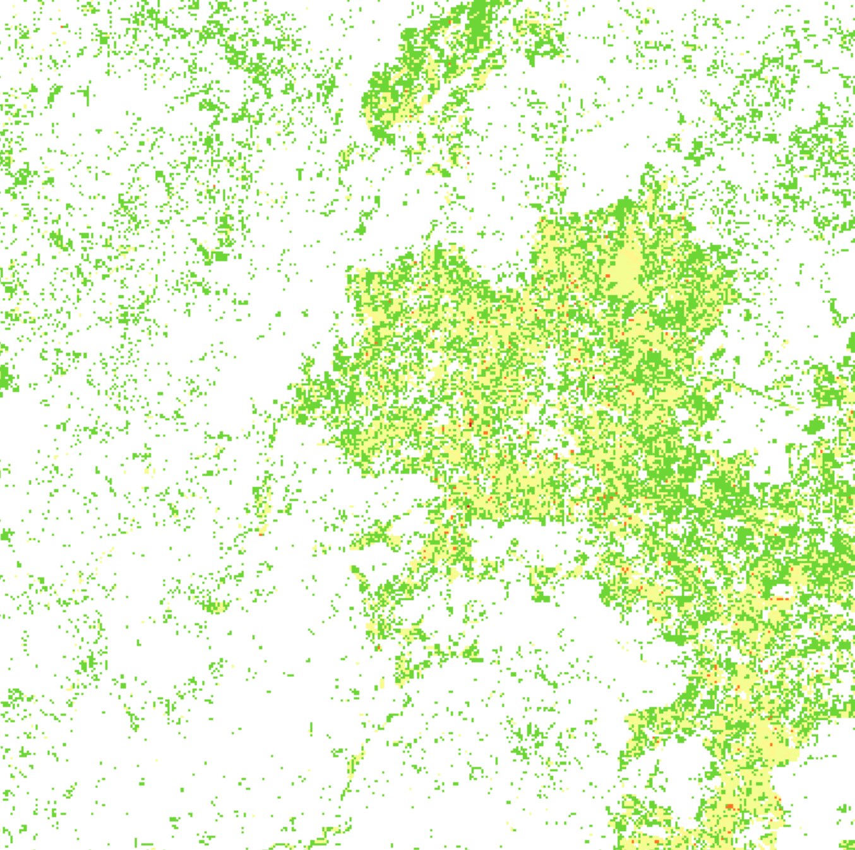
Global Forest Watch vs. PyCCD
Global Forest Watch
Forest Loss - 2000 to 2015
PyCCD with a Data Cube
Land Change - 2000 to 2016
PyCCD Execution: 372 x 372 pixels, 8 parallel cores, 2.3 hours (~1 msec / clear pixel)

Slide 7
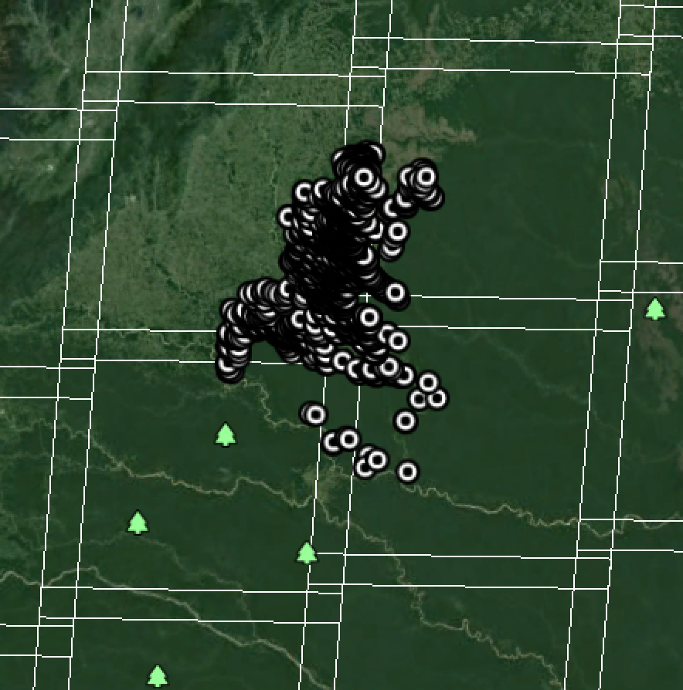
Example Alerts from Colombia
Deforestation Alert Samples
Data provided by Colombia
February 2017 Alerts in Caqueta, central Colombia
The CEOS SEO plans to investigate these alert locations against Landsat PyCCD results, Sentinel-1 PyCCD results and ALOS
JJ-Fast results.

Slide 8
CBERS-4 Coverage Summary
Brian Killough / NASA, CEOS SEO
SDCG-12, September 4, 2017
Session 3
Agenda Item 18

Slide 9
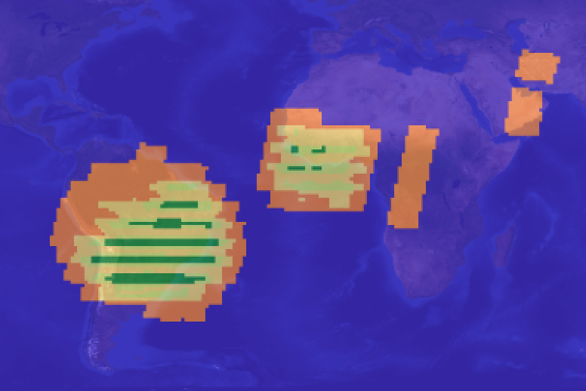
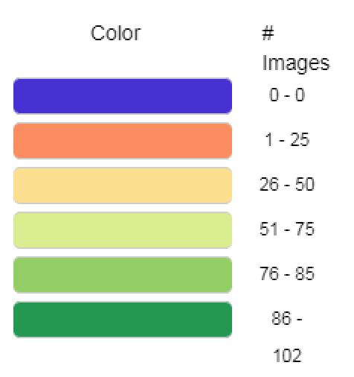
2017 CBERS-4 Summary
Data from the China CBERS-4 archive is not shown. Only data from the INPE archive is reported here.
Jan-1 to July-31, 2017 acquisitions from WFI-2 instrument (VIS and NIR, 73m, 5 day revisit). Though not shown here, the coverage for the IRSCam (SWIR and TIR, 40-80m, 26 day revisit), MUXCam (VIS, 20m, 26 day revisit) and PanMUX (PAN and MS, 5-10m, 26 day revisit) instruments is similar.

Slide 10
GFOI Space Data Services
Brian Killough / NASA, CEOS SEO
SDCG-12, September 5, 2017
Session 5
Agenda Items 23 and 24

Slide 11

Agenda – Session 5
3-Year Work Plan Tasks and Outcomes
  #6: Ensured On-going Coverage
  #7: Interoperable Data Discovery Tools
  #8: Assembly and Delivery of Core Data
  #10: Cloud-Computing Pilot Projects
  #11: Model National GFOI Data Services
Open Data Cube

Slide 12
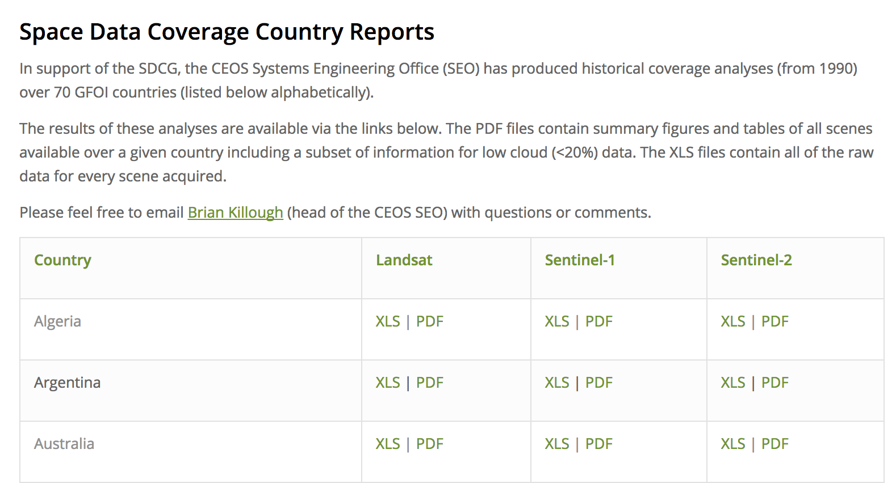
#6: Ensured On-going Coverage
Archive Characterization
The SEO has now automated the production of Landsat, Sentinel-1 and
Sentinel-2 country reports and they are posted online for all 70 GFOI countries. We plan to update these reports on an annual basis.
The most recent update was the addition of ”Collection” information to the Landsat report. Users can now see the Tier-1 and Tier-2 designations.
These reports will be valuable for
countries to assess available scenes
and cloud cover for future data
ordering. The SEO has also provided
additional detailed support to
countries, as needed.

Slide 13
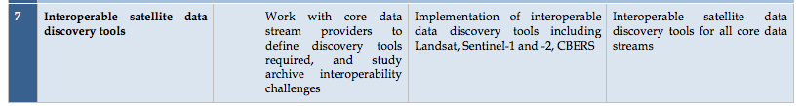
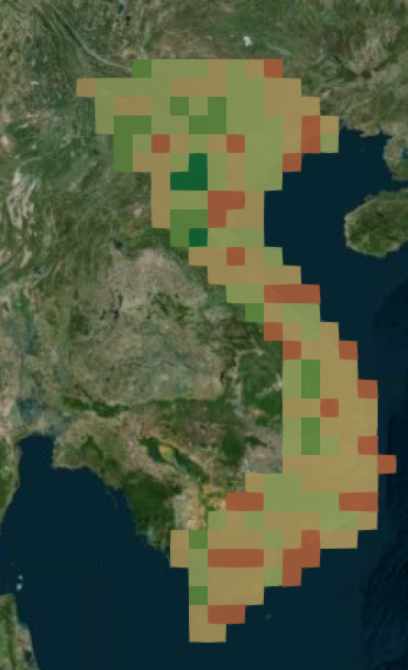
#7: Interoperable Data Discovery Tools
The COVE Tool now includes links to archive databases from: Landsat 7/8, SPOT 1-6, Pleaides-1A/1B, Radarsat-2, TSX, ALOS-1, Sentinel-1A/1B and Sentinel-2A.
The SEO vision is that the COVE tool can provide a “one-stop” location to perform coverage assessments and “discovery” of valid images. It also gives the user direct links to data ordering, when possible.
The new ”COVE Coverage Analyzer” tool can perform country-level and global queries of the Landsat and Sentinel archives in one tool! This will be demonstrated at the Joint SDCG-LSI-GEOGLAM meeting.
Sentinel-1 acquisitions over Vietnam for Jan-Jun 2017 at 0.5 deg

Slide 14
#8: Assembly/Delivery of Core Data
The provision of “core data” for GFOI purposes is in place and there are few issues.
Countries can use scene-based tools (e.g. SEPAL) or the new Data Cube tools as methods for data analysis. These tools can be deployed locally, or on data hubs or computing clouds.
The move toward sustained Analysis Ready Data (ARD) significantly improves the efficiency and effectiveness of core satellite data. This is being worked within CEOS.
The new “GFOI Space Data Portal” will improve the capability of countries to identify and obtain needed satellite datasets.

Slide 15
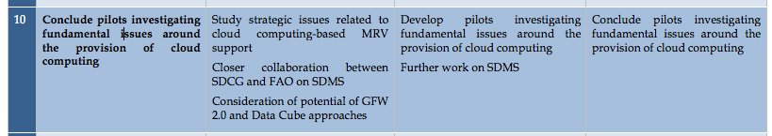
#10: Cloud Computing Pilot Projects
The SEO is pursuing collaborations with Amazon to test the use of AWS cloud computing for Data Cubes.
Most countries prefer local deployment of data for analysis purposes, but there are several countries that desire to use cloud computing.
The SEO is working with several countries that plan to use cloud computing for Data Cube hosting: Uganda, Uruguay, Mexico, Bangladesh.

Slide 16
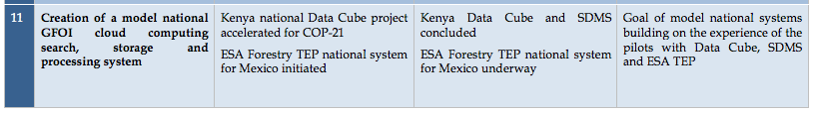
#11: Model National GFOI Data Services
To date, we have not identified a “Model National GFOI Data Services” system, but a GFOI-AWS concept was proposed in May 2016.
FAO is continuing to enhance its SEPAL tool and CEOS is working on its Open Data Cube tools.
As these two initiatives progress, the GFOI group should discuss the notion of a “model” system and what serves the community most effectively and efficiently.

Slide 17
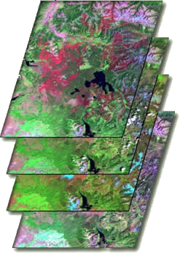

What are Data Cubes?
Data Cube = Time-series multi-dimensional (space, time, data type) stack of spatially aligned pixels ready for analysis
Proven concept in Australia (GA) and planned for the USGS Landsat archive.
Analysis Ready Data (ARD) ... Dependent on processed products to reduce processing burden on users
Open source software approach allows free access, promotes expanded capabilities, and increases data usage.
Unique features: exploits time series, increases data interoperability, and supports many new applications.
TIME
Data Cubes are a popular topic … “The Data Cube Manifesto” (Peter Baumann, EU) and “The Six Faces of the Data Cube” (Peter Strobl, EC)

Slide 18

Open vs. CEOS Data Cubes
The Open Data Cube (ODC) initiative is bigger than CEOS.
The ODC was established by CEOS Agencies, but our goal is to create an open “community” of contributors through “organic” growth.
The primary ODC goal is to use a common architecture among the various implementations so that all users can share tools and increase the impact and value of CEOS satellite data.
The CEOS Data Cube (CDC) is one “implementation” of the ODC. Similarly, Digital Earth Australia (DEA) and USGS Land Change Monitoring, Assessment, and Projection (LCMAP) are implementations.
The CDC goal is to focus on building global capacity to utilise satellite data and contribute to global initiatives (e.g. UN-SDG, GFOI, GEOGLAM).

Slide 19
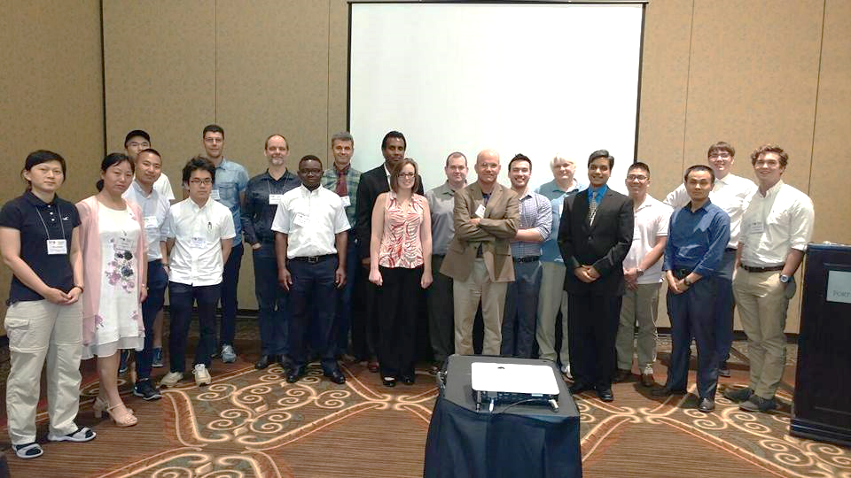

Making Progress …
We have established an “ODC Partners” group which includes representatives from the NASA-SEO, GA, CSIRO, USGS, and UK-Catapult.
We have established an “ODC Steering” group which include technical representatives from NASA-SEO, GA, CSIRO, and USGS.
We have established a new website http://opendatacube.org
We have developed “white papers” for the ODC and CDC that describe the goals of each initiative and an ODC Governance document.
We conducted the first ODC Workshop at the recent IGARSS conference in Fort Worth, Texas, USA in July.
We are planning the 2nd Annual
ODC Technical Meeting in Canberra, Australia
on Feb 14-16, 2018. You are welcome to attend!

Slide 20

CEOS Data Cube Vision
A solution supporting CEOS objectives …
  Build capability of users to apply CEOS satellite data
  Supporting priority CEOS/GEO agendas and SDGs
CEOS Agencies wanting to participate …
  Through provision of CEOS Analysis Ready Data (ARD) products
  Contributing to development and uptake of solutions
Customers feel that they are the focus …
  Training materials and easy installation/maintenance
  A brand that people know and trust
  An active community of users
Scalable solution …
  Operational Data Cubes in 20 countries by 2022
  Key partners (e.g. GEO, World Bank) supporting data cube projects

Slide 21
The “Road to 20” Operational Data Cubes by 2020
Operational
Under Development
Under Review or Expressed Interest
3 operational, 4 under development, 22 under review = 29 total

Slide 22
The “Road to 20” Highlights
Colombia has an operational Data Cube since Dec 2016 with over 25,000 historic Landsat images. They continue to expand the user base, applications and datasets with continued support from the CDC team.
Switzerland has an operational Data Cube since July 2017 with over 4,000 historic Landsat images. They have received Swiss government approval and developed a new website (swissdatacube.org). Their future plans include expanded datasets (Sentinel) and increased applications.
Vietnam is slowly making progress by establishing pilot cubes in several regions using a new high performance computing system. Their focus is on forests, rice, and water applications. VNSC is hosting an internal Data Cube Workshop on Sept 17.
Taiwan is making progress on a local HPC installation through support from CSIRO. Their focus is forests and water applications.
Uganda has received support from the U.K. and the NASA-SEO to install a demo cube for the Karamoja region on a cloud (AWS). They have made rapid progress with little CEOS support.
See the “Road to 20” document on the ODC website for more!

Slide 23
Which have an interest in Forests?
The CDC team is engaging with 29 different countries to consider the deployment of Data Cubes. Many of those countries have a desire to support forest applications.
We know that these 9 countries have an interest in forest applications, but there may be more: Colombia, Switzerland, Vietnam, Taiwan, Kenya, Georgia, Moldova, Hondurus, Canada

Slide 24
Technical Progress
The CDC has established detailed content to support Data Cube deployments
  Installation – system requirements, installation guide
  Data Preparation – ARD guidance, data acquisition guidance
  Data Cube Creation – ingestors for all popular datasets
  Applications – AWS demo, Python notebooks, growing list of algorithms
  Forum – discussion groups for user support
The ODC group is targeting a formal release (Version #1) in
February 2018.
  Establish an end-to-end architecture that allows user deployment
  Establish documentation and training tools

Slide 25
Near-term Development and Testing
Develop a new QGIS tool plugin with a web-based (WCS) connection to a Data Cube hosted on AWS (cloud storage)
Develop sample iPython Notebooks on AWS to demonstrate interactive Data Cube applications and programming simplicity
Test the PyCCD land change detection algorithm with radar datasets
Develop and test a new Water Quality algorithm from Tony Vodacek (Landsat Science Team) based on a Look-Up-Table approach to infer Chlorophyll-A, CDOM and TSS concentrations.
Test Sentinel-1 GRD and SLC cubes with the Random Forest land classification clustering algorithm

Slide 26
Amazon (AWS) Data Cube Demo Portal
Data Cubes
16 cubes with 10+ years each.
Kenya, Cameroon (Lake Chad), Togo (coastal Africa), Ghana, Colombia, Tonga (Pacific Island), Vietnam, Australia (Menindee Lakes), Bangladesh.
User Interface Features
9 applications: cloud coverage maps, custom cloud-free mosaics, fractional cover, NDVI anomaly, water detection, water quality, landslides, coastal change and urbanization.
Outputs in GeoTIFF and GIF animation.
New features added in Sept 2017: data visualization tools, ingestion “on demand” for new cubes or subsetting, indices, mosaics (medoid, geometric median)
This is the first “hands-on” global demo of the Data Cube to show its potential for rapid time series analysis and diverse applications
http://tinyurl.com/datacubeui
Free and Open!

Slide 27
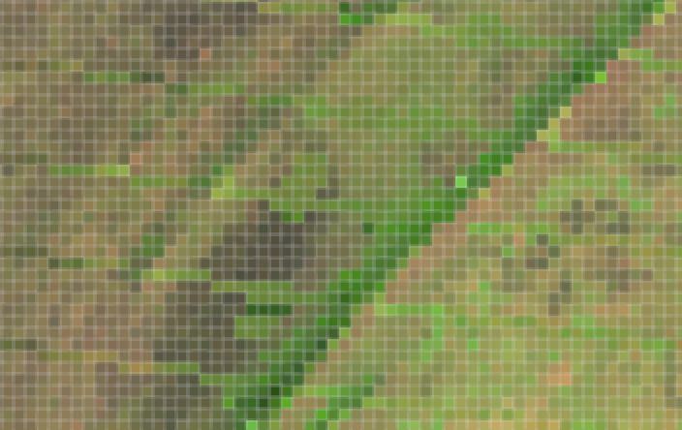
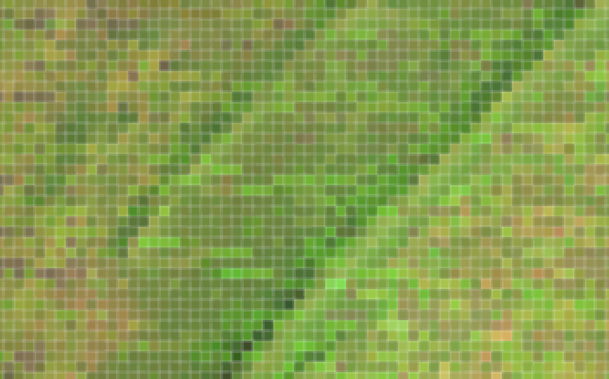
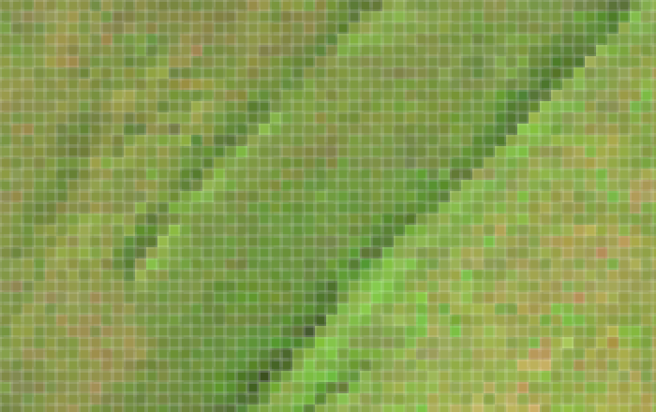

Custom Mosaics
There are 7 custom mosaic products available in the User Interface tool and also in Python code: Least/Most Recent Pixel, Min/Max NDVI, Median, Medoid, Geometric Median
Medoid = an ”real” mosaic based on pixels in the time series that represent minimal dissimilarity
Median = a mosaic product based on the ”midpoint” spectral response from each band in a time series. For shorter time series, this may represent a “real” pixel.
Geometric Median = a “synthetic” mosaic product based on minimal spectral and temporal dissimilarity for each pixel, thereby “weighting” the result toward the most common response.
Most Recent Pixel
Medoid
Median
Geometric Median
Sample Mosaics over Uganda. 11 total scenes from Landsat-7 in 2015.

Slide 28
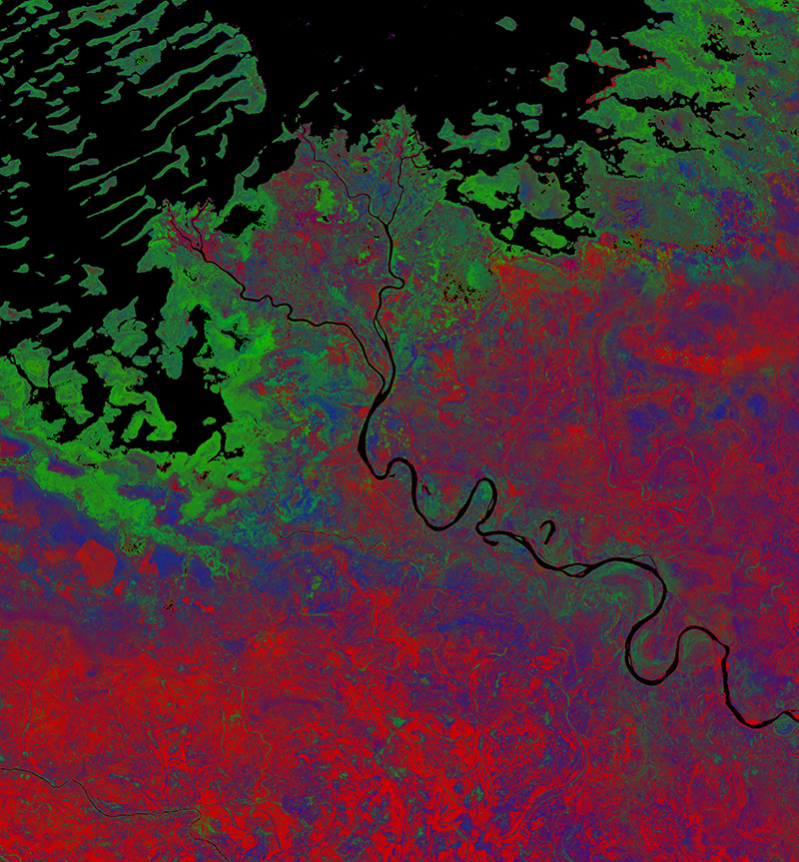
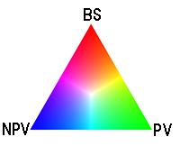
Fractional Cover
Southern Lake Chad
Cameroon, Africa
2015 Fractional Cover
R = Base Soil (BS)
G = Photosynthetic Vegetation (PV)
B = Non-Photosynthetic Vegetation (NPV)
* NPV is dead vegetation, wood, stems, leaves
The fractional coverage algorithm (right) estimates the average vegetation fractional cover over the time period using a linear unmixing technique developed by Juan P. Guerschman (CSIRO).

Slide 29
Land Change Detection
CCDC (Zhu and Woodcock, 2012) was converted to Python by USGS and recently tested by the SEO on the Vietnam Data Cube. We now call this“PyCCD”.
PyCCD time series model fits 7 bands to 6 weighted SINE and COSINE functions in order to find “breaks” that equate to potential land change.

Slide 30
Vietnam Land Change
Bediaye, Vietnam – Data Cube Median Mosaic (left), PyCCD Results (right)
2000 to 2016, 192 Landsat scenes

Slide 31
Global Forest Watch vs. PyCCD
Global Forest Watch
Forest Loss - 2000 to 2015
PyCCD with a Data Cube
Land Change - 2000 to 2016
PyCCD Execution: 372 x 372 pixels, 8 parallel cores, 2.3 hours (~1 msec / clear pixel)

Slide 32
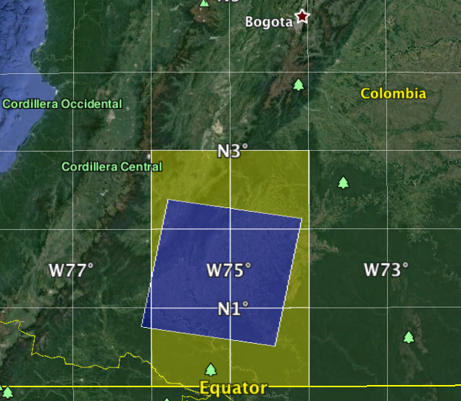
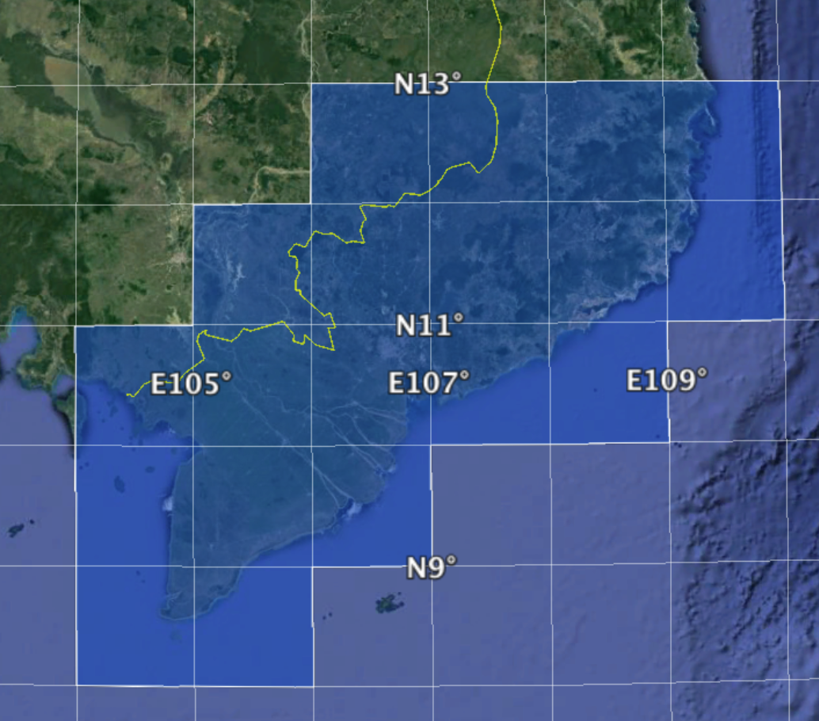
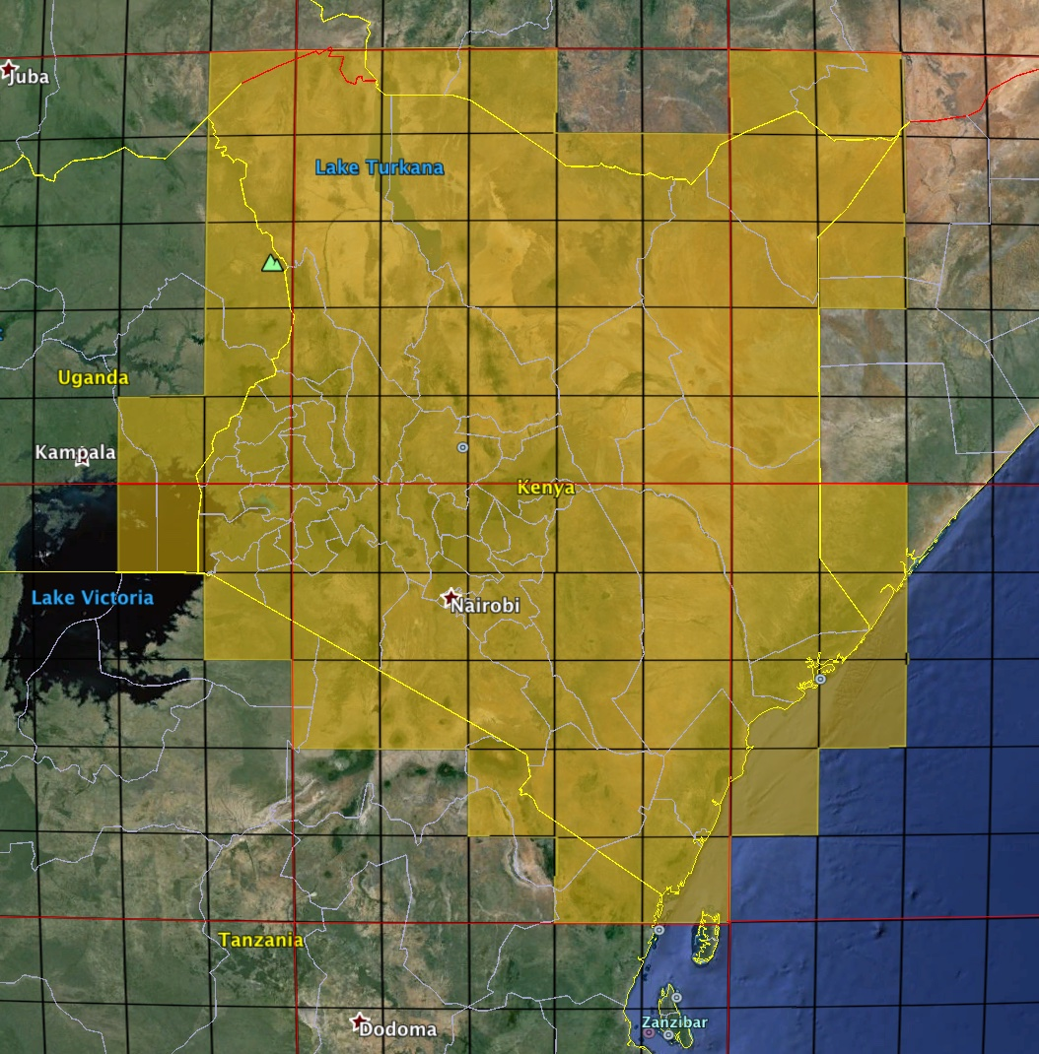
L-Band SAR Data Testing
GOAL: Investigate the use of L-Band radar data within Data Cubes to support land classification and land change applications.
JAXA has provided JERS-1 SAR, ALOS PALSAR and ALOS-2 PALSAR-2 data samples in 1-deg square tiles that are being evaluated by the CEOS Data Cube team. These data were coordinated and prepared by Ake Rosenqvist (SoloEO). ~ 670 total tiles!
Samples include Colombia (ALOS-2 PALSAR-2 Mosaics, JJ-FAST ScanSAR), Vietnam (JERS-1 Mosaic, ALOS PALSAR Mosaics, ALOS-2 PALSAR-2 Mosaics), and Kenya (ALOS PALSAR Mosaics, ALOS-2 PALSAR-2 Mosaics).
Colombia
Kenya
Vietnam

