Slide 1
Open Data Cube Sandbox
Brian Killough
NASA Langley Research Center
CEOS Systems Engineering Office (SEO)
Brian.D.Killough@nasa.gov
July 12, 2021

Slide 2
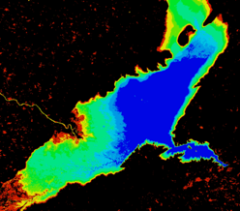
What is the Open Data Cube?
Open Data Cube (ODC) ... an open source geospatial data management and analysis framework for decision-making
metadata
query
Metadata
Database
Index
ODC
API
algorithm
pixel transfer
results
Satellite Data
Open Data Cube Infrastructure
Applications
Google Earth Engine
ODC-Google Sandbox
Jupyter Notebooks

Slide 3
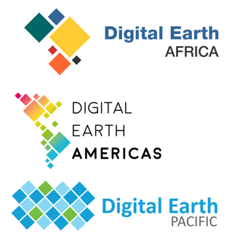
Past, Present, Future
Past (pre-2021) - Initiated and proven in Australia (CSIRO, GA). The ODC concept and brand was born within CEOS (GA, CSIRO, NASA, USGS) and demonstrated in Africa (regional demo).
Present (2021) – Digital Earth Africa (operational) + Digital Earth Pacific (early planning) + Digital Earth Americas (early planning) + many other country-level data cubes ... impacting over 100 countries. Improvements in core ODC code, application algorithms, and cloud computing methods. More free/open satellite datasets are now available ”in the cloud”.
Future (>2021) - The ultimate goal is to achieve a global network of connected regional data cubes using ODC algorithms. We hope to grow the user community and share/test algorithms and methods. Such efforts can demonstrate impact for the UN-SDGs and for non-traditional users (e.g. smaller and developing countries).

Slide 4
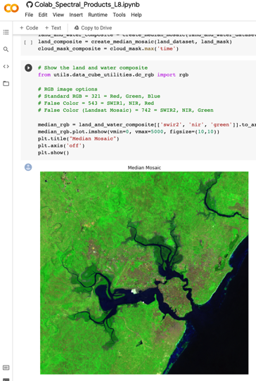
Open Data Cube Sandbox
The CEOS Systems Engineering Office (SEO) has developed a new Open Data Cube (ODC) Sandbox that runs on Google Colab. openearthalliance.org/sandbox
This tool is a free/open Jupyter notebook interface connected to Google Earth Engine datasets that can create sample application products anywhere in the world without the need to download data.
Users will need a Google account and Earth Engine authorization to access the tool.
+
+

Slide 5
Datasets
Applications
Landsat-8 (L8)
Sentinel-2 (S2)
Sentinel-1 (S1)
VIIRS Nightlights
Cloud Statistics (L8 and S2)
Cloud-filtered Median Mosaics
Water Extent
Spectral Products
Vegetation Change
Vegetation Phenology
Sentinel-1 Data Viewer
Mission Coincidences (L8, S1, S2)
VIIRS Nighttime Lights

Slide 6
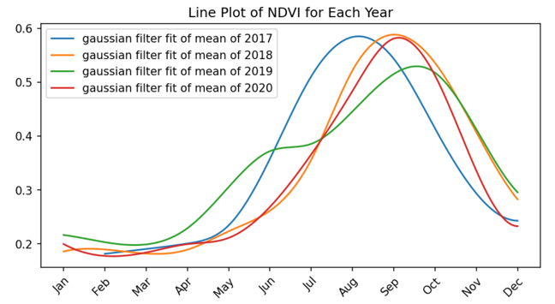
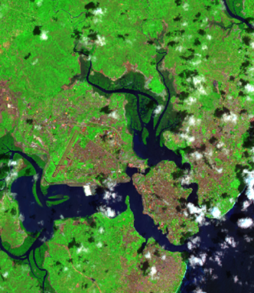
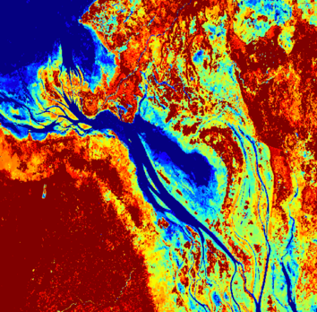
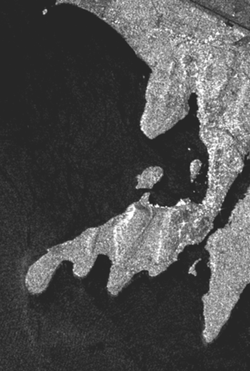
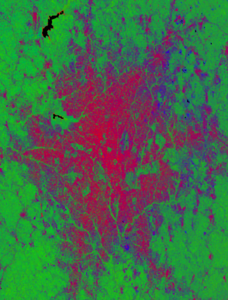
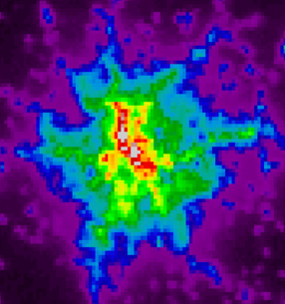
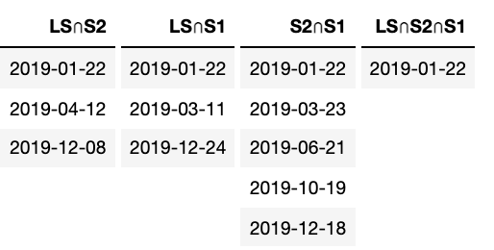
Example Applications
Cloud Statistics
Vegetation Phenology
Water
Time Series
Coincidences
VIIRS Nightlights
Sentinel-1 Radar
Fractional Cover

Slide 7
What is the vision for the future?
A global network of regional interoperable satellite data cubes using ARD and supported by shared tools and algorithms
Increased free and open satellite data in analysis ready data format
Data is no longer downloaded but used in the cloud
Tools and algorithms, such as the Open Data Cube Sandbox, are open source and commonly shared among users for open science
Advancing technologies are tested and evaluated to improve efficiency and effectiveness of data use

Slide 8
Additional Details
The Google Colab environment includes ~12GB RAM memory and ~100GB of storage. Only small analyses are possible. Larger analyses would require scaling to the Google Cloud.
Users can save their notebook modifications in Google Drive or on GitHub for future work.
A User Forum has been created to support users, answer their questions, and share knowledge. forum.openearthalliance.org

Slide 9
Sandbox: openearthalliance.org/sandbox
User Forum: forum.openearthalliance.org
ODC website: opendatacube.org
Twitter: @opendatacube

