Slide 1

The CEOS Open Data Cube Initiative
A new open source data management architecture with global impact
Committee on Earth Observation Satellites
Brian Killough
CEOS Systems Engineering Office (SEO)
NASA LaRC Engineering Directorate
CLC Technical Excellence Presentation
October 30, 2017

Slide 2
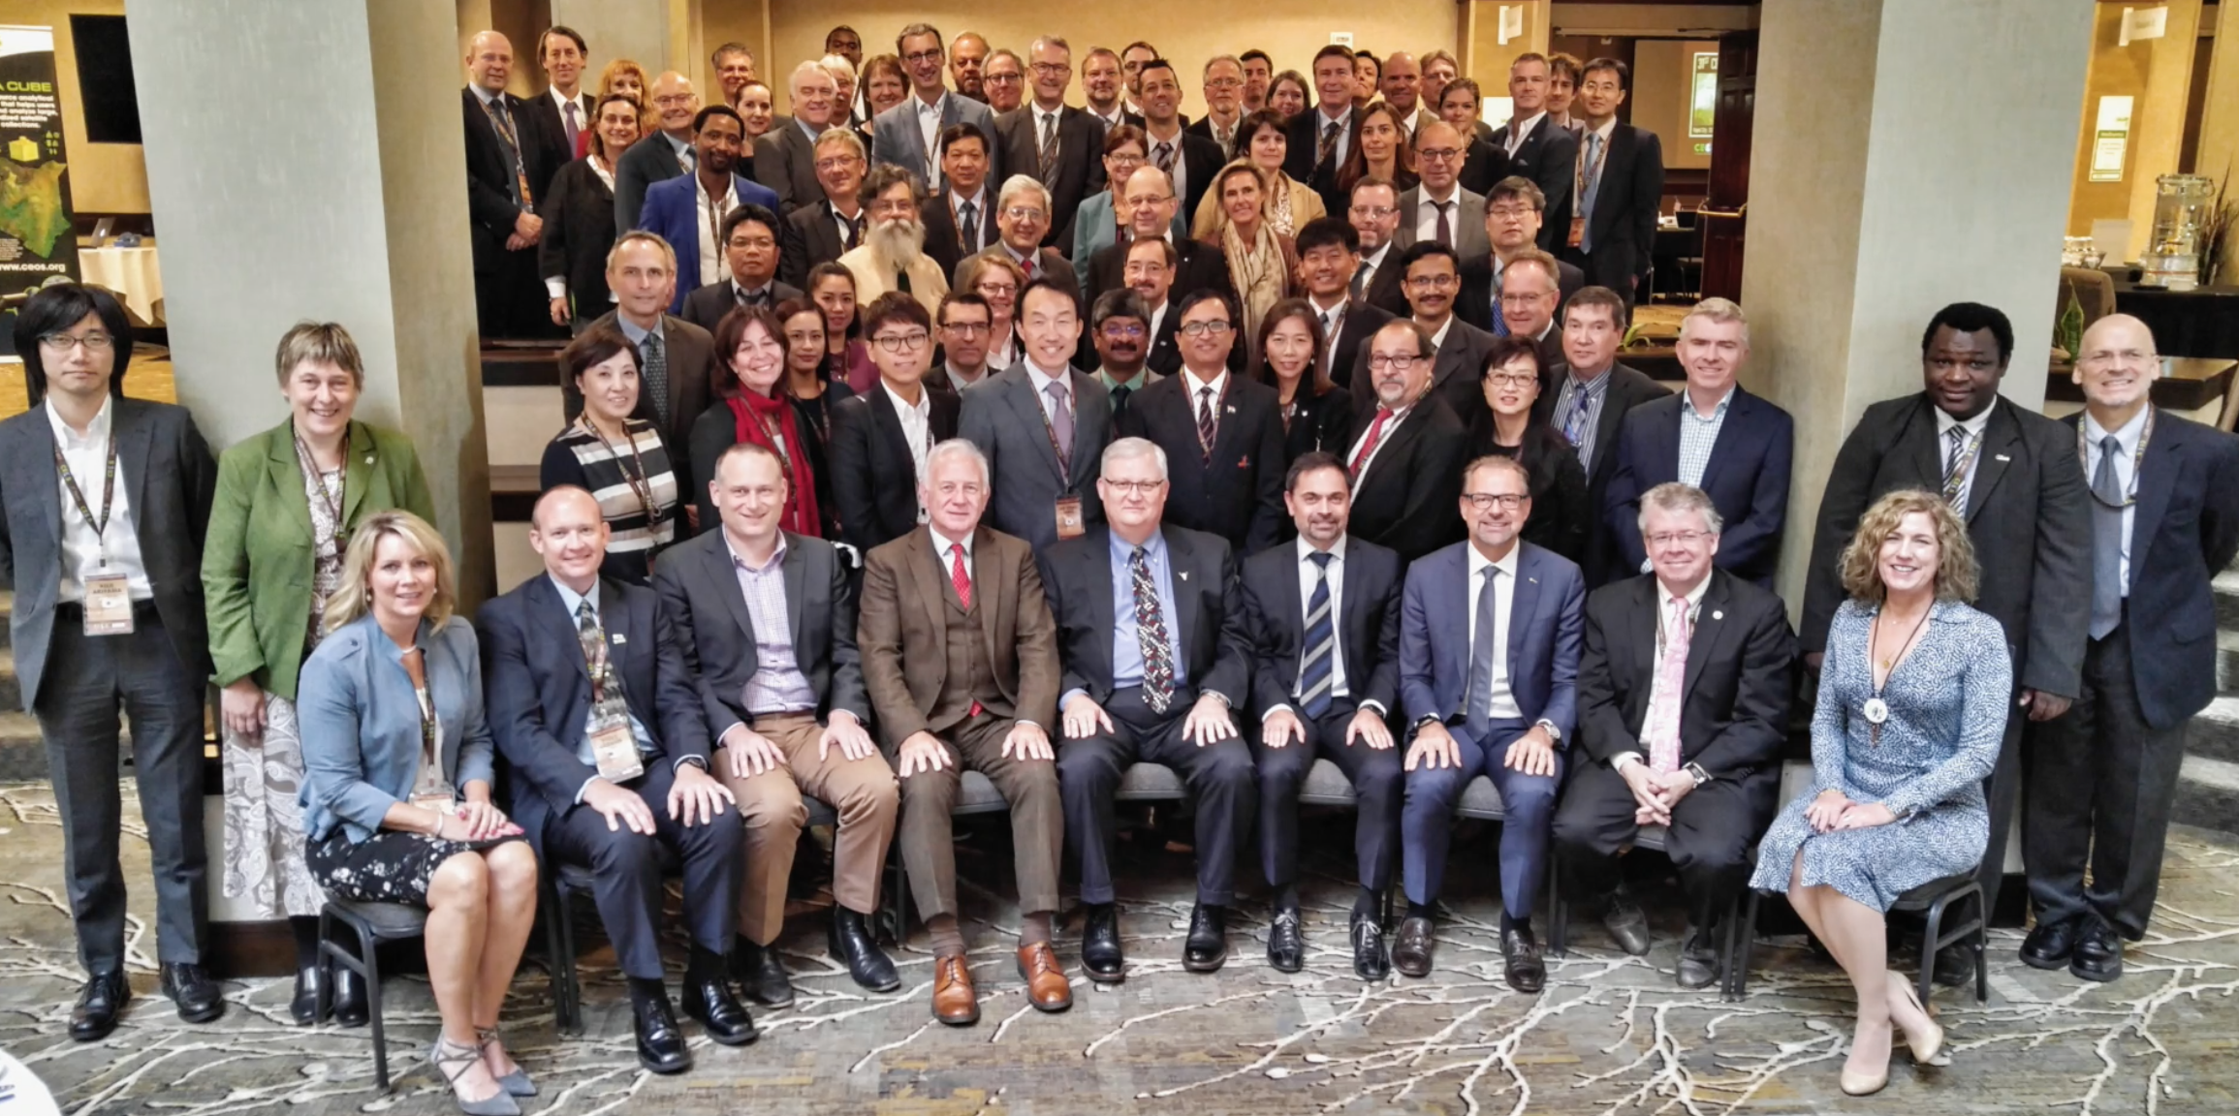

What is CEOS?
www.ceos.org
2017 CEOS Plenary in Rapid City, South Dakota, (USGS Host)
NASA is a member of CEOS.
USGS and NOAA are the other US Agencies.
The Committee on Earth Observation Satellites (CEOS) serves as a focal point for international coordination and data exchange to optimize societal benefit from space-based Earth observations. CEOS represents 22 countries through its 32 space agencies and 28 associate members and is operating 150 satellites as of October 2017.

Slide 3
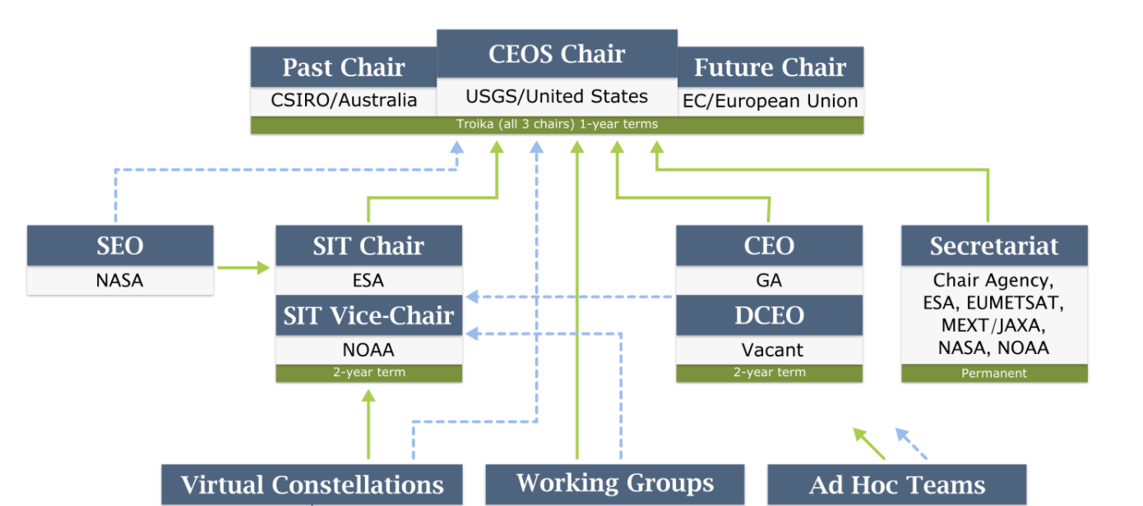
CEOS Organization
Funder: NASA HQ
(Dr. Michael Freilich)
~$2M per year
NASA leads 2 of 7
NASA leads 2 of 5
NASA leads 2 of 6

Slide 4

CEOS Systems Engineering Office
Background
The CEOS Systems Engineering Office (SEO) was established in April 2007 (sponsored by NASA HQ) to support the CEOS organization and facilitate global space agency initiatives.
We have supported CEOS for over 10 years!
The SEO technical functions include: systems engineering tool development, requirements and gap assessments, data acquisition planning, special projects, and system architecture development.
The SEO management functions include: improving communications through web-based tools, managing CEOS social media, meeting logistics, and developing education and outreach products.

Slide 5



What has changed in 10 years?
Free and Open Resources
  Free and open Satellite Data
  (e.g. Landsat in 2007, Sentinel in 2014)
  Open Source Software and Tools
Global Engagement
  Improved communications through internet technology
  Increased global cooperation and collaboration
  (e.g. GEO-Group on Earth Observations, World Bank)
Philanthropy
  Google Earth Engine, World Bank
  International Foundations (e.g. Gates, Clinton)
Improved Technology
  Cloud Computing (e.g. Amazon)
  Data Cubes … the focus of this talk!

Slide 6
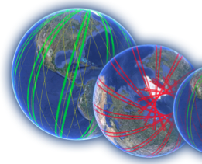
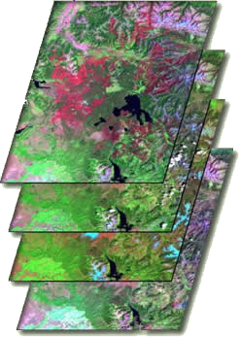

A NASA LaRC Systems Engineering Tool addressing Global Problems
NASA LaRC’s CEOS Systems Engineering Office (SEO) is making significant and growing contributions to the global satellite and data user community through its systems engineering tools and applications, impacting international space agency plans and global decisions.
One of the SEO’s tools (Data Cubes) addresses these global issues ...
What is a Data Cube? Time-series multi-dimensional (space, time) stack of spatially aligned pixels ready for analysis
Proven concept in Australia with plans for global implementation
The NASA LaRC SEO is leading the Data Cube initiative with support from Australia (CSIRO, GA), USGS, and the United Kingdom.
The Data Cube initiative is engaging the CEOS community with involvement of many Agencies and Working Groups and is a significant part of our meeting agendas
The Data Cube is impacting scientists, decision-makers, and space agencies around the world. NASA LaRC is making a difference ...

Slide 7
Benefits of Data Cubes
Expanded use of satellite data
Reduced data preparation burden
Enables data interoperability
Efficient time series analyses
Free and open access
Flexible deployment (local or cloud)
Use of a common architecture
Community development and sharing
Our goal is NOT to sell a product or give out a tool.
Our goal is to provide a SOLUTION that has VALUE and increases the IMPACT of satellite data.

Slide 8

The Data Cube Vision
A solution supporting priority objectives …
  Build capability of users to apply CEOS satellite data
  Support Group on Earth Observations (GEO) and United Nations agendas
Involves many CEOS Agencies …
  Through provision of processed satellite data products
  Contributing to development and uptake of solutions
Customer focused …
  Easy to install and maintain with training materials
  A brand that people know and trust
  An active global community of users
Scalable solution …
  Operational Data Cubes in 20 countries by 2022
  Key partners (e.g. World Bank, Google, Amazon) supporting the data cube development and use

Slide 9
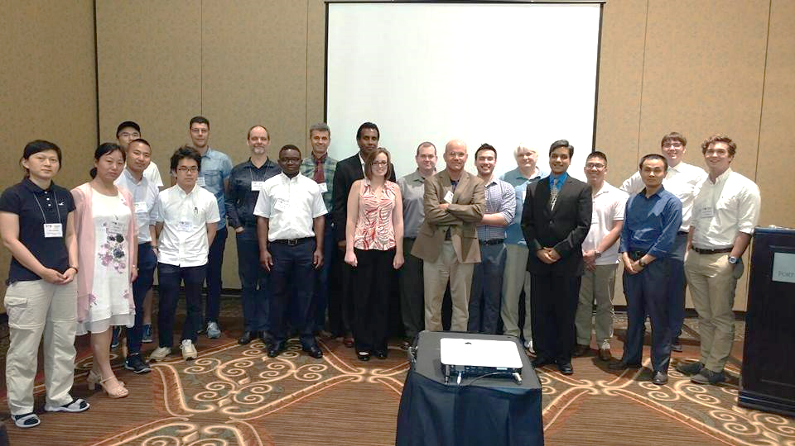

Open Data Cube Progress
The initiative is named “Open Data Cube” or ODC. Website: opendatacube.org
Approved Open Source Software through the NASA LaRC Software Release Process in June 2016. Completed 12 software releases over 2 years.
We established a “Partners” group and “Steering” group which includes representatives from NASA-SEO, GA, CSIRO, USGS, and UK-Catapult to manage the strategic and technical tasks.
We developed strategic “white papers”, open source governance plans, and documentation for deployment and operation.
We conducted the 1st ODC Workshop at the 2017 IGARSS conference in Fort Worth, Texas in July and are planning another in 2018.
We are actively working with World Bank,
Google, and Amazon.
We are interacting with 30 countries!

Slide 10
The “Road to 20”
Colombia has an operational Data Cube since Dec 2016 with over 25,000 historic Landsat images. They continue to expand the user base, applications and datasets. The Colombia Data Cube won the National Environmental Award of Colombian Society of Engineers in May 2017 and has been approved by the Colombia Government and the University of Andes into 2018.
Switzerland has an operational Data Cube since July 2017 with over 4,000 historic Landsat images. They have received Swiss government approval and developed a new website (swissdatacube.org). Their future plans include expanded datasets (Sentinel) and increased applications with both government and university involvement. They are also planning capacity building in Georgia and Moldova.
Vietnam is making progress by establishing pilot cubes in several regions using a new high performance computing system. Their focus is on forests, rice, and water applications. VNSC hosted an internal Data Cube Workshop in September.
Operational
Under Development
Under Review or Expressed Interest
3 operational, 4 under development, 23 expressing interest = 30 total

Slide 11
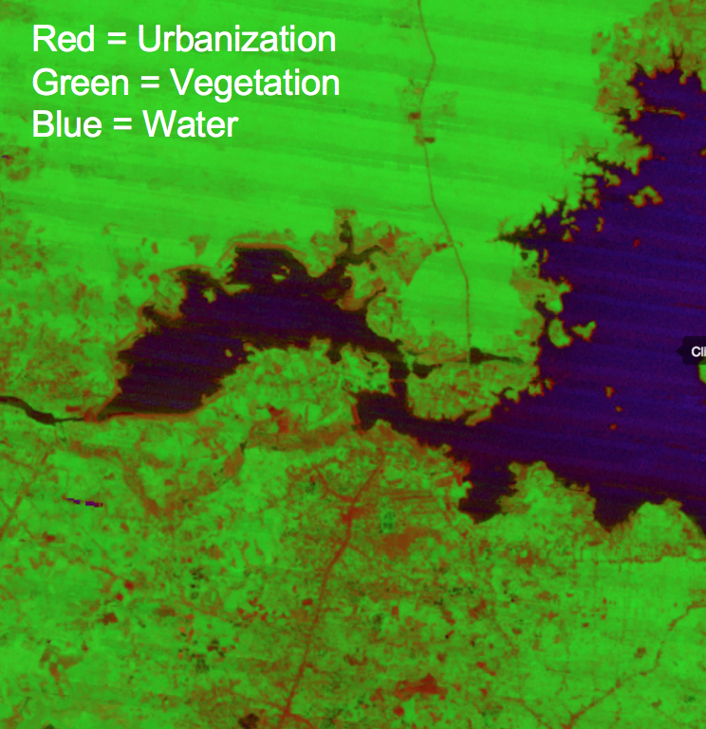
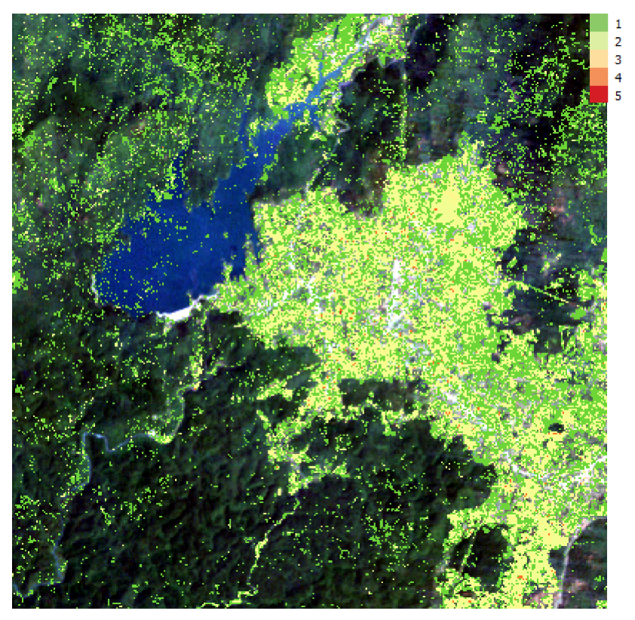
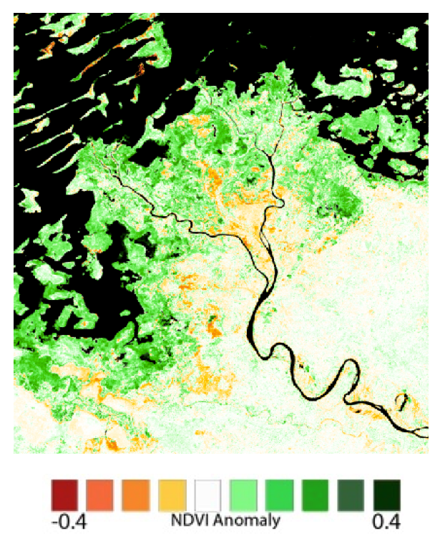
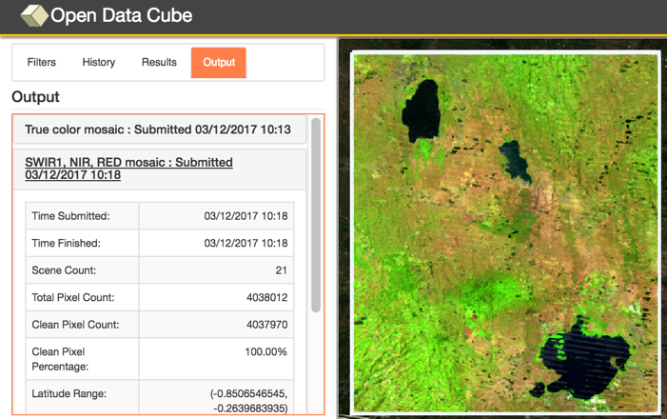
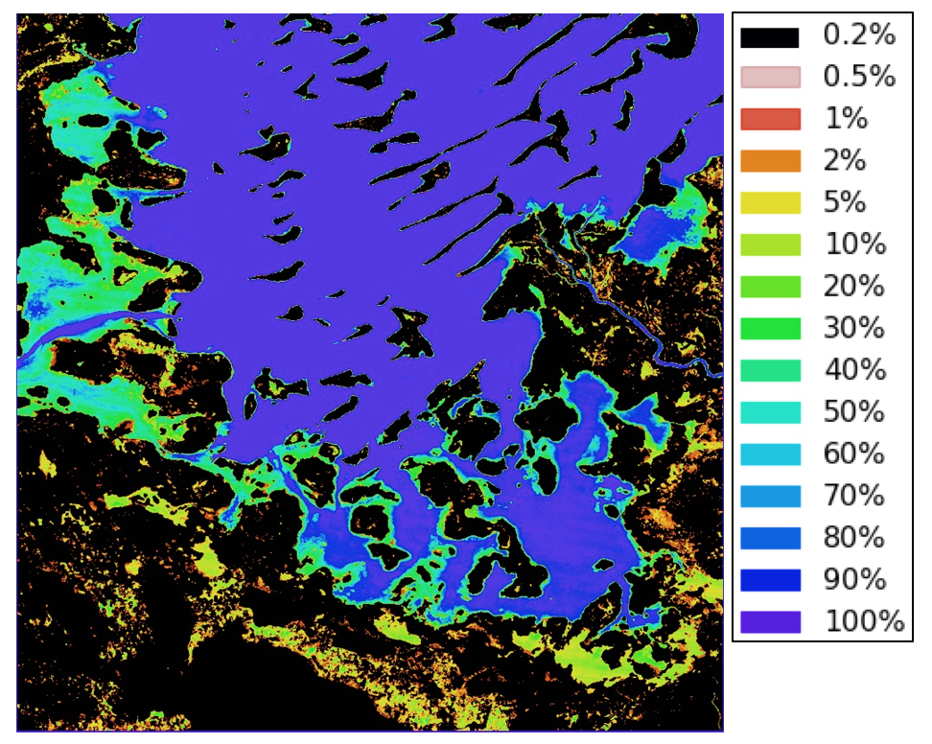
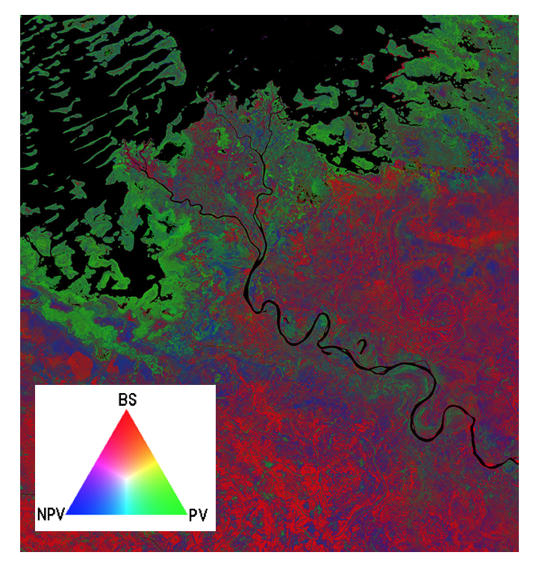
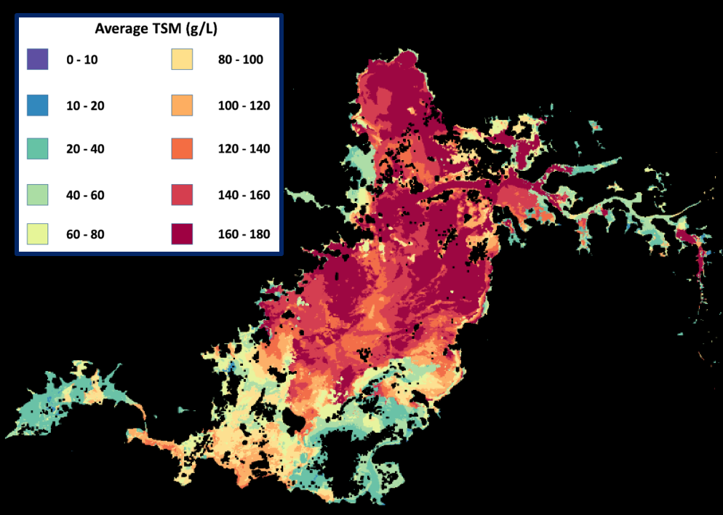
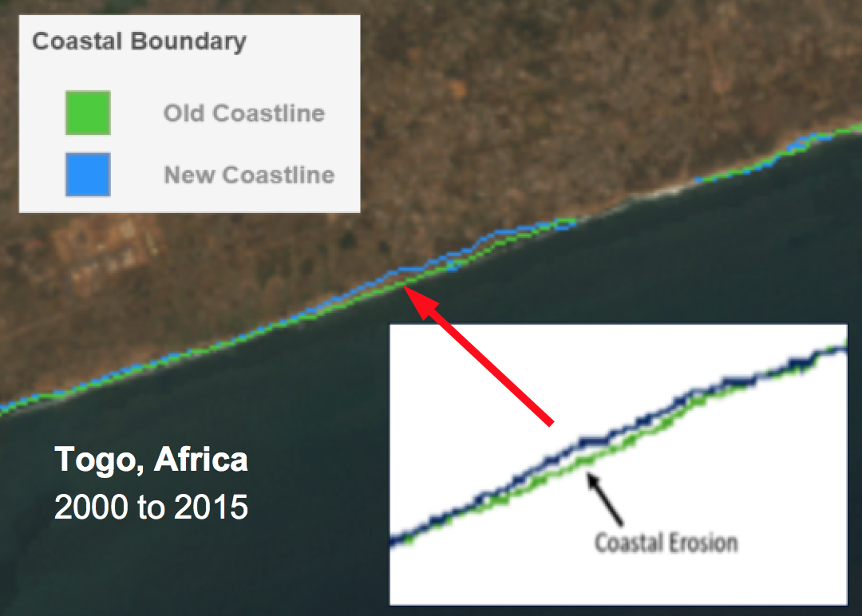
Products with Impact
Cloud-free Mosaics
Land Change Detection
Water Detection
Water Quality
Fractional Cover
Vegetation Anomaly
Coastal Change
Urbanization
The Data Cube is recognized as a technically excellent data architecture supporting a variety of international users

Slide 12

The Future
We expect to complete several
operational Data Cube deployments in 2018:
Vietnam, Taiwan, United Kingdom, Uganda and Uruguay.
Anticipated collaborations with Google and World Bank.
2nd Annual ODC Technical Meeting in Canberra, Australia (Feb 2018),
2nd Training Workshop and dedicated Data Cube Paper Session at the IGARSS Conference in Valencia, Spain (July 2018).
Develop new technical additions: Python Notebook demos,
“Data Cube On-Demand” feature from the cloud, User Interface tools
(pixel plotting, transect plots, clustering), Plugin for the QGIS tool.
Develop and test new applications: land change detection (radar datasets),
Water Quality (Chlorophyll) and land classification clustering.
Add new satellite dataset compatibility: European Sentinel missions,
France’s SPOT-5, and Japan’s ALOS.
Challenges ahead … scaleability, acceptance, public/private collaborations

Slide 13


Team Acknowledgements
Analytical Mechanics and Associates
Sanjay Gowda / Syed Rizvi
Andrew Cherry / Otto Wagner
Shaun Deacon / Kayla Fox
SSAI Support Team
Kim Holloway
External Support Team
Symbios (Australia)
Ake Rosenqvist (Japan)
Alyssa Whitcraft (UMD, Denver)
BoundlessGEO (Washington, DC)
THANKS!

