Slide 1

Open Data Cube
Example Applications
July 2017
Brian Killough
CEOS Systems Engineering Office
NASA Langley Research Center
Email: Brian.D.Killough@nasa.gov

Slide 2
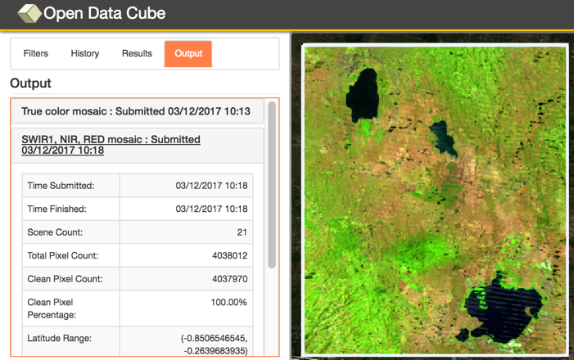

Amazon Cloud (AWS)
Data Cube Demo Portal
Data Cubes
16 cubes with 10+ years each.
Kenya, Cameroon (Lake Chad), Togo (coastal Africa), Ghana, Colombia, Tonga (Pacific Island), Vietnam, Australia (Menindee Lakes), Bangladesh.
User Interface Features
User-selected spatial region and time
9 applications: cloud coverage maps, custom cloud-free mosaics, fractional cover, NDVI anomaly, water detection, water quality, landslides, coastal change and urbanization.
Outputs in GeoTIFF and GIF animation.
Free and open!
This is the first “hands-on” global demo of the Data Cube to show its potential for rapid time series analysis and diverse applications
http://tinyurl.com/datacubeui

Slide 3
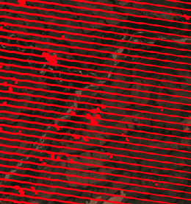
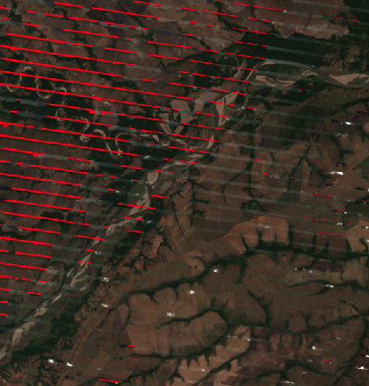
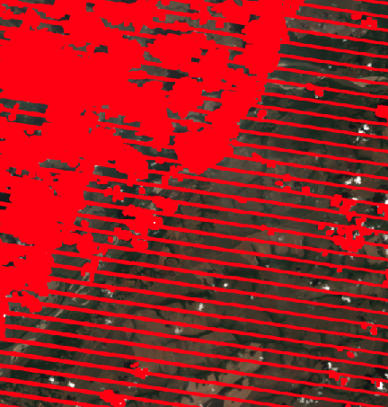

Cloud-filtered Mosaics
JAN
Clouds not detected by CFMask
The final product (above) is a cloud-filtered “most recent pixel” mosaic for Jan-Mar 2015 (3 months). The result is compiled from three (3) Landsat-7 scenes to produce a 97% cloud-free image. The baseline scenes (left) are 30% to 50% cloudy. The cloud or no-data pixels are highlighted in RED. This analysis is produced very rapidly (~1 minute).
FEB
MAR
Meta River, Colombia

Slide 4
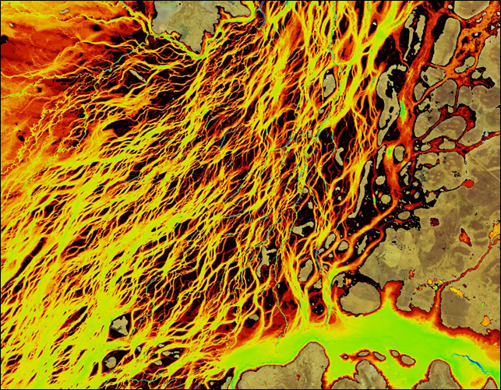
Australian WOFS Algorithm
WOFS = Water Observations from Space
Braided river network of Coopers Creek in Queensland, Australia
Blue = permanent water
Red/Yellow = infrequent flood events
CEOS has implemented the 23-step WOFS algorithm with the Data Cube to produce results similar to those shown here
Braided river networks and flood extent is very difficult to map with traditional methods

Slide 5
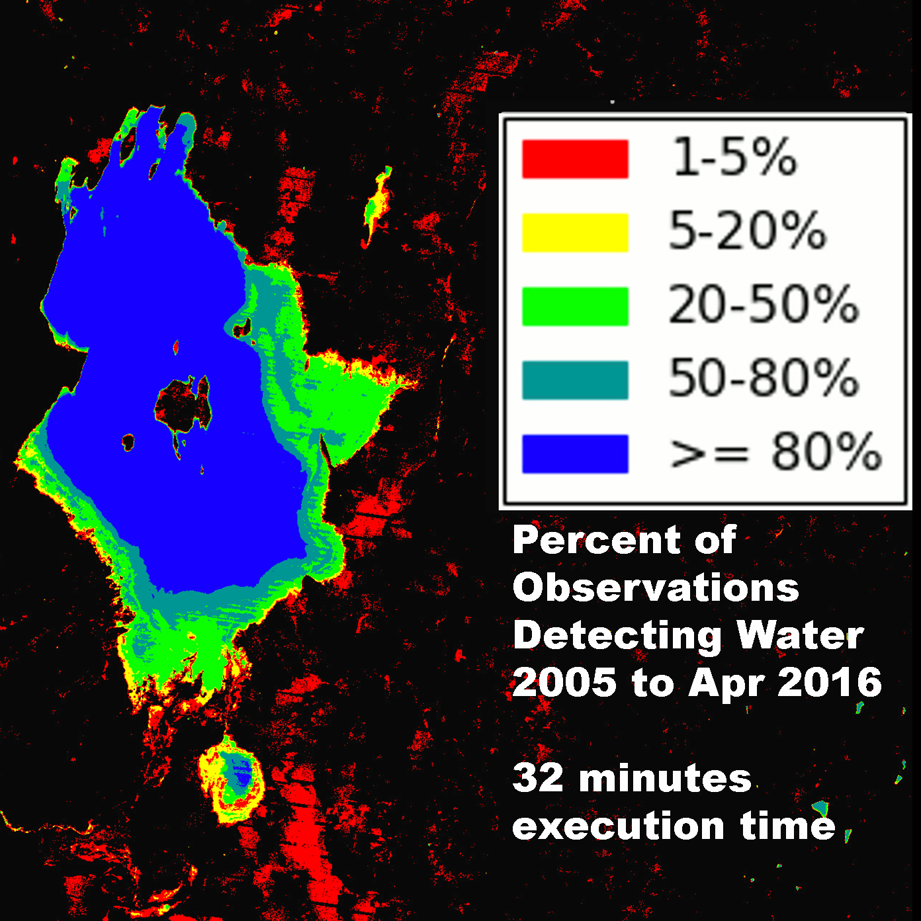
Lake Baringo, Kenya
Time Series Water Detection
Blue = frequent or permanent water
Red/Yellow = infrequent water or flood events
Flood risk can be easily inferred from the 23-step, multi-band Australian WOFS algorithm.
30-meter Landsat resolution allows detailed assessments that are far better than MODIS (250-m).

Slide 6
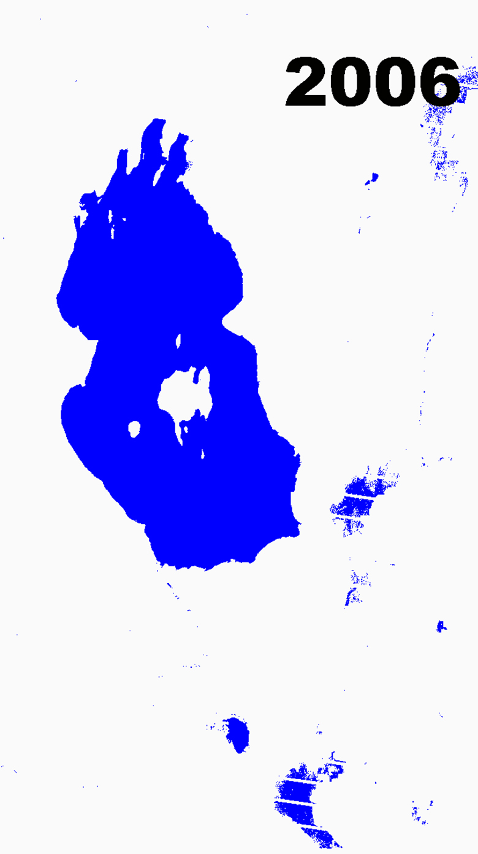
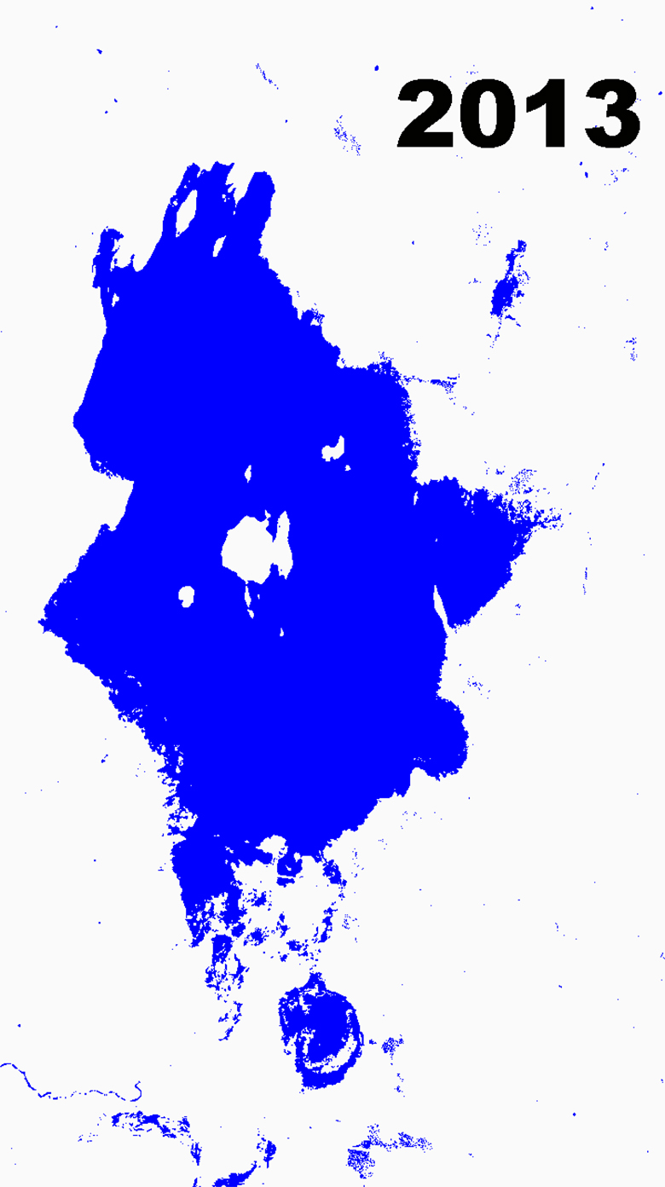
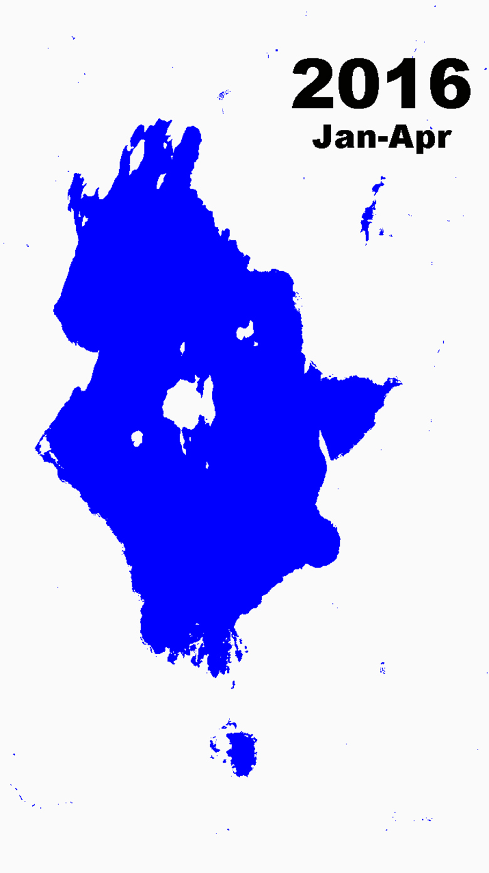
Annual Water Extent
Landsat
“banding”
Extreme droughts in the Baringo region in 2009 had severe impacts on pastures and farming
Extreme floods displaced 600 families and swept away livestock near Lake Baringo in 2013
4 months of dry season data resulted in little water detected outside the lake boundary

Slide 7
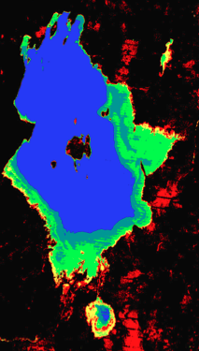
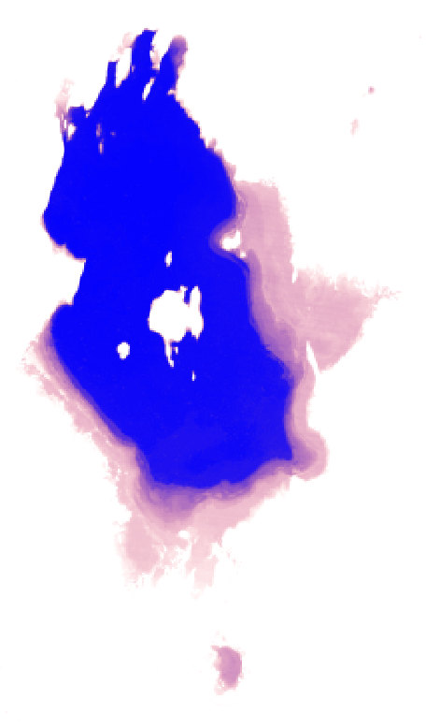
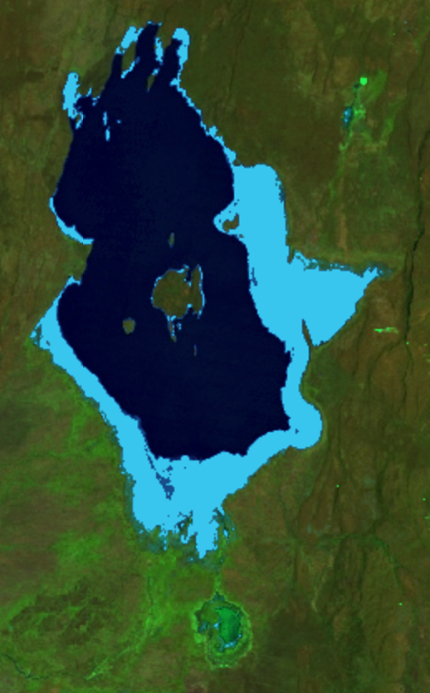
WOFS vs. Other Water Tools
Australian WOFS
2005 to 2016
EC-JRC
1984 to 2015
Aqua Monitor
2005 to 2016
Pekel et al. 2016
Limited to a fixed time range and monthly output.
Donchyts et al. 2016
Limited to land-water and water-land changes. No download.

Slide 8
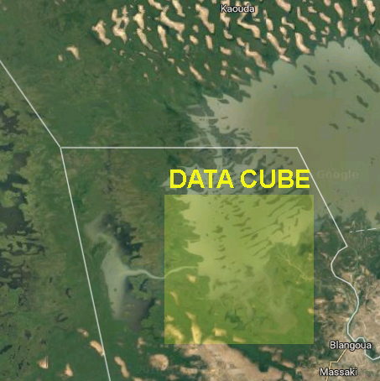
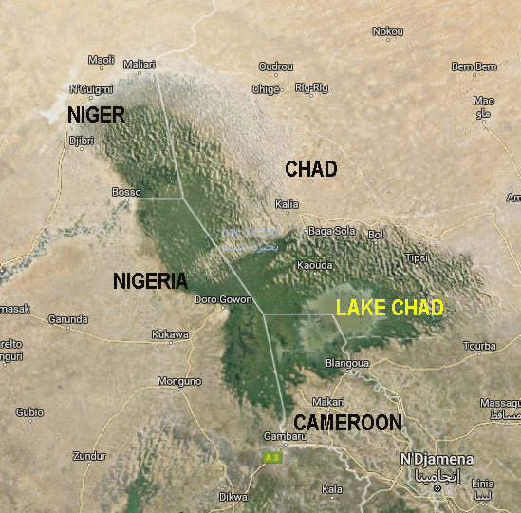
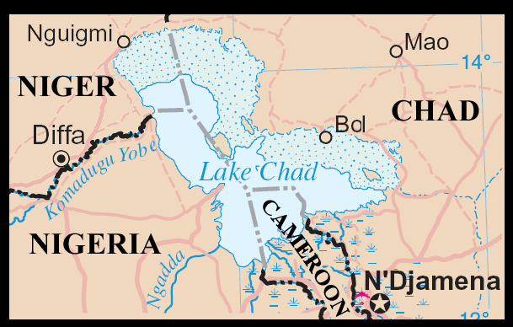
Lake Chad, Africa
Water Detection Demonstration
Historically large and shallow lake has shrunk by 95% from 1963 to 1998 due to increased population demand (reference United Nations). Provides water to 68 million people in 4 bordering countries.
Annual rainy season (May-June) gives rise to floods (Aug-Sept) which fill the lake (Oct-Jan) before evaporation during the dry season
(Feb-Mar).

Slide 9
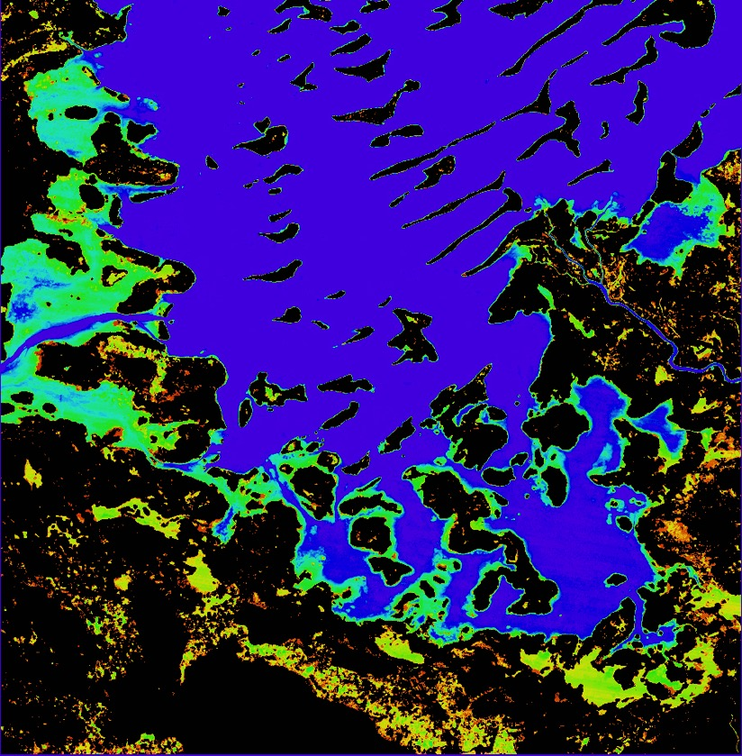

Lake Chad, Cameroon, Africa
Time Series Water Detection
The product shows the percent of observations detected as water over the 17-year time series (water observations / clear observations).
Purple/Blue:
Frequent or permanent water
Red/Yellow:
Infrequent water and/or flood events

Slide 10
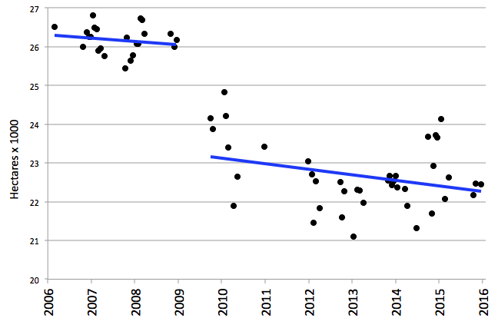
Lake Chad, Cameroon, Africa
10-year Time Series Results
The severe drought in 2008 is evident in the Lake Chad time series results. The overall 10-year trend is a loss of 1.4 hectares per day for this analysis region
Notes:
Lake Chad is a source of livelihood to 30 million people. The shrinking lake has had a substantial impact on the local populations, as entire communities have switched from a fishing-lifestyle to one of farming and agriculture. Local communities that once ringed the shores of the lake are now isolated villages — miles from water — and these populations have literally begun farming the now-dry lake bottom. As of 2015, there are plans are in the works to divert water from the Congo River to the River Chari, which flows into Lake Chad, and revitalize the lake.

Slide 11
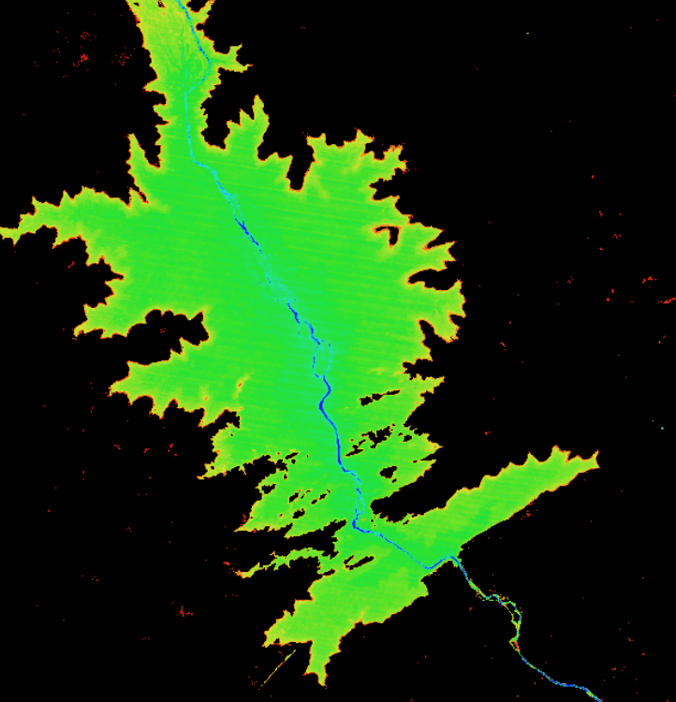
Time Series Water Detection
The Australian Water Observations from Space (WOFS) product shows the percent of observations detected as water over the
17-year time series (water observations / clear observations).
Purple/Blue:
Frequent or permanent water
Red/Yellow:
Infrequent water and/or flood events
Bui National Park along the Black Volta River, western Ghana, Africa
Why does the water only exist for 20% of the 17 years?

Slide 12
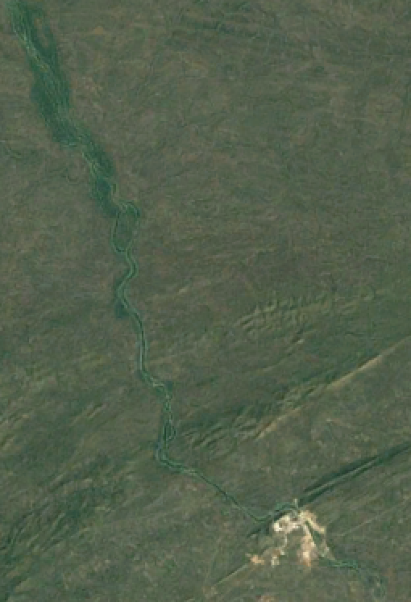
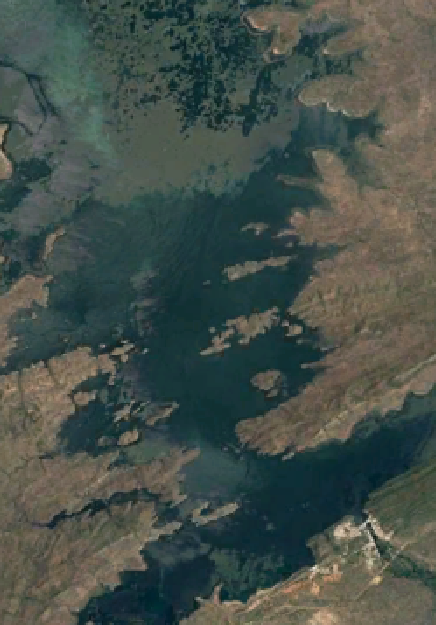
Bui National Park Land Change
Bui National Park started construction of a Dam in Dec 2009. This explains the short existence of water from 2000 through 2016. The images to the left support these results.
Time series observations of water can be used to track the progress of water management projects, such as this project in Ghana.
Dec 2010
Dam under construction
Dec 2016
Dam complete … New Lake!

Slide 13
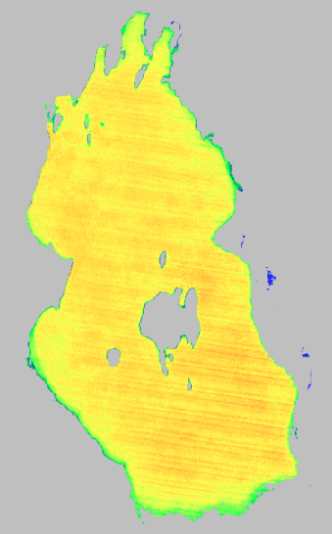

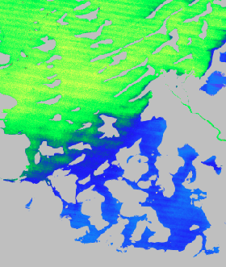

Water Quality
Total Suspended Matter (TSM)
Lake Baringo, Kenya
2006 to 2015 (10 years)
Lake Chad, Cameroon, Africa
2006 to 2015 (10 years)
The results show the average TSM (mg/L) over the time series for persistant water. TSM is closely related to turbidity which is an indicator of water condition for drinking or fisheries
Purple/Blue:
Lower levels of suspended matter
Red/Yellow/Green:
Higher levels of suspended matter
Lake Baringo (left) is commonly turbid with high sediment and high average TSM levels. Lake Chad (right) has higher TSM in the central portion of the lake but lower levels in the southern portion.

Slide 14
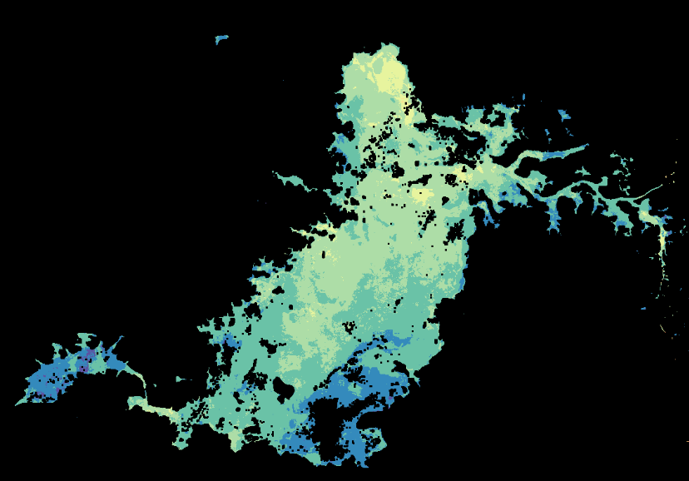
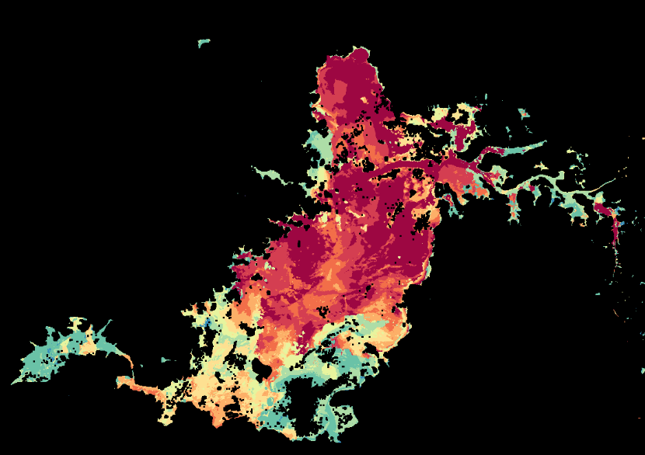
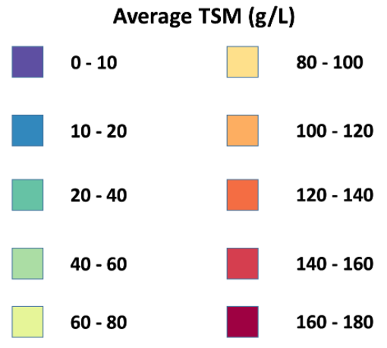
Water Quality
Total Suspended Matter (TSM)
Average TSM
Maximum TSM
The Tri An Reservior in southern Vietnam (near Ho Chi Minh City) supplies drinking water to millions of people.
The results show the average and maximum TSM (mg/L) levels over the 2016 annual time series for persistant water. The product is calculated using Landsat 8 data and the Lymburner TSM Index Algorithm.
TSM is closely related to turbidity which is an indicator of water condition for drinking or fisheries

Slide 15
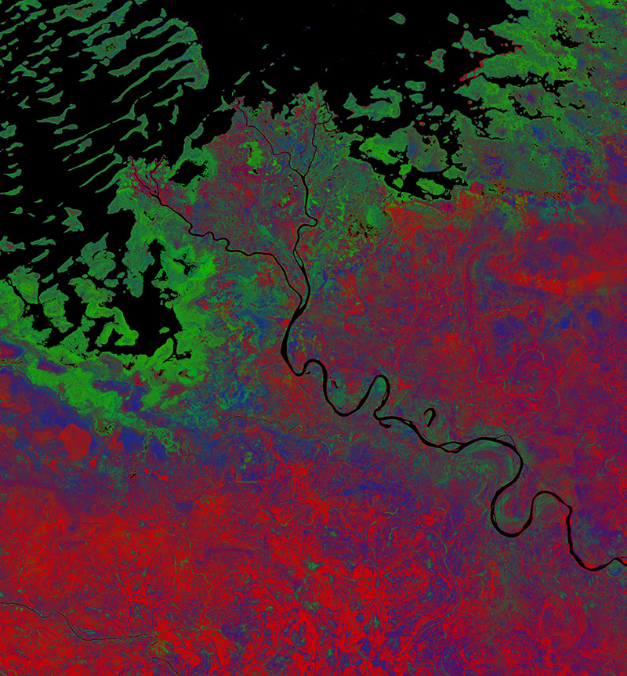
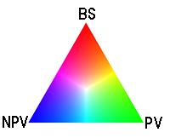
Fractional Cover
Southern Lake Chad
Cameroon, Africa
2015 Fractional Cover
R = Base Soil (BS)
G = Photosynthetic Vegetation (PV)
B = Non-Photosynthetic Vegetation (NPV)
* NPV is dead vegetation, wood, stems, leaves
The fractional coverage algorithm (right) estimates the average vegetation fractional cover over the time period using a linear unmixing technique developed by Juan P. Guerschman (CSIRO).

Slide 16
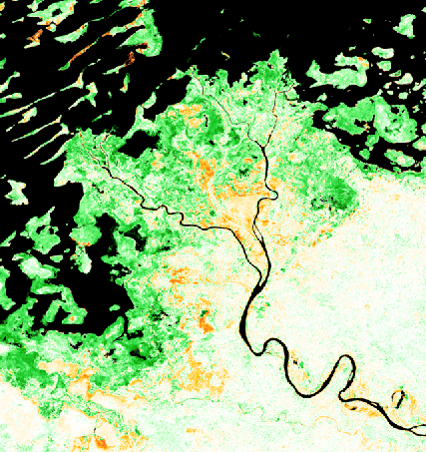

NDVI Anomaly
Chari River inlet to Lake Chad in Cameroon, Africa
NDVI Anomaly comparison of a single Landsat 8 scene on April 4, 2016 to
a 4-year median NDVI for the same month (April, 2013 to 2016)
Consistent with the GEOGLAM Crop Monitor product, but MUCH higher resolution (they use MODIS).
BLACK regions are masks for either clouds or water
Most vegetated areas near the Chari River entrance to Lake Chad show an increased NDVI (green) for this scene as compared to the historical median.
Some reduced NDVI (brown) is seen in a few areas.

Slide 17
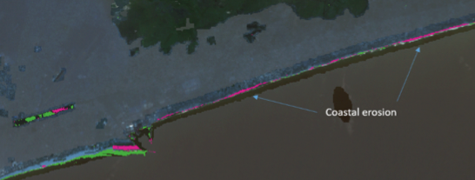
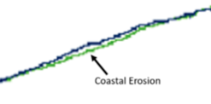
Coastal Change Detection
Lome, Togo, Africa
Water to Land = GREEN
Land to Water = PINK
Conclusion
A time series Data Cube of Landsat data can be used to rapidly assess coastal change and identify regions requiring more detailed analyses.
Coastal region north of Lome
Analysis Period: 2005 to 2013
* The scale of the largest coastal change is a loss of
~3 pixels, or 90 meters. This estimate is also supported by Google Earth imagery.

Slide 18
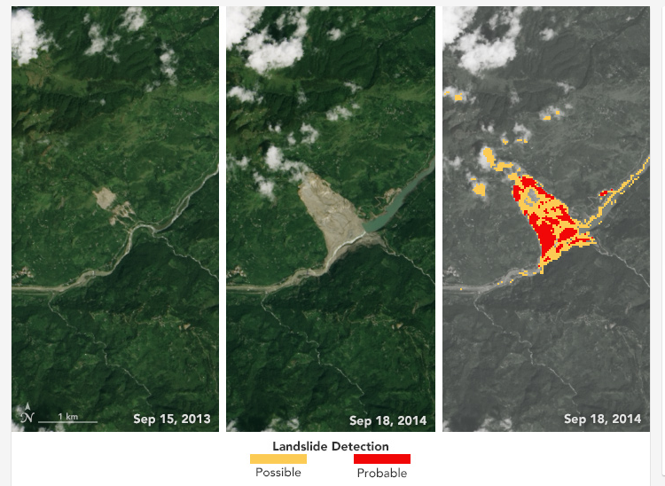
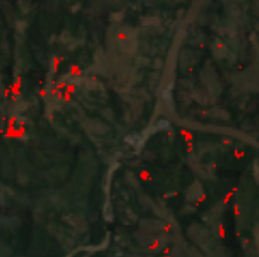
Landslides (SLIP)
The Data Cube User Interface tool includes a Landslide detection tool. The basis of the tool is a method called “SLIP” from Dr. Dalia Kirschbaum at NASA GSFC. The tool uses Landsat and ASTER Digital Elevation data to detect a loss of vegetation on steep slopes, thereby implying a high risk for landslides in a rainfall event.
Sample Data Cube over Salgar, Colombia
(Apr-Jun 2015, baseline 5 scenes). The region reported major landslides in May 2015.
CEOS is evaluating this tool and plans to work with Dr. Krischbaum on refinements and validation.
Example case in Nepal (from Kirschbaum)
Sept 2013 (far left)
Sept 2014 (center)
Sept 2014 (far right, SLIP-DRIP analysis)

Slide 19
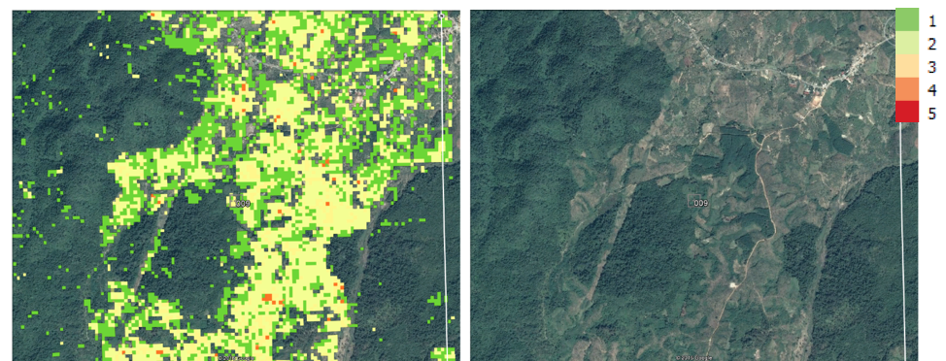
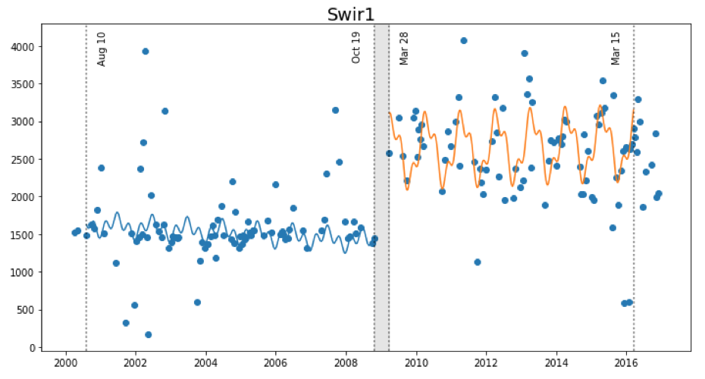
Land Change Detection
The SEO is investigating two approaches for change detection with Data Cubes … CCDC and BFAST
CCDC (Zhu and Woodcock, 2012) was converted to Python by USGS and recently tested by the SEO on the Vietnam Data Cube. We now call this“PyCCD”.
The SEO is also starting a task with Jan Verbesselt in June 2017 to convert BFAST from
R-code to Python and to test on the Data Cube.
PyCCD time series model fits 7 bands to 6 weighted SIN and COS functions in order to find “breaks” that equate to potential land change.

Slide 20
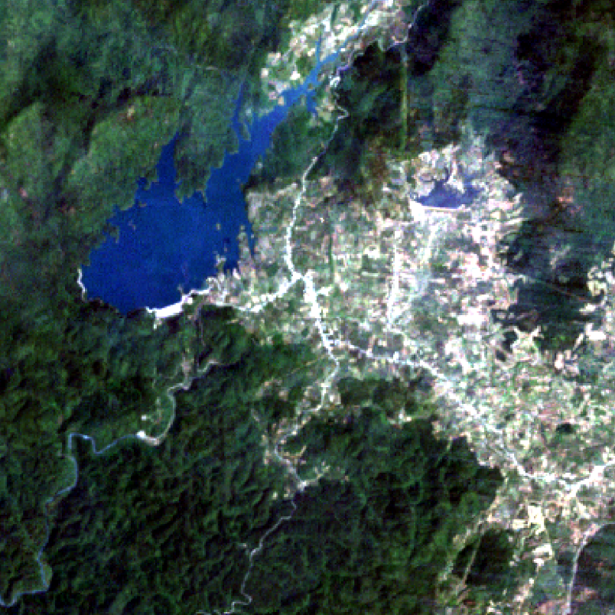
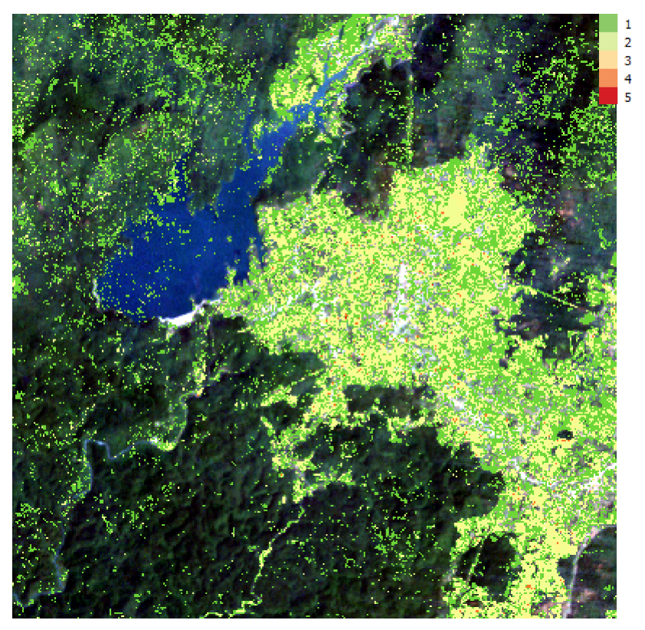
Vietnam Land Change
Bediaye, Vietnam – Data Cube Median Mosaic (left), PyCCD Results using QGIS (right)
2000 to 2016, 192 Landsat scenes, Lat = 11.19 to 11.29, Long = 107.81 to 107.91.

Slide 21
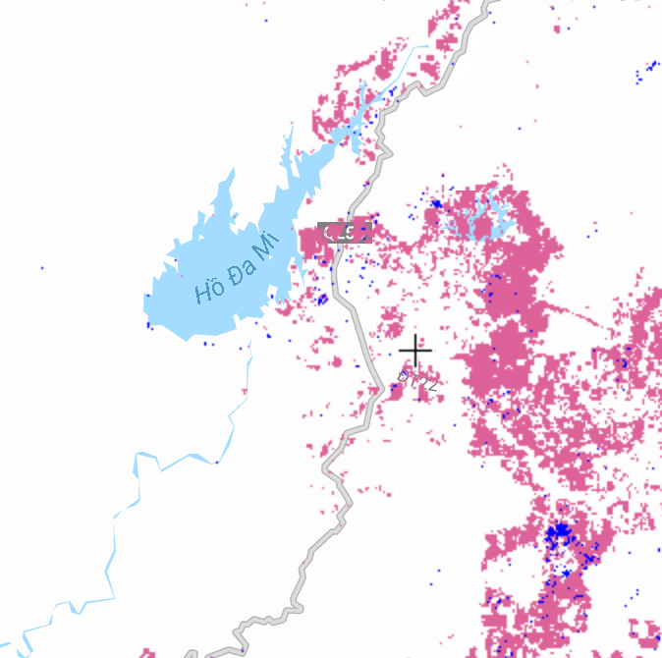
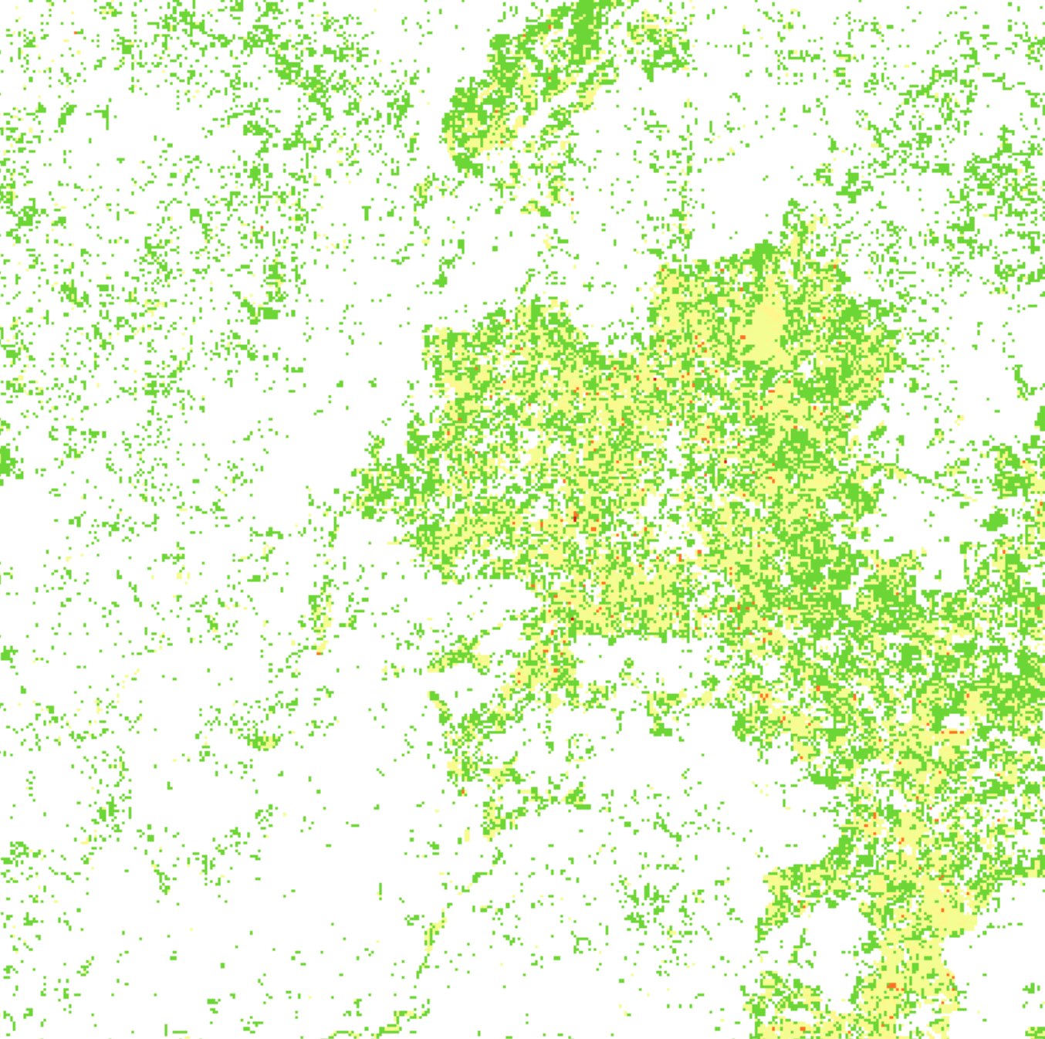
Global Forest Watch vs. PyCCD
Global Forest Watch – Forest Loss
2000 to 2015
PyCCD with a Data Cube – Land Change
2000 to 2016
PyCCD Execution: 372 x 372 pixels, 8 parallel cores, 2.3 hours (~1 msec / clear pixel) which equates to about 10 hours per clear Landsat scene.

Slide 22
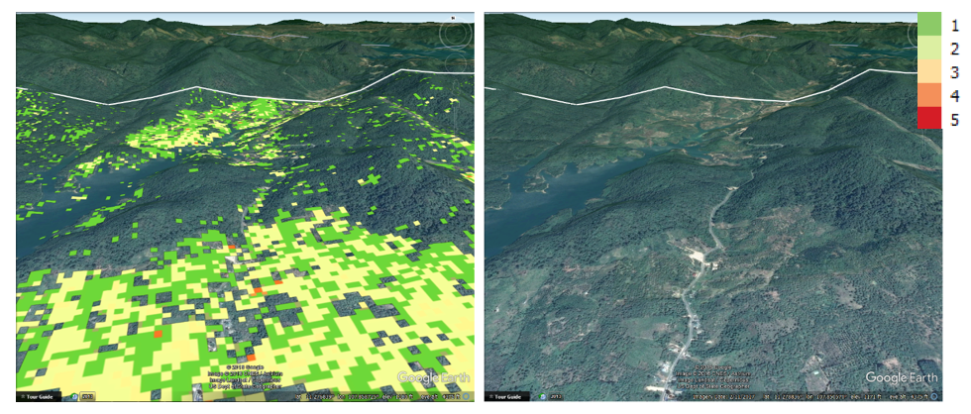
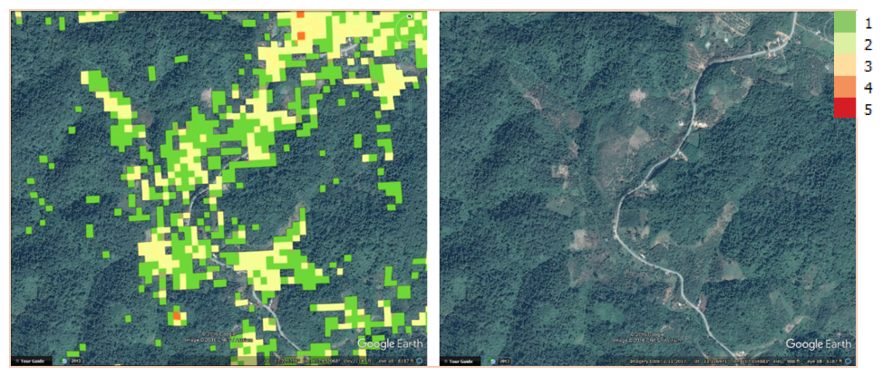
More PyCCD Examples
Deforestation
Roadside Clearing

Slide 23
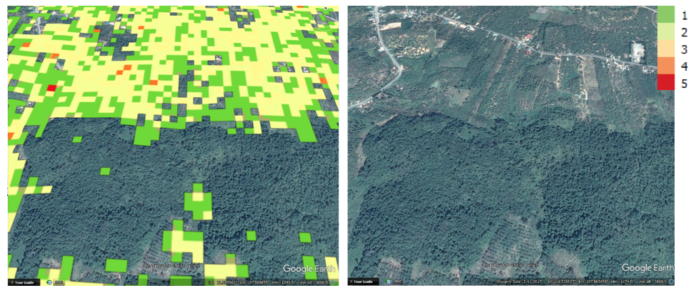
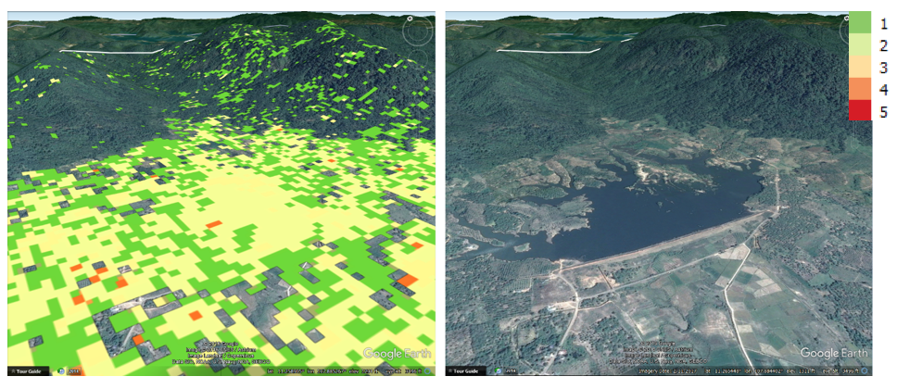
More PyCCD Examples
Possible
Deforestation
Reservoir

Slide 24
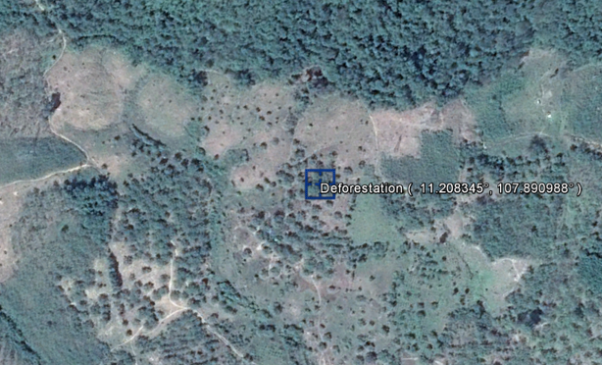
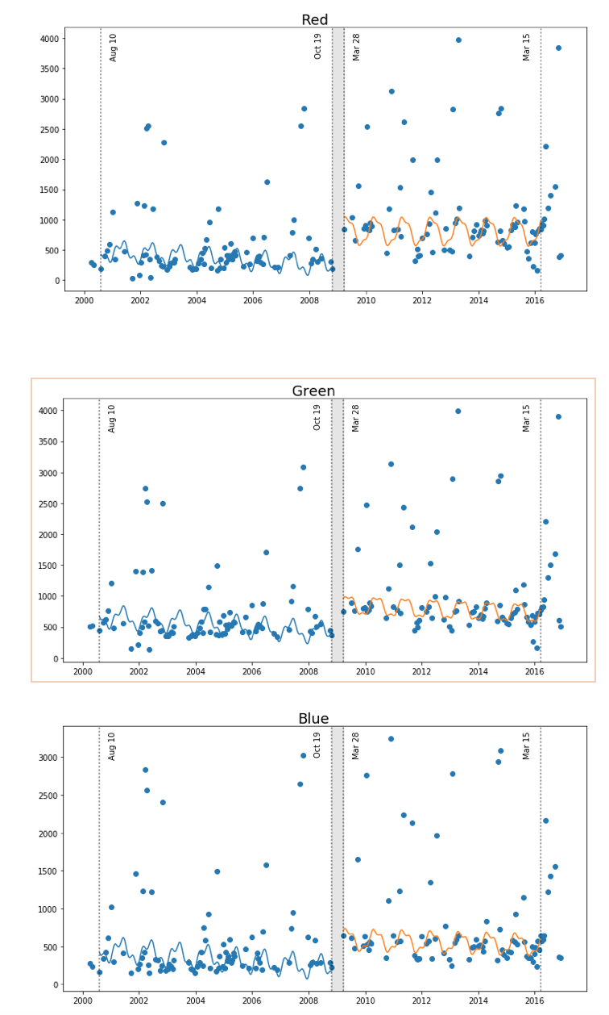
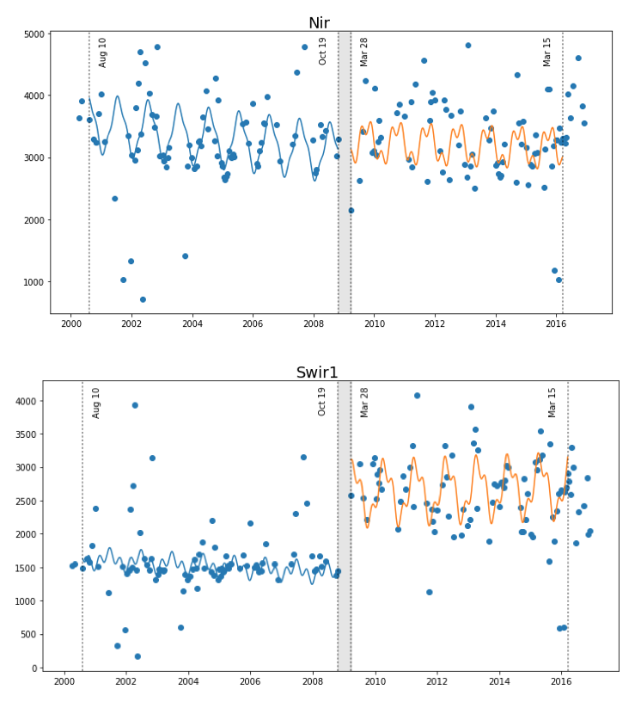
Time Series Models for Deforestation in Vietnam
Deforestation
(single break)
Latitude: 11.208
Longitude: 107.89
Change is most evident in the
SWIR bands

Slide 25
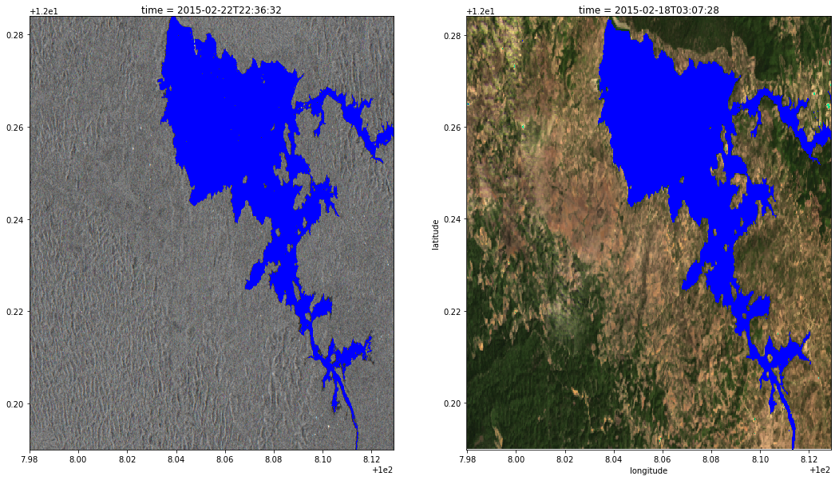
Water Detection with Radar
WASARD (Water Across Synthetic Aperture Radar Data) is a new machine learning algorithm for water detection using radar datasets.
The algorithm is trained using Landsat data and the Australian WOFS water detection algorithm, which has >97% accuracy.
WASARD has shown >96% correlation with WOFS results using Sentinel-1 and ALOS datasets over Vietnam.
WASARD produces a simple linear water classifier algorithm with the format:
(Coefficient-1)*(Band-1) + (Coefficient-2)*(Band-2) + Bias
Sample water detection results for Lake Buon Tua Sarh in Vietnam. The correlation between WOFS and WASARD was 97%.
Sentinel-1 WASARD
Landsat WOFS

Slide 26
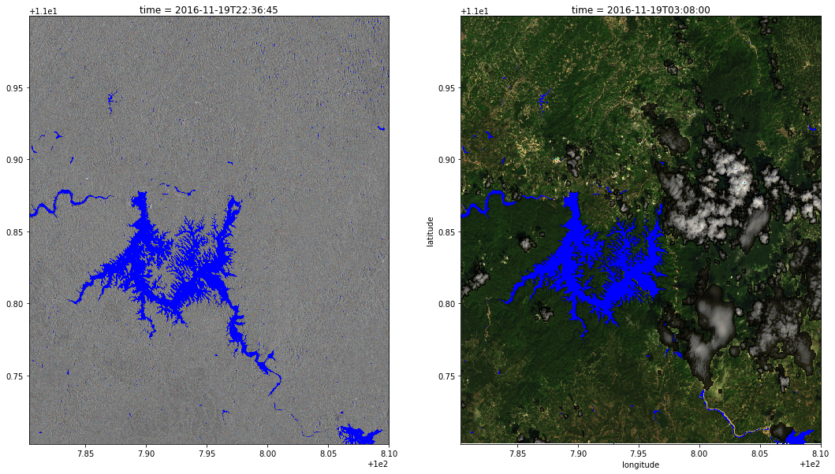
Examples in Vietnam
Sentinel-1
WASARD
Landsat
WOFS
clouds covering
a portion of the water
These Sentinel-1 and Landsat acquisitions are on the same day. The presence of clouds reduces water visibility with Landsat, but using Sentinel-1 and WASARD can achieve a full view of the water extent.

Slide 27
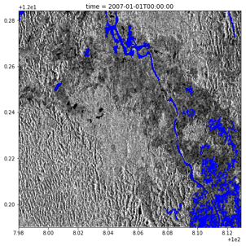
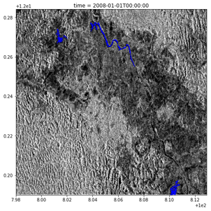
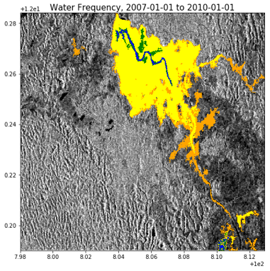




Tracking a Water Reservior
Construction in Vietnam
2007
2008
Water Detection, 2007-2010
Blue = constant water, Yellow = infrequent water
Sentinel-1
WASARD
Landsat
WOFS
2010
2009
Significant annual changes in water extent are visible in ALOS images (above) for Lake Buon Tua Sarh and confirmed with Google Earth images (right). The water dam was constructed in 2009.
2003
2017

Slide 28
Water Across Synthetic Aperture Radar Data (WASARD)
Zachary Kreiser
Student Intern, Yale University

Slide 29
WASARD: Overview
Uses a machine learning algorithm to identify water pixels in a SAR (radar) scene.
Algorithm is “trained” with results from the Australian WOFS algorithm and similar Landsat data (97% accuracy)
Algorithm has been tested on VV / VH bands for Sentinel-1 and the HH / HV bands for ALOS
Since only two bands are used, this classifier can be thought of as a line separating a two dimensional space into regions labeled “Water” and “Not Water
Once an effective classifier has been found, it can be saved and used on additional SAR scenes without retraining with a Landsat scene.

Slide 30

Analysis of Error in WASARD Detection
Landsat
Red:
False Positives
Yellow: False Negatives
Sentinel-1
WASARD has difficulty detecting rivers due to the shallow viewing angles of SAR instruments. WASARD has a 98% correlation with Landsat-WOFS results. Of those pixels with errors, 1.3% are false negatives (mostly rivers and water boundaries) and .08% are false positives (mostly clouds).

Slide 31
Water detection example in Vietnam
With the WASARD mask applied
With the WOFS mask applied
Sentinel-1
Landsat
clouds covering
a portion of the water

Slide 32

Buon Tua Sarh in Dak Nong, Vietnam
Sentinel-1 Acquisition
Landsat-8 Acquisition

Slide 33
With water detection algorithms applied,
Correlation = 96.8%
Sentinel-1 Acquisition (WASARD)
Landsat-8 Acquisition (WOFS)

Slide 34

Looking at water distribution over time
Feb 2015 to
Dec 2016
~ 2years
17 scenes from Sentinel-1 (radar)
% of time containing water:
red: 0-20%
orange: 20-40%
yellow: 40-60%
green: 60-80%
blue: 80-100%

Slide 35
Investigating by looking farther back in time, utilizing data from ALOS-PALSAR annual mosaics
2007
2008
Water Detection, 2007-2010
2010
2009
Only a small fraction of the water has been present consistently from 2007-2010. There are no signs that the large body of water to the north was present prior to 2009.

Slide 36
Cross referencing with Google Earth
2003
2017

Slide 37


The reason … Lake Buon Tua Sarh is a reservoir.
A dam was built in 2009 (see highlighted area)

